Slide 1
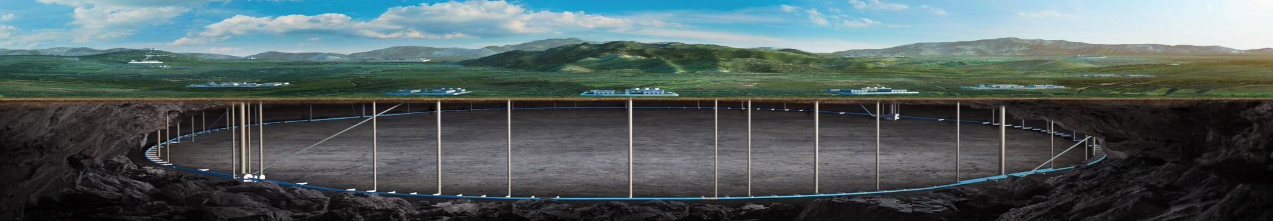


CEPC survey, naming system and MDI mechanics properties
Haijing Wang
On behalf of CEPC survey, naming colleagues and MDI colleagues
CEPC DAY
2025.7.18

Slide 2
Content
EDR accelerator survey and layout progress
Naming progress
MDI mechanics progress
Summary

Slide 3
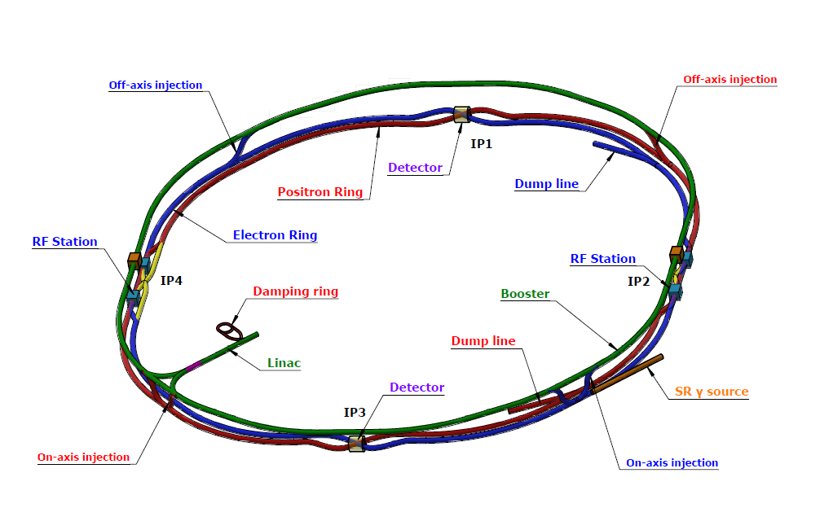
EDR accelerator survey and layout progress
The layout is the basis for the engineering design of each equipment.
Physics survey
Equipment model design
Layout design

Slide 4
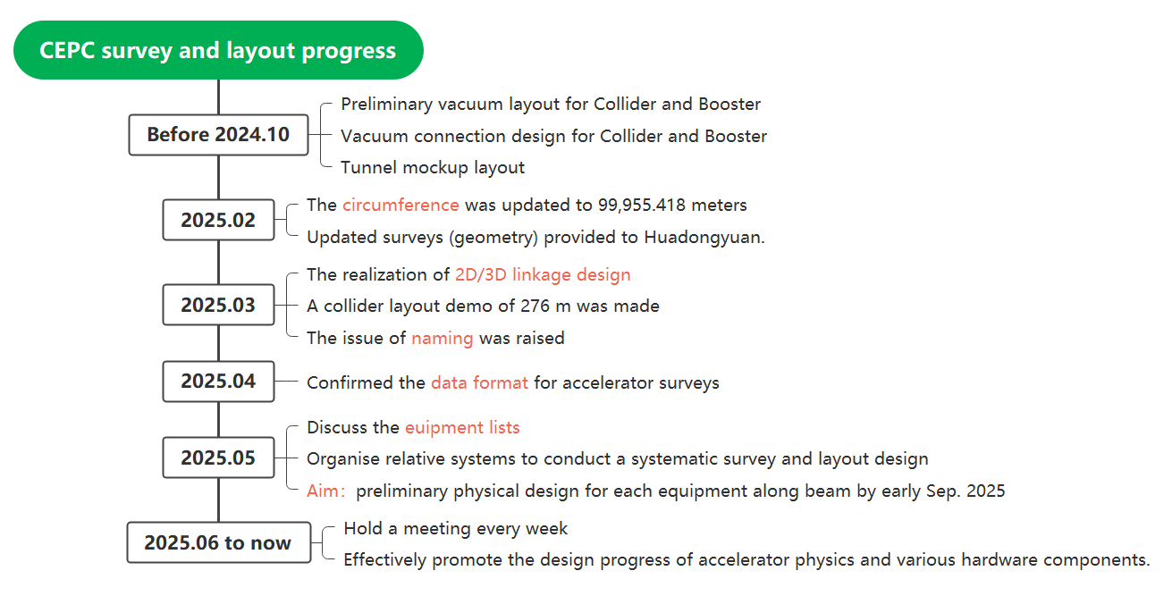
EDR accelerator survey and layout progress

Slide 5
EDR accelerator survey and layout progress
Survey and layout status (overall)
Accelerator | Have survey data? | Finish survey design? | Have model design? | Have layout demo? | Complete survey naming?
Collider | √ | × note 1 | Partial | √ | ×
Booster | √ | × note 2 | Partial | √ | ×
Linac | √ | √ | Partial | × | √
Damping Ring | √ | √ | Partial | × | ×
Transport lines | √ | × note 3 | Partial | × | ×
  note 1, unfinished: ~ early August, 2025
  note 2, unfinished: ~ early August, 2025
  note 3, unfinished: under cross-checking with magnet and mechanics colleagues, ~middle in August, 2025
  √, new completed items from last report on CEPC DAY (25.05.23)

Slide 6
EDR accelerator survey and layout progress
Survey and layout status (equipment status)
Accelerator | Equipment types | Survey design completed | Physics design completed | 3D model design completed
Collider | 99 (97) note 1 | 72 (72) | 18 (12) | 14 (12)
Booster | 28 (29) | 16 (16) | 23 (16) | 9 (8)
Linac | 65(59) | 65 (59) | 34 (14) | 3 (0)
Damping Ring | 14 (16) | 10 (9) | 2 (1) | 2 (1)
Transport lines | 66 (not listed) note 2 | 26 (not listed) | 14 (not listed) | 0
INJ & EXT | 46 (not listed) |  | 10 (not listed) | 0
  No1. (No.2), the item numbers now (the item numbers last report on 25.05.23)
  note 1, efforts are being made to consolidate categories as much as possible. It is anticipated to be reduced to 60-70 types.
  note 2, Sum up all the equipment across the 14 beamlines, where unified types of equipment are counted repeatedly on different beamlines.

Slide 7
EDR accelerator survey and layout progress
Survey and layout status (equipment status)
52%
82%
26%
57%
22%
17%
21%
21%
7%
14%
These data are based on the designs currently given to the layout personnel, the statistics is still in progress. The actual completion rate should be higher.

Slide 8
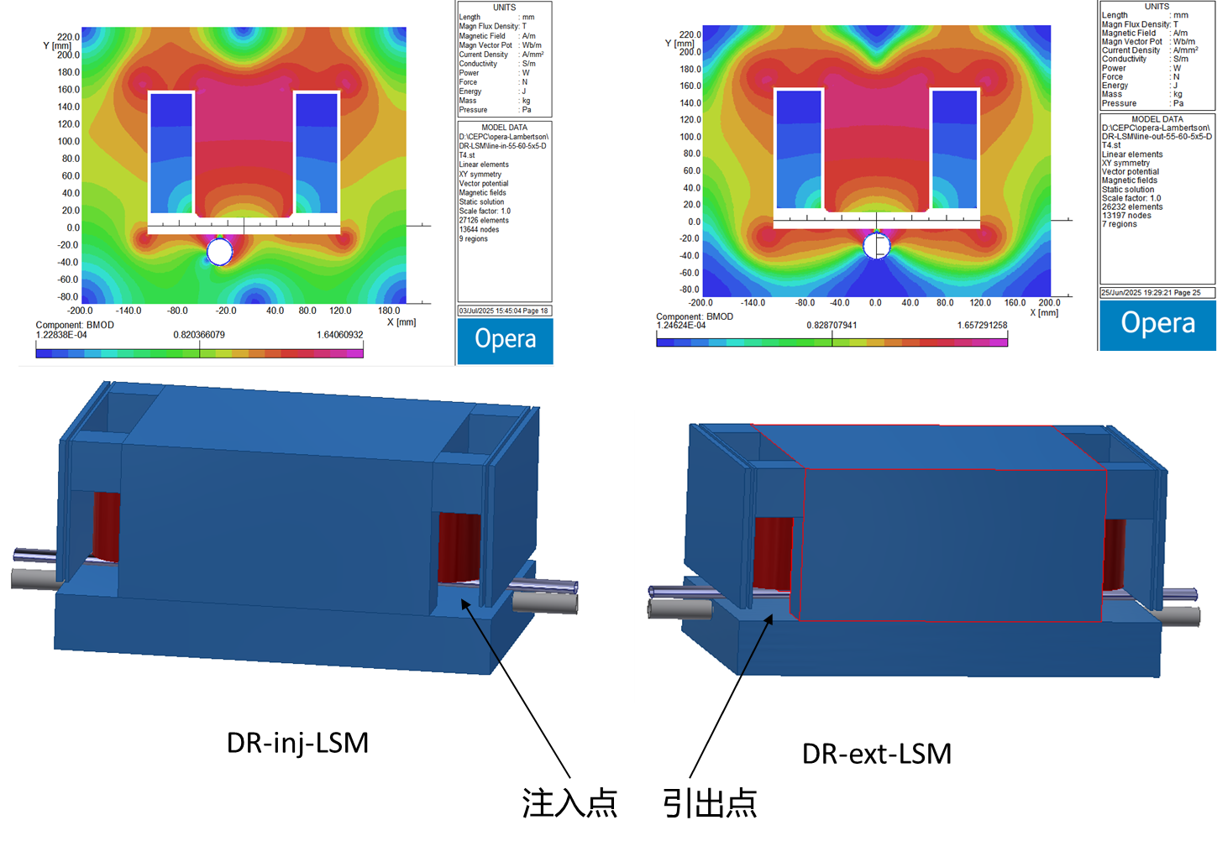
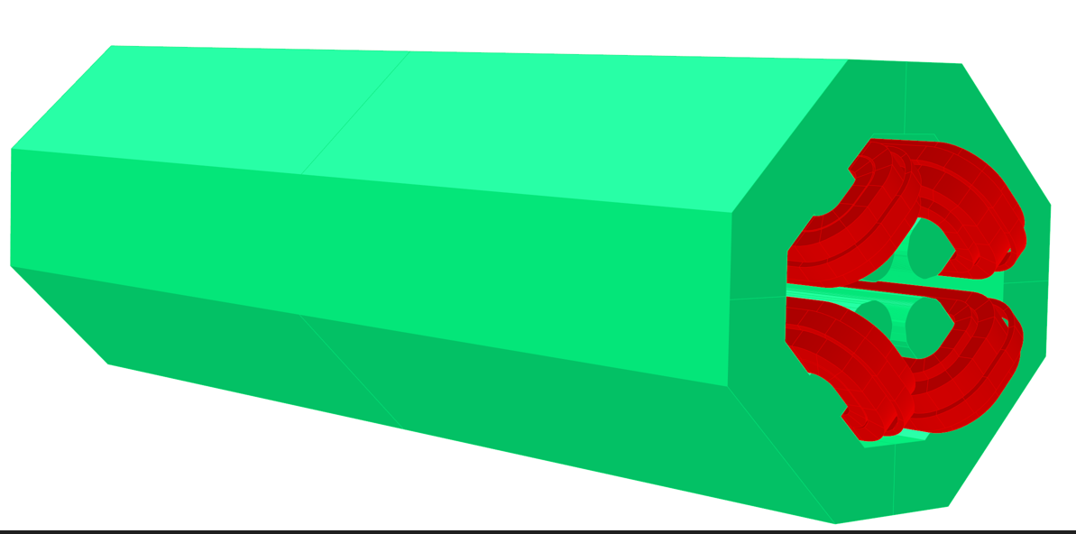
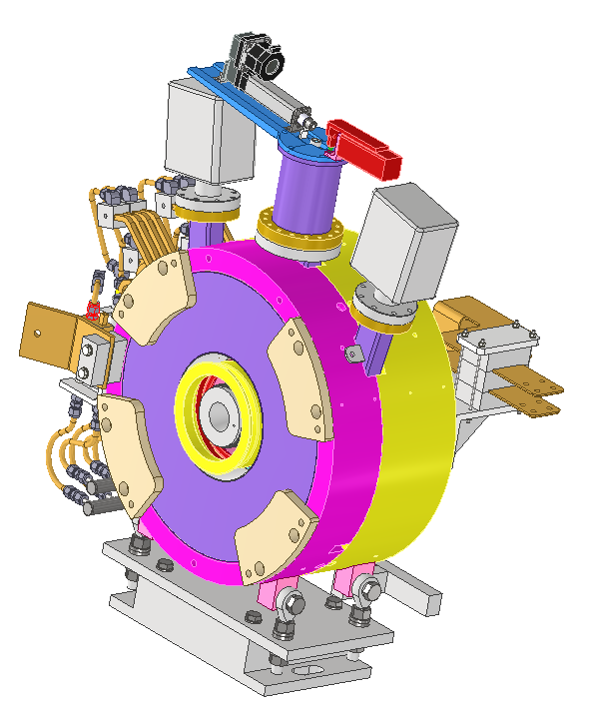
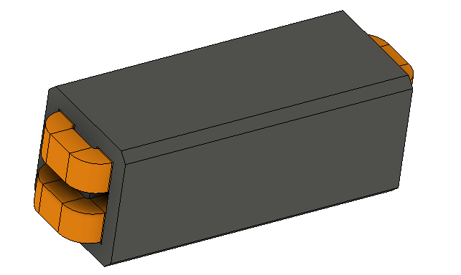
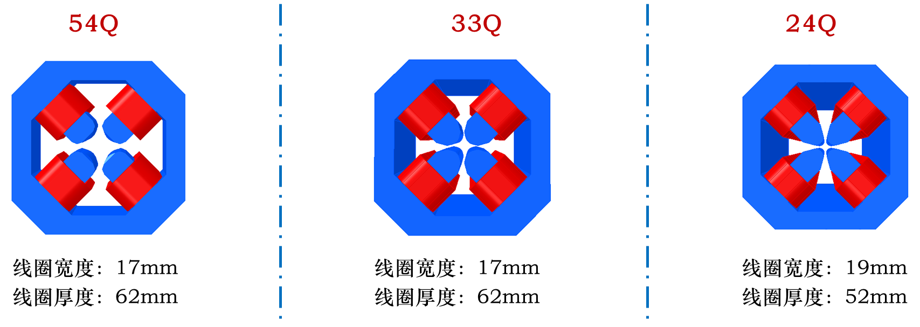
EDR accelerator survey and layout progress
Survey and layout status (equipment status)
LSM for DR INJ & EXT, from L. Huo
QRFB in collider, from M. Yang
PT & AMD for Linac, from J. Zhang
Quadrupoles in TL, from X. Sun
B for Linac, from Y. Wu

Slide 9
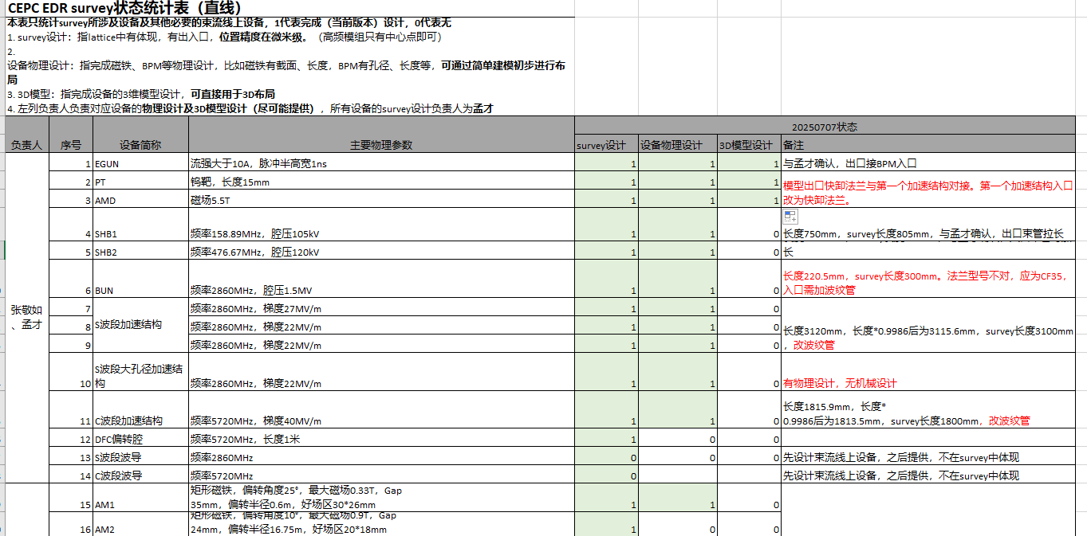
EDR accelerator survey and layout progress
Survey and layout status (equipment list, example)
（Equipment along the beam, including magnets, cryomodules, beam instruments, kickers, LSM, bellows, valves.

Slide 10
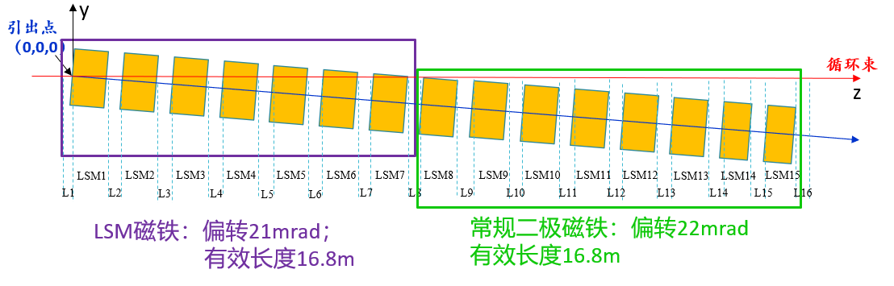
EDR accelerator survey and layout progress
Identify and discuss problems during survey and layout work
  Example 1: LSM or dipole?
    Changed part of LSMs to regular dipoles during LSM design.

Slide 11
EDR accelerator survey and layout progress
Identify and discuss problems during survey and layout work
  Example 2: collimators
    Optimize design according to new lattice, update data formats
    MPS collimators: 12/ring, 4 horizontal, 4 vertical, 4 momentum
    BG collimators: 19/ring, 9 horizontal, 10 vertical *note 1
    Each collimator is allocated a 2-meter reserved space.
  note 1, the design of BG collimator quantity mainly centers on IP1. Considering the design difference between IP1 and IP3, the quantity may be changed in future.

Slide 12
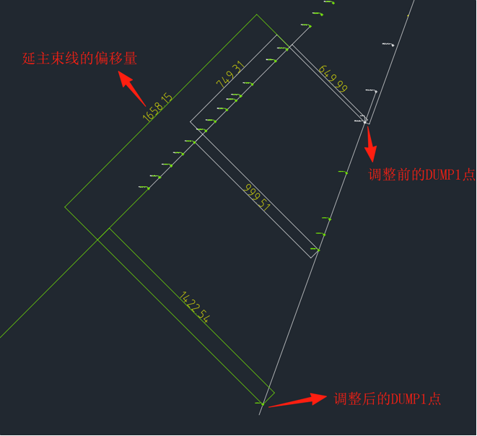
EDR accelerator survey and layout progress
Identify and discuss problems during survey and layout work
  Example 3: DUMP space interference in Linac and update

Slide 13
EDR accelerator survey and layout progress
Identify and discuss problems during survey and layout work
  Example 4: Different vacuum layout considering installation requirements
    Three vacuum layout for Collider, reported last CEPC DAY
    3 vacuum layout for Booster, will be discussed next week
 | V1 | V2 | V3
No. of vacuum tubes | 18 | 20 | 20
No. of vacuum tubes can be pre-installed outside | 10 | 14 | 14
No. of dipole core can be pre-installed outside (total of 24) | 16 | 20 | 24
No. of vacuum connection parts (bellows & pumps) | 16 | 16 | 18
Others |  |  | Dipole length decease ~600mm/164m
Different vacuum layout for Collider

Slide 14
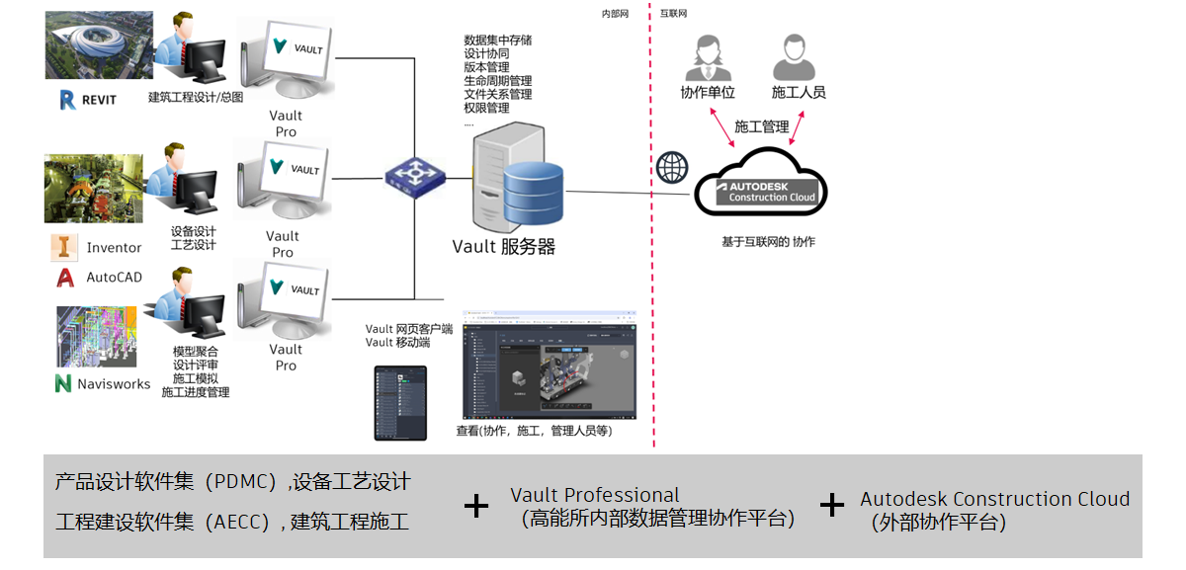
EDR accelerator survey and layout progress
Discuss the possible scheme for modeling and data managing with Autodesk
  Aim: To establish a comprehensive, multidisciplinary 3D digital platform encompassing design, engineering, manufacturing, installation, and management for the CEPC.

Slide 15
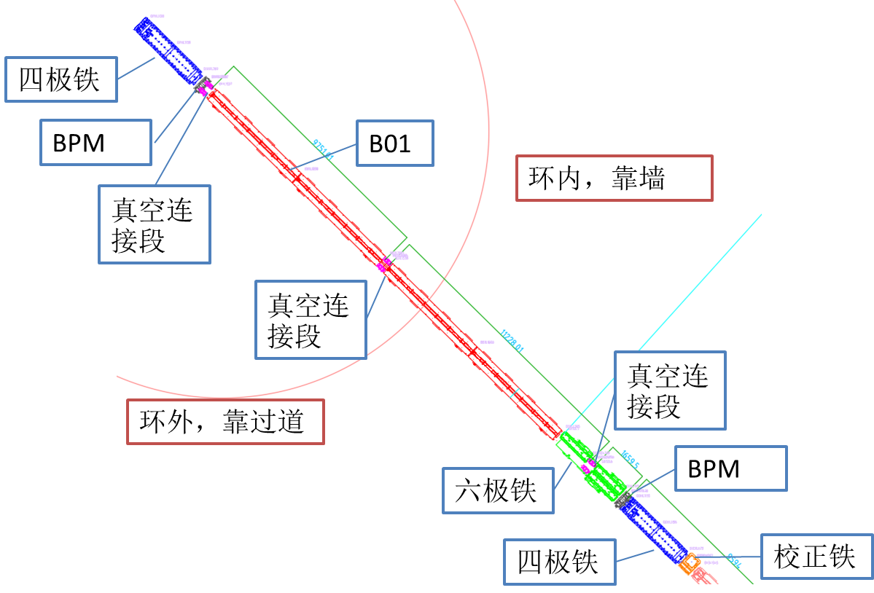
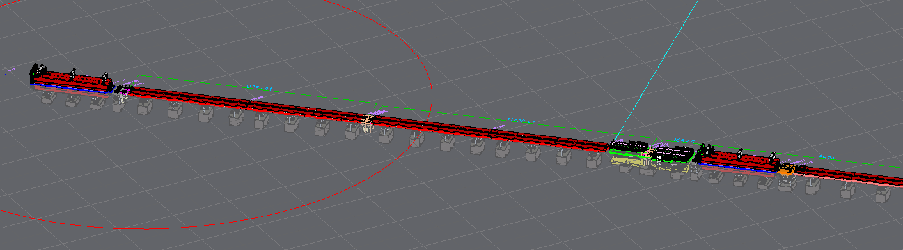
EDR accelerator survey and layout progress
2D/3D linkage design for CEPC
  If the 3D model is changed or replaced, the 2D model will be updated.
  If the 2D model is replaced or its location is changed, the 3D model will be updated.
Part of Collider arc section

Slide 16
EDR accelerator survey and layout progress
Problems and solutions
  We tried to use BIM to make the model more lighter, but it may hide some important components such as adjusting mechanics.
  →We have discussed it with Huadongyuan. They suggested not to employ BIM, but instead to utilize some external interfaces to directly generate three-dimensional models.
  → We have conducted research on NVIDIA's USD (Universal Scene Description) file format and the Omniverse platform, which can encompass models, animations, lighting, materials... With compact file size and high compatibility (have requirements on computers).
  →We have discussed it with Autodesk. They suggested some BIM applying skills, and the application of Navisworks. We haven’t taken a trial yet.
  CEPC is such a big project. The layout is big too. Computer lag reduces work efficiency.
  → We require better workstations.

Slide 17
Naming
We have formulated preliminary opinions.
  The CEPC equipment name consists of four parts: accelerator code + zone code + equipment code + sequence number.
Accelerator Code: Uniformly named.
Zone Code: Uniformly named.
Equipment Code: Assigned by each subsystem, adhering as closely as possible to international standards.
Sequence Number: Assigned by each subsystem according to unified rules
If additional equipment is added later, it can be appended with "P + new sequence number" following the sequence of the upstream equipment with the same equipment code.

Slide 18
Naming
Accelerator Code
  对撞机 C（Collider）
  增强器 B（Booster）
  直线L（Linac）
  阻尼环D（Damping ring）
  输运线T(Tansport lines)

Slide 19
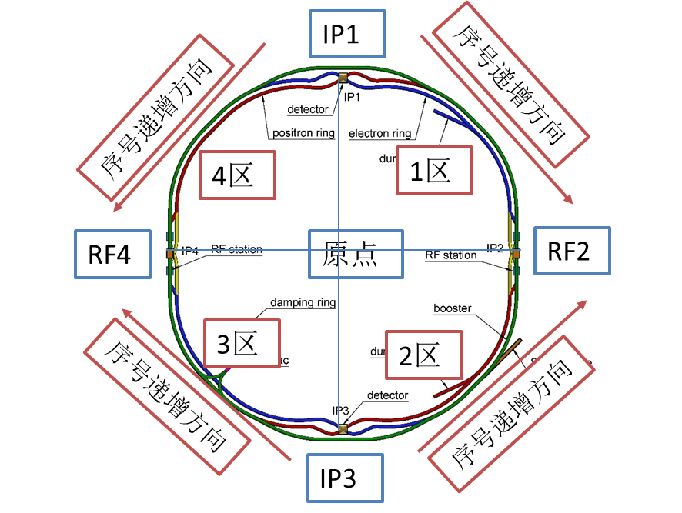
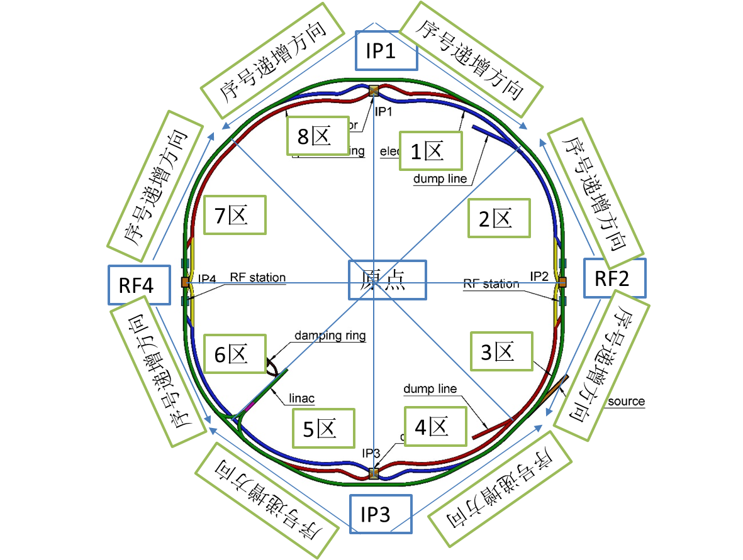
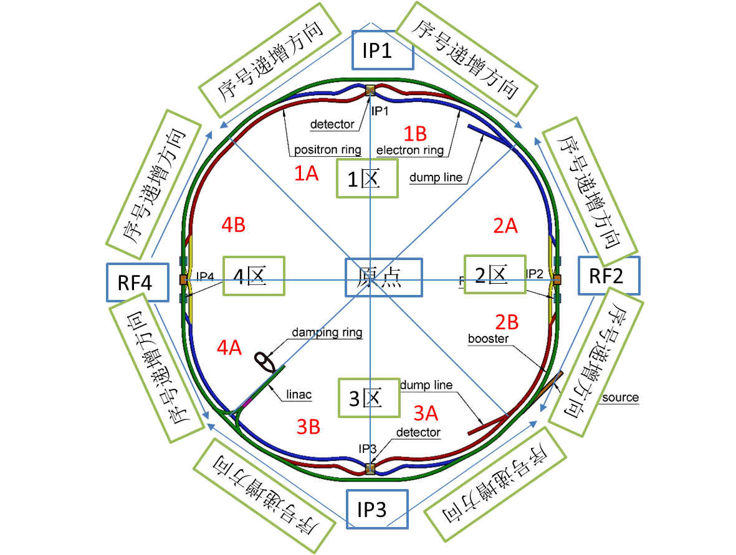
Naming
We have deliberated on three partitioning schemes for the collider and the booster, and have decided to adopt the third scheme.
 | Scheme 1 | Scheme 2 | Scheme 3
IPs correspond to the zones | ☺ | ☹ | ☺
CEPC and SPPC have the same sequential numbering trend | ☹ | ☺ | ☺

Slide 20
Naming
Collider equipment code
  前缀代号+通用代号组成。
  前缀代号：2位字母。以I和O 分别代表内环和外环，以E 和P 分别代表电子和正电子，比如IE 代表内环为电子，OE 代表外环为电子。对于双孔径设备，用DA 表示；共享单孔径设备，用EP表示。
  通用代号（部分设备，已通过各系统收集）
  二极铁：BA、BB、BC（三种长度/间距组合）；
  散焦四极铁：QD
  聚焦四极铁：QF
  散焦六极铁：SD
  聚焦六极铁：SF
  垂直校正磁铁: CV
  水平校正磁铁：CH
  静电-电磁分离器：EMS
  束测元件：BPM、PR、ICT
  波纹管：BLW
  阀门：GV
  真空盒：VA
  准直器：CLM
  Higgs模组：HCM
  Z模组：ZCM
  Ttbar模组：TCM
  注入引出kicker：K
  注入引出切割磁铁：LSM

Slide 21
Naming
Collider naming examples
  C.3A.OE.QD.001:对撞机.3A区.外环电子.散焦四极磁铁.第1台
  C.3B.OP.QD.001:对撞机.3B区.外环正电子.散焦四极磁铁.第1台
  C.3B.DA.QD.001:对撞机.3B区.双孔径.散焦四极铁.第1台（极性对应外环）
  C.3B.DA.B.001.1:对撞机.3B区.双孔径.二极铁.第1台.第1个铁芯
  C.3B.DA.B.001.OTPS:对撞机.3B区.双孔径.二极铁.第1台.外环辅助线圈电源
  C.2B.EP.EMS.01:对撞机.2B区.共享单孔径.静电-电磁分离器.第1台
  C.2B.EP.QD.01:对撞机.2B区.共享单孔径.四极铁.第1台
  C.2A.HCM.01.1:对撞机.2A区.Higgs模组.第1台.第1个腔
  C.2A.HCM.01.KLY3:对撞机.2A区. Higgs模组.第1台.第3个速调管
  C.3B.OP.BPM.001:对撞机.3B区.外环正电子.BPM.第1台。
  C.3B.OP.BLW.001:对撞机.3B区.外环正电子.波纹管.第1台。

Slide 22
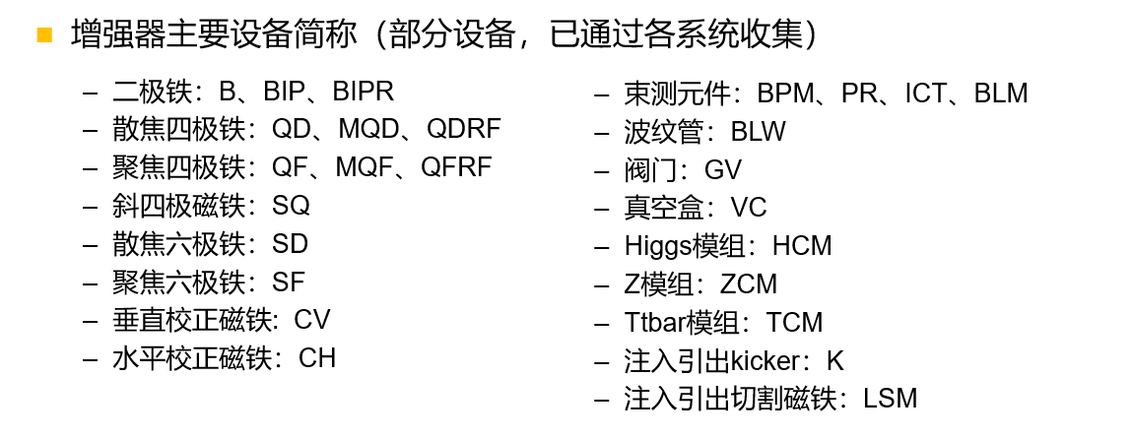
Naming
Booster equipment code
Booster naming examples
  B.3A.QD.001:增强器.3A区.散焦四极磁铁.第1台
  B.3B.BIP.001:增强器.3B区.IP二极铁.第1台
  B.2B.HCM.01.1:增强器.2B区.Higgs模组.第1台.第1个加速腔
  B.2B.HCM.01.SSA1:增强器.2B区.Higgs模组.第1台.第1个加速腔固放。

Slide 23
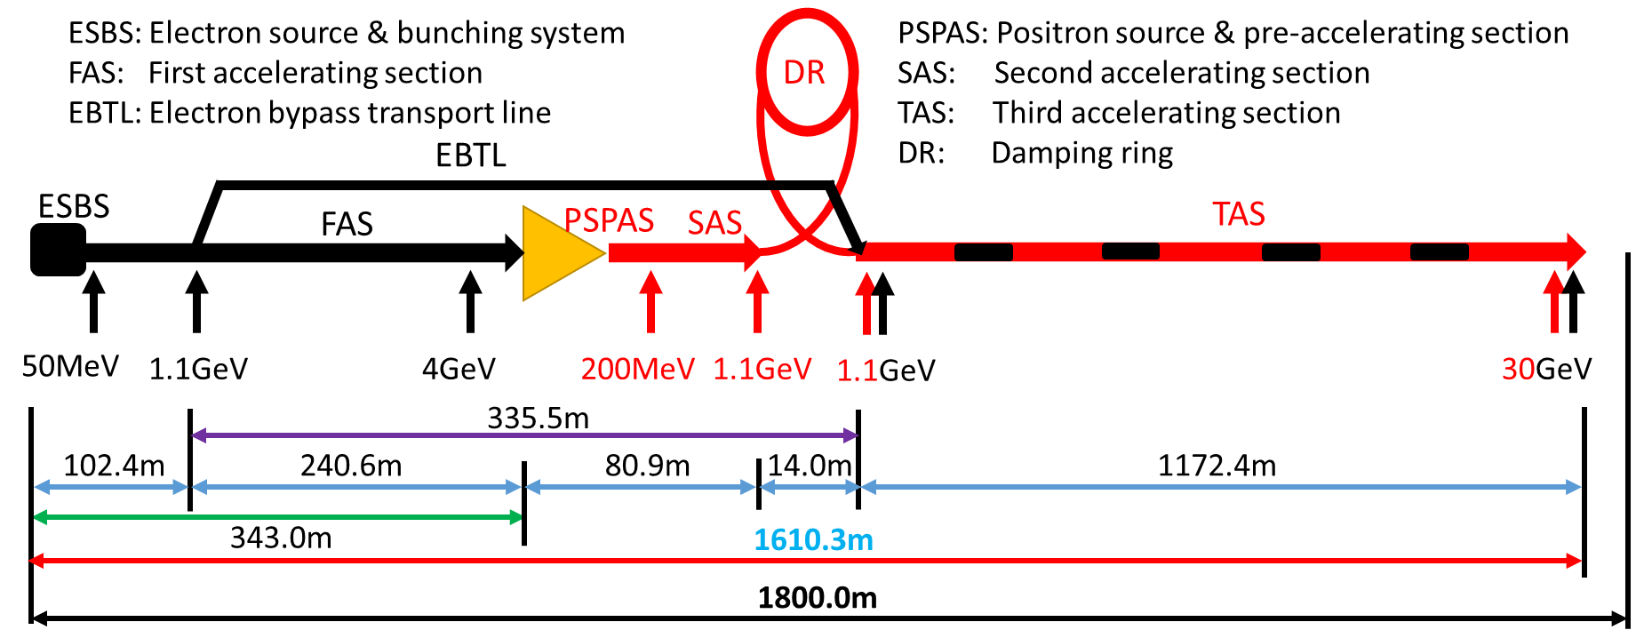
Naming
Linac zone code
  电子源及聚束系统：EBS
  第一加速段：FAS
  电子旁路输运线：BTL
  正电子源及预加速段：PSA
  第二加速段：SAS
  第三加速段：TAS
Linac sequence number
  increase along the direction of beam movement (from the electron gun to the transport line)

Slide 24
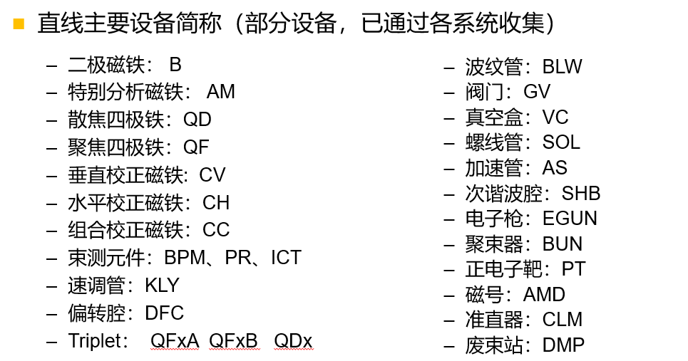
Naming
Linac equipment code
Linac naming examples
  L.EBS.SHB.2，直线.聚束系统. 次谐波腔.第2台
  L.BTL.CH.03，直线.旁路传输线.水平校正磁铁.第3台
  L.FAS.AS.001，直线.第一加速段.加速腔.第1台
  L.FAS.KLY.001直线.第一加速段.速调管.第1台

Slide 25
Naming
Linac zone code: 1/2
Damping ring sequence number
  increase along the direction of beam movement (from injection to exjection)
DR主要设备简称（部分设备，已通过各系统收集）
  二极磁铁： B、BR
  散焦四极铁：QD
  聚焦四极铁：QF
  束测元件：BPM、BLM、PR
Damping ring naming examples
  D.1.B.11，阻尼环.1区. 二极铁.第11台
  波纹管：BLW
  阀门：GV
  真空盒：VC
  高频腔：CAV
  注入引出kicker：K
  注入引出切割磁铁：LSM
1区
2区

Slide 26
Naming
Transport line zone codes
  增强器到对撞机正电子在轴注入输运线，BCNP（Booster to Collider e+ on-axis TL）
  增强器到对撞机负电子在轴注入输运线，BCNE（Booster to Collider e- on-axis TL）
  增强器到对撞机正电子离轴注入输运线，BCFP（Booster to Collider e+ off-axis TL）
  增强器到对撞机负电子离轴注入输运线，BCFE（Booster to Collider e- off-axis TL）
  对撞机到增强器正电子输运线，CBP（Collider to Booster e+ TL ）
  对撞机到增强器负电子输运线，CBE（Collider to Booster e- TL ）
  直线到增强器正电子输运线，LBP（Linac to Booster e+ TL）
  直线到增强器负电子输运线，LBE（Linac to Booster e- TL）
  直线到阻尼环正电子输运线，LD（Linac to Damping ring e+ TL）
  阻尼环到直线正电子输运线，DL（Damping ring to Linac e+ TL）
  对撞机到废束站正电子输运线，CDPP（Collider to dump e+ TL）
  对撞机到废束站负电子输运线，CDPE（ Collider to dump e- TL ）
  增强器到废束站正电子输运线，BDPP（Booster to dump e+ TL）
  增强器到废束站负电子输运线，BDPE（Booster to dump e- TL

Slide 27
Naming
输运线主要设备简称（部分设备，已通过各系统收集）
  二极铁：B
  散焦四极铁：QD
  聚焦四极铁：QF
  束测元件：BPM、PR、ICT
Damping ring naming examples
  T.BCNP.Q.11：输运线.增强器到对撞机在轴正电子.四极铁.第1台
  T.LD.B.05：输运线.直线到阻尼环.二极铁.第5台
  T. BDPP. B.1:输运线.增强器到废束站正电子.二极铁.第1台
  波纹管：BLW
  阀门：GV
  真空盒：VC

Slide 28
Naming
The preliminary opinions was sent to the relevant systems for naming modifications and additions.
  64 items along beam and 11 auxiliary items in Collider
  29 items along beam and 2 auxiliary items in Booster
  26 items along beam and 2 auxiliary items in Linac
  13 items along beam and 1 auxiliary items in Damping ring
  9 items along beam and 1 auxiliary items in Transport lines

Slide 29
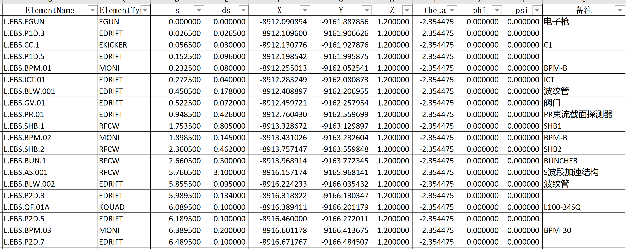
Naming
The naming has been applied in Linac survey

Slide 30
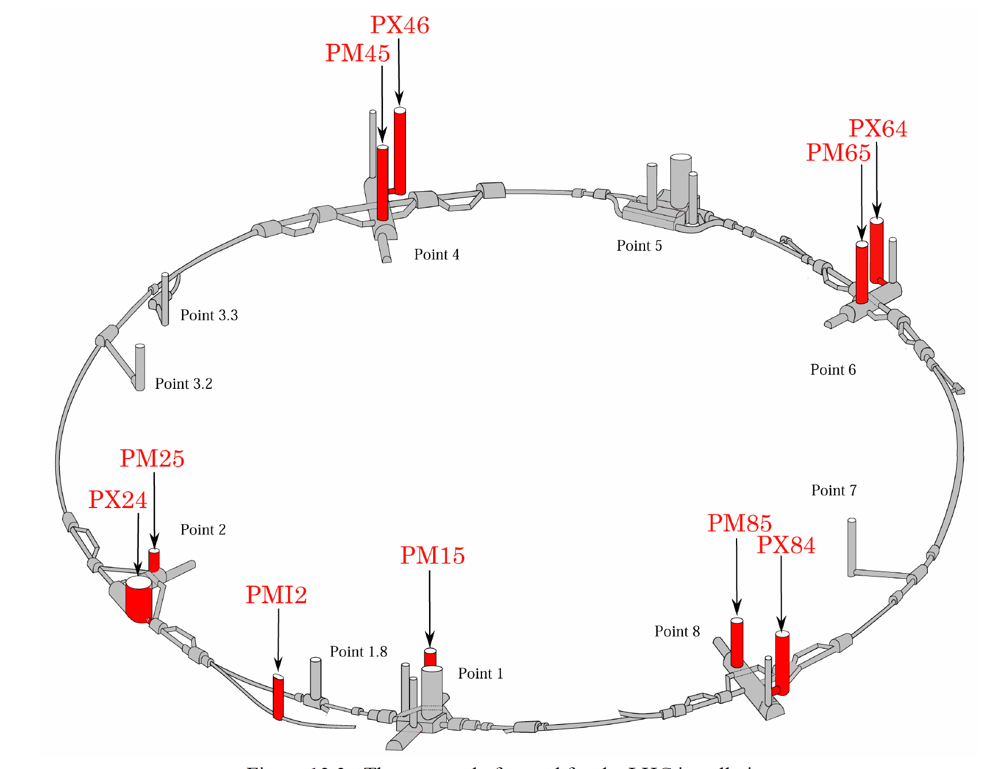
Naming
Shaft naming preliminary consideration
  Shaft type +end position + zone code
  Shaft type: VS (vertical shaft), IS (inclined shaft)
  Position: T (tunnel), E (experiment hall), A (auxiliary experiment hall)
  Zone code: same to collider and booster
LHC竖井命名

Slide 31
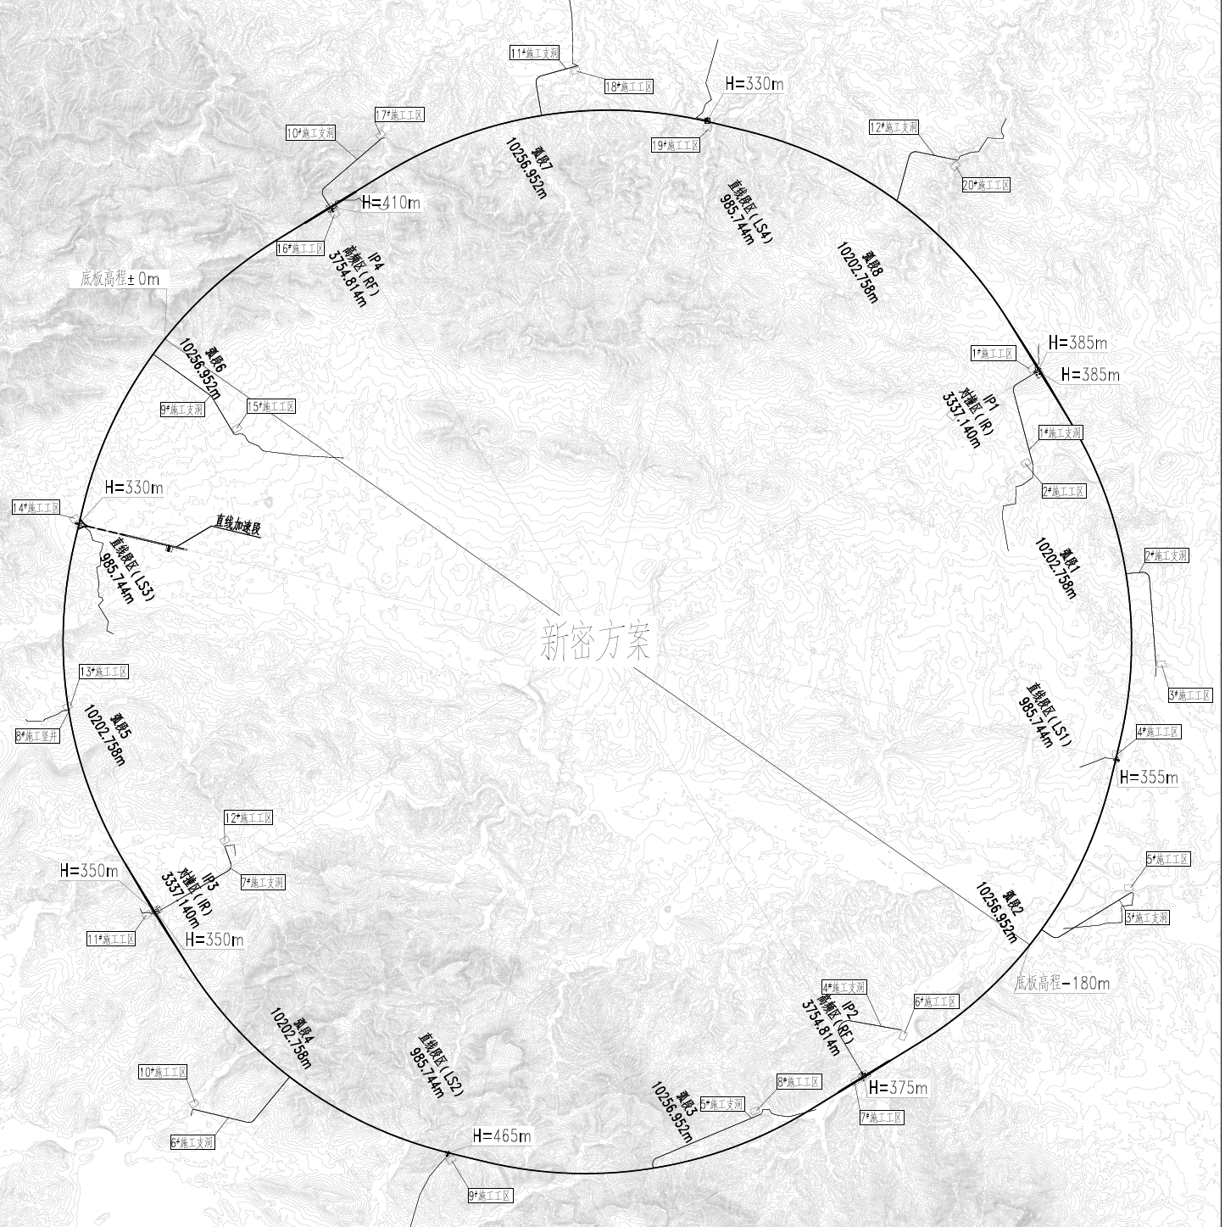
Naming
IST4B
VST41
竖井（10个）
  VSE1：IP1实验大厅竖井
  VSA1：IP1辅助厅竖井
  VST12: 1-2区交接位置竖井
  VST2：IP2高频隧道竖井
  VST23: 2-3区交接位置竖井
  VSE3：IP3实验大厅竖井
  VSA3：IP3辅助厅竖井
  VST34：3-4区交接位置竖井
  VST4：IP4高频隧道竖井
  VST41：4-1区交接位置竖井
IP4
IST1A
IST4
VST4
VSE1
IST4A
VSA1
IP1
IST1
VST34
IST1B
IST3B
VSA3
VST12
VSE3
IST3
IST2A
IP3
IST2
命名初步考虑，待讨论确定
IP2
VST2
IST3A
VST23
IST2B

Slide 32
Naming
IST4B
VST41
斜井（12个）
  IST1A：1A区隧道斜井
  IST1：IP1隧道斜井
  IST1B：1B区隧道斜井
  IST2A：2A区隧道斜井
  IST2：IP2隧道斜井
  IST2B：2B区隧道斜井
  IST3A：3A区隧道斜井
  IST3：IP3隧道斜井
  IST3B：3B区隧道斜井
  IST4A：4A区隧道斜井
  IST4：IP4隧道斜井
  IST4B：4B区隧道斜井
IP4
IST1A
IST4
VST4
VSE1
IST4A
VSA1
IP1
IST1
VST34
IST1B
IST3B
VSA3
VST12
VSE3
IST3
IST2A
IP3
IST2
命名初步考虑，待讨论确定
IP2
VST2
IST3A
VST23
IST2B

Slide 33
MDI mechanics progress
Items | Requirements
MDI layout and integration | The layout should fulfill the physics and technical requirement with all the devices included. A detailed installation and alignment schedule should be made.
SC quadrupole mechanics | Position accuracy: ≤100 μm (X/Y directions) Vibration of SC quadrupoles: 1-100Hz RMS ≤4nm
RVC | A safe and reliable structure within the detective angle of acos 0.99. RF shielded. Leak rate: ≤2.7 ×10^{–11} Pa·m³/s
Items | 2024 | 2025 | 2026 | 2027
MDI layout | More detailed layout, identify the MDI interface dimensions The locations for additional BPMs (almost done, a coherent assembly version) |  | Continuously updating according to the physical and technical design Detailed installation and alignment schedule | Wrap up the unfinished work. Prepare the EDR report.
Cryostat support design | More detailed support structure and FEA Design of auxiliary support (the analyses are converging) |  | Vibration decreasing methods, eg. damping material
RVC design | Mechanical design Prototype development and leak rate experiment (quotation finished, preparing engineering drawings) |  | Structure optimization Finish the leak rate experiment

Slide 34
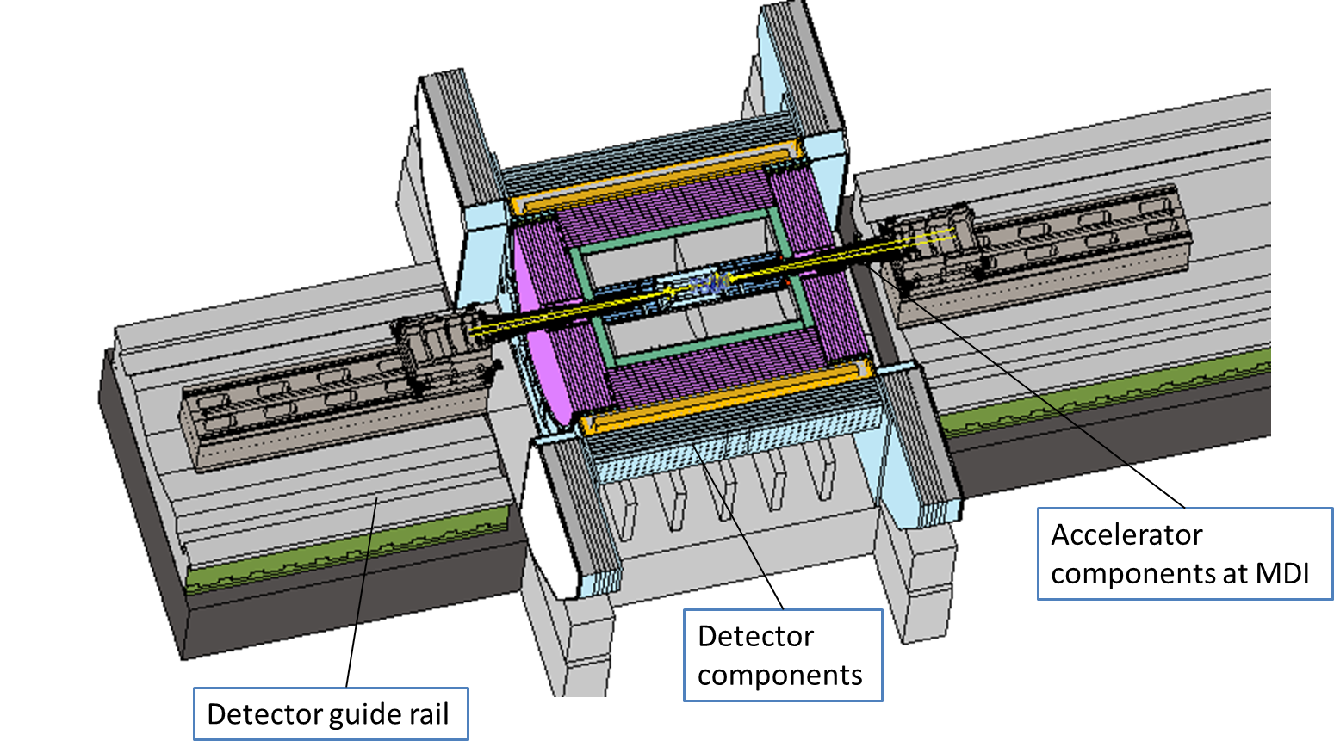
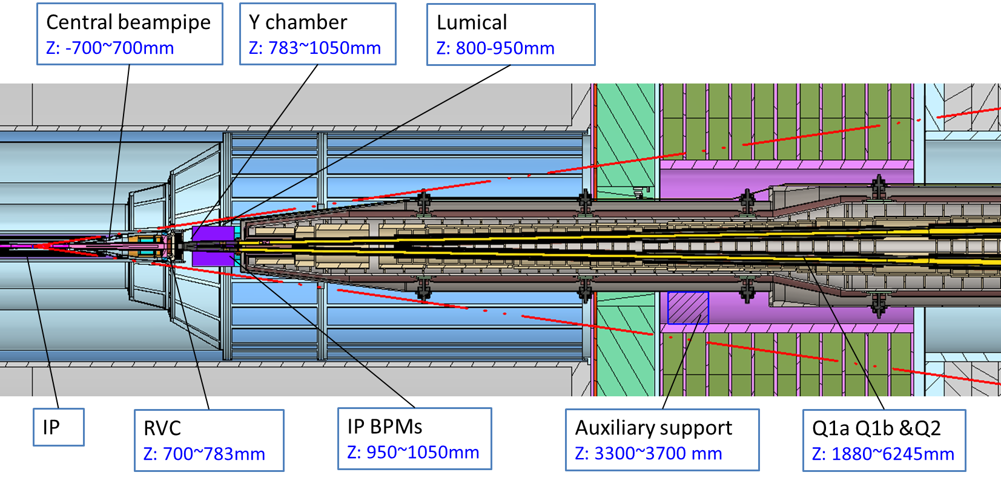
MDI mechanics progress
MDI layout
  Detective angle: acos0.99
  IP chamber：±700mm
  Yoke length：11950mm
Distance to detective angle
  IP chamber flange: 5.3mm
  RVC: 14.9mm

Slide 35
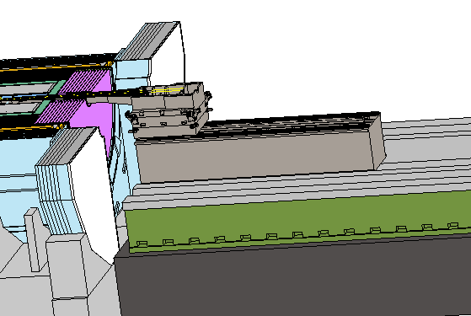
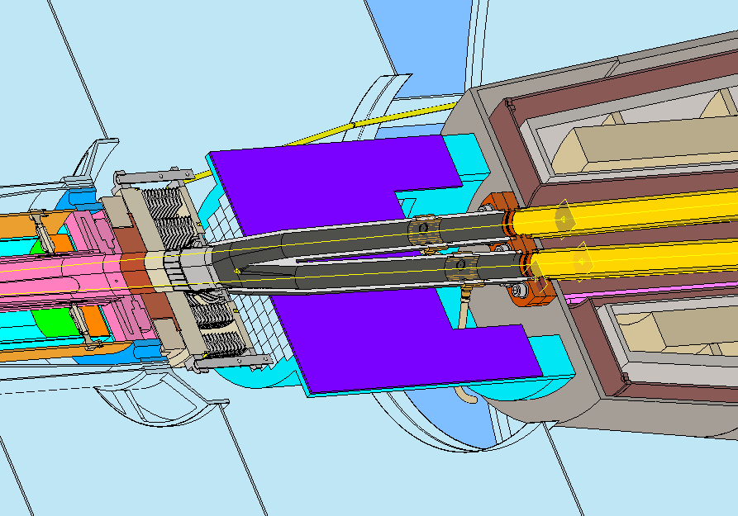
MDI mechanics progress
Mechanical interface between accelerator and detector
Accelerator
cryostat support
Central beampipe
Lumical
RVC
Y chamber
IP BPM
Detector guide rail

Slide 36
MDI mechanics progress
The mechanics and vibration analyses
  Static structure: the displacement of quadrupoles, and their uneven deformation
  Vibration analyses: modal, harmonic responses
  Structure optimization: to decrease deformation and enhance natural frequencies
  Quench analyses: the response when all the Lorentz forces vanished in 0.2 s
  Load used in analyses:
    Gravity
    Lorentz forces: 2.7e5 N in total in TDR, 1.48e5 N in total now. To facilitate a single-variable comparison and maintain a certain safety factor, the calculations still employ the former. A unified update will be implemented once the design converges.
    Cryogenic temperature

Slide 37
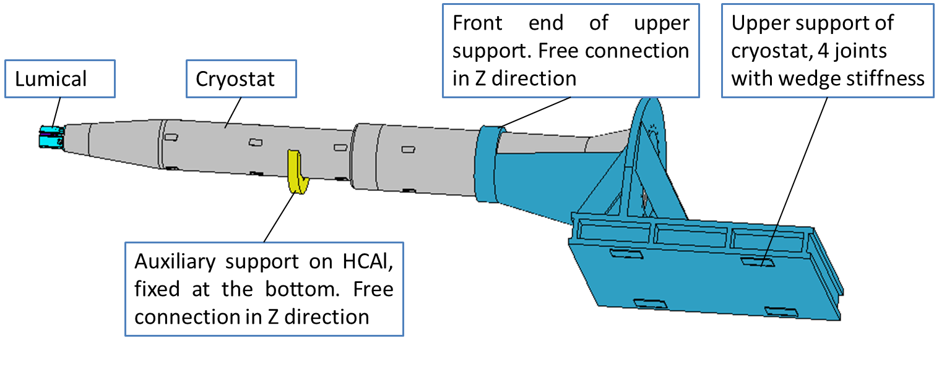
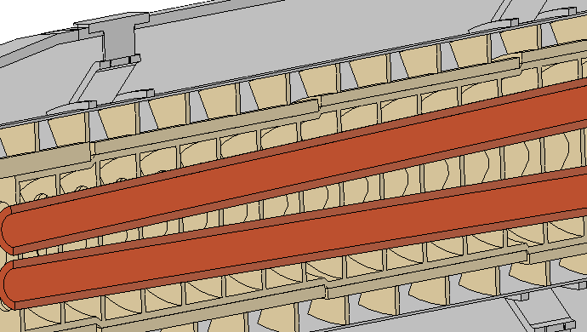
MDI mechanics progress
The analyses model
  Composed by the designed cryostat without thermal shielding or other auxiliary components, the simplified Lumical with designed dimensions, and simplified cryostat supports (~8.6 tons).
  The model above is sufficient for main structural optimization and deformation analysis. A comprehensive analysis that includes designed support and connection with detector will be proceeded once the structural optimization has converged.
Fan shaped anti-solenoid support
SC quadrupole support

Slide 38
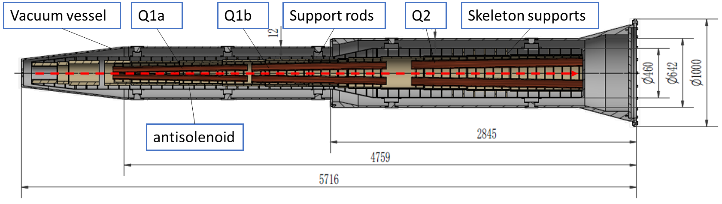
MDI mechanics progress
The analyses model (Cryostat)
Model | TDR | IARC 24 | Thinner | Thicker | Thicker II
Cryostat length /mm | 5613 | 5716 | 5599 | 5716 | 5577
Vacuum vessel thickness /mm | 4/8 | 4/8 | 3/3 | 12/16 | 6/6
Helium vessel thickness/mm | 3 | 3 | 2 | 3 | 10/10
End diameter/mm | 1000 | 1000 | 1000 | 1000 | 1000
Cryostat weight/kg | 2.7 | 2.4 | 1.3 | 2.7 | 2.2
Cross section of “Thicker”
  TDR: iron quadrupoles
  IARC 24: iron-free quadrupoles
  Thinner: Thinner cryostat walls
  Thicker: Thicker cryostat walls
  Thicker II: another thicker version with adjustable support rods
Bonded
Frictional in Z direction

Slide 39
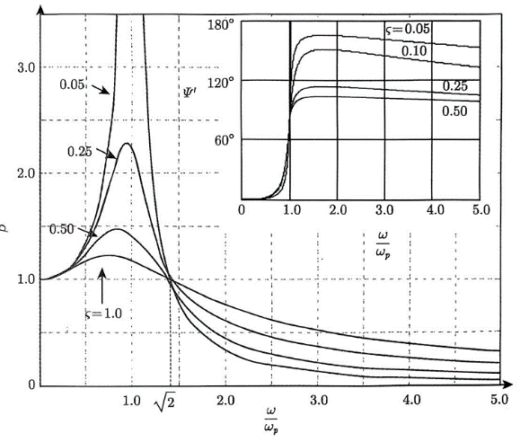
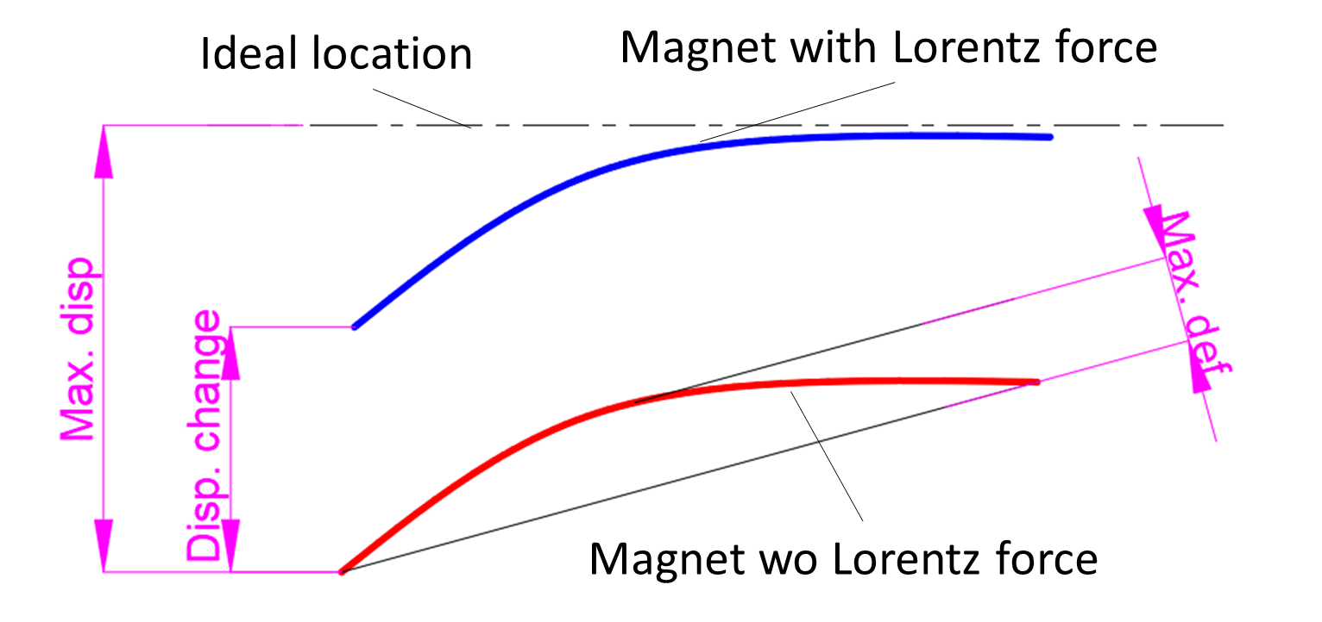
MDI mechanics progress
Primary concerned metrics
  Max. def: the maximum uneven deformation in Y (vertical) direction of quadrupole, difficult be adjusted by alignment.
    Length/diameter, CEPC Q1a: 20 vs BEPCII SCQ: 4.5, the uneven deformation of quadrupoles should be considered
  Disp. change: Displacement change in Y direction before and after Lorentz force
    If the change is small enough, re-alignment can be neglect after having Lorentz force.
    BEPCII also concerned this metric before installation
  Natural frequencies
    Relates to vibration response. The higher the better.
Ref.
  HEPS ≥54Hz
  Quadrupole of arc section of CEPC: ~45 Hz

Slide 40
MDI mechanics progress
  Misalignment and vibration of quadrupole can lead to beam emittance growth and luminosity degradation.
  The steps on the inner wall of vacuum can generate HOMs.
* The response now only considers the mechanics aspect.
 | Related requirements | Response now* | Other related factors
Position accuracy (X/Y) of SC quadrupoles≤100μm | Adjusting resolution≤5μm Adjusting accuracy≤30μm | ≤5μm ≤30μm from HEPS experience | Alignment method, ground settlement、correctors…
 | Max. def. and disp change, ＜ 50μm | FEA，＜40μm
Small vibration, 1-100Hz RMS ≤4nm | High natural frequency | FEA, ~50Hz and 1 (same level to HEPS, and arc section of CEPC) | Damping，installation foundation stability, ground vibration…
 | Low amplification factor
Related requirements | Response now | Other related factors
Deformation at the front of vacuum chamber<0.5mm | FEA，＜0.5mm | Installation error and so on
Notes:
表述修改，更准确

Slide 41
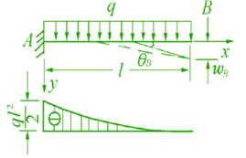
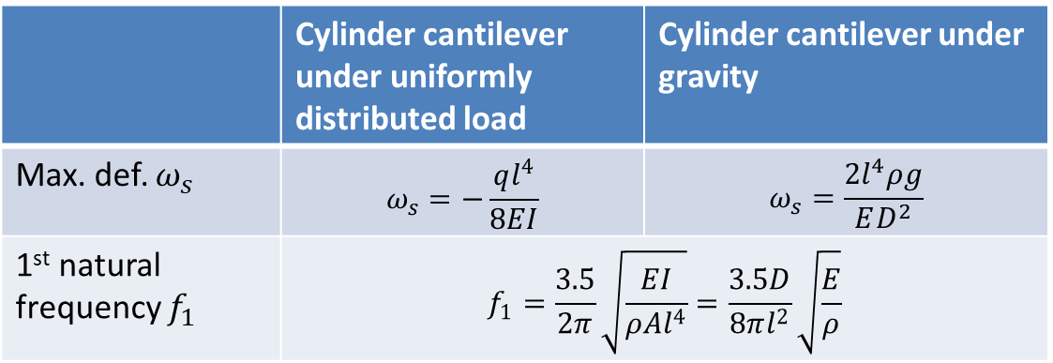
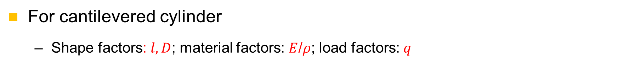
MDI mechanics progress
Iron quadrupole vs iron-free quadrupole
Structure optimization (skeleton, wall thickness)
Material optimization
Auxiliary support
METHOD
KEY POINTS
Decrease deformation
Improve stability (natural frequencies)
For cantilevered cylinder
  Shape factors: $l, D$; material factors: $E$/$ρ$; load factors: $q$
 | Cylinder cantilever under uniformly distributed load | Cylinder cantilever under gravity
Max. def. $ω_{s}$ | $$ω_{s}=−\frac{ql^{4}}{8EI}$$ | $$ω_{s}=\frac{2l^{4}ρg}{ED^{2}}$$
1st natural frequency $f_{1}$ | $$f_{1}=\frac{3.5}{2π}\sqrt{\frac{EI}{ρAl^{4}}}=\frac{3.5D}{8πl^{2}}\sqrt{\frac{E}{ρ}}$$

Slide 42
MDI mechanics progress
Details in:
Haijing Wang, Mini-Review of CEPC MDI (9-June 10, 2025), https://indico.ihep.ac.cn/event/26255/
Conclusions on mechanical FEA
  Iron-free quadrupole and optimized skeleton has benefits (Max. disp. of SC quadrupoles/cryostat decreased)
  Material optimization，no obvious effect
  Auxiliary support，significant effect (max. change from 2 mm to 84 um, 1st natural frequency from 17.7Hz to 49.2 Hz)
  Thicker vacuum vessel: significant effect (max. change from 84 um to 33 um)→can be considered comprehensively with radiation.
  Support rods: significant effect→ can be optimized further
Works to be done
  Further optimization with collaboration with other colleagues: compromise solution with other aspects of optimization, updated loads (radiation shielding, Lorentz force)
  After above analyses converged, we will taking into account all the relative components and make a whole FEA.

Slide 43
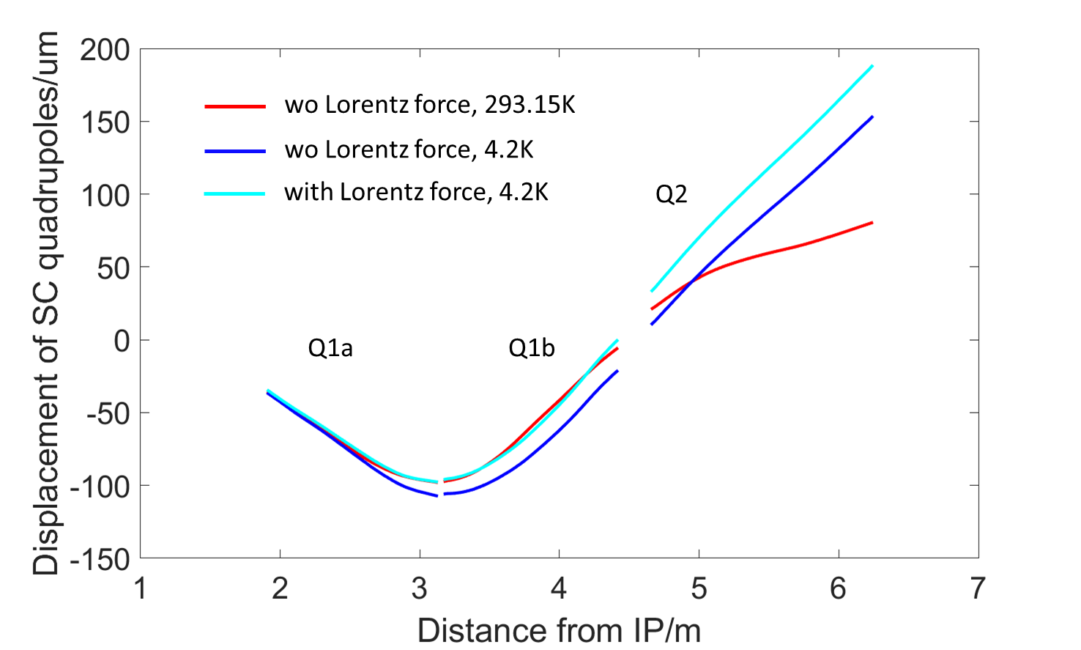
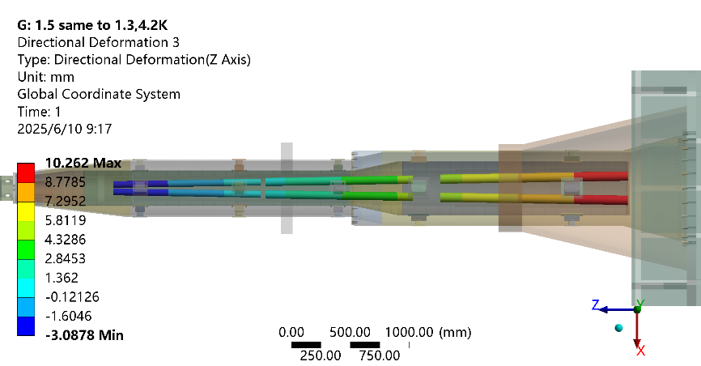
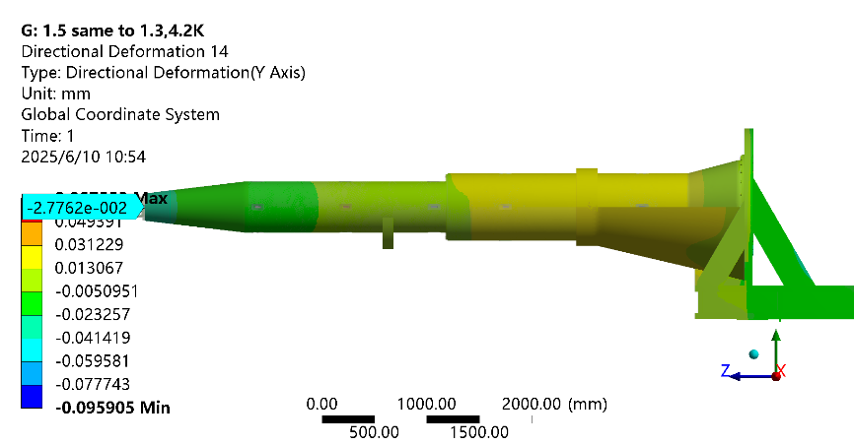
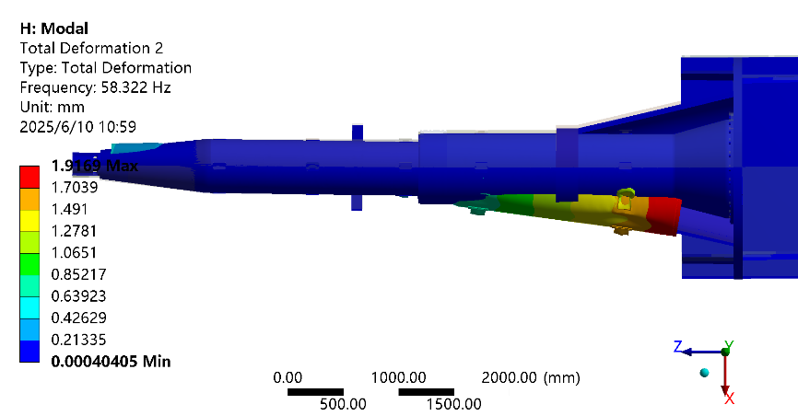
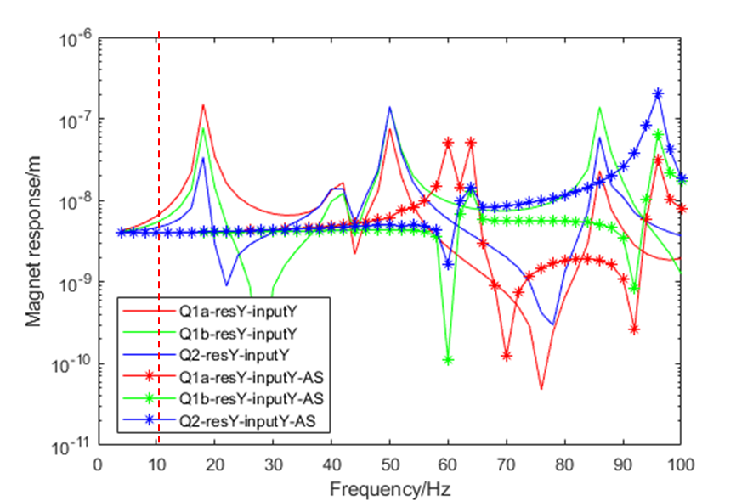
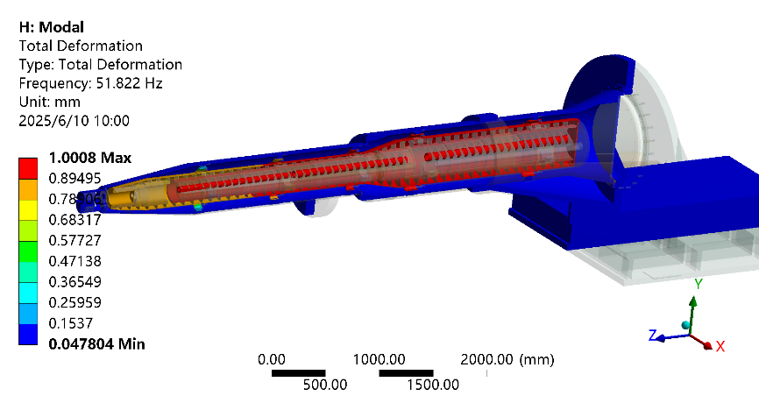
MDI mechanics progress
Simulation results for “Thicker” model, with Lorentz force and gravity
Z disp. of SC quadrupoles, 4.2 K
SC quadrupole displacement
Y disp. of vacuum vessel, 4.2 K
1st order of mode, 4.2 K
2nd order of mode, 4.2 K
Harmonic response, 1-100Hz

Slide 44
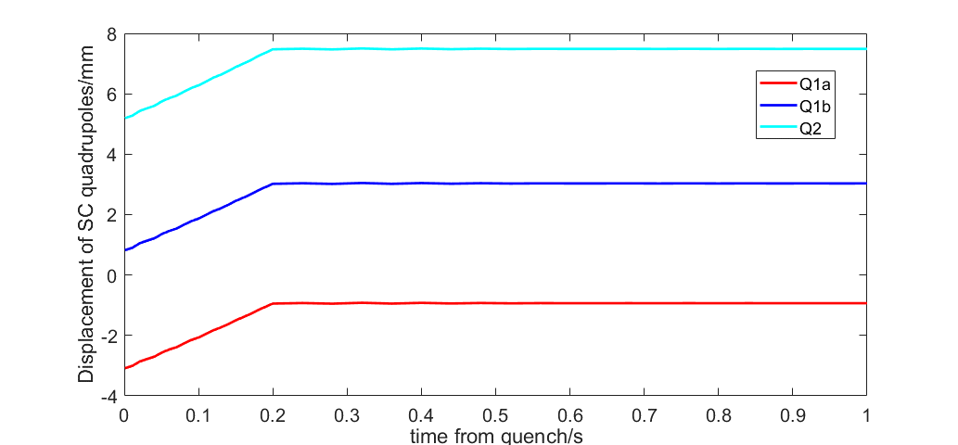
MDI mechanics progress
Quench analyses
  When quenching, the Lorentz forces vanish in 0.2 s. All the other loads remains the same in short period.
  Three timesteps have been set.
  It seems there is no sudden positional jitter caused by the disappearance of the Lorentz force. Either for the Von mises stress.
  We are checking on it.
Displacement of SC quadrupoles when quenching
Time
1e-3 | Original Lorentz force
0.2 | Lorentz force decrease to 0, ramping
1 | Lorentz force: 0

Slide 45
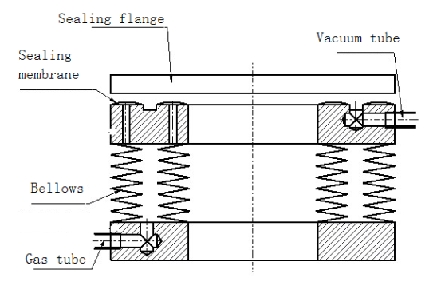
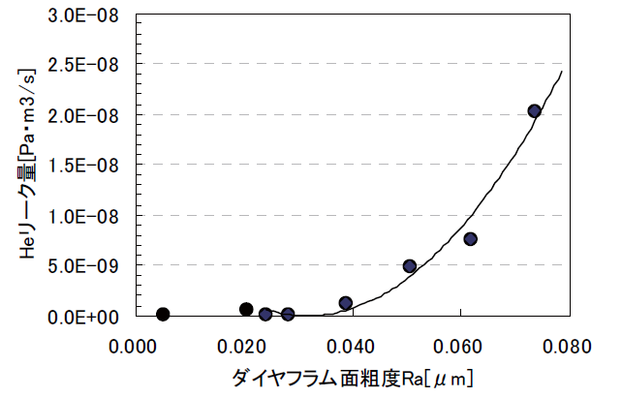
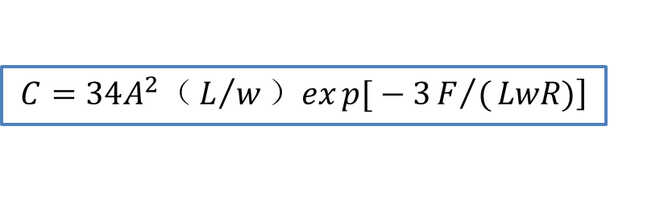

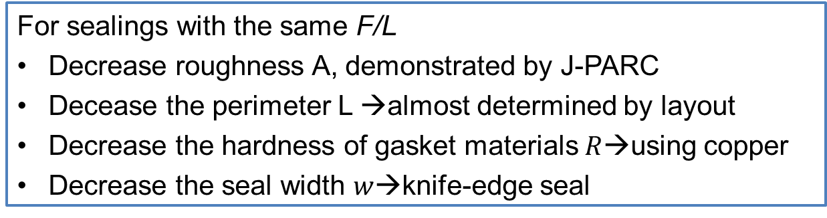
MDI mechanics progress
RVC
  Leak rate requirement: 2.7 $×$10^{–11} Pa·m³/s
  Leak rate: 𝑄=𝐶∙∆𝑃
  Decrease ∆𝑃 (experience from CSNS)
    Single-layer →double layer, leak rate can be improved from 1e-6 Pa.m³/s to 8.5e-10 Pa.m³/s.
Inflatable seal
$$\left.C=34A^{2}（L/w）exp{[}−3F/(LwR)\right]$$
  For sealings with the same F/L
  Decrease roughness A, demonstrated by J-PARC
  Decease the perimeter L →almost determined by layout
  Decrease the hardness of gasket materials$R$→using copper
  Decrease the seal width $w$→knife-edge seal
Roughness and conductance, J-PARC

Slide 46
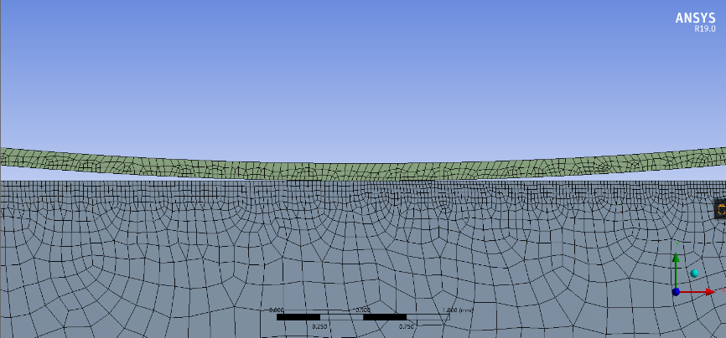
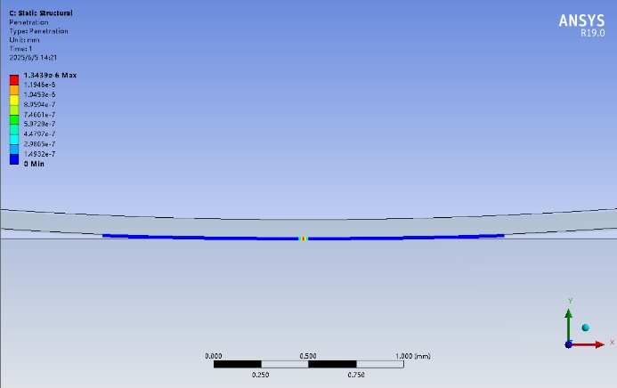
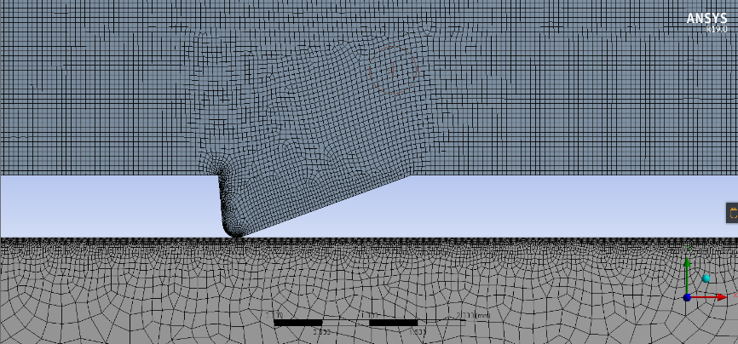


MDI mechanics progress
FEA estimation
  Two FEA cases has been made, for membrane inflatable seal and knife-edge inflatable seal, separately.
  The preliminary FEA result shows both method can obtain the leak rate at the level of 10–11 Pa·m3/s.
Membrane inflatable seal
$$\left.C=34A^{2}（L/w）exp{[}−3F/(LwR)\right]$$
Knife-egde inflatable seal

Slide 47


MDI mechanics progress
A prototype will be developed (quotation finished, preparing engineering drawings).
The influence of RVC displacement on the leakage rate will be simulated through an adjustment mechanism.
Fake model of vacuum vessel
Fake model of IP chamber, fixed
Adjustment mechanism
RVC

Slide 48
Summary
The detailed equipment-level survey is currently underway. The physics designs of the elements along beam are in intense progress. We are hoping to finish the first version of survey and physics design in early September.
We have formulated preliminary opinions on equipment naming. The naming catalog is currently being compiled and expanded.
We have finished a relatively detailed MDI layout with all the components coherent. The mechanics and vibration analyses and the structure optimization is basically converged. The engineering design of RVC has been started and a experiment scheme has been made.

Slide 49
Thanks for your attention!

