Slide 1
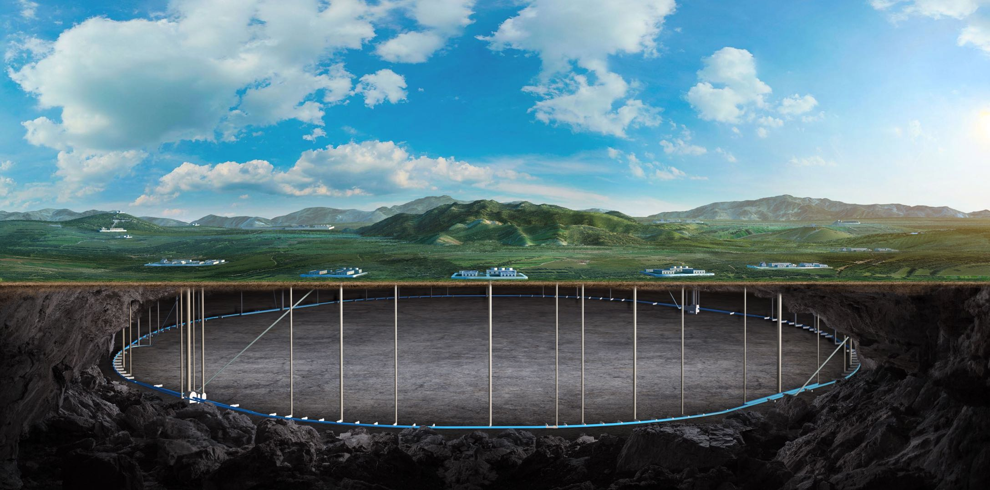
CEPC vacuum chamber design with photon absorbers in comparison with TDR vacuum design
Guangyi Tang
On behalf of CEPC RP Group, Yongsheng Ma, Na Wang and Mei Yang
11. July. 2025, Beijing, IHEP

Slide 2
Content
Design criteria and photon absorber @FCC
CEPC TDR shielding scheme v.s. photon absorber scheme
Prompt dose level in the tunnel for TDR scheme
Protection of radiation-sensitive equipment
Cables, electronics, optical fiber …
Induced dose level in the tunnel for TDR scheme
TDR shielding scheme v.s. photon absorber scheme
Induced/Prompt dose level in the tunnel
Magnet shielding for photon absorber scheme
Conclusion

Slide 3
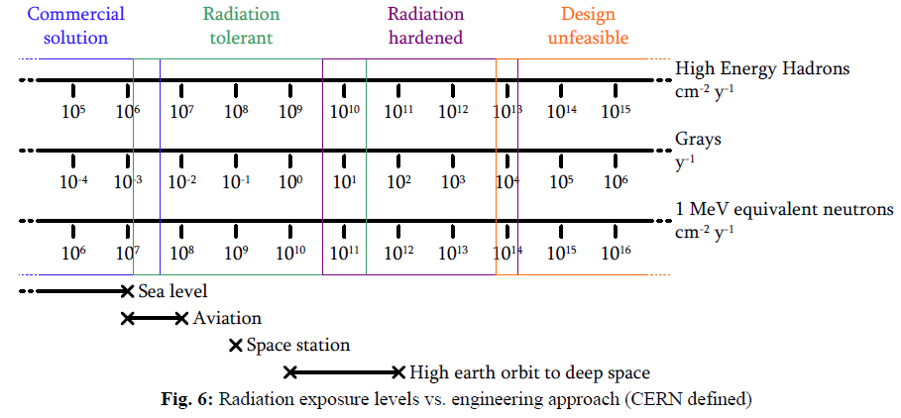
Radiation level for electronics
Radiation-sensitive equipment: electronics, optical fibers and cables/insulations.
In the collider tunnel, the radiation level is much higher than in the linac/transport line/damping ring. Electronics in the collider tunnel without shielding may be broken soon.
First priority to design shielding in collider tunnel.
Use absorbed dose, 1MeV-equivalent neutron fluence and high energy hadron fluence to assess the radiation exposure levels.
For electronics:
High Energy hadron fluence < $2×{10}^{10} cm^{−2}y^{−1}$
Absorbed dose < 20 Gy/y
1MeV equivalent neutron fluence < $2×{10}^{11} cm^{−2}y^{−1}$
CAS - CERN Accelerator School: Power Converters, 245-263
We set upper limits here.

Slide 4
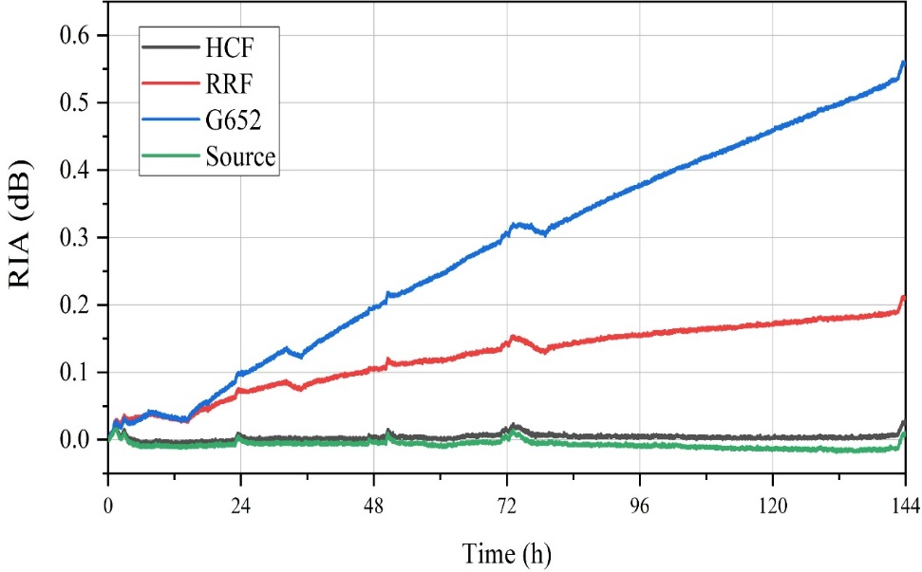
Radiation level for optical fibers and cables
Radiation-sensitive equipment: electronics, optical fibers and cables/insulations.
In the collider tunnel, the radiation level is much higher than in the linac/transport line/damping ring. Electronics in the collider tunnel without shielding may be broken soon.
First priority to design shielding in collider tunnel.
Use absorbed dose, 1MeV-equivalent neutron fluence and high energy hadron fluence to assess the radiation exposure levels.
For optical fibers:
Accumulated absorbed dose < 100 Gy for ordinary optical fiber
Accumulated absorbed dose < 10 kGy for radiation-resistant optical fiber
For cables/insulations:
Absorbed dose < 1 MGy considered for polyethylene, PVC, etc..
Total dose:
354Gy@HCF，268Gy@RRF，195Gy@G652
2025 European Edition of the International Workshop on the Circular Electron-Positron Collider (CEPC), Barcelona, Spain: CEPC large scale and precision control system study in EDR (remotely) · IFAE Indico
Radiation Induced Attenuation (dB)
RADIATION PROBLEMS IN THE DESIGN OF THE LARGE ELECTRON - POSITRON COLLIDER (LEP). (1984)

Slide 5
FCC photon absorber scheme: thermal analysis
From FCC Week 2025 talk
Internal External

Slide 6
FCC photon absorber scheme: dose levels
From FCC Week 2025 talk

Slide 7
FCC photon absorber scheme: electronics bunker
FCC Week 2025 talk

Slide 8
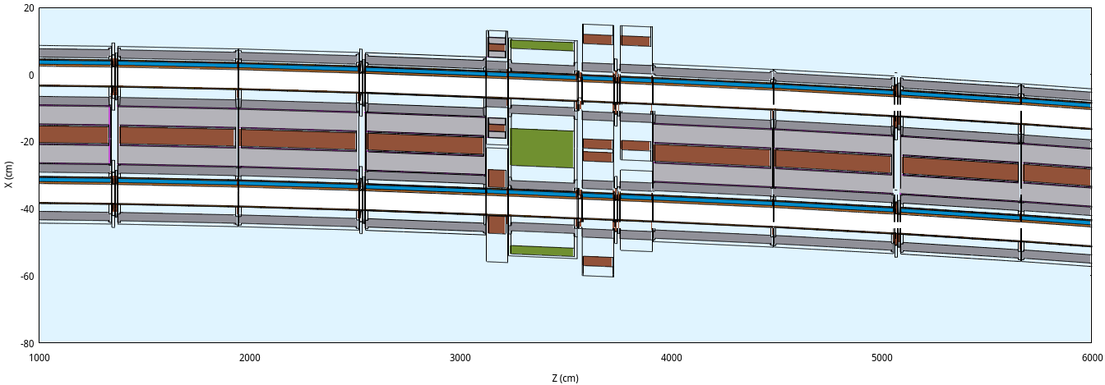
TDR simulation setup: a typical collider arc region
According to mechanical arrangement, a beamline shows below
Dipoles with bellows and pumps -> Correctors -> Quadrupole -> BPMs -> Sextopoles -> Dipoles with bellows and pumps

Slide 9
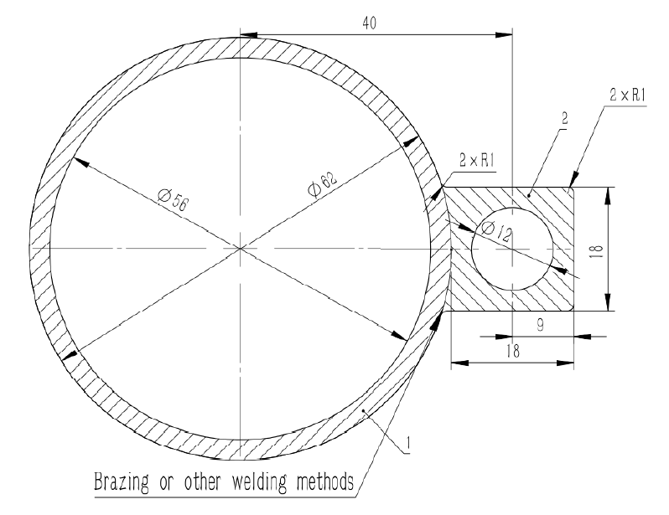
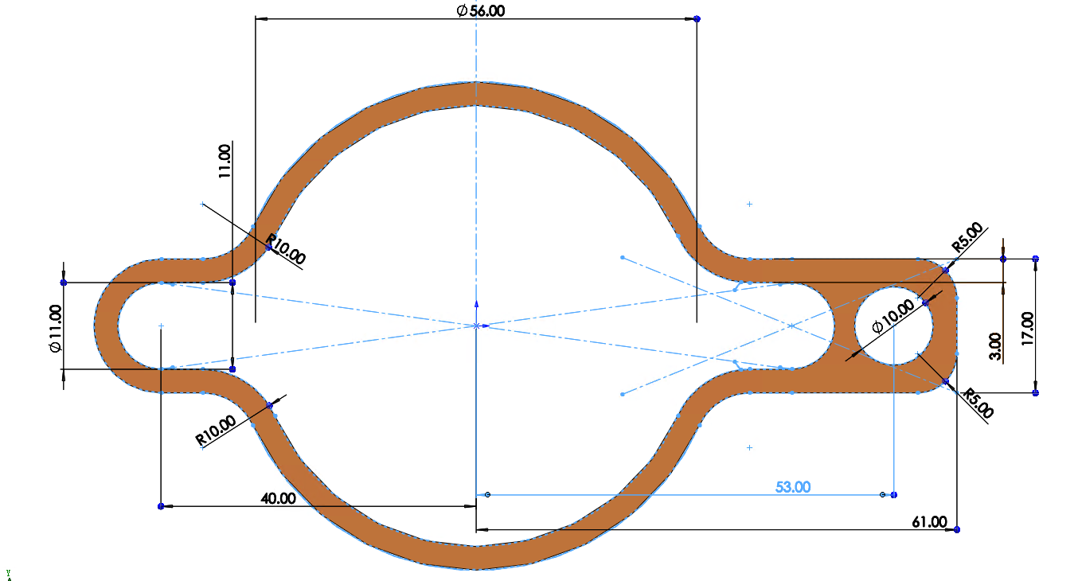
Photon absorber simulation setup：vacuum chamber
TDR scheme
Diameter: 56mm
Photon absorber scheme
Diameter: 56mm; Total width (beampipe + antechamber + cooling pipe): 109.5mm
From Yongsheng

Slide 10
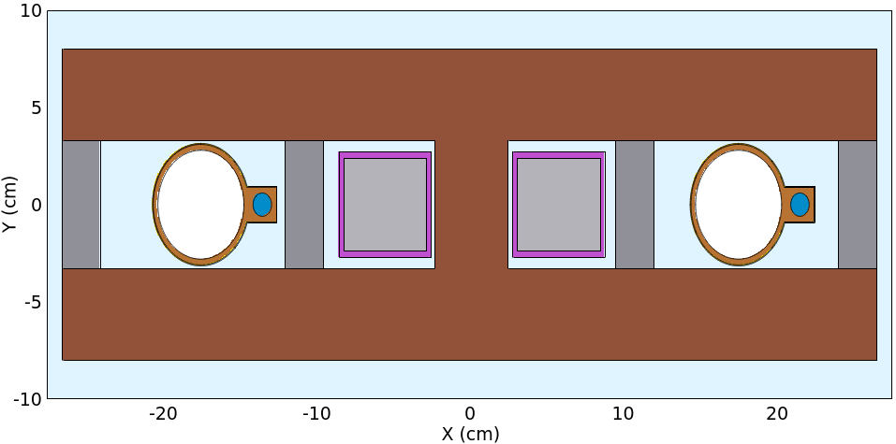
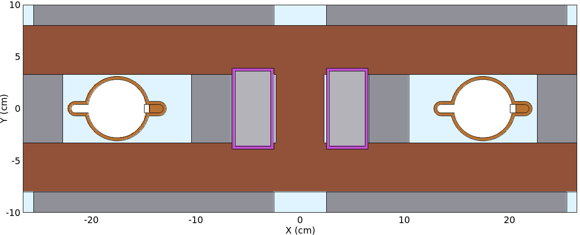
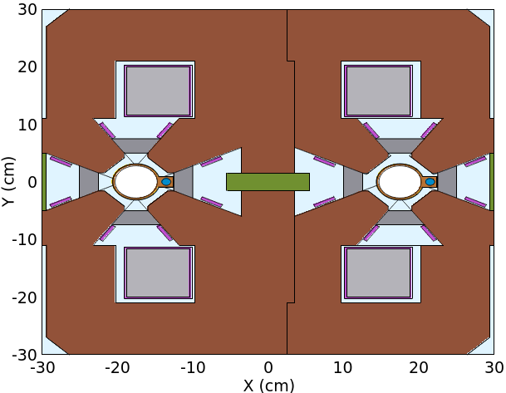
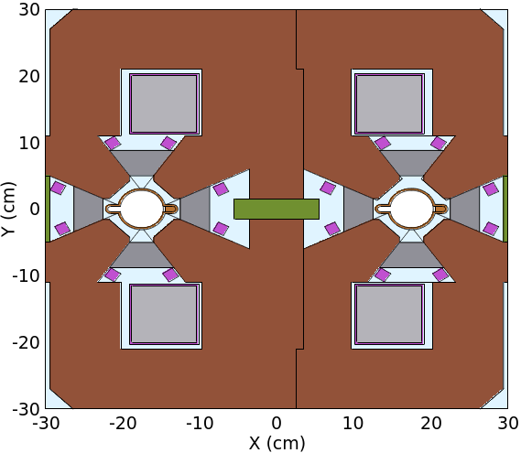
Photon absorber simulation setup：magnets
From Mei
TDR scheme, width of lead: 25mm
The costs of magnets are same; the powers increase 10%, according to TDR design.
Photon absorber scheme, width of lead in dipole/quadrupole: 38mm, with extra 20mm lead on the top/under the bottom of dipole
Dipole
Quadrupole
with epoxy resin insulation
with epoxy resin insulation

Slide 11
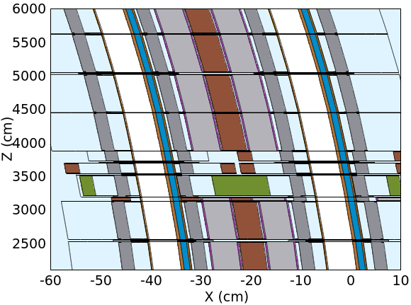
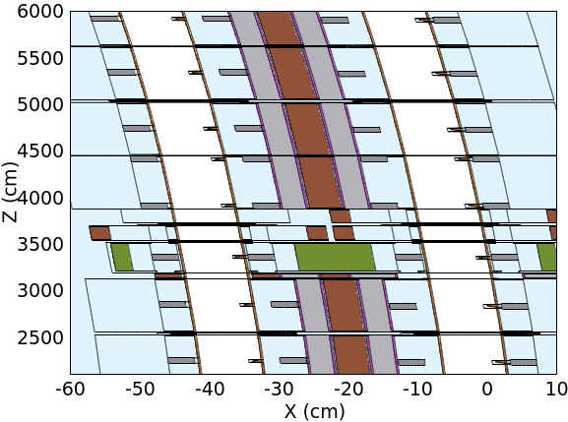
Beamline arrangement
TDR scheme
25mm thick lead
Photon absorber scheme
Photon absorber located in dipole and quadrupole, with lead around
Dipole
Sexto
Quadru
Dipole

Slide 12
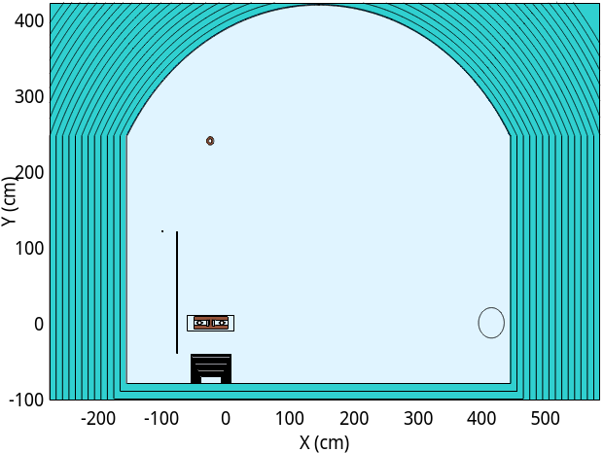
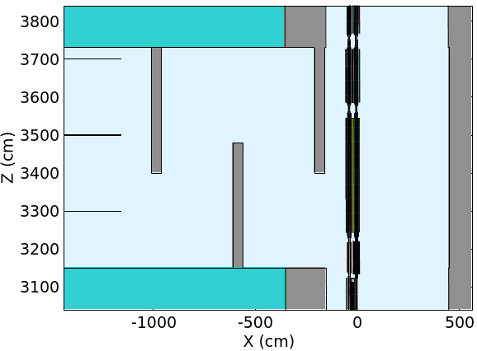
TDR scheme: tunnel and auxiliary tunnel maze
The dose level in the tunnel is so high that would damage cables, fibers and electronics.
Add lead/concrete block to protect the cables on the cable trays. The cable trays are located in the inner wall.
Auxiliary tunnels with mazes are designed to contain all electronics.
0.5m
0.5m
internal
5m
external
2.5m
5.8m
booster
6m
3.5m
3.5m
Lead/concrete block
cable trays
2.5m
2.5m
collider
support
0.5m

Slide 13
Content
Design criteria and photon absorber @FCC
CEPC TDR shielding scheme v.s. photon absorber scheme
Prompt dose level in the tunnel for TDR scheme
Protection of radiation-sensitive equipment
Cables, electronics, optical fiber …
Induced dose level in the tunnel for TDR scheme
TDR shielding scheme v.s. photon absorber scheme
Induced/Prompt dose level in the tunnel
Magnet shielding for photon absorber scheme
Conclusion

Slide 14
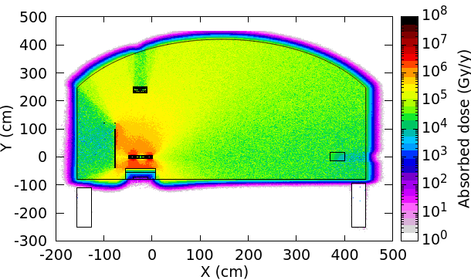
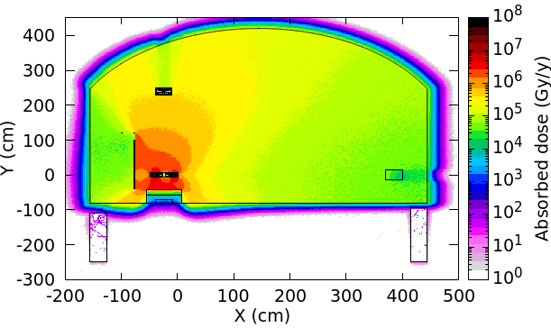
Prompt dose level for TDR scheme
@ttbar SR
Internal wall: 600kGy/y, external wall: 70kGy/y
Internal wall:50kGy/y,
Dose level caused by beamloss is much lower than that caused by SR. Dose level @Z/WW is also negligible.
@Higgs SR
Internal wall: 180kGy/y, external wall: 60kGy/y
Internal wall 30kGy/y,
After 18 years operation, the cumulative absorbed dose to the outer ring cable (950 kGy) remains below the upper limit (1 MGy). By the lead/concrete shielding, the cumulative absorbed dose to the inner wall cables decrease from 4.8MGy to 550 kGy, lower than 1 MGy upper limit, so that the cables are safe.
Without lead/concrete shielding
With lead/concrete shielding
internal
external
internal
external

Slide 15
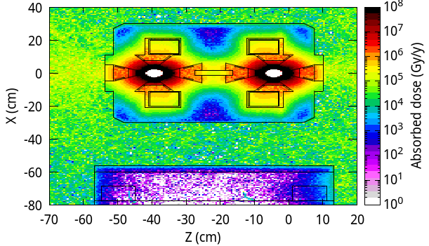
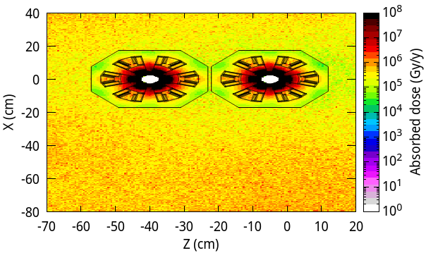
Radiation protection for cable insulation
The cables next to quadrupoles and sextopoles are safe since the magnet cores are good shielding block.
Accumulated absorbed dose < 800 kGy, around quadrupoles < 8 MGy, around sextopoles
Safe for polyethylene or epoxy resin insulations. However caution is advised.
The other cables next to equipment needs radiation hardening.
Cables with SiO2/ceramic insulation and organic cover
During equipment installation, organic materials are used to protect the ceramic from damage.
Multilayer insulations with wire meshing
Assume 10k RMB per cable, 78160 cables signify 790M RMB
Plan to test the feasibility of composite insulation layer cables.

Slide 16
Radiation protection for electronics for TDR scheme
For electronics
With a 3-leg maze, radiation in the auxiliary tunnel decreases to a safe level
Number of electronics (power supply): ~ 26000 for magnets, ~ 30000 for vacuum system, ~ 12000 for BPM
198 auxiliary tunnels supply enough space to contain all electronics.
Alternatively, by shielding with 20cm lead and 20cm concrete, radiation in gaps between supports decreases to a safe level.
 | Upper limit | 3-leg maze with 1m-thick concrete wall | between supports 15-cm lead + 15-cm concrete
High energy hadron fluence (${cm}^{−2}{ y}^{−1})$ | $$2×{10}^{10}$$ | $$<3×{10}^{6}$$ | $$\text{< }3×{10}^{8}$$
Absorbed dose (Gy/y) | 20 | $\text{< }\text{1}\text{0}$ (1m far from entrance) | <20
1MeV equivalent neutron fluence (${cm}^{−2}{ y}^{−1})$ | $$2×{10}^{11}$$ | $$<3×{10}^{8}$$ | $$\text{< }1×{10}^{11}$$

Slide 17
Radiation protection for fiber/cables for TDR scheme
Upper limit for ordinary optical fiber: accumulated absorbed dose < 100 Gy Upper limit for radiation-resistant optical fiber: accumulated absorbed dose < 10 kGy
Radiation-resistant optical fibers are safe in the inner trench with 30cm concrete cover and safe in the outer trench with thinner-than-10cm concrete cover.
Ordinary optical fibers are safe in outer trench with 30cm concrete cover.
For cable insulations (polyethylene, etc.) on the cable trays: accumulated absorbed dose <1 MGy
Use 2cm-thick 2m-high lead sheet, or 10cm-thick 2m-high concrete block to shield radiation. Cost: 830M RMB for lead, or 30M RMB for concrete
 | Trench with 10-cm concrete cover | Trench with 30-cm concrete cover
inner trench | <72 kGy | <140 Gy
outer trench | <7 kGy | <27 Gy
@Higgs
@ttbar

Slide 18
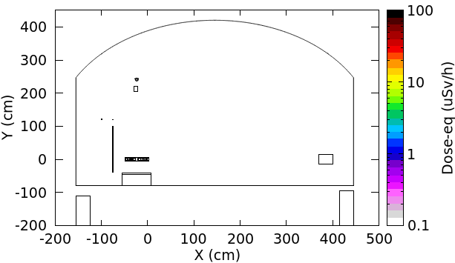
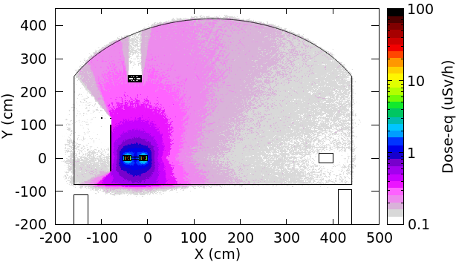
Induced dose-eq, 10min after shutdown for TDR scheme
For 4 operations (120/45.5/80/180 GeV), simulate the induced dose-eq caused by SR and random beam losses.
The dose-eq after 1-year running and 10-min shutdown is shown below
@Higgs operation：1m away from equipment <1 uSv/h，surface of equipment ~10 uSv/h
SR random beam losses
Similar radiation level around the end of BEPCII Linac. Working 500h per year

Slide 19
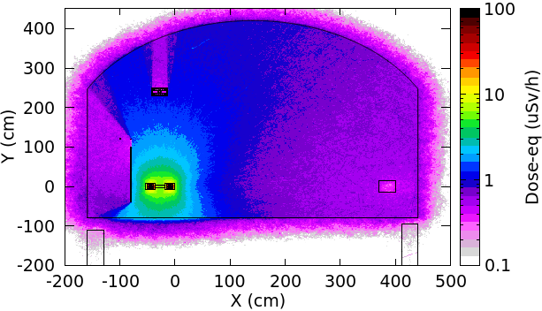
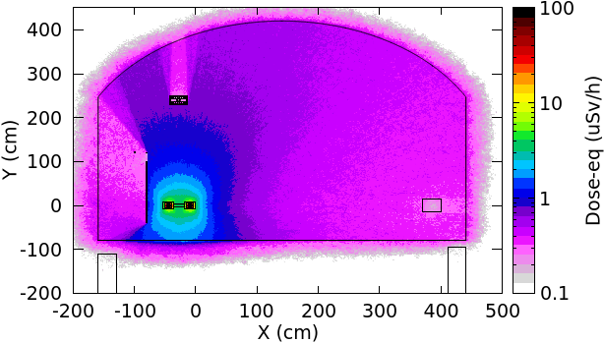
Induced dose-eq, 10min after shutdown for TDR scheme
@Z operation: 1m away from equipment <2 uSv/h， surface of equipment ~ 20 uSv/h
SR can be negligible
A little higher than radiation level around around the end of BEPCII Linac. Working ~100h per year.
@ WW operation: 1m away from equipment <1 uSv/h， surface of equipment ~10 uSv/h
SR can be negligible

Slide 20
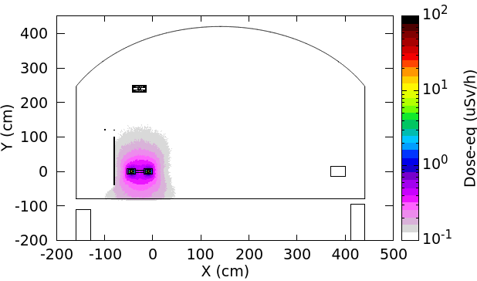
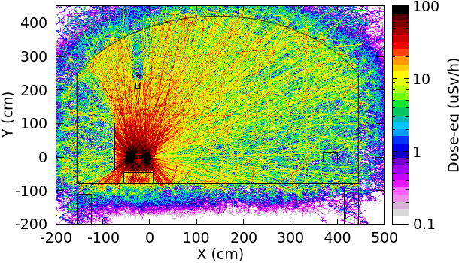
Induced dose-eq, 10min after shutdown for TDR scheme
@ttbar operation： 1m away from equipment <20 uSv/h， surface of equipment >100 uSv/h
SR random beam losses
Higher than the radiation level around BEPCII positron target. Considering 5mSv/a as the upper limit for workers, a short time (~10h) stay is permitted.

Slide 21
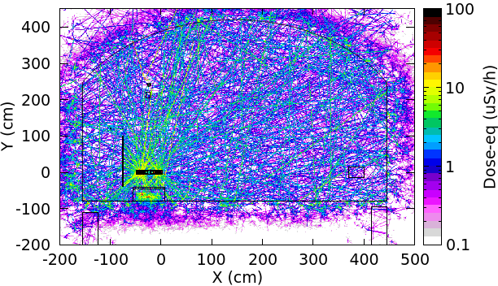
Induced dose-eq, 1day after shutdown for TDR scheme
@ttbar operation： 1m away from equipment <5 uSv/h， surface of equipment >10 uSv/h
SR
Considering 5mSv/a as the upper limit for workers, a long time (~200h) stay is permitted. So the induced radiation levels for all operations are acceptable.
Slightly higher than the dose-eq @Z/WW operation.

Slide 22
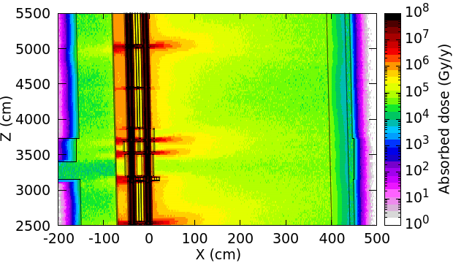
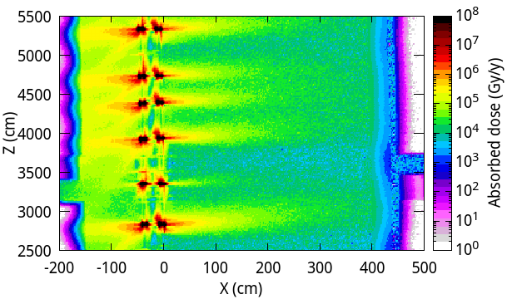
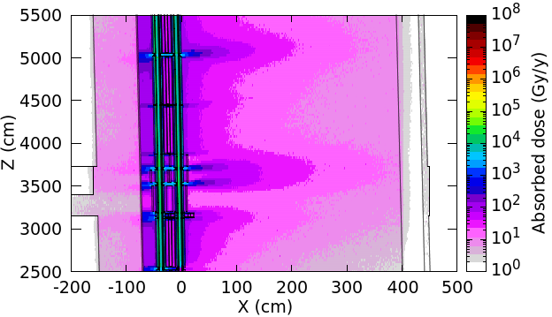
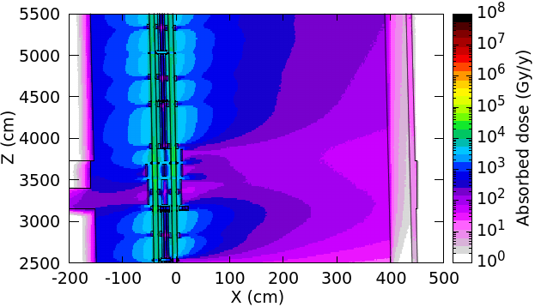
Prompt dose level comparison between TDR scheme and Photon absorber scheme
TDR @ttbar SR
@Z beamloss
@ttbar, the absorbed dose for TDR scheme is higher, but using the concrete/lead block can reduce the absorbed dose around the inner side of the tunnel where the cable trays are.
Photon absorber scheme

Slide 23
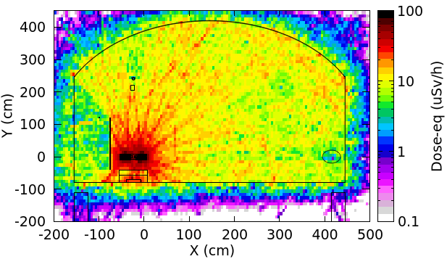
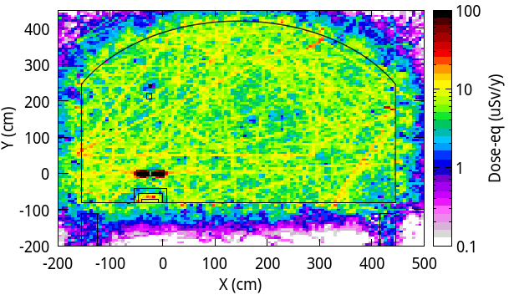
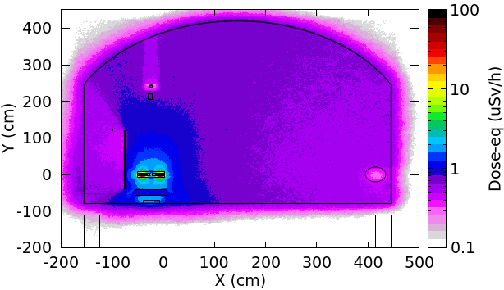
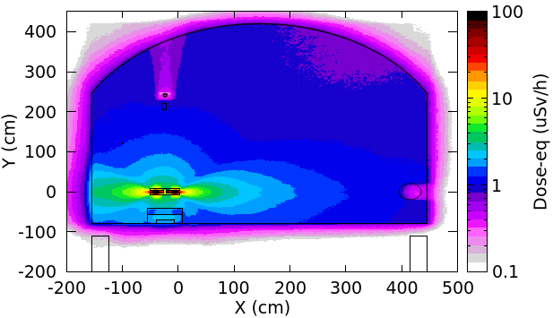
Induced dose-eq comparison in collider tunnel, 10min after shutdown, between TDR scheme and Photon absorber scheme
TDR scheme
@ttbar SR
For TDR scheme, @ttbar operation, the induced dose-eq is higher, it is better to wait more time
@Z beamloss
@Z operation, the radiation level using TDR scheme is better.
Photon absorber scheme

Slide 24
Radiation protection for electronics between TDR scheme and Photon absorber scheme
For photon absorber scheme, the electronics are still in auxiliary tunnel with maze
 | Upper limit | TDR scheme |  | Photon absorber scheme
 | Upper limit | 3-leg maze with 1m-thick concrete wall | between supports 15-cm lead + 15-cm concrete | 3-leg maze with 1m-thick concrete wall
High energy hadron fluence (${cm}^{−2}{ y}^{−1})$ | $$2×{10}^{10}$$ | $$<3×{10}^{6}$$ | $$\text{< }3×{10}^{8}$$
Absorbed dose (Gy/y) | 20 | $\text{< }\text{1}\text{0}$ (1m far from entrance) | <20
1MeV equivalent neutron fluence (${cm}^{−2}{ y}^{−1})$ | $$2×{10}^{11}$$ | $$<3×{10}^{8}$$ | $$\text{< }1×{10}^{11}$$

Slide 25
Radiation protection for fiber, cable insulation between TDR scheme and Photon absorber scheme
Upper limit for ordinary optical fiber: accumulated absorbed dose < 100 Gy Upper limit for radiation-resistant optical fiber: accumulated absorbed dose < 10 kGy
For cable insulations (polyethylene, etc.) on the cable trays: accumulated absorbed dose <1 MGy
Use 2cm-thick 2m-high lead sheet, or 10cm-thick 2m-high concrete block to shield radiation.
 | TDR scheme |  | Photon absorber scheme
 | Trench with 10-cm concrete cover | Trench with 30-cm concrete cover | Trench with 10-cm concrete cover | Trench with 30-cm concrete cover
inner trench | <72 kGy | <140 Gy
outer trench | <7 kGy | <27 Gy

Slide 26
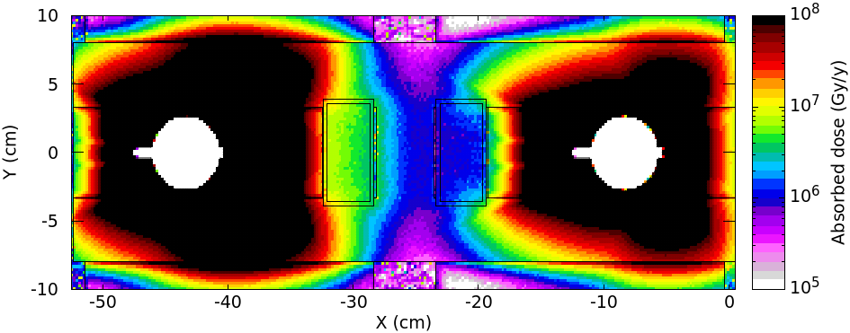
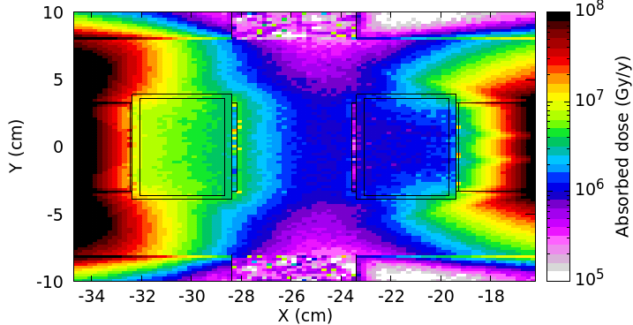
Photon absorber scheme: dose to magnet insulation
For ttbar operation, in dipoles
TDR scheme：absorbed dose rate $1.9×{10}^{6}$ Gy/y ; Upper limit: $2×{10}^{7}$ Gy
Dose to internal insulation is significant larger than external
Max. absorber dose to internal insulation: ${10}^{7}$ Gy/y. Cannot withstand 18 years. Should add more lead around photon absorber.
Internal External

Slide 27
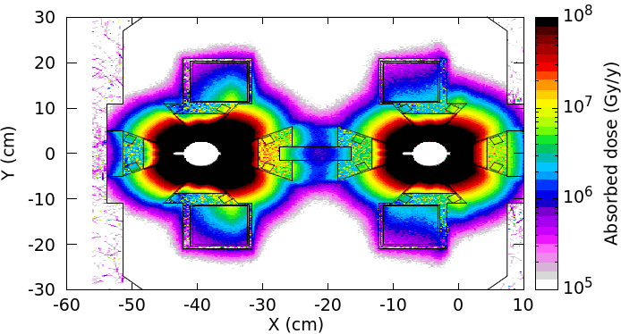
Photon absorber scheme: dose to magnet insulation
For ttbar operation, in quadrupoles
TDR scheme: absorbed dose rate $1.9×{10}^{6}$ Gy/y; Upper limit: $2×{10}^{7}$ Gy
Dose to internal insulation is significant larger than external
Max. absorber dose to internal insulation: ${10}^{7}$Gy/y. Cannot withstand 18 years. Should add more lead around photon absorber.
More difficulties than TDR scheme because of small space.
Internal External

Slide 28
Summary for the comparison
Impact factor |  | CEPC TDR scheme | Photon absorber scheme
Impedance |  | The impedance … | The impedance increase due to the absorbers are less than 5% of the total budget, acceptable from the instabilities; The asymmetry of the structure will further introduce transverse monopolar impedance, this will be estimated.
Magnet coil insulation |  | Epoxy resin insulation need 25mm-thick lead shielding. | Epoxy resin insulation need more lead shielding around SR absorber
vacuum |  | The vacuum chamber and NEG coating process are well designed. | Conceptual design is close to be finished, but the NEG coating process and lots risks of vacuum chamber with absorber due to welding should be carefully assess.
Radiaton protection | Cables | Lead/concrete shielding near inner wall | On the wall without shielding
 | Optical fiber | Trench with concrete cover | ---
 | electronics | In auxiliary tunnel. Or in the gap between supports with lead/concrete shielding | In auxiliary tunnel. Or in the gap between supports with lead/concrete shielding

Slide 29
Summary for the comparison
Impact factor | CEPC TDR scheme | Photon absorber scheme
Cost | 1.lead/concrete shielding, increases 30 ~ 830M CNY. Cables, increases at most 790M CNY; Cooling for magnets and lead, increase 10M CNY. 2. Trench and concrete, estimating 3.Gap between supports, probably not use | 1. Photon absorber，vacuum chamber, 1.3B CNY; Less lead is used than TDR scheme, -100M CNY; Cooling for absorber and lead, estimating BPM, estimating 2. Trench and concrete, estimating 3.Gap between supports (bunker), estimating
 | Total: 830M ~1830M CNY + | Total: 1200M CNY +
Engineering design | The support of lead in the magnet and cooling；The arrangement of lead/concrete near the inner wall | Manufacturing photon absorber. The support of lead in the magnet and cooling；

Slide 30
Conclusion
For TDR scheme:
The induced dose-eq levels are safe for a long-time work in the tunnel, except the short-cooling-after-ttbar-operation case.
Radiation level in the auxiliary tunnel is safe for electronics, radiation level around inner wall with shielding is safe for cables, radiation level in the trench is safe for optical fiber.
The preliminary thermal analysis shows the water cooling can bring 72% deposited heat out so that the ventilation load is acceptable.
For photon absorber scheme,
the NEG coating process and lots risks of vacuum chamber with absorber due to welding should be carefully assess; The epoxy resin insulation in magnet cannot withstand with 38mm lead shielding, we are trying to add more shielding to protect insulation.
The induced dose-eq levels are safe for a long-time work in the tunnel.
Electronics should be in auxiliary tunnel and optical fiber should be in trench. The cables can be probably in the cable trays without shielding.
The thermal analysis is on-going.

Slide 31
Conclusion
The photon absorber scheme has not been well optimized. However, the radiation level @ttbar operation using photon absorber scheme is better than using TDR scheme, meanwhile the radiation level @Z operation using photon absorber scheme is not.
For both photon absorber scheme and TDR scheme, challenges in design water cooling system and supporting exist.
We are currently planning a series of experiments, including the process for fixing cooling water pipes on lead, the thermal conductivity between lead and cooling water pipe, and the aging test for composite insulation layer cables.
Thank you

Slide 32
backup

Slide 33
Radiation protection for fiber, cable insulation
Upper limit for ordinary optical fiber: accumulated absorbed dose < 100 Gy Upper limit for radiation-resistant optical fiber: accumulated absorbed dose < 10 kGy
Radiation-resistant optical fibers are safe in the inner trench with thicker-than-30-cm concrete cover and safe in the outer trench thinner-than-10-cm concrete cover.
Ordinary optical fibers need thicker cover or deeper trench.
For cable insulations (polyethylene, etc.) on the cable trays: accumulated absorbed dose <1 MGy
Use 2cm-thick 2m-high lead sheet, or 10cm-thick 2m-high concrete block to shield radiation. Cost: 830M RMB for lead, or 30M RMB for concrete
 | Trench with 10-cm concrete cover | Trench with 30-cm concrete cover
inner trench | <8 kGy/y | <15 Gy/y
outer trench | <0.7 kGy/y | <3 Gy/y
@Higgs
@ttbar

