Slide 1
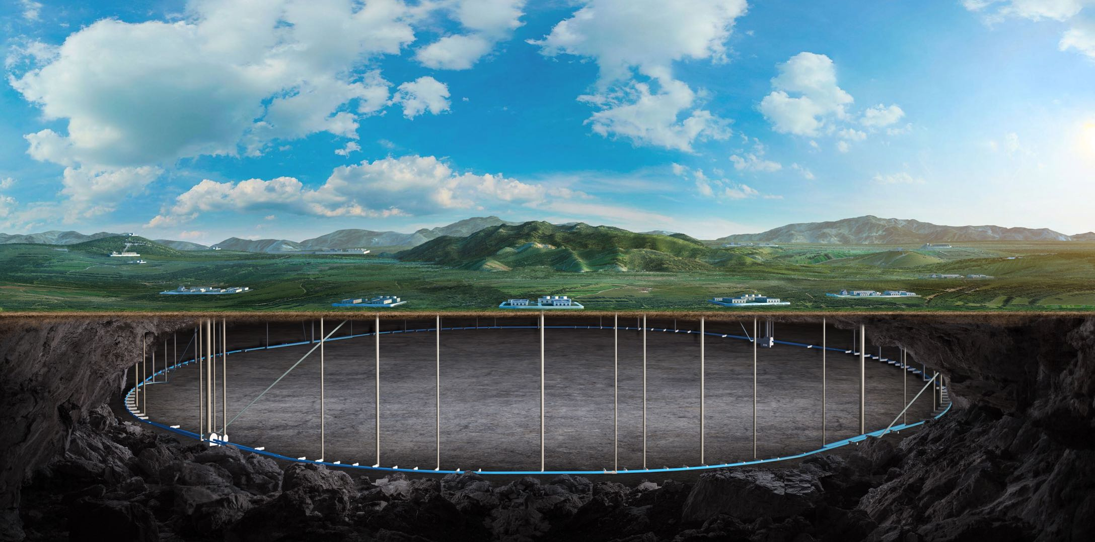
“CEPC vacuum chamber design with photon absorbers in comparison with TDR vacuum design” review
status
Guangyi Tang
On behalf of CEPC RP Group, Yongsheng Ma, Na Wang and Mei Yang
. July. 2025, Beijing, IHEP

Slide 2
Committee member and presentation
Committee member:
Radiation protection: Adolfo Esposito (INFN), James C. Liu (SLAC), Markus Widorski (CERN)
Vacuum: Roberto Kersevan (CERN), Kyo Shibata (KEK)
Magnet: Mika Masuzawa (KEK)
Presentation:
“Verification of the TDR vacuum chamber shielding design in comparison with antechamber vacuum system with photon absorbers” review: Introduction
CEPC vacuum chamber design with photon absorbers in comparison with TDR vacuum design
Radiation shielding structure and water cooling design of CEPC collider magnet
Verification of the TDR vacuum chamber shielding design in comparison with antechamber vacuum system with photon absorbers

Slide 3
“Verification of the TDR vacuum chamber shielding design in comparison with antechamber vacuum system with photon absorbers” review: Introduction
CEPC overview
CEPC TDR radiation protection overview
Magnet insulation lead shielding
Collider dump
Linac dumps and bulk shielding
Residual nuclei production
Charge to review committee

Slide 4
CEPC vacuum chamber design with photon absorbers in comparison with TDR vacuum design
Preview of CEPC vacuum system
SR pathway diagram
Vacuum chamber design of collider in TDR
Structure of vacuum chamber with absorbers
Mechanical adaption with magnets
Design of Absorber
Impedance of absorbers
Conclusion

Slide 5
CEPC vacuum chamber design with photon absorbers in comparison with TDR vacuum design
Conclusion
The structure of vacuum chamber will be more complex, bad to NEG coating process;
The structure of BPM, RF shielding bellows will be more complex but acceptable;
The space for absorber needs to be considered, and requiring good machining and installation accuracy;
The impedance increase due to the absorbers are less than 5% of the total budget ⇒ acceptable from the instabilities;
Lots risks of vacuum chamber with absorbers due to the welding between beam pipe and absorbers;
Prototypes should be carried out to access its feasibility.

Slide 6
Radiation shielding structure and water cooling design of CEPC collider magnet
Arc shielding design for Collider magnets in TDR
Radiation Water Cooling Design of CEPC Collider Magnets
Distribution of synchrotron radiation deposition
Thermal analysis in DAD without water cooling
Water cooling design for DAD radiation deposition
Water cooling design for DAQ radiation deposition
DAD modification for Synchrotron Radiation Absorber
Summary

Slide 7
Radiation shielding structure and water cooling design of CEPC collider magnet
Summary
Cooling with stainless steel water-cooled tubes can significantly reduce the temperature rise of magnets and lead, and reduce the ventilation load so that the temperature in tunnel is stable.
Lead shielding all along the arc region with cooling is feasible to reduce the temperature rise of the magnet by further increasing the contact surface
New types of dipole and quadrupole compatible with photon absorber are finished. The cost is same with TDR types and power increases 10% for new types dipole.
Further evaluation is needed for the temperature rise and water cooling design with photon absorbers. Further structural analysis is needed for the photon absorber scheme.

Slide 8
Verification of the TDR vacuum chamber shielding design in comparison with antechamber vacuum system with photon absorbers
Design criteria and photon absorber @FCC
CEPC TDR shielding scheme v.s. photon absorber scheme
Prompt dose level in the tunnel for TDR scheme
Protection of radiation-sensitive equipment
Cables, electronics, optical fiber …
Induced dose level in the tunnel for TDR scheme
TDR shielding scheme v.s. photon absorber scheme
Prompt/Induced dose level in the tunnel
Magnet shielding for photon absorber scheme
Conclusion

Slide 9
Summary for the comparison
Impact factor |  | CEPC TDR scheme | Photon absorber scheme
Magnet coil insulation |  | Epoxy resin insulation needs 25mm-thick lead. | Epoxy resin insulation needs thicker lead around SR absorber
vacuum |  | The vacuum chamber and NEG coating process are well designed. | Conceptual design is close to be finished, but the NEG coating process and lots risks of vacuum chamber with absorber due to welding should be carefully assess.
Impedance |  | The impedance is well considered, and meets the requirement. | The impedance increase due to the absorbers are less than 5% of the total budget, acceptable from the instabilities; The asymmetry of the structure will further introduce transverse monopolar impedance, this will be estimated.
Radiaton protection | Cables | Lead/concrete shielding near inner wall | On the wall without shielding
 | Optical fiber | Trench with concrete cover | Trench with concrete cover
 | electronics | In auxiliary tunnel. Or in the gap between supports with lead/concrete shielding

Slide 10
Summary for the comparison
Impact factor | CEPC TDR scheme | Photon absorber scheme
Cost | 1. Lead/concrete shielding, increases 30 ~ 830M CNY; 2. Cables, increases at most 790M CNY; 3. Cooling for magnets and lead, increase 100M CNY; 4. Trench and cover, estimating; 5.Gap between supports, probably not use; | 1. Photon absorber, vacuum chamber, increase 1.3B CNY; 2. Less lead is used than TDR scheme, decrease -100M CNY; 3. Cooling for absorber and lead, estimating; 4. BPM, estimating; 2. Trench and cover, estimating; 3.Gap between supports, probably not use/
 | Total: 920M ~1920M+ CNY | Total: 1200M+ CNY
Engineering design | The support of lead in the magnet and cooling; The arrangement of lead/concrete near the inner wall | Manufacturing photon absorber. The support of lead in the magnet and cooling；

Slide 11
Verification of the TDR vacuum chamber shielding design in comparison with antechamber vacuum system with photon absorbers
Conclusion:
For TDR scheme:
The induced dose-eq levels are safe for a long-time work in the tunnel, except the short-cooling-after-ttbar-operation case in which it is safe for a short-time work (10h).
Radiation level in the auxiliary tunnel is safe for electronics, radiation level around inner wall with shielding is safe for cables, radiation level in the trench is safe for optical fiber.
The preliminary thermal analysis shows the water cooling can bring 72% deposited heat out so that the ventilation load is acceptable and the temperature in tunnel is stable.
Based on the addition of inner shielding walls in the new tunnel, the rational design of trench covers, and the maze of the auxiliary tunnel, TDR is feasible, with cost increasing 830M ~1830M CNY + cost of trench covers.
For photon absorber scheme,
the NEG coating process and lots risks of vacuum chamber with absorber due to welding should be carefully assess; The epoxy resin insulation in magnet cannot withstand with 38mm lead shielding, we are trying to add more shielding to protect insulation.
The induced dose-eq levels are safe for a long-time work in the tunnel. Radiation level in the auxiliary tunnel is safe for electronics, radiation level around inner wall is safe for cables, radiation level in the trench is safe for optical fiber.
The thermal analysis is on-going.

Slide 12
Verification of the TDR vacuum chamber shielding design in comparison with antechamber vacuum system with photon absorbers
Conclusion:
For photon absorber scheme,
Once the NEG coating process, vacuum welding process and magnet insulation shielding design are ready, photon absorber scheme will be feasible, with cost increasing 1200M CNY + cost of trench covers, BPM and cooling system.
The photon absorber scheme has not been well optimized. However, the radiation level @ttbar operation using photon absorber scheme is better than using TDR scheme, meanwhile the radiation level @Z operation using photon absorber scheme is not.
For both photon absorber scheme and TDR scheme, challenges in design water cooling system and supporting exist.
We are currently planning a series of experiments, including the process for fixing cooling water pipes on lead, the thermal conductivity between lead and cooling water pipe, and the aging test for composite insulation layer cables.
Thank you

