Slide 1

CEPC control system EDR design and development status
环形正负电子对撞机
Circular Electron Positron Collider
18 July, 2025
Dapeng Jin
Institute of High Energy Physics, CAS, Beijing

Slide 2
Outline
Part of the main tasks & development
Next to do
Summary

Slide 3
Part of the main tasks & development

Slide 4
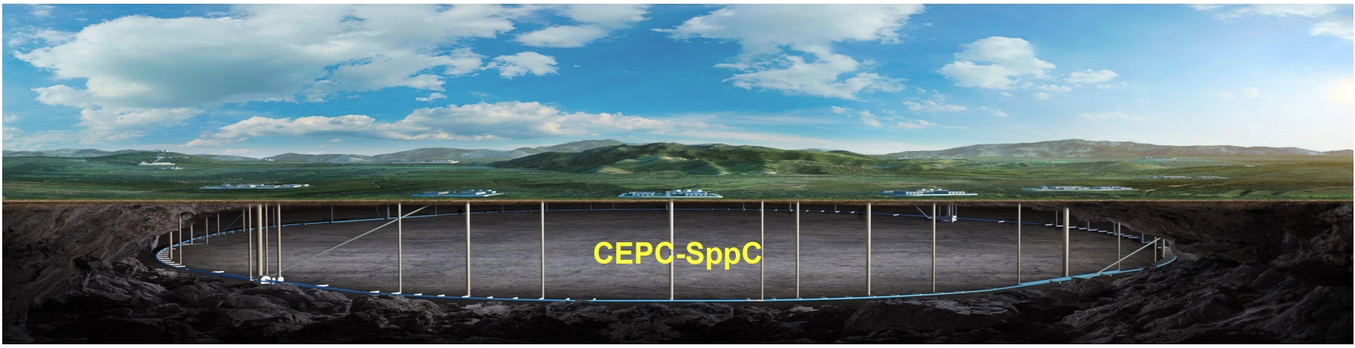
Fiber routing & radiation experiment
Overall
Fiber routing in tunnel with IP3 as the center.
Radiation hardness & cost.
~3000km 48-core opt. fiber needed.
IP3

Slide 5
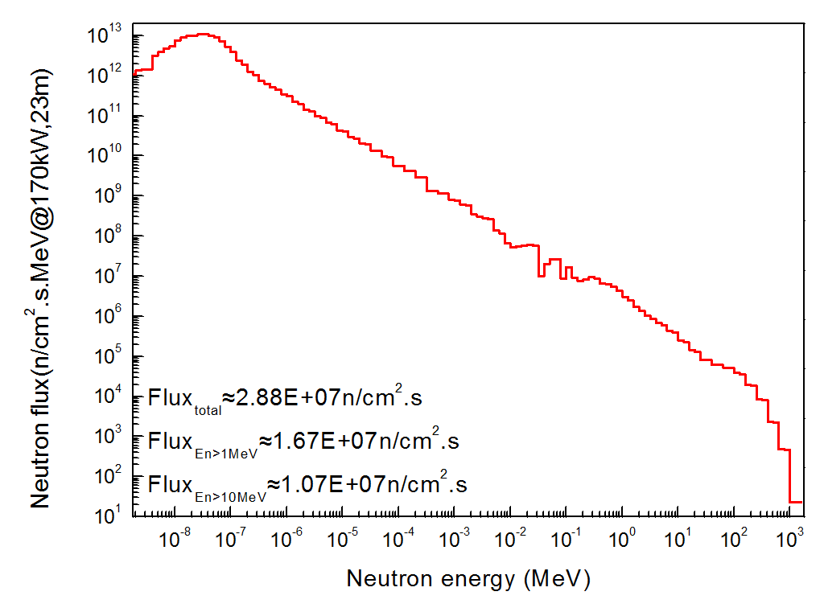
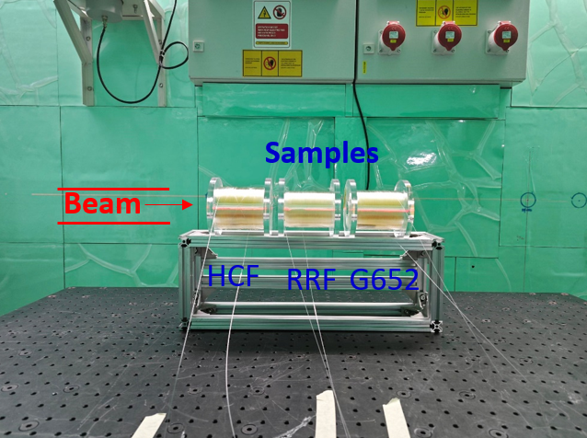
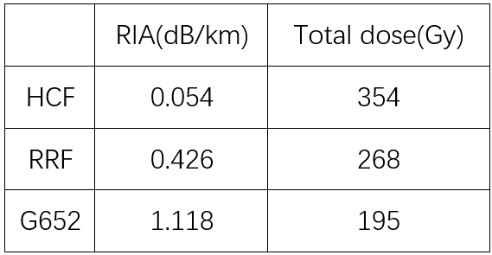
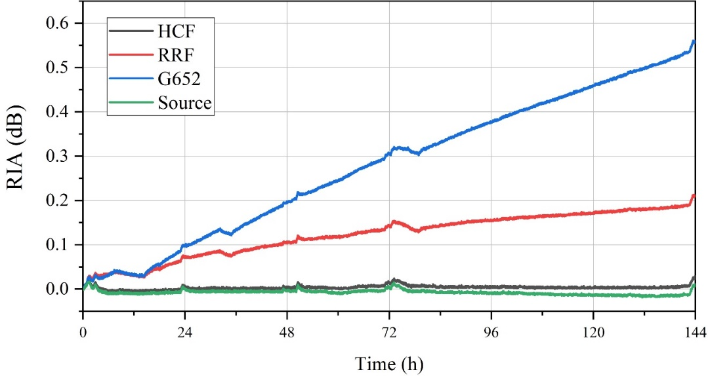
Fiber routing & radiation experiment
Rad. Exp.
Neutron radiation experiment done at ANIS of CSNS.
Ge doped fiber is very radiation sensitive.
Even F doped fiber is not suitable for accelerator.
HCF is much better with a price ~50RMB/core/m at present.
Further experiment planned.
Total dose:
354Gy@HCF，268Gy@RRF，195Gy@G652
1550nm
Joint fiber radiation experiment among YOFC, CSNS & IHEP.

Slide 6
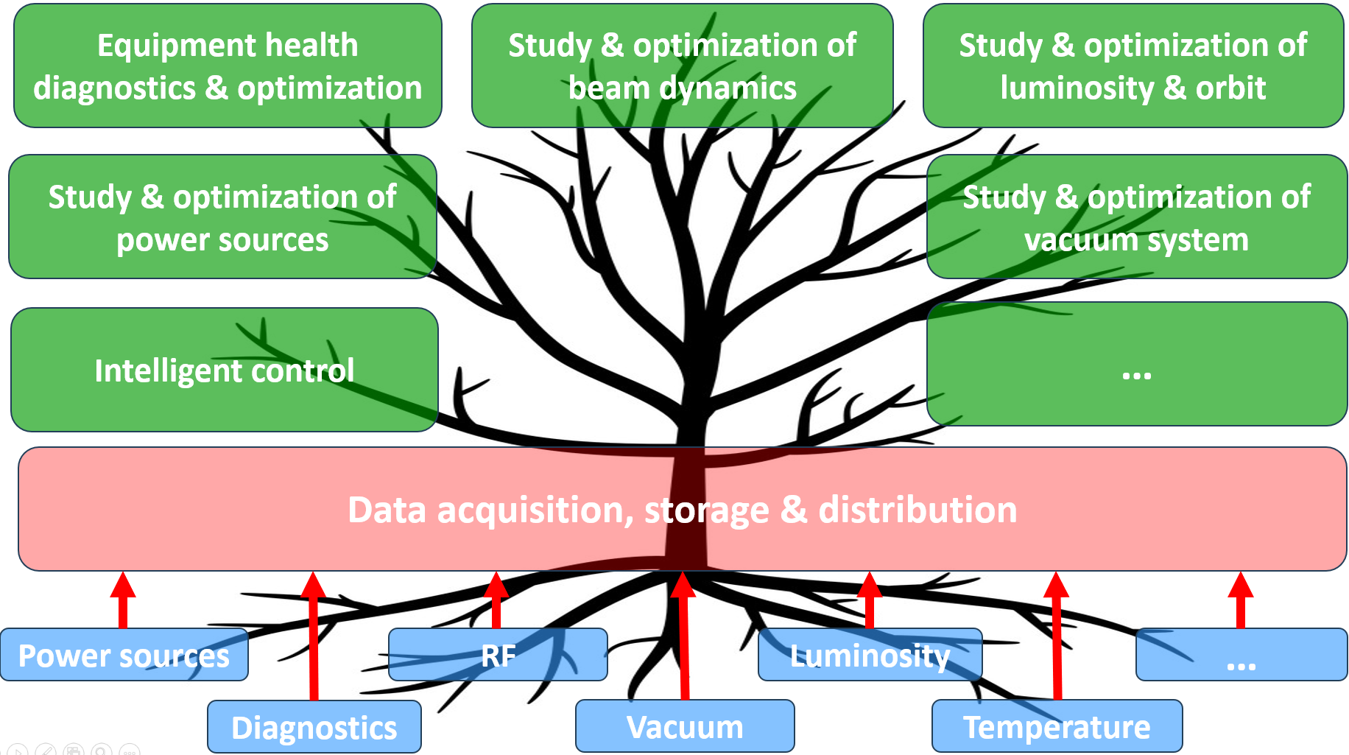
System monitoring & DAQ
AI related issues
AI is essential for the large & complex facility.
High quality data
High speed DAQ
Open loop applications
High perform. computing
Closed loop applications
High perform. actuator
High Performance applications
High bandwidth
Digital twin
Slow control & monitoring
Other applications
…

Slide 7
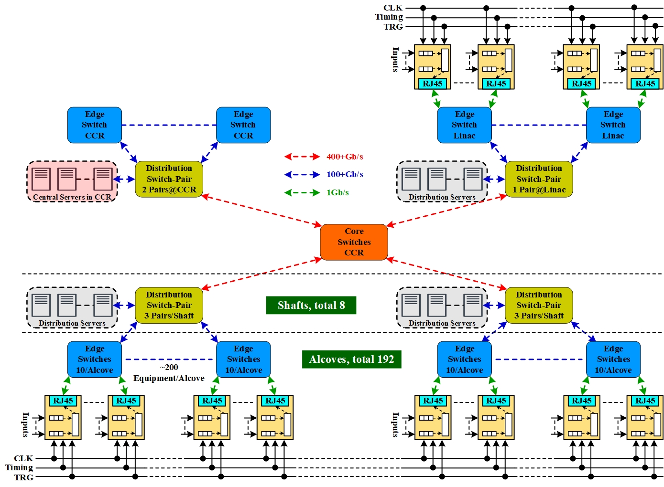
System monitoring & DAQ
Joint design
Services with multi-region data deployed on central servers .
Services with only local data deployed on distribution servers.
Joint design of control, DAQ/AI-related applications and network.
Network traffic localized as much as possible.
Distributed data acquisition, storage & services.
Physical separation of control & DAQ network.

Slide 8
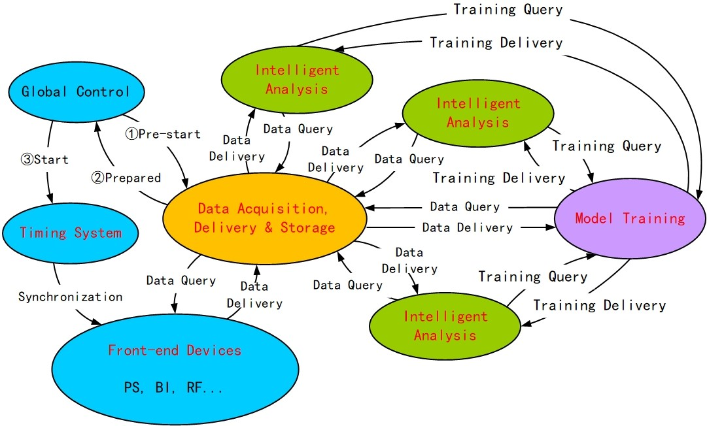
System monitoring & DAQ
Logic structure of DAQ
Preliminary logic structure of data acquisition, storage, distribution & analysis

Slide 9
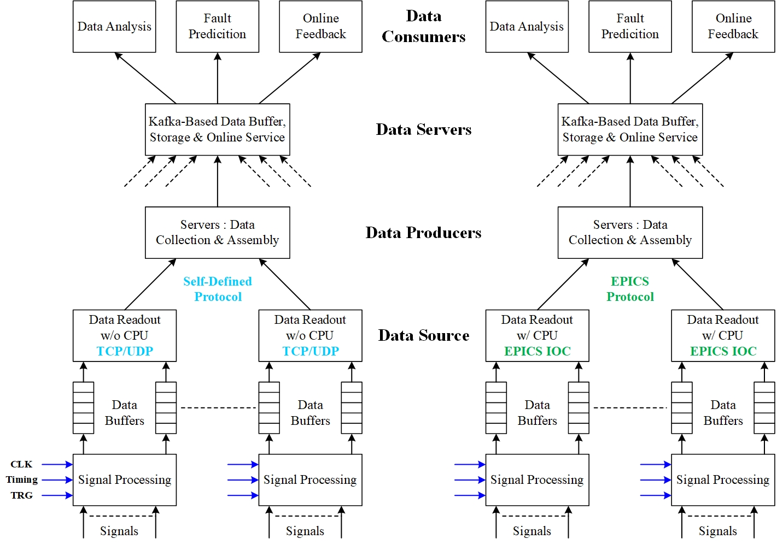
System monitoring & DAQ
Dataflow & tools
Data format & tools, HDF5?
Design & development of Kafka servers.
Fault tolerance & recovery.
Note: Referenced to documents of Sinong Cheng, from APS-U and Apache Software Foundation.
Dataflow & tools of data acquisition, storage, distribution & analysis

Slide 10
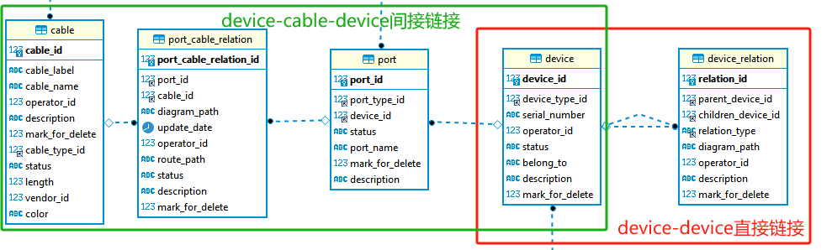
System monitoring & DAQ
Component & cable database
Indirect connection of devices through cable
Direct connection of devices : housing

Slide 11
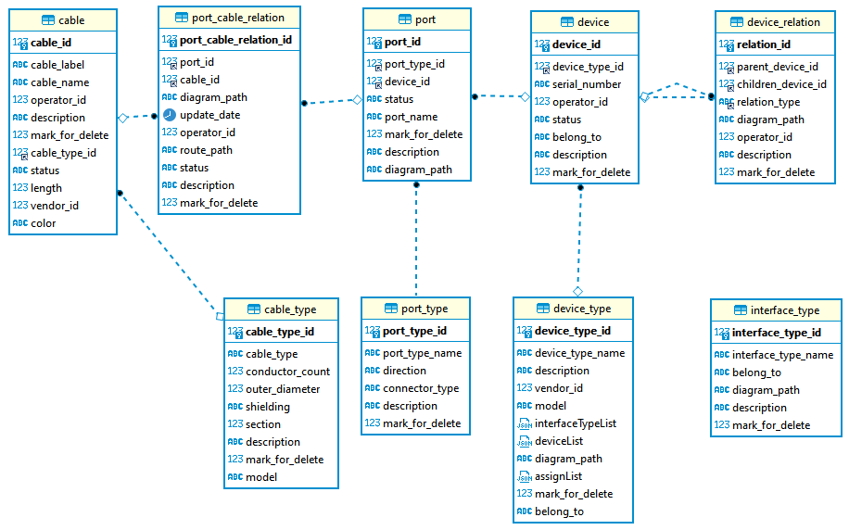
System monitoring & DAQ
Component & cable database
Data from users
用户数据
Dictionary data managed by administrator
管理员管理的字典数据

Slide 12
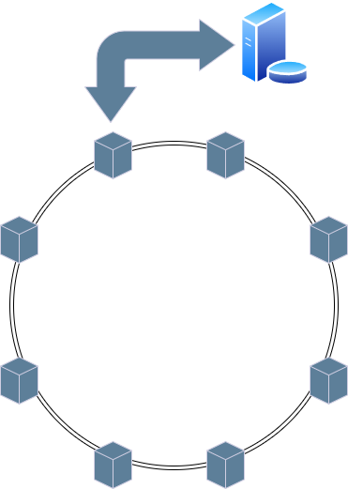
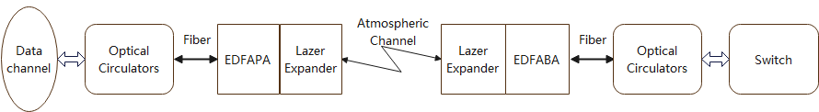
Timing system & reference line
Timing system with wireless transmission
Motivation: To achieve high-precision global clock transmission, and timing synchronization
  Within a 100 km range through wireless transmission
  Reducing the need of radiation-hard optical fibers
  Providing a backup technical solution.
Research
  Long-distance free space optical wireless transmission system
  Data transmission and clock synchronization technology
  Large scale, multi-cascaded clock synchronization technology
Main node
Structure of cascaded clock synchronization system
Schematic of long-distance FSO transmission

Slide 13
Timing system & reference line
Timing system with wireless transmission
Progress
  Long-distance Free Space Optical wireless transmission system.
    A 1 km distance laser wireless transmission system has been designed and tested.
    Data transmission and clock synchronization tests have been conducted with a bit error rate of less than 1E-13 and a synchronization accuracy of 20 ps (without optimizition).
  Point-to-point data transmission and clock synchronization technology
    A new high-precision clock synchronization hardware node has been designed and tested.
    With fiber, the TIE jitter of receive clock is 2.28 ps, the clock synchronization accuracy is 3.33 ps.
  Large scale, multi-cascaded clock synchronization technology
    A machine learning-based approach is proposed to gather multi-node information and dynamically adjust the phase of all nodes to alleviate long-term clock drift caused by cascading.
    A small system with 7 nodes is scheduled, aiming for a timing accuracy of better than 10 ps across all nodes.

Slide 14
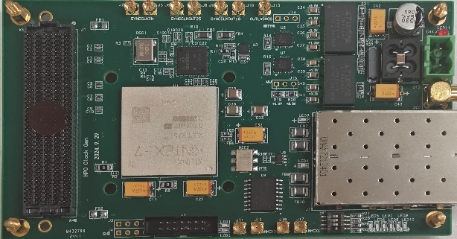
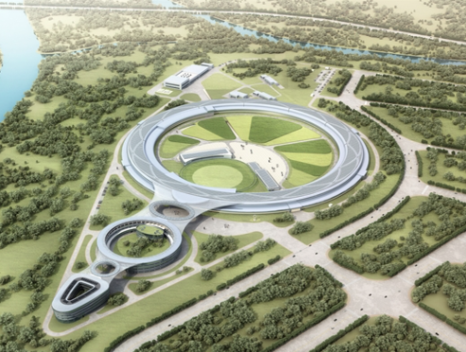
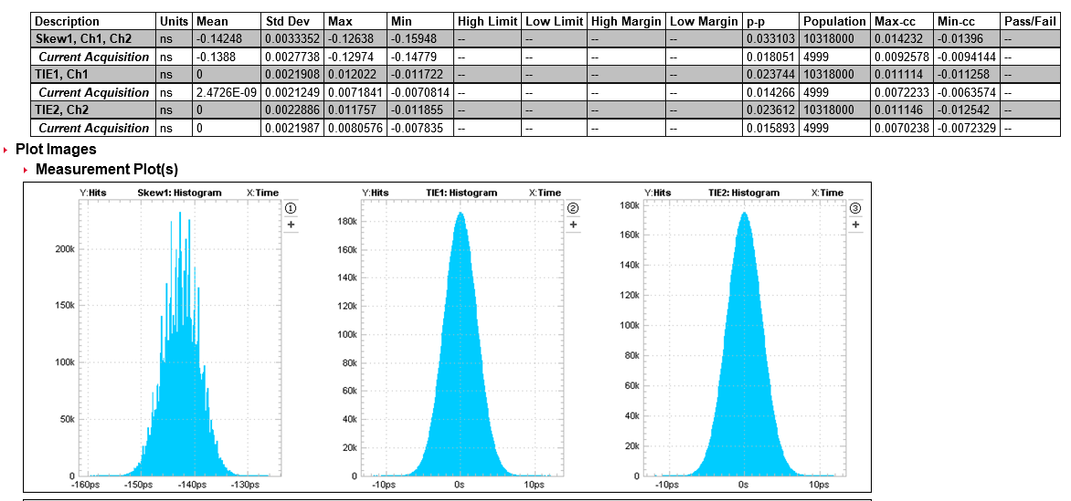
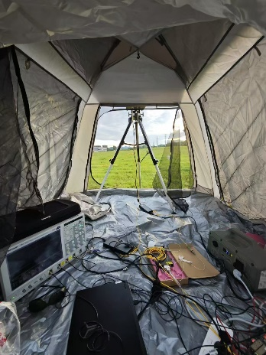
Timing system & reference line
Timing system with wireless transmission
RMS=2.28ps
RMS=3.33ps
High-precision clock synchronization hardware node
Test setup of 1 km FSO Equipment in HEPS
TIE jitter of receive clock
Clock synchronization

Slide 15
Next to do
Further radiation experiment of optical fibers focusing on HCF.
DAQ design and implementation, applied first in BEPCII.
Further development of component-cable database and application in BEPCII & PWFA.
Long-distance & long time test of reference line.
Larger system integration & test of wireless transmission based timing system.
Further design of fast orbit feedback system & fast protection system.
Further design of network.

Slide 16
Summary
Key issues of control system go forward steadily.
Much work will be done with manpower limited.
Thanks for your attention!

