Slide 1
Cabling, cooling and other services in Ref-TDR
Ji Quan
(On behalf of the CEPC Mechanics Working Group)
July 18, 2025

Slide 2
How to incorporate the design content of cables and cooling pipes
within the existing chapter framework?

Slide 3
IDRC (Barcelona) :
However, unless I have overlooked something, the two main recommendations we made in April the 2nd review in April have been addressed yet:
Refine the routing plans for cables and services, especially in the critical interface areas between sub-detectors and through the barrel-to-endcap transitions to the outside of the detector and the auxiliary facilities.
优化电缆与服务的布线方案，尤其要重点关注子探测器之间的关键接口区域，以及通过桶部到端盖的过渡区域，直至探测器外部及其附属设施
Pay particular attention to the air-cooling and service routing for the vertex detector, where space within the beam-pipe assembly is extremely limited. It is essential to verify that sufficient space is available to ensure the proper functionality of the air-cooling system, without compromising reliability or maintenance access.
Note：
1. PPT报告(4月15日)里进行了阐述
2. 在Ref-TDR里：
强调不够，大部分内容删掉了
与梁志均有约定，
他负责回答与Vertex
有关的问题
如何理解：？
如何回答：？
第一个建议 ---

Slide 4
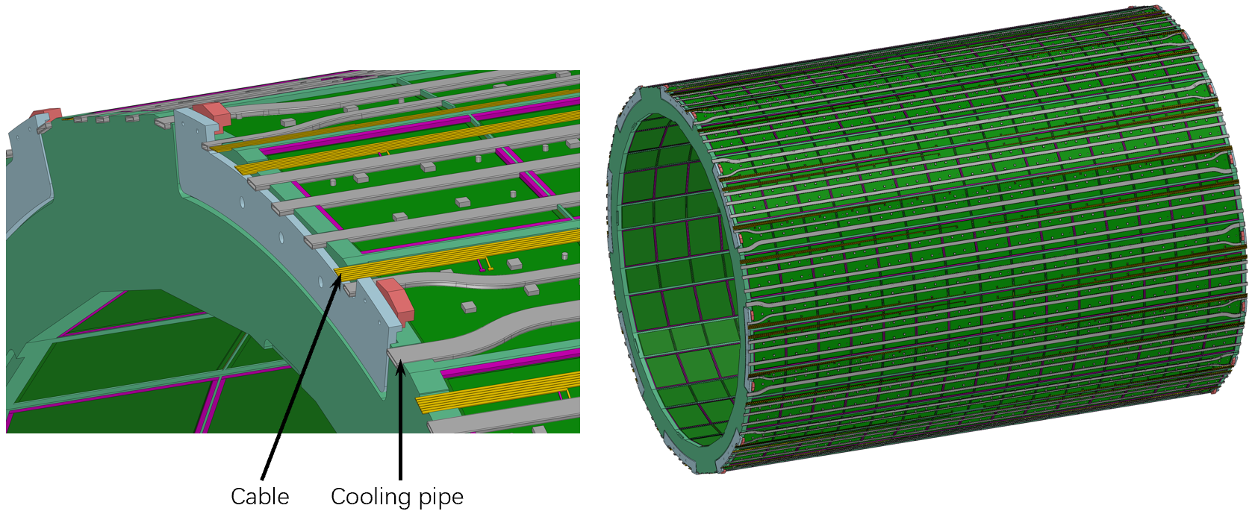
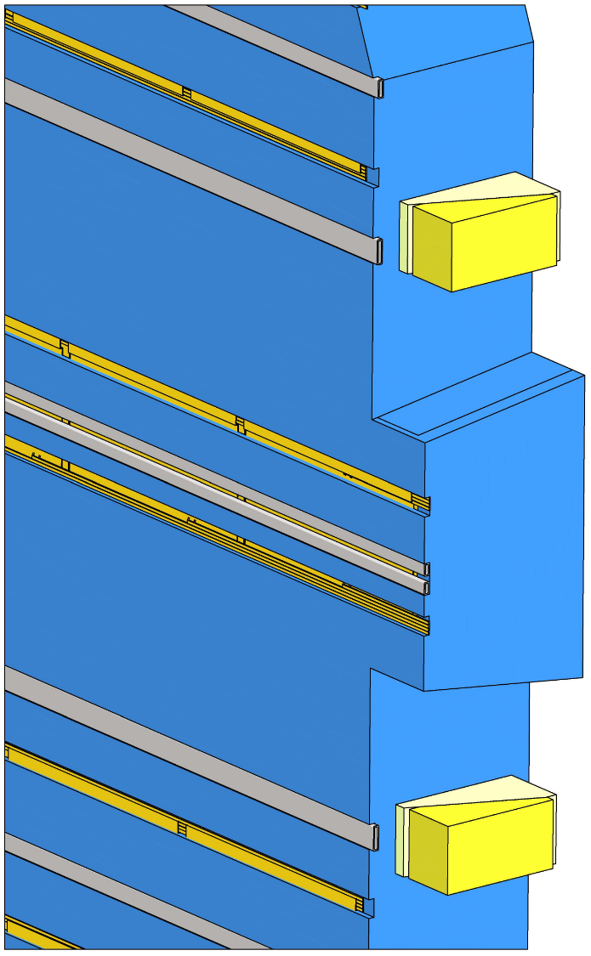
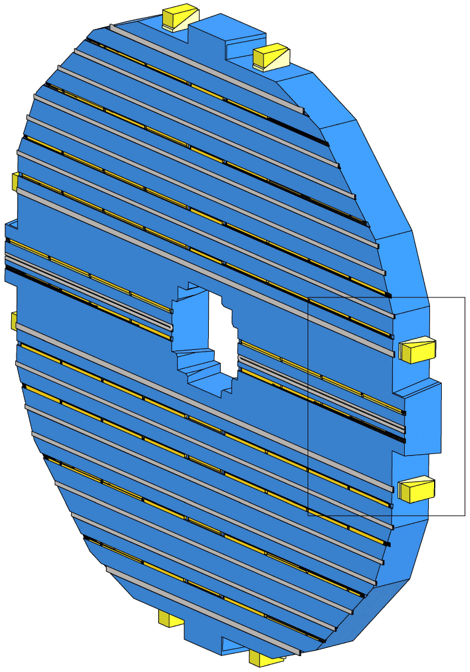
In the Mechanical Design Review PPT (Apr. 15, 2025) :
4 --- 1
各子探测器关于
电缆和水管的设计进展

Slide 5
In the Mechanical Design Review PPT (Apr. 15, 2025) :
4 --- 2
快速连接设计

Slide 6
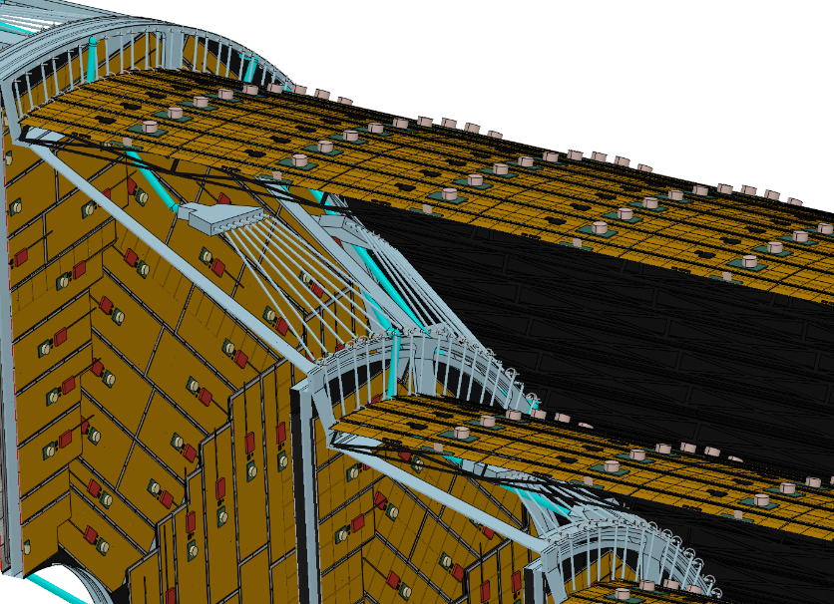
In the Mechanical Design Review PPT (Apr. 15, 2025) :
4 --- 3
引线路径
和
象限布局设计
引线空间的设计原则：
1. 横向 --- 各子探测器内部消化
2. 竖直 --- 桶部探测器与端部探测器
之间预留了空间：
竖直间隙：
端部ECAL与桶部ECAL
端部HCAL与桶部HCAL
端部Yoke与桶部Yoke
小
20
30
60
大

Slide 7
In the Mechanical Design Review PPT (Apr. 15, 2025) :
4 --- 4
通道设计
电缆 --- 地沟
水管 --- 空中

Slide 8
Ref-TDR机械总体的Writing principles：
Two points:
机 械
总 体

Slide 9
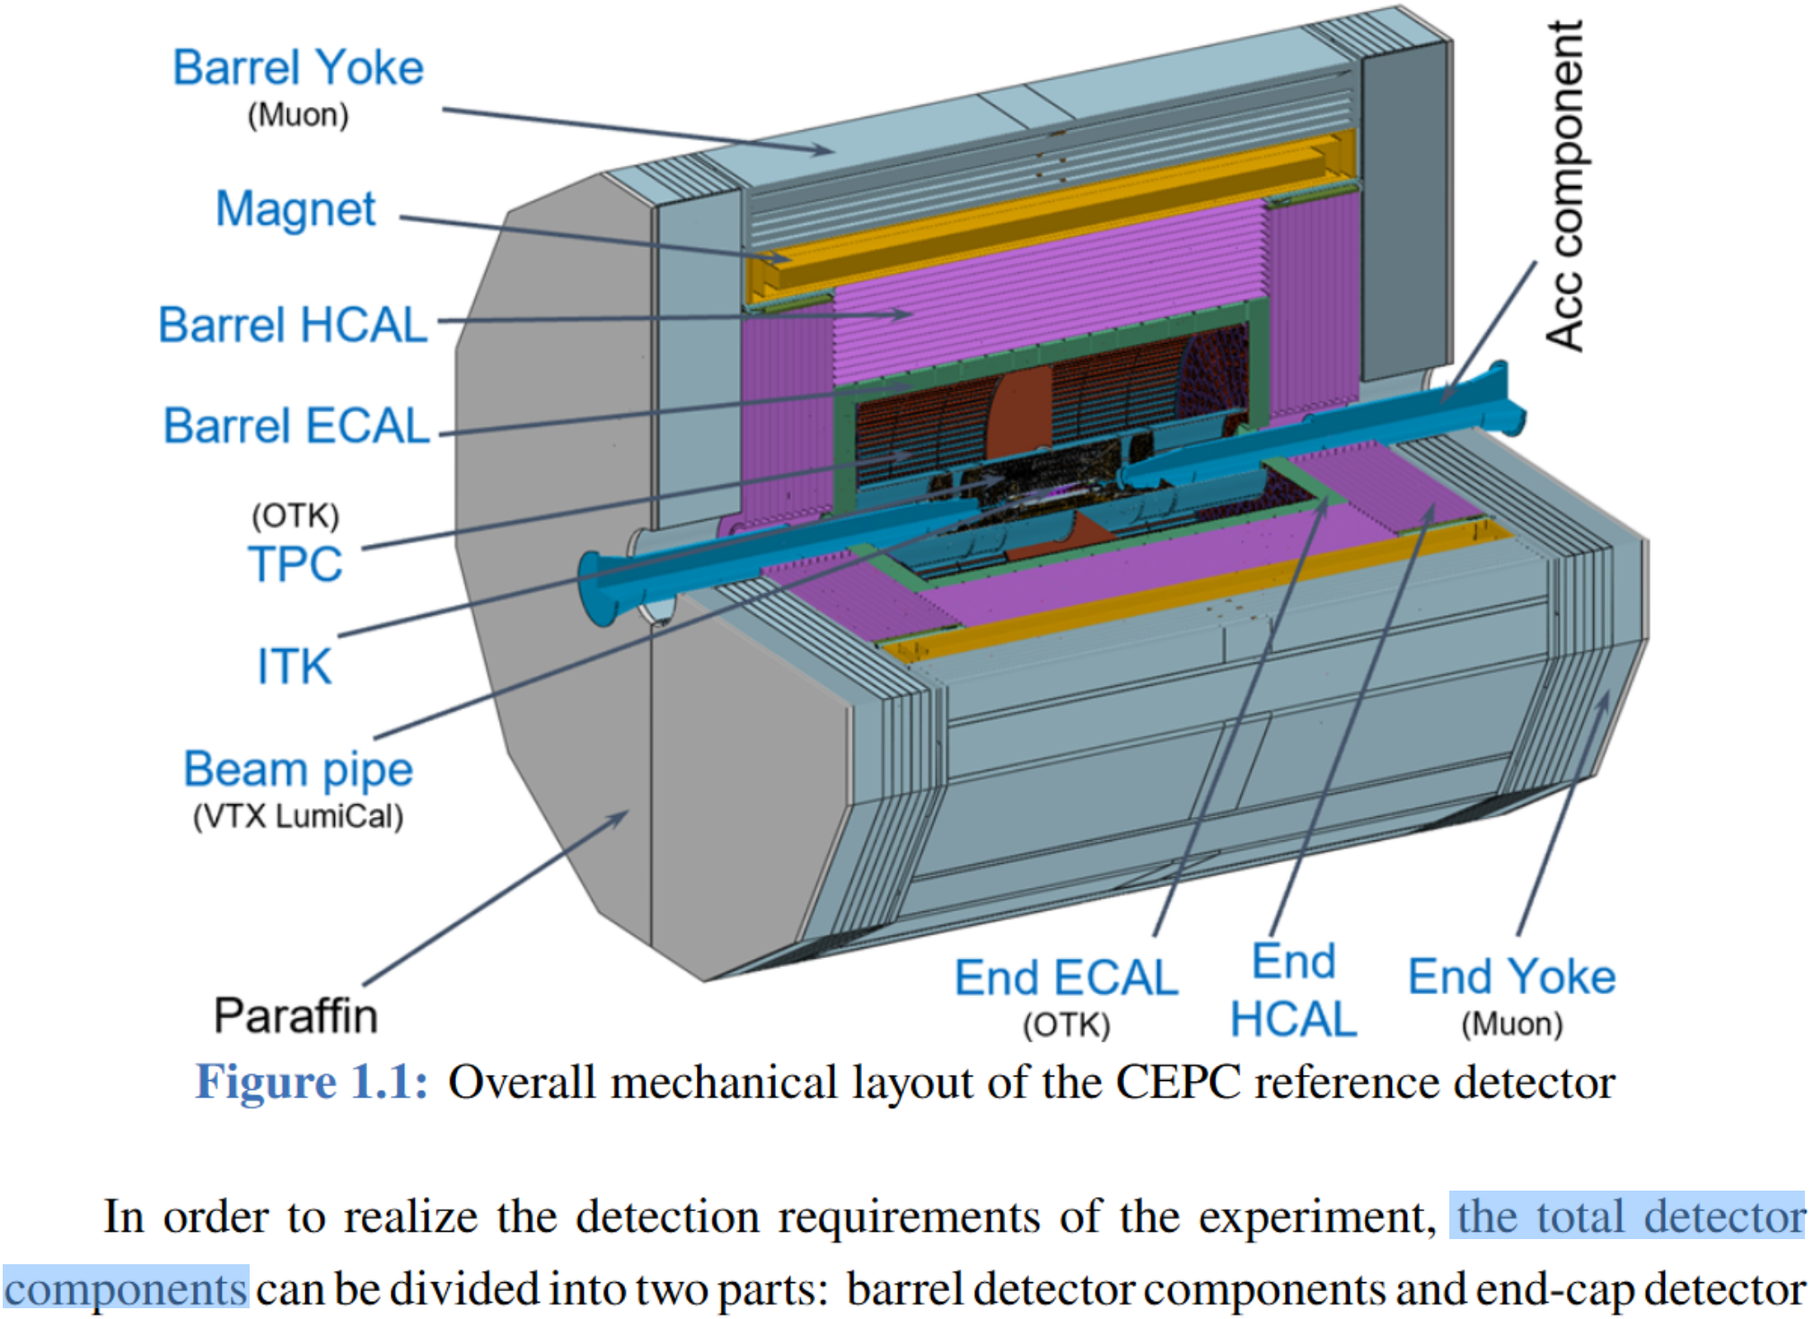
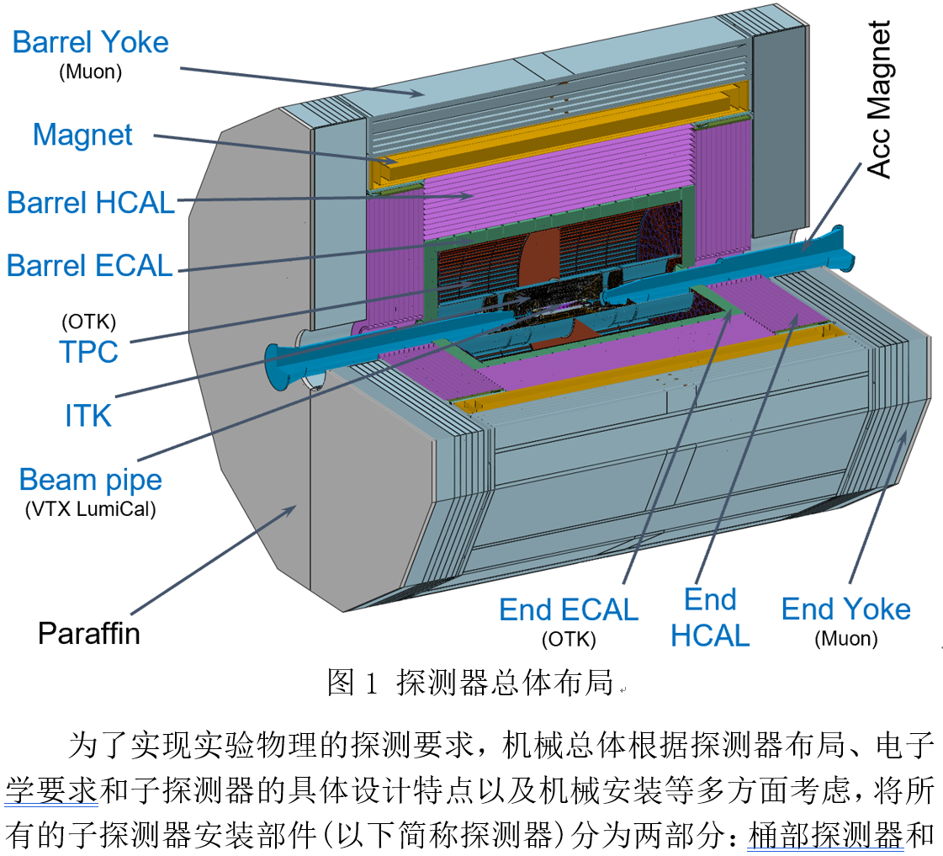
体现“机械”的设计意图
图中名字的含义：指安装的零部件名字
不是探测器的名字
未经修改的一版 --- 英文版

Slide 10
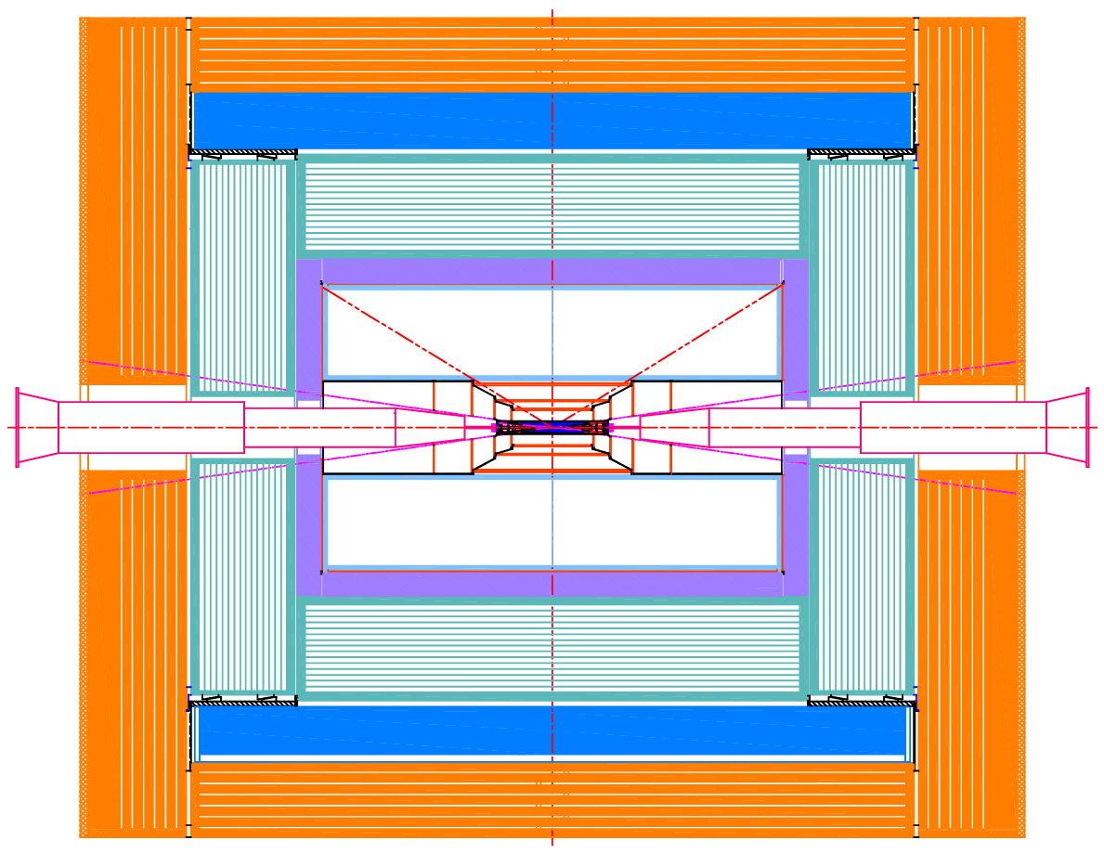
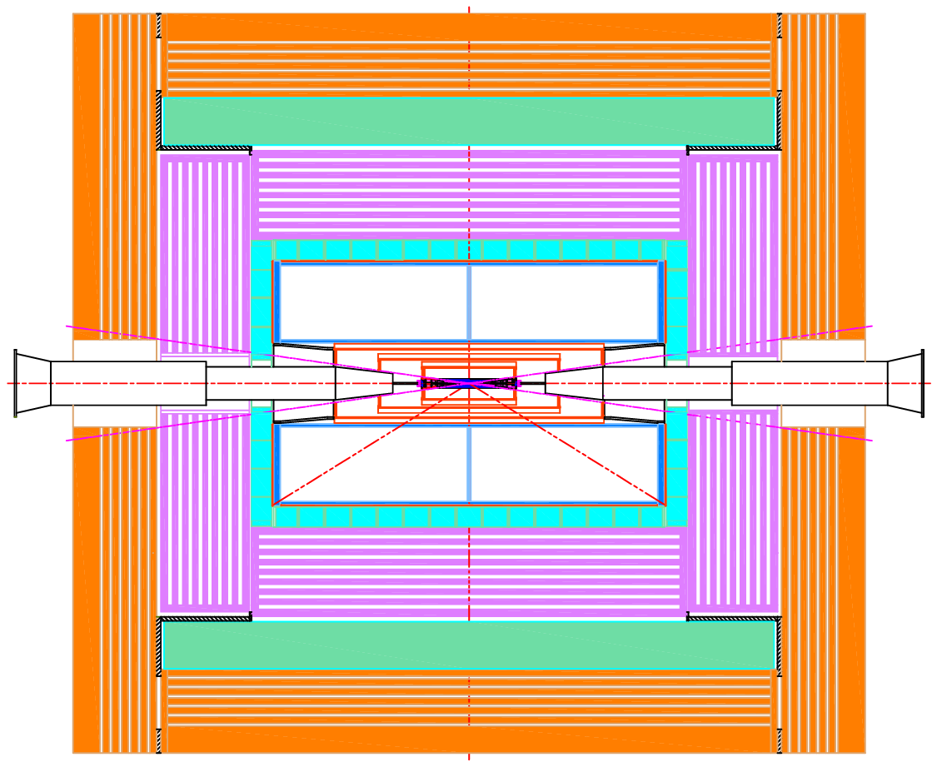
体现“探测器”的设计意图
应王建春要求，提供的探测器布局图
摘自王建春的报告

Slide 11
In chapter 14 Mechanics and Integration (Ref-TDR):
14.1 Overall mechanical design of the detector
14.1.1 Overall layout
14.1.2 Design requirements
1. Sub-detector boundary dimensions
2. Dimensional tolerances, installation clearances
and Coaxiality of sub-detectors
3. Design requirements for the connection of each sub detector
4. Interface between detector and accelerator
14.2 Sub-detector Connections
14.2.1 Yoke design
14.2.2 Superconducting solenoid magnet
14.2.3 Barrel HCAL
14.2.4 Barrel ECAL
14.2.5 TPC
14.2.6 ITK
14.2.7 Beam pipe
14.2.8 End ECAL
14.2.9 End HCAL
14.2.10 Overall Reliability and safety assessment
14.3 Detector installation
14.3.1 Technical route
14.3.2 Installation of sub-detectors
1. Alternating installation
2. Core shaft installation
3. Cantilever installation
4. Positioning and Alignment of the Entire Detector System
14.4 Layout of the underground hall
14.4.1 Configuration of the experimental hall
14.4.2 Auxiliary hall
14.4.3 Passageway for the underground hall
14.5 Summary
建议：
在机械总体章节
管线排布设计内容，作为总体要求的一部分：
1. ……
2. ……
3. ……
4. 管线排布要求
1) 引线路径
2) 快速连接
3) 象限布局设计
5. Interface between detector and accelerator
体现“总体”的设计意图

Slide 12
Thank you for your attention!

