Slide 1

Analytic NLO Gravitational Waveform
David A. Kosower
Institut de Physique Théorique, CEA–Saclay
work with Giacomo Brunello and Stefano De Angelis
[2511.05412]
New Frontiers of Quantum Field and Gravity,
Beijing, China
Jan 12–16, 2026

Slide 2
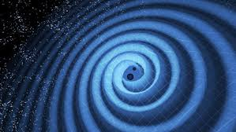
Gravitational Waves
LIGO

Slide 3
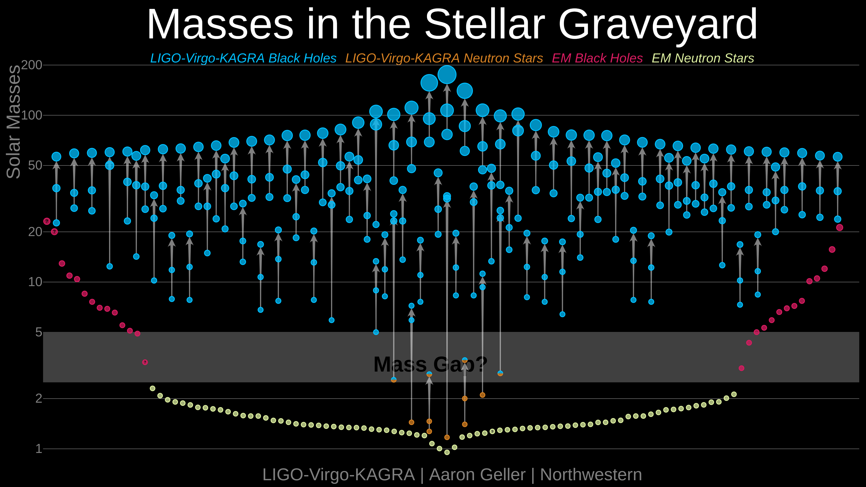
Gravitational Wave Events
LIGO–VIRGO–KAGRA
  ~200 confirmed events since Sept 2015 gracedb.ligo.org/latest/
  In GWTC-1,2,3, runs O1–O3
  Run O4a: May 2023–Jan 2024 (LIGO), O4b: Apr 2024–Dec 2024 (LIGO+VIRGO), O4c: Jan 2025– (LIGO+VIRGO)
  Mostly binary black holes, some neutron-star mergers, some mixed

Slide 4
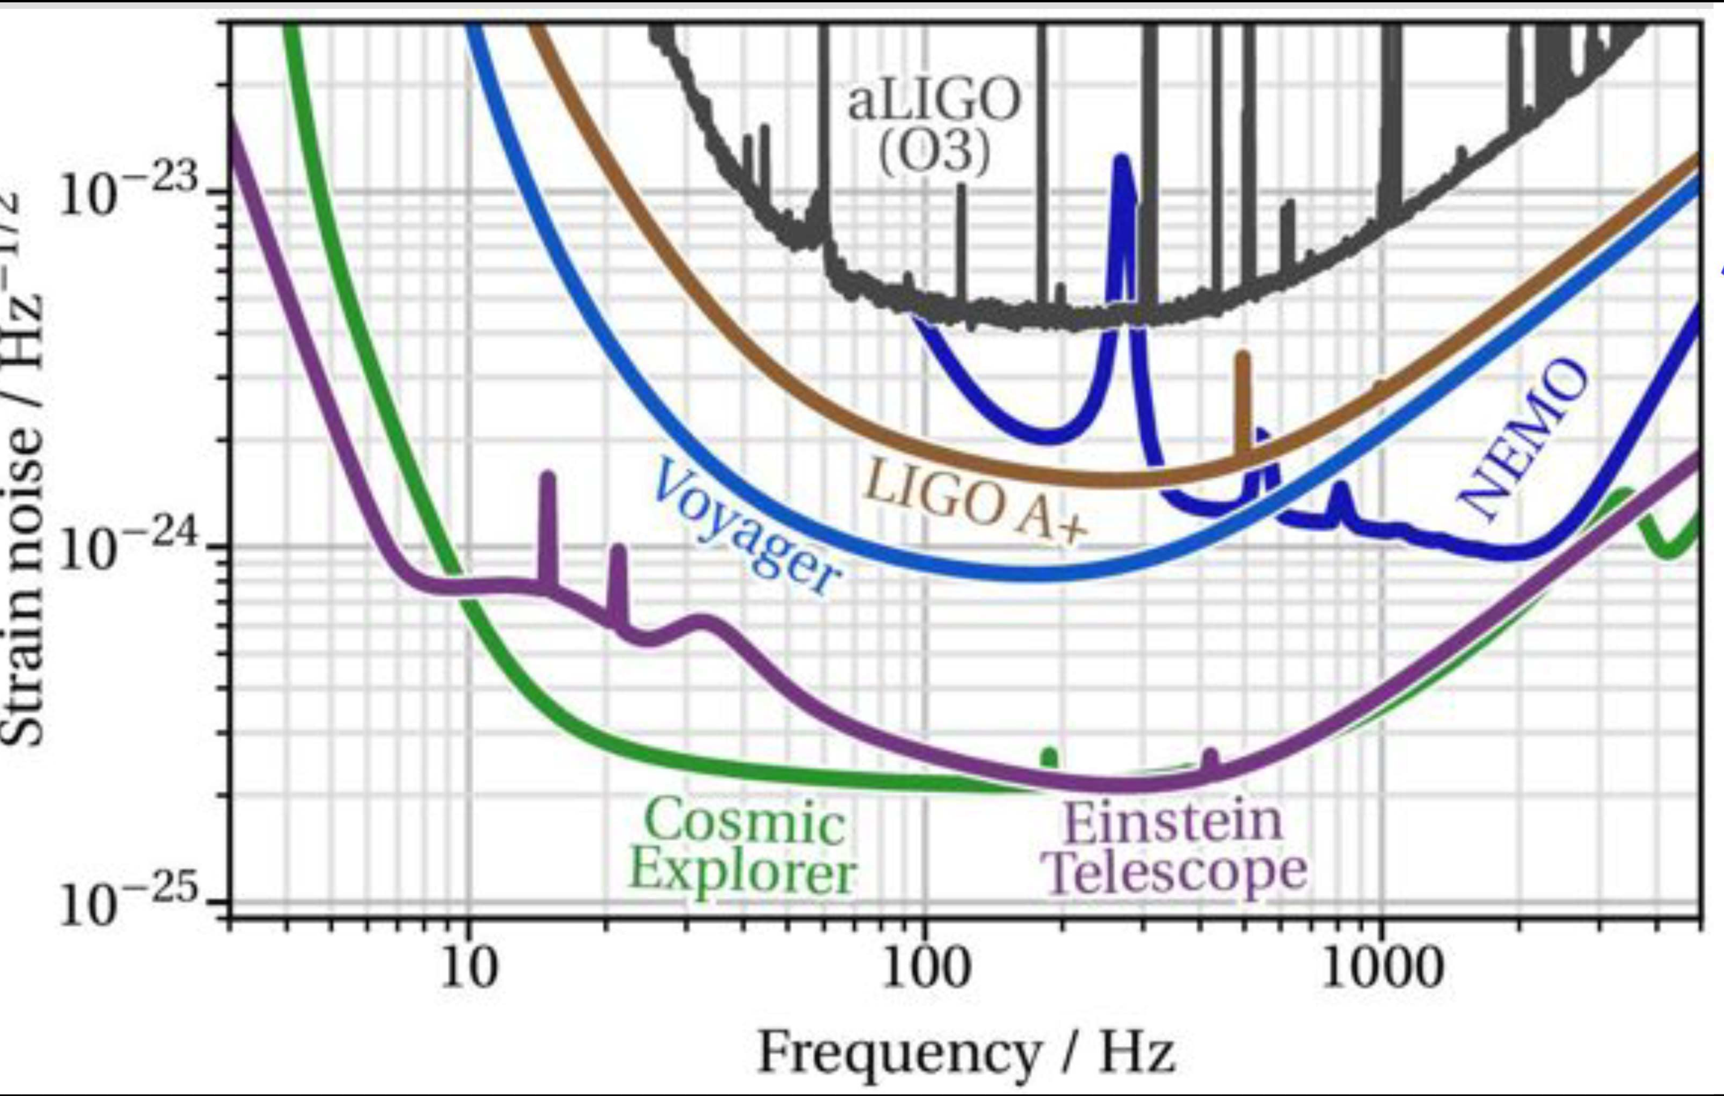
Future Terrestrial GWOs
Will require higher precision
Barsotti

Slide 5
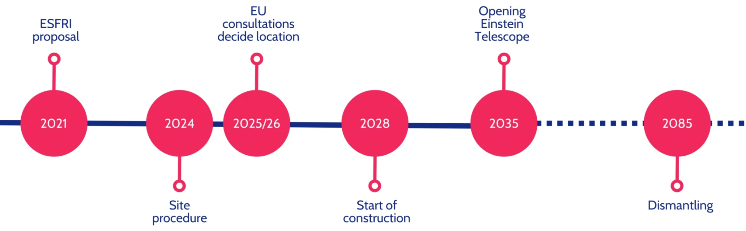
Future Terrestrial GWOs
Einstein Telescope (Europe)
  300 m underground triangular 10-km
  on the Dutch-German border
  or 300 m underground L in Sardinia + X
Cosmic Explorer (US)
  Two L sites, one with 40 km arms,
  one 20 km arms
Barsotti

Slide 6
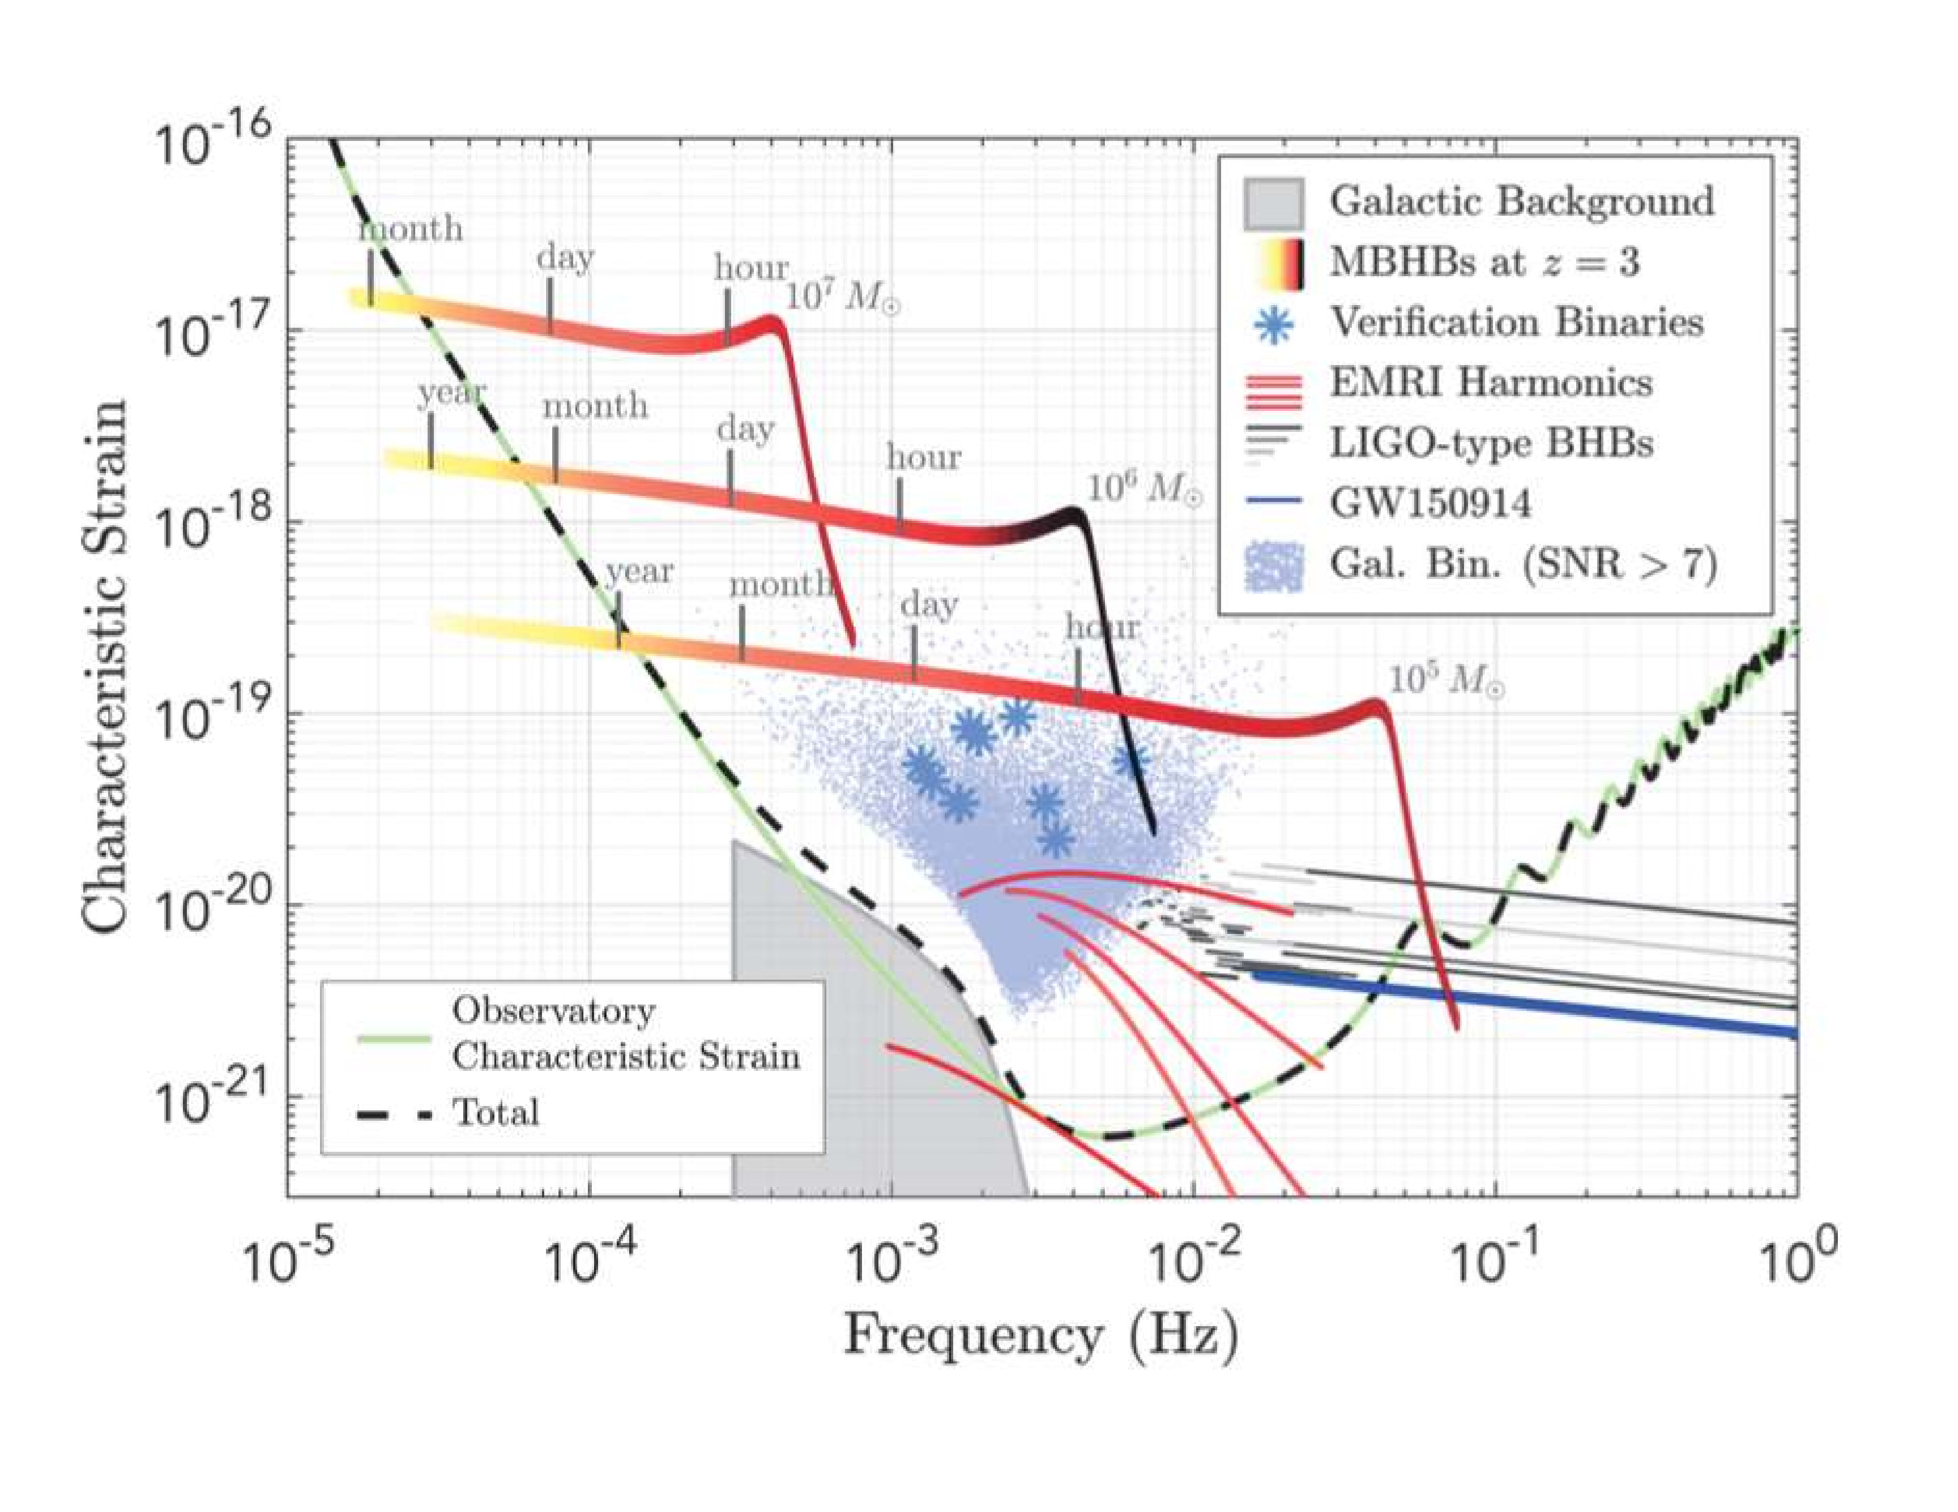
LISA
From LISA L3 Mission proposal (via Robson–Cornish–Liu [1803.01944])

Slide 7
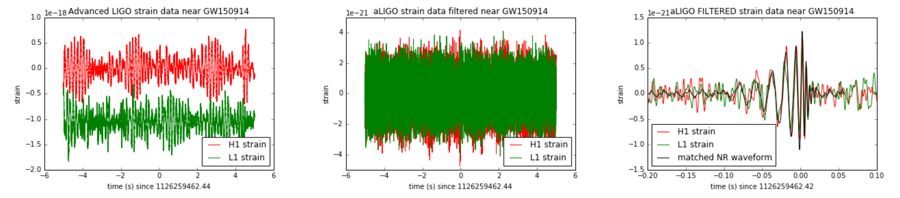
Theorists’ Role
One aspect of detection & analysis
High noise level: 400 times larger than signal! Rehman [1711.07421]
To extract the signal, we need theoretical templates
That’s where theorists come into the picture
Also need theoretical calculations to measure parameters of mergers once seen — masses, spins, etc.

Slide 8
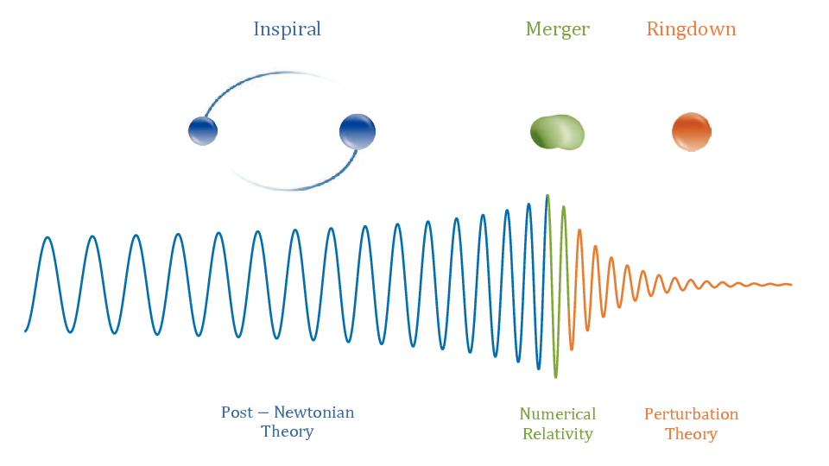
Basic Setup in Mergers
Two slowly inspiralling
compact objects
Ringdown
  Perturbation theory: normal
  modes of final black hole
Merger
  Strong fields: numerical relativity
Inspiral
  Weak-field perturbation theory
Waveform templates
  For detection
  For measurements
Antelis et al

Slide 9
Quantum Scattering Amplitudes
We’re interested in a bound-state classical problem
How could quantum scattering amplitudes help?
  Three decades of innovation in the technology of calculations
  Calculations based on fundamental physical principles: factorization, unitarity; manifestly gauge invariant
  Calculate only what’s needed for physical quantities (no auxiliary Hamiltonians or potentials)
  Separate spin from integration in a natural way
  Rethink QFT: banish unphysical aspects of Feynman diagrams
  Organize calculations, reveal new structure
  Most frontier calculations in QCD use at least some of these technologies
  Double Copy

Slide 10
A Flourishing of New Ideas…
…that I lack time to discuss
EFT Matching
Cheung, Rothstein, Solon; Bern, Kosmopoulos, Luna, Roiban, Teng;
Bern, Parra-Martinez, Roiban, Ruf, Shen, Solon, Zeng
Eikonal Phase
Amati, Ciafaloni, Veneziano; Di Vecchia, Heissenberg, Russo, Veneziano
Amplitude analysis
Bjerrum-Bohr, Damgaard, Plante, Vanhove
Heavy mass field theory
Brandhuber, Chen, Travaglini, Wen; Damgaard, Haddad, Helset
World line formalisms
Goldberger, Rothstein; Levi, Steinhoff; Dlapa, Kälin, Liu, Porto;
Jakobson, Mogull, Plefka, Steinhoff; Shen; Edison, Levi
Spin Exponentiation
Arkani-Hamed, Huang, O’Connell; Guevara, Ochirov, Vines; Chen, Huang, Kim, Lee;
Bautista, Guevara, Kavanagh
EFT post-Newtonian
Foffa, Mastrolia, Sturani, Sturm; Blümlein, Maier, Marquard, Schäfer

Slide 11
Set-up
Scatter two charged ‘things’
If they’re both massive, look at point particles
Calculate radiation emitted during scattering
impact parameter b
distinguishable particles

Slide 12
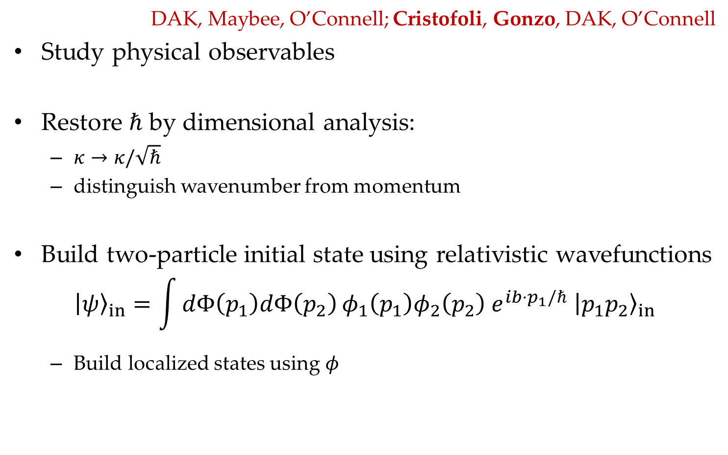
KMOC Approach
DAK, Maybee, O’Connell; Cristofoli, Gonzo, DAK, O’Connell
Study physical observables
Restore $ℏ$ by dimensional analysis:
  $κ→κ/\sqrt{ℏ}$
  distinguish wavenumber from momentum
Build two-particle initial state using relativistic wavefunctions
$${\left|ψ\right\rangle }_{in}=\int{dΦ\left(p_{1}\right)dΦ\left(p_{2}\right)}φ_{1}\left(p_{1}\right)φ_{2}\left(p_{2}\right) {e^{ib⋅p_{1}/ℏ} \left|p_{1}p_{2}\right\rangle }_{in}$$
  Build localized states using $φ$

Slide 13
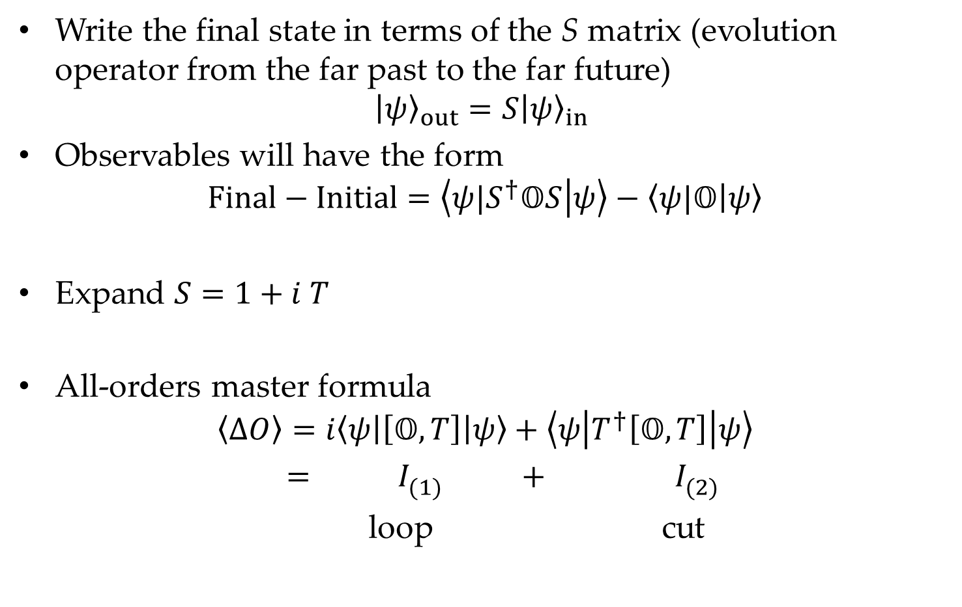
Write the final state in terms of the S matrix (evolution operator from the far past to the far future)
$${\left|ψ\right\rangle }_{out}=S{\left|ψ\right\rangle }_{in}$$
Observables will have the form
$$Final−Initial=\left\langle {ψ|S}^{†}𝕆S | ψ\right\rangle −\left\langle ψ|𝕆 | ψ\right\rangle$$
Expand $S=1+i T$
All-orders master formula
$$\left\langle ΔO\right\rangle =i\left\langle ψ\left|\left[𝕆, T\right]\right|ψ\right\rangle +\left\langle ψ\left|T^{†}\left[𝕆, T\right]\right|ψ\right\rangle$$
$$= I_{(1)}^{} + I_{(2)}^{}$$
loop cut

Slide 14
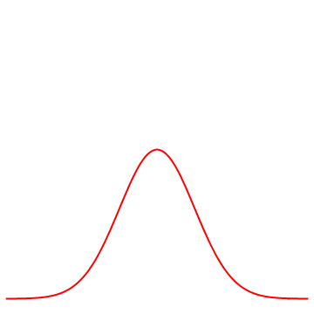
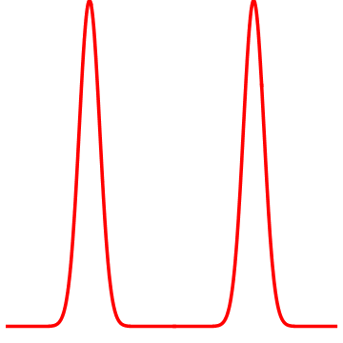
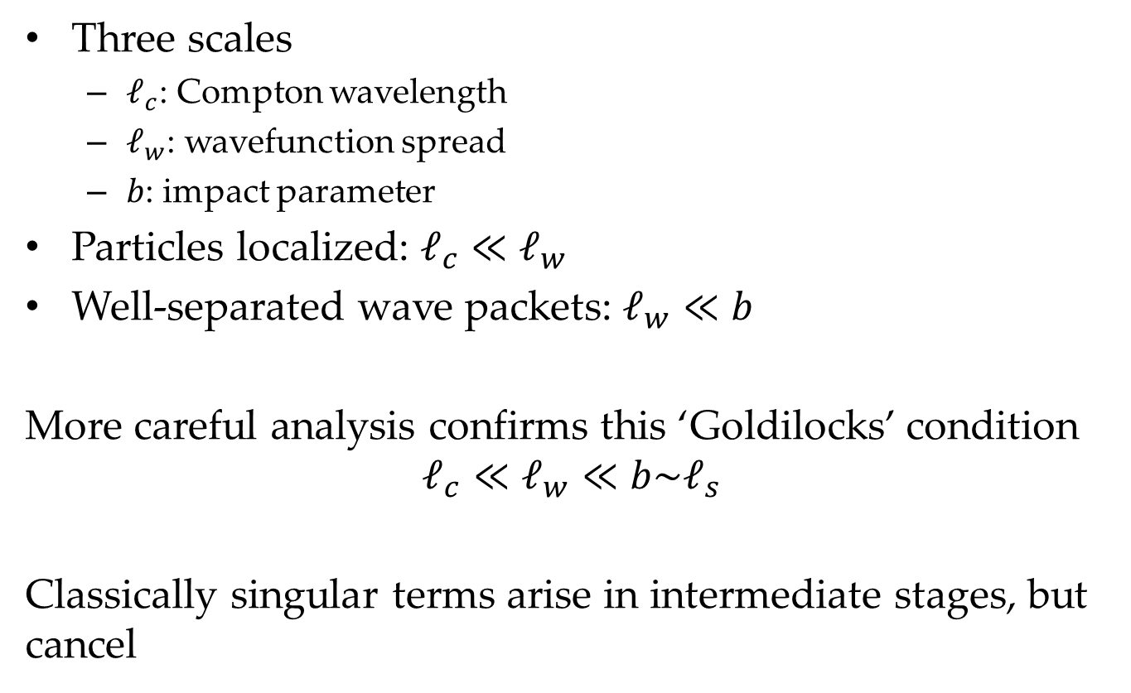

Classical Limit, part 2
Three scales
  $ℓ_{c}$: Compton wavelength
  $ℓ_{w}$: wavefunction spread
  $b$: impact parameter
Particles localized: $ℓ_{c}≪ℓ_{w}$
Well-separated wave packets: $ℓ_{w}≪b$
More careful analysis confirms this ‘Goldilocks’ condition
$$ℓ_{c}≪ℓ_{w}≪b\sim ℓ_{s}$$
Classically singular terms arise in intermediate stages, but cancel
$$b$$

Slide 15

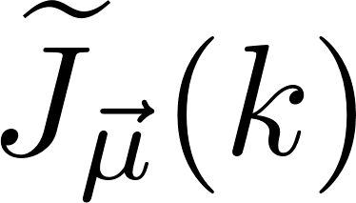
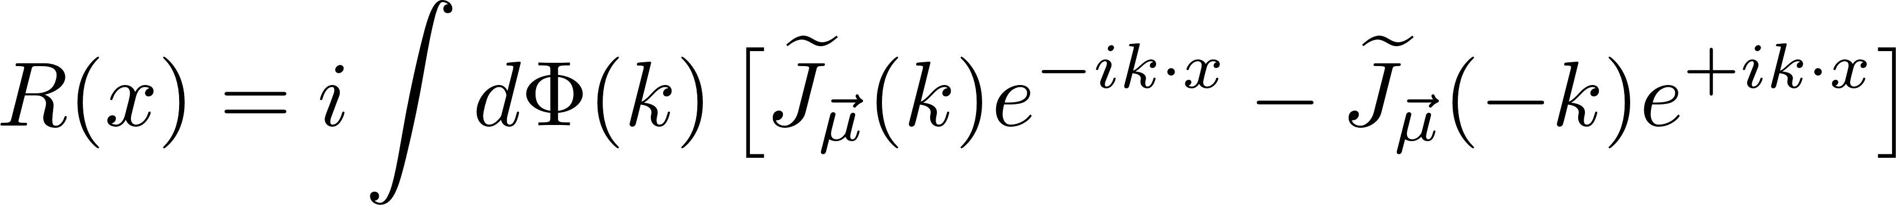
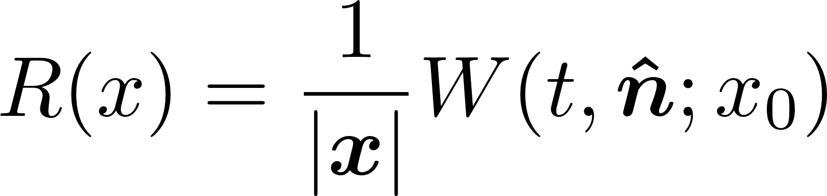
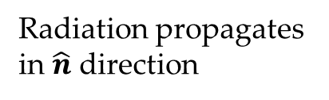
Local Observables
Local radiation observable
Waveform is leading large-distance behavior
Radiation propagates in $\hat{n}$ direction
Scattering region

Slide 16
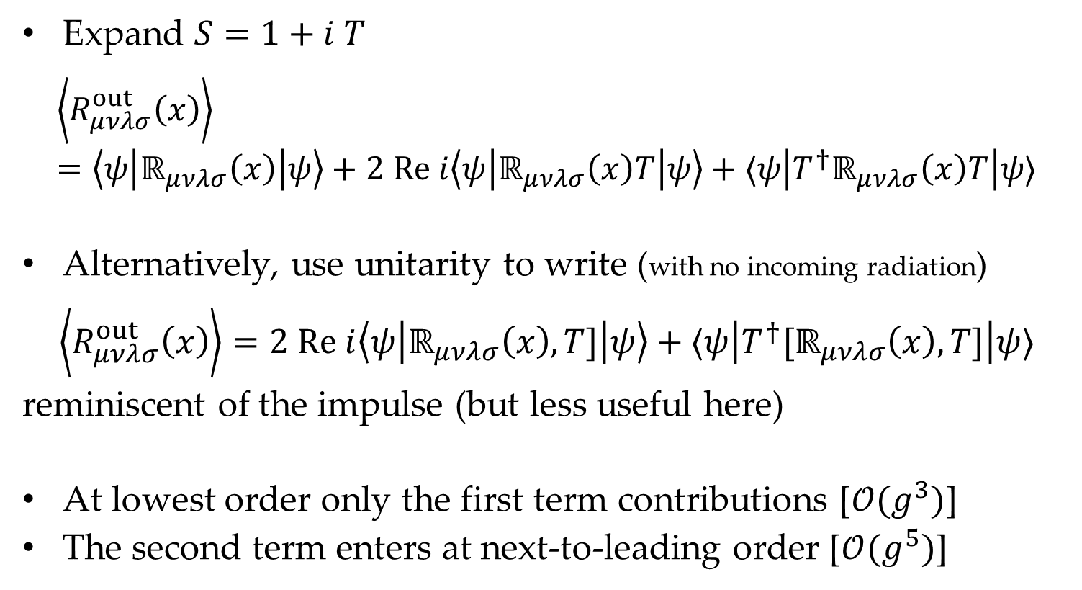
Waveform
Expand $S=1+i T$
$$\left\langle R_{μνλσ}^{out}\left(x\right)\right\rangle =\left\langle ψ\left|ℝ_{μνλσ}\left(x\right)\right|ψ\right\rangle +2 Re i\left\langle ψ\left|ℝ_{μνλσ}\left(x\right)T\right|ψ\right\rangle +⟨ψ\left|T^{†}ℝ_{μνλσ}\left(x\right)T\right|ψ⟩$$
Alternatively, use unitarity to write (with no incoming radiation)
$$\left\langle R_{μνλσ}^{out}\left(x\right)\right\rangle =2 Re i\left\langle ψ\left|ℝ_{μνλσ}\left(x\right),T]\right|ψ\right\rangle +⟨ψ\left|T^{†}[ℝ_{μνλσ}\left(x\right),T]\right|ψ⟩$$
reminiscent of the impulse (but less useful here)
At lowest order only the first term contributions [$𝒪(g^{3})$]
The second term enters at next-to-leading order [$𝒪(g^{5})$]

Slide 17
NLO Waveforms
Previous calculations
A. Brandhuber, G. R. Brown, G. Chen, S. De Angelis, J. Gowdy, & G. Travaglini (2023)
A. Herderschee, R. Roiban, and F. Teng (2023)
A. Georgoudis, C. Heissenberg, and I. Vazquez-Holm (2023)
S. Caron-Huot, M. Giroux, H. S. Hannesdottir, and S. Mizera (2023)
L. Bohnenblust, H. Ita, M. Kraus, and J. Schlenk (2023)
Related: A. Elkhidir, D. O'Connell, M. Sergola, I. A. Vazquez-Holm (2023)

Slide 18
What’s New?
Focus directly on frequency-domain waveform
Combine Fourier and loop integrals
  Treat them on the same footing for reduction
Simpler expression

Slide 19

Linearized gravitational field operator
$$𝒪_{𝒲}=κ{ ε}_{(λ)}^{μν} h_{μν}$$
The Goldilocks conditions become
$$\frac{1}{m_{i}}≪Gm_{i}≪b≪r$$

Slide 20
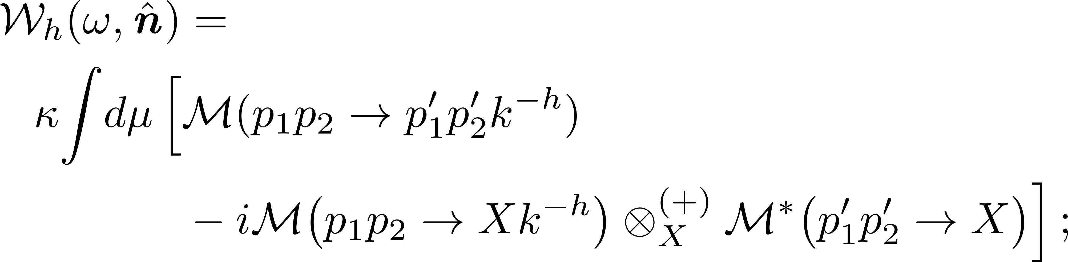
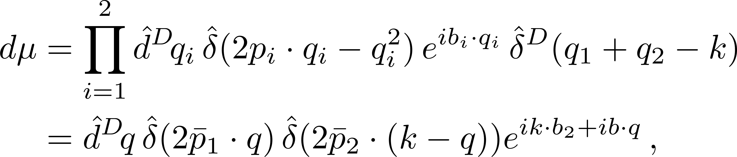

Frequency-Domain Waveform
$⊗_{X}$ sum over intermediate states
$q_{i}$ momentum mismatches between incoming and outgoing

Slide 21
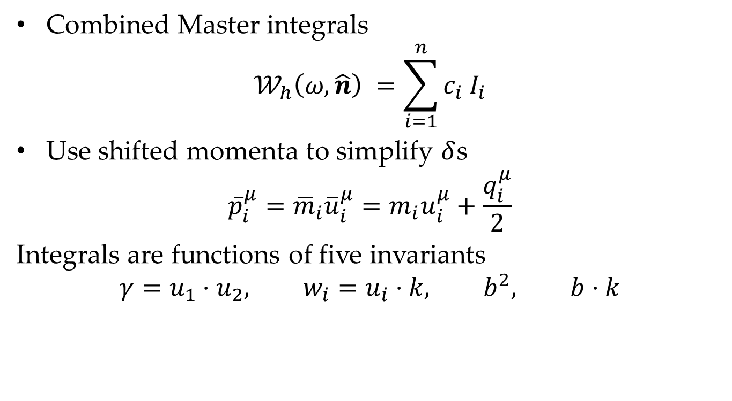
Organization
Combined Master integrals
$$𝒲_{h}\left(ω,\hat{n}\right) =\sum_{i=1}^{n}{c_{i} I_{i}}$$
Use shifted momenta to simplify $δ$s
$${\overline{p}}_{i}^{μ}={\overline{m}}_{i}{\overline{u}}_{i}^{μ}=m_{i}u_{i}^{μ}+\frac{q_{i}^{μ}}{2}$$
Integrals are functions of five invariants
$$γ=u_{1}⋅u_{2}, w_{i}=u_{i}⋅k, b^{2}, b⋅k$$

Slide 22
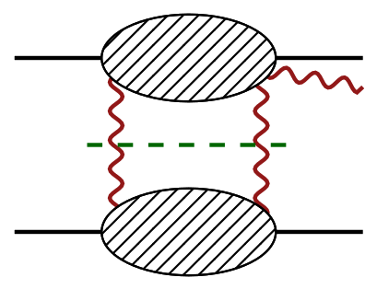
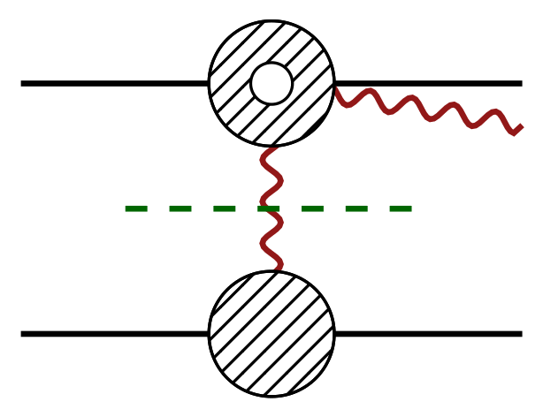

Calculation
Construct integrand from cuts, dropping local terms in $q$
Internal graviton state sums as in dimensional reduction or a la ‘t Hooft–Veltman, external momenta always four-dimensional

Slide 23
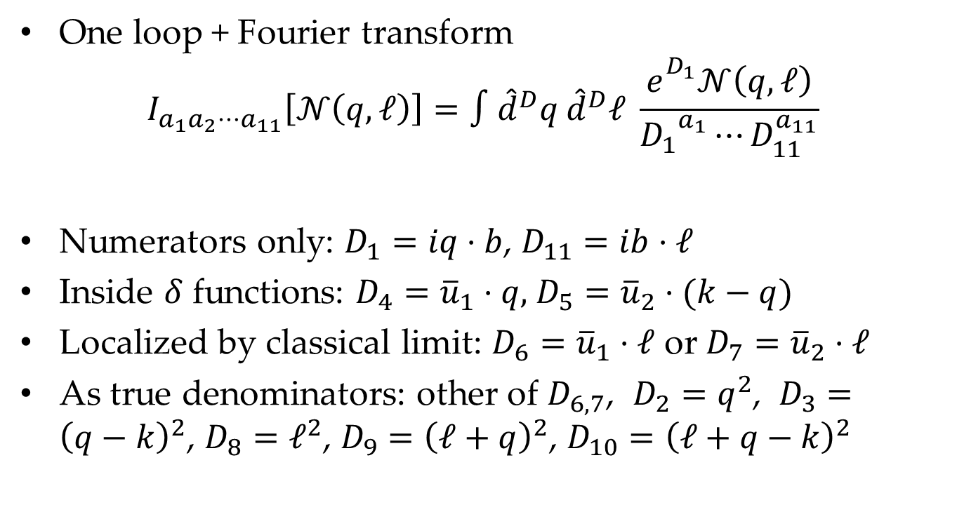
Integrals
One loop + Fourier transform
$$I_{a_{1}a_{2}⋯a_{11}}\left[𝒩\left(q,ℓ\right)\right]=∫{\hat{d}}^{D}q {\hat{d}}^{D}ℓ \frac{e_{}^{D_{1}}𝒩\left(q,ℓ\right)}{{D_{1}}_{}^{a_{1}}⋯D_{11}^{a_{11}}}$$
Numerators only: $D_{1}=iq⋅b$, $D_{11}=ib⋅ℓ$
Inside $δ$ functions: $D_{4}={\overline{u}}_{1}⋅q,$ $D_{5}={\overline{u}}_{2}⋅(k−q)$
Localized by classical limit: $D_{6}={\overline{u}}_{1}⋅ℓ$ or $D_{7}={\overline{u}}_{2}⋅ℓ$
As true denominators: other of $D_{6,7}$, $D_{2}=q^{2}$, $D_{3}={\left(q−k\right)}^{2}$, $D_{8}=ℓ^{2}$, $D_{9}={\left(ℓ+q\right)}^{2}$, $D_{10}={\left(ℓ+q−k\right)}^{2}$

Slide 24
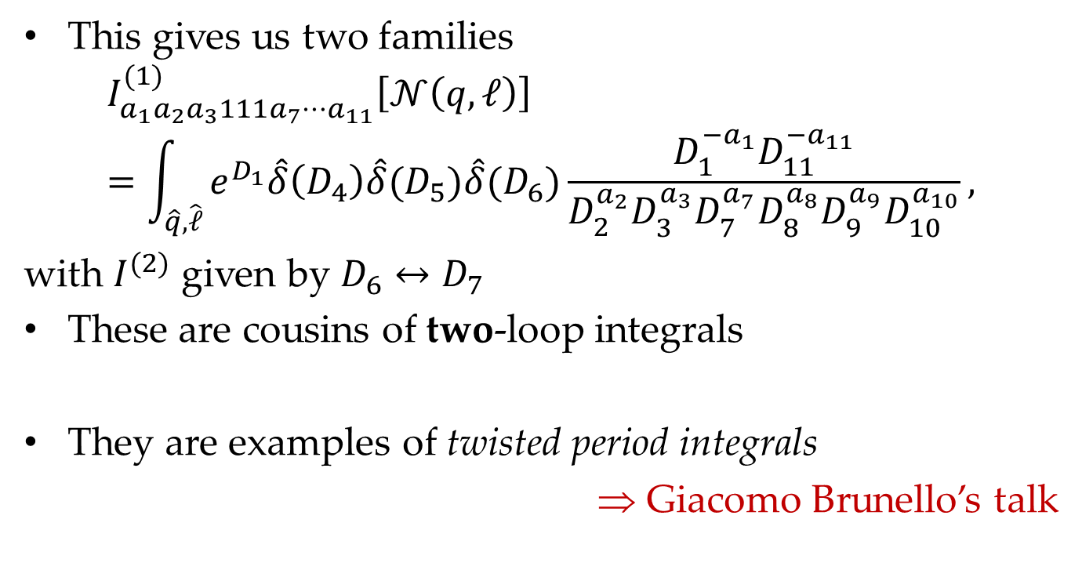
Integrals
This gives us two families
$$I_{a_{1}a_{2}a_{3}111a_{7}⋯a_{11}}^{(1)}\left[𝒩\left(q,ℓ\right)\right]=\int_{\hat{q},\hat{ℓ}}{e^{D_{1}}\hat{δ}\left(D_{4}\right)\hat{δ}(D_{5})\hat{δ}(D_{6})\frac{D_{1}^{{−a}_{1}}D_{11}^{{−a}_{11}}}{D_{2}^{a_{2}}D_{3}^{a_{3}}D_{7}^{a_{7}}D_{8}^{a_{8}}D_{9}^{a_{9}}D_{10}^{a_{10}}}},$$
with $I^{(2)}$ given by $D_{6}↔D_{7}$
These are cousins of two-loop integrals
They are examples of twisted period integrals
⇒ Giacomo Brunello’s talk

Slide 25
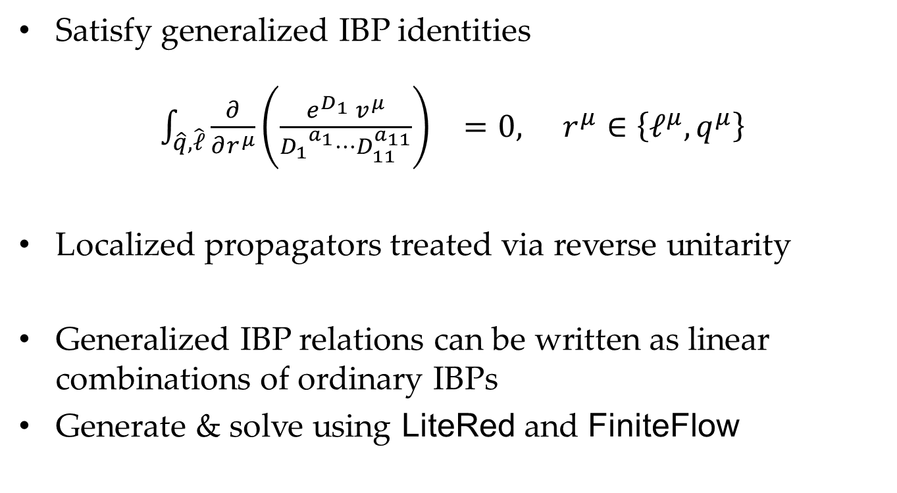
Integration By Parts
Satisfy generalized IBP identities
$\int_{\hat{q},\hat{ℓ}}{{\frac{∂}{∂r^{μ}}\left(\frac{e^{D_{1}} v^{μ}}{{D_{1}}_{}^{a_{1}}⋯D_{11}^{a_{11}}}\right)}^{}=0,}$ $r^{μ}∈\left\{ℓ^{μ},q^{μ}\right\}$
Localized propagators treated via reverse unitarity
Generalized IBP relations can be written as linear combinations of ordinary IBPs
Generate & solve using LiteRed and FiniteFlow

Slide 26
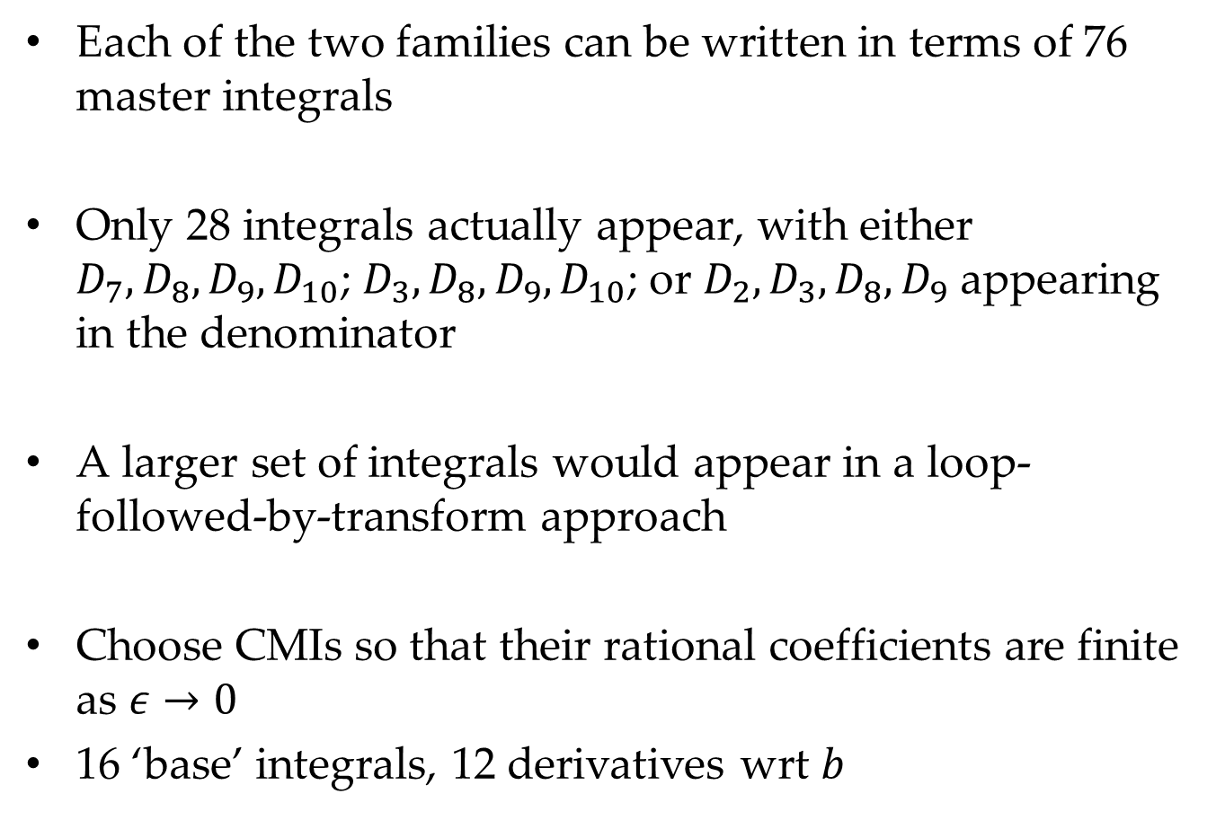
Combined Master Integrals
Each of the two families can be written in terms of 76 master integrals
Only 28 integrals actually appear, with either $D_{7},D_{8},D_{9},D_{10}$; $D_{3},D_{8},D_{9},D_{10}$; or $D_{2},D_{3},D_{8},D_{9}$ appearing in the denominator
A larger set of integrals would appear in a loop-followed-by-transform approach
Choose CMIs so that their rational coefficients are finite as $ε→0$
16 ‘base’ integrals, 12 derivatives wrt $b$

Slide 27
Infrared Divergences
Result is infrared divergent
Reflects the fact that we haven’t yet expressed the observable precisely
Nonetheless, we are close: divergence exponentiates into an overall phase times the tree, which is unobservable

Slide 28
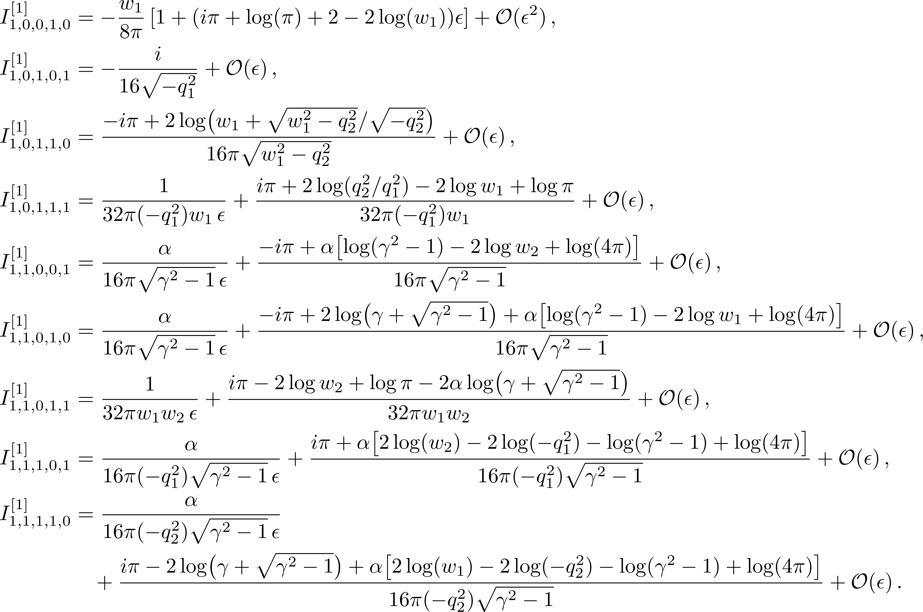
Evaluating Integrals
Evaluation of loop integral and Fourier transform sequentially
  Combined differential equations to be explored
10 masters

Slide 29
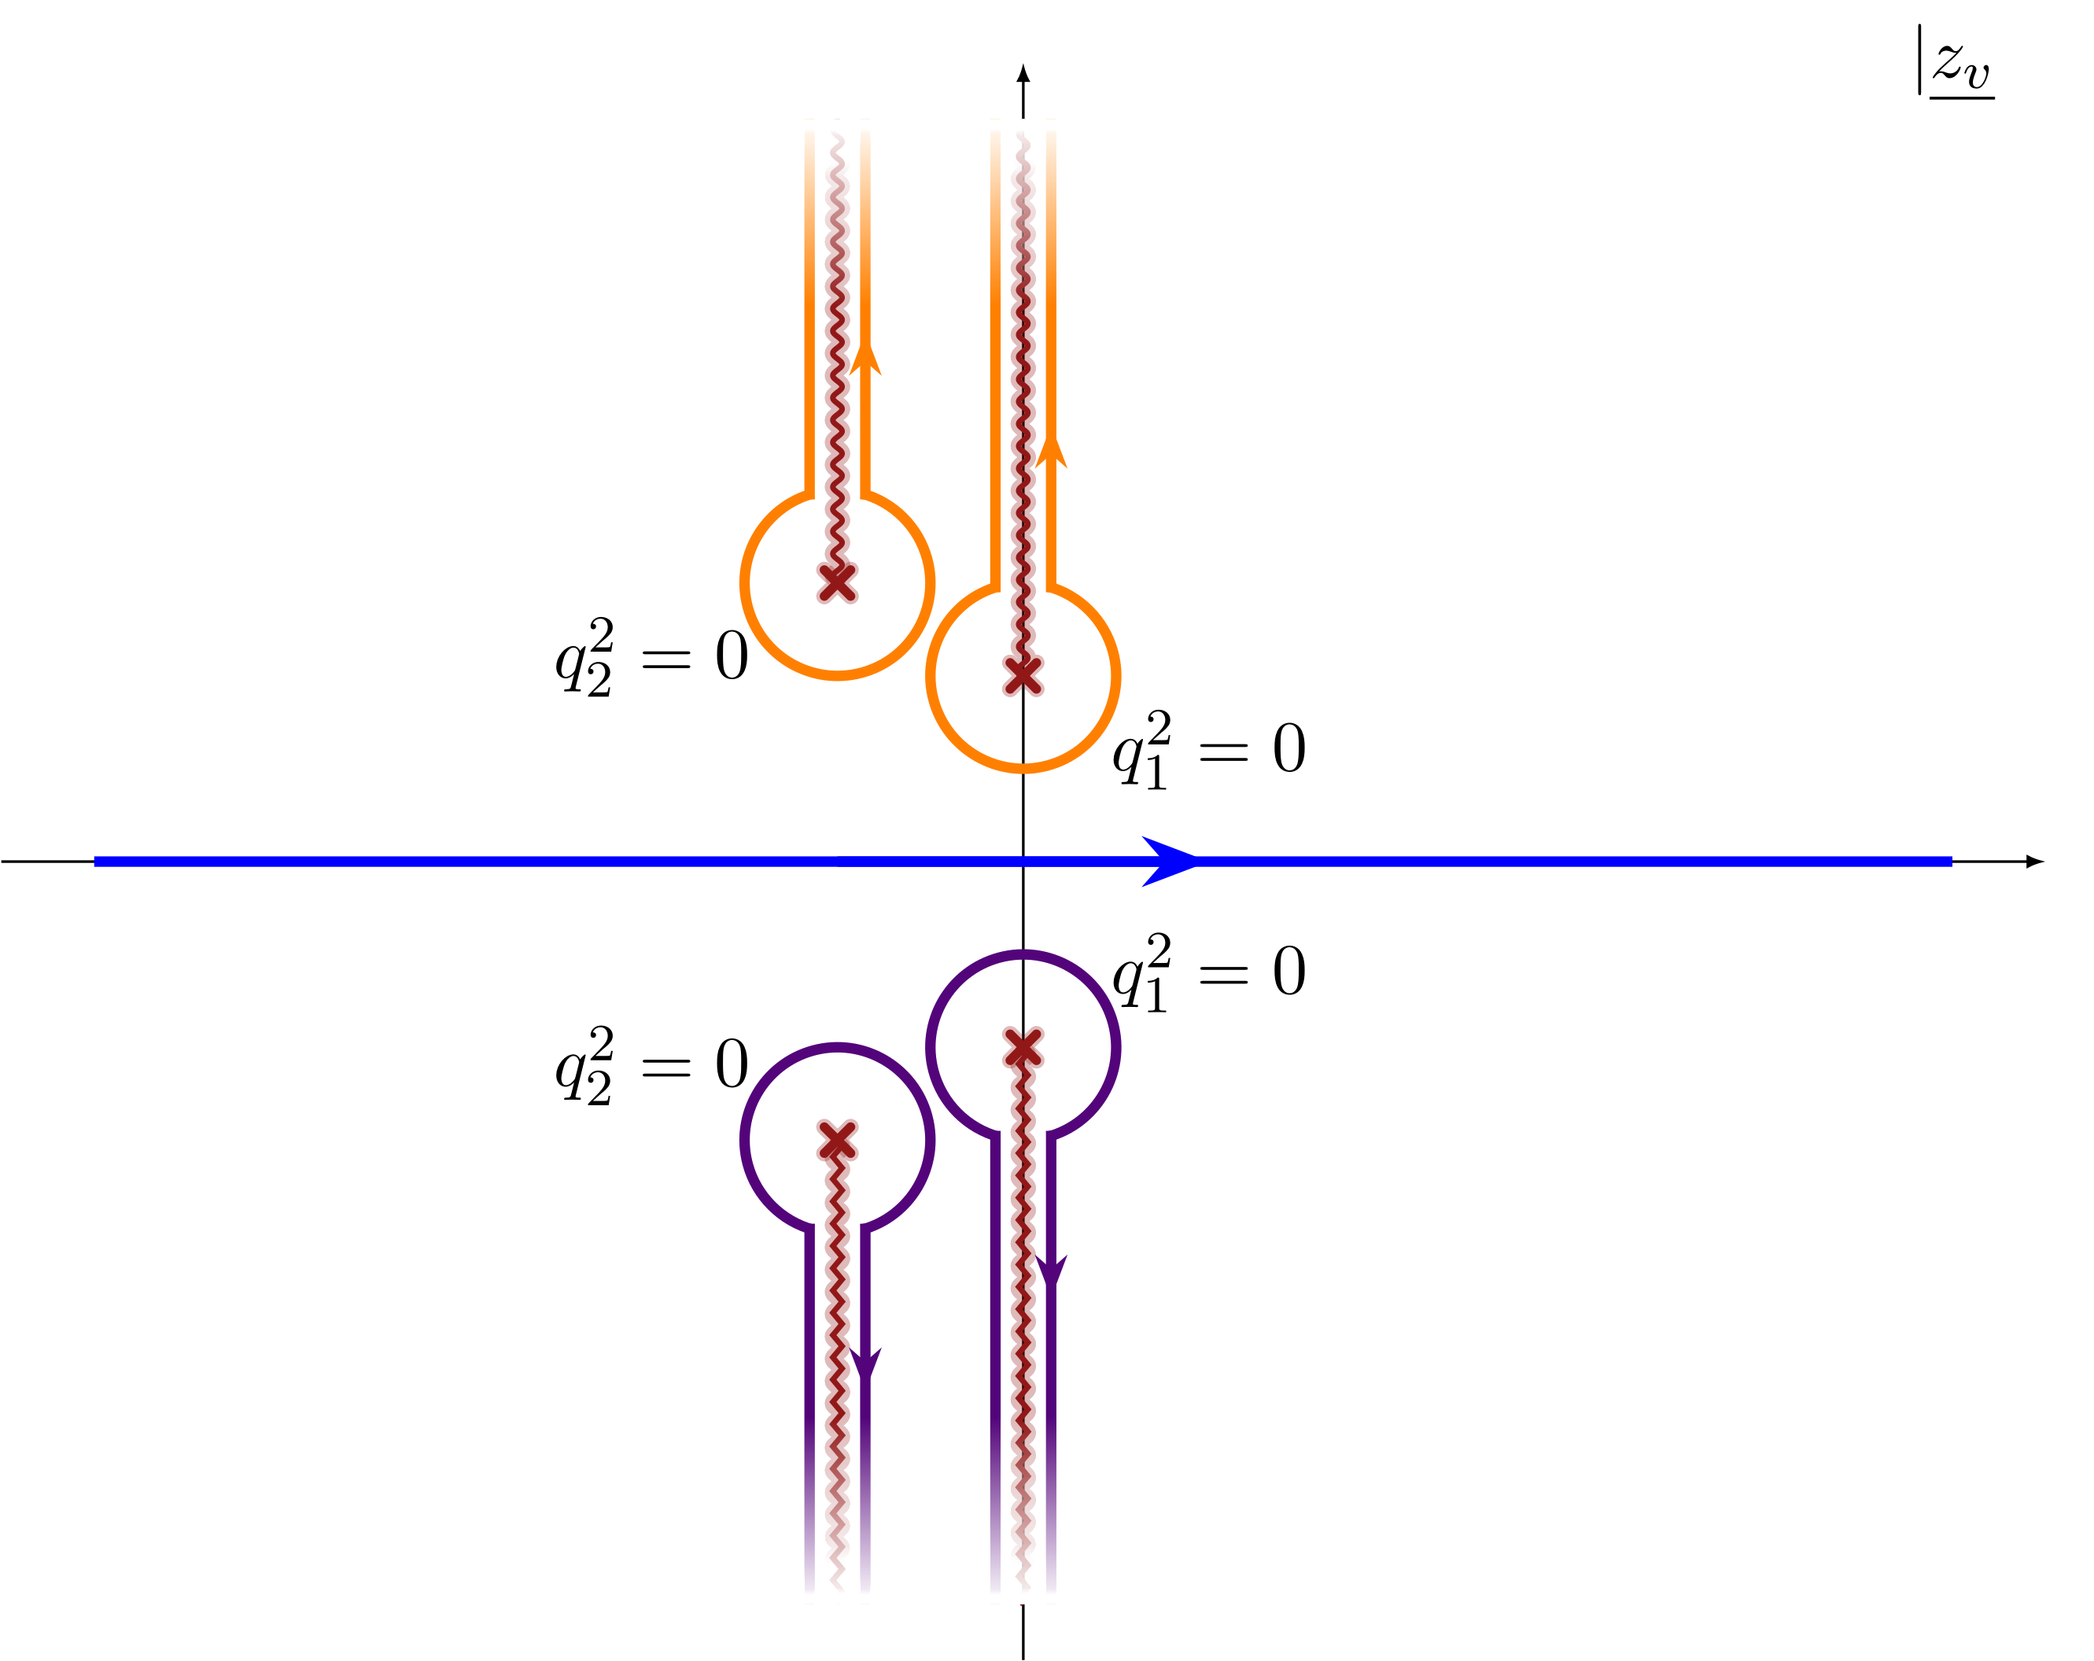
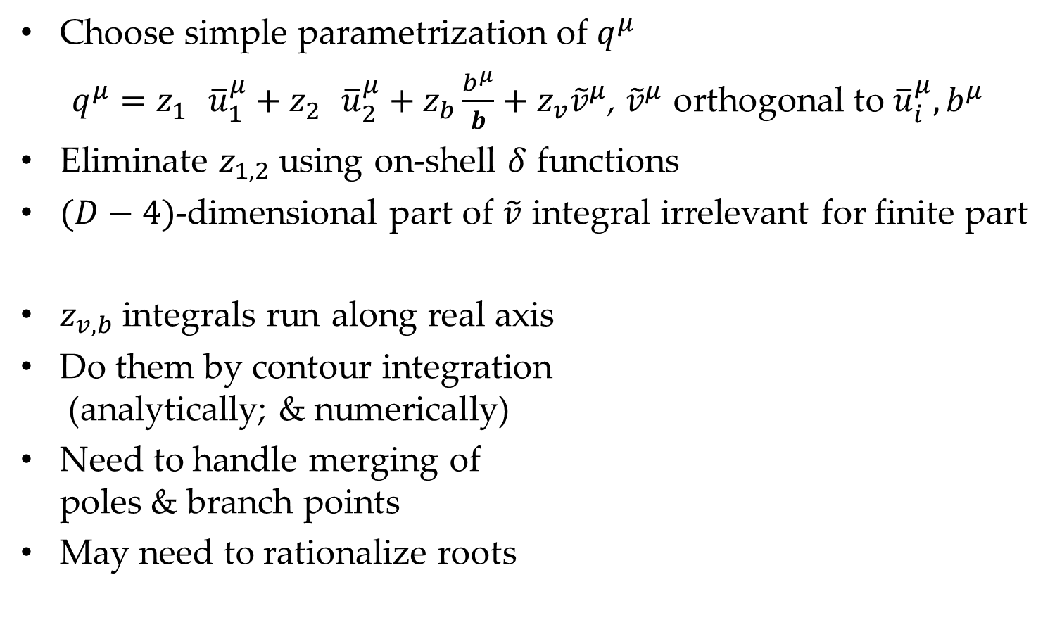
Evaluating Integrals: Fourier Transform
Choose simple parametrization of $q^{μ}$
$q^{μ}=z_{1}^{} {\overline{u}}_{1}^{μ}+z_{2}^{} {\overline{u}}_{2}^{μ}+z_{b}\frac{b^{μ}}{b}+z_{v}{\tilde{v}}^{μ}$, ${\tilde{v}}^{μ}$ orthogonal to ${\overline{u}}_{i}^{μ}, b^{μ}$
Eliminate $z_{1,2}$ using on-shell $δ$ functions
$(D−4)$-dimensional part of $\tilde{v}$ integral irrelevant for finite part
$z_{v,b}$ integrals run along real axis
Do them by contour integration
(analytically; & numerically)
Need to handle merging of
poles & branch points
May need to rationalize roots

Slide 30
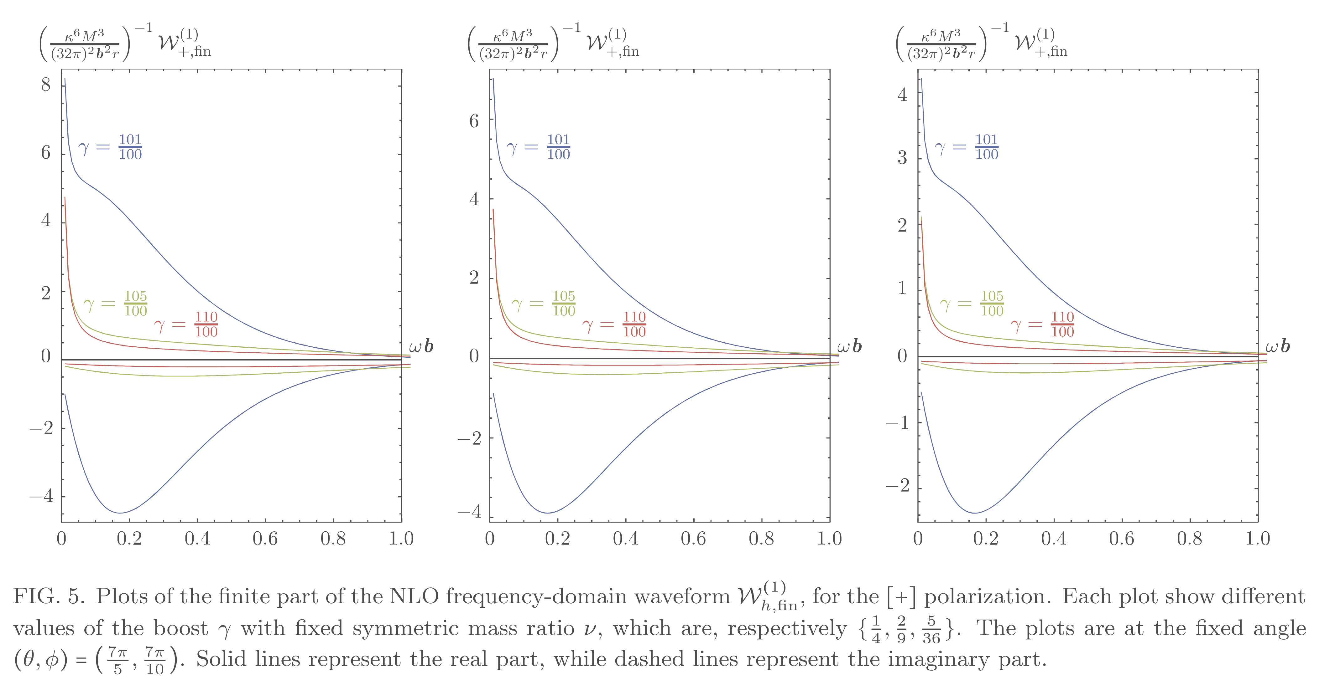
NLO corrections to frequency-domain waveform

Slide 31
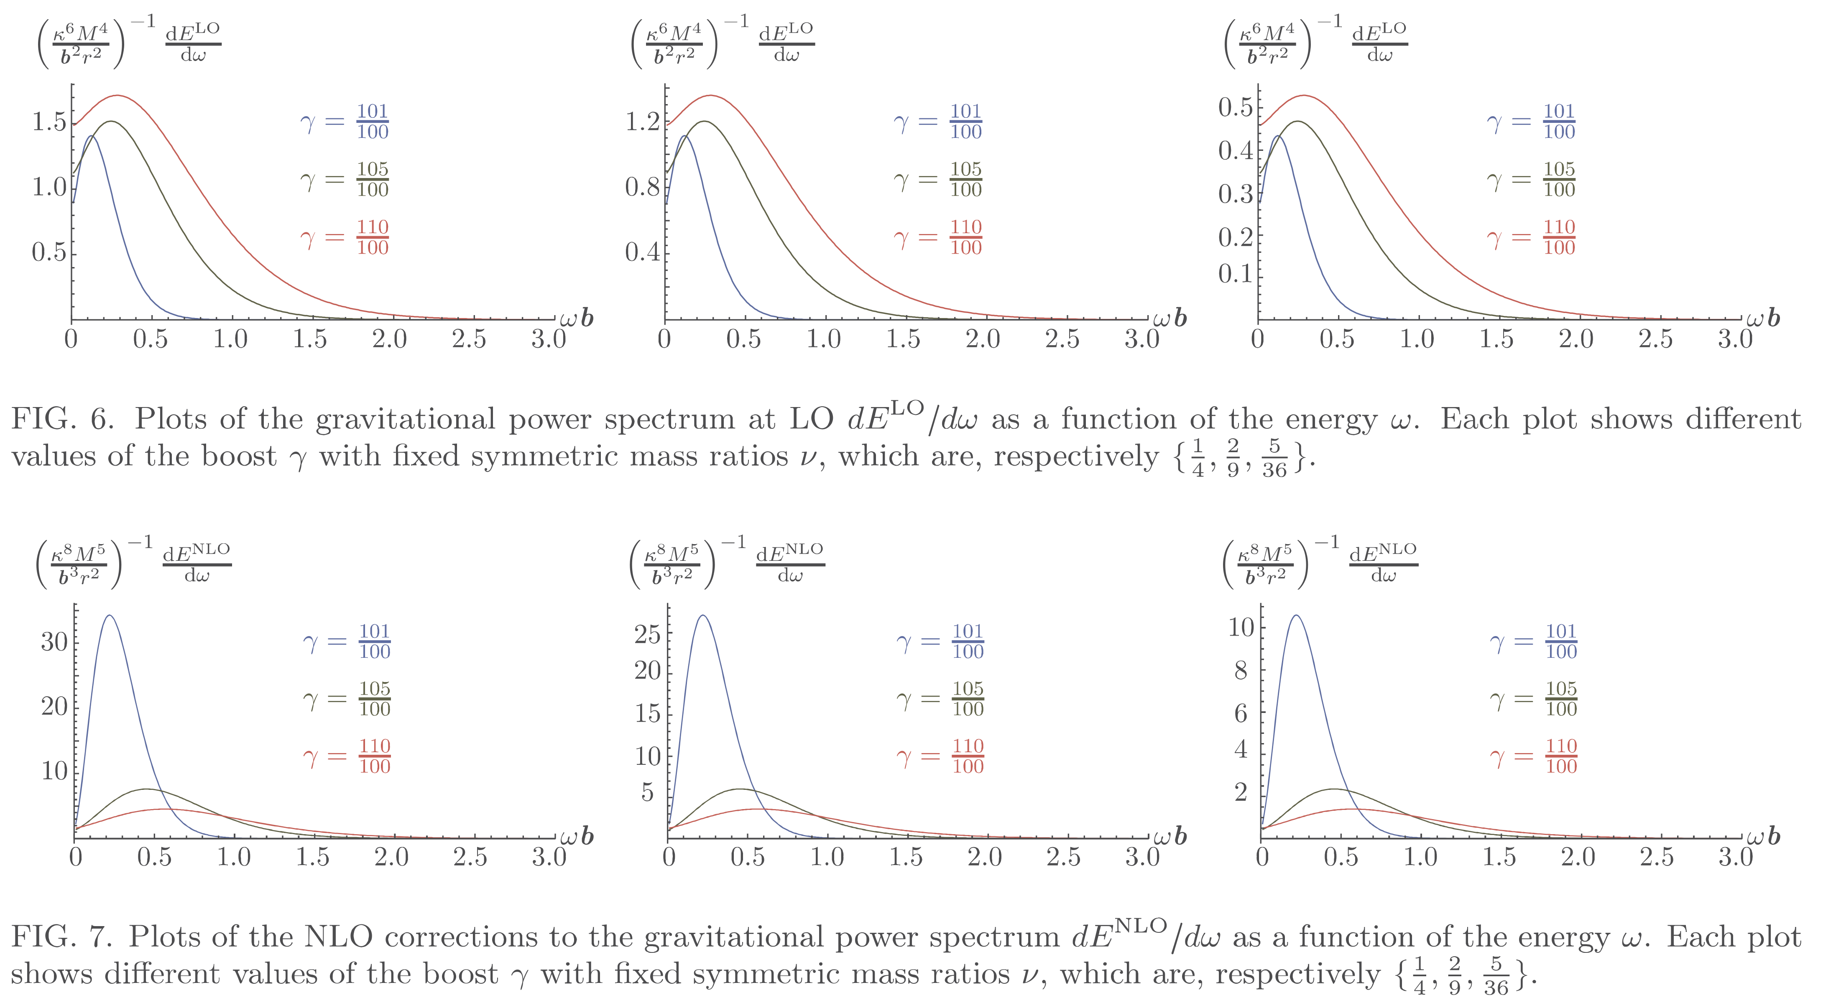

LO vs NLO power spectra $\frac{dE}{dω}=\frac{2}{κ^{2}}∫dΩ \sum_{h}{{\left|ω 𝒲_{h}\left(ω,Ω\right)\right|}^{2}}$

Slide 32
Summary
Compact expression for NLO Waveform in gravitational scattering
Treat loop and Fourier integrals together for reduction to basis
Future: evaluate loop and Fourier integrals together

Slide 33
Gravitational Waves
The waves are anything but violent, though
LIGO/VIRGO use laser interferometers
  Incredible isolation and vibration removal
  Near-perfect mirrors
Noise is 400 times larger than signal!
Need theoretical input for waveforms

Slide 34
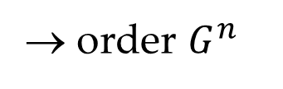
Public Service Announcement
Lower the comprehension potential barrier
Post-Minkowskian, nPM
Super-classical
→ order $G^{n}$
→ classically singular

Slide 35
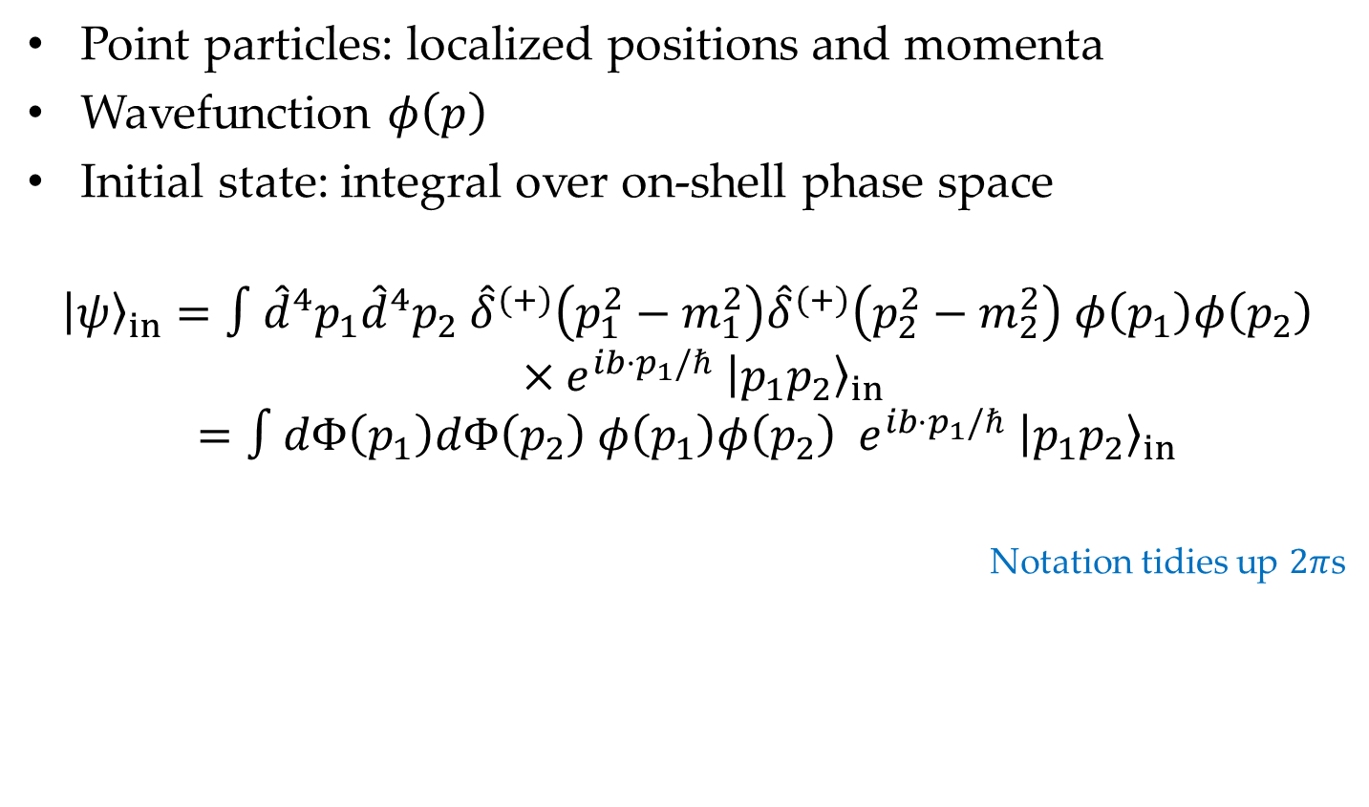
Wave Packets
Point particles: localized positions and momenta
Wavefunction $φ\left(p\right)$
Initial state: integral over on-shell phase space
$${\left|ψ\right\rangle }_{in}=∫{\hat{d}}^{4}p_{1}{\hat{d}}^{4}p_{2} {\hat{δ}}^{(+)}\left(p_{1}^{2}−m_{1}^{2}\right){\hat{δ}}^{(+)}\left(p_{2}^{2}−m_{2}^{2}\right) φ\left(p_{1}\right)φ\left(p_{2}\right) \\ ×e^{ib⋅p_{1}/ℏ} {\left|p_{1}p_{2}\right\rangle }_{in}$$
$$=∫dΦ\left(p_{1}\right)dΦ\left(p_{2}\right) φ\left(p_{1}\right)φ\left(p_{2}\right) e^{ib⋅p_{1}/ℏ} {\left|p_{1}p_{2}\right\rangle }_{in}$$
Notation tidies up $2π$s

Slide 36
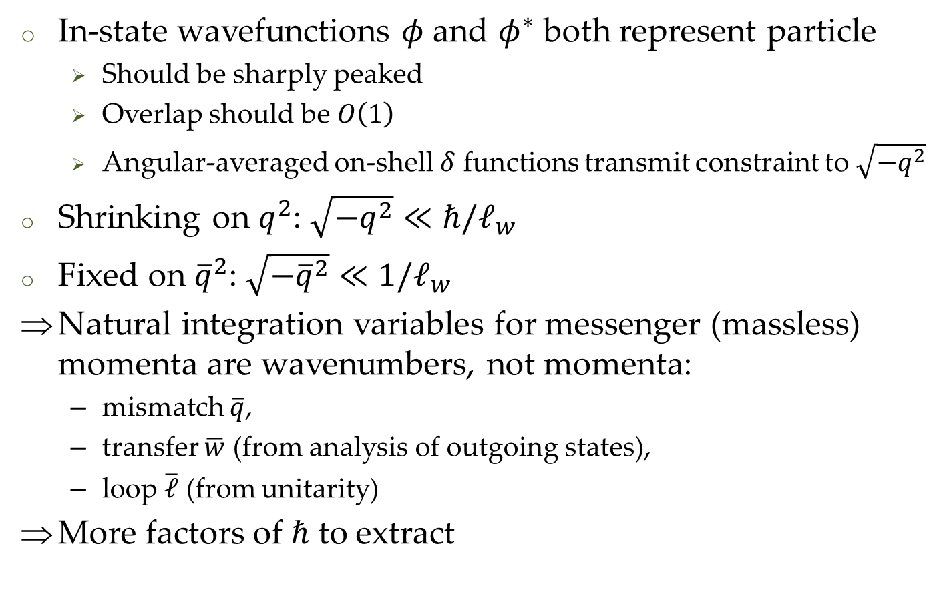
Classical Limit, part 2
In-state wavefunctions $φ$ and $φ^{∗}$ both represent particle
  Should be sharply peaked
  Overlap should be $O\left(1\right)$
  Angular-averaged on-shell $δ$ functions transmit constraint to $\sqrt{−q^{2}}$
Shrinking on $q^{2}$: $\sqrt{−q^{2}}≪ℏ/ℓ_{w}$
Fixed on ${\overline{q}}^{2}$: $\sqrt{−{\overline{q}}^{2}}≪1/ℓ_{w}$
Natural integration variables for messenger (massless) momenta are wavenumbers, not momenta:
  mismatch $\overline{q}$,
  transfer $\overline{w}$ (from analysis of outgoing states),
  loop $\overline{ℓ}$ (from unitarity)
More factors of $ℏ$ to extract

Slide 37

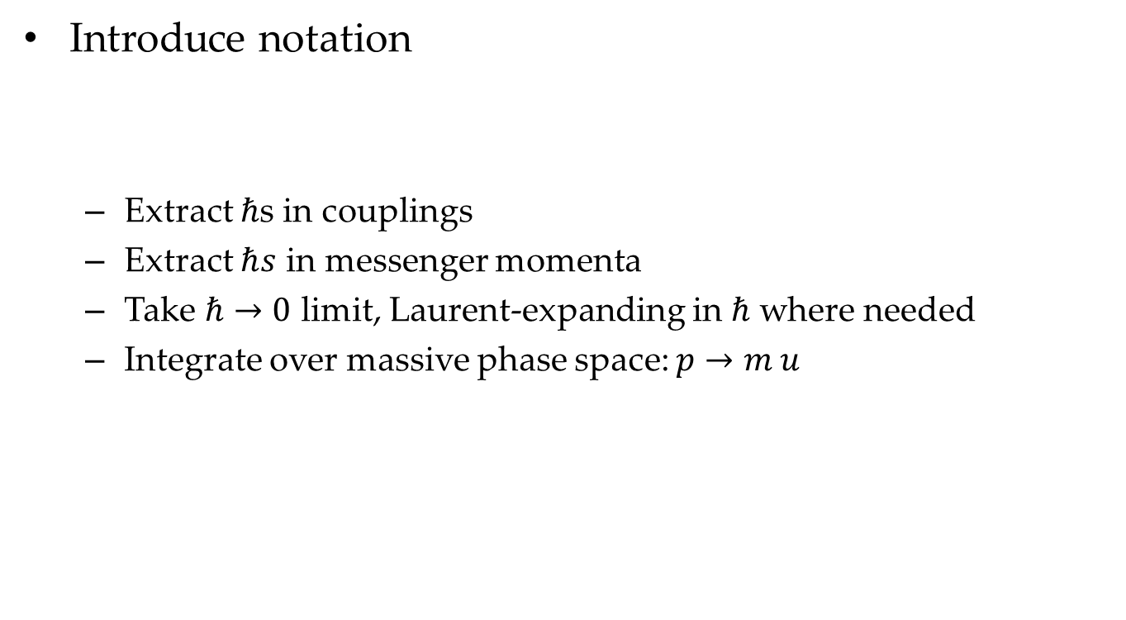
Classical Limit, tachlis
Introduce notation
  Extract $ℏ$s in couplings
  Extract $ℏs$ in messenger momenta
  Take $ℏ→0$ limit, Laurent-expanding in $ℏ$ where needed
  Integrate over massive phase space: $p→m u$

