Slide 1

Quantum Scattering Amplitudes from the Attoscopic to the Ronnascopic
David A. Kosower Institut de Physique Théorique, CEA–Saclay
Peking University, Beijing, China
北京大学, 北京
January 14, 2026

Slide 2
Frontiers of Observation
From 10⁻¹⁸ m at the LHC attometer
Through human scales
To observations of black hole mergers at distances of 10²⁵ m
And out to the edge of the observable universe at 10²⁷ m ronnameter

Slide 3
The ultimate language for describing quantum phenomena is Quantum Field Theory
Sometimes it’s even the best way to describe classical phenomena
Goal: predict observable quantities

Slide 4
Quantum Field Theory
Path Integrals over Quantum Fields
There were other formulations before
Could there be other useful formulations?

Slide 5
Scattering Amplitudes
No need for a Lagrangian, Feynman rules or path integrals
“Quantum Field Theory without the quantum fields” —Lance Dixon
A toolkit and philosophy for getting to observables efficiently
An interesting subject of study in its own right

Slide 6
Connections
Mathematics:
Polylogs & Motives
Grassmannians
Algebraic Geometry
Integrability
Amplitudes
String Theory
Classical Gravity
New Formulations of Fundamental Physics
LHC Phenomenology
Yang-Mills:
super- or QCD
Supergravity

Slide 7

Amplitudes Community
Over 200 participants at the annual conference, dominated by younger physicists
Bo Feng, Song He, Alex Ochirov, Gang Yang, Yang Zhang
Fei Teng, HuaXin Zhu
Xu, Zhang, & Chang (1984) [Tsinghua] “Chinese magic”

Slide 8
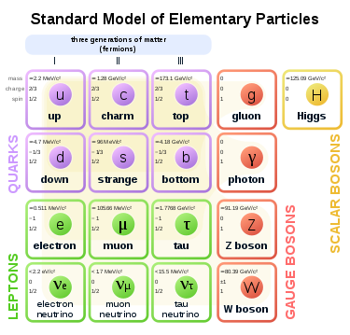
At the Attoscopic Frontier
The discovery of the Higgs boson completed our picture of the Standard Model

Slide 9
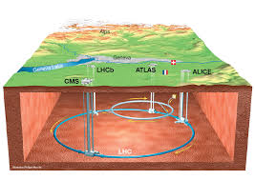
Experiment and Theory
The LHC is our experimental instrument
Search for new physics & the next scale
in rare events
in events at the tails of distributions
in small deviations from the Standard Model
Need to understand known physics precisely

Slide 10
Rates
Need to know relative rates of signal and background processes
Rates are given by integrals of squares of more basic quantities: scattering amplitudes
Amplitudes are the basic building blocks we must calculate

Slide 11
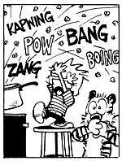
Traditional Approach
Lots and lots of Feynman diagrams
Factorial growth with the number of legs or loops

Slide 12
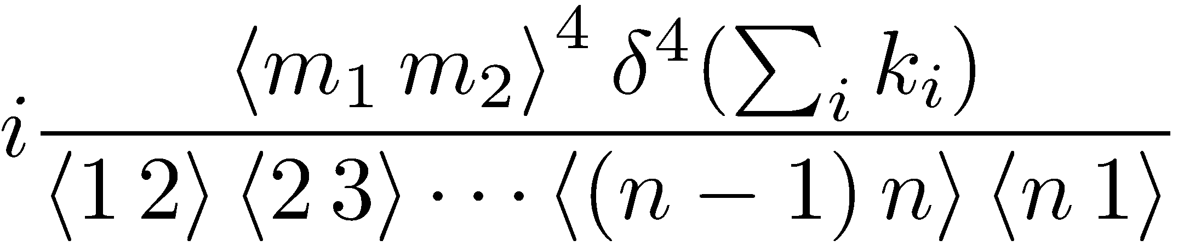
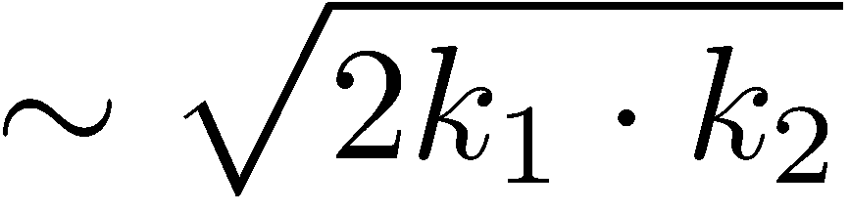
Results Are Simple!
Parke–Taylor amplitude (A^{MHV})
Mangano, Parke, & Xu

Slide 13
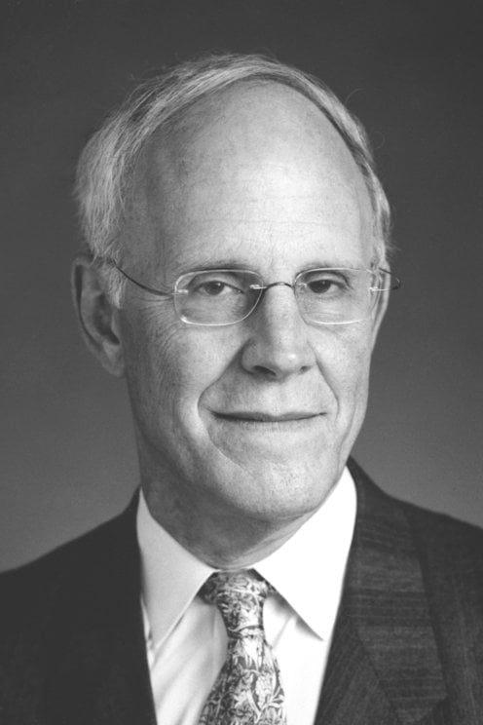
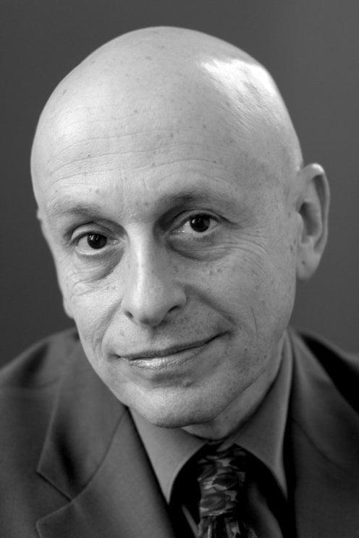
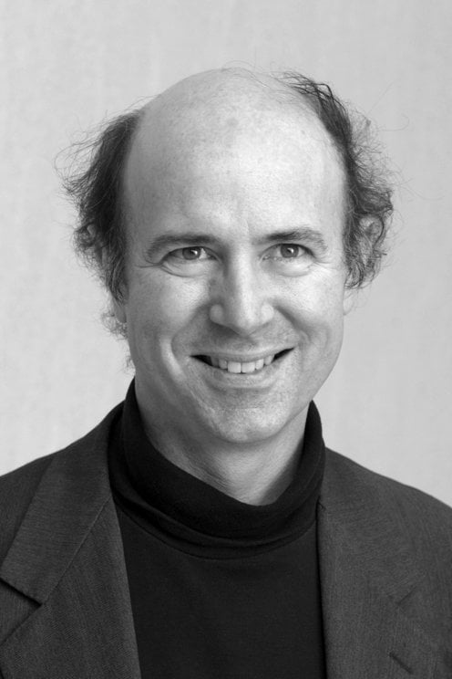
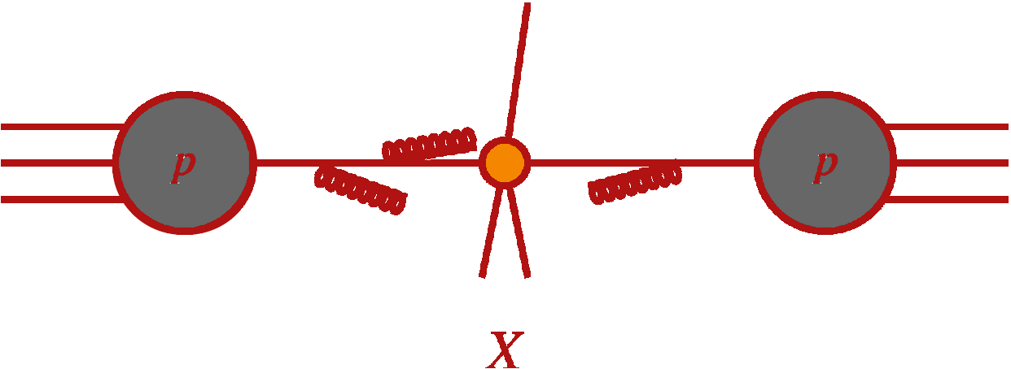
QCD Is Everywhere at the LHC
Murray Gell-Mann (1929-2019)
Quantum chromodynamics describes proton structure
Essential part of theoretical predictions at LHC
Dominant backgrounds to measurements and searches
David Gross
David Politzer
Frank Wilczek

Slide 14
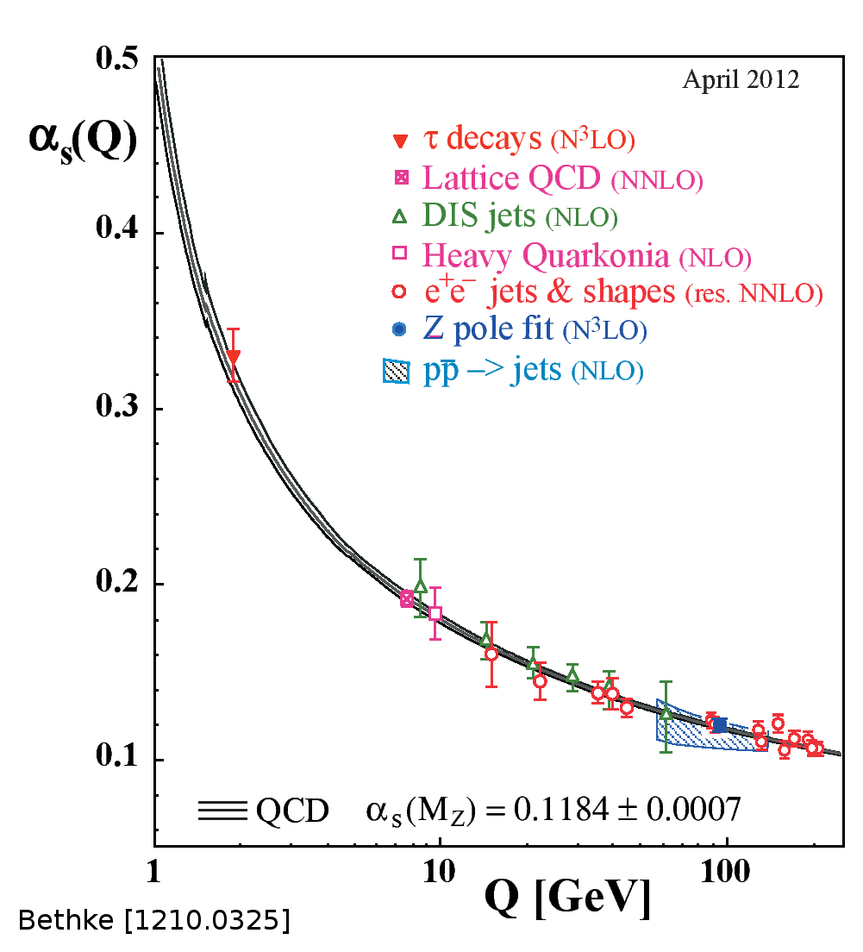
Perturbative QCD
Strong coupling is not small: α_{s}(M_{Z}) ≈ 0.12 and running is important
events have high multiplicity of jets
each jet has a high multiplicity of hadrons
higher-order perturbative corrections are important

Slide 15
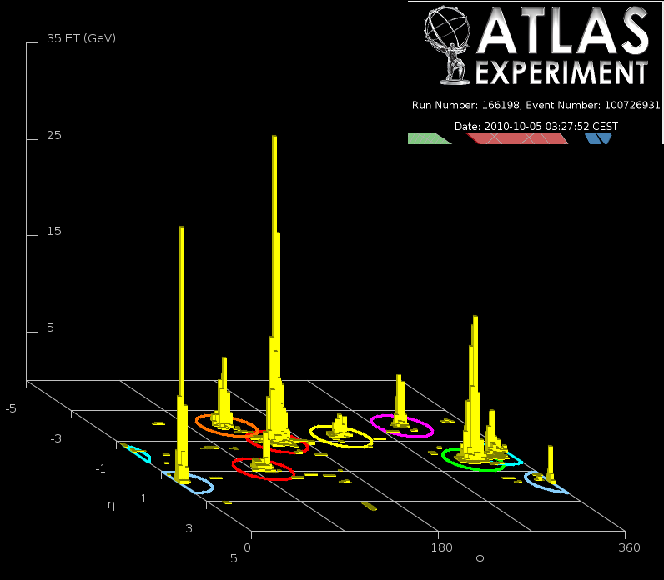

Slide 16
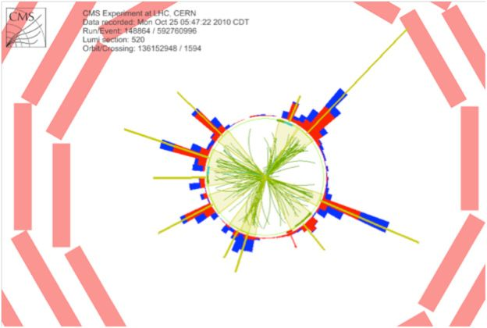
A CMS 10-Jet Event

Slide 17
Perturbative QCD
The lowest order approximation corresponds to tree diagrams
Unlike other theories, it isn’t quantitatively reliable because of running: dependence on scale
The next order (“next-to-leading”) includes one-loop contributions, and is the first quantitatively reliable order
Unitarity methods helped spark the “NLO Revolution”
Next-to-next-to-leading order (NNLO) needed for precision physics

Slide 18
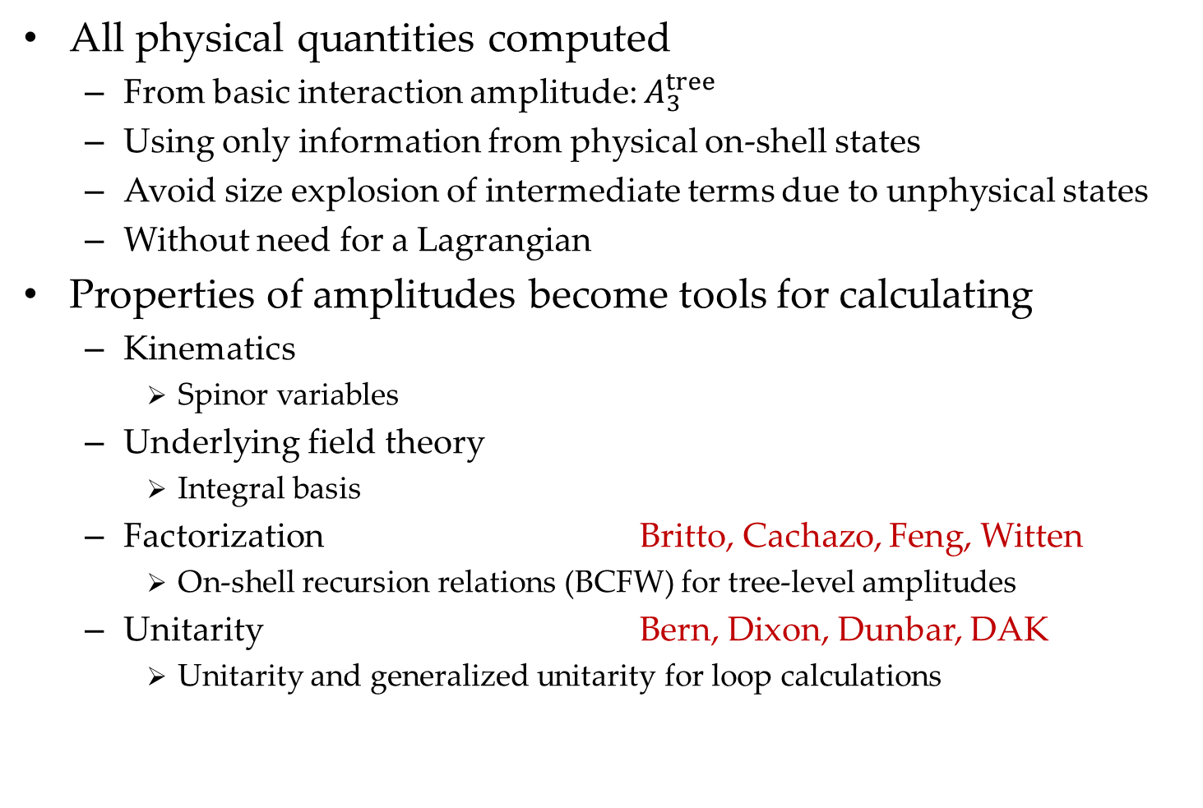
On-Shell Methods
All physical quantities computed
From basic interaction amplitude: $A_{3}^{tree}$
Using only information from physical on-shell states
Avoid size explosion of intermediate terms due to unphysical states
Without need for a Lagrangian
Properties of amplitudes become tools for calculating
Kinematics
Spinor variables
Underlying field theory
Integral basis
Factorization Britto, Cachazo, Feng, Witten
On-shell recursion relations (BCFW) for tree-level amplitudes
Unitarity Bern, Dixon, Dunbar, DAK
Unitarity and generalized unitarity for loop calculations

Slide 19

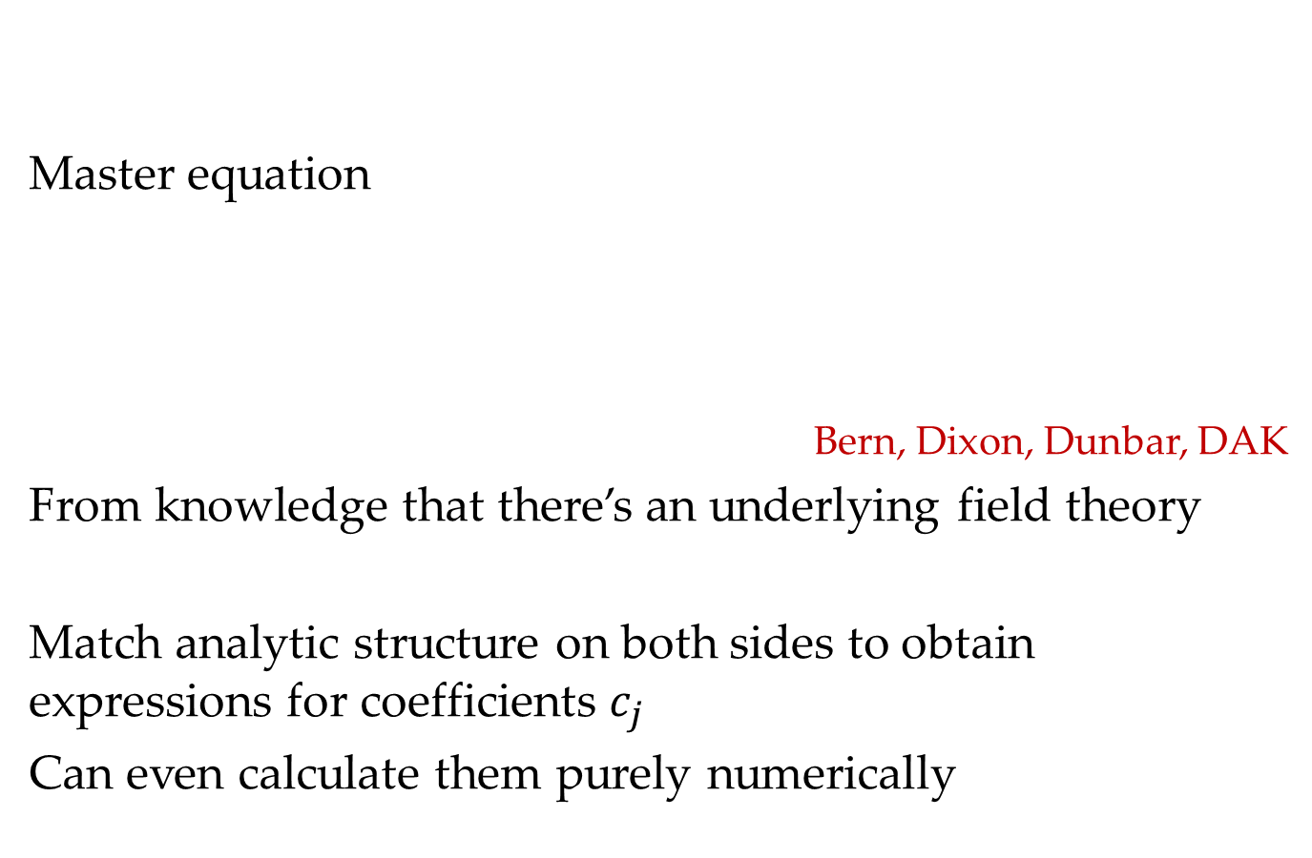
NLO Revolution: Unitarity at One Loop
Master equation
Bern, Dixon, Dunbar, DAK
From knowledge that there’s an underlying field theory
Match analytic structure on both sides to obtain expressions for coefficients $c_{j}$
Can even calculate them purely numerically

Slide 20
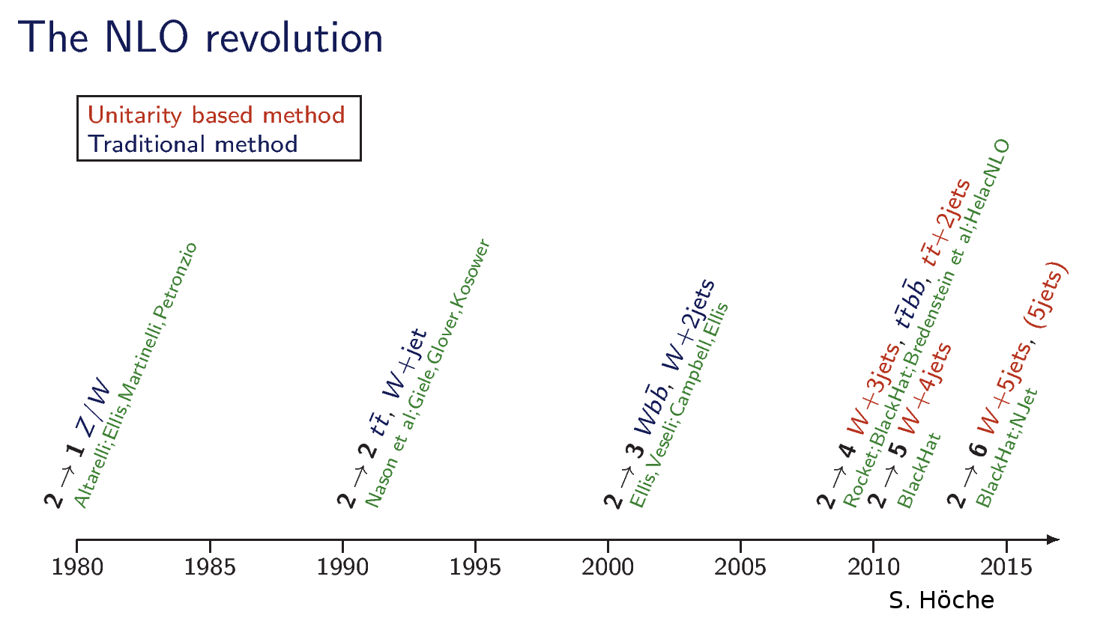
BlackHat: Berger, Bern, Dixon, Febres Cordero, Gleisberg, Hoeche, Ita, DAK, Maître, Ozeren

Slide 21
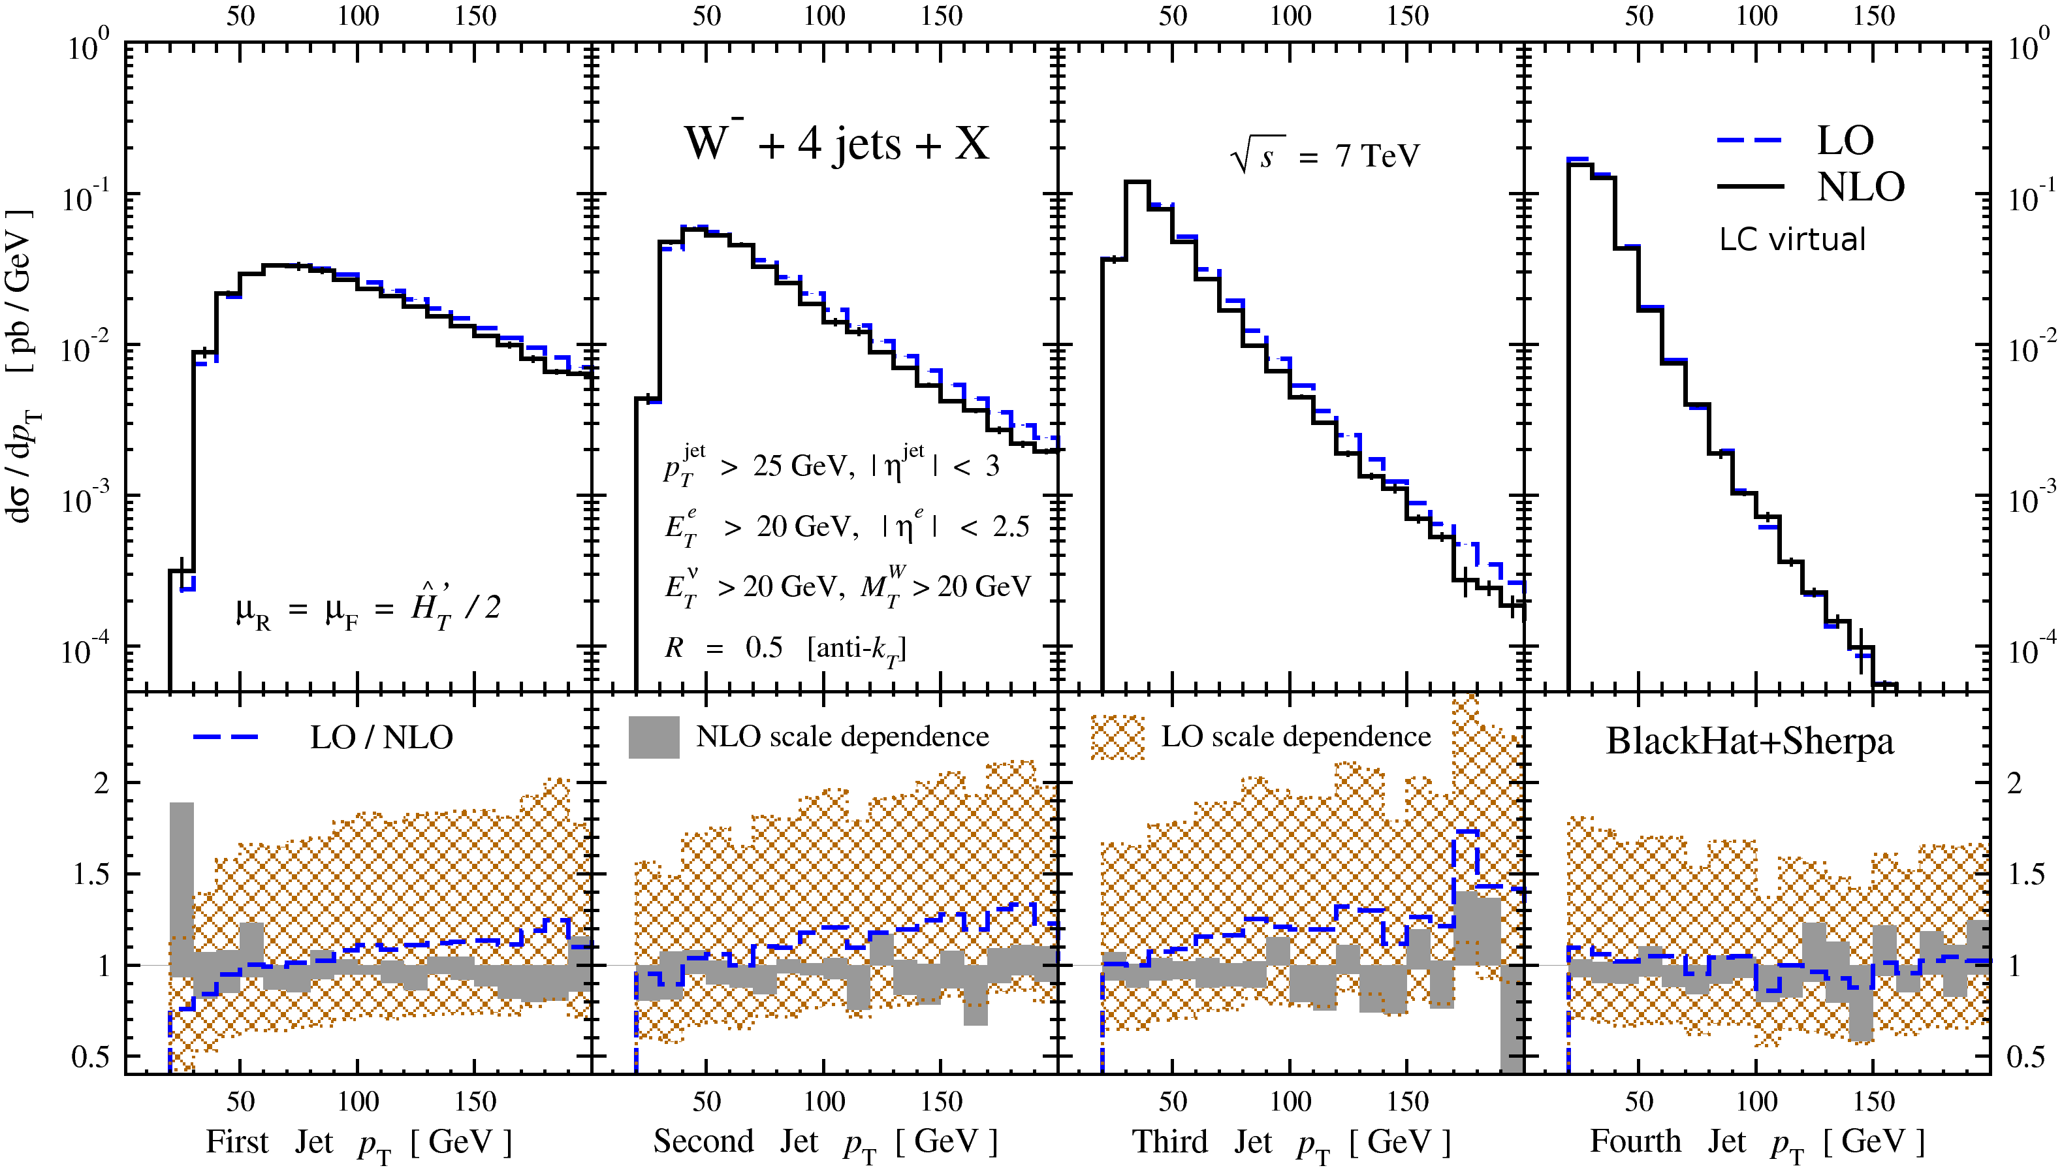
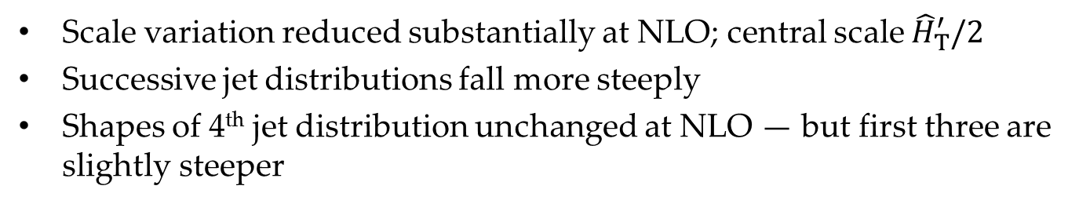
W+4 Jets
Scale variation reduced substantially at NLO; central scale ${\hat{H}}_{T}^{′}/2$
Successive jet distributions fall more steeply
Shapes of 4th jet distribution unchanged at NLO — but first three are slightly steeper

Slide 22
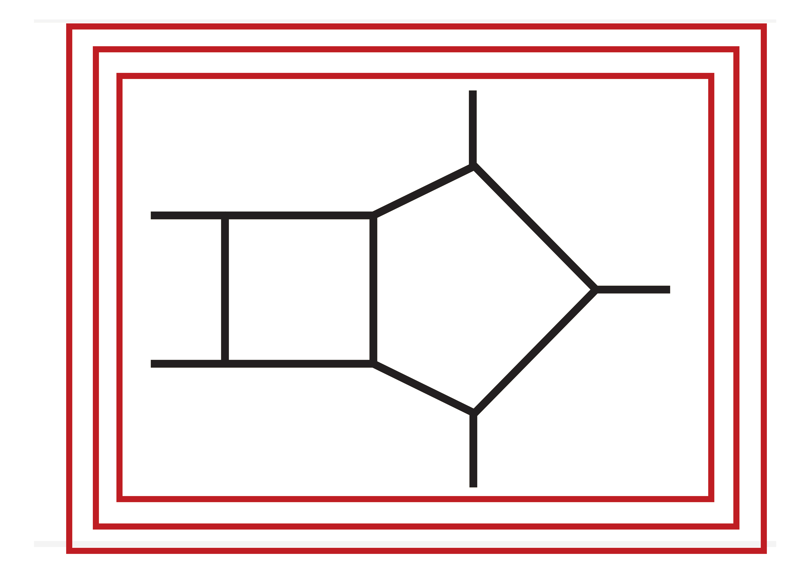
Next-to-Next-to-Leading Order
Goal: push perturbative computations in QCD to precision level (1~3% theoretical uncertainties)
Path: compute five- and higher-point two-loop amplitudes
Abreu, Febres Cordero, Ita, Jaquier, Page, Zeng; Badger, Brønnum-Hansen, Hartanto, Peraro; Chicherin, Henn, Wasser, Gehrmann, Zhang, Zoia; Abreu, Dixon, Herrmann, Page, Zeng;
Use of integration-by-parts: separate
Terms which contribute
Terms which integrate to zero
Use of computational algebraic geometry
Rely on recent analytic results for two-loop integrals
Compute coefficients numerically using unitarity, reconstruct analytics
Recently completed: five-parton amplitudes, all helicities

Slide 23
Integrals
Can get rid of Feynman diagrams
Feynman integrals are with us forever
In QCD, organizing and calculating them are the biggest current challenges
Systems of integrals have many linear relations
Find them using integration by parts
Chertykin & Tkachov; Laporta; … A. Smirnov [FIRE]; Usovitch [KIRA]; Lee [LiteRed]; Guan, Liu, Ma, Wu [Blade]; Wu, Boehm, Ma, Xu, Zhang [NeatIBP]
Computing
Differential equations Gehrmann & Remiddi; Henn; …
Polylogarithms: symbols and relations Goncharov, Spradlin, Volovich, Vergu
Elliptic functions and functions on Calabi-Yau

Slide 24

From the Very Small…
To the Very Large
The Universe had a very violent origin
It remains a violent place

Slide 25

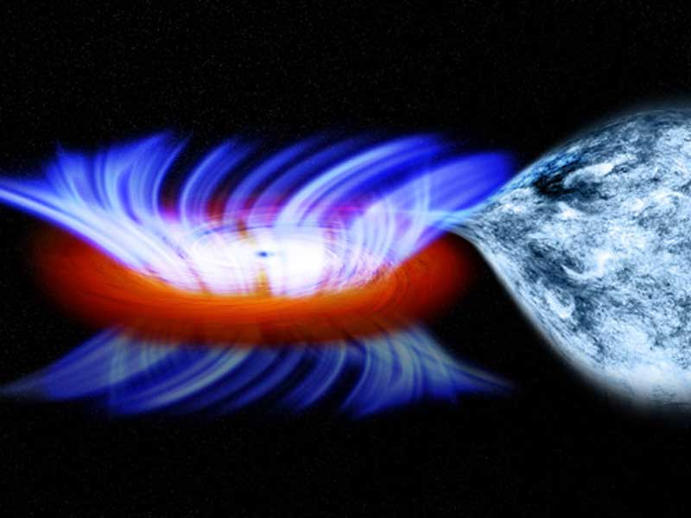

Much of that violence is associated with black holes
Imagine a small black hole — 3 $M_{⨀}$ — eating the Earth
It’s about 8.9 km in size, a bit smaller than Paris
Would release about $3.2⋅{10}^{40}$ J
Sun’s luminosity is about $3.9⋅{10}^{26}$ W, $1.3⋅{10}^{44}$ J over its lifetime
Supernova releases ${10}^{46}$ J in a few seconds, mostly in neutrinos
Peak visible luminosity $5⋅{10}^{36}$ W $∼$ a galaxy
Luminosity of the local Supercluster $∼{10}^{42}$ W
Peak luminosity of $30M_{⨀}$ black hole merger
$\sim 4⋅{10}^{49}$ W
according to omnicalculator.com/physics/black-hole

Slide 26
Until a decade ago, this violence was invisible
It’s all in gravitational radiation

Slide 27
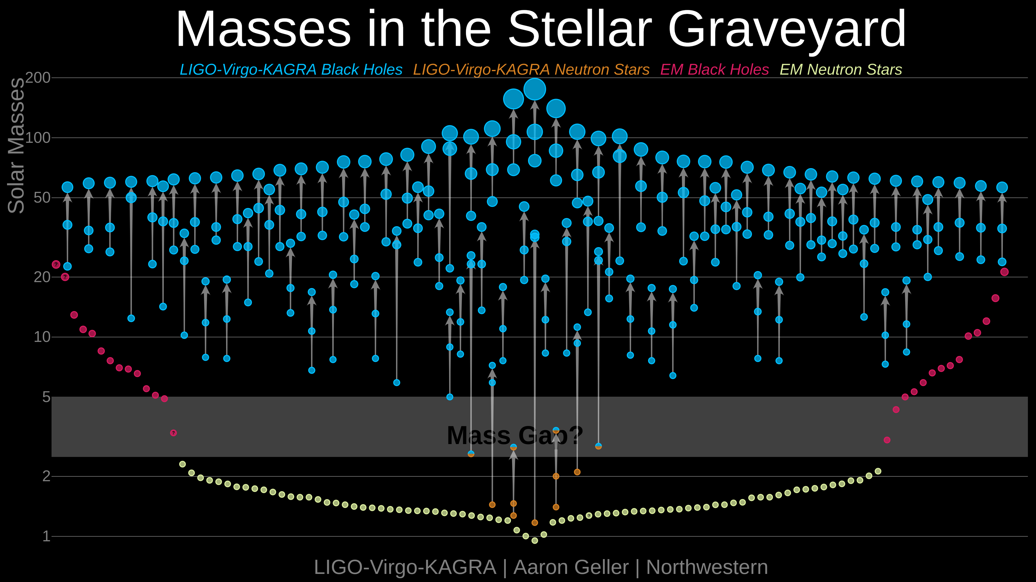
Gravitational Wave Events
LIGO–VIRGO–KAGRA
~200 confirmed events since Sept 2015 gracedb.ligo.org/latest/
In GWTC-1,2,3, runs O1–O3
Run O4a: May 2023–Jan 2024 (LIGO), O4b: Apr 2024–Dec 2024 (LIGO+VIRGO), O4c: Jan 2025– (LIGO+VIRGO)
Mostly binary black holes, some neutron-star mergers, some mixed

Slide 28
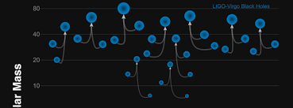
Science Goals
Determine presence and distribution of heavy compact objects
Already discovered unexpected class of black holes, tens of solar masses, indeed binaries of such black holes
More surprises?
Neutron stars
Determine equation of state
Contribution to transferric element production
Measure Hubble constant?
Limits on exotic compact objects
Precision strong-field tests of Einstein gravity
Insight into quantum gravity [in the LISA/TaiJi & TianQin era]?

Slide 29
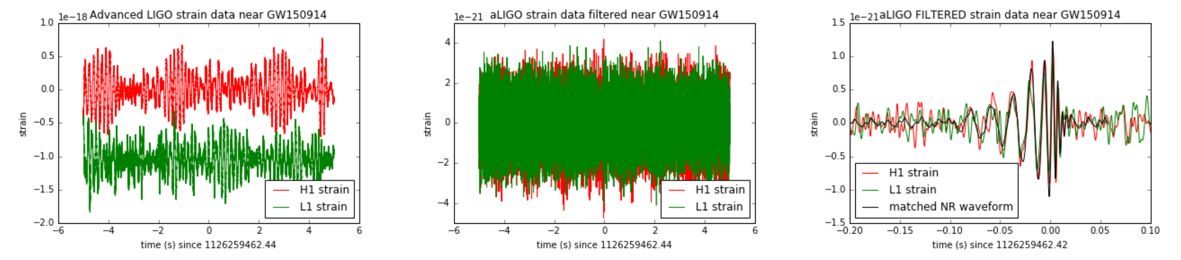
Theorists’ Role
One aspect of detection & analysis
High noise level: 400 times larger than signal! Rehman [1711.07421]
To extract the signal, we need theoretical templates
That’s where theorists come into the picture
Also need theoretical calculations to measure parameters of mergers once seen — masses, spins, etc.

Slide 30
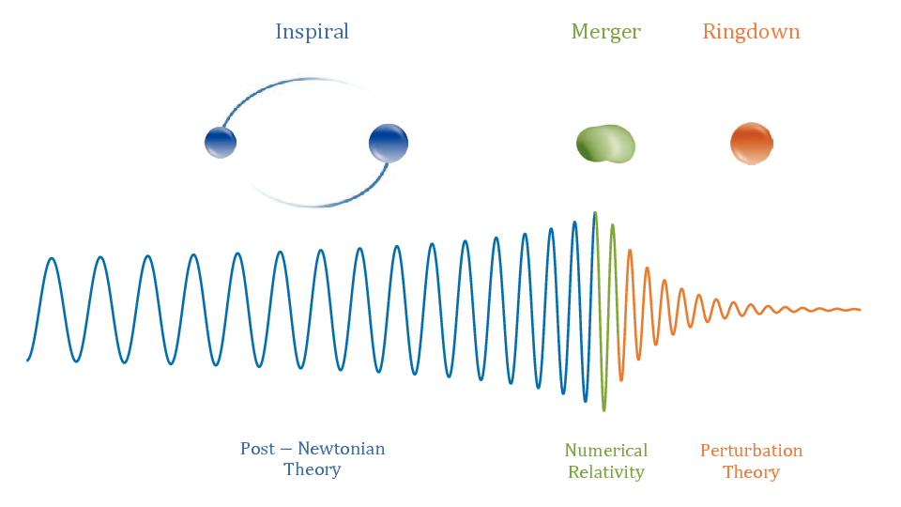
Basic Setup in Mergers
Two slowly inspiralling compact objects
Ringdown
Perturbation theory: normal modes of final black hole
Merger
Strong fields: numerical relativity
Inspiral
Weak-field perturbation theory
Waveform templates
For detection
For measurements
Antelis et al

Slide 31
Numerical Relativity
Key tool for merger phase
Tool for cross-checking other calculations
Computationally expensive
Not realistic for 100Ks of templates needed
Accumulates errors over long inspirals
Can’t be the only tool

Slide 32
Approaches
Traditional: solve General Relativity perturbatively
Effective Field Theory: use separation of scales to compute better in General Relativity
Goldberger, Rothstein
An idea: use scattering amplitudes

Slide 33
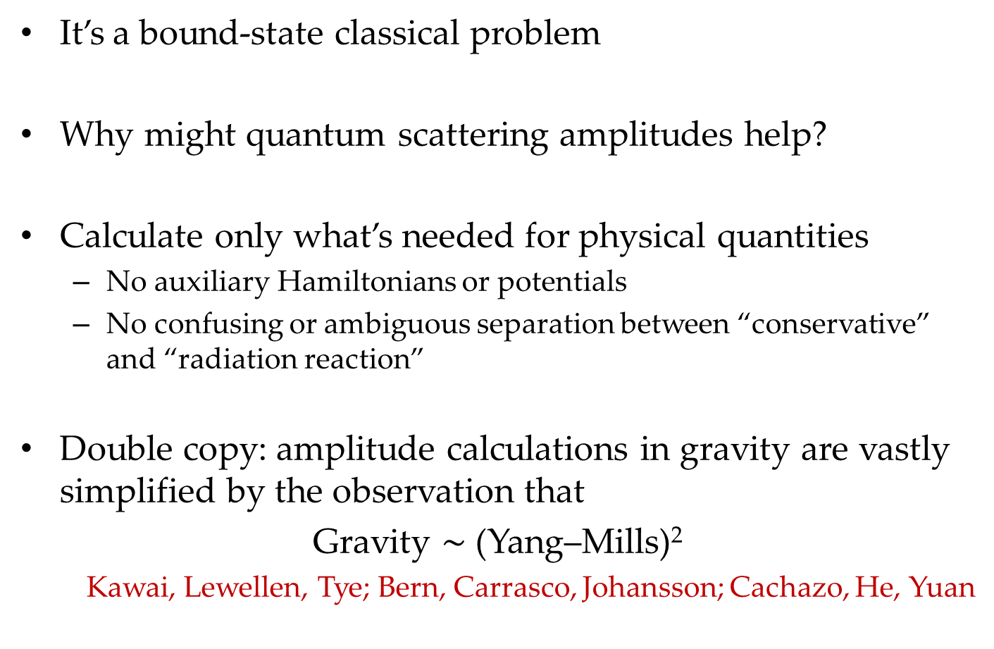
Scattering Amplitudes
It’s a bound-state classical problem
Why might quantum scattering amplitudes help?
Calculate only what’s needed for physical quantities
No auxiliary Hamiltonians or potentials
No confusing or ambiguous separation between “conservative” and “radiation reaction”
Double copy: amplitude calculations in gravity are vastly simplified by the observation that
Gravity $\sim$ (Yang–Mills)²
Kawai, Lewellen, Tye; Bern, Carrasco, Johansson; Cachazo, He, Yuan

Slide 34
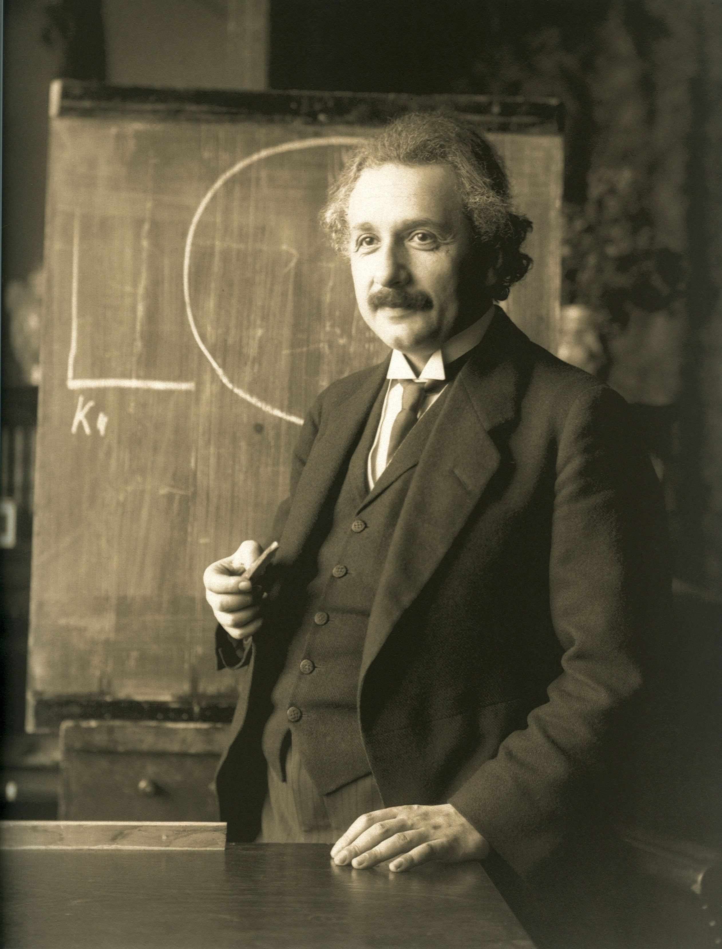
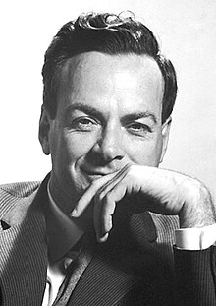
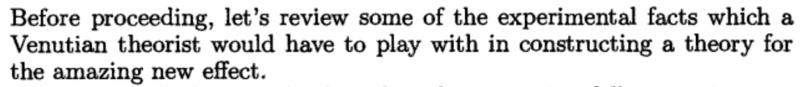
Scattering Amplitudes Approach
Gravitation = General Relativity ← geometry
Inspiration from Feynman
Gravitation = spin-2 field theory

Slide 35
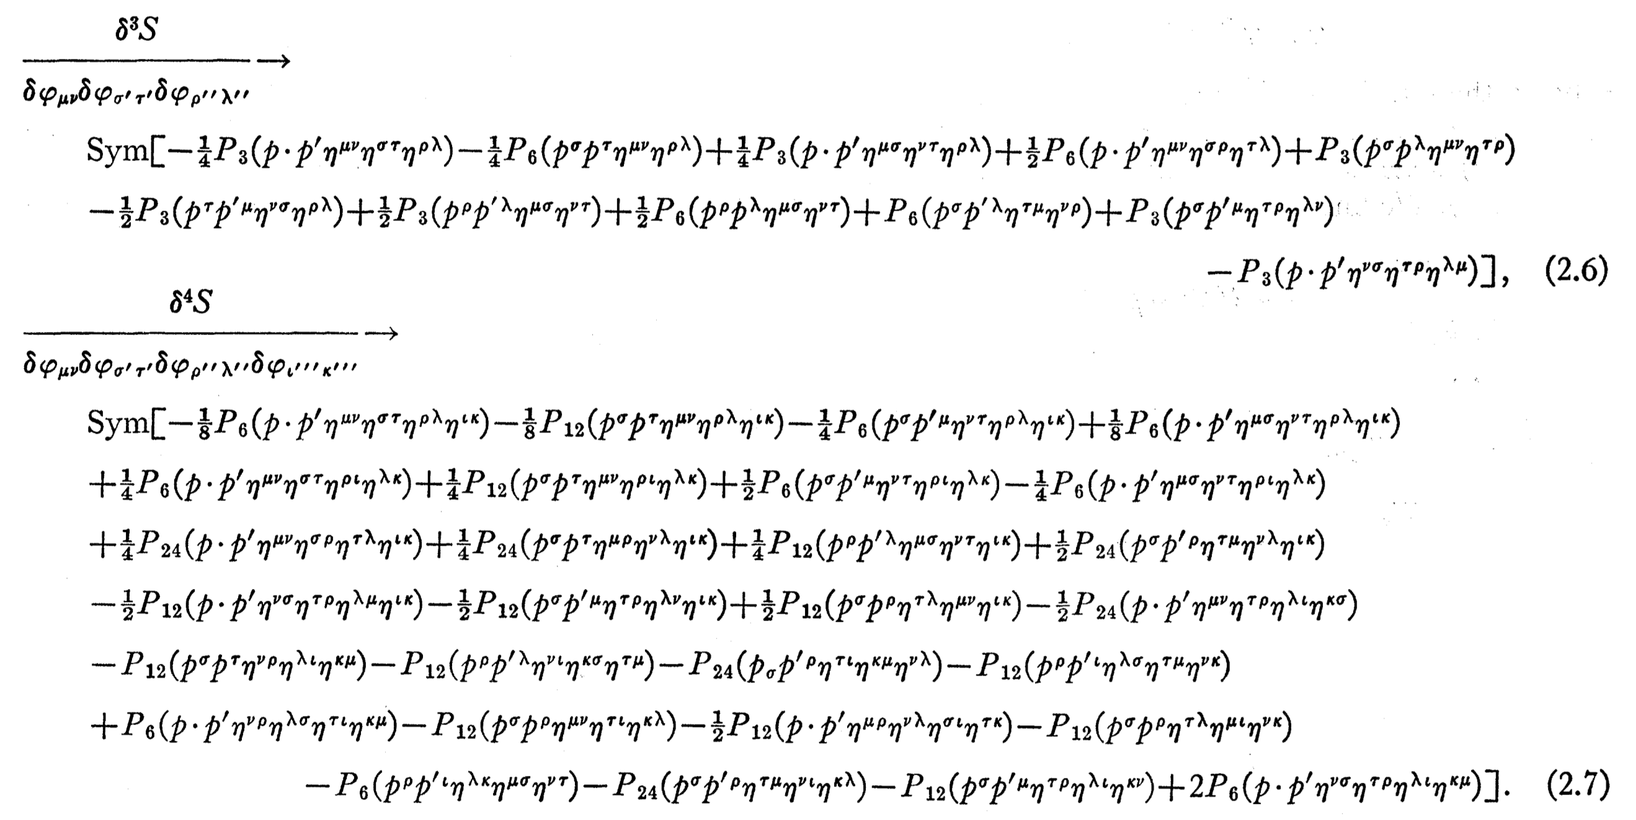

Feynman Vertices
De Witt:
Three-point
Four-point
$⋮$

Slide 36
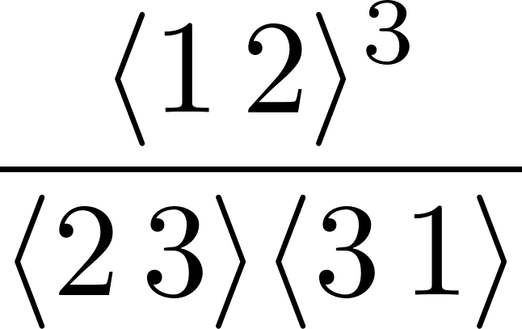
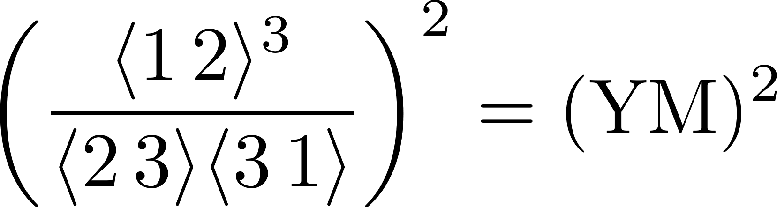
Beyond Feynman: Double Copy
Yang–Mills three-point amplitude
Gravity three-point amplitude
Field-theory equivalent of Kawai–Lewellen–Tye expression for closed-string amplitudes in terms of open-string ones

Slide 37
Scattering Amplitudes Tools
Organize in terms of gauge-invariant objects
Recursion for amplitudes/integrands
Unitarity for loop amplitudes
Differential equations for loop integrals

Slide 38
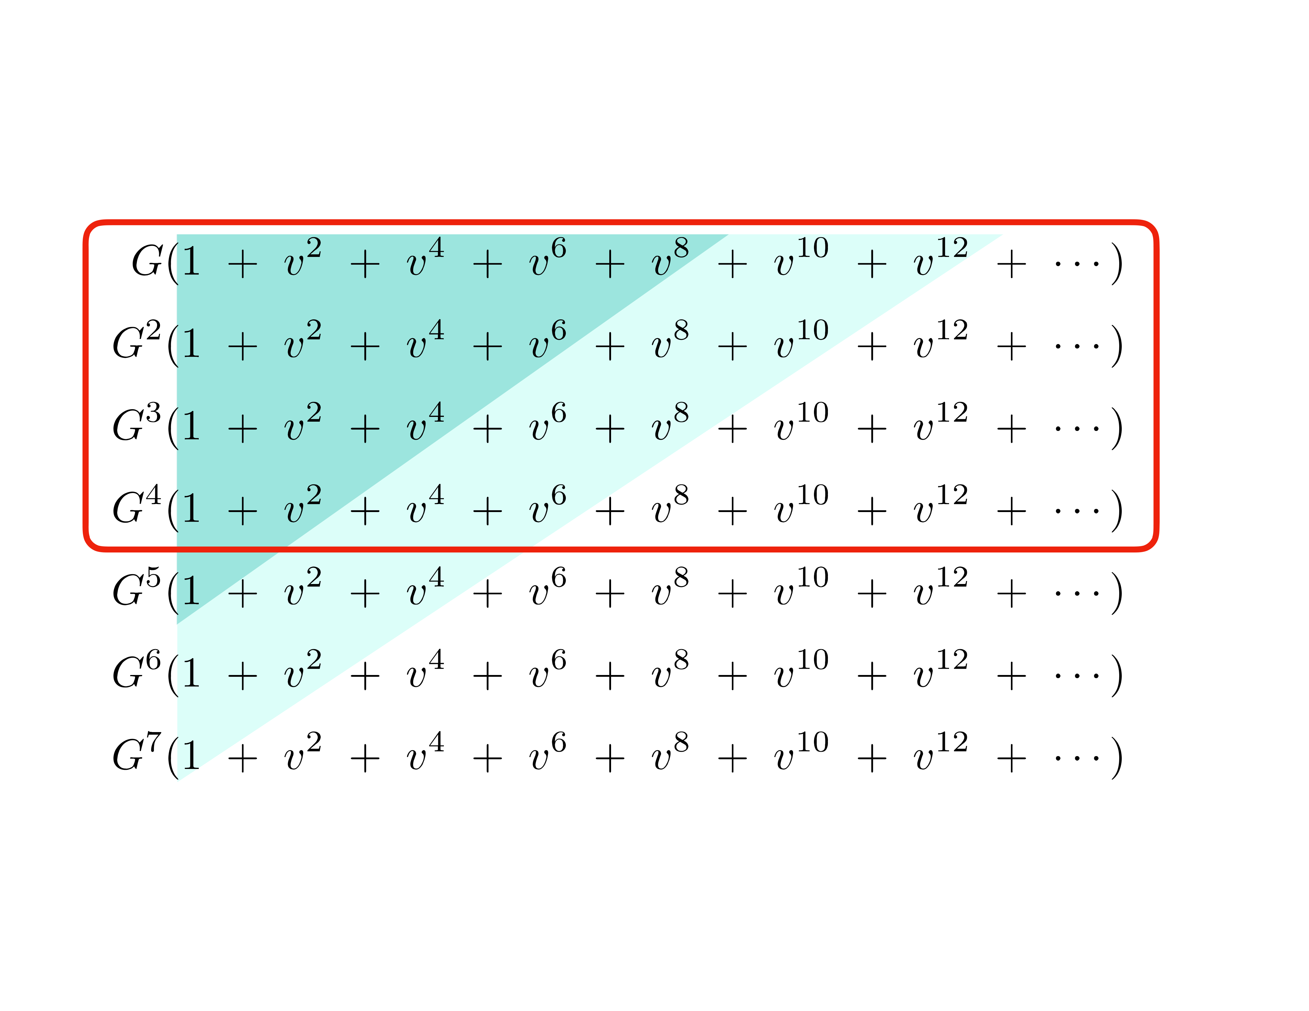
State of the Art
Snowmass Review [2204.05194] – Buonanno, Khalil, O’Connell, Roiban, Solon, Zeng

Slide 39
A Flourishing of New Ideas…
…that I lack time to discuss
EFT Matching
Cheung, Rothstein, Solon; Bern, Kosmopoulos, Luna, Roiban, Teng; Bern, Parra-Martinez, Roiban, Ruf, Shen, Solon, Zeng
Eikonal Phase
Amati, Ciafaloni, Veneziano; Di Vecchia, Heissenberg, Russo, Veneziano
Amplitude analysis
Bjerrum-Bohr, Damgaard, Plante, Vanhove
Heavy mass field theory
Brandhuber, Chen, Travaglini, Wen; Damgaard, Haddad, Helset
World line formalisms
Goldberger, Rothstein; Levi, Steinhoff; Dlapa, Kälin, Liu, Porto; Jakobson, Mogull, Plefka, Steinhoff; Shen; Edison, Levi
Spin Exponentiation
Arkani-Hamed, Huang, O’Connell; Guevara, Ochirov, Vines; Chen, Huang, Kim, Lee; Bautista, Guevara, Kavanagh
EFT post-Newtonian
Foffa, Mastrolia, Sturani, Sturm; Blümlein, Maier, Marquard, Schäfer

Slide 40
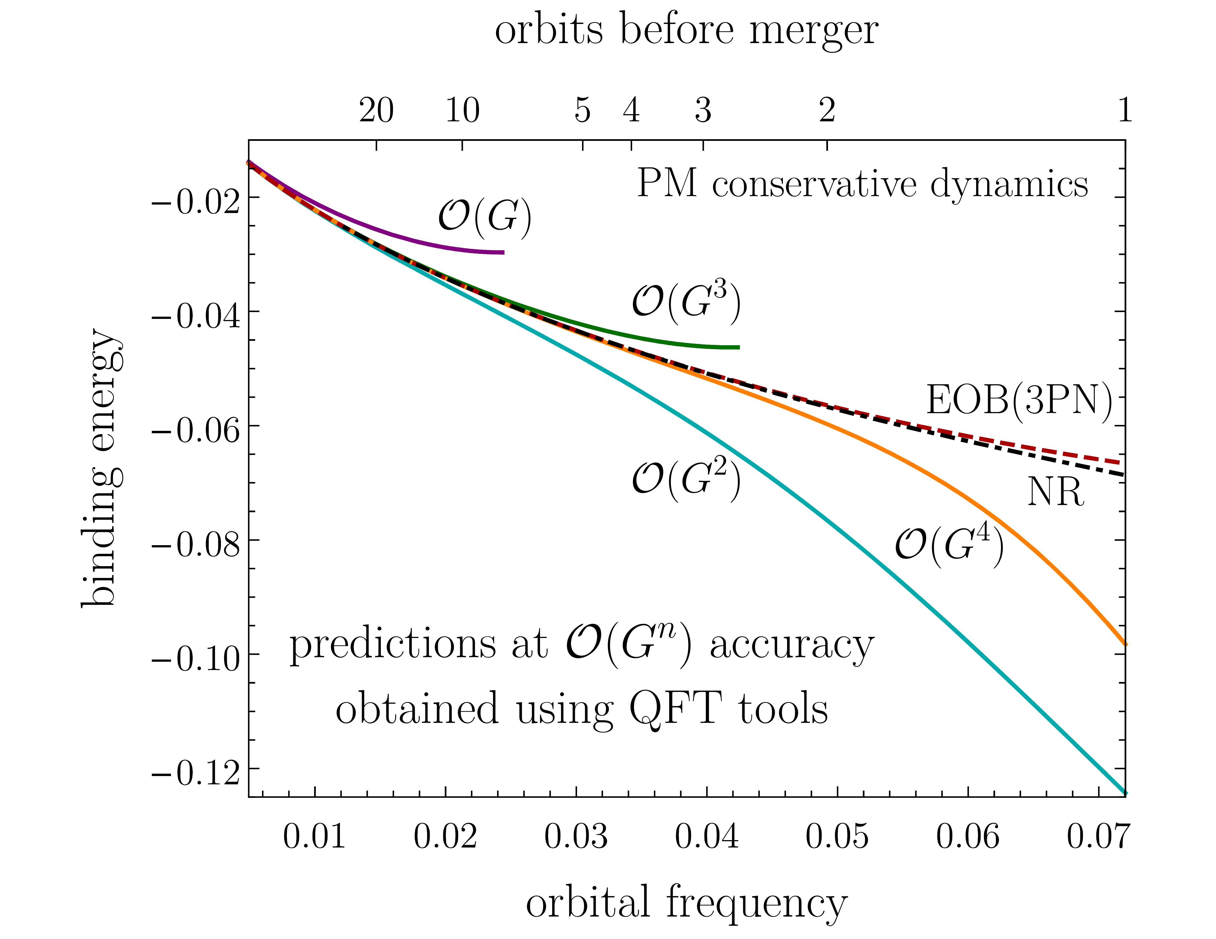
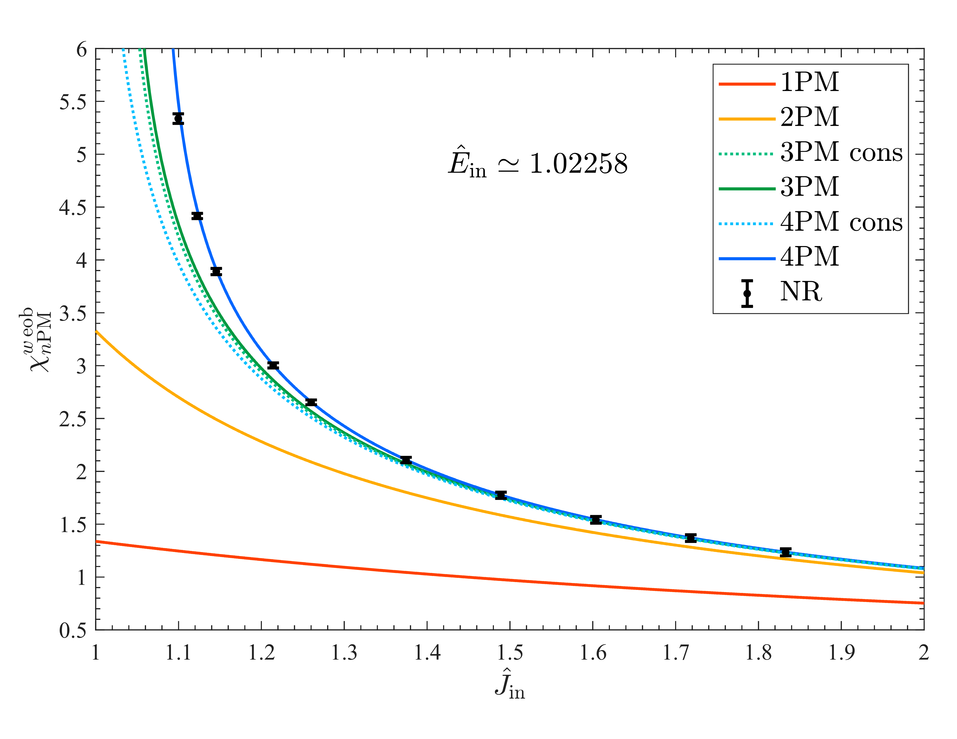
Towards Application
Binding Energy
Buonanno, Khalil, O’Connell, Roiban, Solon, Zeng
Combine perturbative results with Effective-One-Body Hamiltonian
Damour, Rettegno

Slide 41
Set-up
Scatter two ‘things’
If they’re both massive, look at point particles

Slide 42
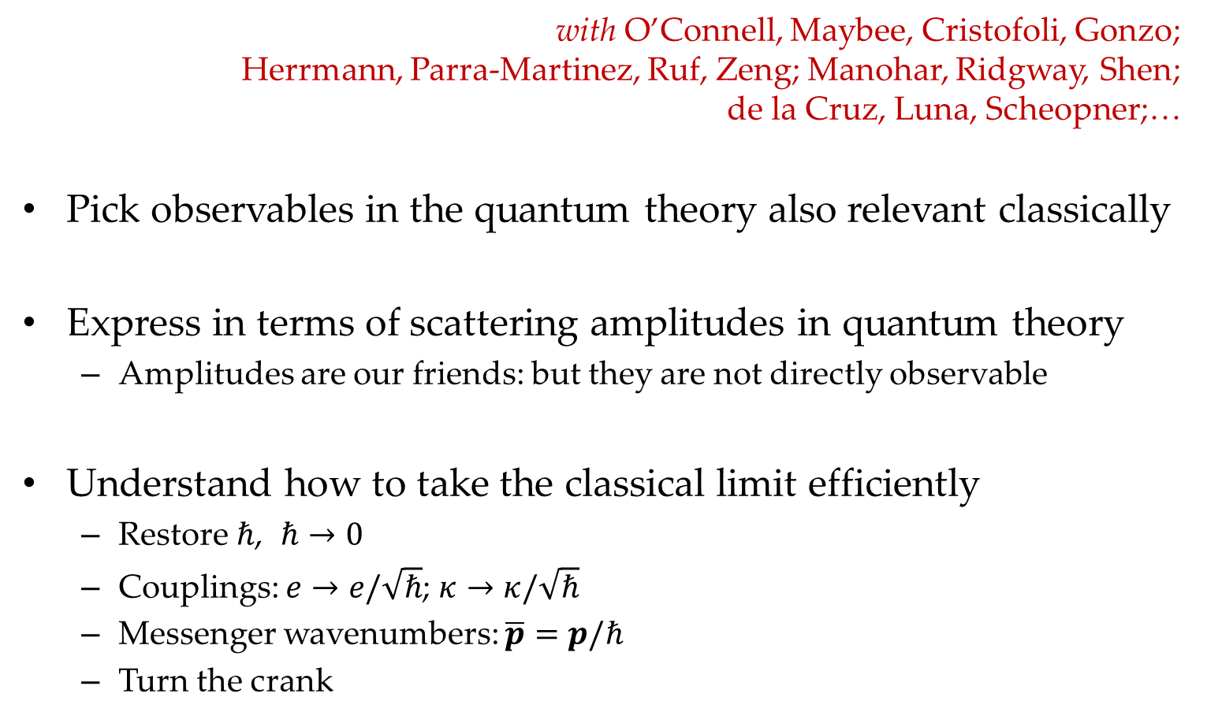
KMOC Formalism
with O’Connell, Maybee, Cristofoli, Gonzo; Herrmann, Parra-Martinez, Ruf, Zeng; Manohar, Ridgway, Shen; de la Cruz, Luna, Scheopner;…
Pick observables in the quantum theory also relevant classically
Express in terms of scattering amplitudes in quantum theory
Amplitudes are our friends: but they are not directly observable
Understand how to take the classical limit efficiently
Restore $ℏ$, $ℏ→0$
Couplings: $e→e/\sqrt{ℏ}$; $κ→κ/\sqrt{ℏ}$
Messenger wavenumbers: $\overline{p}=p/ℏ$
Turn the crank

Slide 43
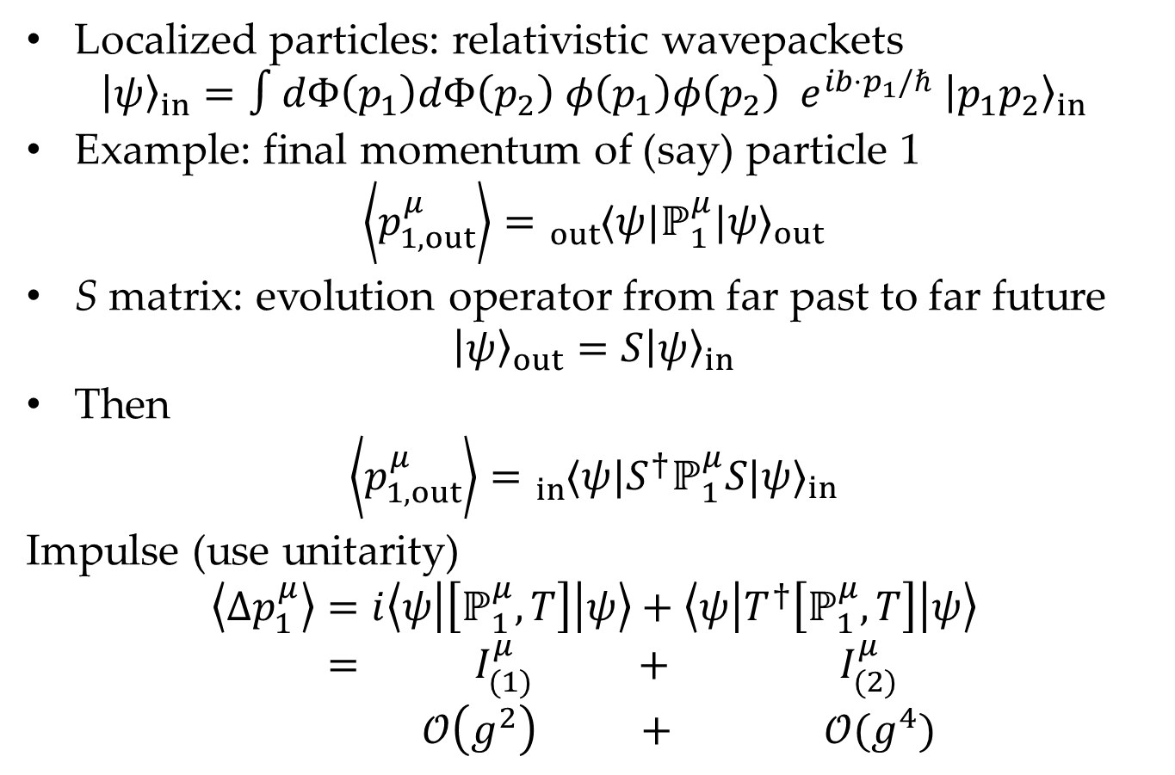
Build Observables
Localized particles: relativistic wavepackets
$${\left|ψ\right\rangle }_{in}=∫dΦ\left(p_{1}\right)dΦ\left(p_{2}\right) φ\left(p_{1}\right)φ\left(p_{2}\right) e^{ib⋅p_{1}/ℏ} {\left|p_{1}p_{2}\right\rangle }_{in}$$
Example: final momentum of (say) particle 1
$$\left\langle p_{1,out}^{μ}\right\rangle ={}_{out}^{}{⟨ψ|}ℙ_{1}^{μ}{|ψ⟩}_{out}$$
S matrix: evolution operator from far past to far future
$${\left|ψ\right\rangle }_{out}=S{\left|ψ\right\rangle }_{in}$$
Then
$$\left\langle p_{1,out}^{μ}\right\rangle ={}_{in}^{}{⟨ψ|S^{†}}ℙ_{1}^{μ}S{|ψ⟩}_{in}$$
Impulse (use unitarity)
$$\left\langle Δp_{1}^{μ}\right\rangle =i\left\langle ψ\left|\left[ℙ_{1}^{μ}, T\right]\right|ψ\right\rangle +\left\langle ψ\left|T^{†}\left[ℙ_{1}^{μ}, T\right]\right|ψ\right\rangle$$
$$= I_{(1)}^{μ} + I_{(2)}^{μ}$$
$$𝒪\left(g^{2}\right) + 𝒪(g^{4})$$

Slide 44

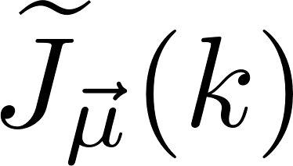
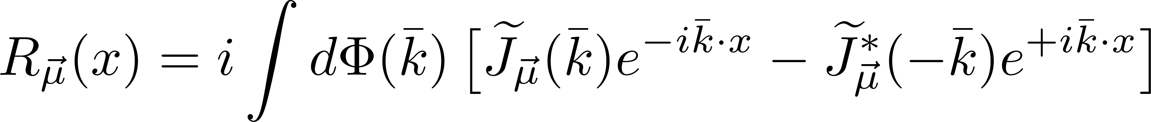
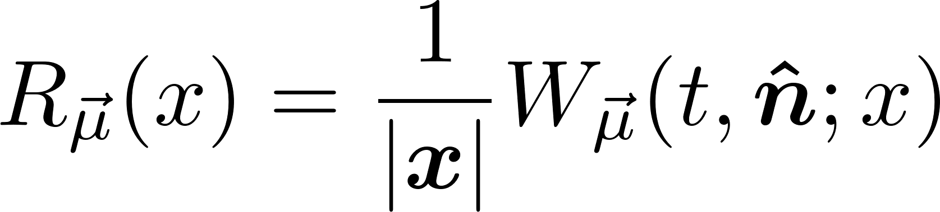
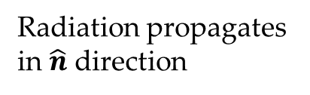
Point-Like Observables
Local radiation observable
Waveform is leading large-distance behavior
Radiation propagates in $\hat{n}$ direction
Scattering region

Slide 45
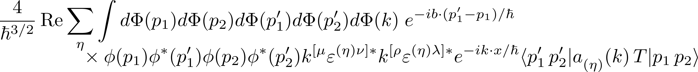

Example: LO Waveform
Write using $S$ matrix & rewrite $S$ matrix
All-orders
At LO, only the first term contributes
The matrix element is a five-point amplitude

Slide 46
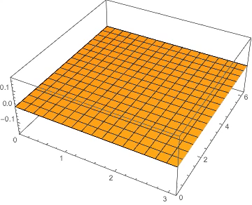

At leading order (courtesy of Radu Roiban)
based on Kovacs, Thorne; Jakobsen, Mogull, Plefka, Steinhoff; Herderschee, Roiban, Teng

Slide 47


Slide 48
Summary: Quantum Scattering Amplitudes
Powerful framework and computational technology for both quantum and classical observables at experimental frontiers
Virtuous circle of improvement:
new ideas ⇒ new calculations ⇒ new observations ⇒ new ideas …
New conceptual approach to quantum field theory as well
谢谢

Slide 49
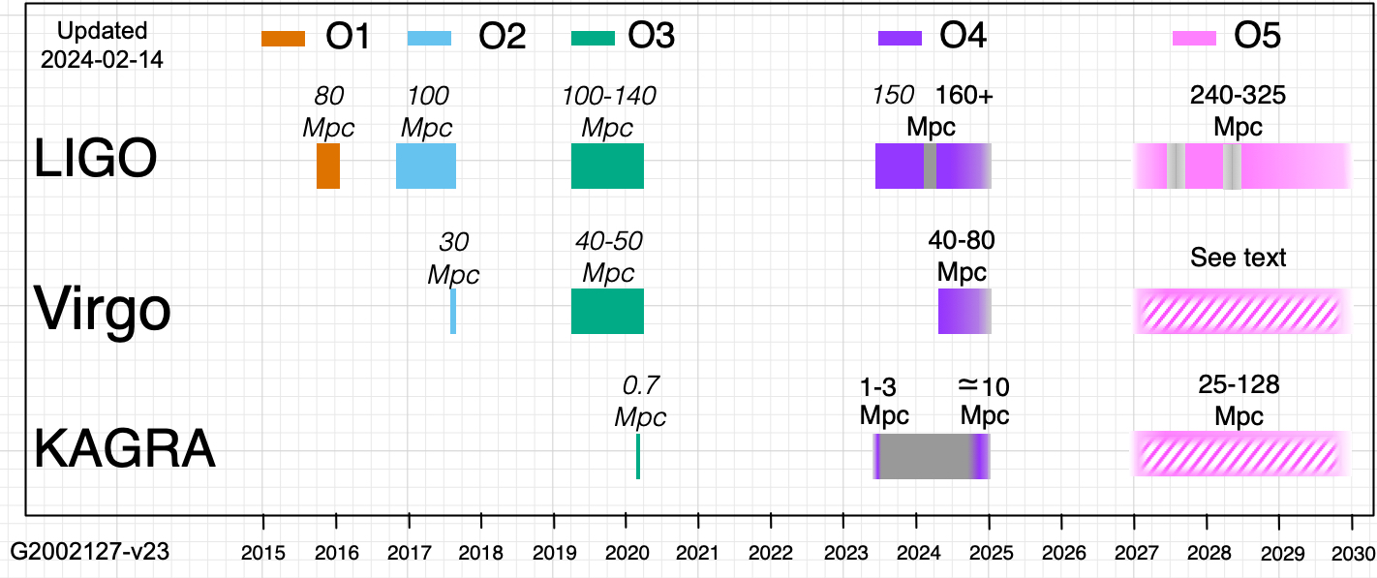
Future Terrestrial GWOs
There’s still life in LVK

Slide 50
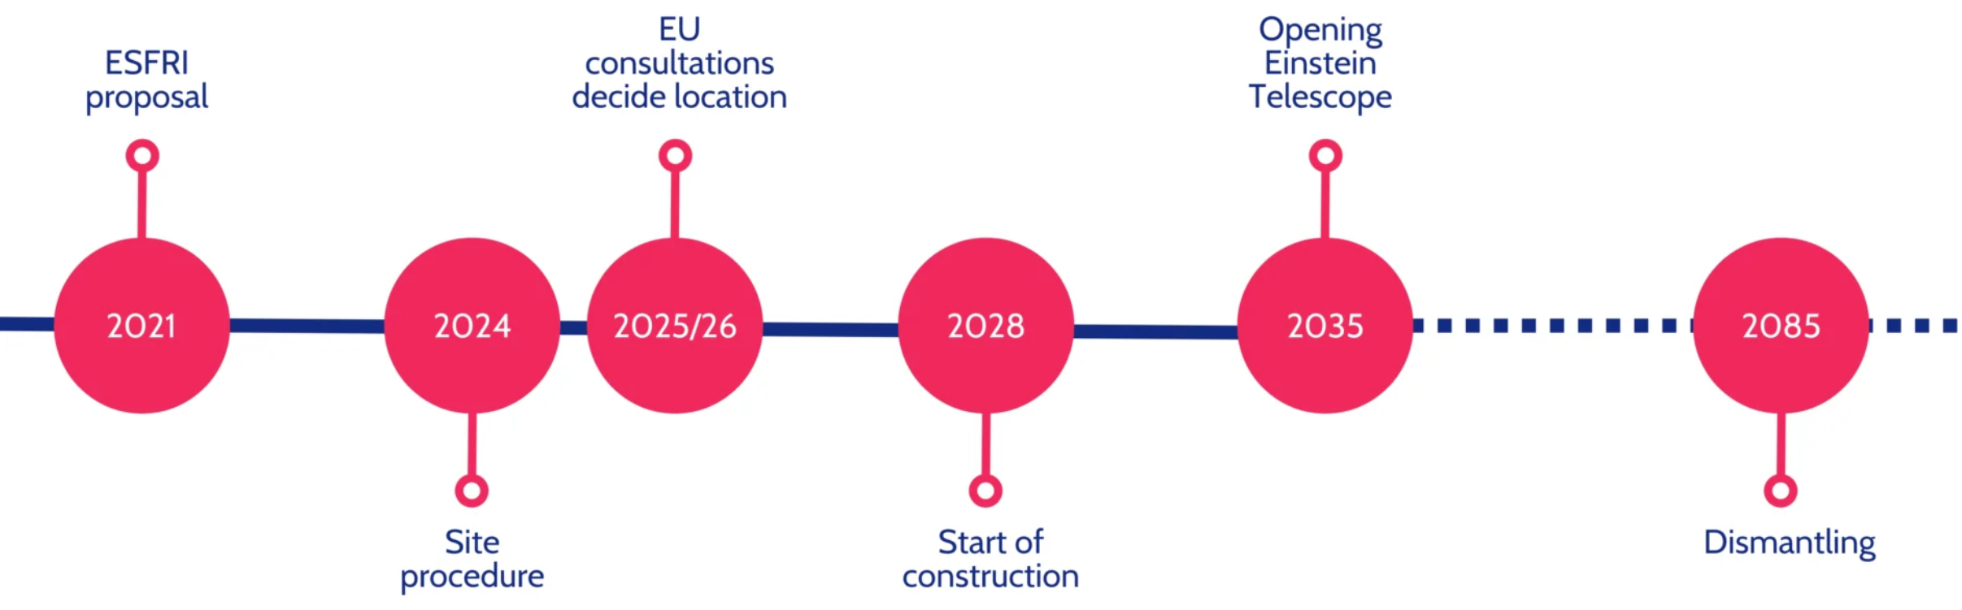
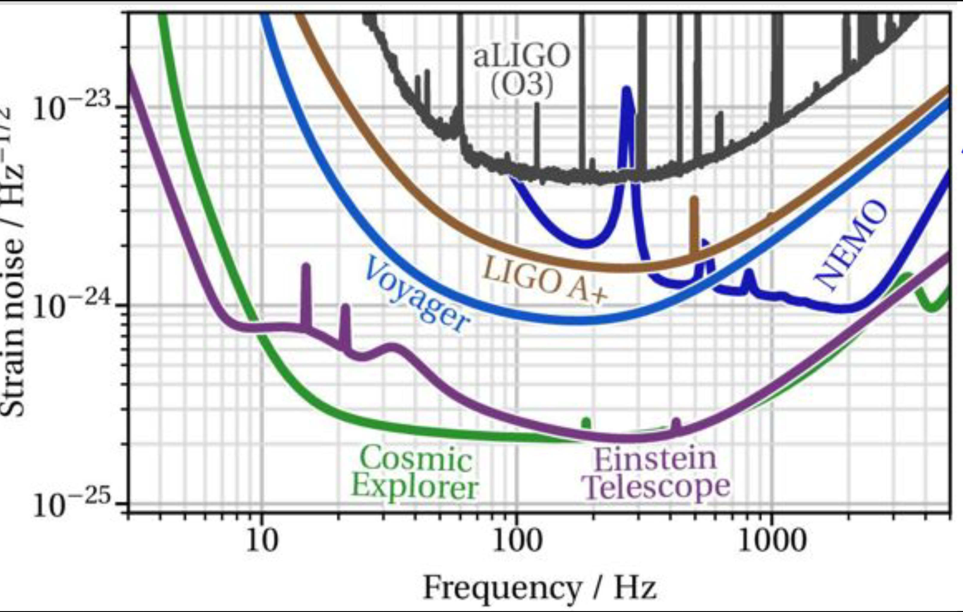
Future Terrestrial GWOs
Einstein Telescope (Europe)
300 m underground triangular 10-km on the Dutch-German border
or 300 m underground L in Sardinia + X
Cosmic Explorer (US)
Two L sites, one with 40 km arms, one 20 km arms
Barsotti

Slide 51
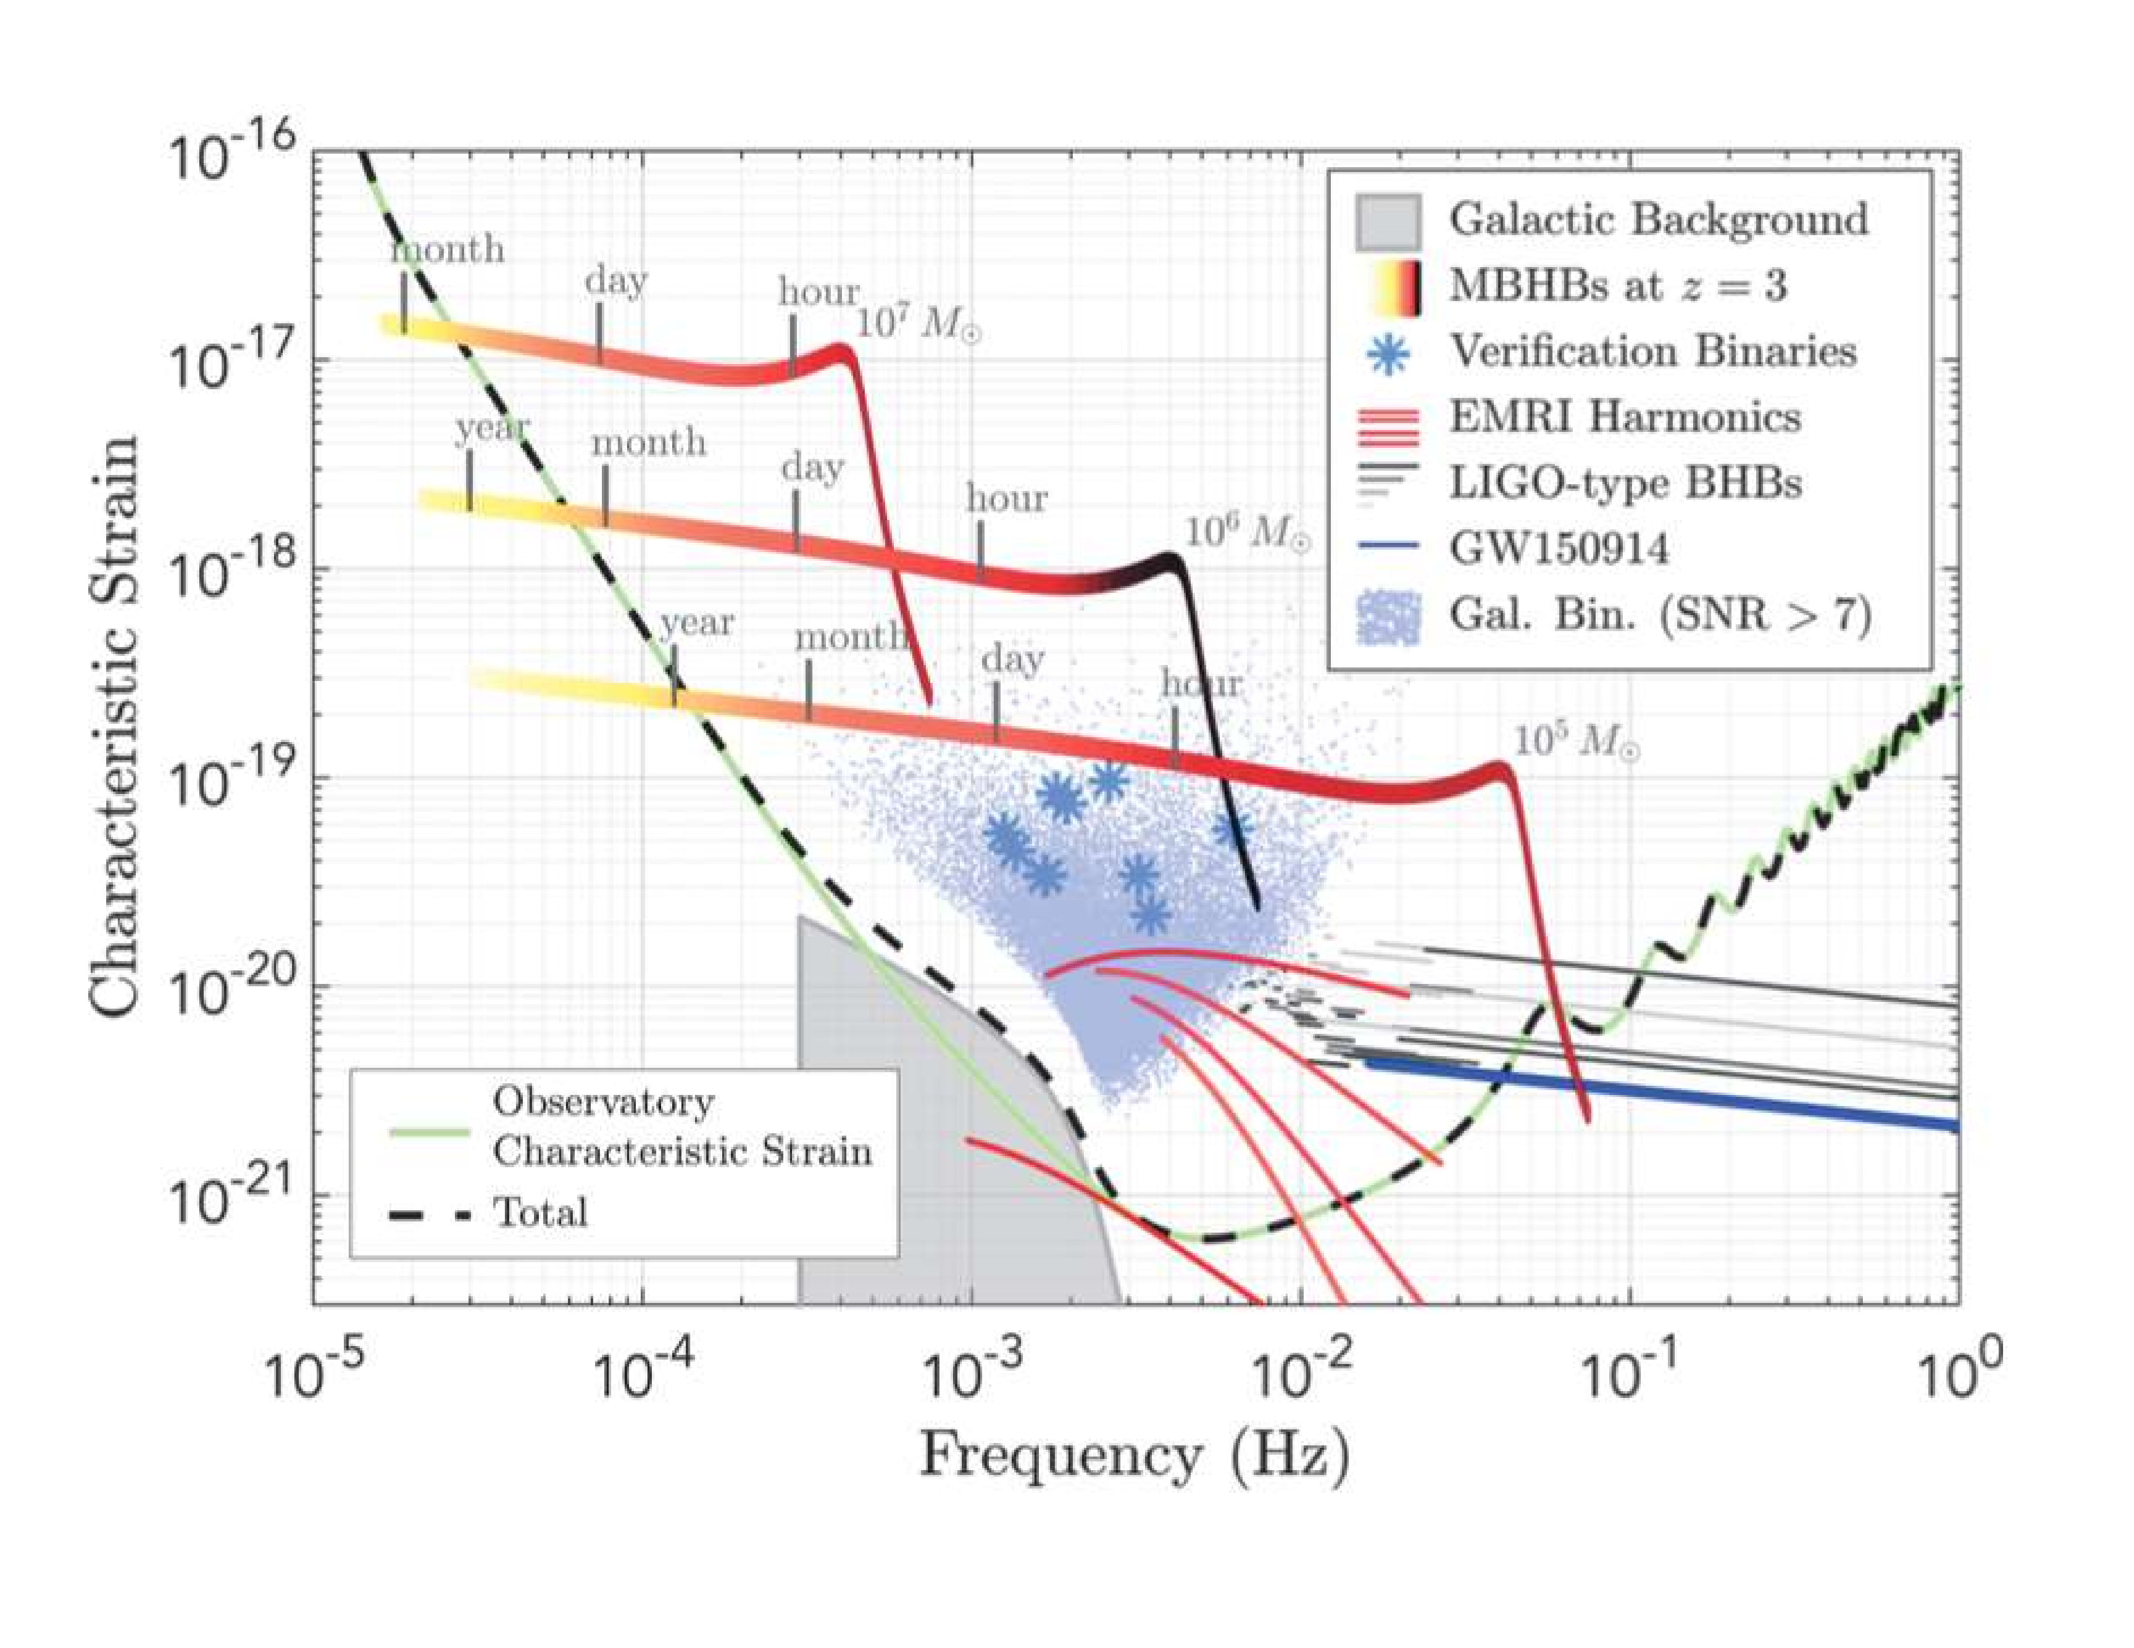
LISA
From LISA L3 Mission proposal (via Robson–Cornish–Liu [1803.01944])

