Slide 1
Time-stamping photons with sub-nanosecond resolution for quantum imaging and telescopy
7.7.2025 IHEP Beijing seminar
Andrei Nomerotski
Florida International U & Czech Technical U

Slide 2
Types of fast Imaging
“normal” cameras: 0.1 ms → 10 μs
Burst mode cameras: 1 μs → 10 ns
Data-driven cameras: 10 → 0.01 nsec
Streak cameras: 1 psec
Repetitive “pump/probe cameras” : fsec
10⁻⁴ sec
10⁻⁶ sec
10⁻⁹ sec
10⁻¹² sec
10⁻¹⁴ sec

Slide 3
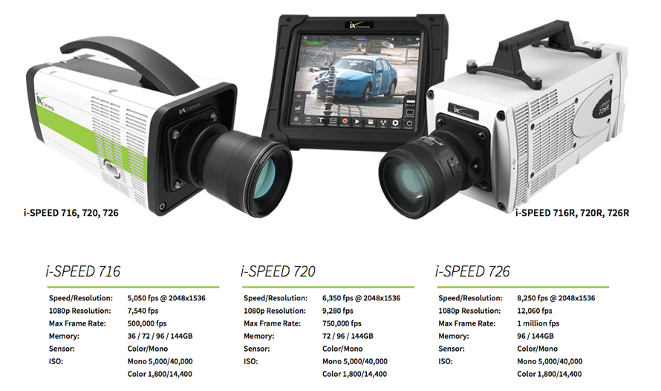
Modern CMOS Imagers
Ever increasing complexity and data rate
One example (ix-cameras.com)
2048x1536: 8 kfps → 26 Gpix/sec
BUT: Not fast enough! 100000 nsec → 1 nsec

Slide 4
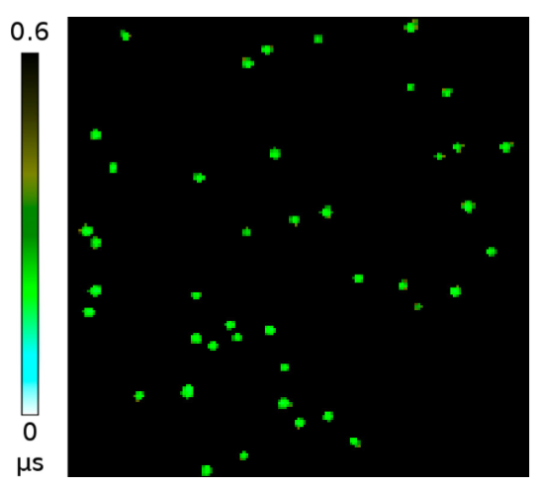
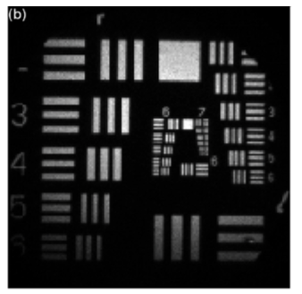
Imaging with photon counting
Photons appear as standalone objects ←→ data driven readout
Has parallels with x-ray imaging and particle detection
Low occupancy
Integrated image

Slide 5
Timepix Optical Cameras

Slide 6
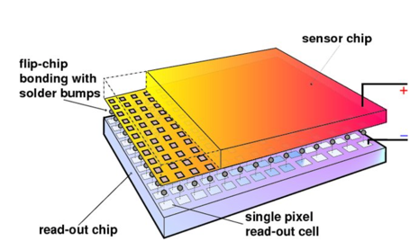
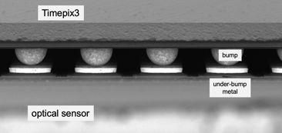
Hybrid pixel detectors
Have roots in R&D for LEP/LHC vertex detectors
credit: IZM
Lukas Tlustos and Erik H. M. Heijne, Performance and limitations of high granularity single photon processing X-ray imaging detectors, in CERN proceedings (2005)
Decouple readout chip and sensor
optimize technologies for chip and sensor separately
Use different sensors with same readout, versatile approach for x-rays (Si, CZT)
→ we will use OPTICAL sensors

Slide 7
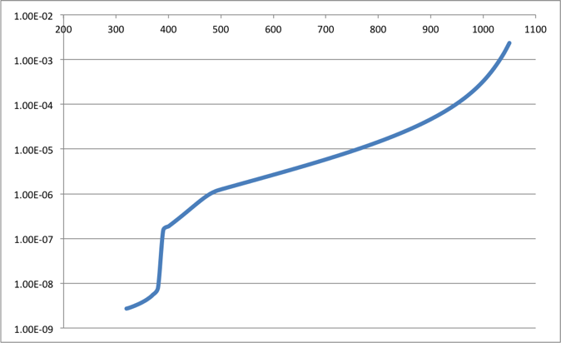
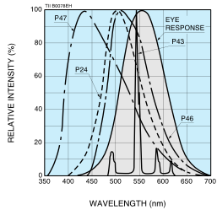
Photon absorption in silicon
Blue photons are absorbed near the surface (~0.25 um for 430 nm, P47 max emission)
Longer wavelengths penetrate deeper (~1 um for 500 nm, ~10 um for 800 nm)
l, nm
d, m

Slide 8
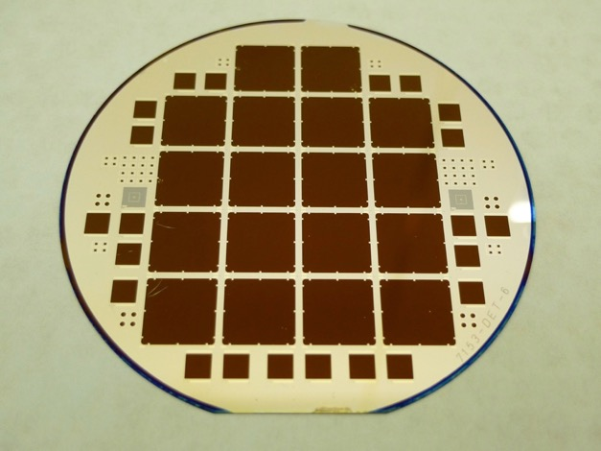
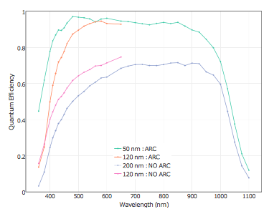
Thin window optical sensors
High QE
M. Fisher-Levine, A. Nomerotski, Timepixcam: a fast optical imager with time-stamping,
Journal of Instrumentation 11 (03) (2016) C03016.
Backside illuminated optical sensors
Anti-reflective coating, thickness 300 um
Nomerotski et al, Characterization of TimepixCam, a fast imager for the time- stamping of optical photons,
Journal of Instrumentation 12 (01) (2017) C01017.
Developed at BNL, first produced at CNM (Barcelona) in 2015
Surface preparation is very important, inspired by astronomical CCDs (LSST)

Slide 9
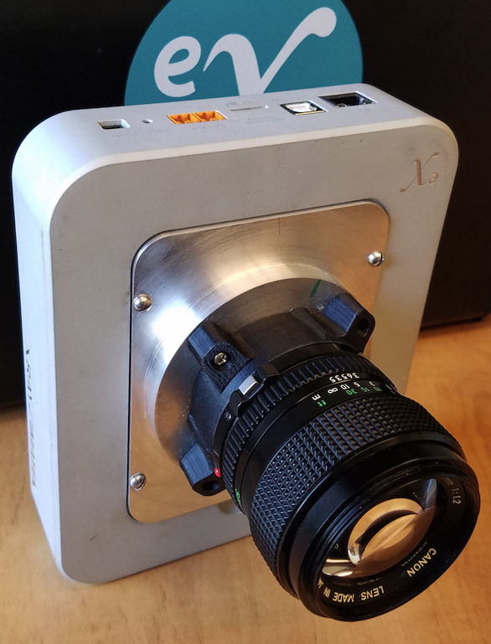
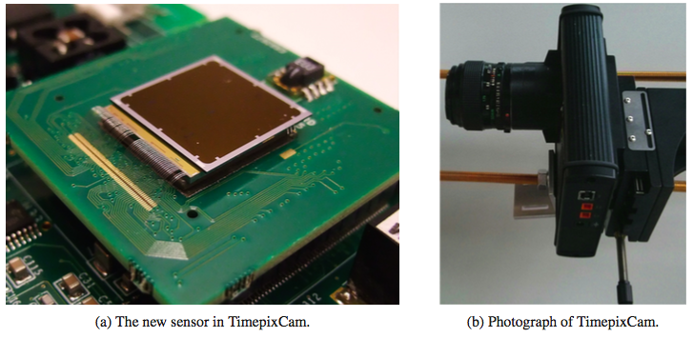
TimepixCam

Slide 10
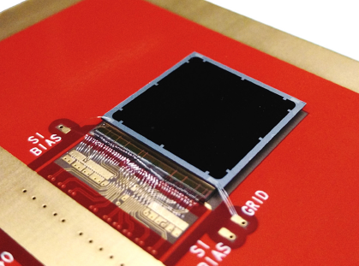
Timepix3 Camera → Tpx3Cam
Camera = sensor + ASIC + readout
Timepix3 ASIC:
256 x 256 array, 55 x 55 micron pixel
14 mm x 14 mm active area
1.56 ns timing resolution
Data-driven readout, 600 e min threshold, 80 Mpix/sec, no deadtime
each pixel measures time and flux, ~1μs pixel deadtime when hit
T. Poikela et al, Timepix3: a 65k channel hybrid pixel readout chip with simultaneous ToA/ToT and sparse readout,
Journal of Instrumentation 9 (05) (2014) C05013.
Sensor is bump-bonded to chip
Use existing x-ray readouts:
SPIDR (Nikhef & ASI)
www.amscins.com
Zhao et al, Coincidence velocity map imaging using Tpx3Cam, a time stamping optical camera with 1.5 ns timing resolution,
Review of Scientific Instruments 88 (11) (2017) 113104.

Slide 11
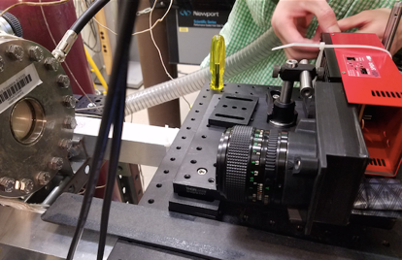
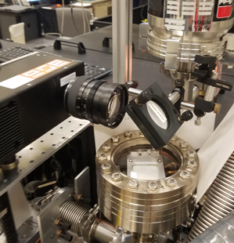
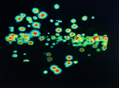
Advantages of optical approach
Outside of vacuum
Decoupled from setup
No cooling in vacuum
No HV close to electronics
Power of optics
lens & mirrors
magnification/ demagnification, flexible mapping between scintillator screen and sensor
“Hybrid” approach
Use same camera for different applications
Easily upgradable: different cameras with same setup
Use different photocathodes/ intensifiers with same camera

Slide 12
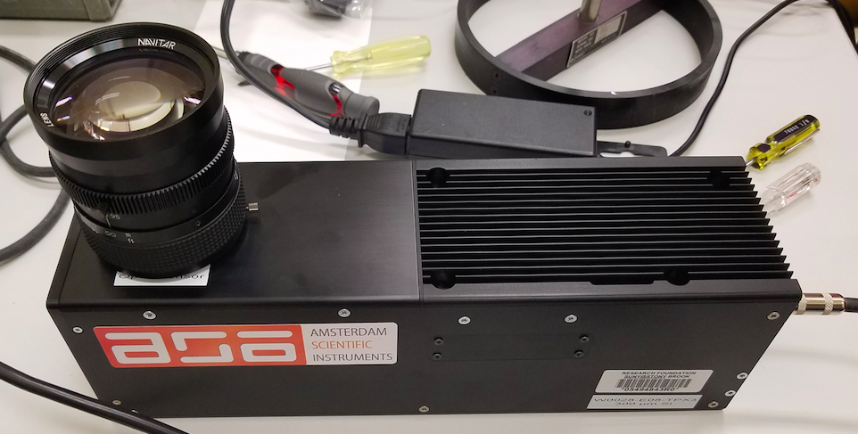
Use existing readouts of x-ray detectors:
TPX3Cam @ ASI
SPIDR readout for Timepix3 (Nikhef, ASI)
J. Visser et al, SPIDR: a readout system for Medipix3 and Timepix3, Journal of Instrumentation 10 (12) (2015) C12028.

Slide 13
Applications & Results

Slide 14
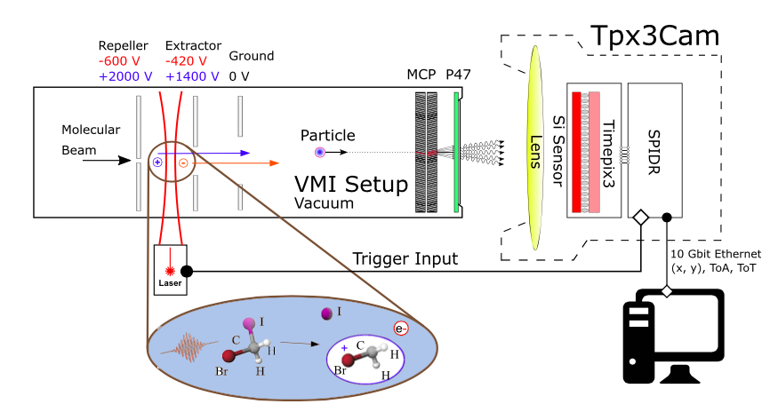
Ion Imaging
Google Scholar 134 citations

Slide 15
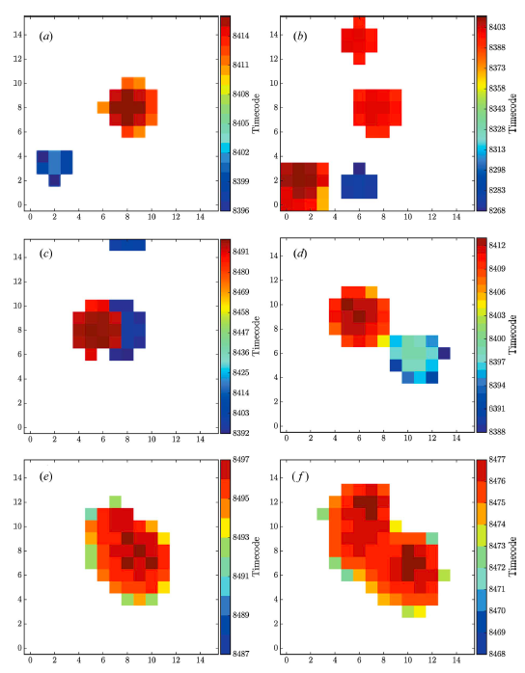
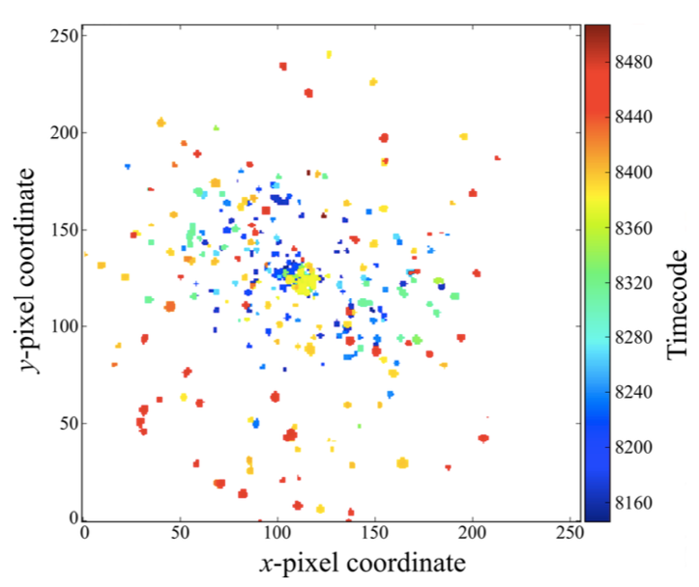
Ions in TimepixCam

Slide 16
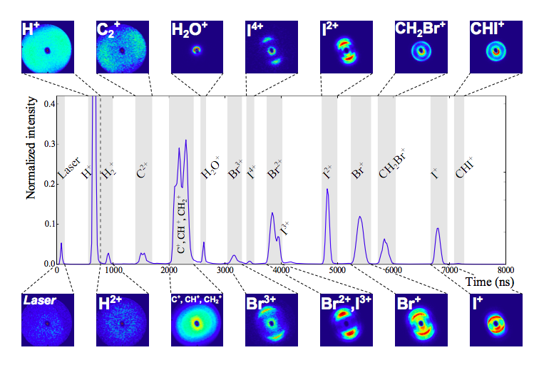
FLASH data, paper submitted to Journal of Synchrotron Radiation

Slide 17
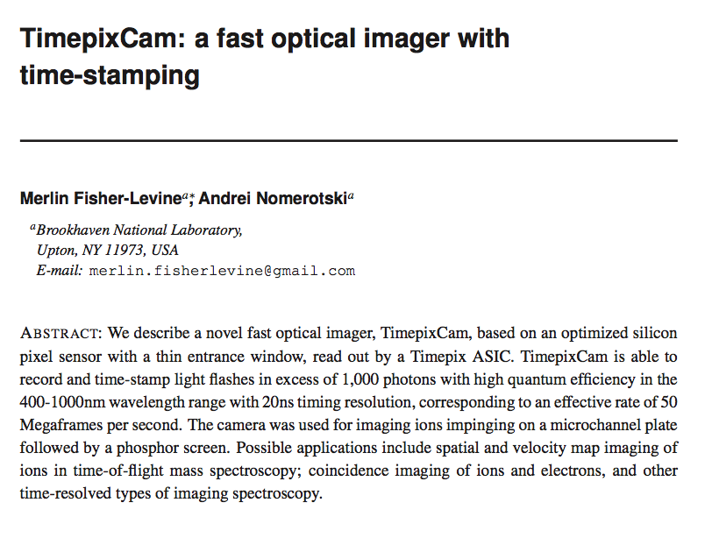
TimepixCam
First results were presented at IWORID in June 2015, paper published in 2016

Slide 18
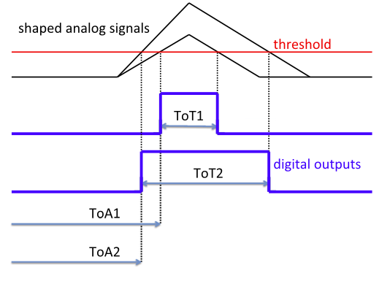
ToT vs ToF: timewalk

Slide 19
Single (optical) photons

Slide 20
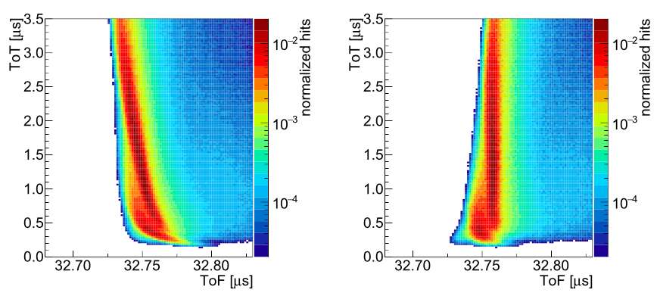
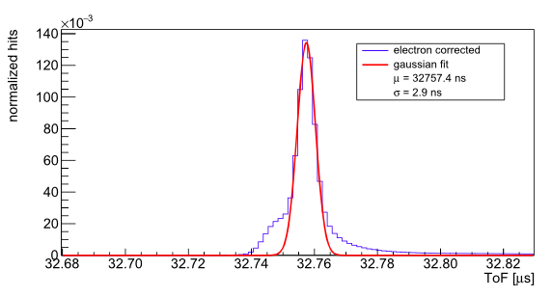
Correction of time walk
before TOT correction
after TOT correction

Slide 21
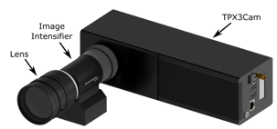
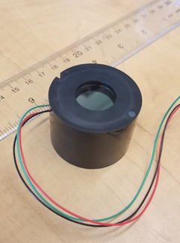
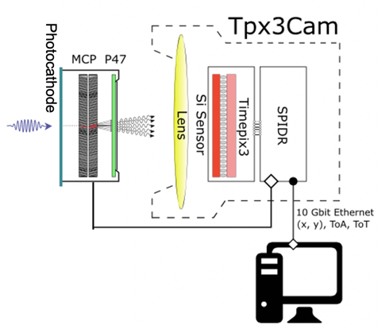
Intensified camera: use off-the-shelf image intensifier
Image intensifier (Photonis PP0360EG)
Cricket@
Intensifier
Intensified cameras are common:
iCCD
iCMOS cameras

Slide 22
Photocathodes
Can choose any wavelength!
GaAs
Photonis photocathodes

Slide 23
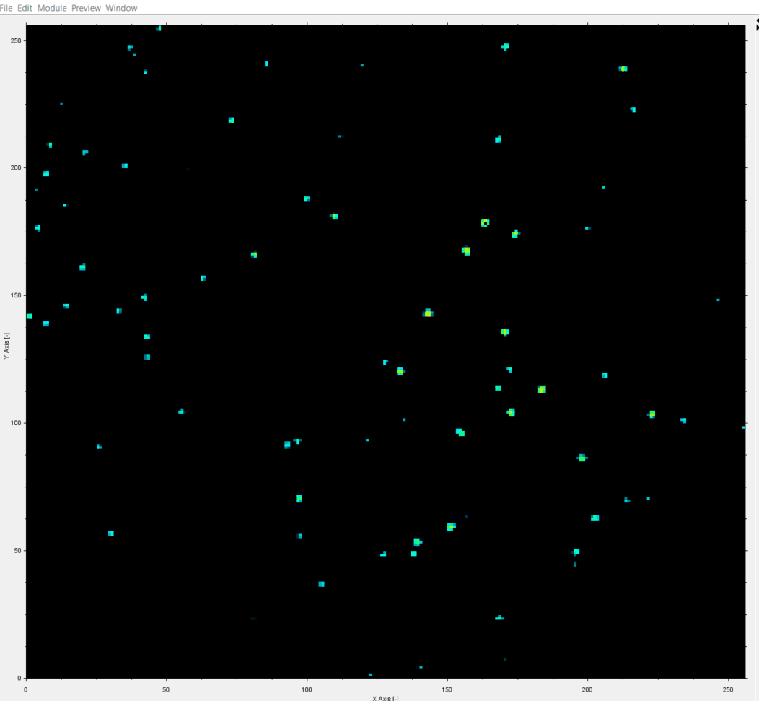
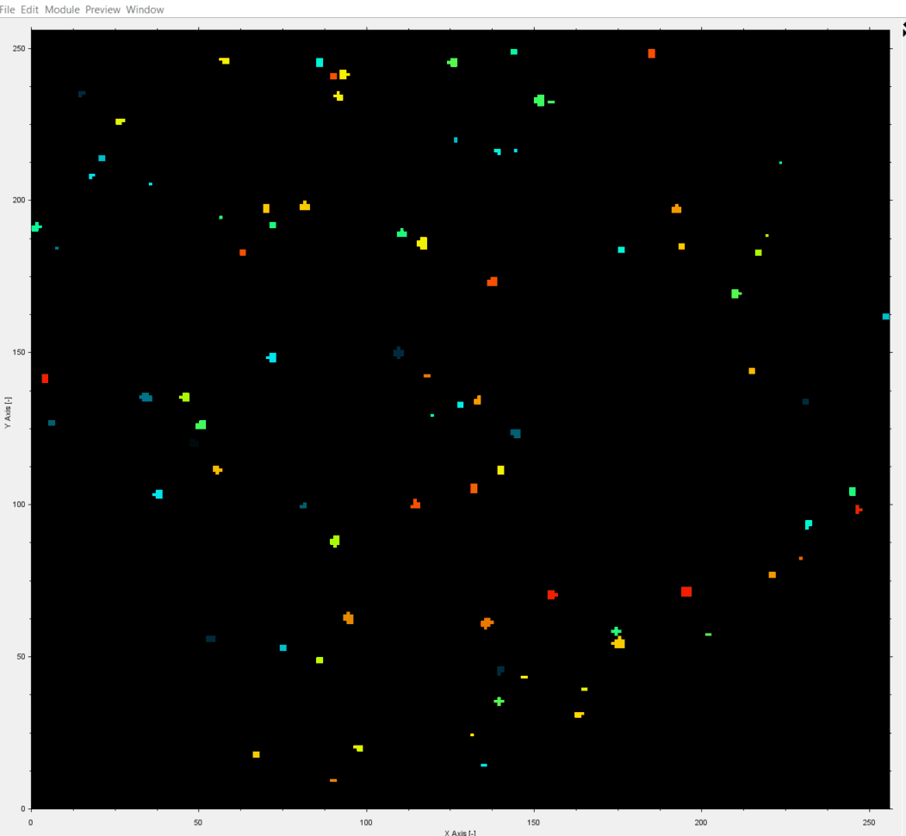
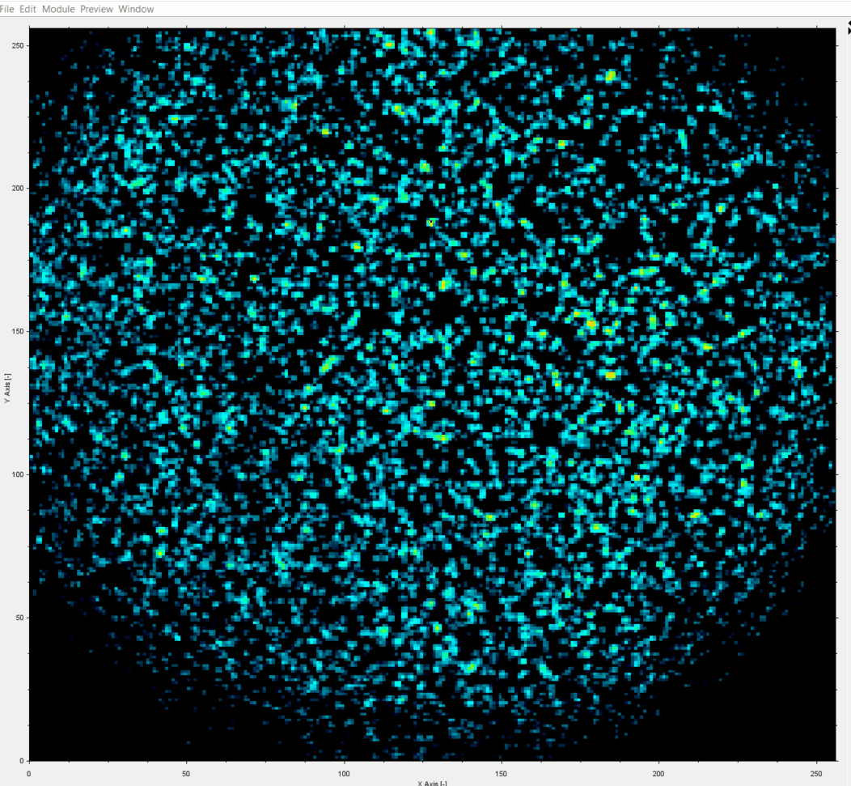
Single Photons in Tpx3Cam
1 ms slice of data
1.5ns time-stamping
TOT
TOA
Tpx3Cam + intensifier by Photonis
data taken by J. Long (ASI)
TOT

Slide 24
TOA
TOT
Each photon is a cluster of pixels
3D (x,y,t) centoiding
Spatial resolution: 0.1 pixel / photon
Time resolution: < 1 ns / photon

Slide 25
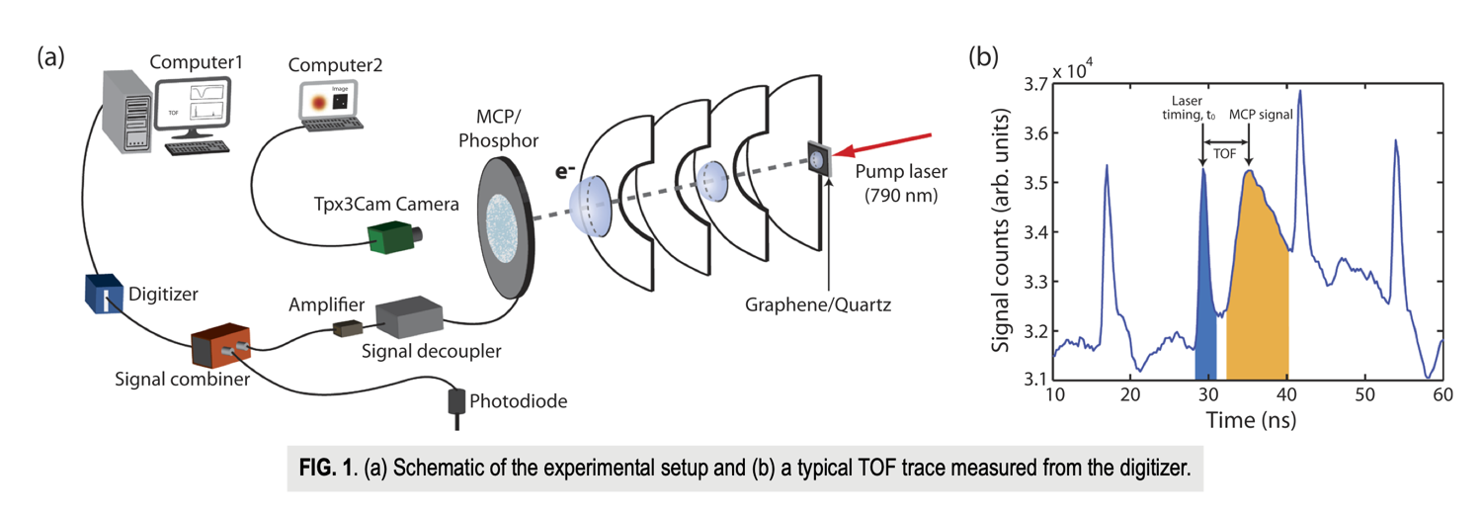
Imaging capable of 1 Mhits/s and 30ps timing
Electron spectroscopy at WSU
D.Debrah , G.Stewart, G.Basnayake, A.Nomerotski , P.Svihra , S.K.Lee, and Wen Li Developing a camera-based 3D momentum imaging system capable of 1 Mhits/s Rev. Sci. Instrum. 91, 023316 (2020)
32 ps timing resolution from MCP+digitizer
0.7 ns deadtime
Imaging of electrons with 1Mhit/sec rate: Tpx3Cam
Improved from few kHz rate

Slide 26
Other applications
HEP: TPC optical readout
Neutron imaging
X-ray imaging
Lifetime imaging

Slide 27
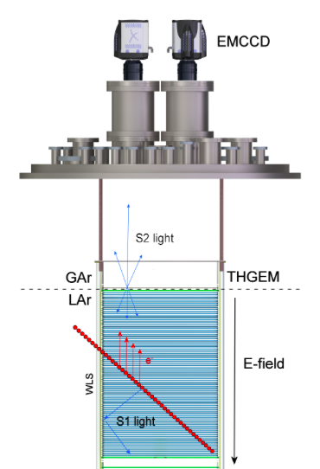
Optical readout for LAr TPC
Image light from avalanches in gas phase
hep.ph.liv.ac.uk/ariadne/index.html
Kostas Mavrokoridis, Adam Roberts et al
Tpx3Cam can measure drift time
→ converts 2D to 3D

Slide 28
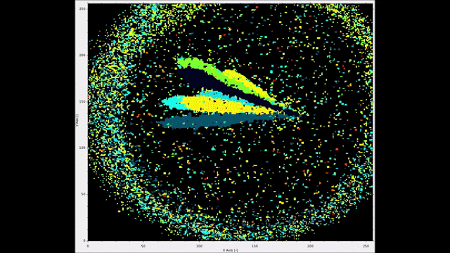
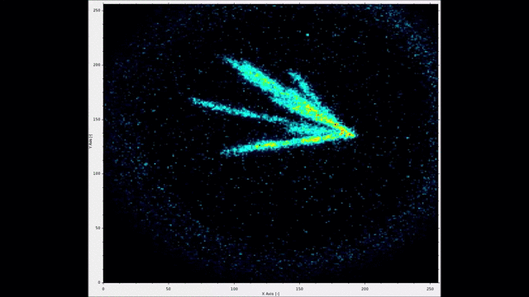
5.5 MeV alphas in CF₄ gas
Using Tpx3Cam in Oct 2018
Color = TOA
Color = TOT
First demonstration of 3D optical readout of a TPC using a single photon sensitive Timepix3 based camera, A Roberts, P Svihra,
A Al-Refaie, H Graafsma, J Küpper, K Majumdar, A.Nomerotski ….
Journal of Instrumentation 14 (06), P06001

Slide 29
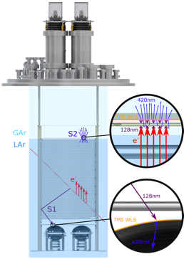
TPX3Cam on ARIADNE 1-ton dual phase Liquid argon TPC
LAr Cosmic Muons (10msec slice)
Image light from avalanches in gas phase in THGEM
hep.ph.liv.ac.uk/ariadne/index.html
Kostas Mavrokoridis et al
D. Hollywood et al, 2020 ARIADNE—A novel optical LArTPC: technical design report and initial characterisation using a secondary beam from the CERN PS and cosmic muons JINST 15 P03003
A. Roberts et al., 2019 First demonstration of 3D optical readout of a TPC using a single photon sensitive Timepix3 based camera JINST 14 P06001

Slide 30
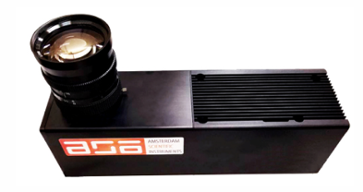
More ideas
Scintillator flashes are imaged by intensified Tpx3Cam
Alphas, hard x–rays, neutrons, …
Thin fast scintillator
Difficulty: light collection efficiency (but it’s single photon sensitive)
Advantage: outside of the beam, around the corner (with mirrors)

Slide 31
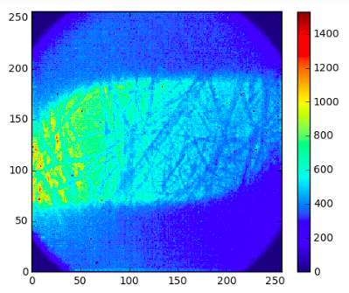
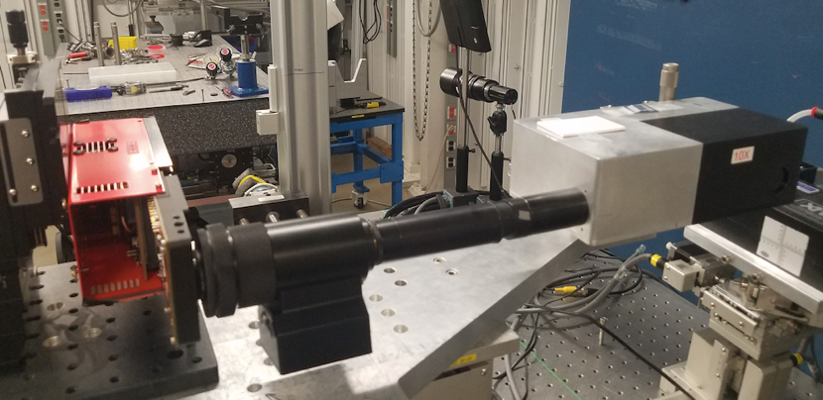
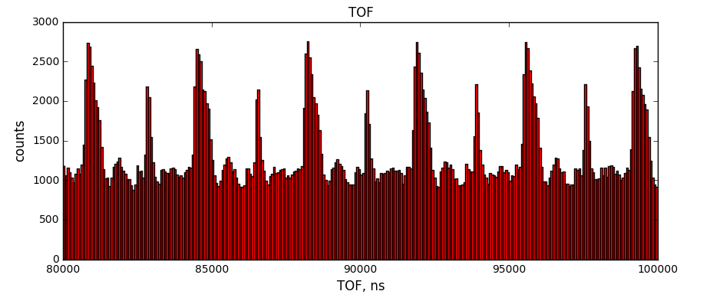
Optical detection of x-rays
25 keV x-rays converted to light in thin LYSO, ASP (Argonne NL), tested in 2019
image of foam target
beam
Intensified Tpx3Cam
Jeph Wang (LANL)
Time-resolved beam structure
Advantage: efficiency to high energy (> 20 keV) x-ray where silicon is inefficient
Difficulty: high rates, MCP saturation and slow recovery

Slide 32
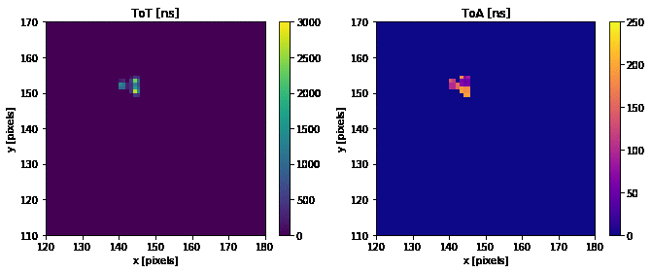
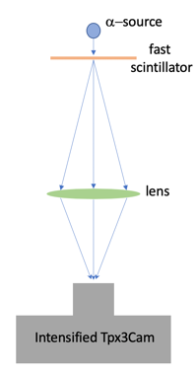
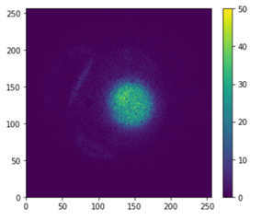
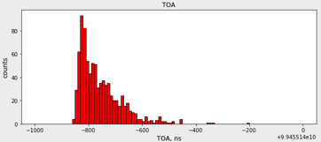
Alphas in LYSO in Tpx3Cam
TOT
TOA
Am241 5.5 MeV alphas
LYSO 0.5 mm thickness
Alpha hits in Tpx3Cam
LYSO decay 40ns
Single alpha hit
Occupancy map
TOA, ns
G. D'Amen et al JINST 16 P02006, Feb 2021

Slide 33
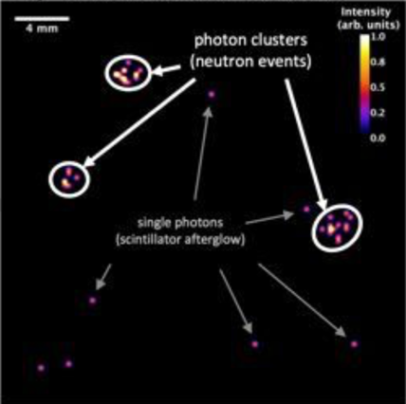
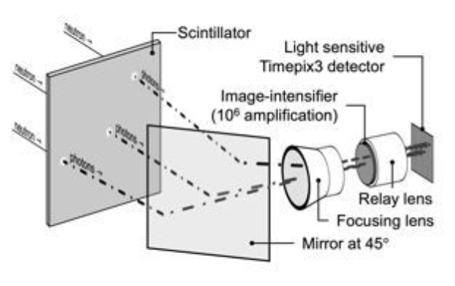
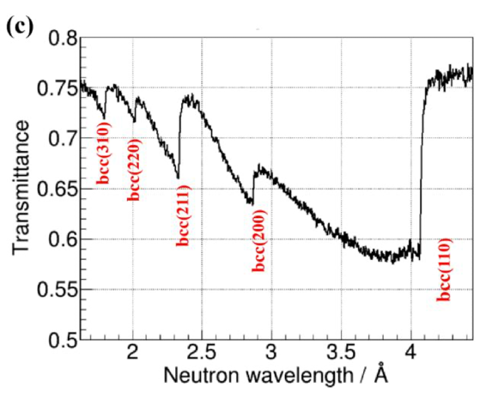
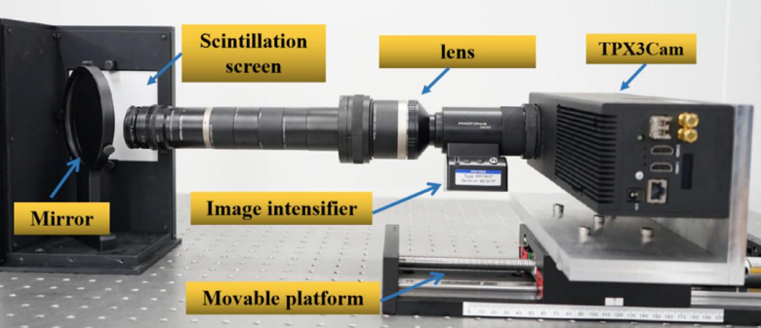
Neutron detection with Tpx3Cam
6Li-based scintillator
Neutrons produce alphas
Time resolved
Tpx3Cam neutron event display
Losko, A. S. et al. New perspectives for neutron imaging through advanced event-mode data acquisition. Sci. Reports 11, 21360, Nov 2021
J.Yang et al, A novel energy resolved neutron imaging detector based on a time stamping optical camera for the CSNS, NIM A, volume 1000, 165222, Apr 2021
Material characterization with Bragg edges

Slide 34
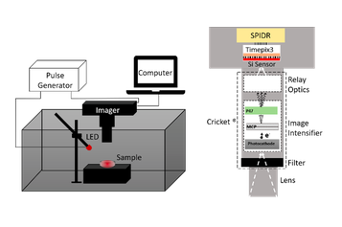
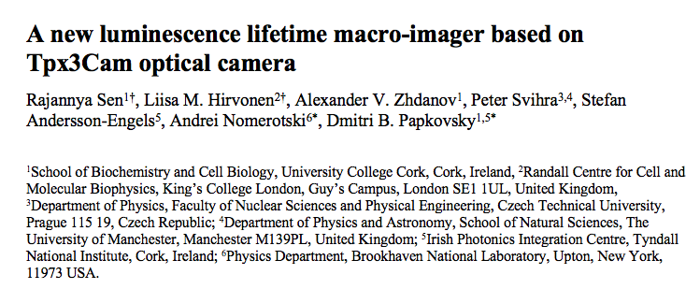
Lifetime imaging with oxygen sensors
Sensor lifetime depends on oxygen concentration → in-vivo monitoring of oxygen in tissues
Biomedical Optics Express 11 (1), 77-88 (2020)

Slide 35
telescopes

Slide 36
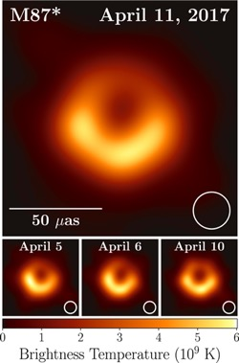
Astronomy picture of the decade
sensitive to features
on angular scale
$∆θ\sim \frac{λ}{b}$
dime at Moon: 5 arcsec
2019 ApJL 875
Black hole in the center of M87 imaged at 1.3mm
Achieved by radio interferometry with ~10000 km baselines

Slide 37
Classical interferometery

Slide 38
Radio
Optical
$$\overset{¯}{n}≫1$$
$$\overset{¯}{n}≪1$$
mode population
mode population
One photon at a time! Need to bring paths to common point in real time
Need path length compensated to better than c/bandwidth
Need path length stabilized to better than $λ$
Can literally record entire waveform, over some band, separately at each receiver station and interfere later offline
Accuracy ~ 1 mas
Max baselines to ~ 100 m

Slide 39
Two-photon techniques

Slide 40
Second photon for quantum assist
Measure photon quantum state at one station → teleport the sky photon to 2nd station
Correlation of counters are sensitive to sky photon phase → direction
Need to transfer the photon quantum state → can use quantum networks, this will allow long distances
Verified experimentally in quantum optics settings: M Brown et al, PRL 131, 210801 (2023)

Slide 41
Quantum Network
Attenuation in fibers → need quantum repeater to reproduce qubits
Simple amplification will not conserve the quantum state
Qubit teleportation: produce entangled photons and send them to two locations
Bell State Measurement (BSM) on one photon will collapse the wave function of the other one (or swap entanglement, or teleport photon)
A.Zeilinger

Slide 42
Hanbury Brown - Twiss effect
If points are close enough two options of photons paths are coherent = photon phases not so different and they interfere
Interference produces photon bunching or HBT effect
visibility = S/B = 46%

Slide 43
Stellar Intensity Interferometry
renewed interest due to progress in fast detectors!

Slide 44
New ideas extending original proposal
Extensions of Stellar Intensity Interferometry bridging to quantum-enhanced ideas
Perfect to start exploring this approach
arxiv.org/abs/2010.09100

Slide 45
Possible impact on astrophysics and cosmology
offers orders of magnitude better astrometry with major impact
Parallax: improved distance ladder - sensitive to Dark Energy
Proper star motions - sensitive to Dark Matter
Microlensing, see shape changes
Black hole accretion disk imaging
Gravitational waves through coherent motions of stars - microHz range
Exoplanets etc
https://arxiv.org/abs/2010.09100

Slide 46
Requirements for detectors
Photons must be indistinguishable so close enough in frequency and time to interfere → temporal & spectral binning : need ~ 10 pm * 10 ps
$$∆t∗∆E≥ℏ/2$$
Fast spectrometers at Heisenberg limit
Fast imaging techniques are the key
Promising technologies: SPADs, SNSPDs
Target 1-100 ps resolution
Spectral binning: diffraction gratings, echelle spectrometers
High photon detection efficiency

Slide 47
Benchtop Verification
SPAD and SNSPD readout
arxiv.org/abs/2301.07042 published in Optics Express

Slide 48
arxiv.org/abs/2301.07042
HBT and HOM Cancellation
HBT and HOM Cancellation

Slide 49
Phase dependence
arxiv.org/abs/2301.07042
Population of HBT peaks as function of phase = phase oscillations

Slide 50
Next step: spectral binning

Slide 51
Spectral binning
Two beams of thermal photons → diffraction grating
Based on intensified Tpx3Cam, ns time resolution
spectral resolution for Ar lines ~0.15 nm
Ar spectrum
A.Nomerotski et al. Intensified Tpx3Cam, a fast data-driven optical camera with nanosecond timing resolution for single photon detection in quantum applications, arxiv.org/abs/2210.13713, published in JINST

Slide 52
Next step: faster spectrometer based on LinoSPAD2
Diffracted photon stripe projected on to linear array
Spectrometer time resolution: 5 ns →100 ps

Slide 53
Possible technologies: SPAD
SPAD = single photon avalanche device Semiconductor device: p-n junction with amplification
LinoSPAD2
512 x 1 pixels
24 x 24 micron pixels
Max PDE (with microlenses) ~ 30%
50 ps resolution
Developed in EPFL (Switzerland)
AQUA group (E.Charbon)
C. Bruschini et al, Linospad2: a 512x1 linear spad camera, in Quantum Sensing and Nano Electronics and Photonics XIX, vol. 12430, pp. 126–135, SPIE, 2023.

Slide 54
SPAD arrays with 50 ps resolution
Two beams from SPDC source
Coincidence of two single photons
time difference, σ=57 ps
arxiv.org/abs/2304.11999

Slide 55
SPAD arrays with 50 ps resolution
time difference, σ=110 ps
visibility = 50%
Two beams from Ar lamp + polarizer after
beamsplitter
HBT peak
arxiv.org/abs/2406.15323
arxiv.org/abs/2406.13959
Next step: HBT in spectral bins for broadband light

Slide 56
Spectrometer with LinoSPAD2
Used Ar lamp coupled to SM fiber
Ar spectral lines
spectral resolution 0.04 nm
arxiv.org/abs/2304.11999
arxiv.org/abs/2304.11999
Achieved 0.04 nm spectral and 40 ps timing resolution
only x10 more than
$$∆t∗∆E≥ℏ/2$$

Slide 57
Colored HBT peaks in LinoSPAD2
dual spectrometer in Prague
HBT peak in two spectral bins
time difference, σ=70 ps
visibility = 3.8%
S.Kulkov, L.Rademacherova
unpublished, work in progress

Slide 58
Colored HBT peaks in LinoSPAD2

Slide 59
telescopes

Slide 60
On-sky measurements
Need to couple to single mode fiber
Need adaptive optics
Both are difficult tasks

Slide 61
Quantum Optics applications
with time stamping of single photons
Some examples how nanosecond scale resolution is used in Quantum Optics

Slide 62
Quantum photon sources -
spontaneous parametric down-conversion (SPDC) sources
Produce two photons correlated (sometimes entangled) in
Time
Position
Energy

Slide 63
Multidimensional Quantum Illumination
In collaboration with NRC (Ottawa) D.England, Y.Zhang et al
dl*dt ~ 5 ns * 0.5 nm
Y Zhang, D England, A Nomerotski, P Svihra et al, Multidimensional quantum-enhanced target detection via spectrotemporal-correlation measurements, Physical Review A 101 (5), 053808
Pump photon wavelength vs time difference
P Svihra et al, Multivariate Discrimination in Quantum Target Detection, Appl. Phys. Lett. 117, 044001 (2020)

Slide 64
Quantum light-field microscope
Ottawa NRC group
Use one photon for position and one photon for angle information
This allows refocussing at arbitrary distance

Slide 65
1- and 2-D ion crystals
Paul trap
RF 18 MHz
Ba ions
50-100 ns micromotion period

Slide 66
Down-conversion of x-rays
NSLS-II @ BNL
first imaging of x-ray cone
record rate of pair detection ~ few Hz
arxiv.org/abs/2310.13078

Slide 67
Detected simultaneously 3 types of correlations: time, spatial & energy
TOT correlation
poor resolution
18 ns resolution due to
variation of conversion depth
Motivation: x-ray detectors with good timing and energy resolutions
Scope: entanglement studies for x-rays

Slide 68
Sensor R&D
Ideas for 2d imaging sensors which can provide 20 ps resolution

Slide 69
by Medipix4 collaboration
X. Llopart

Slide 70
First Tpx4 measurements
Optical sensor + Tpx4, no intensifier
TOF vs TOT
272 ps
Tested with 450 nm laser, pulse width 90 ps
Silicon sensor bias 60 V

Slide 71
First Tpx4 measurements
Single photon sensitive (intensified) optical Tpx4 camera
TOF vs TOT
resolution 827 ps @ 70 V
hi-QE-blue Photonis intensifier
Tested with attenuated 450 nm laser, pulse width 90 ps
Silicon sensor bias 20 - 70 V

Slide 72
Direct detection after MCP in Timepix
External amplification in MCP
Has been implemented before with Timepix3
Limitation: photocathode QE ~ 35%

Slide 73
Hybrid SPADs: 20 ps timing
20 ps timing is needed for next round of CERN experiments in 10 years, there will be lots of investment in fast ASICs
example: Timespot1 chip
32 x 32
50 ps
55 micron pitch
Hybrid detector: SPAD + 20 ps chip
SPAD sensor
ASIC

Slide 74
Main points to take home
Quantum-assisted two-photon interferometry dramatically enhance astrometric precision with great impact on astro science
Requires single photon cameras with 10 ps scale resolution
Broad program in quantum-assisted optical interferometry ahead, efforts underway to develop new timing technologies
This will be useful in many fields including the quantum
Entangled x-rays motivate pixels with ns timing resolution and good energy resolution

Slide 75
“The great advances in science usually result from new tools rather than from new doctrines”
Freeman Dyson (1923-2020)

Slide 76
Acknowledgements
Eden Figueroa
Paul Stankus
Tom Tsang
Justine Haupt
Mael Flament
Guodong Cui
Sonali Gera
Dimitros Katramatos
Michael Keach
Steven Paci
Alex Parsells
Jonathan Schiff
Denis Dolzhenko
Stepan Vintskevich
Anze Slosar
Zhi Chen
Jesse Crawford
Aaron Mueninghoff
Jingming Long
Erik Hogenbirk
Martin van Beuzekom
Bram Bouwens
Erik Maddox
Jord Prangsma
Duncan England
Yingwen Zhang
Boris Blinov
Mila Zhukas
Maverick Millican
Alex Kato
Peter Svihra
Michal Marcisovsky
Sergei Kulkov
Jakub Jirsa
Raphael Abrahao
Brianna Farella
Ryan Mahon
Edoardo Charbon
Tommaso Milanese
Ermanno Bernasconi
Claudio Bruschini
interns

