Slide 1
CEPC Silicon Tracker Detector Module
Xuhao Yuan
2025-07-11

Slide 2
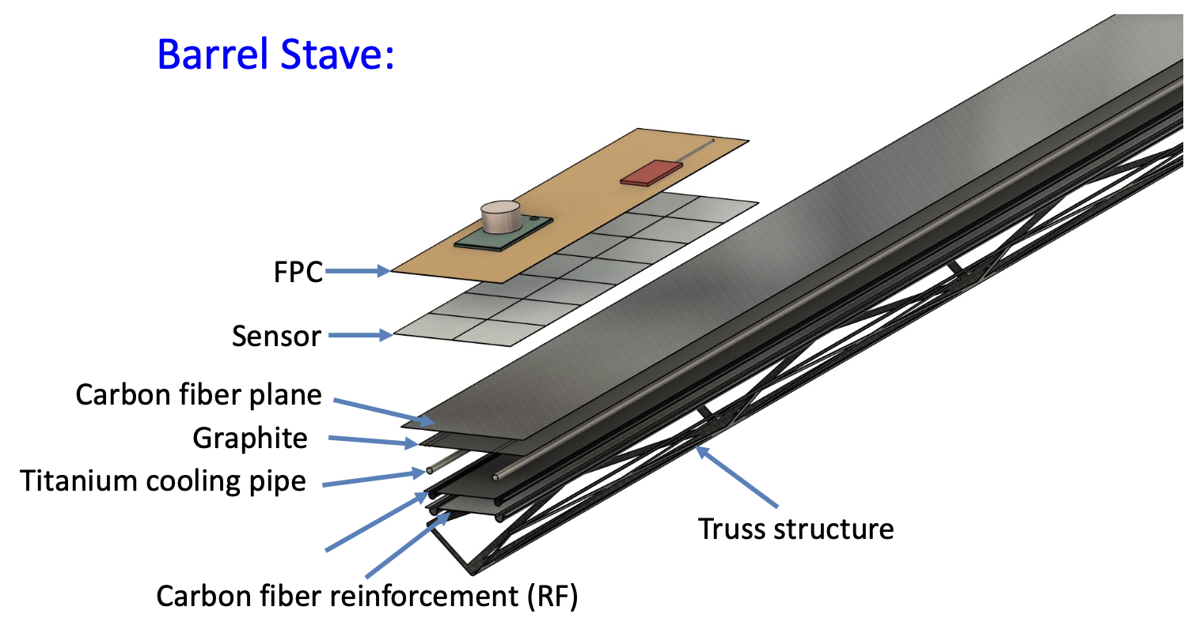
TDR design
Taking ITK Barrel as the example
Overall design
Sensor tiling, spatial constraints (bonds), protection
Geometric coverage, gaps
Stave size, mounting, power/readout paths
Radiation length, including epoxies
Reference datum

Slide 3
Main mechanical & thermal issues
Mechanical
Mechanical simulation of module and stave (with epoxies and realistic interfaces)
Stress concentrators, fracture points, stiffness required in 3D
Stave modal analysis
Radiation length
Prototypes of module & stave
Module level
Sensor packing, protection (sensor, bonds), spatial requirements
Hybrid dimensions, data path, trace routing density
Manipulability, stiffness, handling
Power/grounding, nearby components
Electrical consequence, chemical compatibility of putting materials in contact with silicon chips
How to handle during construction and testing, how to store
Stave level
Structure, core designs, mechanical/thermal interfaces
Module arrangement, placement process, reference datum
Manipulability, required stiffness, handling procedures
Attachment of data flex, power flex
Module replacement scheme
Manufacturable, bondable, testable
Thermal
Cooling requirements
All heat loads (including power dissipation in cables)
$ΔT$ btw CO2 set point and CMOS temperature
$δT$ across CMOS
CMOS operating temperature, dew point
Total cooling power for cooling plant
Prototypes of module & stave -> may be the same one as mechanical
Efficacy of different thermal path designs using different core designs and different interface materials
$ΔT$ and $δT$, with full thermal load
Realistic mockup of power dissipation from distribution
Effect of different number of cooling tubes, tube run
Internal condensation on tube
Thermal contraction in stave at -30℃, establish fracture limit
Thermal simulation of module and stave
$ΔT$ and $δT$, thermal runaway margin
Thermal contraction in stave at -30℃
CTE mismatch stresses on sensors
Internal stresses (on epoxy, thermal/mechanical layers), fracture limit
Optimal location for temperature monitoring

Slide 4
Outline
Stave design & prototype R&D
ITK Module design & prototype R&D

Slide 5
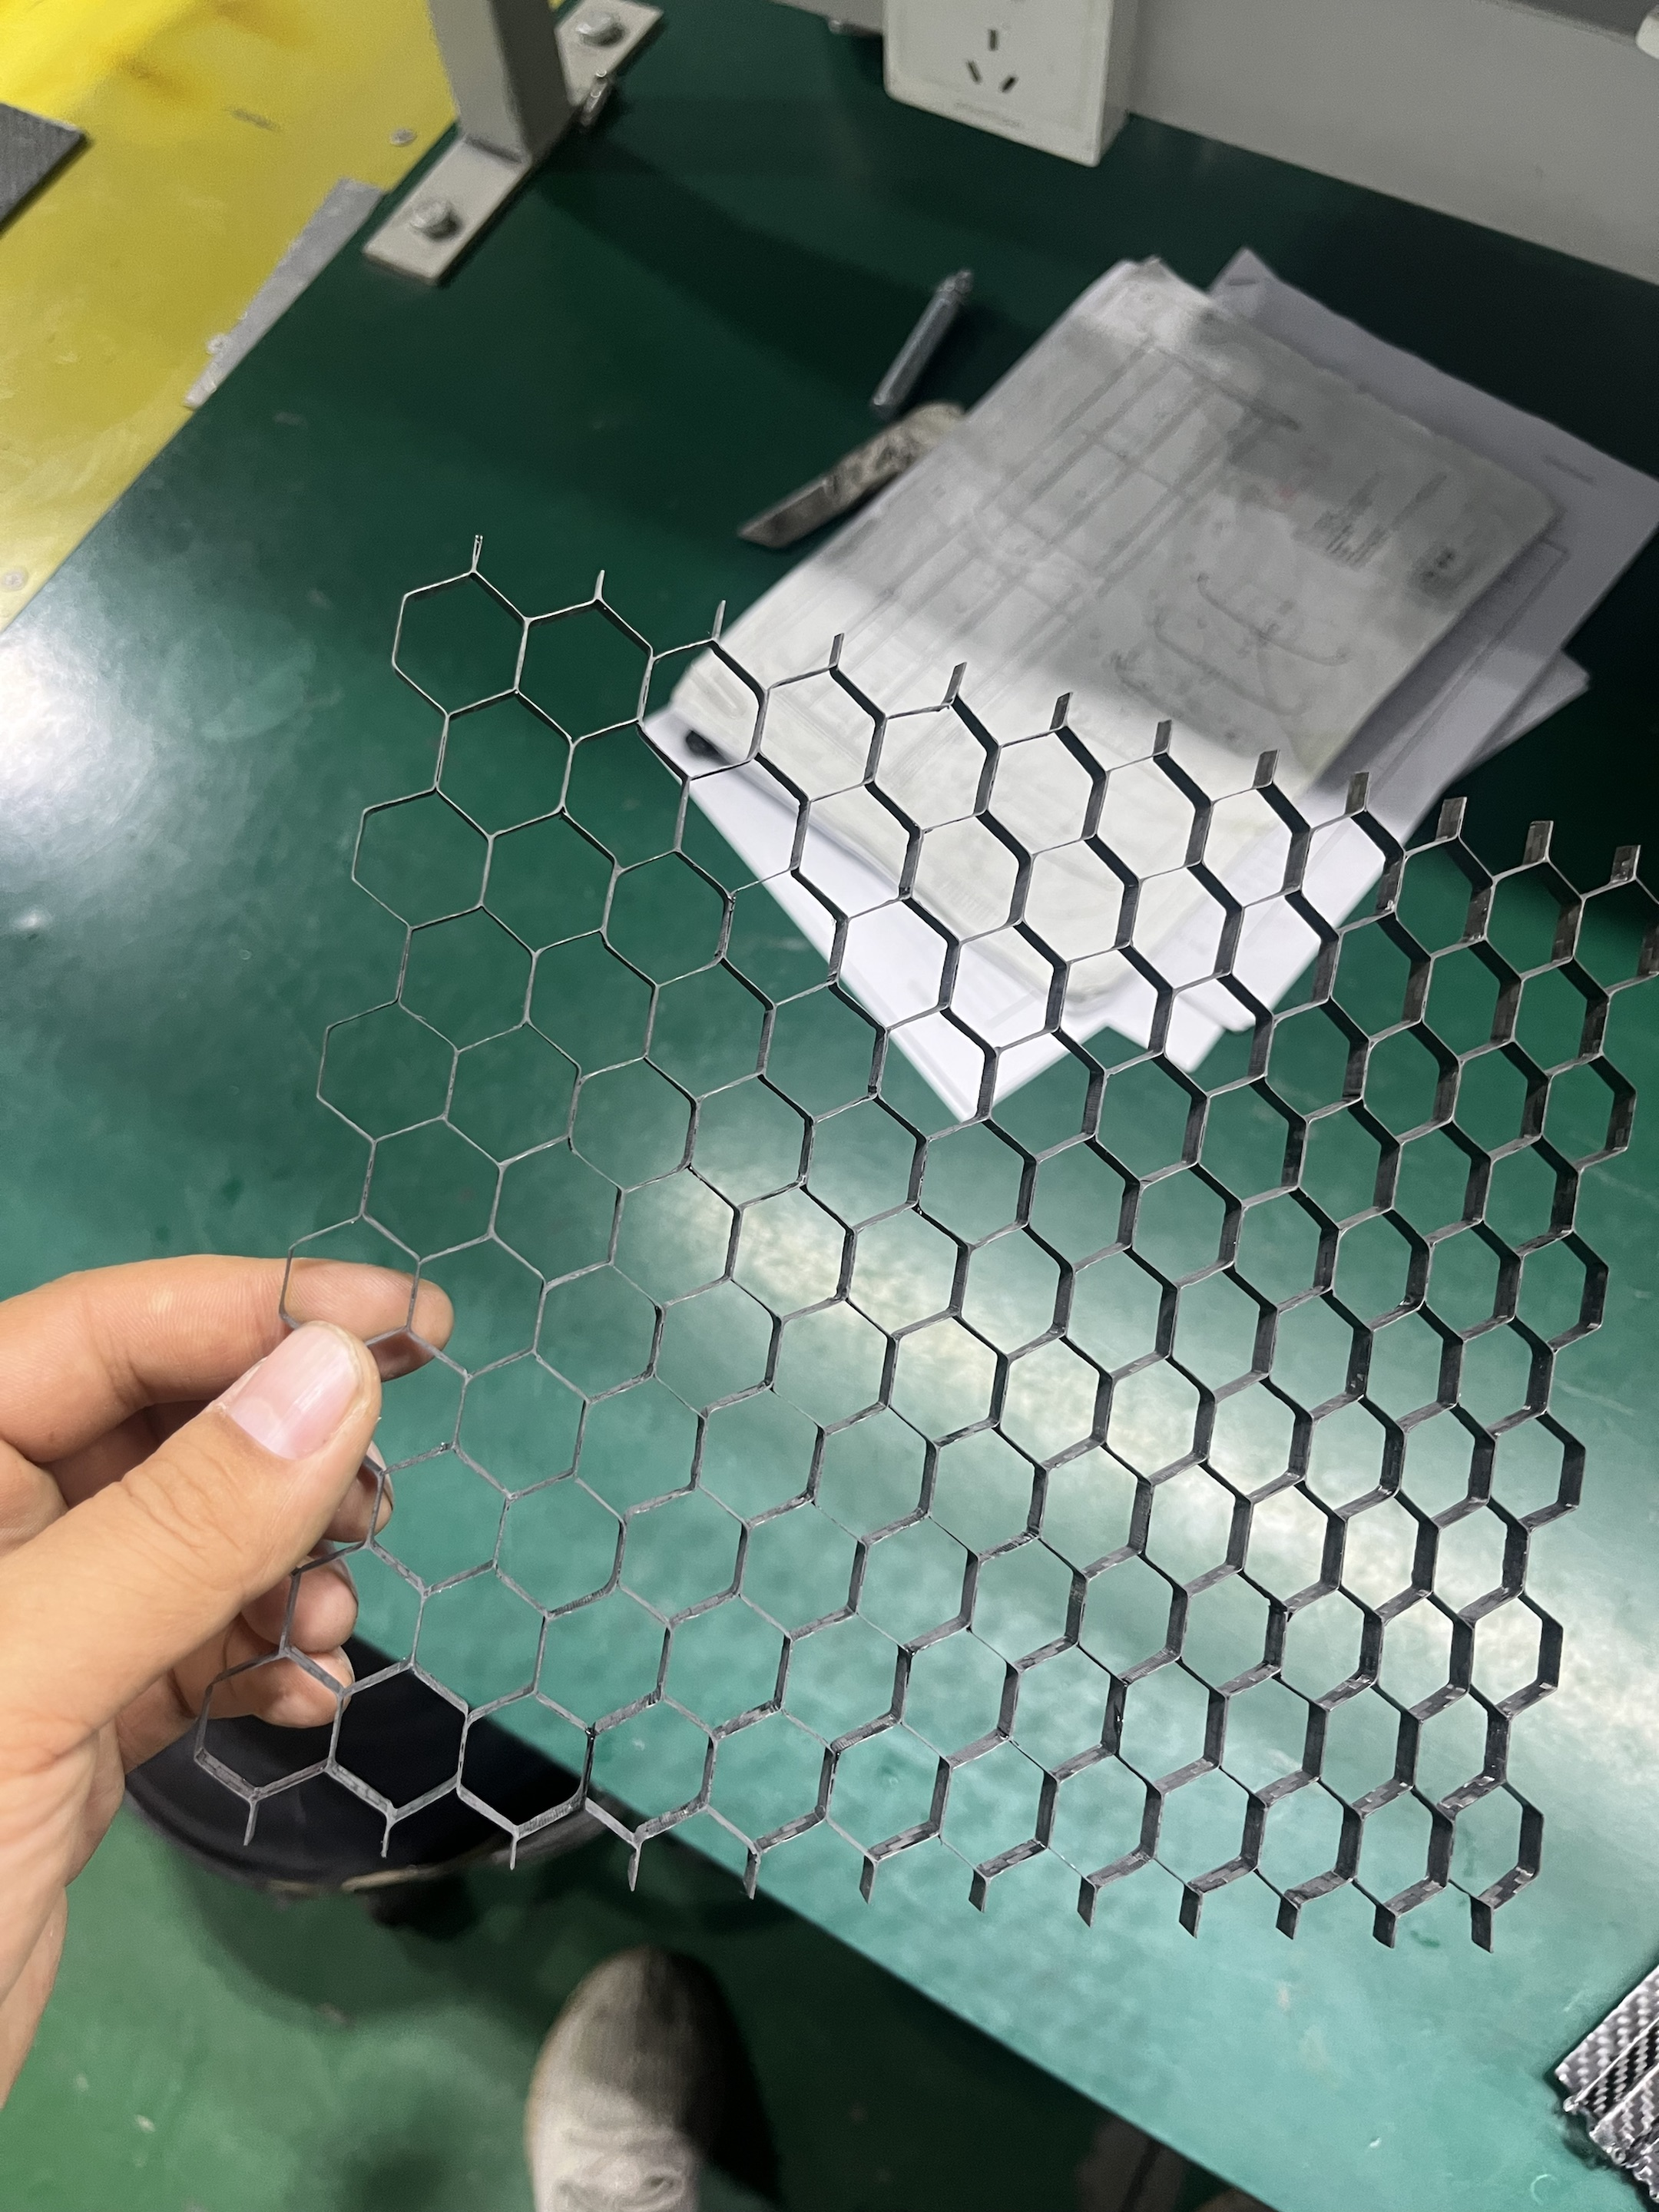
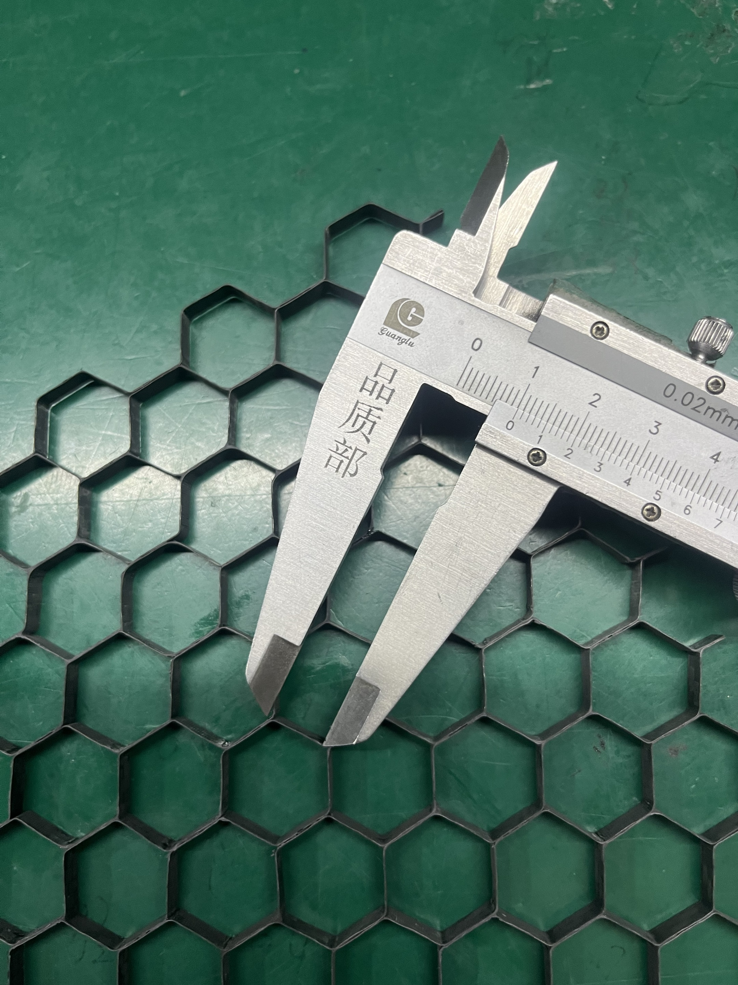
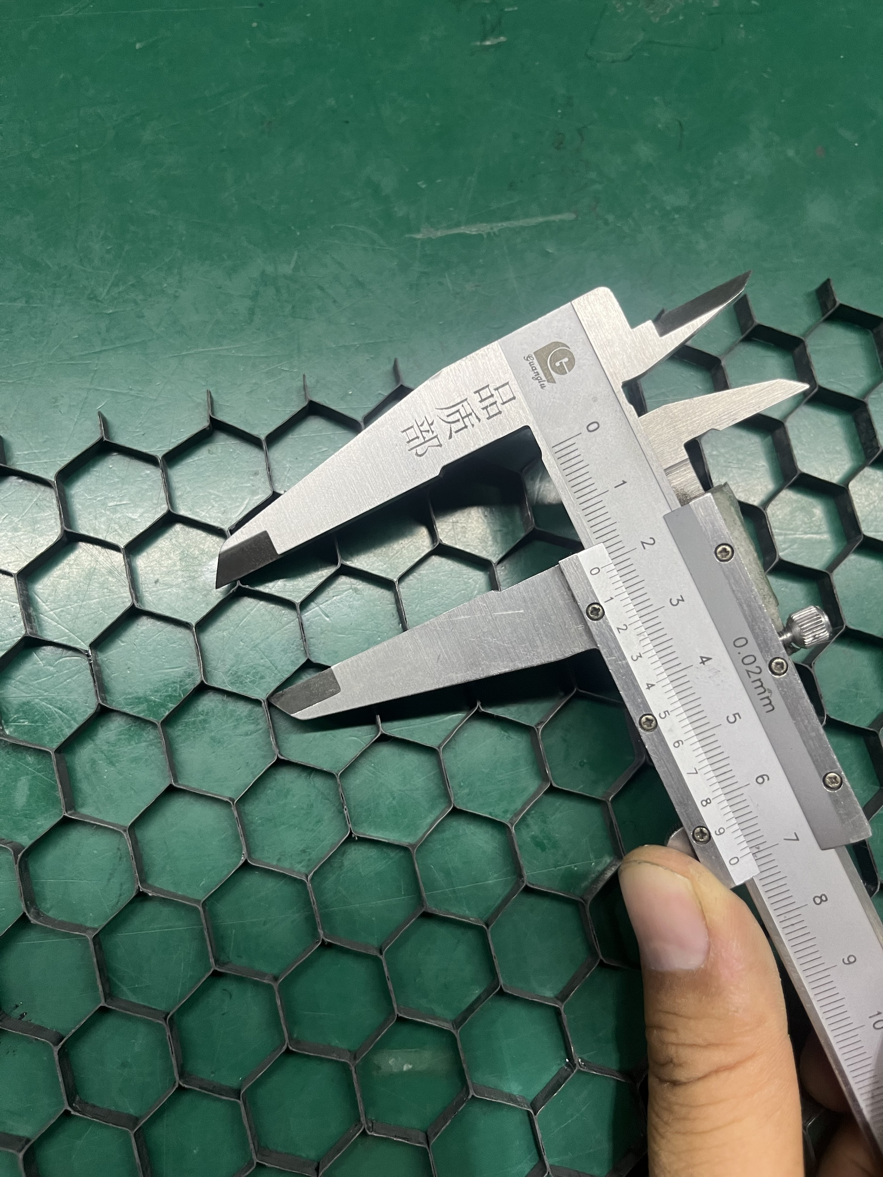
Bare stave
CMOS chips with 2x2 cm², more uniform heating area (~200 mW/cm²)
Looking for carbon fiber honey comb (CF-HC) + two carbon fiber (CF) facing
Large size HC reduce bare stave density, but with high stiffness
Comparing with traditional foam-sandwich structure
Structure foam-> Evonik Rohacell 51 IG (0.051g/cm3)
Thermal foam -> Allcomp K-9 carbon foam (0.2g/cm3, ~35W/m.K)
0.04g/cm3
Carbon fiber -> K13C2U high-modulus carbon fibers in EX1515 epoxy matrix (45 gsm, 0.1? mm THINCK)

Slide 6
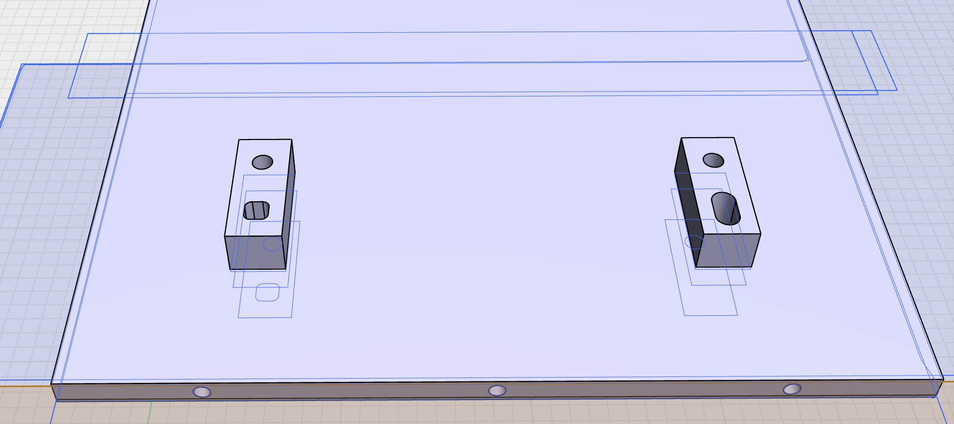
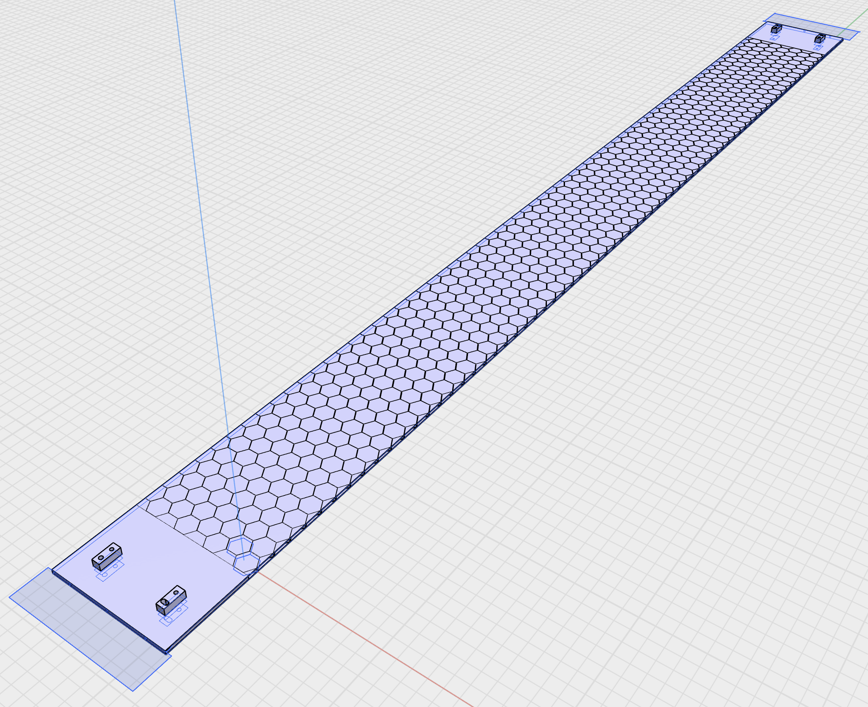
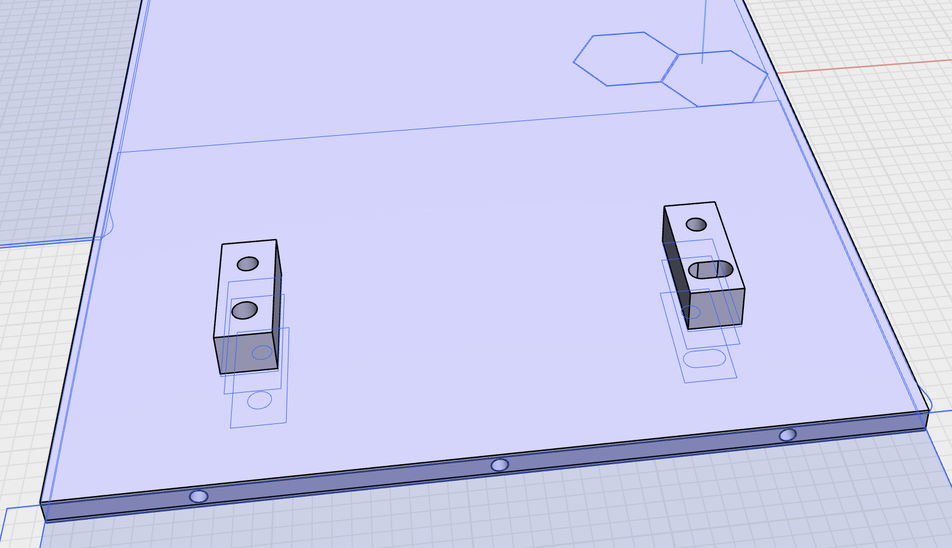
CF-CFHC-CF structure
bare stave size ~ 1 400 x 120 mm²
center active area~ 1 200 x 120 mm²
Two AL End-of-Stave (EOS) for mounting in future test
3 Ti tube bury inside, with OD 2.2 mm, thickness 0.15 mm

Slide 7
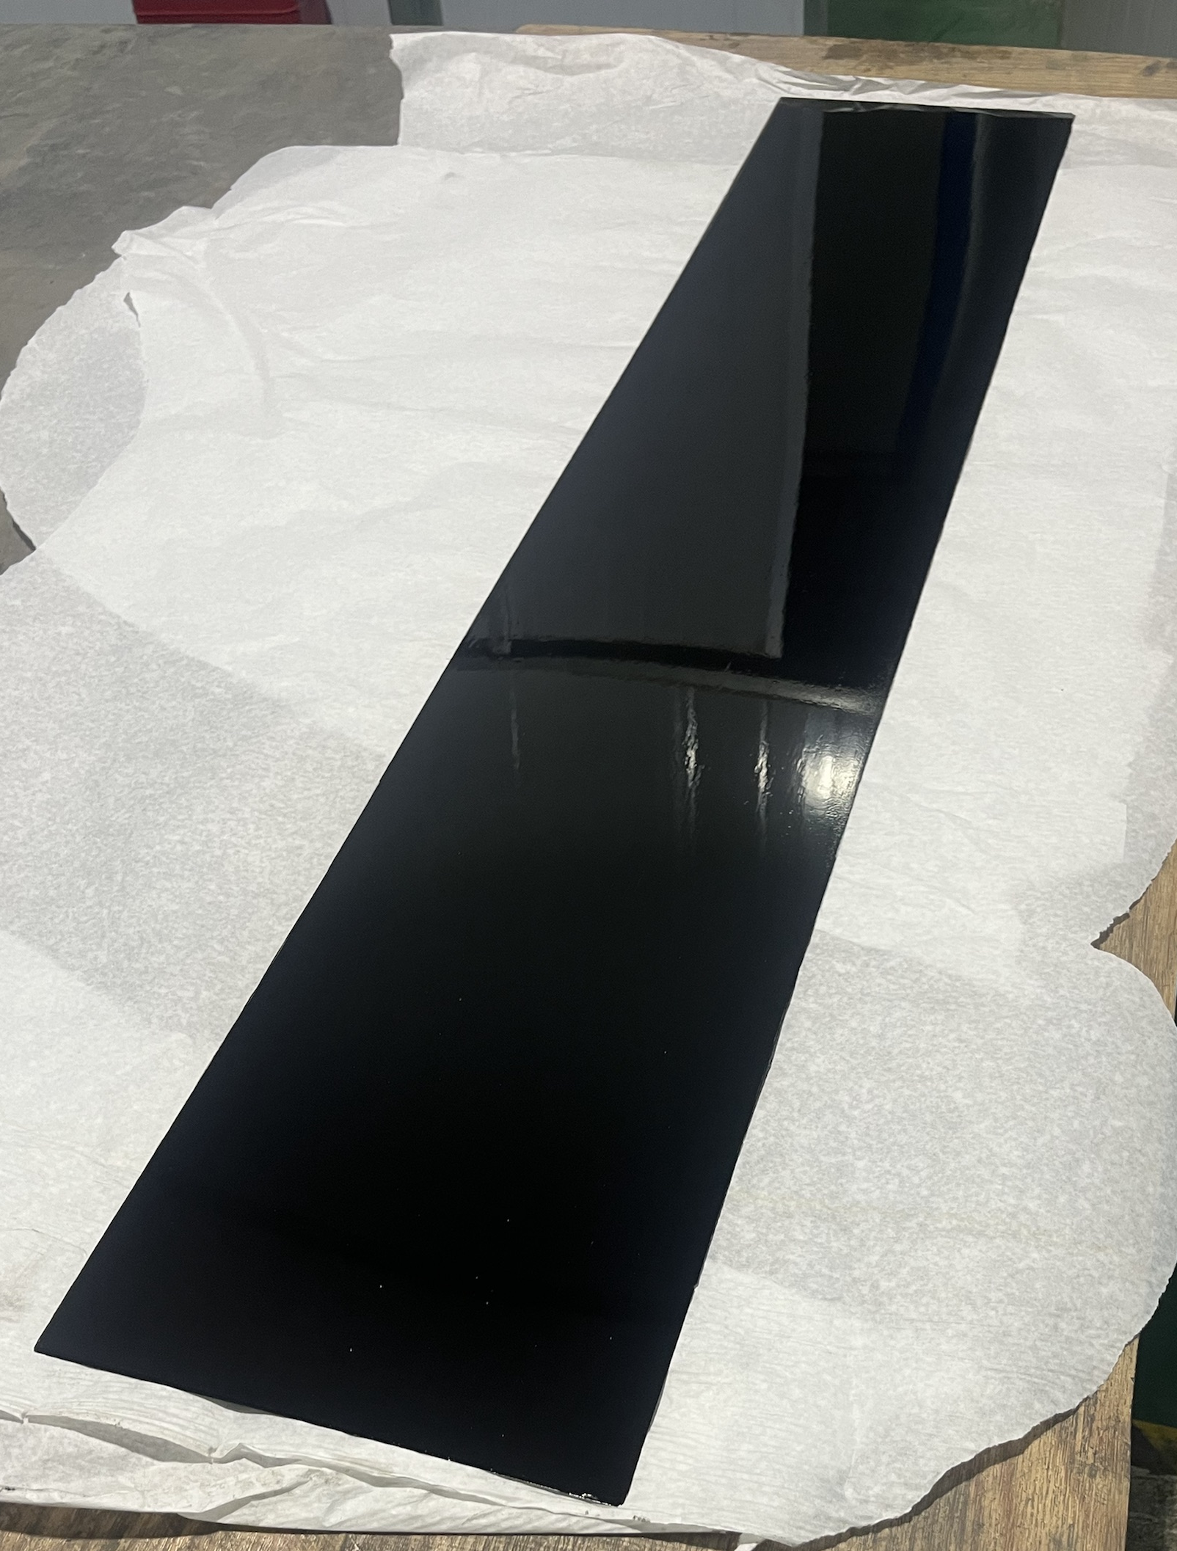
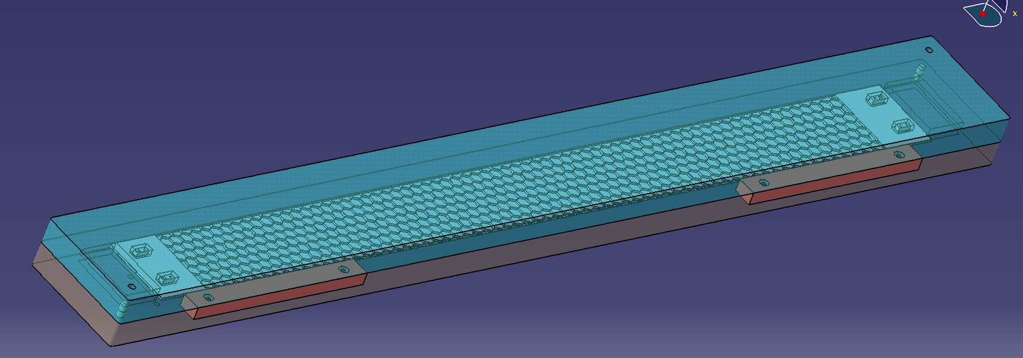
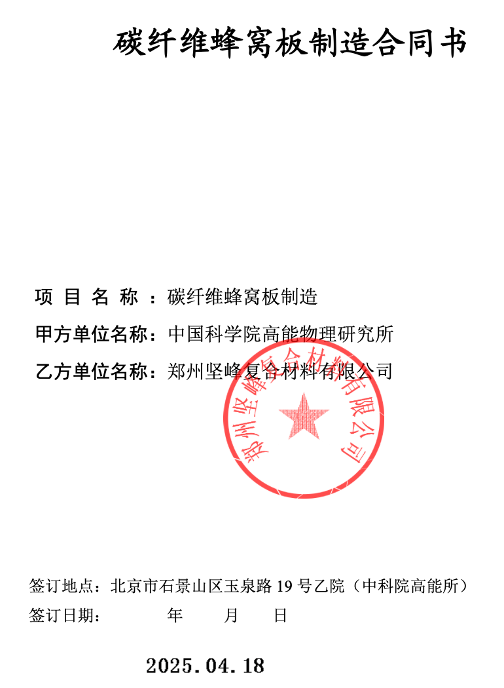
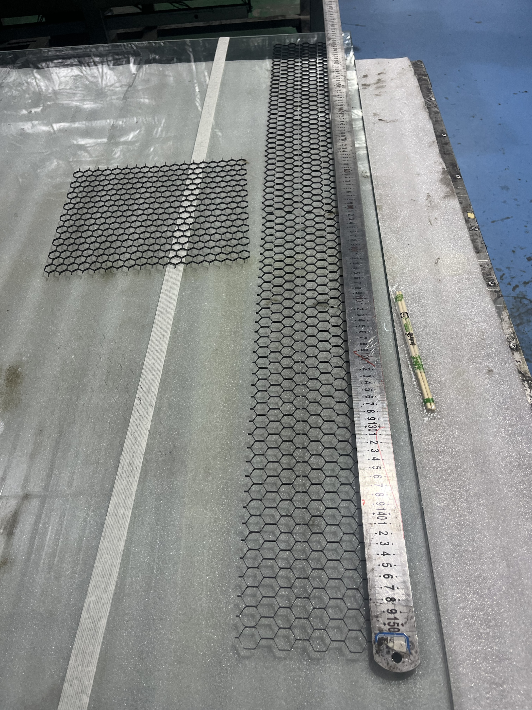
Material preparation
Contract signed in April
Carbon fiber facing + honey comb + Ti tube with VCR connector ready in weeks
Jigs for honey comb ready by April
CF facing ready by May
M40J
M40J
2cm CFHC (3mm THCK)

Slide 8
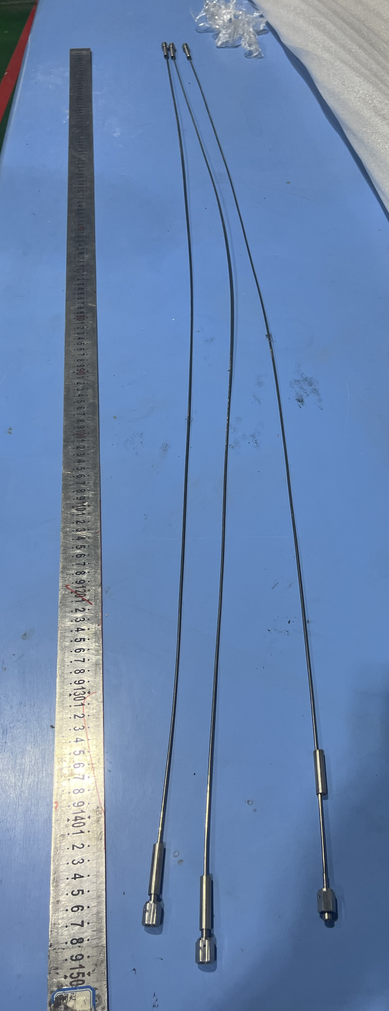
Ti tube status
First 3 Ti tube ready in May
ID ~2.2 mm, Thickness ~ 0.15 mm, Total length ~ 1 400 mm
NOT VCR connector yet, local machine-shop made connector => to be updated next time
Laser welding for Ti tube <-> steel connector, sealing with He gas
0.15 MPa gas test in water, no bobble in water for 5min => will modified in future

Slide 9
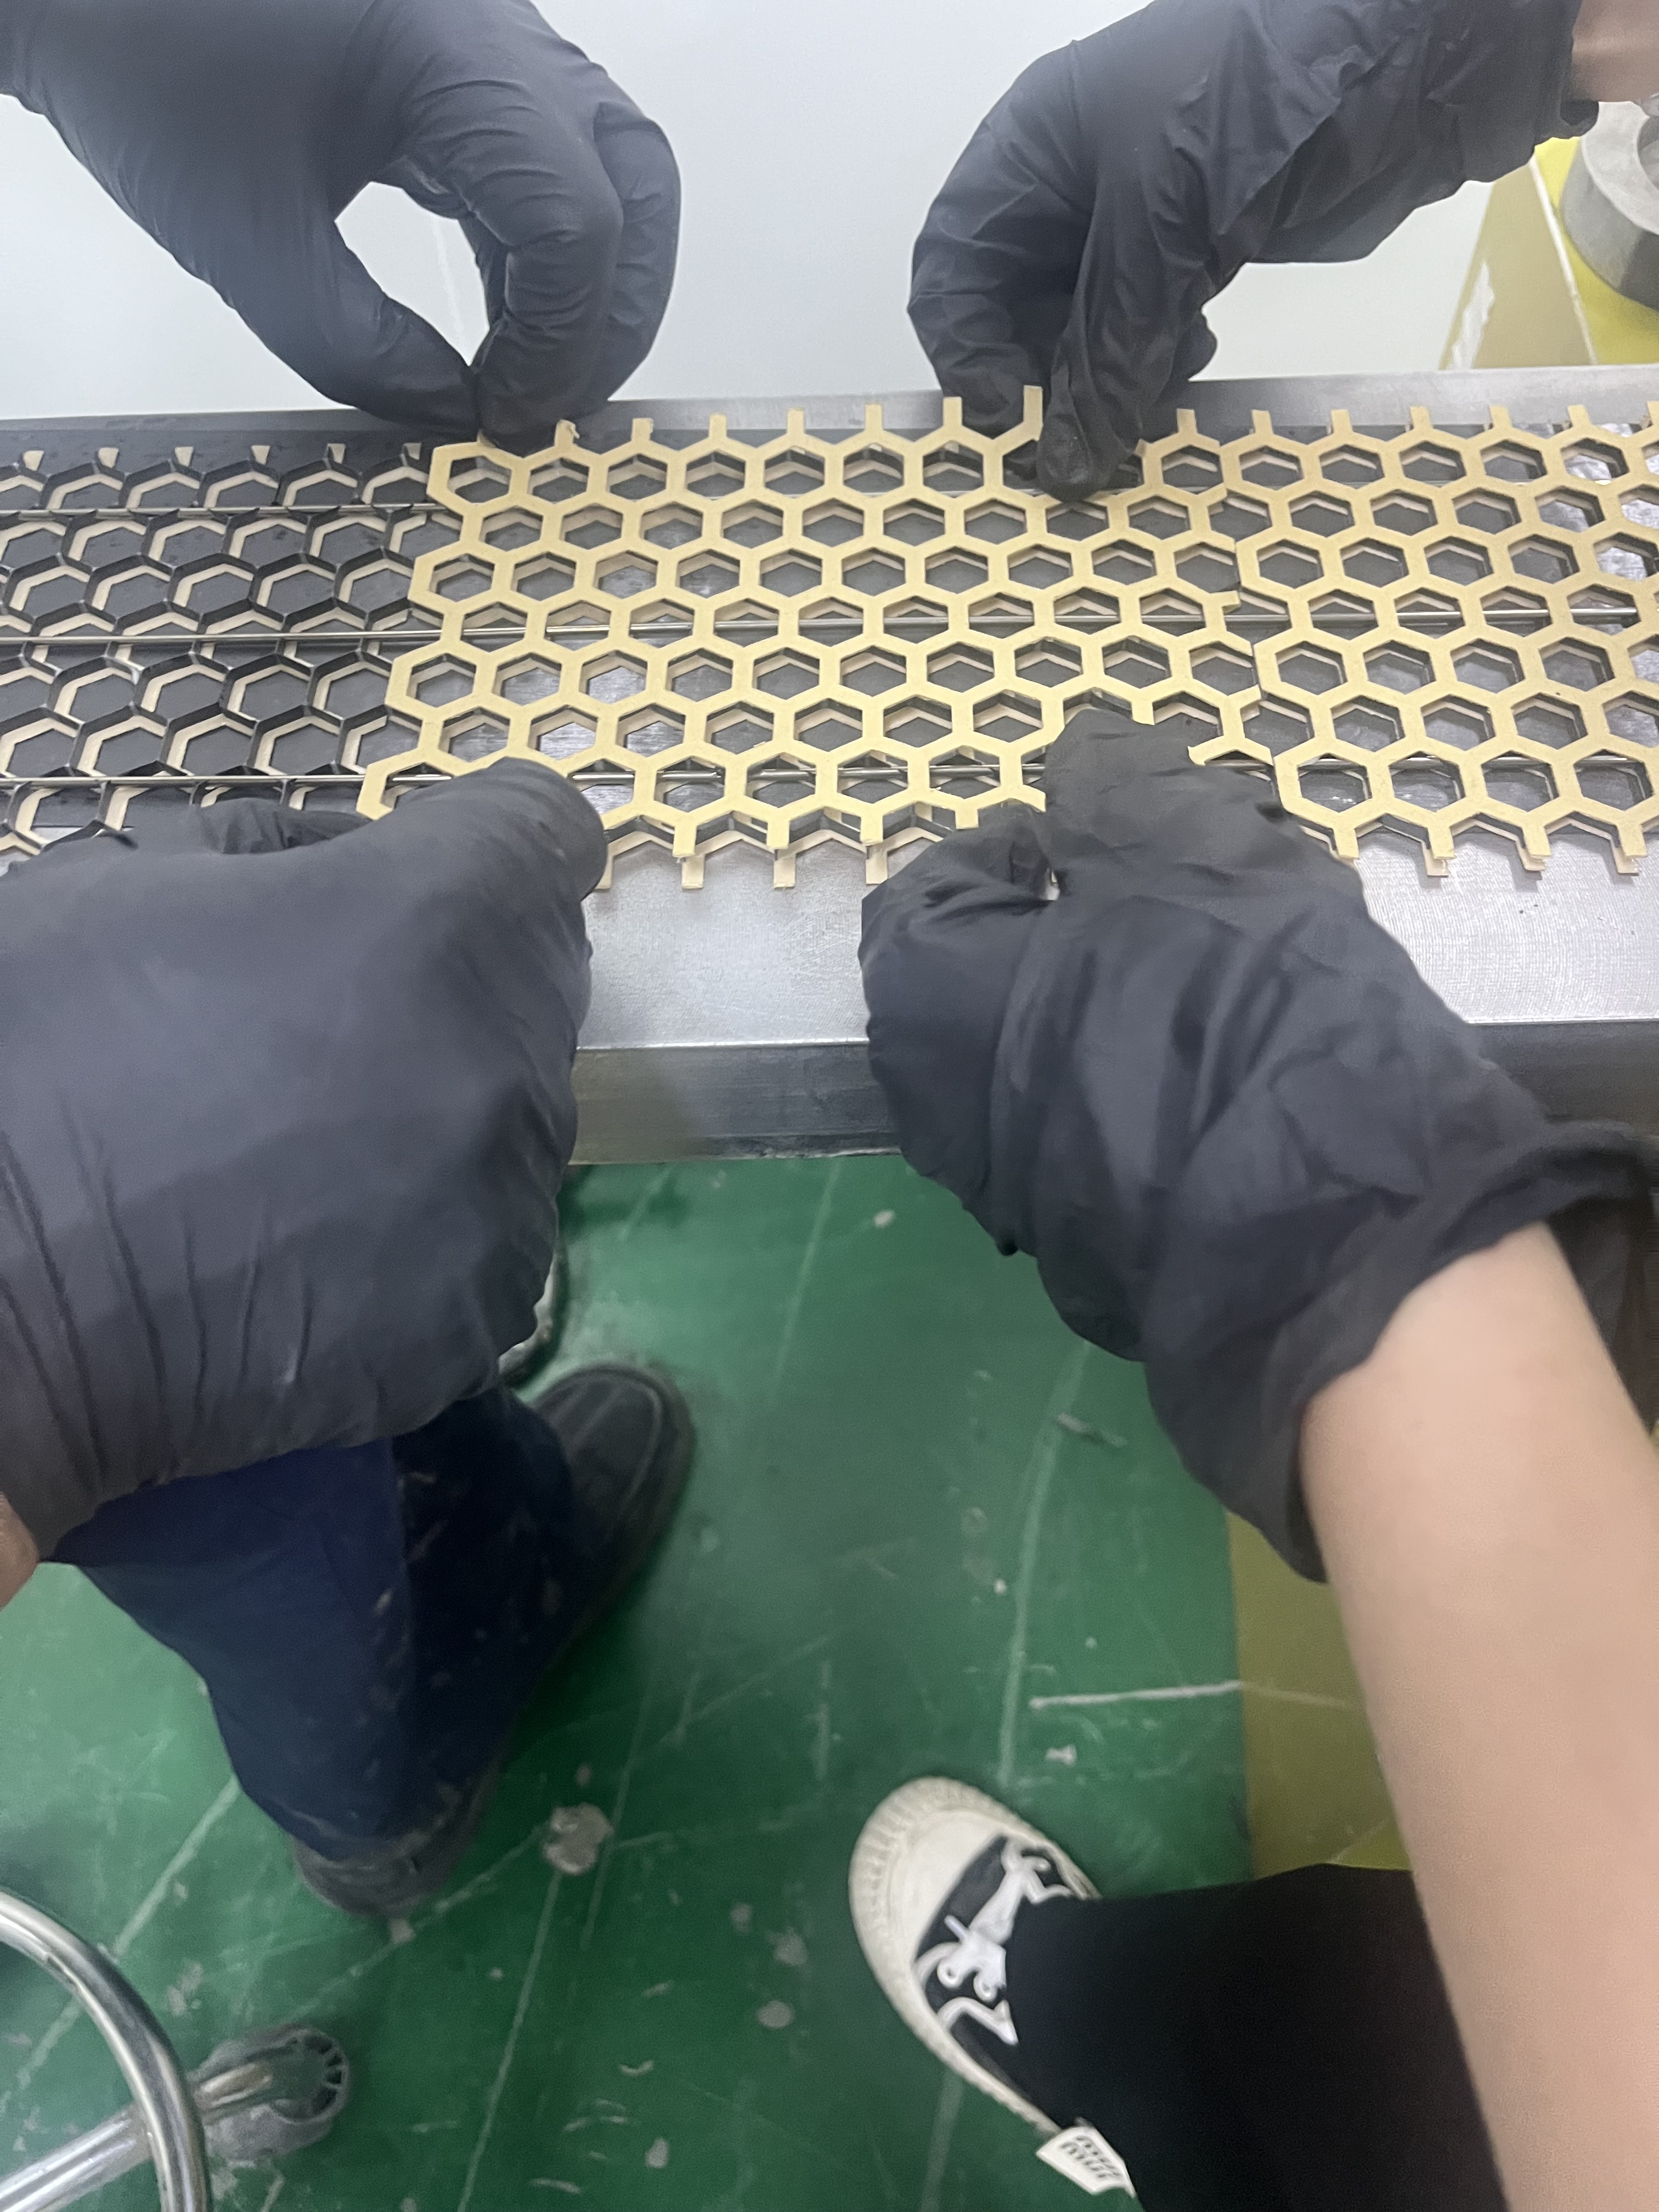
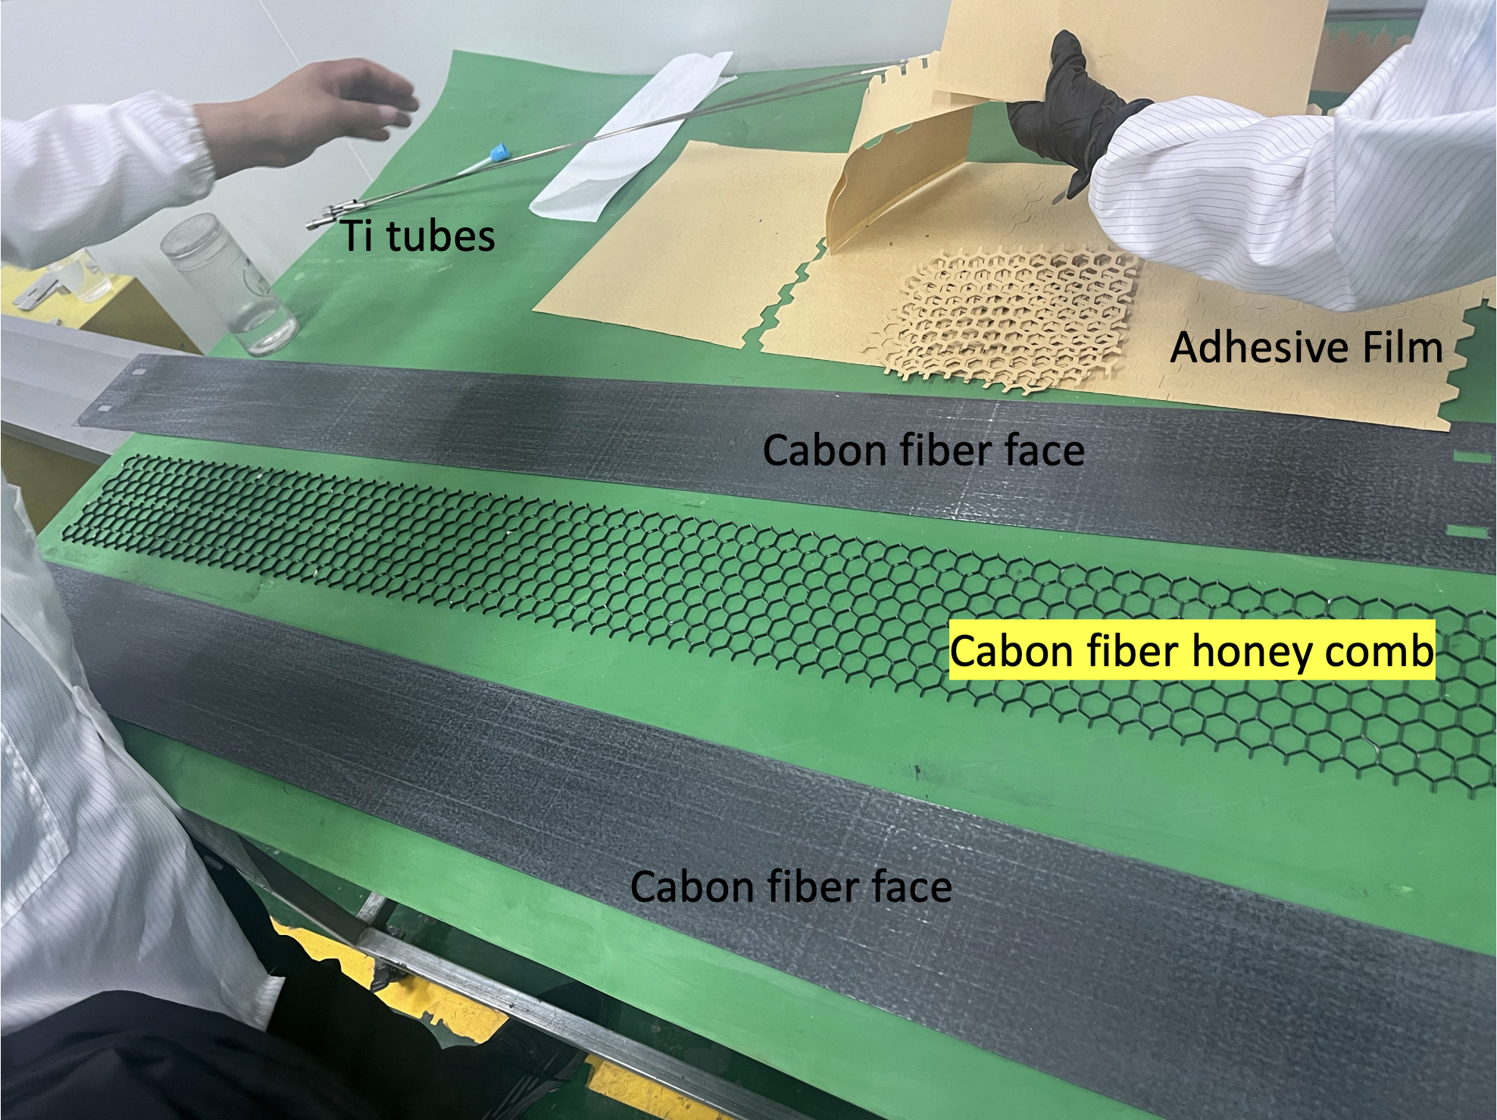
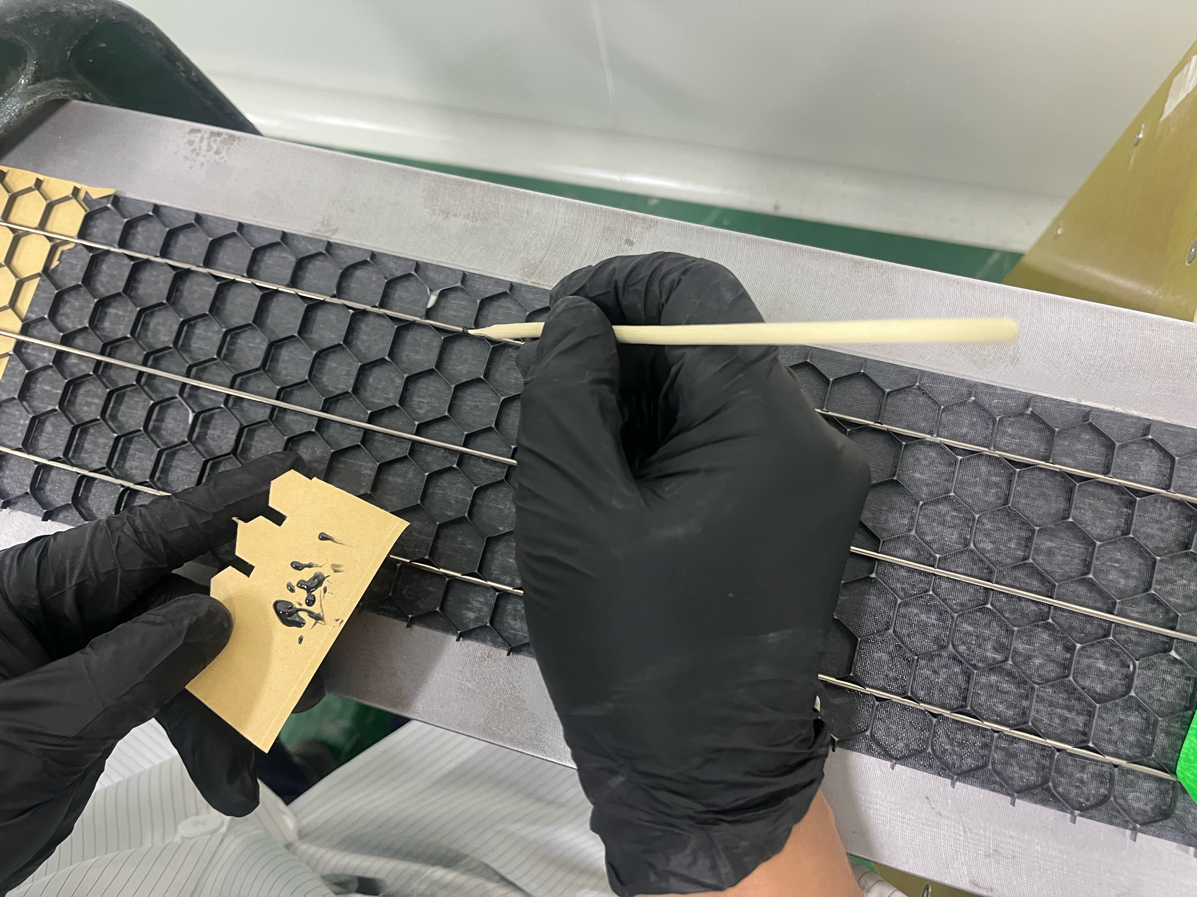
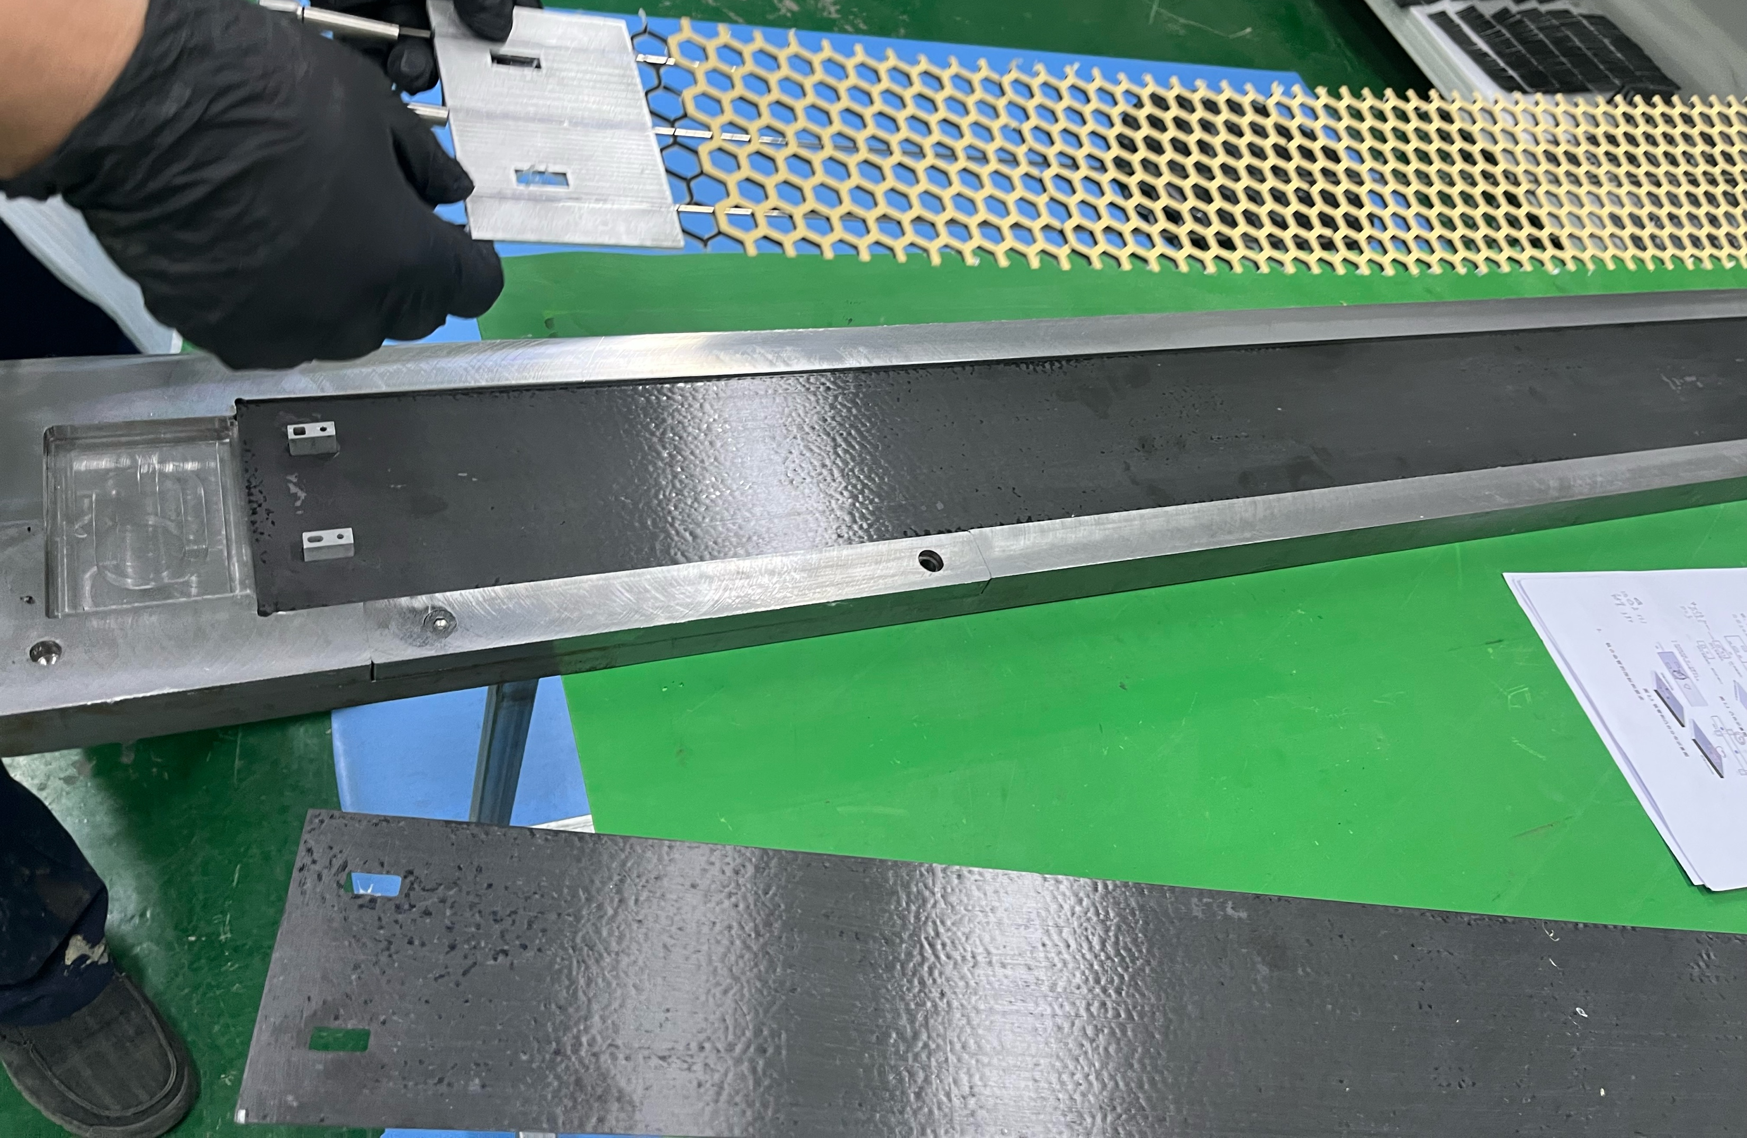
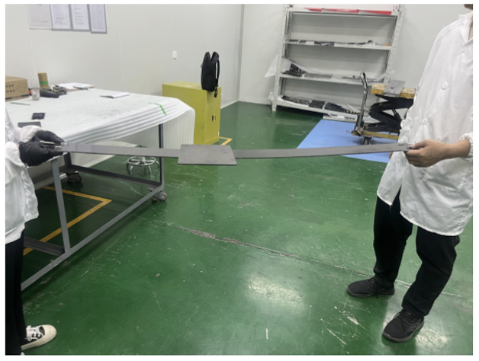
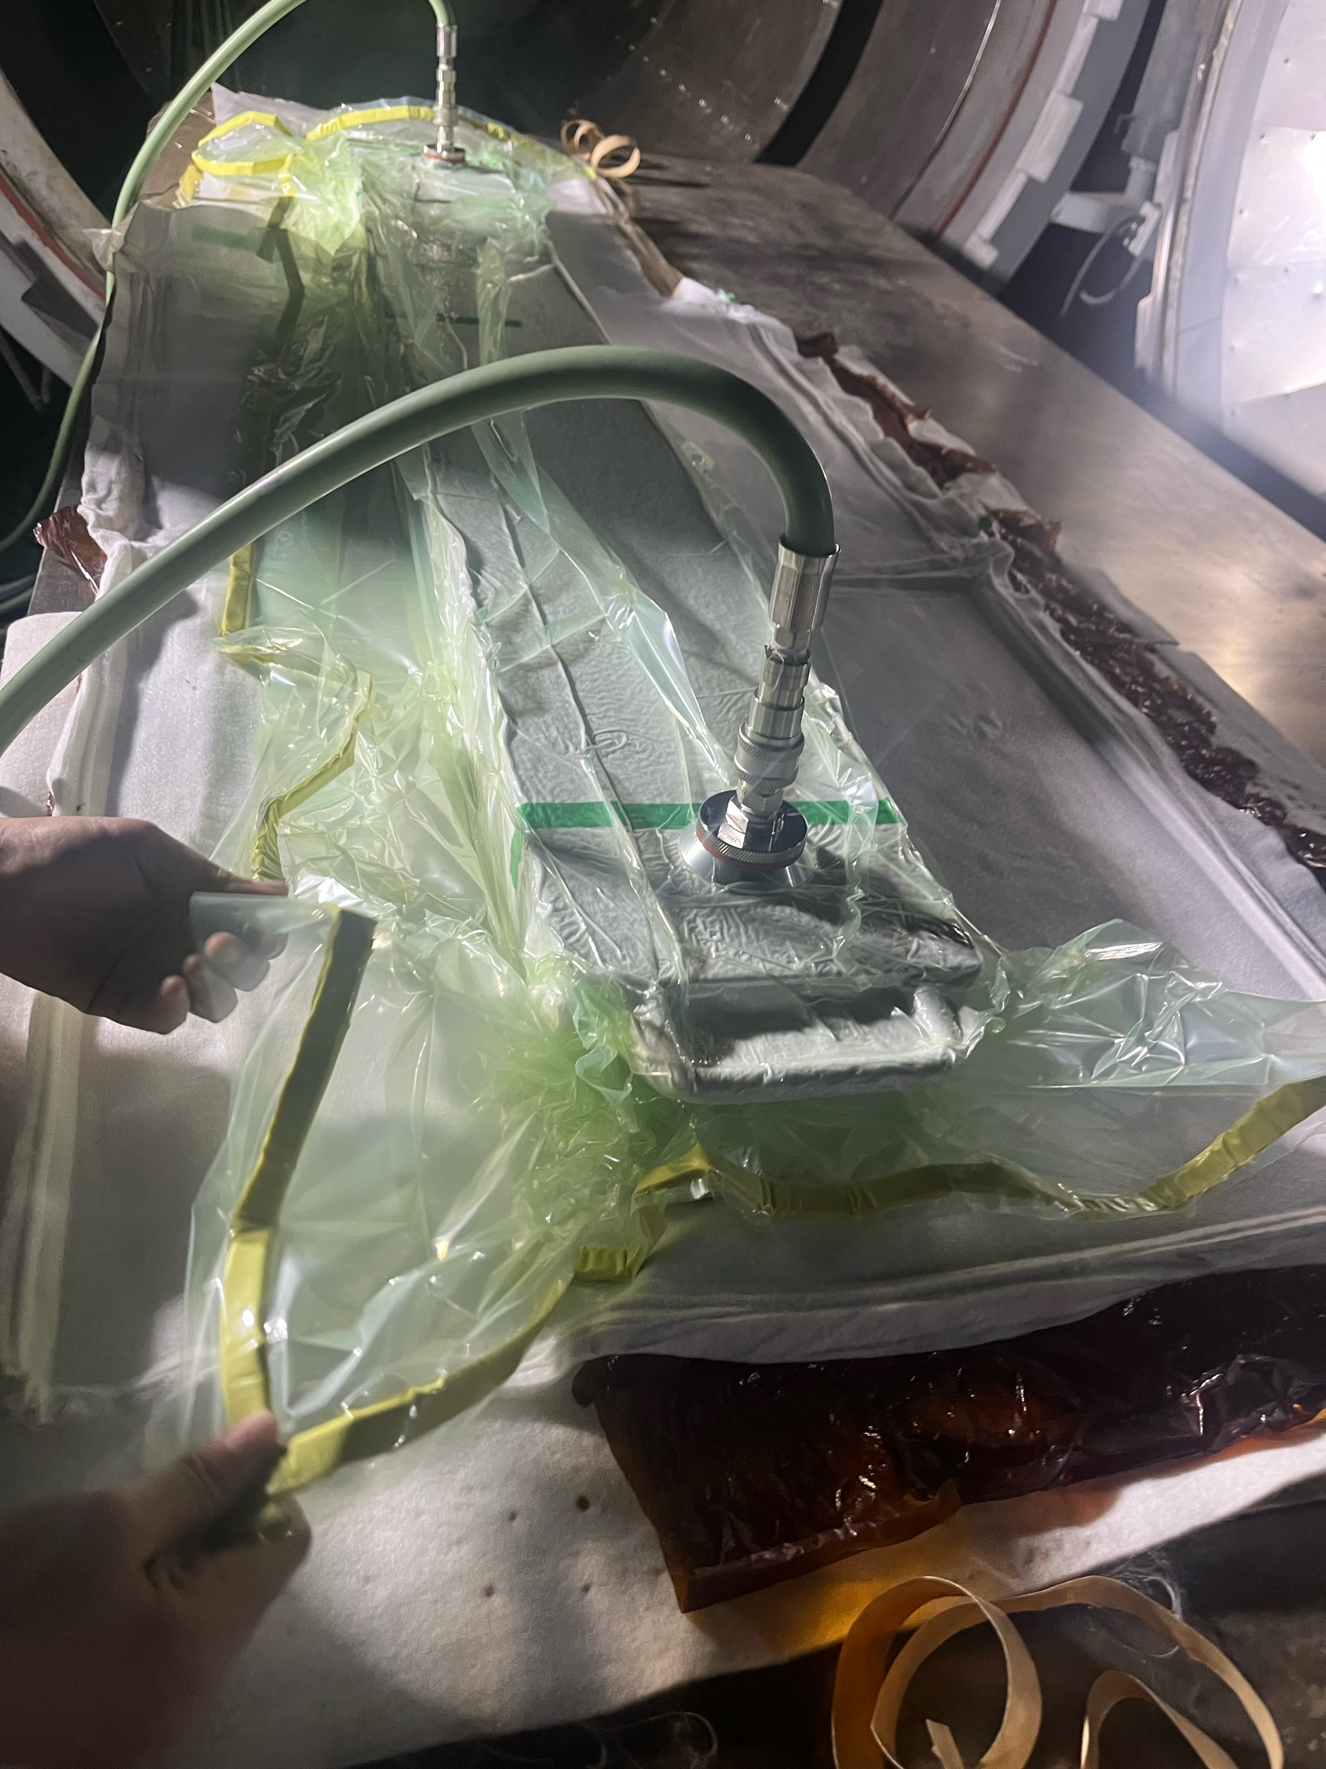
Bare stave production
x2

Slide 10
Numbers
Cabon fiber faces x2 | 118 g x2 | Thk 0.5 mm; Thinner faces ~0.15 mm next time
Cabon honey comb | 23.2 g | ThK 3 mm
Adhesive film | 38.9 g | BERGQUIST GAP FILLER TGF 4500CVO for CMS IT
End of stave | 76 g x2 | Carbon fiber to be used next time
Ti tube | 33.33 g x3 | Thinner/finer size next time
Edging | 10.5 g | NO need all; Ultem inserts
Paint | 4.5 g | NO need
Total | 566.67 g | Goal: ~400 g
Further M/T tests to do soon

Slide 11
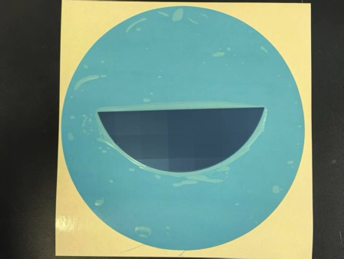
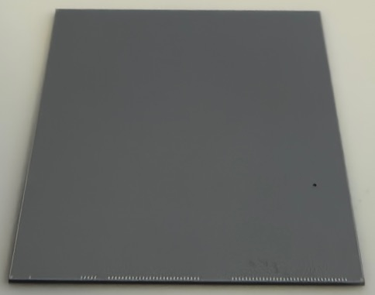
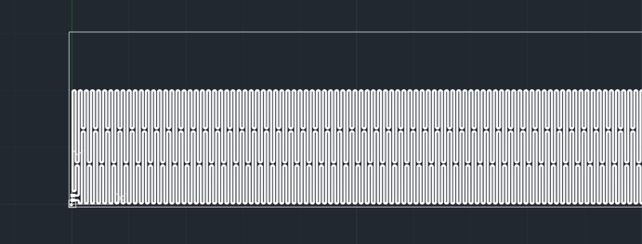
Module mockup preparation
Dummy chips v0 received by end of Match
Size as COFFEE => CAN BE modified in the next iteration
Fiducial marks + wire bonding pads. Thermal circuits to be added in the next iteration
Dummy hybrid v0 received last week
199.14 mm x 30.27 mm x 0.3 mm
With wire bonding pad and fiducial marks
Thermal circuit will be added in the next version to simulate the heat dissipation
Next version hybrid with heating pad
1st dummy hybrid

Slide 12
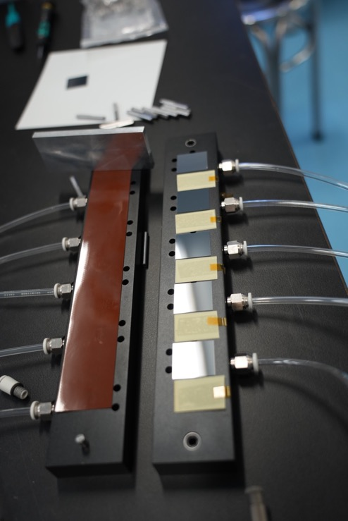
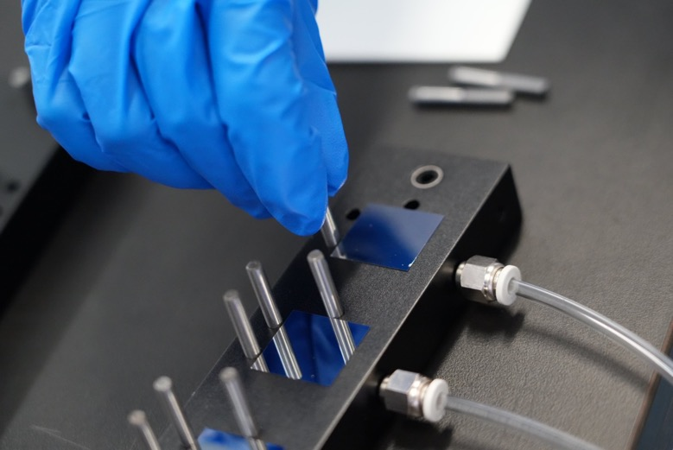
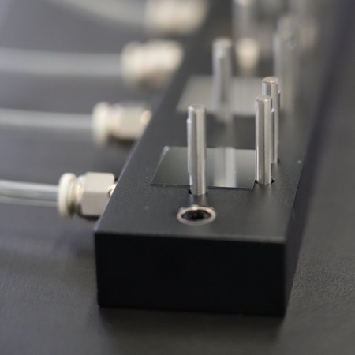
Mechanical mockup producing
Jigs-based assembly. Using gantry for high precision in future
Chips positioning according to D-shape pins, with vacuum fixing

Slide 13
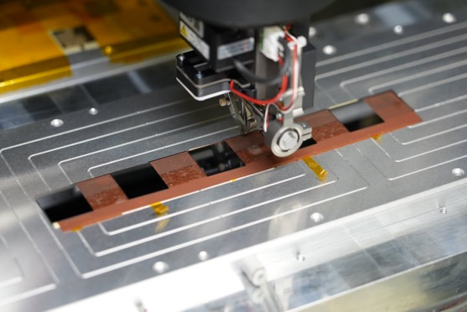
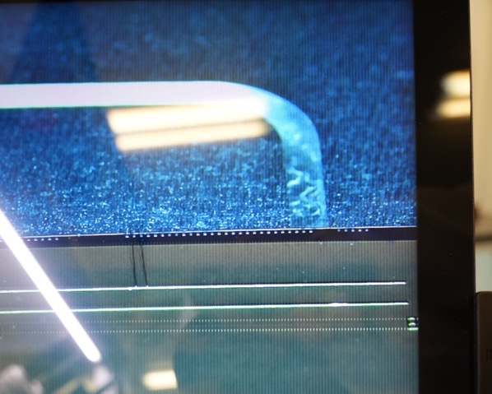
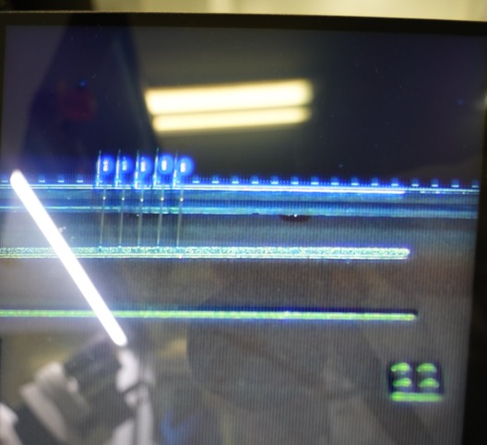
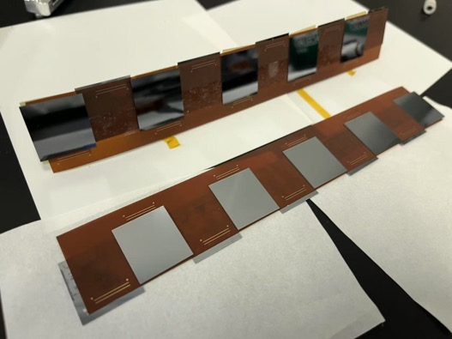
Mechanical prototype
The first mechanical prototype produced
Also with wire bonding tests: Two layers of the chips are both bonded => looks good
To-do next
Modules with thermal power
Stave level assembly

Slide 14
Summary
Testing mockup produced for stave/modules
Future plan listed in P3~P4

