Slide 1
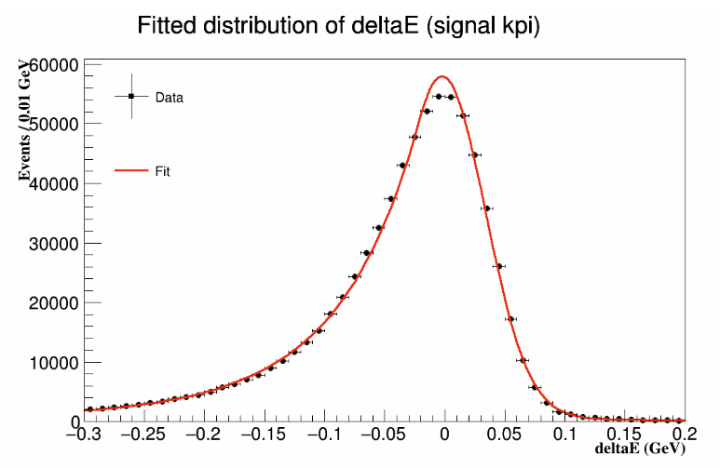

Slide 3
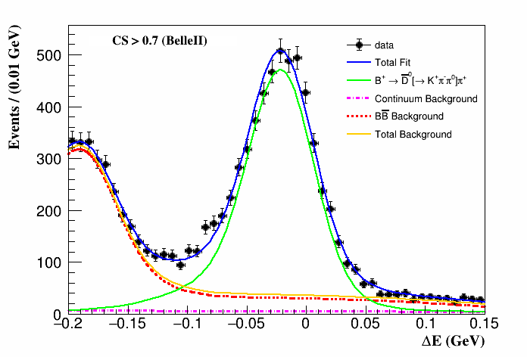
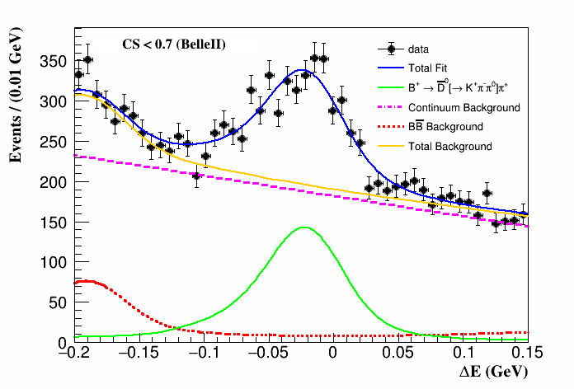
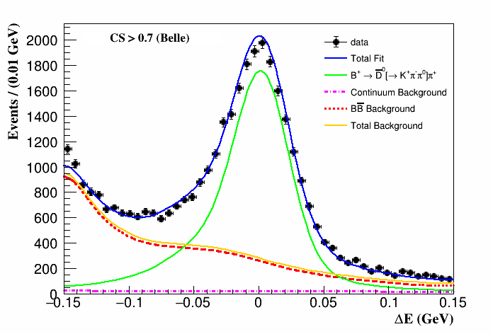
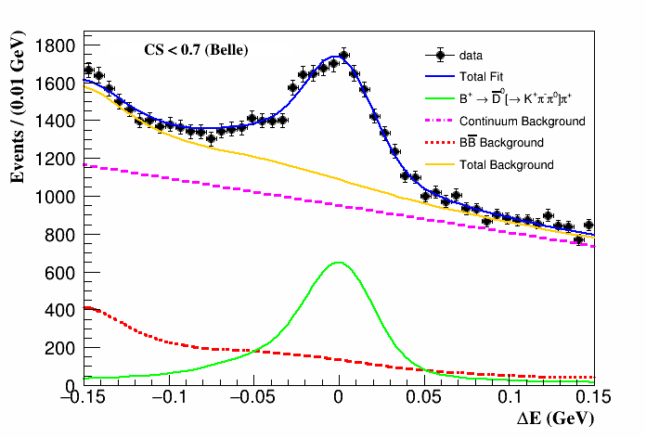
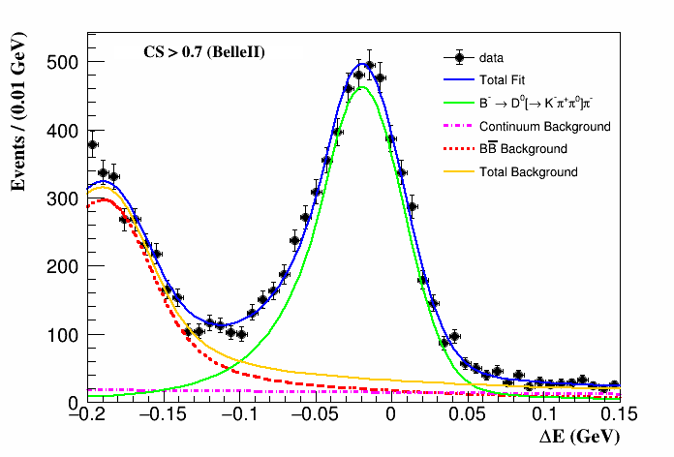
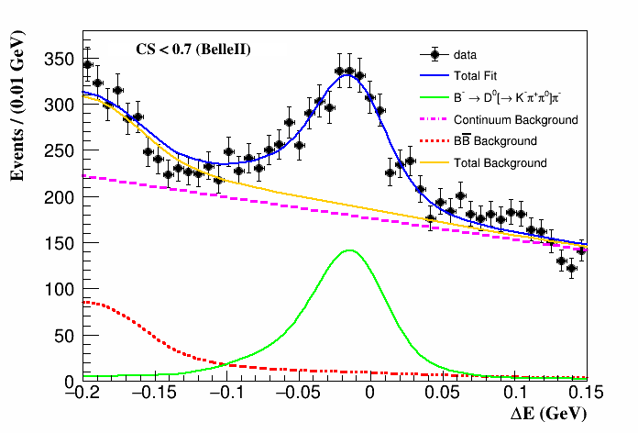
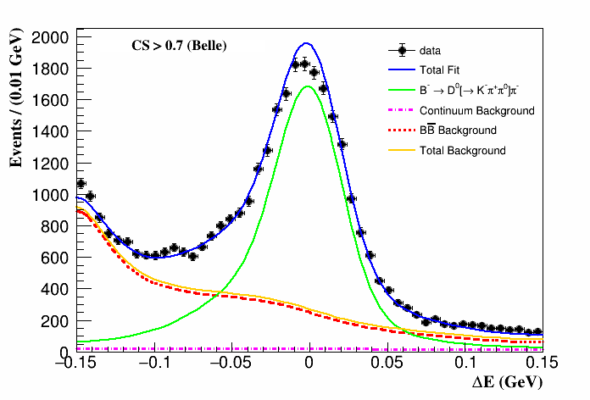
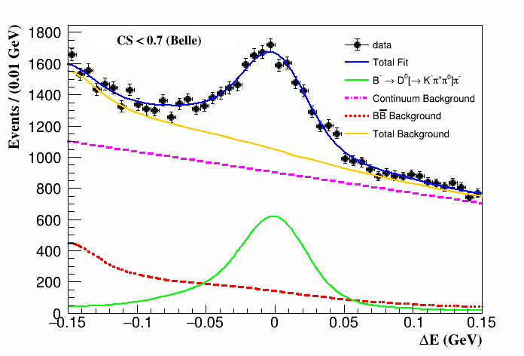

Slide 4
$$τ^{+}→K^{+}(η^{′}→(η→γγ)π^{+}π^{−})ν_{τ}$$
$τ^{−}→e^{−}{\overline{ν}}_{e}ν_{τ}$ / $μ^{−}{\overline{ν}}_{μ}$ $ν_{τ}$
Selections for candidates
Tracks
$dr<1.0 cm$,$\left|dz\right|<3.0 cm$,$P_{t}>0.1GeV/c$,$−0.8660<cosθ<0.9563$, $nGoodTracks=4$
Photons
$$clusterNHits >1.5, |clusterTiming|<200 ns, −0.8660< cosθ <0.9563, beamBackgroundSuppression > 0.9, fakePhotonSuppression > 0.8$$
$K^{±}$
Selection of tracks + kaonIDNN > 0.9, eID_noSVD_noTOP < 0.9, muID_noSVD < 0.9
$e^{±}$
Selection of tracks + eID_noSVD_noTOP > 0.9, muID_noSVD < 0.9
$μ^{±}$
Selection of tracks + eID_noSVD_noTOP < 0.9, muID_noSVD > 0.9
$π^{±}$
$$pionIDNN>0.8$$
$η^{′}$
$$0.90<M\left(ηπ^{+}π^{−}\right)<0.98 GeV/c^{2}$$
$η$
$$0.50<M\left(γ_{η}γ_{η}\right)<0.58 GeV/c^{2}$$
$γ_{η}$
Selection of photons + $E_{fwd}>0.15 GeV$, $E_{brl}>0.15 GeV$, $E_{bwd}>0.18 GeV$
Event
$\left({\overset{⃑}{p}}_{sig}^{CM}∙\hat{t}\right)∙\left({\overset{⃑}{p}}_{tag}^{CM}∙\hat{t}\right)<0$ for any pair of track or cluster in one event
$γ_{π^{0}}$
Selection of photons + $E_{fwd}>0.16 GeV$, $E_{brl}>0.08 GeV$, $E_{bwd}>0.14 GeV$

Slide 5
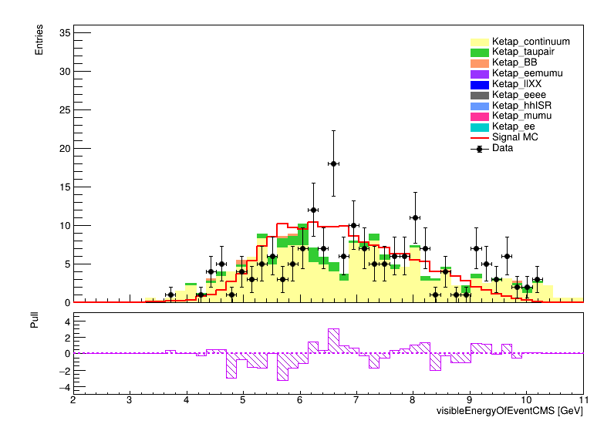
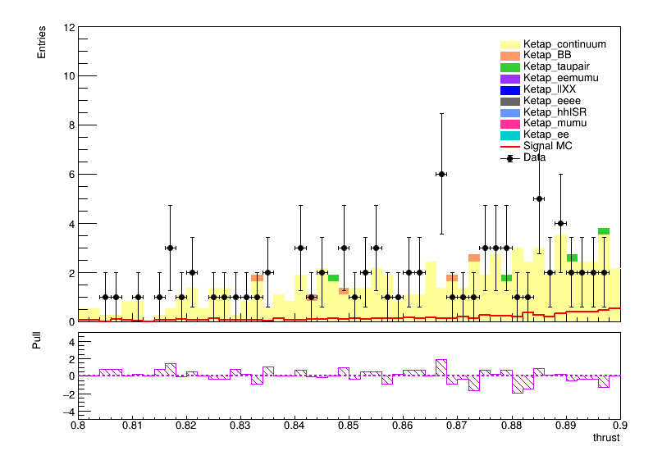
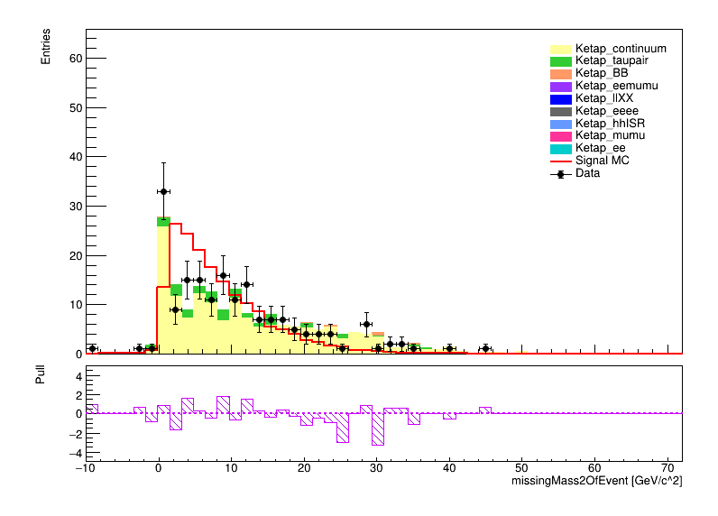
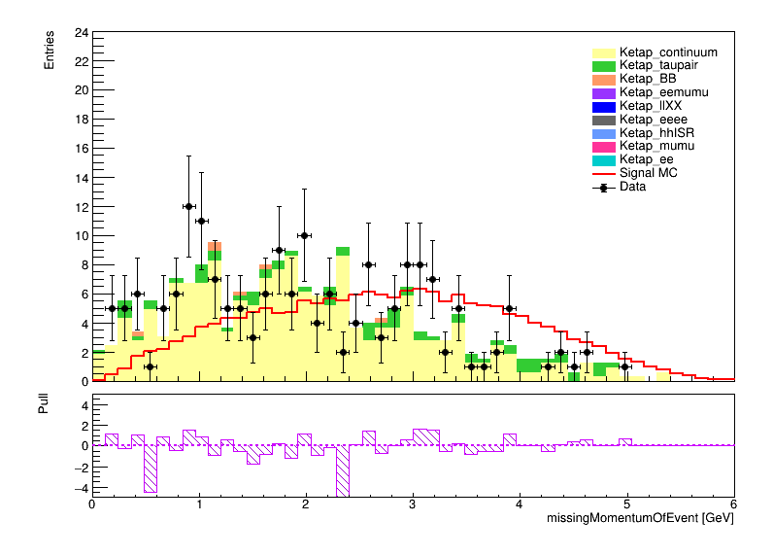
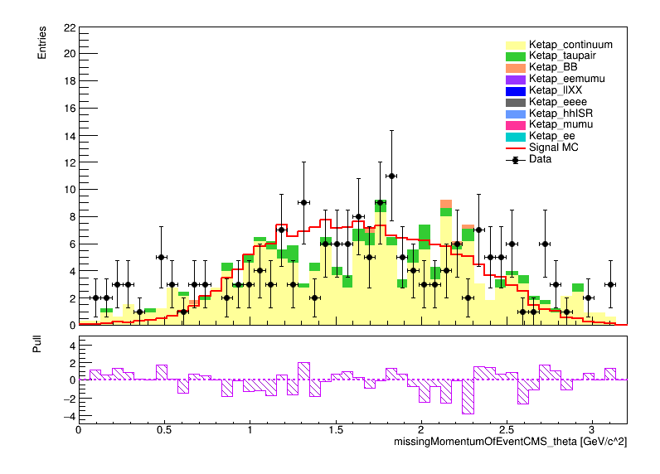
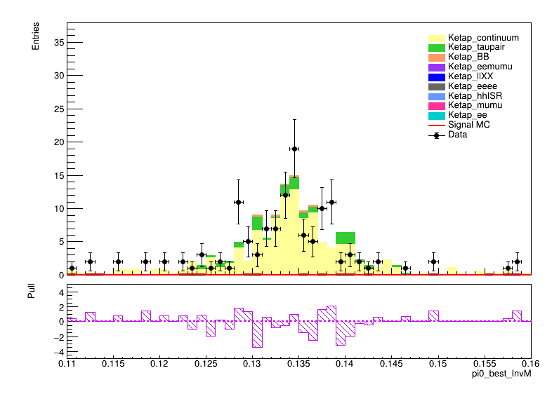
$$E_{vis}^{CM}$$
$$thrust$$
$$M_{miss}^{2}$$
$$P_{miss}$$
$$θ_{miss}^{CM}$$
$$M^{best}(π^{0})$$

Slide 6
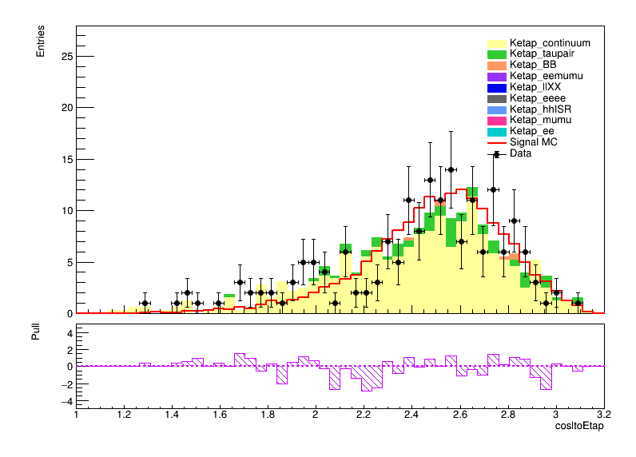
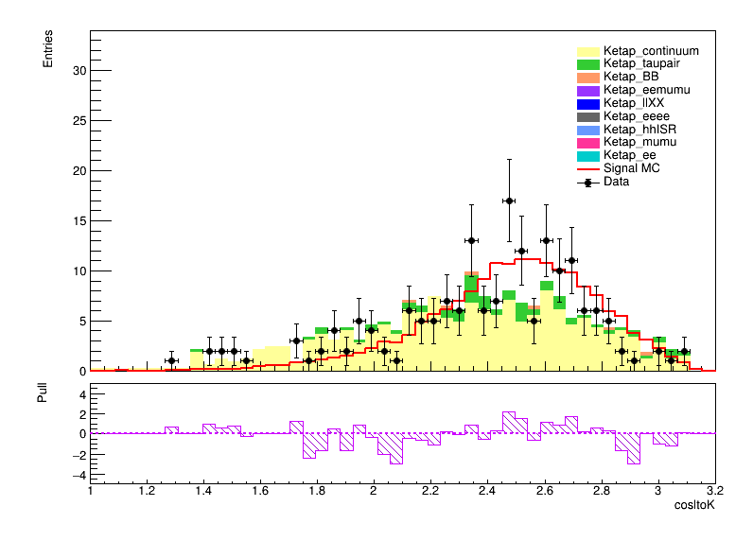
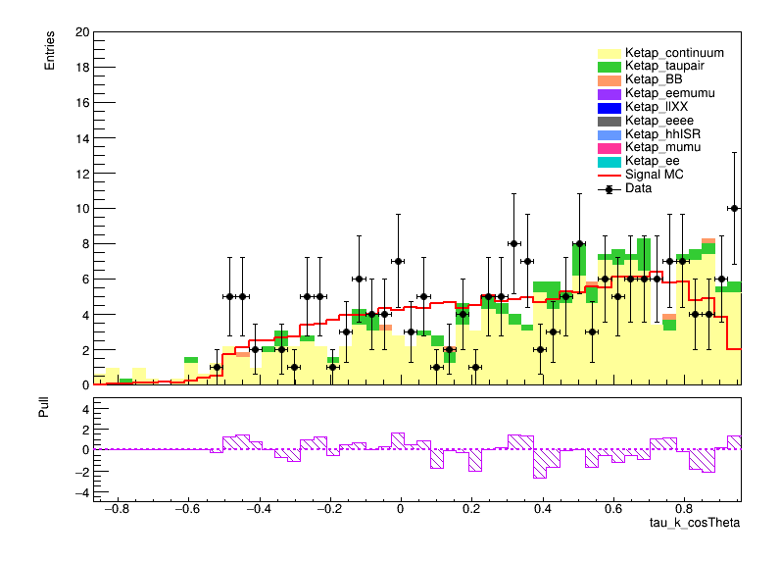
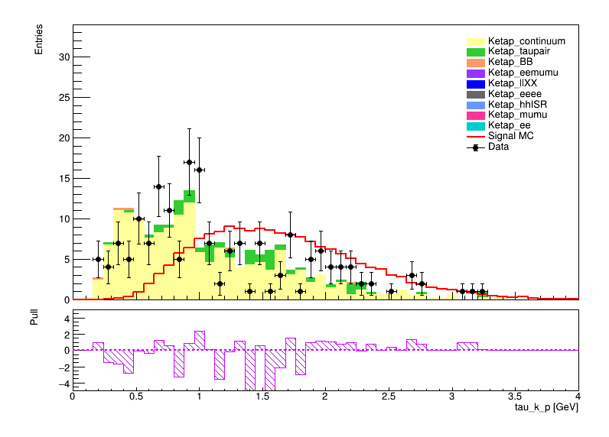
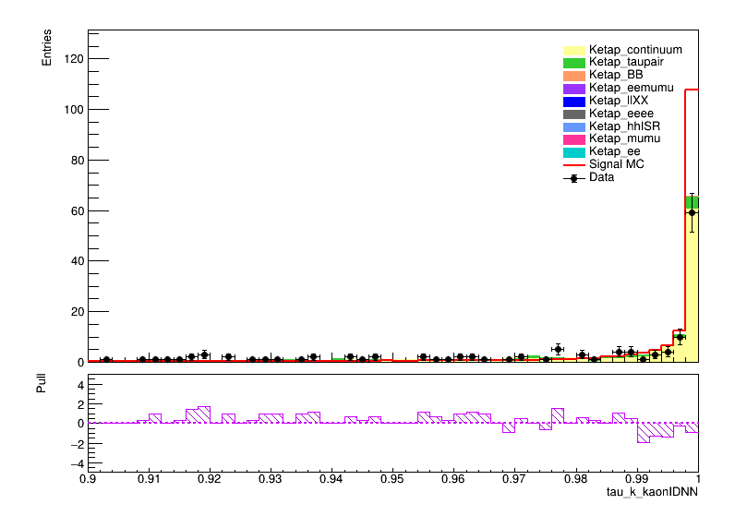
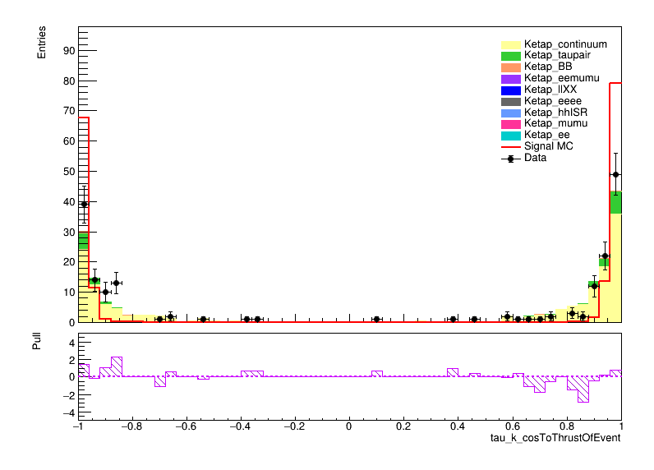
$$cosθ(lep,η^{′})$$
$$cosθ(lep,K)$$
$$cosθ(K)$$
$$P(K)$$
$$KaonIDNN$$
$$cosθ(K,thrust)$$

Slide 7
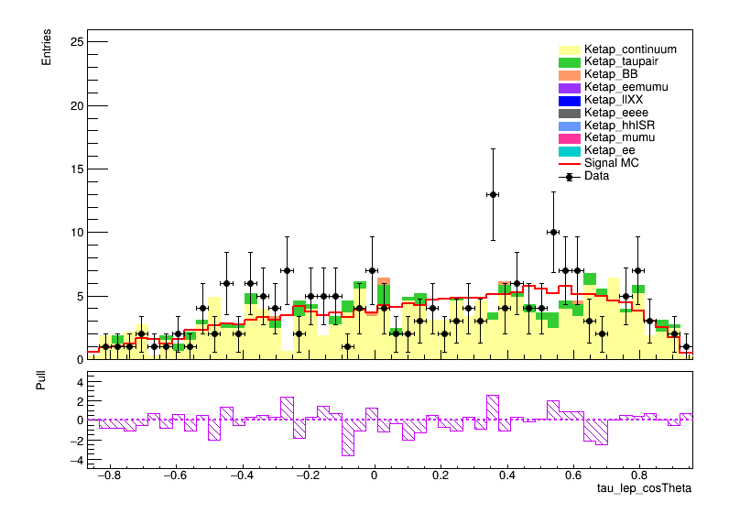
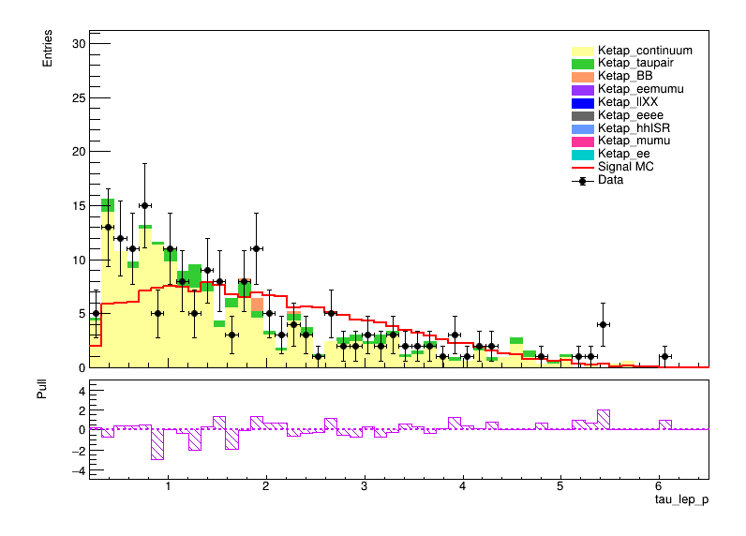
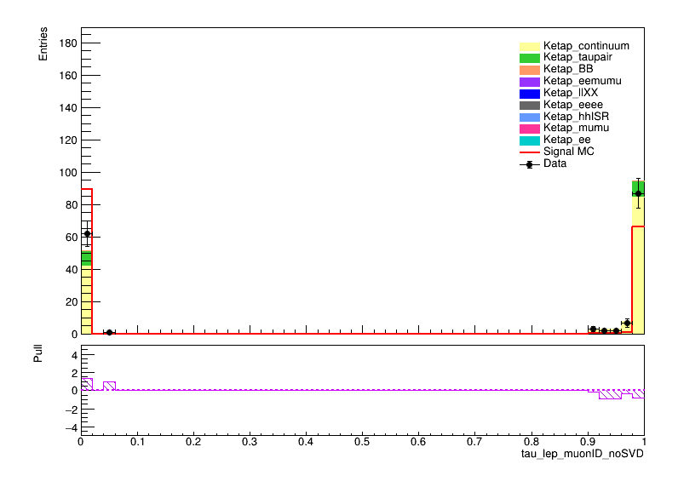
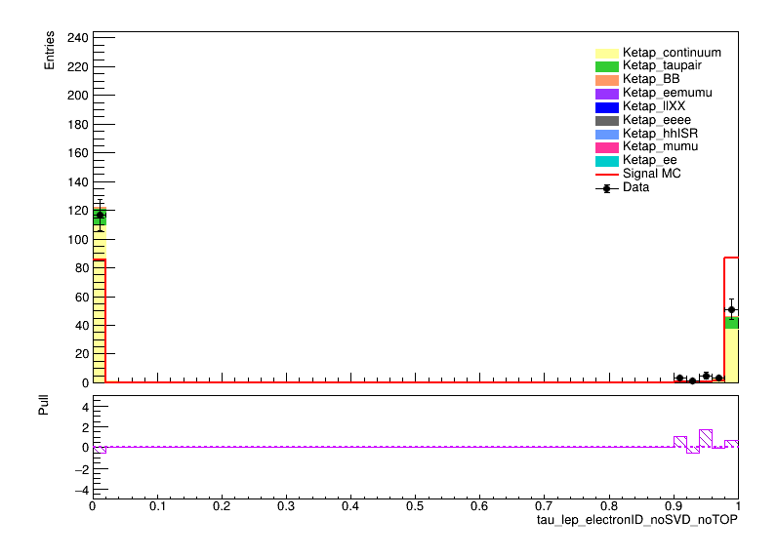
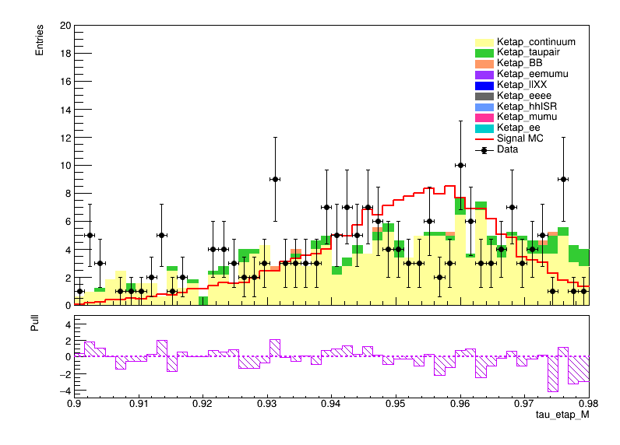
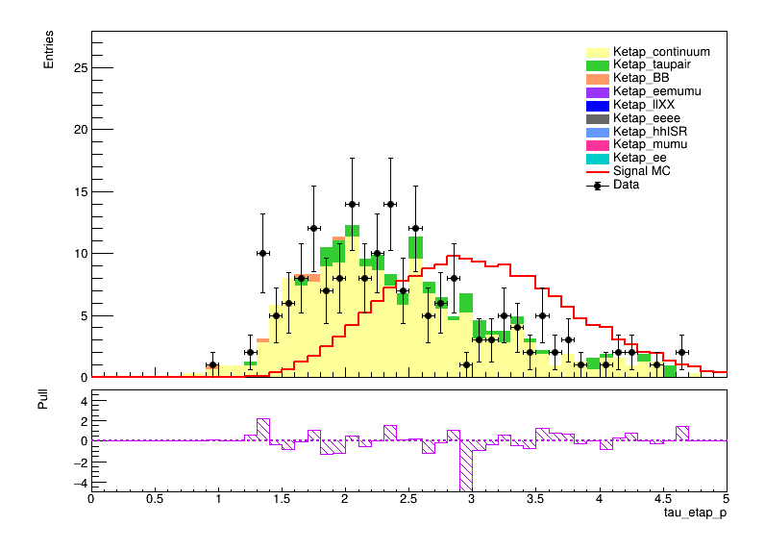
$$cosθ(lep)$$
$$P(lep)$$
$$muonID_noSVD$$
$$eID_noSVD_noTOP$$
$$M_{η^{′}}$$
$$P_{η^{′}}$$

Slide 8
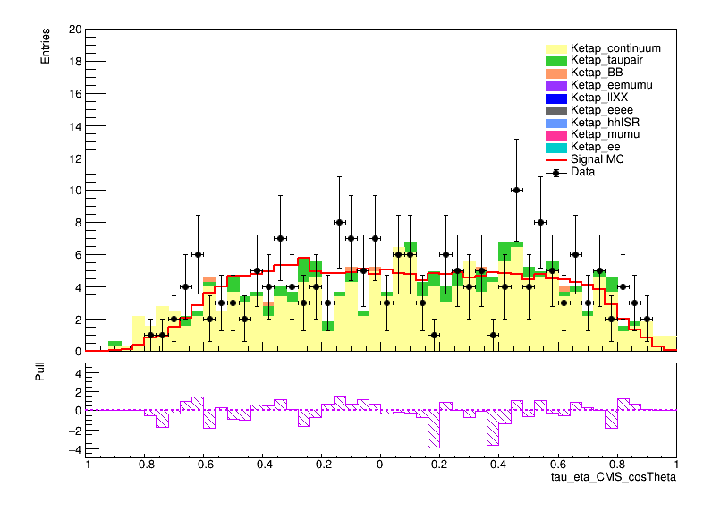
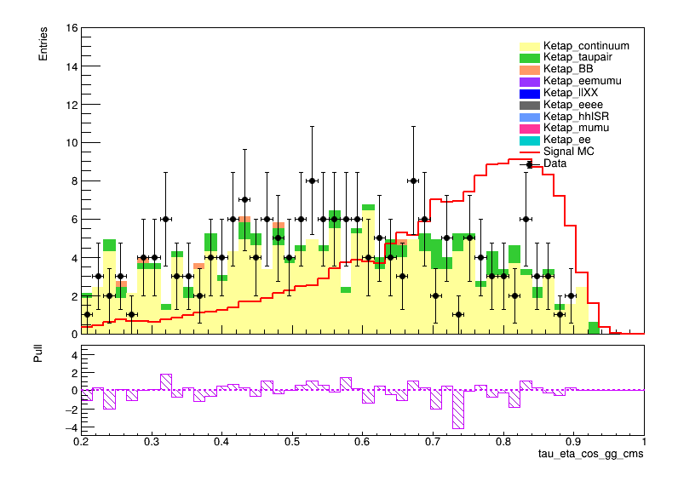
$${cosθ}^{CMS}(η)$$
$${cosθ}^{CMS}(γ,γ)$$

