Slide 1
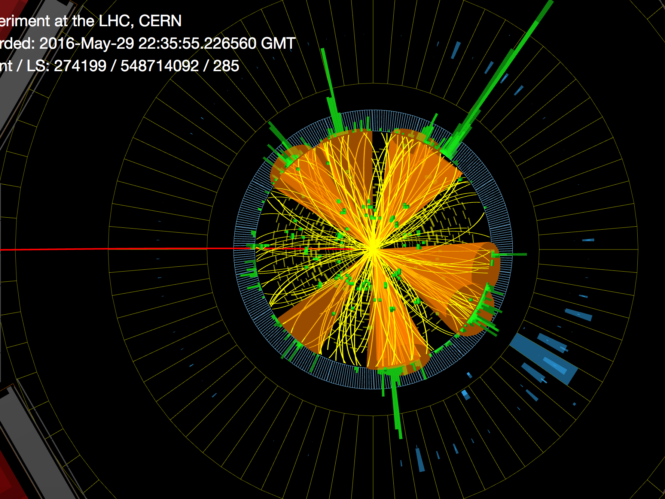
Four-top quark Searches at the LHC
Long Wang (BUAA)
Jul. 17, 2025 @ IHEP

Slide 2
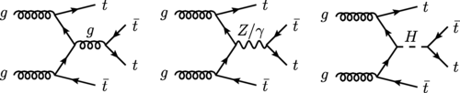
Motivation
BSM
Cross section receives significant contribution in various SM extensions
Squark & gluino decays
New Scalar boson production associated with ttbar
Pair production of scalar gluons
Top-Higgs interaction
Probes the Yukawa-coupling and its CP property
EFTs
Constrains the four-fermion operators of EFT
Notes:
Test perturbative QCD calculations

Slide 3
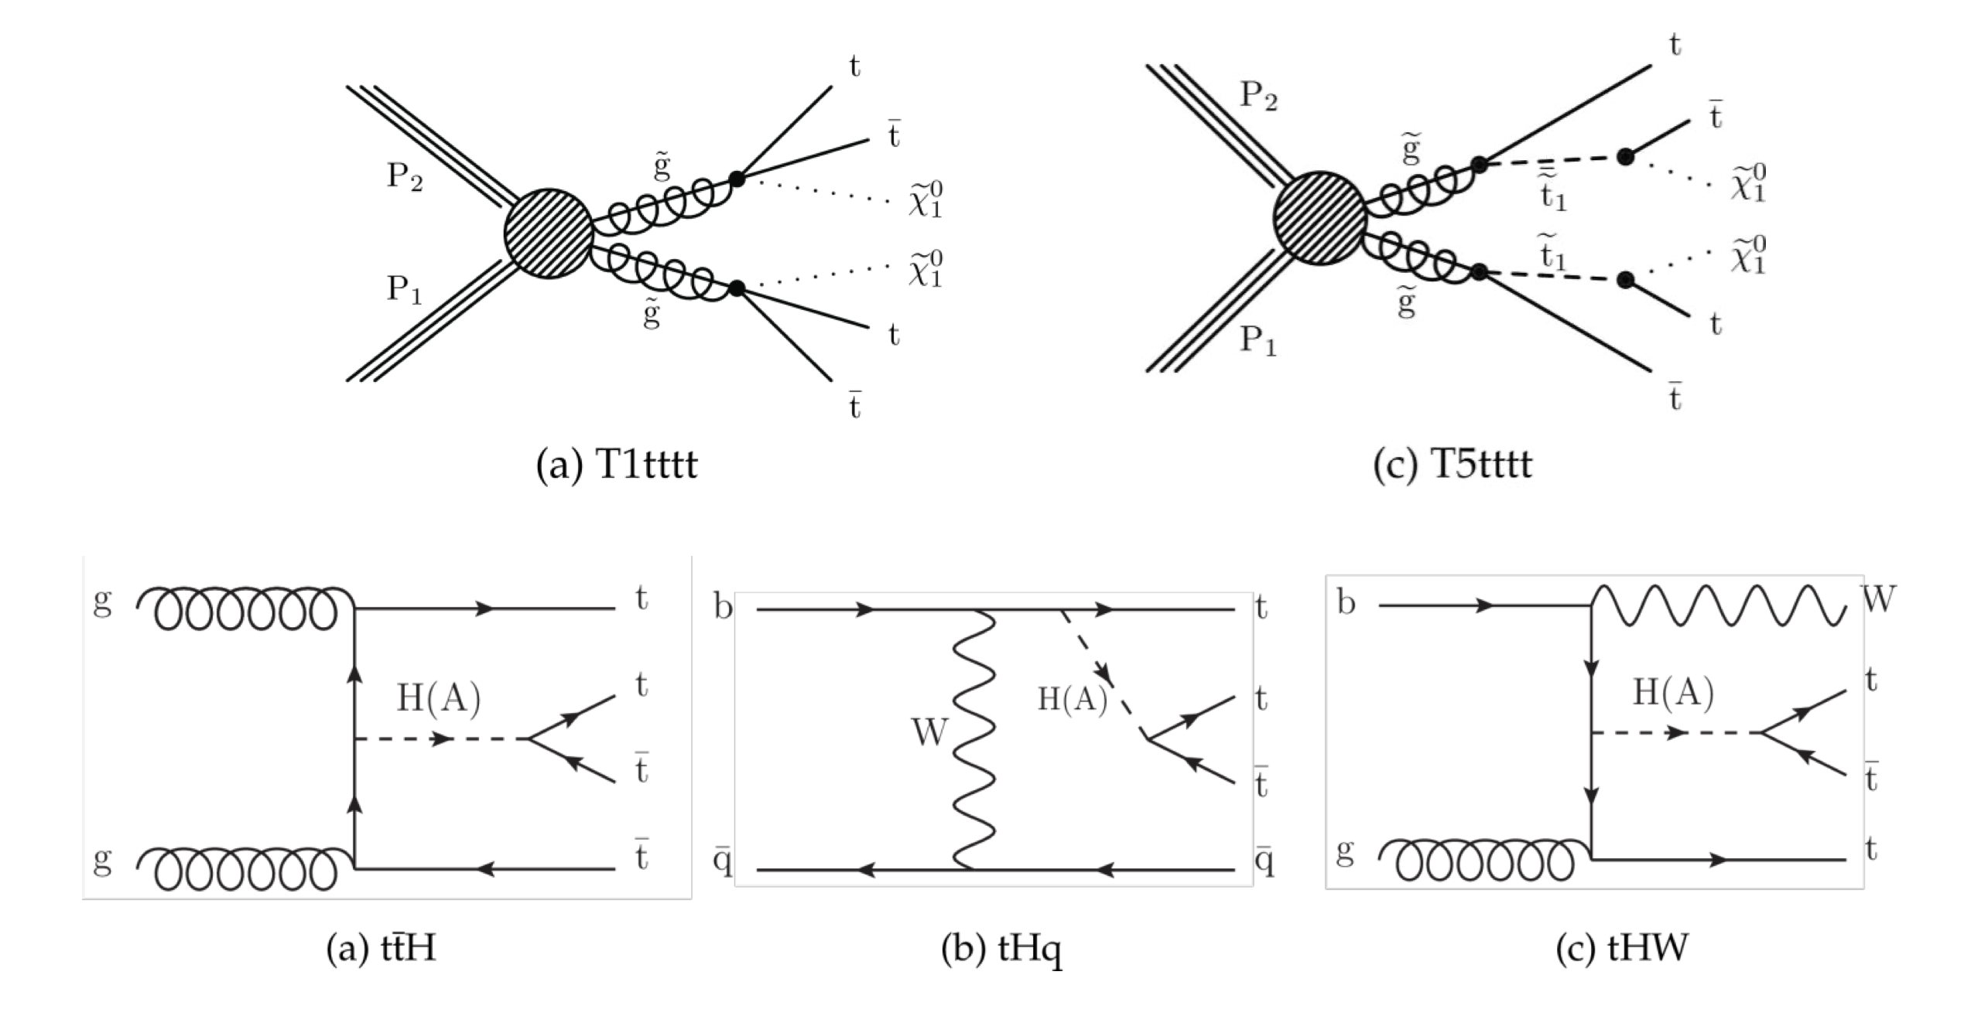
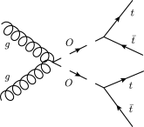
Four-top quarks beyond the SM
Gluino pair production
Pseudoscalar production in association with ttbar
Color-octet scalar states (sgluons)

Slide 4
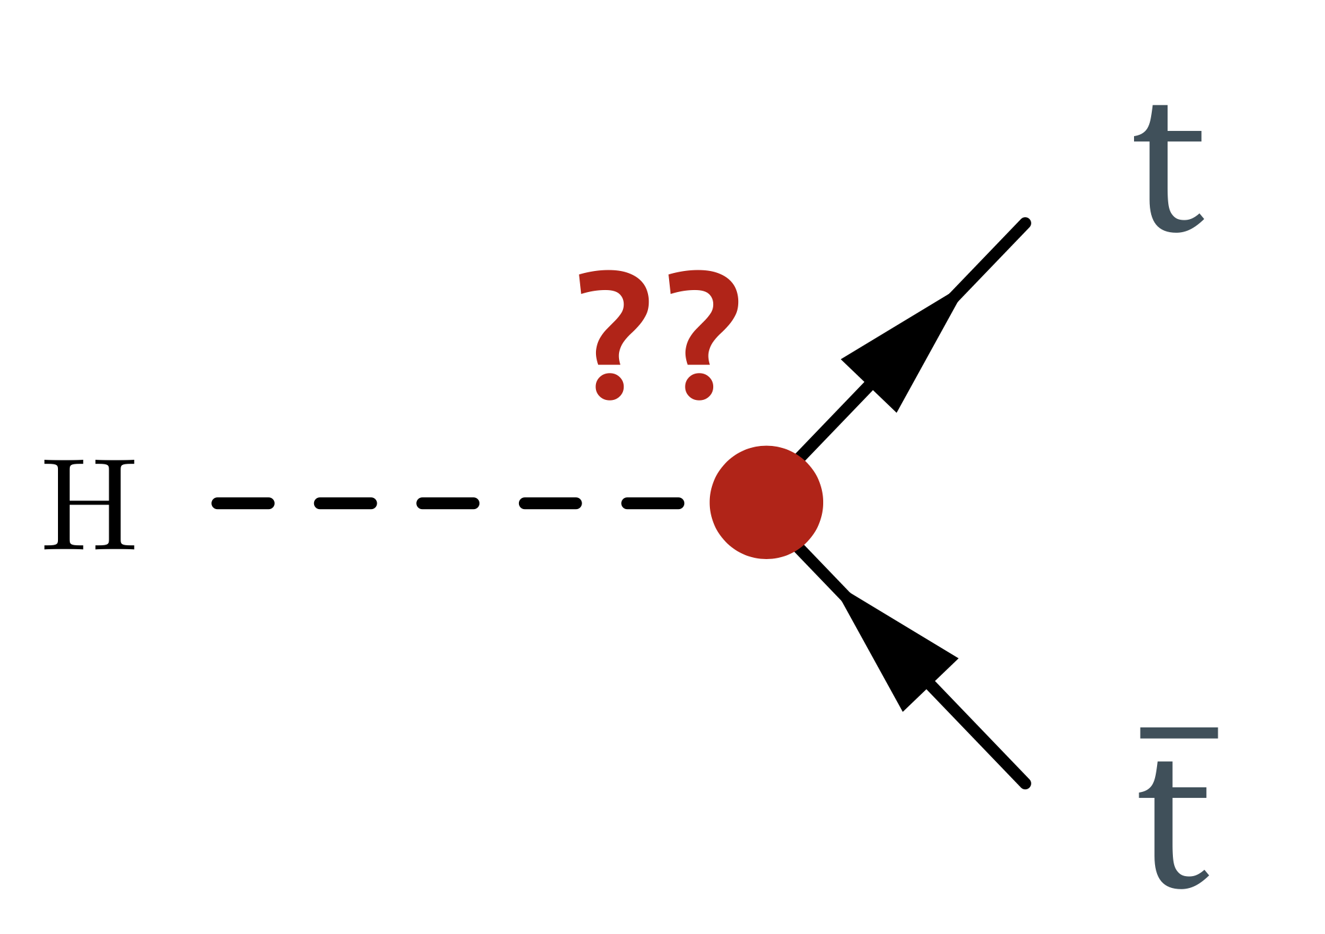
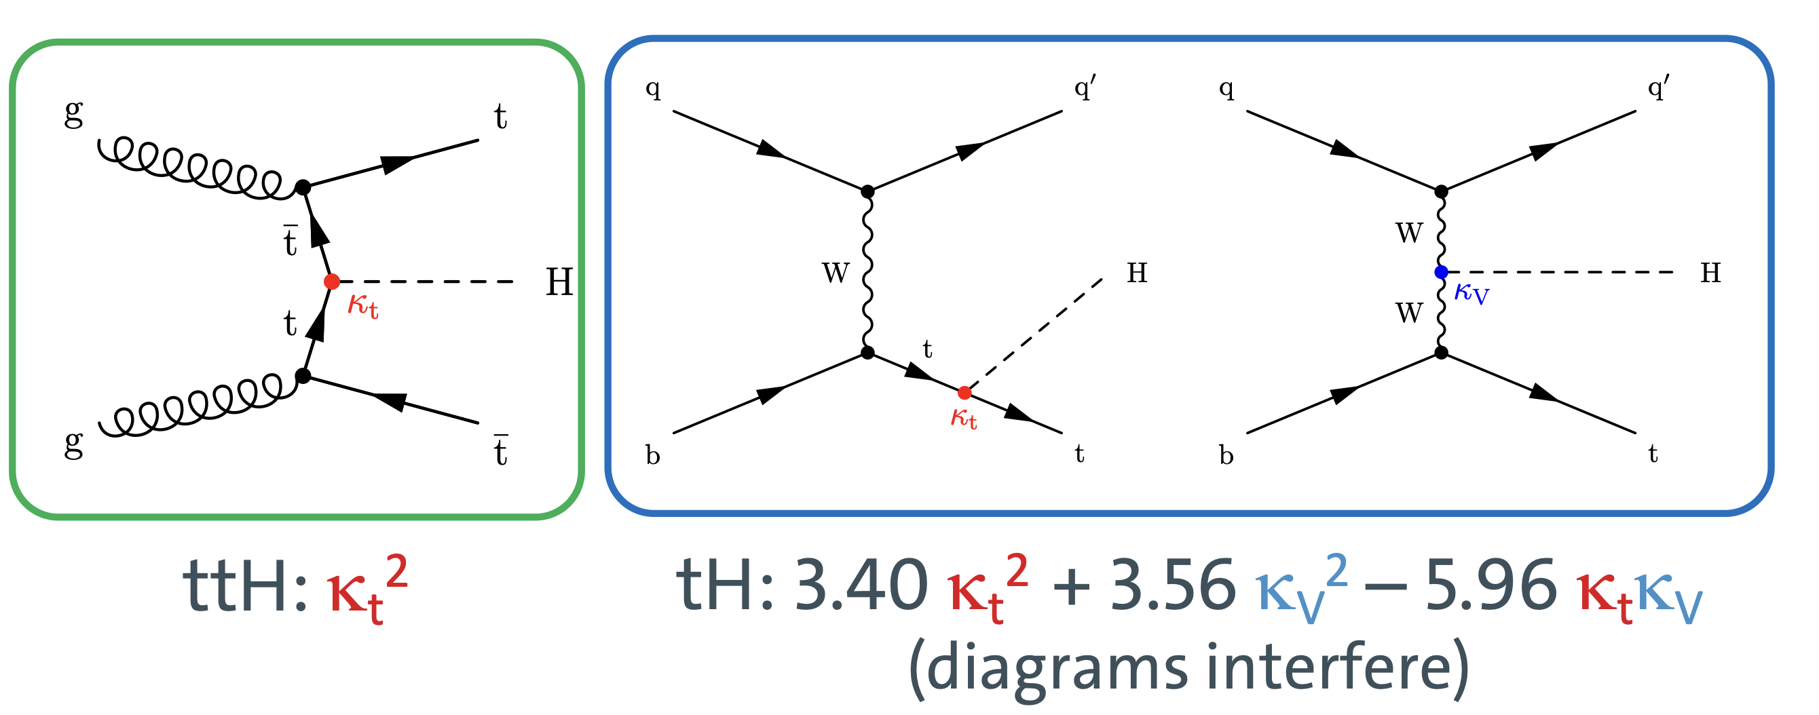
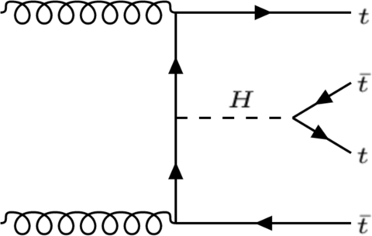
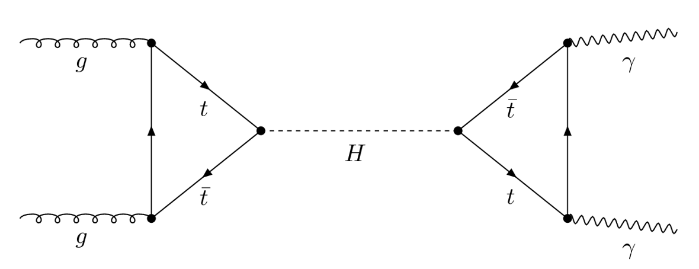
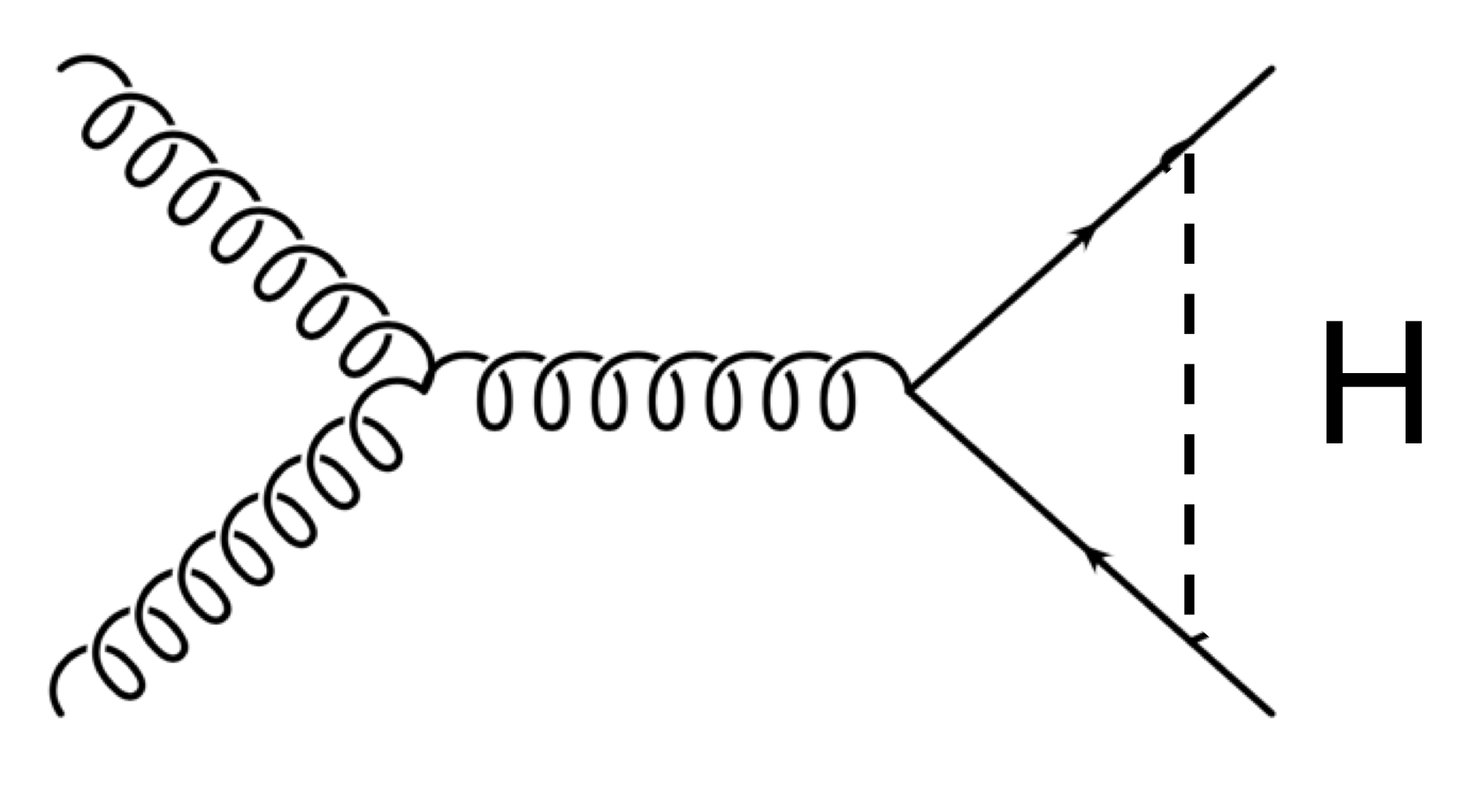
The top Yukawa coupling -- y_{t}
Top quark associated production ttH, tH
Virtual contributions to top quark production
Loop induced single Higgs process

Slide 5
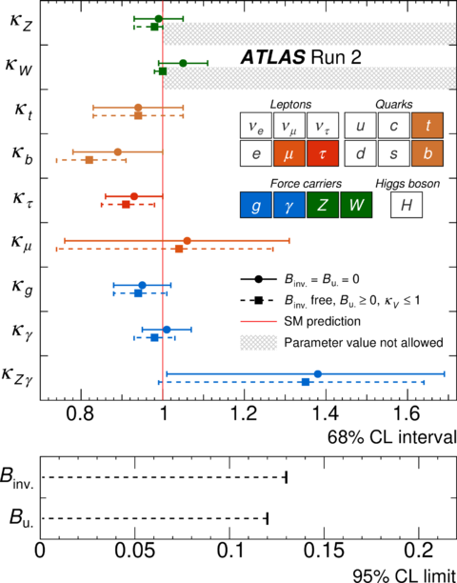
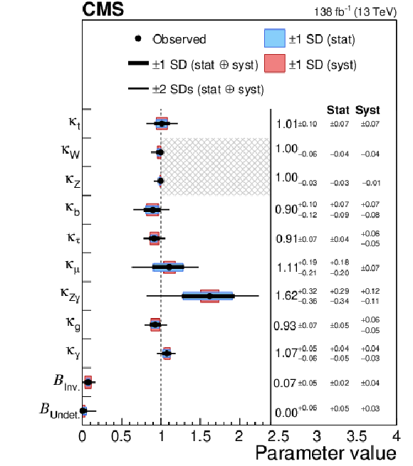
y_{t} from Higgs boson measurement
Nature 607 (2022) 52
Nature 607 (2022) 60
Extract y_{t} from Higgs combination fit
  Most precise
  Assumptions on particles in the loop, total decay width

Slide 6
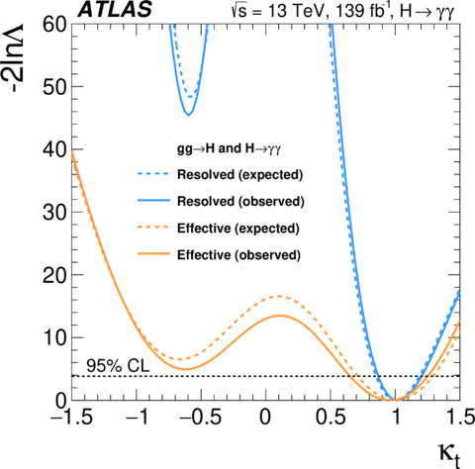
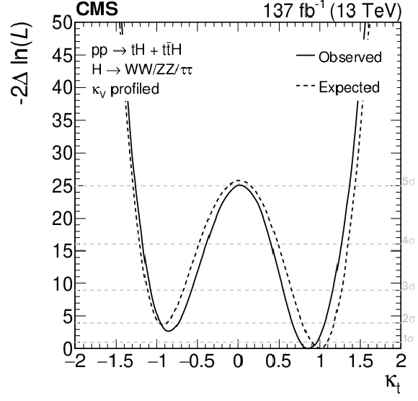
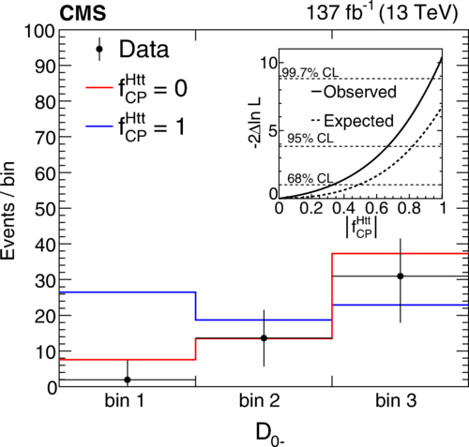
y_{t} from ttH, tH
Eur. Phys. J. C 81 (2021) 378
Phys. Rev. Lett. 125 (2020) 061801
JHEP 07 (2023) 088
Direct measurement of top Yukawa coupling and probes of CP structure.
  Dependent on other Higgs decays

Slide 7
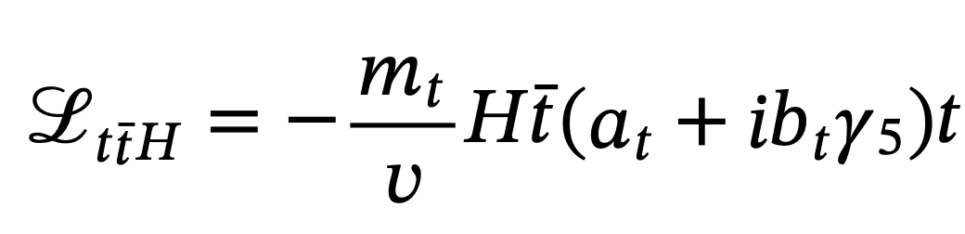
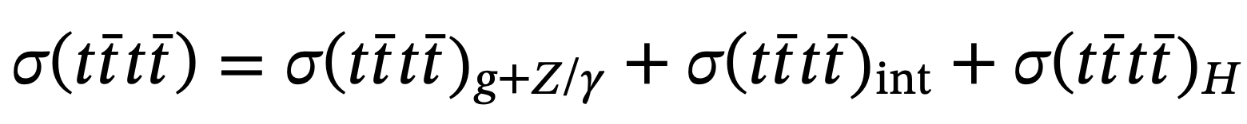
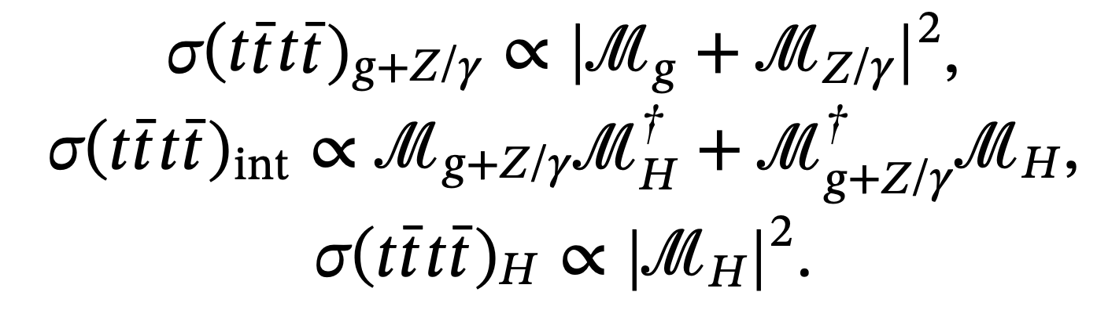
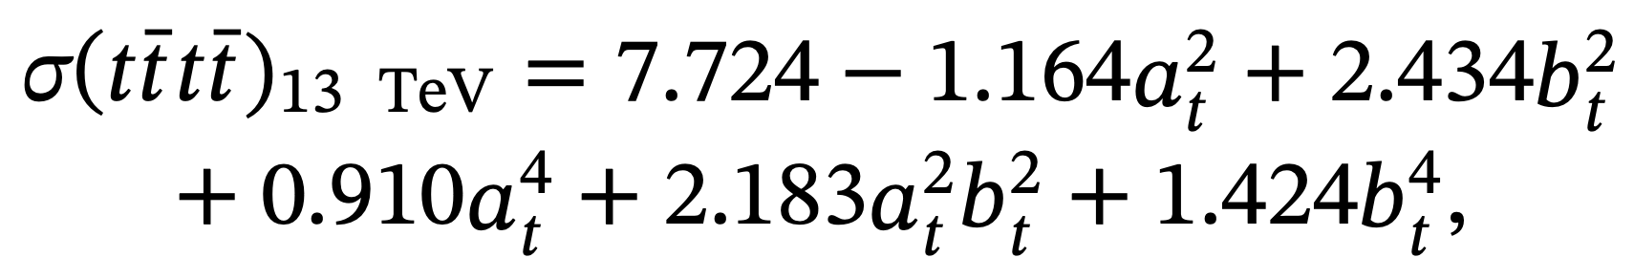
y_{t} from four-top quarks
MadEvent@LO
Only depends on top-Higgs coupling, independent of Higgs decay
Offers a probe to the CP phase of the top Yukawa coupling

Slide 8
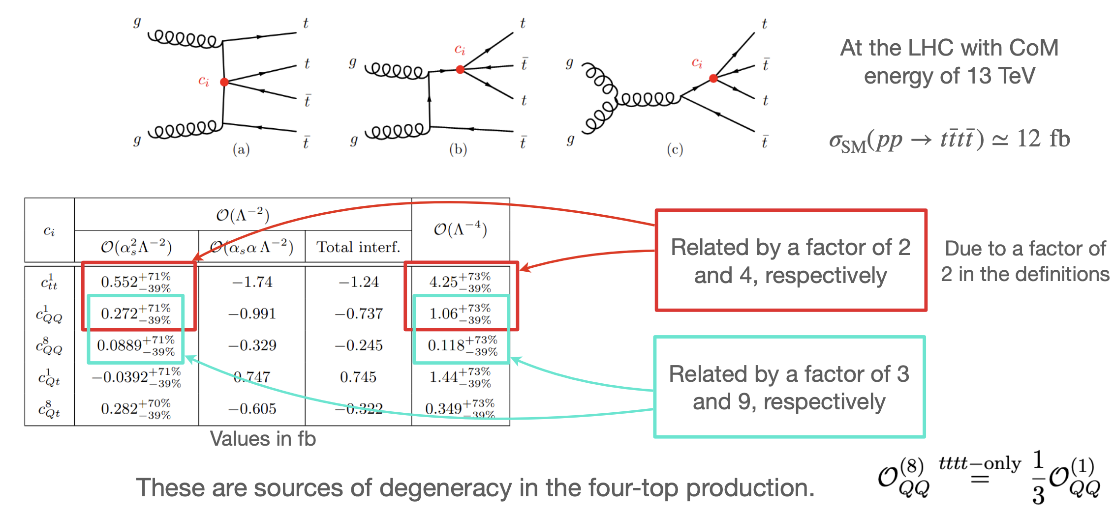
Four-top EFTs
Production enhanced by the high sensitivity of the process to four-quark operators

Slide 9
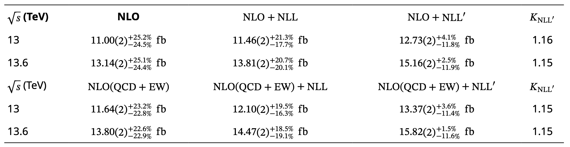
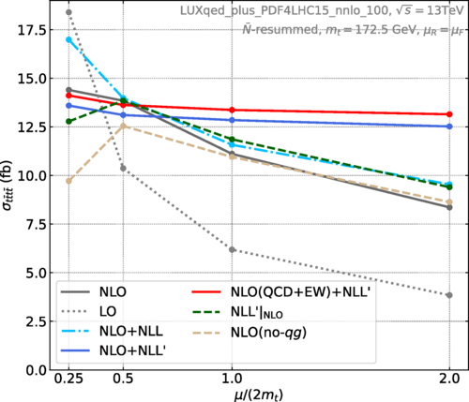
Four-top prediction at the LHC
Phys. Rev. Lett. 131, 211901
Large uncertainty due to scale variation
High order QCD corrections from soft gluon emissions
Next-to-leading logarithmic accuracy
Constant 𝒪 (𝛼_{𝑠}) nonlogarithmic contributions do not vanish at threshold
Electroweak corrections are included up to 𝒪(𝛼²)
Reduction of scale unc by a factor of 2
15% correction to NLO result

Slide 10
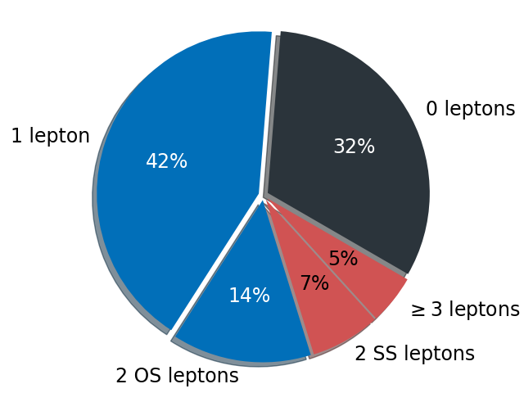
Four-top production at the LHC
Heaviest final state observed at the LHC
Large object multiplicity: tttt→W⁺W⁻W⁺W⁻bbbb
  High event hadronic activity and sphericity
Significant background from QCD and ttbar
Final states defined by lepton multiplicity
  0L: All hadronic W decays
  1L+OS2L: largest branching fraction
  SS2L+ML: clean background
Heavy use of machine learning techniques
  BDTs (CMS) and GNNs (ATLAS) for signal identification
  NNs for top tagging

Slide 11
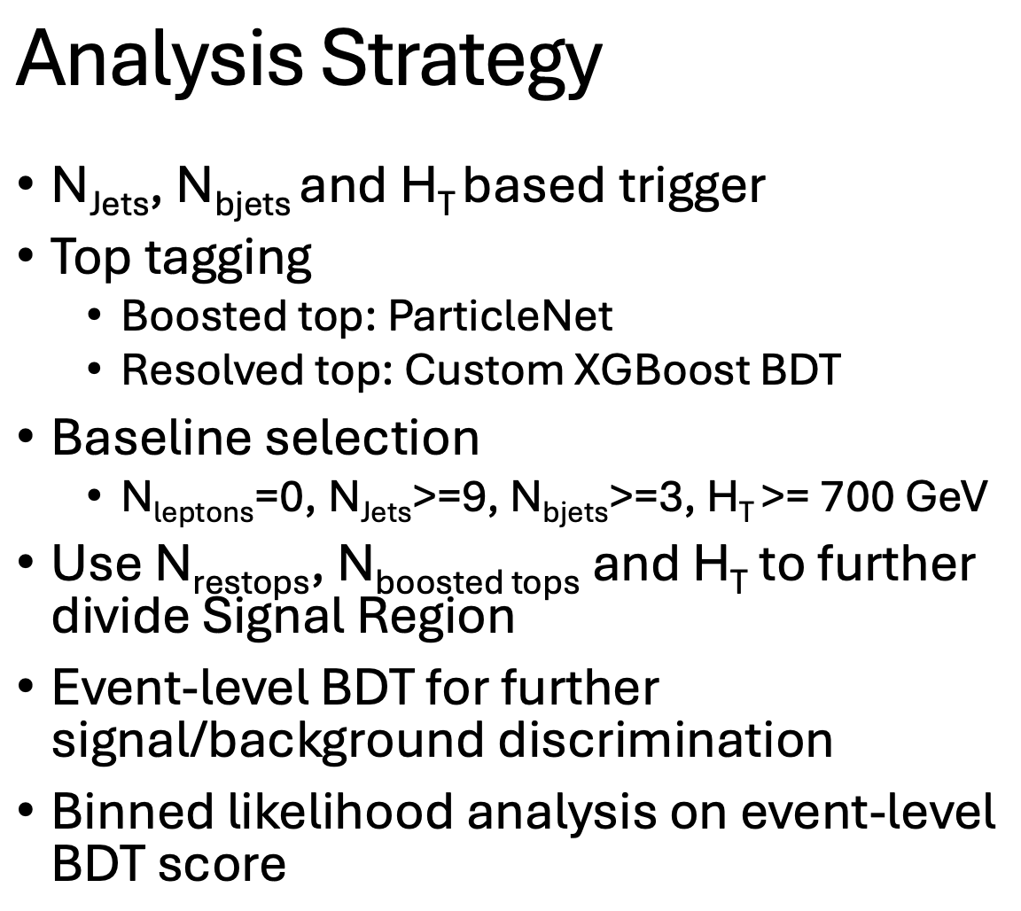
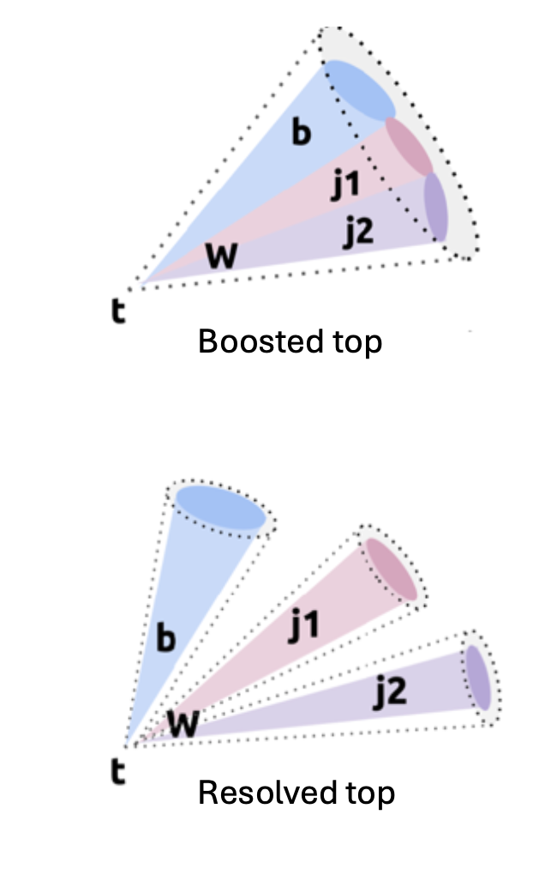
I.1 CMS all hadronic search
UCSB, Korean U.
*Run3 preapproval
Challenge
  Huge irreducible QCD + ttbar background
  QCD simulation not well modeled in high jet multiplicity region

Slide 12
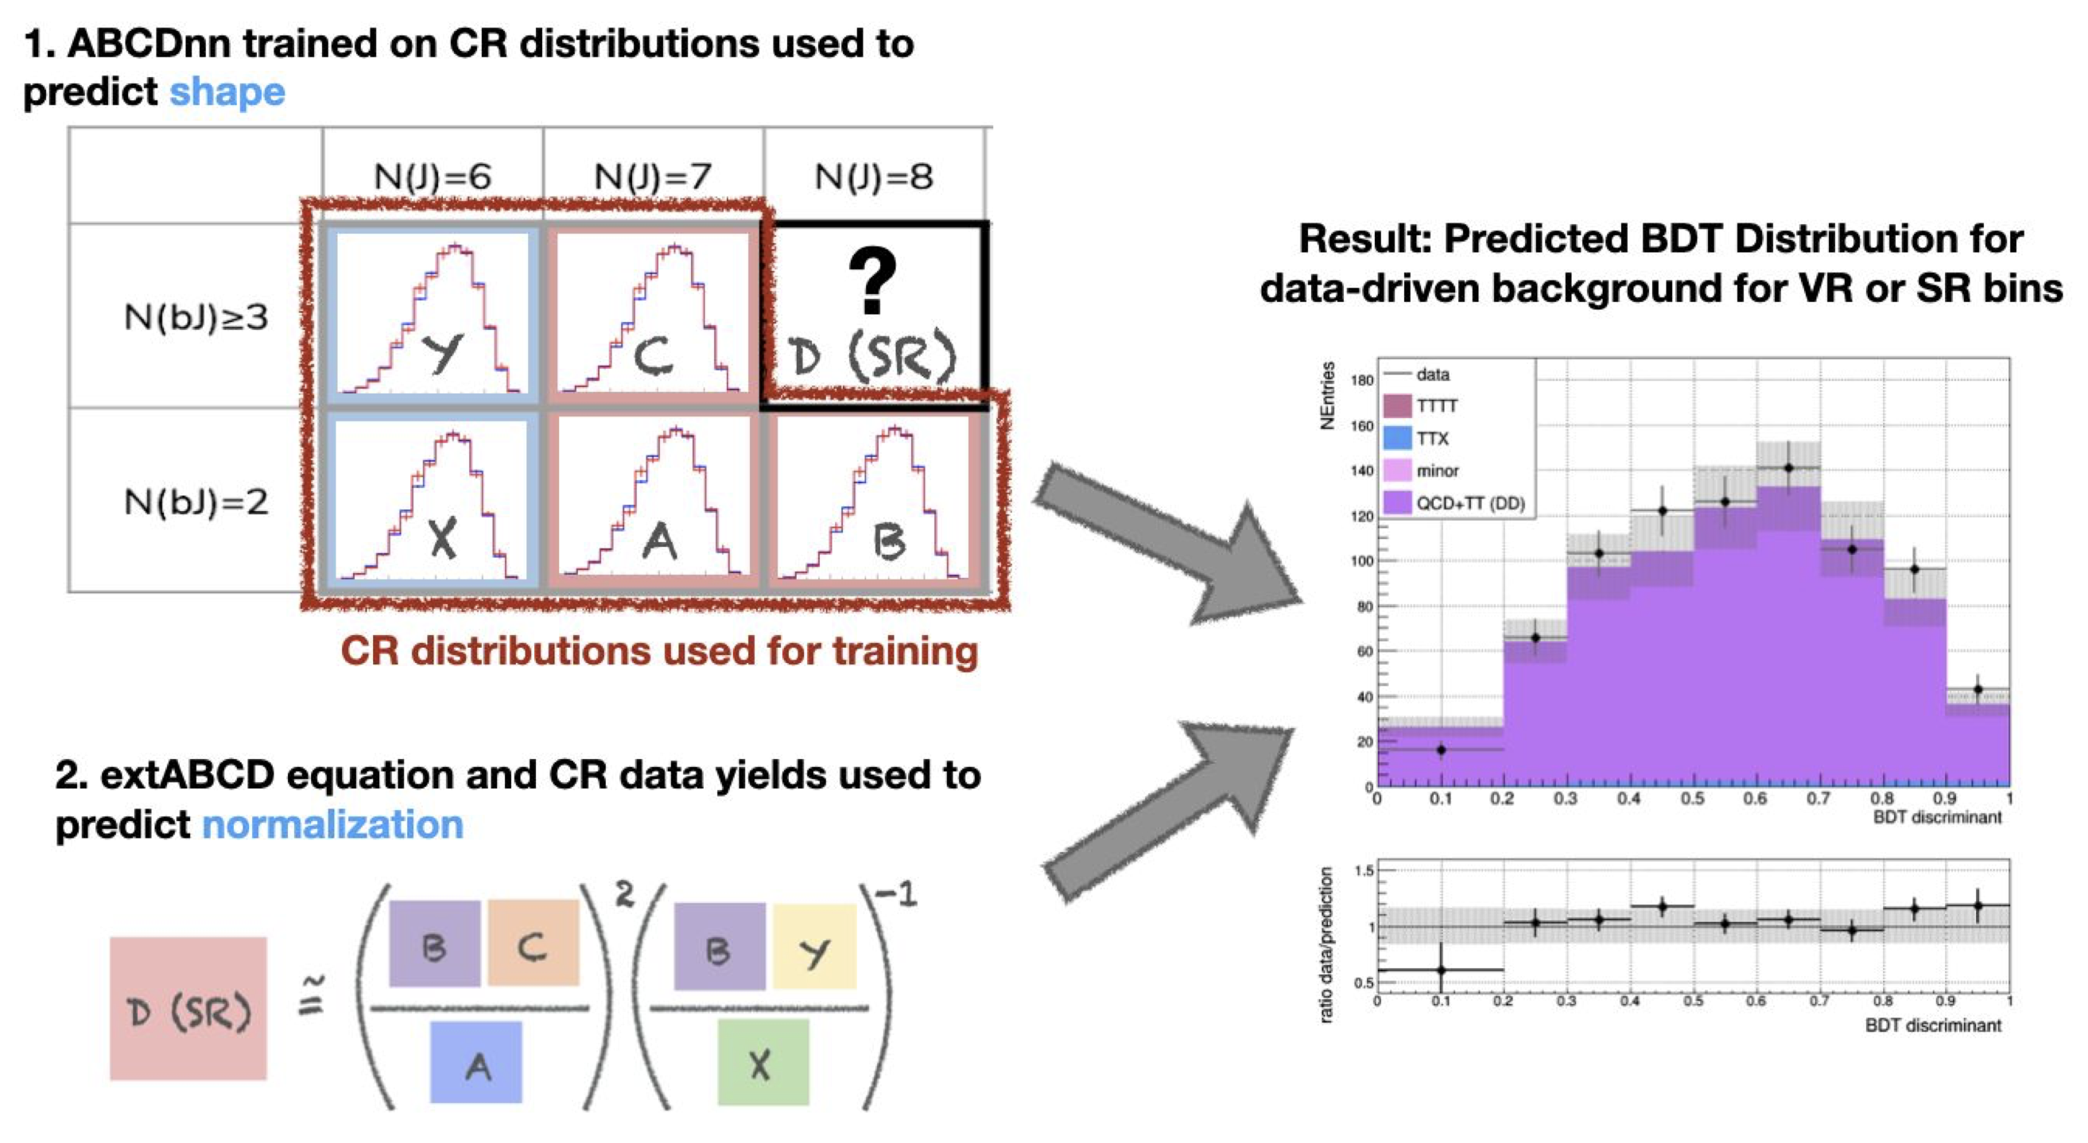
I.1 CMS all hadronic search
UCSB, Korean U.
Data driven background estimation

Slide 13
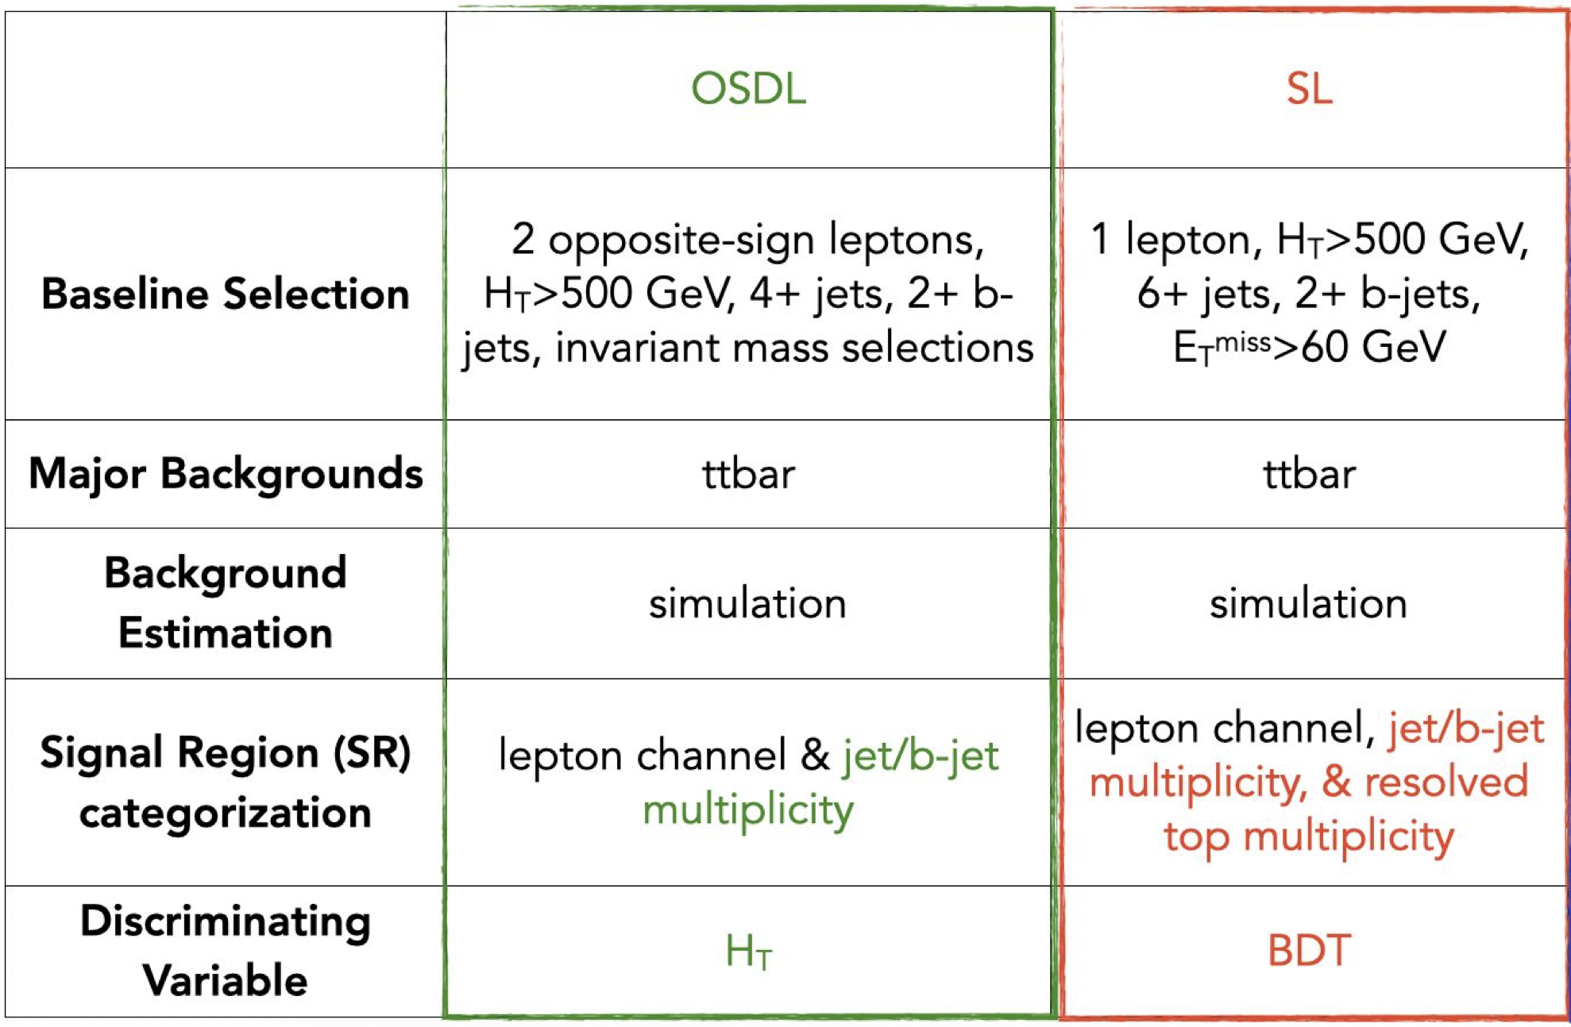
I.2 CMS 1L & OS2L searches
Brown U.
UC Riverside
Comparing to 2016 search, new resolved top tagger and finer categorization

Slide 14
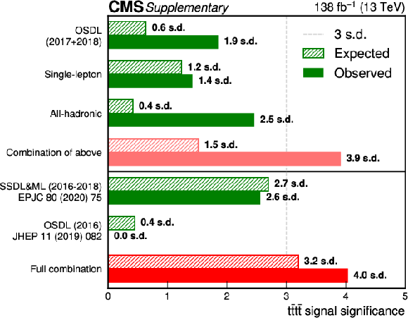
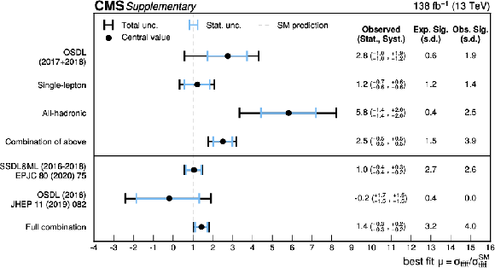
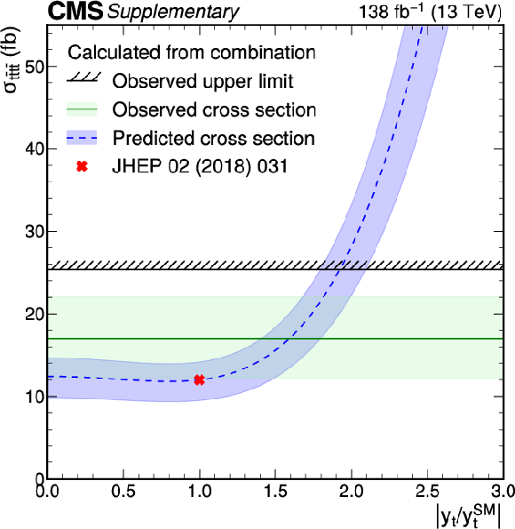
I.3 Combination of 0L, 1L & OS2L
Vrije U. Brussel, Chulalongkorn U
Set an evidence of tttt at CMS
Result used to constrain y_{t}
*Whole analyses period 2019-2022

Slide 15
II. CMS search in SS2L & ML
Ghent U.
Re-analysis of full Run2 dataset with improvements on
  Legacy event reconstruction: better calibration & correction
  Deepjet for b tagging: higher efficiency
  TOP leptonMVA ID: suppress non-prompt leptons
  Analysis methods
Multi-classification with BDTs in signal region
  3 classes: tttt, ttV, ttbar with misidentified lepton

Slide 16
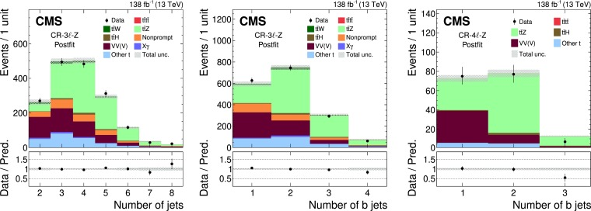
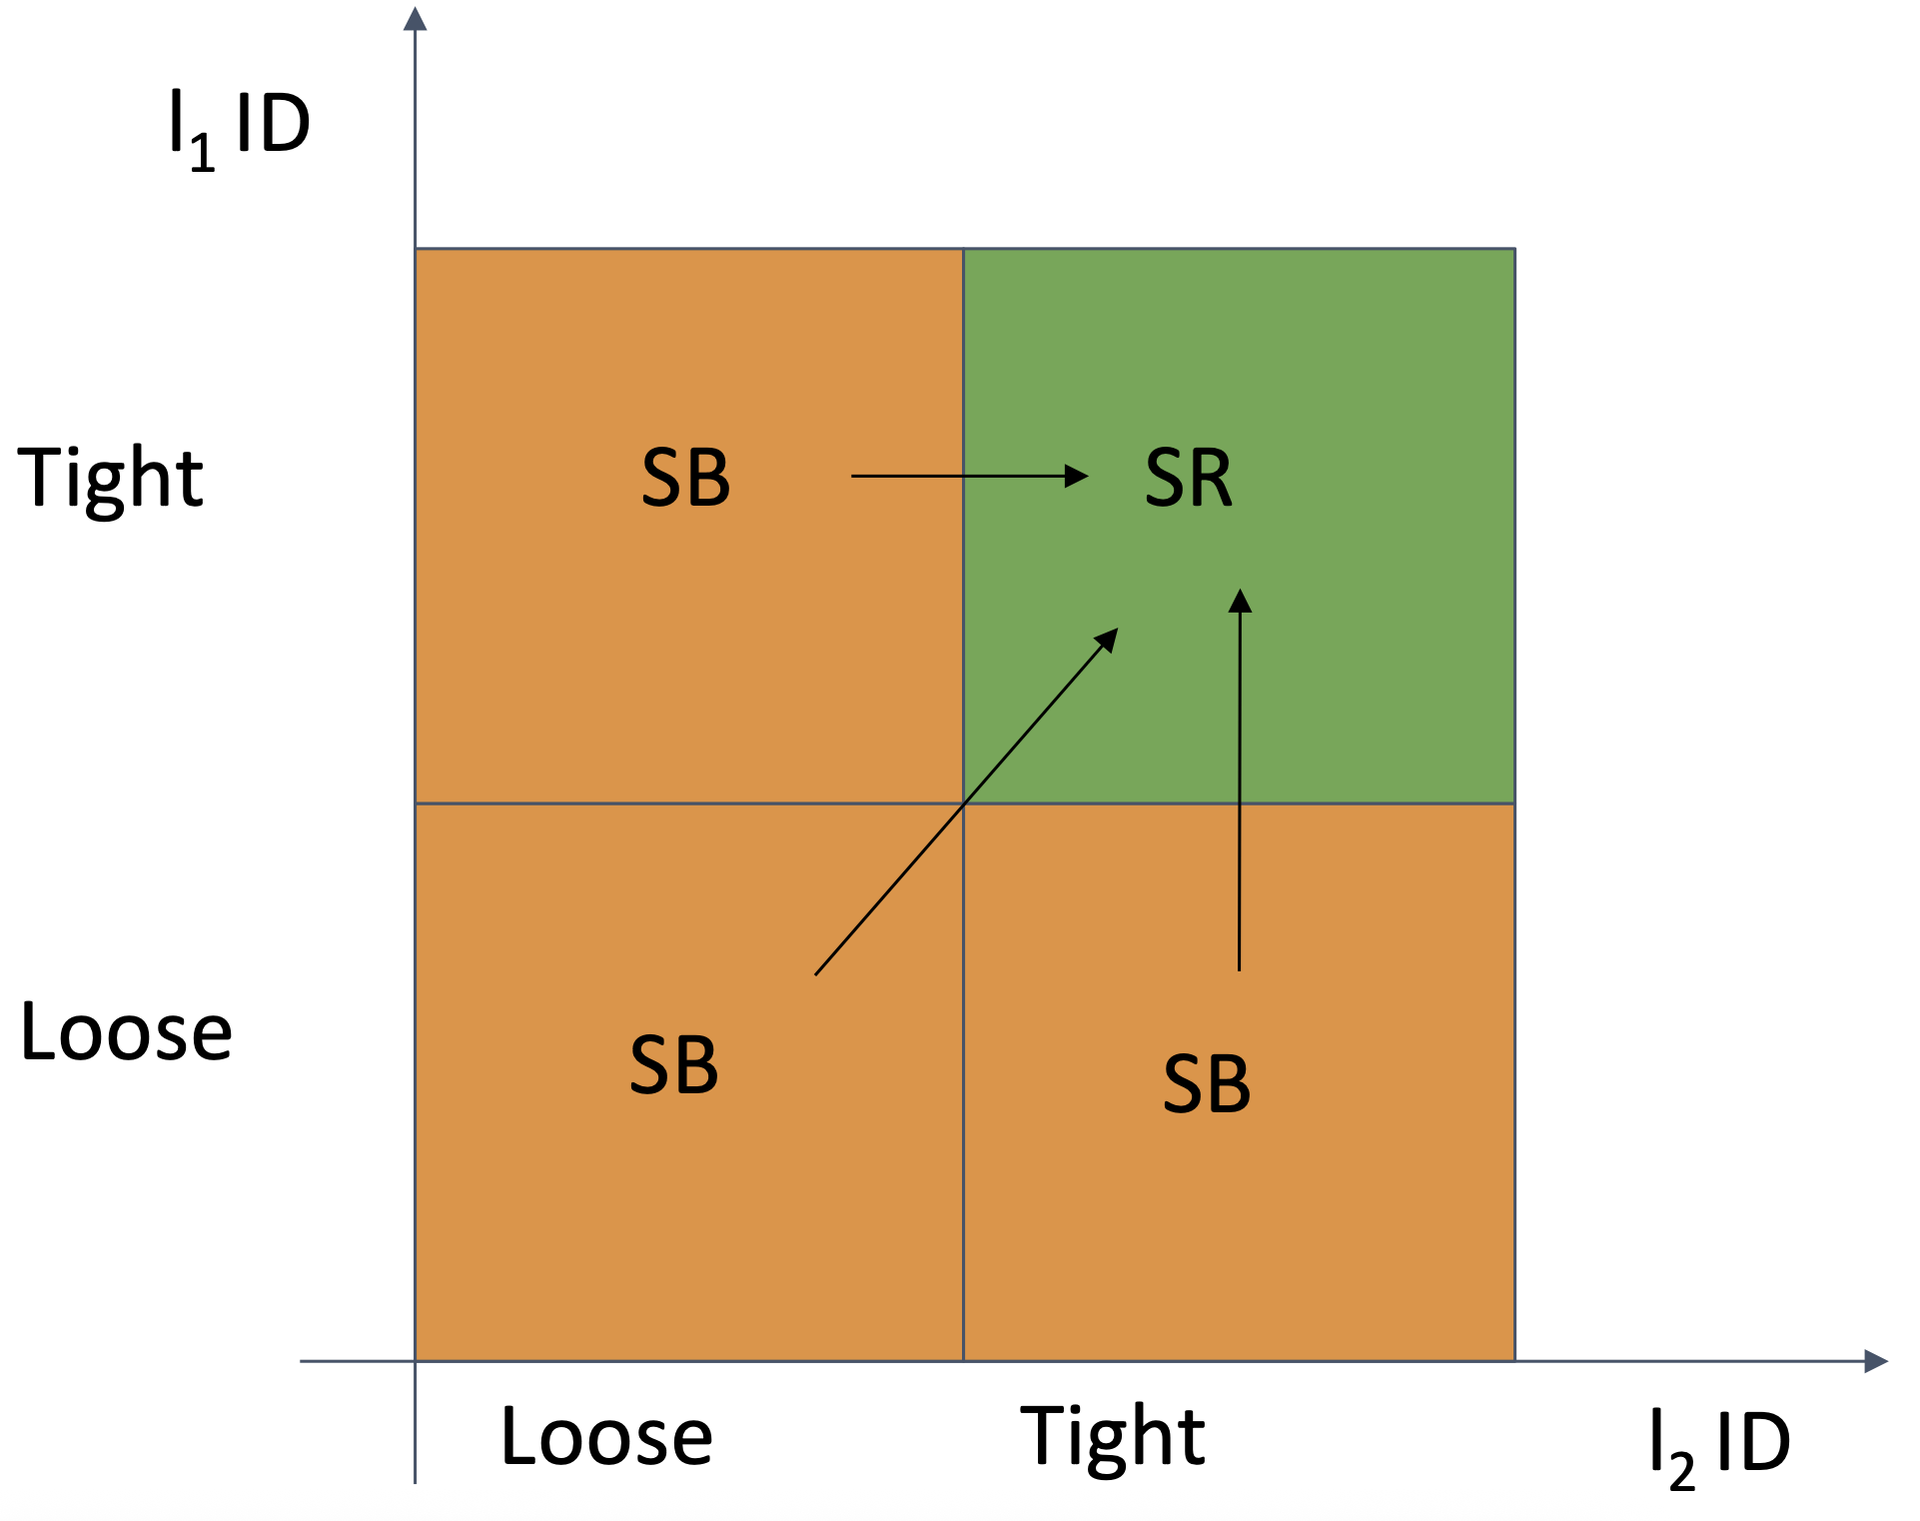
CMS background estimation
Prompt (leptons) background:
  Estimated from MC simulation,
  ttW in 2l&3l channels; ttZ in 3l&4l channels, free floating in the statistical fit
  ttt and other single top associated processes
  WZ in 2l&3l channels, ZZ in 4l channels
Non-prompt (leptons) and charge mis-ID background
  Fake rate method

Slide 17
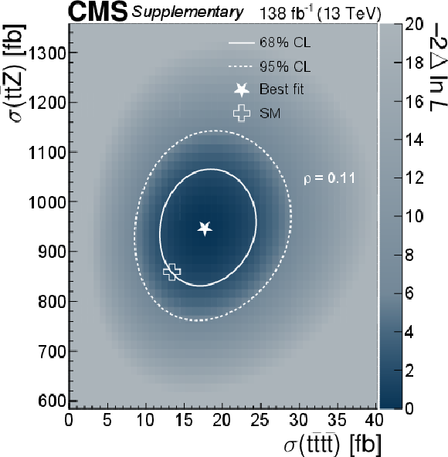
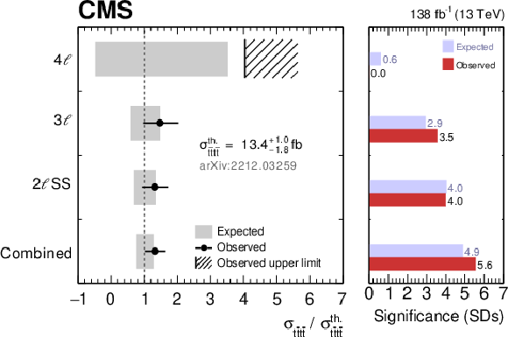
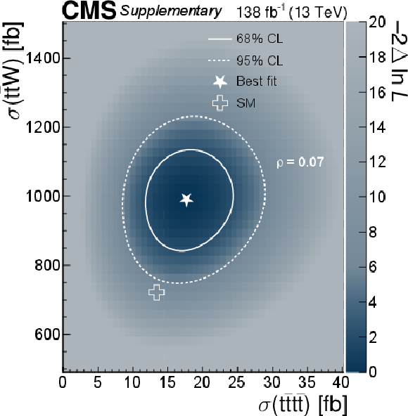
CMS signal extraction
First observation of tttt at CMS

Slide 18
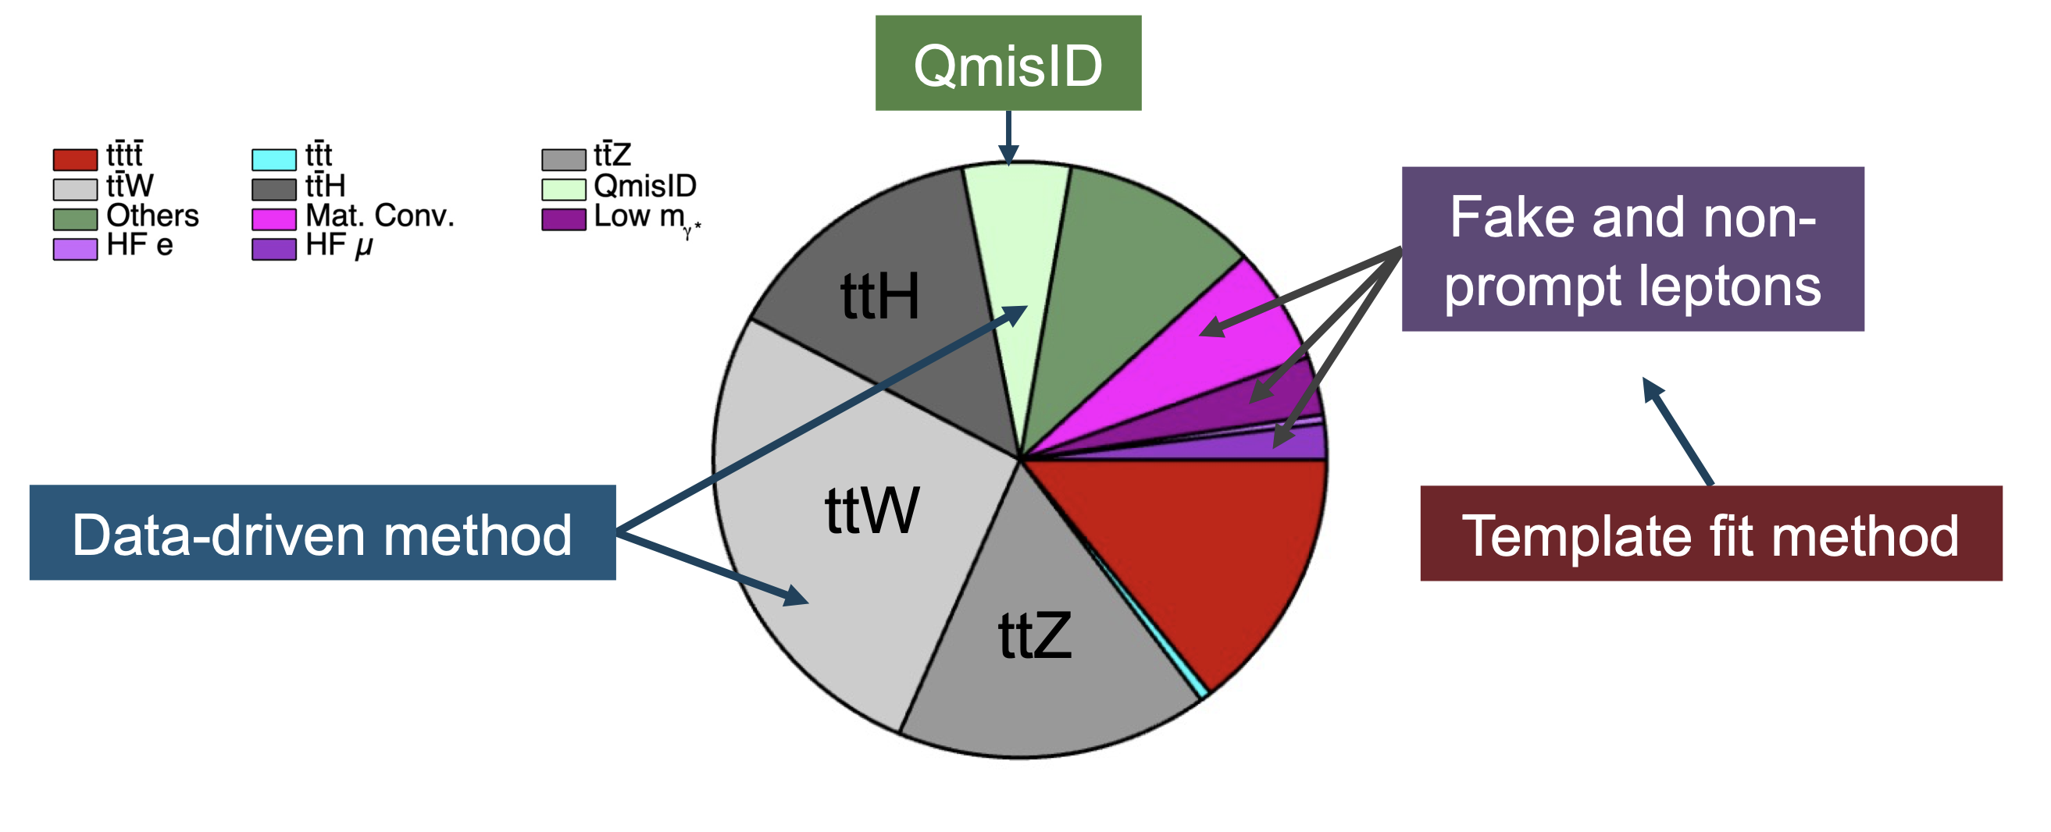
III. ATLAS search in SS2L & ML
Background modeling:
ttW jet multiplicity distributions corrected using data
Template method to estimate non-prompt background
  CRs included in fit to determine the normalization of these components
Charge mis-assignment background
  From charge flip rate in data

Slide 19
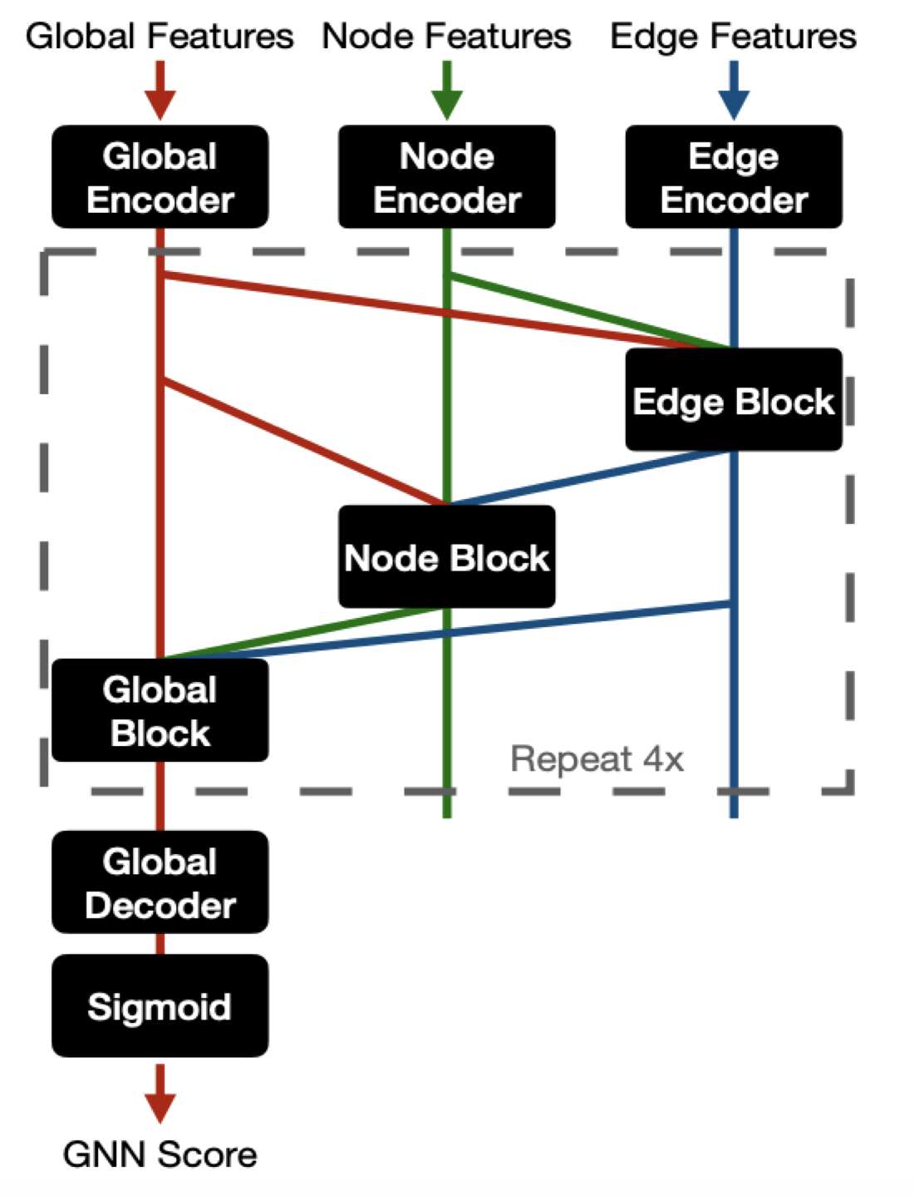
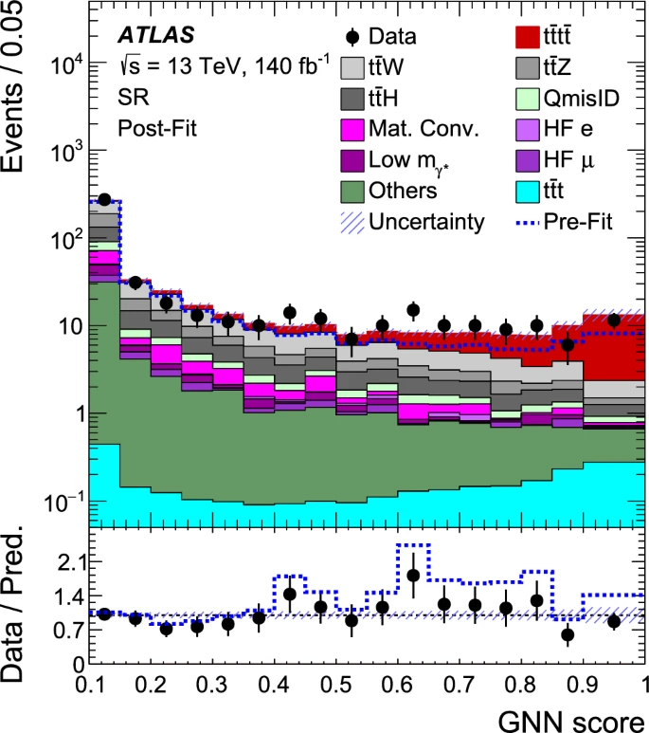
ATLAS signal extraction
GNN is constructed to combine the information about objects (jets, lepton, MET) in an event into graphs, with node, edge, and global properties.
Signal, background normalization, ttW modeling in one fit

Slide 20
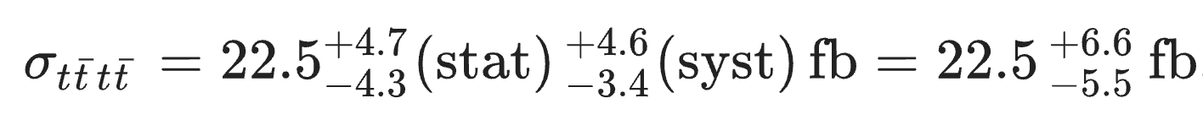
ATLAS search result
First observation of tttt at ATLAS

Slide 21
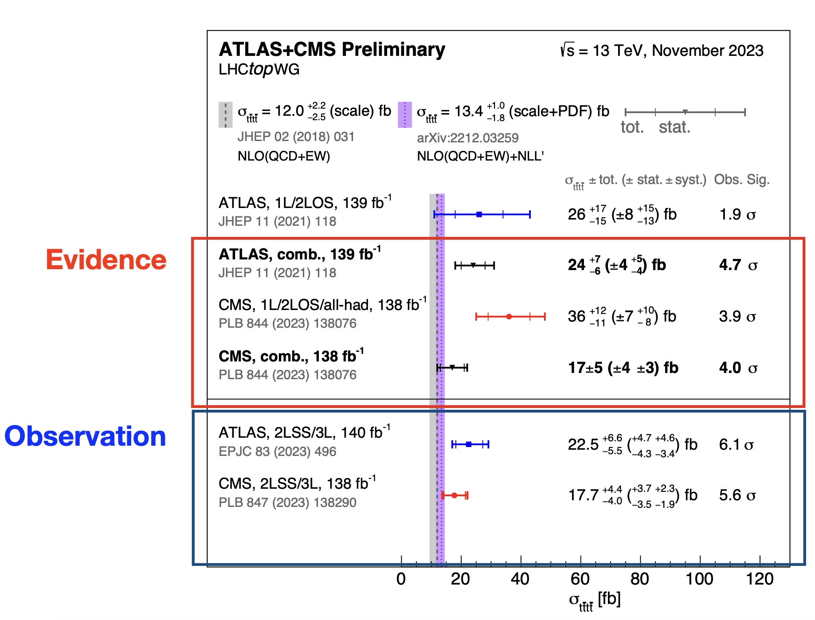
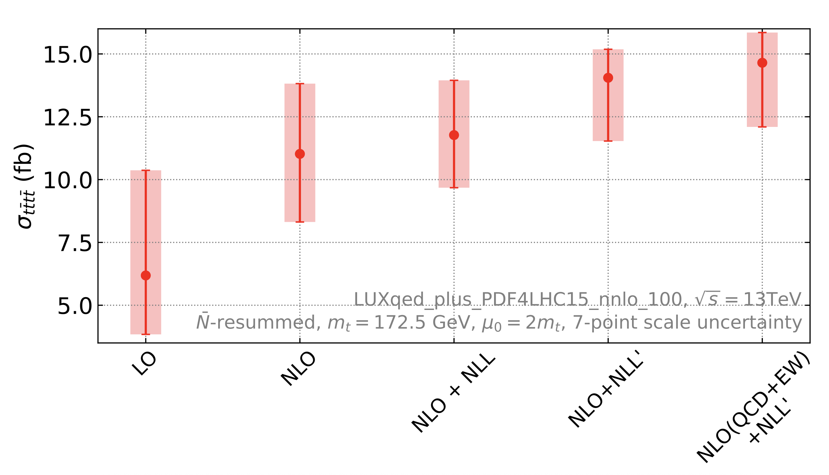
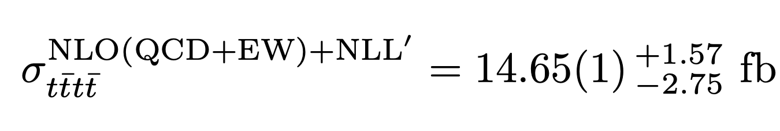
Four-top searches summary
@NLO(QCD+EW)+NLL’
Still agree with SM within 1.8sigma.
Can we really see hints of BSM through tttt?
At least can probe y_{t} and test perturbative QCD from it!

Slide 22
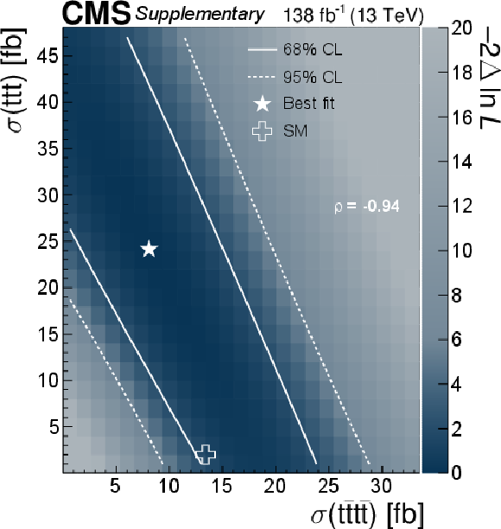
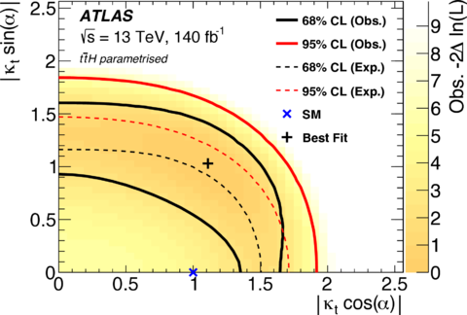
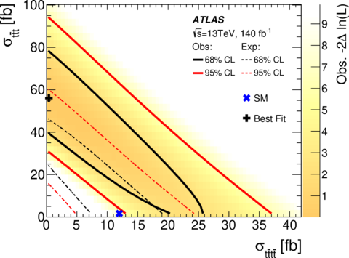
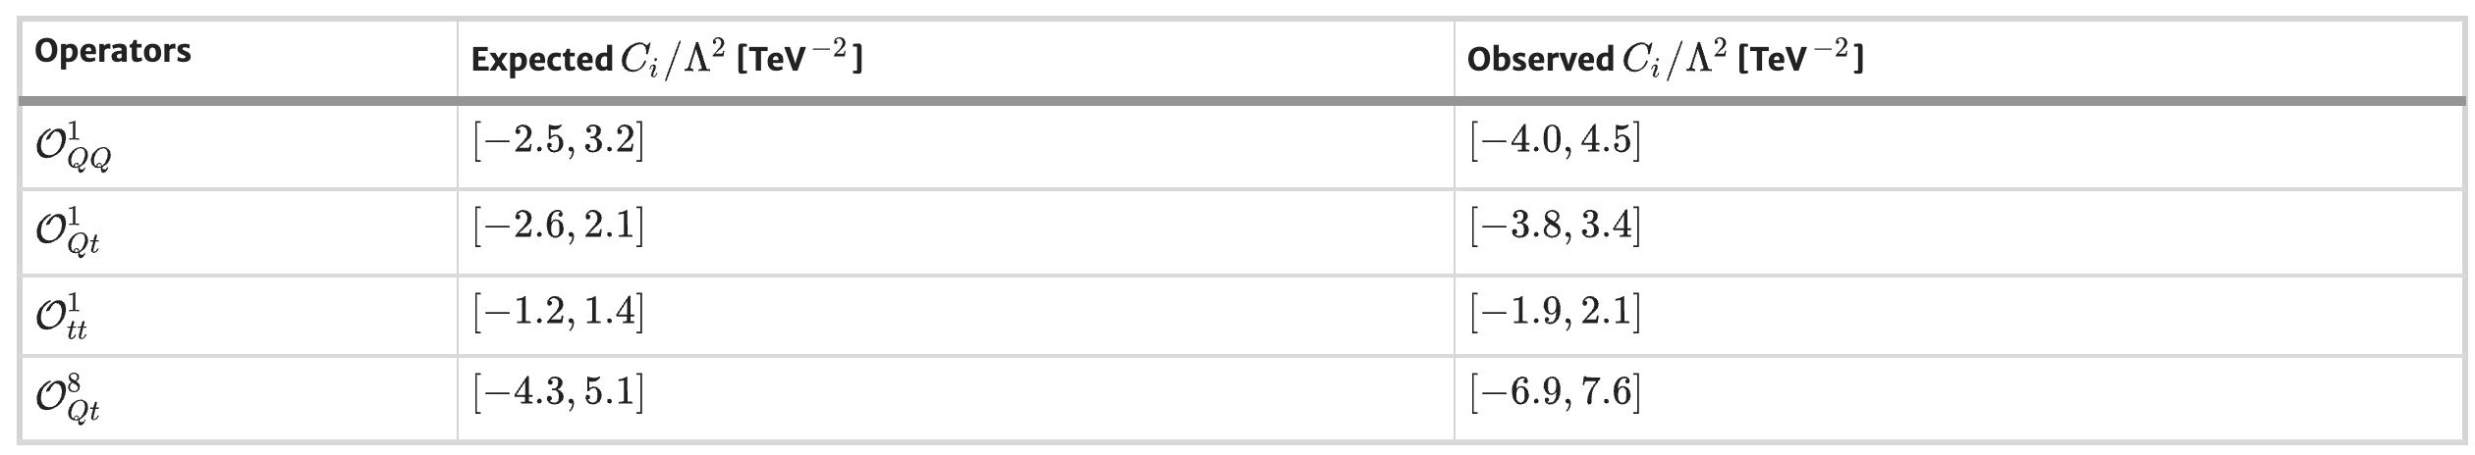
Result interpretation
CMS has better handling of 3 tops
ATLAS result used to constrain the top Yukawa CP structure
ATLAS result used to constrain the EFT four-top Wilson coefficients
CMS EFT and BSM constraints underway
Interpretations rely on the order of four-top theoretical calculations

Slide 23
Future aspects
Production xsec of tttt increase by 30(19)% from 13TeV to 14(13.6)TeV
  This increasement for most background is smaller → expect better signal to background ratio
Higher CoM leads to partons at lower Bjorken x values enter the phase space for tttt production
  Improved theoretical uncertainties related to PDFs
Better understanding of ttW and ttZ from Run2 studies
  Improved background modelling in the jet multiplicity region of tttt
LHC/HL-LHC is the only place to experimentally study four-tops till FCC-pp or SppC in the distant future

Slide 24
Outlook @ Run3
Twice the size of dataset at Run3
SS2L + ML @ Run3: taken by CERN+Ghent+KIT
0L @ Run3: GoingToPreApp by the Run2 UCSB/KU group
1L @ Run3: no news from Brown group, Vrije interested
OS2L @ Run3: PIs retired from UCR

Slide 25
Thank you for your attention!

