Slide 1
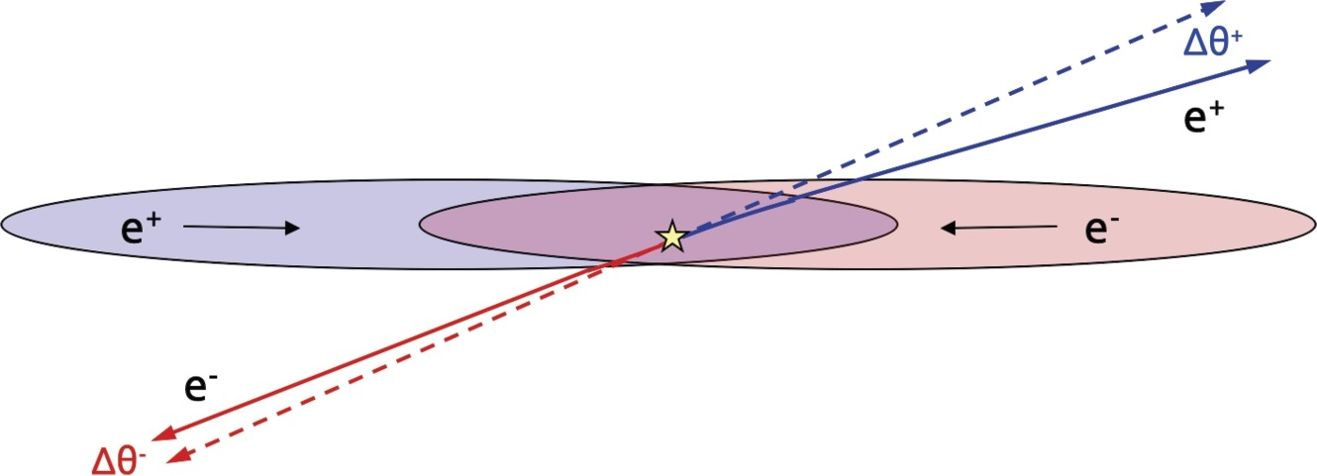
GuineaPig++ Bhabha Deflection
Wang Yilun (Nanjing University) Zhang Lei (Nanjing University)

Slide 2
Contents
Introduction
GuineaPig++ Configuration
Deflected Bhabha
Conclusion

Slide 3
Introduction
In $e^{+}e^{−}$ collisions, bunches deflects Bhabha scattered electrons and positrons by its large charge density, which bias the luminosity measurements
In LEP, this effect yield an underestimation of integrated luminosity by about 0.1 %
GuineaPig (Generator of Unwanted Interactions for Numerical Experiment Analysis – Programme Interfaced to GEANT) simulates the interaction of two colliding ultra-relativistic beams
Notes:
在正负电子对撞过程中，束团具有很高的电荷密度，会偏转bhabha散射的正负电子，从而影响亮度测量。在LEP上，这种效应使得积分亮度被低估了约%0.1。guineapig就是对两极端相对论束团之间的相互作用进行模拟的软件，被用于模拟这一过程。

Slide 4
Introduction – GuineaPig++
GuineaPig++ is the C++ conversion of GuineaPig
Version GuineaPig++ 1.2.2
https://gitlab.cern.ch/clic-software/guinea-pig/
The GuineaPig++ on IHEP Compute Cluster is 1.2.1
Notes:
guineapig++是guineapig改为c++语言后的版本，目前使用的版本是guineapig++ 1.2.2。高能所集群上的版本是1.2.1

Slide 5
Introduction – FCC
Acceptance (Theta): 62-88 mrad (wide) 64-86 mrad (narrow)

Slide 6
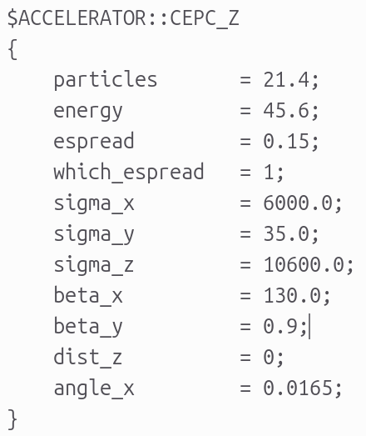
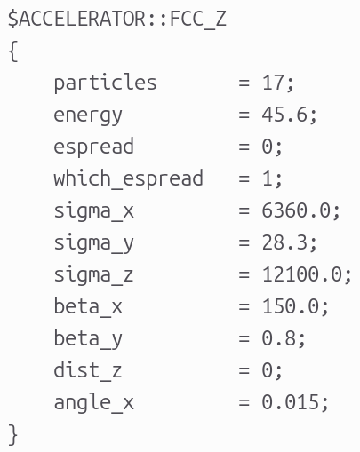

Slide 7
Deflected Bhabha - Input
BHLUMI
$\sqrt{s}=240 GeV \left(H\right), 160 GeV \left(W\right), 91.2 GeV (Z)$
$20<θ<120 mrad$
$20000$ Events
Boosted to lab frame
Notes:
使用BHLUMI产生事例，质心能量分别设置为240GeV，160GeV 和 91.2 GeV，theta范围为20-120 mrad，产生20000个事例，boost到实验室坐标系

Slide 8
Deflected Bhabha - Results
Higgs mode, 2 Runs, each 20000 events
GuineaPig++ output $5317+5280=10597$ Events, $21194$ Particles
W mode, 2 Runs, each 20000 events
Output $9615+9601=19216$ Events, $38432$ Particles
Z mode, 20000 events
Output all $20000$ Events
Notes:
进行两次计算，每次输入20000个事例，然而软件总共只对其中5317+5280=10597个事例进行计算，共21194个粒子。对W模式

Slide 9
LAB Frame
$$25<θ<100 mrad$$
$\left|y\right|>25 mm @ z=1000 mm$

Slide 10
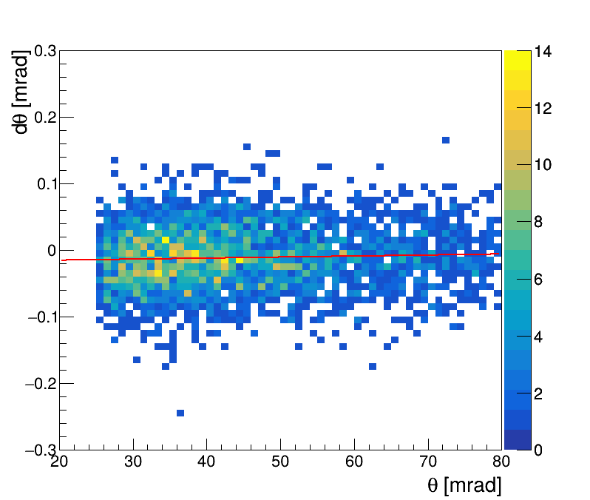
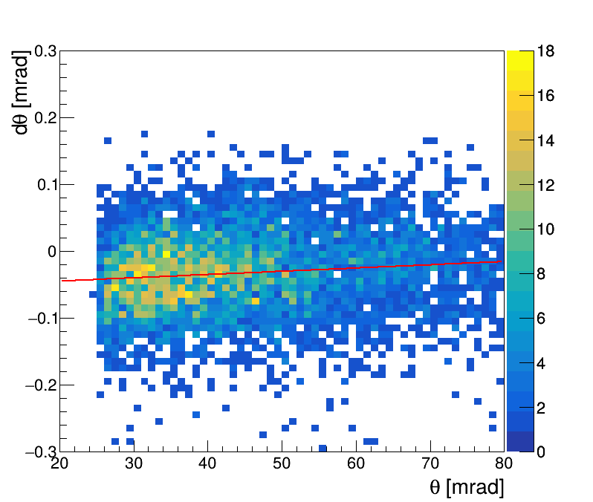
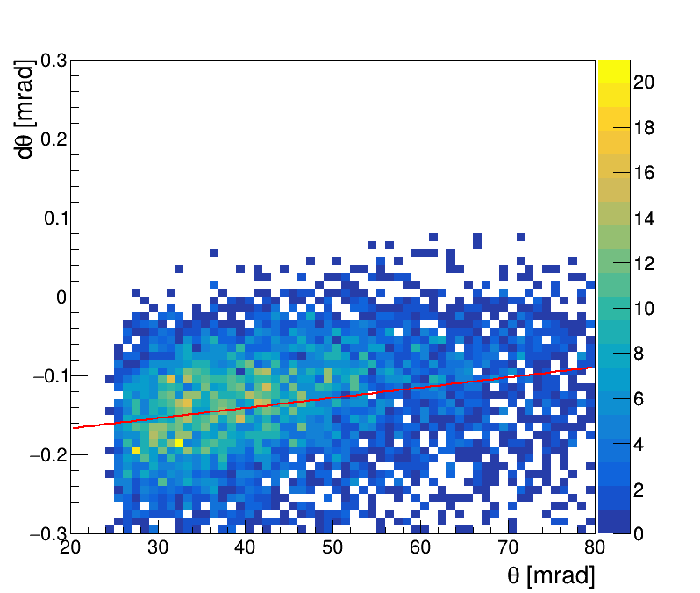
Deflected Bhabha – dTheta
Cuts : $25<θ<100 mrad \left|y\right|>25 @ z=1000 mm$
H mode W mode Z mode
H : $dθ=0.15501×{10}^{−3} θ−0.0181886$
W : $dθ=0.46606×{10}^{−3} θ−0.0541699$
Z : $dθ=1.2886×{10}^{−3} θ−0.192132$
Notes:
这是三种模式下偏转后的theta角度相比偏转前的变化及其拟合结果，可以看出theta角度越小的粒子偏转越明显，且能量最低、束团粒子数多的Z模式偏转效应尤其明显

Slide 11
Deflected Bhabha – Cross Section ( H mode )
 | Before Deflection | After Deflection
Total Cross Section [nb] | 46.394 | -
$$25<θ<100 mrad$$ $$\left|y\right|>25 @ z=1000 mm$$ | 3248 / 21,194 | 3232 / 21,194
Cross Section [nb] | 7.1099 | 7.0749
Difference | $0.493 \%$ fewer events ( $0.493 \%$underestimation of luminosity )
Notes:
BHLUMI产生子结果的总截面为46.394nb，在探测范围内，粒子数为（）偏转后变为（），也就是截面分别为（） 和（）。偏转后测量到的粒子数减少了%$0.493$，也就是亮度测量值偏小了%$0.493$

Slide 12
Deflected Bhabha – Cross Section ( W mode )
 | Before Deflection | After Deflection
Total Cross Section [nb] | 103.508
$$25<θ<100 mrad$$ $$\left|y\right|>25 @ z=1000 mm$$ | 2872 / 19,230 | 2857 / 19,230
Cross Section [nb] | 15.459 | 15.378
Difference | $0.522 \%$ fewer events
Notes:
W 模式下，BHLUMI产生子结果的总截面为103.508 nb，在探测范围内，粒子总数为 2872 偏转后变为 2857，也就是截面分别为 15.459 nb 和 15.378 nb。偏转后测量到的粒子数减少了%$0.522$

Slide 13
Deflected Bhabha – Cross Section ( Z mode )
 | Before Deflection | After Deflection
Total Cross Section [nb] | 316.836 | -
$$25<θ<100 mrad$$ $$\left|y\right|>25 @ z=1000 mm$$ | 6096 / 40000 | 6013 / 40000
Cross Section [nb] | 48.286 | 47.628
Difference | $1.312 \%$ fewer events
Notes:
Z 模式下，BHLUMI产生子结果的总截面为 316.836 nb，偏转前后 探测范围内截面分别为 48.286 nb 和 47.628 nb。偏转后测量到的粒子数减少了%$1.312。$

Slide 14
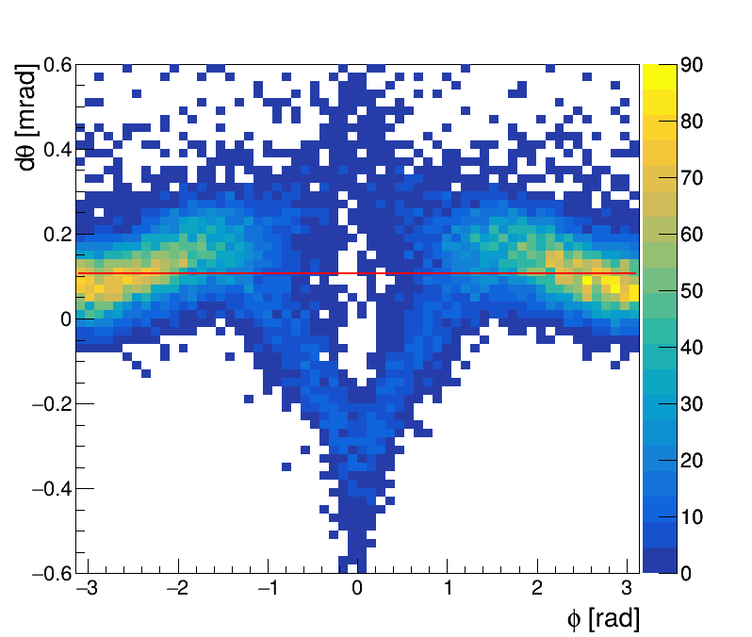
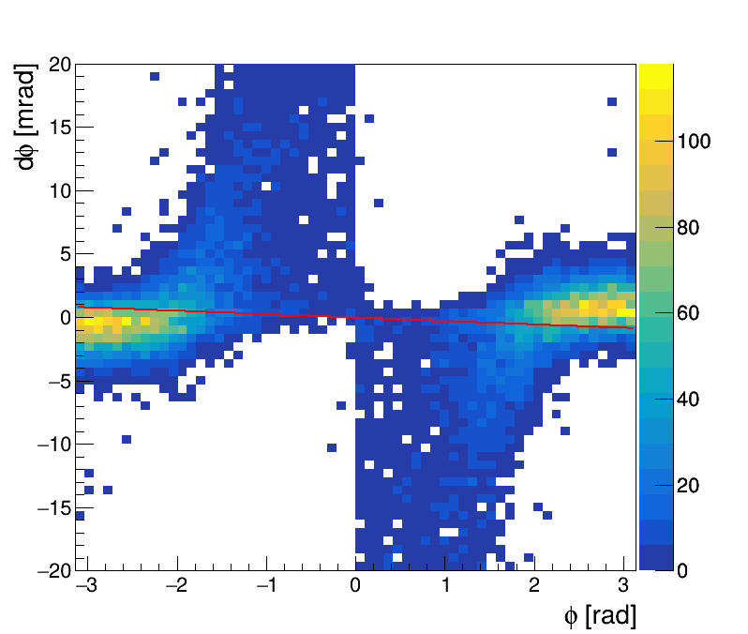
$$dθ−φ \& dφ−φ$$

Slide 15
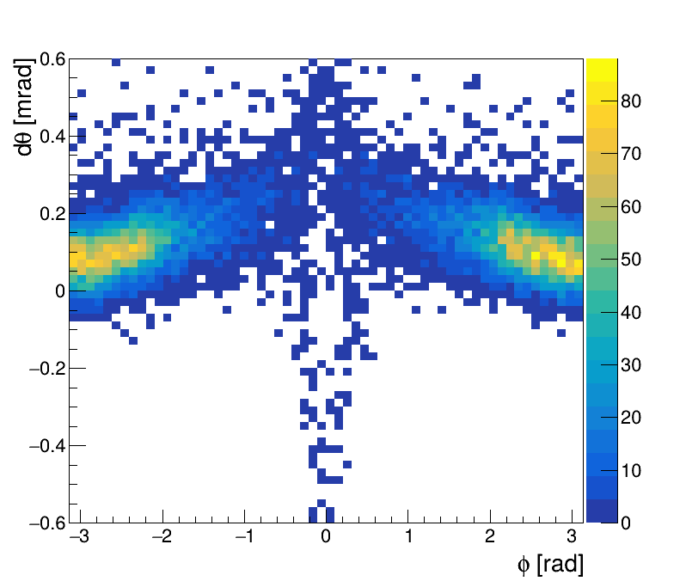
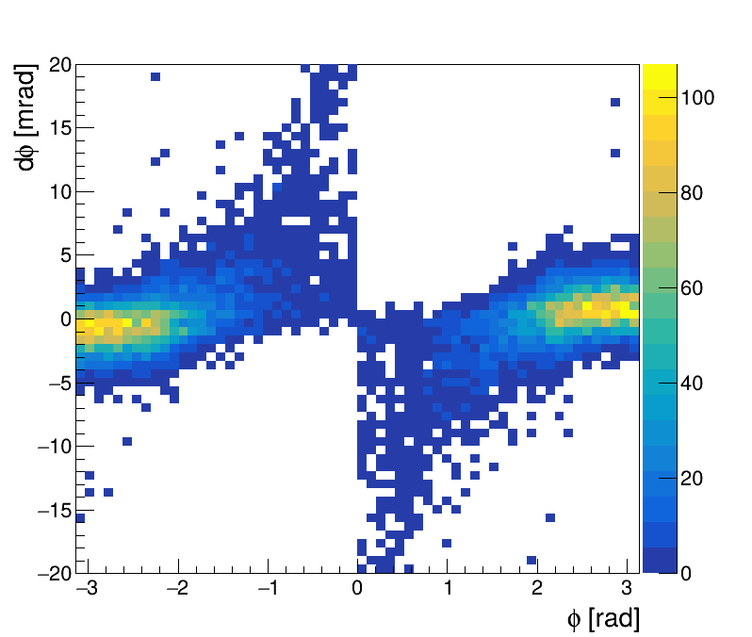
$$dθ−φ \& dφ−φ \& 25<θ<100 mrad$$

Slide 16
$$25<θ<100 mrad$$
 | Before Deflection | After Deflection
$$25<θ<100 mrad$$ | 28175 / 40000 | 28082 / 40000
Difference | $0.330 \%$ fewer events

Slide 17
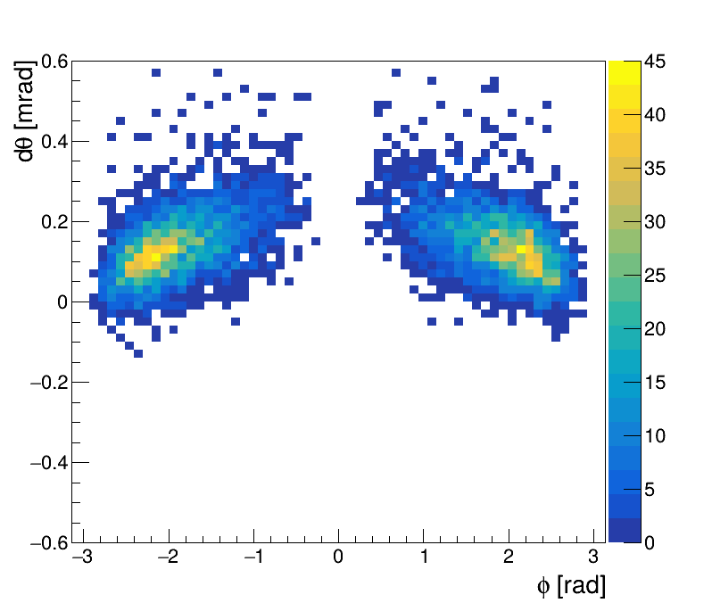
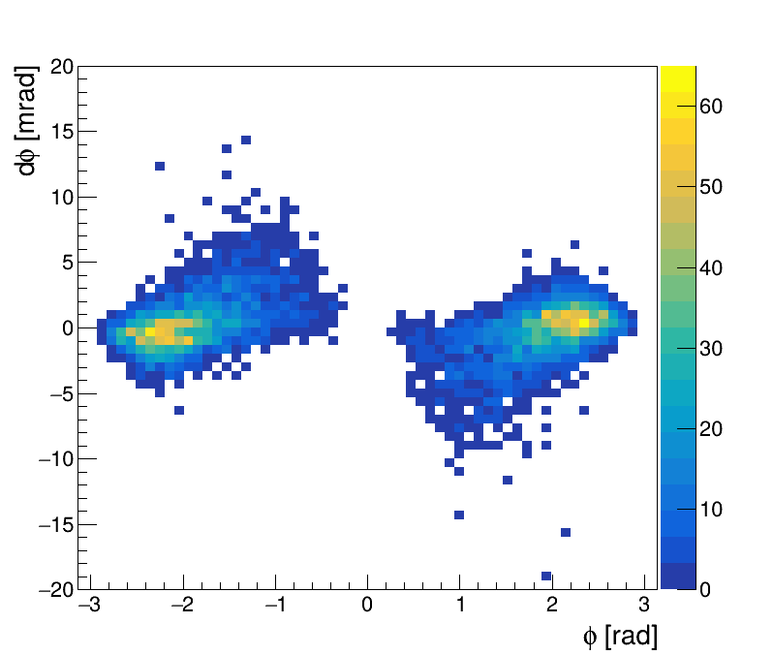
$$dθ−φ \& dφ−φ \& 25<θ<100 mrad$$
$\& z>25 mm @ z=1000 mm$

Slide 18
$$25<θ<100 mrad \& |y|>25 mm @ z=1000 mm$$
 | Before Deflection | After Deflection
$$25<θ<100 mrad$$ | 12172 / 40000 | 12011 / 40000
Difference | $1.323 \%$ fewer events

Slide 19
CM Frame
$$25<θ<100 mrad$$

Slide 20
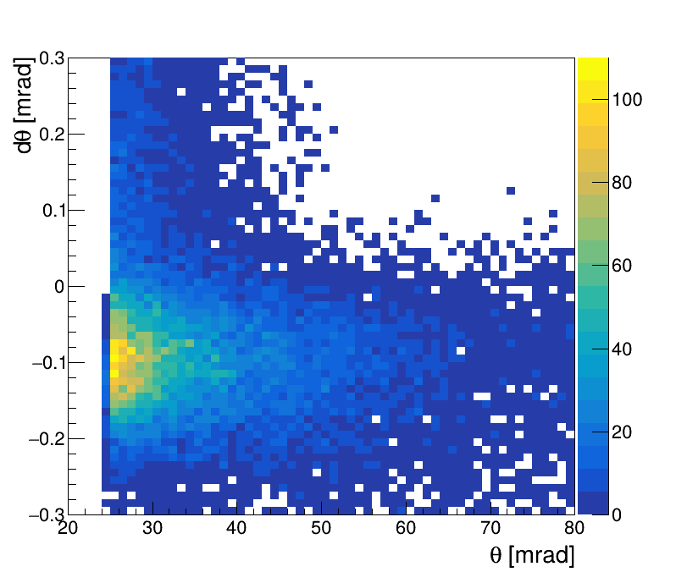
$$dθ−θ$$

Slide 21
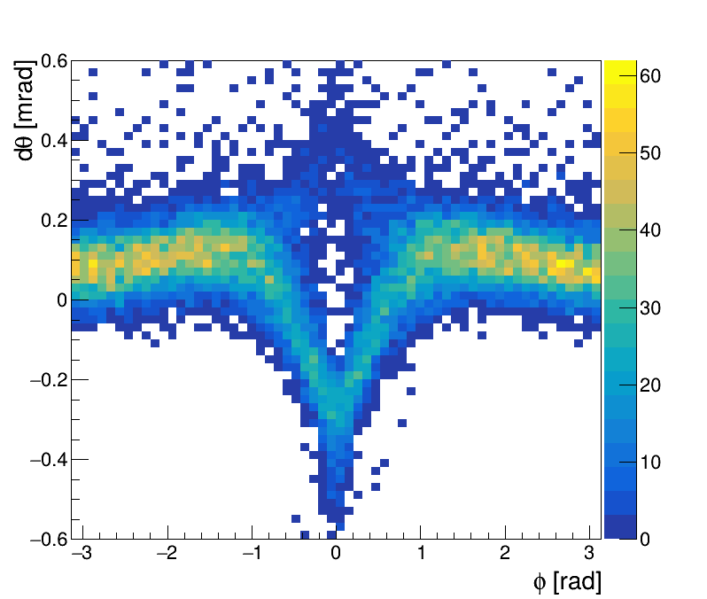
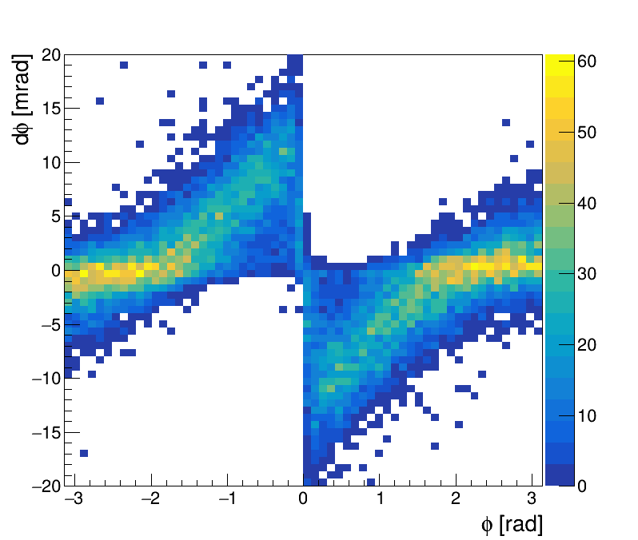
$dθ−φ \& dφ−φ$

Slide 22
Deflected Bhabha – Z mode, CM Frame
 | Before Deflection | After Deflection
$$25<θ<100 mrad$$ | 25396 / 40000 | 25302 / 40000
Difference | $0.370 \%$ fewer events
Notes:
Z 模式下，BHLUMI产生子结果的总截面为 316.836 nb，偏转前后 探测范围内截面分别为 48.286 nb 和 47.628 nb。偏转后测量到的粒子数减少了%$1.312。$

Slide 23
Deflected Bhabha – FCC
 | Before Deflection | After Deflection
$$25<θ<100 mrad$$ | 23550 / 40000 | 23442 / 40000
Difference | $0.459 \%$ fewer events

Slide 24
Conclusion
In $e^{+} e^{−}$collisions, bunches bias the luminosity measurements by its large charge density
This bhabha deflection effect is simulated by GuineaPig++, 1.2.2
The parameters are set to the operation modes of CEPC, and events are generated by BHLUMI
Bhabha deflection induces about 0.493 % fewer bhabha events at Higgs mode, 0.522 % at W mode, and 1.312% at Z mode
Notes:
总结，在正负电子对撞中，束团的高电荷密度会导致亮度测量出现偏差。这种bhabha偏转效应可以由GuineaPig++软件进行模拟。软件的参数设为CEPC higgs模式下的参数，使用BHLUMI产生事例。绘制了theta分布和z=647mm处的击中位置分布。bhabha偏转会导致bhabha事例数减少%$0.493$，导致亮度测量比实际低%$0.493$

