Slide 1
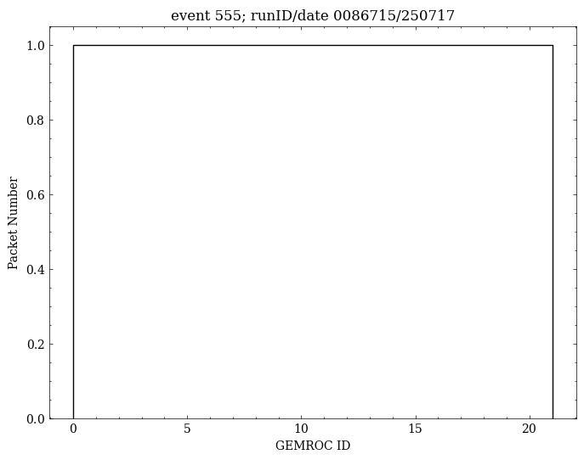
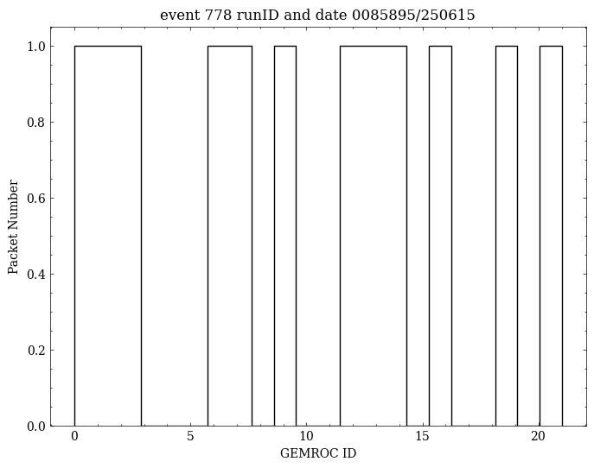
Communication error but complete GEMROC ID throughout the entire run.
Communication error and incomplete GEMROC ID appearance.

Slide 2
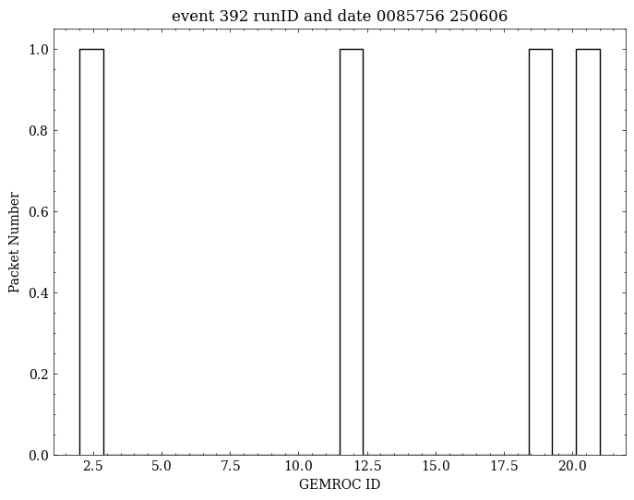
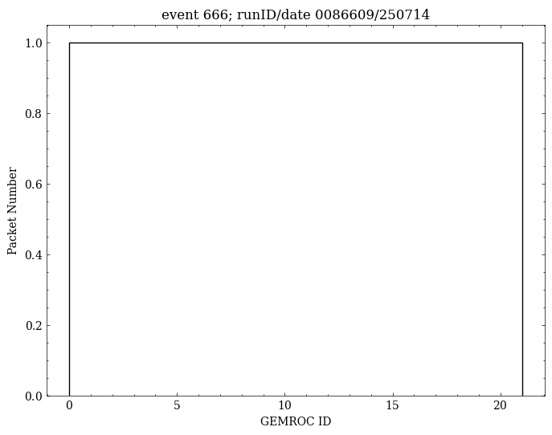
No communication error but incomplete GEMROC ID appearance.
No communication error and complete GEMROC throughout the entire run.

Slide 3
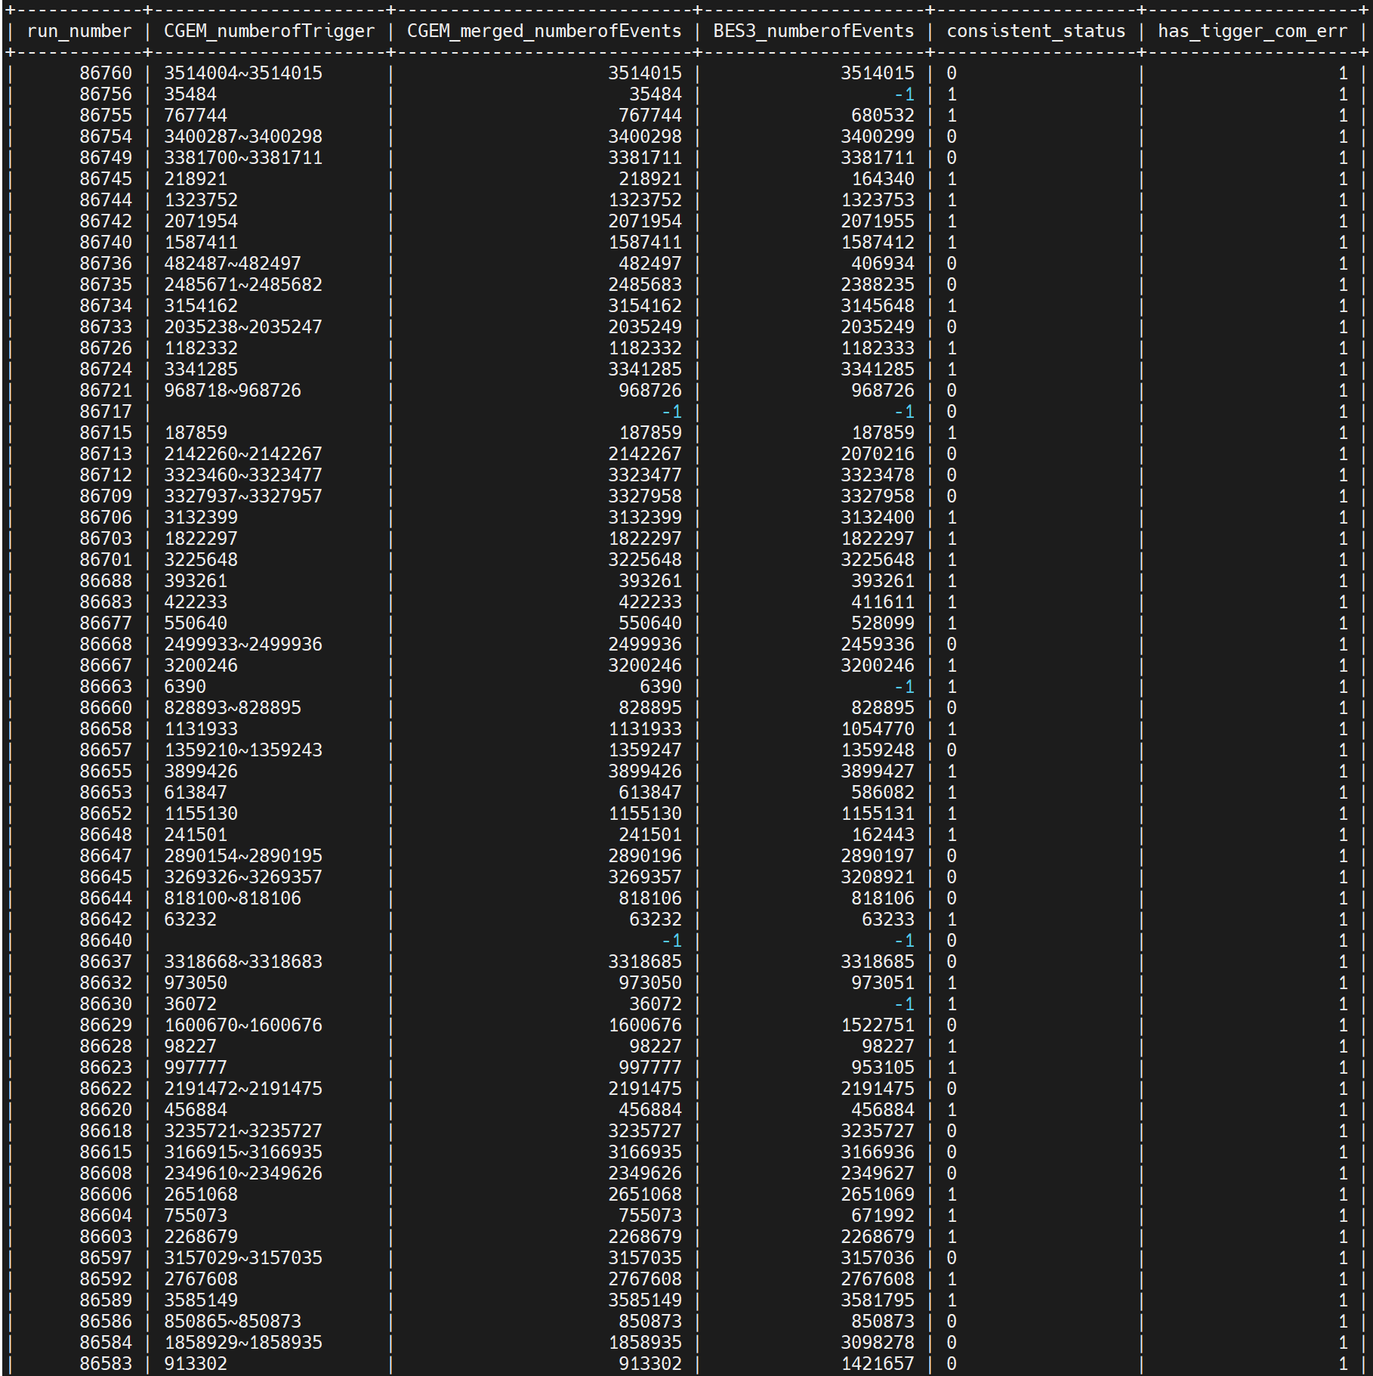
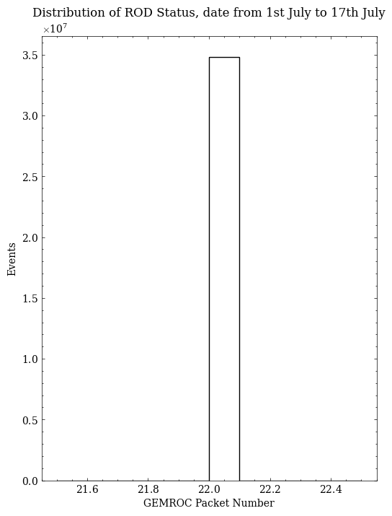
Distribution of GEMROC Packet number within a single event from July 1st to July 17th.
There are still lots of communication errors.

Slide 4
From the database, there are 183 runs with communication errors that are not classified as bad runs.
From offline data inspection, among all non-bad runs, there are 39 runs with incomplete GEMROC IDs.
There are 15 runs that meet both of the above conditions.
Conclusion:
No apparent relationship has been found between incomplete GEMROC IDs and communication errors.

