Slide 1
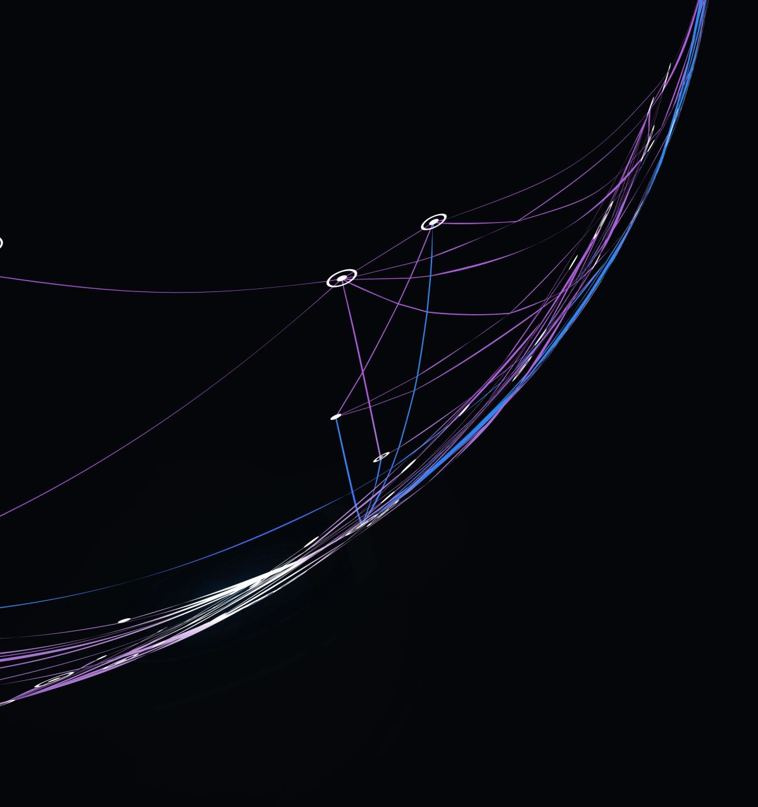
(Brief) Review of Standard Model Measurements at TeV
Yusheng Wu (吴雨生)
University of Science and Technology of China
Oct 11-12, 2025
TeV物理前沿专题研讨会暨第31届LHC Mini-Workshop
@ 山东大学 青岛

Slide 2
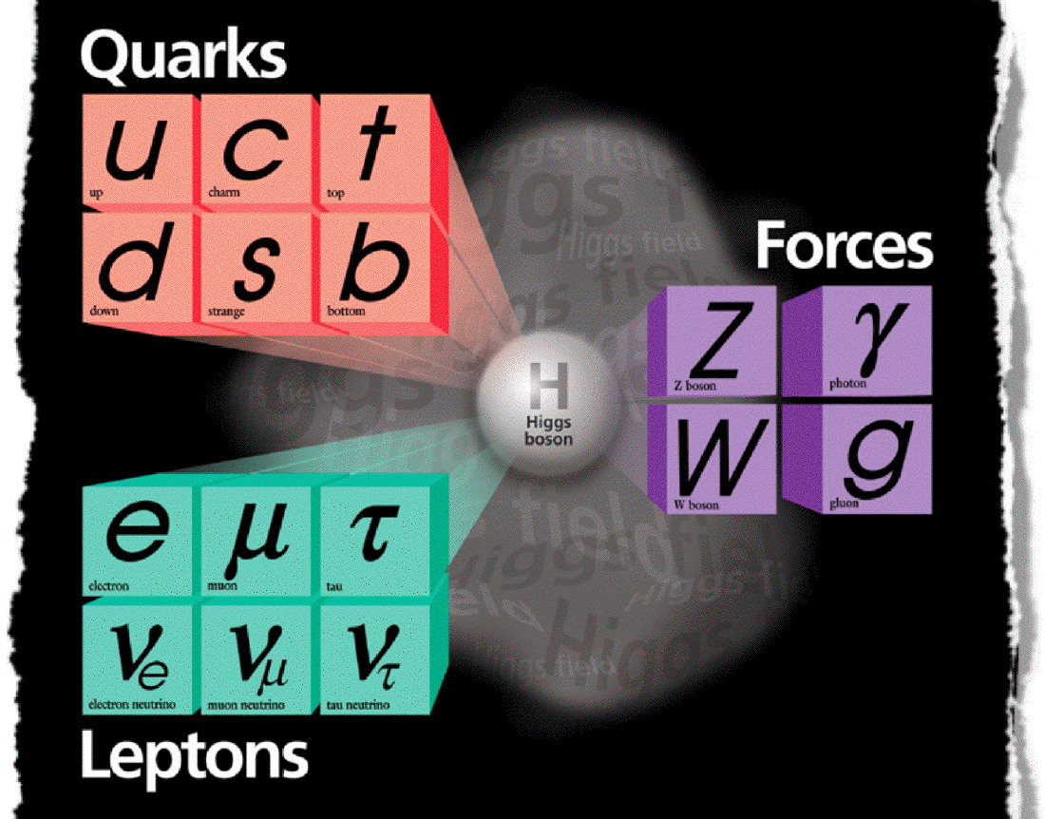
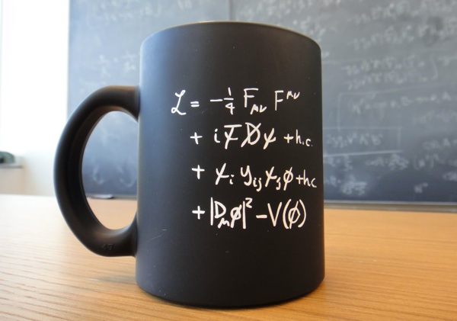
The concise, successful “Standard Model” for microscopic world → Becoming “complete” after decades’ advances in both theory and experiment Key science questions yet to be answered → Dark matter, ν mass, matter-antimatter asymmetry, …
Systematically perform precision measurements
(hope) to locate the territories pointing to new physics

Slide 3
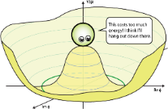

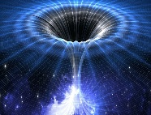
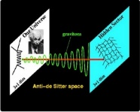
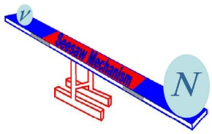
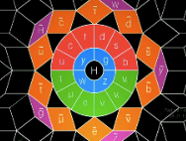

Multifold means of measurements
Collider/Accelerator/Reactor
New Physics
Matter:
atoms, laser,
plasma, magnets,
bulk matter
Cosmic Ray:
space, sea level,
underground
This talk focuses on methodology and progress of measurements at energy frontiers (LHC ATLAS/CMS)
Disclaimer: not a complete review, rather a short recap, and a biased selection of topics to stimulate discussions

Slide 4
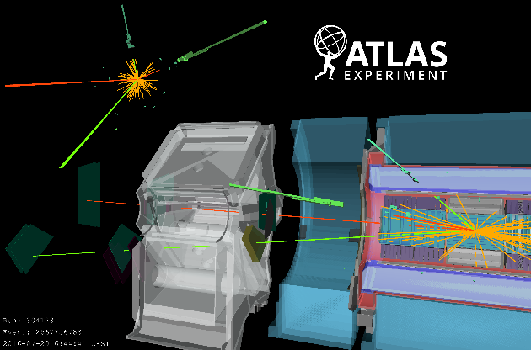

Measurement of phenomena at smallest scales
BSM?
New Physics
SM
Collider endeavors: precision comparisons between observations and predictions
>> precisely test the Standard Model (cross-sections, parameters, interactions …)
>> search for new physics phenomena (resonances, deviations)
>>> all rely on measuring and understanding physics final states precisely

Slide 5
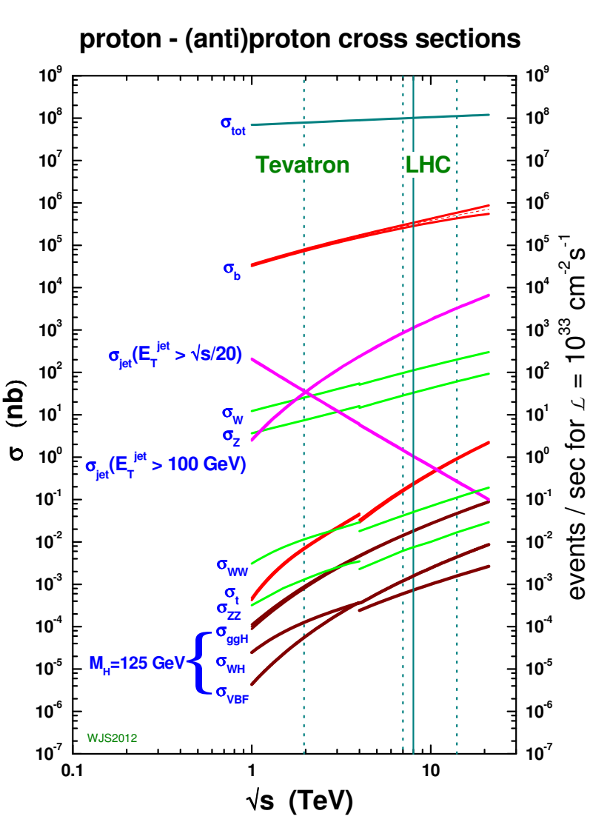
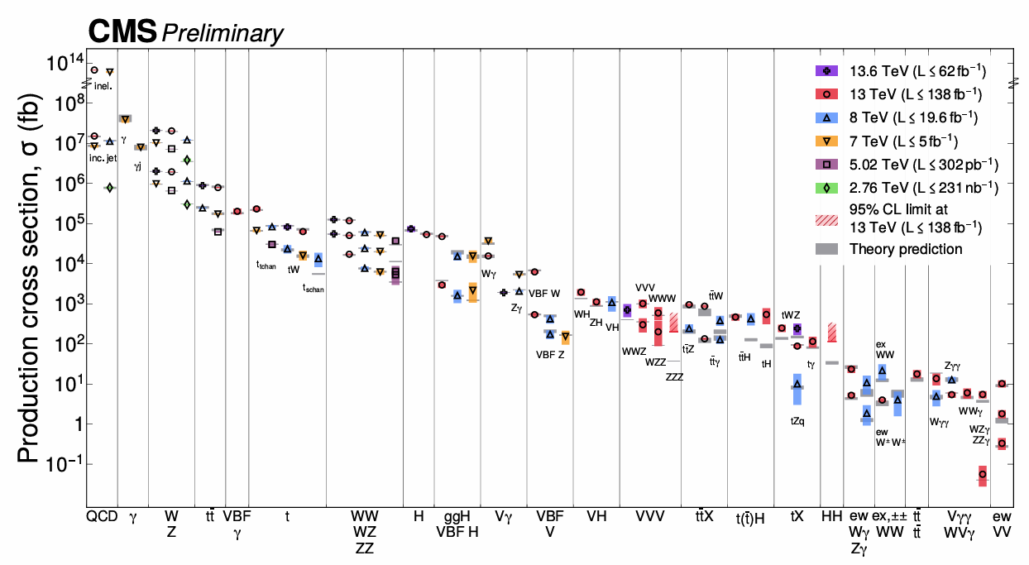
Many orders of precision test!
From precision to exploration, precision test of SM at 15 orders !

Slide 6
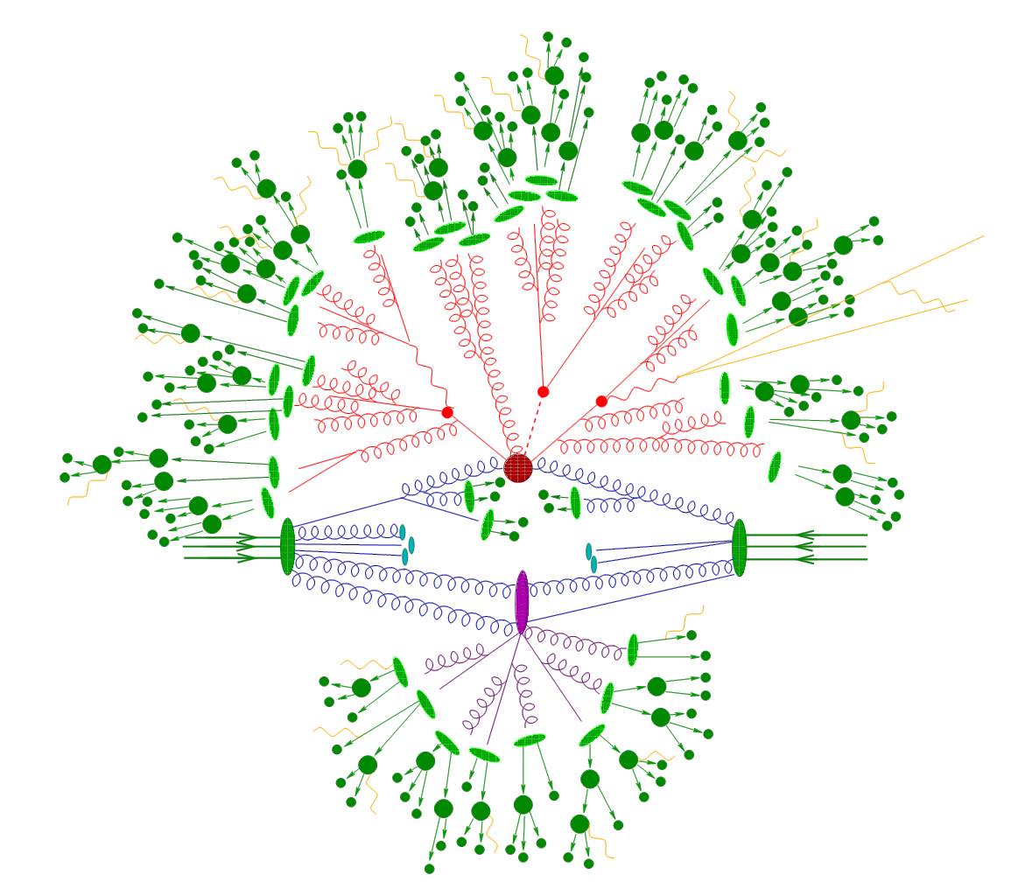
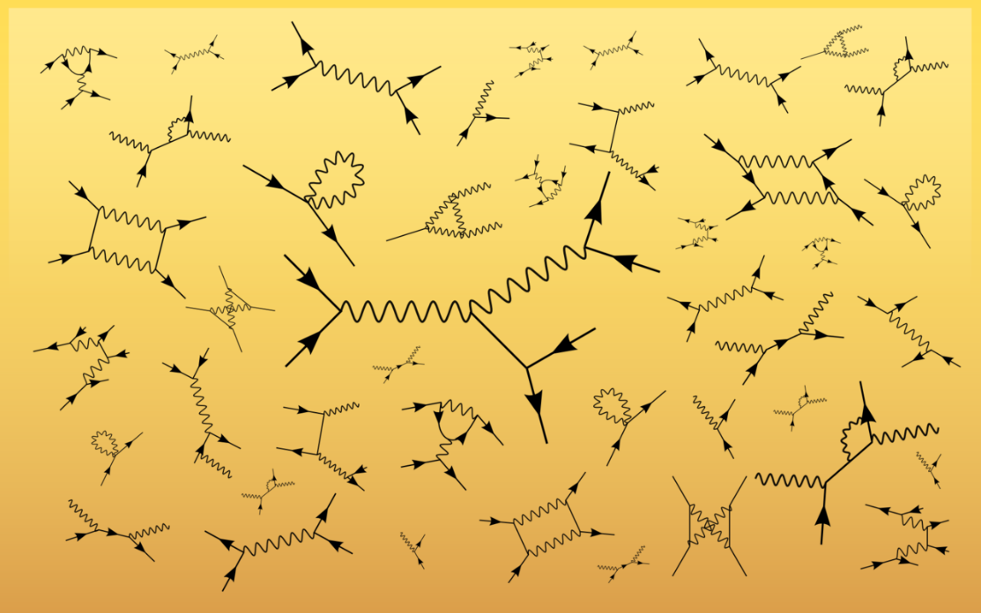
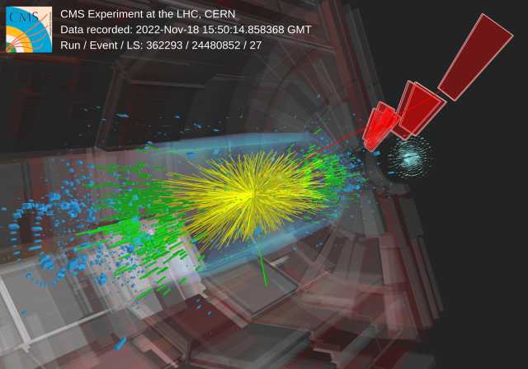
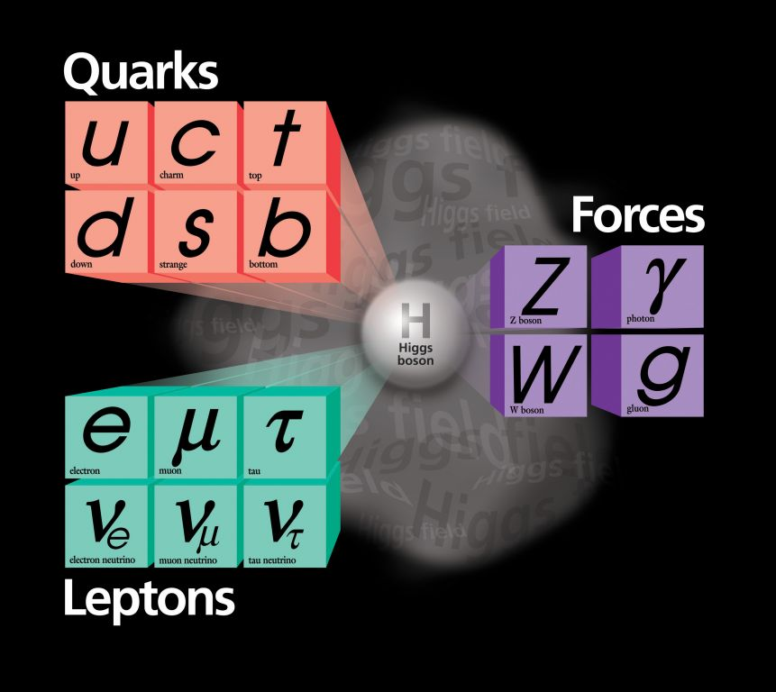
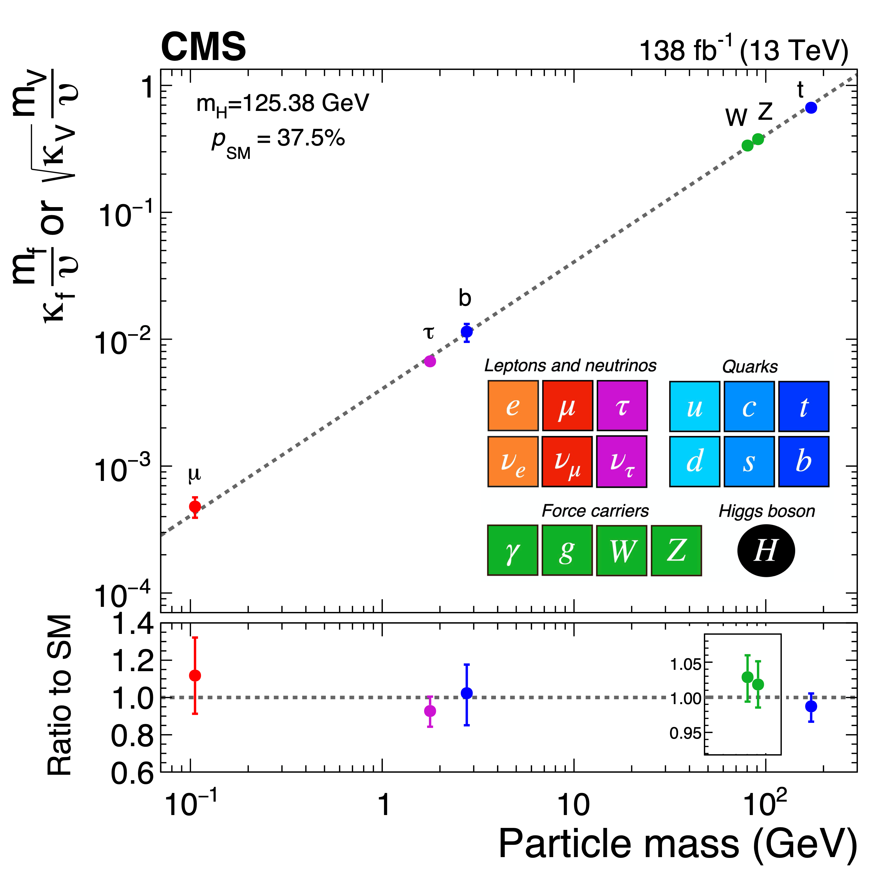
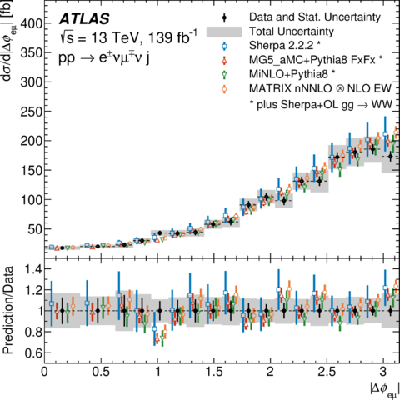
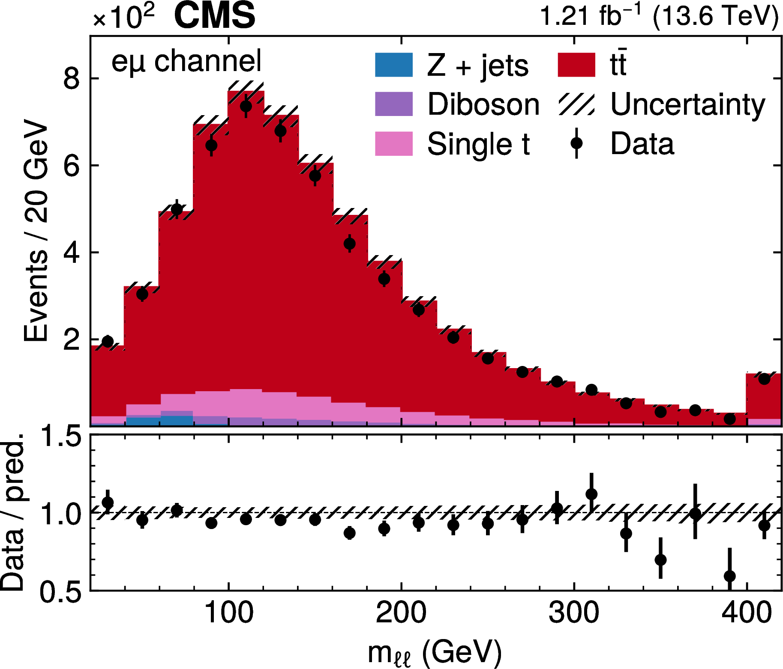
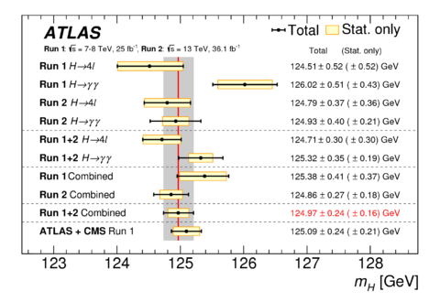
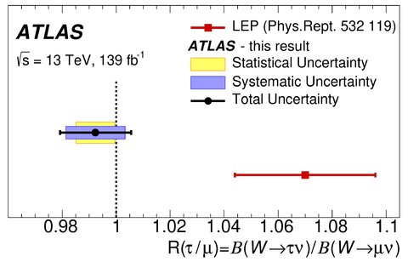
Full Chain Efforts: Predictions and measurements
Predictions
Measurements
Quantum field structures, symmetries and intrinsic properties, model parameters
Couplings, interactions
Cross-sections
Detector observables

Slide 7


Full Chain Efforts: Another View
Inclusive/Total Phase Space
Fiducial
Phase Space
Detector
Phase Space
Predictions
Measurements
Extrapolation to other phase spaces
(more modeling dependent)
Direct detector measurement (less modeling dependent)
A lot of efforts to optimize measurement precisions, and follow-up of of precision theoretical calculations

Slide 8
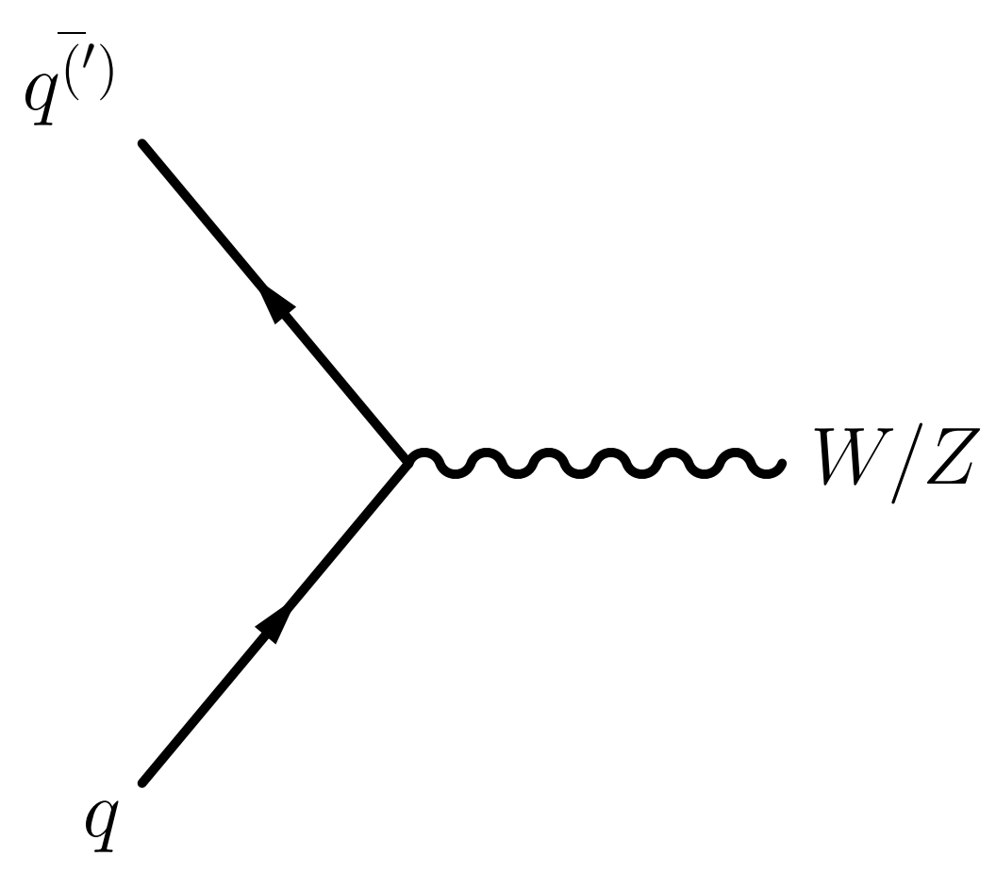
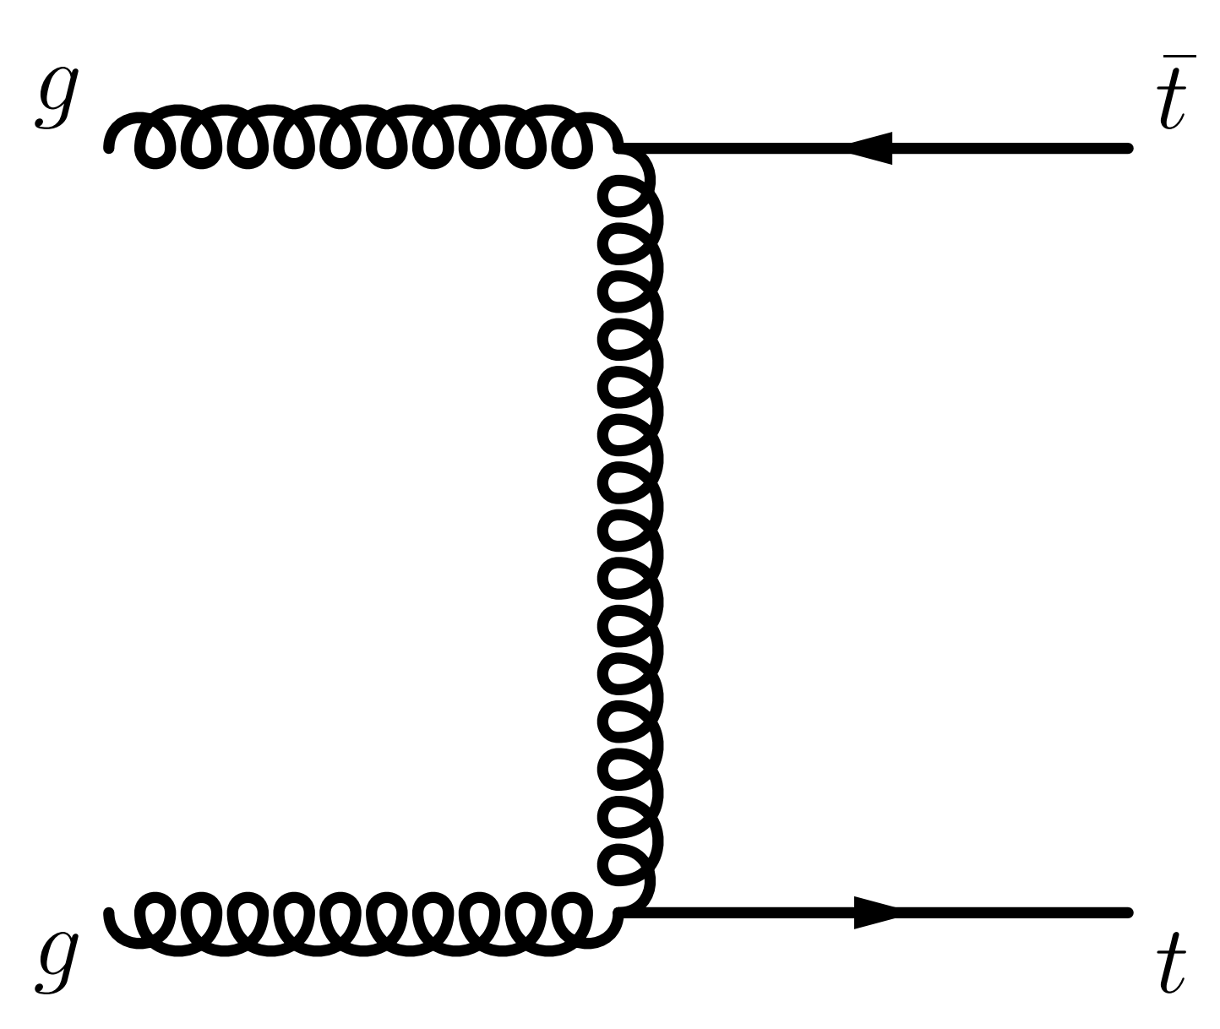
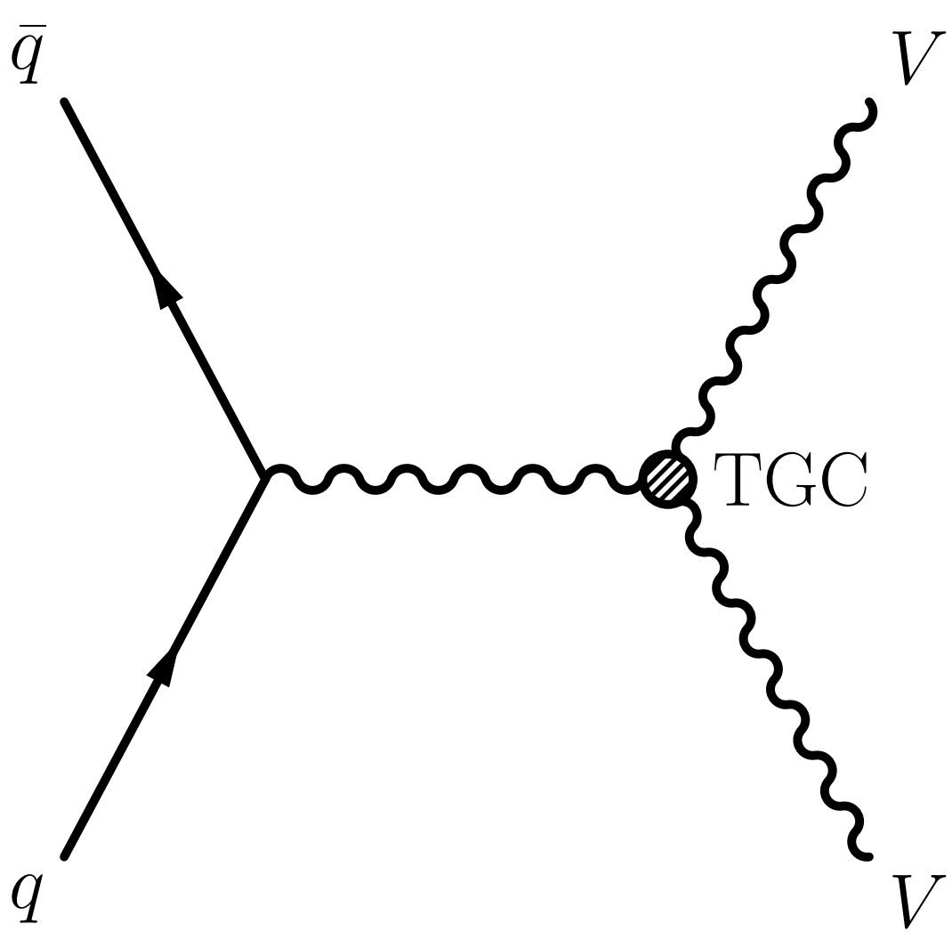
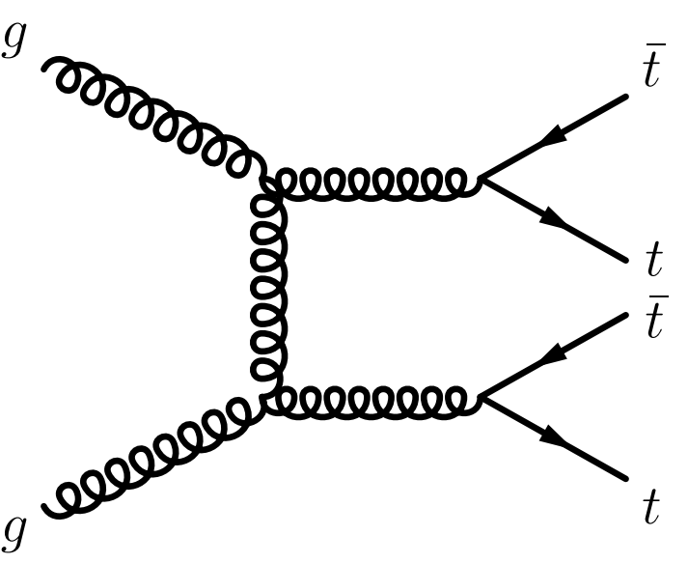
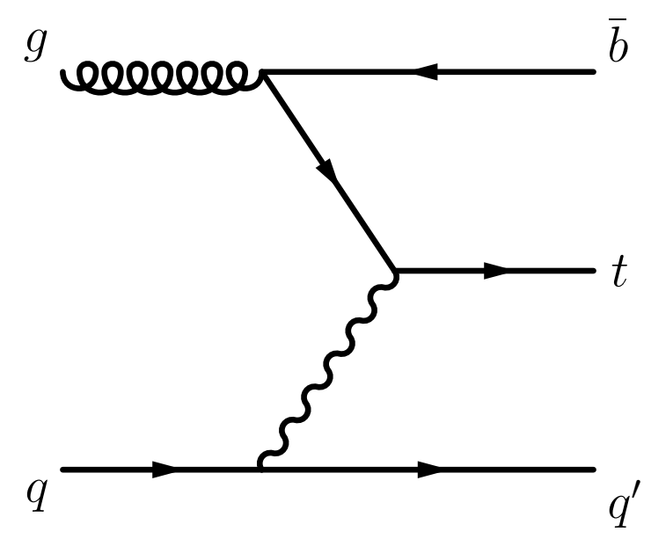
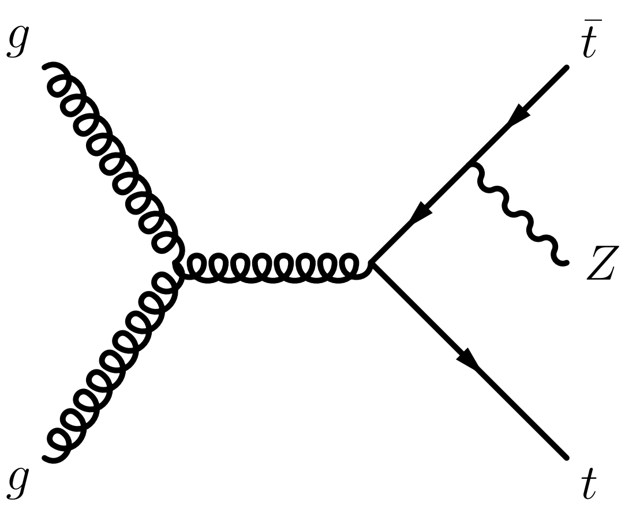
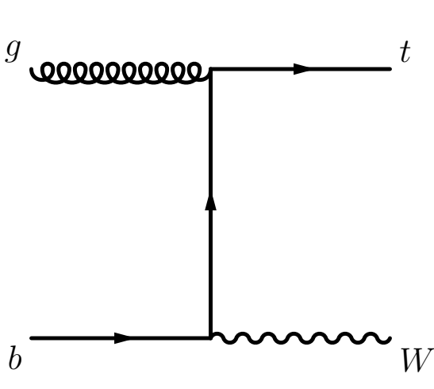
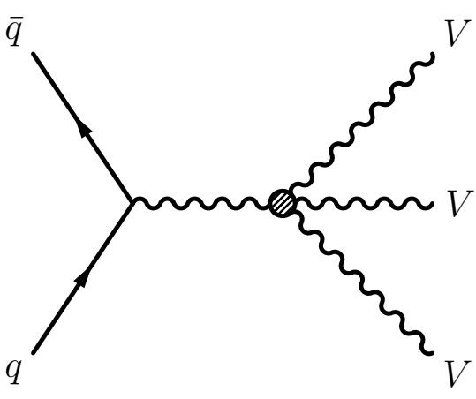
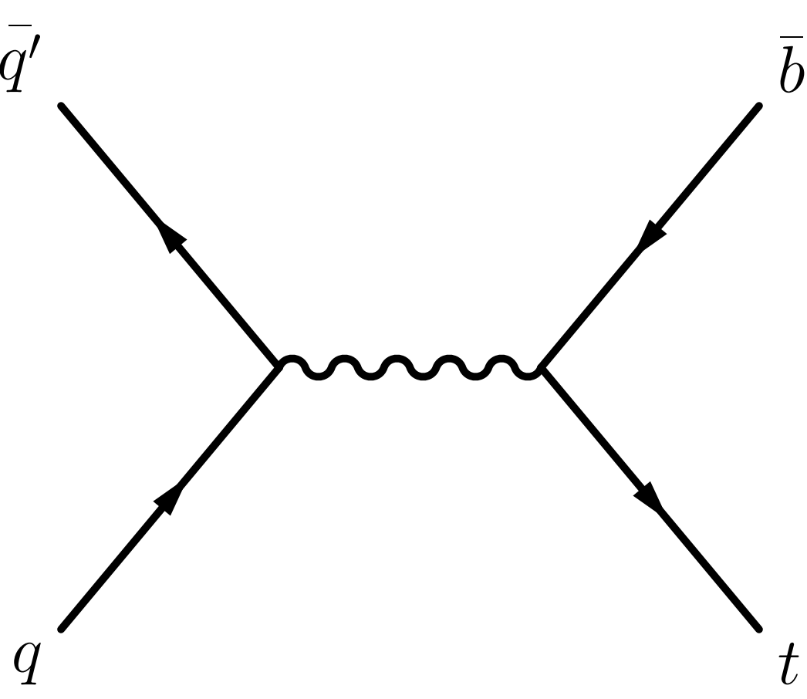
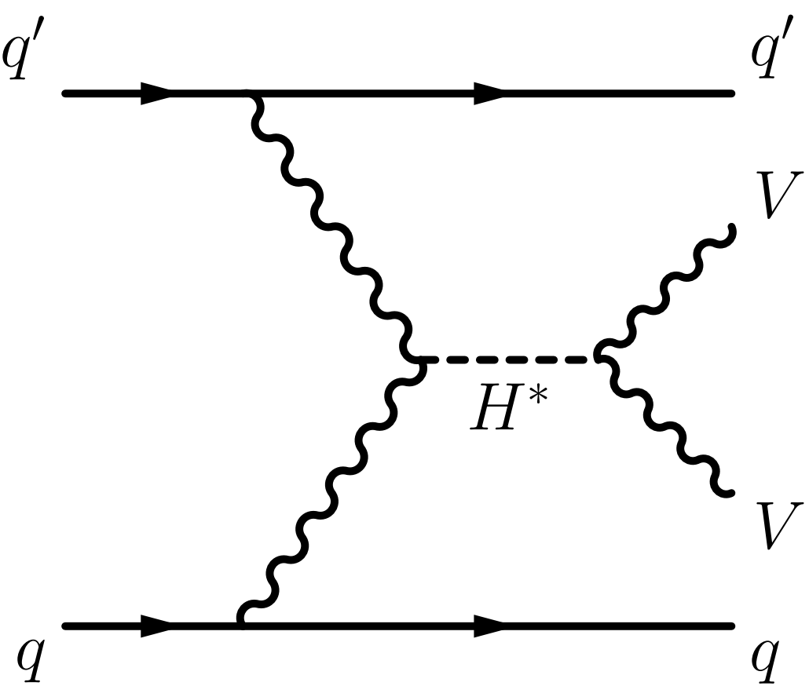
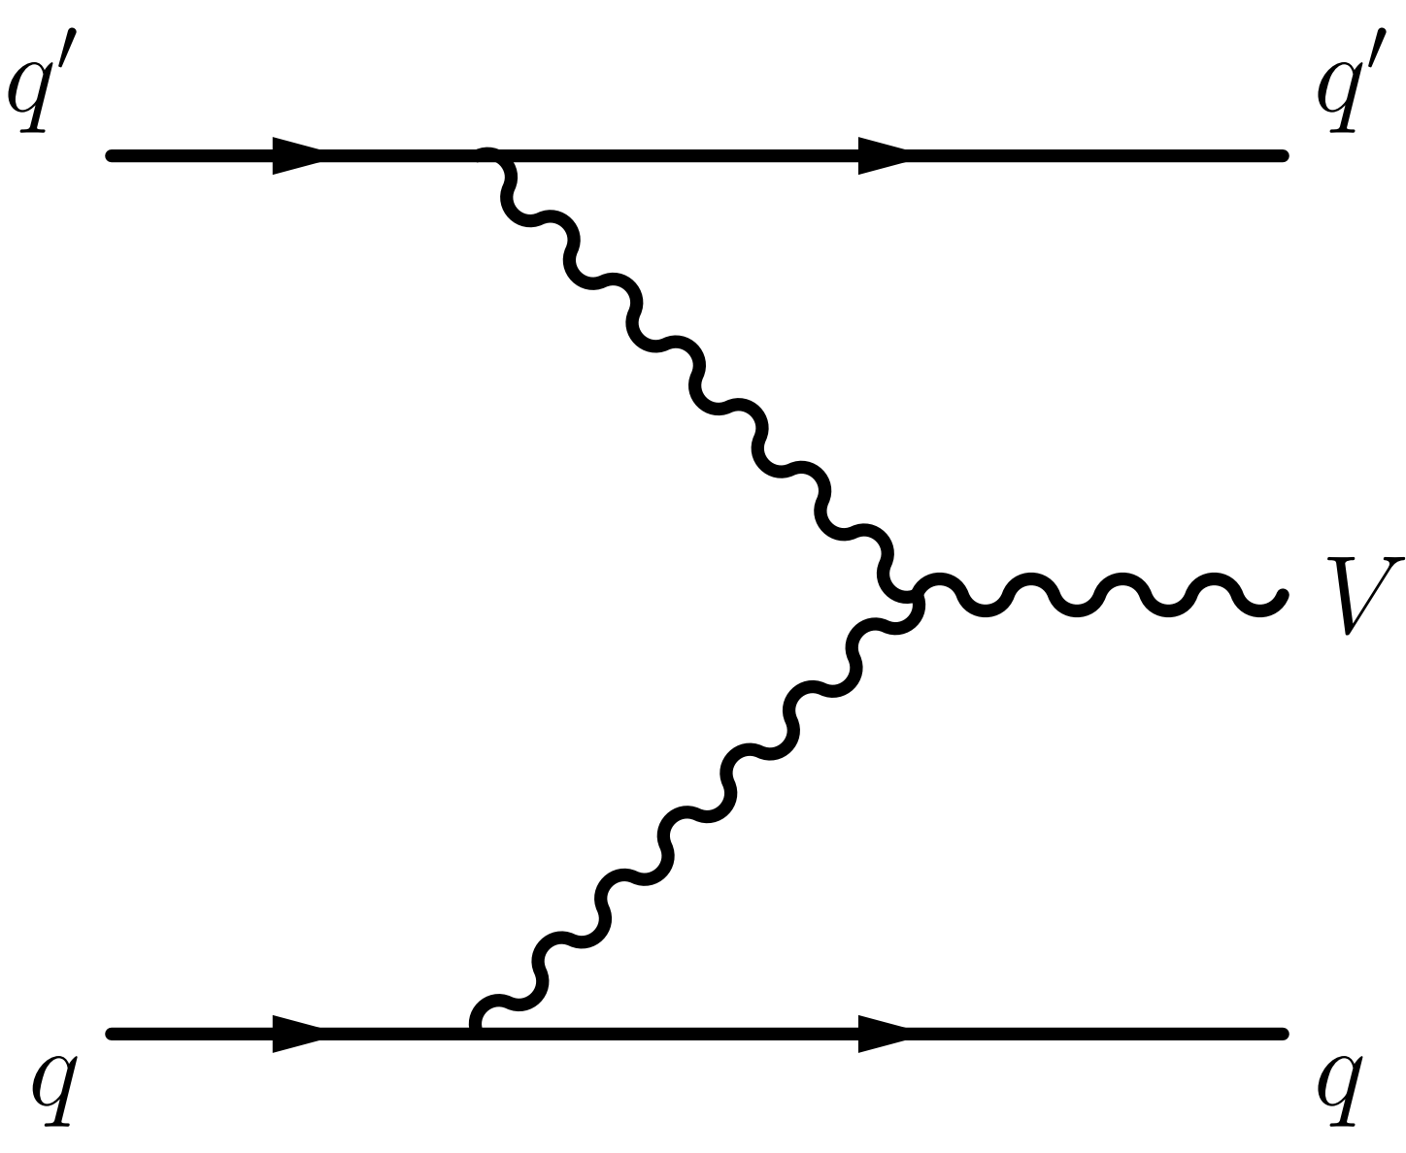
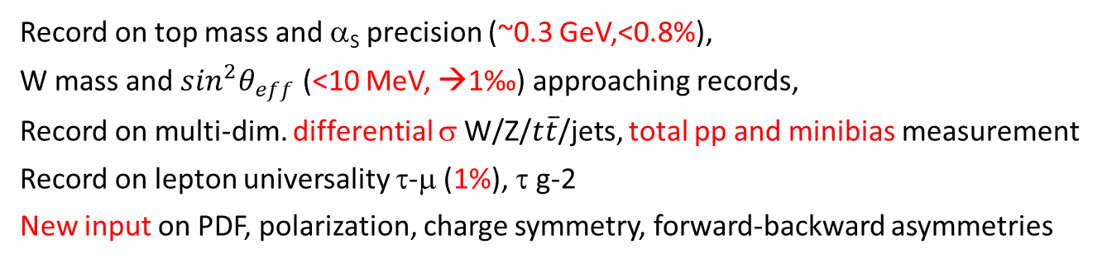
Where we are
More: https://twiki.cern.ch/twiki/bin/view/AtlasPublic/
http://cms-results.web.cern.ch/cms-results/public-results/publications/
Precision
Record on top mass and α_{S} precision (~0.3 GeV,<0.8%),
W mass and $\sin^{2}θ_{eff}$ (<10 MeV, →1‰) approaching records,
Record on multi-dim. differential σ W/Z/$t\overline{t}$/jets, total pp and minibias measurement
Record on lepton universality τ-μ (1%), τ g-2
New input on PDF, polarization, charge symmetry, forward-backward asymmetries
Measurement
Exploration
Unique Higgs measurements
Record on Diboson σ (~2%), single-t σ (→5%), VBF V, tt+γ/W/Z σ precision (→ 5-10%)
Record precision in studying 3-body vertices and high-E behavior
CKM |V_{tb}| (5%), record in multi-jet, V + jets and DPI measurements
Observation of rare VBS VV processes, γγ→VV, tVq, four-top, tri-bosons processes
Record precision in four-body vertex precision
Searched for rare decays, top FCNCs
Explore boson polarization in VV production etc. (EWSB, quantum), jet substructure and event shapes (internal QCD), heavy flavor jets + X (proton structure), threshold phenomena (toponium?) …
EW
QCD

Slide 9
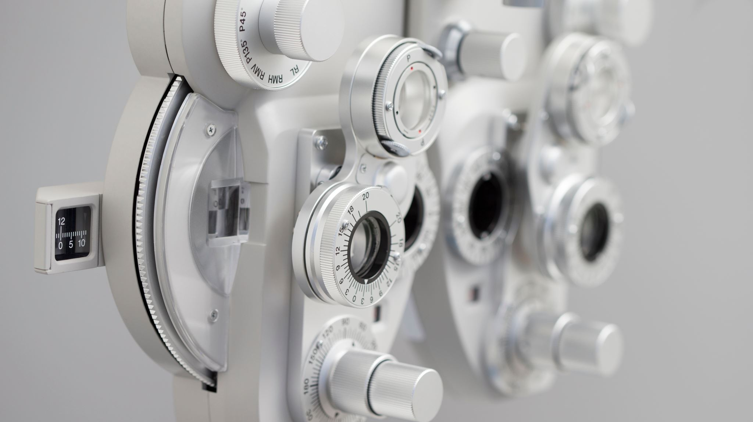
Precision by Precision

Slide 10
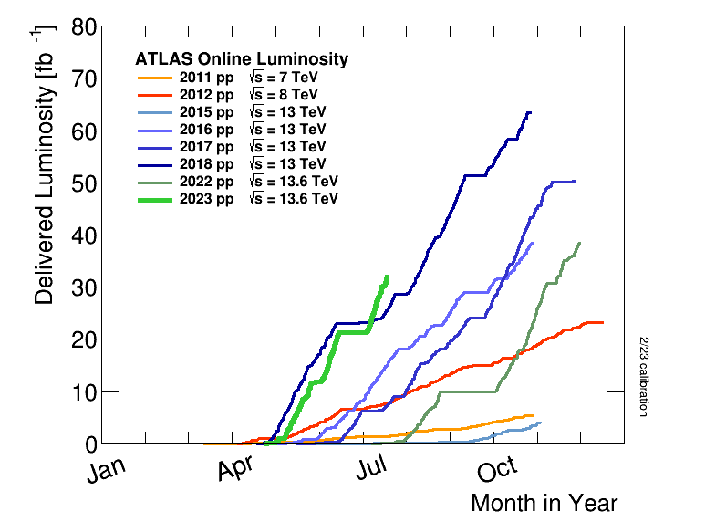
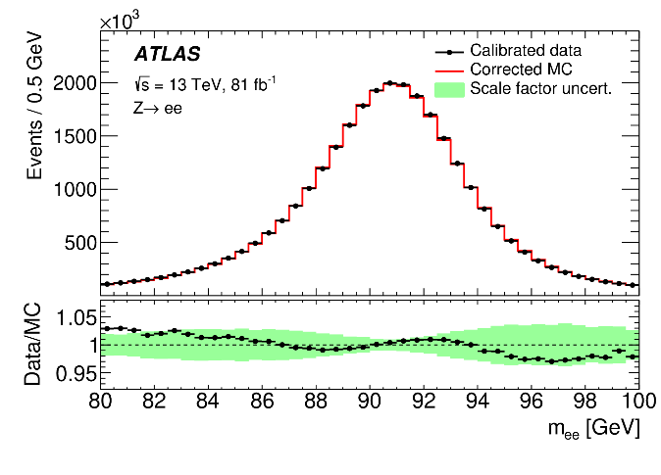
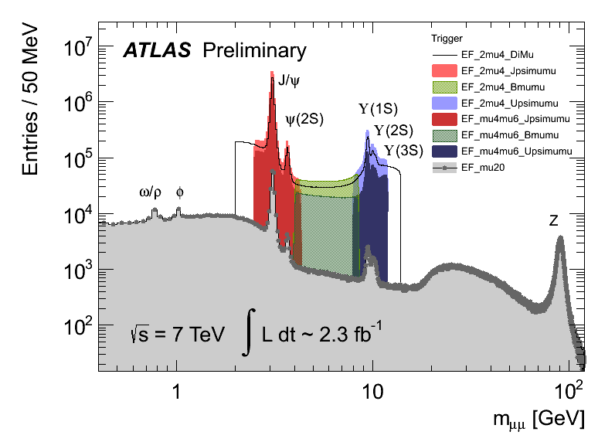
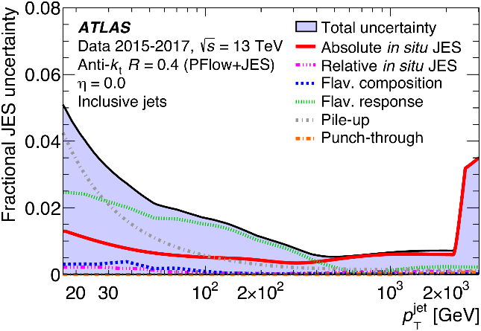
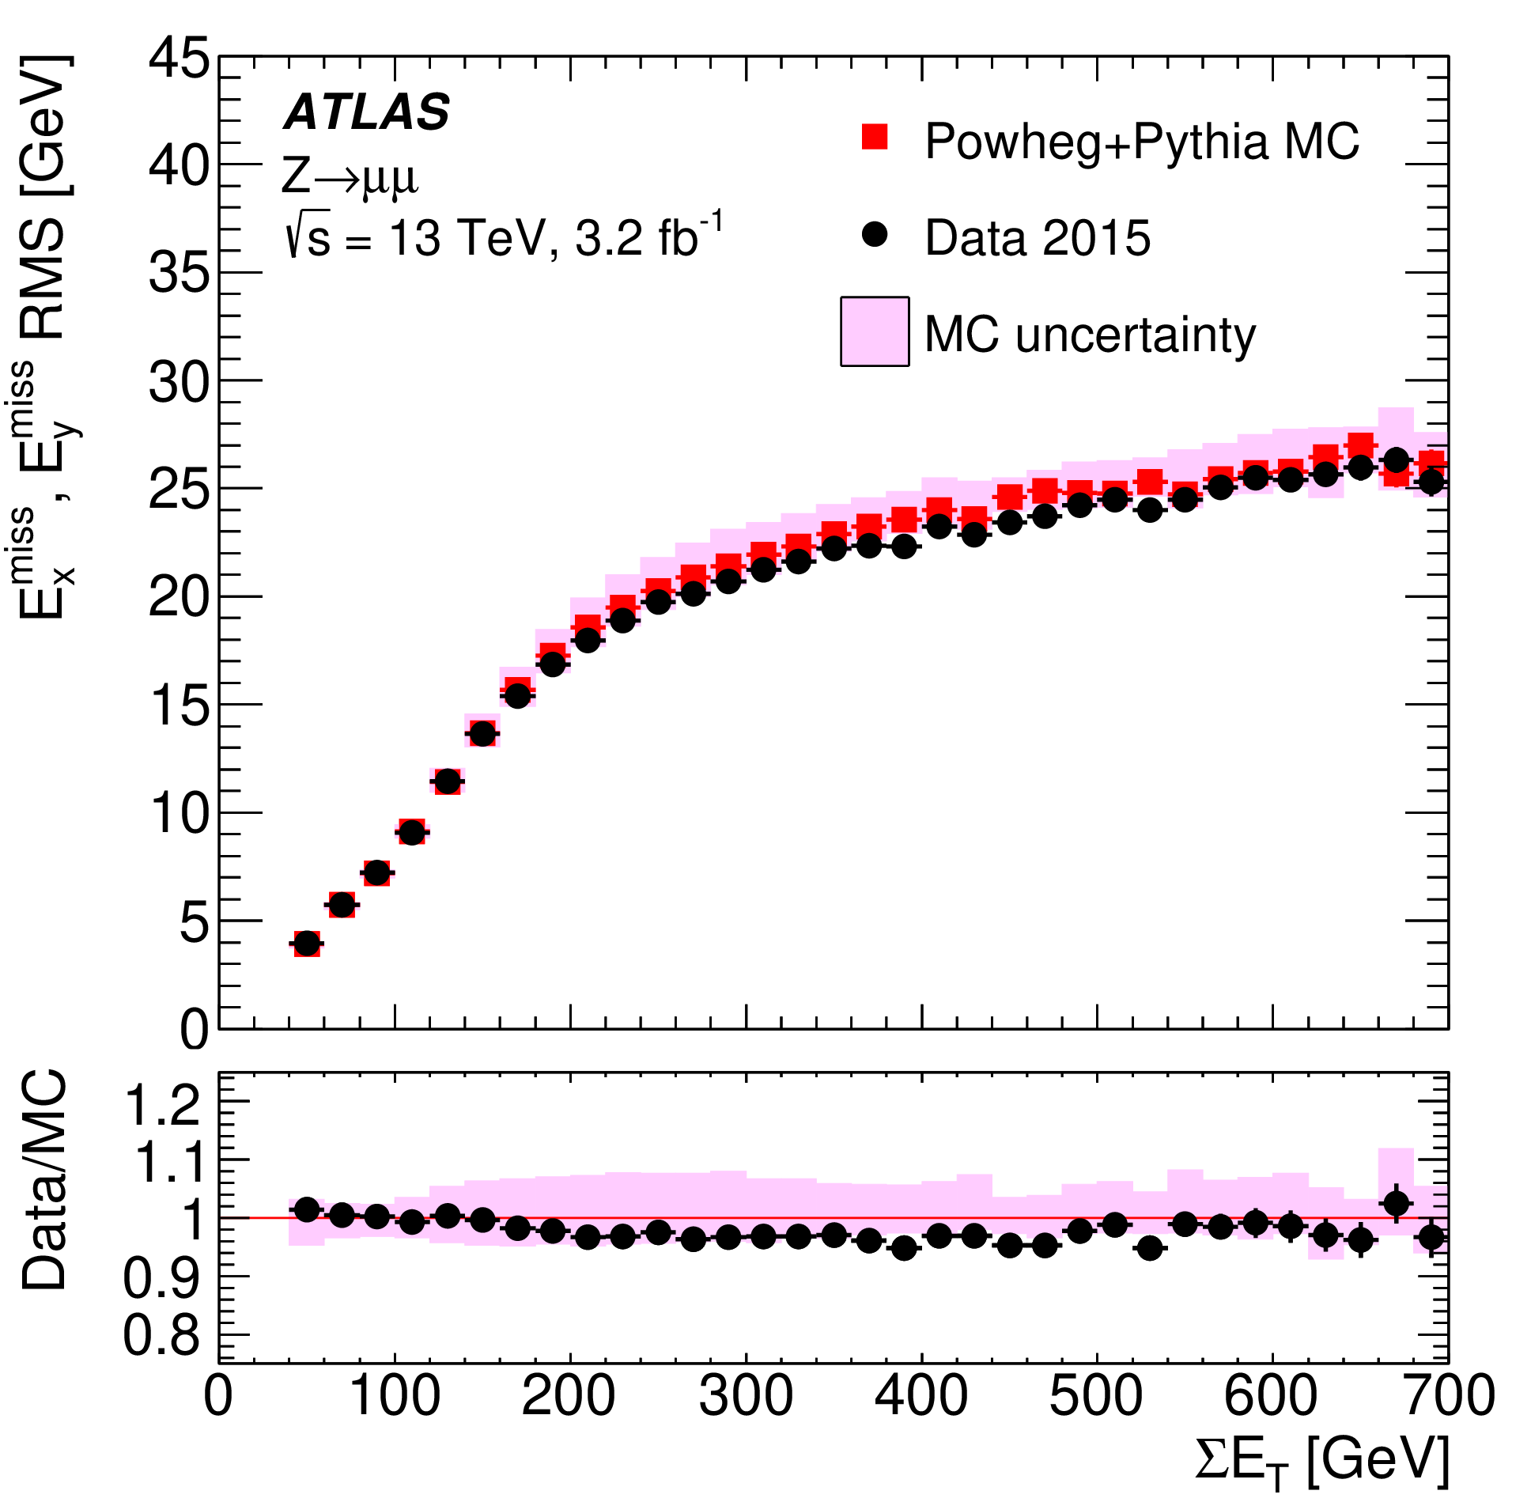
Frontline Precision
Physics successes owing to precise understanding of e, μ, jets, E_{T}^{miss}, and tagging of heavy-flavor jets
Per-mil to percentage precision achieved in many
dimuon mass
Z(ee)
scale
JINST 14 (2019) P12006
Tremendous efforts from LHC, detector teams to make the data collection smooth
Jet energy scale
Missing E_{T} resolution
EPJC 81 (2021) 689
EPJC 78 (2018) 903

Slide 11
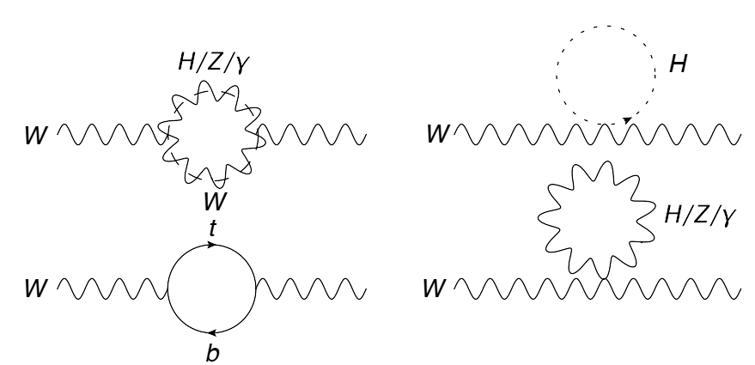
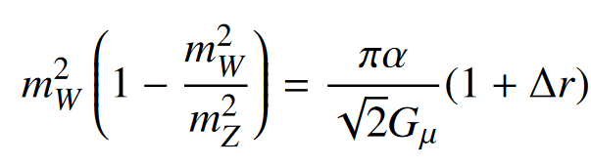
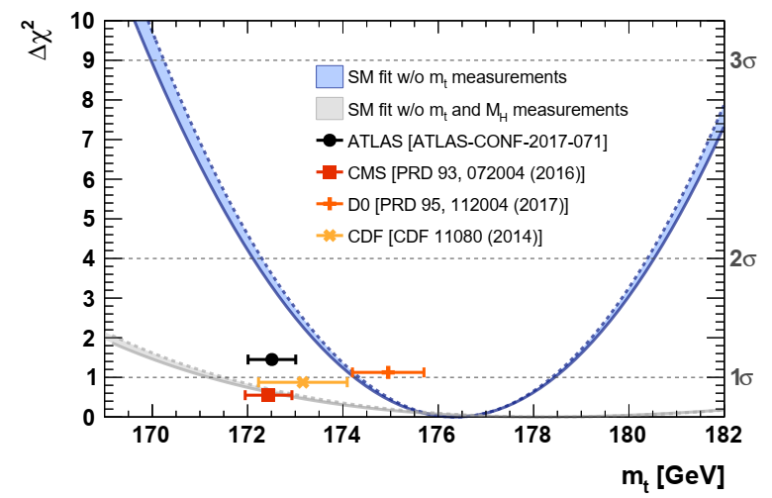
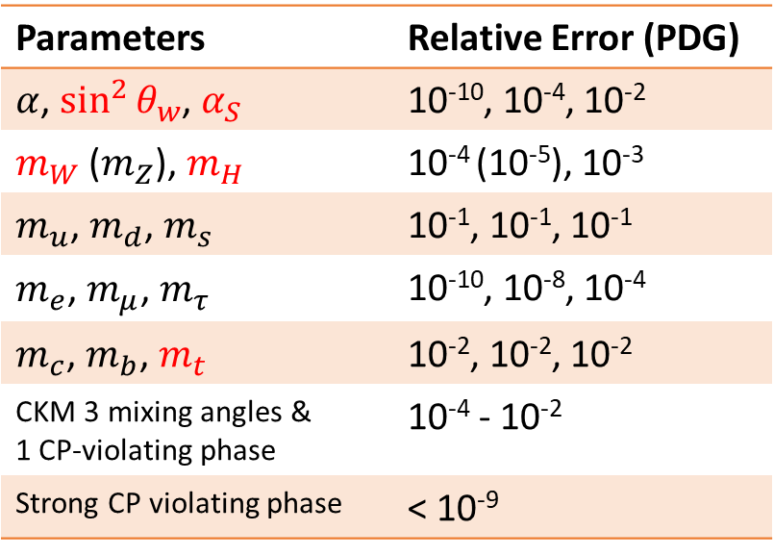

Internal Precision
Measuring these parameters precisely:
stringent test of SM internal consistency
high sensitivity to new physics
probe of running nature of fundamental couplings
19 free parameters
or 26 parameters (including neutrino sector with masses)
Parameters | Relative Error (PDG)
$α$, $\sin^{2}{θ_{w}}$, $α_{S}$ | 10⁻¹⁰, 10⁻⁴, 10⁻²
$m_{W}$ ($m_{Z}$), $m_{H}$ | 10⁻⁴ (10⁻⁵), 10⁻³
$m_{u}$, $m_{d}$, $m_{s}$ | 10⁻¹, 10⁻¹, 10⁻¹
$m_{e}$, $m_{μ}$, $m_{τ}$ | 10⁻¹⁰, 10⁻⁸, 10⁻⁴
$m_{c}$, $m_{b}$, $m_{t}$ | 10⁻², 10⁻², 10⁻²
CKM 3 mixing angles & 1 CP-violating phase | 10⁻⁴ - 10⁻²
Strong CP violating phase | < 10⁻⁹
Loops
Those sensitive for EW & TeV scale colliders to measure are marked in red
$m_{t}$ w.r.t. $m_{H}$
EPJC 78, 675 (2018)

Slide 12
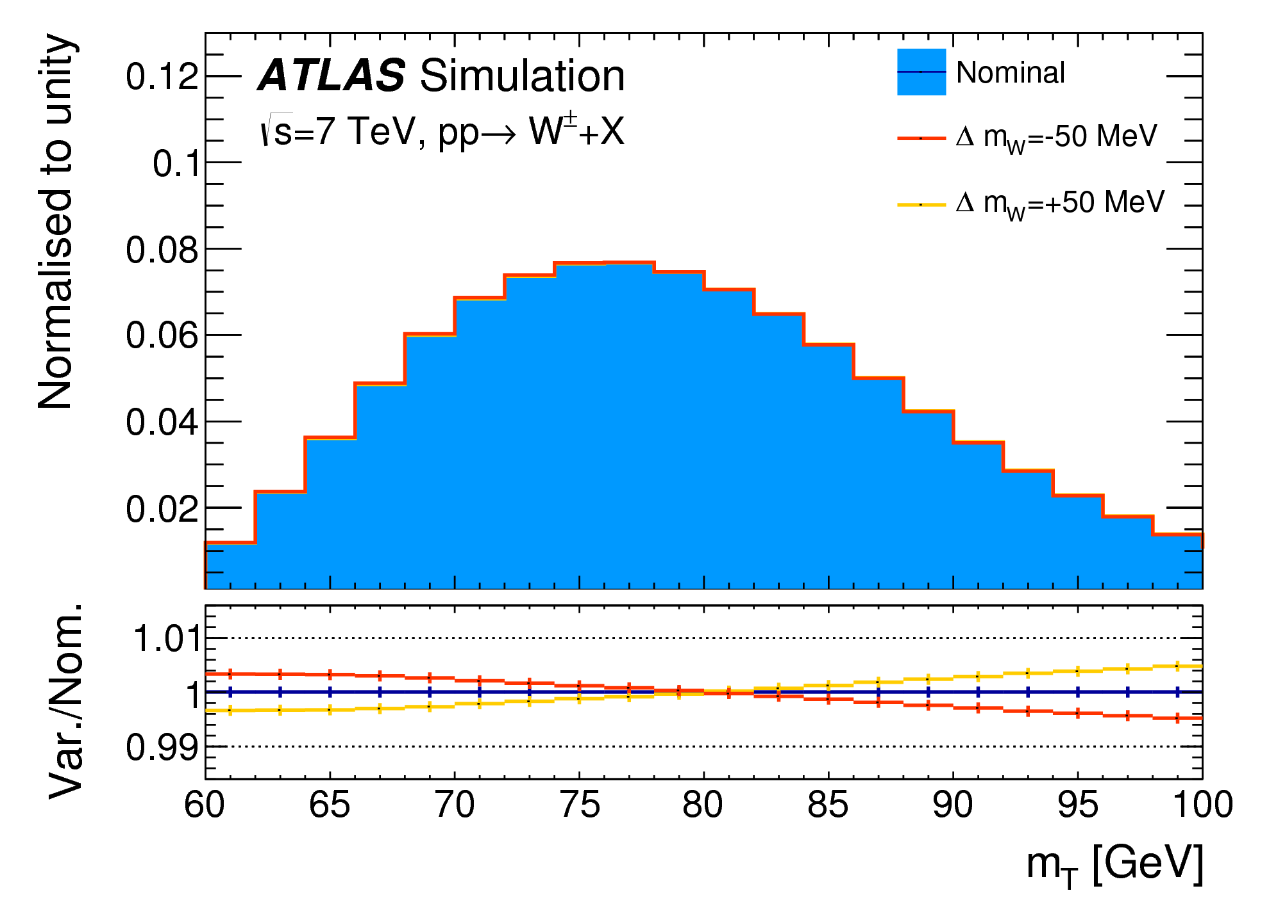
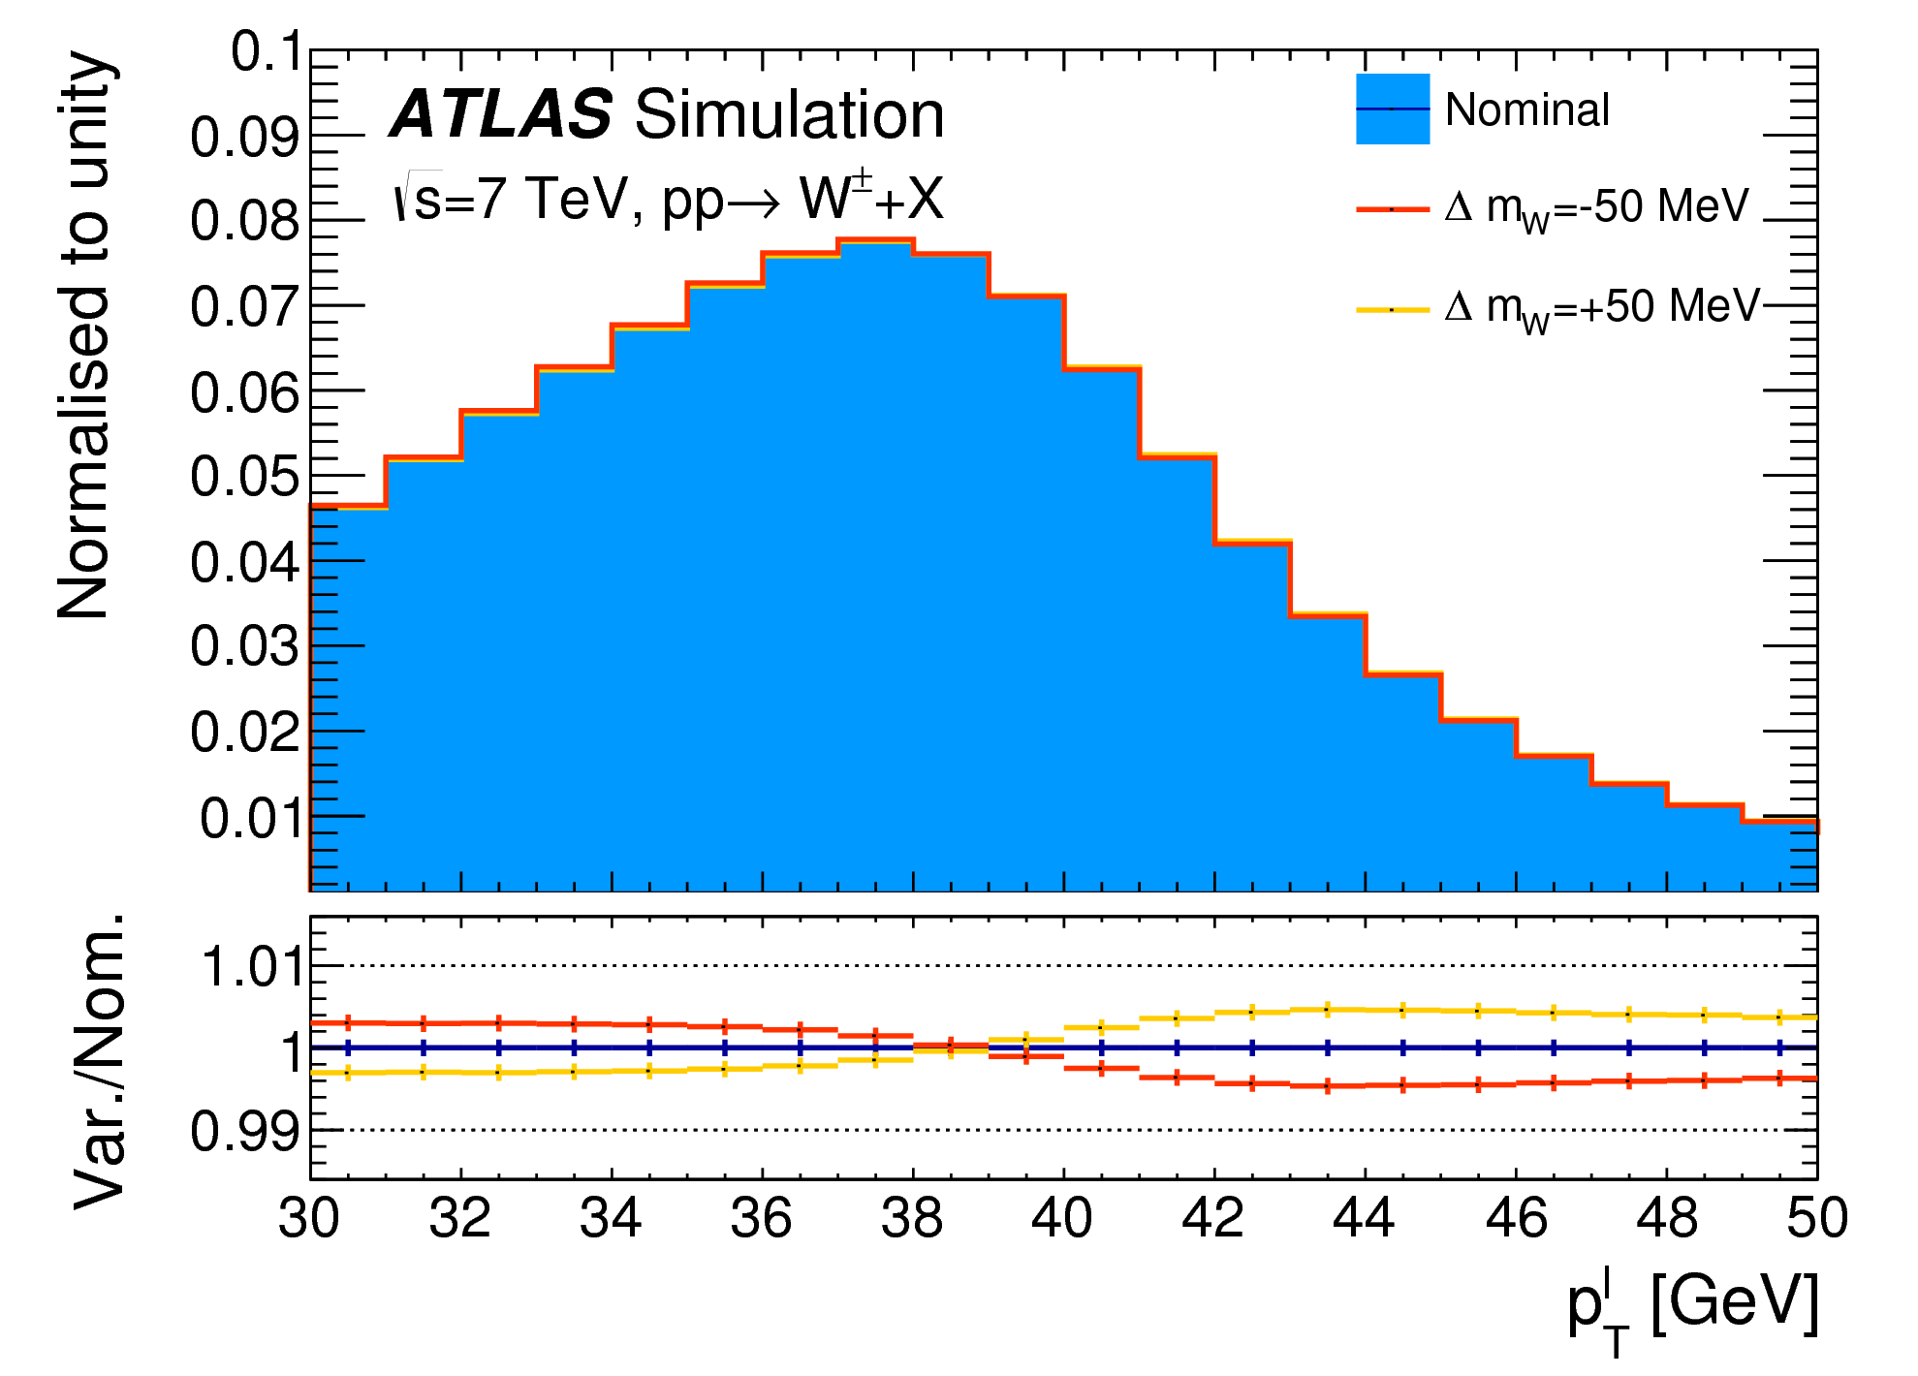
Example of Demanding mW measurement
EPJC 78 (2018) 110
Sensitive variables p_{T}^{lepton} and m_{T}W
O(10) MeV m_{W} precision requires per-mil precision in predicting and measuring p_{T}^{l} and m_{T}
Correcting MC simulation to start-of-art predictions
Calibrating physics objects to best possible precisions

Slide 13
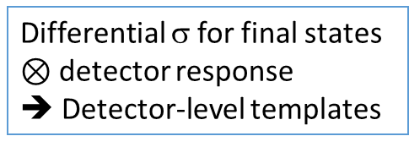
ATLAS Example of Modelling and Corrections for mW Study
Needs precise modelling upon all corners:
from matrix-element all the way to final state particles
W, Z process initially modelled with Powheg+Pythia8:
NLO QCD + QED final state radiation + LL QCD resummation
Correct to start-of-art predictions based on Drell-Yan factorisation formula
Rapidity distribution:
Correct to perturbative NNLO via DYNNLO
Helicity σ and A_{i}:
Correct to perturbative NNLO via DYNNLO
Differential σ for final states
$⊗$ detector response
➔ Detector-level templates
p_{T}(V): sensitive in small p_{T}, subject to large uncertainties
Correct to Pythia 8 tuned with data — AZ tunes
(approximately NLO QCD + NLL resummation accuracies)
Breit-Wigner mass distribution, vary as mW
(uncertainty on width considered)
Corrections on variables insensitive to mW ➔ reliable modelling, minimum biases to mW

Slide 14
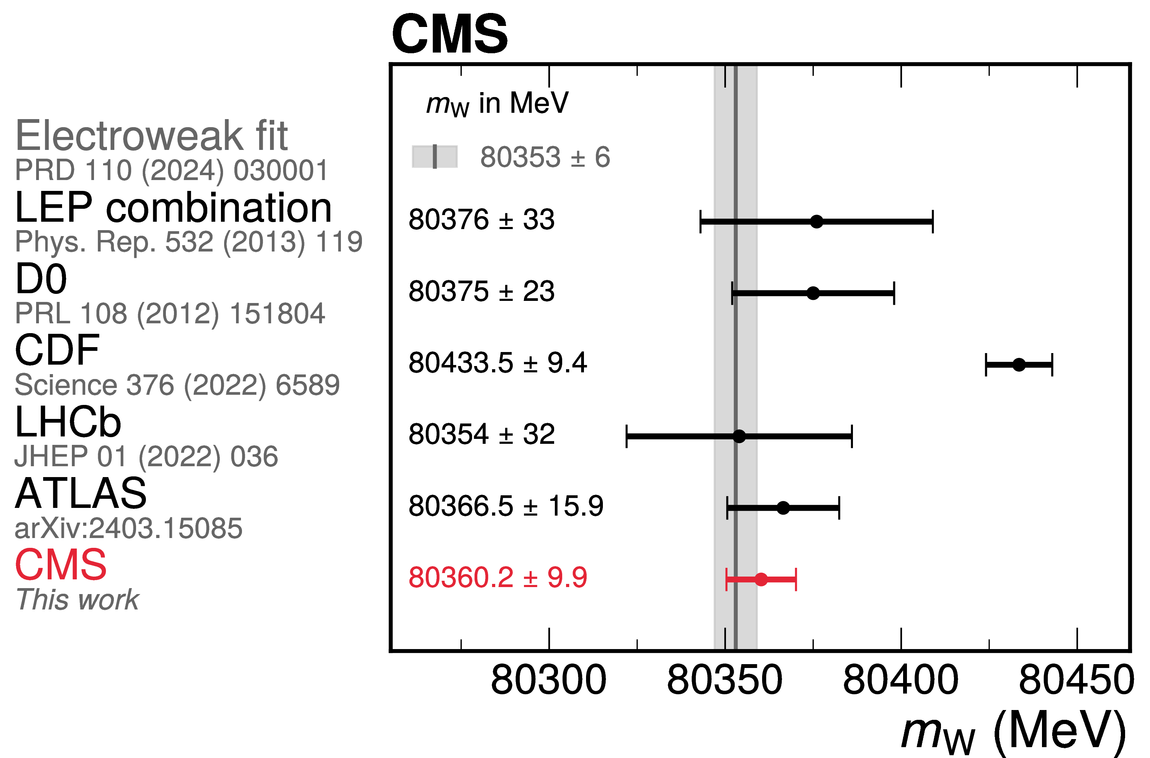
Results in W mass
arXiv:2412.13872, submitted to Nature
The future?
Balance of pile-up conditions
Choice of methodology (observable, modelling, fitting)
Reduction of modelling/PDF uncertainties
Updated design of measurement paths?

Slide 15
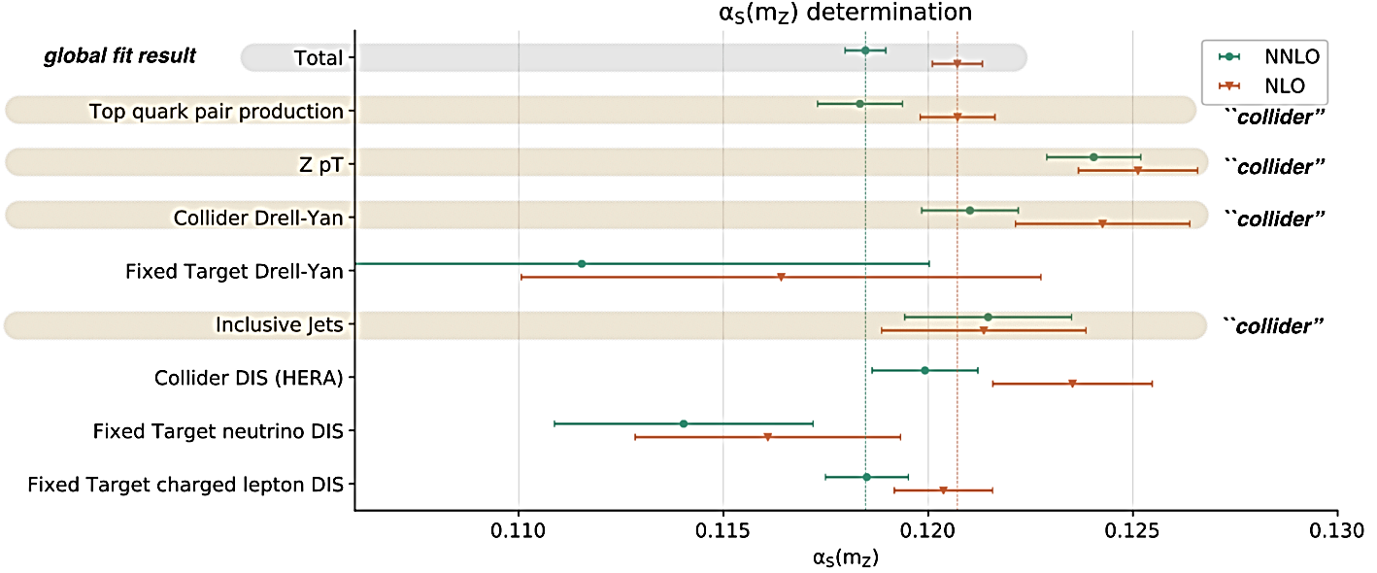


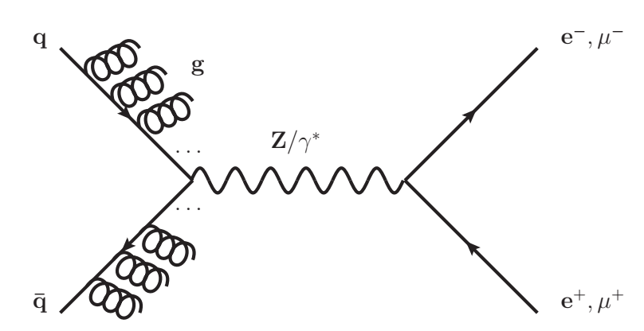
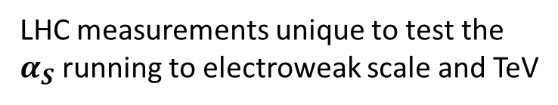
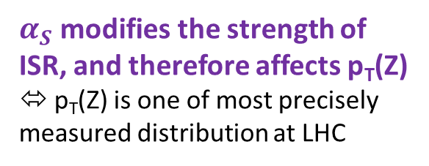


Precision of $α_{S}$ ←→ everything
LHC measurements unique to test the $α_{S}$ running to electroweak scale and TeV
Many different methodologies, relevant examples below
arXiv:1811.11801
PDF fit with collider results (e.g., inclusive jet) can give constraint to $α_{S}$
(sensitivity from parton σ and DGLAP scaling)
Utilize the abundant production of jets and V+jets
Transverse energy-energy correlation (TEEC)
dated back to e+e-, to explore multi-jet FSR correlation affected by $α_{S}$
and novel particle-based EEC (Huaxing Zhu etc. → dedicated discussion later)
$α_{S}$ modifies the strength of ISR, and therefore affects p_{T}(Z)
⬄ p_{T}(Z) is one of most precisely measured distribution at LHC

Slide 16






Z pT → $α_{S}$
ATLAS-CONF-2023-015
Very precise Z pT measurement matching to very precise modelling can yield great precision in $α_{S}$
Demonstration of ZpT and $α_{S}$ relationship
State of art prediction:
DYTurbo: N⁴LL resummation
+ aN³LO perturbative
with N³LO MSHT20 PDF
Evolution of $α_{S}$ precision v.s. increased accuracies of prediction
Best single-measurement so far <0.8%,
Very delicate dependence on modelling uncertainties

Slide 17

pp Precision
Eur. Phys. J. C 83 (2023) 441
Total pp cross-section can be very precisely determined (forward detector, special run)
Important for hadronic models (and for nuclear physics, cosmic-ray, etc.)
Posing challenges to analytic modelling, cross-experiment examination

Slide 18

V Precision
Eur. Phys. J. C 84 (2024) 1126
Ultra Precision V pT measurement with low pile-up data,
Extending to very small pT
Confronting high precision predictions

Slide 19


Jet Precision
JHEP 05 (2018) 195
A large potential to study large dynamic ranges of jet physics,
next updates desired : - )

Slide 20


VV Precision
PRL 107 (2011) 041802
JHEP 08 (2025) 142
Using WW production as an example, we are entering VV precision regime

Slide 21

Precision by Touching Rareness
Example with measuring vector boson scattering
and tribosons

Slide 22

Vector boson scattering and tribosons
of rarest to probe:
Vector boson scattering (VBS)
and triboson production (VVV)
Cross-section at O(fb)
Deep connection with Higgs physics, and sensitive to four-body gauge-vertices

Slide 23


Evolution of VBS observations
PRL 113 (2014) 141803
Almost ten years ago, started with same-sign WW pairs + jj
with a handful of signal events
All EW VVjj modes have been observed by now,
First-order validation of predictions from EWSB
Start to study the differential distributions and constrain anomalous QGCs (aQGCs) and more

Slide 24



Precision Efforts with The Rarest VBS ZZ
Nature Physics 19 (2023) 237–253
Fiducial cross-section as small as 0.1 fb, but rich in physics mechanisms
Define signal regions with leptonic decay final states, study carefully background modelling with both data and MC

Slide 25



Precision Efforts with The Rarest VBS ZZ
Upgrade the gear from straight selection on kinematics to machine learning, to maximize the S/B
Next: to investigate differential measurements, dependence of m(ZZ) by Goldstone theorem, polarization states, etc.
Visibly see the signal!

Slide 26


VVV efforts: example
PRL 125 (2020) 151802
Phys. Rev. Lett. 132 (2024) 121901
Observation of production of three massive bosons
Observation of WWγ and a constraint on Higgs/light-quark Yukawa couplings

Slide 27

Precision by Systematic Exploration
Example with four-lepton

Slide 28



Golden/Precise Channel for Higgs Discovery and Measurement
PRL 131 (2023) 251802
Cover Page for Higgs Birthday
Data accumulation for
four-lepton channel observation
Main player for property measurement: example for precision mass determination

Slide 29

Four-lepton for Precision Knowledge
JHEP 07 (2021) 005
A precise measurement of four-lepton final state can probe
Z→4l and relevant rare decays around m(4l) = 90 GeV
Continuum and off-shell effects at 100-180 GeV
Higgs boson physics at 125 GeV
Diboson ZZ physics beyond 180 GeV

Slide 30




Off-shell Higgs and Higgs width
PLB 846 (2023) 138223
Can we measure Higgs boson width down to MeV precision?
→may through off-shell Higgs boson (with assumptions)
Derived Γ_{H} < 10.5 MeV at 95% CL, comparable to CMS, being both best precision so far
Look for high-mass 4l events, optimization for sensitivity

Slide 31


ZZ Differential and EFT
JHEP 07 (2021) 005
Precision different measurements
Constraints to EFT coefficients (SMEFT Warsaw basis)

Slide 32



ZZ polarization
JHEP 12 (2023) 107
Look more precisely into SM structures:
helicity-dependent interactions, and goldstone theorem predictions,
next-level sensitivity to new physics
A comprehensive study + ML → first evidence on Z_{L}Z_{L} production
Next march to 5σ and study energy dependence

Slide 33


Interesting channel for HH study
ATLAS-CONF-2024-005
With a good understanding of the final state, one can use it as a tool to study more “rare” topics:
such as di-Higgs production: 4 lepton + two b

Slide 34




Direct Connection with New Physics
PRL 131 (2023) 251801
PRL 122 (2019) 231801
One leading channel for Higgs-portal DM, Higgs invisible decay search is
Z+H → dilepton +MET:
ZZ being main background process
Look precisely into Z→4l+X decays to search for dark photons

Slide 35

Roadmap into Future?
Several (wild and incomplete) ideas for discussions
Polarization, QM, Toponium etc. will have dedicated discussion and not covered here

Slide 36


There are tons of final states covered and uncovered
Explored states often motivated by physics interests that are accessible by the time
To continue explore those precisely with new techniques and to
explore new channels becoming more accessible now

Slide 37


V + flavored Jets (or even gluon vs quark)
Eur. Phys. J. C 84 (2024) 984
Large mismodelling seen for production of flavored jets
Jet tagging technics improving over years, good opportunities to review this further
Diverse probes: QCD dynamics, HF PDF, intrinsic charms, HF related new physics, VV decays, VH Yukawa couplings …
New results on Z+b/c measurements, we start to make charm-jet process more accessible

Slide 38




Back to multi-jet
JHEP 12 (2015) 105
Probes to DPI, QCD dynamics, alphasS,
High-order 2→X calculations
But also, to use these abundant processes as a platform (jet factory) to study more intrinsic properties: jet charge, special kinematic regions, new physics, etc.
arXiv:2403.19742

Slide 39





γγ collider: a good start and a lot to continue
Heavy ion beams with enhanced rate
to observe γγ → ll, γγ production
pp beams to probe γγ → WW
γγ → X
Nature Physics 13 (2017) 852–858
PLB 816 (2021) 136190
PRL 131 (2023) 151802
γγ −> ττ
Light-by-light scattering
Clean central activity

Slide 40



Explore extra detector dimensions
Study detector response in more details
→ Expand the physics coverage
ATL-SOFT-PUB-2023-002
Example: exploitation of energy loss and time-of-flight to search for long-lived, anomalously charged particles
Example: extra timing dimension to help reject pileup contributions, and more

Slide 41

Use EFT as a proper tool
ATL-PHYS-PUB-2022-037
Observe derivation
→ Global test to identify the source?

Slide 42

Interplay with Cosmic Ray
CR observatories (e.g., LHAASO ) provide precision CR physics potentials (and new physics possibly)
Crucial to have next gen. of hadronic models, at this moment, suffer large unc. from modelling
LHC can offer critical contributions to tune those models (such as EPOS-LHC)
e.g. benefit from pO collision data taken recently at special runs

Slide 43

Ratio measurement(s)
In the case of systematically dominated physics studies, how to further increase precision?
In some cases, ratio measurements can help, example with 3/2 jet ratios (sensitive to alphas)
This can evolve to other channels, with dedicated physics targets to be designed
Phys. Rev. D 110, 072019 (2024)

Slide 44

Novel way to present measurements?
Phys. Rev. Lett. 133 (2024) 261803
Novel techniques,
With physics impact to be further studied
An attempt of N-tuple measurement of Z+jets (with machine learning)

Slide 45

Further insights on interference effects?
e.g. scattering amplitude cancellation effects in certain phase space of VV production
Interests to observe it (again)
Potential to measure and utilize lots of interference effects in the SM?
Phys. Rev. Lett. 133 (2024) 101802

Slide 46

Summary

Slide 47

This is a short story to give some (biased) ideas about SM measurements with LHC/ATLAS/CMS
We made a lot of progress (into SM structure, rareness, and new-physics sensitive phases), and we are continuing to push forward the fronts
Which has been guaranteed by both precision in experimental apparatus and theoretical advances (not covered here)
We desire for even more outstanding insights (breakthroughs) through this diverse program of SM measurements
Collaborations with theorists warmly welcomed (crucial to expand the measurement territories with common interests)!

Slide 48

Thanks!

