Slide 1
CSNS & CSNS-II beam instr.
July 25, 2025
R. Yang

Slide 2
CSNS-II Upgrade 2025
Finish all the maintain work before Aug. 15 (ddl.)
Job list
 | 动机
H0CT/INDCT | Installed =>
LRBPM18 | Installed =>
LRBTPM09 | To be mapped => Installation
R1BPM01 | Manufacture
INMWS01/INMWS02/INDMWS01 | 2 Delivered, 1 vacu. checking
INDVS01 | Installed
icBLM | ?

Slide 3
2025 Summer maintain
Finish all the maintain work before Aug. 15 (ddl.)
Job list
 | 动机 | 时间段/联系人
RCS BPM探头标定 | 技术部要求 | 2025年6月-9月/Rehman
MEBT WS01换丝 | 运行中碳丝熔断 | 2025年6月/李芳
LRBT CT位置更换 | 相位测量需求 | 2025年6月/李芳
SCCT-Test安装 | CT新探头安装 | 2025年6月/黄蔚玲
WCM前放升级 | 当前WCM信号<50 mV, SNR不足 | 2025年6-9月/李芳
LRBT BPM电子学更换 | LRBT头尾改为Libera电子学 | 2025年6-9月/徐智虹、李芳
LW样机光路和H0探测升级 | 实验需要 | 2025年8月-9月/杨仁俊
RCS IPM线缆屏蔽和磁铁拆除 | IPM调试需要 | 2025年8月-9月/杨仁俊

Slide 4
加速器关键时间节点
计划时间 | 事项 | 备注
2025.08.15 | 开始DTL腔体老练
2025.8.15 | LRBT设备启动加电调试
2025.8.15 | RCS设备启动加电调试
2025.9.1 | 加速器开始调束
2025.10.1 | 恢复打靶供束

Slide 5
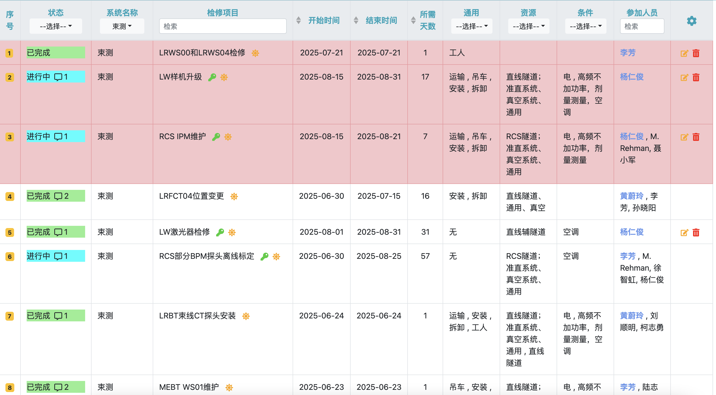
常规检修任务进度跟踪
Tbc:
1, did anyone prepare connection for the IPM shielding bellow? (Mengyu)
2,

Slide 6
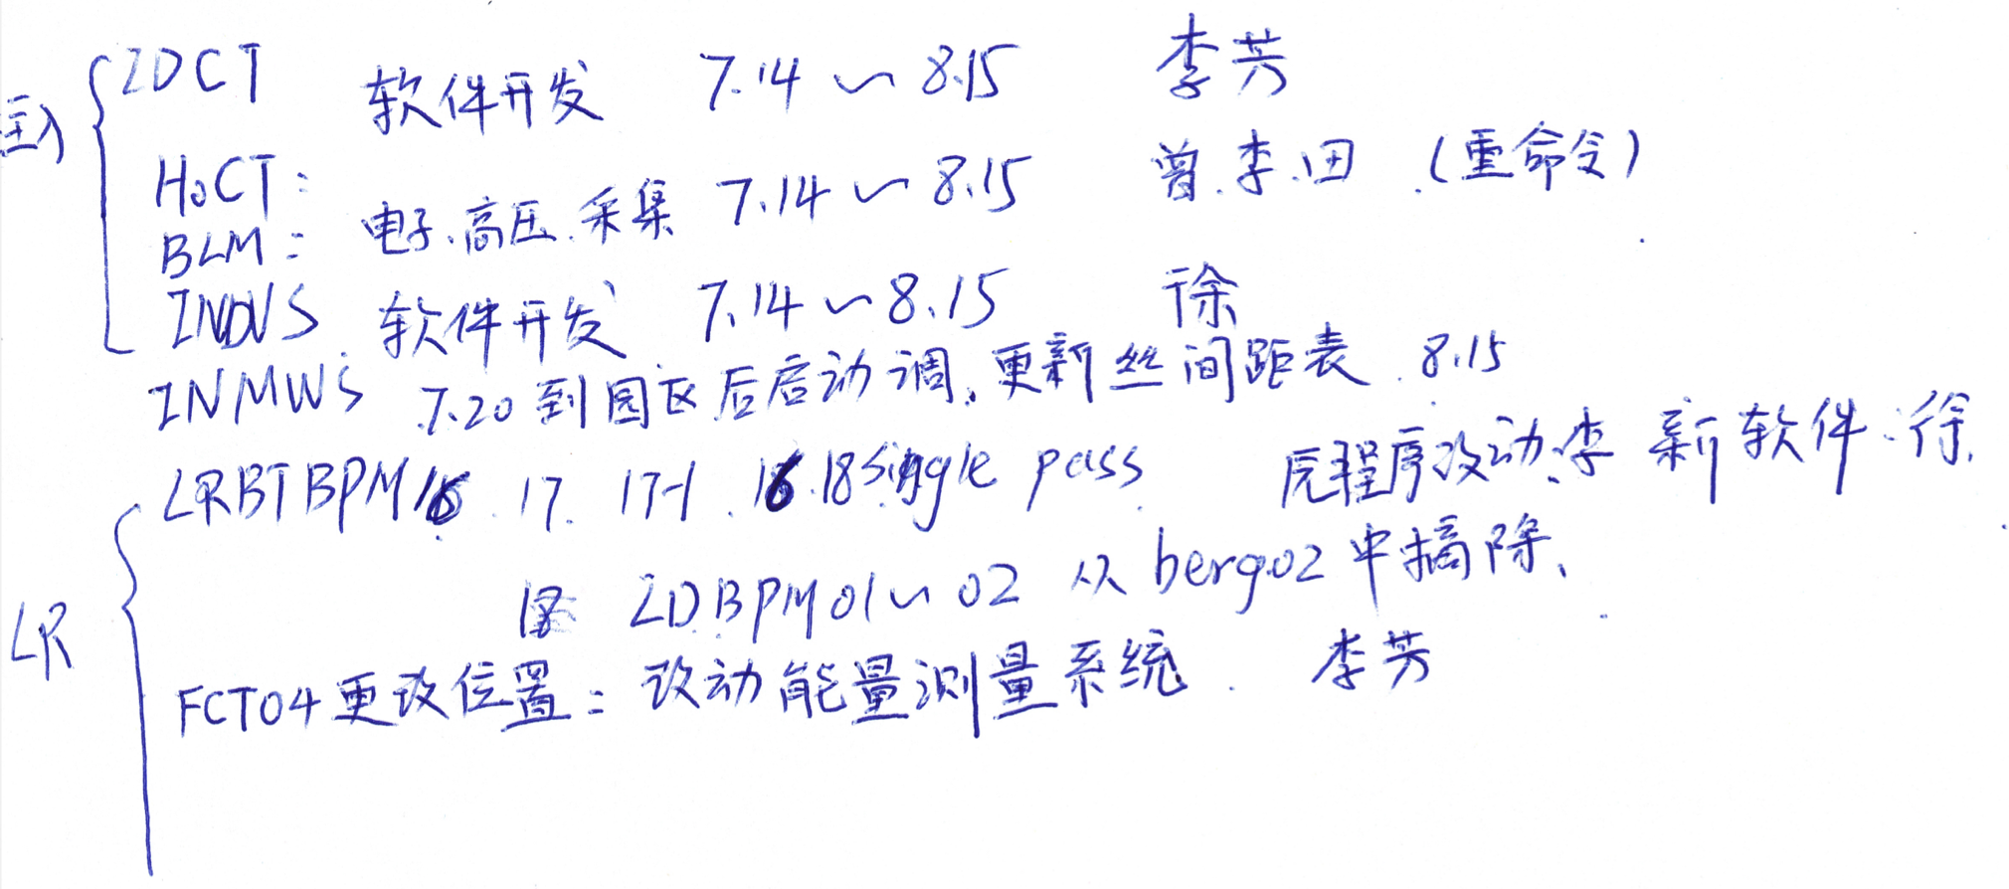
CSNS-II upgrade 2025 (DAQ part)
Schedule: ~Aug. 15 => Sep. 1 (ready) => beam test ?

Slide 7
Reminding
Summer maintenance, CSNS-II upgrade and e- injector are tasks of BI group, NOT personal project!
=> Specifications, CPM, regular discussion (keep group leader updated)
Responsibility
  Watch your detector/electronics/software (equality!)
  Supervision is NOT favored upon request!
  Focusing on key milestones (Installation, Startup, …)
Act ahead of schedule
Update/Response in time (tunnel work daily, …)

