Slide 1
The estimation methods of Beam Induced Backgrounds at CEPC
Haoyu SHI
2025.7.22
On Behalf of the BG Working Group

Slide 2
Sources and Simulation Steps/Tools
Single Beam
Touschek Scattering
Beam Gas Scattering(Elastic/inelastic)
Beam Thermal Photon Scattering
Synchrotron Radiation
Luminosity Related
Beamstrahlung
Radiative Bhabha Scattering
Injection
SuperKEKB like sudden beam loss
Failure Case(injection/extraction/Power Loss…)
For Ideal beam with high order magnet error
Other errors like misalignment not included yet
Background | Generation | Tracking | Detector Simu.
Synchrotron Radiation | BDSim/Geant4 | BDSim/Geant4 | CEPCSW/FLUKA
Beamstrahlung/Pair Production | Guinea-Pig++ | SAD
Beam-Thermal Photon | PyBTH[Ref]
Beam-Gas Bremsstrahlung | PyBGB[Ref]
Beam-Gas Coulomb | BGC in SAD
Radiative Bhabha | BBBREM
Touschek | PyTSK with SAD
One Beam Simulated
Simulate each background separately
Whole-Ring generation for single beam BGs
Multi-turn tracking(1000 turns)
Using built-in LOSSMAP
SR emitting/RF on
Radtaper on
No detector solenoid yet
Notes:
Implemented The superKEKB way of bg simulation

Slide 3
Inputs for the generation/tracking step
Acc. Design parameters
The number in red is we used in generators
A dedicated version of acc. Lattice(SAD file)
The lattice file is given by Yiwei, then slice the components(-200m to 10m, shorter than 1cm) and add aperture by Haoyu.
I’ll take 3 examples, representing 3 kinds of sources(generators) we used.
Beamstralung/Pair Production
Beam Gas Scattering
Synchrotron Radiation(not finished yet today).
 | Higgs
Number of IPs | 2
Solenoid(T) | 3
Circumference (km) | 99.955
Half crossing angle at IP (mrad) | 16.5
Bending radius (km) | 10.7
SR power per beam (MW) | 50
Energy (GeV) | 120
Energy loss per turn (GeV) | 1.8
Bunch number | 446
Bunch spacing (ns) | 277.0
[ × 23.08 ns] | 12
Train gap [%] | 63
Bunch population (10¹¹) | 1.3
Beam current (mA) | 27.8
Beta functions at IP b _{x}*/b _{y}* (m/mm) | 0.3/1
Emittance e_{x}/e_{y} (nm/pm) | 0.64/1.3
Betatron tune n_{x}/n_{y} | 445/445
Beam size at IP s_{x} /s_{y} (um/nm) | 14/36
Bunch length (natural/total) (mm) | 2.3/4.1
Energy spread (natural/total) (%) | 0.10/0.17
Energy acceptance (DA/RF) (%) | 1.6/2.2
Beam-beam parameters x_{x} /x_{y} | 0.015/0.11
Beam lifetime (Bhabha/beamstrahlung) (min) | 40/40
Beam lifetime requirement (min) | 20
Luminosity per IP (10³⁴ cm^{–2} s^{–1}) | 8.3

Slide 4
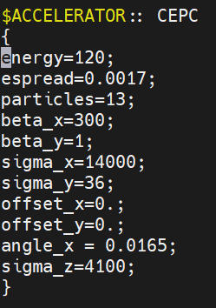
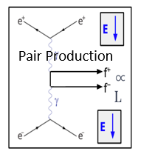
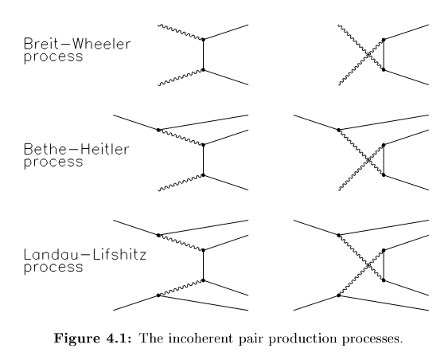
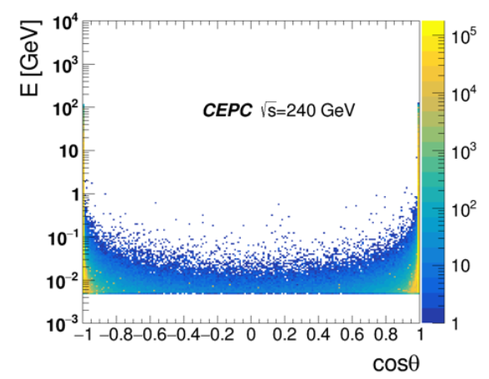
Beamstrahlung/Pair Production
W. Xu, Y. Tang
Incoherent Pair Creation/Two photon…
Charged Particles attract by the opposite beam emit photons(beamstrahlung), followed by some processes including the electron-positron pair production.
Using Guinea-pig++(v1.2.1) as the generator and implementing the external magnetic field by code updating.
The generator using center-of-mass frame, performing the interaction slice by slice using macro particles.
It generates the beam particles with energy or momentum change, the low pt pairs, the photons, the hadrons, or even mini-jet. All the particle information will be outputted. Only electrons/positrons will be used for next step(by transformed back to lab frame).
The time used for generating 2000BX is ~ 1 week.
D. Schulte

Slide 5
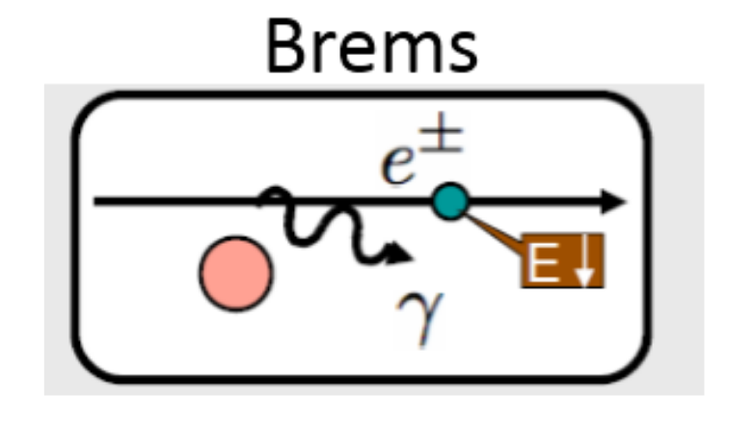
Beam Gas Bremsstrahlung Scattering
Y. Teng
Bremsstrahlung scattering with residual gas. Written in Python.
Rate $∝P, Z$, related to Z of the gas(Currently assuming H₂)
It should generate beam particles and photon. Currently beam particles only. Only energy changed after the scattering, the position and direction keeps unchanged.
Lowest delta energy is set to 0.016(energy acceptance).
Using 10⁻⁷ Pa uniform distribution of the vacuum level. Assume 5 off-angle particles could be generated per cm. Calculate the number of particles generated per slice component, then get the initial distribution after scattering.
Tracking 1000 turns, output the information of all lost particles.
Calculate loss rate using beam lifetime provided by acc. Colleague(~200 h @ Higgs), the scale the loss number in the IR to per second.
$$σ_{brem}=4αr_{e}^{2}[\frac{4}{3}\left(ln\frac{1}{η}−\frac{5}{8}\right)F\left(Z\right)+\frac{1}{9}Z\left(Z+1\right)(ln\frac{1}{η}−1)]$$
$$\frac{1}{τ}=σρ_{gas}c=σc\frac{P}{k_{B}T}$$
$$Loss Rate=\frac{Loss Number}{Loss Time}=\frac{Bunch number∗Particles per Bunch∗(1−e^{−1})}{Beam Lifetime}$$

Slide 6
Collimator and Aperture setting
In SAD, aperture is treated as an element, rather than the parameter of an element. SAD will mark the particle as lost when its position outside of the aperture.
As shown in the right figure, the mismatch between the “real” loss position(2) and the outputted loss position(3) will implement error. The slice of the component could mitigate it.
By changing the aperture setting, we can add collimators. Currently only two apertures(before and after the components) have been added. More will be done in future, when we study the collimators carefully.
SAD Aperture
3
2
1

Slide 7
Synchrotron Radiation - I
Y. Tang
The SR photons are produced by beam particles in Geant4.
The beam generated at -150m, tracked to 150m.
The magnetic field is added into the geometry using the parameters given by accelerator group. Currently, the last upstream bending magnet, the final focusing quadruples and the detector solenoid(uniform) is integrated.
Using a dedicated physics list(including the X-ray reflection, the photelectric, Compton scattering, Rayleigh scattering and pair production), recording the SR photons generated and tracking them.
If the photons can leave the beam pipe(after interacting with beam pipe) in certain region, it will be recorded.
The output file will be used to run detector simulation in CEPCSW.
The BX rate is 1.4e6 @ Higgs.
The bunch population is 1.3e11 @ Higgs.
One electron generates 3 photons pn average.
The photons are ~1e18 per second.
Currently, we simulated 1e11 electrons.
Shielding Methods | Hit Density at VXD(MHz/cm²)
Original | 117,191
-1.9m Cu mask | 91.2
-1.9m Cu mask+5um Au | 61.7
-1.9m+ -4.3m Cu mask + 5um Au | 10
-1.9m W mask + 5um Au | <1(0)

Slide 8
The way to perform detector simulation
All the BG samples have some relationship to time. Pair BG samples are generated per BX. Single BG samples can be translated to per unit time.
The data file outputted by generators will be converted into root file.
Currently, the detector simulation is performed by CEPCSW. We have pair production and 4 types of single beam.
We perform the simulation using 20000BX(10 BX per task, 2000 tasks. Thus, we have 2000 root files as result).
For pair BG, we have 2000 BX in total, and randomly choose 10 per task.
For single BG, we have some samples per type. A Poisson sampling will be conducted(the average number can be calculated using the rate) to determine how many single BG particles could be chosen at 10BX window(2770ns @ Higgs).
Currently, the simulation will be run by Haoyu, while the digitization and analysis will be run separately by sub-detector people(Hancen, Zhan, Xin, Weizheng, Haopeng, Renjie, etc.).

Slide 9
BG Level at Higgs/Z with mitigation
We have obtained a preliminary estimate of the beam-induced background levels in Higgs/Low-Lumi-Z/High-Lumi-Z mode with latest CEPCSW.
The VXD results taken the SR into account. No safety factor.
The relatively changes are used for MDI group to check the effectiveness of the mitigation methods(collimators, shielding, etc.)
The exact number in the table could be used as a ref. for other sub-systems, BUT SHOULD NOT be treated as a solid foundation of the design.
Sub-Detectors | Ave. Hit Rate |  |  | Max. Hit Rate |  |  | Max. Occupancy Per BX(%)
 | Higgs | Low-Lumi-Z | High-Lumi-Z | Higgs | Low-Lumi-Z | High-Lumi-Z | Higgs | Low-Lumi-Z | High-Lumi-Z
VXD(MHz/cm²) | 2.5(0.11) | 9.4(0.31) | 58(2.0) | 2.8 | 19 | 126 | 0.0023 | 0.0021 | 0.0022
ITK-B/E(kHz/cm²) | 0.45/1.4 | 0.85/2.7 | 5.0/16 | 3.5/30 | 3.6/26 | 22/160 | 0.0032/0.0012 | 6.4e-3/2.5e-3 | 6.4e-3/2.5e-3
TPC(kHz/cm²) | 1.2 | 2.6 | 16 | 13 | 12 | 76 | 0.075 | 0.071 | 0.22
OTK-B/E(kHz/cm²) | 0.37/0.94 | 0.66/1.5 | 4.0/9.2 | 1.6/11 | 1.2/7.0 | 7.2/42 | 2.1e-3/3.7e-2 | 4.6e-4/6.0e-3 | 4.6e-4/6.0e-3
ECal-B/E(MHz/bar) | 0.0068/0.031 | 0.011/0.050 | 0.068/0.32 | 0.86/3.6 | 0.33/6.4 | 1.9/40 | 0.8/3.5 | 0.2/0.9 | 0.2/0.8
HCal-B/E(kHz/gs cell) | 0.0023/0.12 | 0.0042/0.12 | 0.026/0.76 | 7.0/320 | 12/170 | 70/960 | 4.0e-4/4.0e-2 | 4.0e-4/3.0e-3 | 3.0e-4/3.0e-3
Muon-E(Hz/cm²) | 2.6 | 1.0 | 6.8 | 27 | 32 | 110 | 0.72 | 0.08 | 0.12

Slide 10
Questions to be answered
What is the definition of “Hit”?
What is the basic unit of a dedicated detector?
How to calculate the average hit rate?
How to calculate the maximum hit rate?
How to calculate the maximum occupancy?
What’s the results of all information above?

Slide 11
VTX
H. Lu
A hit means a point provided by the CEPCSW in a dedicated position with energy deposition(“conbineHits=on”).
The basic unit used in estimation is sensor(cell/repeated sensor unit).
The area of sensor in Layer1-4 is 3.296*8.049mm², while in Layer 5-6 is 12.8*25.6mm²
It’s chosen by the detector based on the electronic read-out design.
The hit density is calculated by counting the number of hit on a basic unit(a sensor) per BX(ave. number of 20000BX we currently have).
The average hit density the average of all the hit densities on same layer per BX.
The maximum hit density is the highest number of all the sensors on same layer per BX.
However, the occupancy is calculated at sensor level. It is the ratio of fired pixels in one sensor. The max. is the highest number.

Slide 12
The results of VTX per Layer
H. Lu
Total average : 0.11 MHz/cm²

Slide 13
ECal
W. Song
A hit means a fired crystal bar(the energy deposition higher than the threshold) in a certain time(per BX, 277ns @ Higgs currently).
Currently, only the simulated time information is considered.
The basic unit in estimation is crystal bar.
The hit density is the ratio of fired time over all simulated times(using 20000BX we have).
The average hit density the average of all the hit densities in whole detector.
The maximum hit density is the highest number of the hit density among all the crystal bars.
However, the occupancy is the ratio of fired crystal bars in a certain time(per BX).

Slide 14
Converting per BX to Hz
For Higgs, the bunch spacing is 277ns.
Therefore, the numbers of BX per second could be calculated. It is
However, the gap of the beam train is 63%, it means only 37% of the space in the ring contains the beam. So, the actual number of the BX would be
For the calculation of average hit rate from BX to Hz, we take 1.4e6 as the scale factor, while for the maximum, we take 3.6e6 as the scale factor.
To be discussed.
$$No of BX=\frac{1 s}{277 ns}≈3.61×{10}^{6}$$
$$Actual No of BX≅\frac{1 s}{277 ns}×37\%≈1.33×{10}^{6}$$

Slide 15
TPC
X. She
The hit in TPC means the number voxels(500um*500um*2mm) with contains electron(“fired voxels”). It can be counted.
The deposited energy(by CEPCSW) converted to primary electron-ion pairs, then, the primary electrons undergo drift, diffusion and voxelization processes in a certain time(34us).
The basic unit of calculation in R is layer(10 voxel, 5mm in R), with whole range in Z.
The hit density is calculated per layer(using the area at the endcap) in 34us
Eg, the layer between 63.5~64cm in R, the area is ~115.40cm²
The average is the integration of whole detector region divided by whole area of the endcap.
The maximum is the integration of one layer(5mm in R)
In most of the cases, it should be the inner most layer. Therefore, usually calculated the numbers from the inner most layer directly.
Max. hit density = number of fired voxels / area at the endcap.
The occupancy is the ratio of fired voxels in a certain time(34us).
The total number of voxel is ~4.5×10⁹
Notes:
,

Slide 16
Backup

Slide 17
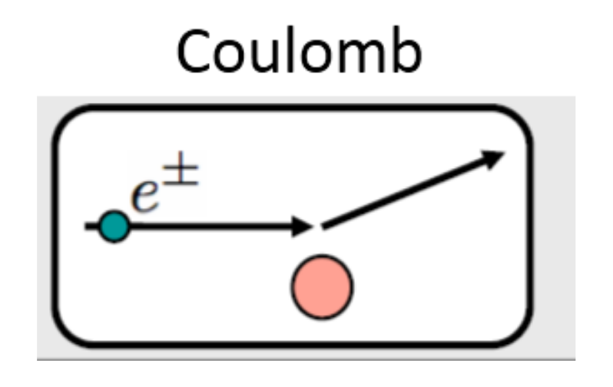
Beam Gas Coulomb Scattering
Y. Teng
Coulomb scattering with residual gas. Built-in code in SAD(code by us).
Rate $∝P, Z, T^{−1}, E^{−1}, R^{−2}$, related to beta function
Only theta changed after the scattering, the position keeps unchanged.
Highest theta is set to 0.001(need to be changed to perform the scan).
Using 10⁻⁷ Pa uniform distribution of the vacuum level. Assume 5 off-angle particles could be generated per cm. Calculate the number of particles generated per slice component, then get the initial distribution after scattering.
Tracking 1000 turns, output the information of all lost particles.
Calculate loss rate using beam lifetime provided by acc. Colleague(16 h @ Higgs), the scale the loss number in the IR to per second.
$$σ_{matt}=\frac{4πZ^{2}r_{e}^{2}}{γ^{2}}\left(\frac{1}{θ_{min}^{2}+θ_{1}^{2}}\right)=\frac{4πZ^{2}r_{e}^{2}}{γ}∙\frac{{192β}_{s}β_{max}}{192γR^{2}+β_{s}β_{max}Z^{2/3}}$$
$$\frac{1}{τ}=σρ_{gas}c=σc\frac{P}{k_{B}T}$$
$$Loss Rate=\frac{Loss Number}{Loss Time}=\frac{Bunch number∗Particles per Bunch∗(1−e^{−1})}{Beam Lifetime}$$

