Slide 1



Design of Muon Detector
Xiaolong Wang
Fudan University
July 29th, 2025

Slide 2
The Muon Detector
Designed for Muon ID. Furthermore,
  Trigger signal,
  Pion veto,
  Search for LLPs,
  Detect the leakage of HCAL.

Slide 3
Geometry and main parameters
Endcap
Barrel

Slide 4
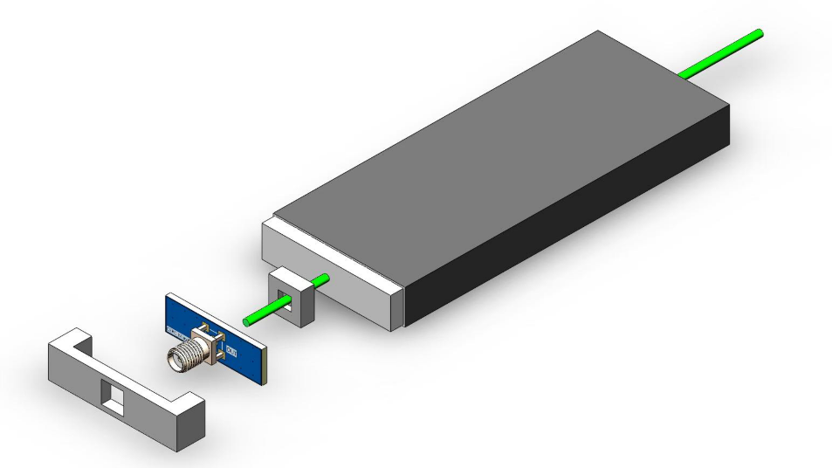
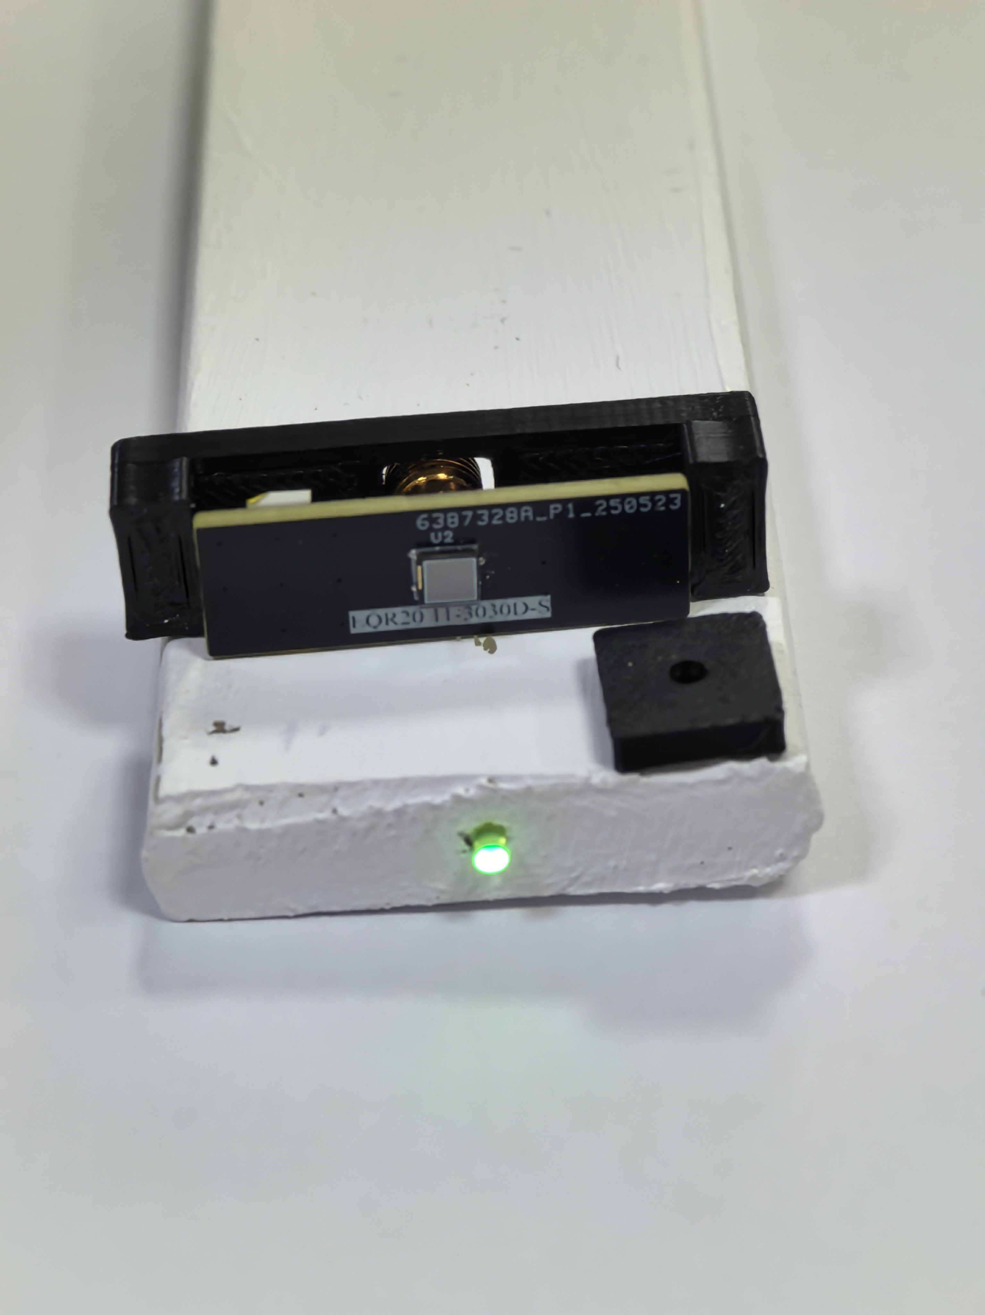
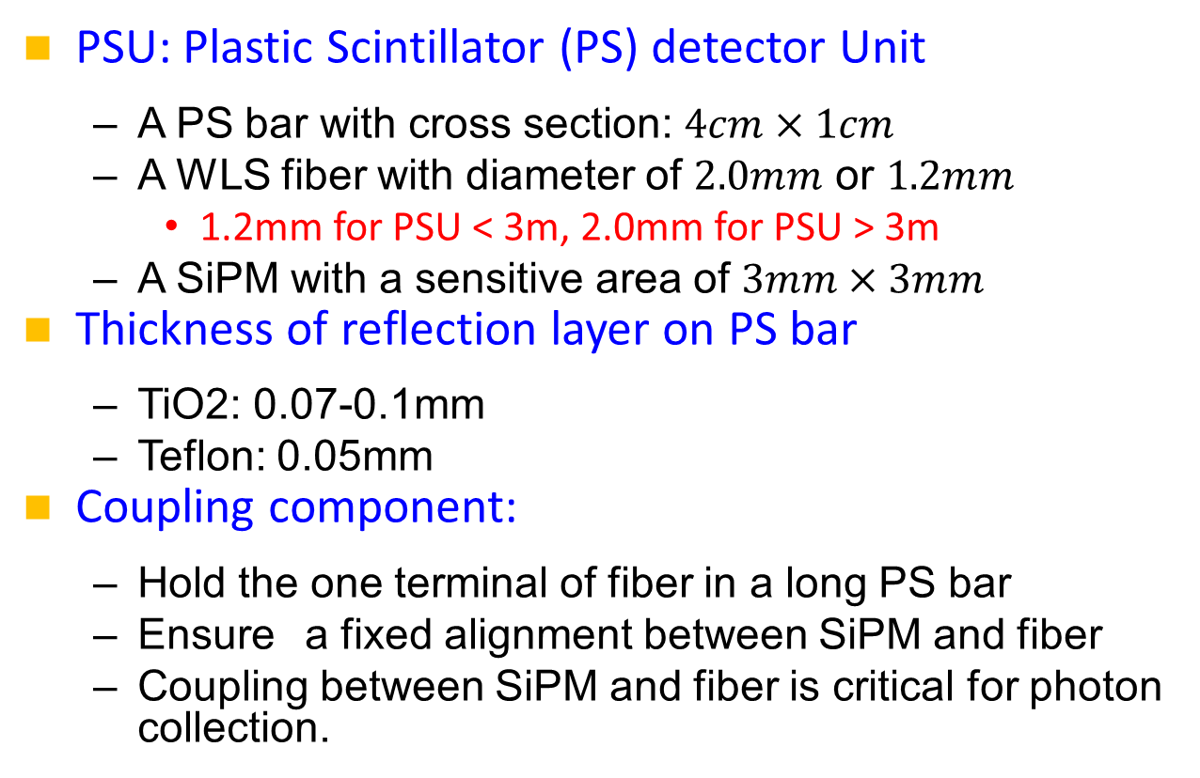
Detector channel (PSU)
PSU: Plastic Scintillator (PS) detector Unit
  A PS bar with cross section: $4cm×1cm$
  A WLS fiber with diameter of $2.0mm$ or $1.2mm$
    1.2mm for PSU < 3m, 2.0mm for PSU > 3m
  A SiPM with a sensitive area of $3mm×3mm$
Thickness of reflection layer on PS bar
  TiO2: 0.07-0.1mm
  Teflon: 0.05mm
Coupling component:
  Hold the one terminal of fiber in a long PS bar
  Ensure a fixed alignment between SiPM and fiber
  Coupling between SiPM and fiber is critical for photon collection.
5m PSU at FDU

Slide 5
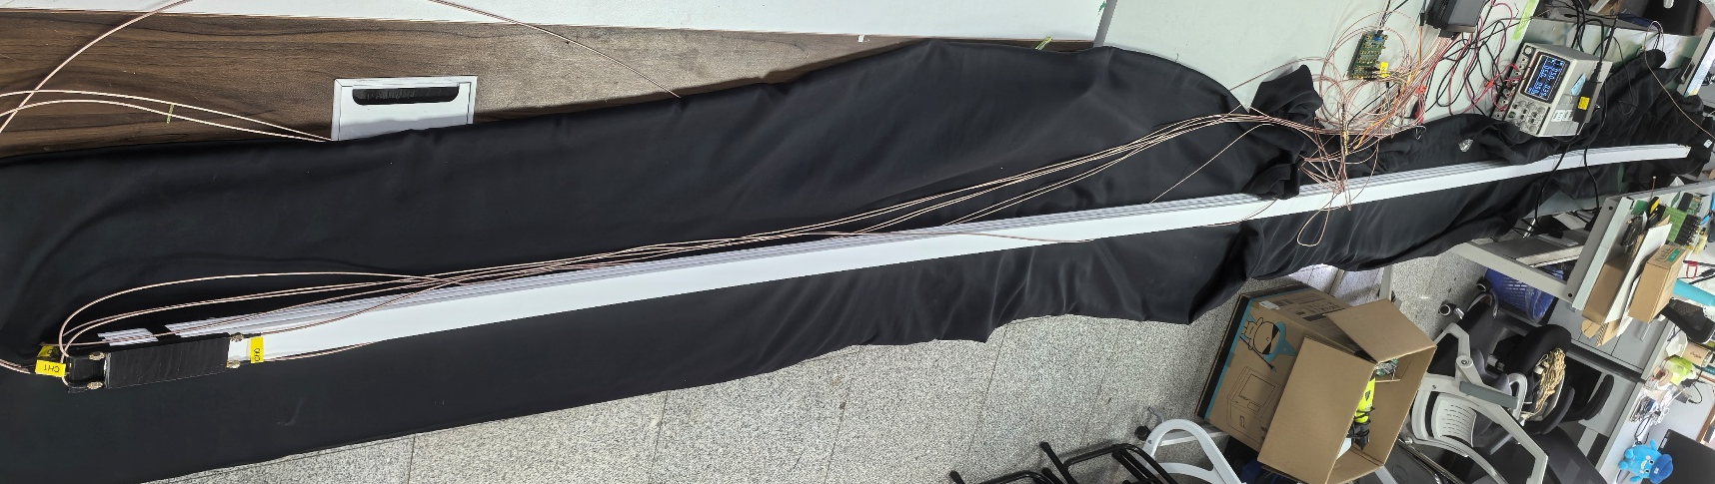
Newest test on 5m PSU
Efficiency: >95%
Time resolution: ~1ns
We are testing on new WLS fiber.

Slide 6
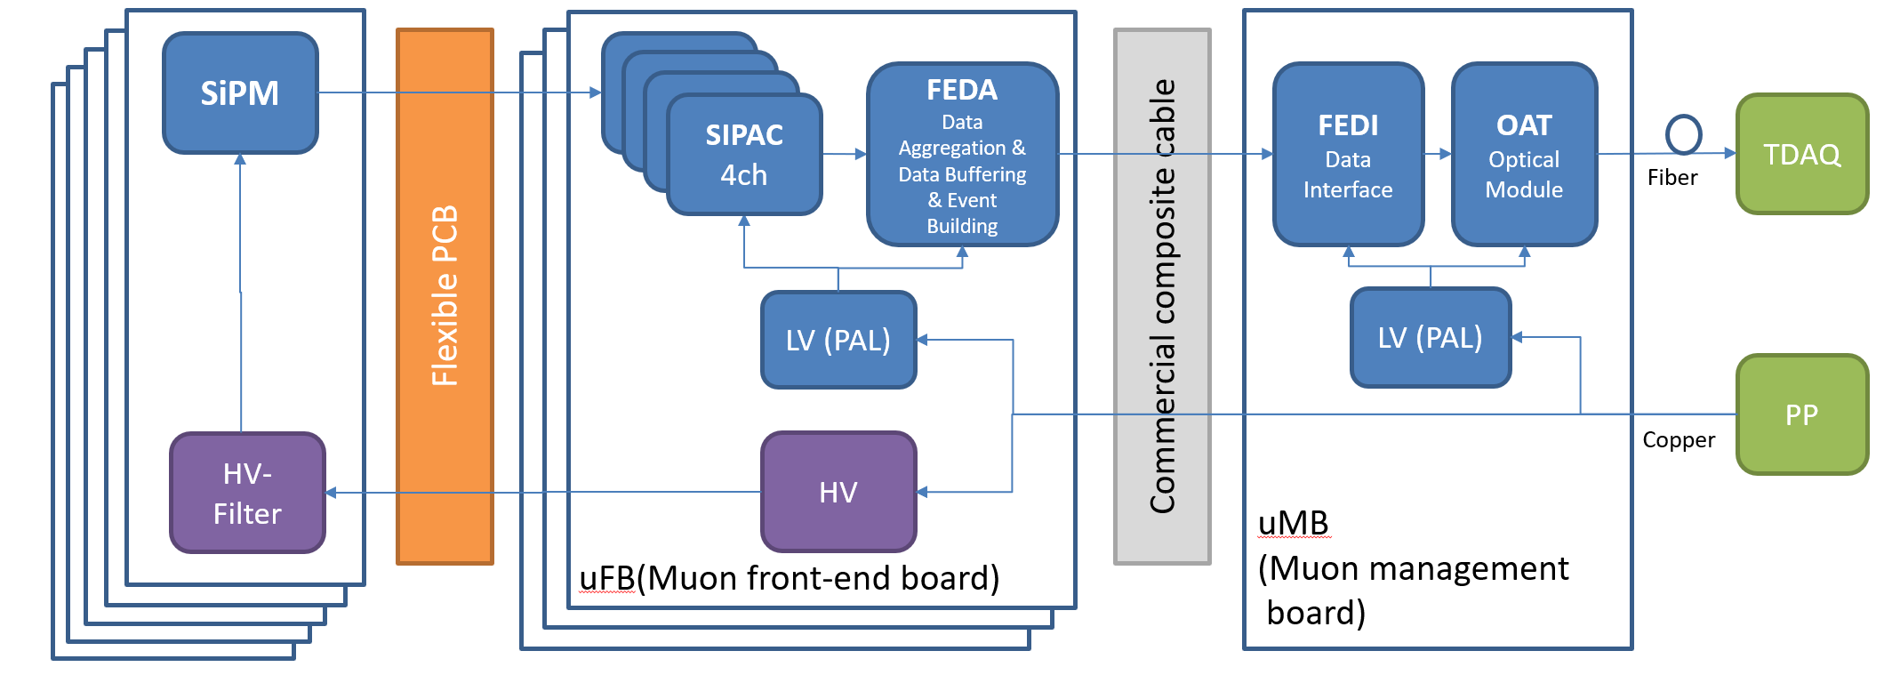
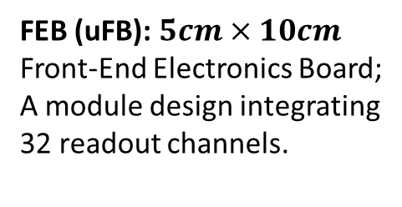
Electronic system
SiPM Tile:
SiPM+PCB of each PSU
FEB (uFB): $5cm×10cm$
Front-End Electronics Board;
A module design integrating 32 readout channels.
MB (uMB):
Management Board;
Central node for multiple functions.

Slide 7
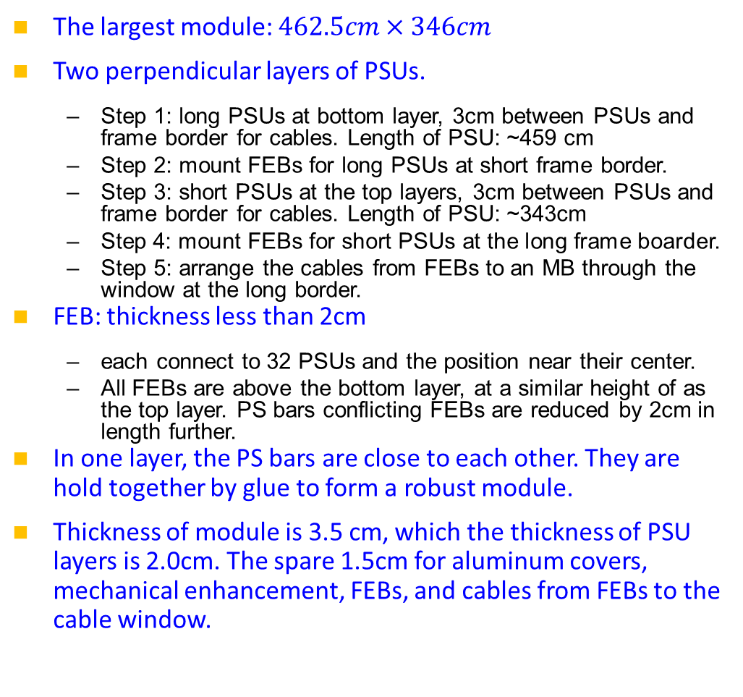
Internal structure of barrel module
The largest module: $462.5cm×346cm$
Two perpendicular layers of PSUs.
  Step 1: long PSUs at bottom layer, 3cm between PSUs and frame border for cables. Length of PSU: ~459 cm
  Step 2: mount FEBs for long PSUs at short frame border.
  Step 3: short PSUs at the top layers, 3cm between PSUs and frame border for cables. Length of PSU: ~343cm
  Step 4: mount FEBs for short PSUs at the long frame boarder.
  Step 5: arrange the cables from FEBs to an MB through the window at the long border.
FEB: thickness less than 2cm
  each connect to 32 PSUs and the position near their center.
  All FEBs are above the bottom layer, at a similar height of as the top layer. PS bars conflicting FEBs are reduced by 2cm in length further.
In one layer, the PS bars are close to each other. They are hold together by glue to form a robust module.
Thickness of module is 3.5 cm, which the thickness of PSU layers is 2.0cm. The spare 1.5cm for aluminum covers, mechanical enhancement, FEBs, and cables from FEBs to the cable window.
Cable window
Near the middle of barrel
Near the endcap

Slide 8
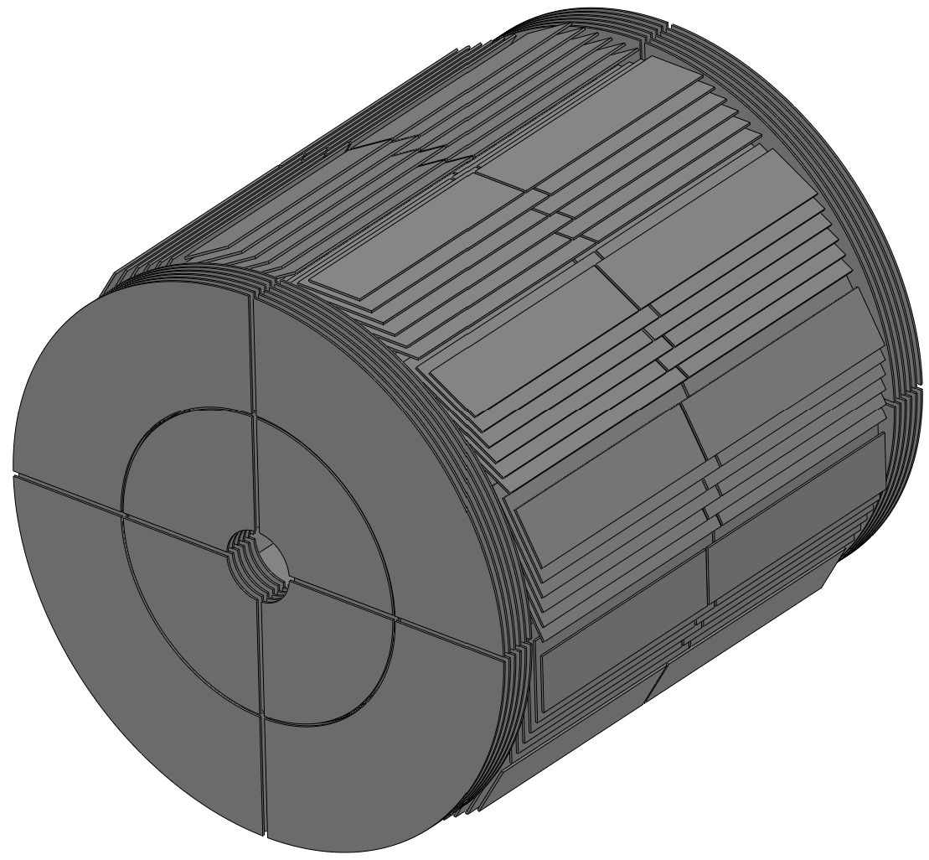
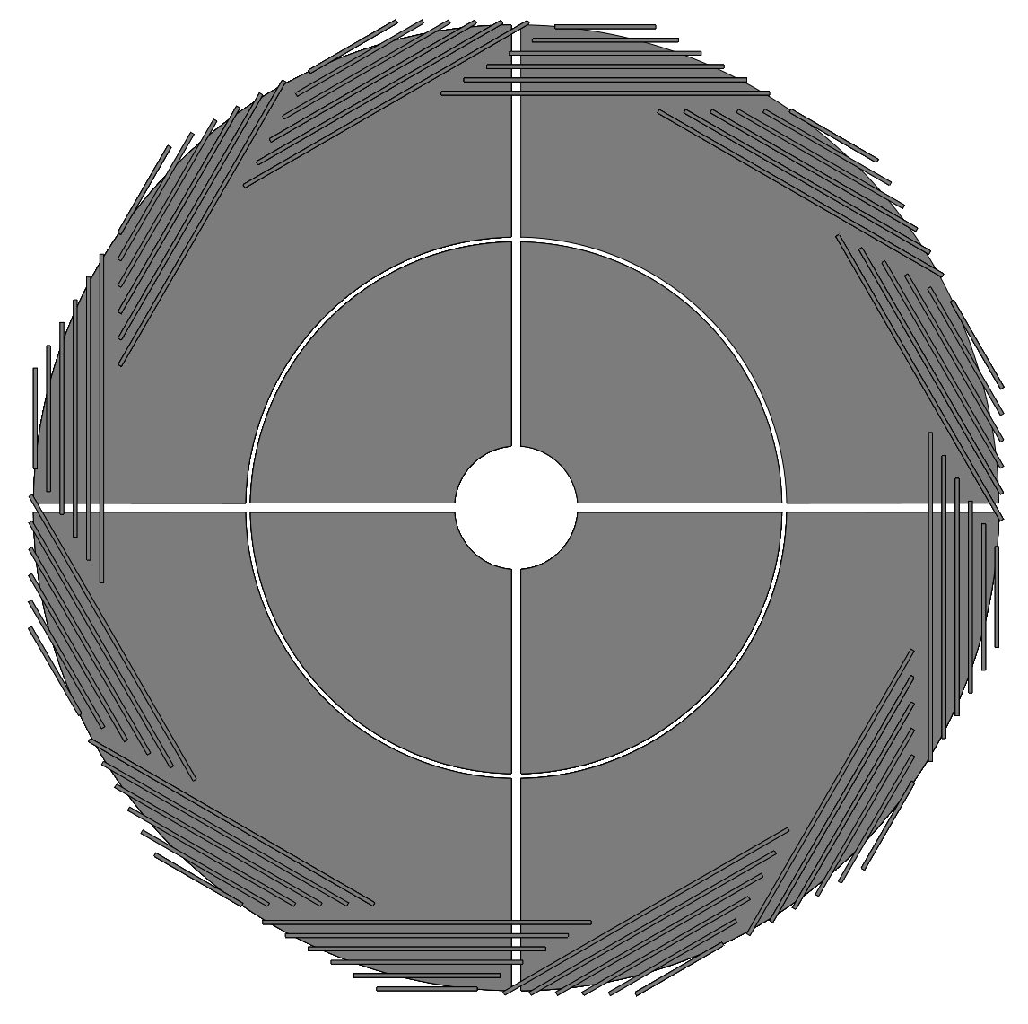
Positions of SiPMs and FEBs
The SiPMs and FEBs are new the endcap or the barrel’s outer edge, minimizing the radiation damage.

Slide 9
Cabling from module to MB in barrel
Commercial composite cable for connection between FEBs and MB.
All the cables for one module is combined to one bunch.
Each sector (1/12 of the barrel, one side) has one MB.

Slide 10
Inner module in endcap
Cable window
Similar procedure in arranging the PSUs and FEBs.
Bottom layer for horizontal PSUs, and top layer for vertical PSUs.
FEBS are mounted on the outer arc border.
FEBs for the two layers of PSUs may have the same position, especially at the middle of the arc border. In this case, shift their positions to avoid their confliction.
The area close to the beam pipe is fully covered by PS bars and WLS fibers, enhancing the detection coverage.
Rate capability (kHz/cm2) of PSU is well above the beam induced bkgs (<5 Hz/cm2).
SiPMs and FEBs are far away from the beam pipe, minimizing the radiation damage.

Slide 11
Outer module in endcap
Do it similarly for the outer module.
Cable window
Inner module
Outer module

Slide 12

Cabling for endcaps
After rotating the inner and outer modules inside a detector, 5cm from the detector modules and the vertical surface of the iron structure should be assigned for cabling, i.e., a tunnel with a cross section $5cm×4cm$ inside the gap between iron plates.
MB at top
This one is not necessary, very difficult for cabling.
MB at bottom

Slide 13
Regarding the simulation
The geometry in the simulation is according to the design, except the very small space between PSUs and module frame borders for cables.
However, there are questions in defining the MuID.
Our suggestion: number of layers with hits of a charged track.
In TDR chapter 9:
In TDR chapter for software?
In TDR chapter for performance?
The new software group of the Muon Group is trying to understand the MuID.

Slide 14
Geometry simulation
In TDR for barrel module:
For endcap module:
Bottom layer
Bottom layer

Slide 15
Thank you for your attention!
Oct. 21st, 2024, CEPC Detector Ref-TDR Review

Slide 16
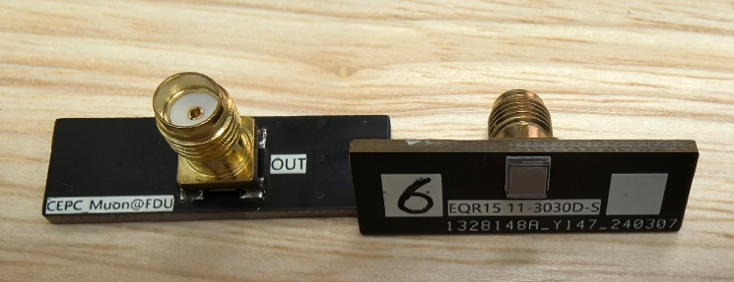
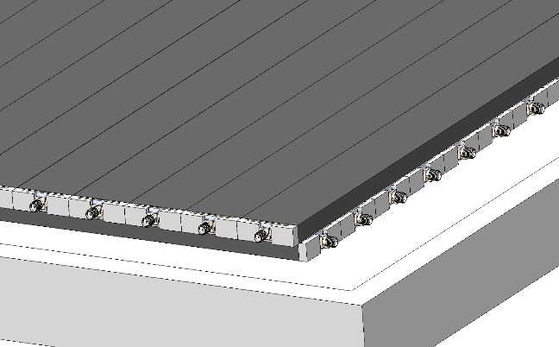

Module and electronics
Detector module
  Superlayer with perpendicular channels
  Carriers for preamps held at the frame
  Space between PS bars and aluminum layer is allowed for long cables.
  All the electronics should be integrated into the module.
Micro-coaxial cable
An example
Board at corner
High Density electronic board, $<10cm×10cm$
superlayer
Hole for 1-2 cables and2-4 fibers
Data output via fibers
Module
Electronic board

Slide 17
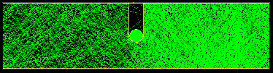
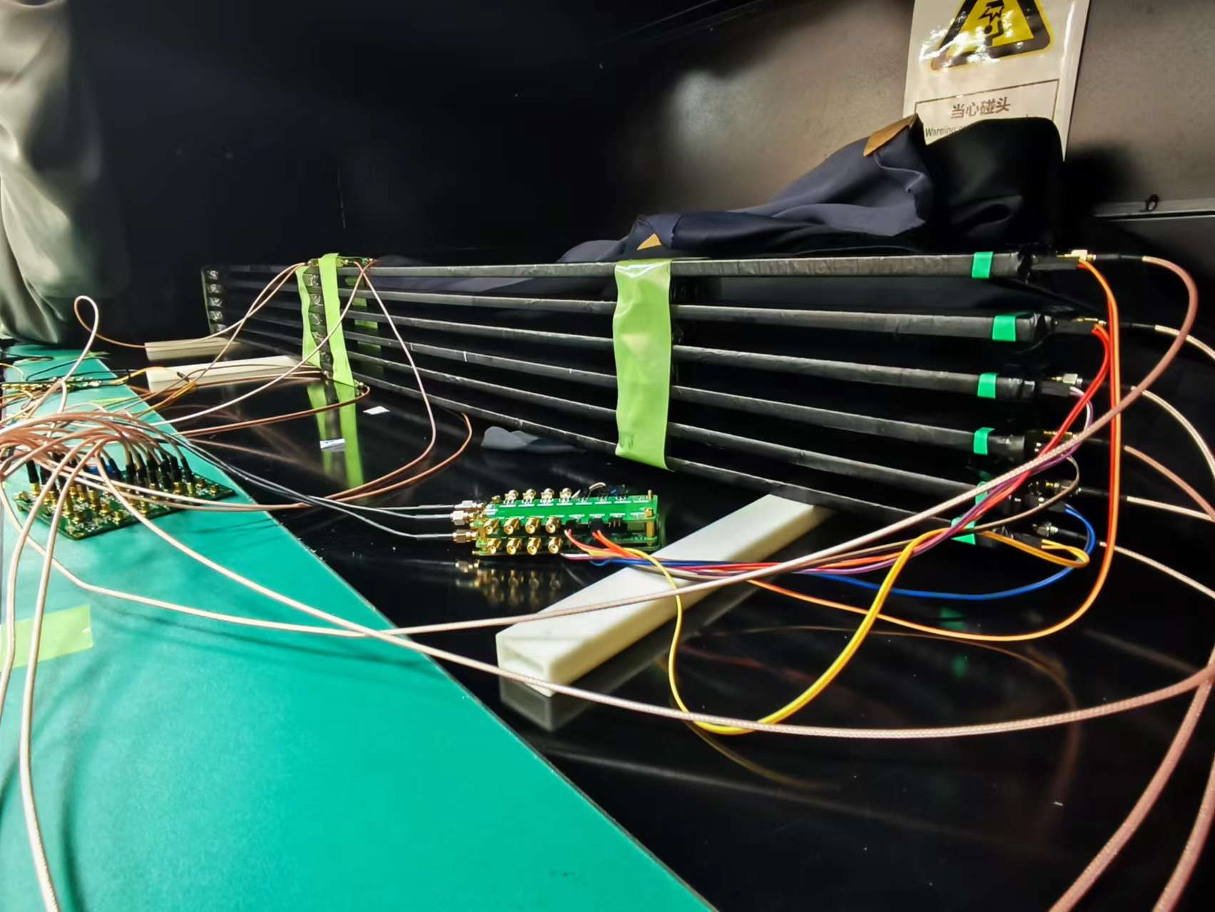
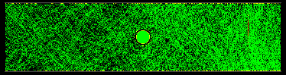
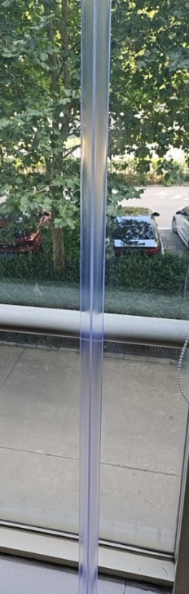
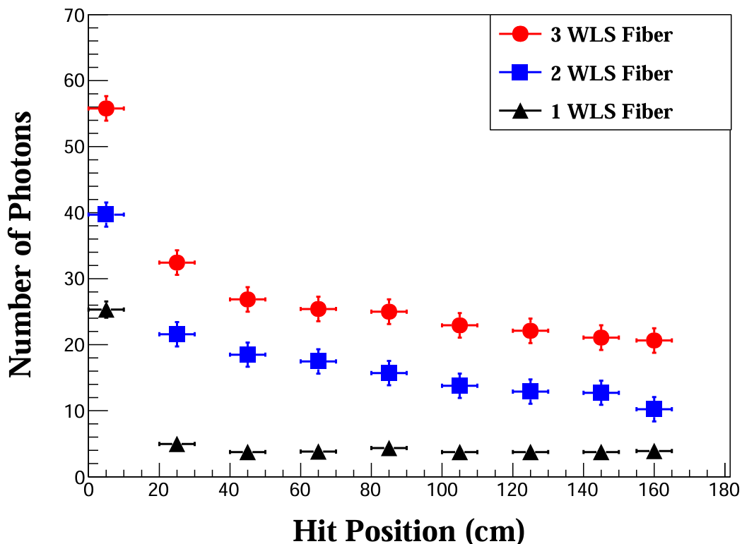
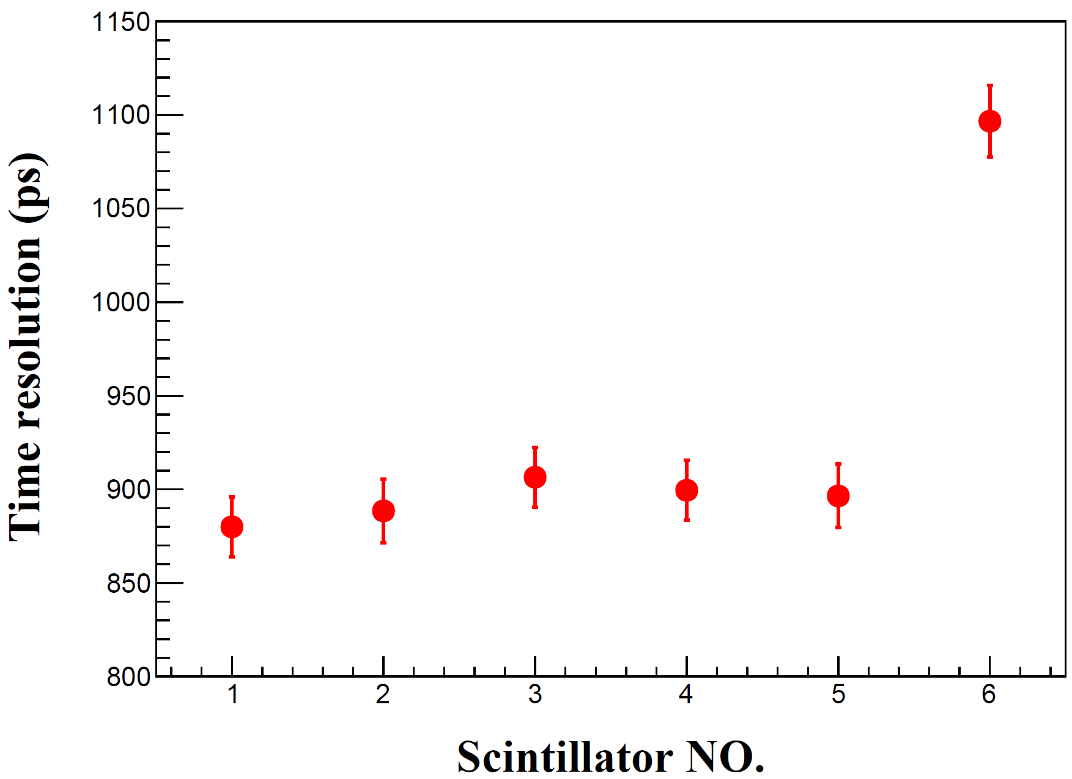
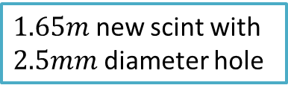

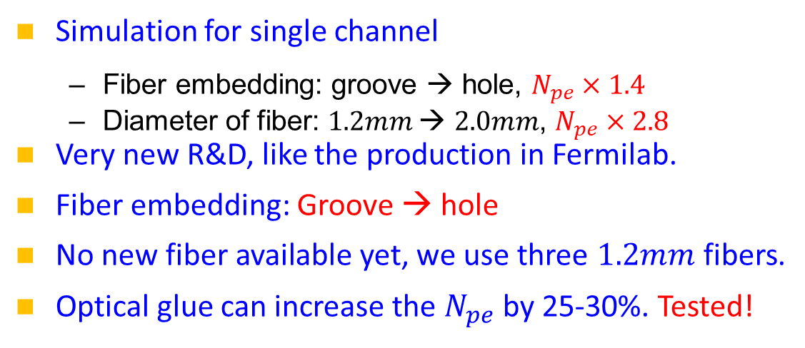


Improvements on the scint. strip
Simulation for single channel
  Fiber embedding: groove → hole, $N_{pe}×1.4$
  Diameter of fiber: $1.2mm$→ $2.0mm$, $N_{pe}×2.8$
Very new R&D, like the production in Fermilab.
Fiber embedding: Groove → hole
No new fiber available yet, we use three $1.2mm$fibers.
Optical glue can increase the $N_{pe}$ by 25-30%. Tested!
Use NDL EQR15 $3mm×3mm$
$1.65m$ new scint with $2.5mm$ diameter hole
Without optical glue
Trigger at middle
$$σ_{T}<1ns$$
$$ε=95\%$$
New scintillator provided by GNKD, with our R&D!
Scintillator production at Fermilab
Very positive to the design of long module ($>4m$).

Slide 18
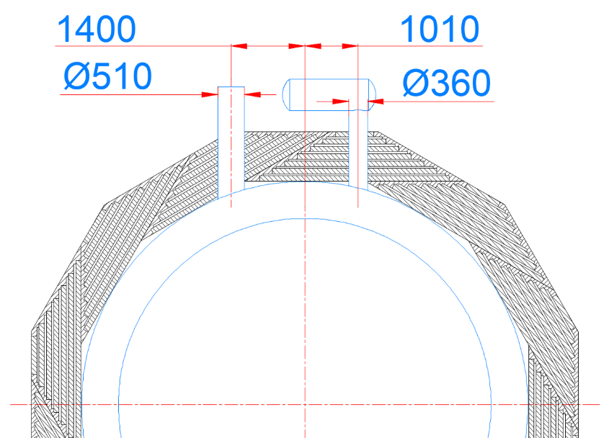
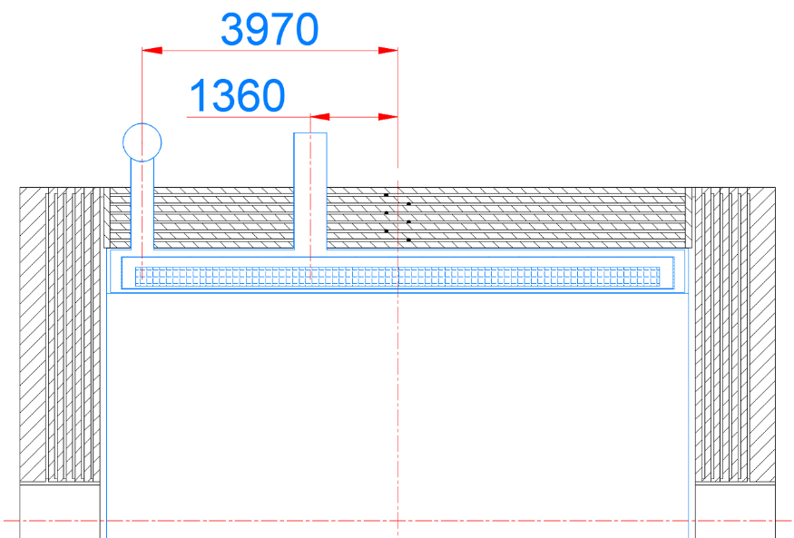
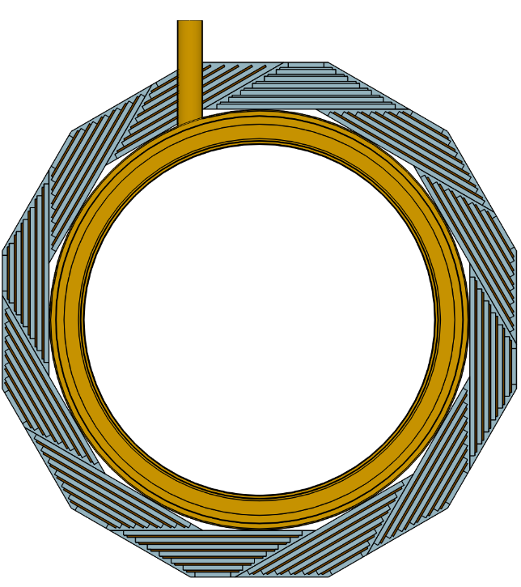
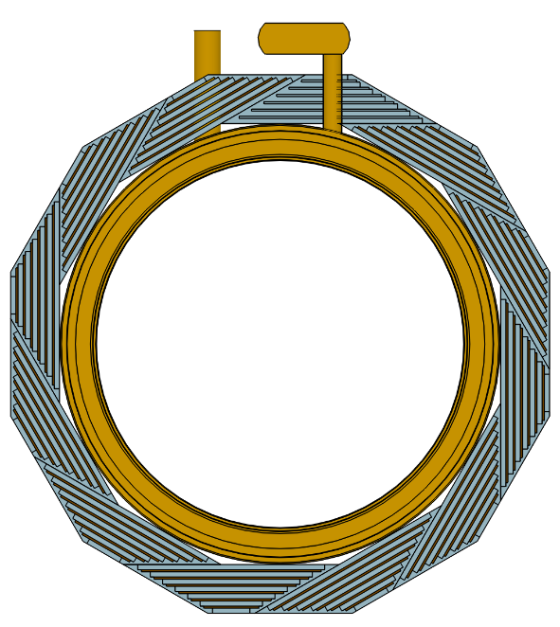
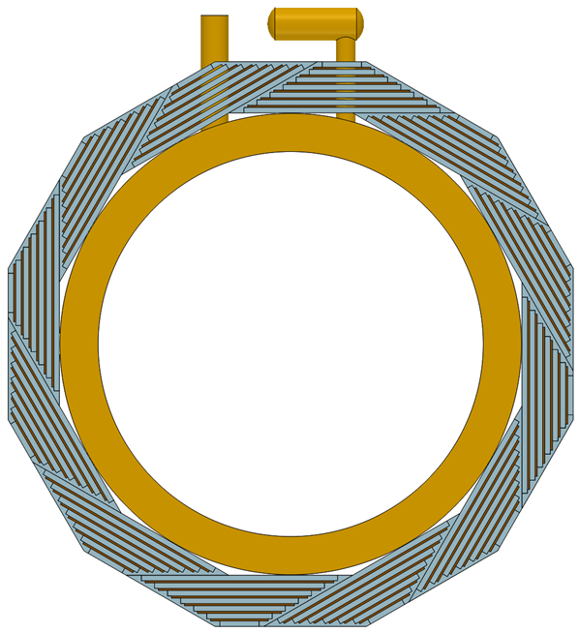
And the chimneys for magnetics

Slide 19
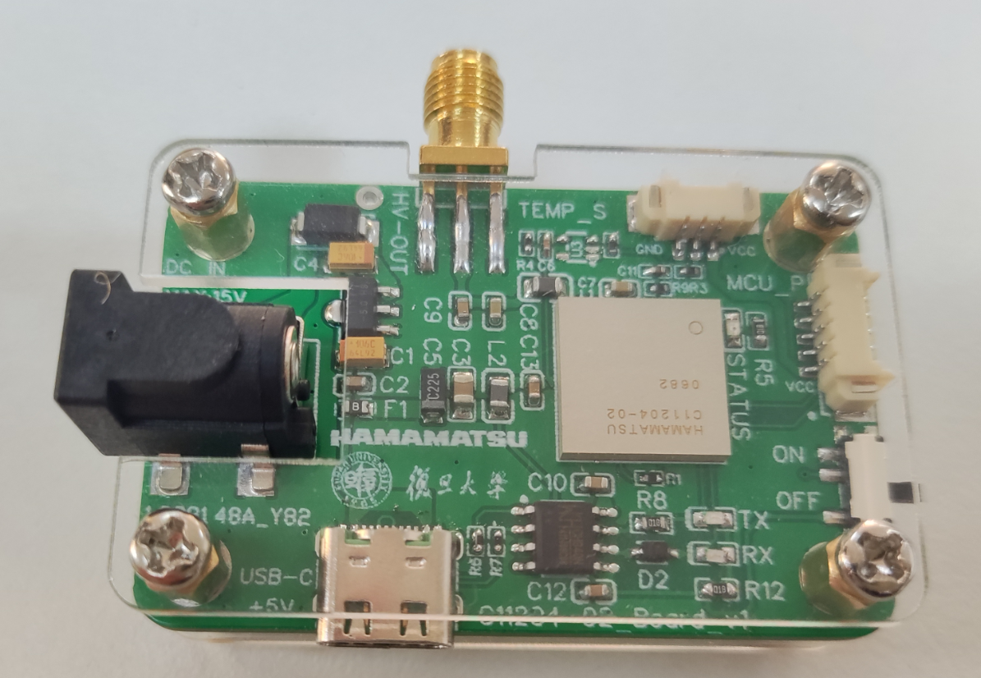
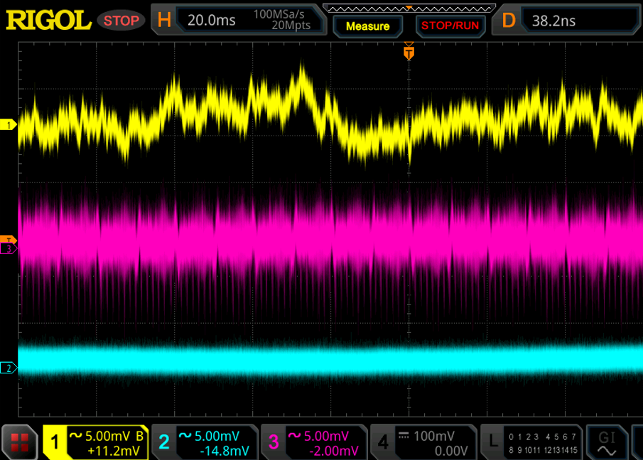
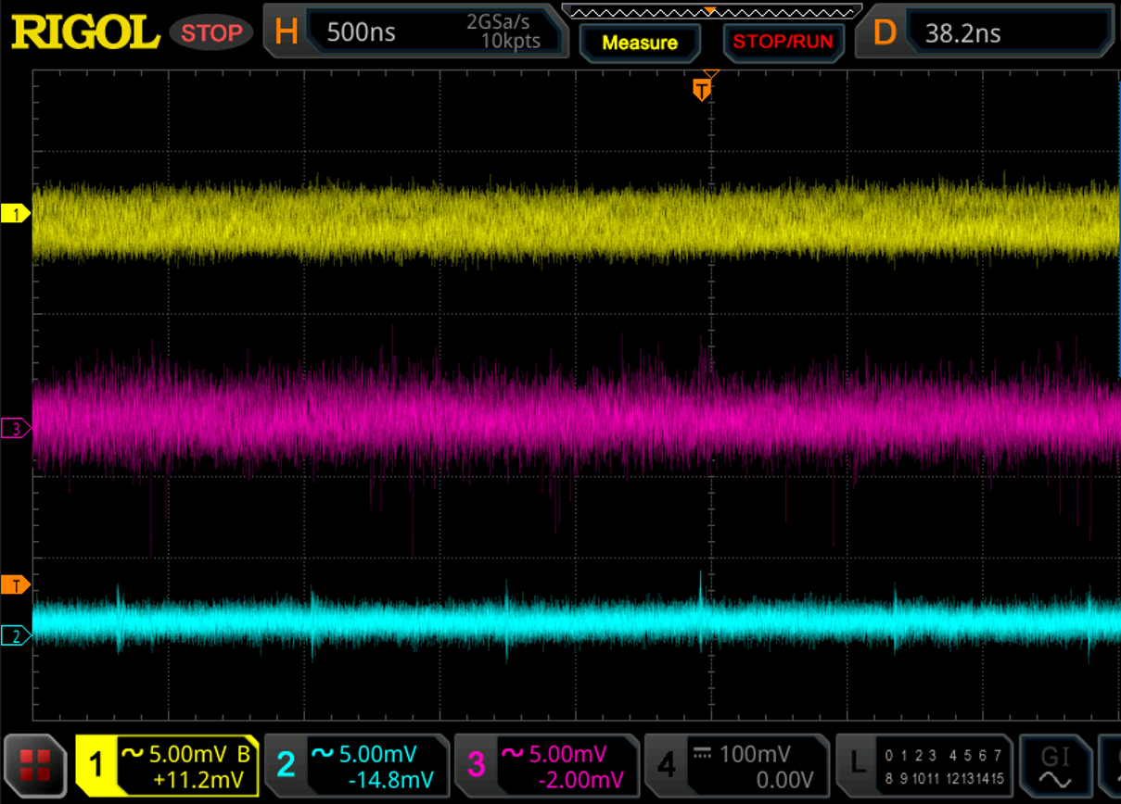
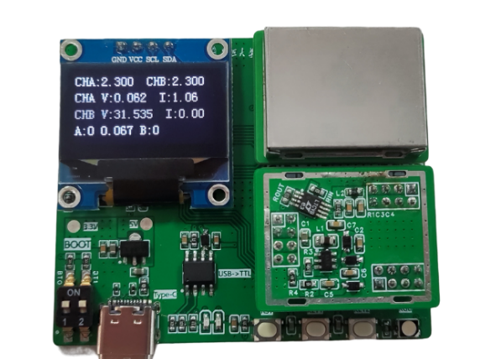
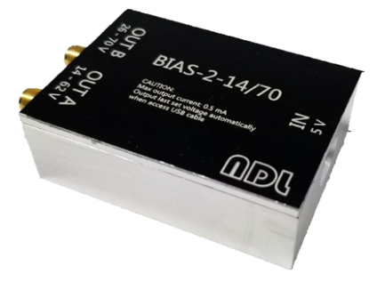
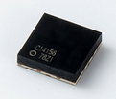
SiPM mini power
Study on mini power to be integrated into the FEE.
Temperature sensor
SiPM POWER | BIAS-2-14/70 @NDL | C14156 @Hamamatsu | MAX5026 @Fudan
Voltage (V) Output Range | 14~70 | 0~80 | 0~71
Current (mA) Output Range | 0.5 | 2 | 2
Number of SiPMs driven | 100 | 400 | 400
Power consumption (mW) | 250 | 100 | 200
Ripple noise (mV/Vpp) | 5.2 | 0.1 | 2
Price (¥) | ~2000 | 500 | 30
DC Power supply
USB-C communicate
Ripple noise @ OUTPUT:45V
NDL
NDL
1$ = 7¥
CAEN
CAEN
HAMAMATSU
HAMAMATSU
20ms/div
500ns/div

