Slide 1


Primary Research on BHLUMI & other Generators
Renjie Ma

Slide 2

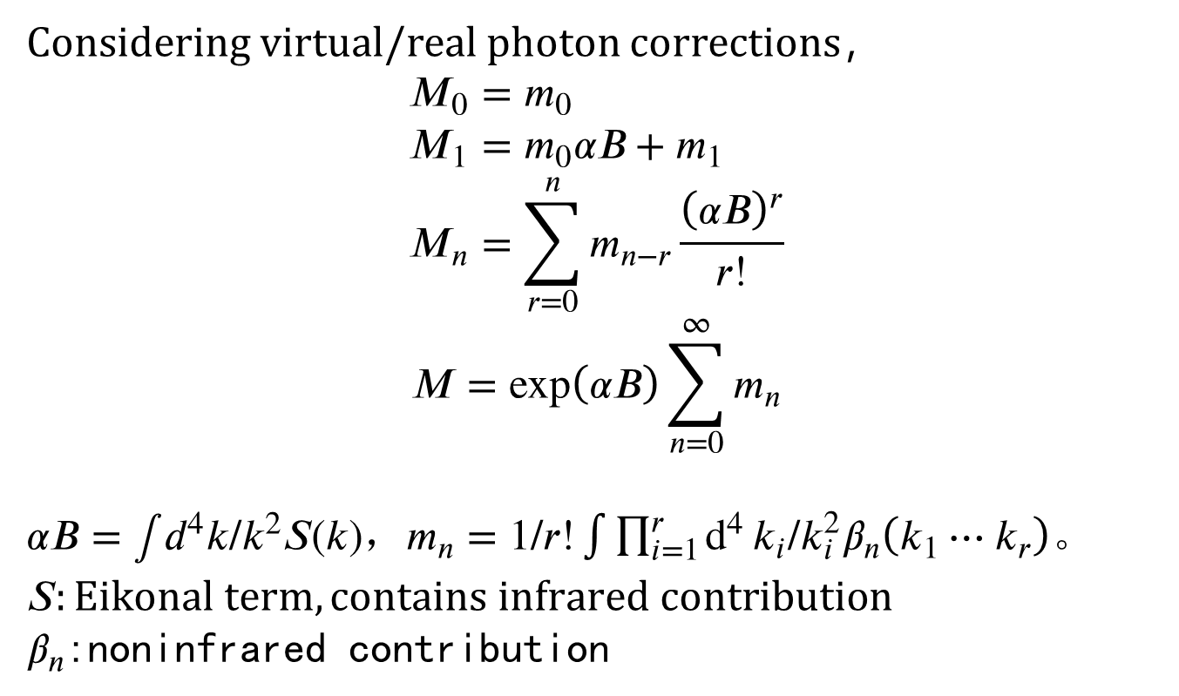
YFS Theory
Considering virtual/real photon corrections，
$$M_{0}=m_{0} \\ M_{1}=m_{0}αB+m_{1} \\ \begin{aligned}M_{n}=\sum_{r=0}^{n}{m_{n−r}\frac{{\left(αB\right)}^{r}}{r!}}\#\end{aligned}$$
$$\begin{aligned}M=\exp\left(αB\right)\sum_{n=0}^{∞}{m_{n}}\#\end{aligned}$$
$αB=∫d^{4}k/k^{2}S(k)$，$m_{n}=1/r!\int{\prod_{i=1}^{r}{d^{4}}}k_{i}/k_{i}^{2}β_{n}\left(k_{1}⋯k_{r}\right)$。$S:Eikonal term,contains infrared contribution$
$β_{n}$:noninfrared contribution

Slide 3
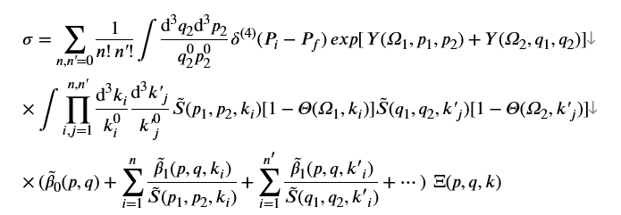
YFS Theory
Consider process:$e^{+}\left(p_{1}\right)+e^{−}\left(q_{1}\right)→e^{+}\left(p_{2}\right)+e^{−}\left(q_{2}\right)+nγ\left(k_{i}\right)+n^{′}γ\left(k′_{i}\right)$,We have:

Slide 4
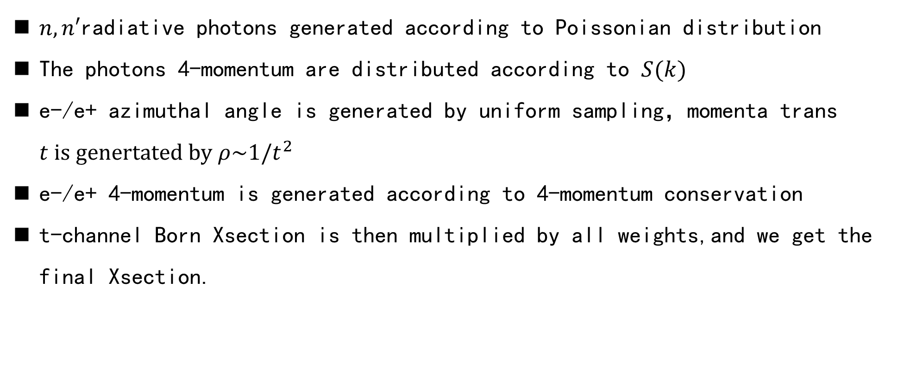
YFS Theory
$n,n′$radiative photons generated according to Poissonian distribution
The photons 4-momentum are distributed according to $S(k)$
e-/e+ azimuthal angle is generated by uniform sampling，momenta trans $t is genertated by ρ\sim 1/t^{2}$
e-/e+ 4-momentum is generated according to 4-momentum conservation
t-channel Born Xsection is then multiplied by all weights,and we get the final Xsection.

Slide 5
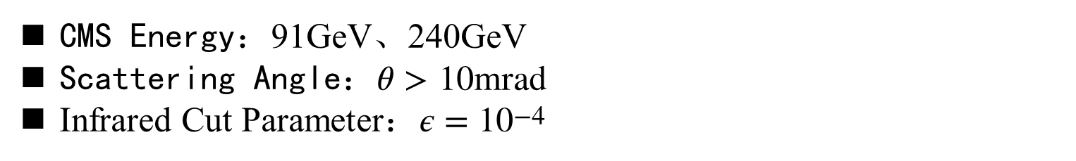
BHLUMI&ReneSANCe
Unlike BHLUMI,ReneSANCe calculates 1-loop corrections.As a result,their radiative photon numbers is quite different.
CMS Energy：91GeV、240GeV
Scattering Angle：$θ>10mrad$
Infrared Cut Parameter：$ε=10^{−4}$
BHLUMI&ReneSANCe Xsec(nb)
 | BHLUMI | ReneSANCe | difference（%）
91GeV | 1293.5095 | 1297.5656 | 0.31573
240GeV | 188.26645 | 188.42609 | 0.084782
The Xsec difference between 2 generaters is up to 0.1%

Slide 6
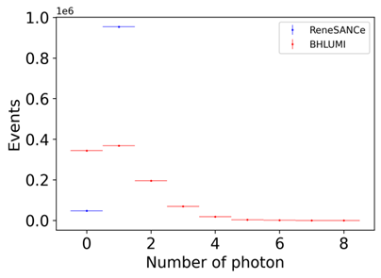
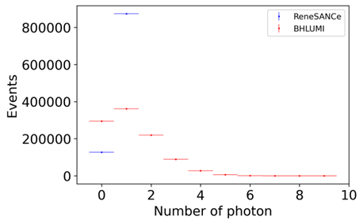
BHLUMI ReneSANCe radiative photon numbers per event distribution
（91GeV(left) 240GeV(right)）

Slide 7
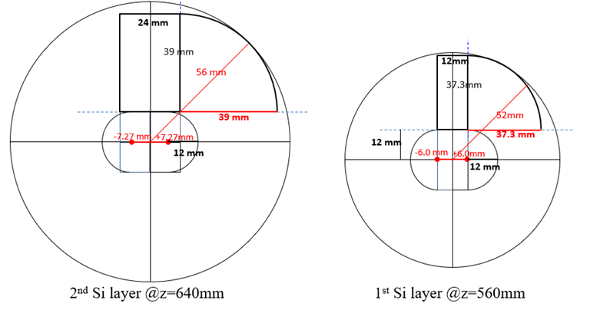

BhaBha Xsec on the LumiCal
$$σ_{acc}=σ_{gen}\frac{N_{acc}}{N_{gen}}$$
CMS Energy：91GeV,240GeV
Scattering Angle：18mrad~100mrad
Final State Invariant Mass：$\frac{s^{′}}{s}>0.5$
LumiCal Si Wafer Geometry

Slide 8
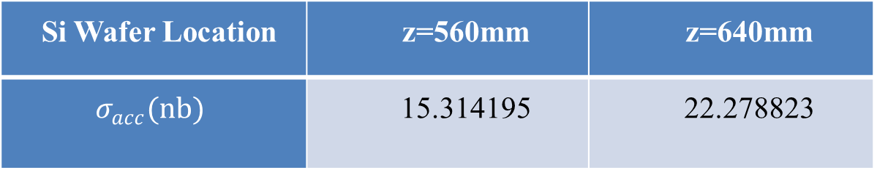
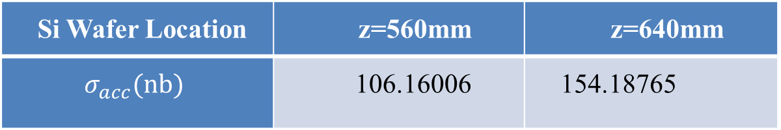
Si Wafer Location | z=560mm | z=640mm
$$σ_{acc}(nb)$$ | 106.16006 | 154.18765
91GeV
Si Wafer Location | z=560mm | z=640mm
$$σ_{acc}(nb)$$ | 15.314195 | 22.278823
240GeV

Slide 9
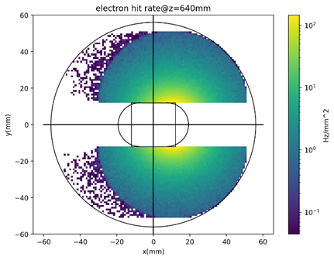
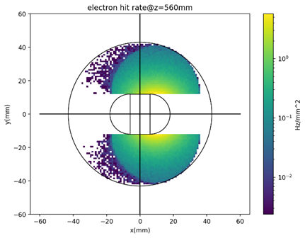
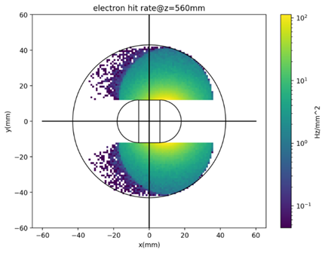
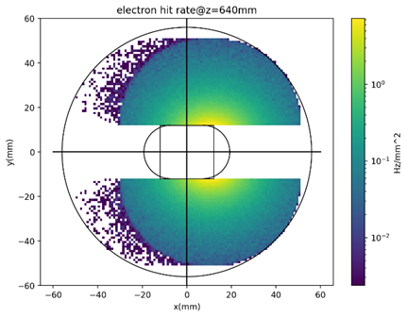
BhaBha Hit Rate on LumiCal
91GeV
240GeV
Z mode:Max~100Hz/mm2,Avg~5Hz/mm2
Higgs mode:Max~5Hz/mm2,Avg~0.3Hz/mm2

Slide 10
Thanks!

