Slide 1
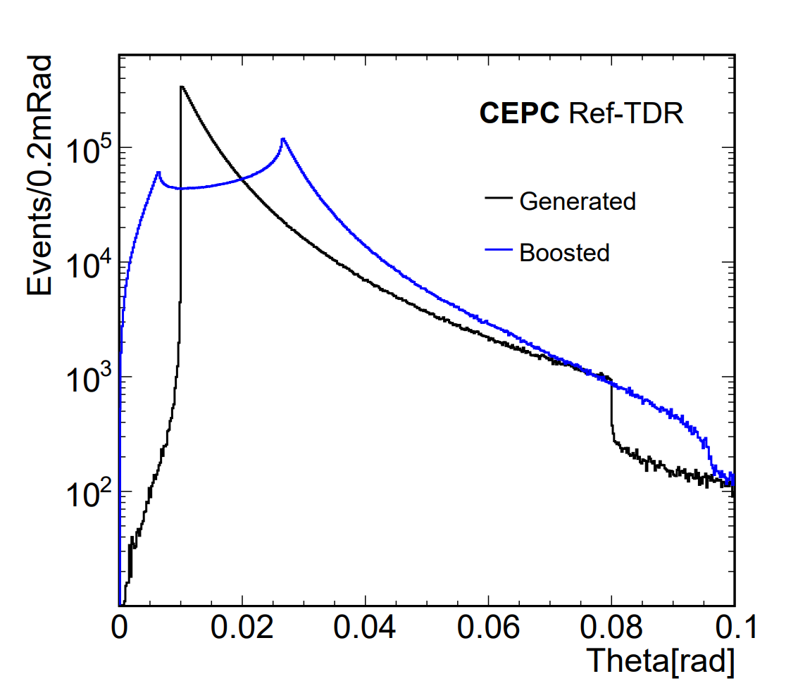
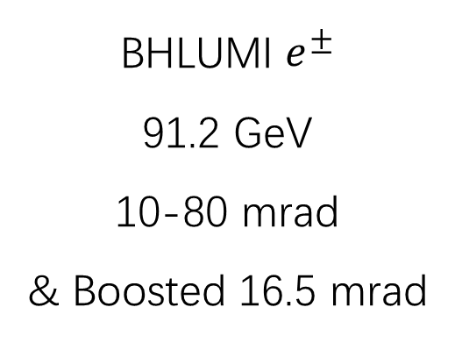
$e^{±}$ Theta Distribution
BHLUMI $e^{±}$
91.2 GeV
10-80 mrad
& Boosted 16.5 mrad

Slide 2
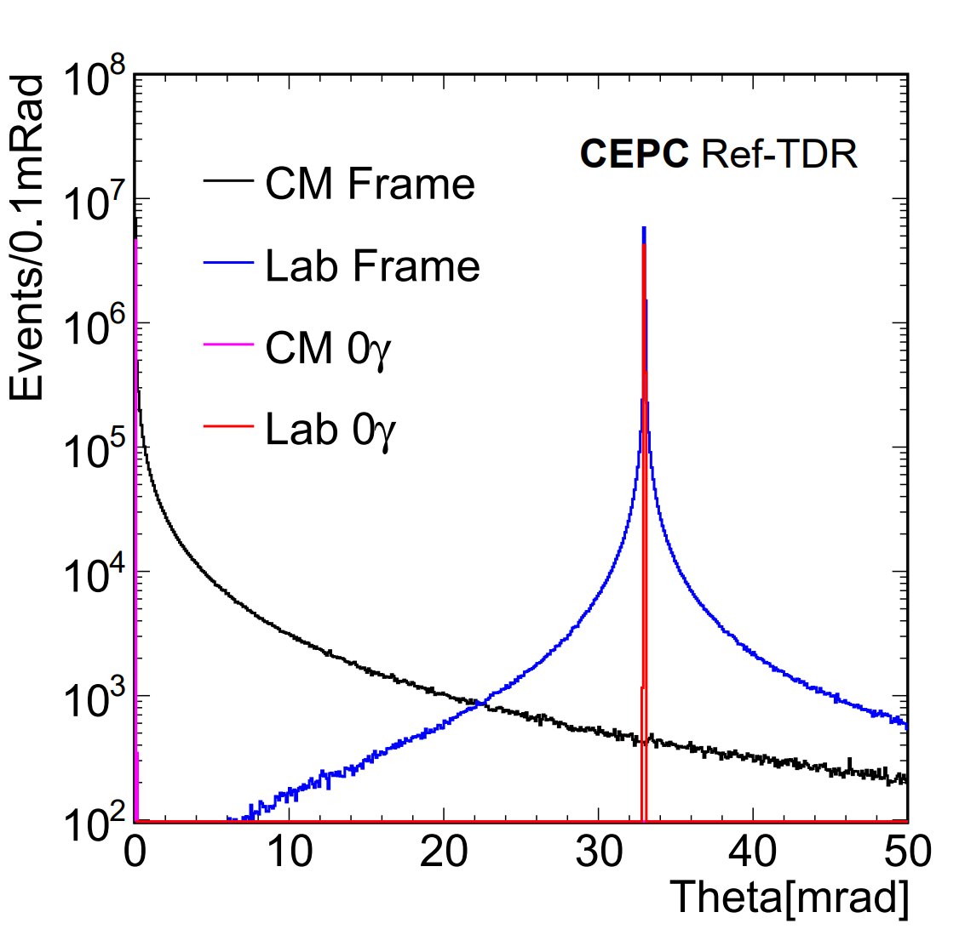
$$π−θ_{e^{+}}−θ_{e^{−}}$$
BHLUMI $e^{±}$
91.2 GeV
10-80 mrad
& Boosted 16.5 mrad

Slide 3
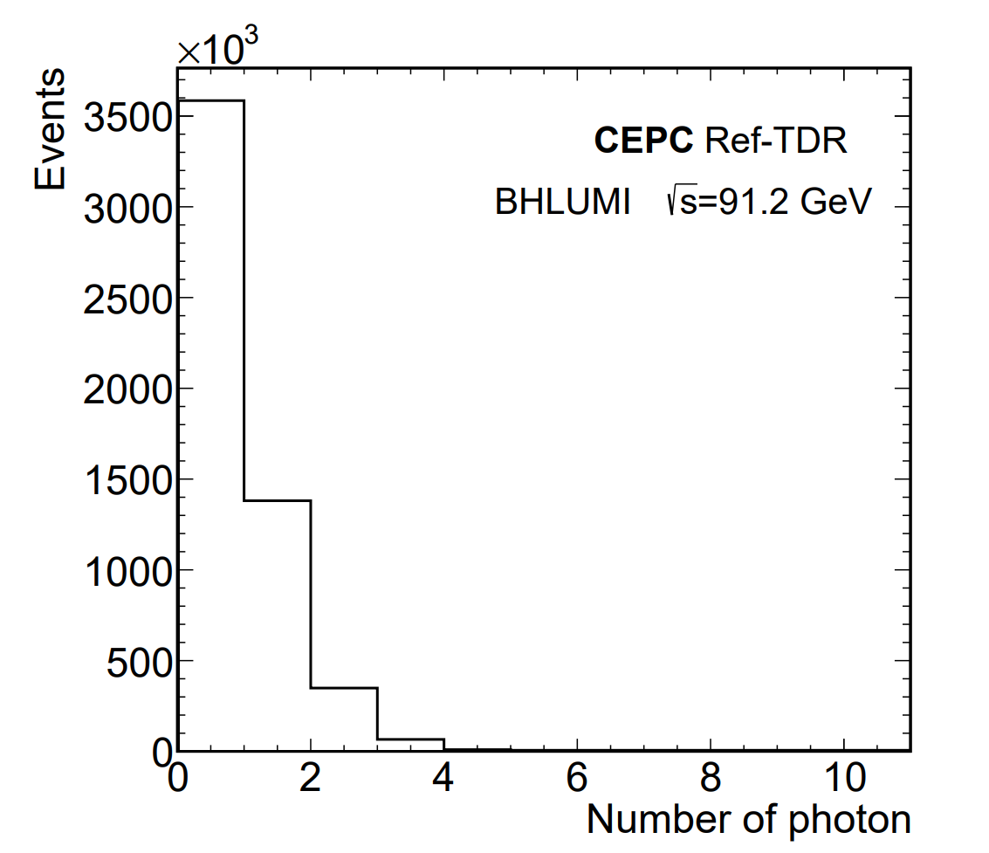
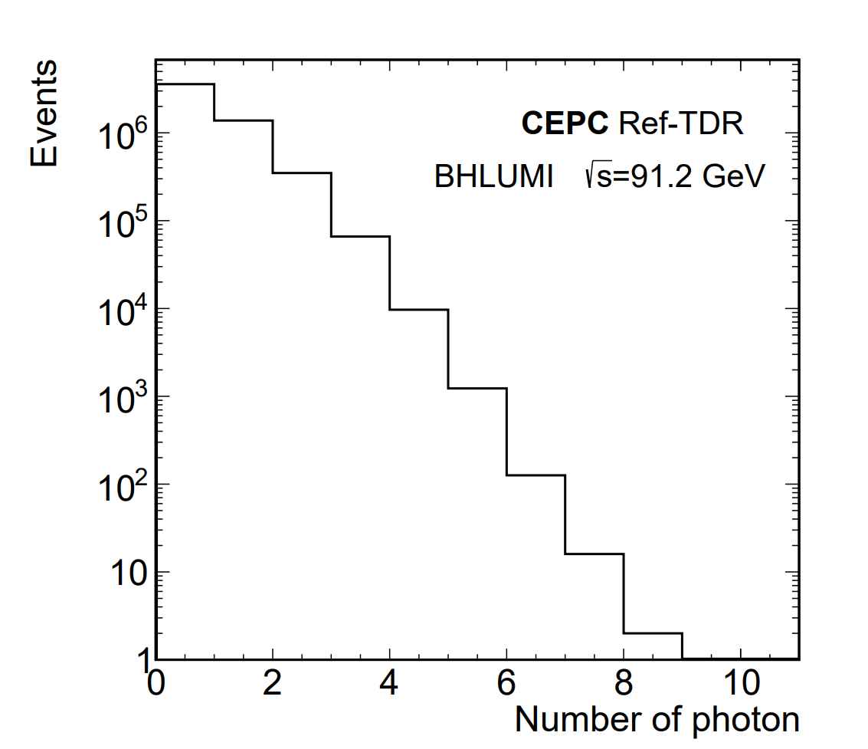
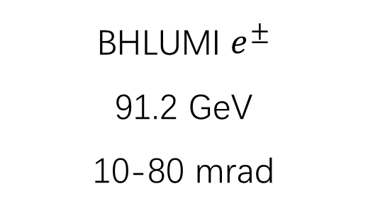
BHLUMI Number of Photons
BHLUMI $e^{±}$
91.2 GeV
10-80 mrad
( Log Y )

Slide 4
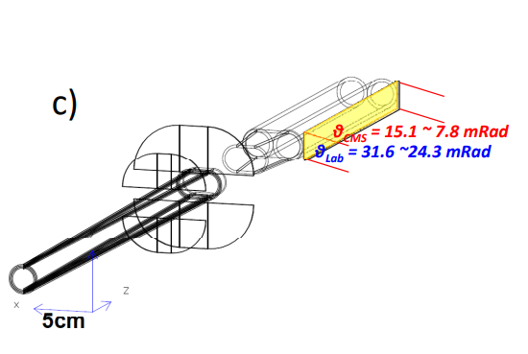
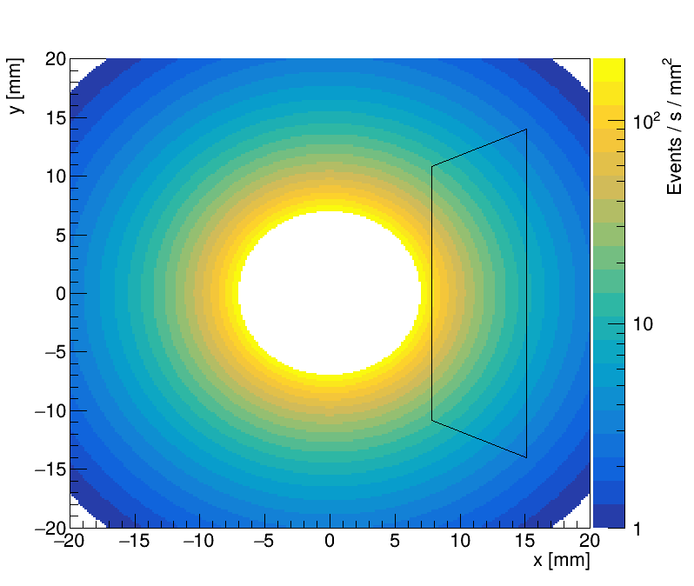
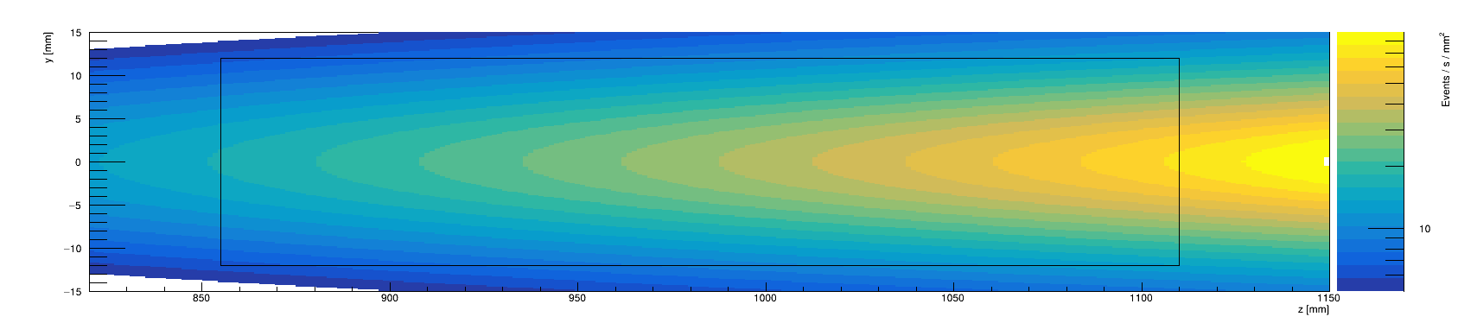
BHLUMI and Fastlumi at CEPC
x-y
x-z

Slide 5
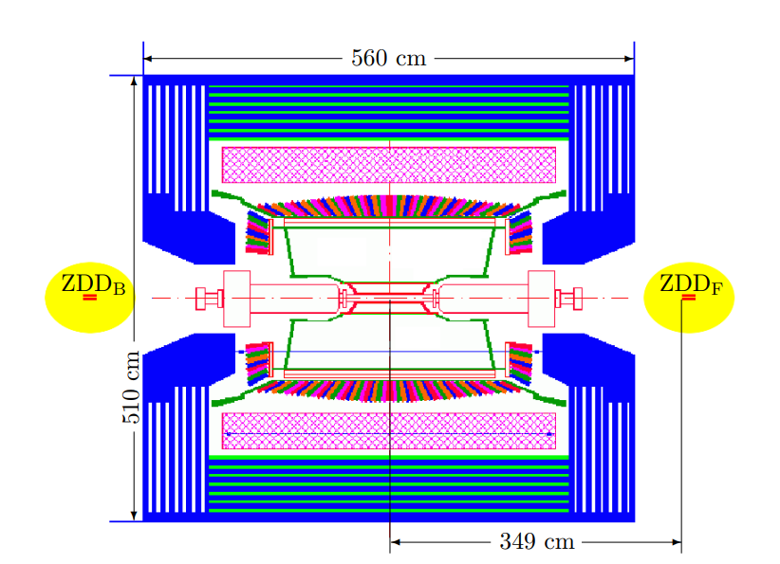
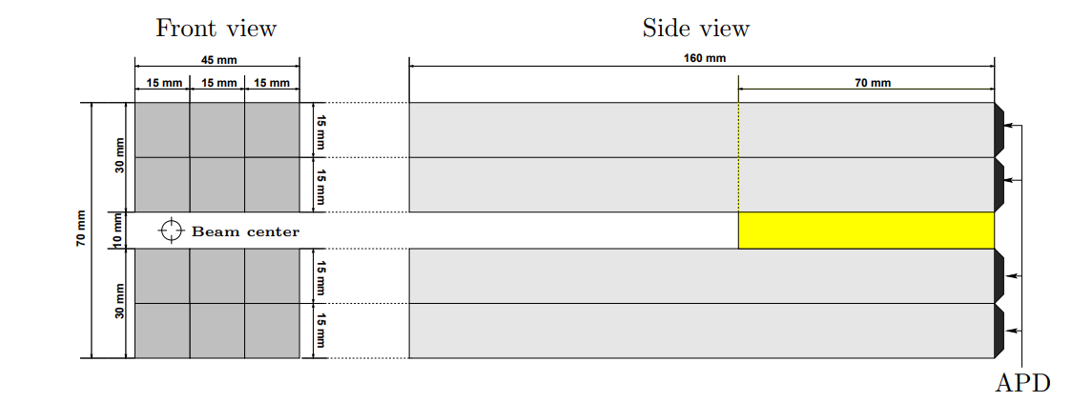
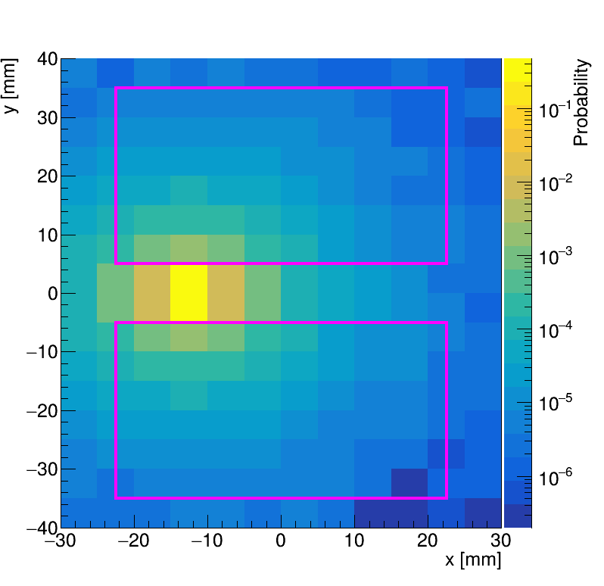
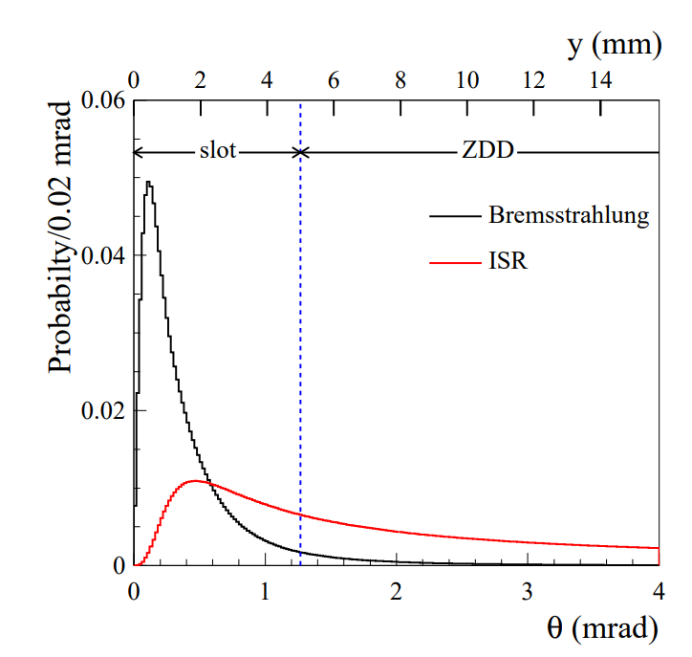
BBBrem and BESIII
BBBrem
HitRate @ ZDD
4.68 GeV

Slide 6
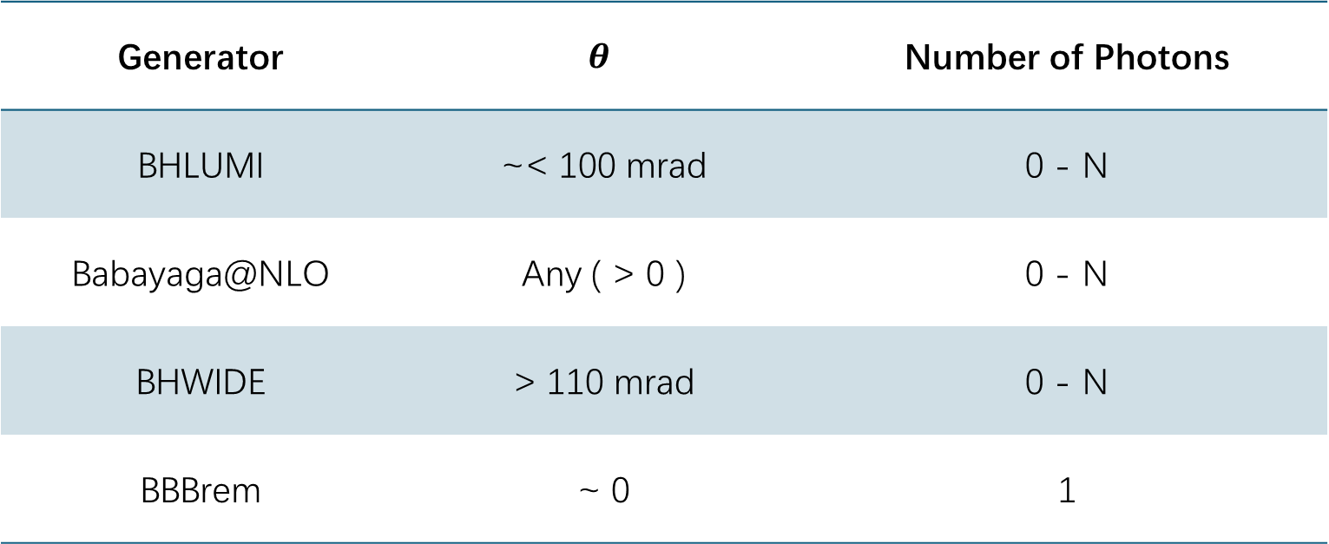
Generator | $$θ$$ | Number of Photons
BHLUMI | ~< 100 mrad | 0 - N
Babayaga@NLO | Any ( > 0 ) | 0 - N
BHWIDE | > 110 mrad | 0 - N
BBBrem | ~ 0 | 1

Slide 7
Generator | Precision
BHLUMI | 0.054 % @ LEP2 Energies (91~209 GeV) [1]
Babayaga@NLO | 0.1 % @ flavor factories (1~10 GeV) [2]
BHWIDE | 0.3 % @ Z (91 GeV), 1.5 % @ LEP2 Energies [3]
BBBrem | 0.2~0.3 % [4]
[1] Improved Bhabha cross section at LEP and the number of light neutrino species
https://doi.org/10.1016/j.physletb.2020.135319
[2] Status of the BabaYaga event generator
https://doi.org/10.1051/epjconf/201921807004
[3] BHWIDE 1.00: O(α) YFS Exponentiated Monte Carlo for Bhabha Scattering at Wide Angles for LEP1/SLC and LEP2
https://doi.org/10.1016/S0370-2693%2896%2901382-2
[4] BBBREM – Monte Carlo simulation of radiative Bhabha scattering in the very forward direction
https://doi.org/10.1016/0010-4655(94)90085-X

Slide 8
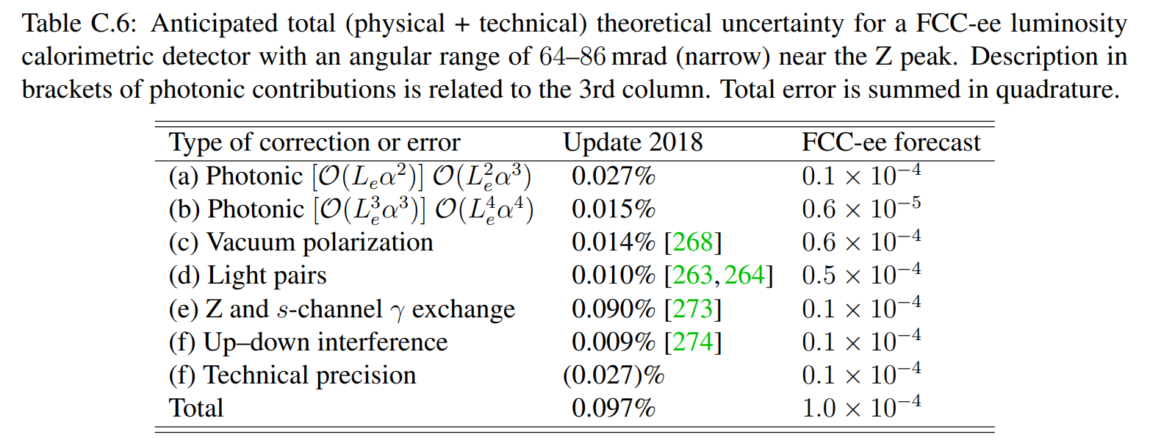
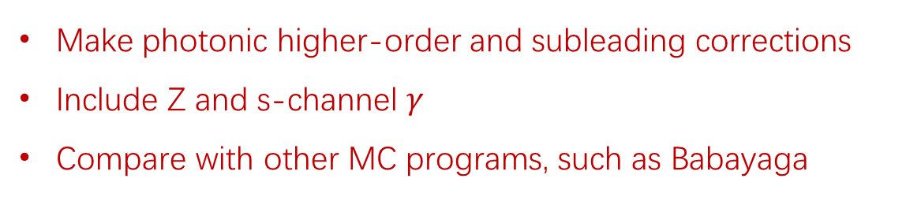
CEPC LumiCal
25-100 mrad
1/27
1/25
1/2.3
1/2
1/90
1/9
1/27
Make photonic higher-order and subleading corrections
Include Z and s-channel $γ$
Compare with other MC programs, such as Babayaga
BHLUMI: the path to 0.01% theoretical luminosity precision, https://doi.org/10.1016/j.physletb.2019.01.012

