Slide 1

Using Machine Learning in ROOT
TMVA:The Toolkit for Multivariate Data Analysis with ROOT
A ROOT-integrated project providing a machine learning environment for the processing and evaluation of multivariate classification, both binary and multi class, and regression techniques targeting applications in high-energy physics.
Many methods used for training
Neural networks
Boosted/Bagged decision trees
Linear discriminant analysis (H-Matrix and Fisher discriminants)
……
More details
https://root.cern/manual/tmva/
https://root.cern.ch/d/tmva.html

Slide 2
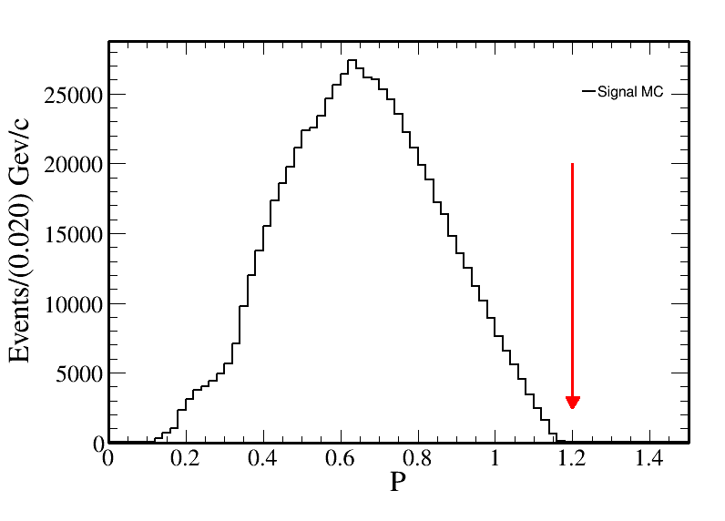
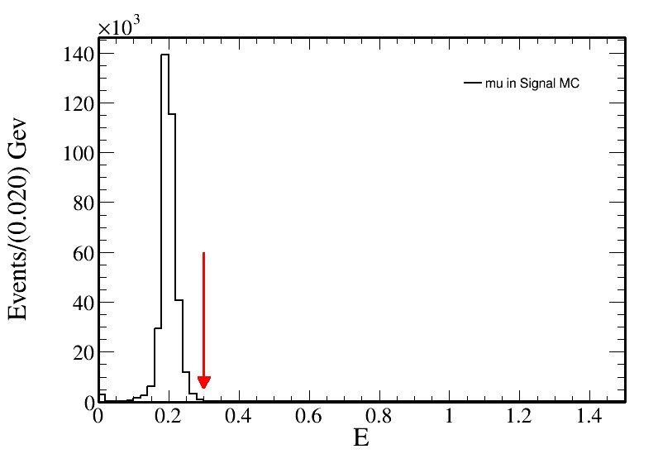
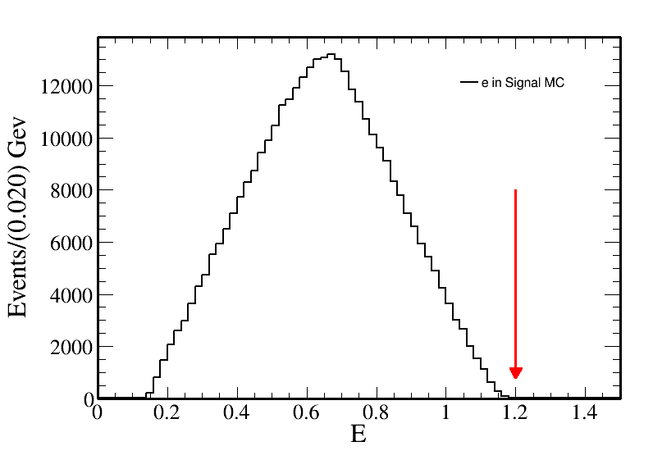
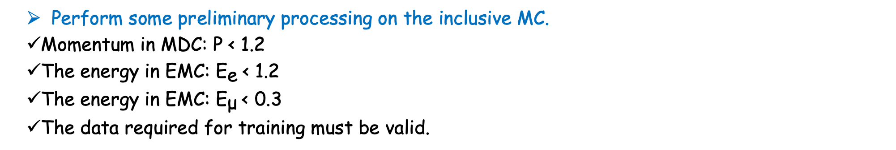
Use TMVA to help distinguish signals from backgrounds.
Perform some preliminary processing on the inclusive MC.
Momentum in MDC: $\text{P}\text{ < 1.2}$
The energy in EMC: ${\text{E}}_{\text{e}} \text{< 1.2}$
The energy in EMC: ${\text{E}}_{\text{μ}} \text{< 0.3}$
The data required for training must be valid.

Slide 3
Use TMVA to help distinguish signals from backgrounds.
Training and testing data.
The inclusive MC signal and background are distinguished through topology, with 70% used as training sample and 30% as test sample.
Four methods were used for training respectively.
Fisher(Fisher discriminant)
FisherG(Fisher with Gauss-transformed input variables)
MLP(Multilayer Perceptron)
BDTG(Boosted Decision Trees)

Slide 4
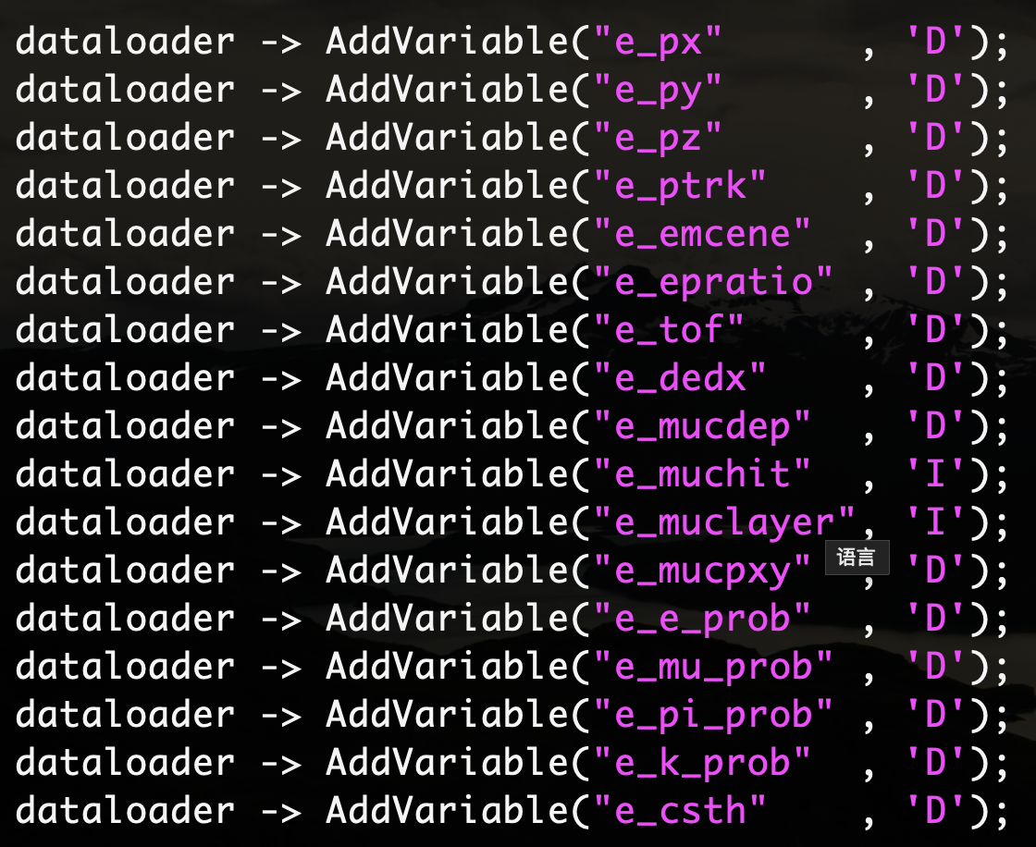
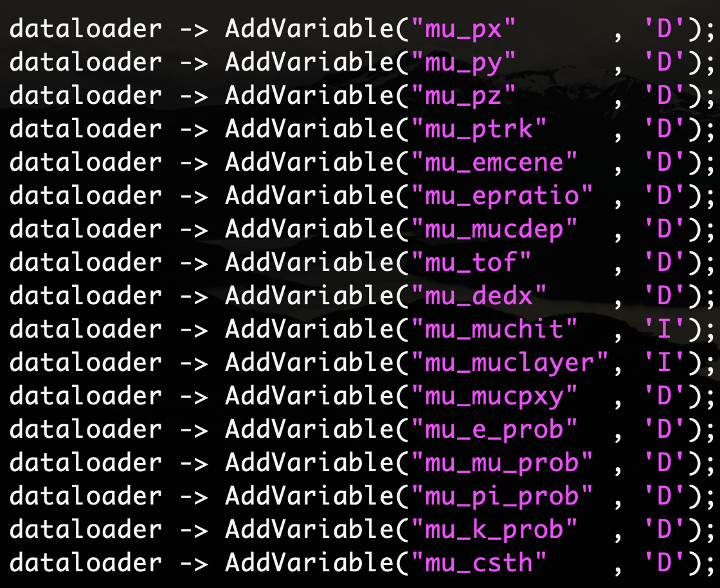
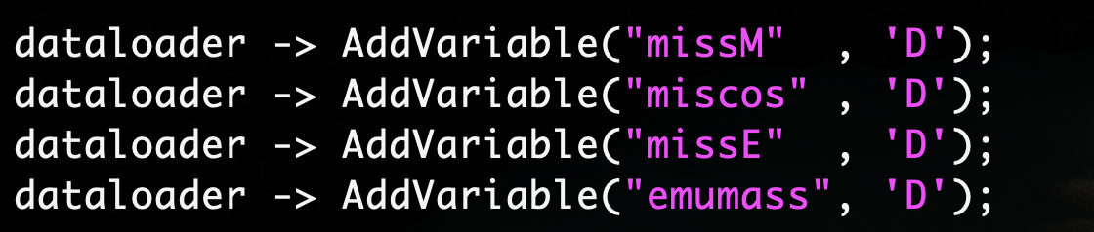
Use TMVA to help distinguish signals from backgrounds.
The training used 38 variables.

Slide 5
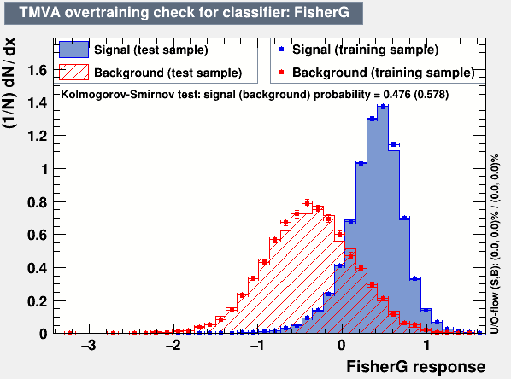
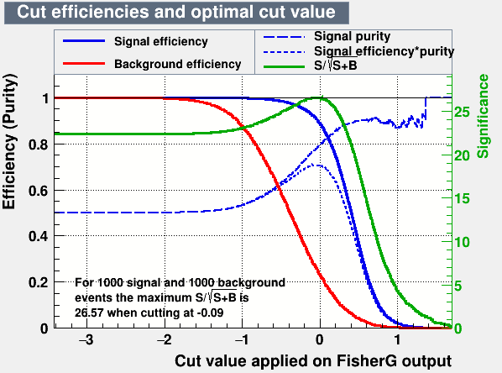
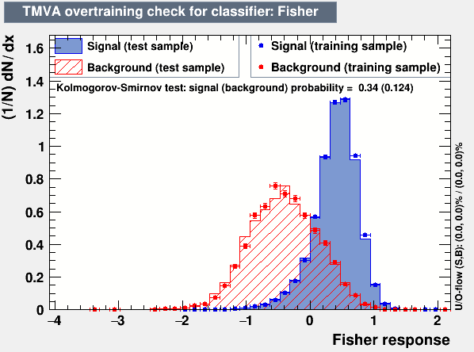
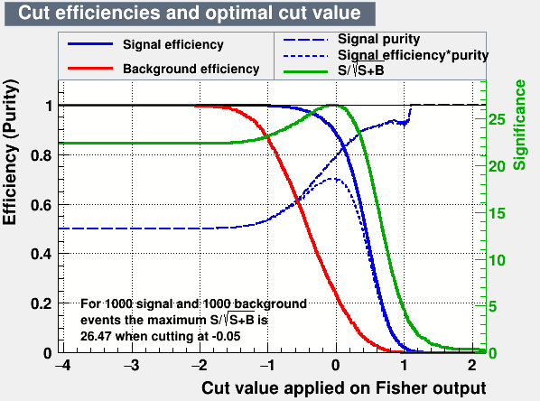
Settings and Results for Fisher and FisherG
The difference of these two training methods seem not very big.
It is not possible to distinguish the signal from the background very well.
The result is on the right.

Slide 6
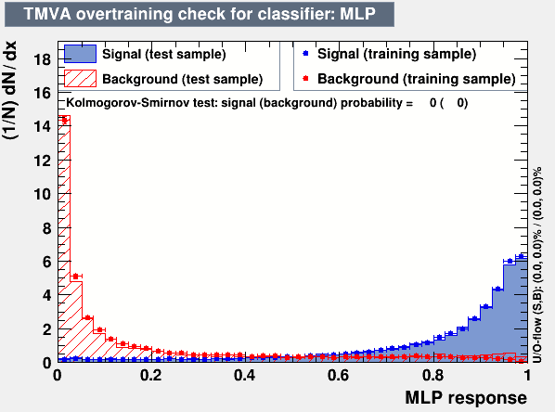
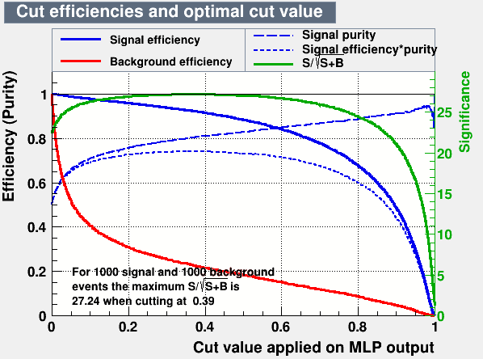
Settings and Results for MLP
Settings
Use the hyperbolic tanh as the activation function; do not transform the data; train for 600 cycles; the number of hidden layers is the number of input features plus 5; conduct a test every 5 cycles; do not use regularization.

Slide 7
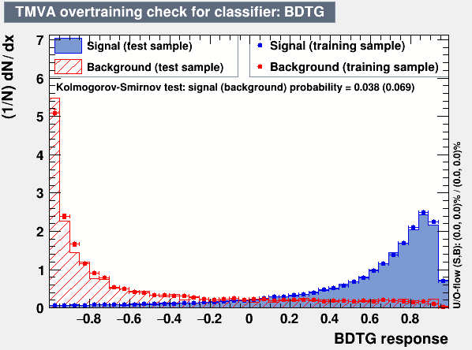
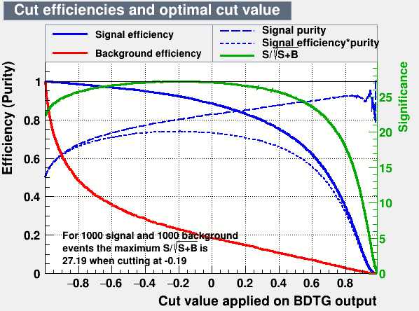
Settings and Results for BDTG
Settings
Do not use the histogram method; generate 1000 trees; the minimum number of samples at each node is 2.5% of the total samples; use gradient boosting; the learning rate is 0.10; use the bagging method; use 50% of the samples each time for bagging; perform 20 cuts during feature selection; the maximum depth of the tree is 2.

Slide 8
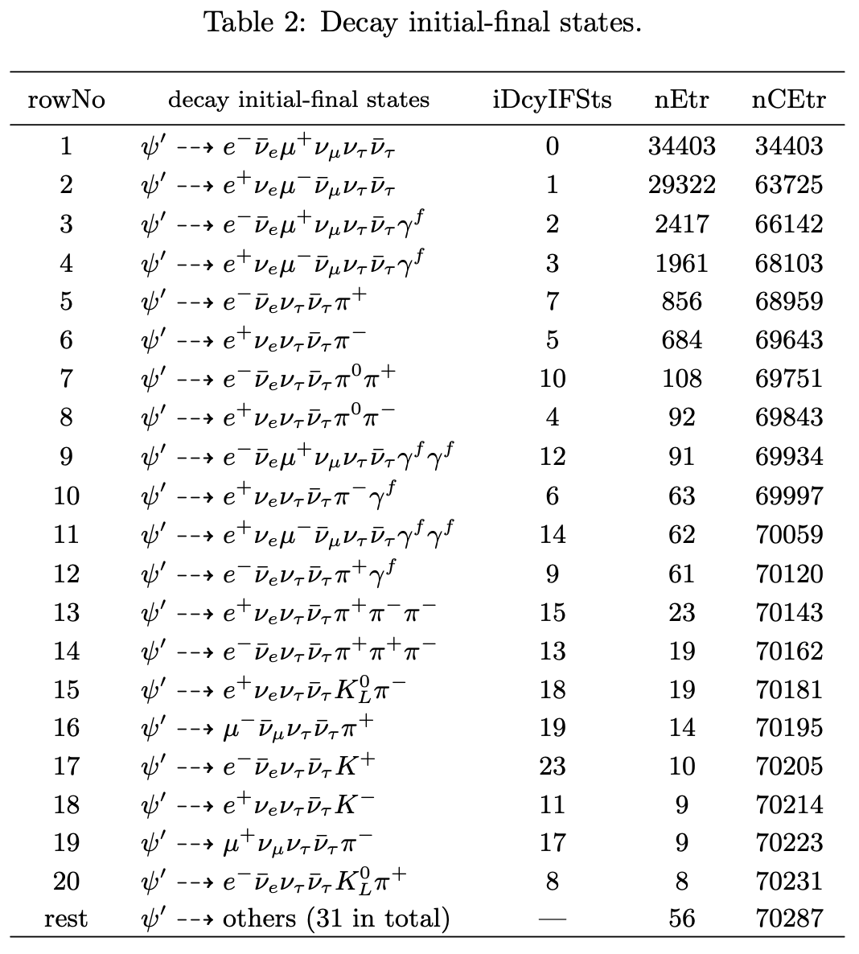
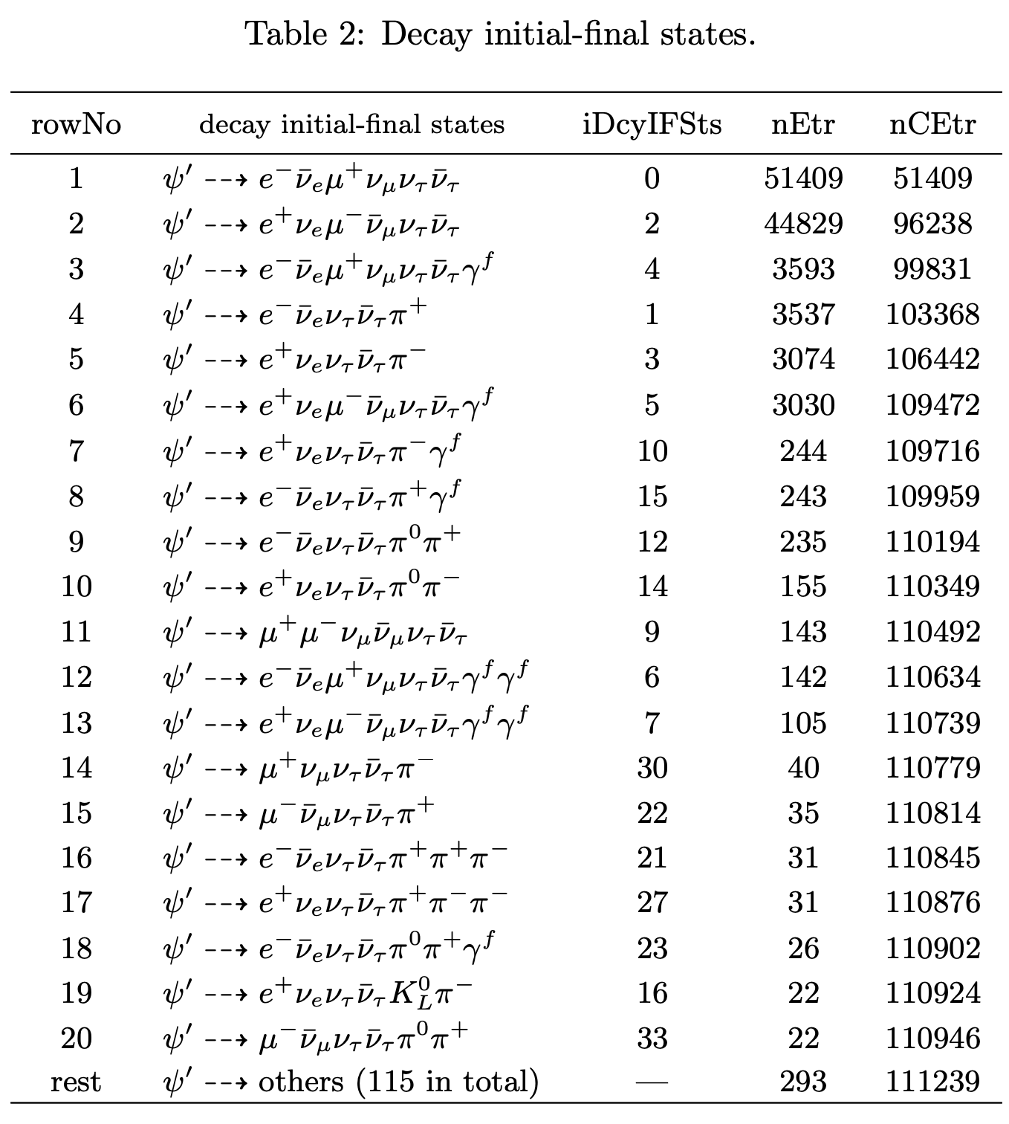
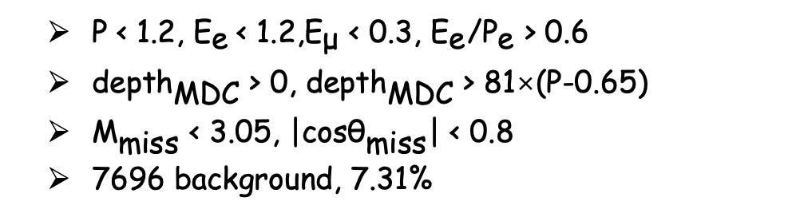
Compared with traditional manual selection
MLP method is the best in the four methods
Used MLP response > 0.6
2031 background, 2.89%; Detection efficiency is 15.36%.
$\text{P}\text{ < 1.2, }{\text{E}}_{\text{e}} \text{< 1.2,}{\text{E}}_{\text{μ}}\text{ < 0.3,} {\text{E}}_{\text{e}}\text{/}{\text{P}}_{\text{e}}\text{ > 0.6}$
$\text{dept}{\text{h}}_{\text{MDC}}\text{ > 0, }\text{dept}{\text{h}}_{\text{MDC}}\text{ > 81}\text{×}\text{(}\text{P}\text{−0.65)}$
${\text{M}}_{\text{miss}} \text{<} \text{3.05,} \text{|}\text{cos}{\text{θ}}_{\text{miss}}\text{|} \text{<} \text{0.8}$
7696 background, 7.31%

Slide 9
Separator page

Slide 10
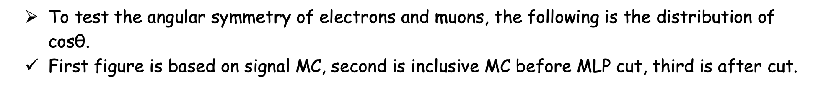
Angle symmetry check
To test the angular symmetry of electrons and muons, the following is the distribution of $\text{cosθ}$.
First figure is based on signal MC, second is inclusive MC before MLP cut, third is after cut.

Slide 11
Separator page

Slide 12
Background analyse
Exchanging Z bosons produces tau pairs that may be asymmetric in their Angle distribution.
Does it affect the results?

Slide 13
Separator page

Slide 14



Examination of T/CP Invariance in the ${\text{e}}^{\text{+}}{\text{e}}^{\text{−}}\text{→}{\text{τ}}^{\text{+}}{\text{τ}}^{\text{−}}$Reaction at BESIII
Yunhe Yang¹, Wiriya Ruangyoo², Ziyu Zhang¹, Zhiyong Wang⁴, Aiqiang Guo³ and Chunxu Yu¹
¹NanKai University
²Suranaree University of Technology
³Institute of Modern Physics
⁴Institute of High Energy Physics

Slide 15
Outline
1. Motivation
2. Method
3. Monte Carlo sample
4. Event selection
5. Background analysis
6. Systematic uncertainty
7. Results based on inclusive MC
8. Summery and next to do

Slide 16
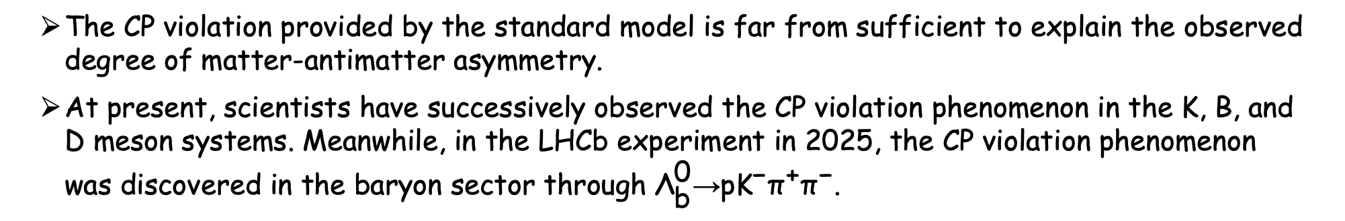
1. Motivation
The CP violation provided by the standard model is far from sufficient to explain the observed degree of matter-antimatter asymmetry.
At present, scientists have successively observed the CP violation phenomenon in the K, B, and D meson systems. Meanwhile, in the LHCb experiment in 2025, the CP violation phenomenon was discovered in the baryon sector through ${\text{Λ}}_{\text{b}}^{\text{0}}\text{→}\text{p}{\text{K}}^{\text{−}}{\text{π}}^{\text{+}}{\text{π}}^{\text{−}}$.

Slide 17
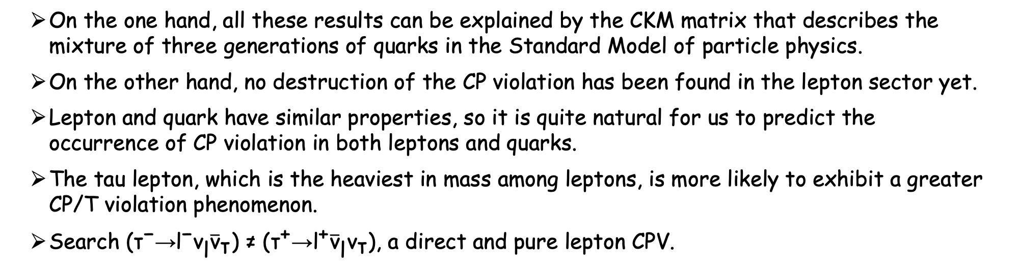
1. Motivation
On the one hand, all these results can be explained by the CKM matrix that describes the mixture of three generations of quarks in the Standard Model of particle physics.
On the other hand, no destruction of the CP violation has been found in the lepton sector yet.
Lepton and quark have similar properties, so it is quite natural for us to predict the occurrence of CP violation in both leptons and quarks.
The tau lepton, which is the heaviest in mass among leptons, is more likely to exhibit a greater CP/T violation phenomenon.
Search $\text{(}{\text{τ}}^{\text{−}}\text{→}{\text{l}}^{\text{−}}{\text{ν}}_{\text{l}}{\overline{\text{ν}}}_{\text{τ}}\text{) ≠ }\text{(}{\text{τ}}^{\text{+}}\text{→}{\text{l}}^{\text{+}}{\overline{\text{ν}}}_{\text{l}}{\text{ν}}_{\text{τ}}\text{)}$, a direct and pure lepton CPV.

Slide 18
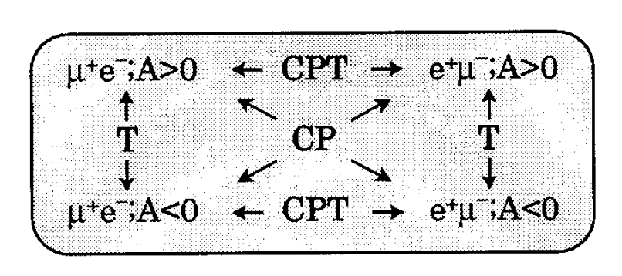
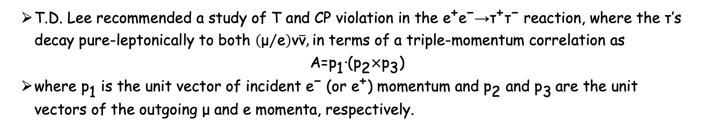
2. Method
T.D. Lee recommended a study of T and CP violation in the ${\text{e}}^{\text{+}}{\text{e}}^{\text{−}}\text{→}{\text{τ}}^{\text{+}}{\text{τ}}^{\text{−}}$ reaction, where the $\text{τ}$’s decay pure-leptonically to both $\left({\text{μ}}/{\text{e}}\right)\text{ν}\overline{\text{ν}}$, in terms of a triple-momentum correlation as
$$\text{A}\text{=}{\text{p}}_{\text{1}}\text{∙}\text{(}{\text{p}}_{\text{2}}\text{×}{\text{p}}_{\text{3}}\text{)}$$
where ${\text{p}}_{\text{1}}$ is the unit vector of incident ${\text{e}}^{\text{−}}$ (or ${\text{e}}^{\text{+}}$) momentum and ${\text{p}}_{\text{2}}$and ${\text{p}}_{\text{3}}$are the unit vectors of the outgoing $\text{μ}$ and e momenta, respectively.
---reference: arXiv:hep-ex/9711013

Slide 19
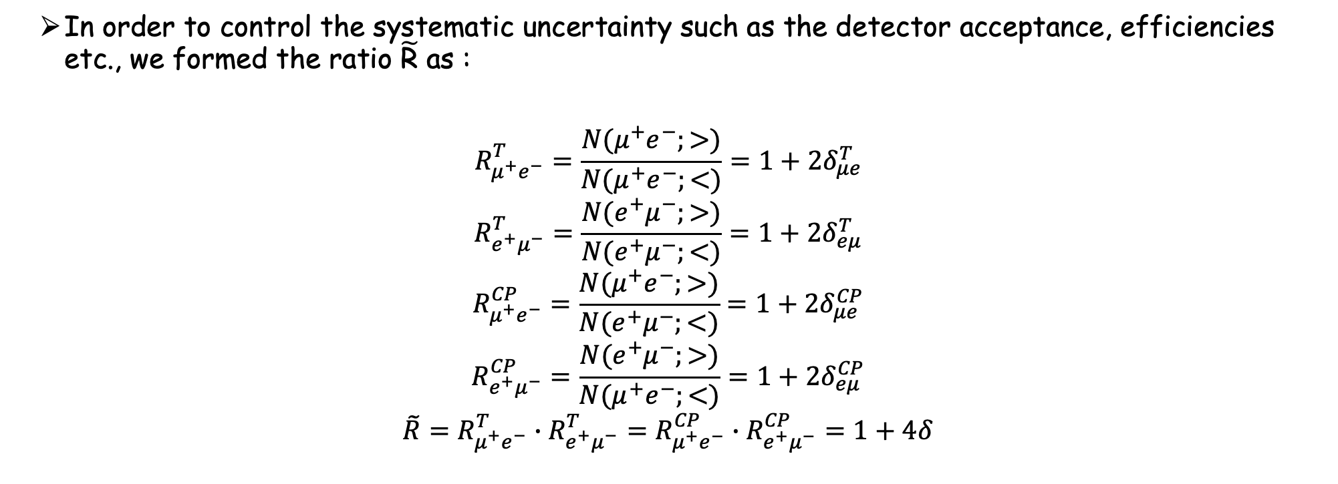
2. Method
In order to control the systematic uncertainty such as the detector acceptance, efficiencies etc., we formed the ratio $\tilde{\text{R}}$ as :
$$R_{μ^{+}e^{−}}^{T}=\frac{N(μ^{+}e^{−};>)}{N(μ^{+}e^{−};<)}=1+2δ_{μe}^{T}$$
$$R_{e^{+}μ^{−}}^{T}=\frac{N(e^{+}μ^{−};>)}{N(e^{+}μ^{−};<)}=1+2δ_{eμ}^{T}$$
$$R_{μ^{+}e^{−}}^{CP}=\frac{N(μ^{+}e^{−};>)}{N(e^{+}μ^{−};<)}=1+2δ_{μe}^{CP}$$
$$R_{e^{+}μ^{−}}^{CP}=\frac{N(e^{+}μ^{−};>)}{N(μ^{+}e^{−};<)}=1+2δ_{eμ}^{CP}$$
$$\tilde{R}=R_{μ^{+}e^{−}}^{T}∙R_{e^{+}μ^{−}}^{T}=R_{μ^{+}e^{−}}^{CP}∙R_{e^{+}μ^{−}}^{CP}=1+4δ$$

Slide 20
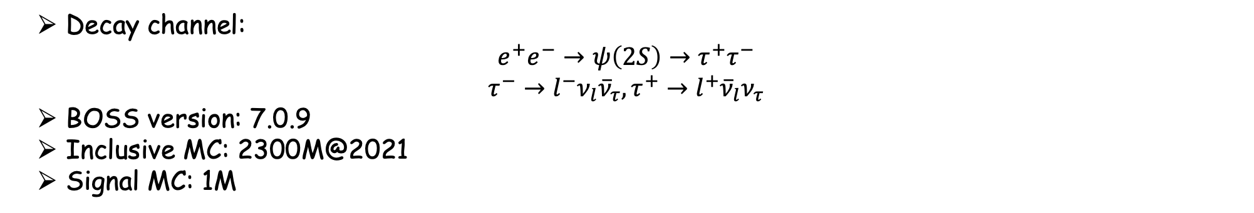
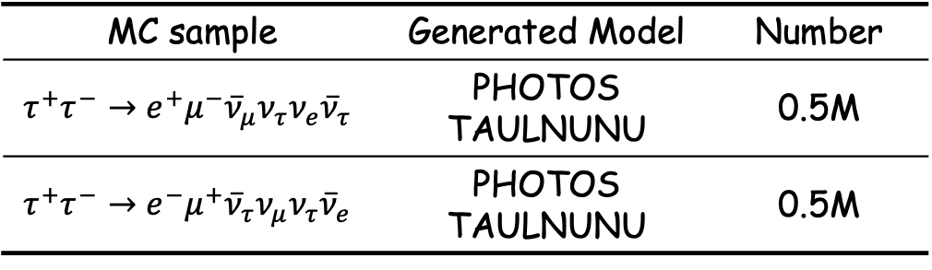
3. Monte Carlo sample
Decay channel:
$$e^{+}e^{−}→ψ\left(2S\right)→τ^{+}τ^{−}$$
$$τ^{−}→l^{−}ν_{l}{\overline{ν}}_{τ}, τ^{+}→l^{+}{\overline{ν}}_{l}ν_{τ}$$
BOSS version: 7.0.9
Inclusive MC: 2300M@2021
Signal MC: 1M
MC sample | Generated Model | Number
$$τ^{+}τ^{−}→e^{+}μ^{−}{\overline{ν}}_{μ}ν_{τ}ν_{e}{\overline{ν}}_{τ}$$ | PHOTOS TAULNUNU | 0.5M
$${τ^{+}τ}^{−}→e^{−}μ^{+}{\overline{ν}}_{τ}ν_{μ}ν_{τ}{\overline{ν}}_{e}$$ | PHOTOS TAULNUNU | 0.5M

Slide 21
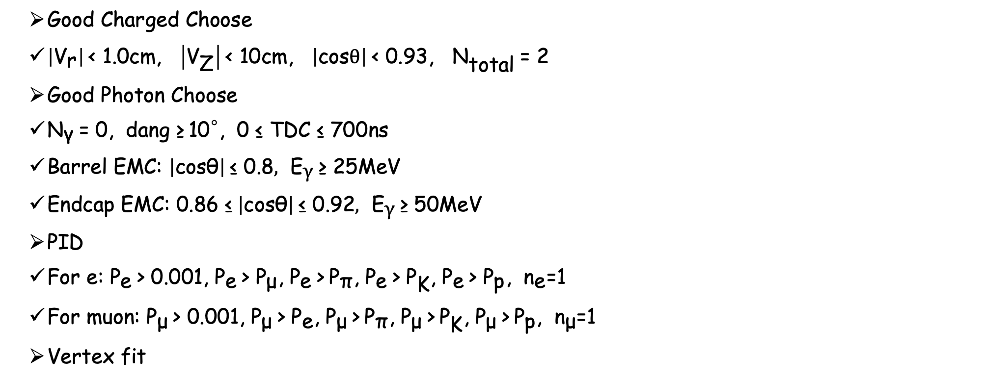
4. Event selection
Good Charged Choose
$\left|{\text{V}}_{\text{r}}\right| \text{< 1.0}\text{cm}\text{, }\left|{\text{V}}_{\text{Z}}\right| \text{< 10}\text{cm}\text{, }\left|\text{cos}\text{θ}\right| \text{< 0.93, }{\text{N}}_{\text{total}} \text{= 2}$
Good Photon Choose
${\text{N}}_{\text{γ}} \text{= 0, }\text{dang}\text{ ≥}{ \text{10}}^{\text{◦}}\text{, 0 ≤ }\text{TDC}\text{ ≤ 700}\text{ns}$
$\text{Barrel} \text{EMC}\text{: }\left|\text{cosθ}\right| \text{≤}\text{ 0.8}\text{,} {\text{E}}_{\text{γ}} \text{≥}\text{ 25}\text{MeV}$
$\text{Endcap} \text{EMC}\text{: 0.86 ≤} \left|\text{cosθ}\right| \text{≤}\text{ 0.92}\text{,} {\text{E}}_{\text{γ}} \text{≥}\text{ 50}\text{MeV}$
PID
$\text{For} \text{e}\text{: }{\text{P}}_{\text{e}} \text{> 0.001, }{\text{P}}_{\text{e}} \text{> }{\text{P}}_{\text{μ}}\text{, }{\text{P}}_{\text{e}} \text{>}{ \text{P}}_{\text{π}}\text{, }{\text{P}}_{\text{e}} \text{> }{\text{P}}_{\text{K}}\text{, }{\text{P}}_{\text{e}} \text{> }{\text{P}}_{\text{p}}\text{, }{\text{n}}_{\text{e}}\text{=1}$
$\text{For} \text{muon}\text{: }{\text{P}}_{\text{μ}} \text{> 0.001, }{\text{P}}_{\text{μ}} \text{> }{\text{P}}_{\text{e}}\text{, }{\text{P}}_{\text{μ}} \text{>}{ \text{P}}_{\text{π}}\text{, }{\text{P}}_{\text{μ}} \text{>}{ \text{P}}_{\text{K}}\text{, }{\text{P}}_{\text{μ}} \text{>}{ \text{P}}_{\text{p}}\text{, }{\text{n}}_{\text{μ}}\text{=1}$
Vertex fit

Slide 22
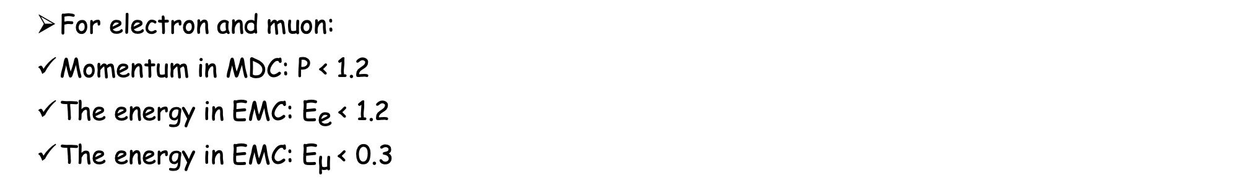
4. Further selection
For electron and muon:
Momentum in MDC: $\text{P} \text{<} \text{1.2}$
The energy in EMC: ${\text{E}}_{\text{e}} \text{< 1.2}$
The energy in EMC: ${\text{E}}_{\text{μ}} \text{<} \text{0.3}$

Slide 23
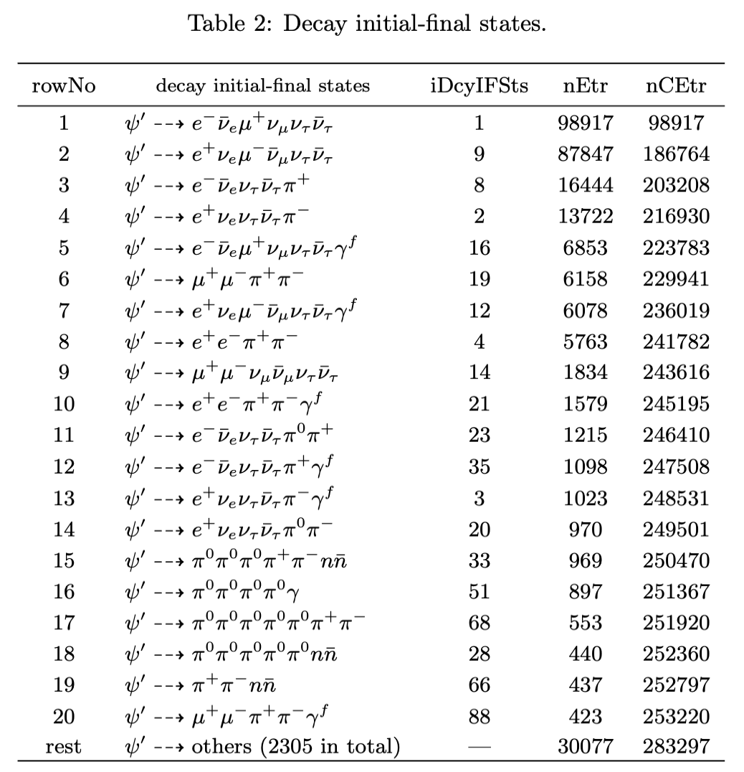
4. Further selection
Muon and Pion, need MUC information.
Electron, Muon
Need ep-ratio information

Slide 24
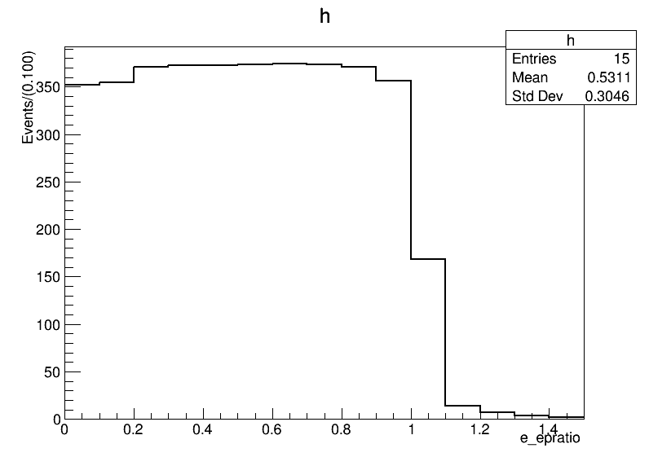
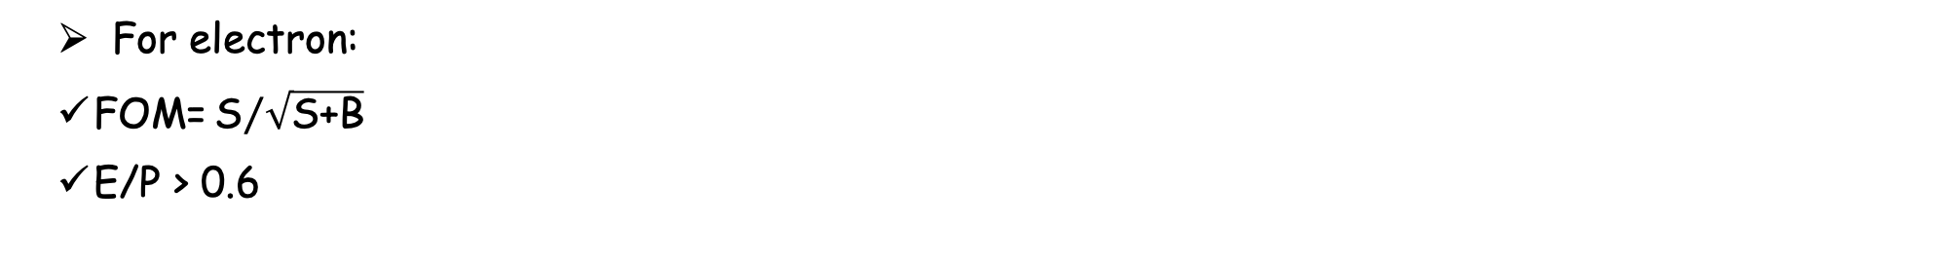
4. Further selection
For electron:
$\text{FOM}\text{=}{\text{S}}/{\sqrt{\text{S}\text{+}\text{B}}}$
$\text{E}\text{/}\text{P}\text{ > 0.6}$

Slide 25
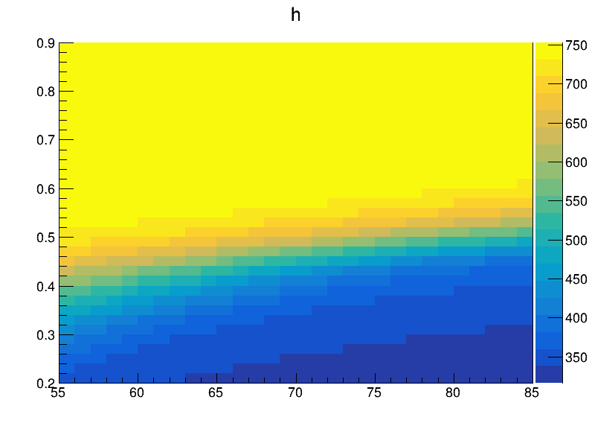
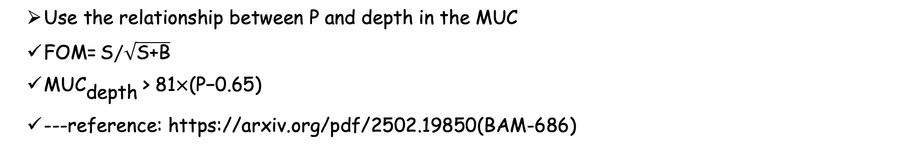
4. Further selection
Use the relationship between P and depth in the MUC
$\text{FOM}\text{=}{\text{S}}/{\sqrt{\text{S}\text{+}\text{B}}}$
$\text{MU}{\text{C}}_{\text{depth}} \text{> 81}\text{×}\text{(}\text{P}\text{−0.65)}$
---reference: https://arxiv.org/pdf/2502.19850(BAM-686)

Slide 26
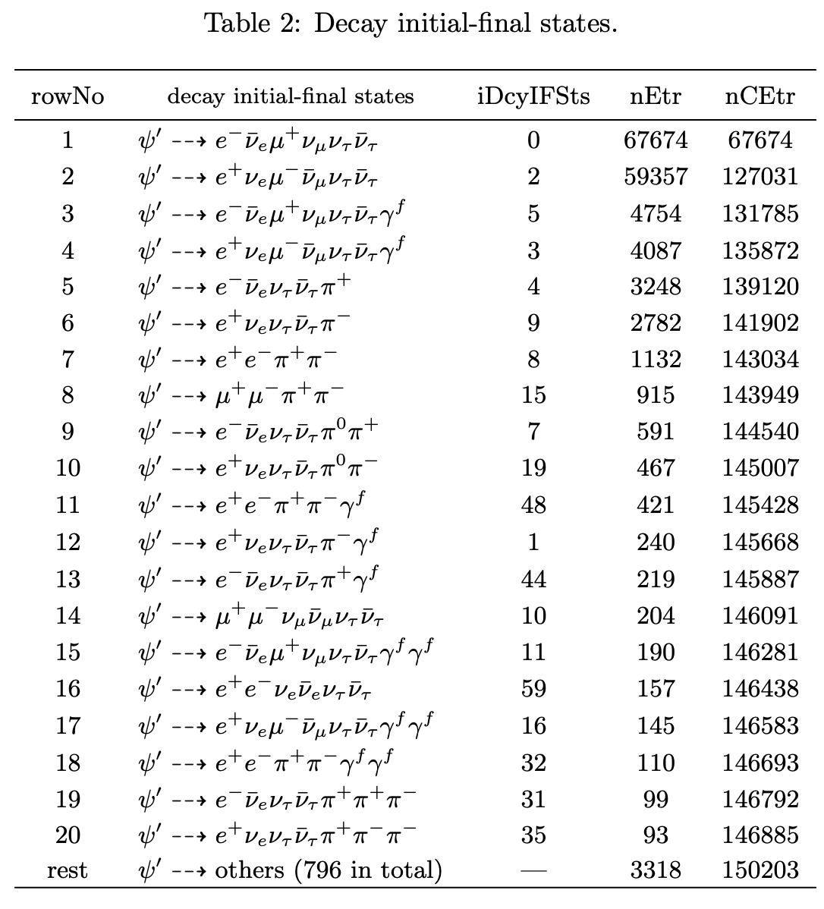
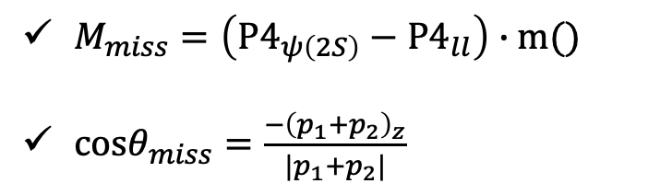
4. Further selection
The left background
Need the miss mass and miss $\text{cos}\text{θ}$
$M_{miss}=\left(P4_{ψ\left(2S\right)}−P4_{ll}\right)∙m()$
$cosθ_{miss}=\frac{−{\left(p_{1}+p_{2}\right)}_{z}}{|p_{1}+p_{2}|}$

Slide 27
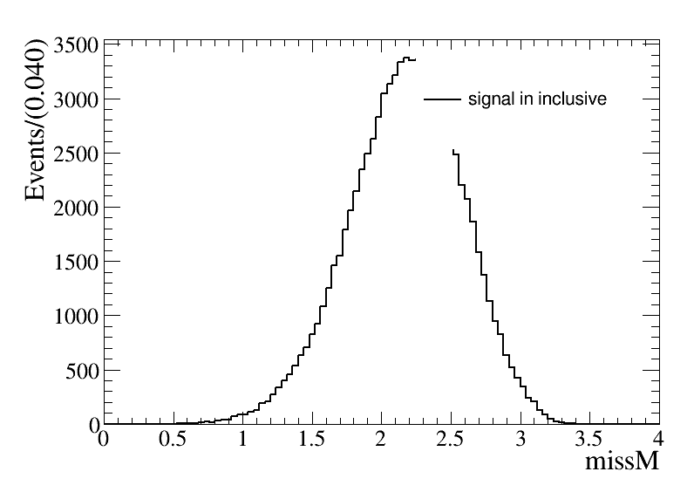
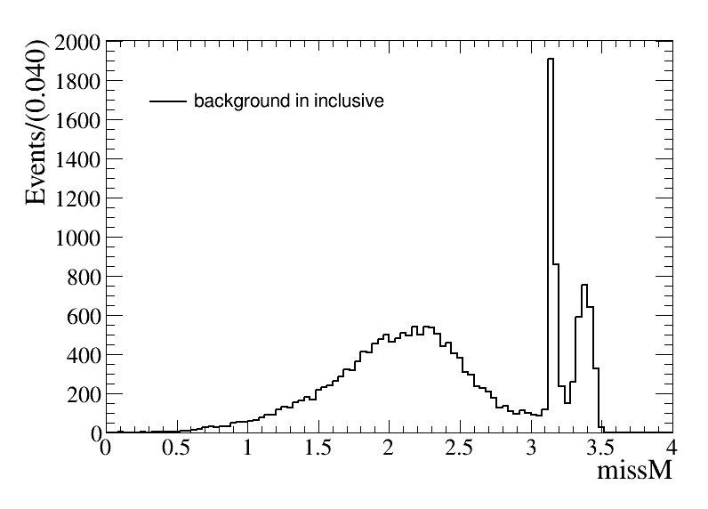
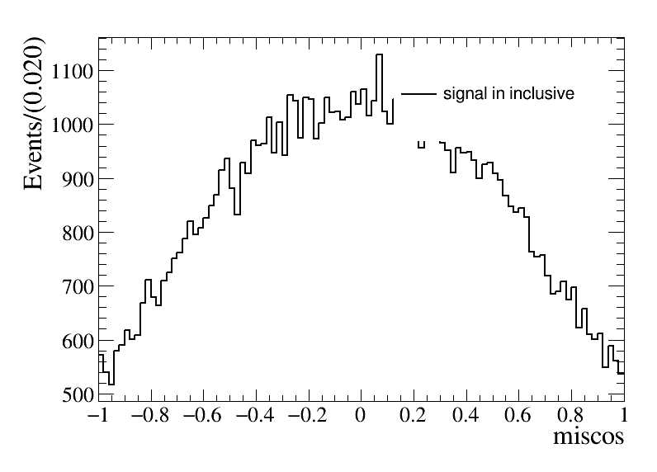
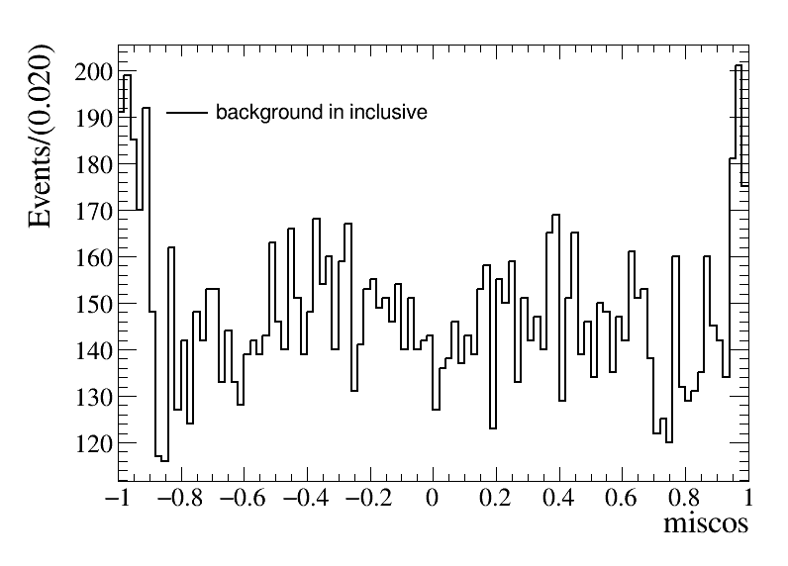
4. Further selection
The missing mass: $M_{miss}<3.05$
The missing $cosθ$: $|cosθ_{miss}|<0.8$

Slide 28
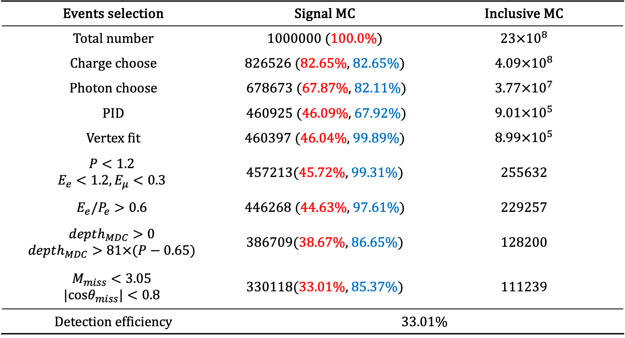
4. Cut flow
Events selection | Signal MC | Inclusive MC
Total number | 1000000 (100.0%) | $23×{10}^{8}$
Charge choose | 826526 (82.65%, 82.65%) | $4.09×{10}^{8}$
Photon choose | 678673 (67.87%, 82.11%) | $3.77×{10}^{7}$
PID | 460925 (46.09%, 67.92%) | $9.01×{10}^{5}$
Vertex fit | 460397 (46.04%, 99.89%) | $8.99×{10}^{5}$
$$P<1.2$$ $$E_{e}<1.2,E_{μ}<0.3$$ | 457213(45.72%, 99.31%) | 255632
$$E_{e}/P_{e}>0.6$$ | 446268 (44.63%, 97.61%) | 229257
$$depth_{MDC}>0$$ $$depth_{MDC}>81×(P−0.65)$$ | 386709(38.67%, 86.65%) | 128200
$$M_{miss}<3.05$$ $$|cosθ_{miss}|<0.8$$ | 330118(33.01%, 85.37%) | 111239
Detection efficiency | 33.01%

Slide 29
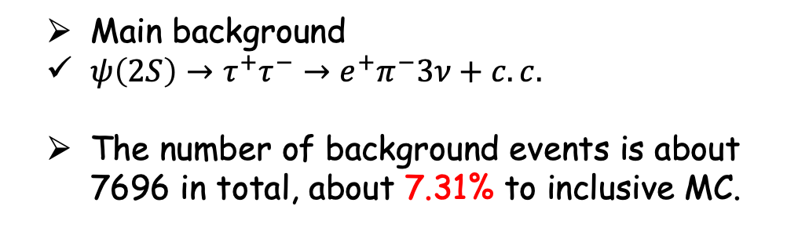
5. Background analysis
Main background
$ψ\left(2S\right)→τ^{+}τ^{−}→e^{+}π^{−}3ν+c.c.$
The number of background events is about 7696 in total, about 7.31% to inclusive MC.

Slide 30
5. Signal MC Vs invlusive MC

Slide 31
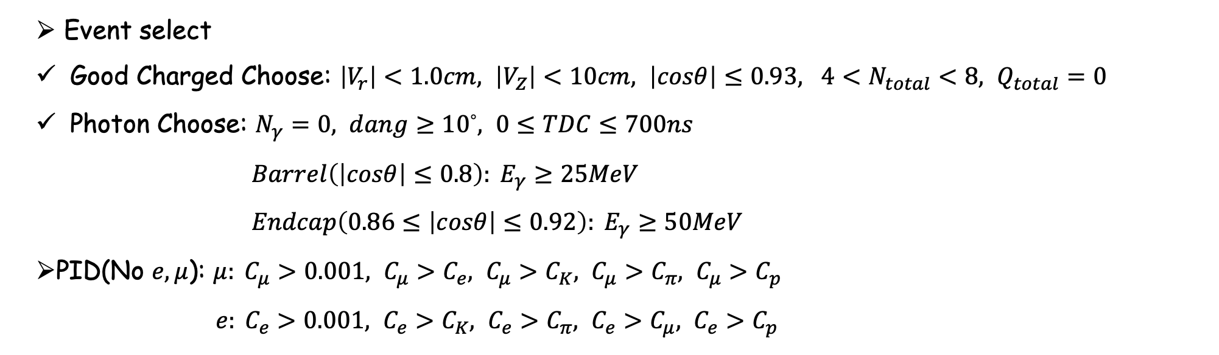
6. Systematic uncertainty
As a uncertainty of the systematic detector effect, we formed the observables using the high multiplicity samples which have the number of tracks larger than 4. These samples should not have any angular correlations among any combination of charged tracks.
Event select
Good Charged Choose: $\left|V_{r}\right|<1.0cm, \left|V_{Z}\right|<10cm, \left|cosθ\right|≤0.93, {4<N}_{total}<8, Q_{total}=0$
Photon Choose: $N_{γ}=0, dang≥{10}^{◦}, 0≤TDC≤700ns$
$Barrel\left(\left|cosθ\right|≤0.8\right): E_{γ}≥25MeV$
$Endcap\left(0.86≤\left|cosθ\right|≤0.92\right): E_{γ}≥50MeV$
PID(No $e, μ$): $μ: C_{μ}>0.001, C_{μ}>C_{e}, C_{μ}>C_{K}, C_{μ}>C_{π}, C_{μ}>C_{p}$
$e: C_{e}>0.001, C_{e}>C_{K}, C_{e}>C_{π}, C_{e}>C_{μ}, C_{e}>C_{p}$

Slide 32
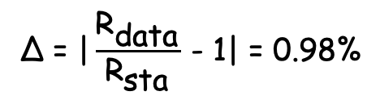
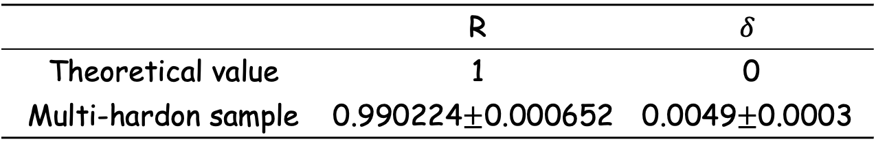
6. Systematic uncertainty
The total systematic error given by using multi-hadron samples is 0.98%, and this is taken as the total systematic uncertainty.
 | R | $$δ$$
Theoretical value | 1 | 0
Multi-hardon sample | $$\text{0.990224}\text{±}\text{0.000652}$$ | $$\text{0.0049}\text{±}\text{0.0003}$$
$$\text{Δ}\text{ = |}\frac{{\text{R}}_{\text{data}}}{{\text{R}}_{\text{sta}}} \text{− 1| = 0.98\%}$$

Slide 33

7. Result based on inclusive MC
The result based on inclusive MC
$$\tilde{R}=R_{μ^{+}e^{−}}^{T}∙R_{e^{+}μ^{−}}^{T}=R_{μ^{+}e^{−}}^{CP}∙R_{e^{+}μ^{−}}^{CP}=1+4δ$$
$$\tilde{R}=1.002±0.00005±0.01$$
$$δ=0.0006±0.00001±0.002$$

Slide 34
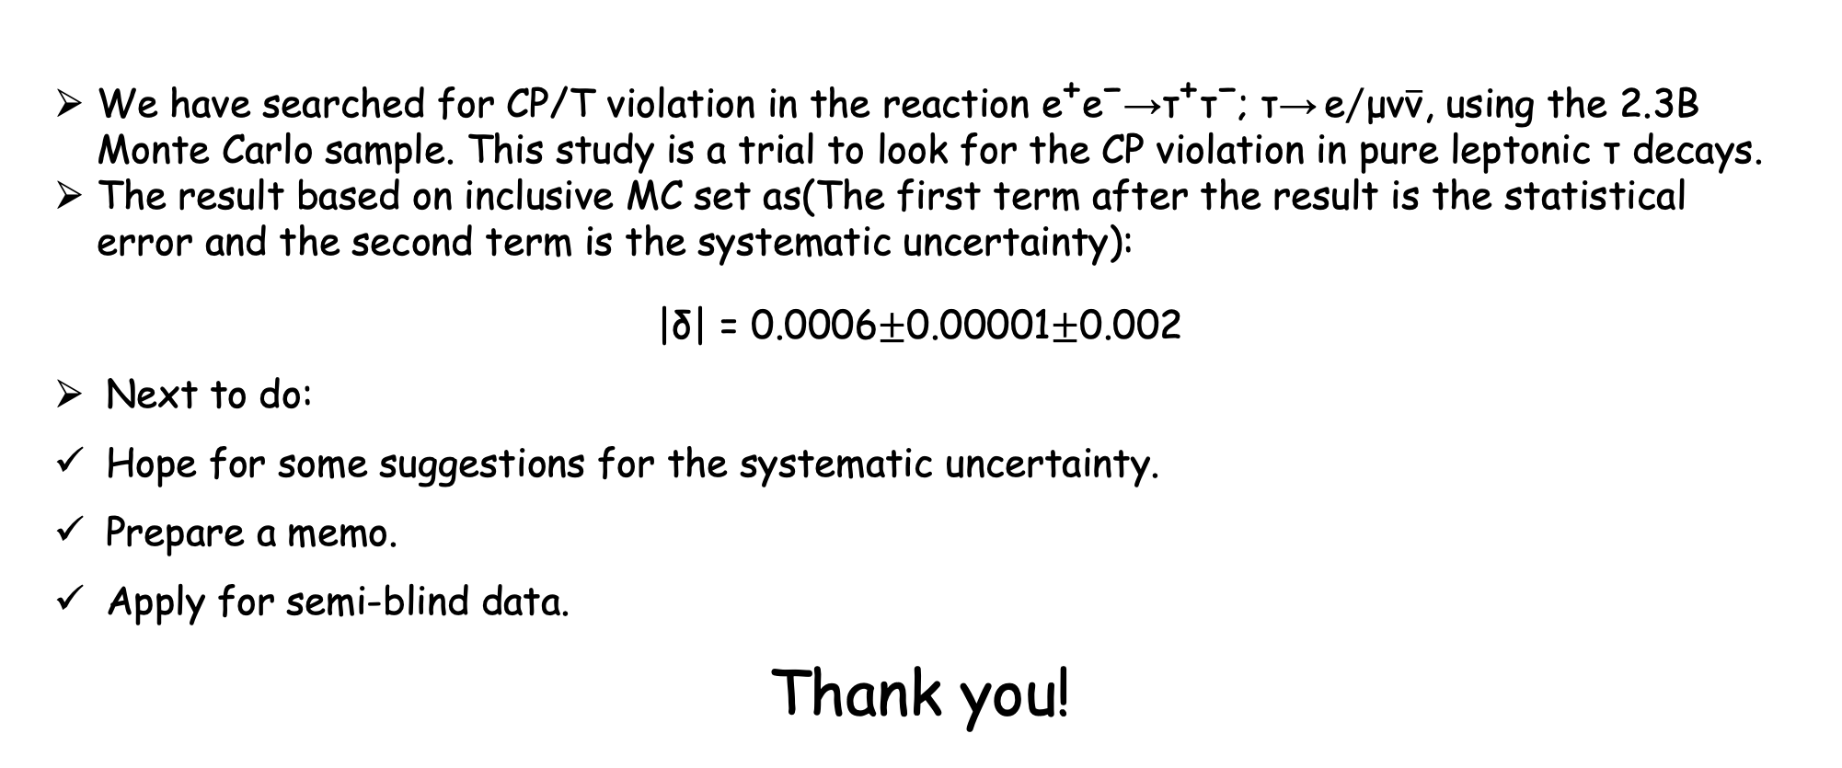
8. Summery and next to do
We have searched for CP/T violation in the reaction ${\text{e}}^{\text{+}}{\text{e}}^{\text{−}}\text{→}{\text{τ}}^{\text{+}}{\text{τ}}^{\text{−}}$; $\text{τ}\text{→}{\text{e}}/{\text{μν}\overline{\text{ν}}}$, using the 2.3B Monte Carlo sample. This study is a trial to look for the CP violation in pure leptonic $\text{τ}$ decays.
The result based on inclusive MC set as(The first term after the result is the statistical error and the second term is the systematic uncertainty):
$$\text{|}\text{δ}\text{| = }\text{0.0006}\text{±}\text{0.00001}\text{±}\text{0.002}$$
Next to do:
Hope for some suggestions for the systematic uncertainty.
Prepare a memo.
Apply for semi-blind data.
Thank you!

Slide 35
5. Signal MC Vs invlusive MC

Slide 36
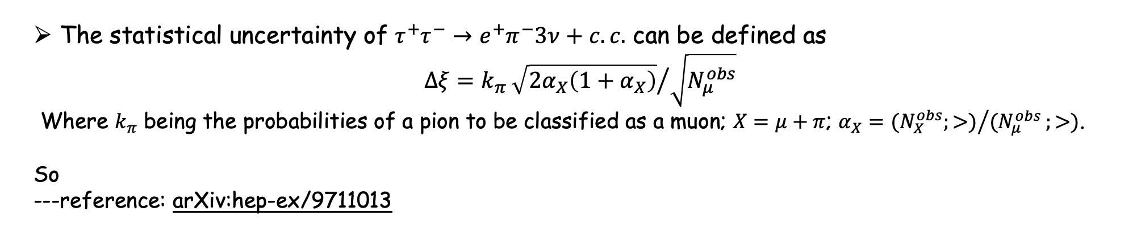
Background analysis
The statistical uncertainty of $τ^{+}τ^{−}→e^{+}π^{−}3ν+c.c.$ can be defined as
$$Δξ=k_{π}{\sqrt{2α_{X}\left(1+α_{X}\right)}}/{\sqrt{N_{μ}^{obs}}}$$
Where $k_{π}$ being the probabilities of a pion to be classified as a muon; $X=μ+π$; $α_{X}={{(N}_{X}^{obs};>)}/{(N_{μ}^{obs}};>)$.
So
---reference: arXiv:hep-ex/9711013

Slide 37
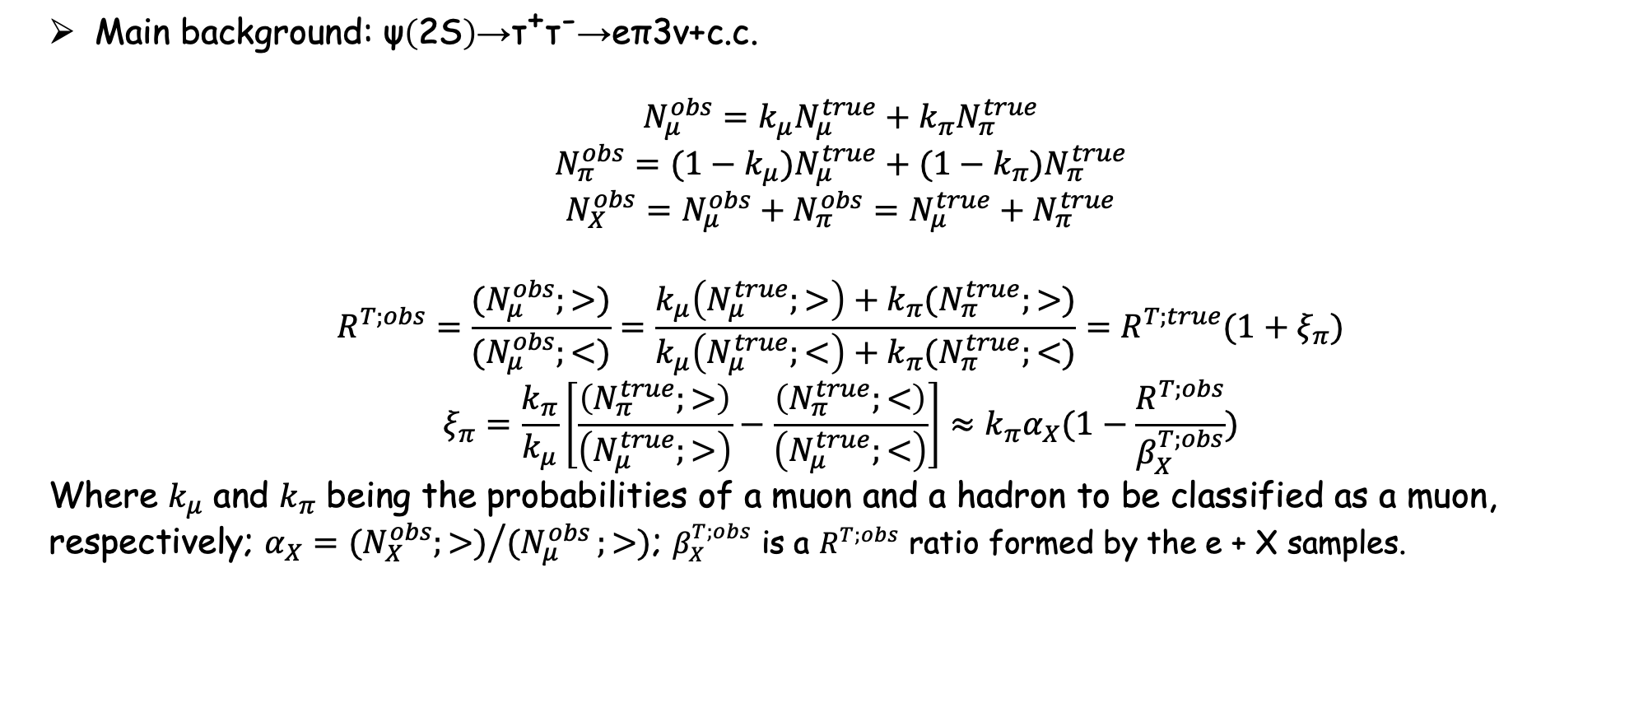
Background analysis
Main background: $\text{ψ}\left(\text{2}\text{S}\right)\text{→}{\text{τ}}^{\text{+}}{\text{τ}}^{\text{−}}\text{→}\text{eπ}\text{3}\text{ν}\text{+}\text{c}\text{.}\text{c}\text{.}$
$$N_{μ}^{obs}=k_{μ}N_{μ}^{true}+k_{π}N_{π}^{true}$$
$$N_{π}^{obs}=({1−k}_{μ})N_{μ}^{true}+(1−k_{π})N_{π}^{true}$$
$$N_{X}^{obs}=N_{μ}^{obs}+N_{π}^{obs}=N_{μ}^{true}+N_{π}^{true}$$
$$R^{T;obs}=\frac{(N_{μ}^{obs};>)}{(N_{μ}^{obs};<)}=\frac{k_{μ}\left(N_{μ}^{true};>\right)+k_{π}(N_{π}^{true};>)}{k_{μ}\left(N_{μ}^{true};<\right)+k_{π}(N_{π}^{true};<)}=R^{T;true}(1+ξ_{π})$$
$$ξ_{π}=\frac{k_{π}}{k_{μ}}\left[\frac{\left(N_{π}^{true};>\right)}{\left(N_{μ}^{true};>\right)}−\frac{\left(N_{π}^{true};<\right)}{\left(N_{μ}^{true};<\right)}\right]≈k_{π}α_{X}(1−\frac{R^{T;obs}}{β_{X}^{T;obs}})$$
Where $k_{μ}$ and $k_{π}$ being the probabilities of a muon and a hadron to be classified as a muon, respectively; $α_{X}={{(N}_{X}^{obs};>)}/{(N_{μ}^{obs}};>)$; $β_{X}^{T;obs}$ is a $R^{T;obs}$ ratio formed by the e + X samples.

Slide 38
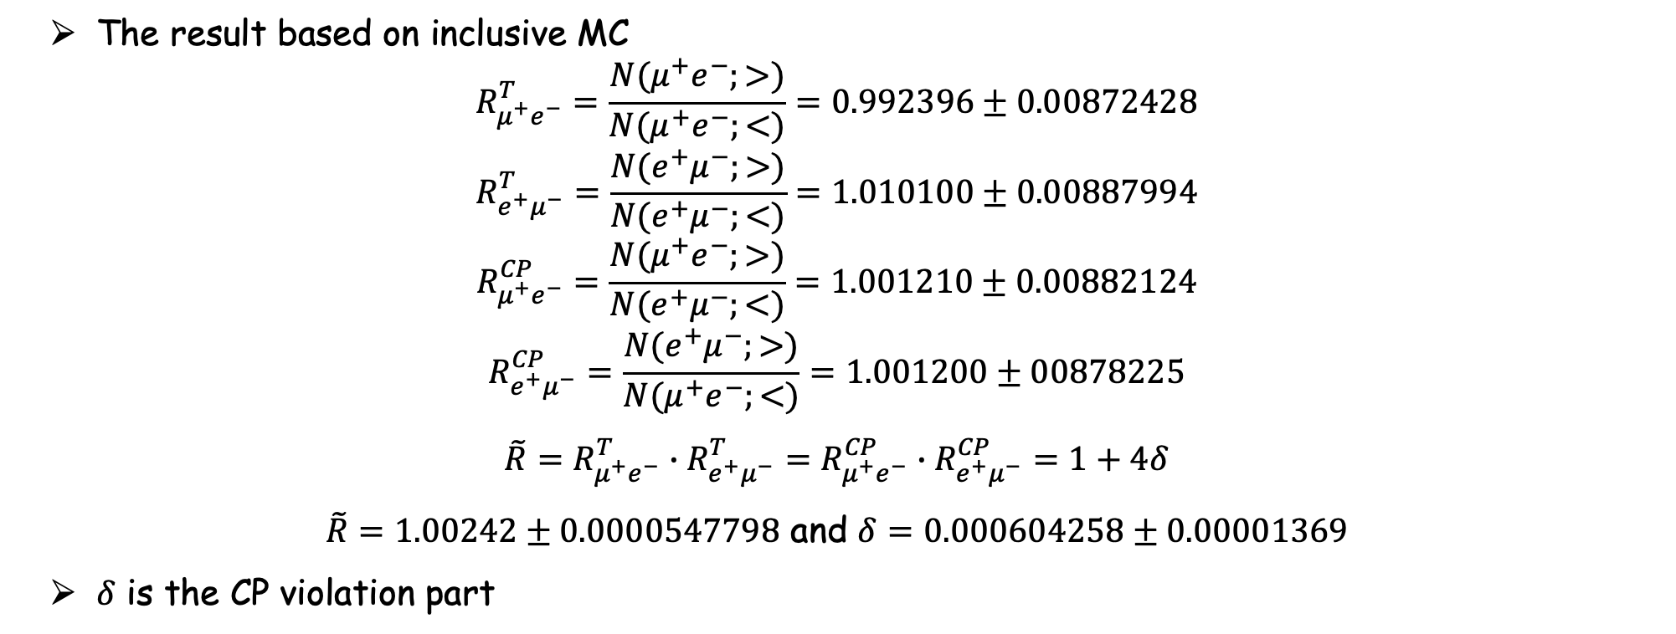
Result
The result based on inclusive MC
$$R_{μ^{+}e^{−}}^{T}=\frac{N(μ^{+}e^{−};>)}{N(μ^{+}e^{−};<)}=0.992396±0.00872428$$
$$R_{e^{+}μ^{−}}^{T}=\frac{N(e^{+}μ^{−};>)}{N(e^{+}μ^{−};<)}=1.010100±0.00887994$$
$$R_{μ^{+}e^{−}}^{CP}=\frac{N(μ^{+}e^{−};>)}{N(e^{+}μ^{−};<)}=1.001210±0.00882124$$
$$R_{e^{+}μ^{−}}^{CP}=\frac{N(e^{+}μ^{−};>)}{N(μ^{+}e^{−};<)}=1.001200±00878225$$
$$\tilde{R}=R_{μ^{+}e^{−}}^{T}∙R_{e^{+}μ^{−}}^{T}=R_{μ^{+}e^{−}}^{CP}∙R_{e^{+}μ^{−}}^{CP}=1+4δ$$
$\tilde{R}=1.00242±0.0000547798$ and $δ=0.000604258±0.00001369$
$δ$ is the CP violation part

Slide 39
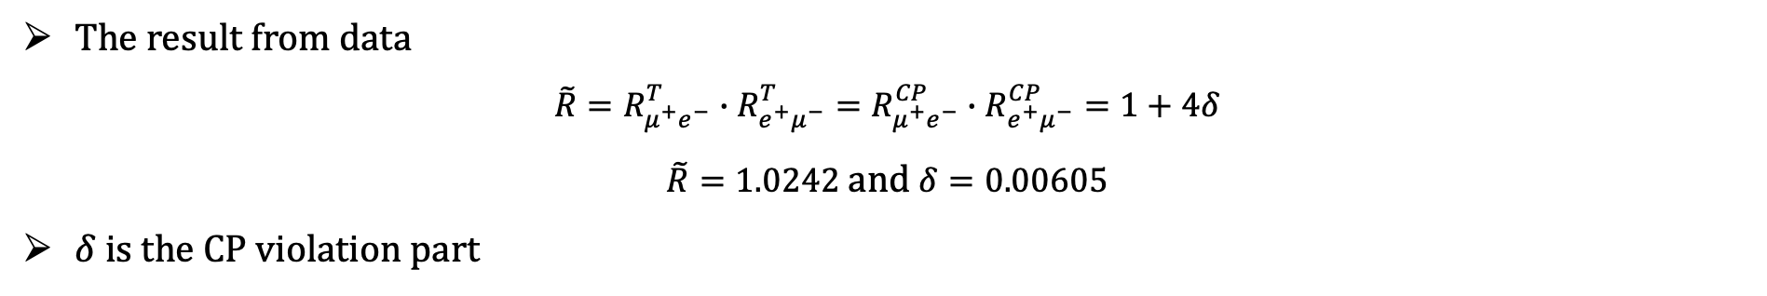
Result
The result from data
$$\tilde{R}=R_{μ^{+}e^{−}}^{T}∙R_{e^{+}μ^{−}}^{T}=R_{μ^{+}e^{−}}^{CP}∙R_{e^{+}μ^{−}}^{CP}=1+4δ$$
$\tilde{R}=1.0242$ and $δ=0.00605$
$δ$ is the CP violation part

