Slide 1
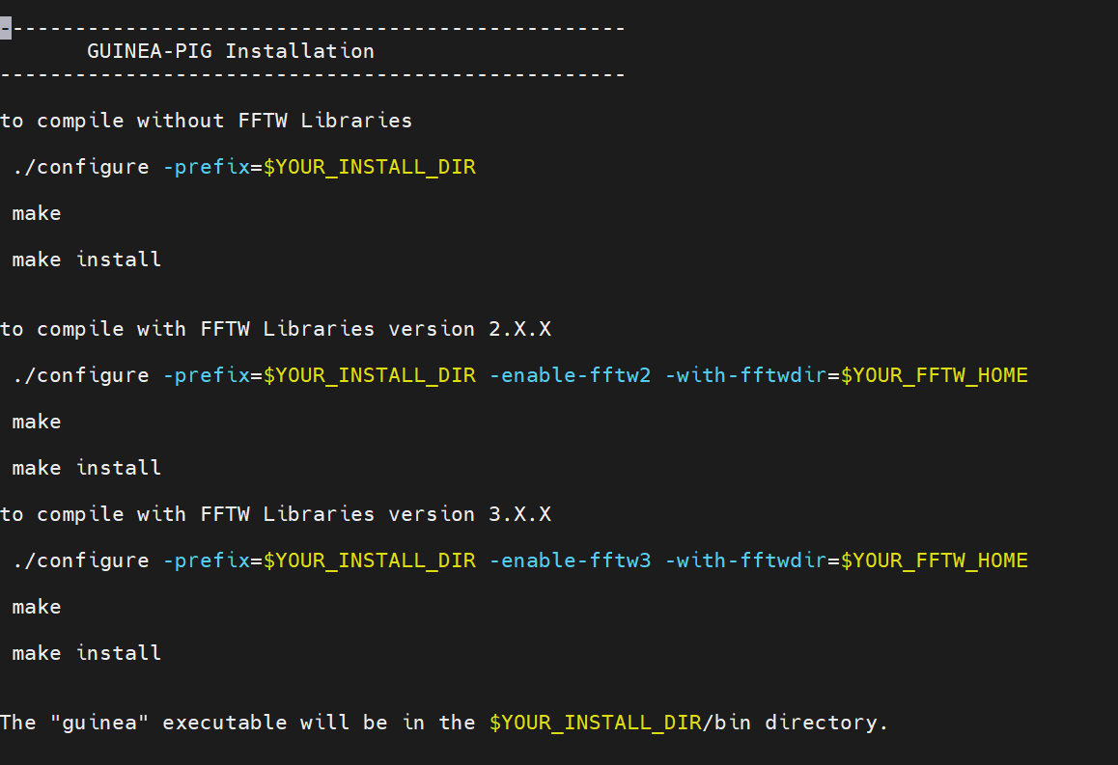
1. 配置环境
export PATH=/cvmfs/container.ihep.ac.cn/bin:$PATH && hep_container shell CentOS7 # 进入CentOS7环境
拷贝几个文件到本地目录：
/cefs/higgs/tangyanbang/config/guinea-pig #这是guinea-pig的源码
/cefs/higgs/tangyanbang/config/setup.sh #mditookit
/cefs/higgs/tangyanbang/config/config_guinea/ mdi_env.sh #依赖项

Slide 2
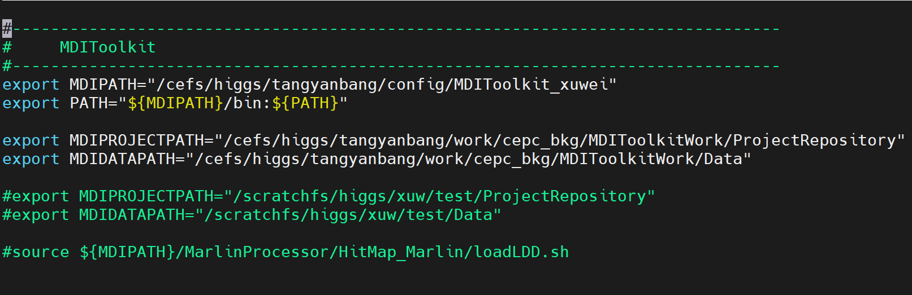
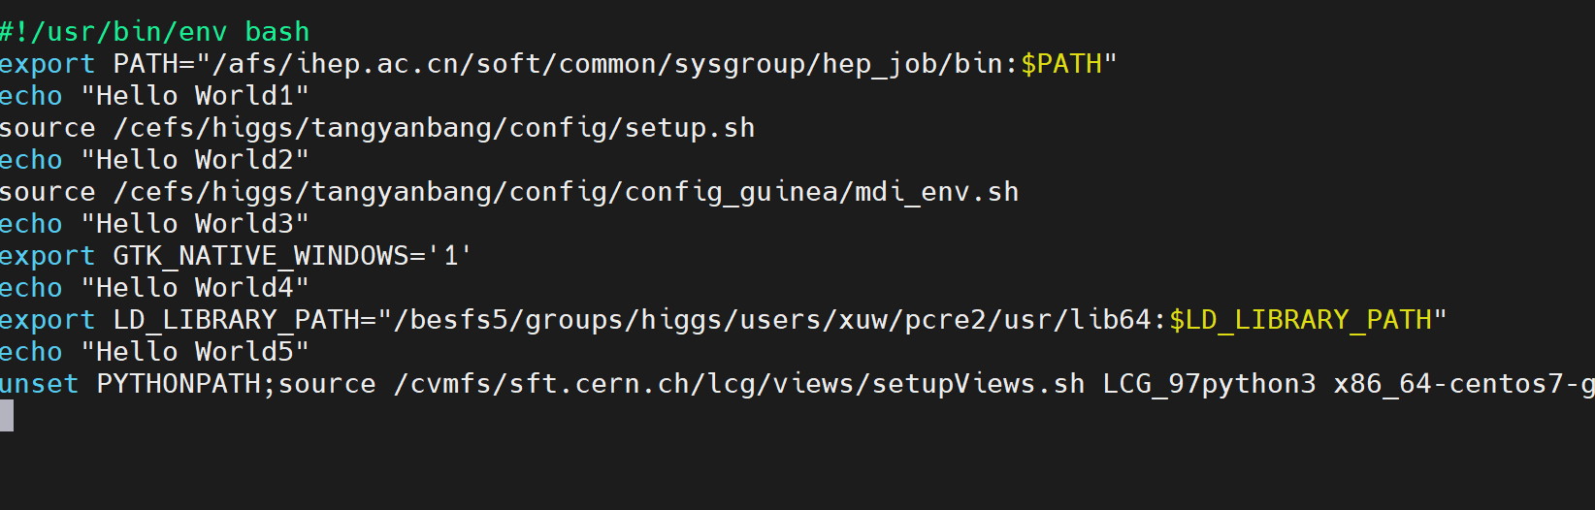

Slide 3
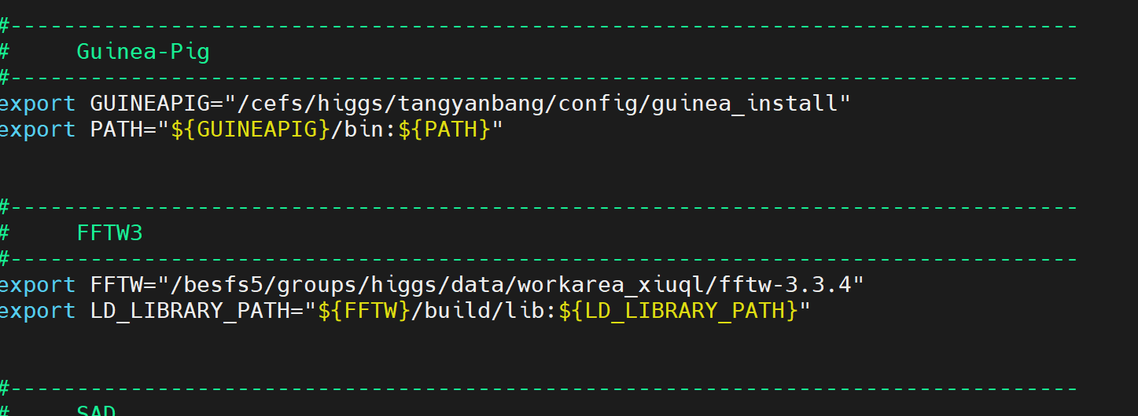

Slide 4
