Slide 1
Selected highlights from LHCb
钱文斌
中国科学院大学
2025/09/13
第二届重味物理前沿论坛研讨会
2025/09/13
UCAS, Wenbin Qian
1

Slide 2
Outline of the talk
Introduction
Selected highlights on CP violation
Selected highlights on spectroscopy studies
Prospects and conclusion
2025/09/13
UCAS, Wenbin Qian

Slide 3
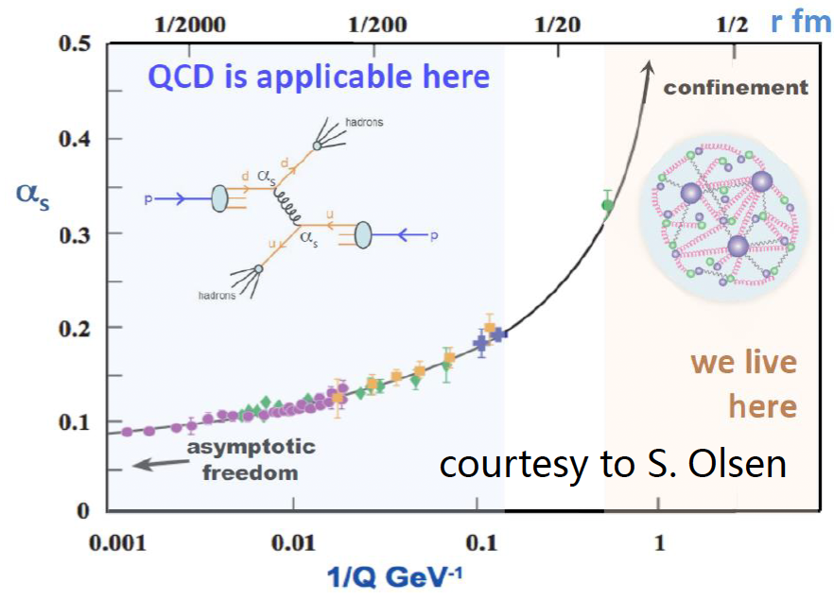
Flavor physics goals
SM model very successful;
Still an effective theory, many unexplained phenomena;
Most related to flavor and hadron physics
Understanding QCD at low energy
New Physics hunting
Properties of QCD confinement
Structures of hadrons
Matter and antimatter asymmetry observed in the Universe
Origin of dark matter? New particles or new forces? Flavor hierarchy
Non-perturbative!
2025/09/13
国科大 钱文斌
3

Slide 4
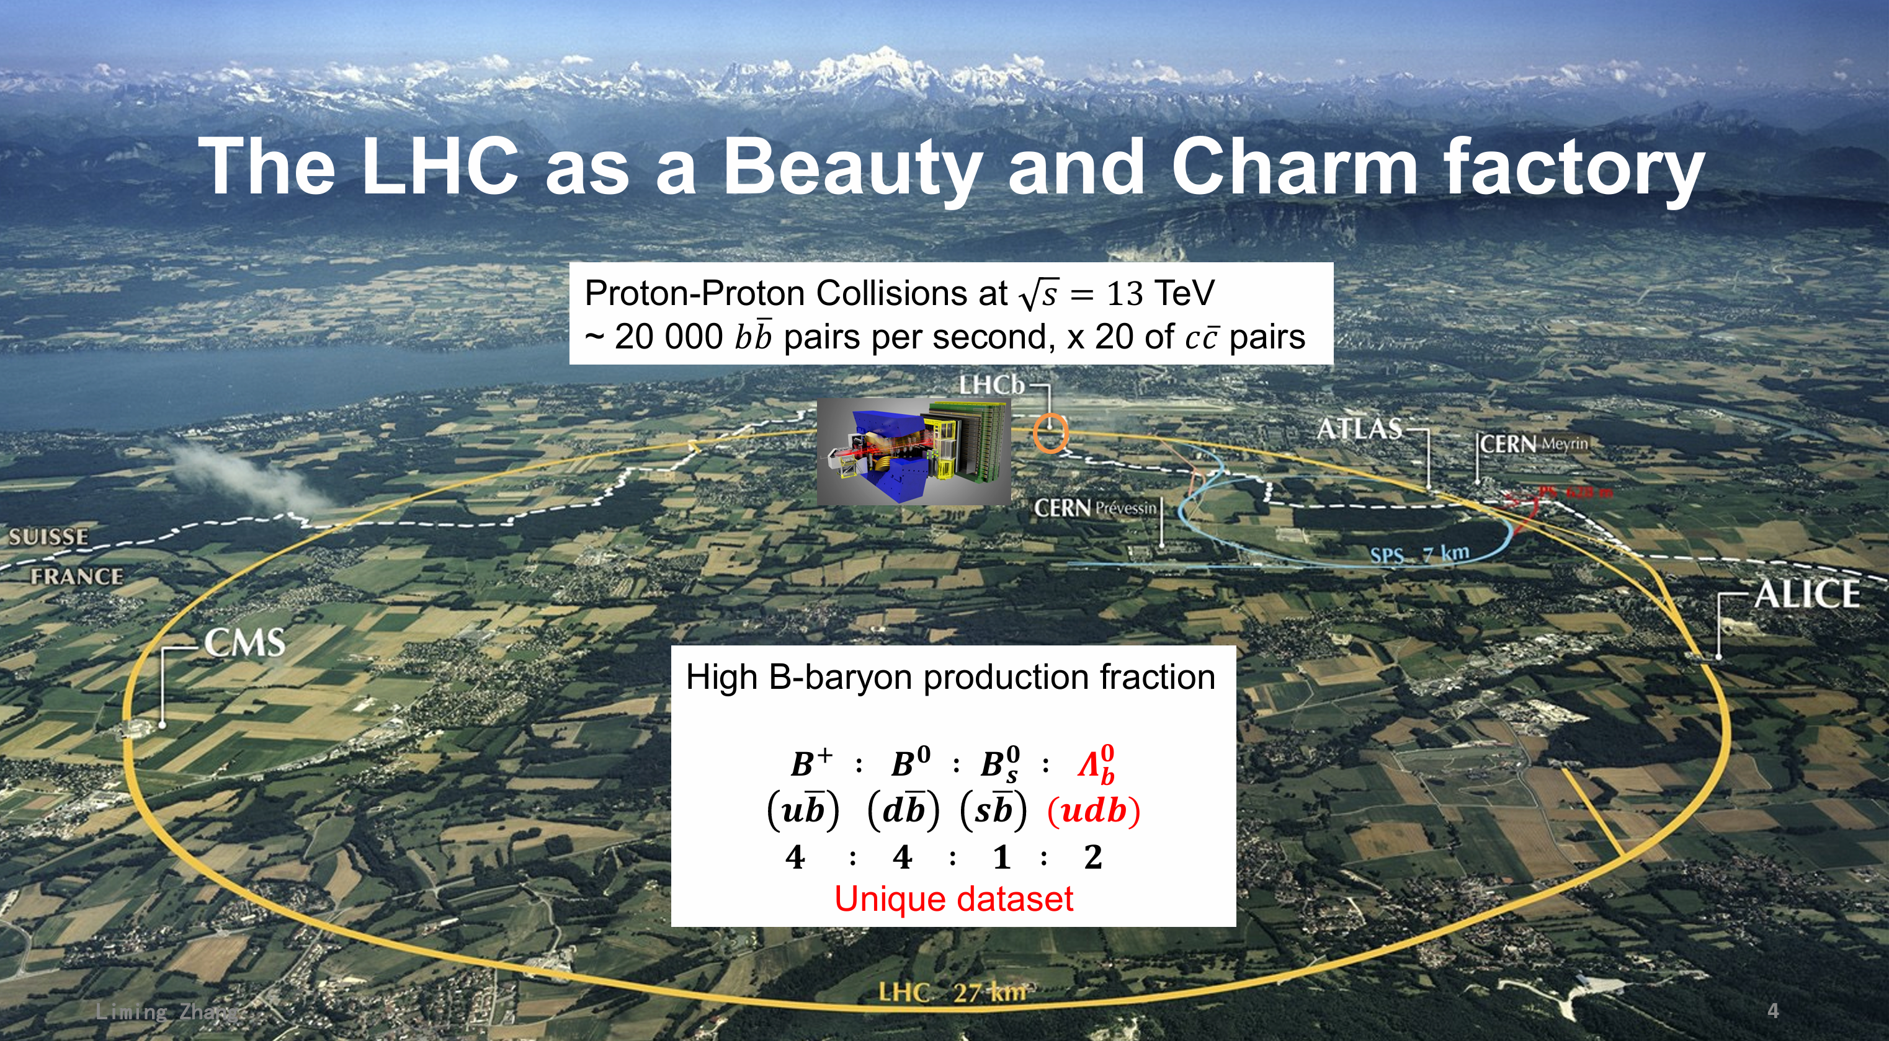
LHC: a new energy and luminosity frontier
Now 13.6 TeV
2025/09/13
UCAS, Wenbin Qian
4

Slide 5
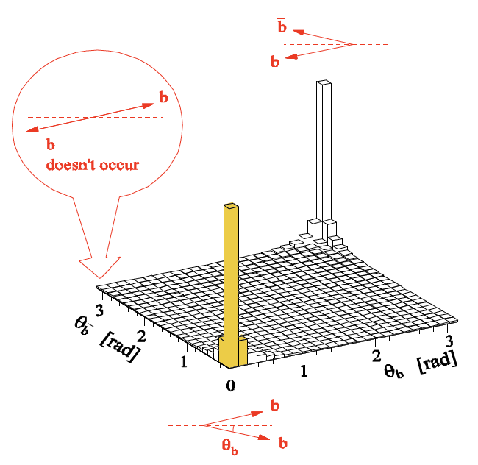
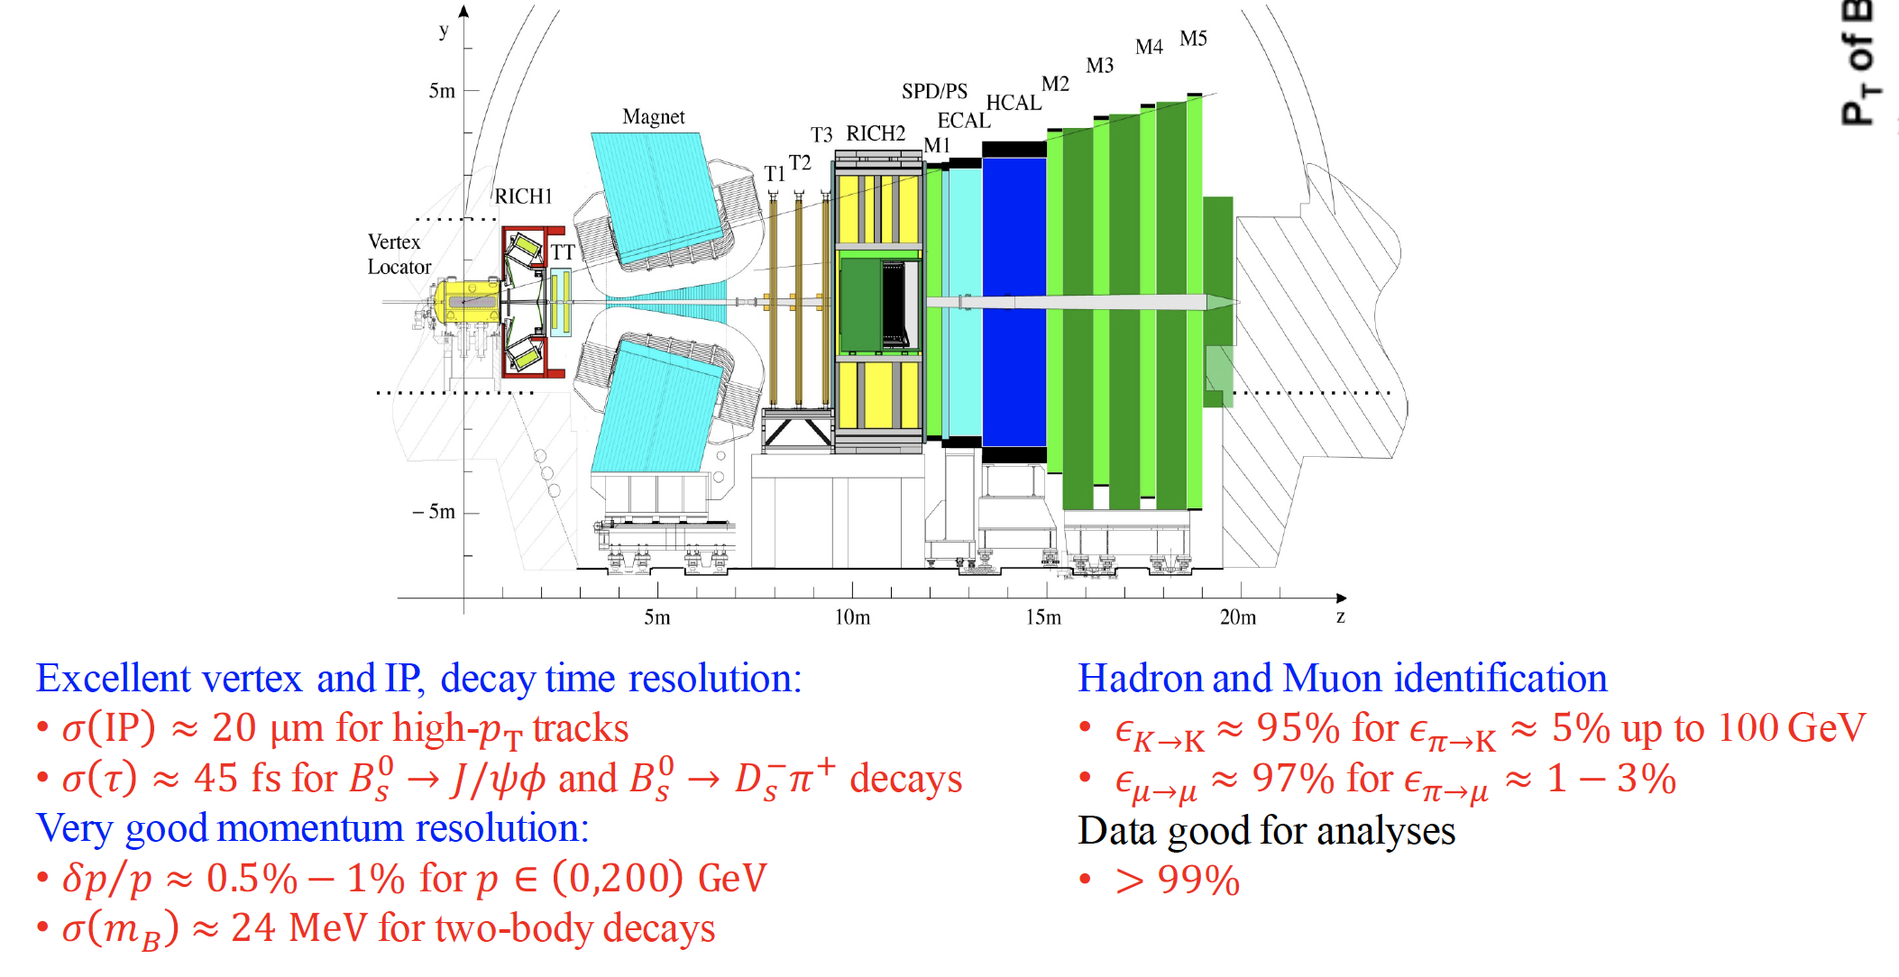
The LHCb detector (Run 1+2)
2008 JINST 3 S08005
Designed for CP violation and heavy flavor studies
2025/09/13
国科大 钱文斌
5

Slide 6
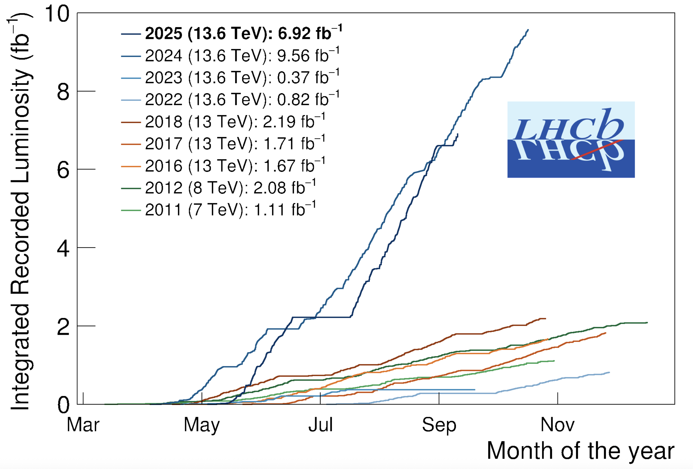
The LHCb status
Run 1:
  2011 (7 TeV): 1 fb⁻¹
  2012 (8 TeV): 2 fb⁻¹
Run 2:
  2015-2018 (13 TeV): 6 fb⁻¹
Run 3:
  2024 alone (13.6 TeV): 9.56 fb⁻¹
  2025 (13.6 TeV): > 6.92 fb⁻¹
A new LHCb detector for Run 3 operates at $×5$ higher instantaneous luminosity
Similar performance, while efficiency for hadron final states increased by a factor of 2
2025/09/13
国科大 钱文斌
6

Slide 7
Outline of the talk
Introduction
Selected highlights on CP violation
Selected highlights on spectroscopy studies
Prospects and conclusion
2025/09/13
UCAS, Wenbin Qian

Slide 8
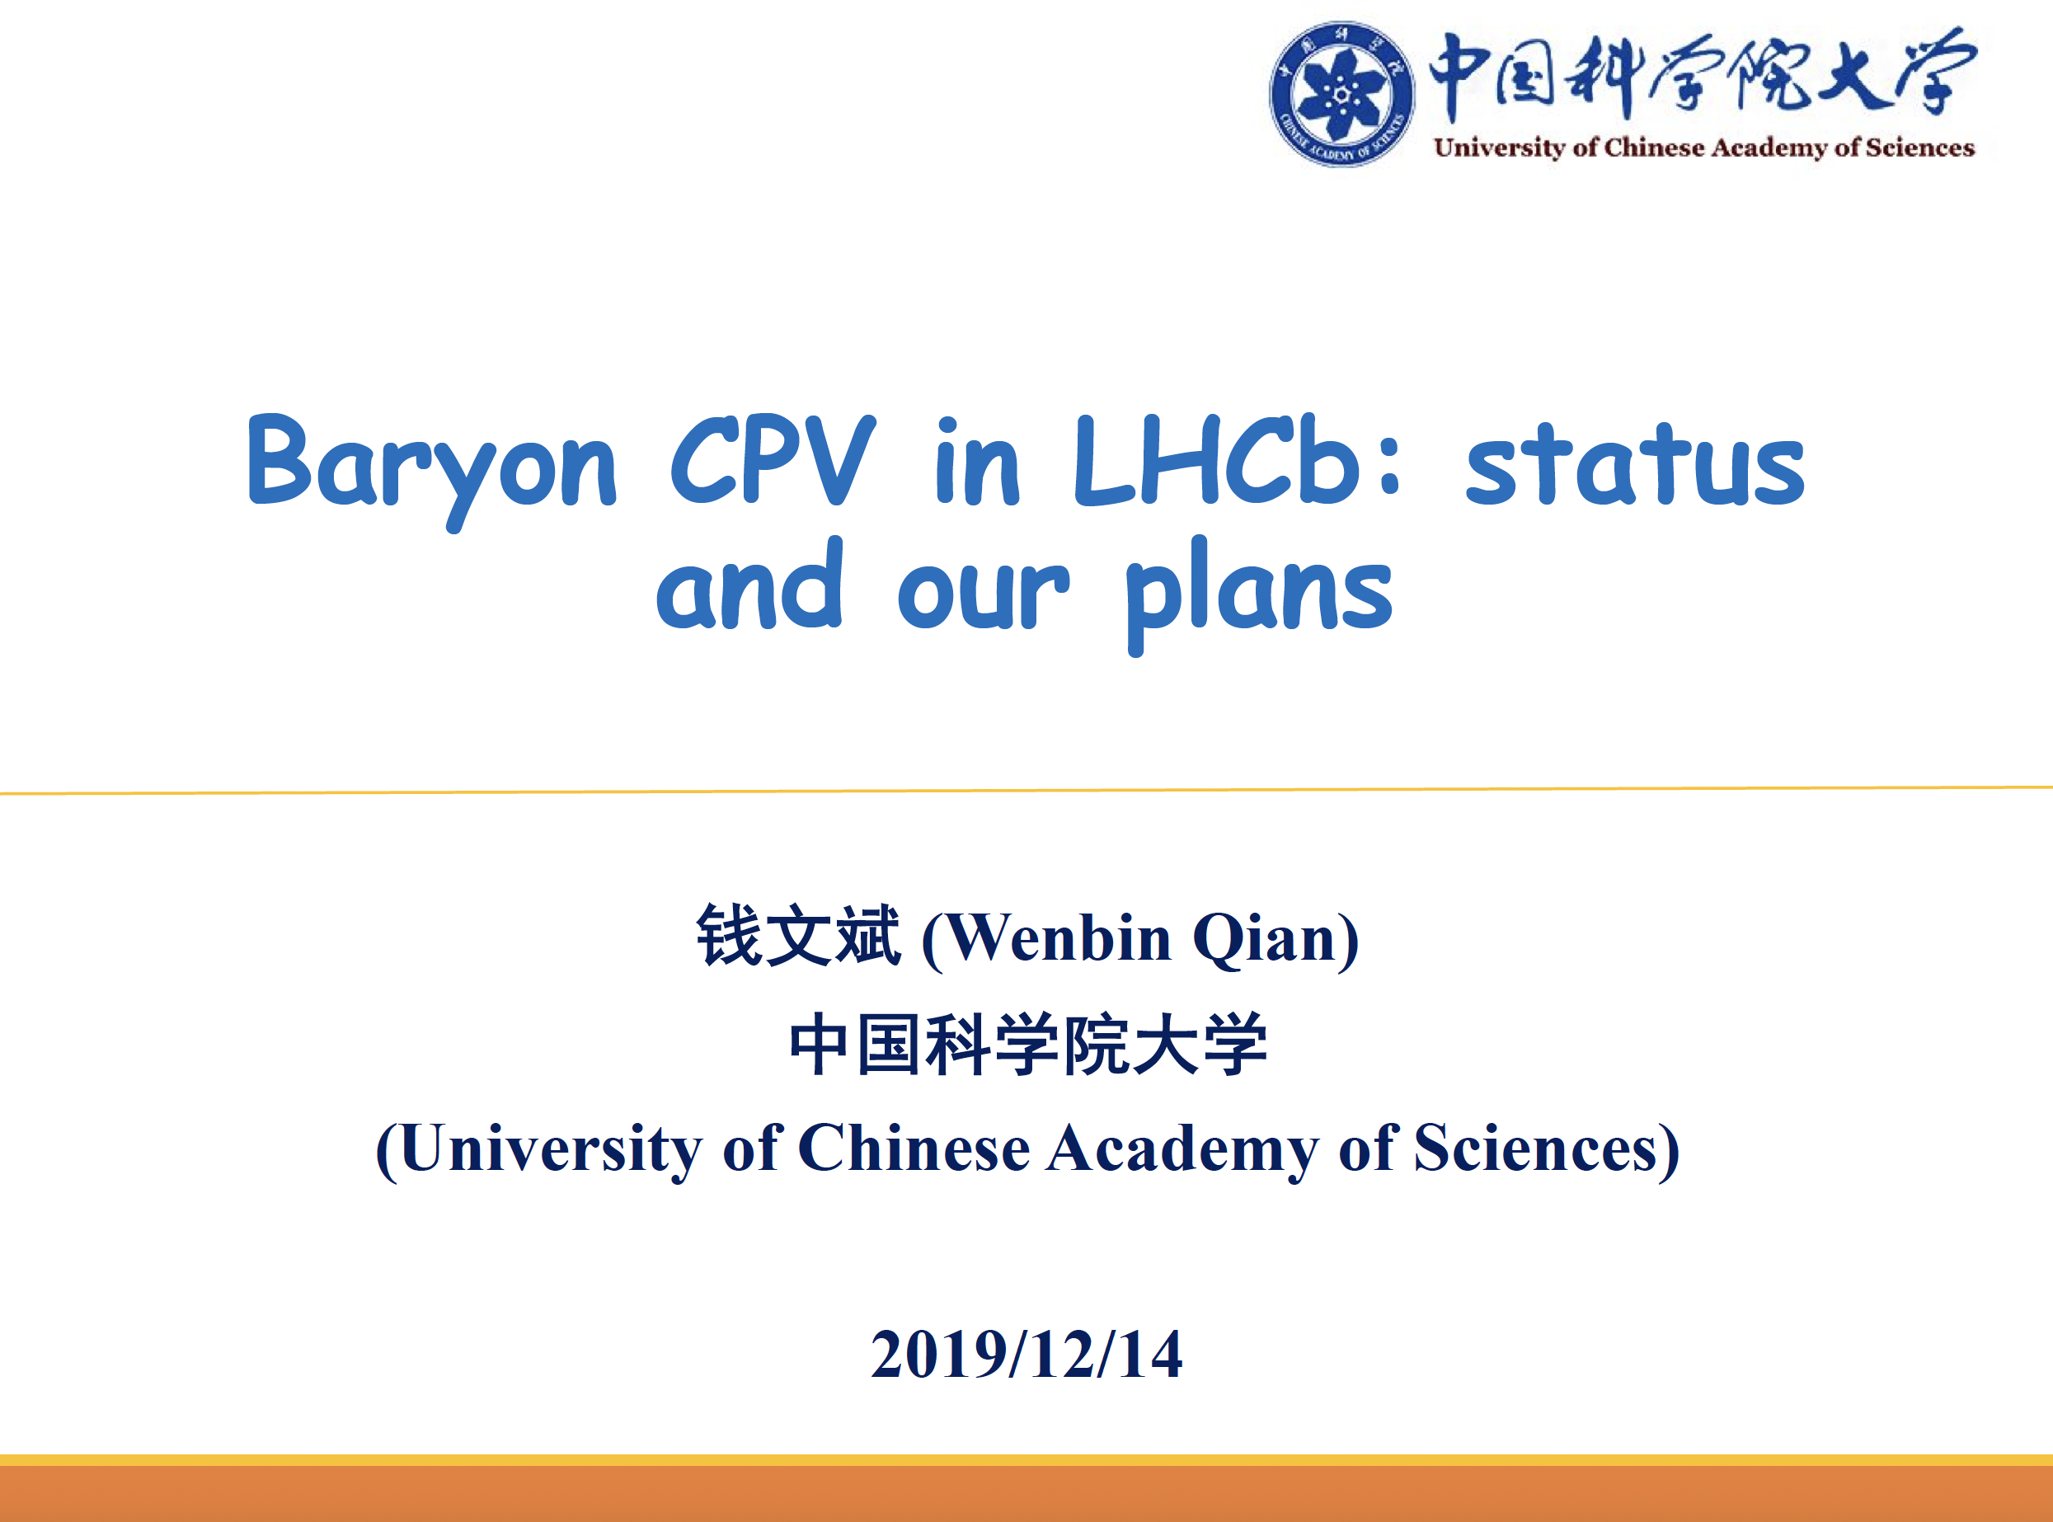
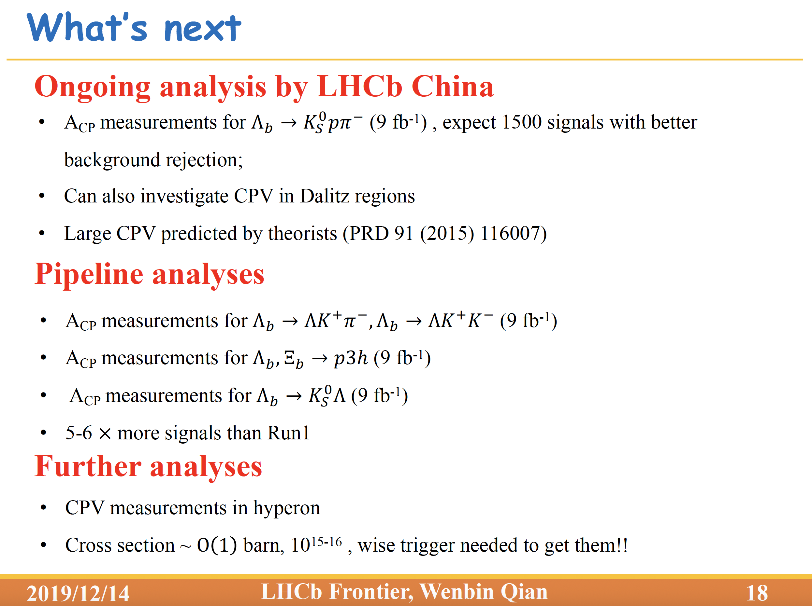
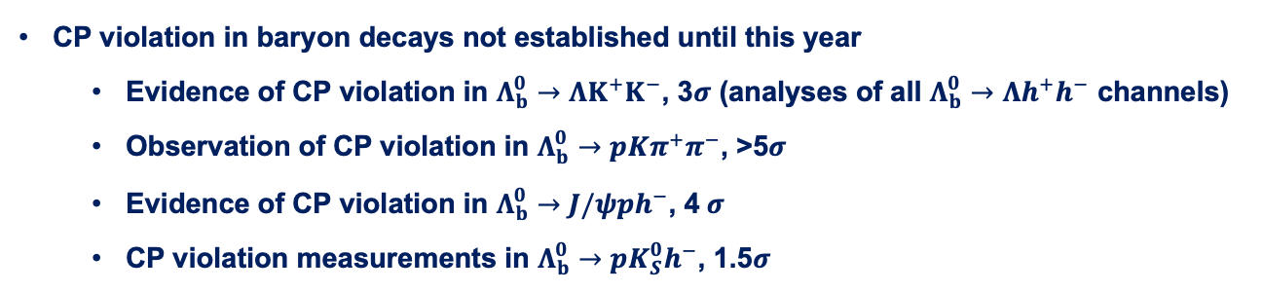
CP violation in baryon decays
第一届LHCb前沿物理研讨会
CP violation in baryon decays not established until this year
  Evidence of CP violation in $Λ_{b}^{0}→ΛK^{+}K^{−}$, 3$σ$ (analyses of all $Λ_{b}^{0}→Λh^{+}h^{−}$ channels)
  Observation of CP violation in $Λ_{b}^{0}→pKπ^{+}π^{−}$, >5$σ$
  Evidence of CP violation in $Λ_{b}^{0}→J/ψph^{−}$, 4 $σ$
  CP violation measurements in $Λ_{b}^{0}→pK_{S}^{0}h^{−}$, 1.5$σ$
2025/09/13
国科大 钱文斌
8

Slide 9
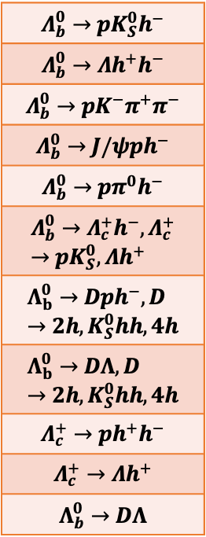
CP violation searches by LHCb China group
2016 | 2017 | 2018 | 2019 | 2020 | 2021 | 2022 | 2023 | 2024 | 2025
$$Λ_{b}^{0}→pK_{S}^{0}h^{−}$$
$$Λ_{b}^{0}→Λh^{+}h^{−}$$
$$Λ_{b}^{0}→pK^{−}π^{+}π^{−}$$
$$Λ_{b}^{0}→J/ψph^{−}$$
$$Λ_{b}^{0}→pπ^{0}h^{−}$$
$$Λ_{b}^{0}→Λ_{c}^{+}h^{−}, Λ_{c}^{+}→pK_{S}^{0}, Λh^{+}$$
$$Λ_{b}^{0}→Dph^{−}, D→2h, K_{S}^{0}hh, 4h$$
$$Λ_{b}^{0}→DΛ, D→2h, K_{S}^{0}hh, 4h$$
$$Λ_{c}^{+}→ph^{+}h^{−}$$
$$Λ_{c}^{+}→Λh^{+}$$
$$Λ_{b}^{0}→DΛ$$
CCNU
CCNU +UCAS
CCNU +UCAS +PKU
CCNU +UCAS
CCNU +UCAS +PKU
CCNU +UCAS +PKU + IHEP
UCAS + Tsinghua
Joint efforts from LHCb China
UCAS + PKU + WHU
UCAS
CCNU +UCAS +PKU
UCAS
9 years of studies
Covering all modes
UCAS
UCAS
UCAS + LZU
CCNU
CCNU +UCAS
2024/07/14
UCAS, Wenbin Qian
UCAS
9

Slide 10
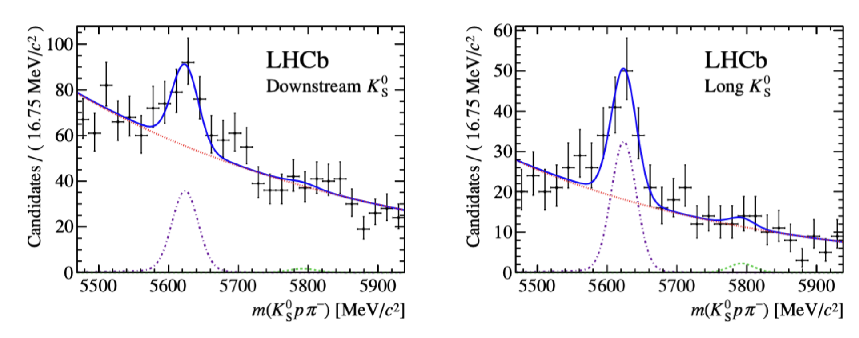
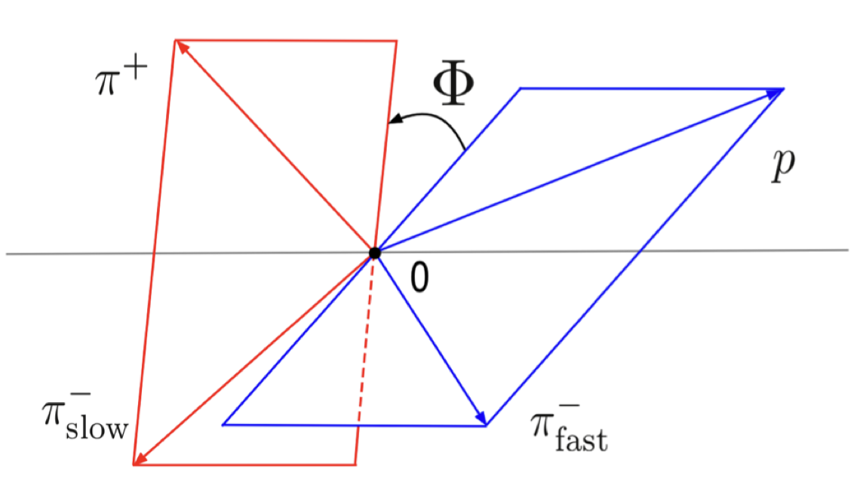
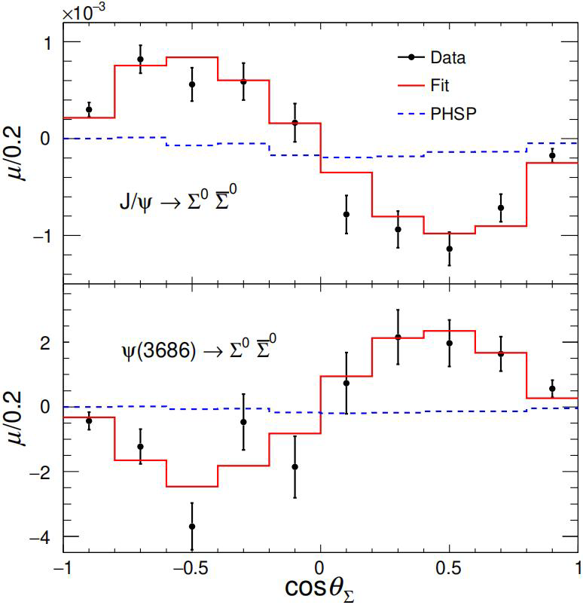
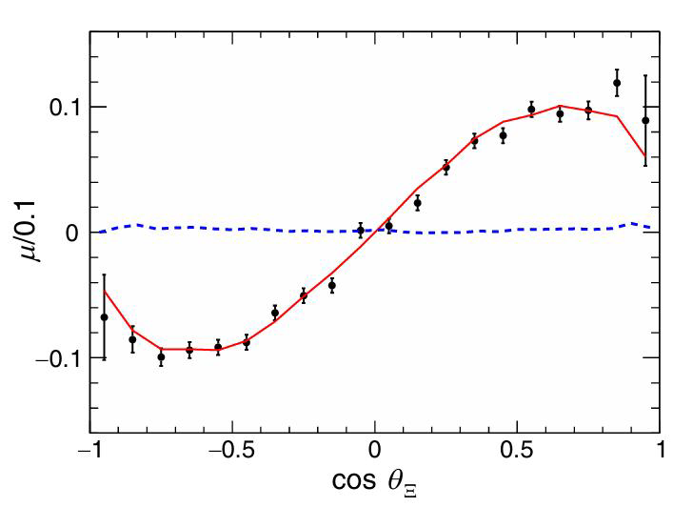




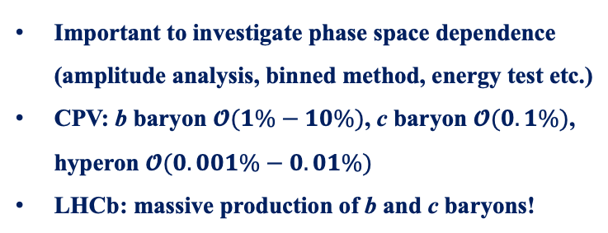
Methods to search for CP violation
JHEP04(2014)087
PRD108(2023)L011101
PRL133 (2024) 101902
Nature Phys.13(2017)391
Many methods have been explored to search for CP violation in baryon decays
Direct CP violation ($∝sin\left(Δδ_{ST}\right)sin(Δφ_{EW})$)
Triple-product asymmetry ($∝cos\left(Δδ_{ST}\right)sin(Δφ_{EW})$)
$$Λ_{b}^{0}→pK_{S}^{0}π^{−}$$
$$Λ_{b}^{0}→pπ^{+}π^{−}π^{+}$$
Decay parameters asymmetry
Important to investigate phase space dependence (amplitude analysis, binned method, energy test etc.)
CPV: b baryon $𝓞(1\%−10\%)$, c baryon $𝓞(0.1\%)$, hyperon $𝓞(0.001\%−0.01\%)$
LHCb: massive production of b and c baryons!
$J/ψ$ $→Ξ^{0}{\overline{Ξ}}^{0}, Ξ^{0}→Λπ^{0}$
2025/09/13
国科大 钱文斌
10

Slide 11
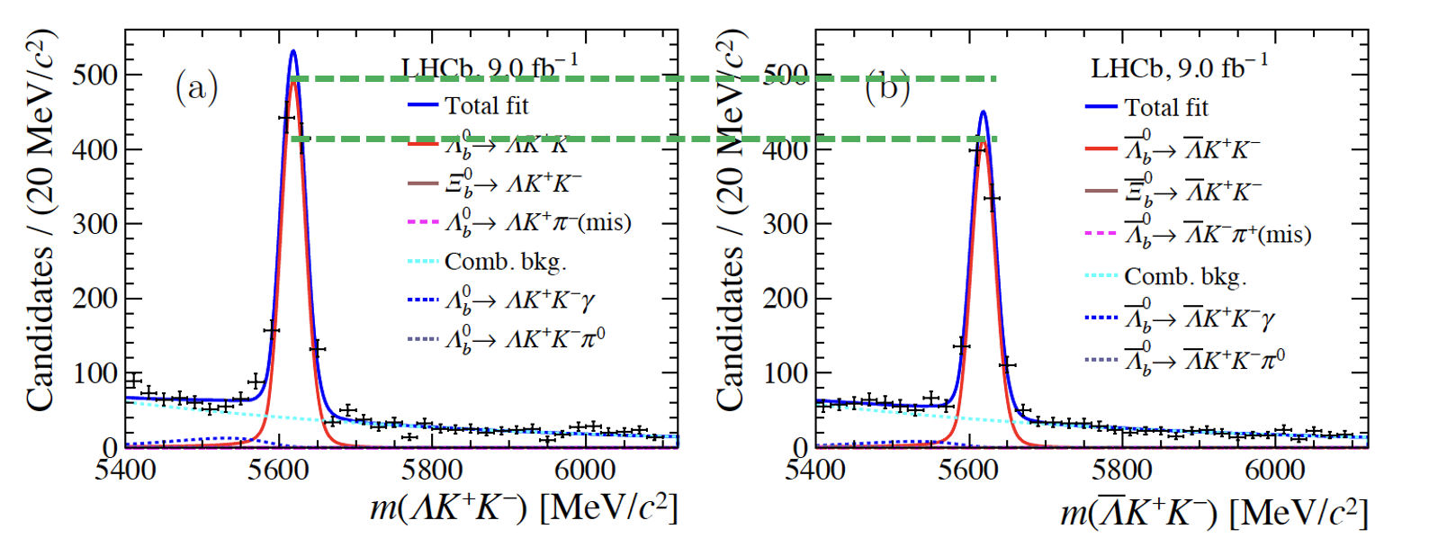
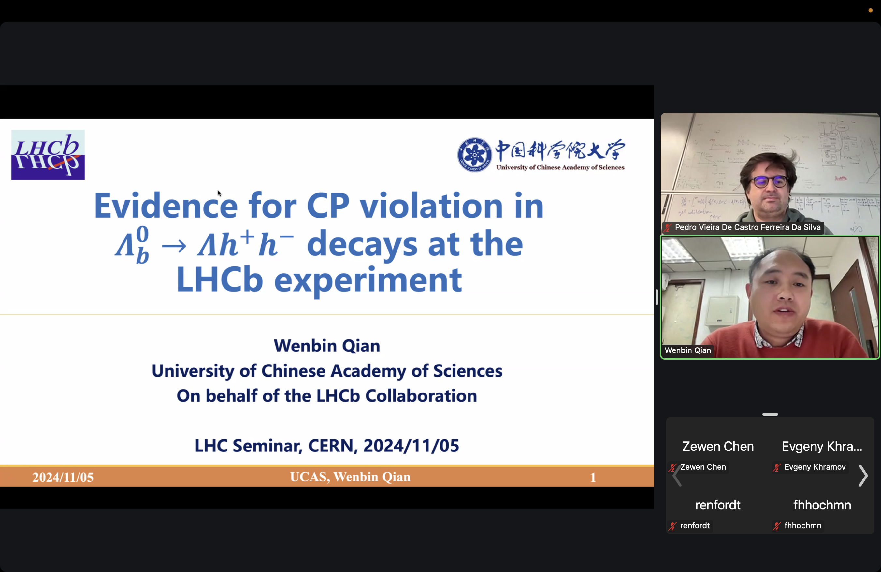


Evidence of CP violation
PRL 134 (2025) 101802
$$Λ_{b}^{0}→ΛK^{+}K^{−}$$
$$ΔA_{CP}=0.083±0.023±0.016$$
First evidence of CP violation, 3.1$σ$
Three body decays, need to know which resonance contributes
2025/09/13
UCAS, Wenbin Qian
11

Slide 12
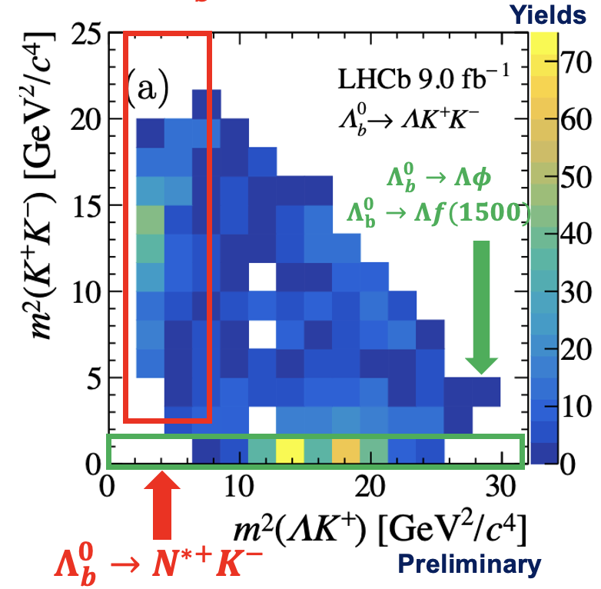
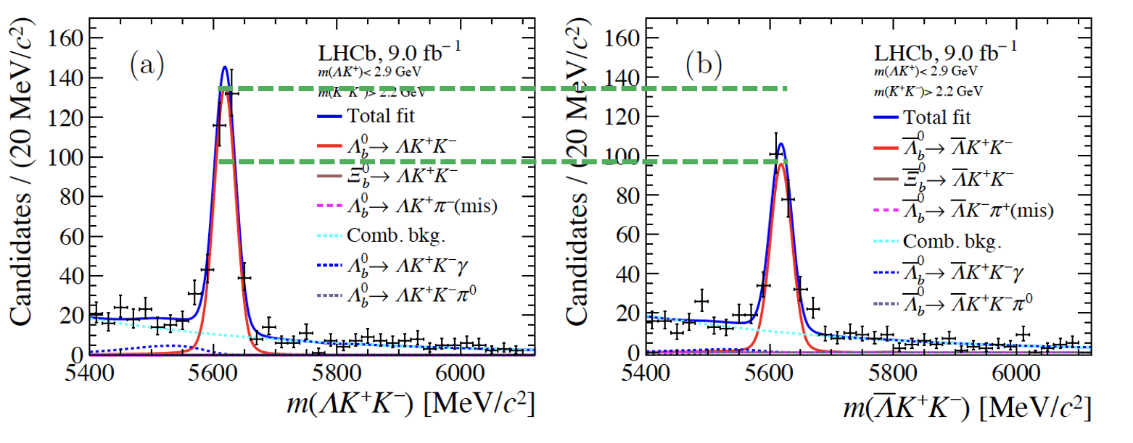



Looking into Dalitz plot ($Λ_{b}^{0}→ΛK^{+}K^{−}$)
PRL 134 (2025) 101802
Preliminary
$$ΔA_{CP}(N^{∗+}K^{−})=0.165±0.048±0.017$$
First evidence of CP violation in local resonant region, 3.2$σ$
region
Consistent with 0 within 2.5$σ$
PRD107 (2023) 053009
$$ΔA_{CP}(Λφ)=0.150±0.055±0.021$$
Predicted CPV (resonant), ~1.5%
2025/09/13
UCAS, Wenbin Qian
12

Slide 13
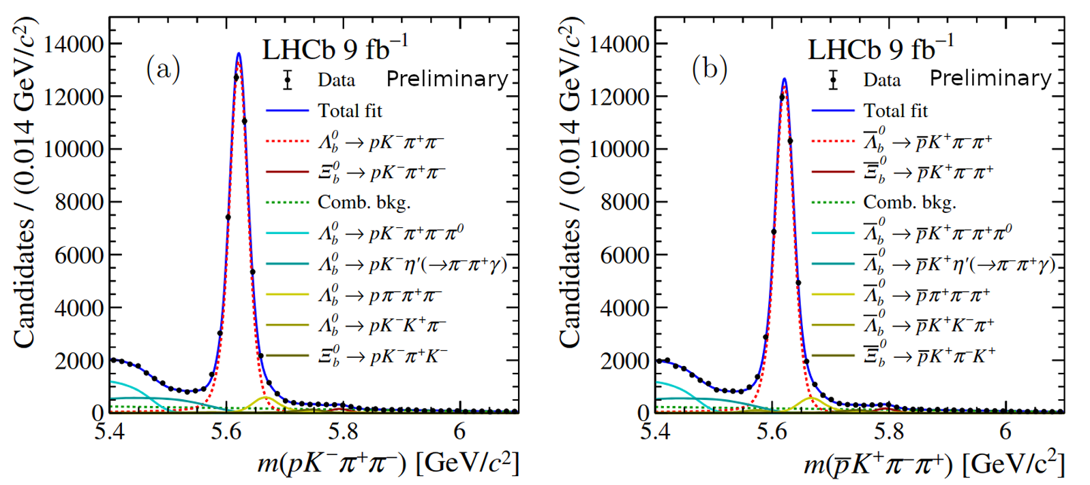


Observation of CP violation in baryon decays
LHCb-PAPER-2024-054
CP symmetry violated by more than 5$σ$
2025/09/13
UCAS, Wenbin Qian
13

Slide 14
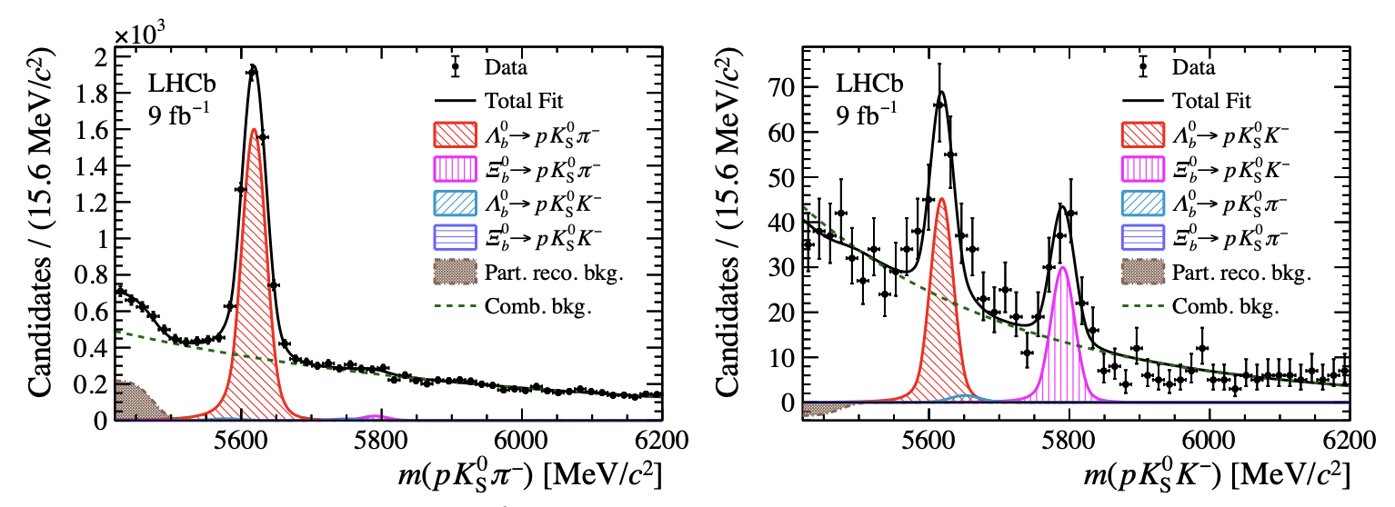
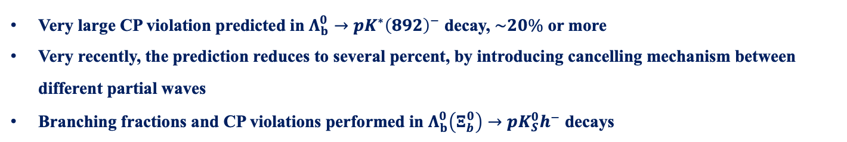



Unexpected small CP violation
arXiv:2508.17836
Very large CP violation predicted in $Λ_{b}^{0}→pK^{∗}{\left(892\right)}^{−}$ decay, $\sim 20\%$ or more
Very recently, the prediction reduces to several percent, by introducing cancelling mechanism between different partial waves
Branching fractions and CP violations performed in $Λ_{b}^{0}\left(Ξ_{b}^{0}\right)→pK_{S}^{0}h^{−}$ decays
~5000
$$\sim 130, 8.1σ$$
$$\sim 90, 8.0σ$$
$$1σ$$
2025/09/13
UCAS, Wenbin Qian
14

Slide 15
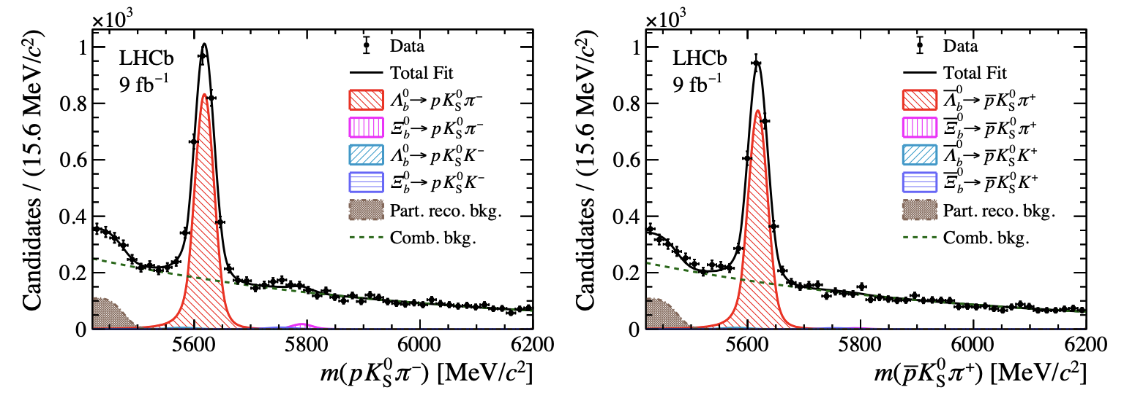
Unexpected small CP violation
arXiv:2508.17836
Very large CP violation predicted in $Λ_{b}^{0}→pK^{∗}{\left(892\right)}^{−}$ decay, $\sim 20\%$ or more
Very recently, the prediction reduces to several percent, by introducing cancelling mechanism between different partial waves
Branching fractions and CP violations performed in $Λ_{b}^{0}\left(Ξ_{b}^{0}\right)→pK_{S}^{0}h^{−}$ decays
$$A^{CP}\left(Λ_{b}^{0}→pK_{S}^{0}π^{−}\right)=\left(3.4±1.9±0.9\right)\%$$
2025/09/13
UCAS, Wenbin Qian
15

Slide 16
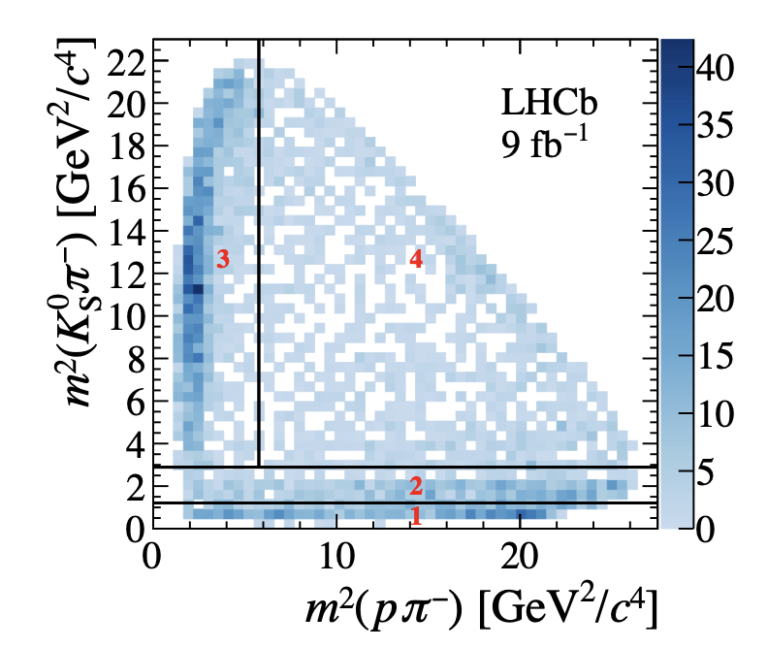
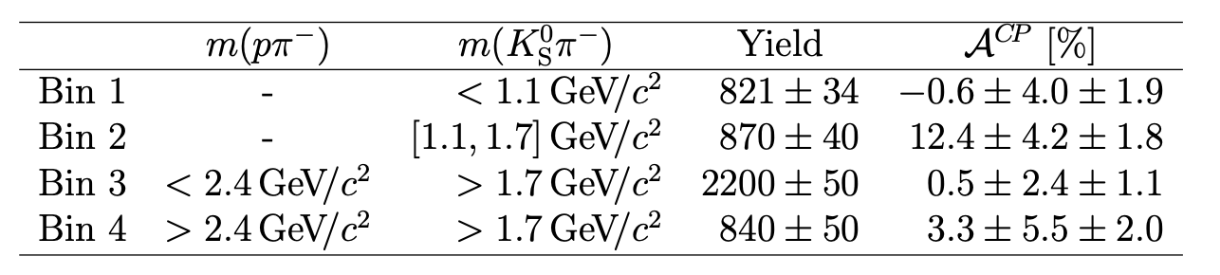
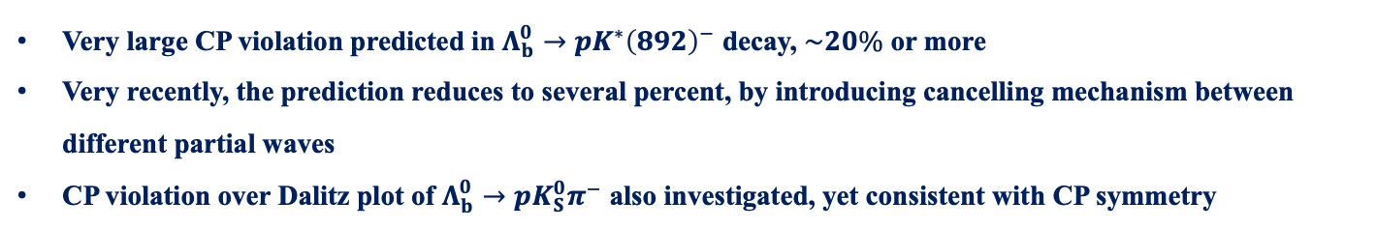
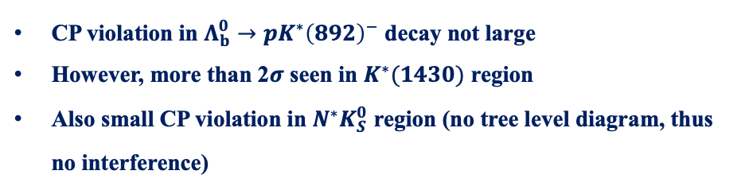
Unexpected small CP violation
arXiv:2508.17836
Very large CP violation predicted in $Λ_{b}^{0}→pK^{∗}{\left(892\right)}^{−}$ decay, $\sim 20\%$ or more
Very recently, the prediction reduces to several percent, by introducing cancelling mechanism between different partial waves
CP violation over Dalitz plot of $Λ_{b}^{0}→pK_{S}^{0}π^{−}$ also investigated, yet consistent with CP symmetry
CP violation in $Λ_{b}^{0}→pK^{∗}{\left(892\right)}^{−}$ decay not large
However, more than 2$σ$ seen in $K^{∗}(1430)$ region
Also small CP violation in $N^{∗}K_{S}^{0}$ region (no tree level diagram, thus no interference)
2025/09/13
UCAS, Wenbin Qian
16

Slide 17
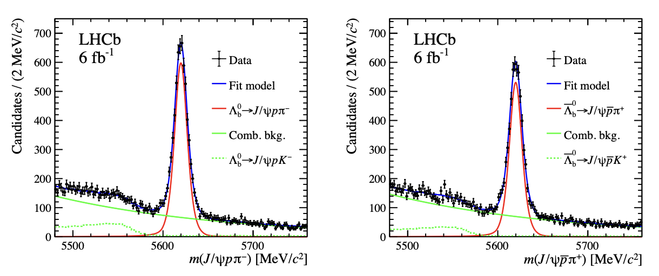

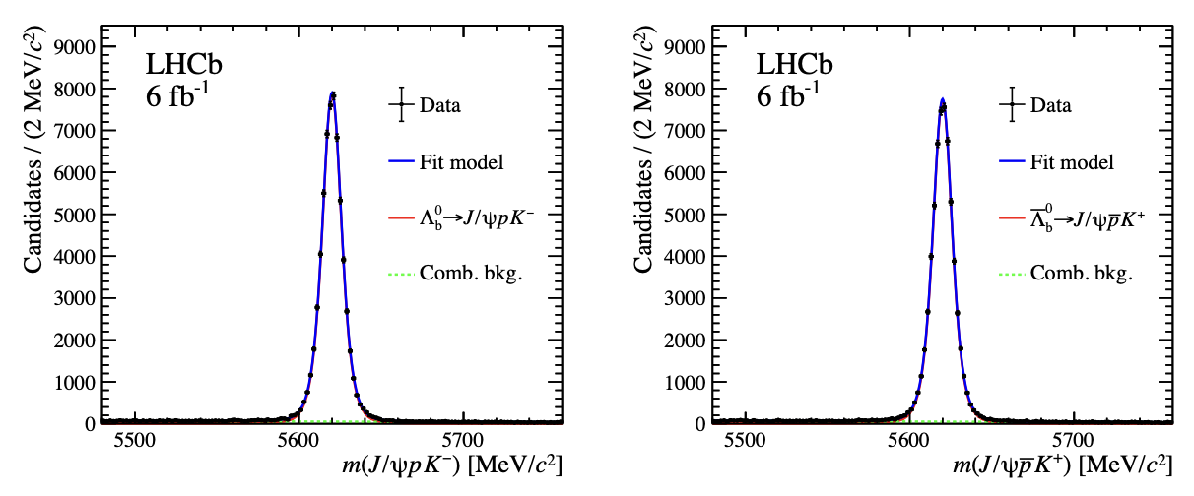




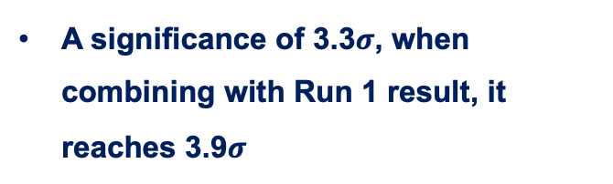
CP violation in $Λ_{b}^{0}→J/ψph$ decays
LHCb-PAPER-2025-021
$Λ_{b}^{0}→J/ψpπ^{−}$
A significance of 3.3$σ$, when combining with Run 1 result, it reaches 3.9$σ$
$Λ_{b}^{0}→J/ψpK^{−}$
CP violation seen in a channel where pentaquark is found!
2025/09/13
UCAS, Wenbin Qian
17

Slide 18


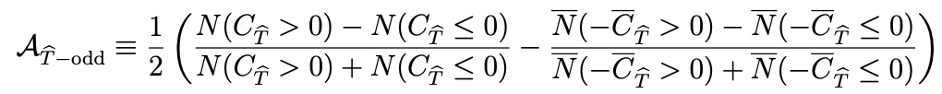
Triple product asymmetry in $Λ_{b}^{0}→J/ψph$ decays
LHCb-PAPER-2025-021
Triple product asymmetry supposed to probe different types of CP violation than direct CP measurements
Very good in cancelling experimental effects, i.e. efficiencies, detection and production asymmetries
No global triple product asymmetry found
2025/09/13
UCAS, Wenbin Qian
18

Slide 19
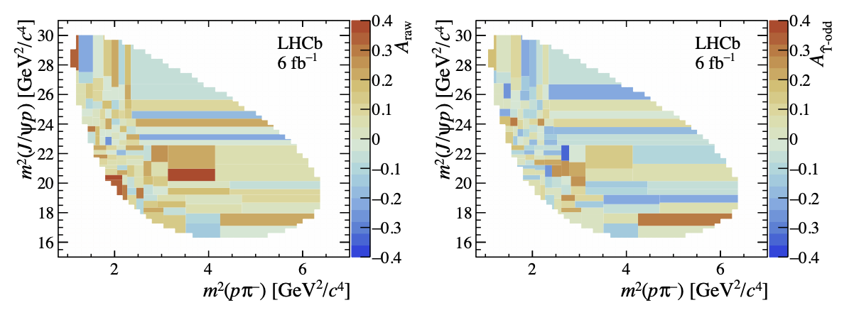


Investigation over Dalitz plot
LHCb-PAPER-2025-021
$$A_{CP}$$
$$A_{TPA}$$
Some enhancement of CP violation in the region of pentaquark, however, not yet significant and also observed after unblinding
Stay tuned for more results with further data collected by LHCb
2025/09/13
UCAS, Wenbin Qian
19

Slide 20
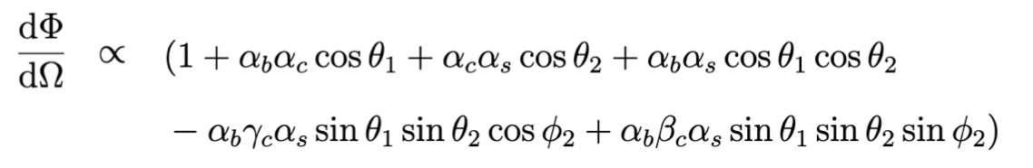
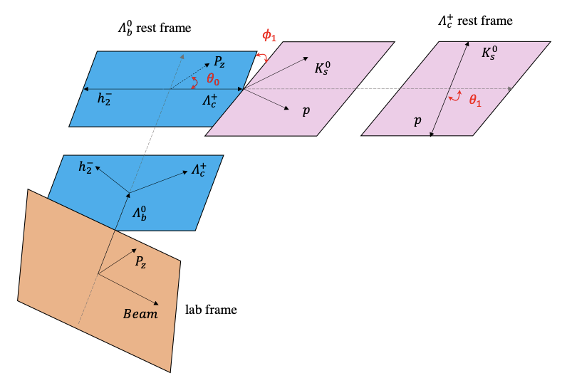
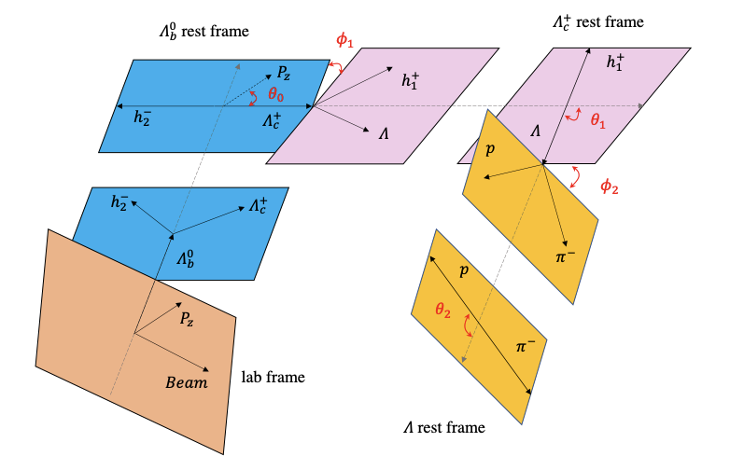
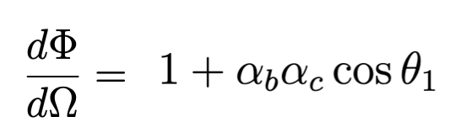






Decay parameter measurements
PRL 133 (2024) 261804
Several decay chains considered:
$$Λ_{b}^{0}→Λ_{c}^{+}{(→Λh^{+})h}^{−}, Λ→pπ^{−}$$
$$Λ_{b}^{0}→Λ_{c}^{+}{(→pK_{S}^{0})h}^{−}$$
$$α_{b}:Λ_{b}^{0}→Λ_{c}^{+}h^{−}$$
$$α_{c}:Λ_{c}^{+}→pK_{S}^{0}$$
$$α_{b}:Λ_{b}^{0}→Λ_{c}^{+}h^{−}$$
$$α_{c},β_{c},γ_{c}:Λ_{c}^{+}→Λh^{+}$$
$$α_{s}:Λ→pπ^{−}$$
2025/09/13
国科大 钱文斌
20

Slide 21
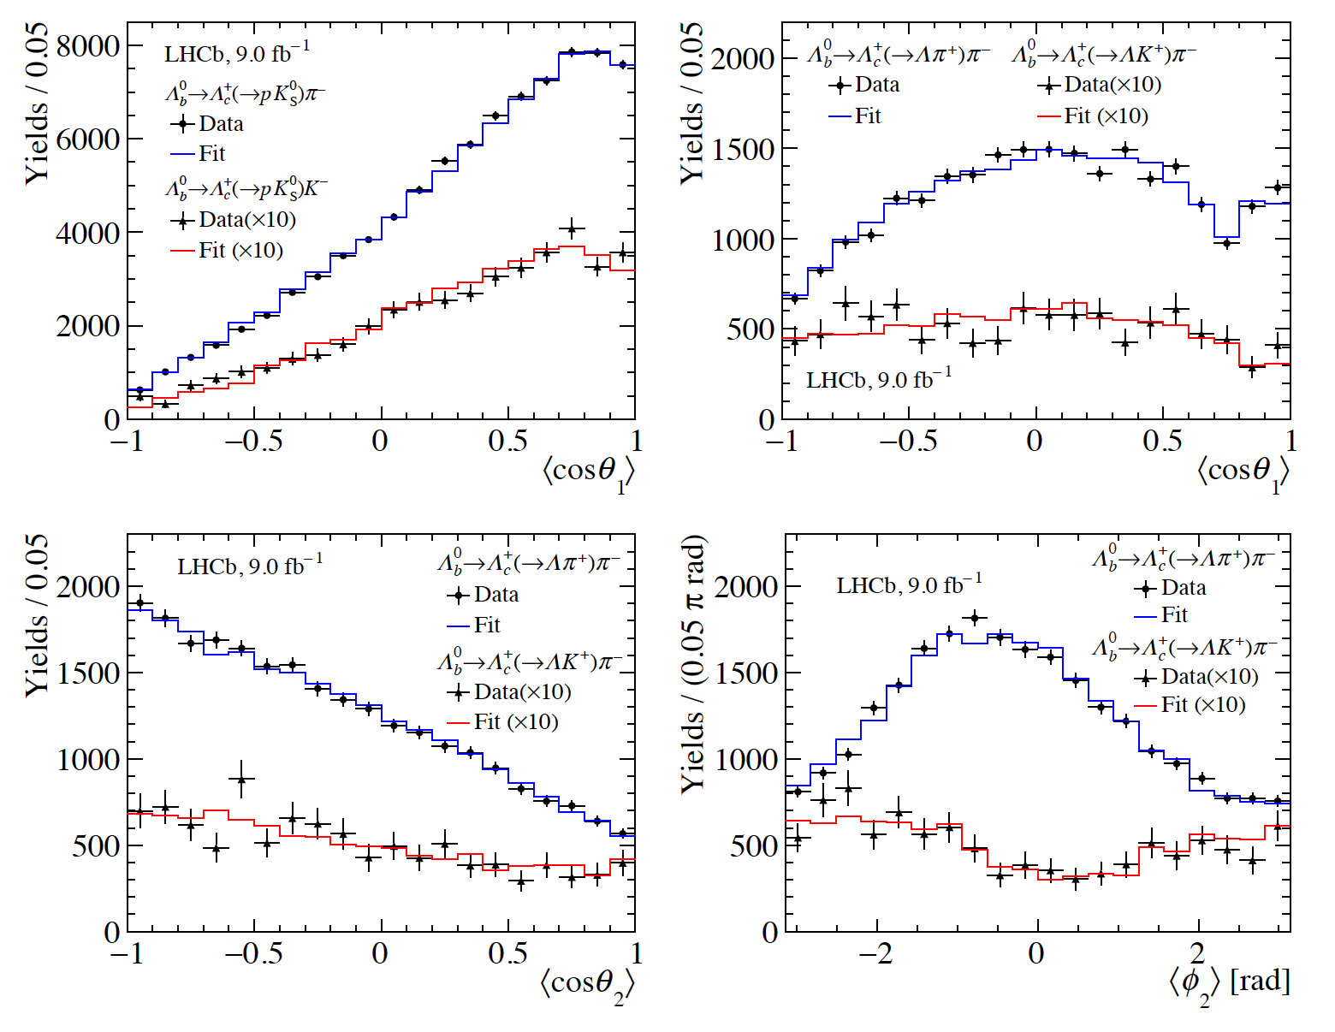
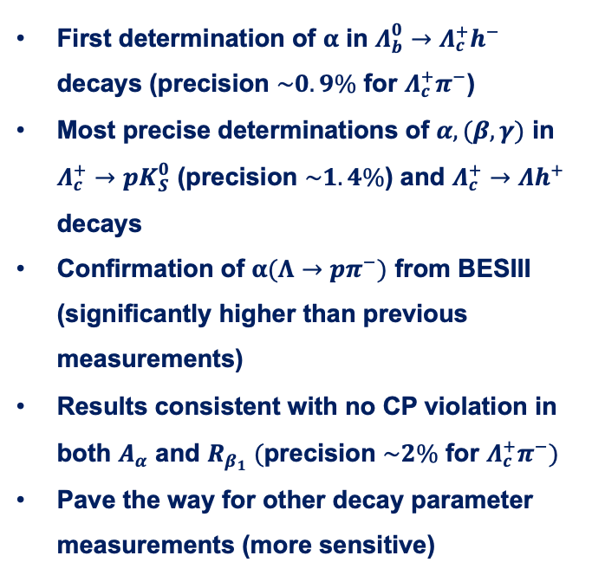












Results of decay parameters
PRL 133 (2024) 261804
$$Λ_{b}^{0}→Λ_{c}^{+}(→pK_{S}^{0})h^{−}$$
$$Λ_{b}^{0}→Λ_{c}^{+}{\left(→Λh^{+}\right)π}^{−}$$
First determination of $α$ in $Λ_{b}^{0}→Λ_{c}^{+}h^{−}$ decays (precision $\sim 0.9\%$ for $Λ_{c}^{+}π^{−}$)
Most precise determinations of $α,(β,γ)$ in $Λ_{c}^{+}→pK_{S}^{0}$ (precision $\sim 1.4\%$) and $Λ_{c}^{+}→Λh^{+}$ decays
Confirmation of $α(Λ→pπ^{−})$ from BESIII (significantly higher than previous measurements)
Results consistent with no CP violation in both $A_{α}$ and $R_{β_{1}} (\text{precision} \sim 2\% \text{for} Λ_{c}^{+}π^{−})$
Pave the way for other decay parameter measurements (more sensitive)
$$Λ_{b}^{0}→Λ_{c}^{+}π^{−}$$
$$Λ_{c}^{+}→Λπ^{+}$$
$$Λ_{b}^{0}→Λ_{c}^{+}K^{−}$$
$$Λ_{c}^{+}→ΛK^{+}$$
$$Λ_{c}^{+}→Λπ^{+}$$
$$Λ_{c}^{+}→Λπ^{+}$$
$$Λ_{c}^{+}→ΛK^{+}$$
$$Λ_{c}^{+}→ΛK^{+}$$
$$Λ_{b}^{0}→Λ_{c}^{+}{\left(→Λh^{+}\right)π}^{−}$$
$$Λ_{b}^{0}→Λ_{c}^{+}{\left(→Λh^{+}\right)π}^{−}$$
2025/09/13
国科大 钱文斌
21

Slide 22
Outline of the talk
Introduction
Selected highlights on CP violation
Selected highlights on spectroscopy studies
Prospects and conclusion
2025/09/13
UCAS, Wenbin Qian

Slide 23
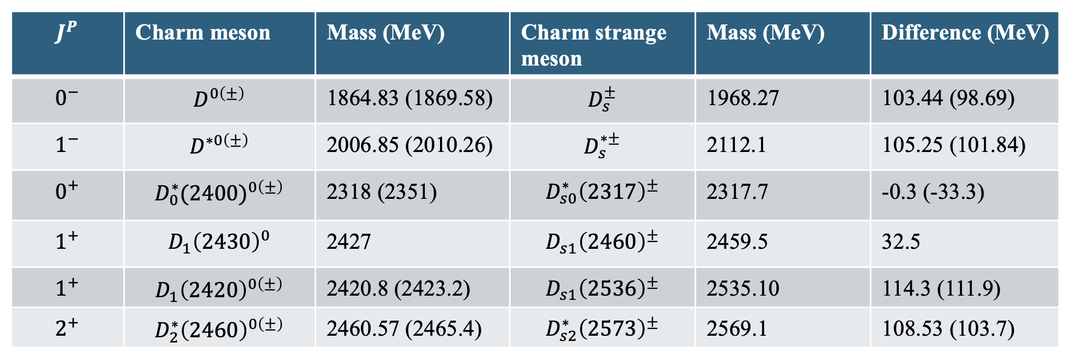





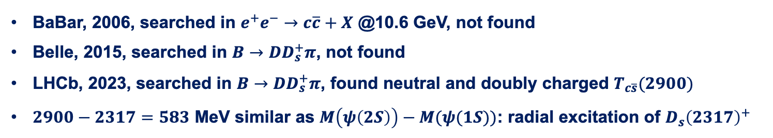
Nature of $D_{s}^{+}(2317)$ and its isospin partner
Discovered more than 20 years ago, however, its structure remains puzzling
$$\vec{s_{l}}$$
$$1/2$$
$$1/2$$
$$3/2$$
BaBar, 2006, searched in $e^{+}e^{−}→c\overline{c}+X$ @10.6 GeV, not found
Belle, 2015, searched in $B→DD_{s}^{+}π$, not found
LHCb, 2023, searched in $B→DD_{s}^{+}π$, found neutral and doubly charged $T_{c\overline{s}}(2900)$
$2900−2317=583$ MeV similar as $M\left(ψ\left(2S\right)\right)−M(ψ(1S))$: radial excitation of $D_{s}{\left(2317\right)}^{+}$
2025/09/13
国科大 钱文斌
23

Slide 24
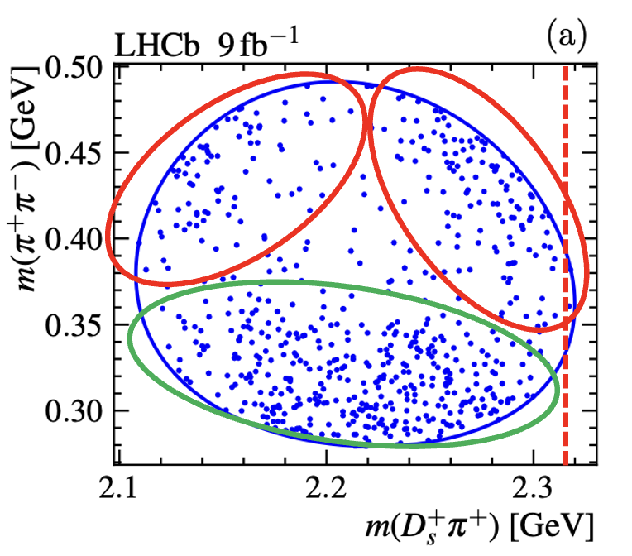
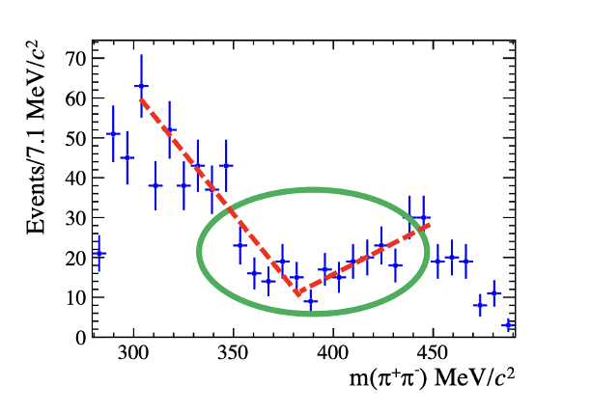
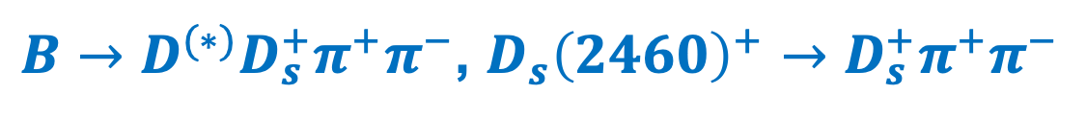
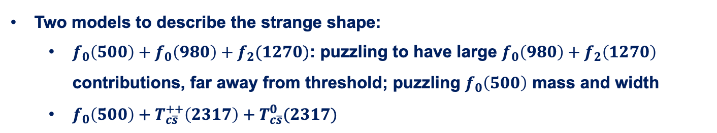
$B→D^{(∗)}D_{s}^{+}π^{+}π^{−}$, $D_{s}{\left(2460\right)}^{+}→D_{s}^{+}π^{+}π^{−}$
Science Bulletin 70 (2025) 1432
Interesting structures seen on Dalitz plot and projections
Very puzzling structures, rarely seen before
Two models to describe the strange shape:
  $f_{0}\left(500\right)+f_{0}\left(980\right)+f_{2}(1270)$: puzzling to have large $f_{0}\left(980\right)+f_{2}\left(1270\right)$ contributions, far away from threshold; puzzling $f_{0}\left(500\right)$ mass and width
  $f_{0}\left(500\right)+T_{c\overline{s}}^{++}\left(2317\right)+T_{c\overline{s}}^{0}(2317)$
2025/09/13
国科大 钱文斌
24

Slide 25
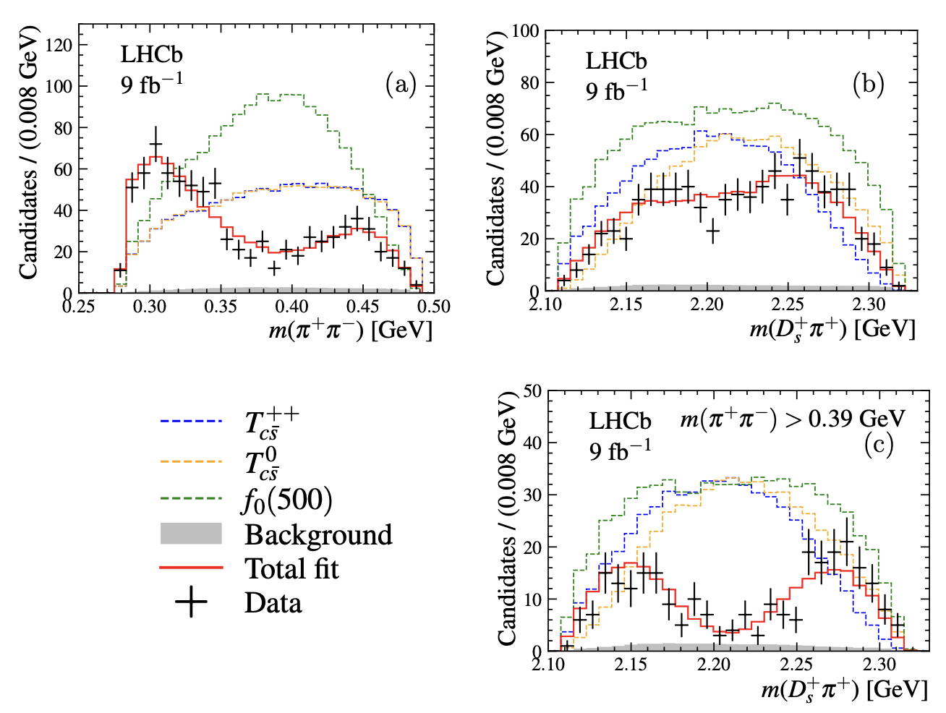
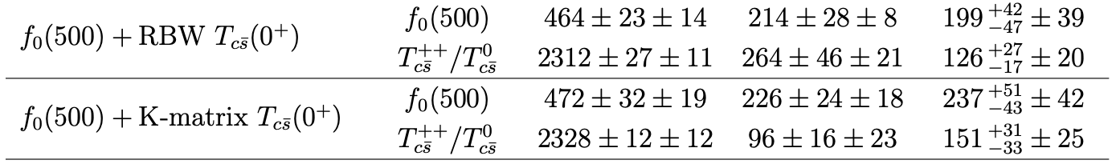

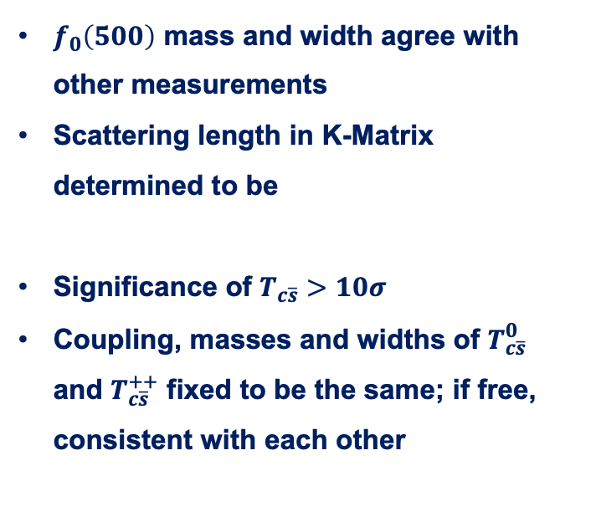

Fit results for models with $T_{c\overline{s}}$
$m\left(π^{+}π^{−}\right)∈\left[279.2, 491.2\right]$ MeV
$f_{0}\left(500\right)$ mass and width agree with other measurements
Scattering length in K-Matrix determined to be
Significance of $T_{c\overline{s}}>10σ$
Coupling, masses and widths of $T_{c\overline{s}}^{0}$ and $T_{c\overline{s}}^{++}$ fixed to be the same; if free, consistent with each other
2025/09/13
国科大 钱文斌
25

Slide 26
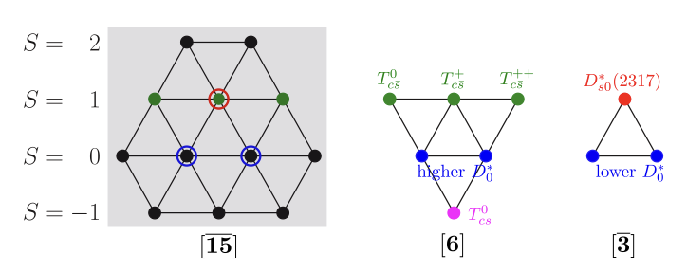

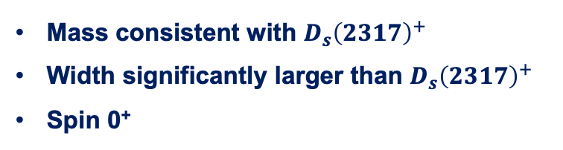
Discussion
Both models with and without $T_{c\overline{s}}$ states can describe data
However, models without $T_{c\overline{s}}$ states have some deficiencies and implausible
Model with $T_{c\overline{s}}$ states:
Relationship with $D_{s}{\left(2317\right)}^{+}?$
Indication of exotic structures in $D_{s}{\left(2460\right)}^{+}$?
Mass consistent with $D_{s}{\left(2317\right)}^{+}$
Width significantly larger than $D_{s}{\left(2317\right)}^{+}$
Spin 0⁺
Fengkun Guo et al.
2025/09/13
国科大 钱文斌
26

Slide 27
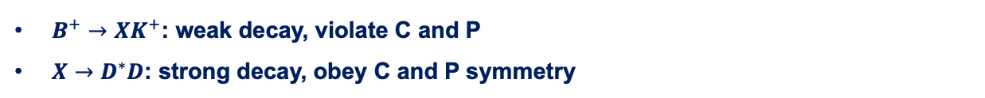









Novel strategy for charmonium studies
$$B^{+}→D^{∗+}D^{−}K^{+}$$
$$D^{∗+}D^{−}$$
$$B^{+}→XK^{+}, X→$$
$$B^{+}→D^{∗−}D^{+}K^{+}$$
$$D^{∗−}D^{+}$$
$B^{+}→XK^{+}$: weak decay, violate C and P
$X→D^{∗}D$: strong decay, obey C and P symmetry
$$A\left({X→D}^{∗+}D^{−}\right)=A(X→D^{∗−}D^{+})$$
C = 1: $|D^{∗+}D^{−}> +|D^{∗−}D^{+}>$
C = $−$1: $|D^{∗+}D^{−}>−|D^{∗−}D^{+}>$
$$A\left({X→D}^{∗+}D^{−}\right)=−A(X→D^{∗−}D^{+})$$
The first time, amplitude analysis can tell the C-parity of resonant particles, decaying not in the C eigenstates
2025/09/13
UCAS, Wenbin Qian
27

Slide 28












Spectrum of $M(D^{∗}D)$
$$B^{+}→D^{∗−}D^{+}K^{+}$$
$$B^{+}→D^{∗+}D^{−}K^{+}$$
$C=+1:$ NR + $η_{c}(3945)$
$C=+1:$ NR + EFF+$χ_{c1}(4010)$
$$J^{P}=0^{−}$$
$$J^{P}=1^{+}$$
$C=−1:$ NR
$C=−1:$ $h_{c}\left(4000\right)+h_{c}(4300)$
$$J^{P}=2^{++} :χ_{c2}(3930)$$
$$J^{P}=1^{−−} :NR+ψ \left(4040\right)$$
Resonances well separated from each other except 1⁺⁺; more theoretically motivated model for future analysis
2025/09/13
UCAS, Wenbin Qian
28

Slide 29










Three new states
Decay 1:
$${\left|A_{1}+A_{2}\right|}^{2}={\left|A_{1}\right|}^{2}+{\left|A_{2}\right|}^{2}+2Re(A_{1}A_{2}^{∗})$$
$$h_{c}(4300)$$
Decay 2:
$${\left|A_{1}+CA_{2}\right|}^{2}={\left|A_{1}\right|}^{2}+{\left|A_{2}\right|}^{2}+2CRe(A_{1}A_{2}^{∗})$$
$$χ_{c1}(4010)$$
Difference:
$C:$ relative $C$ parity of $A2$ to $A1$
$$h_{c}(4000)$$
$$2(C−1)Re(A_{1}A_{2}^{∗})$$
$$∫Re\left(A_{1}A_{2}^{∗}\right)=0$$
Different $J^{P}$:
$C=+1:$ NR + EFF+$χ_{c1}(4010)$
Only interference with same J^{P} but different C party remains
$$J^{P}=1^{+}$$
$C=−1:$ $h_{c}\left(4000\right)+h_{c}(4300)$
2025/09/13
UCAS, Wenbin Qian
29

Slide 30



Confirmation of C relationship
2.7$σ$
Fixed 0
$$A_{λ_{R},λ_{D^{∗+}},0}^{R→D^{∗+}D^{−}}=C_{R}A_{λ_{R},λ_{D^{∗−}},0}^{R→D^{∗−}D^{+}} ⇒A_{λ_{R},λ_{D^{∗+}},0}^{R→D^{∗+}D^{−}}=e^{iΔφ}A_{λ_{R},λ_{D^{∗−}},0}^{R→D^{∗−}D^{+}}$$
$$C_{R}=1⇒Δφ=0, C_{R}=−1⇒Δφ=π$$
2025/09/13
UCAS, Wenbin Qian
30

Slide 31


















Confirmation of $X_{0,1}(2900)$
$X_{0,1}(2900)$ found in $B^{+}→D^{+}D^{−}K^{+}$ decays, a nature idea is to search in $B^{+}→D^{∗+}D^{−}K^{+}$ decays
Confirming $T_{\overline{c}\overline{s}0}^{∗}{\left(2870\right)}^{0}$ and $T_{\overline{c}\overline{s}1}^{∗}{\left(2900\right)}^{0}$ in a new decay channel $B^{+}→D^{∗+}T_{\overline{c}\overline{s}}^{∗}$
$$T_{\overline{c}\overline{s}0}^{∗}{\left(2870\right)}^{0}$$
$$T_{\overline{c}\overline{s}1}^{∗}{\left(2900\right)}^{0}$$
$$m_{0}$$
$$2914±19$$
$$2866±7$$
$$m_{0}$$
$$2887±10$$
$$2904±5$$
$$Γ_{0}$$
128$±32$
57$±13$
$$Γ_{0}$$
92$±23$
110$±12$
This work
Mass and width agree within 2$σ$
Previous work
2025/09/13
UCAS, Wenbin Qian
31

Slide 32
Branching fractions
$X_{0,1}(2900)$ found in $B^{+}→D^{+}D^{−}K^{+}$ decays, a nature idea is to search in $B^{+}→D^{∗+}D^{−}K^{+}$ decays
However, branching fraction ratios between spin 0 and 1 particles show tension
This work
Previous work
Large difference on branching fraction ratio, further hints on structures?
2025/09/13
UCAS, Wenbin Qian
32

Slide 33






$X_{0,1}(2900)→D^{∗}K$?
0⁺ can not decay into $D^{∗}K$
$1^{−}$ not found in $D^{∗−}K^{+}$ decays
$$c\overline{d}$$
$$s\overline{u}$$
$$D^{+}?D^{∗+}$$
$FF\left(B^{+}→T_{\overline{c}\overline{s}1}^{∗}{\left(2900\right)}^{0}D^{+},T_{\overline{c}\overline{s}1}^{∗}{\left(2900\right)}^{0}→D^{∗−}K^{+}\right)<1.5\% @ 95\%$ C.L.
$$\frac{Br(T_{\overline{c}\overline{s}1}^{∗}{\left(2900\right)}^{0}→D^{∗−}K^{+})}{Br(T_{\overline{c}\overline{s}1}^{∗}{\left(2900\right)}^{0}→D^{−}K^{+})}<0.21 @ 95\%$$
2025/09/13
UCAS, Wenbin Qian
33

Slide 34
Outline of the talk
Introduction
Selected highlights on CP violation
Selected highlights on spectroscopy studies
Prospects and conclusion
2025/09/13
UCAS, Wenbin Qian

Slide 35

Prospects
Belle II
0.4 ab⁻¹
15 ab⁻¹
50 ab⁻¹
250 ab⁻¹
2019-2022
2024-2027
Run 1
LS1
Run 2
LS1
Run 3
upgrade
2015-2018
2019-2022
2022-2025
2025-2029
2029-2032
2032-2035
2035-future
Run2
LS2
Run3
LS3
Run4
LS4
Run5-6
Phase I
Upgrade
Phase Ib
Upgrade
Phase II
Upgrade
LHCb
23 fb⁻¹
50 fb⁻¹
300 fb⁻¹
HL-LHC
CMS/ATLAS
200 fb⁻¹
3000 fb⁻¹
BESIII/super $τ$-charm/CEPC
BEPCII upgrade + running of super $τ$-charm/CEPC
2025/09/13
国科大 钱文斌

Slide 36



A new LHCb detector
With our new LHCb detector, already collected more data than Run1+2
More importantly, full software trigger ➜ better performance on hadronic final states
New pixel Velo
New UT
New SciFi
Removed M1 and new readout
Similar PID performance
Twice trigger efficiencies (hadronic)
Removed PS/SPD and new readout
New RICH optics and PMS
2025/09/13
国科大 钱文斌
36

Slide 37
Next LHCb detector from 2030
2025/09/13
UCAS, Wenbin Qian

Slide 38





Future of flavor and hadron physics
1995
2023
2040?
Either we found New physics, or we understand QCD at low energy
2025/09/13
UCAS, Wenbin Qian

Slide 39
Thank you for your attention!
2025/09/13
国科大 钱文斌
39

Slide 40









Doubly charged tetraquark and its Isospin partner
Around 4K signal events
PRL 131 (2023) 041902
PRD 108 (2023) 012017
$$B^{0}→\overline{D^{0}}D_{s}^{+}π^{−}$$
$$B^{+}→D^{−}D_{s}^{+}π^{+}$$
$$T_{c\overline{s}}^{a}{\left(2900\right)}^{0}$$
$$T_{c\overline{s}}^{a}{\left(2900\right)}^{++}$$
$$FF:\left(4.8±1.1±1.4\right)\%$$
$$FF:\left(1.96±0.87±0.88\right)\%$$
$T_{cs}^{a}\left(2900\right) \text{have} \text{quark} \text{content} c\overline{s}\overline{u}d \text{and} c\overline{s}u\overline{d}$
Two states consist with each other: isospin triplet
No other states are needed currently
2025/09/13
国科大 钱文斌
40

Slide 41











How about doubly charged $T_{c\overline{s}}{\left(2900\right)}^{++}$
$$c\overline{s}$$
$$u\overline{d}$$
$T_{c\overline{s}}{\left(2900\right)}^{++}$found in $B^{+}→D^{−}D_{s}^{+}π^{+}$ decays, with $T_{c\overline{s}}{\left(2900\right)}^{++}→D_{s}^{+}π^{+}$
$$c\overline{s}$$
$$u\overline{d}$$
$$c\overline{d}$$
$$u\overline{s}$$
$$c\overline{s}u\overline{d}$$
Search in $B^{+}→D^{−}D^{+}K^{+}$ or $B^{+}→D^{∗−}D^{+}K^{+}$
Negative in search $T_{c\overline{s}0}{\left(2900\right)}^{++}$
$FF\left(B^{+}→T_{c\overline{s}0}{\left(2900\right)}^{++}D^{∗−},T_{c\overline{s}0}{\left(2900\right)}^{++}→D^{+}K^{+}\right)<3.3\% @ 95\%$ C.L.
Work ongoing in $B^{+}→D^{−}D^{+}K^{+}$ decays
Isospin: $B^{0}→{\overline{D}}^{0}D^{0}K_{S}^{0}$ decays
2025/09/13
UCAS, Wenbin Qian
41

