Slide 1

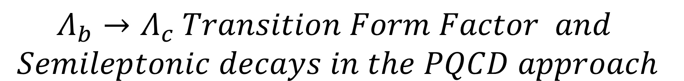
$$Λ_{b}→Λ_{c} Transition Form Factor and$$
$$Semileptonic decays in the PQCD approach$$
2025.09.12-15, 华中师大， 第二届重味物理论坛
汇报人：邹芝田
合作者：李营、周锐

Slide 2
Motivation
01
Outline
Form factors and Semileptonic Baryon decay
02
Summary
04

Slide 3
Motivation
01

Slide 4


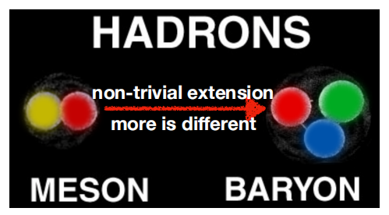
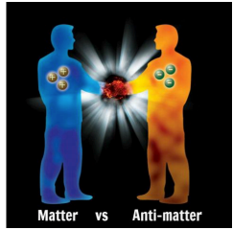
Heavy flavor physics and CPV
heavy flavor physics has achieved great progress in heavy meson systems;
CKM mechanism has been established for CPV in B meson decays;
however, studies on heavy flavor baryon are limited;
CPV is one of the necessary conditions for baryogenesis decays;
CPV is well established in meson decays;
no significant deviation from SM prediction
not strong enough to account for the baryogenesis
Unlike mesons, only direct CPV occurs in baryon decays due to baryon number conservation
A new horizon in particle physics: First observation of baryon CP violation

Slide 5
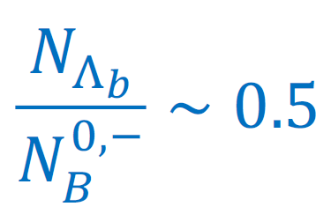
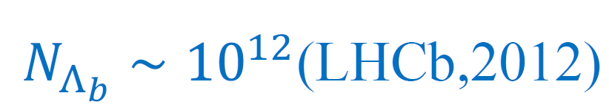
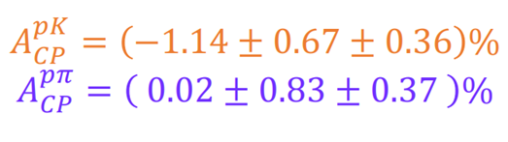

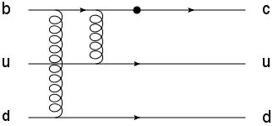
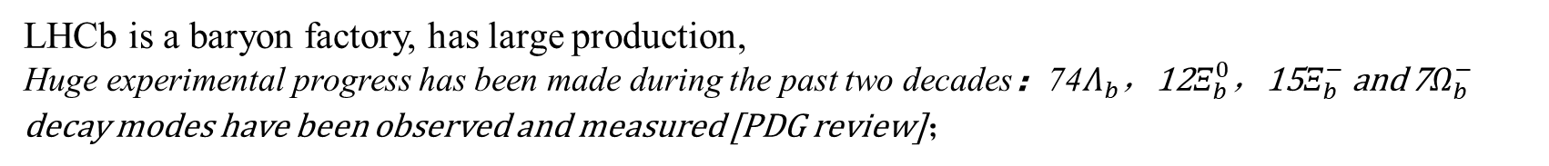
Opportunities and Challenges
LHCb is a baryon factory, has large production,
Huge experimental progress has been made during the past two decades：74$Λ_{b}$，12$Ξ_{b}^{0}$，15$Ξ_{b}^{−}$and 7$Ω_{b}^{−}$ decay modes have been observed and measured [PDG review]；
Precision of b-baryon CPV measurement reached of order 1%
non-zero polarization, more observables
However, baryons are more challenging for theory than Mesons!
1>
More Complex dynamics
Baryons are made of three quarks. Compared to meson decays, one more quark requires one more gluon.
2>
Baryon LCDAs are not well determined
A major source of theoretical uncertainties.
3>
Factorization assumption may not work well
References: Phys. Rev. D 105 (7) (2022) 073005.
Large nonfactorizable effects exist in the color-suppressed and penguin-dominated decays.
• power counting of baryon is different from meson

Slide 6
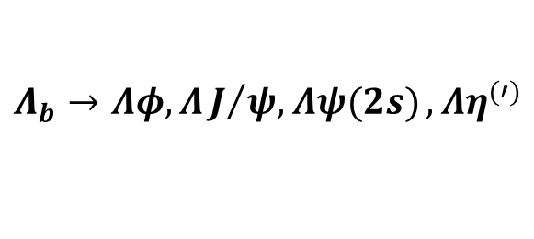



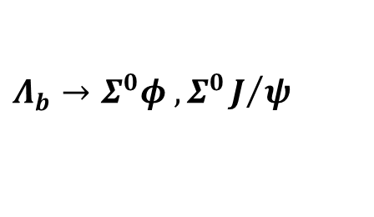
（1）QCD studies on baryon are limited
• GFA (Hsiao,Yao,Geng,2017; Liu,Geng,2021)
• QCDF (Zhu,Ke,Wei,2016,2018)
• PQCD (Lü,Wang,Zou,2009; Yu,Han; Zhou, Zou,li,2022)
• Quark model(Geng,Liu,Tsai,et.al.,2019)
• Light-cone Sum rule (Jiang, Cheng, Khodjamirian,Yu)
（2）烟台大学： 邹芝田， 周锐，李营
$$Λ_{b}→Λ_{c}π,Λ_{c}Κ$$
$$Λ_{b}→Λφ,ΛJ/{ψ, Λψ(2s)}, Λη^{(′)}$$
$$Λ_{b}→Σ^{0}φ , Σ^{0}J/ψ$$
.......
$$Ξ_{b}→Ξ_{c}l^{−}{\overline{ν}}_{l}$$
$$Λ_{b}→Λ_{c}l^{−}{\overline{ν}}_{l}$$

Slide 7
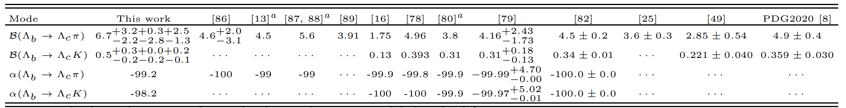
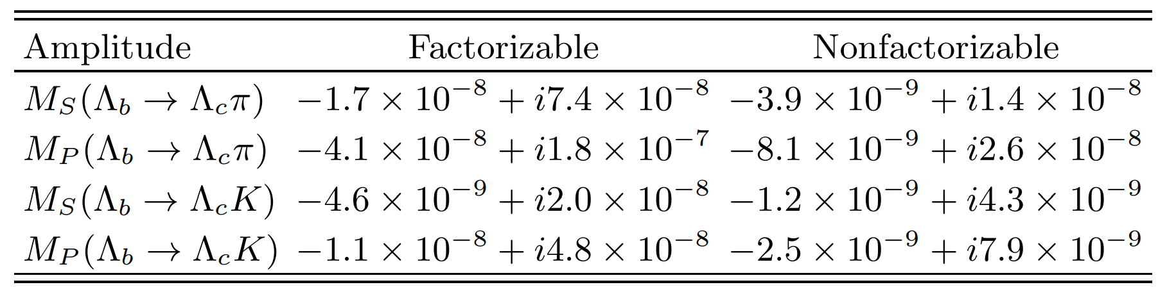


(1)、Nonleptonic two-body decays of $Λ_{b}→Λ_{c}π,Λ_{c}K$ in the perturbative QCD approach
Phys.Rev.D 105 (2022) 7, 073005
Dominated by the factorizable contributions
The Brs are generally larger than other theoretical results due to the involved important nonfactorizable effects.
While the important nonfactorizable contributions can enhance the branching ratios by about 30%。
LHCb: J. High Energy Phys. 04 (2014) 087
As expected in the heavy quark limit and the soft meson limit, the asymmetry parameter is predicted to be -1, which indicate the V −A nature of the weak current and maximum parity violation.

Slide 8
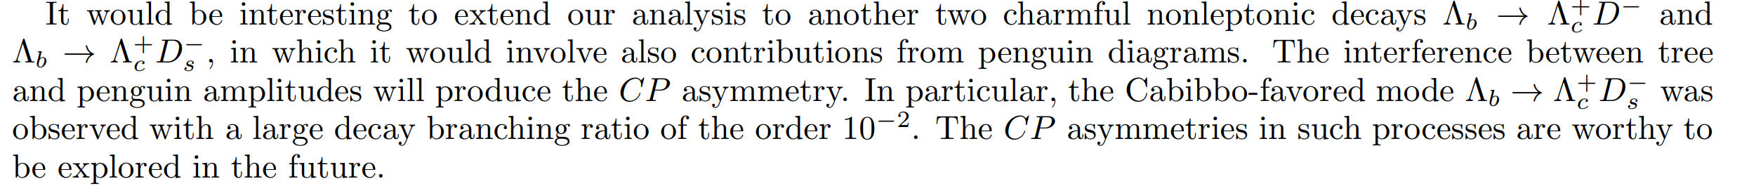
$Λ_{b}→Λ_{c}{D/D}_{s}$ are in progress

Slide 9
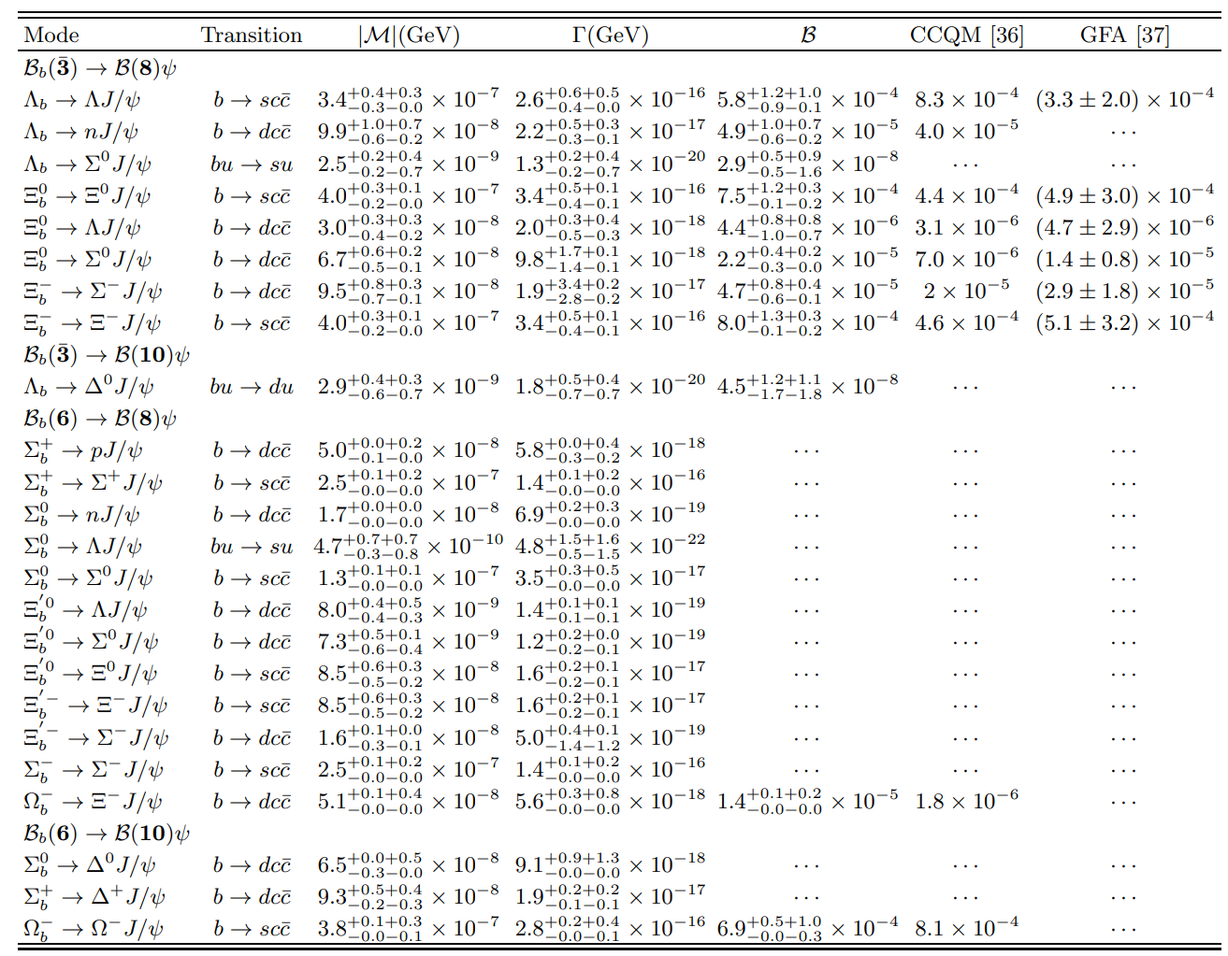
(2)、Charmonium decays of beauty baryons in the perturbative QCD approach
The branching ratios
Phys.Rev.D 109 (2024) 3, 033013

Slide 10
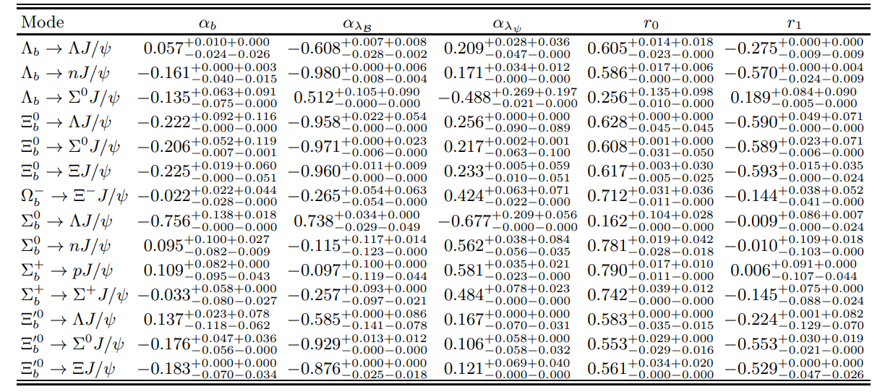
Asymmetry parameters

Slide 11
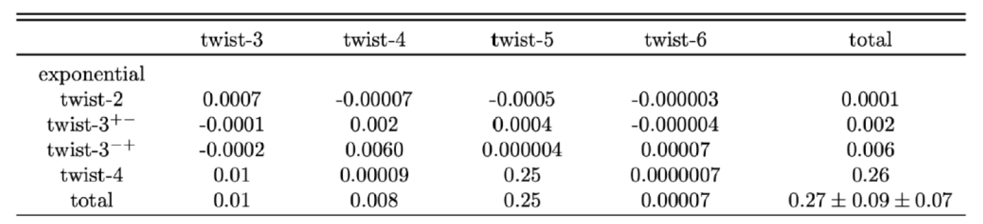
Why $Λ_{b}→Λ_{c} and{ Ξ}_{b}→Ξ_{c}$in PQCD
In 2000, H.n. Li “Applicability of Perturbative QCD to $Λ_{b}→Λ_{c}$ decay” [Phy. Rev. D 61,114002(2000)]
In 2009: Cai-Dian Lv, Yu-Ming Wang, $Λ_{b}^{0}→pπ,pK$ [Phys. Rev. D 80 (2009) 034011]
the form factors are two orders of magnitude smaller than Lattice QCD/experiments, considering only the leading twist of LCDAs of baryons.
In 2022, when consider contributions of high-twist LCDAs, they are consistent with LatticeQCD. [Y.Li, Y.L.Shen, FSY,]

Slide 12
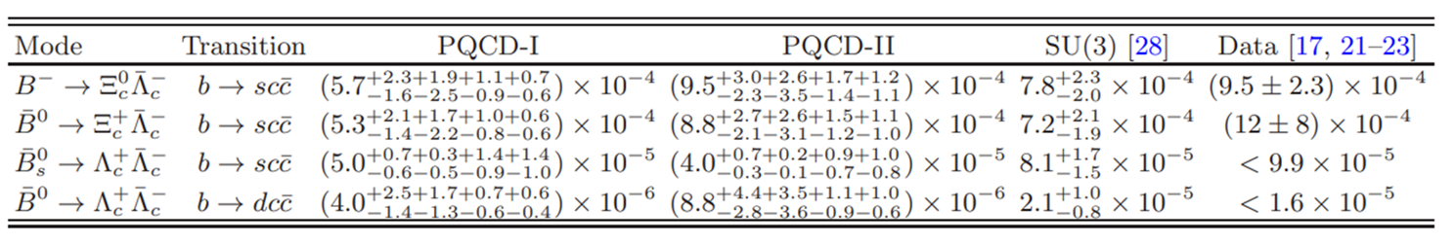
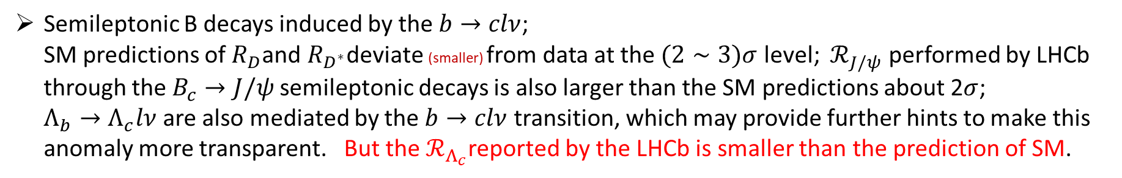
周锐，邹芝田，李营
[JHEP 12 (2024) 159]
Semileptonic B decays induced by the $b→clν$;
SM predictions of $R_{D}$and $R_{D^{∗}}$deviate (smaller) from data at the $(2∼3)σ$ level; ${ ℛ}_{J/ψ}$ performed by LHCb
through the$B_{c}→J/ψ$ semileptonic decays is also larger than the SM predictions about 2$σ$;
$Λ_{b}→Λ_{c}lν$are also mediated by the $b→clν$ transition, which may provide further hints to make this
anomaly more transparent. But the $ℛ_{Λ_{c}}$reported by the LHCb is smaller than the prediction of SM.
Phys.Rev.D 100 (2019) 11, 113004
In the heavy-to-heavy transition form factor, the power correction effect is much greater in the baryon transition process than in the meson transition process.
Phys. Rev. D 94 (2016) 7, 073008
To reduce model dependence ,it is useful to calculate the from factor in the large recoil region directly.
$$Λ_{b}→Λ_{c} and{ Ξ}_{b}→Ξ_{c}$$

Slide 13
Form factors and Semileptonic decays
02

Slide 14
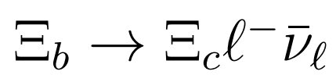
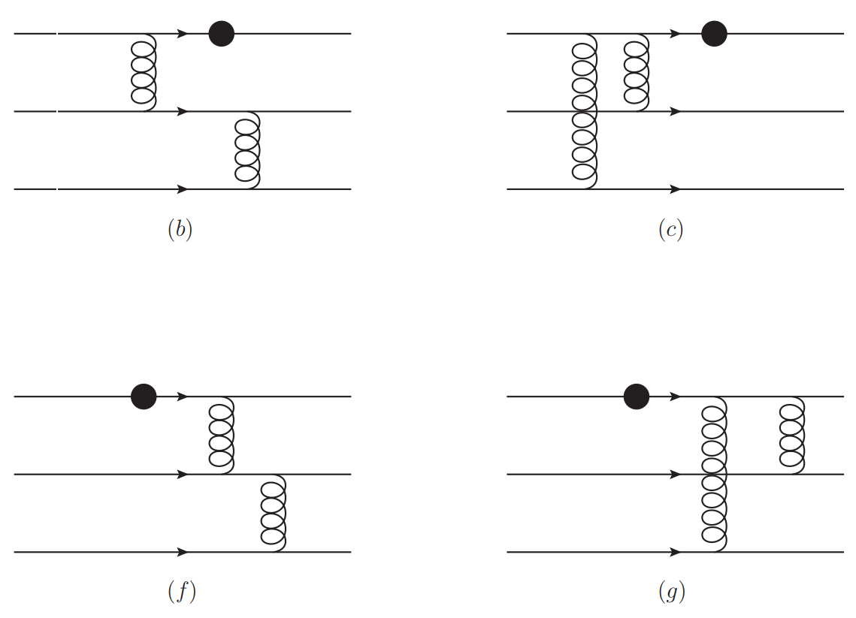
1、
[Phys.Rev.D 111 (2025) 11, 113006]
Lowest-order diagrams for $Ξb → Ξc$transition form factors.

Slide 15
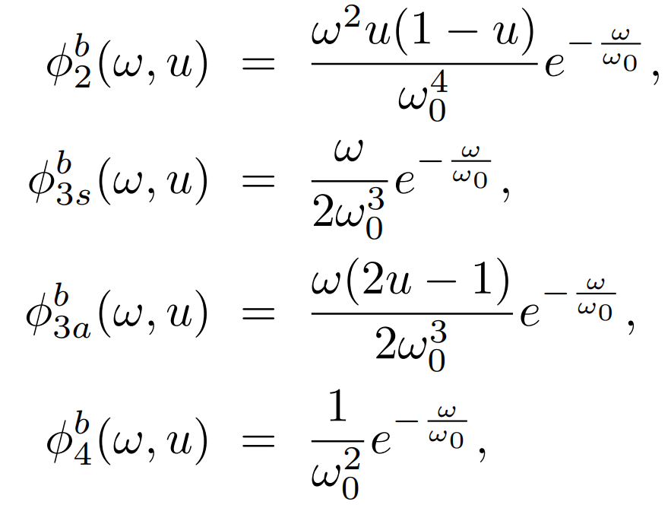
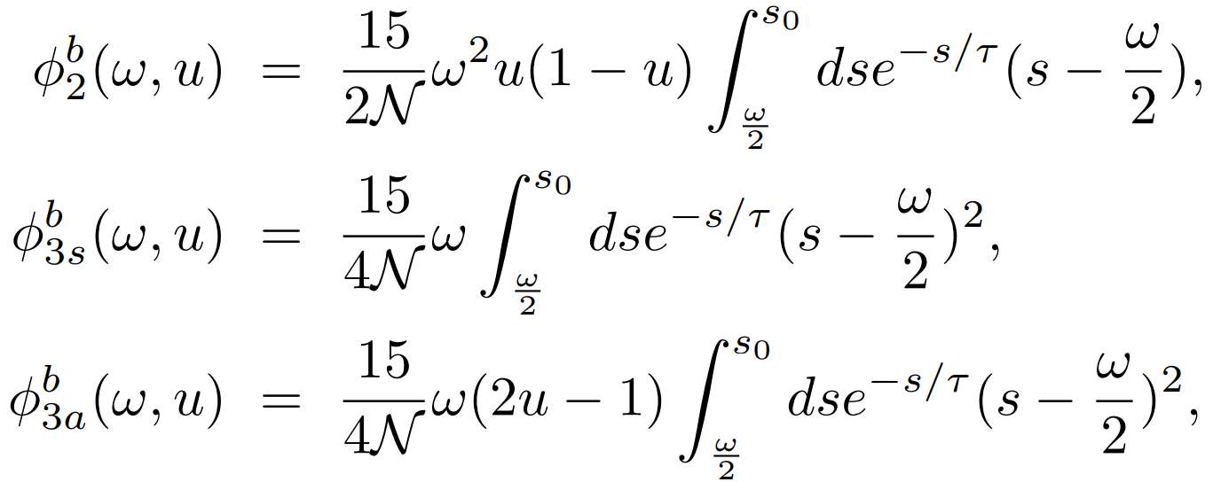
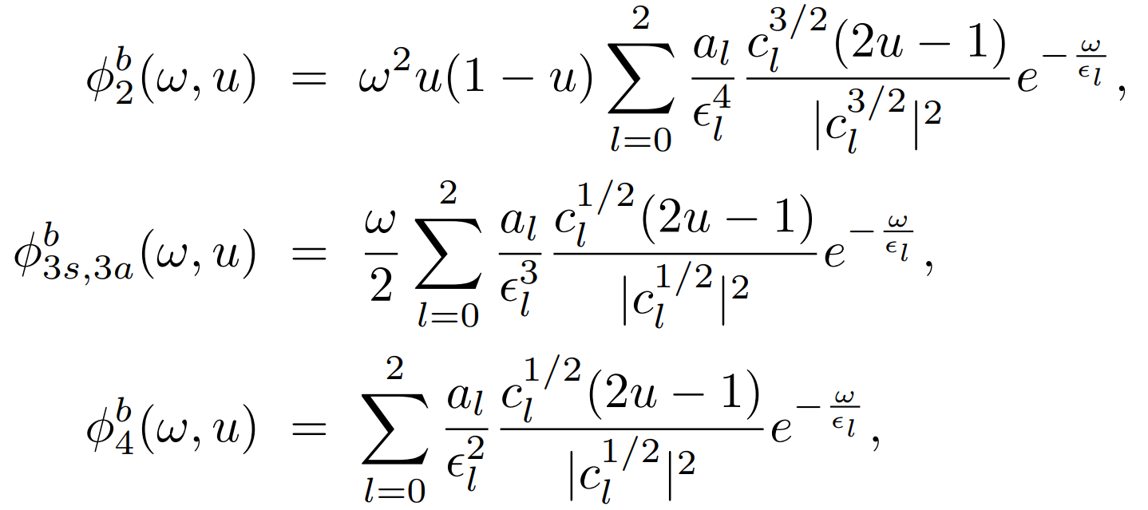
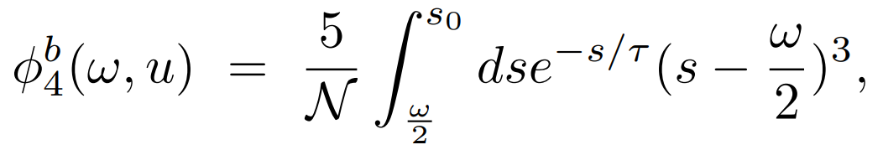

light-cone distribution amplitude
• Exponential model
• QCDSR model
• Gegenbauer model
al and ϵl dependence on a free parameter, A = 0.5 ± 0.2
ω₀ = 0.4 ± 0.1 GeV
s0 = 1.2 GeV
τ = 0.6 ± 0.2
0 < ω < 2s0

Slide 16
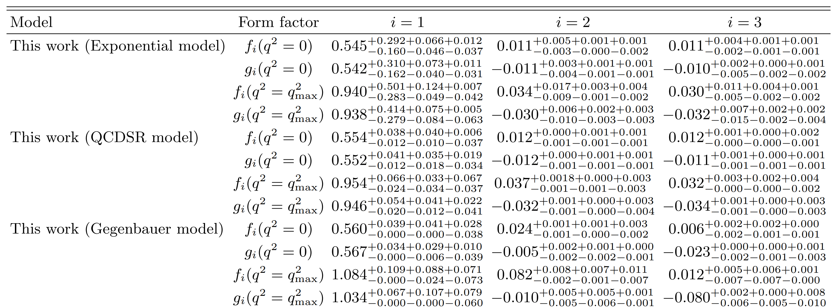
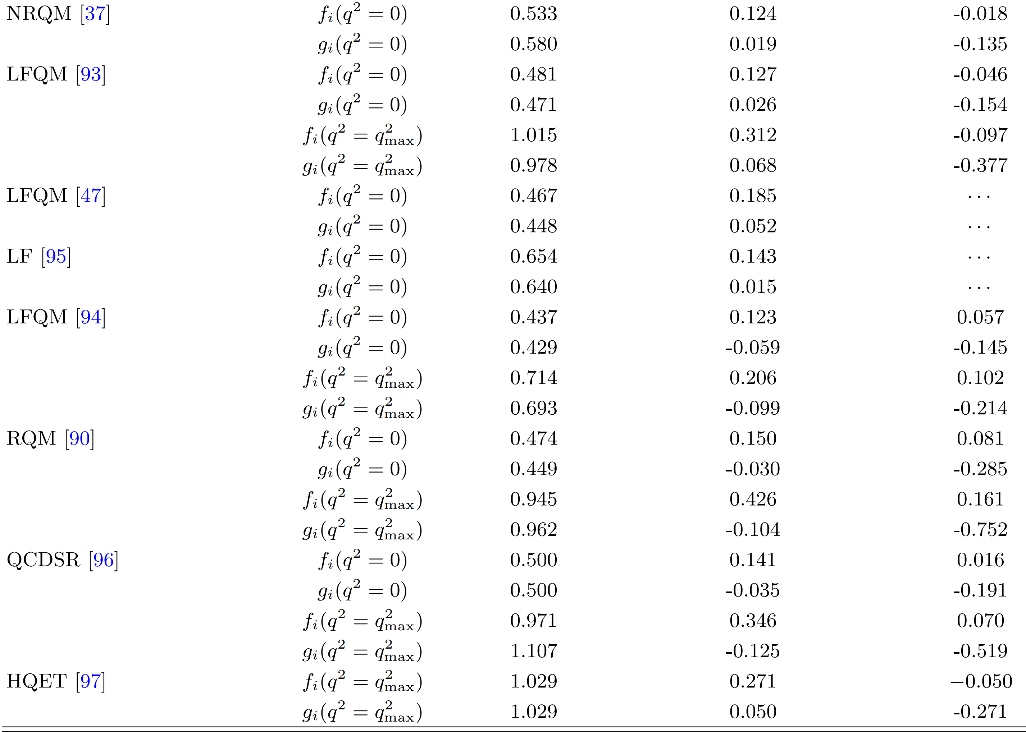

The form factors of $Ξ_{b}→Ξ_{c}$
Notes:
重子波函数精确到twist4，计算了。。。。

Slide 17
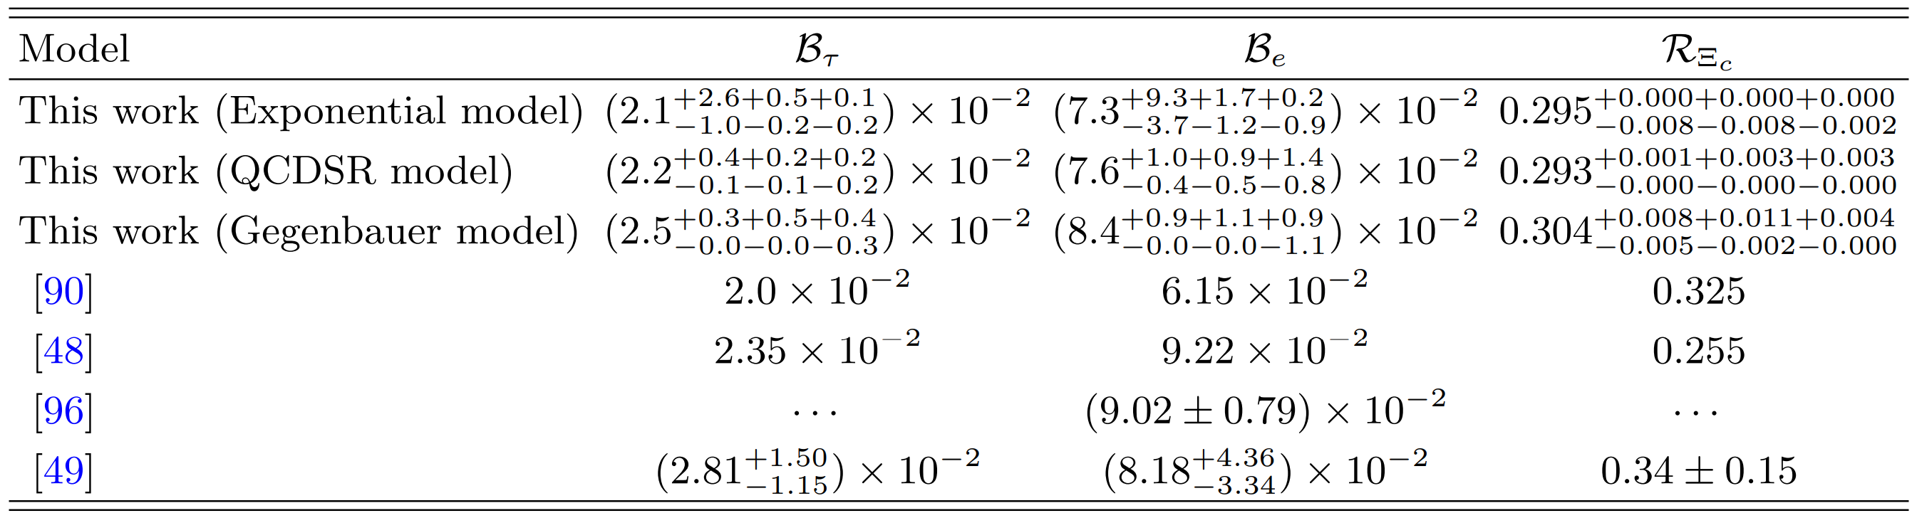
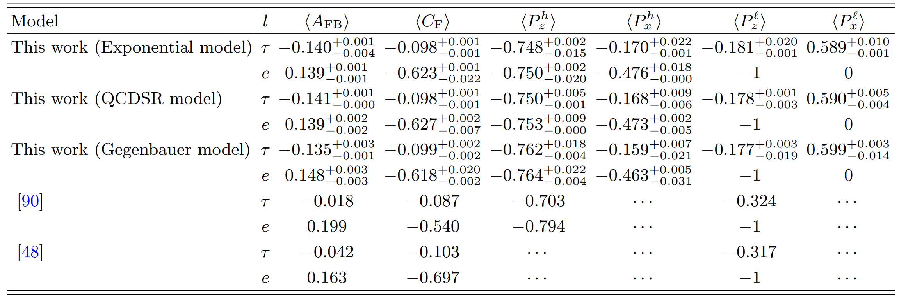

Slide 18
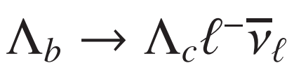

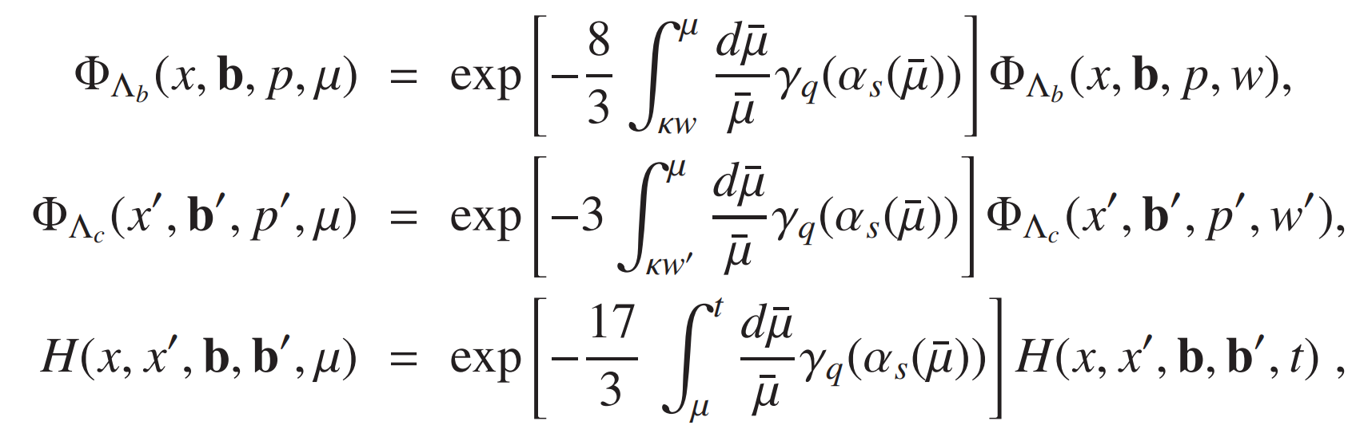
2、
[e-Print: 2509.02257 [hep-ph]]
Take the power correction effect in account
Resume the large single logarithms originating from ultraviolet divergences also appear in the radiative corrections to both the hadronic wave functions and the hard kernels and get the facor

Slide 19
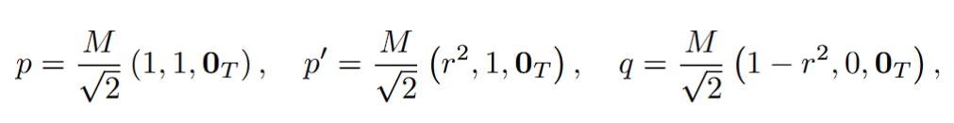
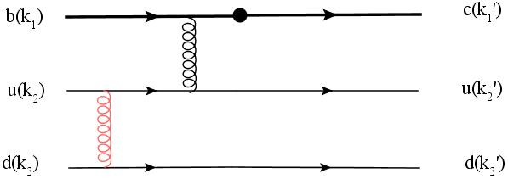
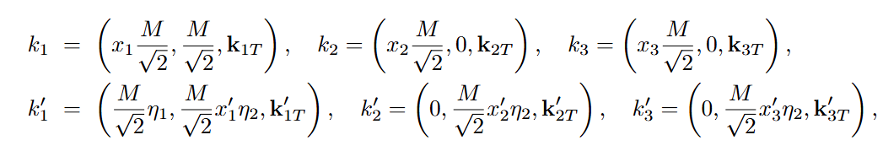
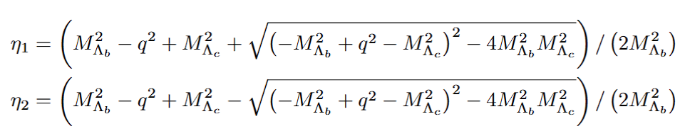

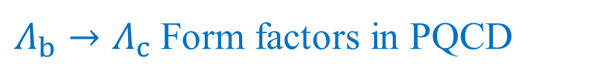

$Λ_{b}→Λ_{c}$ Form factors in PQCD
They obey the conservation laws
PQCD formula for two-body decays
$$F_{i}(q^{2})$$

Slide 20
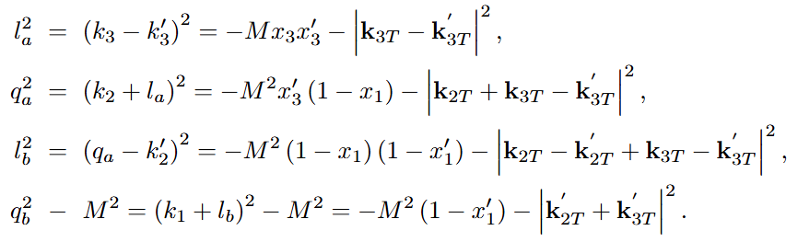

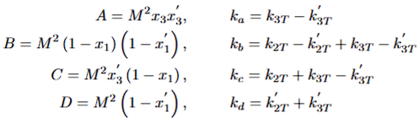

$$×$$

Slide 21
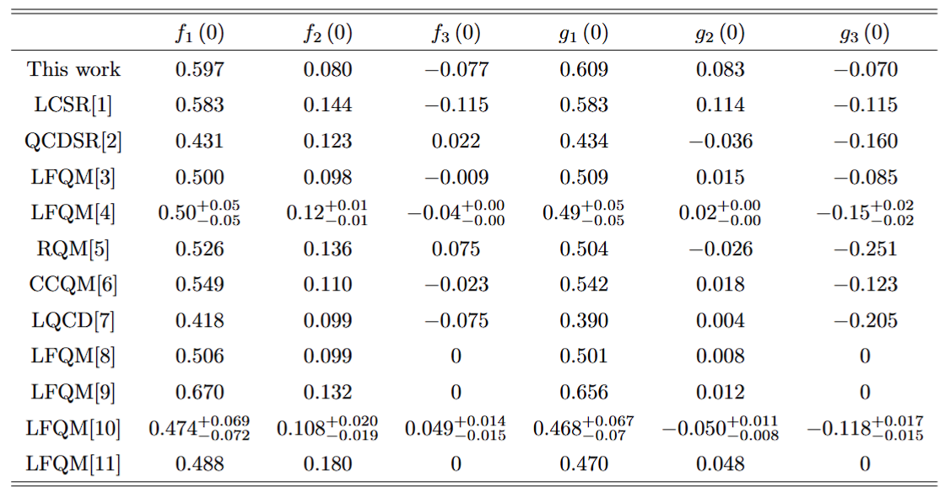
[1]
Yan Miao et al 2022 Chinese Phys.C 46 113107
[6]
T.Gutsche,M.A.Ivanov,J.G.K$\ddot{o}$rner et al,Phys.Rev.D 91(7),074001(2015)
[2]
Z.X.Zhao,R.H.Li,Y.L.Shen et al,arXiv:2010.07150[hep-ph]
[7]
W.Detmold,C.Lehner,and S.Meinel,Phys.Rev.D 92(3),034503(2015)
[3]
J,Zhu,Z.T.Wei,and H.W.Ke,Phys.Rev.D 99(5),054020(2019)
[8]
H.W.Ke,X.Q.Li,and Z.T.Wei,Diquarks and$Λ_{b}→Λ_{c}$ weak decays,Phys. Rev.D 77,014020(2008)
[4]
Y.S.Li,X.Liu,and F.S.Yu,Phys.Rev.D 104(1),013005(2021)
[9]
Z.X.Zhao,Weak decays of heavy barons in the light-front approach,Chin.Phys.C 42,093101(2018)
C.K.Chua,Color-allowed bottom baryon to s-wave and p-wave charmed baryon nonleptonic decays,Phys.Rev.D 100,034025(2019)
[10]
[5]
R. N. Faustov and V.O.Galkin,Phys.Rev.D 94(7) 073008(2016)

Slide 22
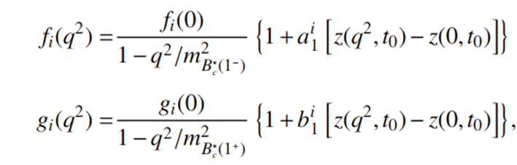
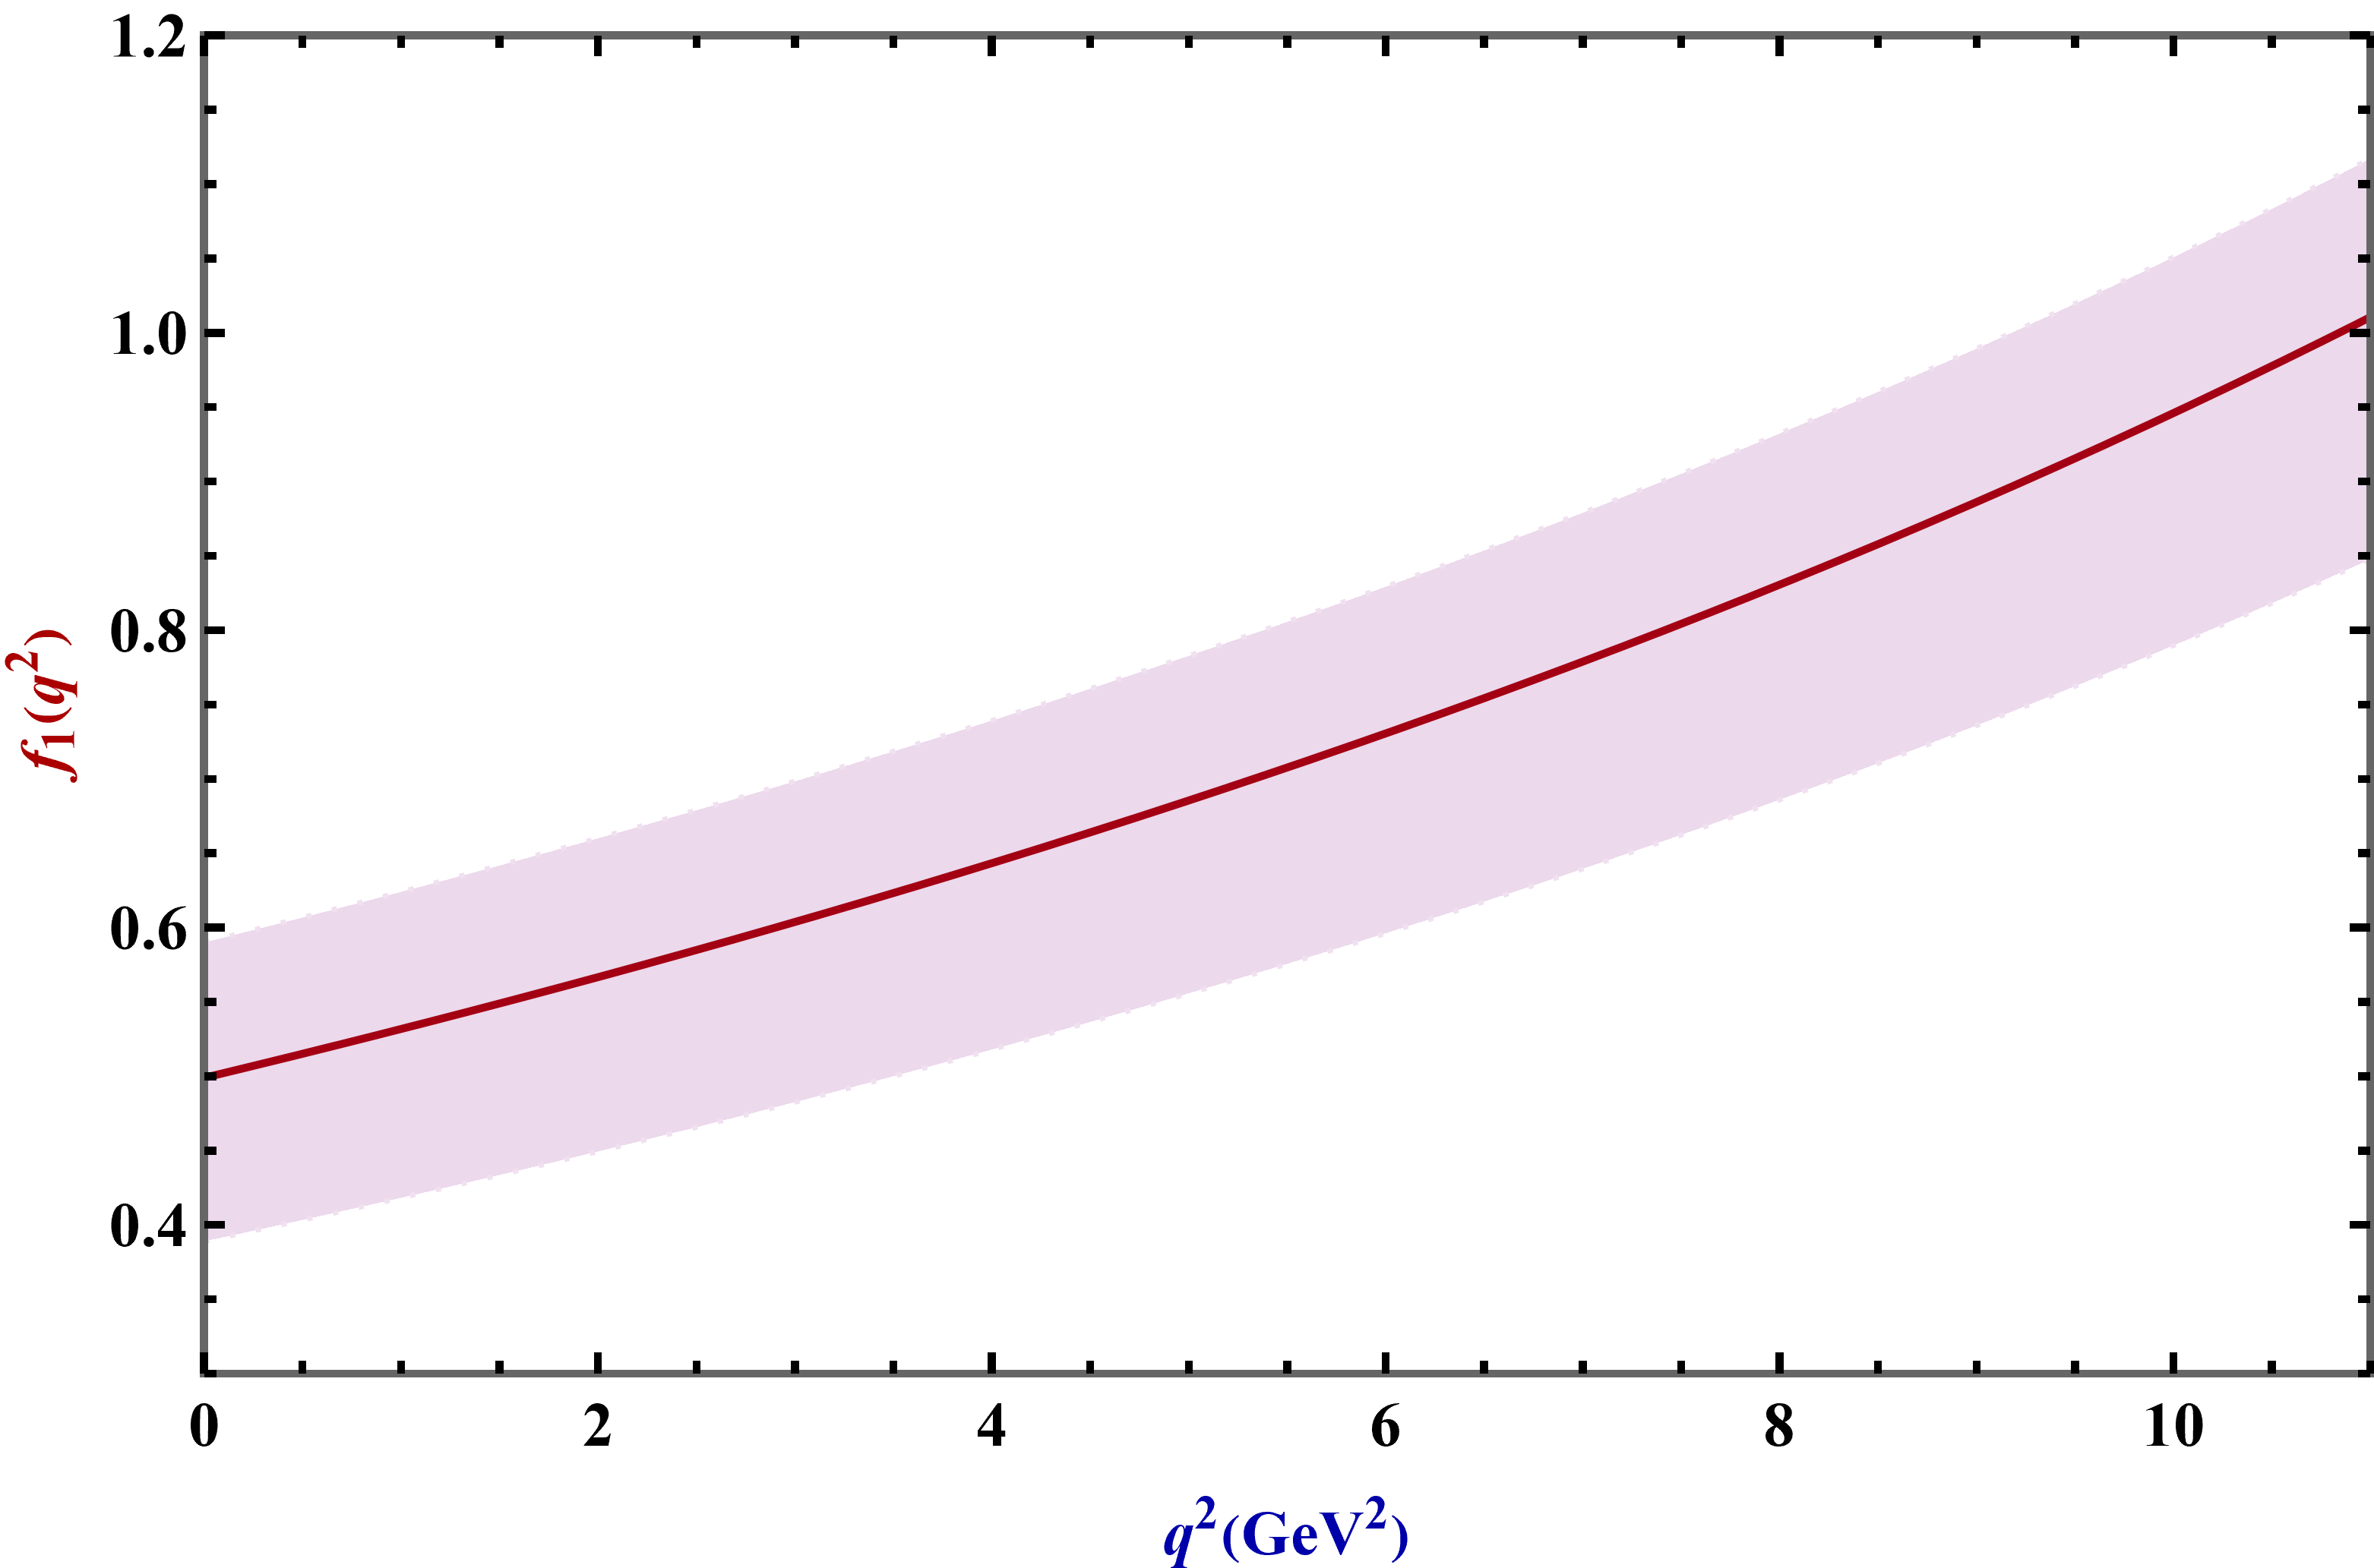
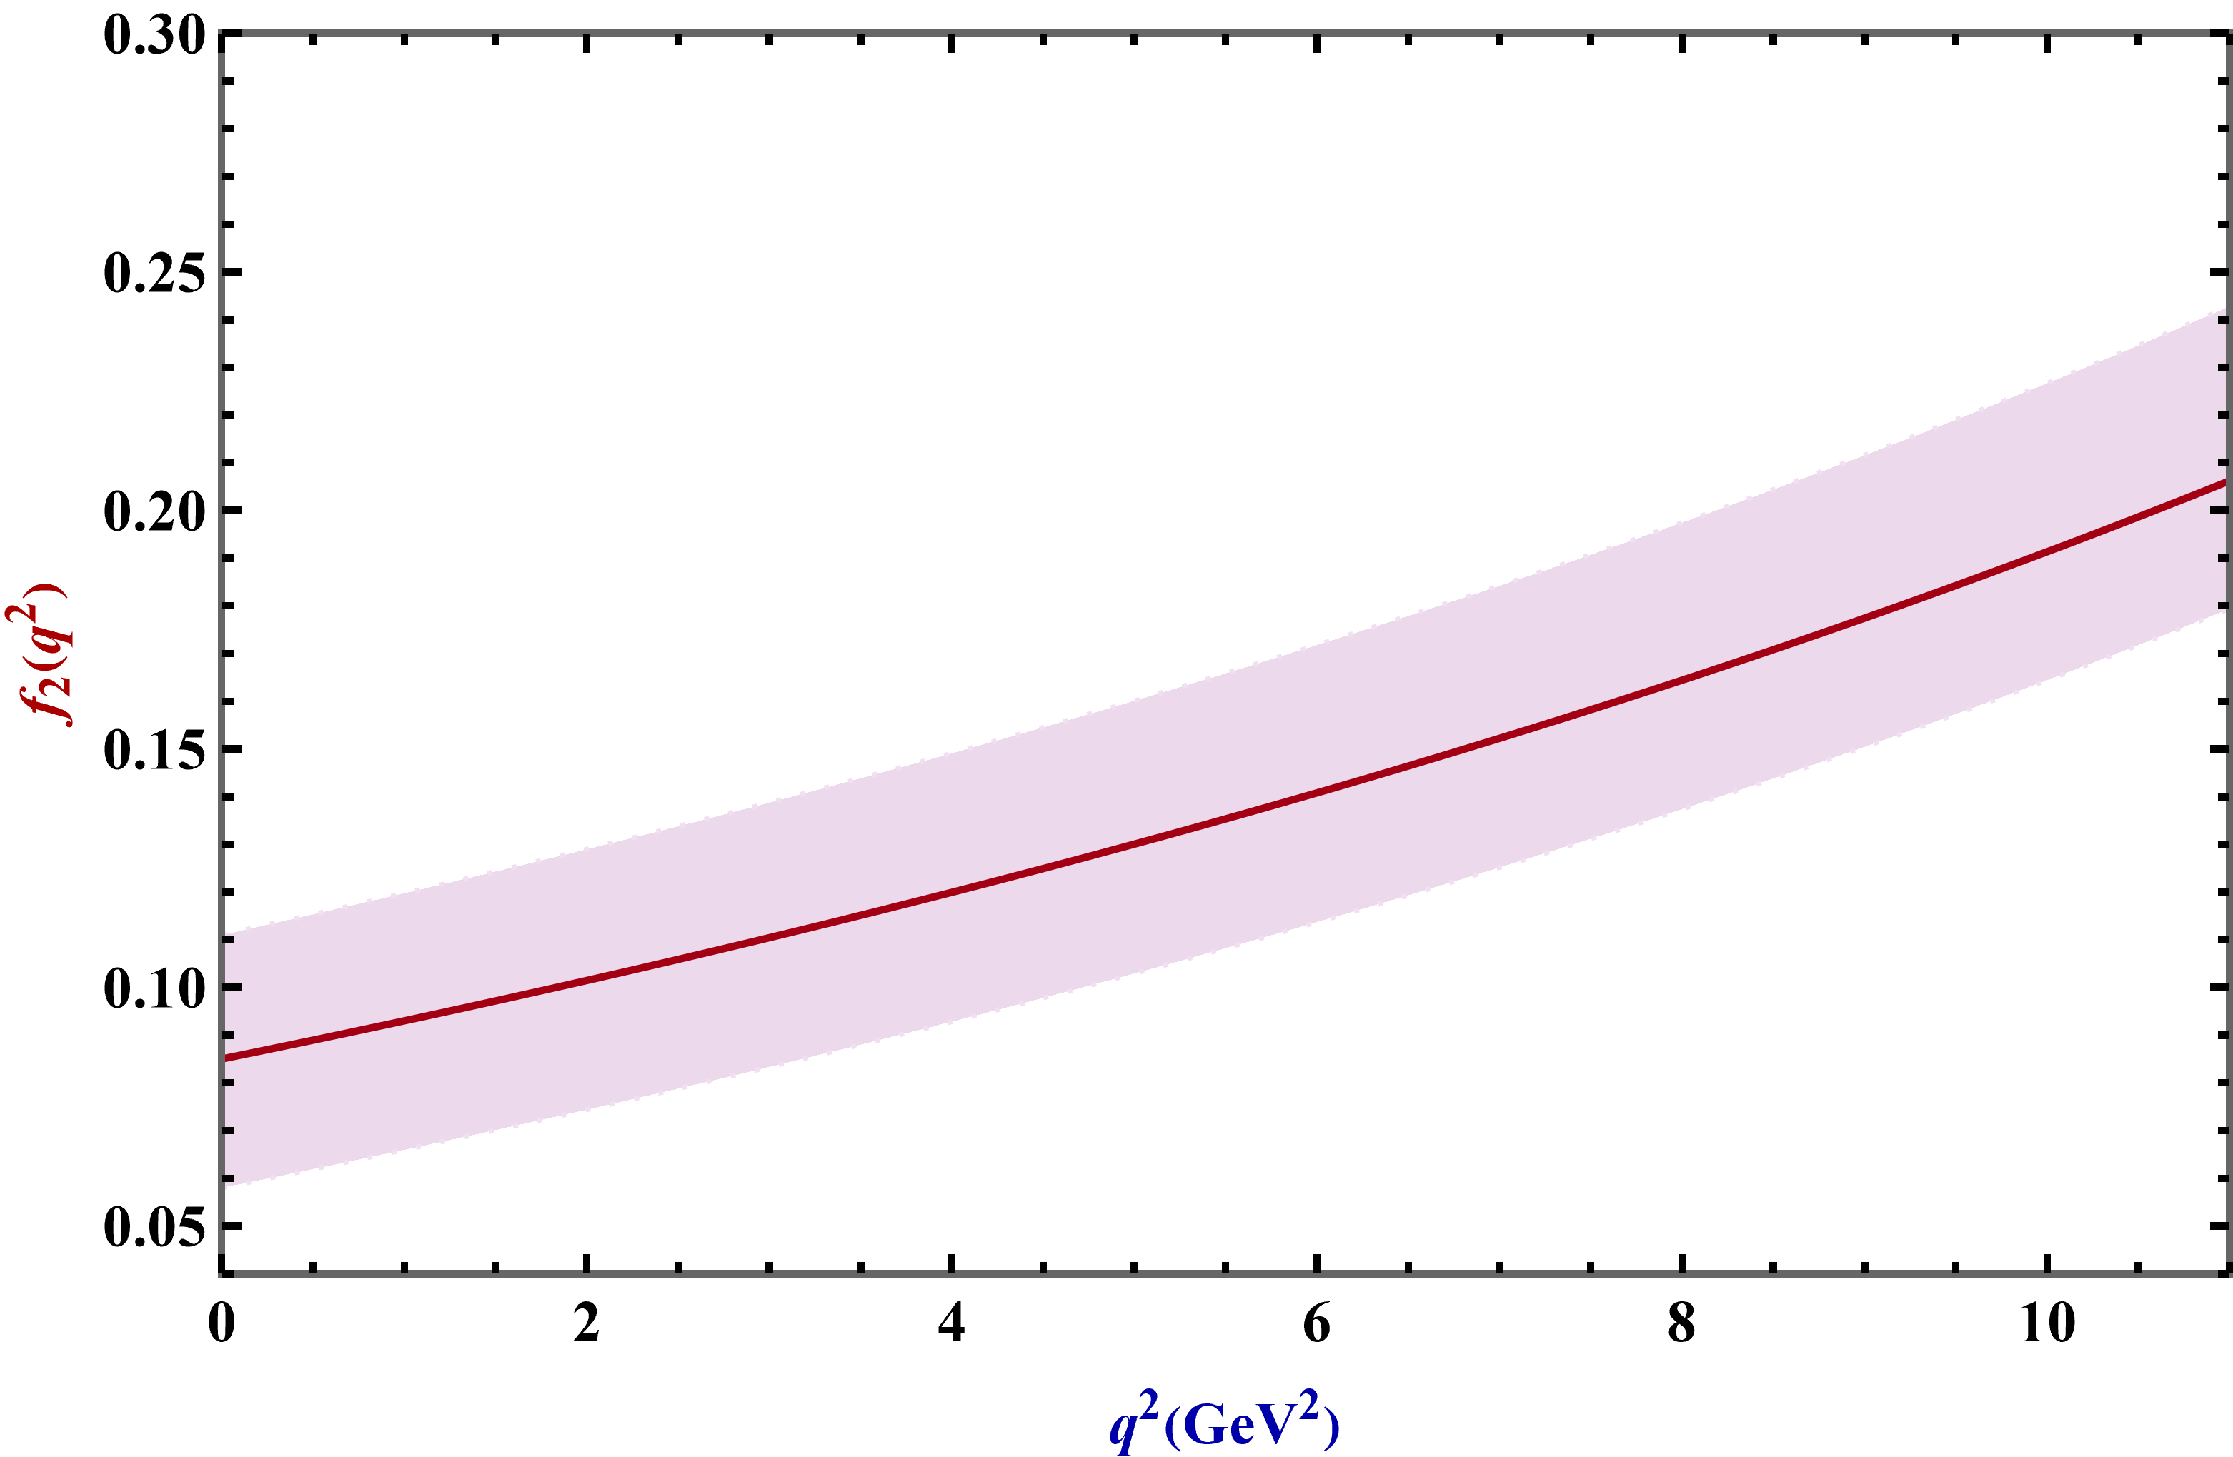
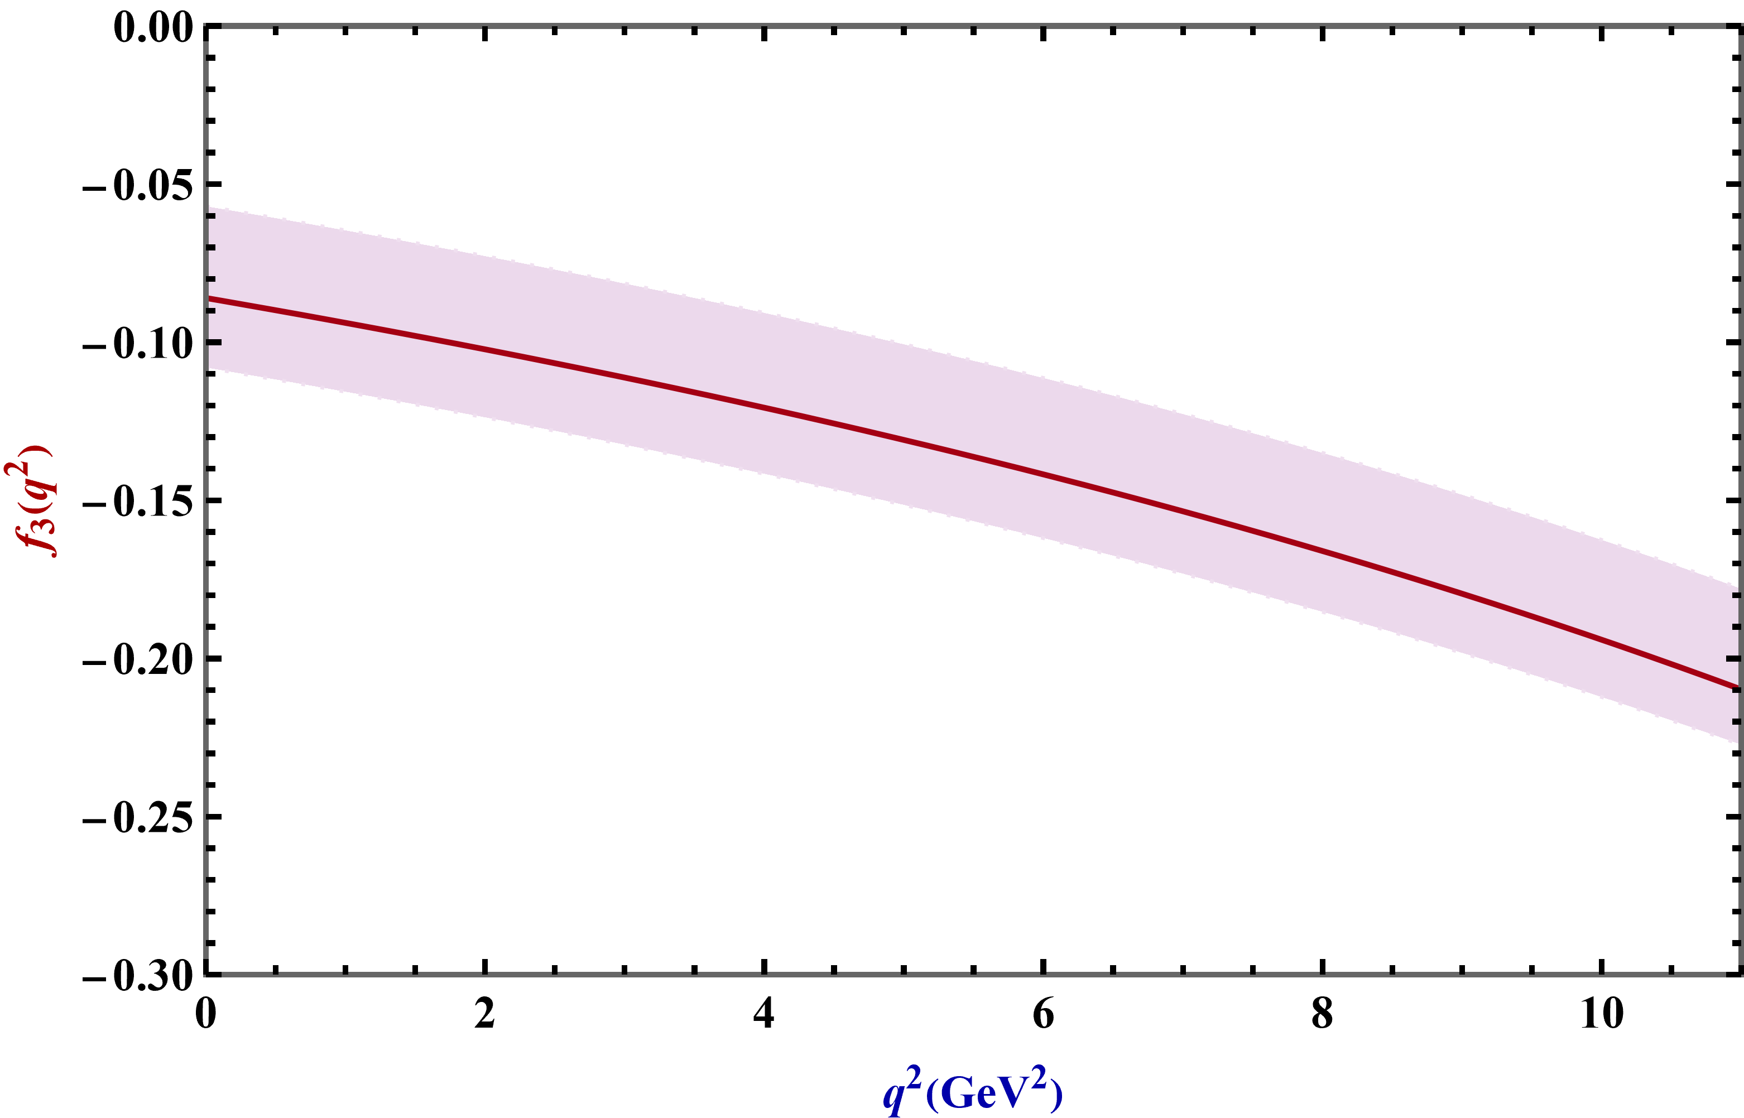
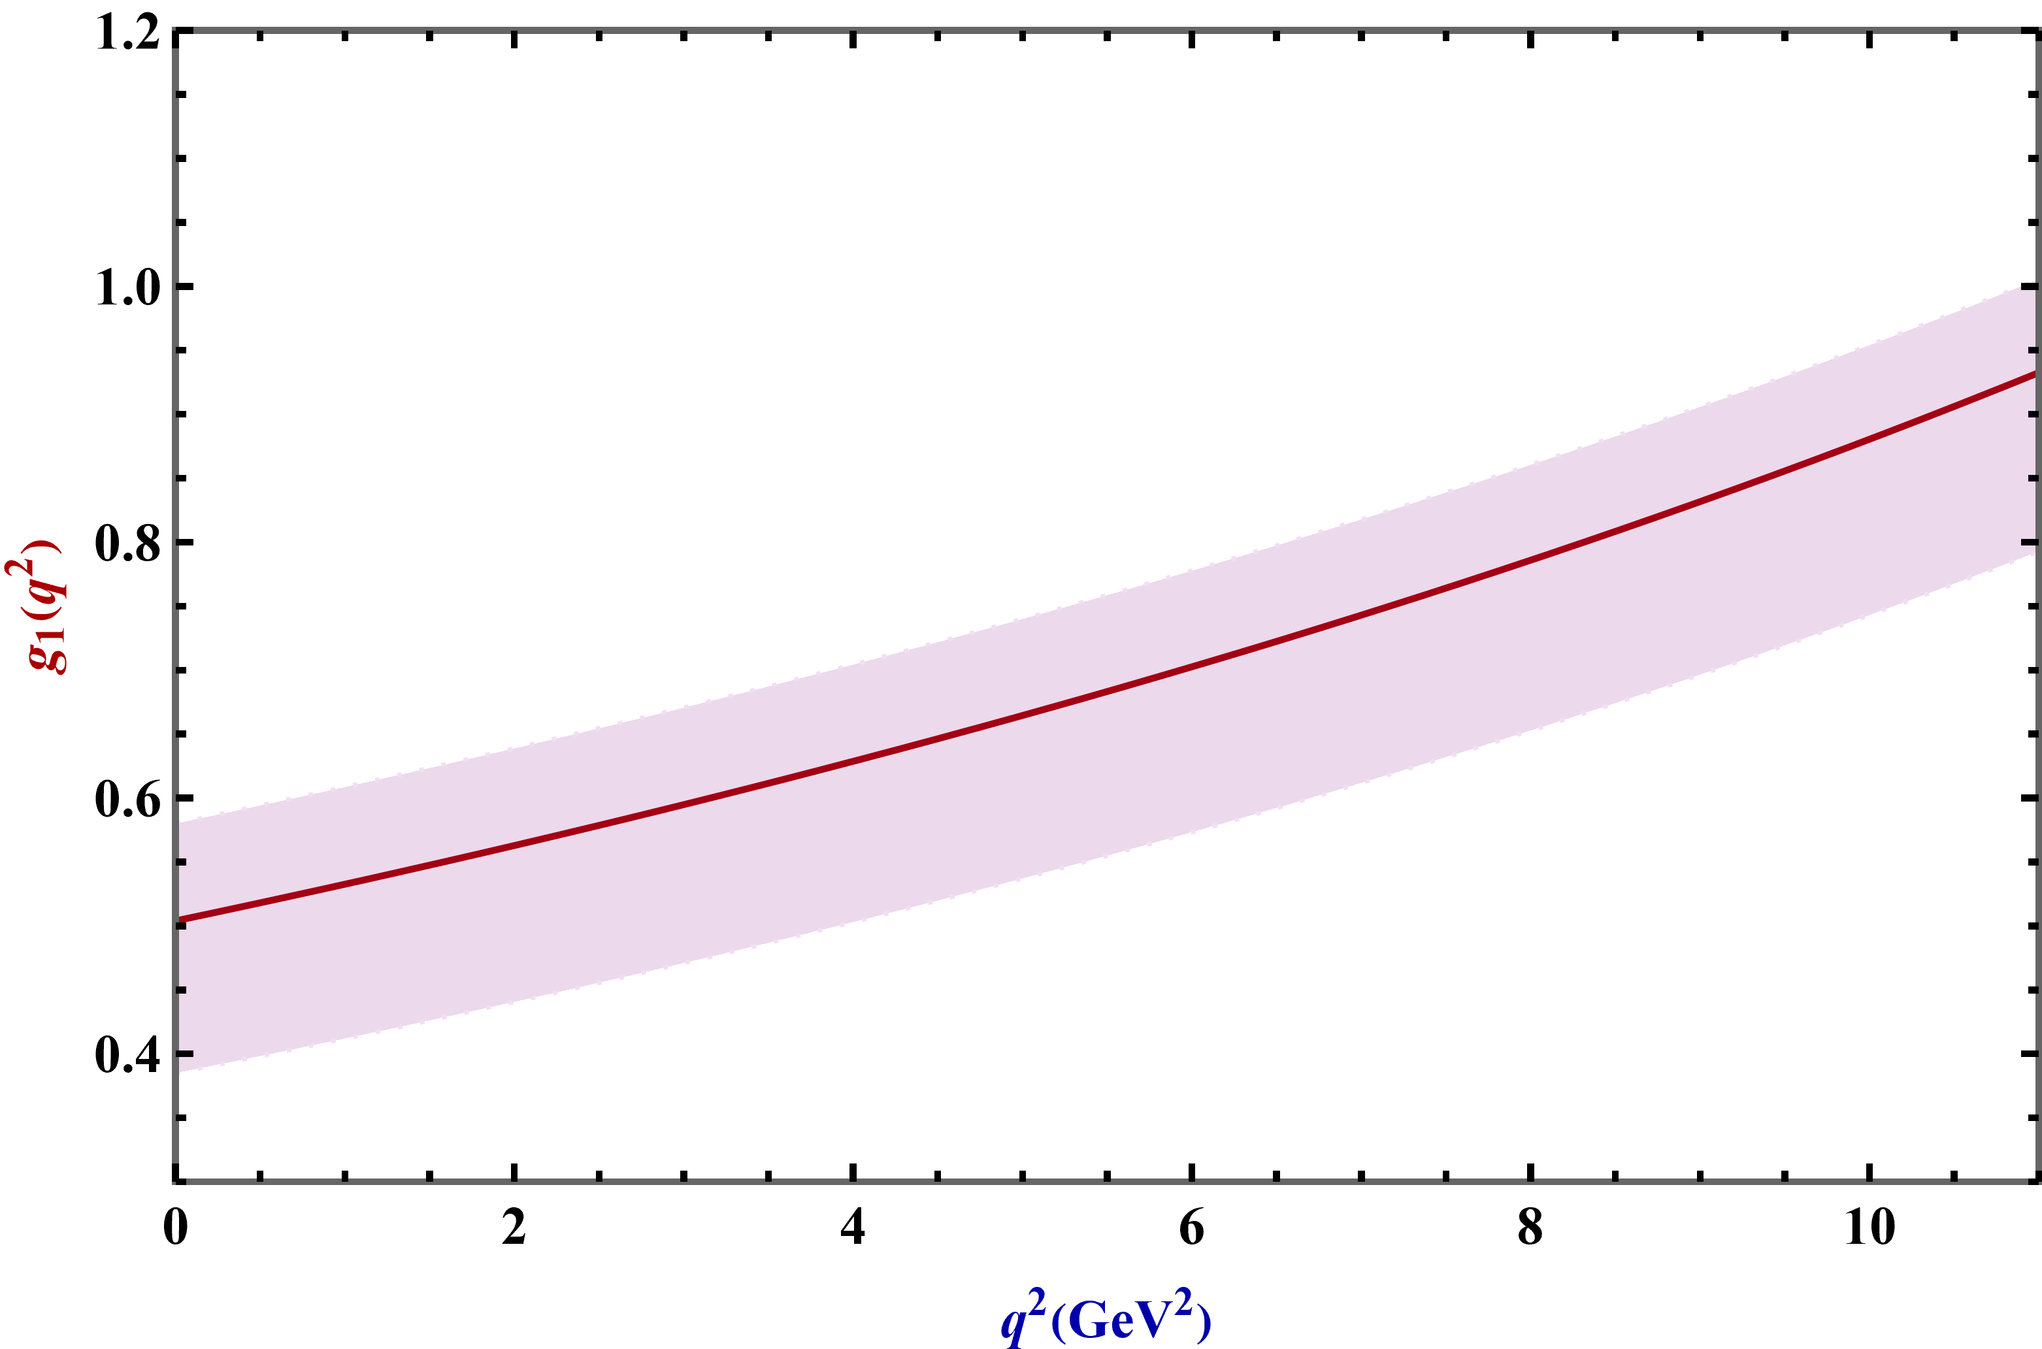
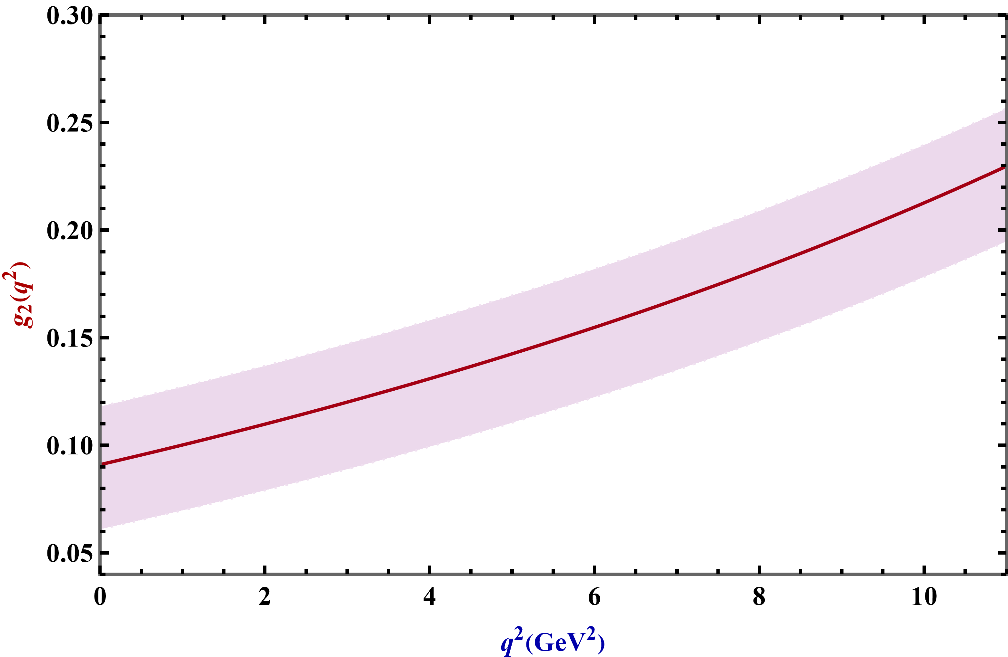


$q^{2}$ dependencies of the form factors.

Slide 23
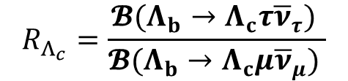
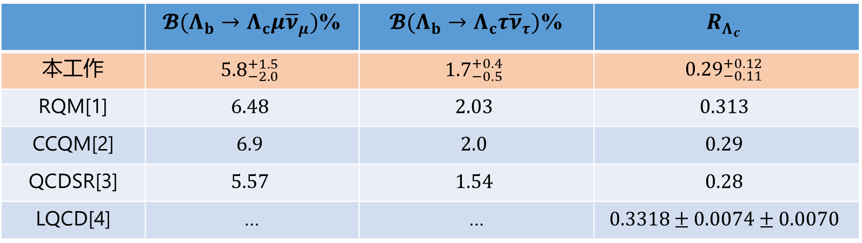
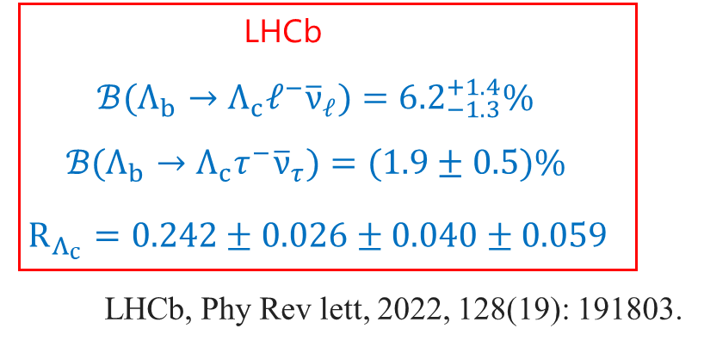
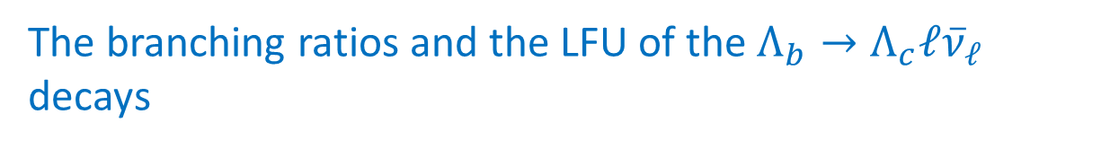
The branching ratios and the LFU of the $Λ_{b}→Λ_{c}ℓ{\overline{ν}}_{ℓ}$ decays
[1] Faustov R N, Physical Review D, 2016, 94(7): 073008.
[2] Gustche T, Physical Review D, 2015, 91(7): 074001.
[3] Zhu J, Physical Review D, 2019, 99(5): 054020
[4] W.detmold, Phys.Rev.D 92(3),034503(2015)

Slide 24
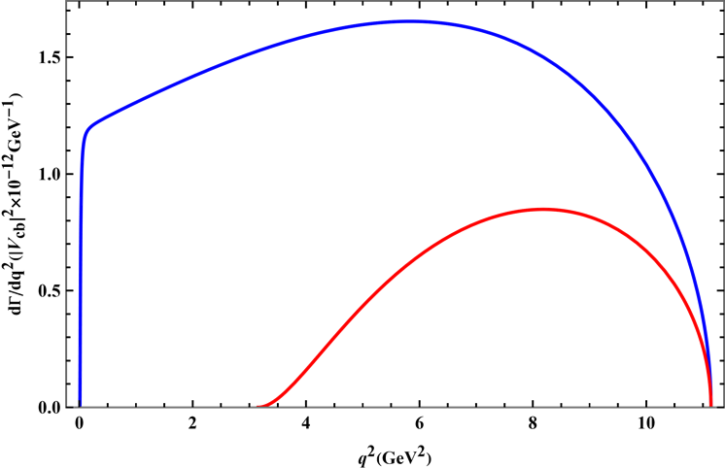
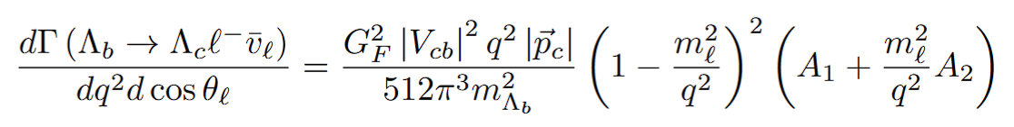


differential decay widths
由于电子和谬子的质量都远远小于两个重子的质量，所以在标准模型下的预期结果应该二者几乎相同

Slide 25





hadron polarization $P_{z}^{h}$ of ${ Λ}_{c}$
$$P_{z}^{h}$$
At zero recoil
$H_{1/2,1}^{2}−H_{−1/2,−1}^{2}=H_{1/2,0}^{2}−H_{−1/2,0}^{2}=H_{1/2,t}^{2}−H_{−1/2,t}^{2}=0$

Slide 26




leptonic forward-backward asymmetry($A_{FB}$)
At zero recoil,one finds $H_{1/2,1}^{2}$=$H_{−1/2,−1}^{2}$

Slide 27




lepton polarization $P_{z}^{l}$
$$P_{z}^{μ}=−1$$
left-handed

Slide 28




convexity parameter C_{F}
$$q^{2}=0$$
$$C_{F}=0$$
In the τ channel, C_{F} also approaches zero near the kinematic threshold q² = $m_{τ}^{2}$, where the ratio $\frac{m_{τ}^{2}}{q^{2}}$→ 1. Over the full q² range accessible in the τ mode, C_{F} remains small, indicating that the cos θ_{ℓ}distribution is nearly linear. In contrast, for the µ-mode, C _{F} can become significantly negative, corresponding to a strongly parabolic angular distribution.

Slide 29

 | $$𝓵$$ | $$\left\langle Γ×{10}^{−15}GeV\right\rangle$$ | $$〈A_{FB}〉$$ | $$〈P_{B}〉$$ | $$〈P_{𝓁}〉$$ | $$〈C_{F}〉$$
本工作 | $$e$$ $$μ$$ $$τ$$ | $$26$$ $$26$$ $$7.7$$ | $${0.193}_{−0.001}^{+0.006}$$ $${0.182}_{−0.003}^{+0.009}$$ $${−0.076}_{−0.001}^{+0.002}$$ | $${−0.928}_{−0.014}^{+0.001}$$ $${−0.930}_{−0.011}^{+0.001}$$ $${−0.630}_{−0.002}^{+0.012}$$ | $$−1.0$$ $$−0.98$$ $${−0.173}_{−0.001}^{+0.007}$$ | $${−0.751}_{−0.007}^{+0.002}$$ $${−0.727}_{−0.007}^{+0.002}$$ $${−0.088}_{−0.001}^{+0.001}$$
RQM[1] | $$e$$ $$μ$$ $$τ$$ | $$29.4$$ $$29$$ $$9.1$$ | $$0.195$$ $$0.189$$ $$−0.021$$ | $$−0.80$$ $$−0.80$$ $$−0.71$$ | … | $$−0.57$$ $$−0.55$$ $$−0.09$$
CCQM[2] | $$e$$ $$μ$$ $$τ$$ | $$32.0$$ … $$9.40$$ | $$0.36$$ … $$−0.007$$ | $$−0.82$$ … $$−0.72$$ | $$−1.00$$ … $$−0.32$$ | $$−0.63$$ … $$−0.10$$
LFQM[3] | $$e$$ $$μ$$ $$τ$$ | … | $$0.18$$ $$0.17$$ $$−0.08$$ | $$−0.81$$ $$−0.81$$ $$−0.77$$ | $$−1.00$$ $$−0.98$$ $$−0.24$$ | …
[1] Faustov R N, Physical Review D, 2016, 94(7): 073008.
[2] Gustche T, Physical Review D, 2015, 91(7): 074001.
[3] Li Y S, Physical Review D, 2021, 104(1): 013005.
14
Notes:
之后我们还对衰变宽度，带电轻子的前后不对称性，轻子和重子的纵向极化，凸度参量的平均值进行了预测。可以看到这些量对形状因子计算中的不确定性不太敏感，因为误差在螺旋度振幅的比值中部分抵消。同时我们注意到由于显著的轻子质量效应，在从谬子模型转换到涛子模型发生了相当大的变化，甚至前后不对称性参数的符号都发生了变化。最后我们还将这些可观测量的结果与其他理论方法的预测进行了比较。并且发现均吻合地很好，这可以通过未来的实验进行检验。

Slide 30

Summary and outlook
We calculate the form factors of the $Λ_{b}→Λ_{c}$ transition within the framework of PQCD with the DAs of the $Λ_{b}$-baryon and further investigate experimental observables.
PQCD is a powerful tool to analyze the heavy baryon decays. The applications of the PQCD formalism extension to other b-baryon decays are in progress.
But we still have a long way to realize.
How to reliably compute the non-factorizable contribution in particular the W-exchange one?

Slide 31
THANKS

Slide 32
Backup Slides

Slide 33








$Λ_{b}(Λ_{c})$ Baryon wave functions

Slide 34




Slide 35





Experimental observables of the semileptonic $Λ_{b}→Λ_{c}ℓ{\overline{v}}_{ℓ}$ decay
$$λ_{Λ_{b}}=−λ_{Λ_{c}}+λ_{W^{−}}$$

Slide 36


The form factors in the space-like region can be parameterized in a three-parameter form as

Slide 37


Slide 38



Gegenbauer-1 model
Exponential model

Slide 39


Gegenbauer-2 model
Free-parton approximation

Slide 40

In the standard model, low-energy effective Hamiltonian is given:
Fermi coupling constant
Local four-quark operators
CKM matrix elements
Wilson coefficient
For two-body nonleptonic B meson decays, the key step is to calculate the hadronic matrix elements

Slide 41


研究成果与进展
Research achievements and progress
两体非轻衰变$B→M_{2}M_{3}$的衰变振幅
Fourier transform

