Slide 1





第二届重味物理前沿研讨会
Electroweak Corrections to Higgs boson production and decay
毕业论文答辩
答辩人：小不点 答辩时间：5.5 指导老师：大不点
陈龙斌
2025-09-14

Slide 2

OutLine
Motivation
Electroweak corrections to Higgs boson+jet production
Precise Higgs boson rare decay study
Conclusion and Outlook

Slide 3
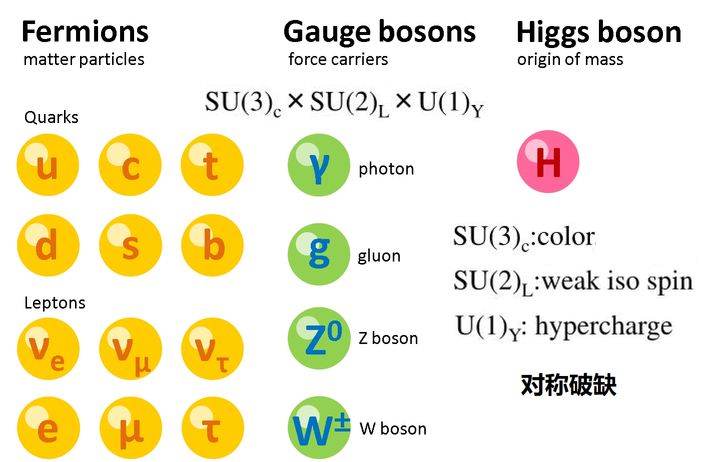
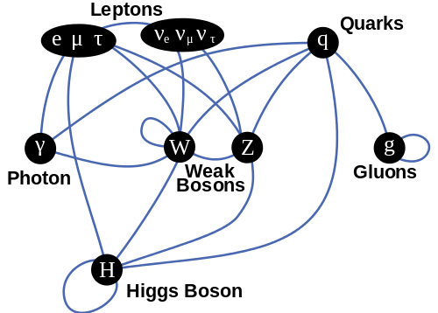
毕业论文答辩
答辩人：小不点 答辩时间：5.5 指导老师：大不点
The Higgs boson enables mass via electroweak symmetry breaking, underpinning the Standard Model and linking to vacuum stability via its potential.
Interactions between particles

Slide 4
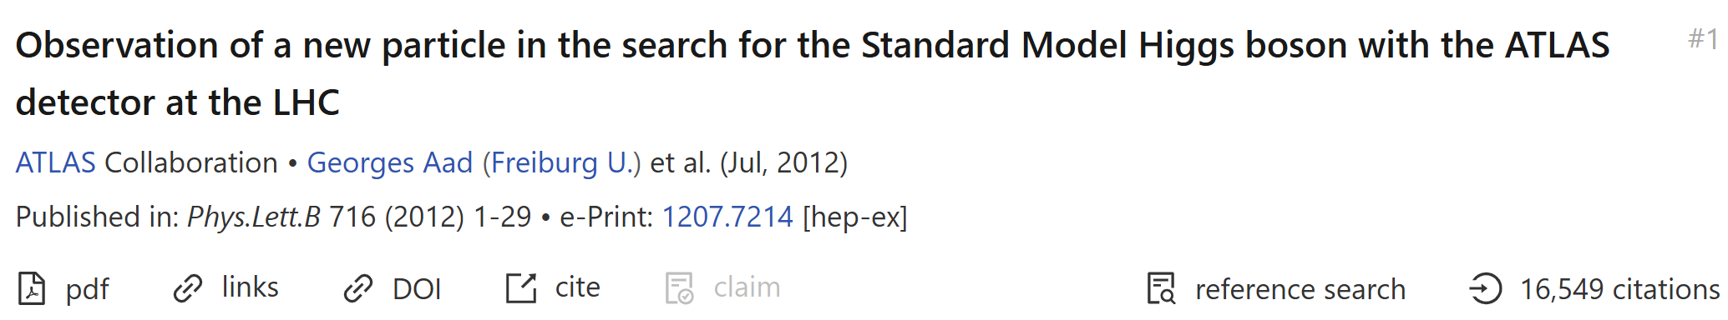
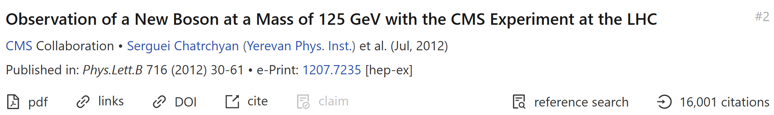
01
Motivation
Discovery of Higgs boson
毕业论文答辩
答辩人：小不点 答辩时间：5.5 指导老师：大不点

Slide 5
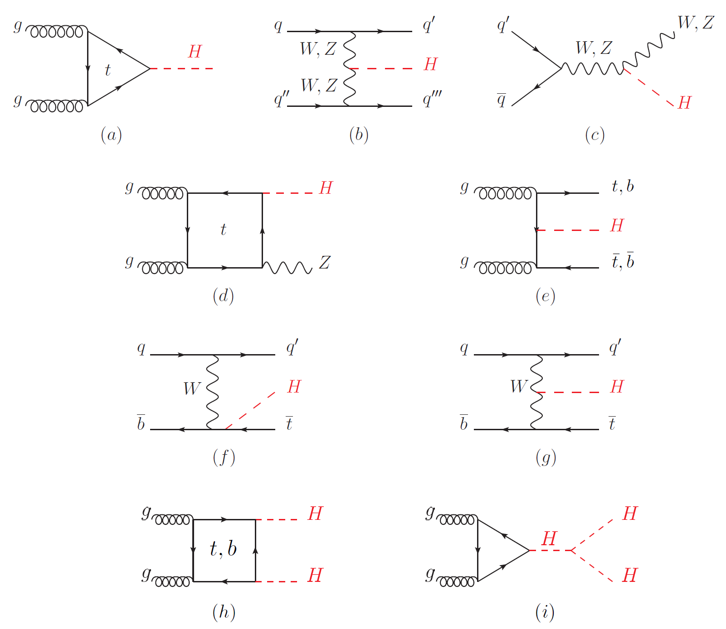
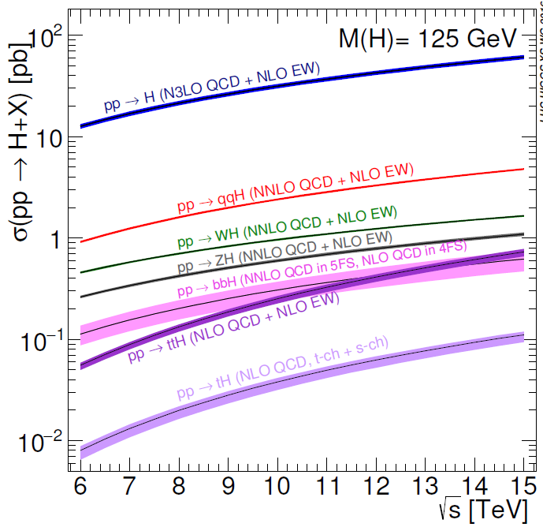
Higgs boson production at LHC
PDG
Precise Higgs boson physics study is crucial to understand SM and probe new physics.

Slide 6
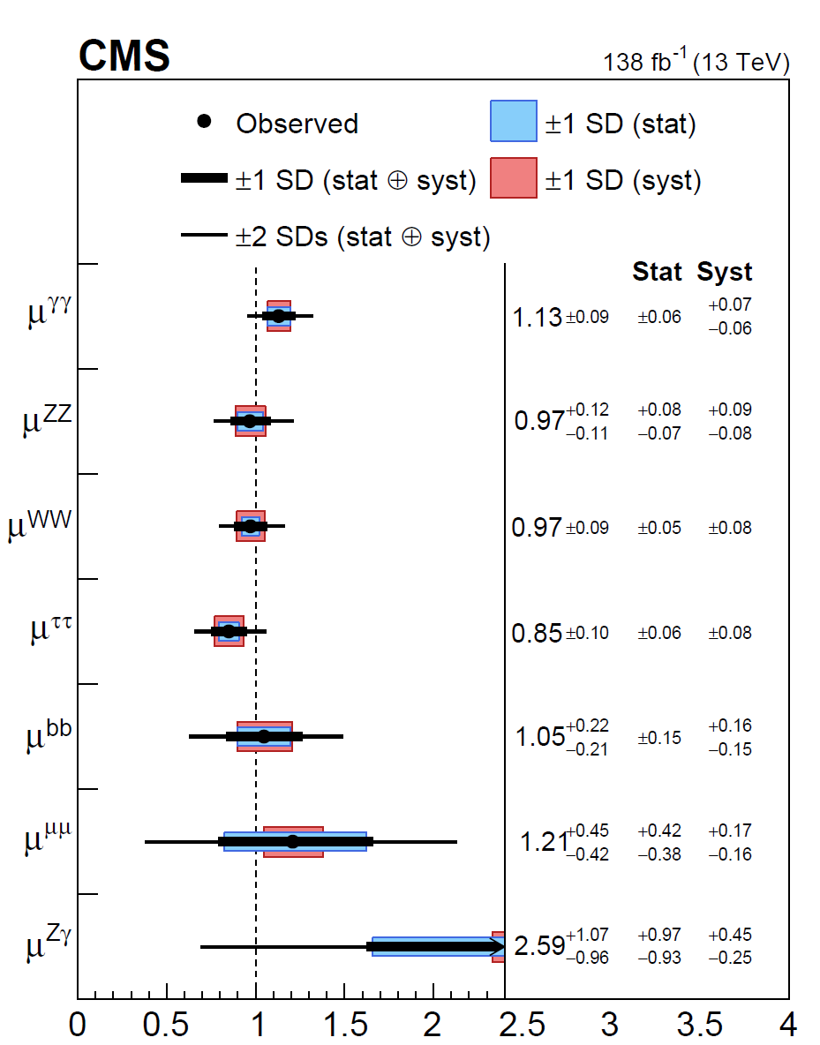
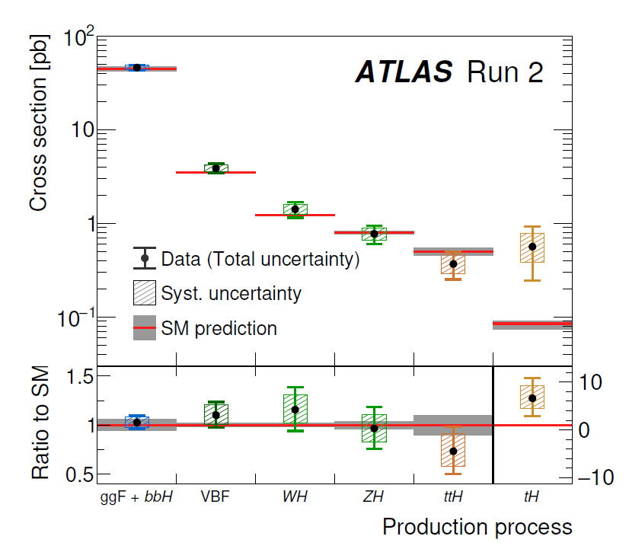
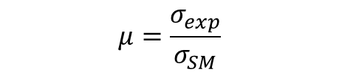
States of Higgs measurement
$$μ=\frac{σ_{exp}}{σ_{SM}}$$
ATLAS
CMS
毕业论文答辩
答辩人：小不点 答辩时间：5.5 指导老师：大不点
Nature 2022

Slide 7
02
毕业论文答辩
EW corrections to Higgs+jet production in gluon fusion
答辩人：小不点 答辩时间：5.5 指导老师：大不点
2507.20882(submitted to JHEP)
In collaboration with Hai Tao Li and Wen-Long Sang

Slide 8
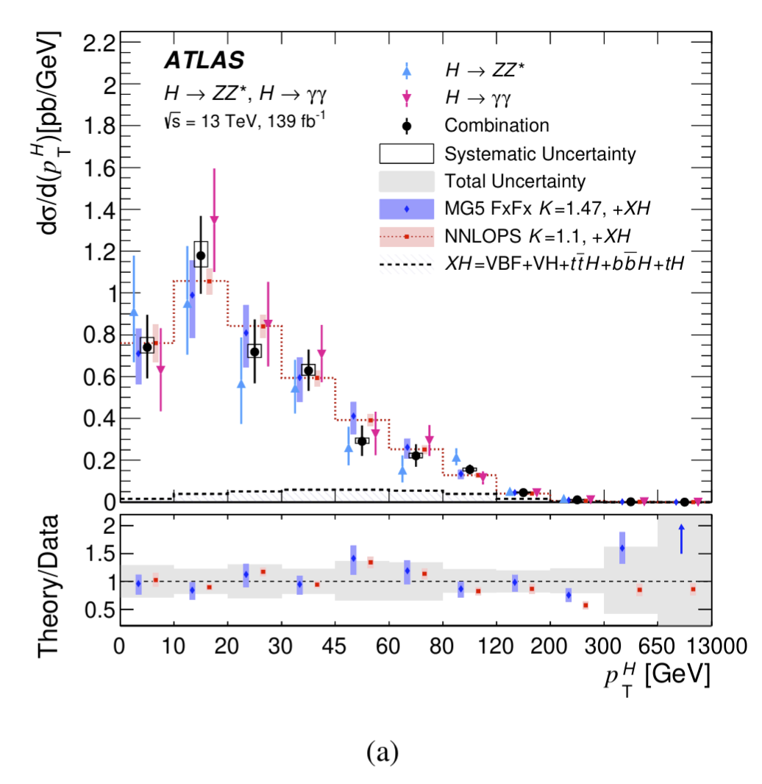
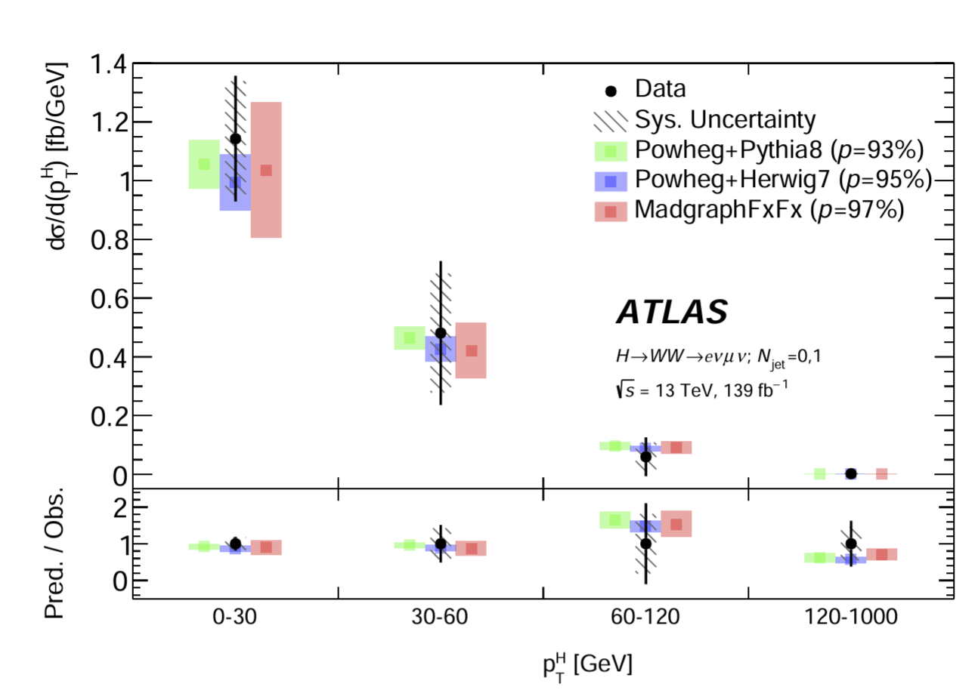

Higgs $p_{T}$ distribution measurement
produce an even more accurate calculation within
the SM.
ATLAS 2301.06822
ATLAS 2207.08615

Slide 9
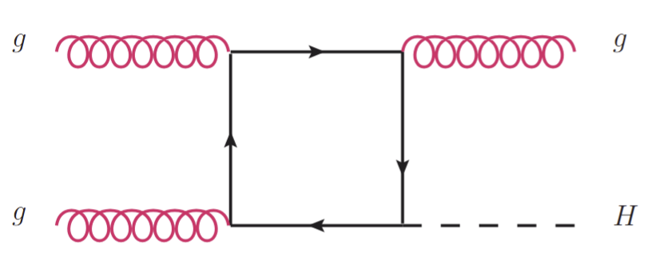
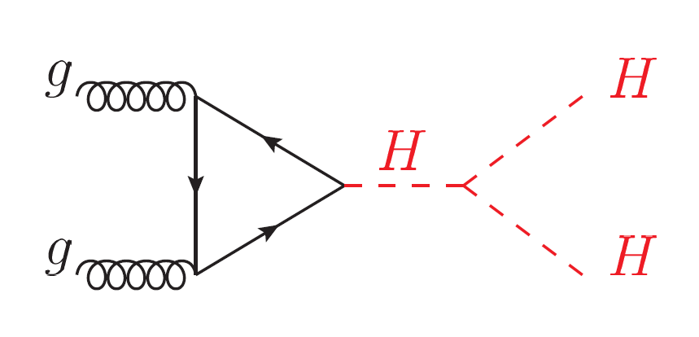
Status of Higgs+jet production perturbative calculation
NLO QCD with full top mass dependence,
Jones et al. 1802.00349, Chen et al. 2110,06953, Bonciani et al. 2206.10490.
NNLO QCD (Heavy top limit)
Boughezal et al. 1302.6216, Chen et al. 1408.5325,
Boughezal et al. 1504.07922, Chen et al. 1607.08817.
NLO EW (Heavy top limit / Light quark contribution/Trilinear self-coupling)
Bonetti et al. 2007.09813, Gao et al. 2302.04160,
Davis et al. 2007.09813, Haisch et al. 2007.09813.
Soft-gluon resummation
Huang et al. 1406.2591, Becher et al. 1407.4111.
produce an even more accurate calculation within
the SM.
EW corrections for Higgs pair production
Bi et al. 2311.16963,
Li et al. 2407.14716.

Slide 10
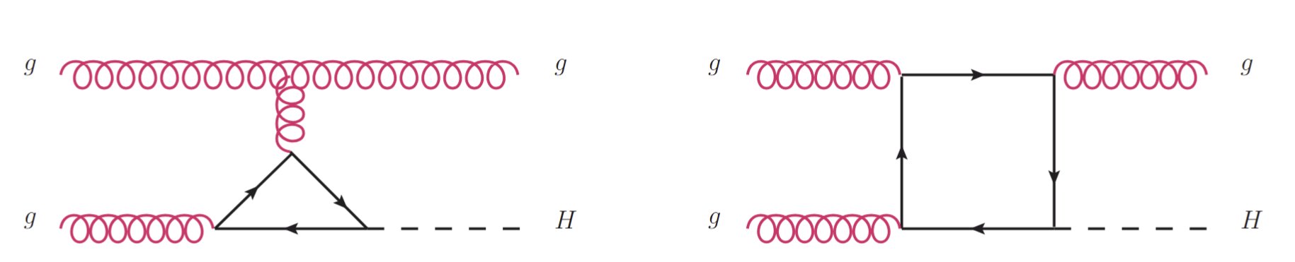
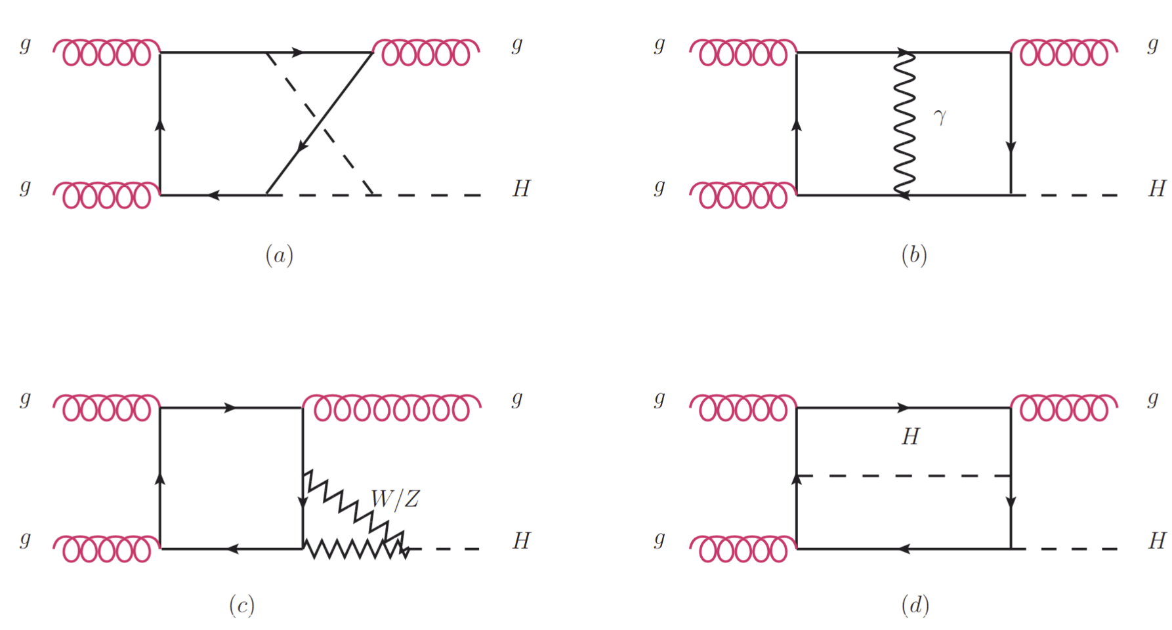
Leading-Order
12 Feynman Diagrams
produce an even more accurate calculation within
the SM.
Next-to-Leading-Order
1416 Feynman Diagrams

Slide 11
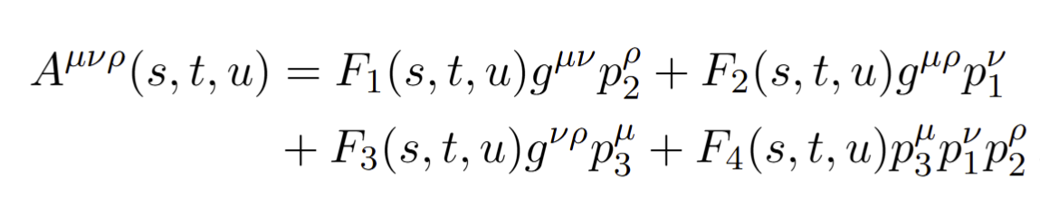

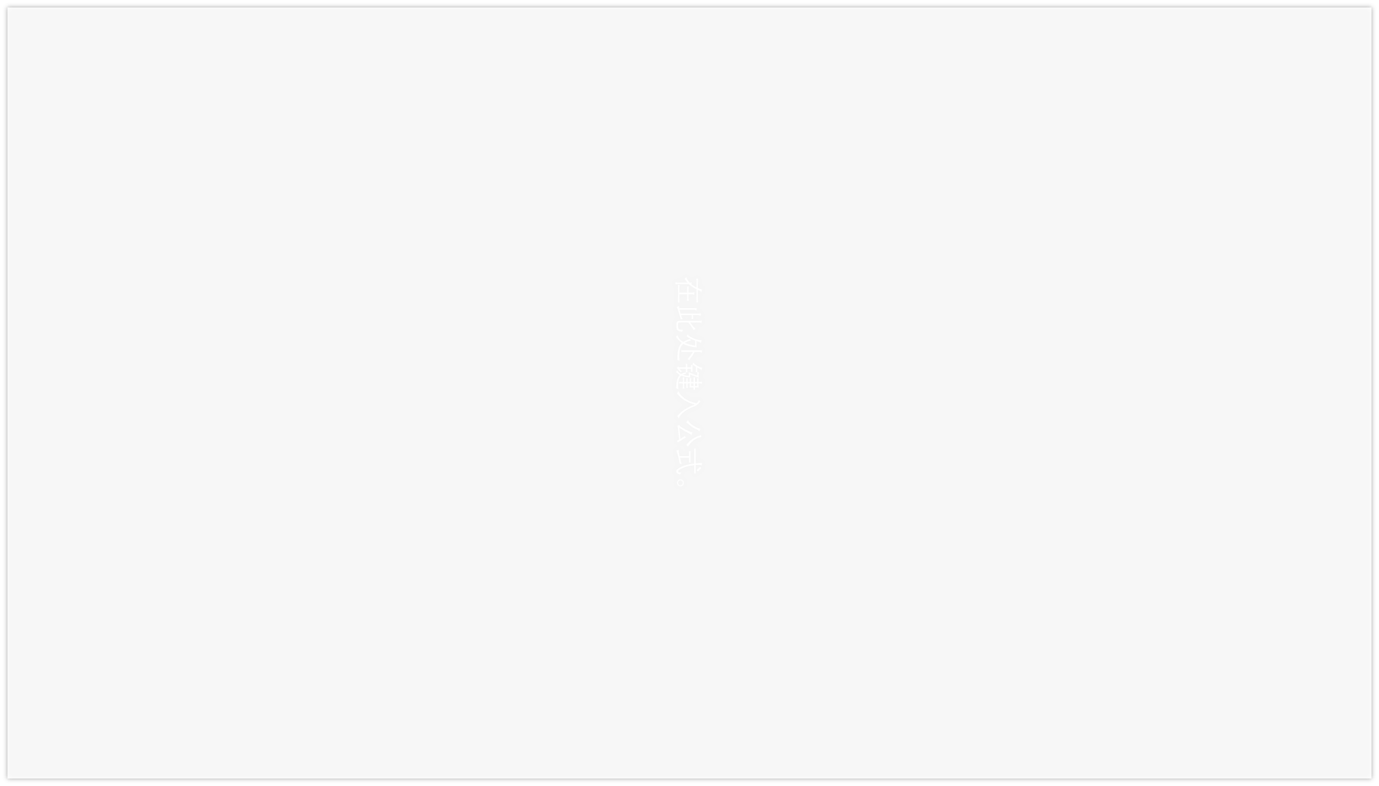
Calculational Framework
$$g\left(p_{1}\right)g\left(p_{2}\right)→g\left(p_{3}\right)H(p_{4})$$
produce an even more accurate calculation within
the SM.
Amplitude Structure $M^{abc}=f^{abc}ε_{1,μ}ε_{2,ν}ε_{3,ρ}^{∗}$
FeynCalc/FormLink
Fire&Kira
&Blade
Feynarts
DEs
EW-Renormalization

Slide 12
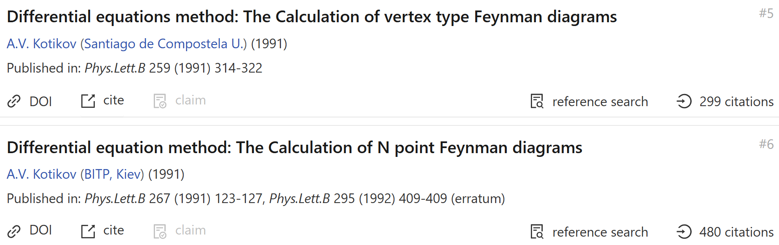
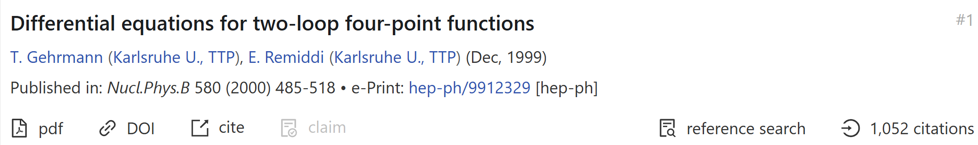
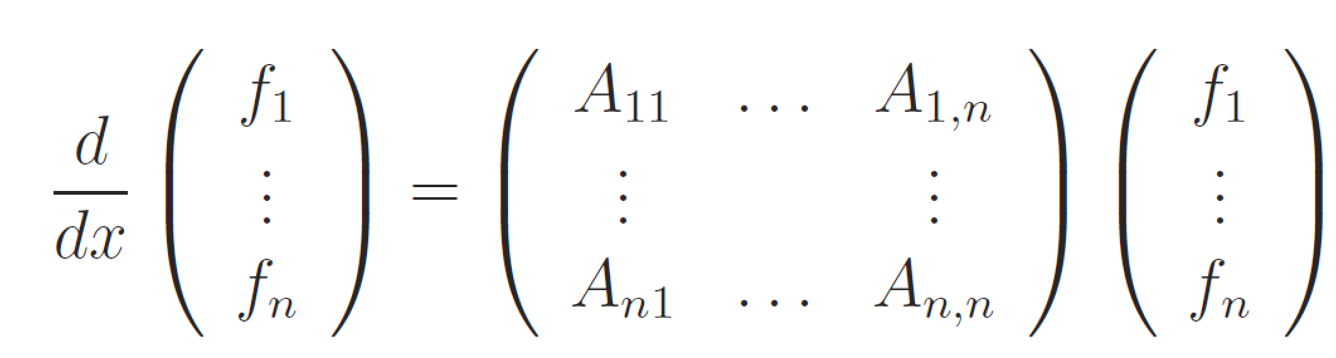
Method of Differential Equations
$f_{i}:$master integrals, x:Lorentz invariant kinematics

Slide 13
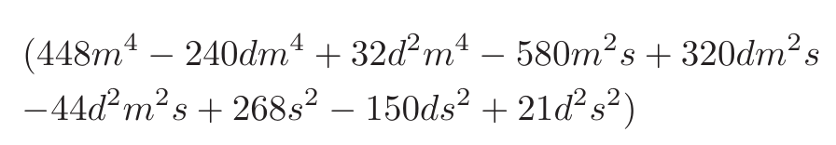
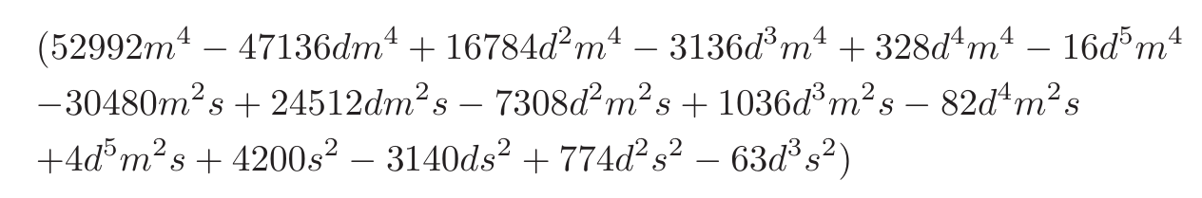
Choosing good basis
Bad Denominator could appear in the IBP reduction
Develop a method to search good basis
Construct good basis for all 108 families
Derive More simple DEs
AMFLOW to Calculate boundary conditions
Solving DEs numerically at all phase space points
Renomalization
produce an even more accurate calculation within
the SM.
Slow down the IBP reduction, results in more complicate DEs.
Good basis: basis whose IBP coefficients without bad denominators .
A.V. Smirnov, V.A. Smirnov, 2002.08042
Johann Usovitsch, 2002.08173

Slide 14
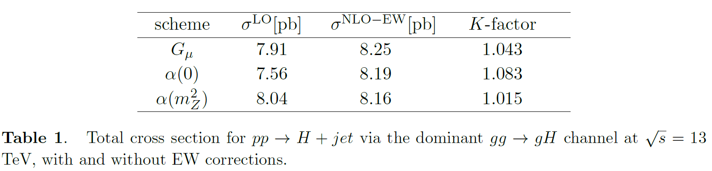
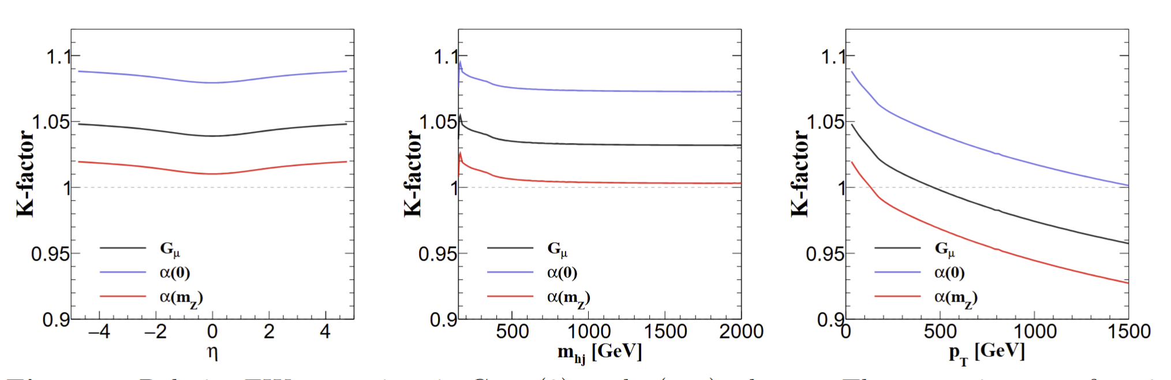
Results
produce an even more accurate calculation within
the SM.

Slide 15
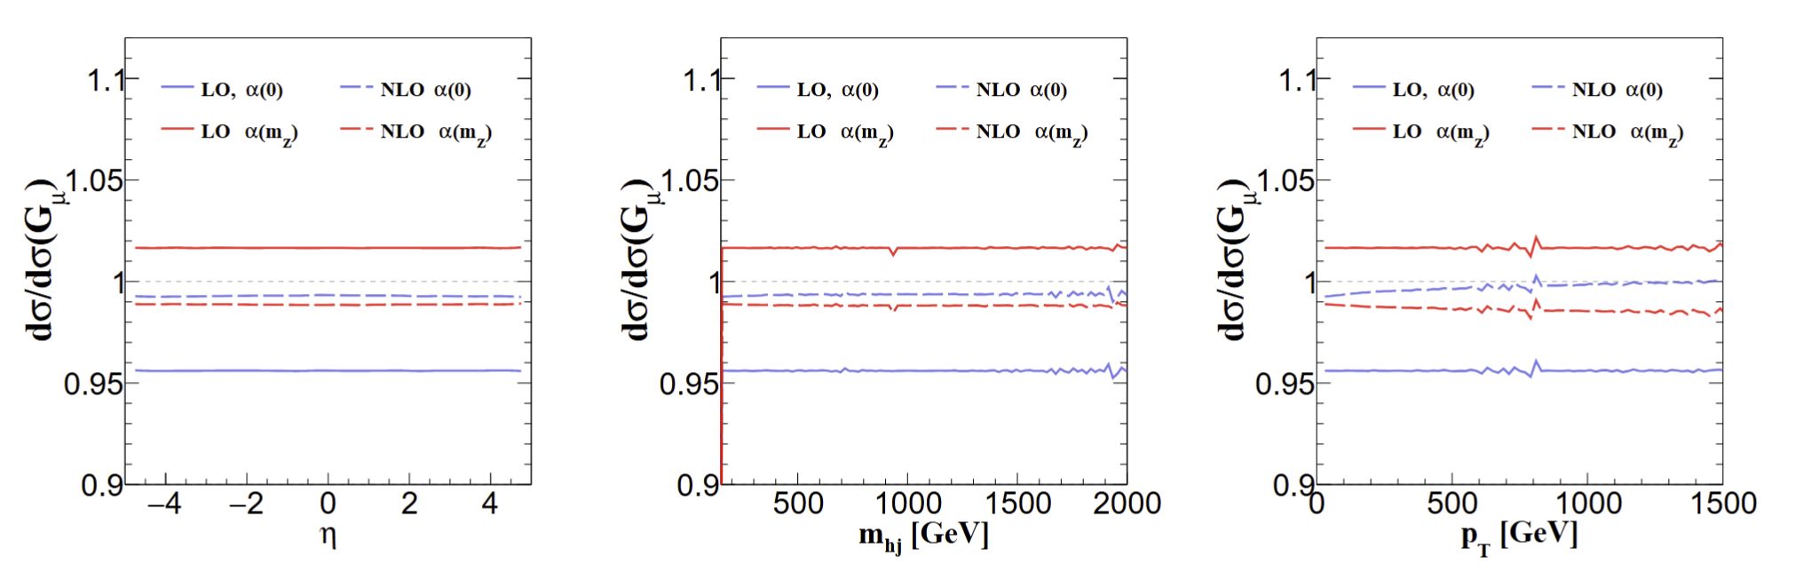
Results
produce an even more accurate calculation within
the SM.
EW corrections bringing the theoretical uncertainty under much tighter control.
Agree with:
Bi, Ma, Mu, 2508.02588

Slide 16

03
毕业论文答辩
EW corrections to Higgs boson rare decay $H→Zγ$
答辩人：小不点 答辩时间：5.5 指导老师：大不点
2404.11441(PRD-Letter), In collaboration with
Zi-qiang Chen, Cong-Feng Qiao, Ruilin Zhu

Slide 17
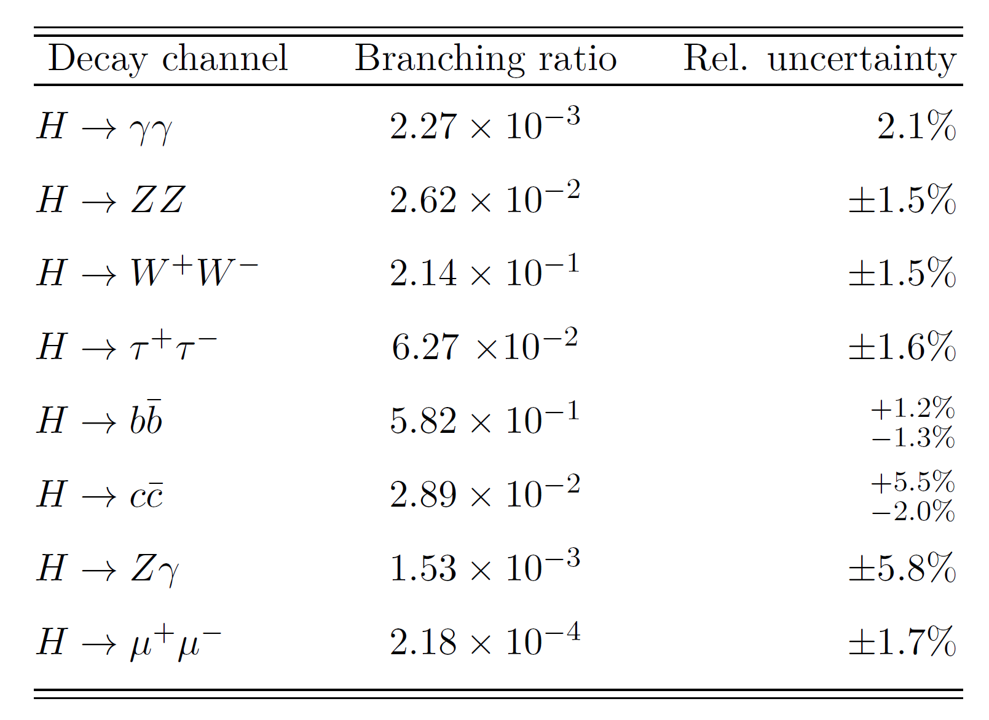
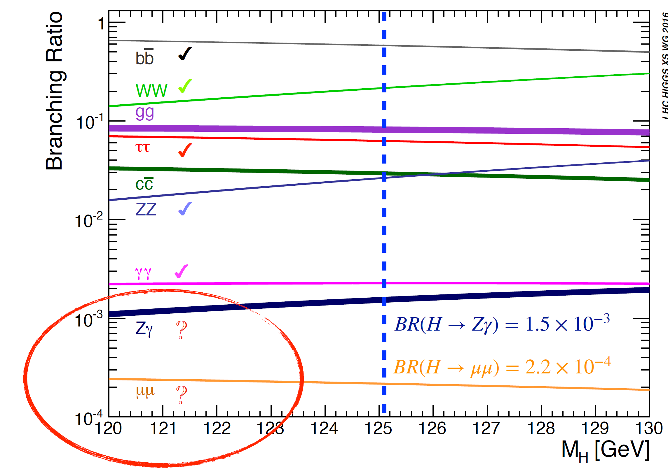
Higgs玻色子主要衰变道及分支比
毕业论文答辩
答辩人：小不点 答辩时间：5.5 指导老师：大不点

Slide 18
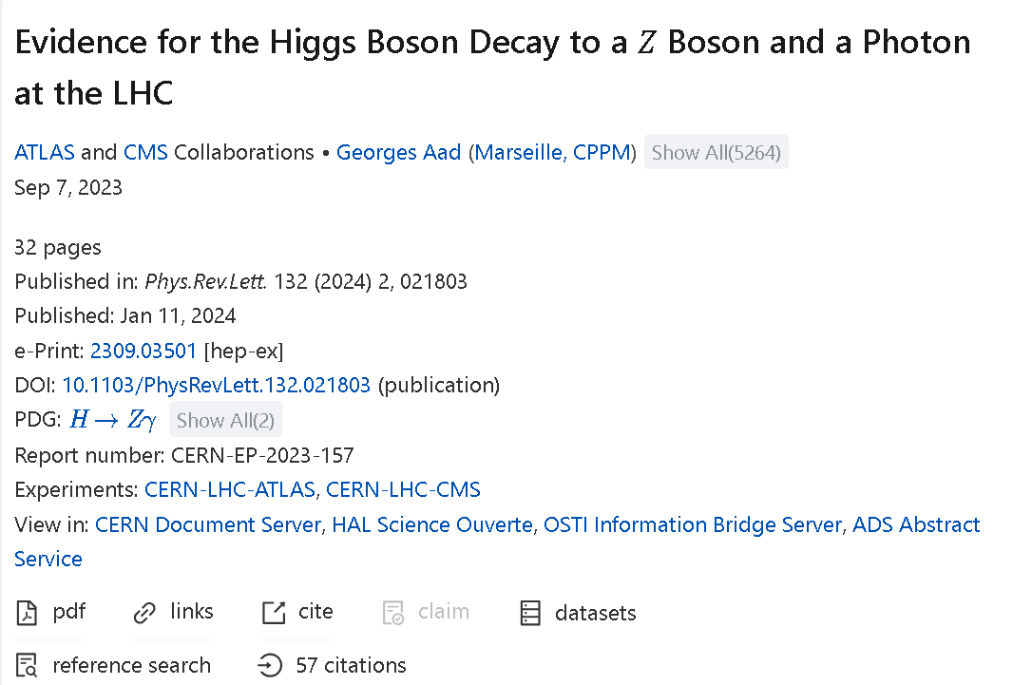

Experimental evidence
3.4 $σ$
Evidence (2309.03501) obtained from a combination of ATLAS (2005.05382) and CMS (2204.12945).
Previous searches: 1806.05996, 1402.3051, 1307.5515, 0806.0611 ...
毕业论文答辩
答辩人：小不点 答辩时间：5.5 指导老师：大不点
ATLAS and CMS, PRL 132 (2024) 021803 [2309.03501]

Slide 19
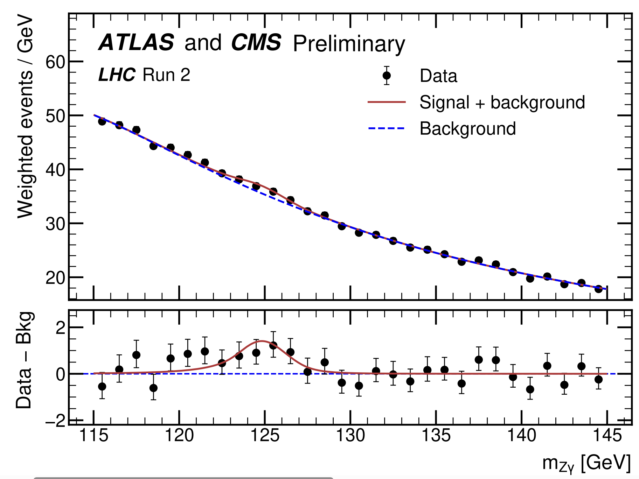


Experimental evidence
Branching Ratio:
$(3.4±1.1)×{10}^{−3}$
Signal Strength:
$μ=2.2±0.7$
produce an even more accurate calculation within
the SM.
$$(μ=σ_{exp}/σ_{SM})$$
Motivation: provide SM prediction as precise as possible.
ATLAS and CMS, PRL 132 (2024) 021803 [2309.03501]

Slide 20
Previous calculations
Leading order:
J.R. Ellis, M. K. Gaillard, D. V. Nanopoulos, Nucl. Phys. B 106 (1976) 292
R.N. Cahn, M. S. Chanowitz, N. Fleishon, Phys. Lett. B 82 (1979) 113-116
QCD corrections:
M. Spira, A. Djouadi, P. M. Zerwas, Phys. Lett. B 276 (1992) 350-353
T. Gehrmann, S. Guns, D. Kara, JHEP 09 (2015) 038 [1505.00561]
R. Bonciani, V. D. Duca, et al, JHEP 08 (2015) 108 [1505.00567]
Having found that the two-loop QCD corrections, which correct
the heavy–quark loop, equal about 0.22% of the leading order width, it is reasonable to
expect that the two-loop electroweak corrections, which correct the electroweak loop, will
yield a larger contribution
Numerical
Analytic
Analytic

Slide 21
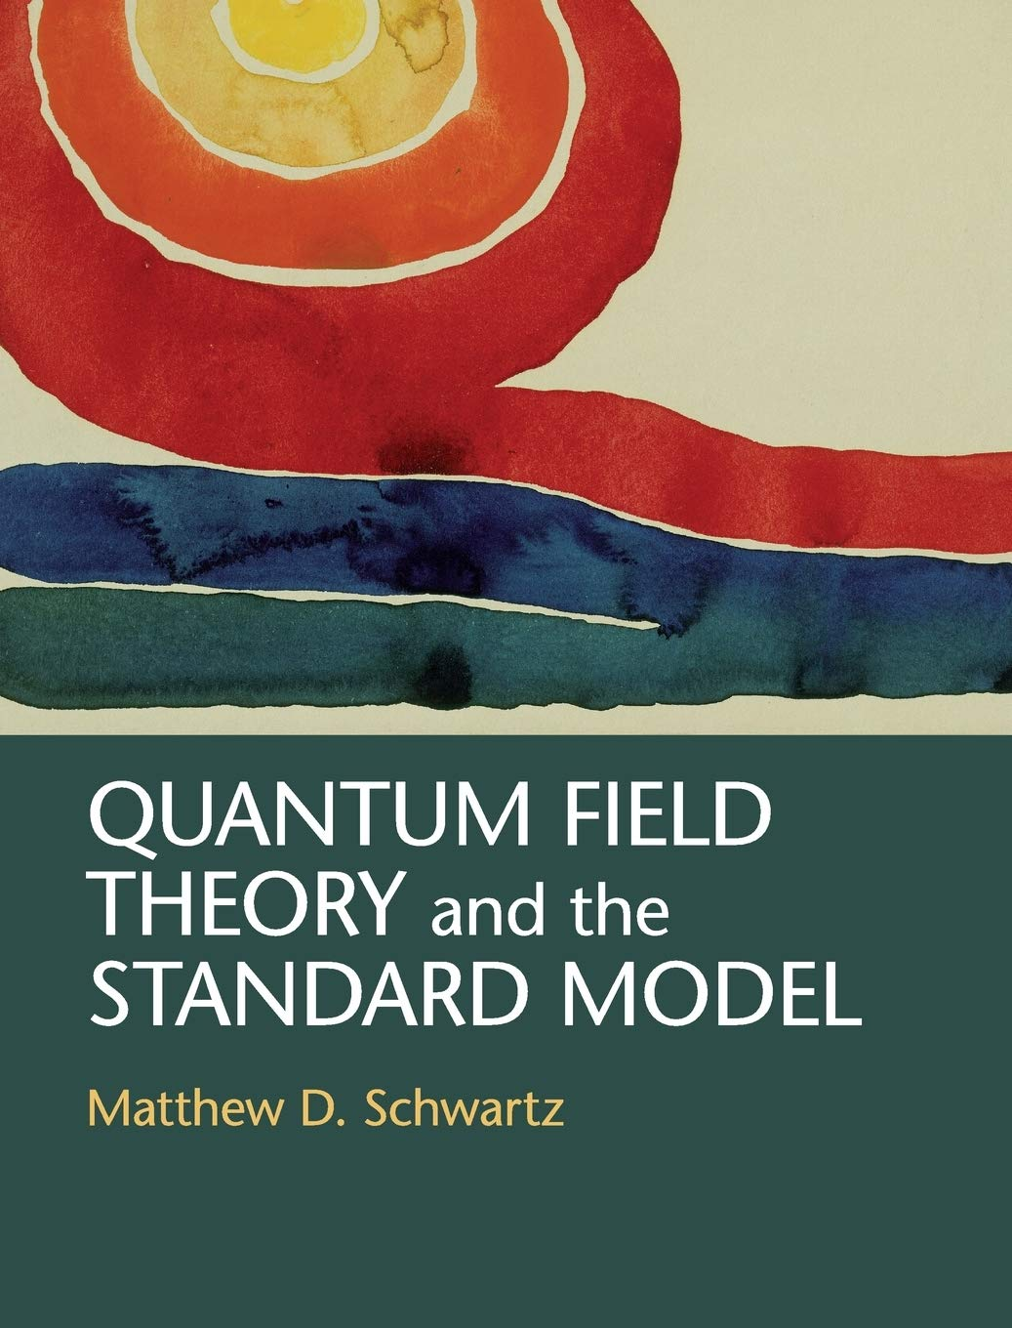
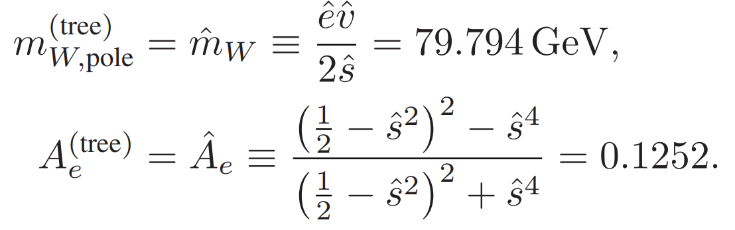
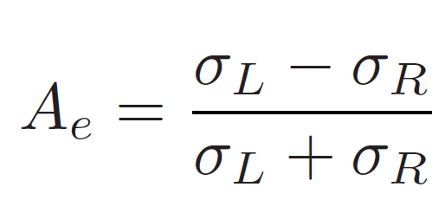
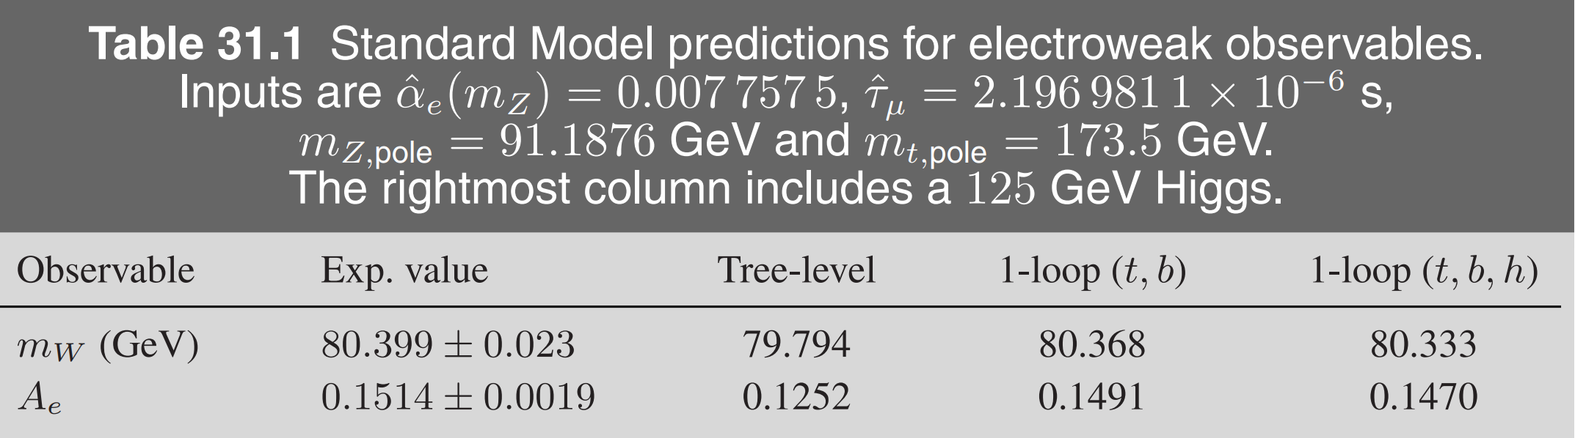
The necessity of electroweak corrections
LO-Outside the experimental bounds – by 40 standard deviations
Having found that the two-loop QCD corrections, which correct
the heavy–quark loop, equal about 0.22% of the leading order width, it is reasonable to
expect that the two-loop electroweak corrections, which correct the electroweak loop, will
yield a larger contribution

Slide 22
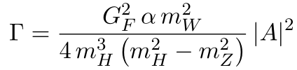



Why NLO EW?
The QCD corrections amount to 0.22% of the LO width. It is resonable to expect that the EW corrections will yield a larger contribution.
The theoretical uncertainty has not been fully discussed
  1505.00561:
  1505.00567:
Having found that the two-loop QCD corrections, which correct
the heavy–quark loop, equal about 0.22% of the leading order width, it is reasonable to
expect that the two-loop electroweak corrections, which correct the electroweak loop, will
yield a larger contribution
$$7.09 keV$$
$$6.68 keV$$

Slide 23
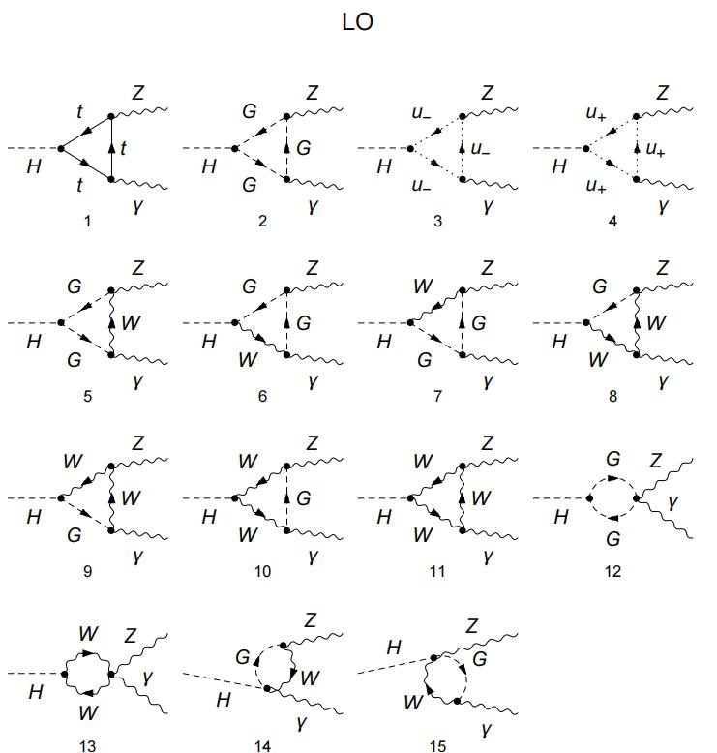
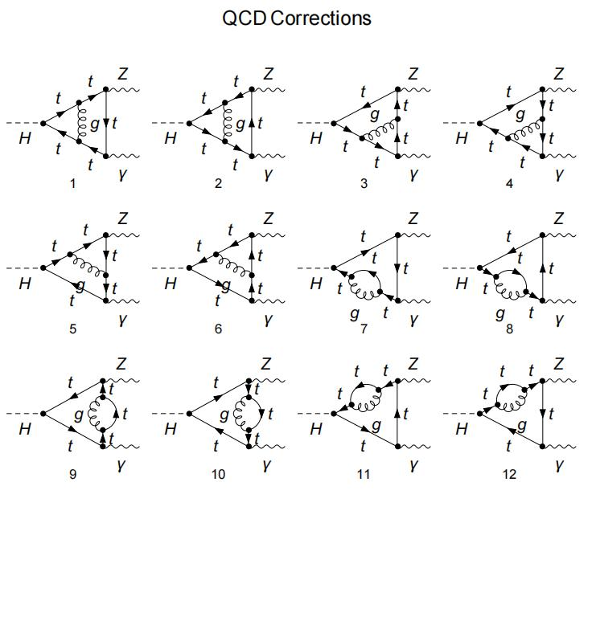
Why NLO EW?
The QCD corrections amount to 0.22% of the LO width. It is resonable to expect that the EW corrections will yield a larger contribution.
The theoretical uncertainty has not been fully discussed
  1505.00561:
  1505.00567:
Having found that the two-loop QCD corrections, which correct
the heavy–quark loop, equal about 0.22% of the leading order width, it is reasonable to
expect that the two-loop electroweak corrections, which correct the electroweak loop, will
yield a larger contribution
$$7.09 keV$$
$$6.68 keV$$

Slide 24

$${\left|Dia 1\right|}^{2}+intf. \sim −10\%$$
Why NLO EW?
The QCD corrections amount to 0.22% of the LO width. It is resonable to expect that the EW corrections will yield a larger contribution.
The theoretical uncertainty has not been fully discussed
  1505.00561:
  1505.00567:
Having found that the two-loop QCD corrections, which correct
the heavy–quark loop, equal about 0.22% of the leading order width, it is reasonable to
expect that the two-loop electroweak corrections, which correct the electroweak loop, will
yield a larger contribution
$$7.09 keV$$
$$6.68 keV$$

Slide 25
Why NLO EW?
The QCD corrections amount to 0.22% of the LO width.
It is reasonable to expect that the EW corrections will yield a larger contribution.
The theoretical uncertainty has not been fully discussed
  1505.00561:
  1505.00567:
Having found that the two-loop QCD corrections, which correct
the heavy–quark loop, equal about 0.22% of the leading order width, it is reasonable to
expect that the two-loop electroweak corrections, which correct the electroweak loop, will
yield a larger contribution
$$7.09 keV$$
$$6.68 keV$$

Slide 26
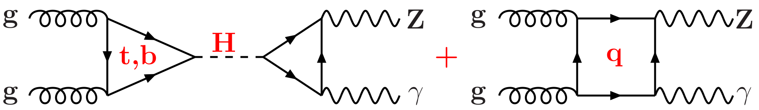
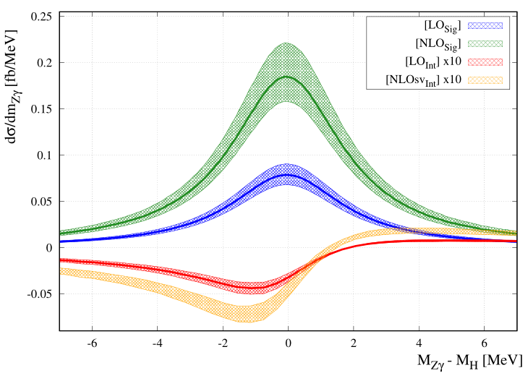
Previous work
Signal background interference: F. Buccioni, F. Devoto, A. Djouadi, et. al, Phys. Lett. B 851 (2024) 138596 [2312.12384]
Having found that the two-loop QCD corrections, which correct
the heavy–quark loop, equal about 0.22% of the leading order width, it is reasonable to
expect that the two-loop electroweak corrections, which correct the electroweak loop, will
yield a larger contribution
Interference effects (Higgs resonance & nonresonance) are small...

Slide 27
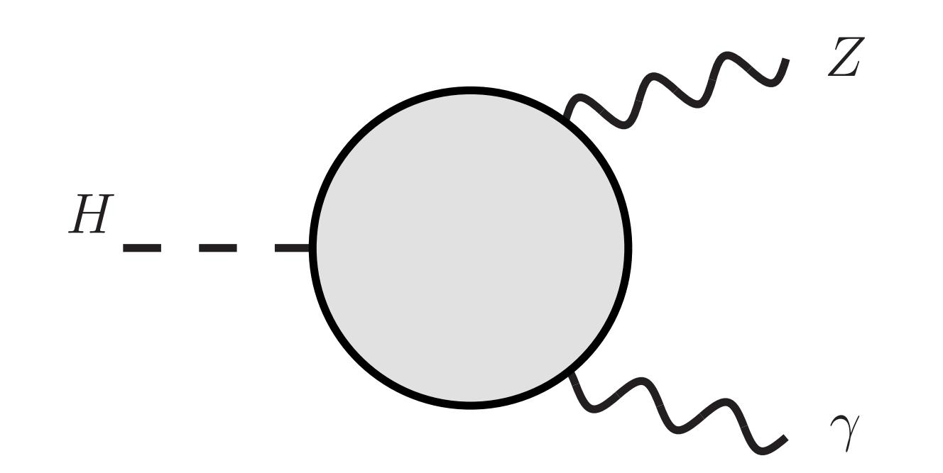
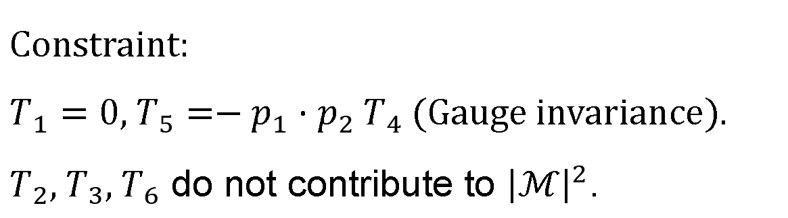

Lorentz structure
$H→Z(p_{1})γ(p_{2})$
$ℳ=T^{μν}ε_{μ}^{∗}(p_{1})ε_{ν}^{∗}(p_{2})$
毕业论文答辩
$$T^{μν}=T_{1}p_{1}^{μ}p_{1}^{ν}+T_{2}p_{2}^{μ}p_{2}^{ν}+T_{3}p_{1}^{μ}p_{2}^{ν}+T_{4}p_{2}^{μ}p_{1}^{ν}+T_{5}g^{μν}+T_{6}ε^{μνρσ}p_{1ρ}p_{2σ}$$
答辩人：小不点 答辩时间：5.5 指导老师：大不点
Constraint:
$T_{1}=0$, $T_{5}=−p_{1}⋅p_{2} T_{4}$ (Gauge invariance).
$T_{2}, T_{3}, T_{6}$ do not contribute to ${\left|ℳ\right|}^{2}$.

Slide 28
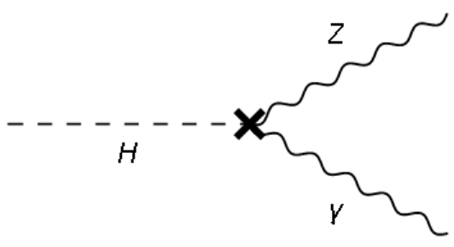
Lorentz structure
$H→Z(p_{1})γ(p_{2})$
$ℳ=T^{μν}ε_{μ}^{∗}(p_{1})ε_{ν}^{∗}(p_{2})$
毕业论文答辩
$$T^{μν}=T_{1}p_{1}^{μ}p_{1}^{ν}+T_{2}p_{2}^{μ}p_{2}^{ν}+T_{3}p_{1}^{μ}p_{2}^{ν}+T_{4}p_{2}^{μ}p_{1}^{ν}+T_{5}g^{μν}+T_{6}ε^{μνρσ}p_{1ρ}p_{2σ}$$
答辩人：小不点 答辩时间：5.5 指导老师：大不点
Constraint:
$T_{1}=0$, $T_{5}=−p_{1}⋅p_{2} T_{4}$ (Gauge invariance).
$T_{2}, T_{3}, T_{6}$ do not contribute to ${\left|ℳ\right|}^{2}$.
Do not need in the calculation of $T_{4}$.

Slide 29
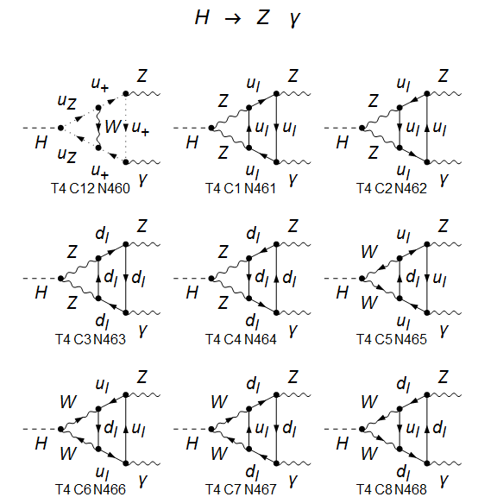
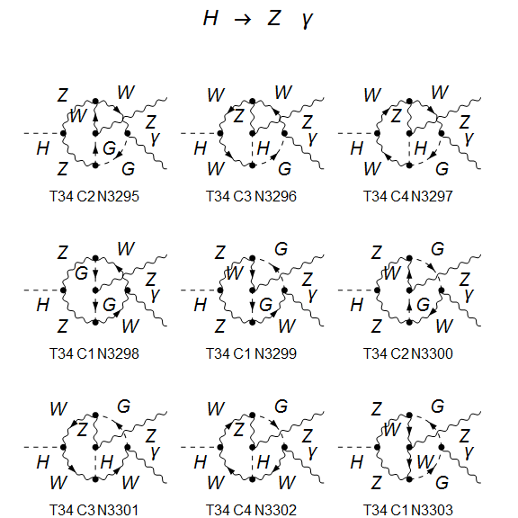
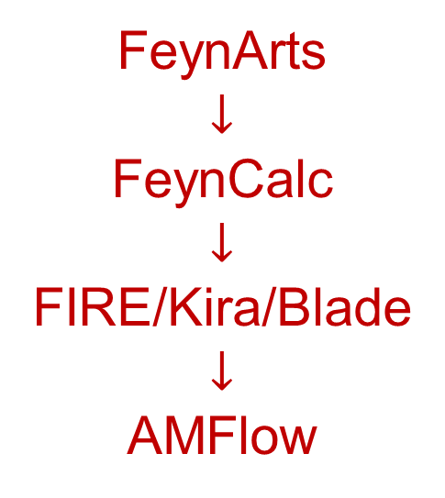
Calculation Framework
About 5000 Feynman diagrams (Feynman gauge)
FeynArts
$$↓$$
FeynCalc
$$↓$$
FIRE/Kira/Blade
$$↓$$
AMFlow

Slide 30
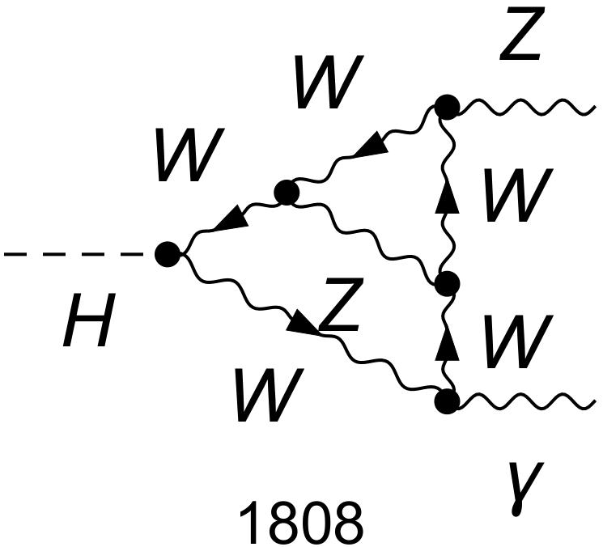


Electroweak coupling
Renomalization
Denner, arXiv:0709.1075
We work in the on-shell renormalization scheme.
Use five different electroweak coupling schemes:
$α(0)$ scheme: all to $α(0)$;
$α(M_{Z}^{2})$ scheme: all to $α(M_{Z}^{2})$;
$α_{G_{μ}}$ scheme: all to $α_{G_{μ}}$;
mixed 1: the one connecting to the external photon to $α(0)$, others to $α(M_{Z}^{2})$;
mixed 1: the one connecting to the external photon to $α(0)$, others to $α_{G_{μ}}$.
no $ln(m_{f})$ terms
毕业论文答辩
答辩人：小不点 答辩时间：5.5 指导老师：大不点

Slide 31
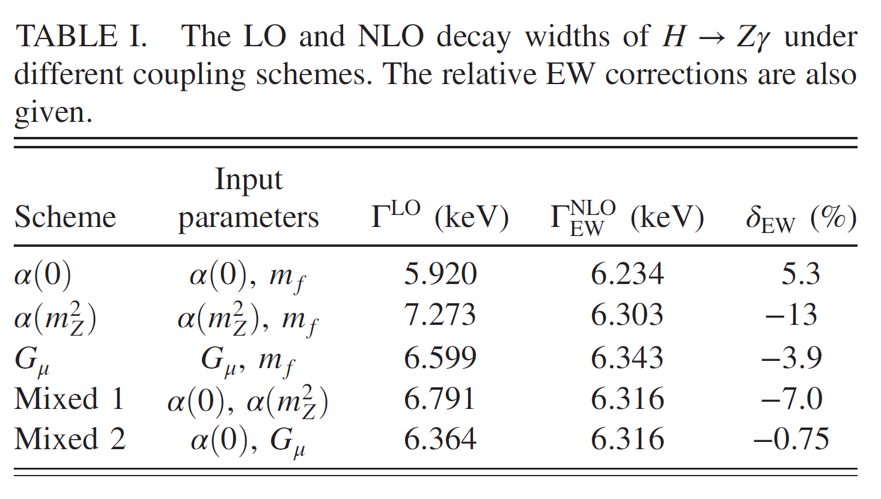
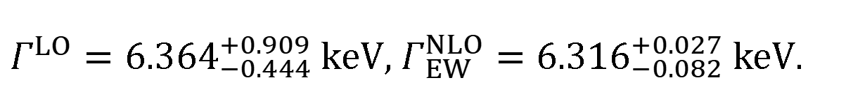

Numerical results
毕业论文答辩
答辩人：小不点 答辩时间：5.5 指导老师：大不点
$Γ^{LO}={6.364}_{−0.444}^{+0.909} keV$, $Γ_{EW}^{NLO}={6.316}_{−0.082}^{+0.027} keV$.
Agree with:
Sang, Feng, Jia, 2405.03464

Slide 32

Numerical results
The EW corrections
more significant than the QCD corrections
greatly suppress the theoretical uncertainty
毕业论文答辩
答辩人：小不点 答辩时间：5.5 指导老师：大不点
$Γ^{LO}={6.364}_{−0.444}^{+0.909} keV$, $Γ_{EW}^{NLO}={6.316}_{−0.082}^{+0.027} keV$.

Slide 33

Numerical results
Combining EW, QCD, $b$-mass corrections: $Γ^{H→Zγ}={6.348}_{−0.085}^{+0.028} keV$
Branching ratio (with SM total width):
毕业论文答辩
答辩人：小不点 答辩时间：5.5 指导老师：大不点

Slide 34
Numerical results
Combining EW, QCD, $b$-mass corrections: $Γ^{H→Zγ}={6.348}_{−0.085}^{+0.028} keV$
Branching ratio (with SM total width):
毕业论文答辩
The EW corrections exacerbate the tension.
答辩人：小不点 答辩时间：5.5 指导老师：大不点

Slide 35


Kun Liu’s Talk at CERN
毕业论文答辩
答辩人：小不点 答辩时间：5.5 指导老师：大不点
https://indico.cern.ch/event/1567538/

Slide 36

Recent experiment results
毕业论文答辩
答辩人：小不点 答辩时间：5.5 指导老师：大不点

Slide 37

Combination of Run 2 and Run 3
毕业论文答辩
Agree with SM prediction.
答辩人：小不点 答辩时间：5.5 指导老师：大不点
Credit: Kun Liu

Slide 38

Conclusion and Outlook
Electroweak corrections are non-negligible for the precise testing of the SM and the search for new physics.
For gg->Hg production, EW corrections amount to a few percent enhancement of the total cross section, with a value of approximately 4.3% in the $G_{μ}$scheme. The differential distributions reveal non-trivial kinematic dependence.
We calculate NLO electroweak corrections to $H→Z γ$, obtain most precise prediction for this channel. The SM prediction agree with recent measurement.
毕业论文答辩
答辩人：小不点 答辩时间：5.5 指导老师：大不点

Slide 39


毕业论文答辩
Thank You！
答辩人：小不点 答辩时间：5.5 指导老师：大不点

