Slide 1
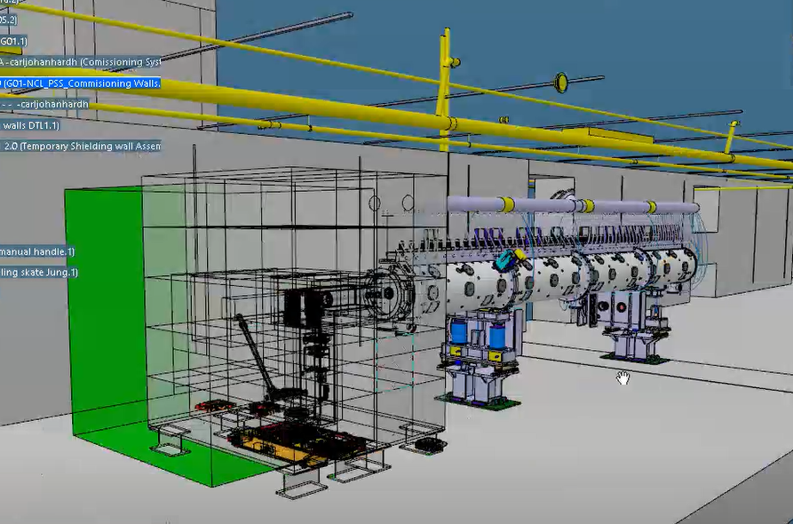
DTL FC(s) shielding(s) - design review
DTL FC2 - to be installed after DTL tank 1
DTL FC4 - to be installed after DTL tank 4
Main components:
1) FC holder
2) Inner core (metallic)
3) Outer blocks (concrete)
4) Metallic plates (external, new!)
Current plan in P6:
IFC FCS 23-Dec-2020
Shielding Procurement ends on 5-March-2020
Shielding Installation ends on 17-March-2020
Shielding/FC Ready for system tests 24-March-2020

Slide 2
CHARGE QUESTIONS
1) Are there any differences with respect to the simulated and documented shielding in ESS-0136227?
2) Is the design and all the corresponding documentation ready to start the CHESS release?
3) Are the main approver and the reviewers identified for the CHESS release?
4) Can the procurement start right after the CHESS release?
5) Is there any possible issue identified in relation to the newly introduced external metallic plates?
6) Is there a consensus on the transportation strategy before the installation and after the uninstallation?
7) What are the foreseen risks during the transportation of the whole shielding?
8) Are there any issues due to the structural loads?
9) Are there any impediments foreseen during service, maintenance and emergency situations?
10) Are there any potential safety issues?
Committee members are free to add further questions during the review.

