Slide 1
On-det interface defined（ progress since last IDRC）
Detector | Max data rate per fiber (Gbps) | Fibers per module | Fiber sum | BEE sum | Data crate sum | Module Max Power (W) | Total Power (kW) | Power channels | Power crate sum | HV requirements | HV channels sum | HV crates sum
VTX | 8 | 1~2 | 88 | 6 | 1 | 25 | 0.45 | 66 | 2 | ~-10V | 66 | 1
TPC | 0.1 | 1 | 496 | 32 | 4 | 32.2 | 16 | 496 | 6 | -500V | 496 | 4
ITK-Barrel | 0.96 | 1 | 2376 | 149 | 15 | 11.2 | 26.6 | 2376 | 25 | 50~200V | 2376 | 10
ITK-EndCap | 2.2 | 1 | 1236 | 78 | 8 | 11.2 | 13.8 | 1236 | 2 | 50~200V | 1236 | 8
OTK-Barrel | 1.4 | 1 | 880 | 34 | 4 | 27.6 | 195 | 2640 | 55 | 150~200V | 880 | 4
OTK-EndCap | 0.7 | 1 | 544 | 45 | 6 | 27.6 | 60 | 1632 | 34 | 150~200V | 544 | 4
ECAL-Barrel | 4.8 | 4 (2) | 1920 | 60 | 6 | 31 | 17.5 | 480 | 5 | 40~60V | 480 | 2
ECAL-EndCap | 4.8 | 4 (2) | 896 | 28 | 4 | 31 | 9.5 | 224 | 4 | 40~60V | 224 | 2
HCAL-Barrel | 0.14 | 1 | 5536 | 346 | 36 | 9 | 66.1 | 5536 | 58 | 40~60V | 5536 | 26
HCAL-EndCap | 1.75 | 1 | 3072 | 192 | 20 | 11 | 41.3 | 3072 | 32 | 40~60V | 3072 | 14
Muon-Barrel | 0.004 | 1 | 288 | 18 | 2 | 2.6 | 0.76 | 288 | 3 | 40~60V | 288 | 2
Muon-EndCap | 0.01 | 1 | 96 | 6 | 1 | 4.7 | 0.45 | 96 | 1 | 40~60V | 96 | 1
Sum |  |  | 17428 | 994 | 107 |  | 447.46 | 18142 | 227 |  | 15294 | 78
Only FEE Power summarized in the table. Extra power for BEE & crate efficiency will be considered in the mechanical system for the counting room
Figure 11.61

Slide 2
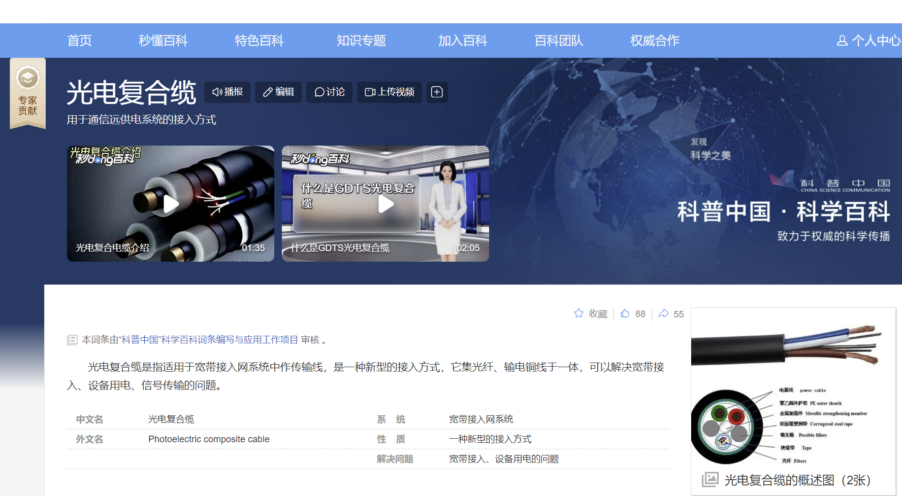
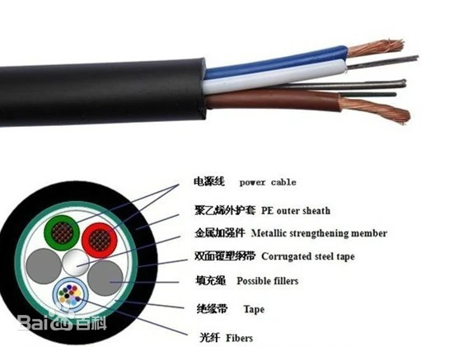
Photoelectric composite cable
Photoelectric composite cable is a common practice in the industry field
Introduction of the composite cable will be added by today 24:00
“ref”: https://baike.baidu.com/item/%E5%85%89%E7%94%B5%E5%A4%8D%E5%90%88%E7%BC%86/1288906

Slide 3
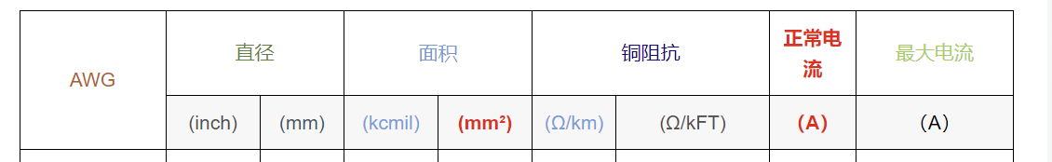
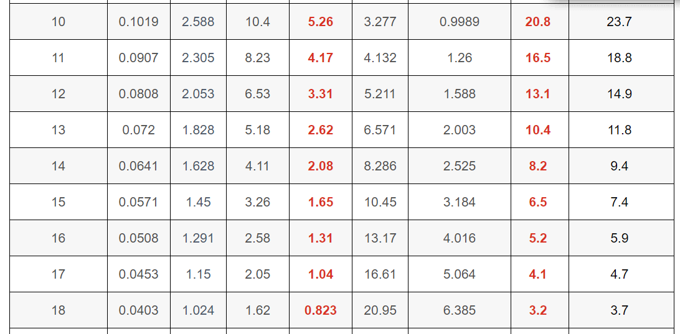
Diameter of cables
https://blog.csdn.net/weixin_42618564/article/details/105155494

Slide 4
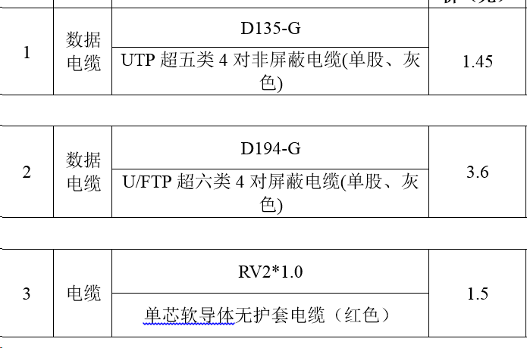
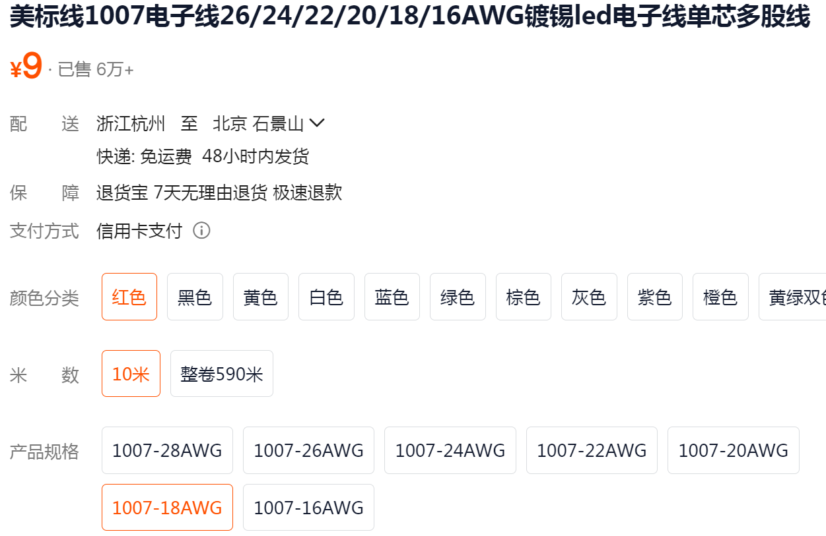
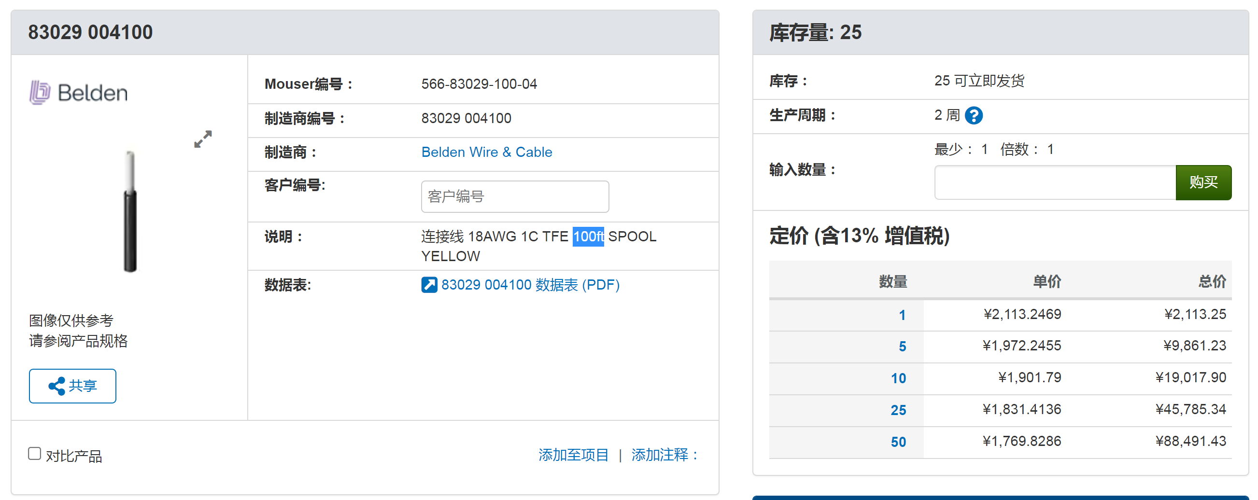
Cable
Cable estimation
  Power cable：LV+GND+HV+GND，4 wires/cable，3m/cable = 25rmb/cable -> 8.5rmb/m/cable
  On-det Data cable@CAL (twisted-pair) ：2-pair twisted cable，3meter，5rmb/m
    HCAL：30RMB （ ~500ch） → 0.05RMB/ch
    ECAL ： 0

Slide 5
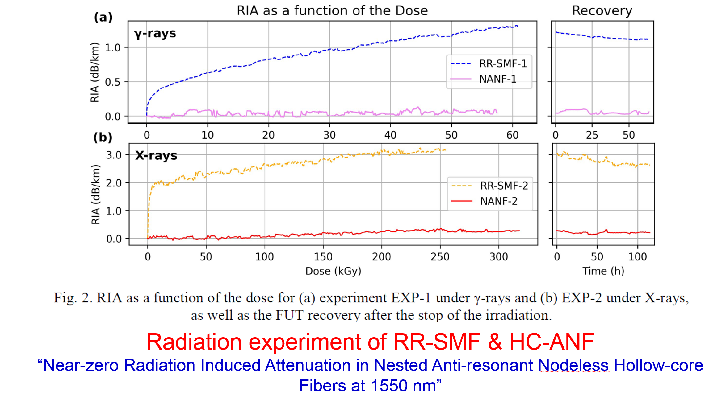
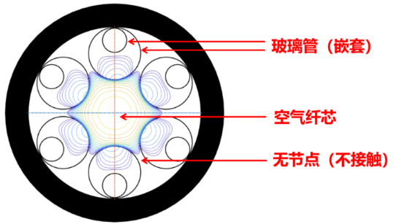
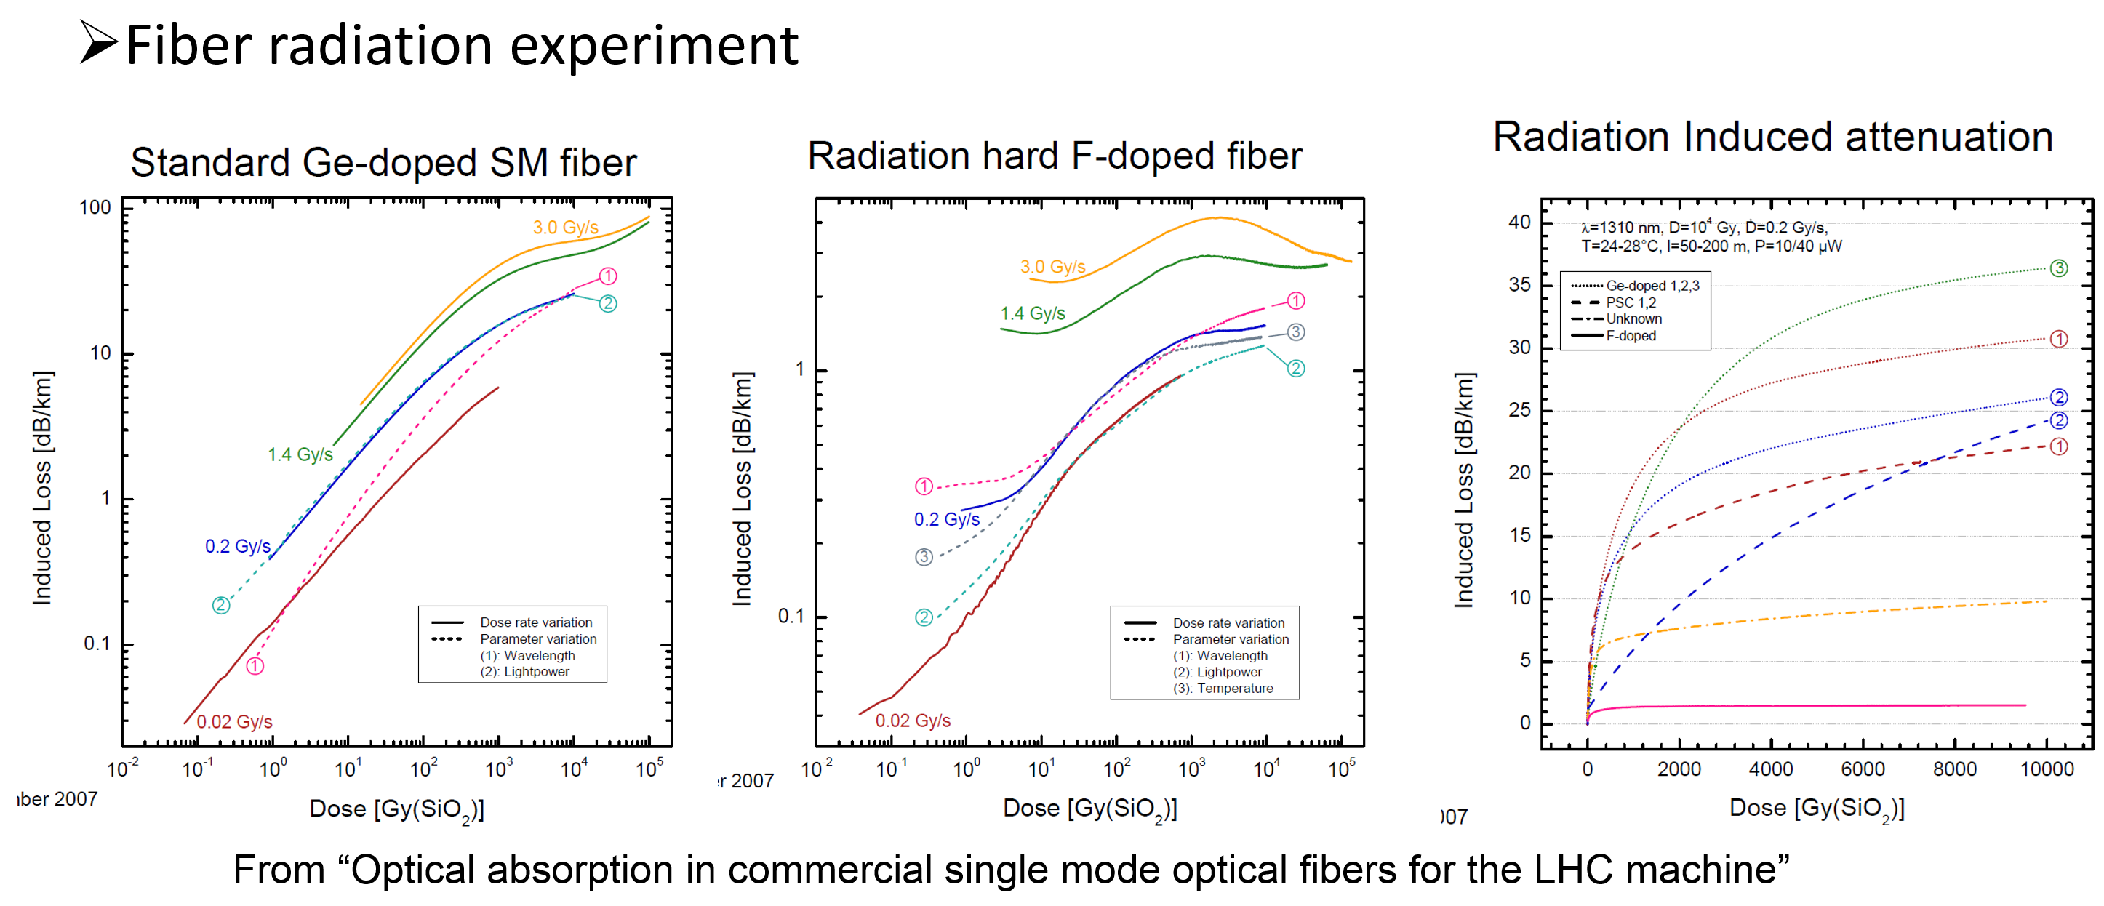
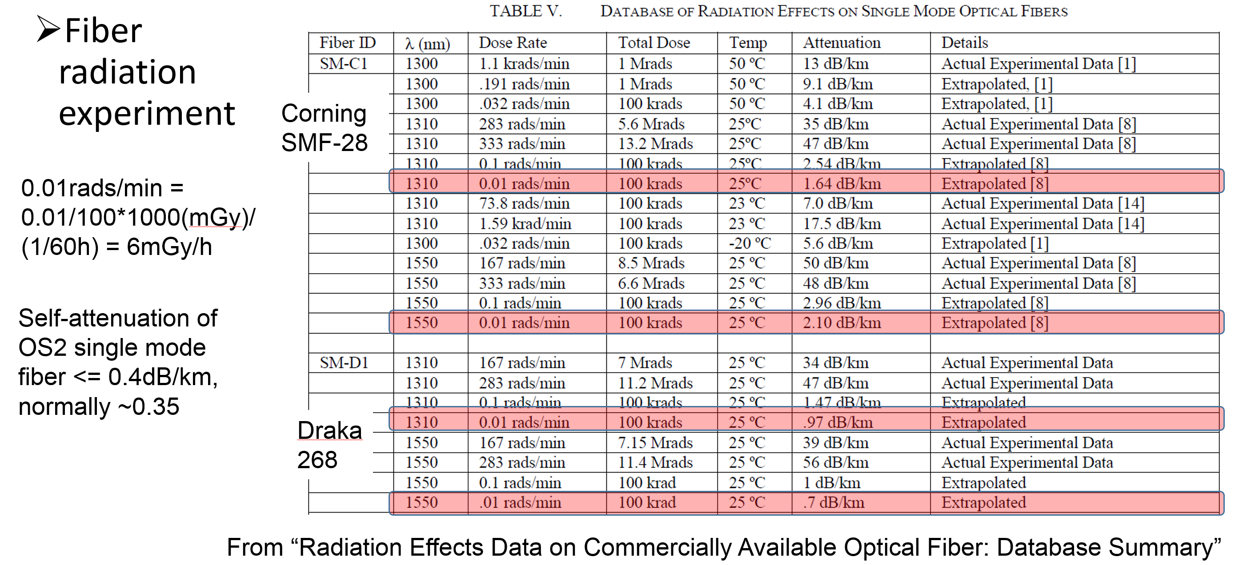
Fiber
Quotation from CEPC Day (February 20, 2025) · Indico of IHEP (Indico)）
  Normal Ge-doped Fiber <10RMB/m
    * qualified for the on-det data transmission
    Others too expensive
  F-doped rad-tol fiber 50RMB/m (48-core 2000RMB/m)
  Air-core fiber ~hundred RMB/m

Slide 6
Patch panel
Patch panel: cable socket & fiber reshuffle
100m to the countring room
e.g. Muon
TRK
Barrel-Endcap surface

Slide 7
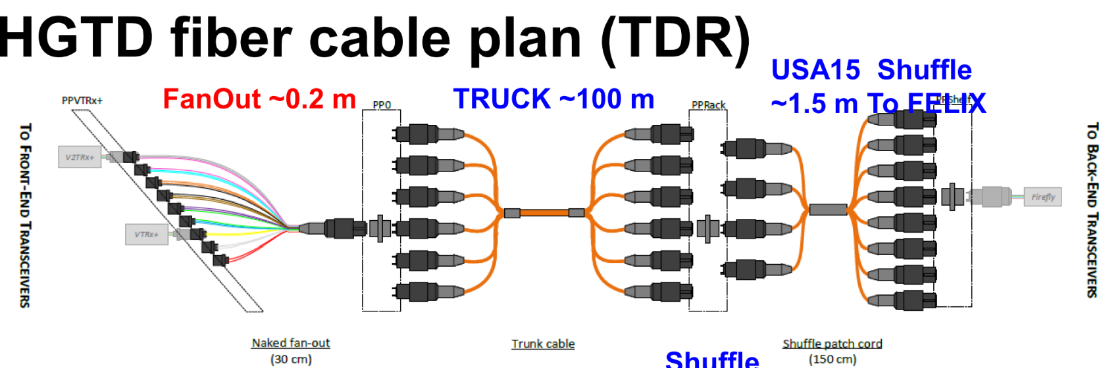
Fiber reshuffle
Reference: HGTD Design
Detector-internal reshuffle: Custom-made, ~CNY 80/fiber
  Left PP0: Custom-made, ~CNY 80/fiber
Detector-external: Commercial standard, CNY 30-40/fiber
  Right PPpack: Commercial product, CNY 30-40/fiber
  Ref: JD.com item 10037720497421: https://item.jd.com/10037720497421.html
Fiber connectors: CNY 10/unit
  Ref: JD.com item 10101961646374: https://item.jd.com/10101961646374.html

Slide 8



BACKUP – Counting room
Aug. 7th, 2024, CEPC Detector Ref-TDR Review

Slide 9
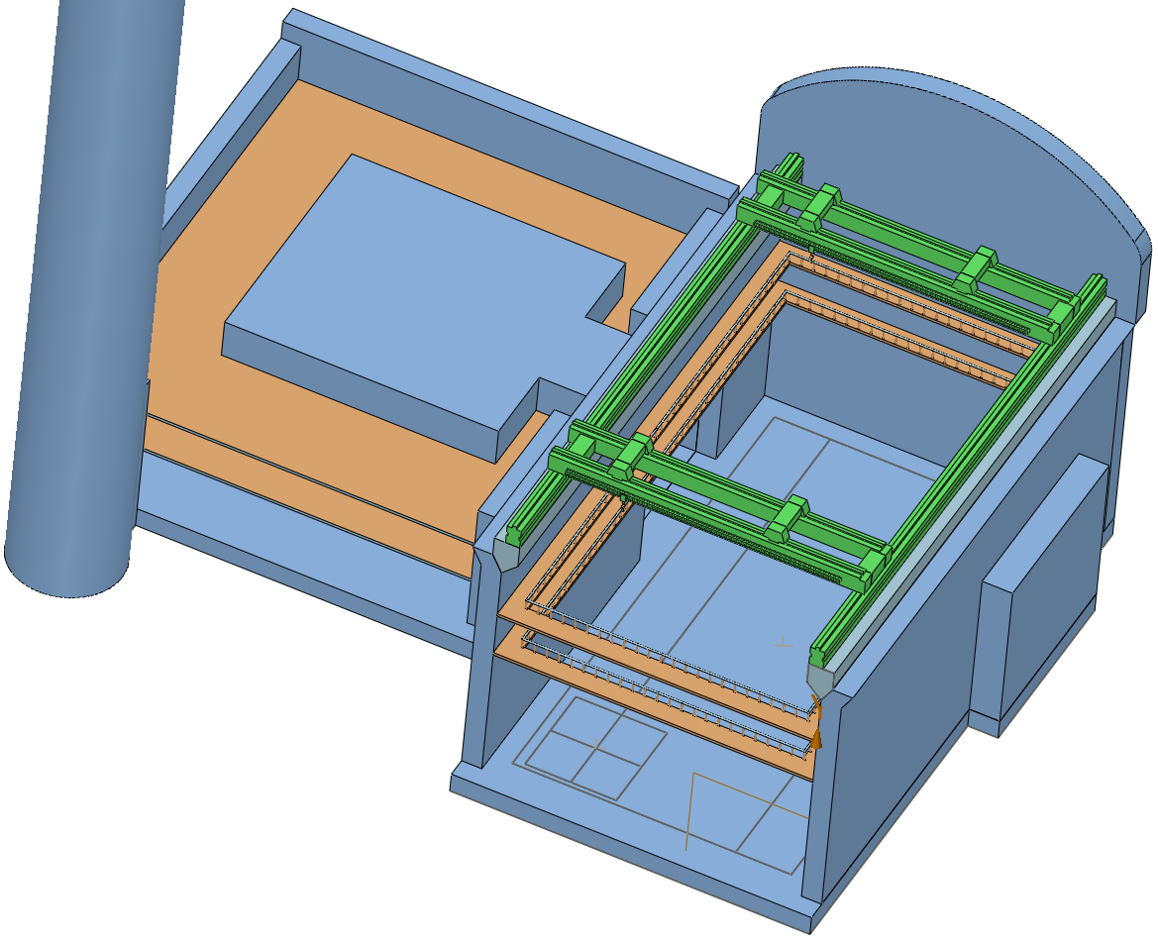
Electronics in the counting room
Minimum crates from current MDI
  107 data crates, 227 power crates, 78 Det-HV crates, 20 Trigger crates
Minimum racks from current MDI
  37 data racks, 24 power racks, 23 Det-HV racks, 10 trigger racks (94 in total)
  More 2 racks for AC-DC power for all the above racks
  96 racks in total
Racks Size: 0.5m × 0.5m
Side clearance 1.5m for heat, face clearance 2m for cabling & heat
  Very rough estimation: 20% more power will be consumed due to the crate efficiency
Total room: 500m²×2floor = 25m × 20m × 2floor
  10 × 10 × 2=200 racks capacity
  Necessary redundancy for future upgrade
See Quan Ji’s talk on Mechanics

Slide 10
Consideration according to the detector design
Background rate
Module Data rate > 10Gbps?
no
1 Fiber/Module
Data Link
Fiber Number
×
yes
2 Fiber/Module
Chip+Module Design
×
Overall Design
(Module Number)
×
×
+
Fiber Power
Detector chip/module/overall
Power
Chn Power
Module Power
Too High?
no
Power Combine
Power Chn
yes
Separate Power
HV
SHV
×
HV
Chn
Normal HV

Slide 11
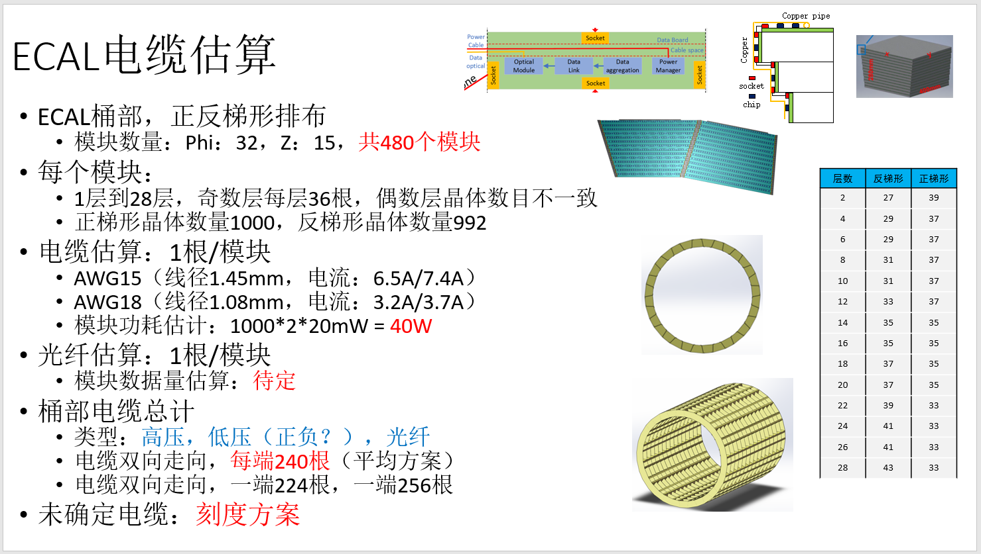
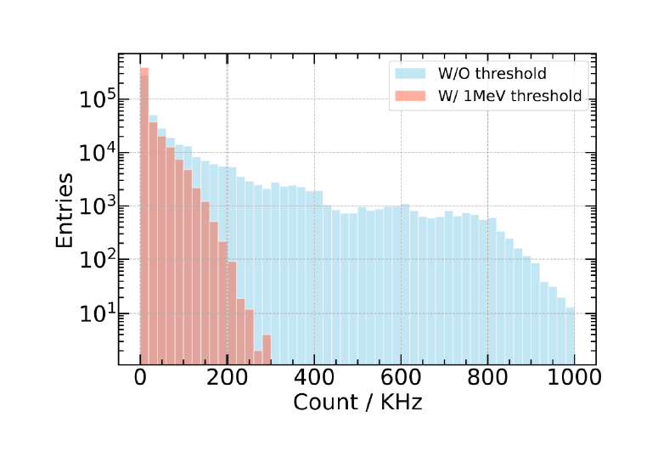
An example of sub-detector consideration (ECAL)
The overall detector design: ~480 Module (Dual-trapezium scheme), ~1000 bar/module
Current bkgrd estimation: avg. event rate 100kHz / crystal bar w/ threshold; Data width 48bit/event (current ASIC scheme)
@Dual readout each crystal bar, total data rate: 1000*100kHz*48bit*2ends=9.6Gbps, not possible for 1 fiber for each module, at least 2 fibers for each module
  For max. bkgrd rate@300kHz@Higgs, also needs enough room
  For Z pole, bkgrd will be much higher, also needs extra room

Slide 12
An example of sub-detector consideration (ECAL)
Data Link:
  Fibers: 480*2=960, -> 60 BEE Brds, 6 crates
Power:
  ASIC: 15mW/ch, each module 1000*2*15mW=30W
    Within the capability of DC-DC power module
  Data Link + Optical Power: 1W each
  Total Power: 31W/0.85*480=17.5kW
    Efficiency of the DC-DC: 85%
  Power chn 100W/chn, each module per power cable: 480 power chn -> power crates 10
HV:
  Sch 1: one HV chn for each module, (limitedly) compensated for each SiPM in ASICs
  HV channels = module number = 480， -> 2 HV crates
  Alt sch2：HV chn for each SiPM? Too many channels & too large control data volume (×)
  Alt sch3：HV chn for sub-region of a module, to compensate the temperature gradient
    Maybe much optimized than sch1，but rely on the detector simulation

Slide 13
Note for the calculation
Avg. & Max background rate both are important
  Max bkgrd rate to calculate the room for the data rate
  Avg bkgrd rate to calculate the total data rate for the electronics –TDAQ interface
Detailed detector design, including the module vs. chip, is necessary for the electronics cabling, powering and HV scheme
  Chip on module to evaluate electronics readout scheme (data link, power, aggregation)
  Overall detector design to evaluate the cabling, HV and crate channels
According to the current electronics design, most detector module following the “1 fiber + 1 Power” manner
  Most module data rate at the level of Gbps, a fiber channels @10Gbps level is proper
  Although the room for a power channel at the module level is large, current scheme not consider power channel merge
    Otherwise needs extra power aggregation board on detector, means extra room and increasing difficulty for Mechanics
    Several detector with enough space (esp. endcaps) with very low power, power channel merge can still be considered

Slide 14
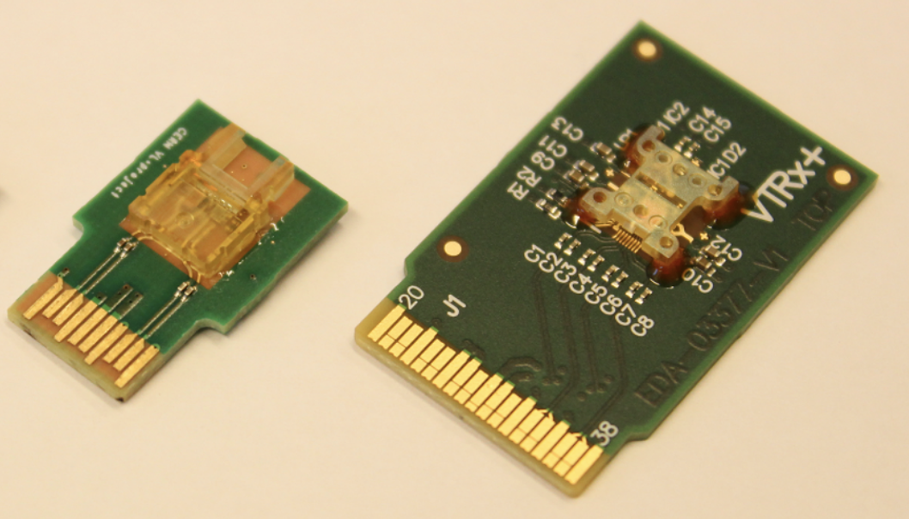
Main parameters for the room calculation – Data Crates
Optical Link
  By using MTX interface for fibers, multiple fiber channels can be integrated in small unit
    Can be 1Rx + 4Tx as a normal design
  Each Tx channel at 10Gbps rate, with 8b10b protocol, and the max valid data rate to be 8Gbps
    Major constraint for the detector module
    If module data rate too high (>8Gbps valid data), multiple Tx fiber channels should be used, while the size of the optical module unchanged
Crates for data
  The common BEE Board considered with 16 optical channels, each @10Gbps/Link
  BEE Board to be designed following the μTCA standard
    μTCA crate height 9U, total room for 14 cards
    2 Ctrl cards for each crate, 1 TTC card (clocking), 1 reserved card
    10 valid slots for BEE boards in each data crate
Racks for data
  Height of a rack 42U
  Height for the heat dissipation 2U each
  Reserve some room for the possible Switch to DAQ
  Max 3 crates in each Data Rack (= 30 BEE Boards = 480 optical channel)
VTRx+
4Tx + 1Rx
Array Optical Module

Slide 15
Main parameters for the room calculation – Power Crates
MV(110V DC to 48V DC) Power Crate & Racks:
  In the electronics room, near the Data Racks
  A crate with a height 3U
    Type1：48 channels, with the capability of 100W output for each channel
    Type2: 96 channels, with the capability of 40W output for each channel
  Concerning the room for heat dissipation, a 42U Power Rack for 10 Power Crates is proper
Pwr-HV (380V AC to 110 DC) Power Crate & Racks:
  Power for the MV Power Racks, may be on the ground or far from radiation
  A crate with a height 6U & total power of 60kW~70kW for a total 10 channels
  A rack for 5 power crates (6U + 2U cooling)

Slide 16
Main parameters for the room calculation – Det-HV Crates
Detector HV crates & racks
  Usually the power of the detector HV source is low, channel density is the major constraint
  (Ref. from the Det-HV crates provided for ATLAS-HGTD) a crate with a height 8U with 14×16=224 channels, independent tuning for each channel
  2U height for heat dissipation for each crate
  A 42U Det-HV Rack can hold 4 Det-HV Crates
    If SHV is needed (as for TPC), SHV-connector is larger, height of the crate -> 10~12U, and a Det-SHV Rack will be for 3 Det-SHV crates

Slide 17
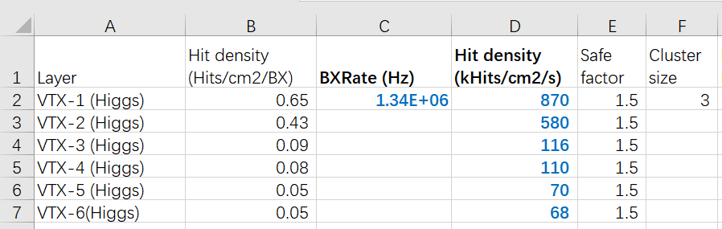
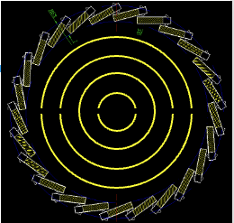
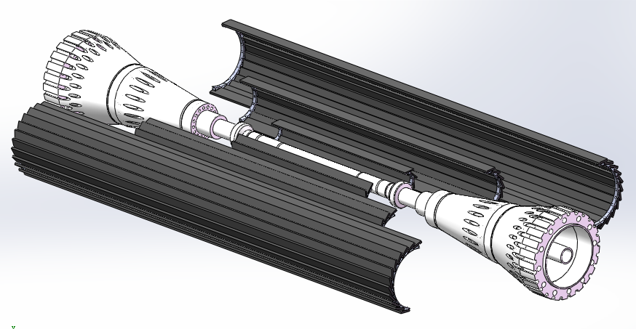
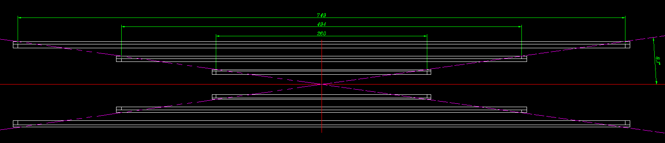
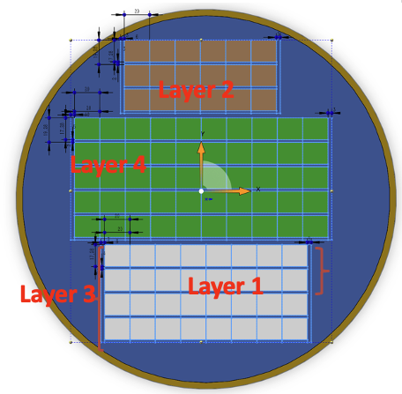
VTX-Data Link
VTX scheme: Inner 4 layers stitching, with 1 typical double-sided ladder (layer 5&6)
Bkgrd rate @50MW @Higgs with safety factor 1.5
Assume RSU@stitching = ladder chip = 1024*512 matrix, then data rate for the innermost layer for a “chip” is 2Gbps, other layers according the bkgrd ratio
Inner 2 layers needs 2 fiber chns for each row, due to the high data rate
  possible to merge into less optical MTX interfaces
In total 88 fibers = 6 BEE Brd = 1 Data Crate
Layer | Comment | Data Rate/chip | Chips/Row | Data rate/row | Rows | Links@10Gbps
1 | Stitching | 2Gbps | 8 | 16G | 2*2=4 | 2*4=8（2 fiber chns）
2 | Stitching | 1.3Gbps | 12 | 15.6G | 3*2=6 | 2*6=12（2 fiber chns）
3 | Stitching | 0.27Gbps | 16 | 4.3G | 4*2=8 | 1*8=8
4 | Stitching | 0.25Gbps | 20 | 5G | 5*2=10 | 1*10=10
5 | Ladder-side0 | 0.16Gbps | 29 | 4.64G | 25 | 1*25=25
6 | Ladder-side1 | 0.16Gbps | 29 | 4.64G | 25 | 1*25=25
  From Zhijun

Slide 18
VTX-Power
Layer | Comment | Power/chip | Chips/Row | Power /row | Rows | Chip Power of Layers | Total Power/Layer (Chip+Link) *1.18
1 | Stitching | 200mW | 8 | 1.6W | 2*2=4 | 6.4W | (6.4+4) *1.18=12.2
2 | Stitching | 200mW | 12 | 2.4W | 3*2=6 | 14.4W | (14.4+6) *1.18=24
3 | Stitching | 200mW | 16 | 3.2W | 4*2=8 | 25.6W | (25.6+8) *1.18=39.5
4 | Stitching | 200mW | 20 | 4W | 5*2=10 | 40W | (40+10) *1.18=58.8
5 | Ladder-side0 | 200mW | 29 | 5.8W | 25 | 145W | (145+25) *1.18=200
6 | Ladder-side1 | 200mW | 29 | 5.8W | 25 | 145W | (145+25) *1.18=200
For simplicity, assume the power of Unit(RSU/Chip) is the same 200mW(40mW/cm2 * 2.6cm*1.6cm)
  Main contribution of power: analog static power + data link, not varying with bkgrd rate
Extra cost by using optical: fixed 1W each set
  0.75W for Data Interface & 0.25W for 1 Rx+4Tx VTRx
Efficiency of PAL DC-DC is 85% = extra efficiency cost of DC-DC 18% (1÷85%=118%)
Total power: 449.8W
  16 power channels each layer for 1~4, each chn for a semi-; 2 chn for each ladder in 5/6 layer, 50 chn in all
  Power will be provided from both ends for long barrel
  66 power channels = 2 power crate
    Very likely to be merged due to the limited room for VTX

Slide 19
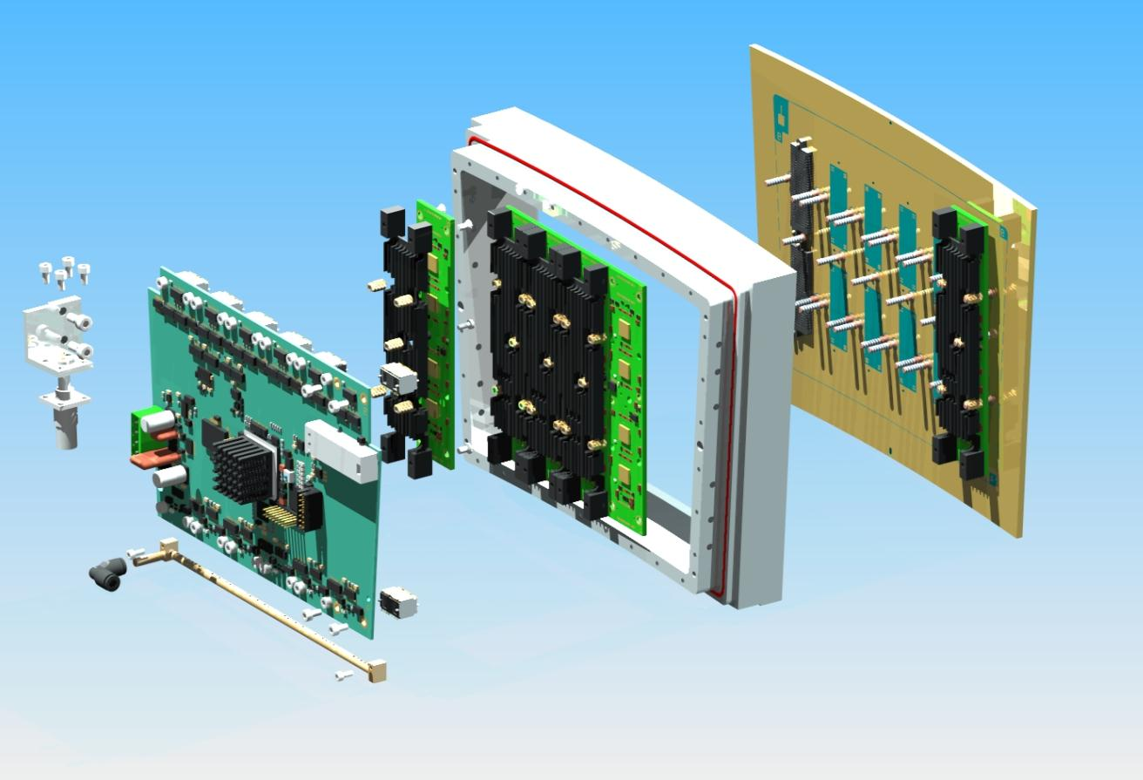
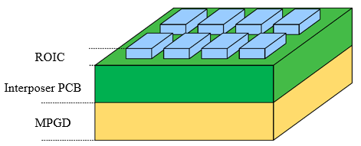
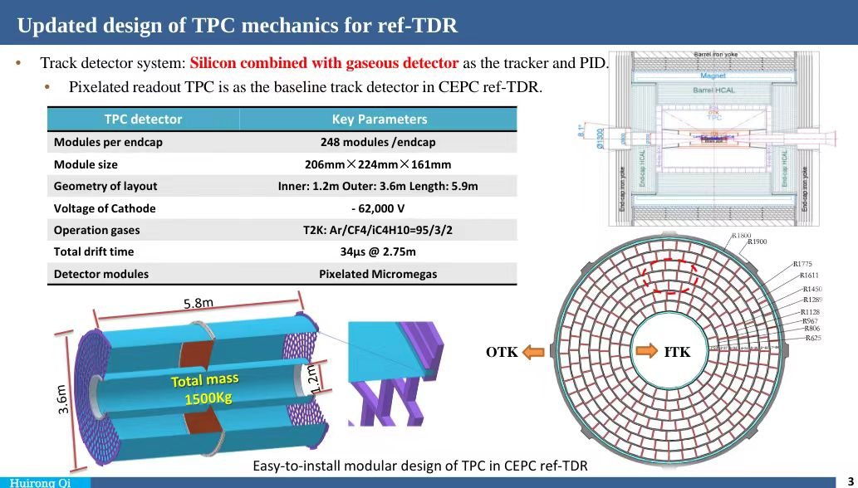
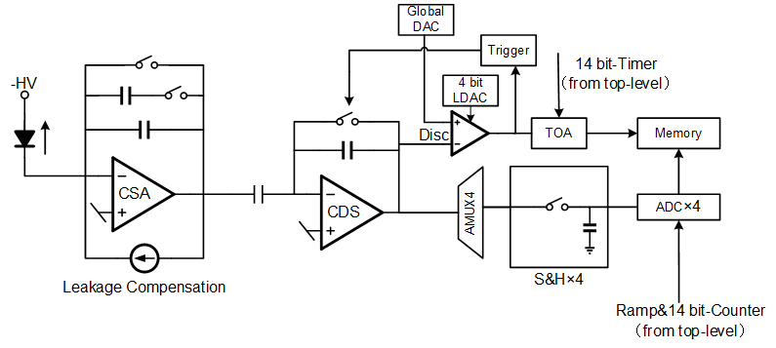
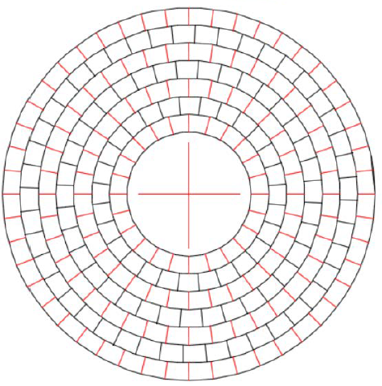
Preliminary readout scheme of Pixel TPC
FEE-0*4
An integrated board with ASIC & MPGD, N(now 4) for a module
0.5mm*0.5mm / pixel
ASIC
MPGD
Aggregation - Power-Link Brd
Fiber
BEE
128 chn ASIC, Q+T measurement
142.8k pixel/module → 1115 chip/module→ 279 chip/FEE-0
  From Huirong
Power:
Limit: <10 kW/endplate ~ 39.7 W/module ~10 W/FEE-0
35mW/ASIC ~ 280μW/chn
Data rate:
80 particles/BX, 12,000 hit/particle, 32(48)b/hit, @ 40M BX Z pole
1 Module: ~100 Mbps(@ innermost)
~248 Module/Endplate

Slide 20
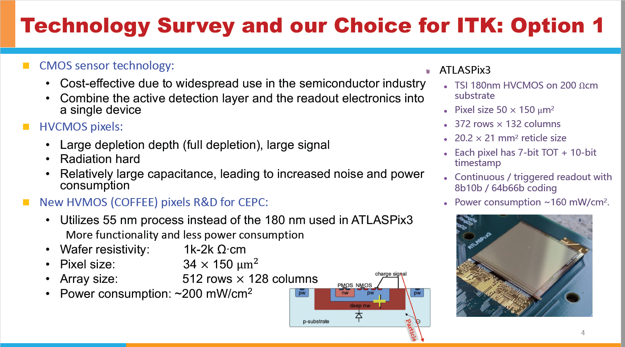
ITK——Power (Barrel)
ITKB | Modules/layer | Layer power (W) | Data Link Power (W) | Total Power(chip+data)/85%
1 | 280 | 3.14k | 280 | 4.02kW
2 | 580 | 6.50k | 580 | 8.32kW
3 | 1344 | 15.1k | 1344 | 19.29kW
Estimated chip power 200mW/cm²，14 chips per module，Module power 11.2W
Extra power: Data Link 1W per module
1 Power channel for each module for reliability & installation simplicity
Power channels: 280 + 580 +1344=2204, -> Power Crates 3+12+14=29, each layer independent
HV range 50~200V (normal HV), independent tuning for each module
  Det-HV channels also 2204, -> Det-HV Crates 10

Slide 21
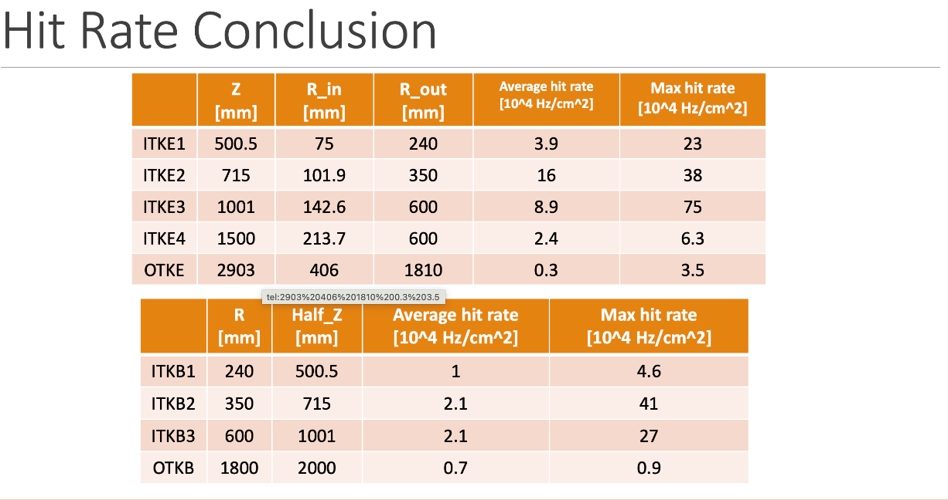
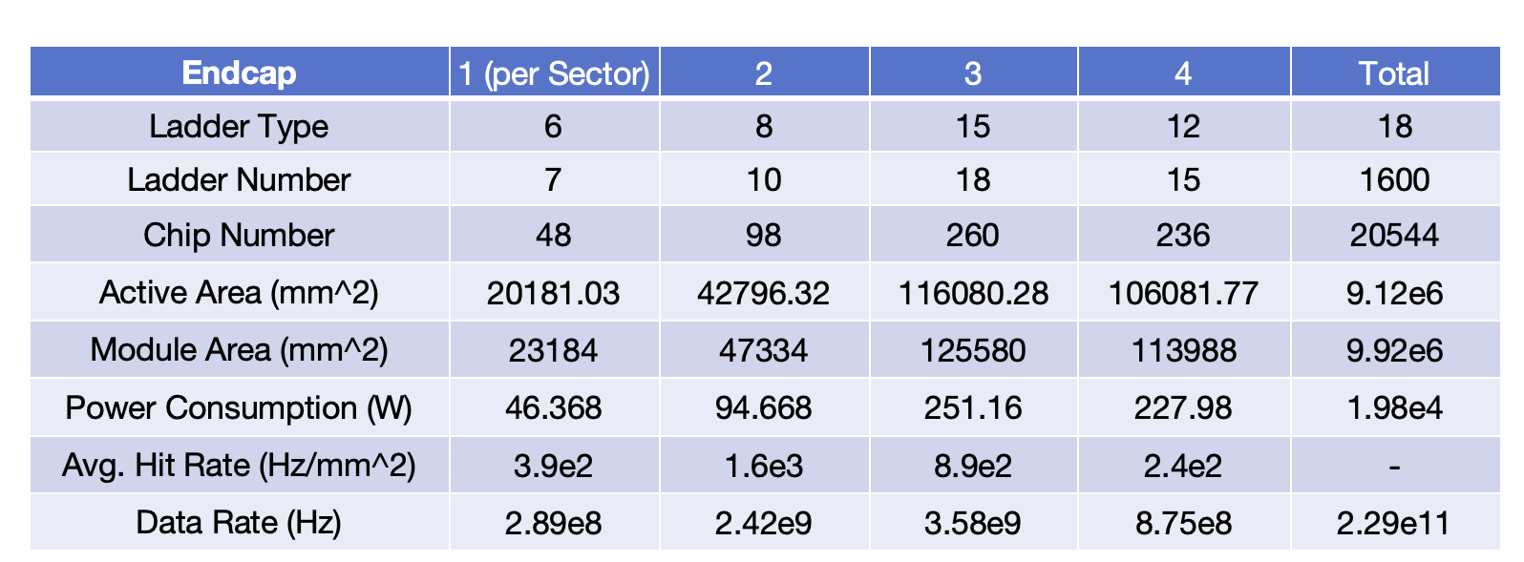
ITK——Data Link (Endcap)
ITKE | Ladder Max chips | Avg bkgrd rate (Hz/cm²) | Max bkgrd rate (Hz/cm²) | Avg Module Data rate (Mbps) | Max Module Data rate (Mbps) | Modules/Ladders(Fibers)
1 | 9 | 39k | 230k | 47.2 | 278.4 | 7*8*2layer*2Endcap =224
2 | 13 | 160k | 380k | 279.7 | 664.3 | 10*32=320
3 | 22 | 89k | 750k | 263.3 | 2218.9 | 19*32=608
4 | 22 | 24k | 63k | 71.0 | 186.4 | 17*32=544
Max module data rate 2.2Gbps, enough room left by using 1 fiber for each ladder
Ladders in total：224+320+608+544=1696，=106 BEE，=12 Data Crates (symmetry from two side)

Slide 22

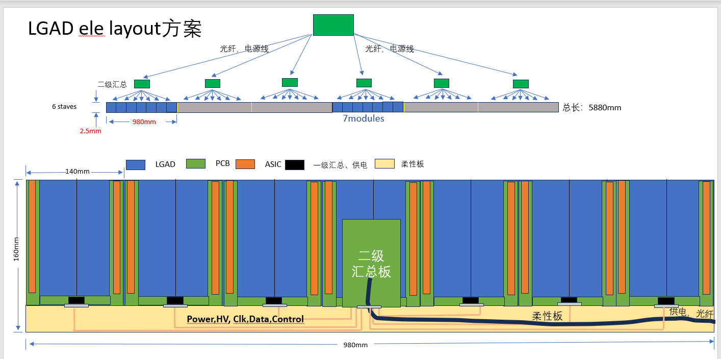
OTK-Data Link
Barrel:
  Data link proposed to locate at the 2nd level aggregation board, for 7 modules (1 ladder), each module 22 ASICs
  Avg module rate 7kHz*14cm*14cm*48bit=65.9Mbps, Max 9kHz→84.7Mbps
  For the optical data rate of 7 modules (1 ladder), avg/max to be 461.3Mbps/1355.2Mbps, with large room for the data link
  A full 6m Stave with 6 Ladders (6 fibers), barrel in total 90 ladders, =540 fibers = 34 BEE = 4 Data Crates
Endcap:
  48 Pedals for 2 endcaps, 10 rings each Pedal with 15 sectors ( Inner 5 rings 1 sector, Outer 5 rings 2 sectors)
  Total area 19.4m², =4041.7cm² for each Pedal, avg. Pedal data rate= 3kHz*4041.7*48bit=582Mbps, Max 35kHz→6.79Gbps
    Consideration 1 fiber for each sector, even concerning the higher data rate for inner sectors, enough room left for the fiber
  48 Pedals with 720 sectors in total, =720 fibers = 45 BEE = 6 Data Crates (each endcap independent)

Slide 23
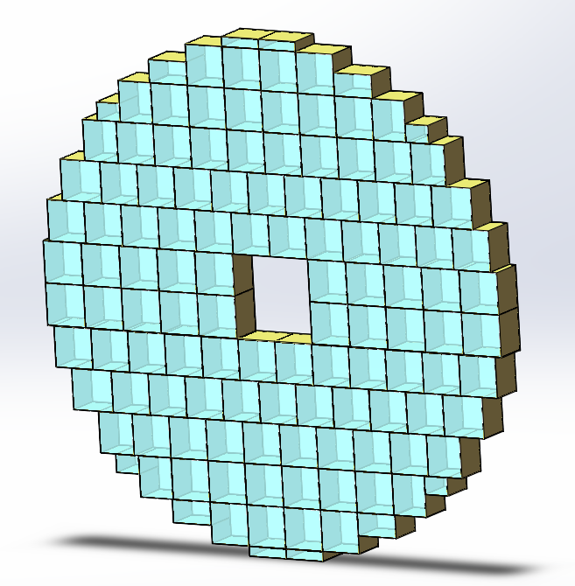
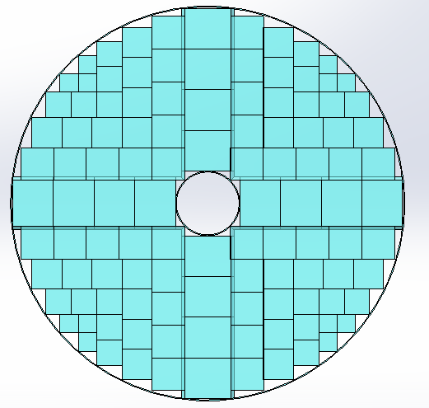
ECAL – endcap
Waiting for the final design of ECAL endcap
According to the current design, module number 122~96, calculated by 130 modules
Expect higher bkgrd rate than barrel, keep the scheme of 2 fibers per module
Fibers:
  130module*2endcap*2 fiber=520
  34 BEE = 4 Data Crates (from 2 sides)
Power：
  Total power: 31W/0.85*260=9.48kW
  260 Power channels = 4 power crates
In optimization
Original design

Slide 24
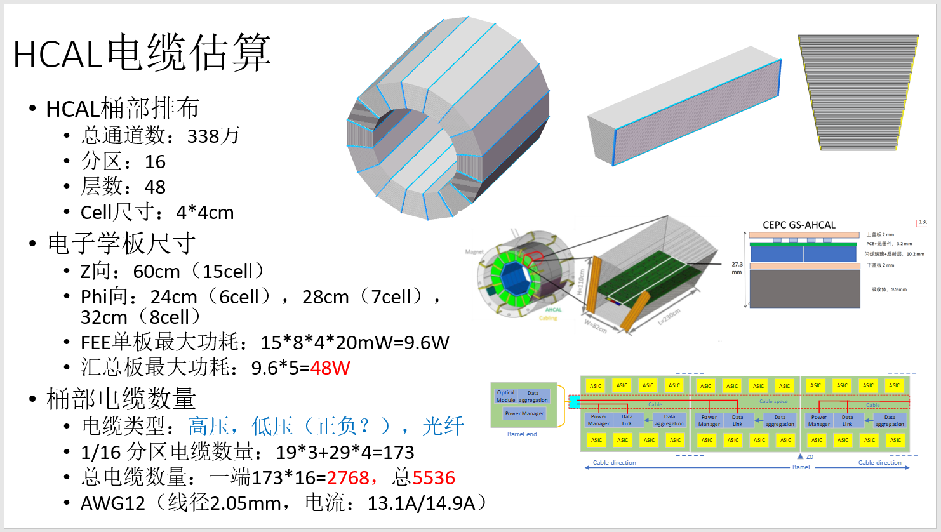
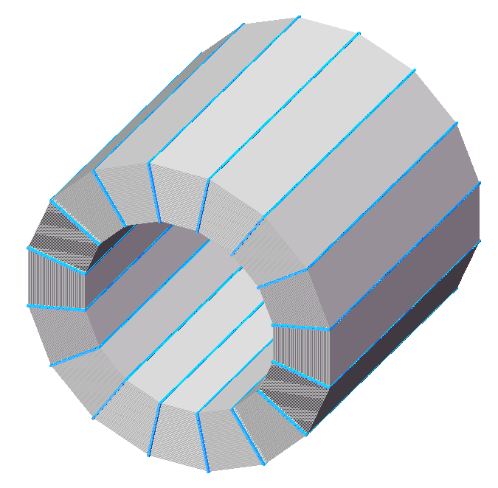
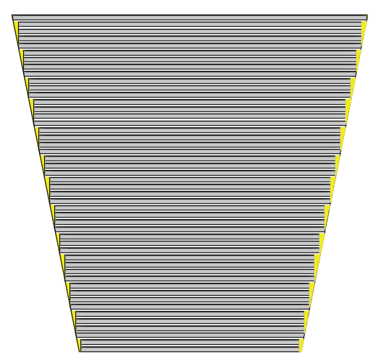
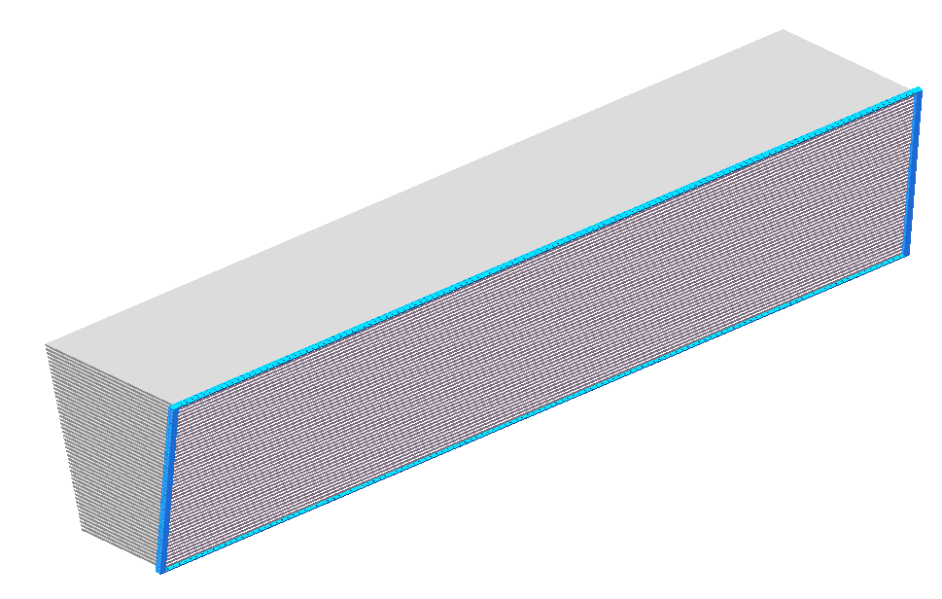
HCAL-Data Link(barrel)
Currently, HCAL is not finalized, especially for the module design, e.g. cell size and channel number
Data have to be aggregated at the end of barrel for each layer, also the DC-DC
By rough estimation, the bkgrd will be low（5kHz/GS）, the aggregated data rate for each layer board should not exceed 8Gbps (10Gbps for the fiber)
  Then 1 fiber for each aggregation board is reasonable
Fibers：
  Aggr. board number every 1/16 sector：19*3+29*4=173
  1 fiber per aggregation board: 173*16*2=5536 fibers
  =346 BEE = 36 Data Crates
1~19layer 3PCBs width
20~48layer 4PCBs width
Aggr Brd for 5 PCBs along z from both ends, with 1 fiber
10 divisions

Slide 25
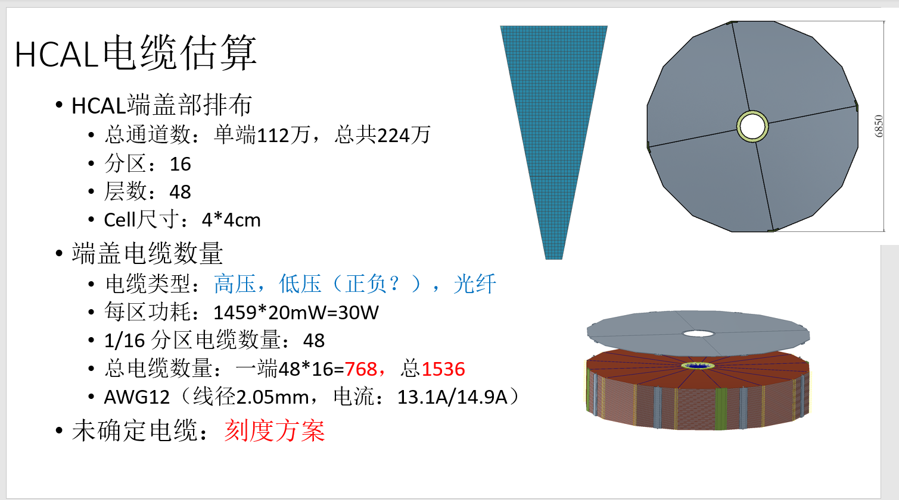
HCAL-Data Link (Endcap)
Current design for HCAL:
  48 layers with 16 sectors
Needs input of the bkgrd rate, assuming 1 fiber is enough (data rate < 8Gbps) for each sector at each layer
Rough calculation:
  each endcap 1.12M channels -> 1458 GS cells for each sector
  MDI: 50kHz/GS max
  1458GS * 50kHz *48bit=3.5Gbps
Using 2 end-boards for each layer of sector, then each board 1.75Gbps, OK for 1 fiber
Fibers
  1 fiber for each sector at each layer
  48layer*16sector*2endcap*2End-board=3072
  =192BEE = 20 Data Crates

Slide 26
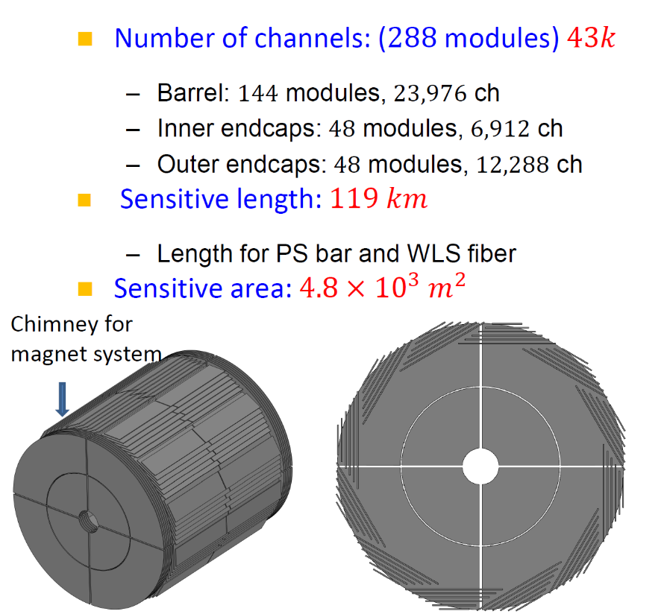
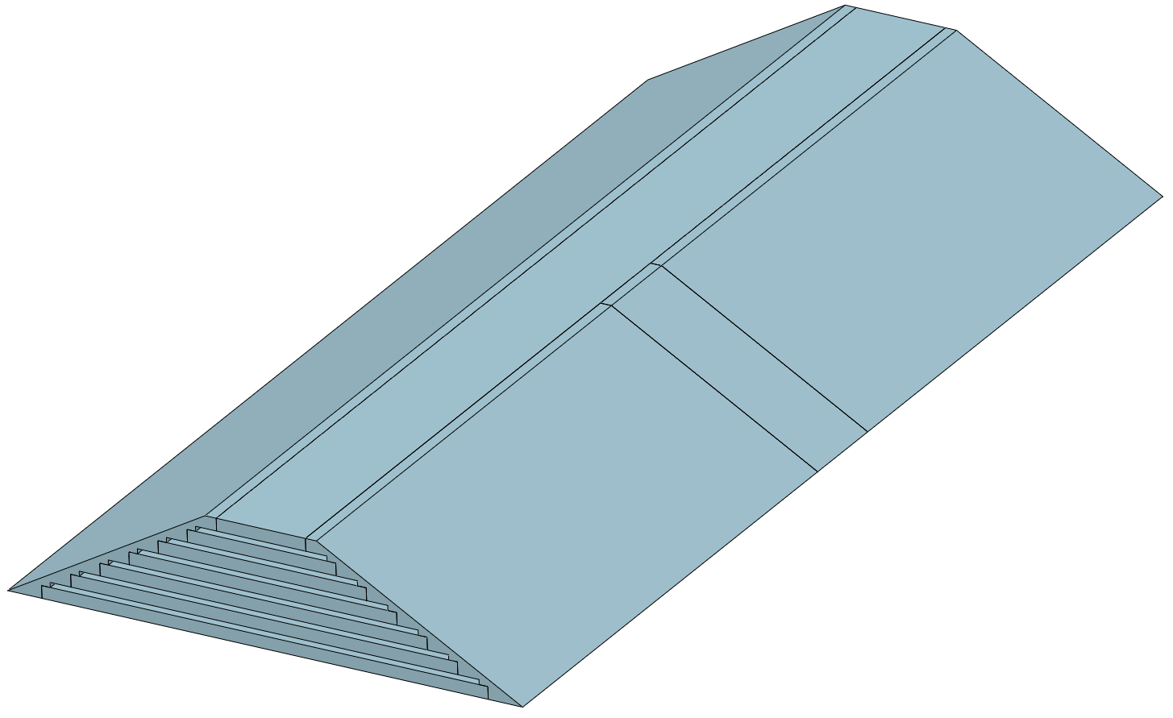
Muon - barrel
Using side board and end board for data aggregation and power distribution
Barrel 144 module, each with 2 boards
  288 fibers = 18 BEE = 2 data crate
  Total data rate: <1kHz*23976*48bit=1.15Gbps (each board 4Mbps)
  Using fiber for universal architecture & clocking precision
  Total FEE power: 23976*15mW/chn=360W
  With data link 1W*288=288W, 85% efficiency
  Total power: 760W
Endcap 96 module
  96 fiber=6 BEE=1data crate
  Total data rate: <1kHz*19200*48bit=921.6Mbps (each board 10Mbps)
  Total FEE power: 19200*15mW/chn=288W
  With data link 1W*96=96W, 85% efficiency
  Total power: 452W
A
B
B
A

Slide 27
Summary for the Racks
No safety factor for all the former calculation
In total
  110 Data Crates, 3 crates per rack, = 37 Data Racks
  237 (LV) Power Crates, 10 crates per rack, = 24 Power Racks
  91 Det-HV Crates, 3/4 crates per rack, = 23 Det-HV Racks
  20 Trigger crates = 10 Trigger Racks
Every LV rack needs an AC-DC power-HV crate, about 134 power-HV crates
  5 crates per rack, = 2 Power-HV Racks
In general, rack backup, room for future upgrade, uncertainty due to the un-finalized detector scheme, esp. the extra space requirements that the trigger algorithm usually asks the rack layout to be corresponded to the detector arrangement, will decrease the density of the rack and crate usage.

