Slide 1
Progress of the studies of the tolerance to machine errors at all energies, with evaluation of the final emittance and energy spread for injection in the collider
Yiwei Wang, Bin Wang, Dou Wang,
Daheng Ji, Cai Meng, Zhiyuan Li, Yuan Zhang
15 Aug, 2025
CEPC day

Slide 2
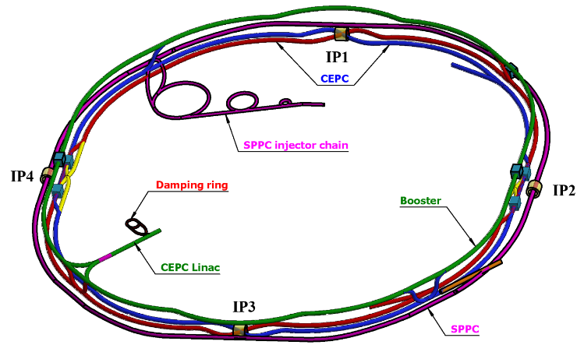
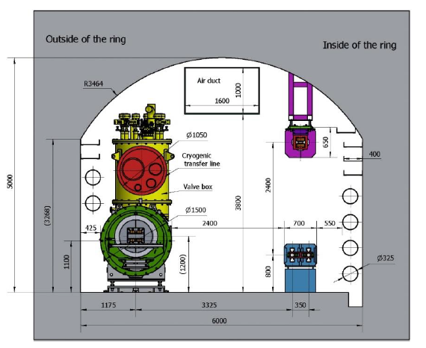
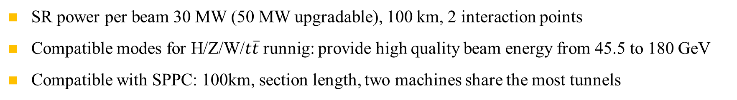
Layout of the CEPC accelerator complex
SR power per beam 30 MW (50 MW upgradable), 100 km, 2 interaction points
Compatible modes for H/Z/W/$t\overline{t}$runnig: provide high quality beam energy from 45.5 to 180 GeV
Compatible with SPPC: 100km, section length, two machines share the most tunnels
CEPC+SPPC complex
Tunnel in the arc regions
CEPC detectors

Slide 3
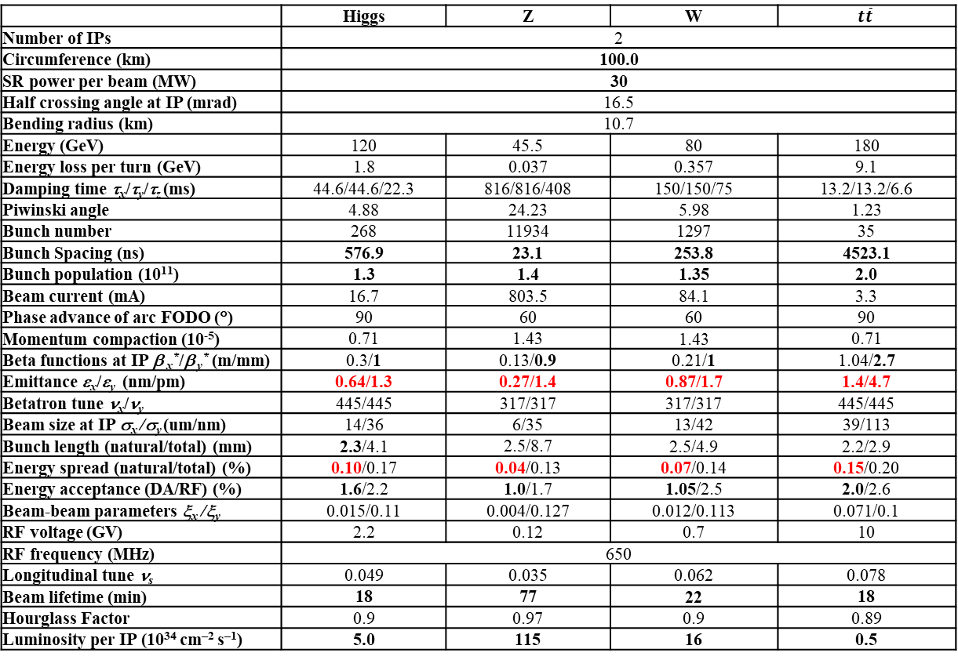
CEPC Design Parameters
 | Higgs | Z | W | $$t\overline{t}$$
Number of IPs | 2
Circumference (km) | 100.0
SR power per beam (MW) | 30
Half crossing angle at IP (mrad) | 16.5
Bending radius (km) | 10.7
Energy (GeV) | 120 | 45.5 | 80 | 180
Energy loss per turn (GeV) | 1.8 | 0.037 | 0.357 | 9.1
Damping time τ_{x}/τ_{y}/τ_{z} (ms) | 44.6/44.6/22.3 | 816/816/408 | 150/150/75 | 13.2/13.2/6.6
Piwinski angle | 4.88 | 24.23 | 5.98 | 1.23
Bunch number | 268 | 11934 | 1297 | 35
Bunch Spacing (ns) | 576.9 | 23.1 | 253.8 | 4523.1
Bunch population (10¹¹) | 1.3 | 1.4 | 1.35 | 2.0
Beam current (mA) | 16.7 | 803.5 | 84.1 | 3.3
Phase advance of arc FODO (°) | 90 | 60 | 60 | 90
Momentum compaction (10⁻⁵) | 0.71 | 1.43 | 1.43 | 0.71
Beta functions at IP β _{x}*/β _{y}* (m/mm) | 0.3/1 | 0.13/0.9 | 0.21/1 | 1.04/2.7
Emittance ε_{x}/ε_{y} (nm/pm) | 0.64/1.3 | 0.27/1.4 | 0.87/1.7 | 1.4/4.7
Betatron tune ν_{x}/ν_{y} | 445/445 | 317/317 | 317/317 | 445/445
Beam size at IP σ_{x} /σ_{y} (um/nm) | 14/36 | 6/35 | 13/42 | 39/113
Bunch length (natural/total) (mm) | 2.3/4.1 | 2.5/8.7 | 2.5/4.9 | 2.2/2.9
Energy spread (natural/total) (%) | 0.10/0.17 | 0.04/0.13 | 0.07/0.14 | 0.15/0.20
Energy acceptance (DA/RF) (%) | 1.6/2.2 | 1.0/1.7 | 1.05/2.5 | 2.0/2.6
Beam-beam parameters ξ_{x} /ξ_{y} | 0.015/0.11 | 0.004/0.127 | 0.012/0.113 | 0.071/0.1
RF voltage (GV) | 2.2 | 0.12 | 0.7 | 10
RF frequency (MHz) | 650
Longitudinal tune ν_{s} | 0.049 | 0.035 | 0.062 | 0.078
Beam lifetime (min) | 18 | 77 | 22 | 18
Hourglass Factor | 0.9 | 0.97 | 0.9 | 0.89
Luminosity per IP (10³⁴ cm^{–2} s^{–1}) | 5.0 | 115 | 16 | 0.5
𝛽y∗ and emittance chosen for luminosity
adequate bunch population Ne for the luminosity and the achievable energy acceptance for lattice design
Number of bunches Nb is adjusted to keep the beam current
Updated bunch spacing for the requirement from detector (D. Wang, Aug 2024, CEPC day)
Ref: CEPC TDR; Radiation Detection Technology and Methods (2024) 8:1–1105, https://doi.org/10.1007/s41605-024-00463-y;

Slide 4
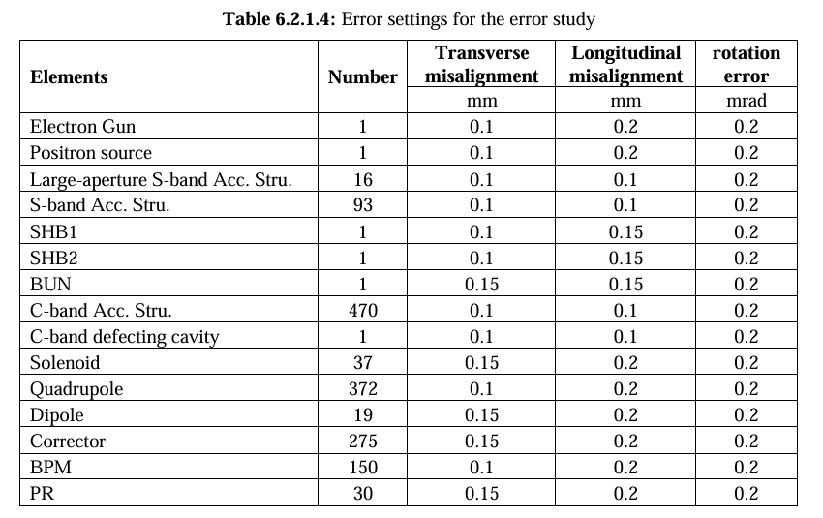
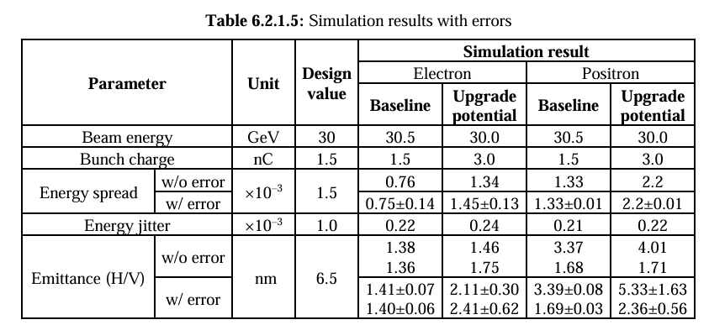
Linac
Emittance and energy spread of beams from linac with errors

Slide 5
Booster
Emittance and energy spread of beams from booster with errors
 | Dipole | Quadrupole | Sextupole
Transverse shift X/Y (μm) | 100 | 100 | -
Longitudinal shift Z (μm) | 100 | 150 | -
Tilt about X/Y (mrad) | 0.2 | 0.2 | -
Tilt about Z (mrad) | 0.1 | 0.2 | -
Nominal field | 1e-3 | 2e-4 | 1e-3
dipole | quadrupole
B1/B0 ≤ 2×10⁻⁴
B2/B0 ≤ 5×10⁻⁴ | B2/B1 ≤ 3×10⁻⁴
B3/B0 ≤ 2×10⁻⁵ | B3/B1 ≤ 2×10⁻⁴
B4/B0 ≤ 8×10⁻⁵ | B4/B1 ≤ 1×10⁻⁴
B5/B0 ≤ 2×10⁻⁵ | B5/B1 ≤ 1×10⁻⁴
B6/B0 ≤ 8×10⁻⁵ | B6/B1 ≤ 5×10⁻⁵
B7/B0 ≤ 2×10⁻⁵ | B7/B1 ≤ 5×10⁻⁵
B8/B0 ≤ 8×10⁻⁵ | B8/B1 ≤ 5×10⁻⁵
B9/B0 ≤ 2×10⁻⁵ | B9/B1 ≤ 5×10⁻⁵
B10/B0 ≤ 8×10⁻⁵ | B10/B1 ≤ 5×10⁻⁵
 | Accuracy (um) | Tilt (mrad) | Gain | Offset w/ BBA(um)
BPM(10Hz) | 0.1 | 10 | 5% | 30
E (GeV) | emitx_0 (m) | emitx_RMS (m) | emity_0 (m) | emity_RMS (m) | bunch length (mm) | bunch length_RMS (mm) | δ | δ_RMS
45.5 | 1.80E-10 | 4.50E-13 | 1.44E-12 | 3.61E-13 | 0.750 | 0.00375 | 0.000370 | 1.850E-06
80 | 5.58E-10 | 1.50E-12 | 4.46E-12 | 1.12E-12 | 1.300 | 0.0065 | 0.000660 | 3.300E-06
120 | 1.26E-09 | 3.00E-12 | 1.01E-11 | 2.52E-12 | 1.850 | 0.00925 | 0.000990 | 4.950E-06
180 | 2.88E-09 | 2.00E-11 | 2.30E-11 | 5.76E-12 | 1.800 | 0.009 | 0.001500 | 7.500E-06
simulation
E (GeV) | emitx_sim (nm) | Emitx_req (nm) | emity_sim (pm) | emity_req (pm)
45.5 | 0.18 | 0.19 | 1.44 | 1.9
80 | 0.558 | 0.56 | 4.46 | 5.6
120 | 1.26 | 1.26 | 10.1 | 12.6
180 | 2.88 | 2.83 | 23 | 28.3
Simulation
Vs
requirement

Slide 6
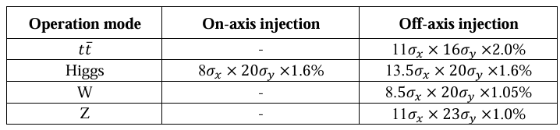
Dynamic aperture requirement
  The dynamic aperture requirement comes from the injection parameters, beam lifetime for the top-up injection.
Considering: 3 sigma injection beam from booster (nominal booster emittance x and energy spread, 1% coupling for emittance x), 4 sigma circulated beam in collider, beam jitter due to kicker strength jitter are usually limit at the order of 10% sigma for circular accelerators.
All the particles from injection will survival w/ error, w/ jitter, w/o beam-beam as the particles located within the dynamic aperture.
E (GeV) | emitx_b (nm) | emitx_c (nm) | emity_b (pm) | emity_c (pm)
45.5 | 0.19 | 0.27 | 1.9 | 1.4
80 | 0.56 | 0.87 | 5.6 | 1.7
120 | 1.26 | 0.64 | 12.6 | 1.3
180 | 2.83 | 1.4 | 28.3 | 4.7

Slide 7
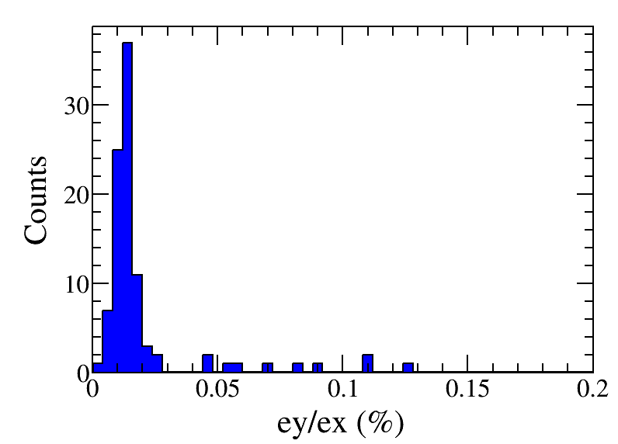
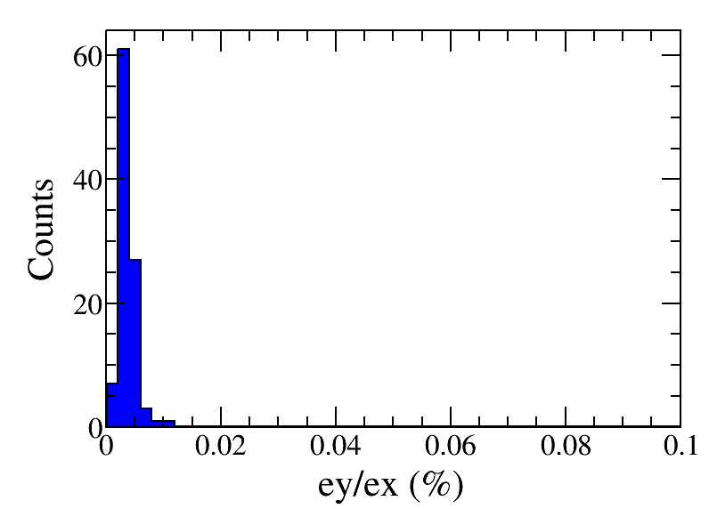
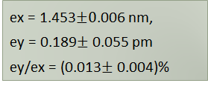

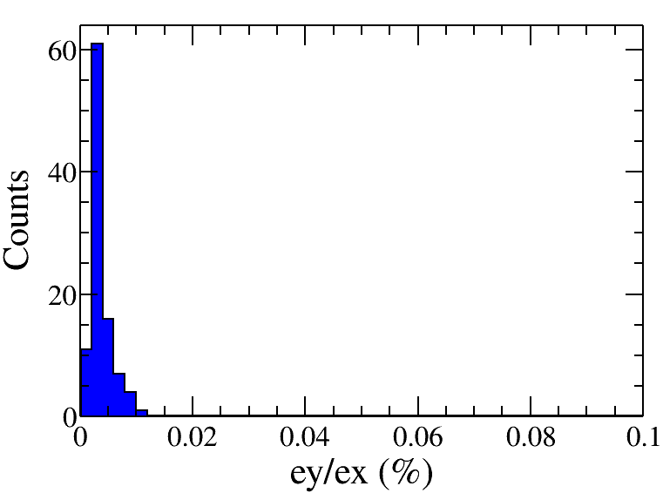
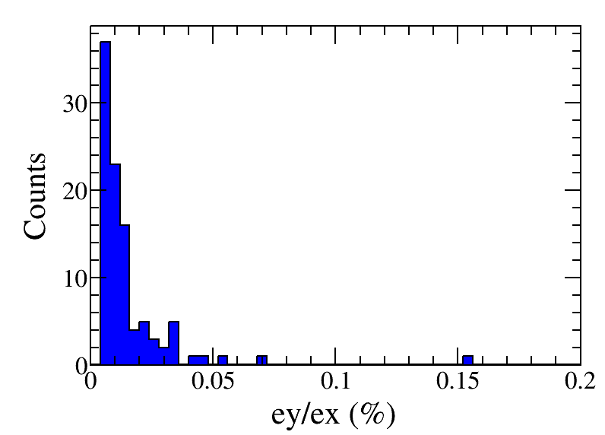

Error assumption in the collider
Component | Δx (mm) | Δy (mm) | Δθ_{z} (mrad) | Field error
Dipole | 0.10 | 0.10 | 0.10 | 0.01%
Arc Quadrupole | 0.10 | 0.10 | 0.10 | 0.02%
IR Quadrupole | 0.10 | 0.10 | 0.10 | 0.02%
Sextupole | 0.10* | 0.10* | 0.10 | 0.02%
ttbar
Higgs
*implement beam-based alignment techniques to reach rms offsets in the order of 10 um with respect to the beam
with a large beta* lattice
ex=0.839 ± 0.001 nm
ey = 0.030 ± 0.001 pm
ey/ex = (0.036 ± 0.001) %
W
Z

Slide 8
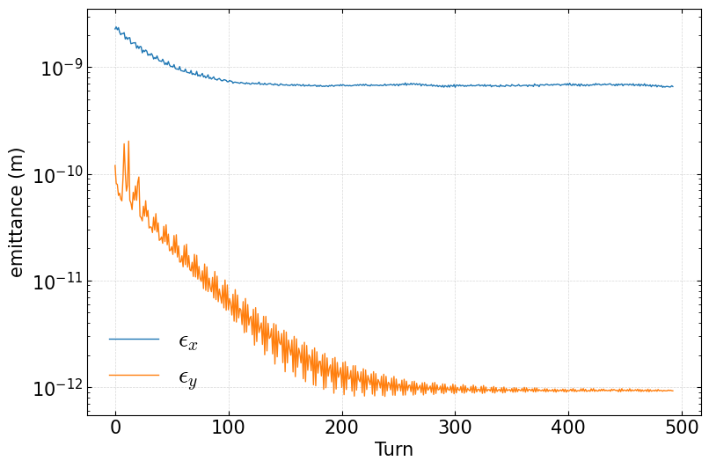
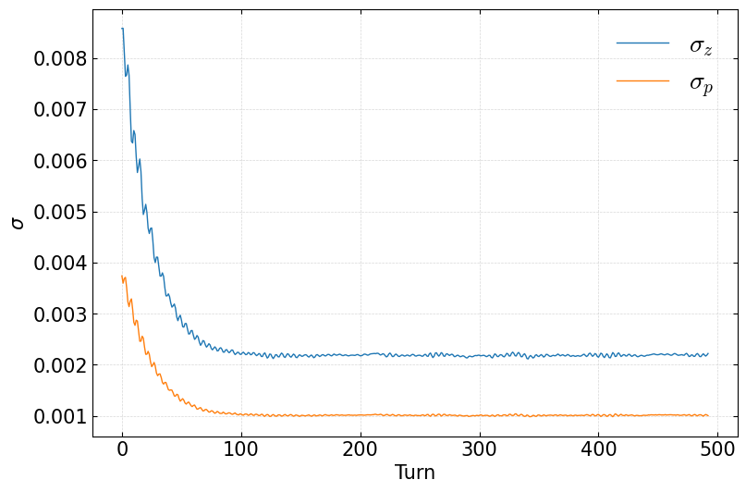
6D Simulation @ Higgs w/ error, w/ jitter, w/o beam-beam
emitx = 0.66 nm (design 0.66nm)
emity = 0.93 pm (design 1.32pm)
sigmap = 0.1% (design 0.10%)
A Lattice with error CEPC_cor_hlat_03.sad (ideal lattice 0.66 nm)
6D simulation with injection beam and errors, 0.1sigma jitter, 3 damping time
w/ error, w/ jitter, w/o beam-beam, all the particles from injection will survival as the DA is larger than the injected beam.

Slide 9
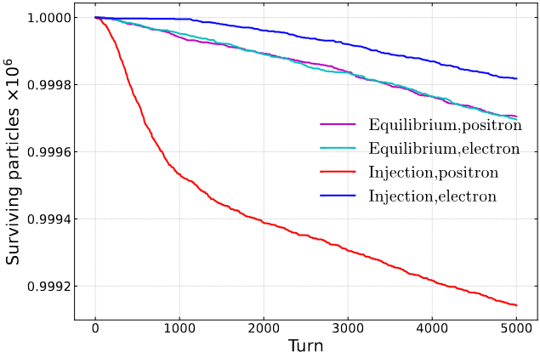
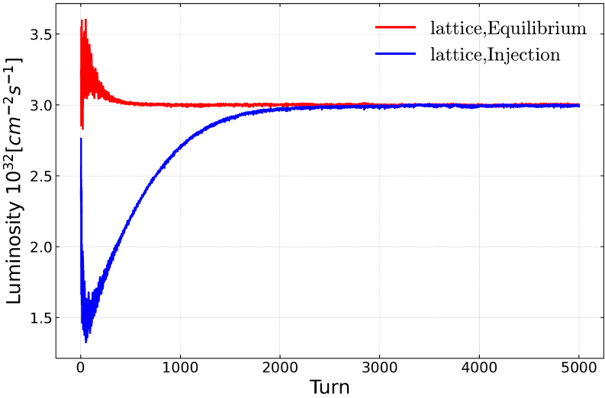
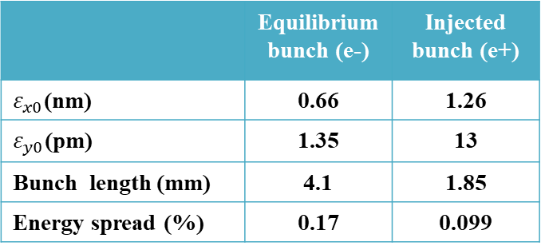
6D Simulation @ Higgs w/o error, w/o jitter, w/ beam-beam
Zhiyuan Li etal., NIMA 1064 (2024) 169386
In collaboration with KEK team
Using an integrated simulation code in APES-T (IHEP homemade, in progress) which can implement element-by-element tracking with strong-strong beam-beam interaction and lattice
 | Equilibrium bunch (e-) | Injected bunch (e+)
$ε_{x0}$(nm) | 0.66 | 1.26
$ε_{y0}$(pm) | 1.35 | 13
Bunch length (mm) | 4.1 | 1.85
Energy spread (%) | 0.17 | 0.099
The injection pattern reaches a stable state equivalent to the equilibrium collision after 2000 turns, with a lifetime of approximately 40-60 minutes (33 min required). The particle loss before stability is about 0.06%.

Slide 10
Summary and to do list
w/ error, w/ jitter, w/o beam-beam, all the particles from injection will survival as the DA is larger than the injected beam.
w/o error, w/o jitter, w/ beam-beam, the particle from injection loss before stability is about 0.06% @ Higgs.
To do list
  Check the requirement on the jitter of injection to collider
  Simulation with ttbar/W/Z modes
  Error + beam beam + jitter + IP tuning will be a long term task.

Slide 11
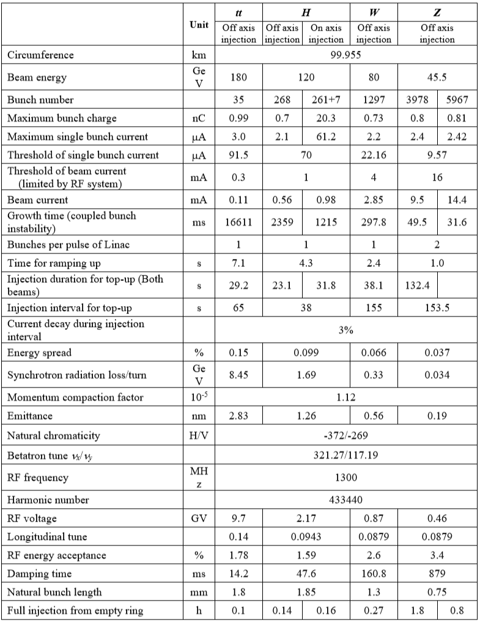
Booster design para

Slide 12
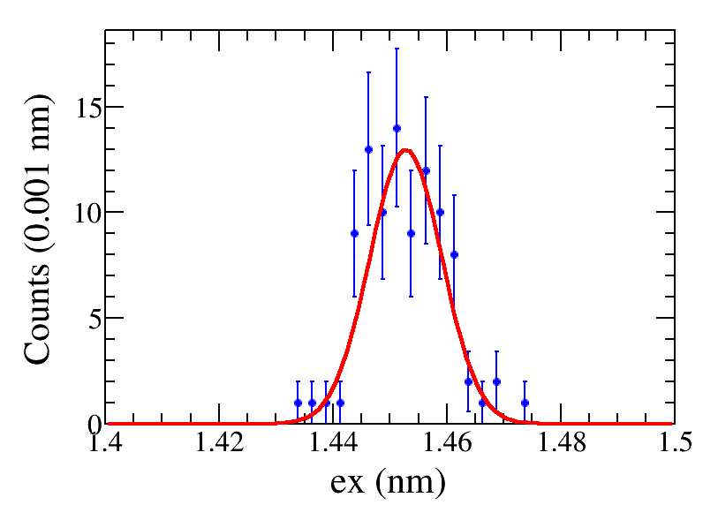
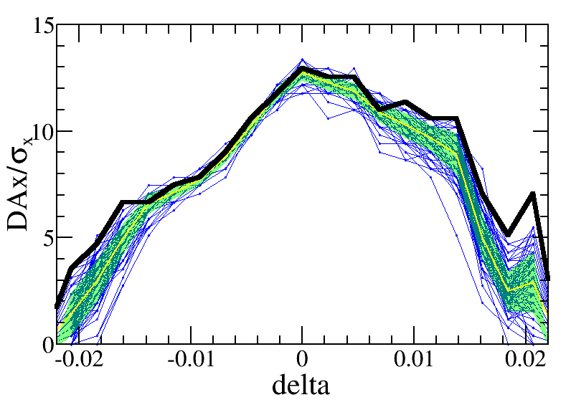
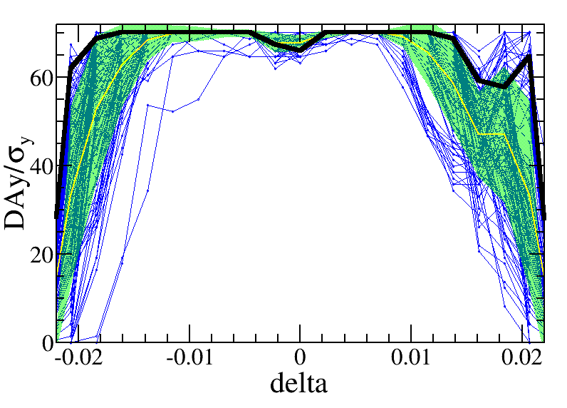
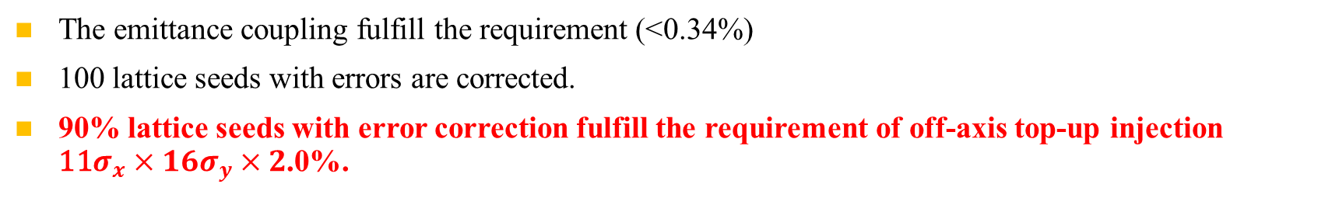
Emittance and dynamic aperture with error @ ttbar
—w/o error
—mean value
—statistic errors
—seeds
—requirement
Effects included in tracking
Synchrotron motion
Radiation loss in all magnets
Tapering
Crab waist sextupole
Maxwellian fringes
Kinematic terms
Finite length of sextupole
Component | Δx (mm) | Δy (mm) | Δθ_{z} (mrad) | Field error
Dipole | 0.10 | 0.10 | 0.10 | 0.01%
Arc Quadrupole | 0.10 | 0.10 | 0.10 | 0.02%
IR Quadrupole | 0.10 | 0.10 | 0.10 | 0.02%
Sextupole | 0.10* | 0.10* | 0.10
  The emittance coupling fulfill the requirement (<0.34%)
  100 lattice seeds with errors are corrected.
  90% lattice seeds with error correction fulfill the requirement of off-axis top-up injection ${\text{11}σ}_{x}×16σ_{y}×2$.0%.

Slide 13
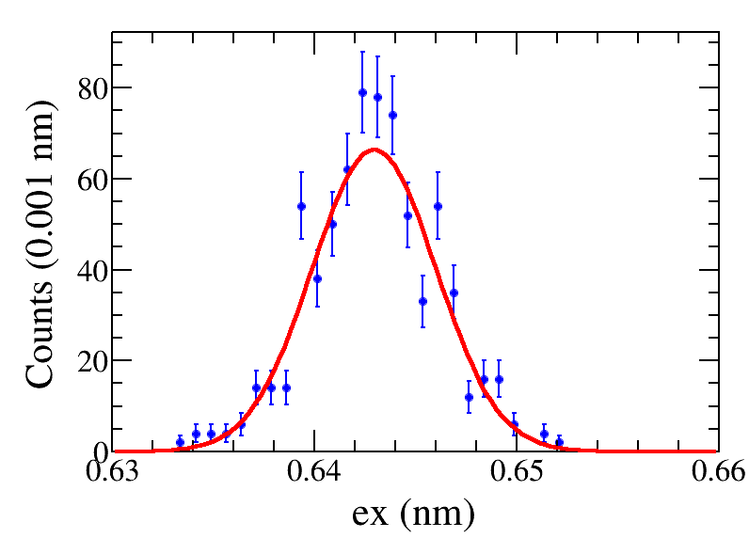
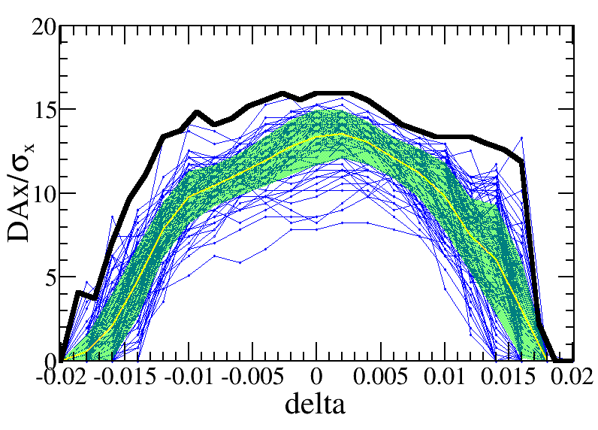
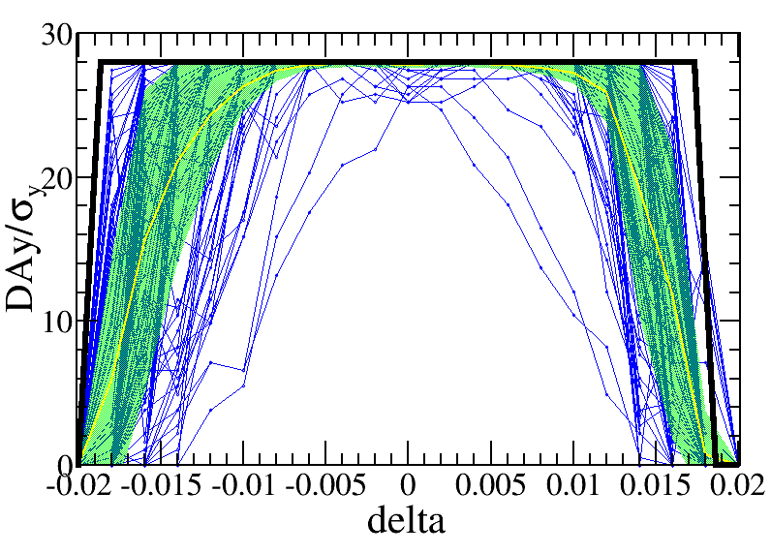
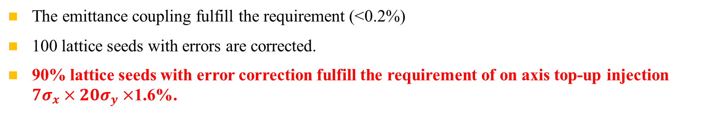
Emittance and dynamic aperture with error @ Higgs
—w/o error
—mean value
—statistic errors
—seeds
—requirement
Effects included in tracking
Synchrotron motion
Radiation loss in all magnets
Tapering
Crab waist sextupole
Maxwellian fringes
Kinematic terms
Finite length of sextupole
Component | Δx (mm) | Δy (mm) | Δθ_{z} (mrad) | Field error
Dipole | 0.10 | 0.10 | 0.10 | 0.01%
Arc Quadrupole | 0.10 | 0.10 | 0.10 | 0.02%
IR Quadrupole | 0.10 | 0.10 | 0.10 | 0.02%
Sextupole | 0.10* | 0.10* | 0.10 | 0.02%
  The emittance coupling fulfill the requirement (<0.2%)
  100 lattice seeds with errors are corrected.
  90% lattice seeds with error correction fulfill the requirement of on axis top-up injection ${\text{7}σ}_{x}×20σ_{y}×$1.6%.

Slide 14
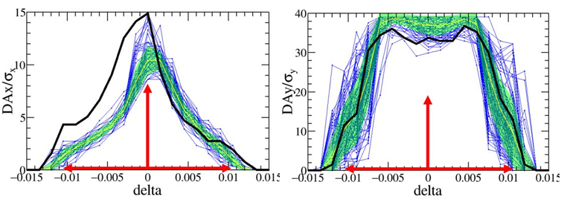
Emittance and dynamic aperture with error @ W
—w/o error
—mean value
—statistic errors
—seeds
—requirement
Effects included in tracking
Synchrotron motion
Radiation loss in all magnets
Tapering
Crab waist sextupole
Maxwellian fringes
Kinematic terms
Finite length of sextupole
Component | Δx (mm) | Δy (mm) | Δθ_{z} (mrad) | Field error
Dipole | 0.10 | 0.10 | 0.10 | 0.01%
Arc Quadrupole | 0.10 | 0.10 | 0.10 | 0.02%
IR Quadrupole | 0.10 | 0.10 | 0.10 | 0.02%
Sextupole | 0.10* | 0.10* | 0.10
  Dynamic aperture for the W lattice with global error correction, where the yellow lines and green bands are the mean value and its corresponding statistical errors. The black line is the DA of bare lattice. The blue lines are the DA of each lattice seed. 91% lattice seeds with error correction fulfil the requirement of off-axis top-up injection 8.5𝜎𝑥×20𝜎𝑦×1.05%

Slide 15
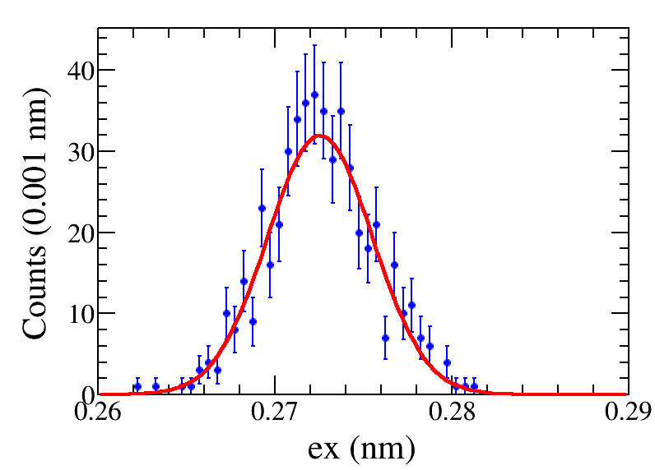
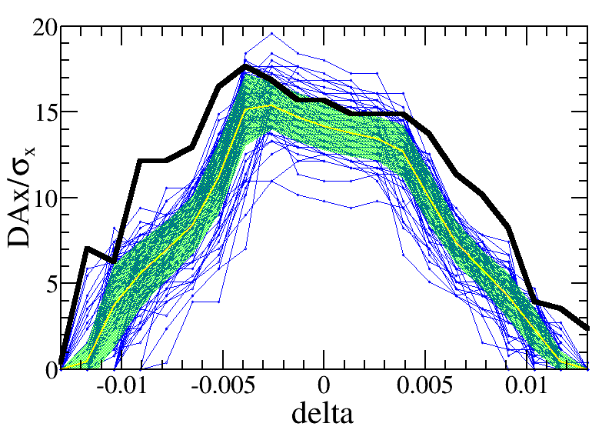
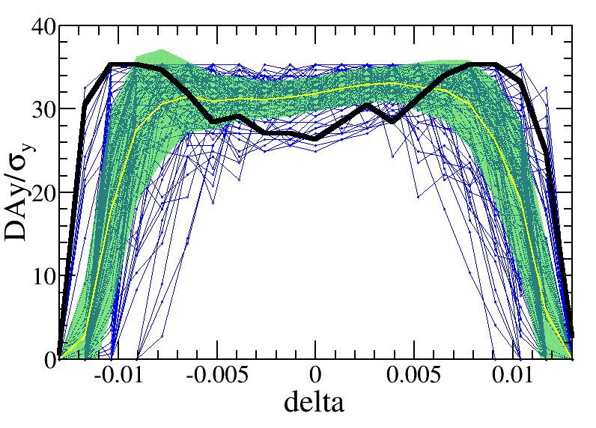
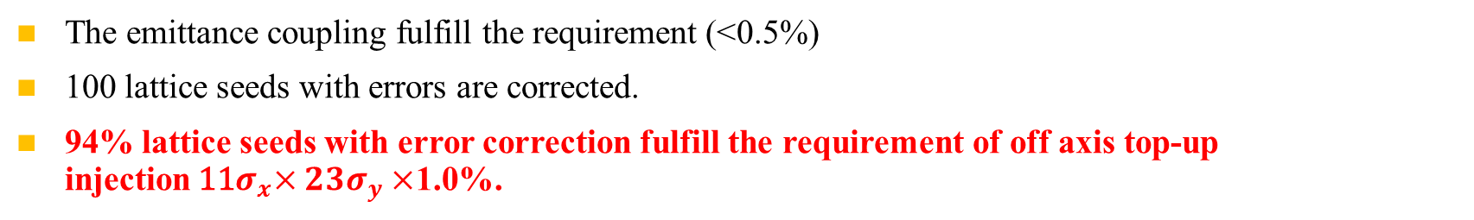
Emittance and dynamic aperture with error @ Z
—w/o error
—mean value
—statistic errors
—seeds
—requirement
Effects included in tracking
Synchrotron motion
Radiation loss in all magnets
Tapering
Crab waist sextupole
Maxwellian fringes
Kinematic terms
Finite length of sextupole
Component | Δx (mm) | Δy (mm) | Δθ_{z} (mrad) | Field error
Dipole | 0.10 | 0.10 | 0.10 | 0.01%
Arc Quadrupole | 0.10 | 0.10 | 0.10 | 0.02%
IR Quadrupole | 0.10 | 0.10 | 0.10 | 0.02%
Sextupole | 0.10* | 0.10* | 0.10
  The emittance coupling fulfill the requirement (<0.5%)
  100 lattice seeds with errors are corrected.
  94% lattice seeds with error correction fulfill the requirement of off axis top-up injection${ \text{11}σ}_{x}×23σ_{y}×$1.0%.

