Slide 1
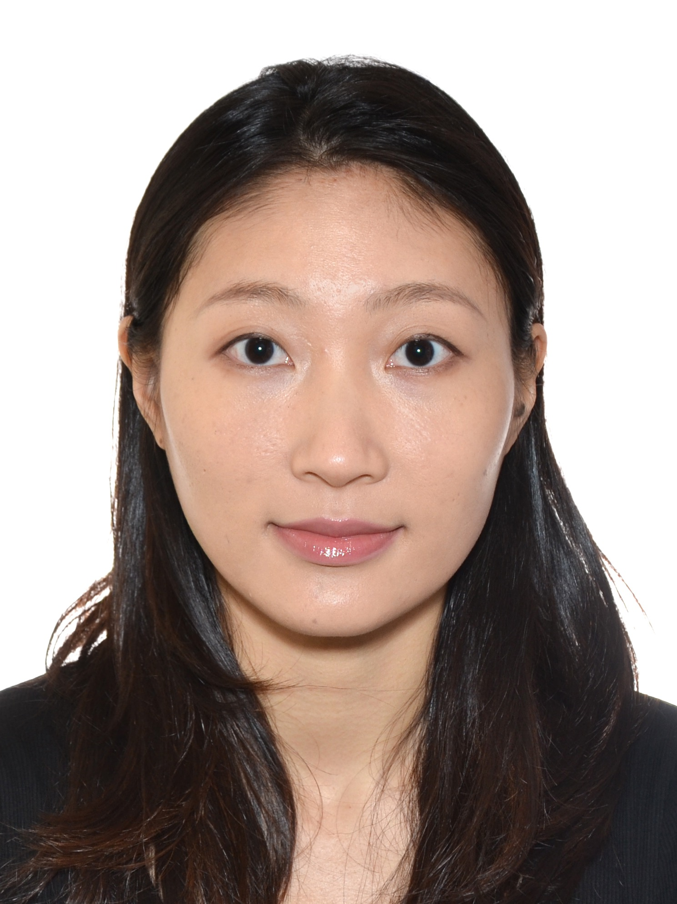

Experimental Physics Division Seminar
Institute of High Energy Physics, CAS
MiniCACTUS-V2: A Depleted Active Pixel Sensor Prototype for Precise Timing in HEP Experiments
Speaker: | Dr. Yujing GAN (干钰静)
Host: | Prof. Qi YAN (严琪)
Time: | 10:00 am, 20 Aug, 2025
Location: | 122 Multidisciplinary Building
Indico: | indico.ihep.ac.cn/event/26919
Zoom ID: | 9866 3125 772
Password: | 250820
Abstract:
The High-Luminosity LHC (HL-LHC) will increase collision rates by a factor of 5–7, requiring detector upgrades to handle higher pile-up. ATLAS will replace its Inner Detector with an all-silicon Inner Tracker (ITk) and add the High Granularity Timing Detector (HGTD) in the forward region, providing a timing resolution with 30–50 ps. While the HGTD baseline uses LGAD sensors, their cost and assembly complexity motivate the exploration of Depleted Monolithic Active Pixel Sensors (DMAPS) as an alternative.
This talk presents MiniCACTUS-V2, a DMAPS prototype designed to have <25 ns readout time while maintaining excellent timing performance. The sensor design incorporates realistic input signal modelling, simulation validation, and transistor-level optimization using foundry data. A gain-boosted cascode preamplifier achieves high gain and low noise with low power consumption. Beam tests demonstrate breakdown voltages within specifications and time resolutions of 63 ps (CSA2) and 80 ps (VPA), both meeting the <25 ns readout target. These results demonstrate DMAPS can provide competitive, high resolution timing solution for future high-energy physics experiments.
About the speaker:
Dr. Yujing Gan earned her Ph.D. in Physics from Central China Normal University and the Universitat Autònoma de Barcelona in 2025. Her research focuses on the development of large pixel DMAPS with precise timing for next-generation collider experiments.

