Slide 1
Weekly Report
Minghao Li 2025.08.12

Slide 2
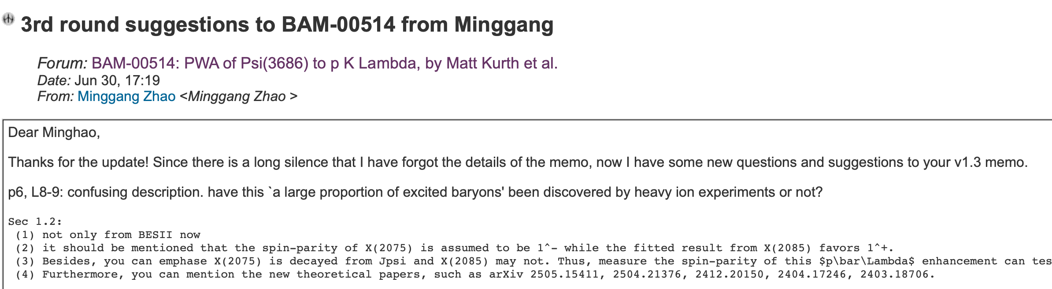
$$ψ\left(3686\right)→pK^{−}\overline{Λ}+c.c.$$
I am currently preparing Prof. Zhao's question and updated the memo.
Read theoretical articles to prepare for writing the draft.

Slide 3
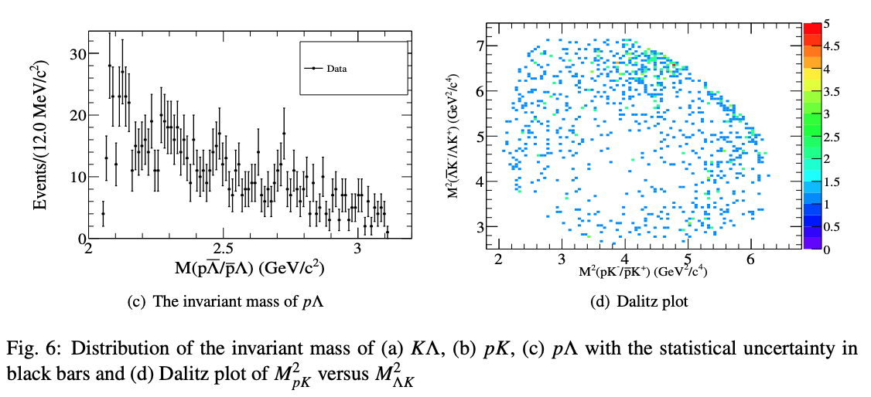
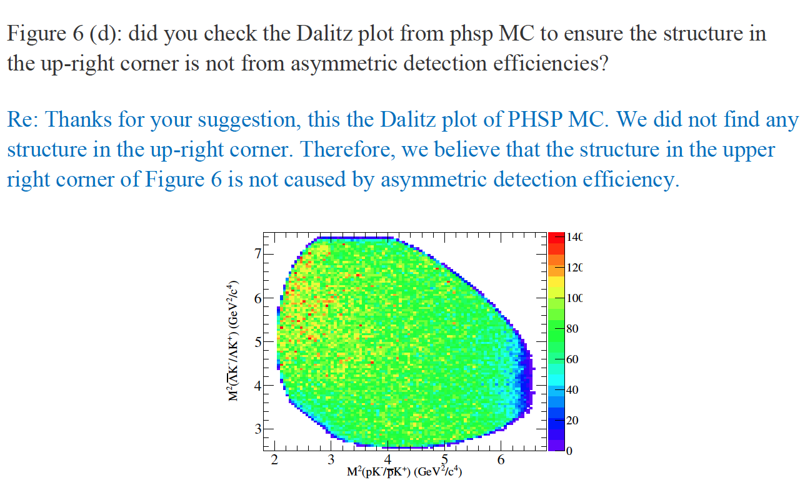
$$ψ\left(3686\right)→pK^{−}\overline{Λ}+c.c.$$

Slide 4
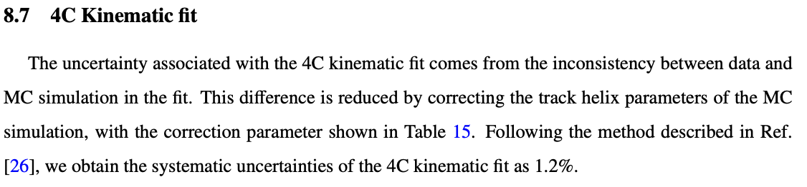
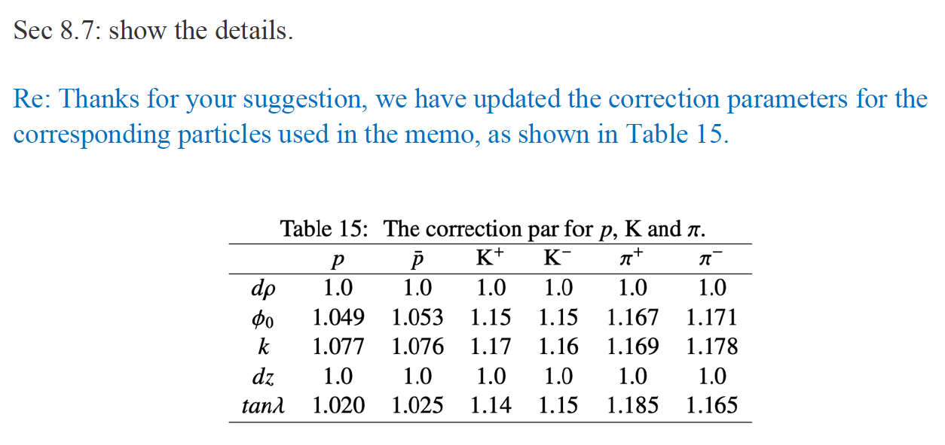
$$ψ\left(3686\right)→pK^{−}\overline{Λ}+c.c.$$

Slide 5
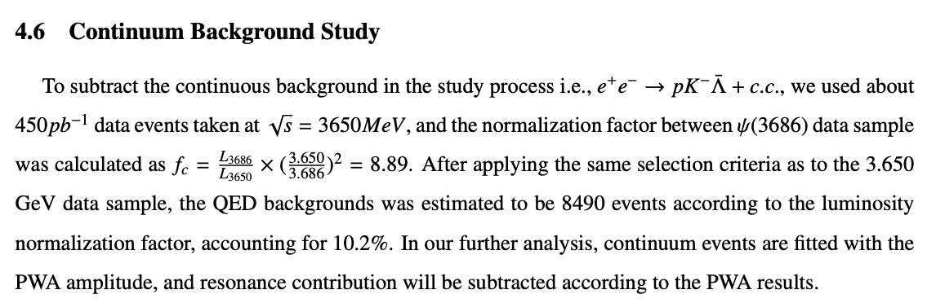
$$ψ\left(3686\right)→pK^{−}\overline{Λ}+c.c.$$
p12, L4: we can see your factor is 8.89, so the subtraction may introduce larger statistical error. so what about using the 3.77 GeV data?
We need to run the data at 3.773 GeV.

