Slide 1
Task 1:Recently I was mainly learning Geant4.
Task 2:Modify the model of CEPC.
Task 3:Run the neutrino interected with detector on fluka.
Next plan:Go on learning the Geant4.

Slide 2
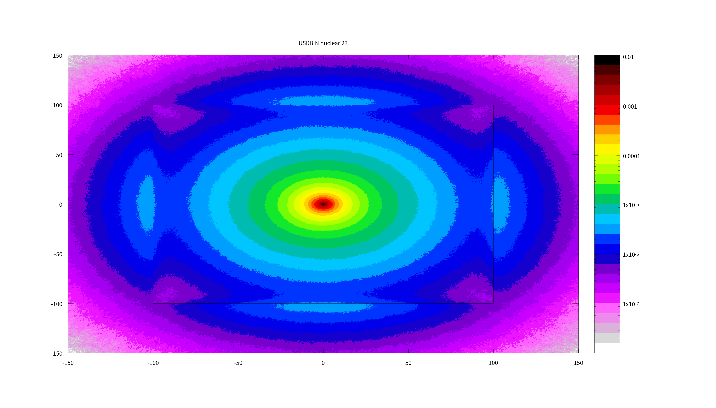
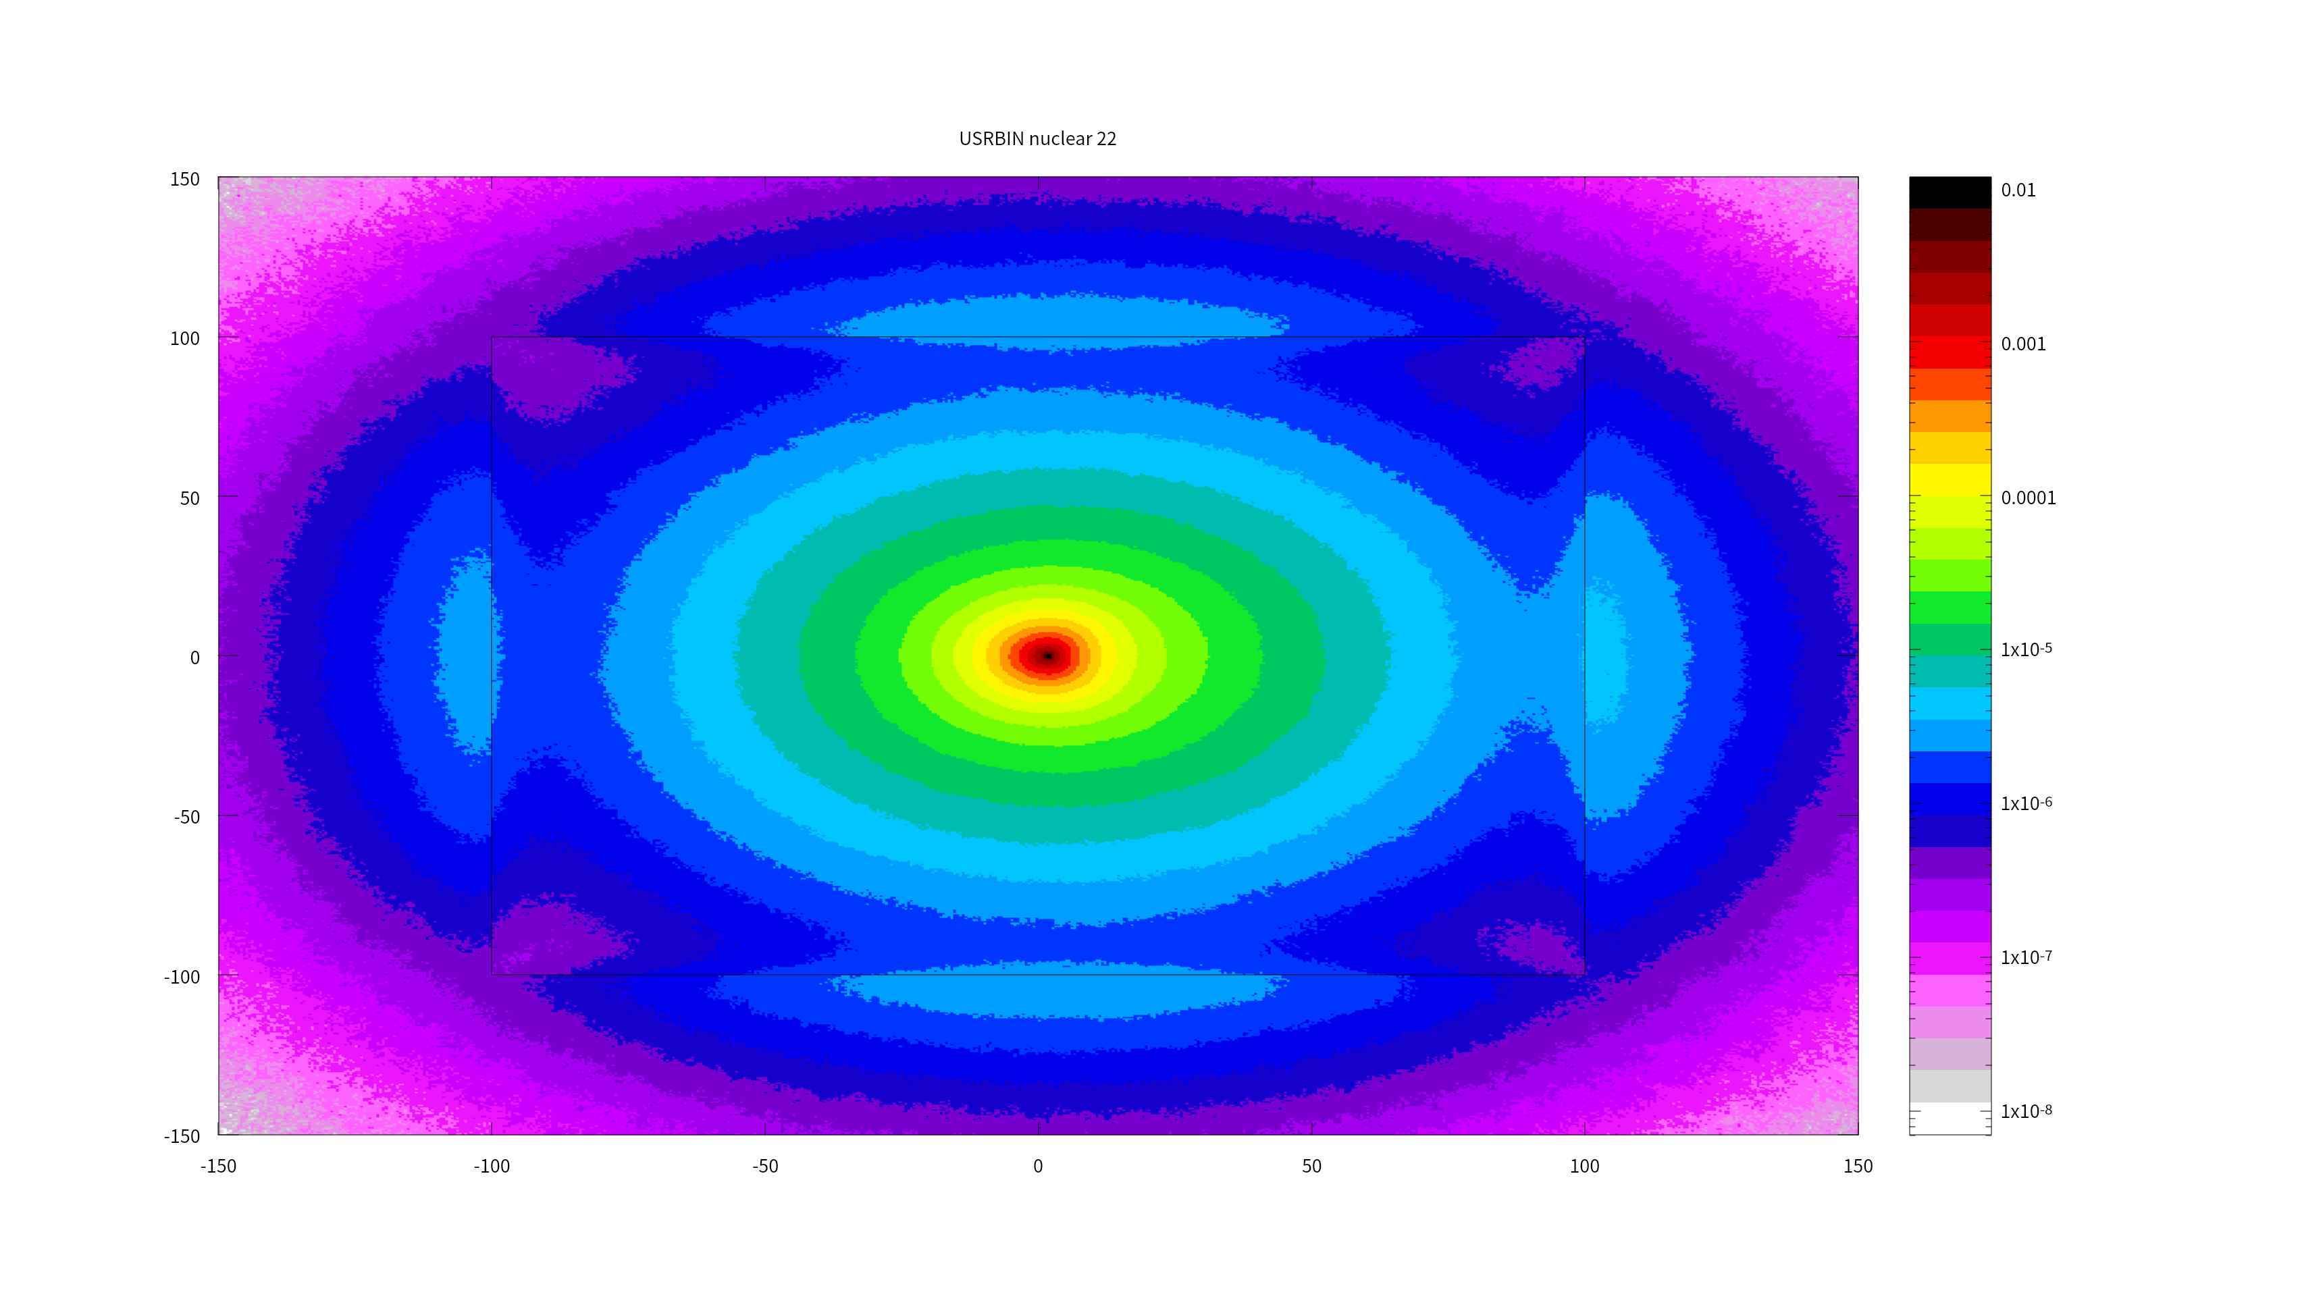

Just want to check out whether the cross section of neutrino interacted with matters during the transport is zero.

Slide 3
Check out the circumstance after modifying the detector of CEPC.

