Slide 1

Implications of the KM3NeT Ultrahigh-Energy Event on Neutrino Self-Interactions
Yuxuan He
City University of Hong Kong
Nov 30th 2025, NuPhyR, ZhuHai
YH, Jia Liu, Xiao-Ping Wang, Yi-Ming Zhong, arxiv 2504.20163
Notes:
Good morning/afternoon, everyone. Today, I’ll discuss our work on how the recent KM3NeT ultra-high-energy neutrino event, KM3-230213A, sheds light on neutrino self-interactions—a key probe for physics beyond the Standard Model. I’m Yuxuan He from City University of Hong Kong, and this is joint work with Jia Liu, Xiao-Ping Wang, and Yi-Ming Zhong

Slide 2
Outline
Introduction to neutrino self-interactions (νSI)
KM3NeT Ultra-high energy (UHE) event
Fit to UHE neutrino data with νSI
Constraints from UHE data to νSI
Conclusion
Notes:
This is outline of this talk

Slide 3
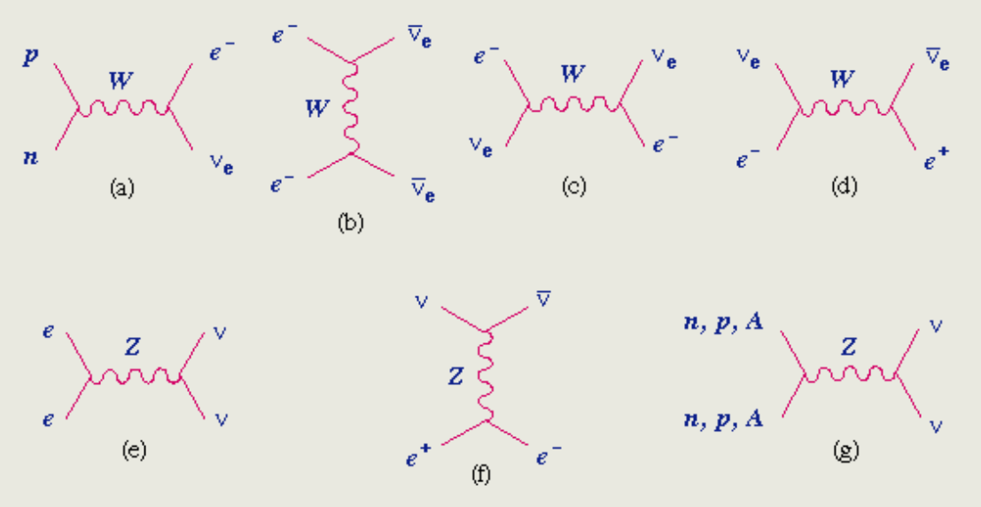
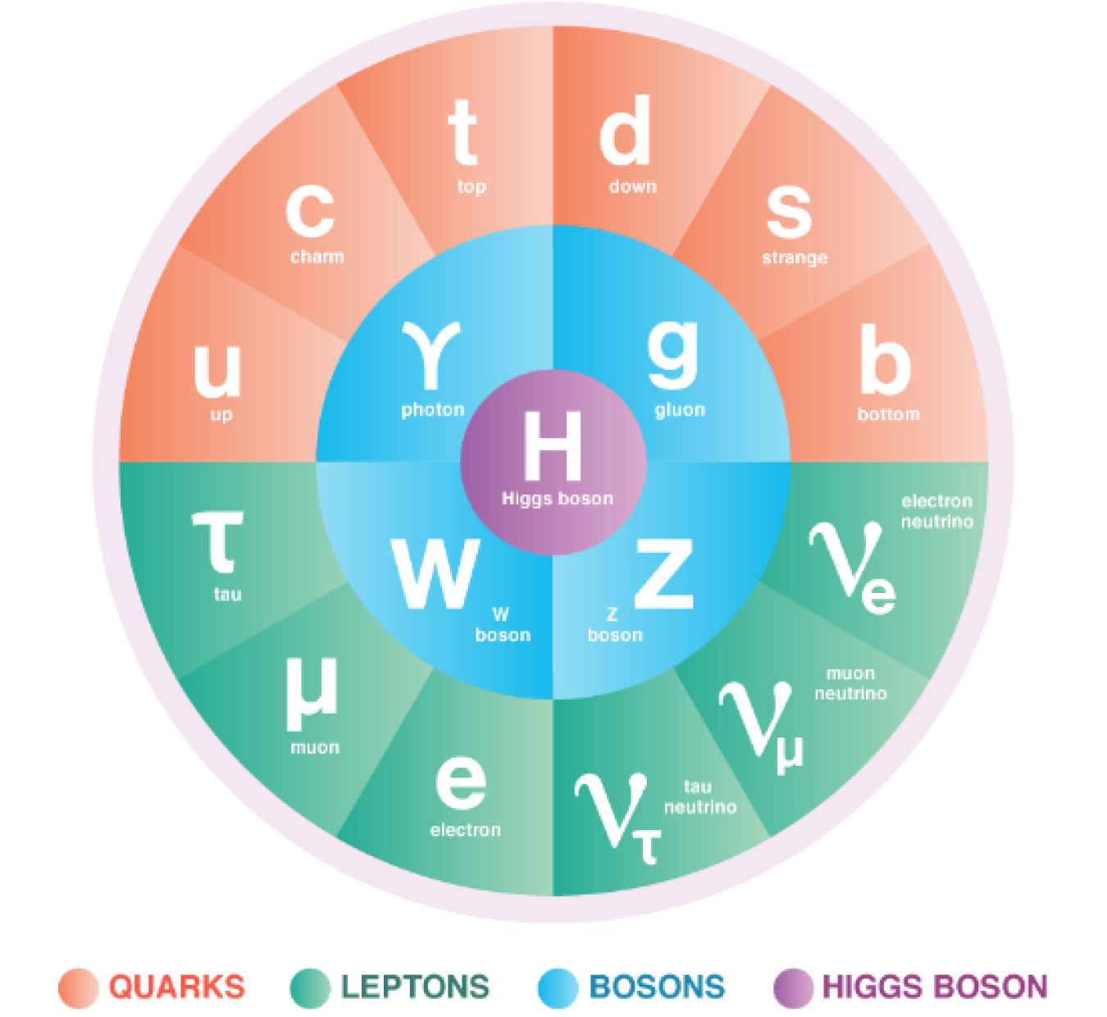
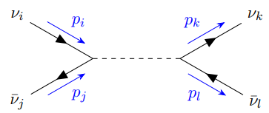
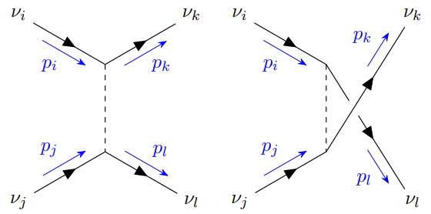
Neutrino self-interactions (νSI)
Neutrinos in SM
Neutrino self-interactions arise in many BSM scenarios
Notes:
In the Standard Model, neutrinos only interact weakly. But many beyond-Standard-Model theories predict self-interactions—mediated by new particles like light bosons. These νSI could reshape cosmology, affect supernovae, and alter neutrino spectra. Crucially, they might resolve tensions like the Hubble constant discrepancy or neutrino mass estimates from experiments like DESI.

Slide 4
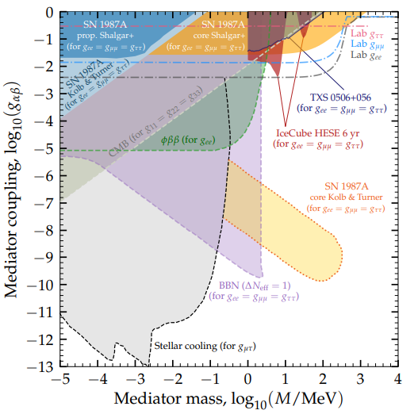
Neutrino self-interactions (νSI)
Effects of νSI and their constraints
Affect BBN by modifying Neff
Affect CMB by altering free-streaming
Affect Supernova
Modify astrophysical neutrino spectra
Tested by collider experiments
N. Blinov et al., Phys.Dark Univ. 42 (2023) 101267
Notes:
νSI impacts cosmology by changing neutrino free-streaming, affecting the CMB and matter power spectra. In astrophysics, it creates spectral ‘dips’ when astrophysical neutrinos scatter off the cosmic neutrino background. Existing constraints come from colliders (e.g., Z-boson decays), Big Bang Nucleosynthesis (altering Neff), and supernovae. For tau neutrinos, collider limits are weakest, making them ideal probes.

Slide 5
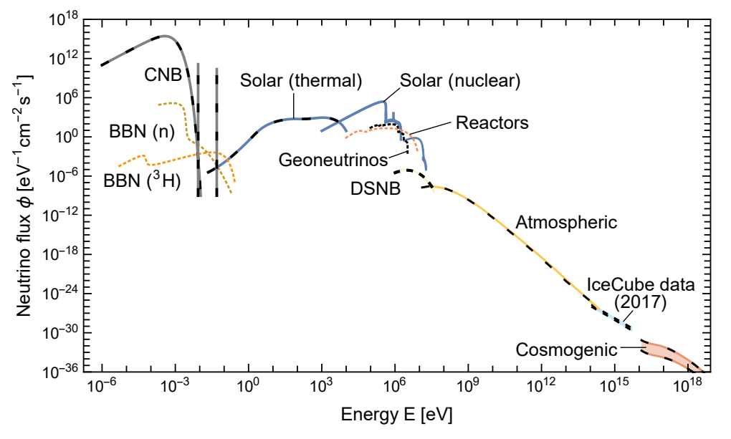
KM3NeT Ultra-high energy (UHE) event
Neutrino Spectrum around the earth
Ultra-high energy Neutrino
Notes:
Neutrinos the can be detected at the ground based observatories have a very wide energy spectrum.

Slide 6
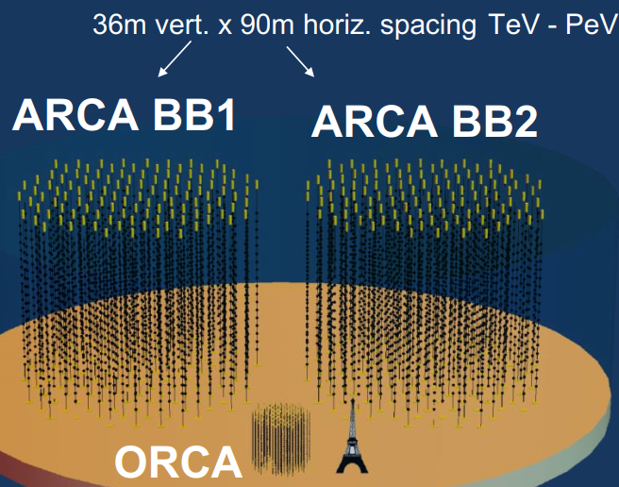
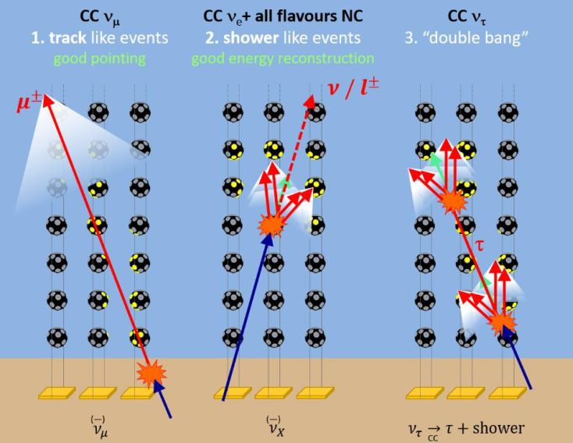
KM3NeT Ultra-high energy (UHE) event
KM3NeT experiments
Next-generation neutrino telescope in the Mediterranean Sea
Notes:
KM3NeT experiments is the Next-generation neutrino telescope in the Mediterranean Sea, which planed to have ARCA and ORCA two facilities, sensvitive to neutrinos form TeV to PeV energy range. They are both water Chenrenkov detectors,

Slide 7
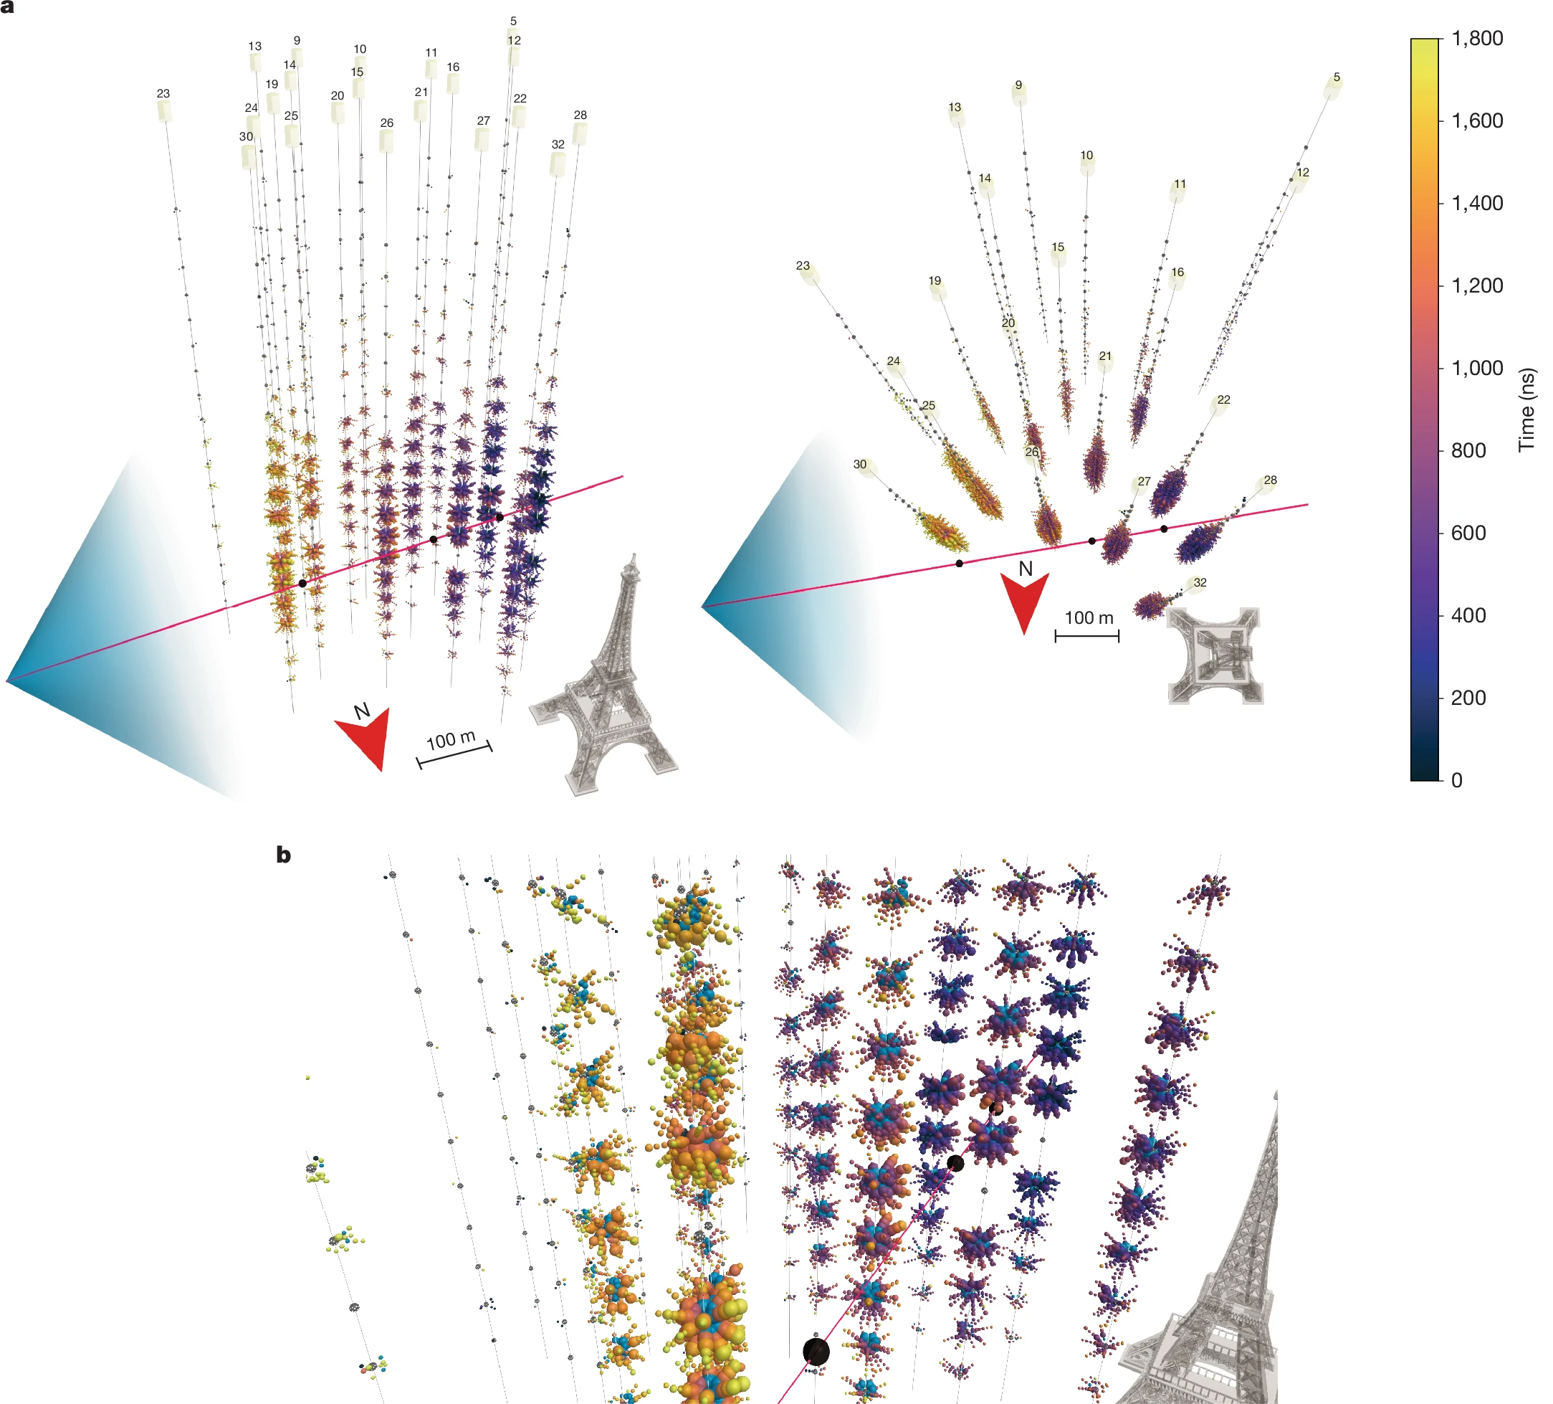
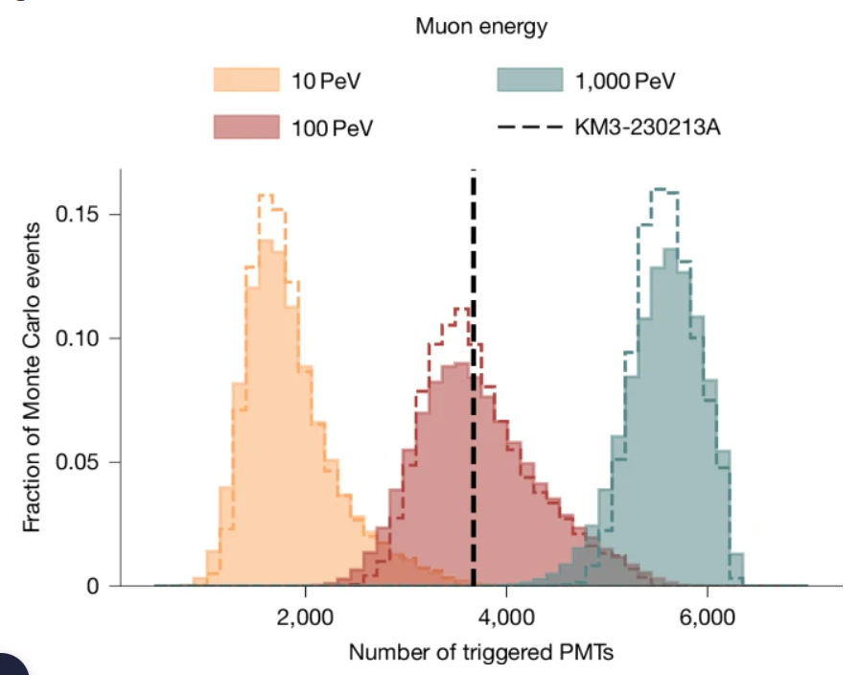
KM3NeT Ultra-high energy (UHE) event
KM3NeT experiments
Next-generation neutrino telescope in the Mediterranean Sea
KM3-230213A event: around 220PeV, most energetic neutrino
KM3NeT, Nature 638 (2025) 8050,
Notes:
In 2023, KM3NeT detected KM3-230213A—a neutrino with energy 220⁺⁵⁷⁰₋₁₁₀ PeV, the highest-energy event ever observed. This plot shows the PMT triggers confirming its significance. However, IceCube and Pierre Auger saw no events at these energies despite larger exposures, creating a 3σ tension. This anomaly makes KM3-230213A a unique probe for new physics.

Slide 8
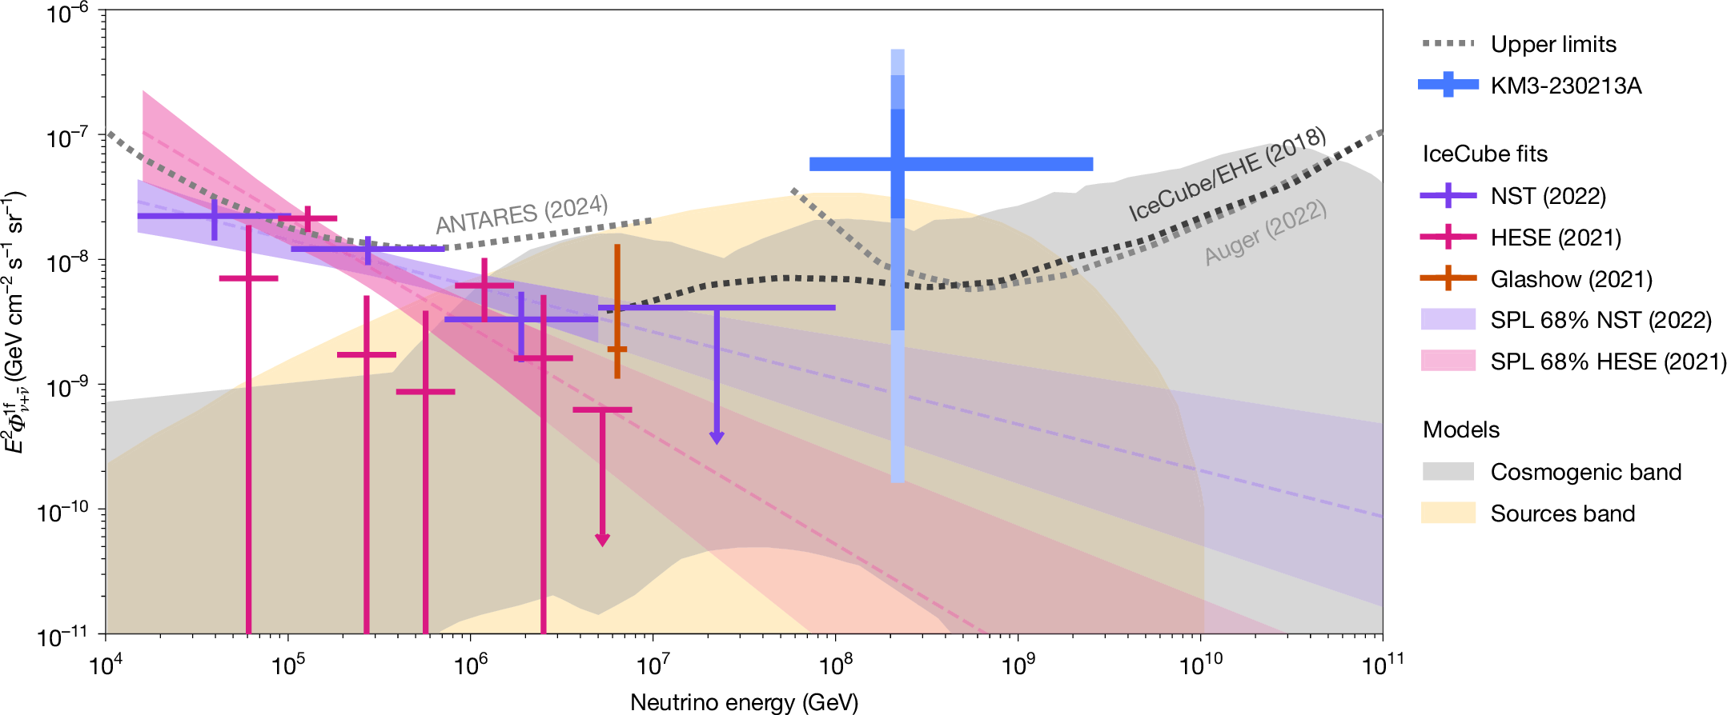
KM3NeT Ultra-high energy (UHE) event
Tension with previous observations
Possible explanations of the KM3-230213A event:
Decaying dark matter, Black hole evaporation......
KM3NeT, Nature 638 (2025) 8050,
KM3NeT, 2502.08173
Notes:
The KM3 event conflicts with IceCube’s non-detection of PeV neutrinos. If neutrinos come from diffuse power-law sources, the tension reaches 3σ. Proposed explanations include decaying dark matter, primordial black holes, or Lorentz violation. Our focus: whether νSI-induced spectral distortions can alleviate this tension while testing new interactions.

Slide 9

Fits to UHE neutrino data with νSI
Implications of KM3 event on νSI
νSI model
We focus on the case that only to be nonzero to avoid stringent constraints for first two generations.
The model needs to be UV completed, but we will not be confined on specific UV completion in this work.
Notes:
We study νSI mediated by a scalar ϕ. The Lagrangian includes couplings g_αβ between ϕ and neutrinos. To avoid tight constraints from electron/muon sectors, we assume only gττ is non-zero. Though this model requires UV completion, we treat it as low-energy effective theory. Key parameters are the mediator mass mϕ and coupling gττ.

Slide 10





Fits to UHE neutrino data with νSI
Propagation of astrophysical neutrinos in the presence of νSI
Around the resonance:
Dips arise in the astrophysical neutrino spectrum
We use nuSIprop to compute the spectrum, assuming a single power-law (SPL) initial spectrum
I. Esteban et al, Phys.Rev.D 104 (2021) 12, 123014
Notes:
Neutrinos propagating through space scatter off the cosmic neutrino background via νSI. Near resonance, s-channel scattering peaks sharply. This reduces the flux at specific energies, creating ‘dips’ where E_dip ≈ mϕ² / (2m_ν). We model this using a transport equation solved numerically with nuSIprop, assuming a power-law source spectrum."

Slide 11




Fits to UHE neutrino data with νSI
We use the following datasets for our fitting
1) IceCube high-energy neutrino datasets NST or ESTES
2) IceCube extremely high energy neutrino constraints IC-EHE
3) Pierre Auger UHE neutrino constraints
4) KM3NeT KM3-230213A
We use the likelihood function for fitting
superscript d runs over datasets.
Sampling over the prior:
Notes:
We combine data from: (1) IceCube’s high-energy tracks (NST/ESTES), (2) IceCube’s ultra-high-energy constraints, (3) Pierre Auger’s limits, and (4) KM3NeT’s event. The joint likelihood tests νSI parameters against all data. For UHE datasets, we use Poisson statistics for event counts; for HE, we fit segmented fluxes or power-law likelihoods.

Slide 12
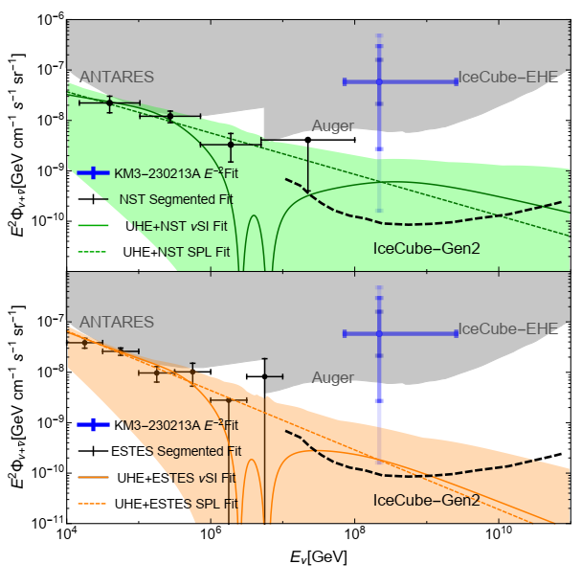
Fits to UHE neutrino data with νSI
The fits of the astrophysical neutrino spectrum with νSI
Softening of the specta index
Notes:
Our best-fit spectra with νSI (solid lines) show dips softening the spectrum versus a power law (dashed). This slightly reduces tension: spectral indices are flatter, boosting UHE flux. Colored bands are 1σ uncertainties. Future IceCube-Gen2 (dashed black) will dramatically improve sensitivity across energies.

Slide 13



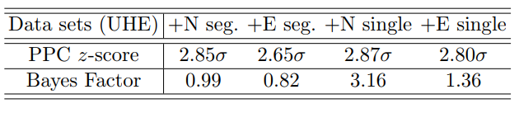
Fits to UHE neutrino data with νSI
Tension and preference of the νSI model
We test the tension between the KM3NeT UHE event, IceCube, and Pierre Auger by performing posterior predictive test (PPC)
We test the preference of the νSI by computing Bayes factors
with
Notes:
Quantifying tension: Posterior predictive checks show νSI reduces tension from 3σ to 2.6–2.8σ—mild but notable. Bayes factors, however, show no strong preference for νSI over a power law, except marginally for IceCube NST data. This hints that νSI could play a role but isn’t yet definitive.

Slide 14
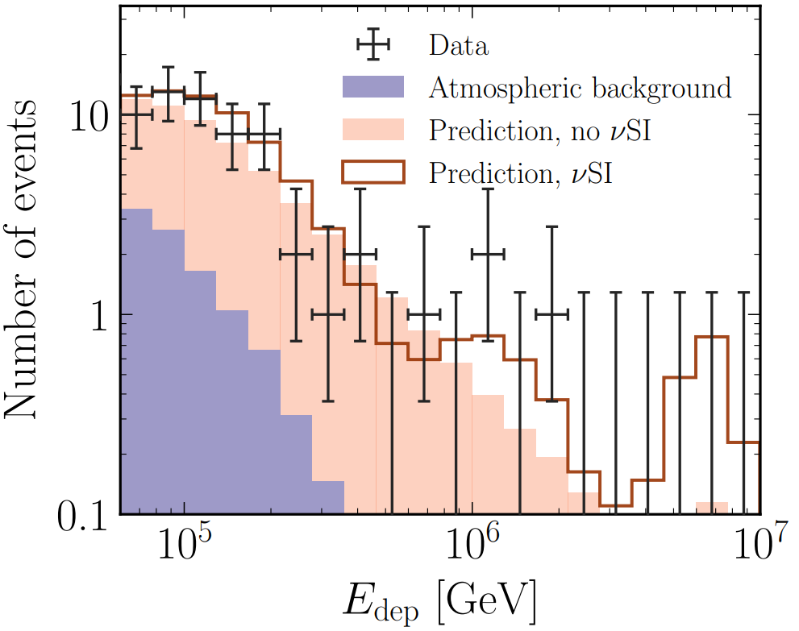
Constraints from UHE data to νSI
Constraints of νSI from astrophysical neutrino data
The presence of the dips reduces the astrophysical neutrino fluxes,
modifies the spectrum shapes
I. Esteban et al, Phys.Rev.D 104 (2021) 12, 123014
Notes:
Spectral dips suppress fluxes. If a dip overlaps with KM3-230213A’s energy (∼100 PeV), we’d expect no events—so its detection constrains gττ. Our 95% limits (green/orange) come from marginalizing the posterior. For mϕ ≈ 100 MeV, we exclude couplings twice as strong as collider limits (gray). IceCube-Gen2 (red dashed) will probe deeper.

Slide 15
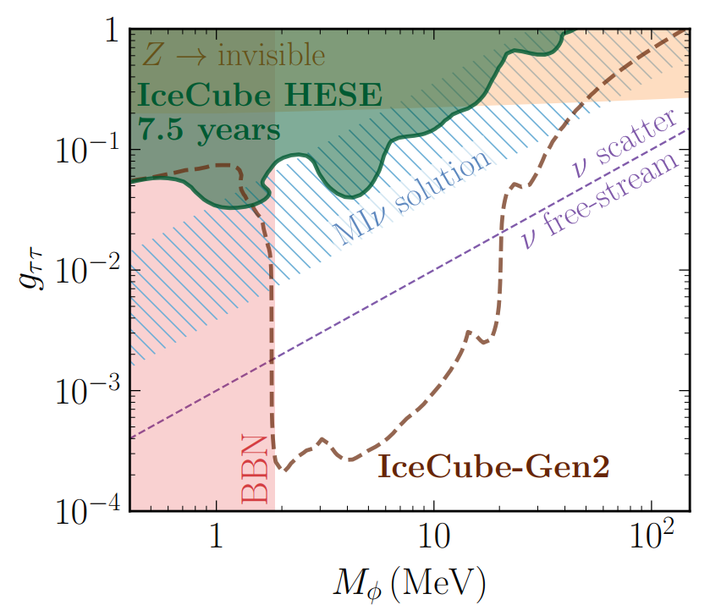

Constraints from UHE data to νSI
Constraints of νSI from astrophysical neutrino data
The presence of the dips reduces the
astrophysical neutrino fluxes,
modifies the spectrum shapes
Derivation of 95% limit from posterior
I. Esteban et al, Phys.Rev.D 104 (2021) 12, 123014
Notes:
Spectral dips suppress fluxes. If a dip overlaps with KM3-230213A’s energy (∼100 PeV), we’d expect no events—so its detection constrains gττ. Our 95% limits (green/orange) come from marginalizing the posterior. For mϕ ≈ 100 MeV, we exclude couplings twice as strong as collider limits (gray). IceCube-Gen2 (red dashed) will probe deeper.

Slide 16
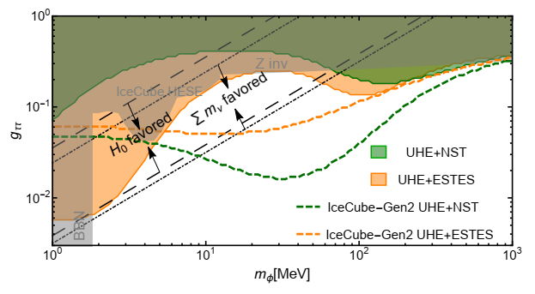
Constraints from UHE data to νSI
Constraints of νSI from astrophysical spectrum
Notes:
Our joint fits with KM3NeT (green: UHE+NST; orange: UHE+ESTES) exclude the shaded regions. At mϕ ∼100 MeV, gττ < 10⁻². Future IceCube-Gen2 could cover most of the ‘moderately interacting neutrino’ parameter space (black dashed/dotted) that resolves Hubble or neutrino mass tensions. Cosmology and neutrino telescopes are now complementary probes.

Slide 17
Conclusions
νSI mildly alleviates KM3NeT-IceCube tension
No strong preference for νSI, except slight in NST fit.
Strongest constraints at mediator mass around 100 MeV.
IceCube-Gen2 will refine νSI probes a lot
Notes:
To summarize: νSI mildly alleviates the KM3NeT-IceCube tension but isn’t strongly favored yet. We’ve set the strongest terrestrial constraints on gττ for 100 MeV-scale mediators—surpassing colliders. With IceCube-Gen2, we’ll test νSI across broader parameter space, potentially resolving cosmological tensions. Thank you. Questions?

Slide 18
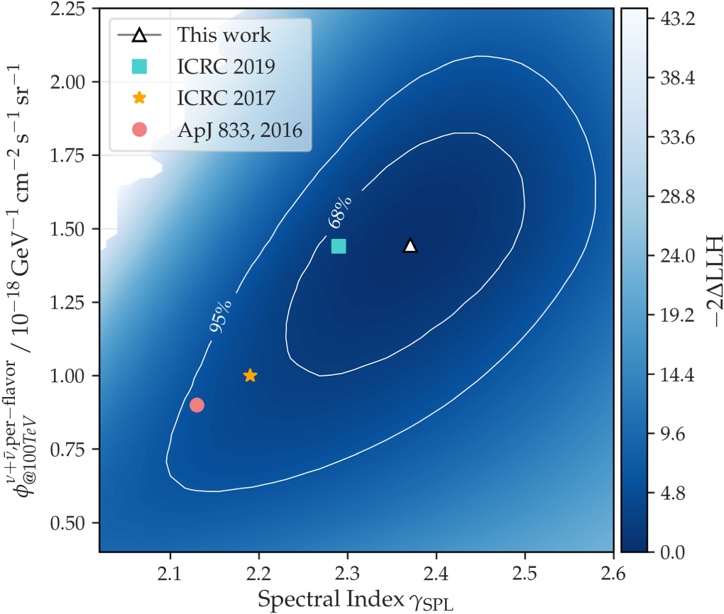



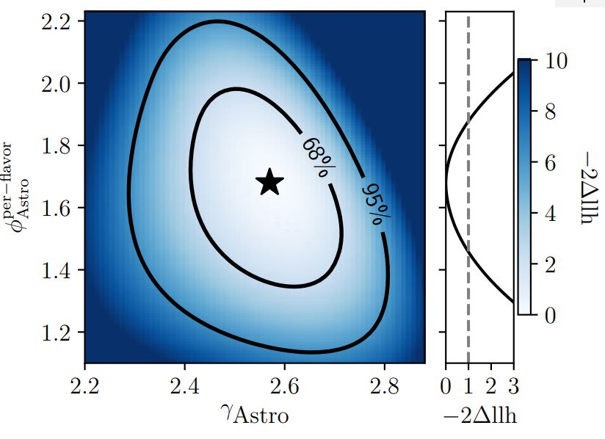


Backups
Likelihoods in fitting

Slide 19
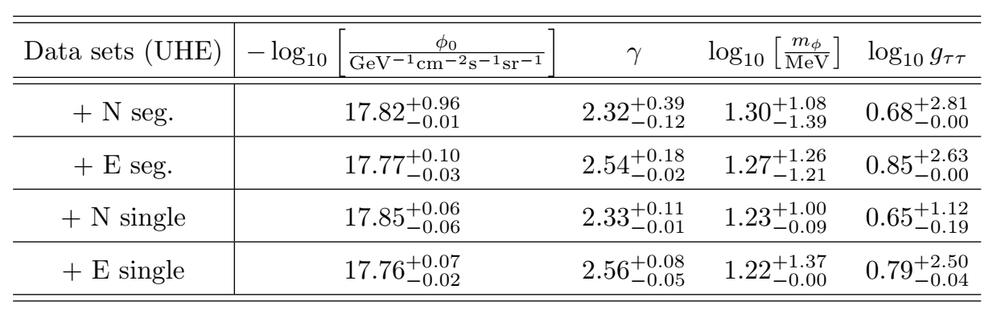
Backups
Fitting of the neutrino spectrum

