Slide 1




Proposal for a next generation neutrino astronomy telescope
Speaker: Zongkang Zeng (曾宗康)^{1,2}
on behalf of the HUNT collaboration
¹ Institute of High Energy Physics, Chinese Academy of Sciences
² Tianfu Cosmic Ray Research Center

Slide 2
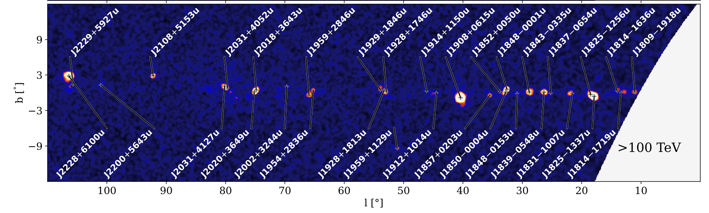
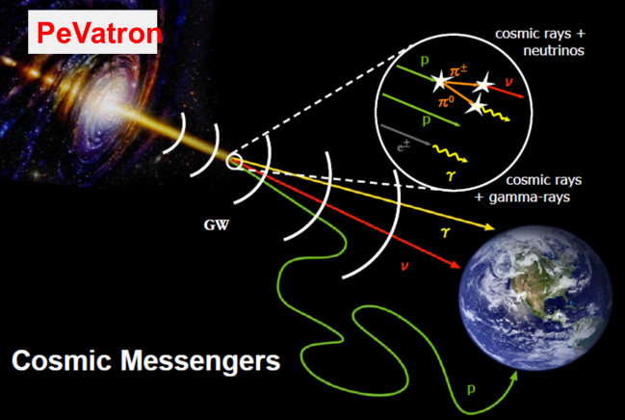
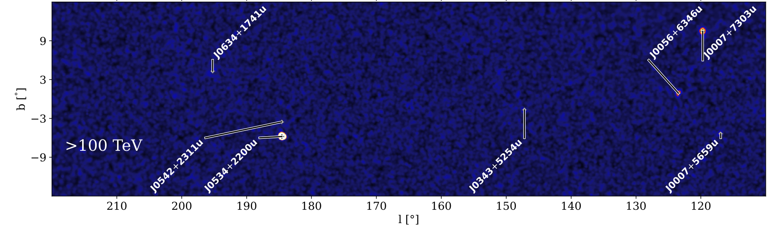
Scientific Goals
High-energy Underwater Neutrino Telescope (HUNT)
Researching the Galactic PeVatrons in the view of neutrinos
Resolving the high energy neutrino sky
Understanding the propagation mechanism of high energy cosmic-rays
Exploring the frontiers of neutrino physics and new physics
E_{γ}>100 TeV
LHAASO, 2024, ApJS
PeVatrons: accelerator of PeV cosmic-rays
(e.g., electrons, protons)
1LHAASO catalog: 43 UHE gamma-ray sources (>4σ)
Notes:
HUNT named ...
Its

Slide 3
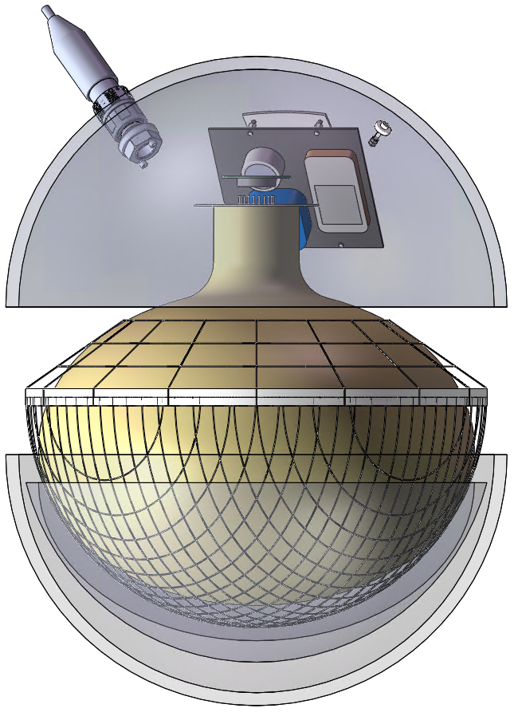
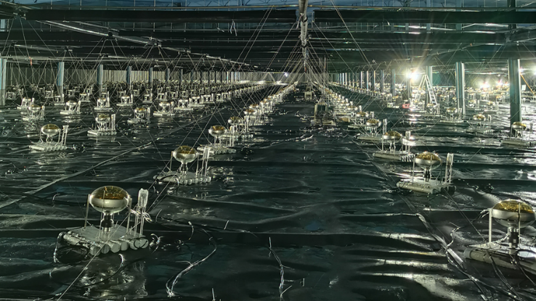
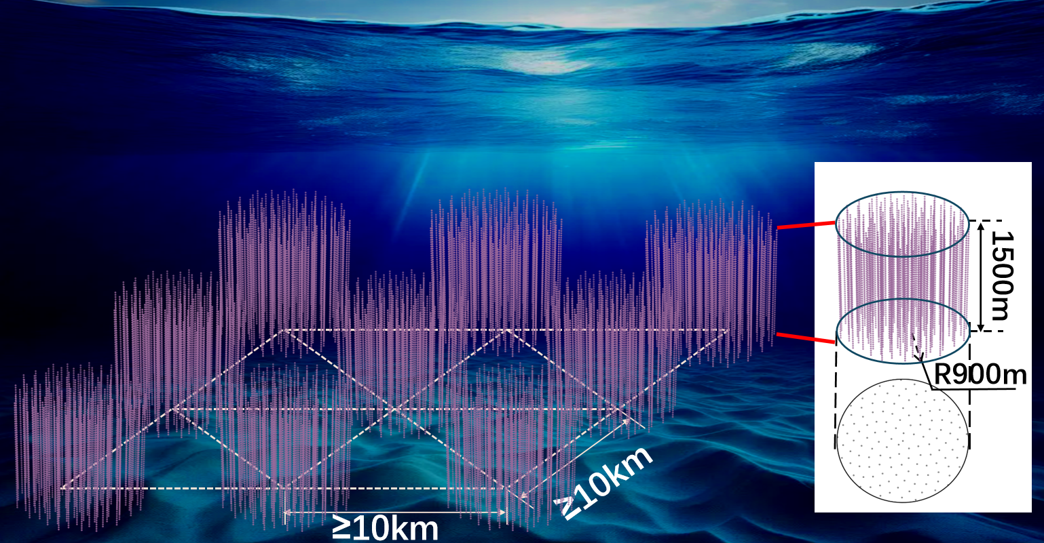
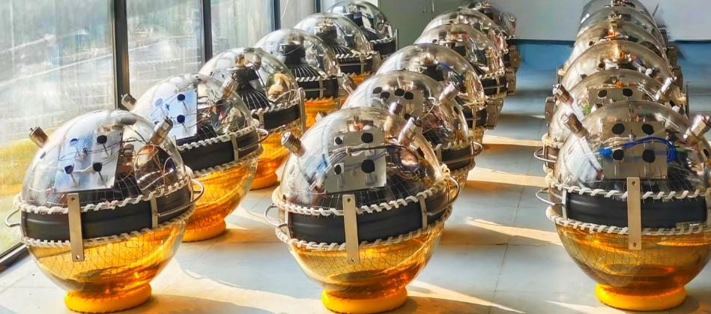
HUNT Project
Neutrino Energy: ~10TeV-100PeV
Detector Volume：30km³ , ~1200 strings (x30 ice cube)
NEW super-scale Optical Module (OM)
20 inch PMT + 23 inch glass sphere
Φ: ~60 cm
20-inch PMTs Used in LHAASO.
Sparse OM arrangement (reduced density).
Much Simpler, Lower Cost and Better Stability.
20-inch PMT
Notes:
also JUON

Slide 4
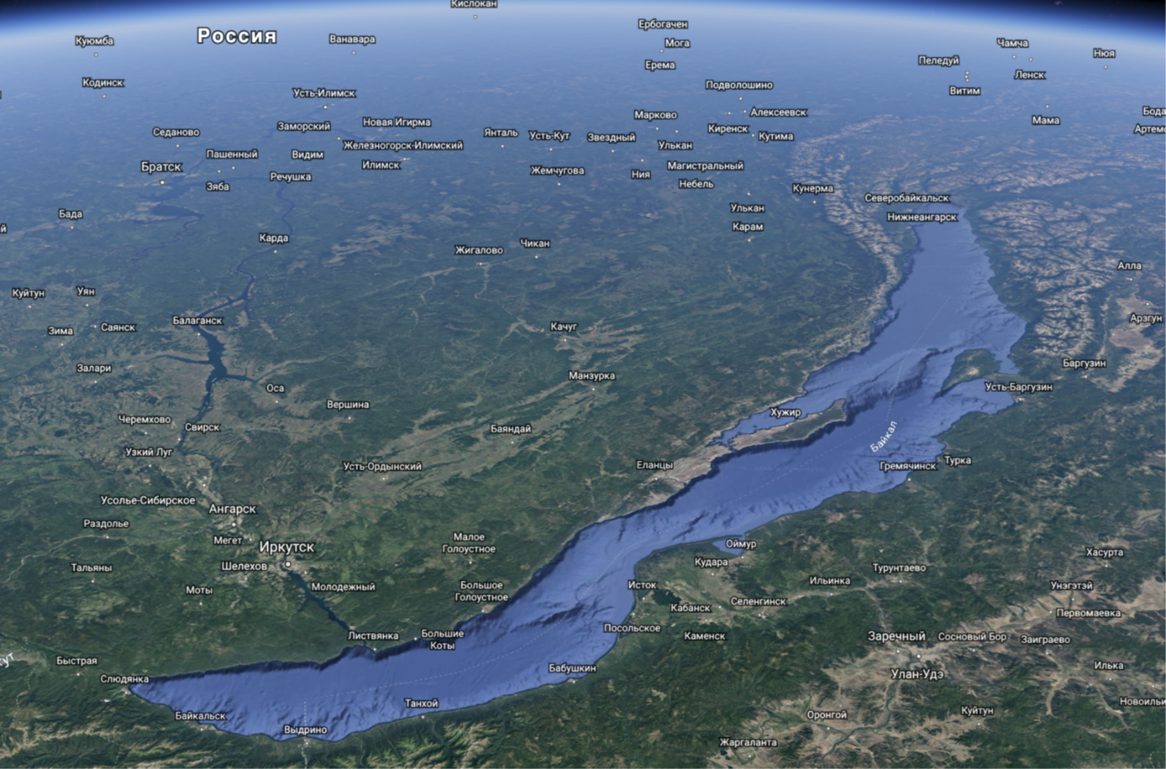
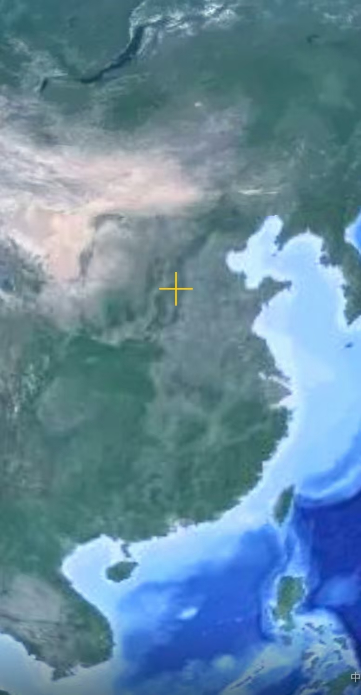
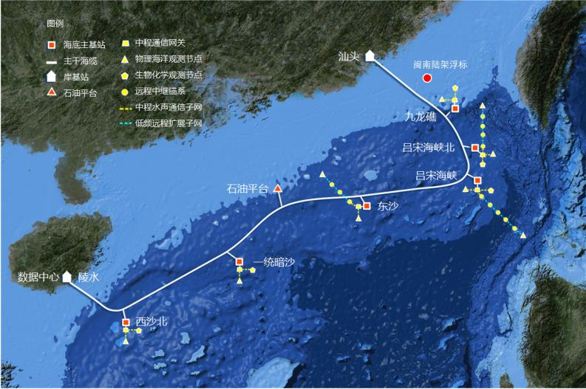
Two Candidate sites
Lake Baikal (water depth ~ 1300 m)
The South China Sea (water depth ~ 3000 m)
South China Sea
Lake Baikal

Slide 5
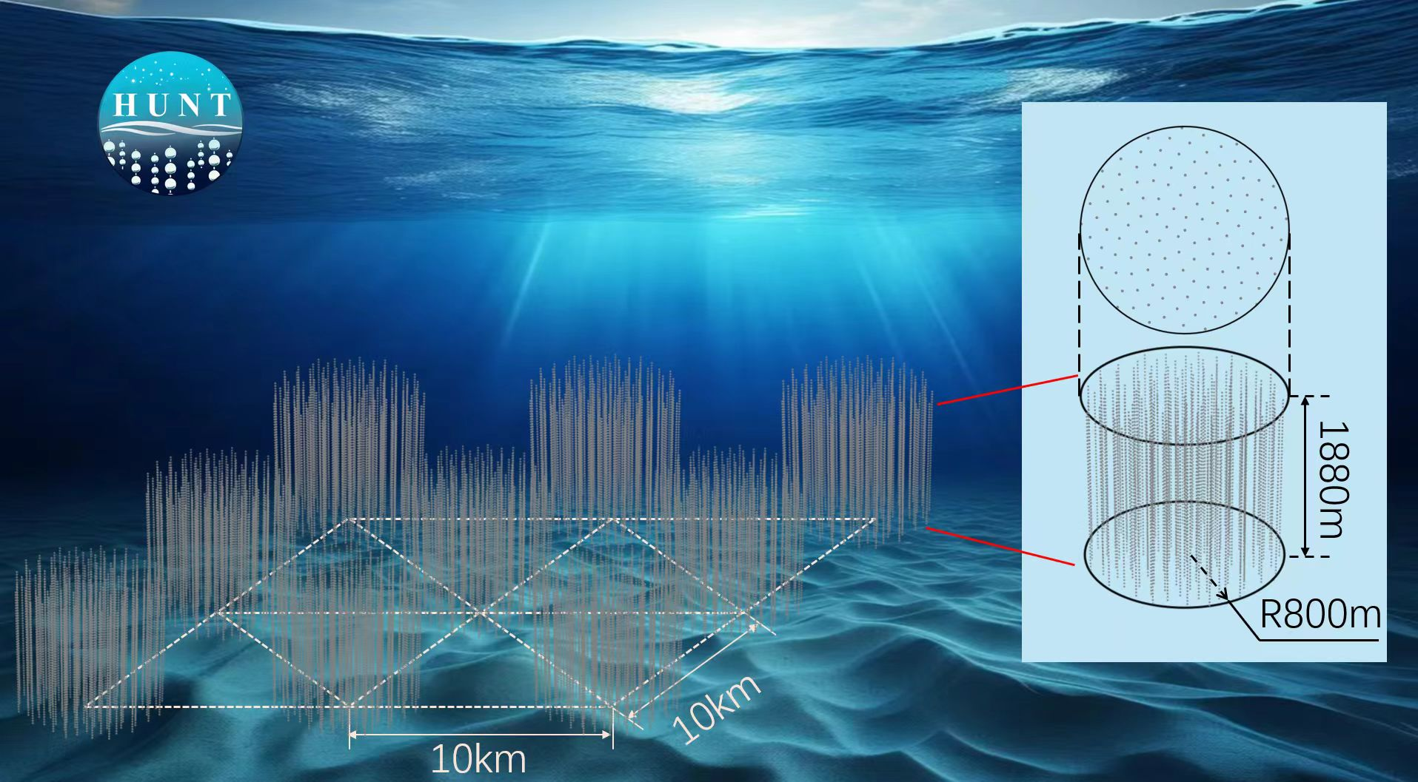
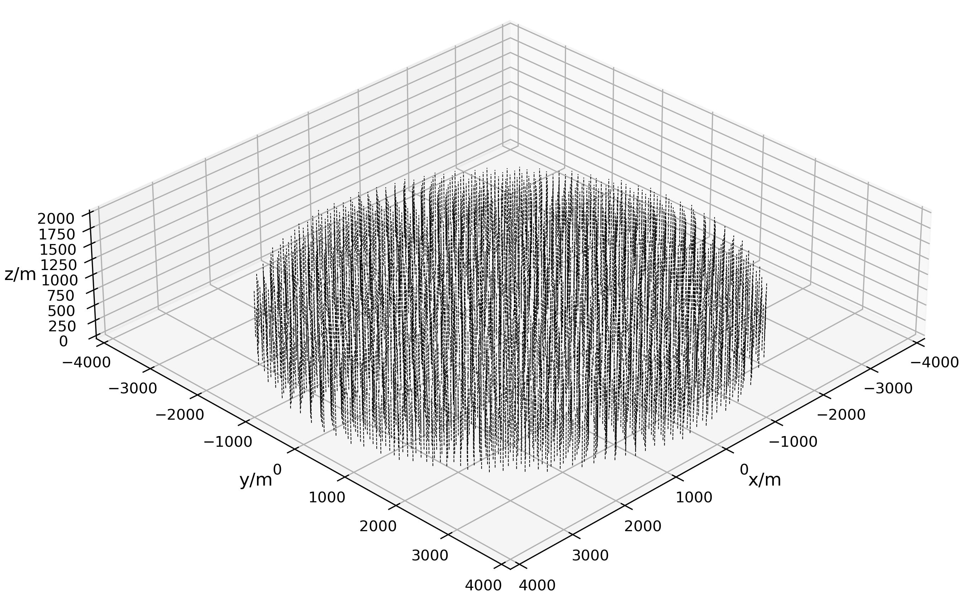
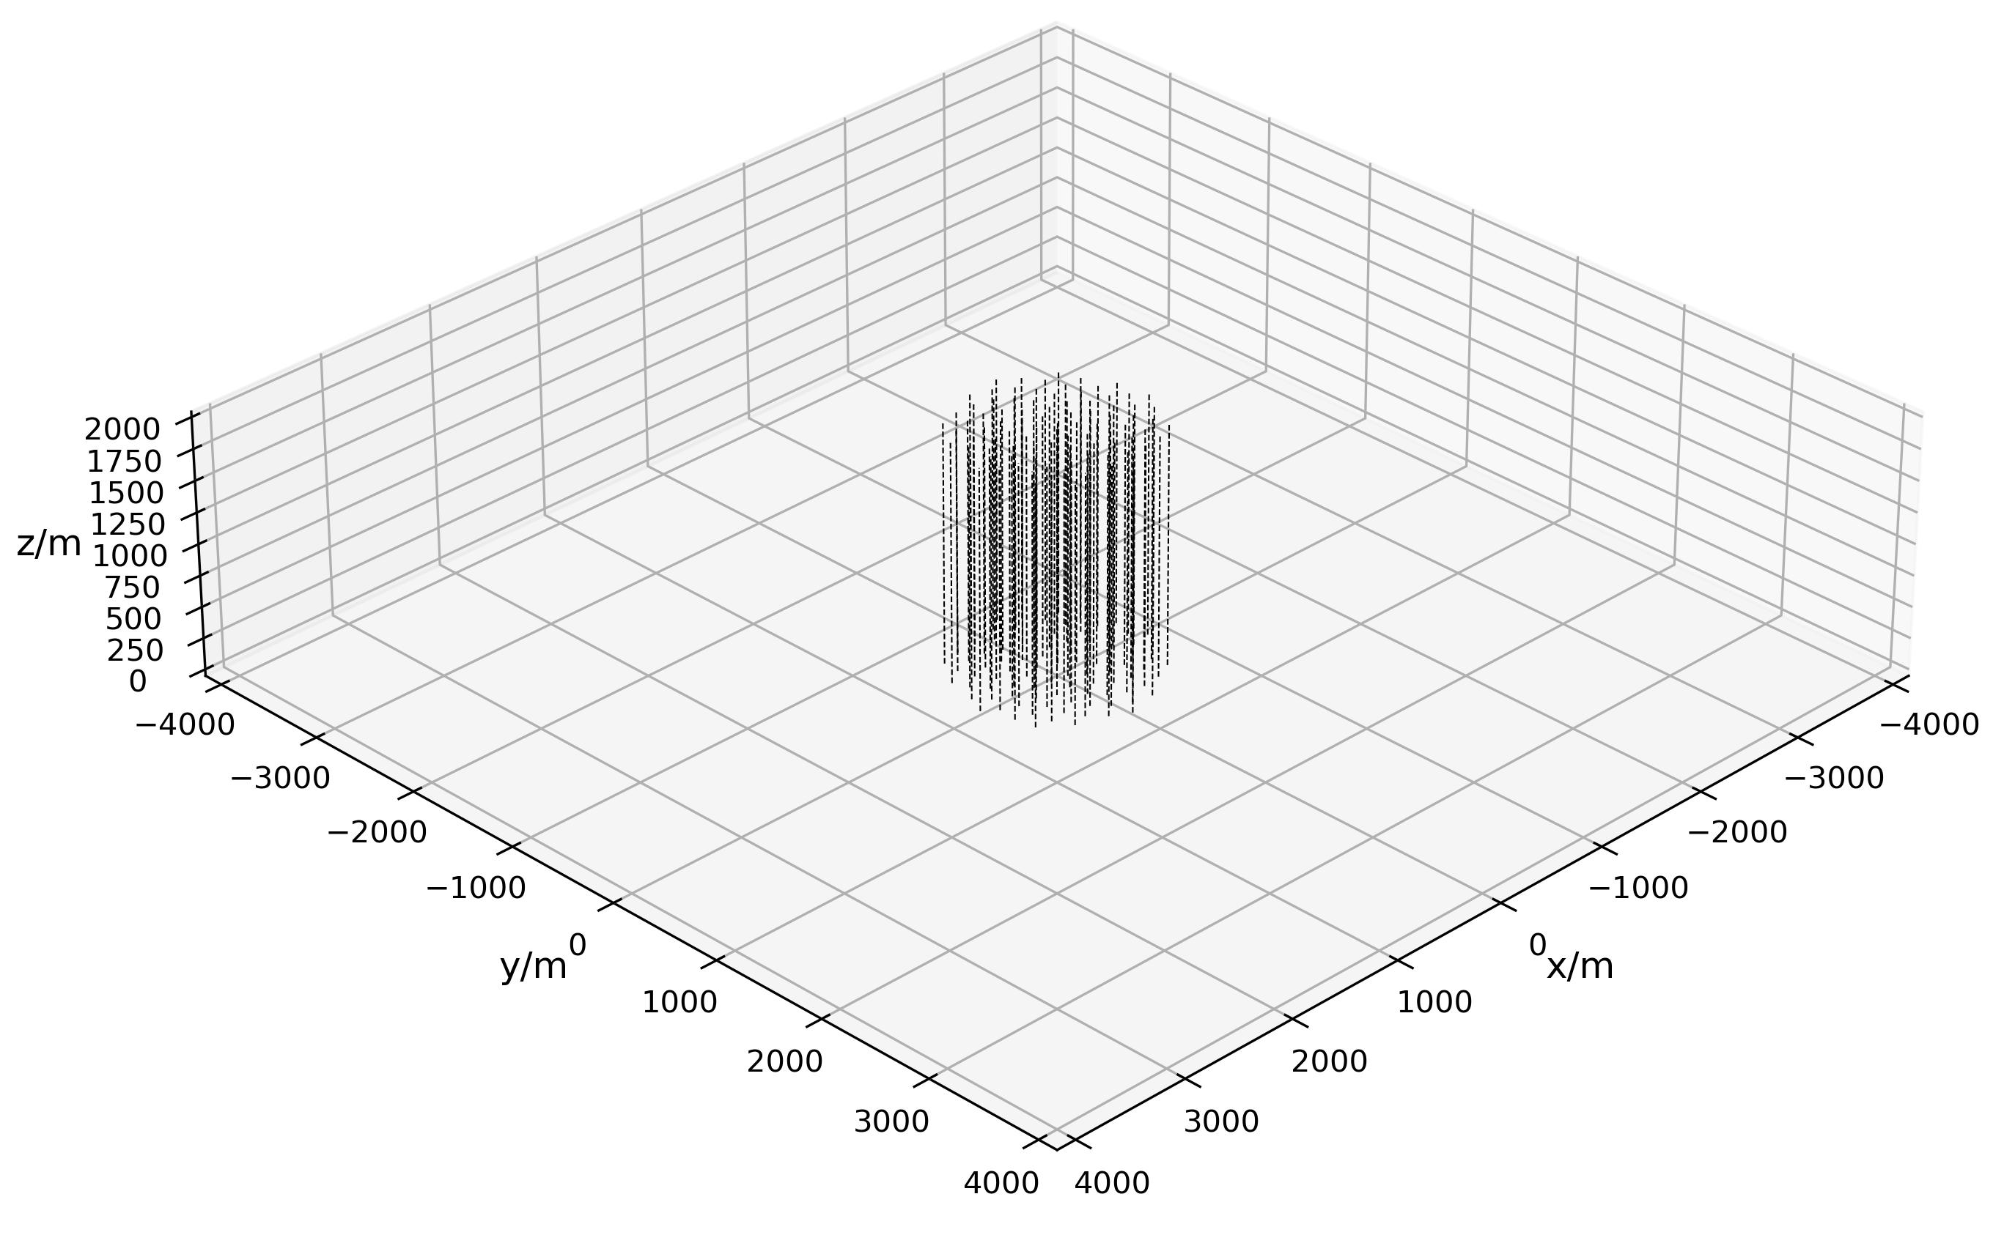
Configuration
Multiple cluster design has large effective volume
Longer track length → better direction resolution-->800m enough
Type 1
Height: 720 m
Radius: 3.8 km
2212-strings
1-cluster
Type 2
Height: 1890 m
Radius: 800 m
128-strings
9-clusters(space 10km)
×9
South China Sea (water depth ~ 3000 m)
Lake Baikal (water depth ~ 1300 m)
More configurations in ICRC2025

Slide 6
Simulation Framework
HUNTSimNet
G4ART
G4DMT
HUNTWeighter
gSeaGen
* developed by KM3Net
Atmospheric neutrinos & muons; Neutrino sources
...
(e.g., MCEq, CORSIKA)
Neutrino interaction
(GENIE)
Secondary particles
Optical Array simulation
OM simulation
Muon injector
(PROPOSAL)
HUNTMuonGun
Environment Background
( ⁴⁰K decay, bioluminescence)
Trigger & DAQ
HUNTAnalysis
* only track events
HUNTData
Final events
Selection
(e.g., Astro/Atm)
Reconstruction
(e.g., tracks, cascades)
Classification
(e.g., T/C)
Noise filter
(e.g., T/B, C/B)
Scientific goals
(e.g., sensitivity，point-like sources)

Slide 7
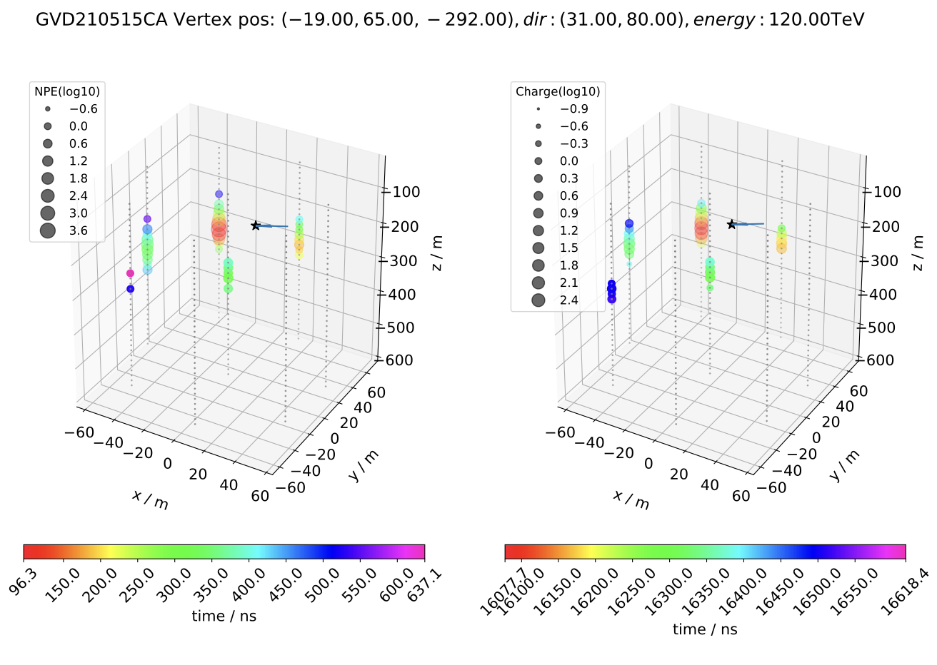
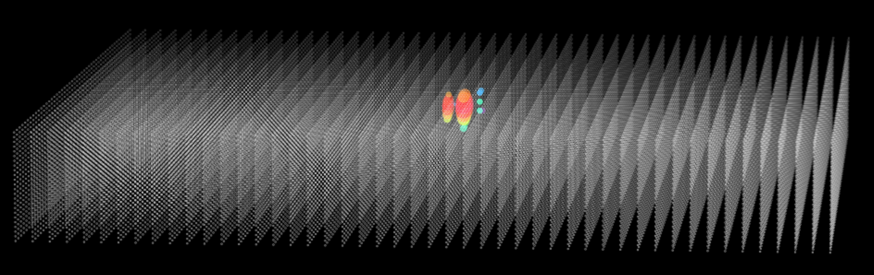
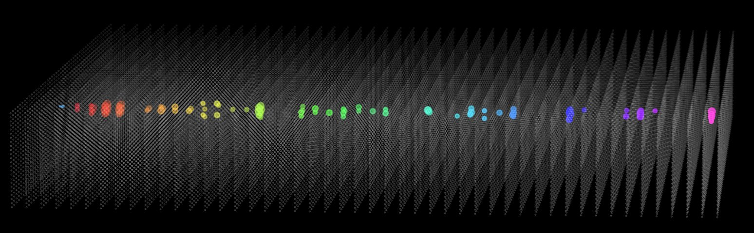
Geant4 Check
Simulation | in-array
Geant4 program verified by Baikal-GVD events
Simulated 13 neutrino events observed by Baikal-GVD, using the reconstructed parameters (e.g., NPE) of these events.
Simulation results are consistent with the GVD observations within the systematic uncertainty.
HUNTSimNeT
Geant4: simulating particle interactions inside the array
CRMC: hadronic interactions above 100 TeV
Two libraries, G4ART and G4DMT, are developed to accelerate the simulation above 100 TeV.
This work
Baikal-GVD
Morphology
Left: Cascade event induced by an 1 PeV electron;
Right: Track event induced by an 100 TeV muon
Takes 137 hours for a 1 PeV νₑ event!
(with one CPU)
Wang, et al., 2024, ChPhC

Slide 8
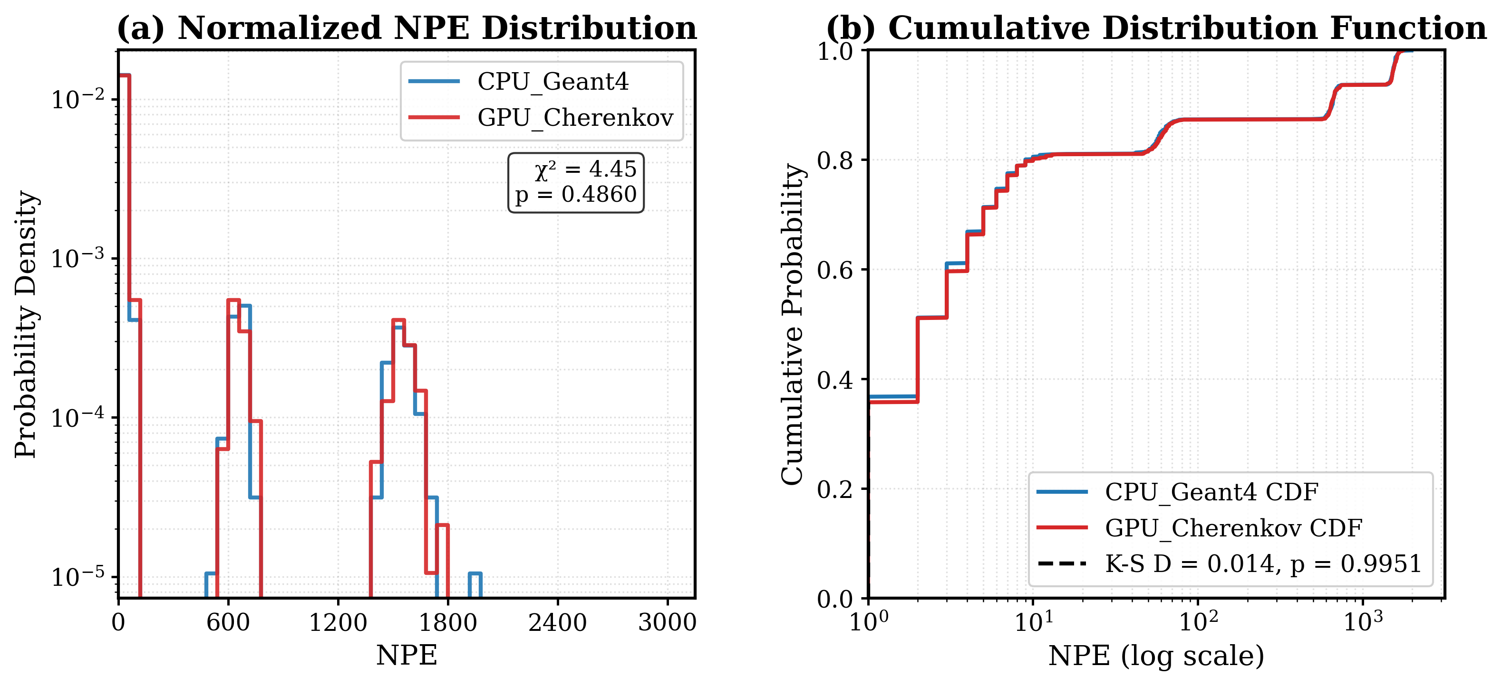
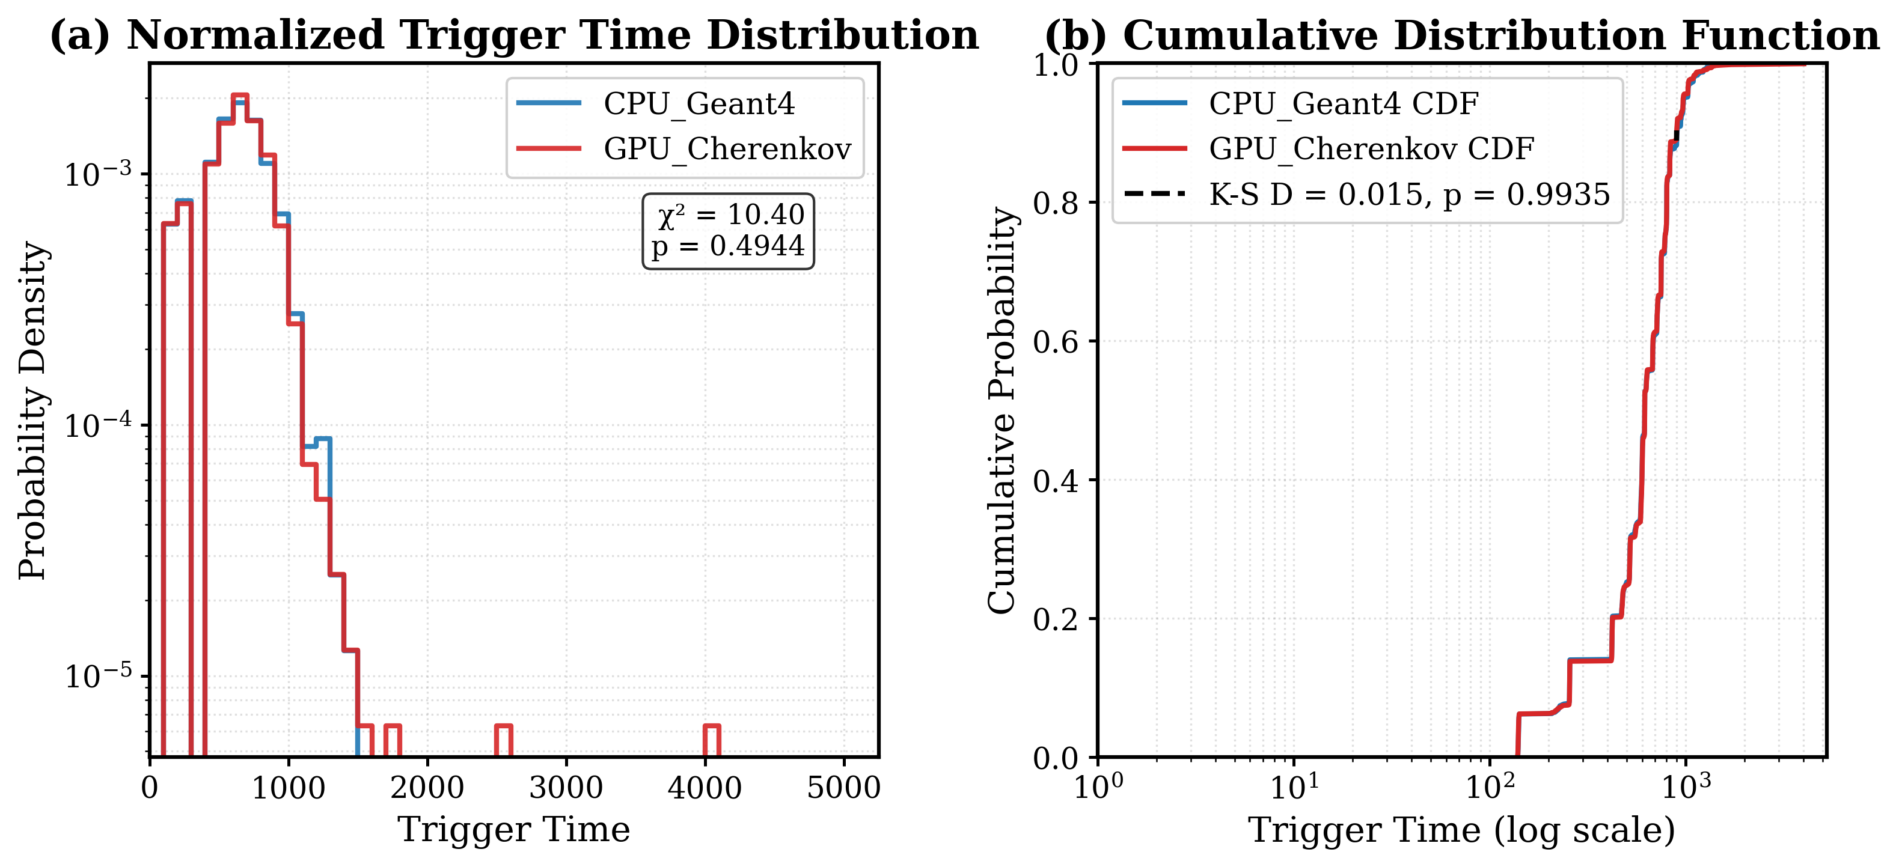
Simulation | in-array
GPU Accelaration
HUNTSimNeT
Geant4: simulating particle interactions inside the array
CRMC: hadronic interactions above 100 TeV
Two libraries, G4ART and G4DMT, are used to accelerate the simulation above 100 TeV.
G4DMT: Geant4 Distributed Multiple Threads
call all CPUs to simulate a primary particle.
G4ART: Geant4 Accelerated Ray Tracing
optical photon simulation. GPU ray tracing. In order to further reduce the CPU computing load.
eg. One νₑ (1 PeV)
default Geant4 takes 137 hours
  w/i 1-core CPU
G4DMT + G4ART takes 410 seconds
  w/i 32-core CPU, 4 GPUs
Improve speed 1200 times faster
The difference of CPU & GPU on Charge and Time distribution

Slide 9
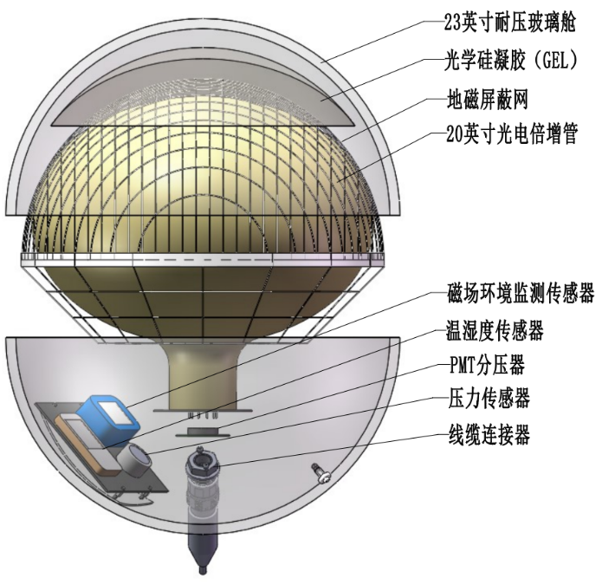
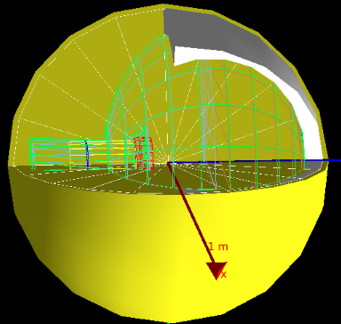
Simulation | in-OM
Achieve a more realistic simulation
23 inch glass sphere
Optical model in Geant4
Optical gel
Magnetic shielding
20 inch PMT
magnetometer
humidity sensor
Voltage divider
pressure gauge
penetrator

Slide 10
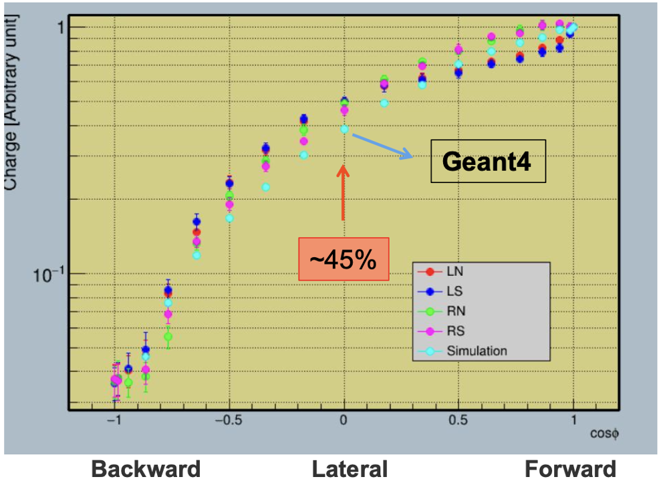
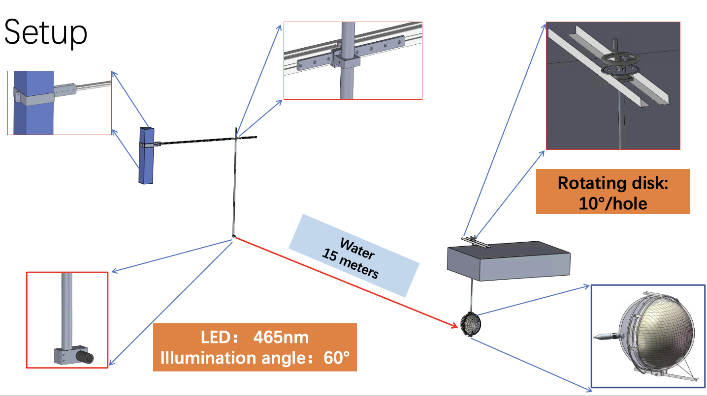
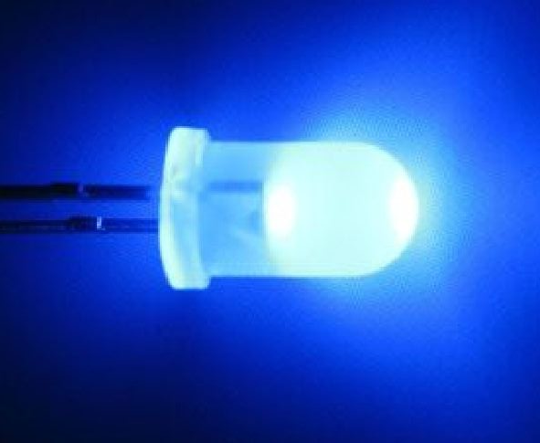
Simulation | in-OM
left (L)
right (R)
Test: Compare OM surface detection efficiency (DE) vs. G4 simulations
Light source: Blue LED (15 m away from OM)
Operation: Rotate OM in different directions to collect charge data
anticlockwise (N)
clockwise (S)
Adjust or optimize the simulation parameters
to realistic simulation

Slide 11

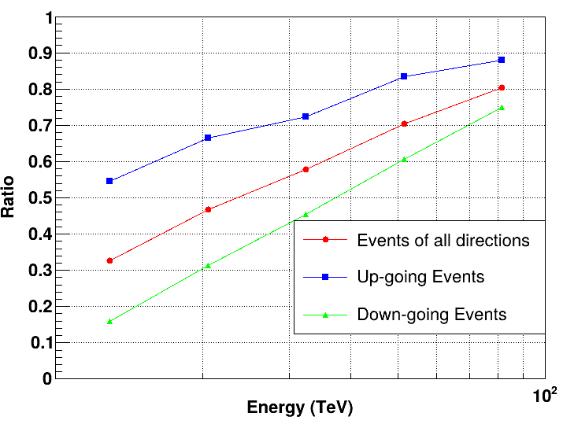
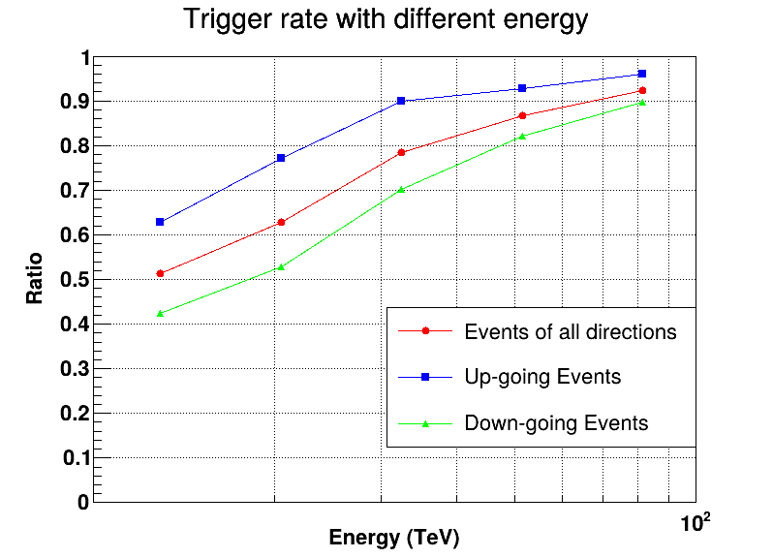
Simulation | Trigger (with k₄₀ noise ~130kHz)
Track
Cascade
Neutrino survival eff. : ~90%, above 100 TeV (include edge evts,nHit ≥7 ).
N_Up-going > N_Down-going due to the OM surface facing down.

Slide 12
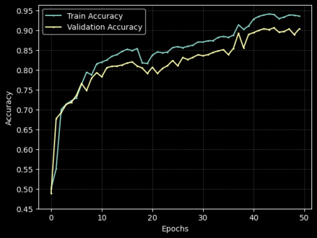
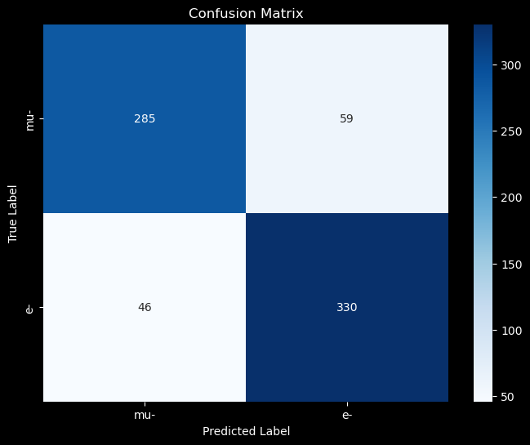
Simulation | particle identification (Machine Learning)
Cascade/Track event classification study based on MC simulation data (w/o noise )
Neural networks work well – Accuracy of CNN & Transformer: >90%
Other directions (Diffusion Model, GAN, data augmentation, etc.) under development.
Medel | Accuracy(mu/e) (%)
CNN | 99/91
GNN | 77/63
Transformer | 96/92
DBSCAN | 92/81
PCA | 89/81
DBSCAN*PCA | 95/82
CNN

Slide 13
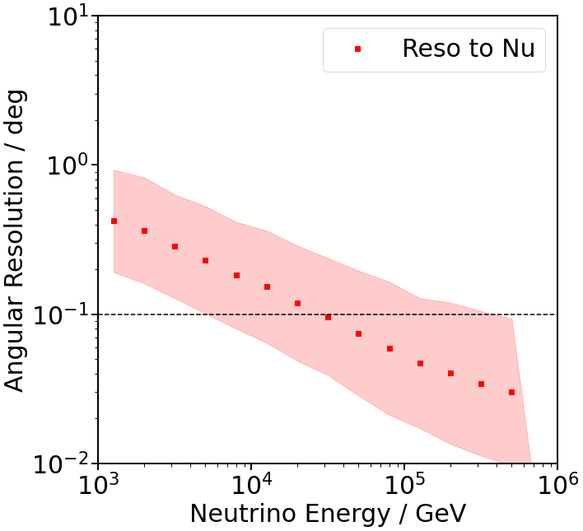
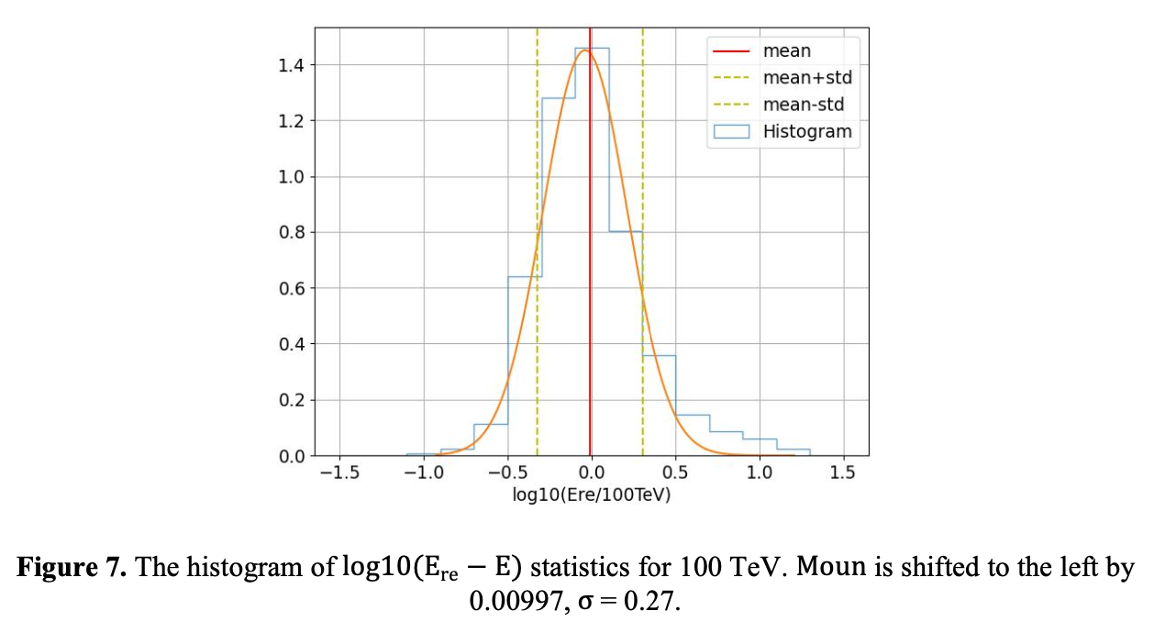
Simulation | Track Reconstruction
PRELIMINARY
Qi et al. 2024
Track events: The energy resolution is around σ(logE_{rec}) = 27%
The relation between the line density of photons along the track and the muon initial energy
Track events: ΔΨ=0.1 deg for Eν > 30 TeV
Likelihood method using the PDF(δt, d)
  δt: time residual between seed and this hit
  d: distance from OM to track

Slide 14
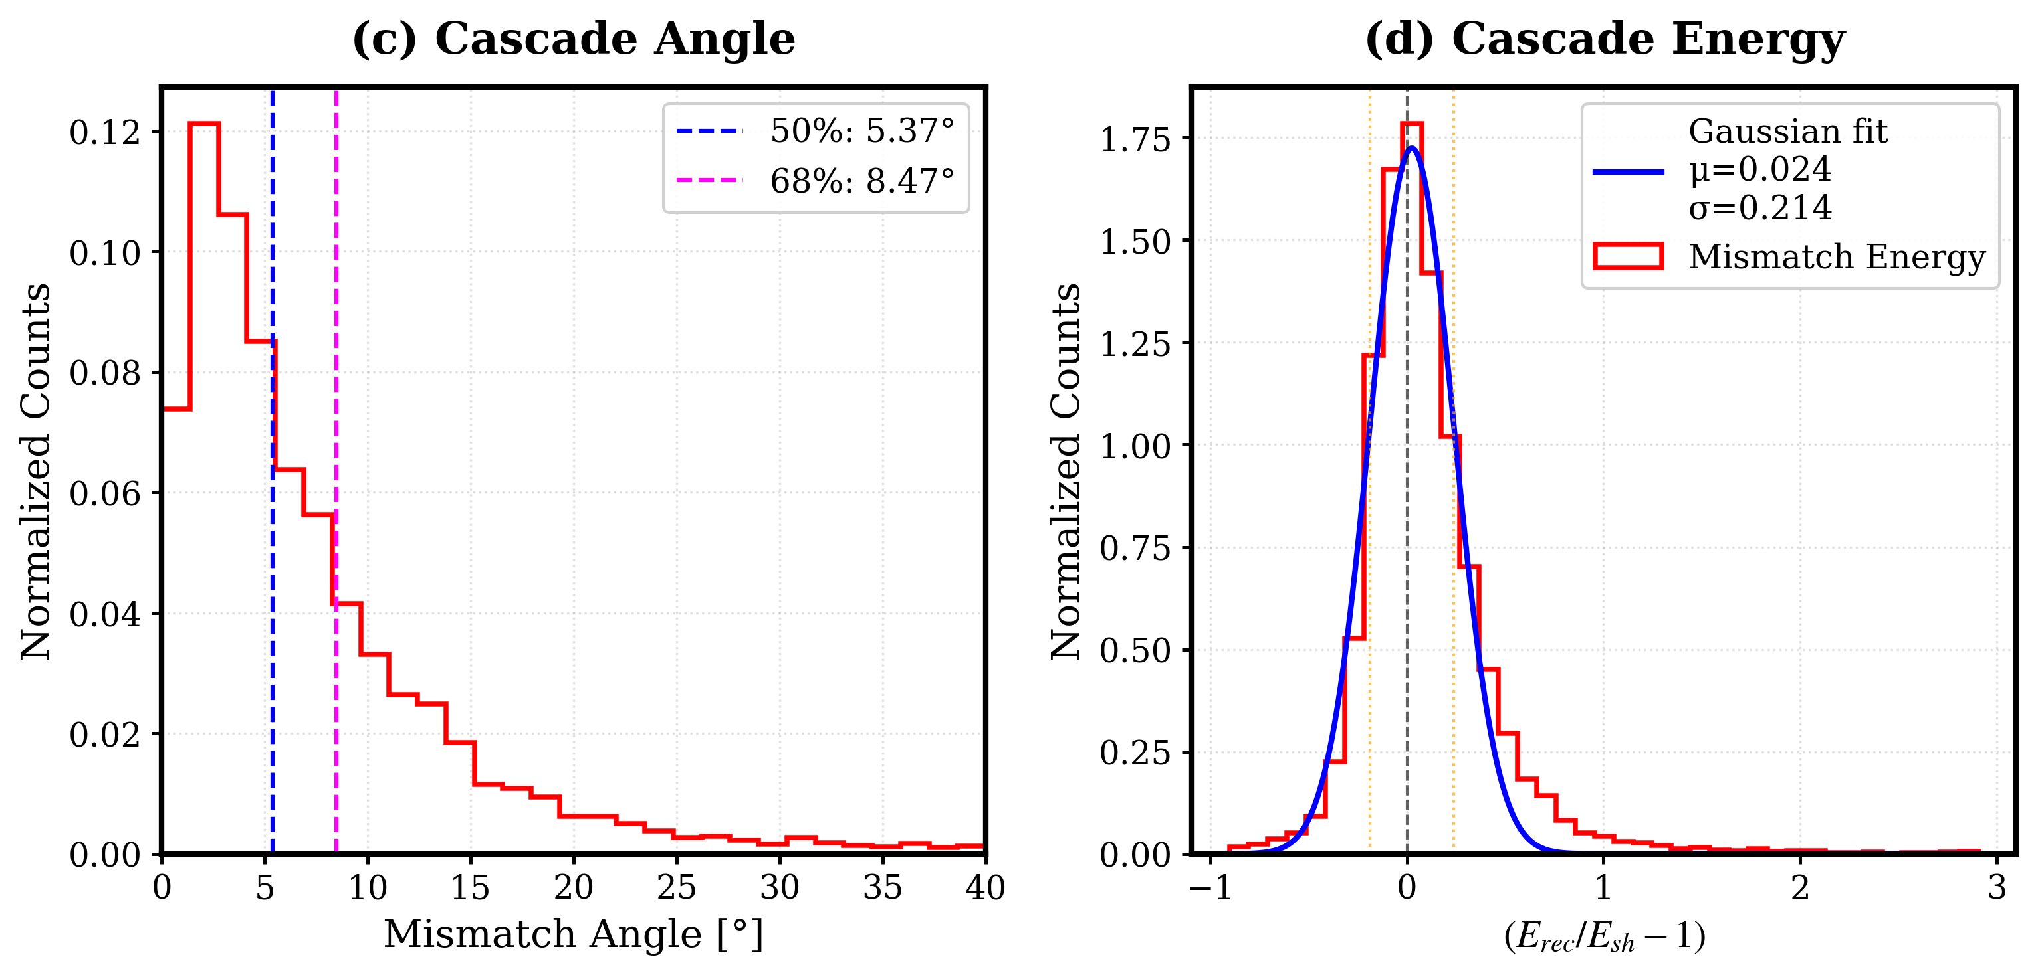
Simulation | Cascade Reconstruction
PRELIMINARY
PRELIMINARY
Angle resolution ~ 5.37°(median)
Energy resolution ~20% (1sigma)

Slide 15
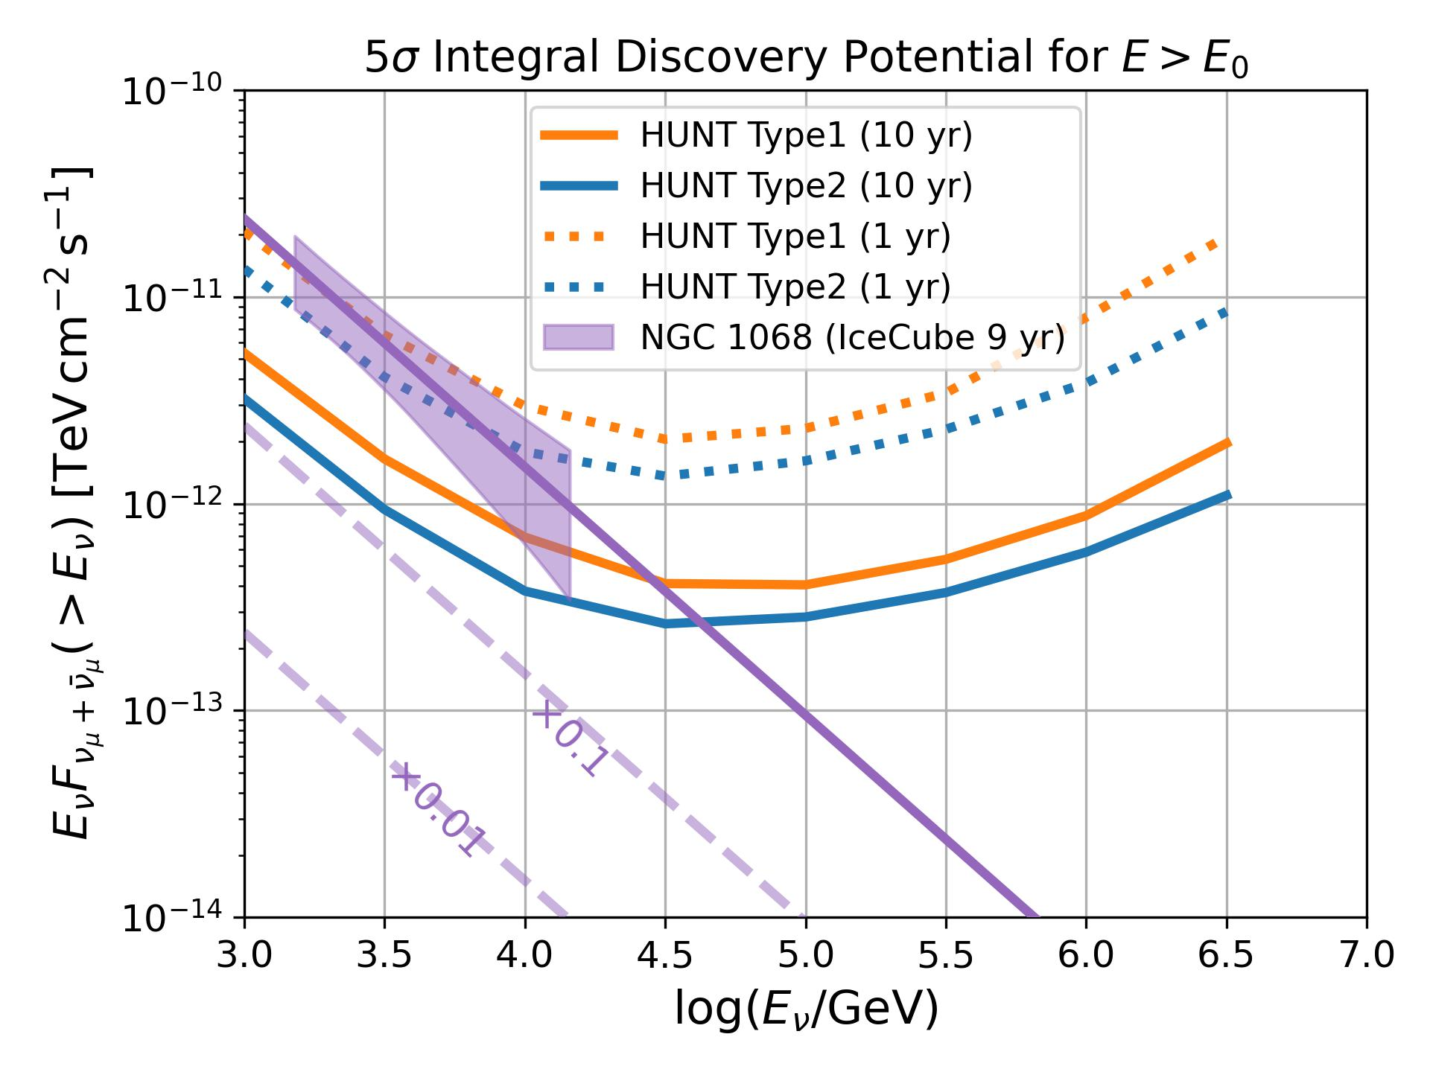
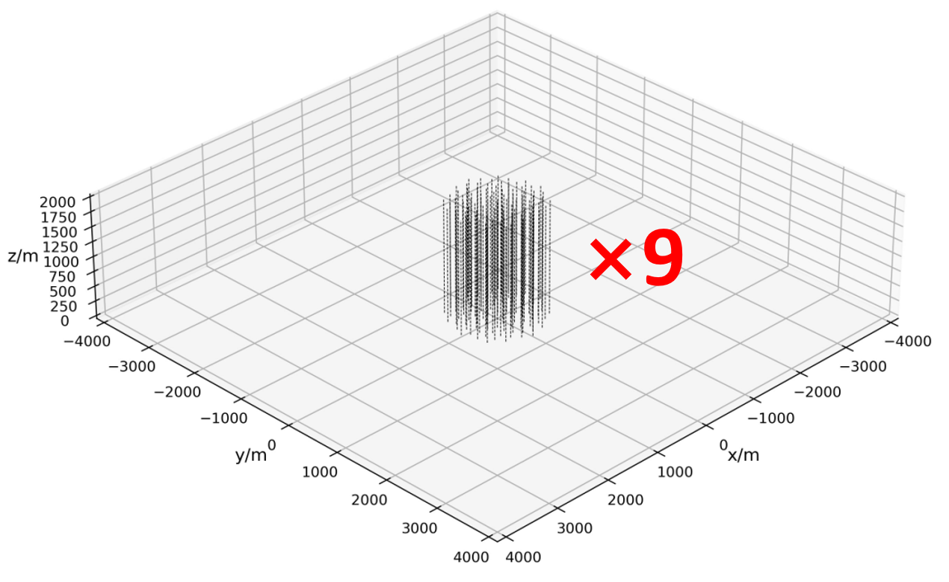
Configuration on Discovery Potential | NGC 1068
Type 1
Type2 √
PRELIMINARY
1，Multiple cluster design has large effective volume
2，Configuration Type 2 has an advantage over Type 1 in discovering new sources
3，for NGC 1068, Operate 1 yr ~ 5 σ with Type2

Slide 16
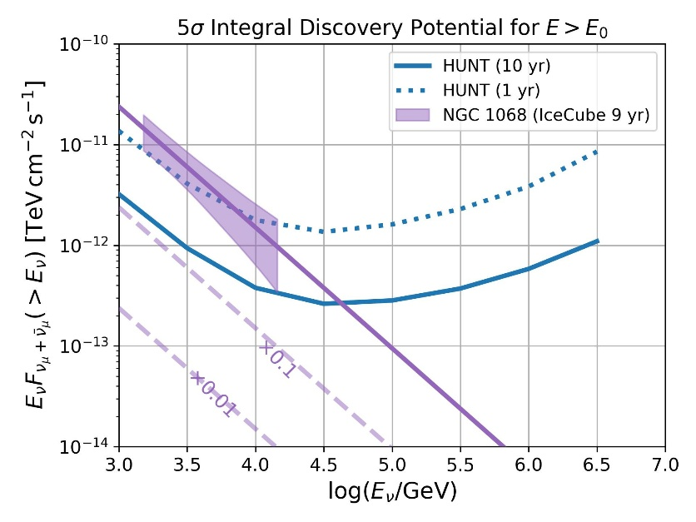
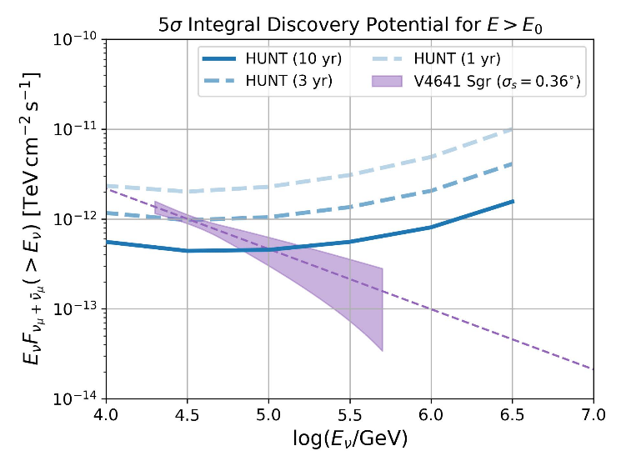
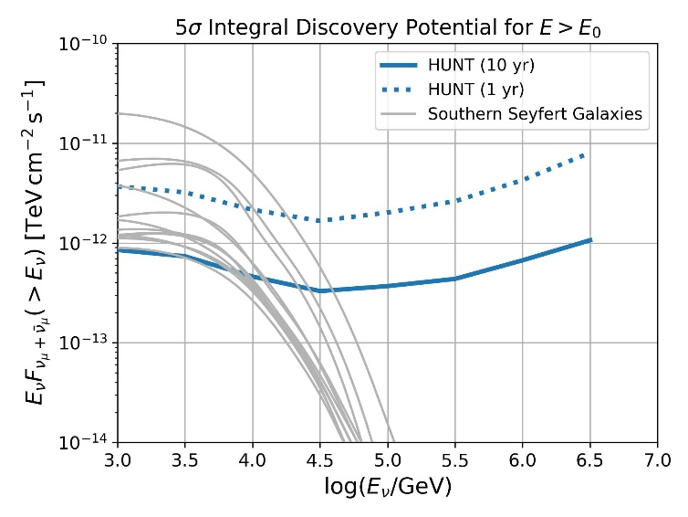
Discovery Potential | other sources
Type2 √
NGC1068
V4641（σ_{s}=0.36°）
Southern Seyfert Galaxies
1 yrs ~ 5 σ
10 yrs ~ 5 σ
3 yrs ~ 5 σ
For NGC 1068, Operate 1 yr ~ 5 σ with Type2
V4641, 3 yrs ~ 5 σ
Southern Seyfert Galaxies, 10 yrs ~ 5 σ
HUNT will discover tens of neutrino sources.

Slide 17
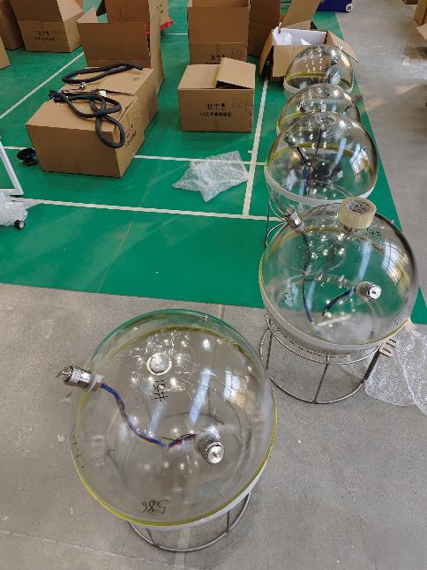
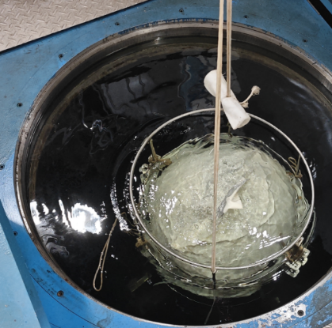
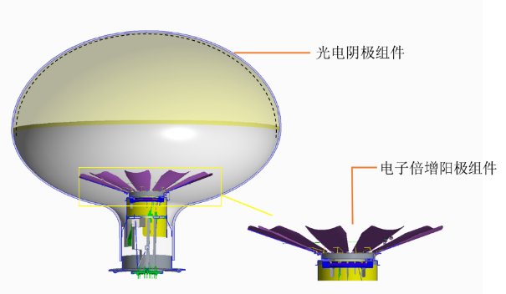
Instruments | PMT & Glass sphere
Short-axis 20-inch PMT
Micro Channel Plate
Larger filed of view than traditional Dynode PMT
23-inch glass sphere
Passed 50 Mpa pressure-resistant test.
~60cm
<48cm
LHAASO
HUNT
10cm shortened to fit the 23-in glass sphere.

Slide 18
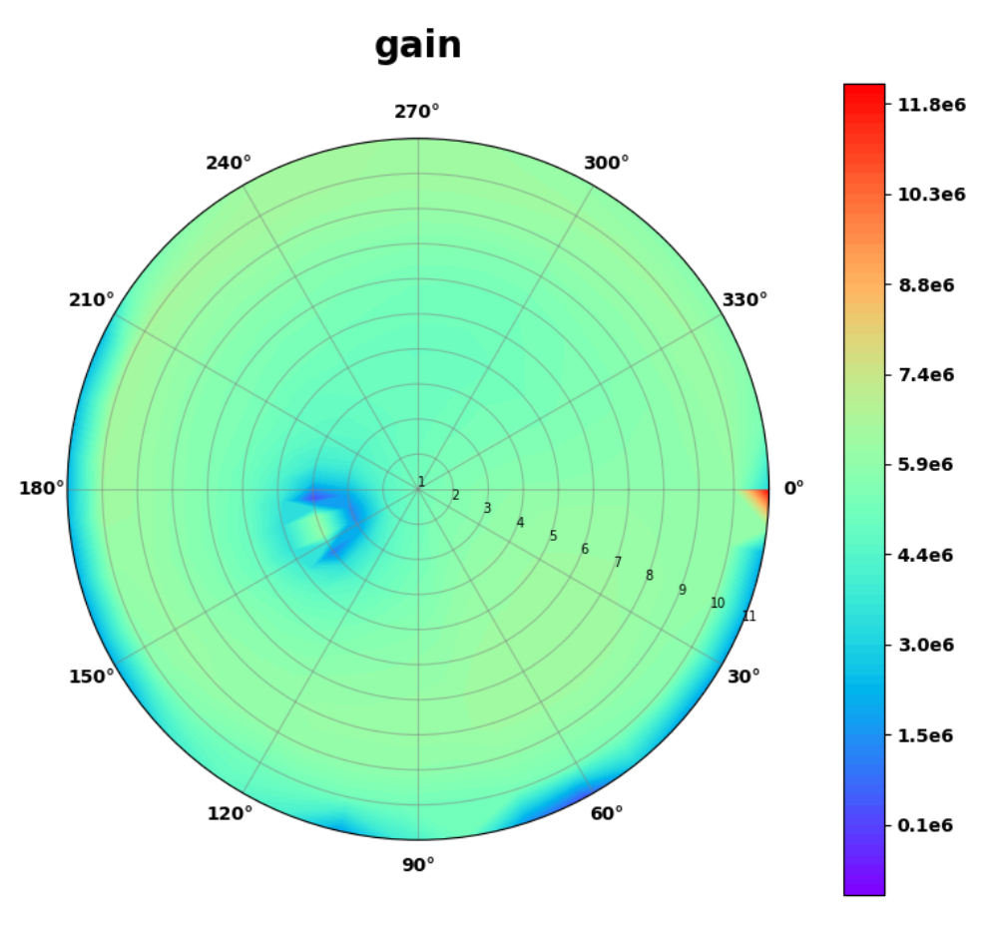
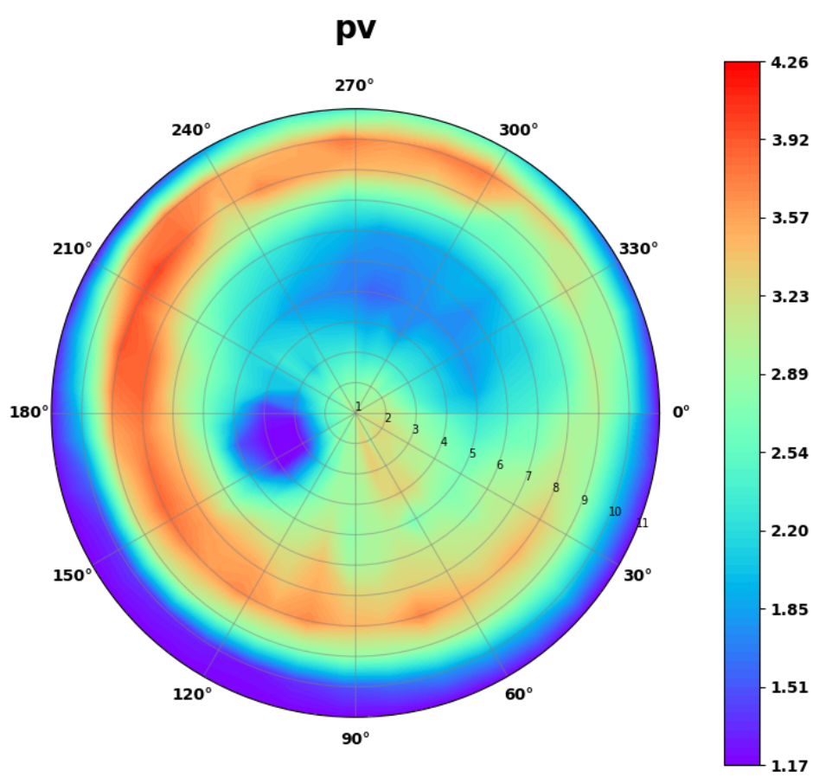
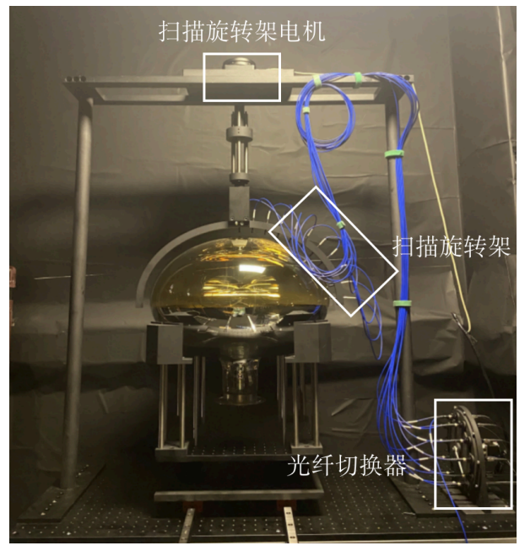
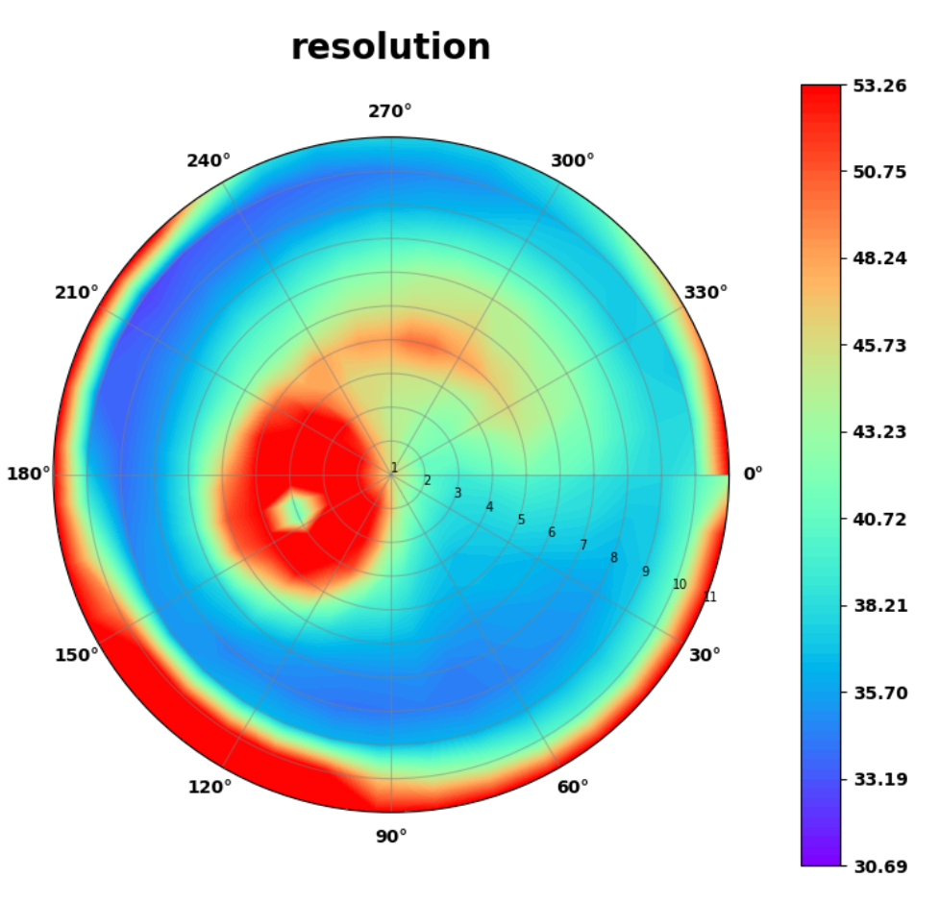
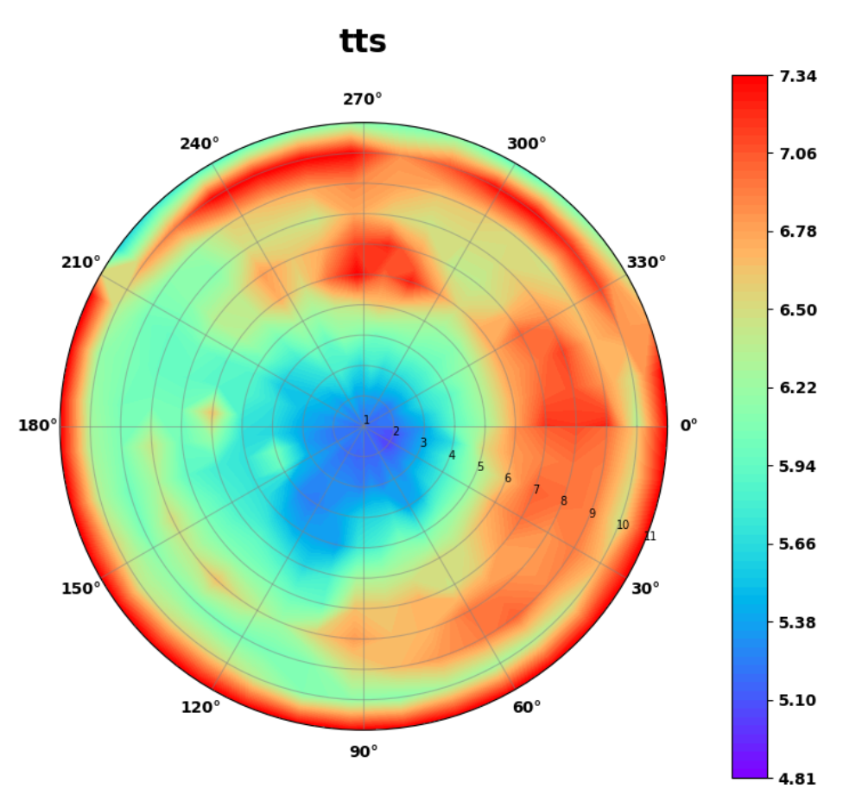
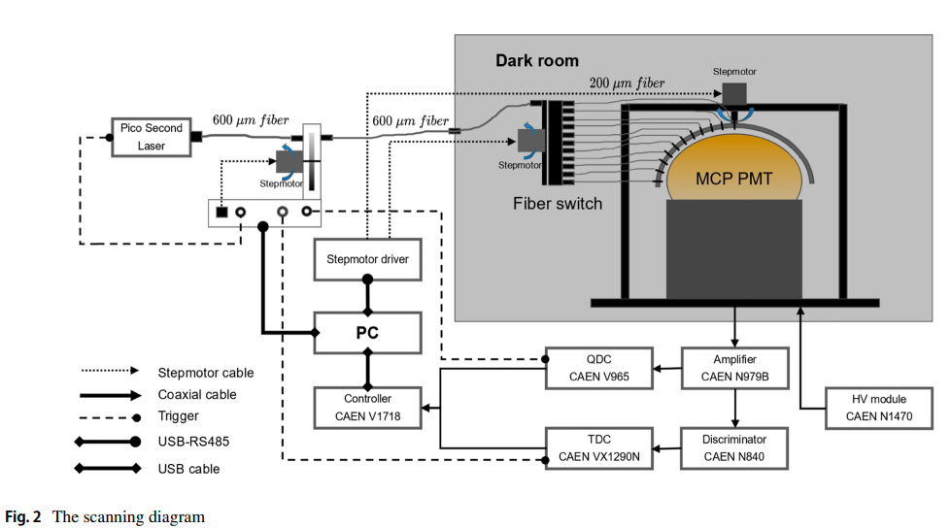
Instruments | 20-inch MCP-PMT scanning device
Design a scanning device, do the PMT test
  Working gain
  SPE resolution
  P/V ratio
  Transit time spread（TTS）
Developing a response model to achieve realistic simulation;
Understanding the performance differences among different PMTs
the performace of PMT

Slide 19
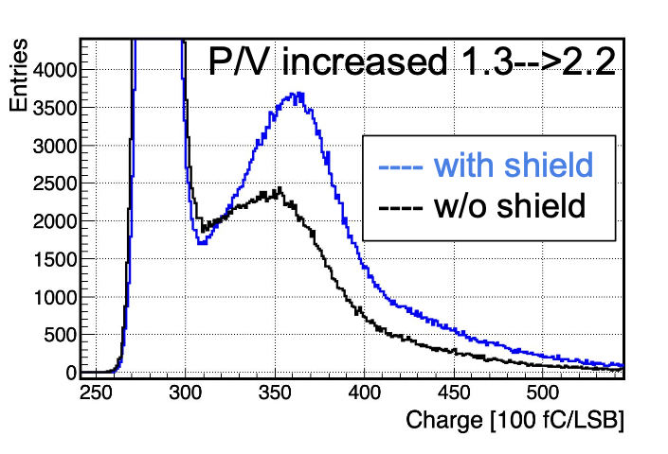
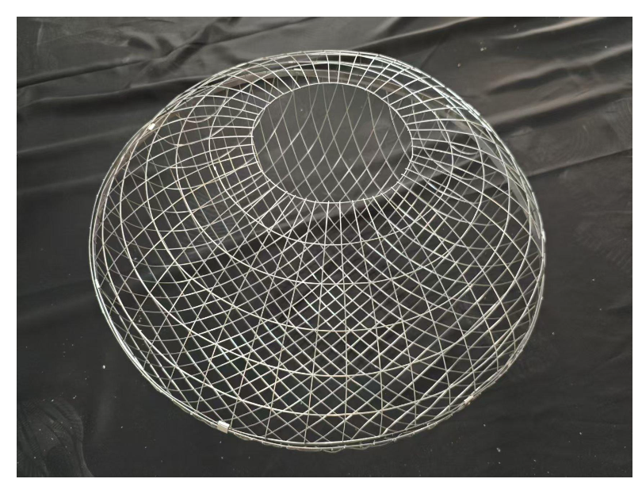
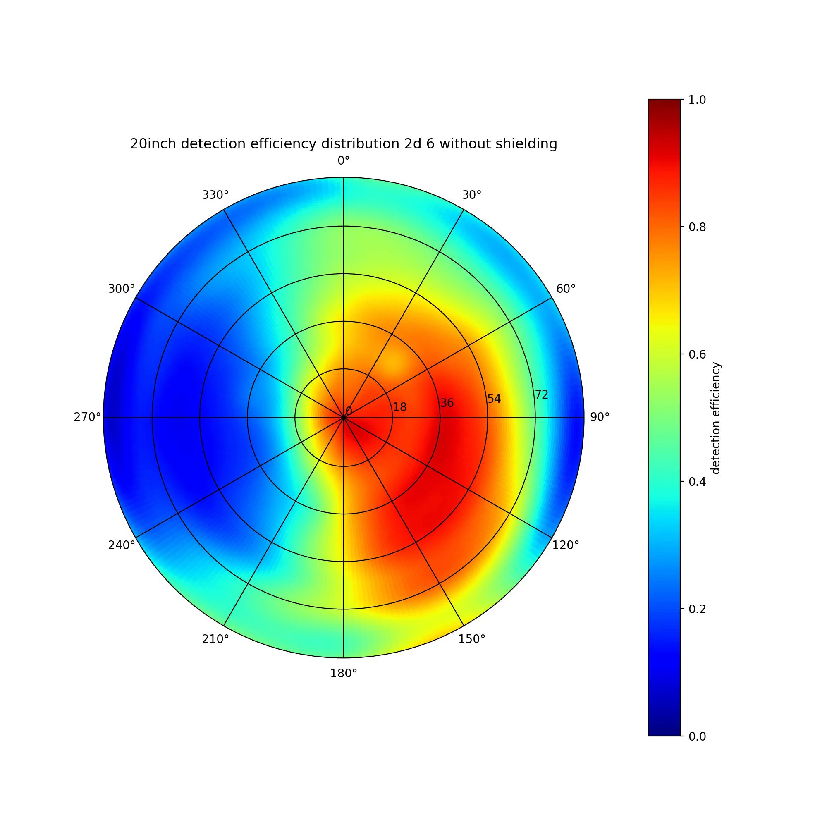
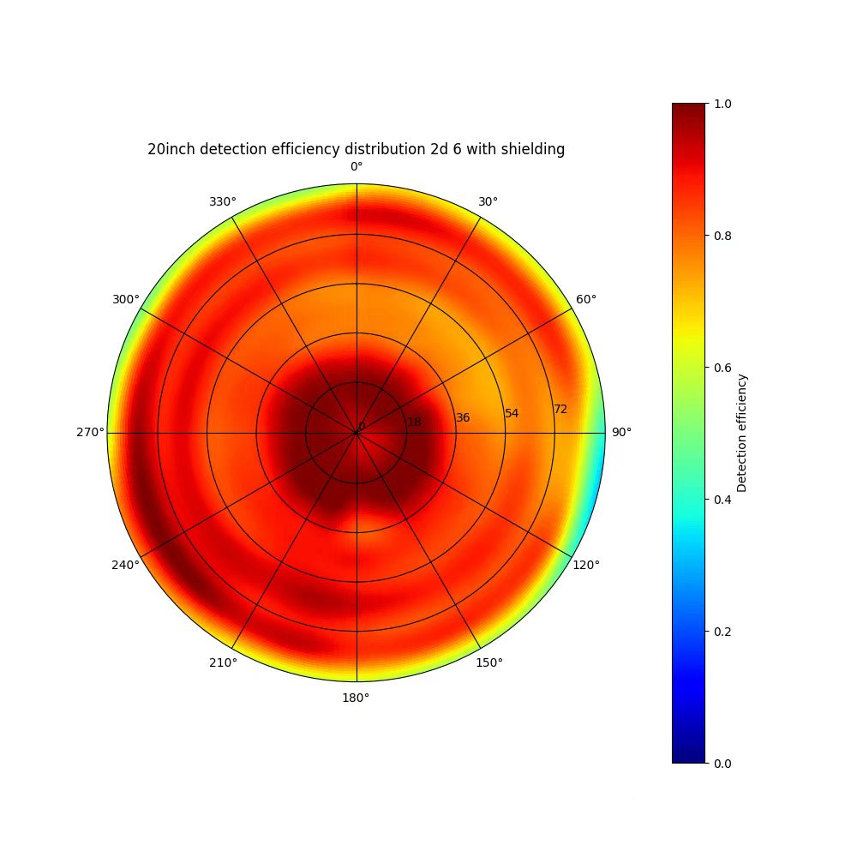
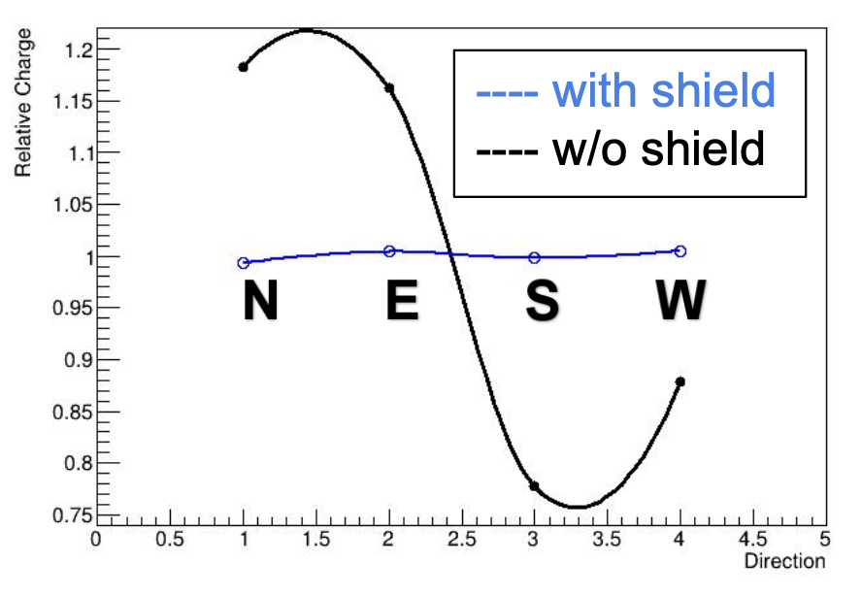
Instruments | Geomagnetic shielding
Geomagnetic field → PMT
Relative Transit time & TTS
Charge distribution
Detection efficiency
Design of geomagnetic shielding
high-permeability materials: Permalloy
Modeling and design via COSMOL software
Effectively reduce
the influence of the geomagnetic field.
Spe calibration
(En resolution)
20 inch MCP detection efficiency distribution
w/ & w/i shielding
reduce the influence to 2%

Slide 20
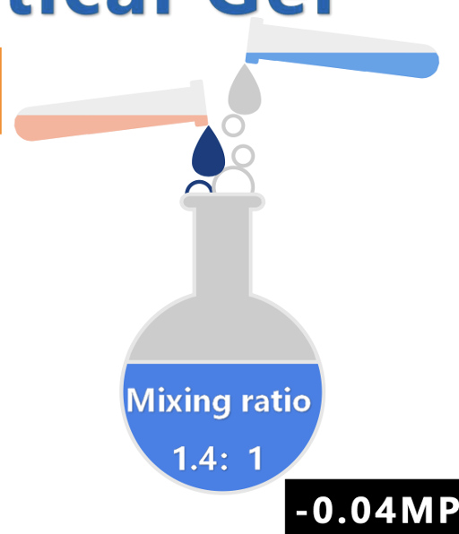


Instruments | Optical gel
UV-transparent gel is used to minimize the discontinuities in the refractive indexes between PMT glass and water.
The dynamical viscosity 1000 mPa$∙$s is too big to removing bubbles
Planning to replace Wacker 612 with low viscosity optical gel
B
-0.04 Mpa
A
20-inch PMT
Fill
2 mm spacing
reduce the influence of total internal reflection

Slide 21








Project progress | Overview
Prototype String 1: Lake Baikal(2024.3), String2: the South China Sea(2025.1),String3: Lake Baikal(2025.3)
8-inch prototype （LHAASO-WCDA）
23-inch OMs deployed
in Lake Baikal
Key R&D program
23-inch OMs deployed
（Lake Baikal）
2022.7
2024.3
2024.9
2025.3
2020.8
2023.2
2025.1
~ 2026.
Startup idea by Zhen Cao.
8-inch PMT test
(China South Sea, -1800m)
23-inch OMs deployed
（the South China Sea, -1600m）
Sea Star Program
(the South China Sea)
海星计划
Notes:
deployed

Slide 22





2024 Baikal String 1
1st string located in GVD
The first Chinese string has 12 Optical Module(OM) + 4 LED calibration ball, we depolyed in March 2024.
The space between OMs is 30m.
OM include: 20 inch MCP + 23 inch Optical ball + Magnetic shield...
30m
Optical Module
LED calibration ball
Details in HUNT OM
In March 2024, completed the first OM deployment
in Lake Baikal.
Chinese string 1st

Slide 23








Wha we can get from 1st string?
2024 Baikal String 1
Timing calibration
Waveform saving function
ΔT ~ 138ns ，equavilant to the distance ~30m
Record:
id,Q ,T
Time delay distribution by LED calibration
A vertical event
Noise Rate Monitoring
Use ~ 35 days data, with same thresold & High Voltage.
date@10.19
date@10.20
Second Level:ΔRate~2%
Hour: ΔRate~4%
The biological environment is stable on Lake Baikal.
Notes:
The noise rate has changed 2% @Second level.

Slide 24





Joint Analysis of 1st String and GVD
Data sample:HUNT LED calibration on April 7, 2024
HUNT LED balls 4, 3, 2 and 1 were turn on in sequence
The nearby GVD strings can detect the LED signals
These merge data can be used to calibrate the time delay between HUNT and GVD array
The comparison of detector efficiency between HUNT and HUNT on the road
HUNT
GVD
10 inch
20 inch
GVD
HUNT
Calibration Time delay by event by events
GVD-HUNT= -38s - 488510850ns
HUNT LED lighting nearby GVD strings
LED event merge（LED）
more evts can be matched with GVD array

Slide 25



2025 South China Sea String 2
The 2nd string,consisting of 4 Optical Modules(OMs) + 1 LED calibration Modules, was installed in 2025/01, site depth ~1300m
The space between OMs is 10 meters.
Spe Calibaration first with 20 inch MCP
in the South China Sea
the south china sea

Slide 26

2025 South China Sea String 2
Bailkal
Two main types of noise components in the South China Sea
Stable background radiation generated by the decay of ⁴⁰K (~ 200-300 kHz)
Unstable bioluminescent signals (~MHz, lasting from 1 second to several hundred seconds).
Burst
Rate【Hz】
the South China Sea
Baseline
Time [s]
Tirgger events : nHit >2,Q > 2.p.e
--> Big challenge : noise filter
The background rate of the OM2
with threshold 0.5 p.e.

Slide 27

Installation
2025 Baikal String 3
The 3rd Chinese string,consisting of 24 Optical Modules(OMs) + 4 LED calibration balls, was installed in 2025/03
The space between OMs is 30 meters, same as the 1st string.
30m
Compared with the 1st string, the main difference is that , its electronics does not have Q/T waveform saving function and only record hit information Q&T .
Optical Module
In March 2025, completed the 2nd OM string deployment in Lake Baikal.
Chinese 3rd string

Slide 28




What we can get from 3rd string?
2025 Baikal String 3
Working gain set at 1E7 with a threshold of ~0.5 p.e., for testing low-threshold operation.
A negative correlation was observed: the deeper the water depth, the lower the noise rate.
Based on the Single channel count, the OM detector effiecicy: HUNT : GVD~6:1.
Muon-likely events and neutrino-likely events are both detected.
Maker size: Q
Colorbar：time(ns)
down-going events（nHit >20）
depth：1300m
580m
@0.5 p.e
SPE
up-going events(nHit=6)
HUNT:GVD～6:1
×
Lake bottom surface
Charge distribution
The relationship between single-channel noise rate
vs different water depth
Perfect Events

Slide 29

2025 Baikal String 3
Preliminary
Dataset：2025/04/30 - 2025/05/05
Trigger condition:
A 300ns time window with 2 Hits, output a trigger.
Events are saved with a trigger time window of T0 ± (-800, 3500) ns.
Trigger time t_{i} (T0)
BlueLine：w/o any selection
RedLine：Up-going evt 3217392
GreenLine：Down-going evt 1183489
evt
i
i+1
…
…
@1.6 p.e.
time
300ns
800ns
3500ns
Nhit
Trigger Algorithm
nHit distribution of trigger events
（6 days raw data）

Slide 30
2025 Baikal String 3
Preliminary
nHit > 7, down-going events more than up-going events;
Down-going events maybe triggered by atmosphere muon mostly;Up-going events maybe from neutrino.
Further analysis are on-going...
Trigger time t_{i} (T0)
BlueLine：w/o any selection
RedLine：Up-going evt 3217392
GreenLine：Down-going evt 1183489
evt
i
i+1
…
…
@1.6 p.e.
time
300ns
800ns
3500ns
Nhit
Trigger Algorithm
nHit distribution of trigger events
（6 days raw data）

Slide 31

APS Data Monitoring
2025 Baikal String 3
Acoustic Positioning System（APS）
--> Used for position measurement.
2025.04.28 - 05.05
The 3rd string equipped with 4 APS models:
APS1 is near 1st OM, close to the lake bottom.
APS4 is near 24th OM, close to the lake surface.
DataSet from April 28th to May 5th (8 days) :
Shaking: Intensity rises from lake bottom to surface; max amplitude ~1m (APS4).
All APS: Consistent movement trends.
Position change rate: Time-period dependent → different underwater activity intensities.
The position monitoring of 4 APS models

Slide 32


Collaborators
24 institutes or universities participate in the R&D work.
第779次香山科学会议（2025年3月）
779th Xiangshan Science Conference in March
(the highest-level science seminar)
International members：
Two MoUs with INR & JINR based on Baikal-GVD.
Two theoretical physicists from APC，France.
Chiang Mai University.
Only HUNT's scientific goals were written in the consensus of the meeting.
Notes:
Joint Institute for Nuclear Research (JINR)
Astroparticle and Cosmology laboratory (APC)

Slide 33
Summary
HUNT will realize significant potential in discovering the neutrino counterparts of Galactic PeVatrons and maping the high-energy neutrino sky.
Prototype strings in Lake Baikal has observed muon-likely events.
We are going to deploy another string（4th） on Lake Baikal in 2026. The 7-strings array in the South China Sea, named Sea Star, will be deployed soon.
Thank you !

Slide 34
Back Up

Slide 35




LHAASO discovered UHE γ sources in the Milky Way
Main process:
1st LHAASO Catalog: 43 UHE gamma ray sources (>4σ)
p
LHAASO Collaboration, 2021, Nature, 594, 33.
LHAASO Collaboration, 2024, ApJS, 271, 25.
Two sources of PeV photons:
Leptonic origin -- Synchrotron radiation produced by relativistic electrons and inverse Compton scattering of low-energy photons. No neutrinos
Hadronic origin -- Interaction of PeV energy cosmic rays with source region matter or photon fields.
a large number of neutrinos
Neutrino and Photon both measured, can point back to the source ( p ).
a
Reveal the puzzle of the origin of high-energy cosmic rays!

