Slide 1
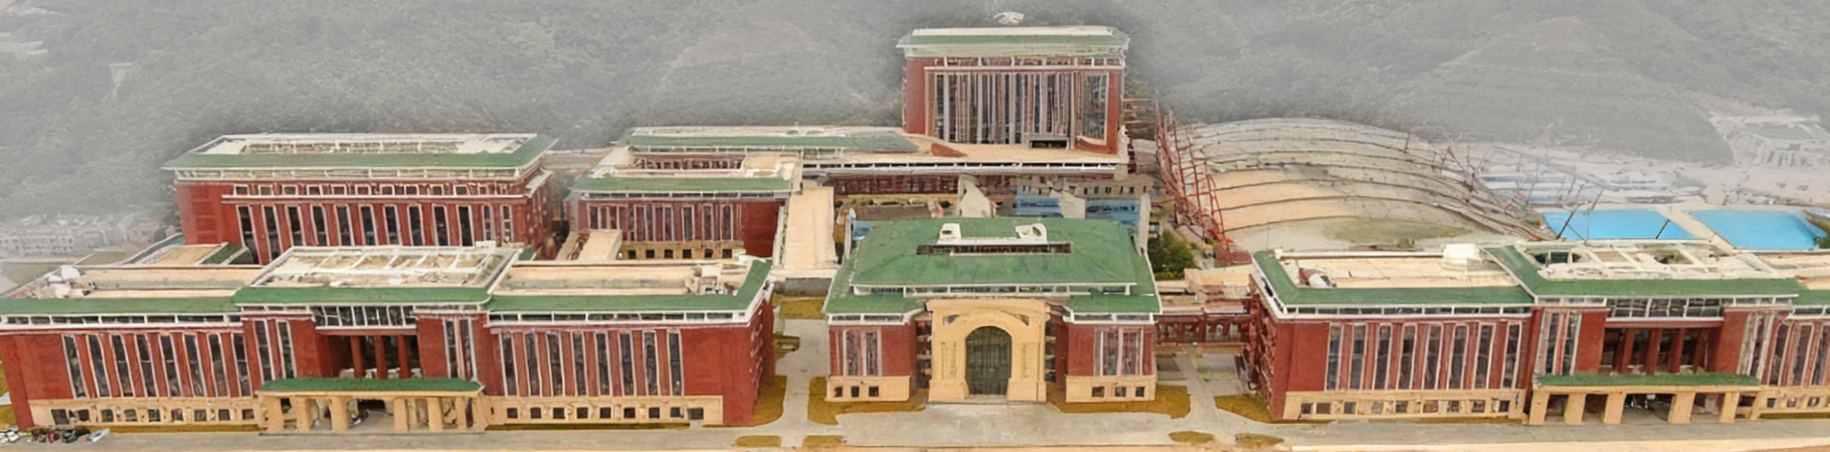
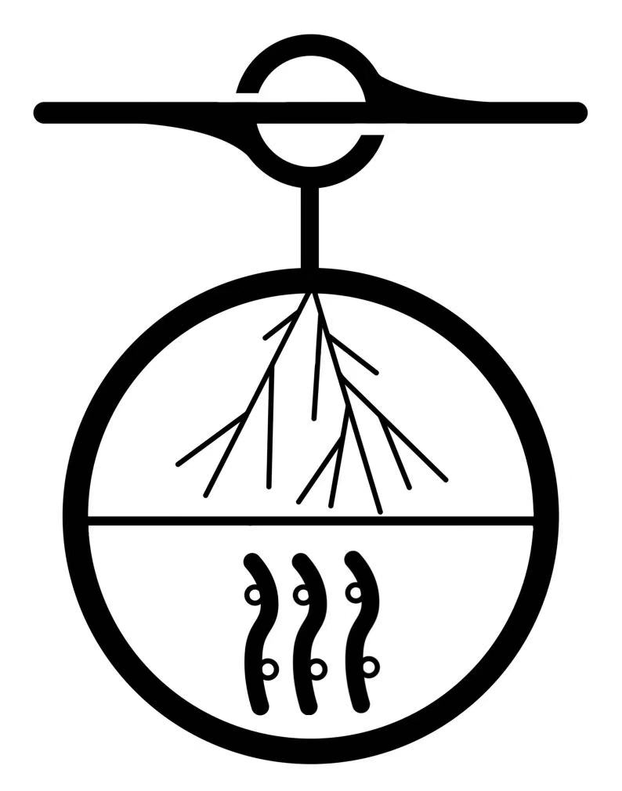
The Plan and Status of NEON
Workshop on Neutrinos and related New Physics Research - Zhuhai
S. Lin for the NEON Group
November 30th, 2025

Slide 2
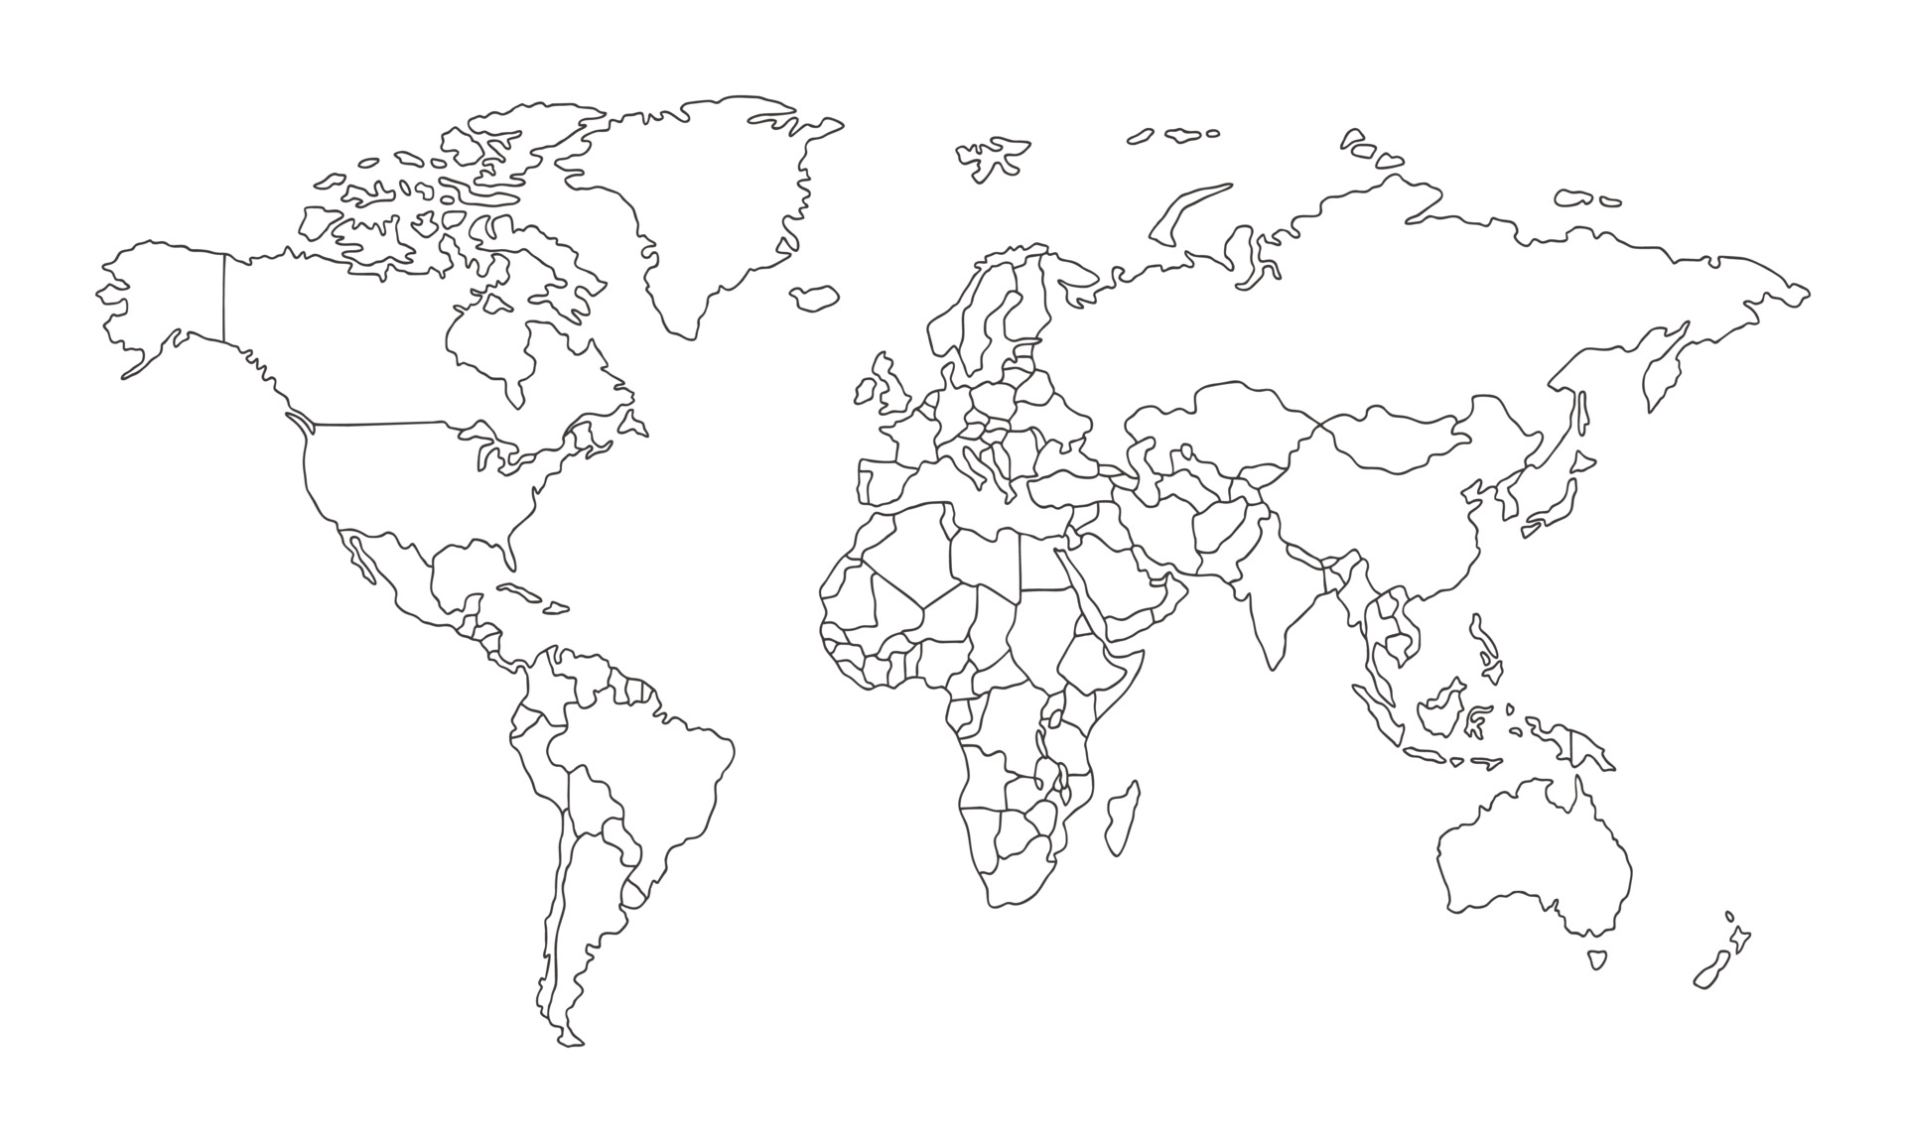
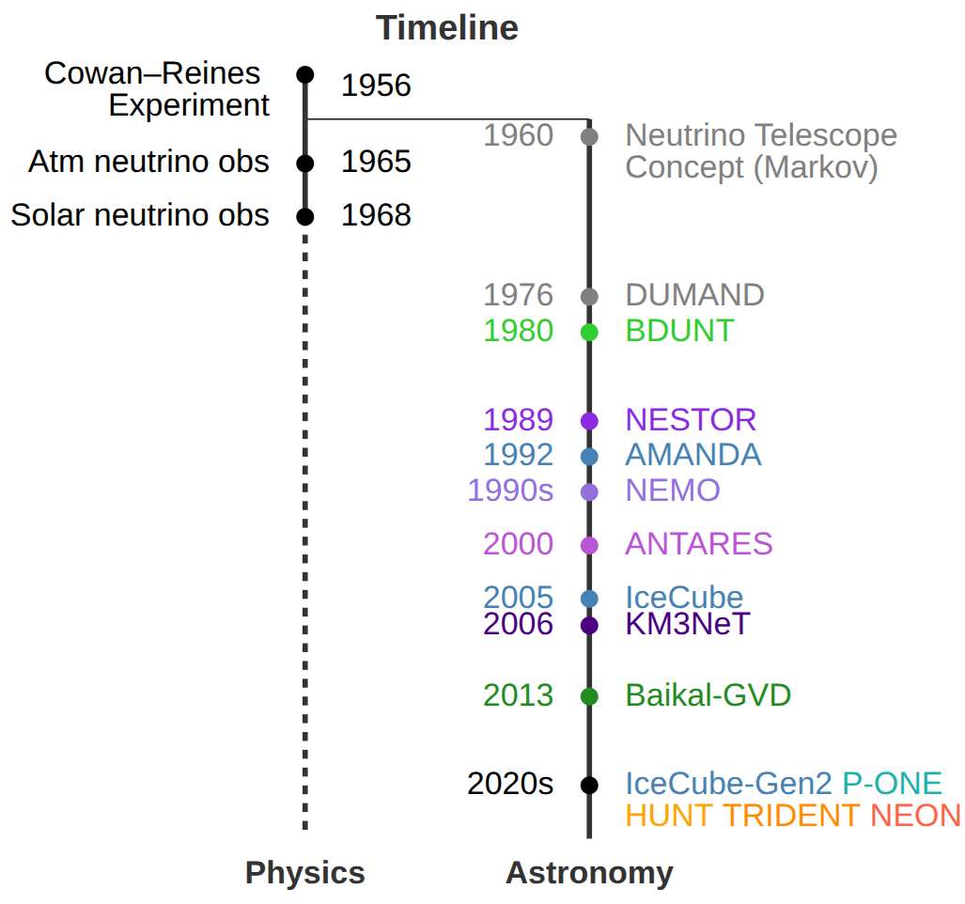
Neutrino Telescopes around the World
[Baikal-GVD]
Lake Baikal
[KM3Net]
Mediterranean Sea
(P-ONE)
East Pacific Ocean
(HUNT, TRIDENT, NEON)
South China Sea
[IceCube] (IceCube Gen-2)
South Pole

Slide 3
Outline
Simulation and Prospects
Experimental Progress
Summary
Conceptual design
Signal analysis
Sensitivity
PMT Test
OM status
Electronic
Trial

Slide 4
Outline
Simulation and Prospects
Experimental Progress
Summary
Conceptual design
Signal analysis
Sensitivity
PMT Test
OM status
Electronic
Trial

Slide 5
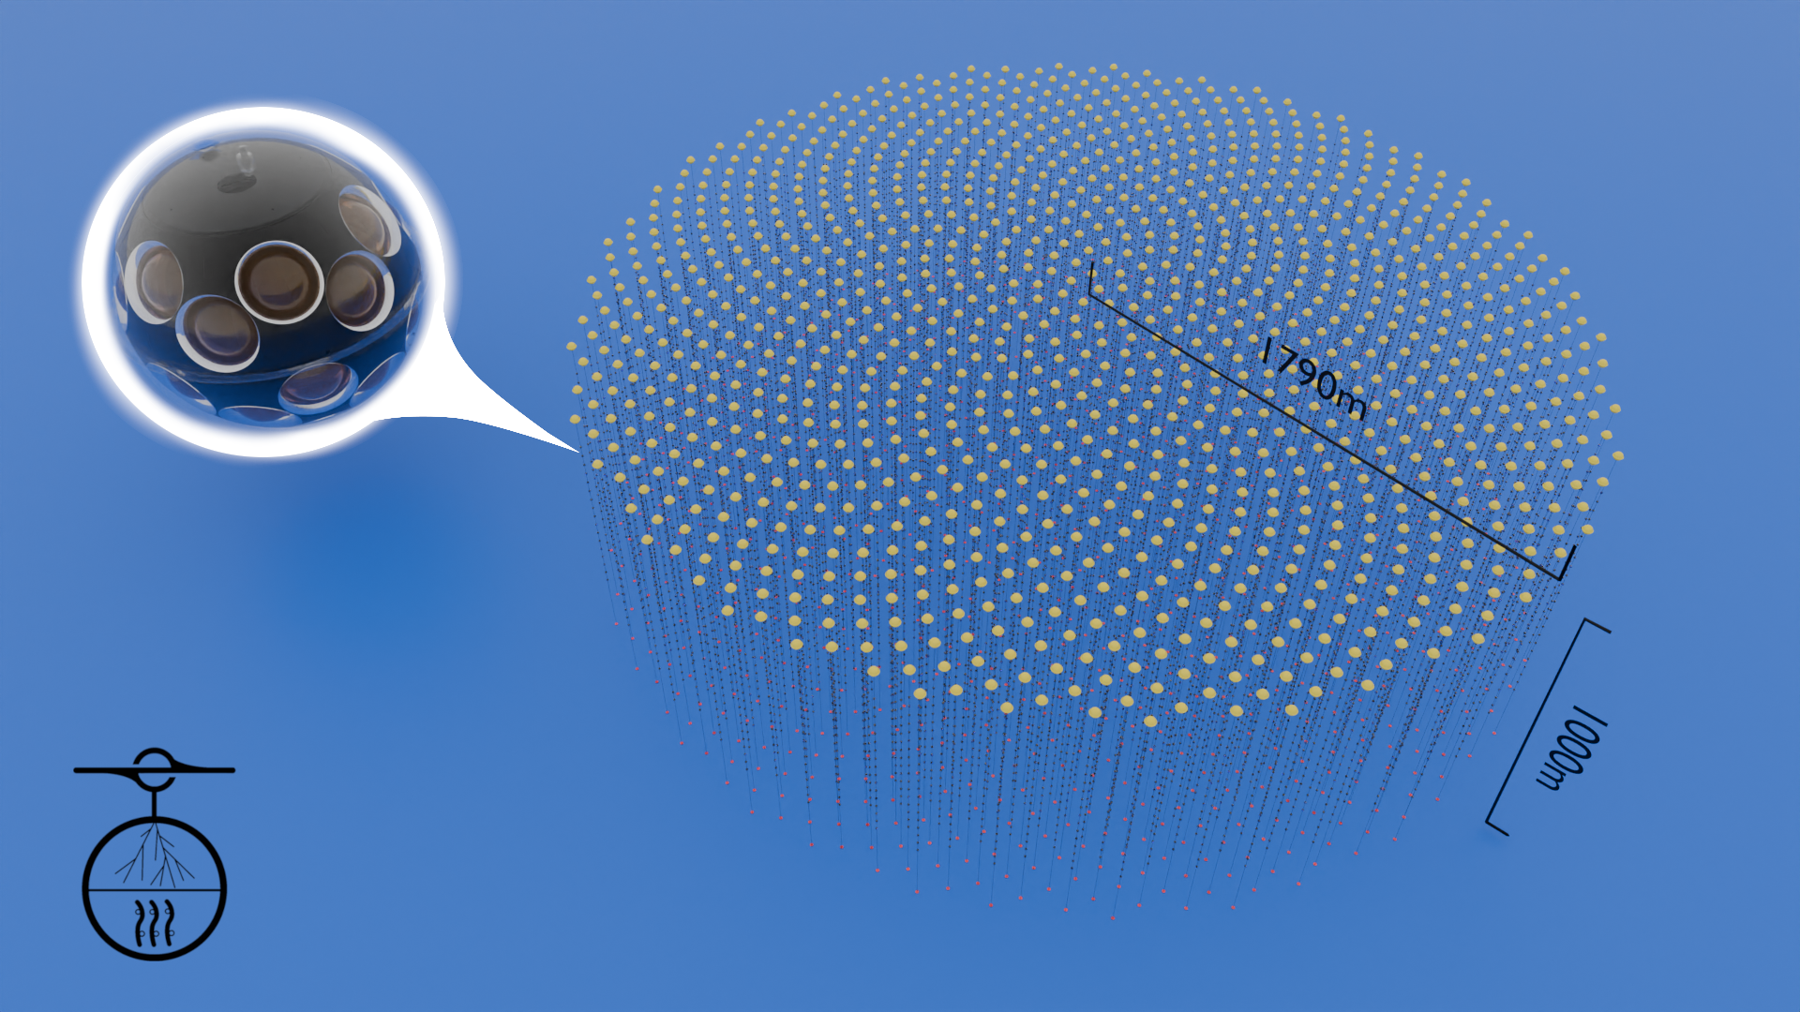
Conceptual Design
Neutrino Observatory in the Nanhai (NEON)
Depth: 1700m / 3500m
Detection Volume: ~10 km³
Number of strings: ~1000
Tiling method: Fibonacci spiral
Inter-string distance: ~100m
Inter-OM distance: 40m
31PMT / OM

Slide 6
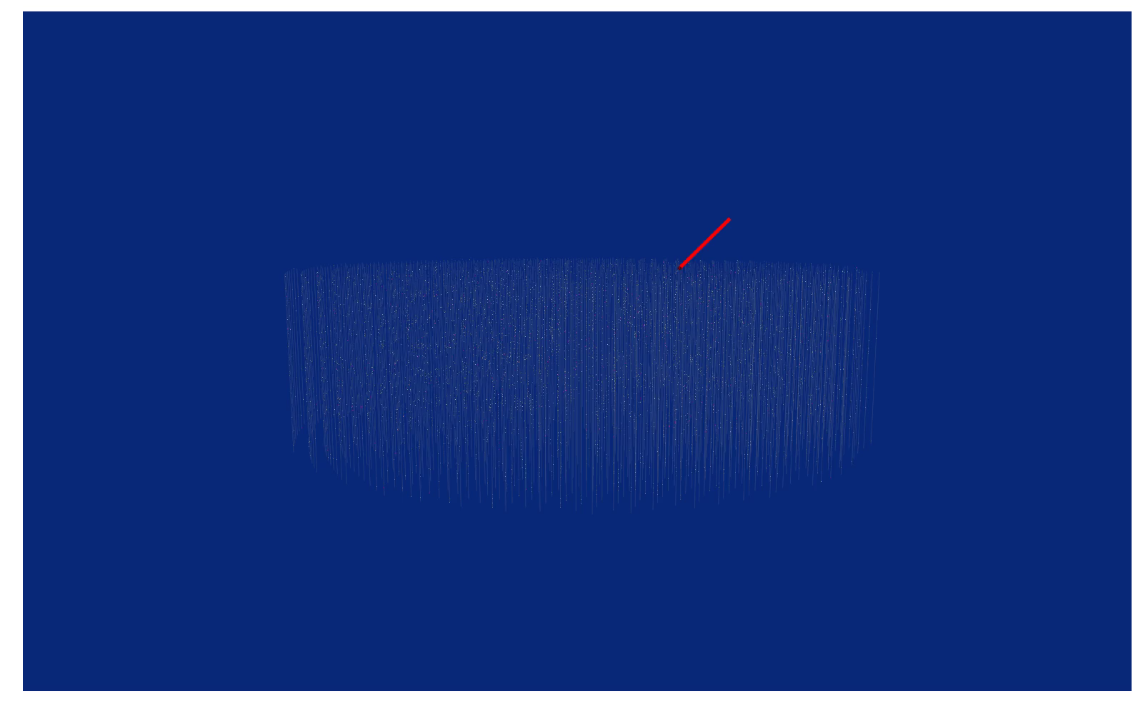
Conceptual Design
Neutrino Observatory in the Nanhai (NEON)
Depth: 1700m / 3500m
Detection Volume: ~10 km³
Number of strings: ~1000
Tiling method: Fibonacci spiral
Inter-string distance: ~100m
Inter-OM distance: 40m

Slide 7
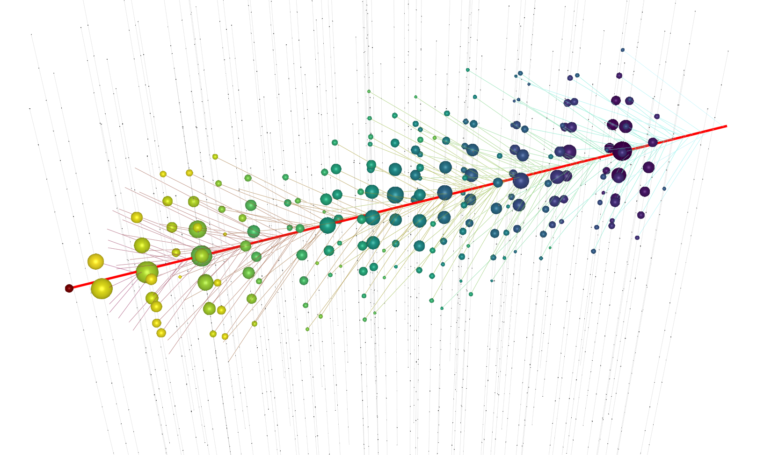
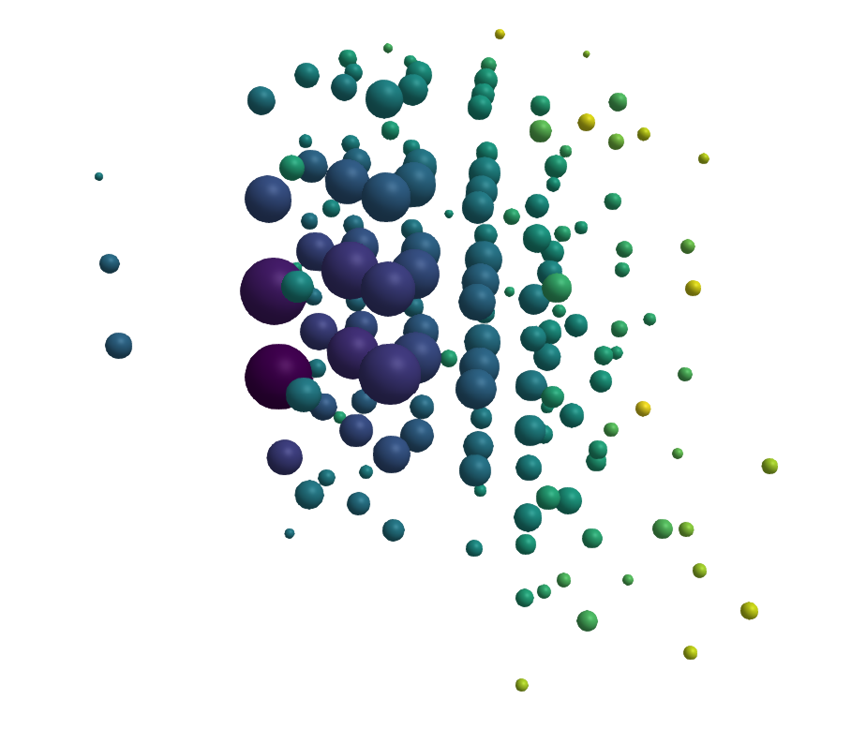
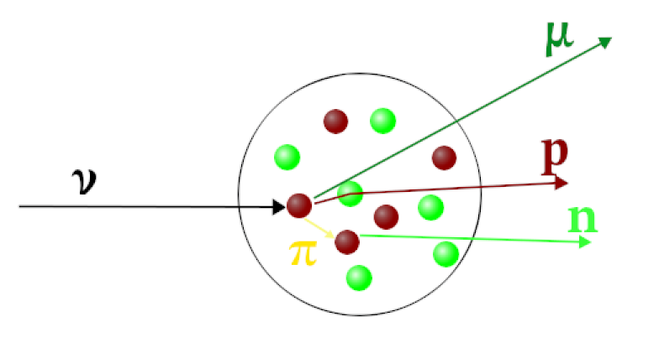
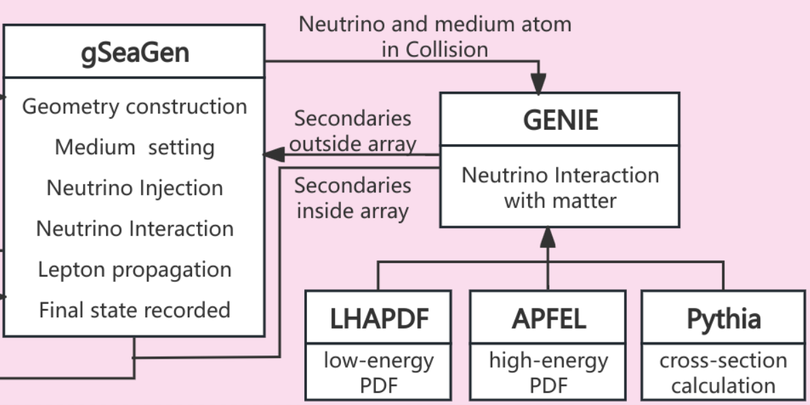
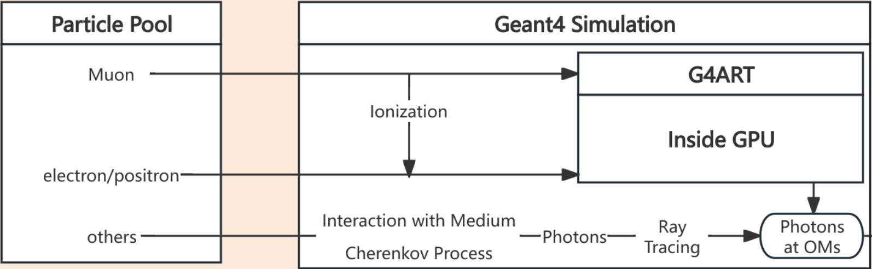
Analysis: Simulation Framework
Digitalization
Track
Cascade
Neutrino interaction
GENIE for neutrino-nuclear interaction
G4ART: Adopting GPU to simulate tons of cerenkov photons

Slide 8
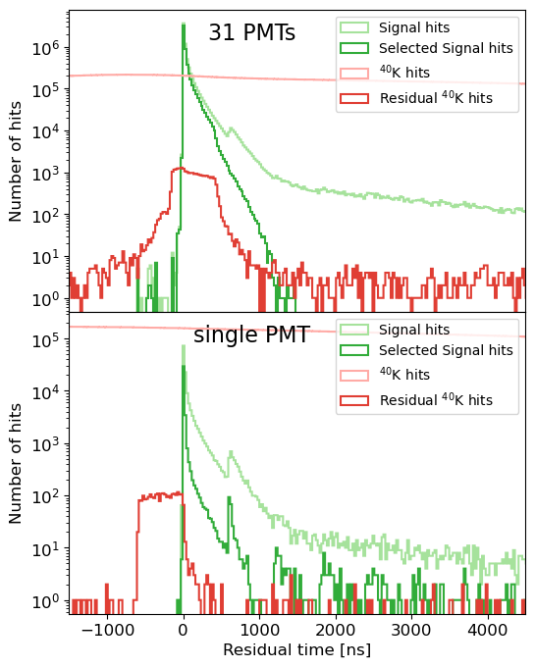
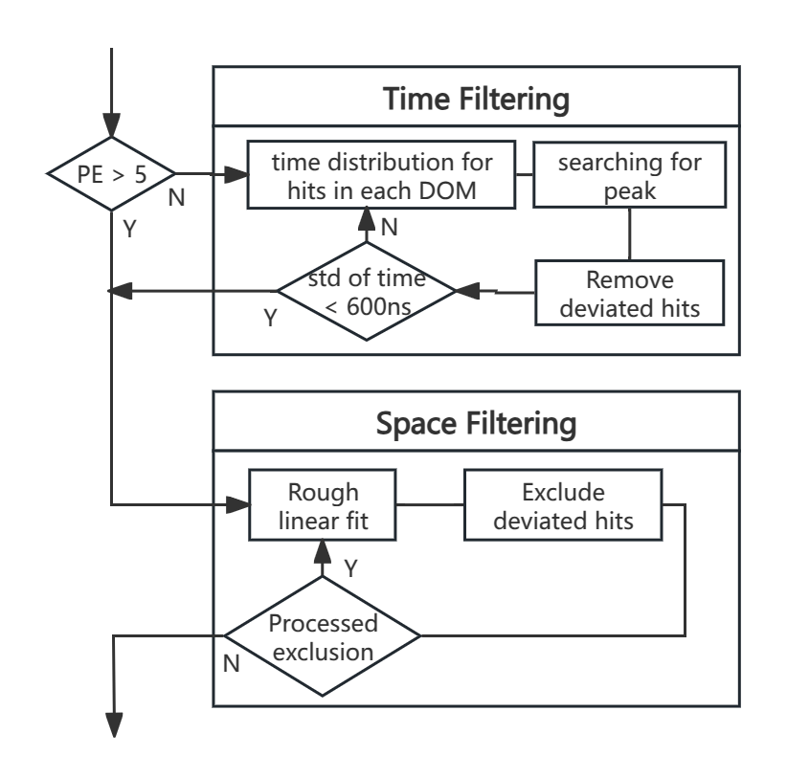
Analysis: Noise filtering
The process to filter noise hits from ⁴⁰K
The 31-PMT OM retains most signals while filtering out noise hits

Slide 9
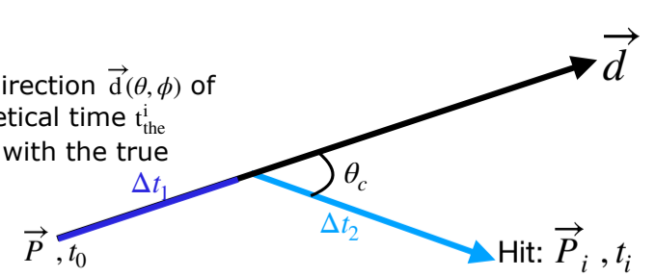
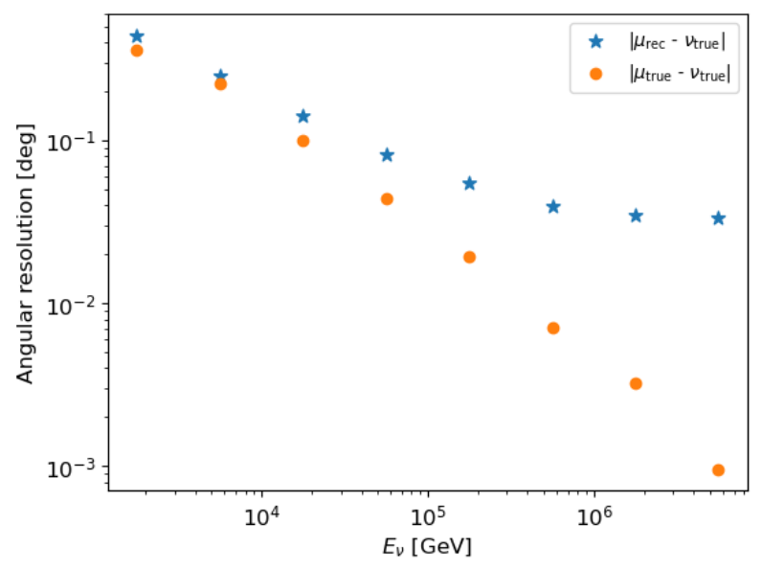
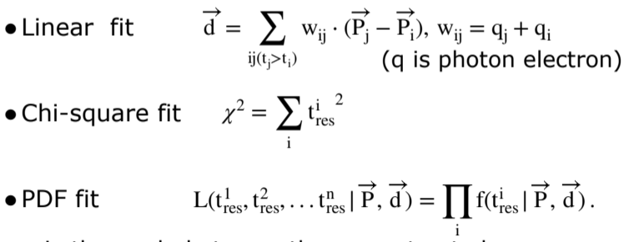
Analysis: Reconstruction
ν_{µ}
µ

Slide 10
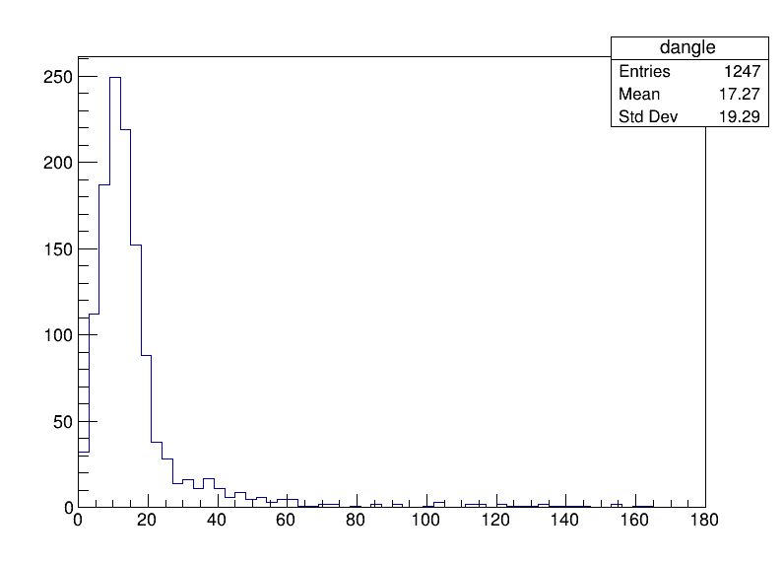
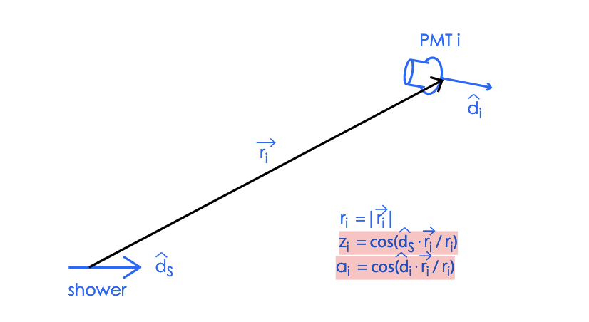
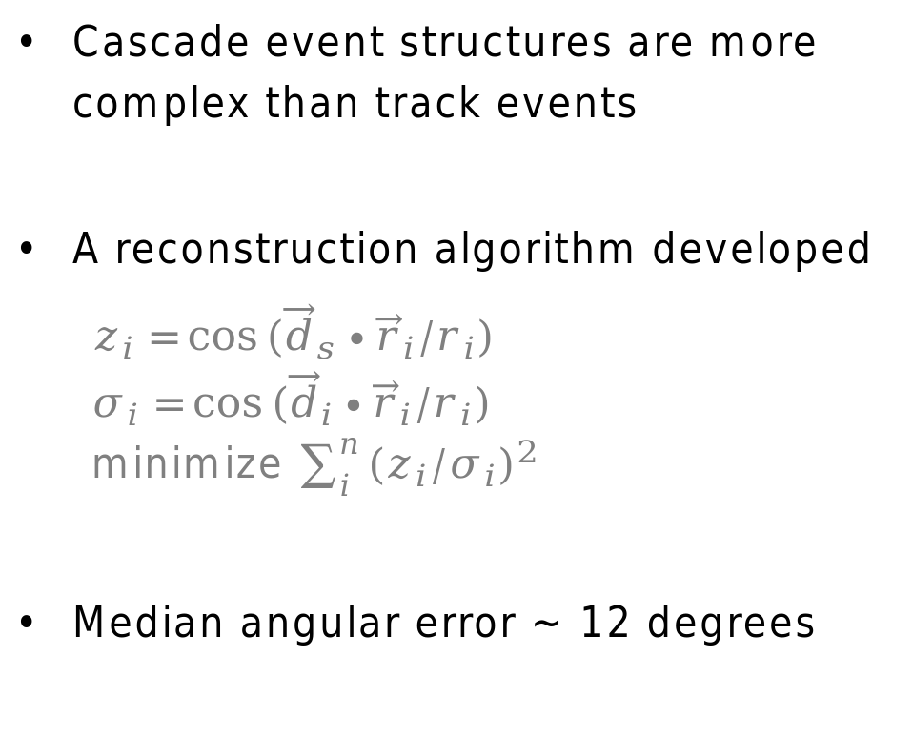
Analysis: Reconstruction
Cascade event structures are more complex than track events
A reconstruction algorithm developed
  $$z_{i}=\cos{({\vec{d}}_{s}∙{\vec{r}}_{i}/r_{i})}$$
  $$σ_{i}=\cos{({\vec{d}}_{i}∙{\vec{r}}_{i}/r_{i})}$$
  minimize $\sum_{i}^{n}{{{(z}_{i}/σ_{i})}^{2}}$
Median angular error ~ 12 degrees
A GNN-based algorithm is under development

Slide 11
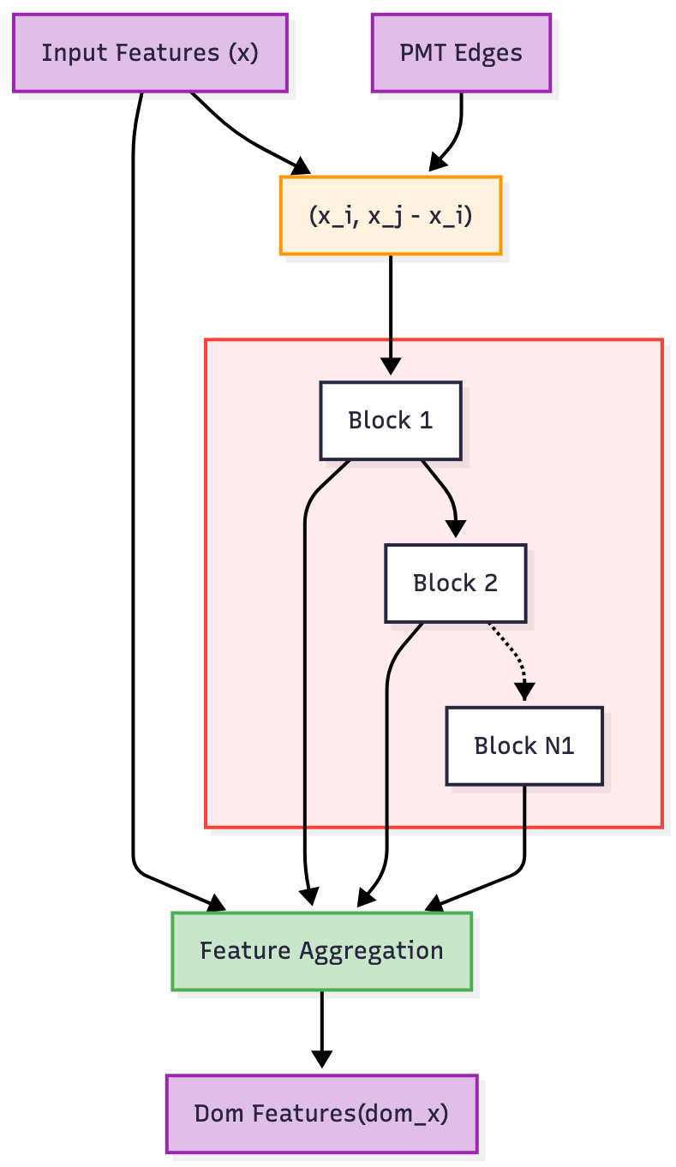
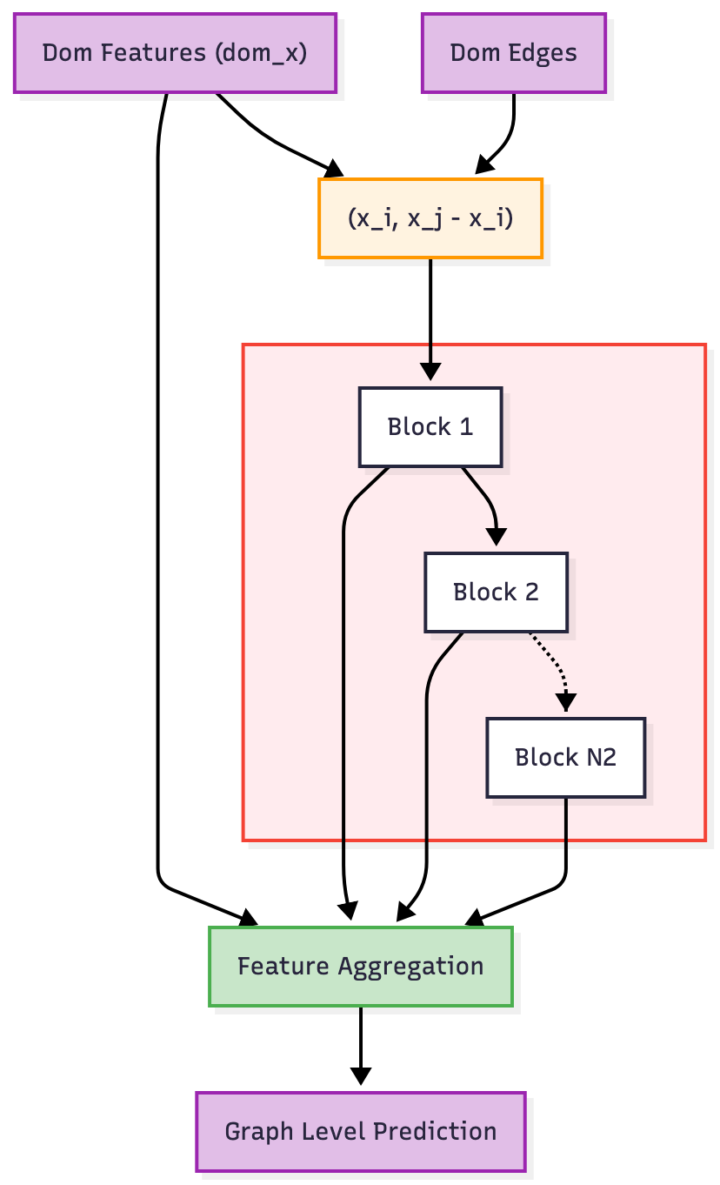
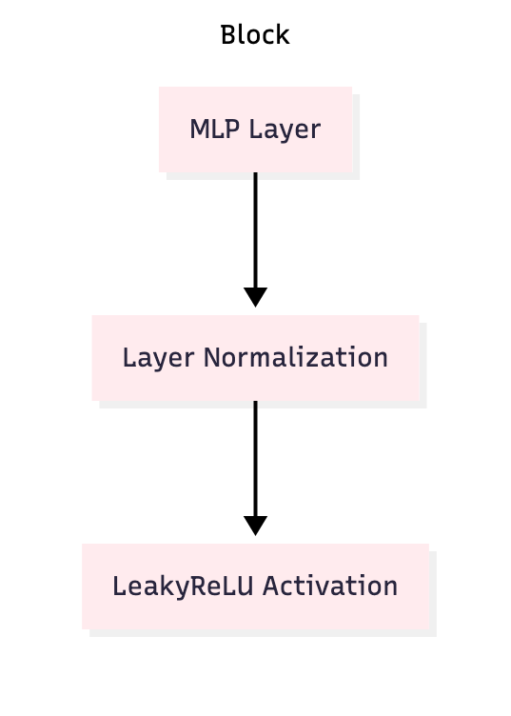
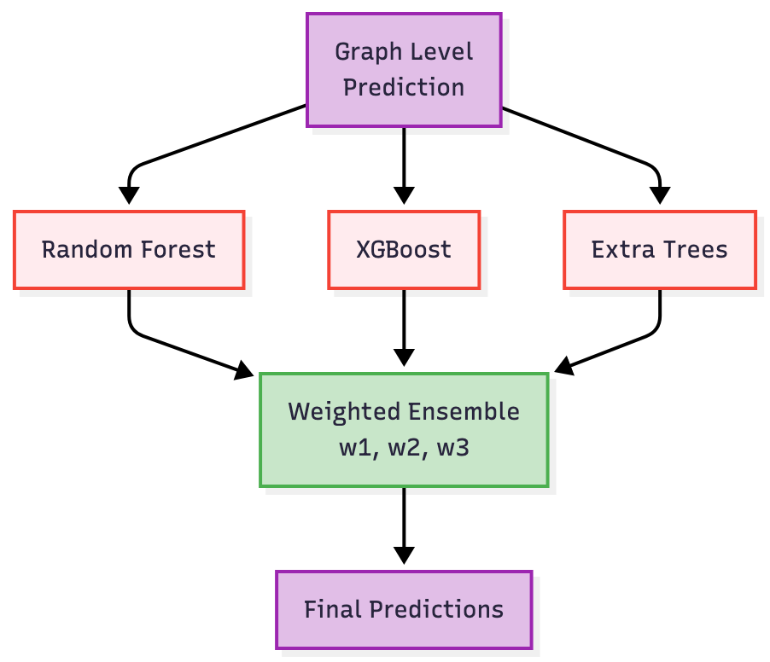
Analysis: GNN Reconstruction
N1, N2 depends on the task
PMT edges: edge between pmts in same dom
Dom edges: edges between doms
x ( pos_x, pos_y, pos_z, pe, t )
Validation Set
GNN-training
Calibration Network

Slide 12
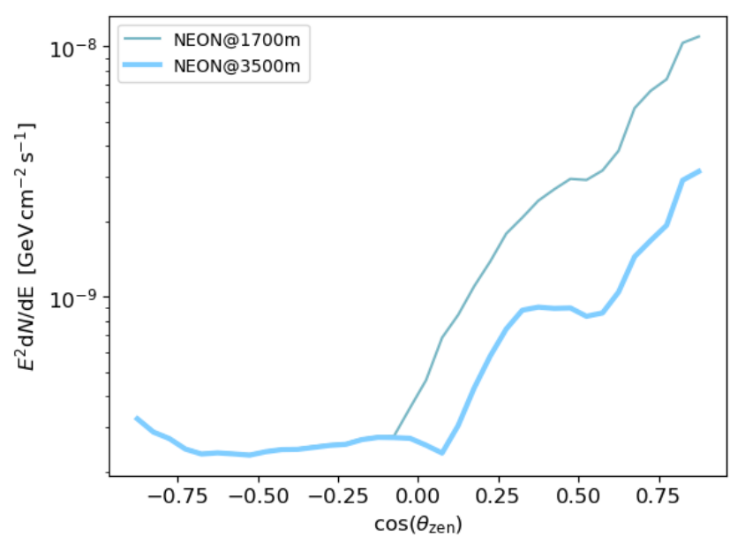
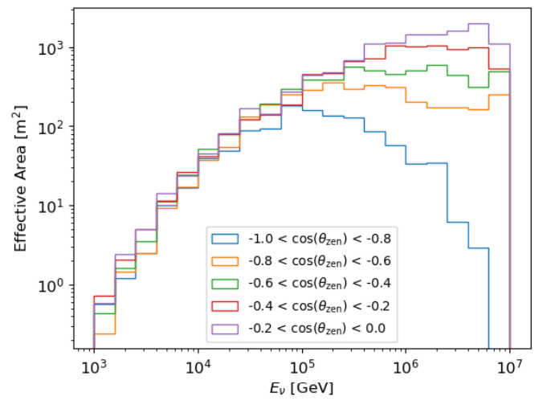
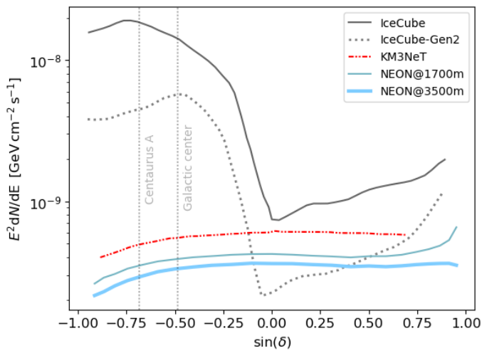
Sensitivity
arXiv:2408.05122
Similar sensitivity to steady sources at 1700 m and 3500 m
Advantage for Galactic center and Centaurus A
A 10-km³ detector achieves 5σ sensitivity of E²Φ ∼ 3 × 10⁻¹⁰ GeV cm⁻² s⁻¹

Slide 13
Outline
Simulation and Prospects
Experimental Progress
Summary
Conceptual design
Signal analysis
Sensitivity
PMT Test
OM status
Electronic
Trial

Slide 14
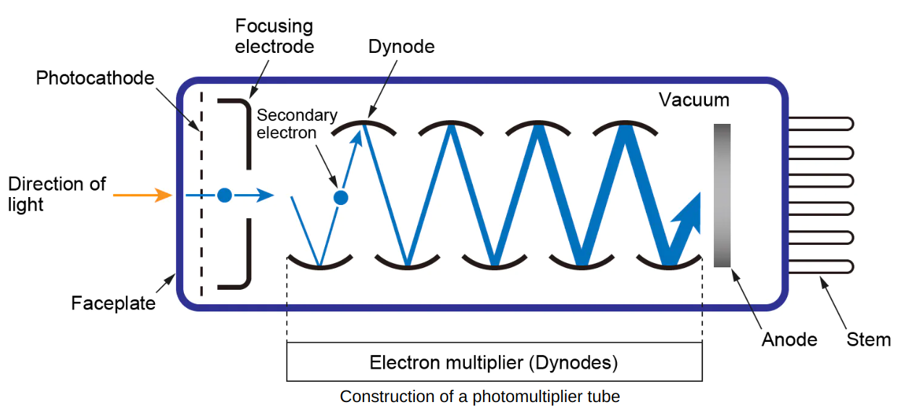
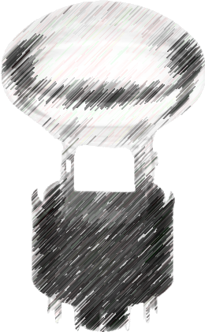
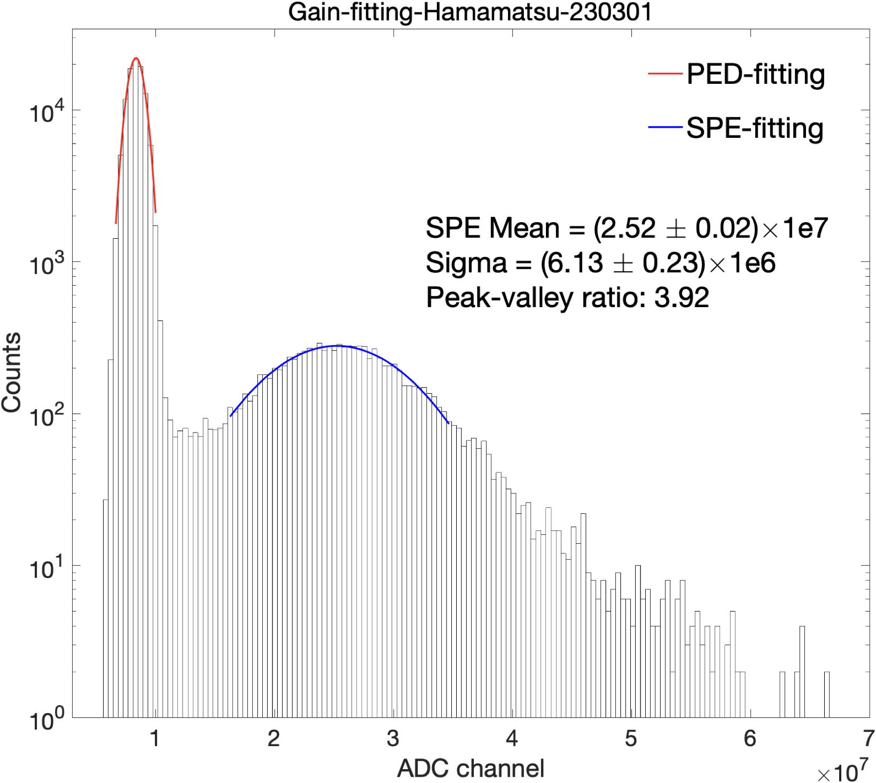
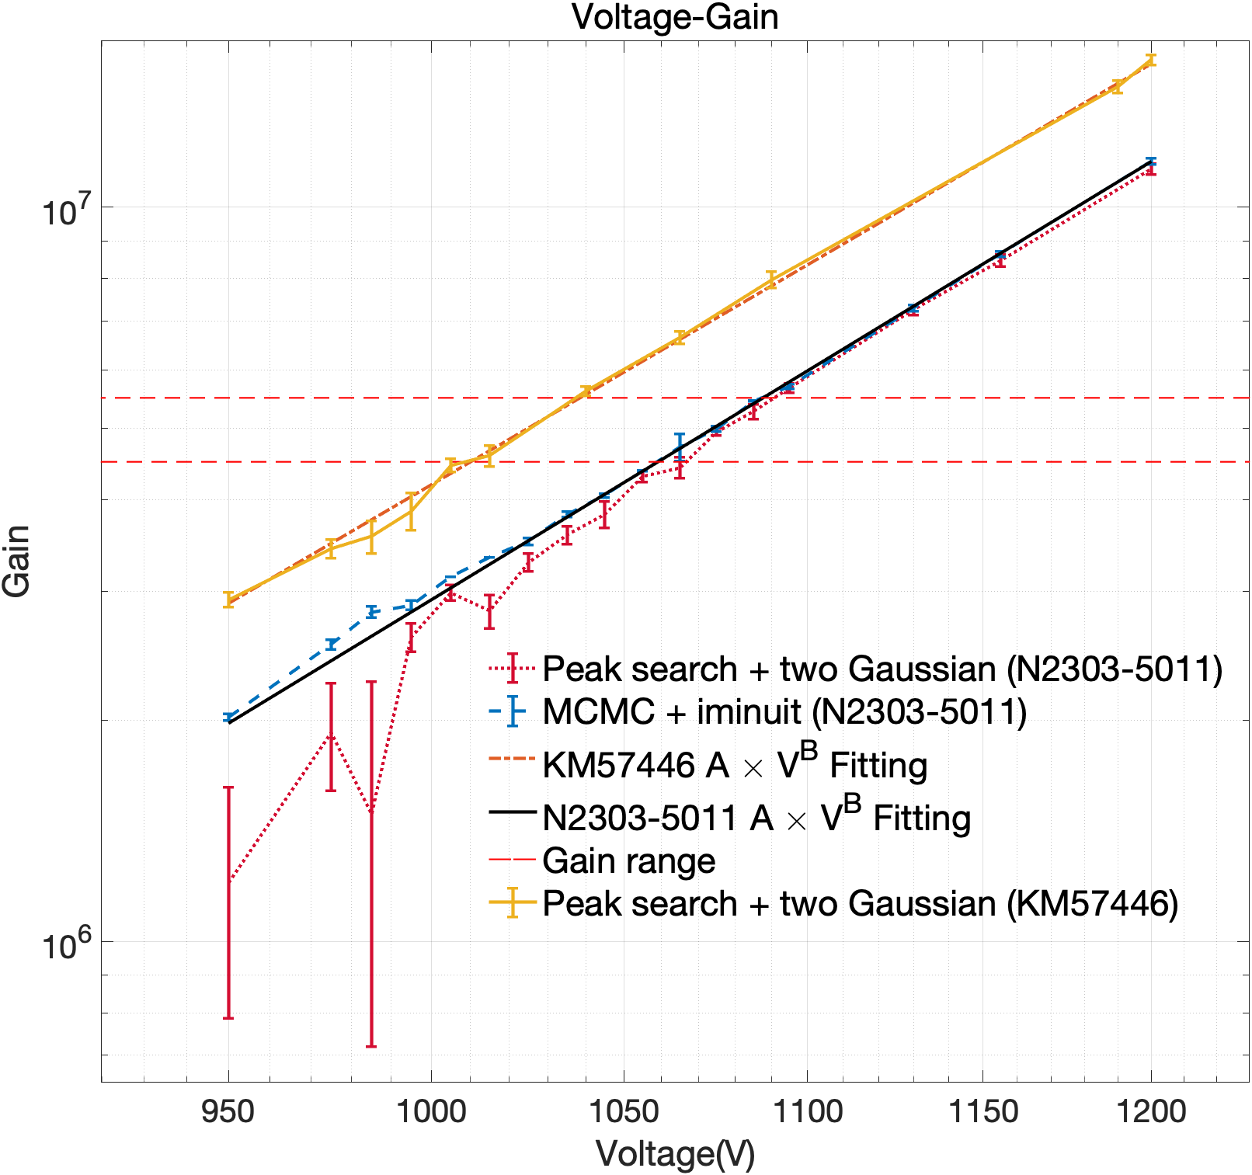
PMT Test
QE~30%
Gain~N_{sec_ele}
Batch Testing
Multi-channel power supply
Optical fiber splitter
Multi-channel oscilloscope
Valley
Peak
Testing 8 PMTs at once!
Manufacturer | QE(%) | Voltage(V) | Gain | Peak/Valley ratio | Dark Current (nA) | Dark Count (Hz)
North Night Vision | 28.5 | 1005 | 5.34E+06 | 2.05 | 1.35 | 526
Hamamatsu | 27.1 | 1000 | 4.88E+06 | 2.25 | 1.23 | 1178
Light

Slide 15
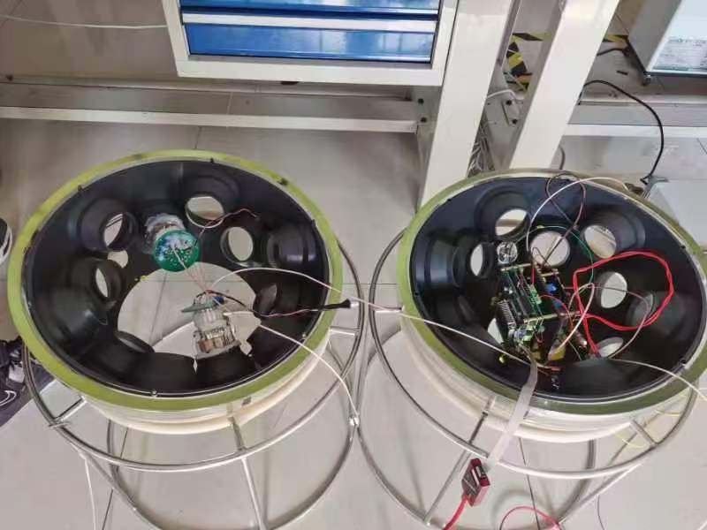
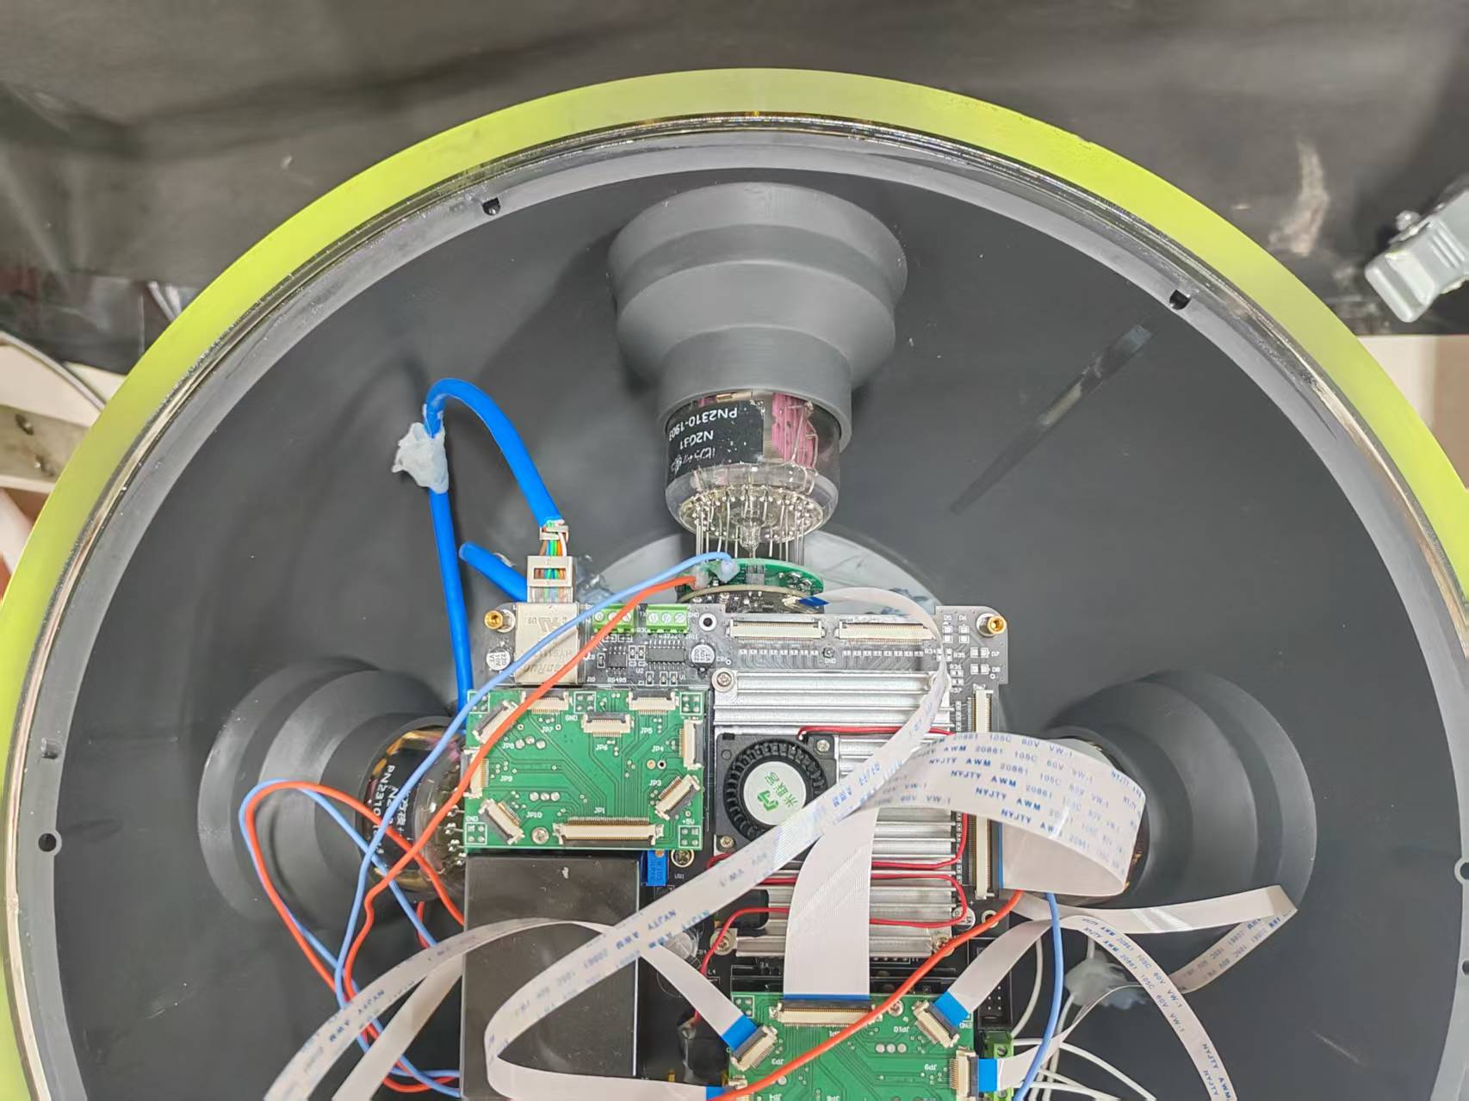
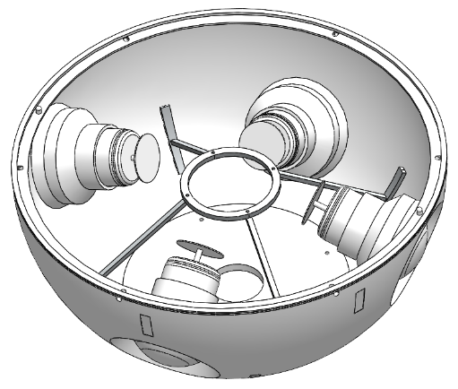
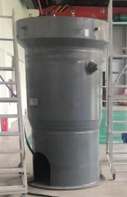
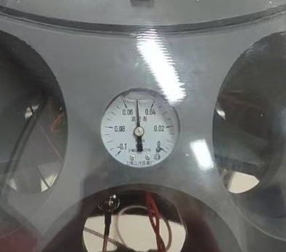
OM Status
First version
Second version
Third version
8-16(preliminary test)/31(deployment)-PMTs per OM
Support bracket (3D printing)
Leak test:
  Vacuum degree better than 0.5 atm for a whole day
Pressure test:
  Able to work at ~4 km deep
Vacuum degree
40 Mpa pressure test

Slide 16
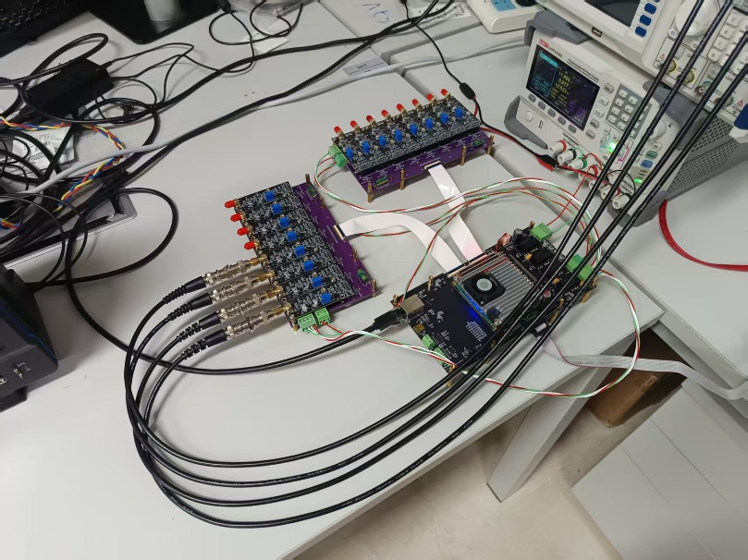
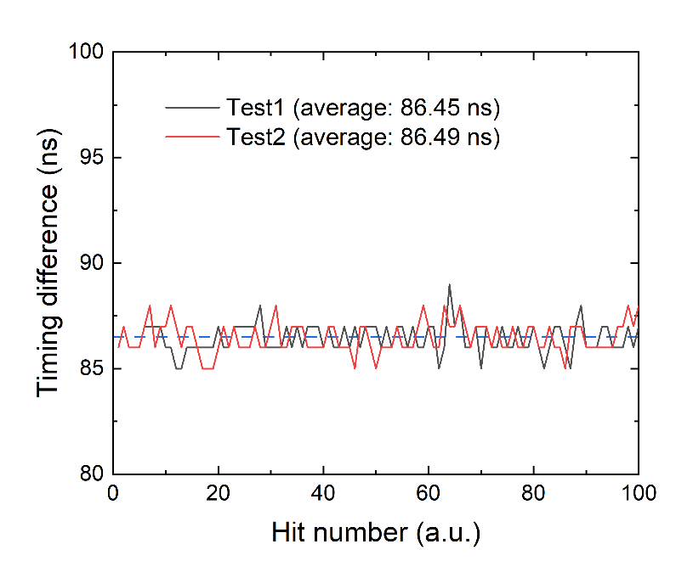
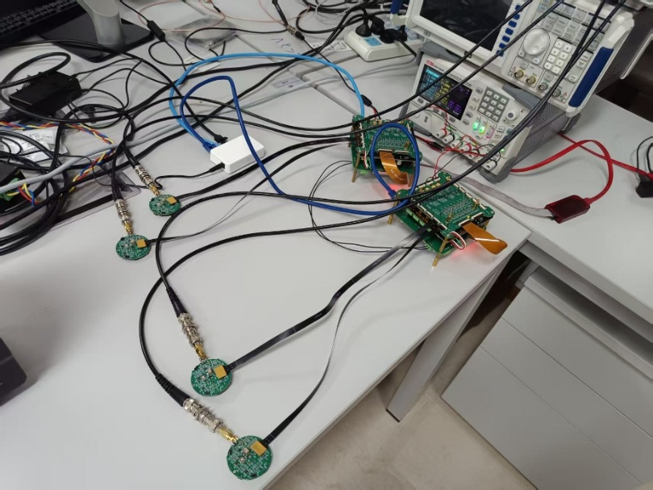
Electronic Status
16-Channel
Single-device Testing
Inter-device Testing
Channel | σ_{Δt} [ns] | σ_{TOT} [ns] | Channel | σ_{Δt} [ns] | σ_{TOT} [ns]
shell a ch1 | 0.70 | 0.89 | shell c ch1 | 0.36 | 0.80
shell a ch2 | 0.50 | 0.68 | shell c ch2 | 0.36 | 0.53
shell a ch3 | 0.41 | 0.61 | shell c ch3 | 0.36 | 0.56
shell a ch4 | 0.41 | 0.78 | shell c ch4 | 0.41 | 0.70
shell b ch1 | 0.42 | 0.46 | shell d ch1 | 0.48 | 0.59
shell b ch2 | 0.46 | 0.66 | shell d ch2 | 0.49 | 0.61
shell b ch3 | 0.75 | 0.66 | shell d ch3 | 0.49 | 0.82
shell b ch4 | 0.72 | 0.76 | shell d ch4 | 0.72 | 0.71
Testing Version
Master
Steady Time Difference
Slave
σ_{Δt} and σ_{TOT} ≤ 1 ns
Packet Loss Rate < 0.001%
For all the channels:
Integrated Version

Slide 17

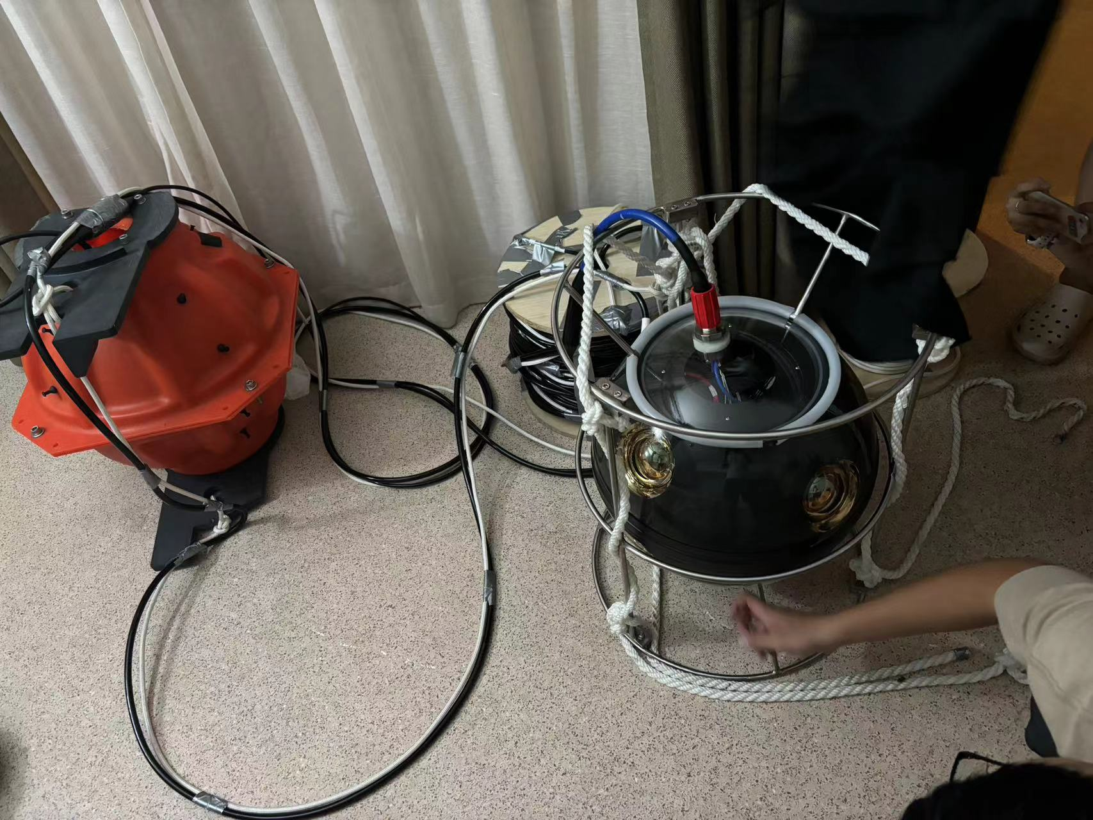
Trials
Last trial in Qiandao Lake:
Single OM works well under water
buoy
26m
OM 2
Next trial in preparation
→ Validate the time sync system
OM 1
2m
anchor

Slide 18
Summary
Proposed a deep sea Neutrino Observatory in the Nanhai (NEON)
Built a simulation and analysis framework
Evaluated sensitivity for different sites
Developing optical modules and electronics
Conducted initial underwater trials; next trial in planning
Advancing step by step with ongoing development...
TODO:
  Next trial
  Water optical measurement
  Cascade Reconstruction
  Self-Veto
  ...

Slide 19
Workshop on Neutrinos and related New Physics Research - Zhuhai
Thank you for your attention!
November 30th, 2025

Slide 20
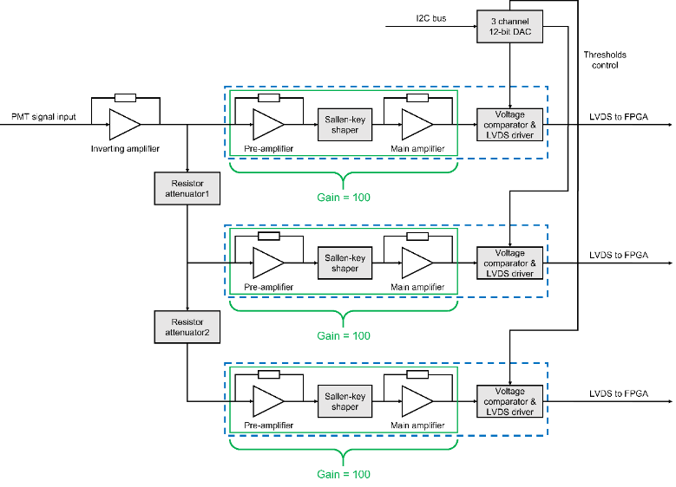
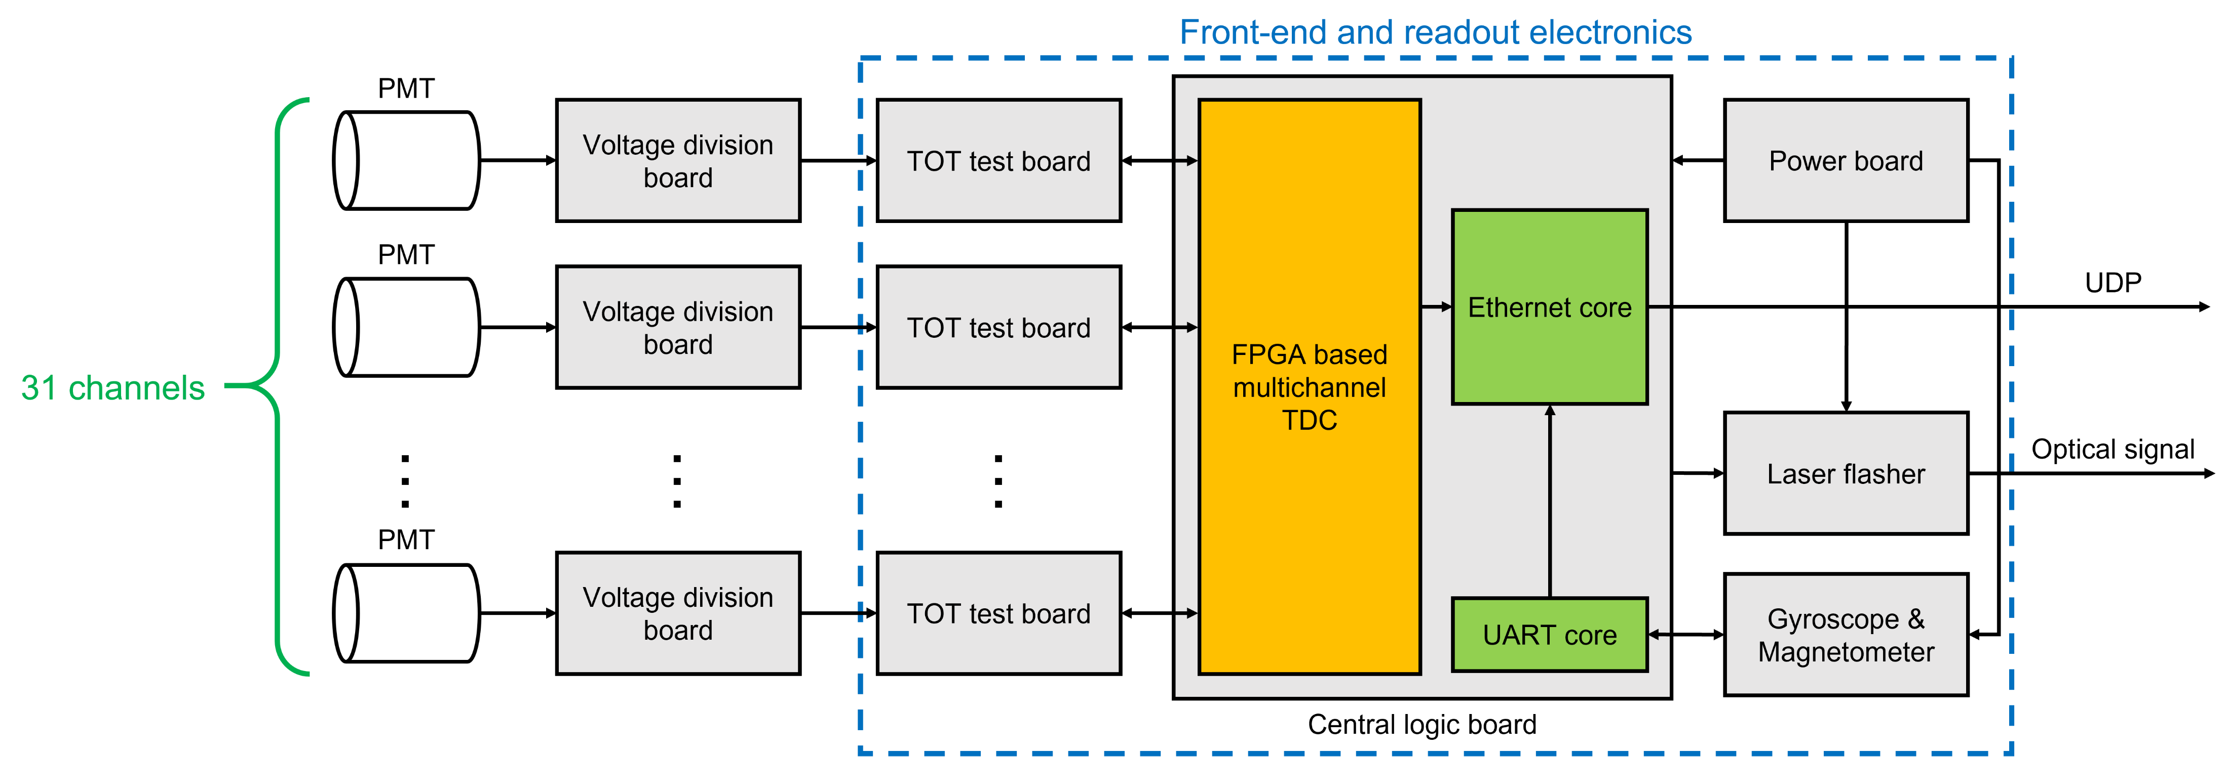
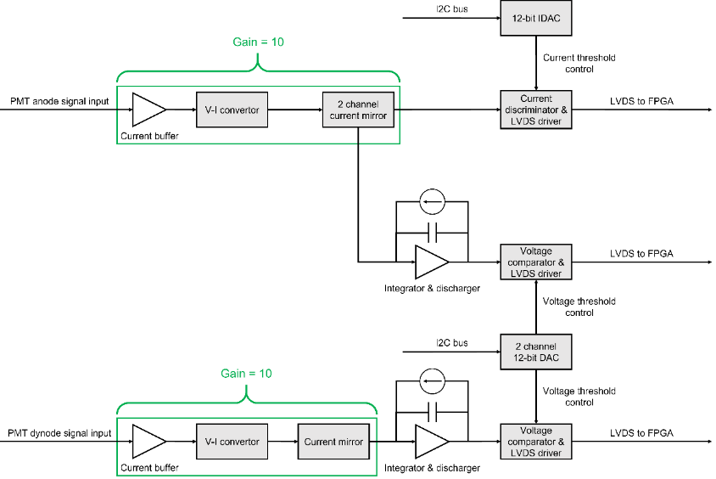
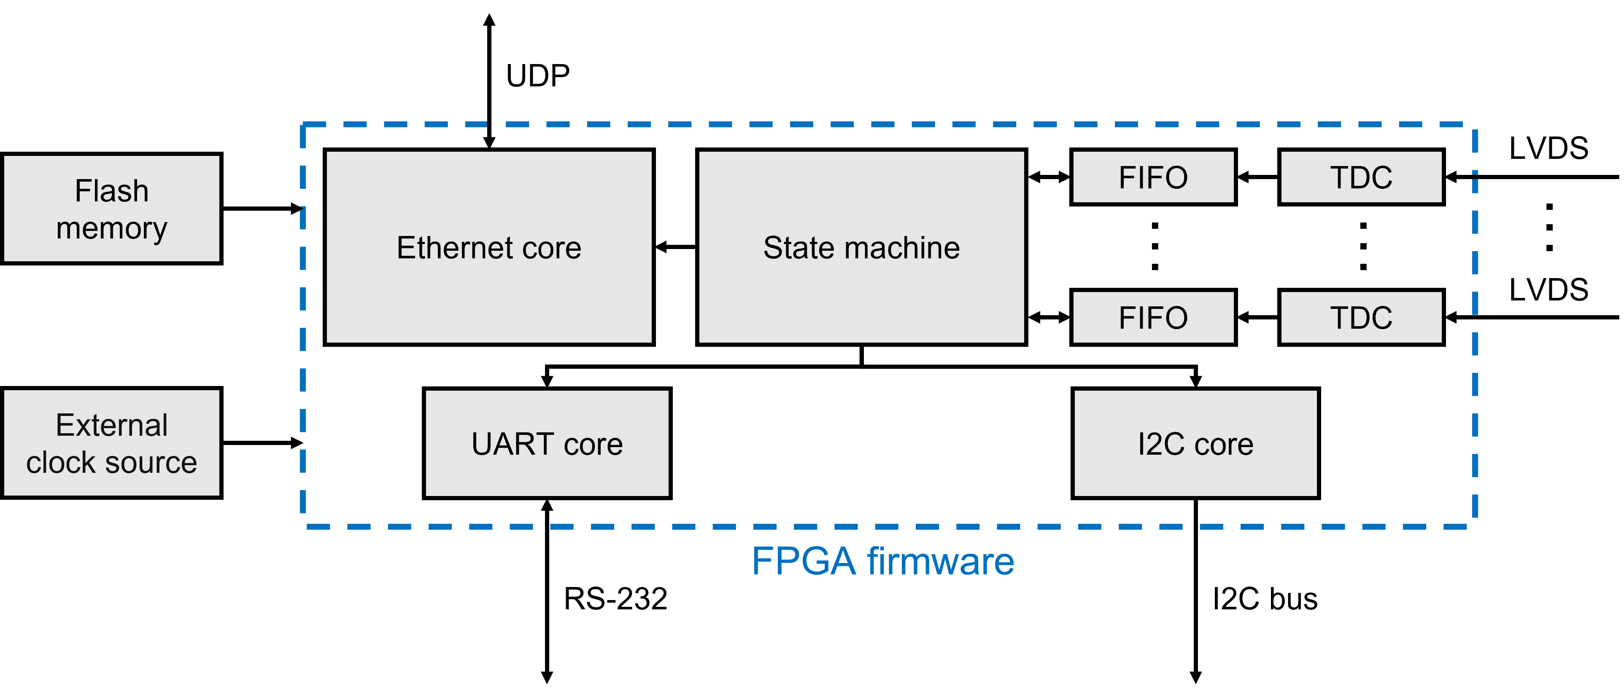
Electronic Design (Appendix)
Front-end and readout electronics

Slide 21
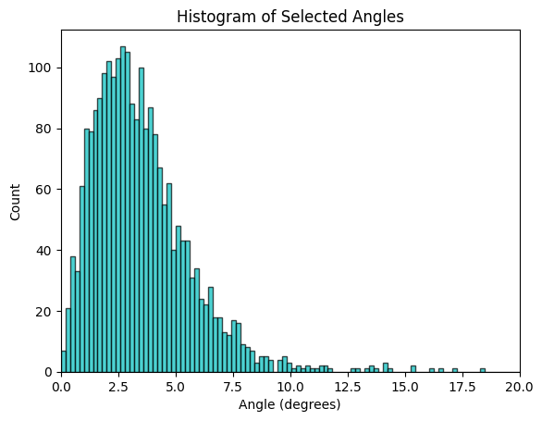
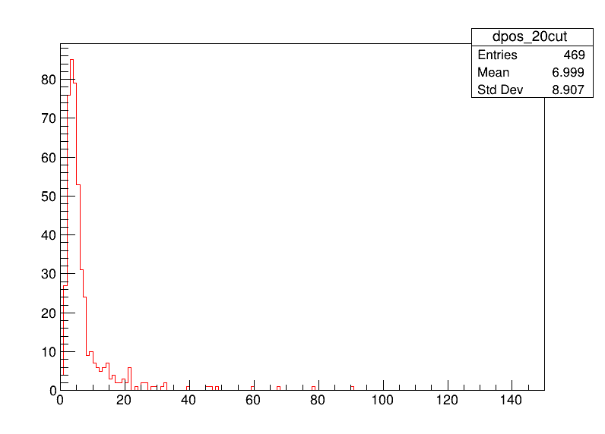
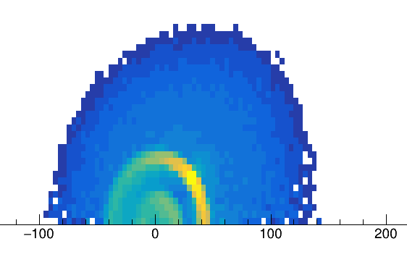


Reconstruction (Appendix)
Shower Vertex Reconstruction of Cascade
GNN
Assuming straight propagation from Vertex to hit position
M-Estimator:
$$M=\underset{hits}{∑}\sqrt{(t_{i}−t_{i}^{exp})^{2}+1}$$
Minimizing T-Res (Melis, 2017)
$$R=c_{w}(t_{i}^{exp}−t_{0})$$
Vertex
Cherenkov angle

