Slide 1

Testing Leptogenesis from Observable Gravitational Waves
Wei Liu (刘威)
Nanjing University of Science and Technology
in collaboration with Yongcheng Wu
Arxiv:2504.07819
Workshop on Neutrinos and related New physics Research
Sun Yat-sen University Zhuhai, Nov. 29-30, 2025

Slide 2
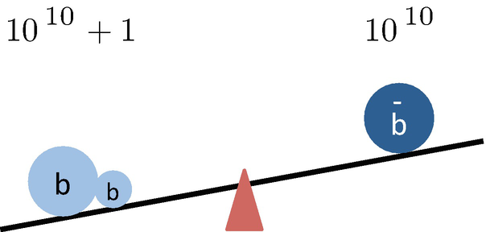

Baryon Asymmetry of the Universe
$$\frac{n_{∆B}}{s}≈(8.59±0.11)×{10}^{−11}$$
from Planck satellite
Figure from Kaori Fuyuto

Slide 3
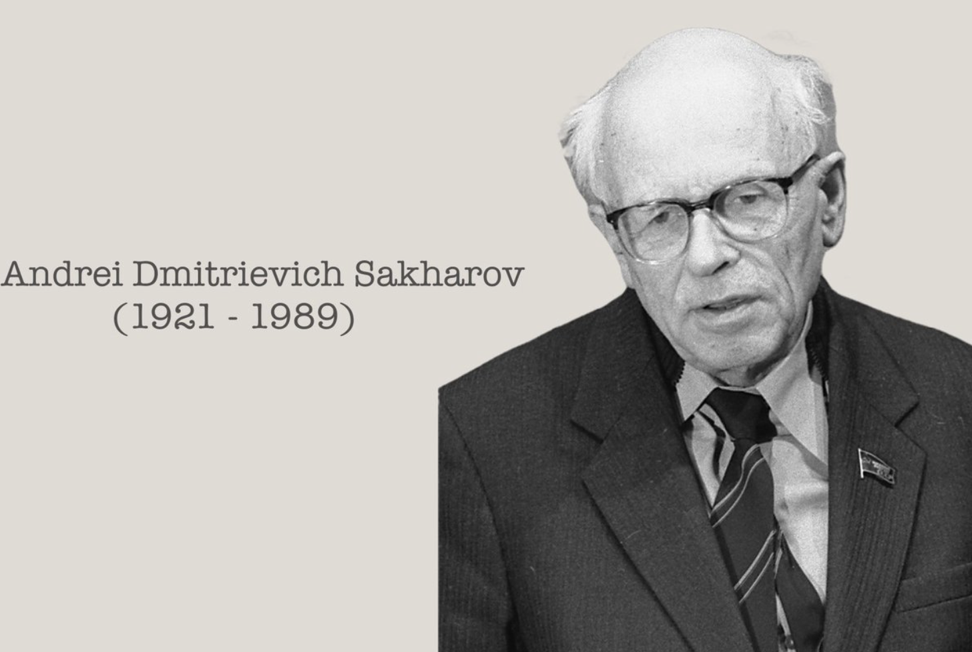

Baryon Asymmetry of the Universe
Sakhorov’s criteria
1. Baryon number violating process,
Generate $n_{∆B}.$
Triangle Anomoly
2. C and CP violations,
$Γ(X→Y+b)≠Γ(\overline{X}→\overline{Y}+\overline{b})$, L and R.
CKM
3. Out of equilibrium.
$Γ(X→Y+b)≠Γ(Y+b→X).$
Electroweak phase transition
Way too small to explain the observed BAU within the SM. We need new physics!

Slide 4
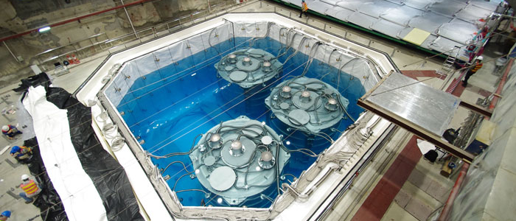
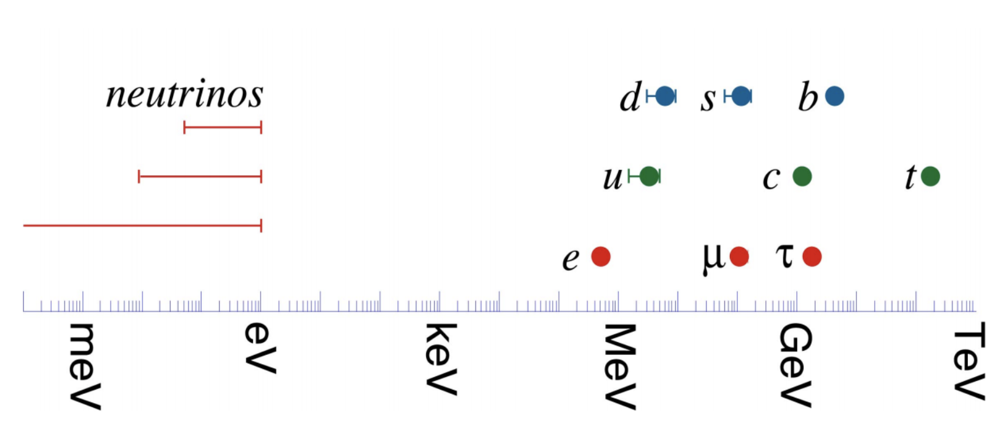

Baryon Asymmetry of the Universe
$$\sum{m_{ ν}}≲0.12 eV$$
from Planck satellite
Seesaw mechanism
$$L⊃−y_{D}\overline{l_{L}}\tilde{H}ν_{R}−M_{R}\overline{{ν_{R}}^{c}}ν_{R}$$
$$M=\left(\begin{matrix}0 & M_{D} \\ M_{D} & M_{R}\end{matrix}\right)$$
$m_{1}≈\frac{−M_{D}^{2}}{M_{R}}$, $m_{2}≈M_{R}$.
The lightness of the observed neutrinos is explained by heavy right-handed neutrinos,
Additional CP violations can exists in the neutrino mass matrix.

Slide 5

Leptogenesis
BAU from neutrino!
1. Lepton number is violated within the neutrino masses terms.
2. Additional CP violations can exists in the neutrino mass matrix.
3. Right-handed neutrinos decay out of equilibrium potentially.
And EW sphaleron to transfer $n_{∆L}$into $n_{∆B}$ before EW phase transition,
$$Y_{B}=\frac{28}{79}Y_{B−L}$$

Slide 6
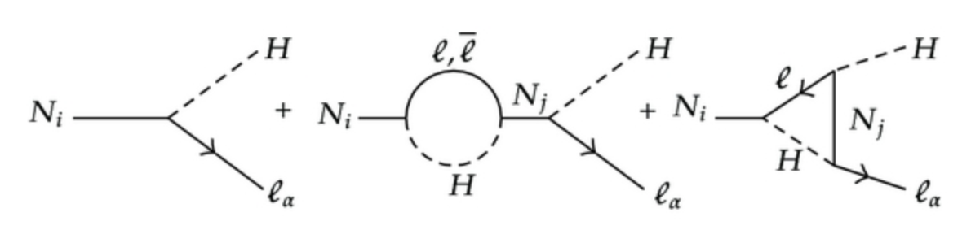

Leptogenesis
$ε_{αα}$ is the CP asymmetry in $N_{1}$ decay,
comes from the interference between the tree-level and one loop amplitude.
Hierarchical RH neutrinos,
$M_{N_{1}}≥{10}^{9}$GeV.
Davidson-Ibarra Bound, no possible signatures.
Higgs mass unstable, Hierarchy problem
Resonant leptogenesis
if at least two of the RH neutrinos masses are degenerate,
Fine-tuned
$ε≲ \frac{1}{2}$, only needs $M_{N_{1}}≥T_{sph}≈130$GeV.
ARS leptogenesis
Degenerate RH neutrinos Oscillate,
Fine-tuned
$M_{N_{1}}≥1$GeV.

Slide 7
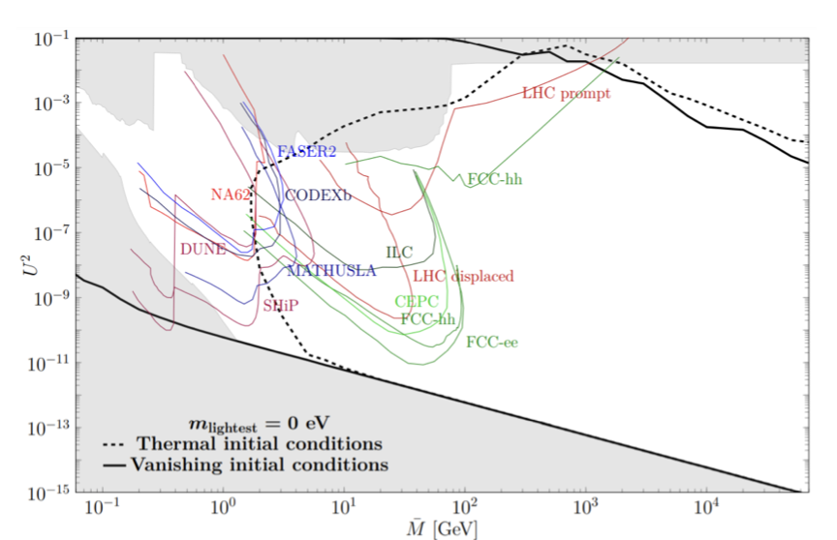
Test Leptogenesis
How to test leptogenesis?
High scale: Collider can not reach
Low scale: Can not measure mass degeneracy
Only allowed region, No test
Marco Drewes, Yannis Georis et al, Phys.Rev.Lett. 128 (2022) 5, 051801

Slide 8

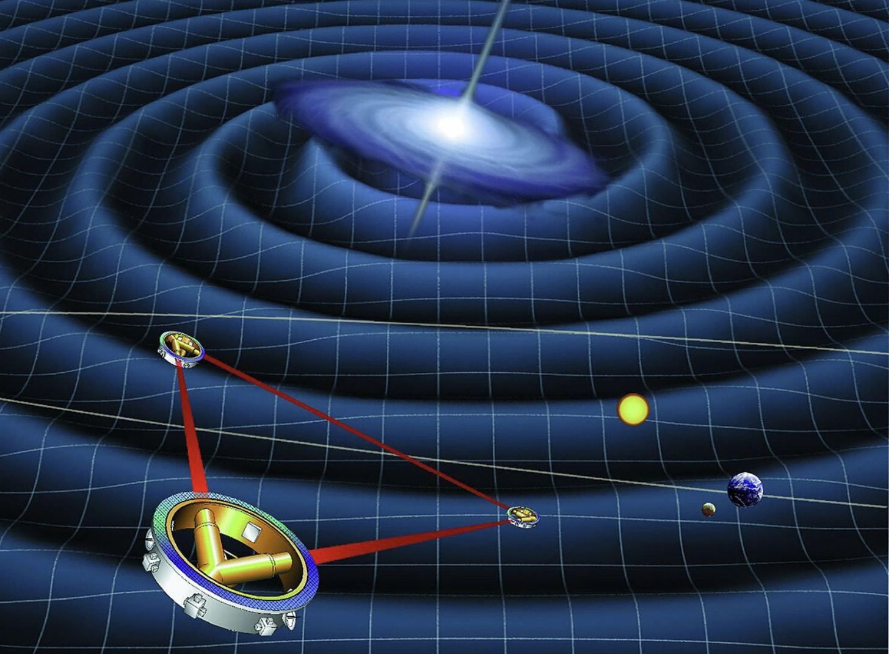
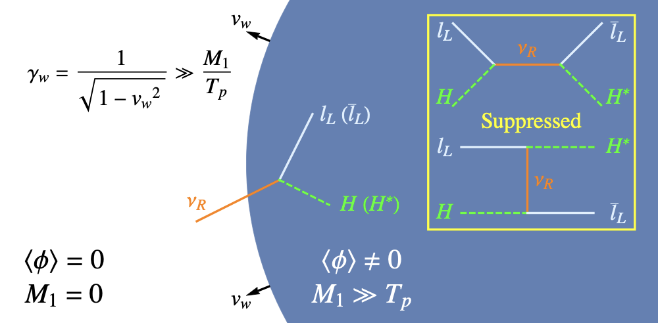
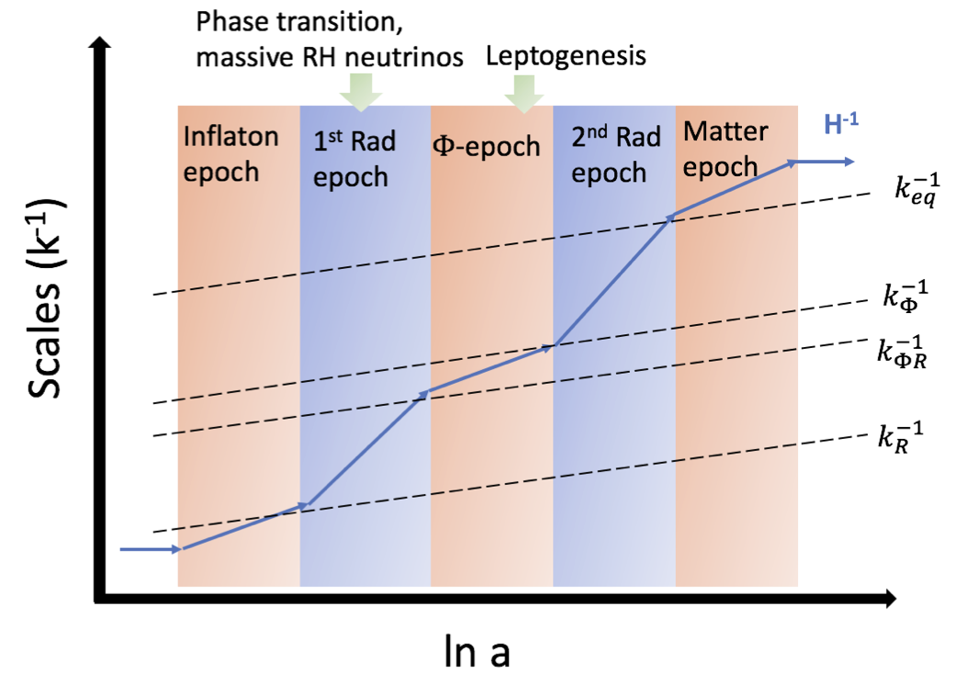
Test Leptogenesis from GWs
Can we test leptogenesis from GWs?
Relativistic bubble wall dynamics
EWPT, RHN mass, wall speed
I. Baldes, S. Blasi et al, Phys.Rev.D 104 (2021) 11, 115029
P. Huang, K. Xie, JHEP 09 (2022), 052
D. Borah, A. Dasgupta et al, JHEP 11 (2022), 136
E. J. Chun, T. P. Dutka et al, JHEP 09 (2023), 164
Early Matter Dominance from RHNs or scalar
Inflation or EWPT GWs
S. Datta, R. Samanta et al, JHEP 11 (2022), 159,
JCAP 11 (2024) 051, JCAP 08 (2025), 095
More from A. Ghoshal et al
Graviton...
Leptogenesis
GWs
From Sakhorov’s 3rd Criteria

Slide 9
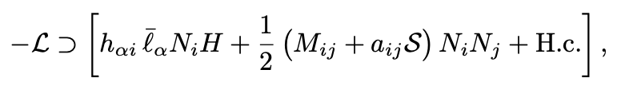
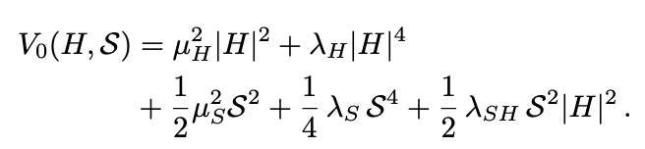

Scalar assisted Leptogenesis
Can we have interplay via Sakhorov’s 2nd Criteria?
CP asymmetry
Can we enhance CP, without finetuned mass splitting?
Can we probe leptogenesis with GWs?
Toy model:
Scalar assisted Leptogenesis, scalar$Z_{2}$ symmetric Model

Slide 10
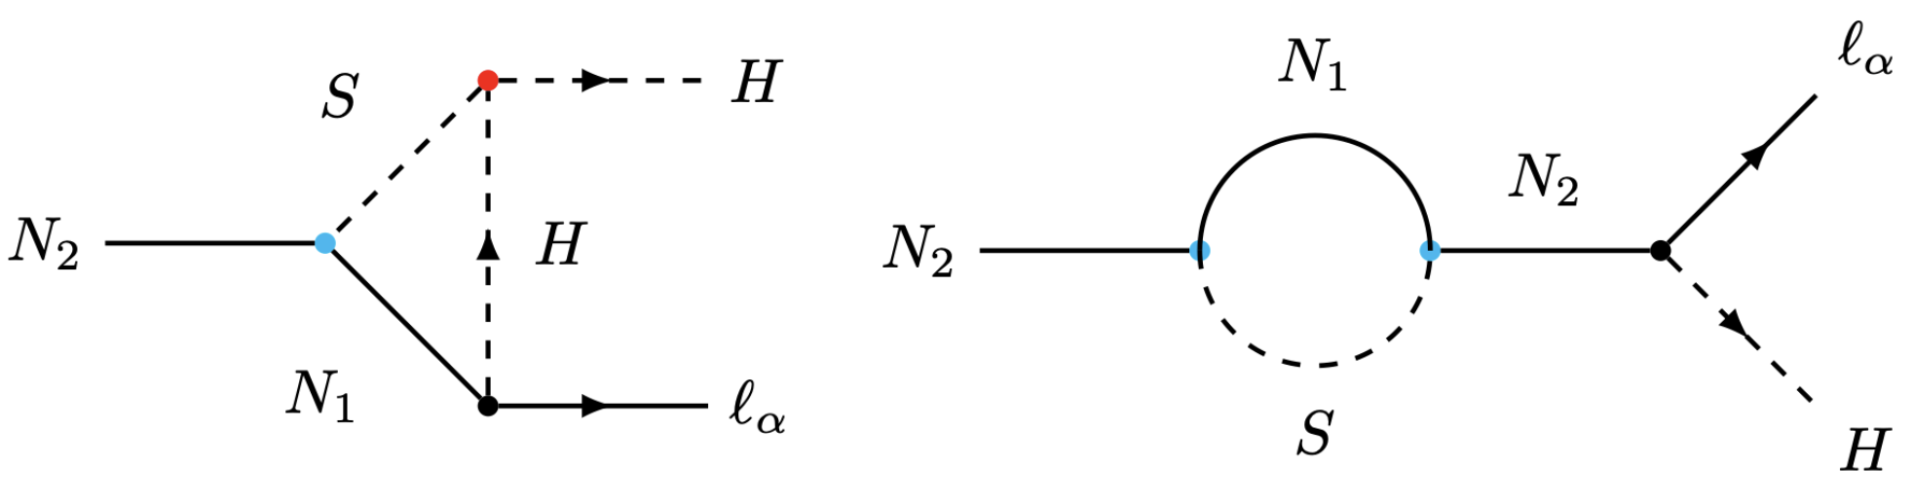
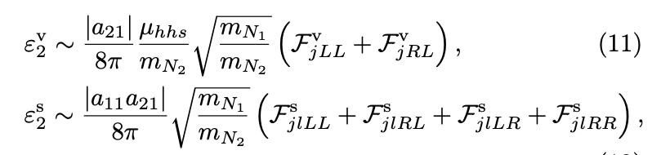

Scalar assisted Leptogenesis
CP Asymmetry
Require $m_{N_{2}}−$ $m_{N_{1}}>m_{S}(T)$
CP Asymmetry from vertex correction, $∝SHH,$ $∝N_{2}N_{1}S$
CP Asymmetry from self energy, $∝{(N_{2}N_{1}S)}^{2}$
Advantage:
Do not need degenerate RHNs, or too heavy RHNs
No fine-tuning, Higgs mass stable
SHH couplings = 2$λ_{SH}ω_{s}$, $ω_{s}$ is the vev of S
Leptogenesis is highly connected to 1st order EWPT, in magnitude
SHH coupling!

Slide 11
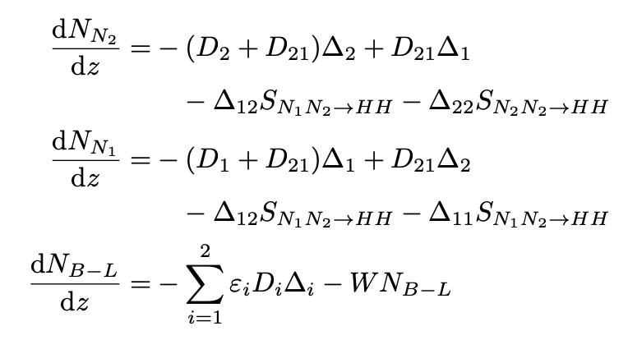
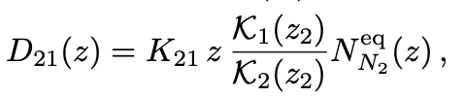
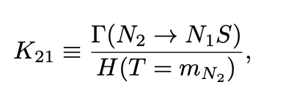
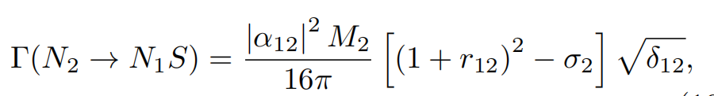

Scalar assisted Leptogenesis
Boltzmann Equations
Additional terms from $N_{2}→N_{1}S:$

Slide 12
Test Leptogenesis from GWs
How can we connect GWs? From EWPT induced from scalar sector
Leptogenesis
BAU
Scalar
?
EWPT
GWs

Slide 13
Scalar induced EWPT
What is EWPT? EW symmetry restoration in the early Universe
Current
W & Z bosons are massive;
Photon is massless,
Mexican-hat like
Phase transition
The early Universe
(Thermal effects)
SU(2)_{L} & U(1)_{Y} bosons are massless,
True vacuum

Slide 14
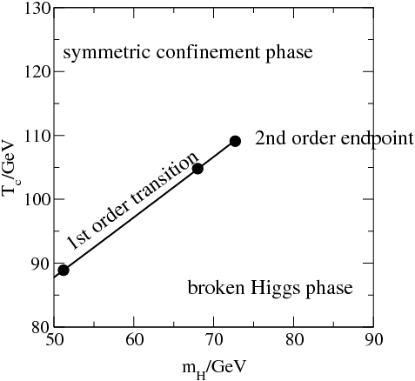
Scalar induced EWPT
It could be –
Lattice calculation shows the phase diagram ==>
Thus in the SM it is a crossover, since M_{h} = 125 GeV > 75 GeV;
However, a 1st-order EWPT is more interesting.
(Needs new physics)
Figure from L.-T. Wang’s talk in IHEP workshop
SM
or
New Phy.
hep-ph/0010275
EW-symmetric phase
EW-broken phase

Slide 15
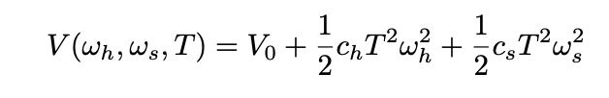


Scalar induced EWPT
At finite temperature:
An Illustration –
Magnitude controlled by $λ_{SH},$ $λ_{S}$, $ω_{s}$
Gravitational wave spectrum
Barrier from SHH coupling! After EWPT

Slide 16
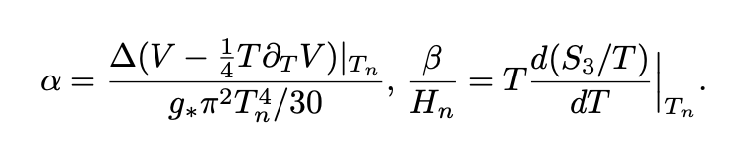
Observable GWs
GW spectrum can be calculated from EWPT:
For the LISA detector, signal-to-noise ratio (SNR):
SNR > 10, can be regarded as criteria of signal

Slide 17
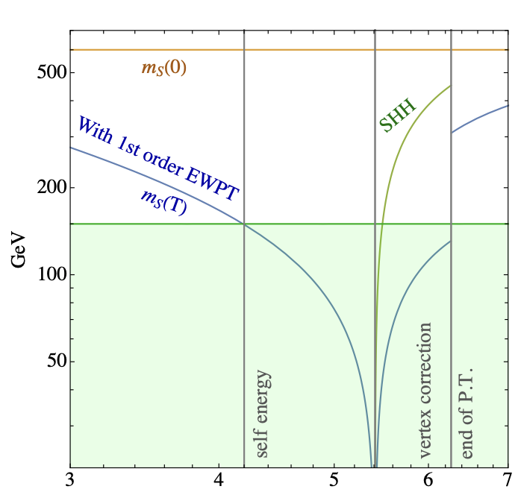
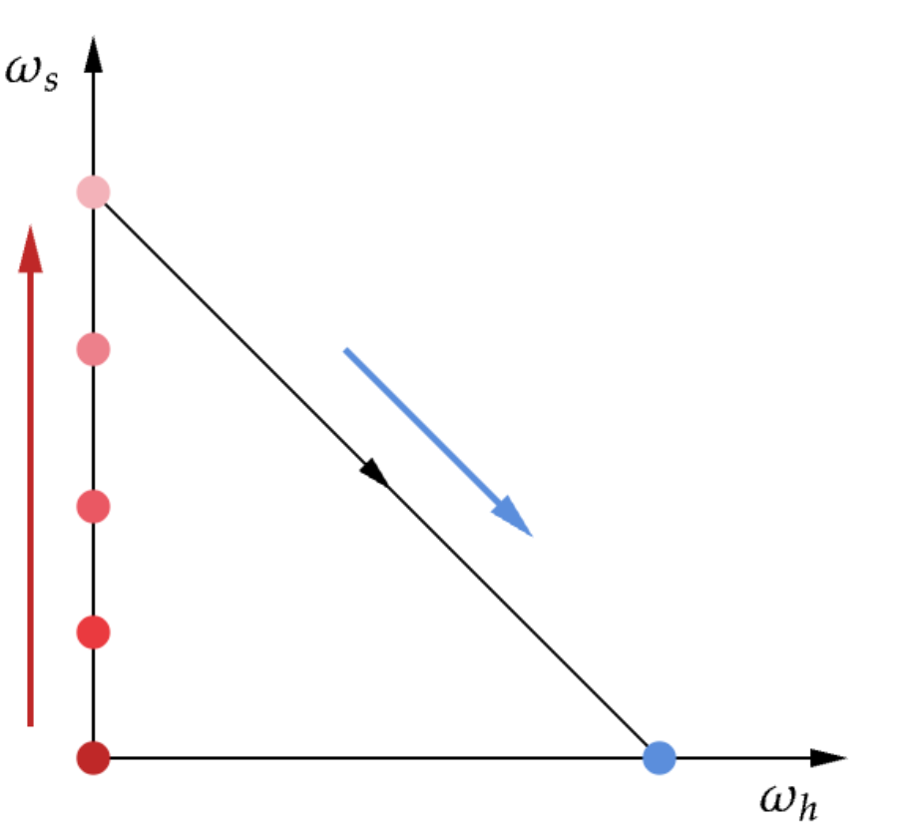
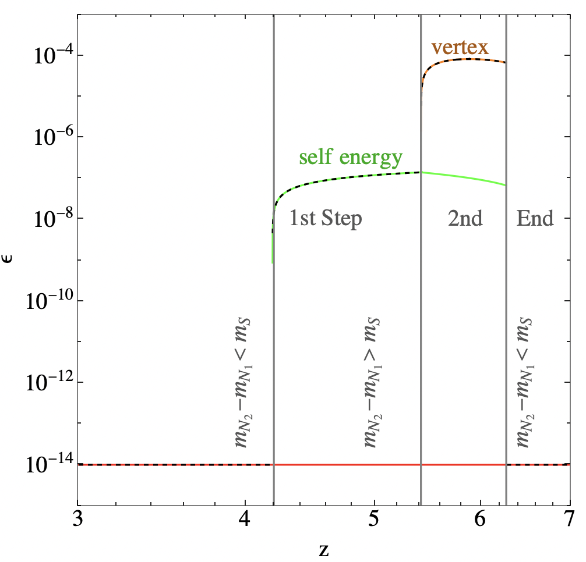




Connection between Leptogenesis and EWPT
Two Step Phase Transition: for $Z_{2}$ symmetric Model
CP Asymmetry is highed related to the EWPT
$$(0,ω_{s})$$
Second step
First step
$$(0,0)$$
$$(ω_{h},0)$$

Slide 18
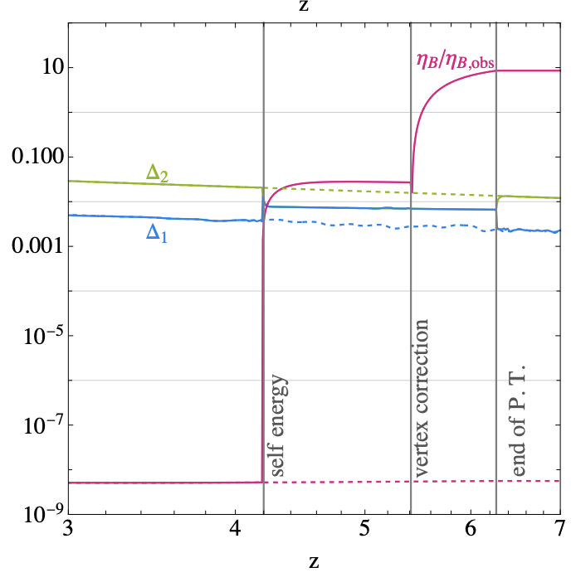
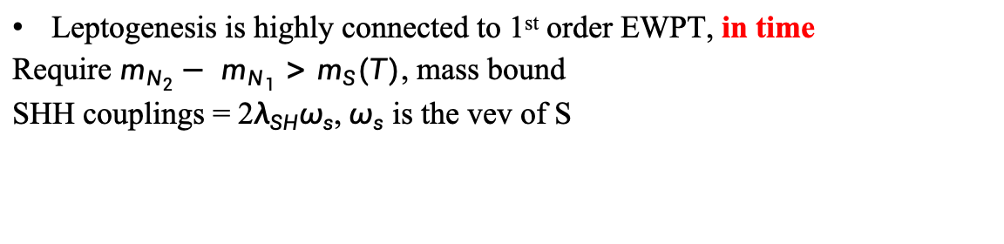
Connection between Leptogenesis and EWPT
Leptogenesis is highly connected to 1st order EWPT, in time
Require $m_{N_{2}}−$ $m_{N_{1}}>m_{S}(T)$, mass bound
SHH couplings = 2$λ_{SH}ω_{s}$, $ω_{s}$ is the vev of S

Slide 19
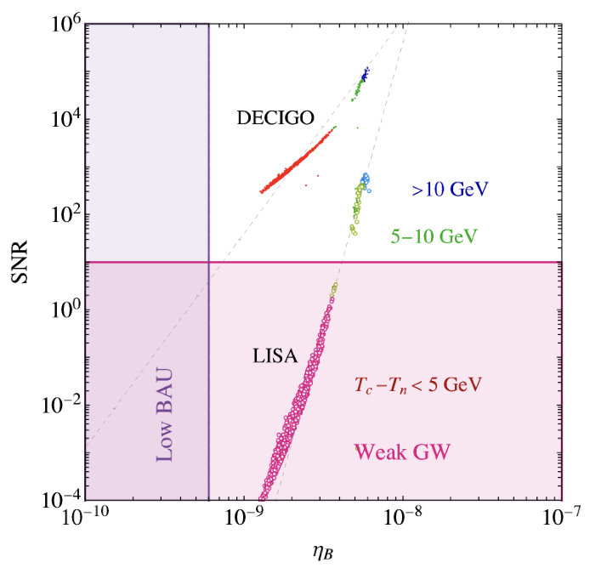

Testing Leptogenesis from Observable GWs
Leptogenesis is strongly correlated to GWs!
$T_{n}$: Nucleation temperature,
$T_{c}$: Critical temperature, degenerate vacuum
$T_{c}− T_{n}>10$ GeV: Strong EWPT,
For one benchmark:
Linear dependence!
General correlation
weaker dependence
when mass bound close before PT
$$m_{N_{2}}−m_{N_{1}}>m_{S}(T)$$
Successful Leptogenesis can lead to observable GWs in the near future

Slide 20

Conclusion
Leptogenesis can be tested via Gravitational Waves
CP Asymmetry can be enhanced by additional scalar
CP Asymmetry connected to 1st-order EWPT
in magnitude, $∝$ $λ_{SH}ω_{s}$, also control 1st-order EWPT
in time, near the EWPT period, EWPT control mass bound
Leptogenesis is strongly correlated to GWs, can be tested from Observable GWs
Further connection with Neutrino mass generation, dark matter in future...

Slide 21
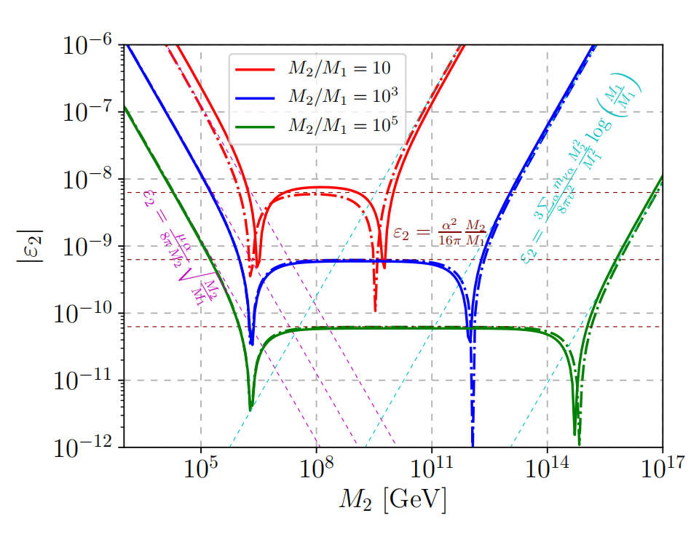
Scalar assisted Leptogenesis
CP Asymmetry from vertex correction
Dominates for light RHNs
CP Asymmetry from self energy
Dominates for not that heavy RHNs
CP Asymmetry from vannila seesaw
Dominates for heavy RHNs
We consider light RHNs to avoid Hierarchy problem
Dominant vertex correction

