Slide 1
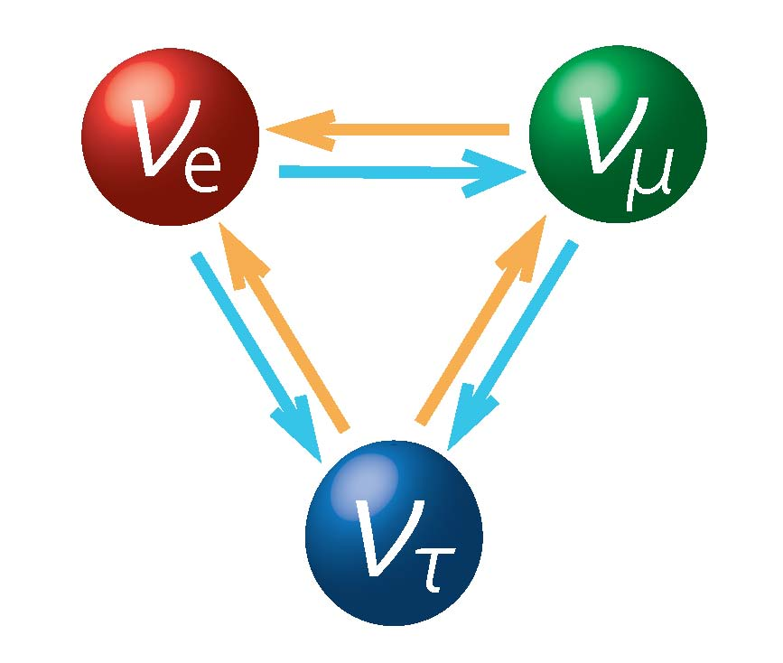

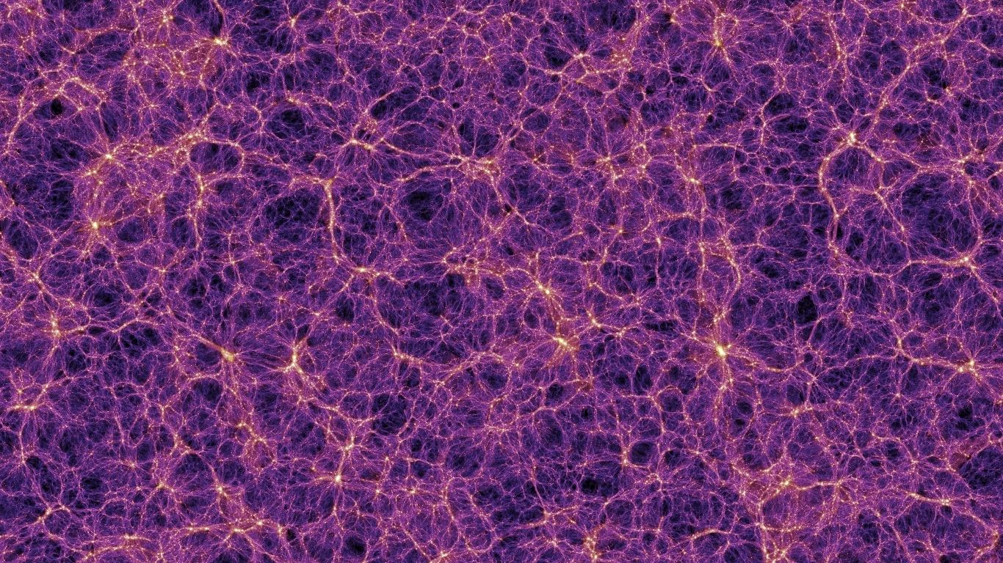
中微子及相关新物理研讨会
NuPhyR
Neutrino in Cosmology
Jun-Qing Xia
Beijing Normal University
2025-11-29

Slide 2
Outline
2
30
History of Universe on Neutrino
Effects of Neutrino on BBN, CMB & LSS
Current Limits & Future Perspective

Slide 3
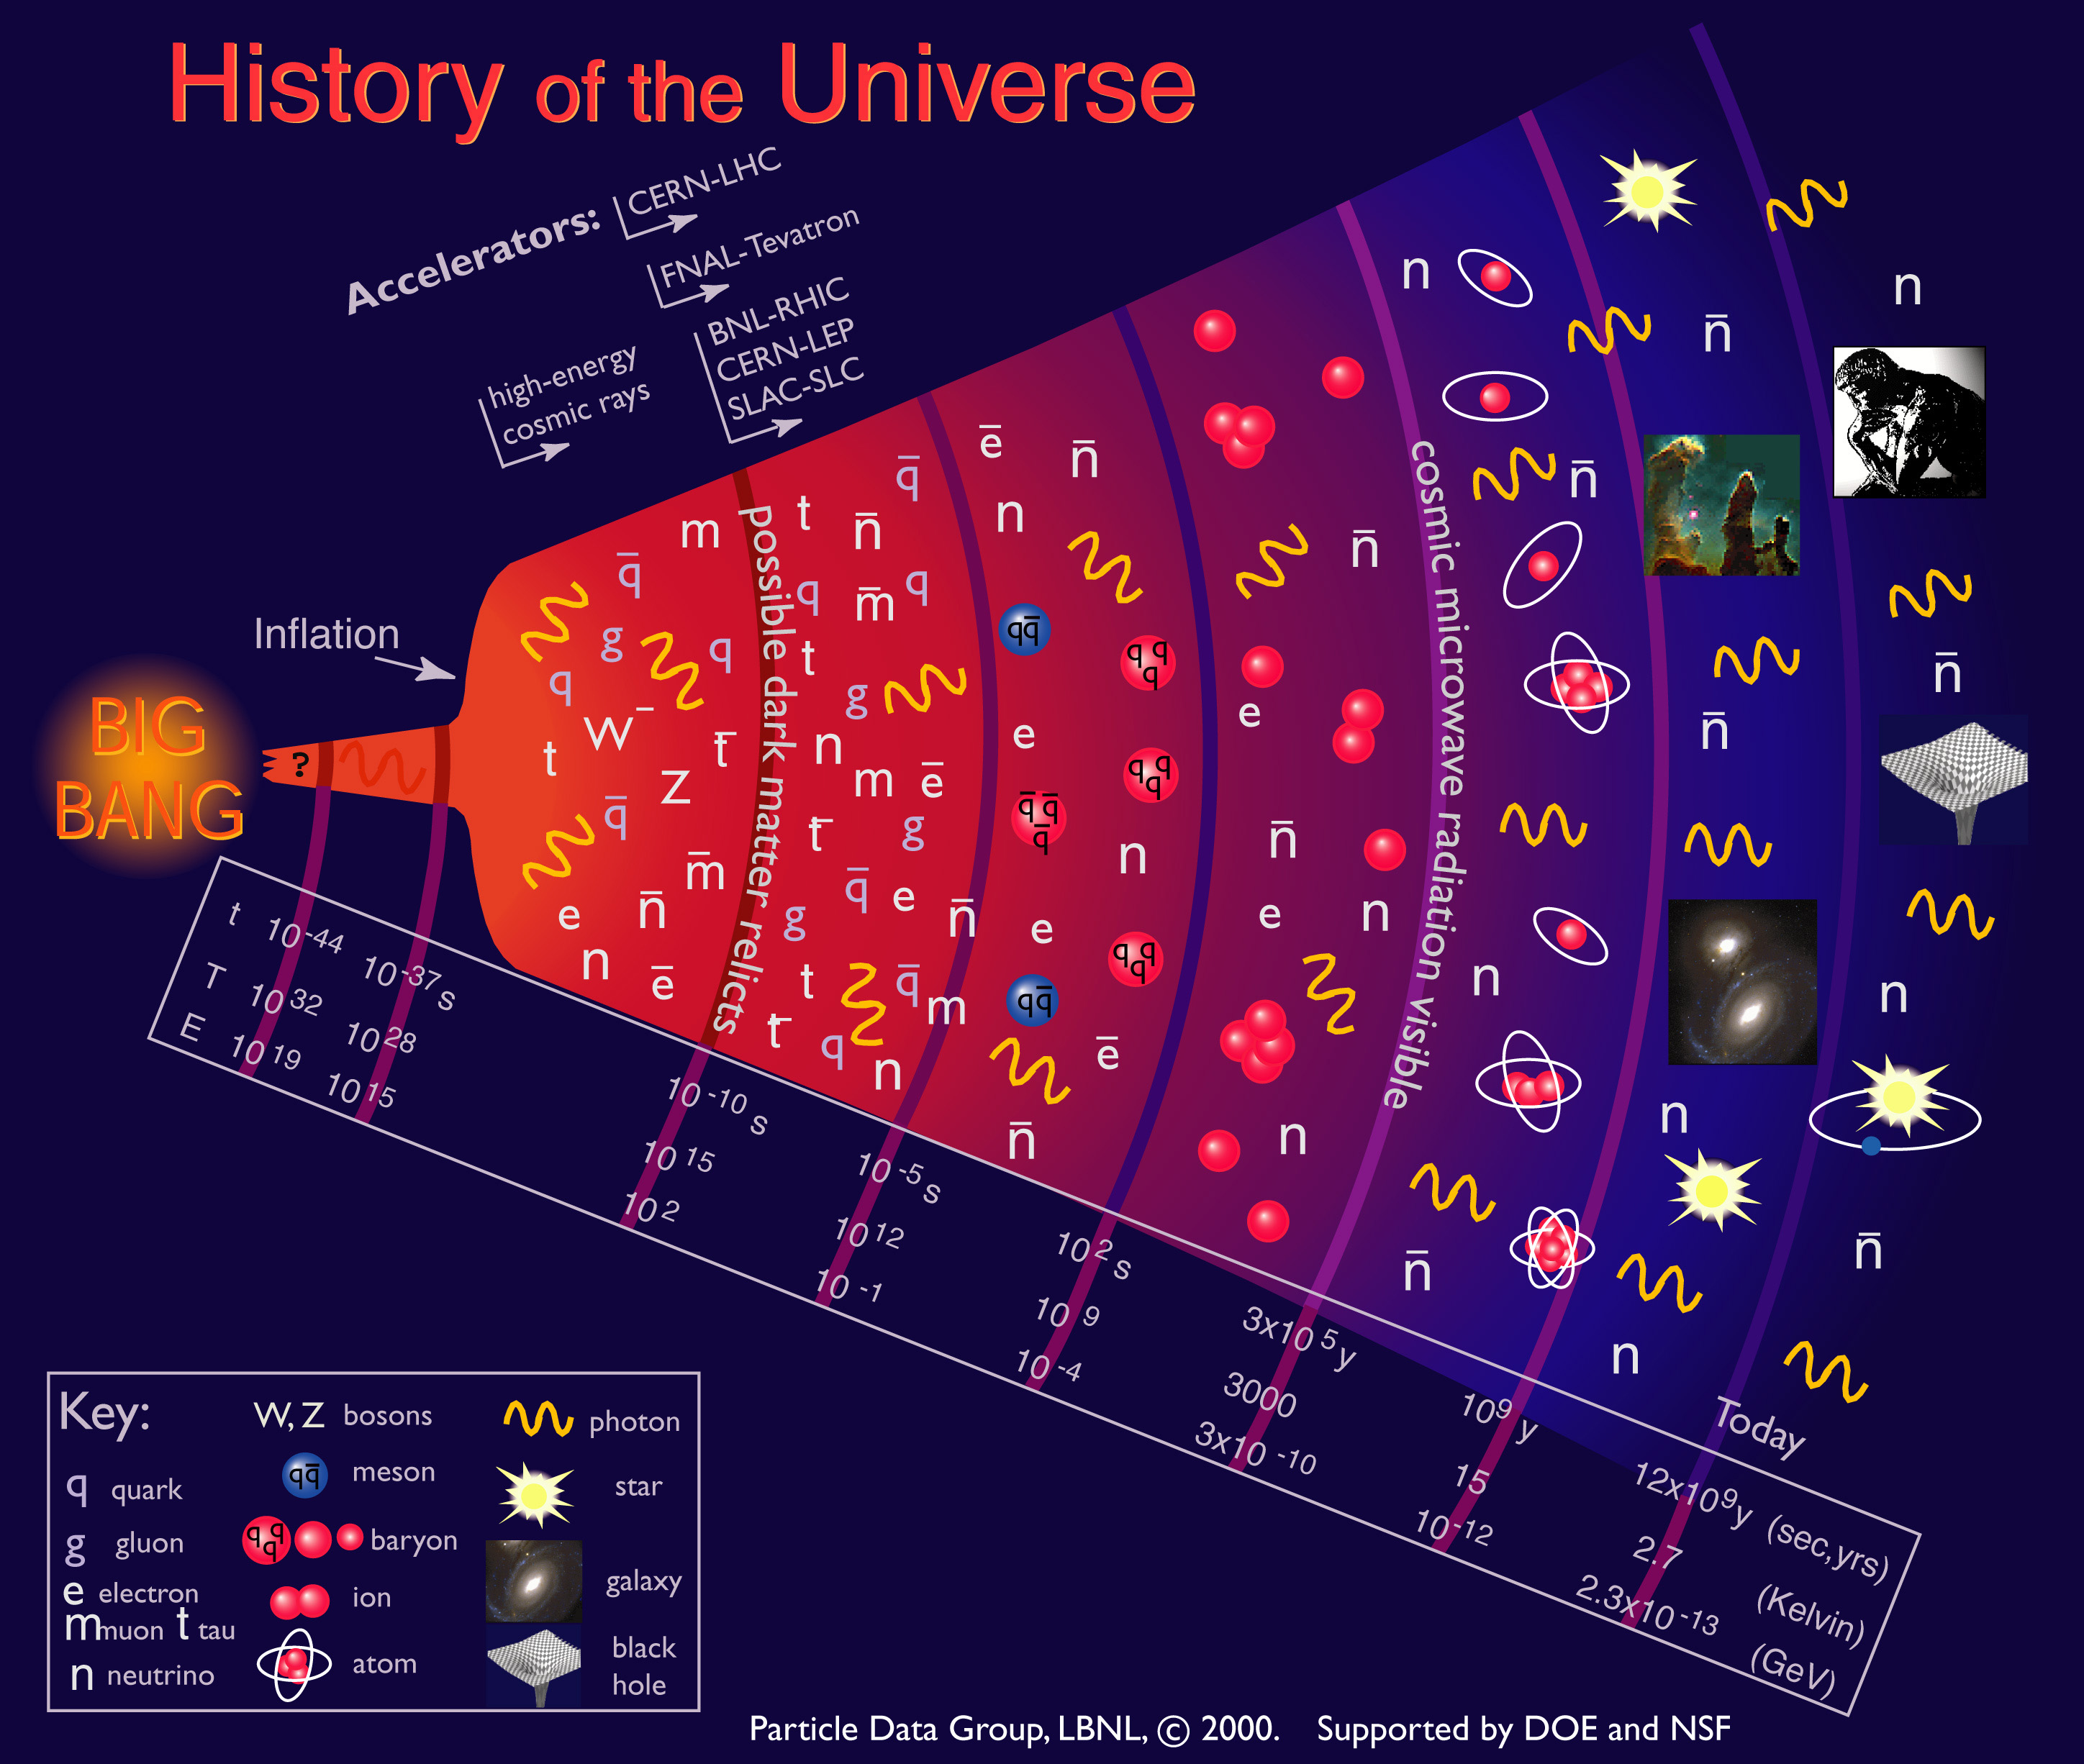
Evolution of Universe
3
30

Slide 4
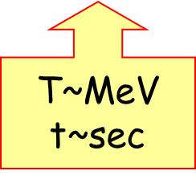
Evolution of Universe
4
30
T > MeV, Neutrinos are coupled with other particles through weak interactions
T < MeV, Neutrinos exit the thermal equilibrium system and begin to travel freely (CNB)

Slide 5

Evolution of Universe
5
30
T > eV, Neutrinos are still relativistic
T < eV, Neutrinos (at least 1 flavor) start transferring to non-relativistic
Massive Neutrinos participate the LSS formation at late time of Universe

Slide 6
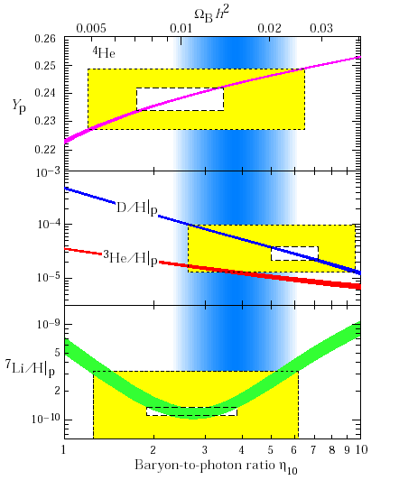
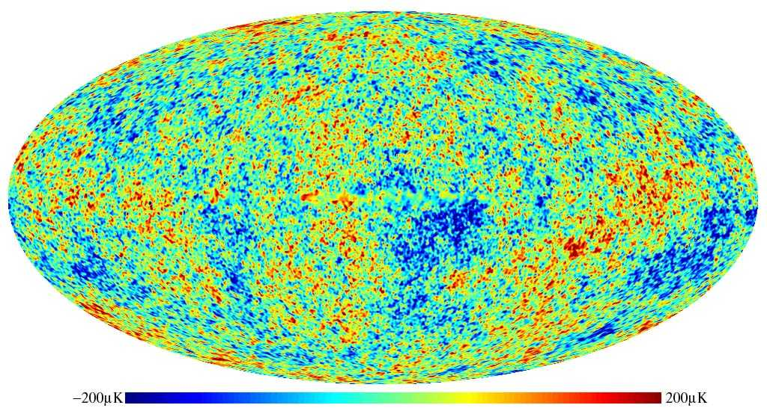
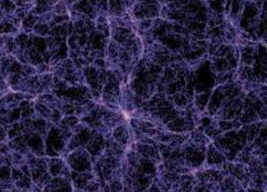
Effects of Neutrino
6
30
BBN
CMB
LSS
T ~ MeV
T < eV
N_{eff}
N_{eff} & m_{ν}

Slide 7
Effects of Neutrino
7
30
BBN
CMB
LSS
T ~ MeV
T < eV
N_{eff}
N_{eff} & m_{ν}

Slide 8
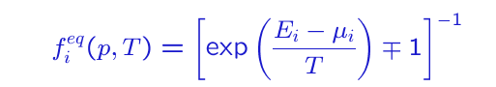

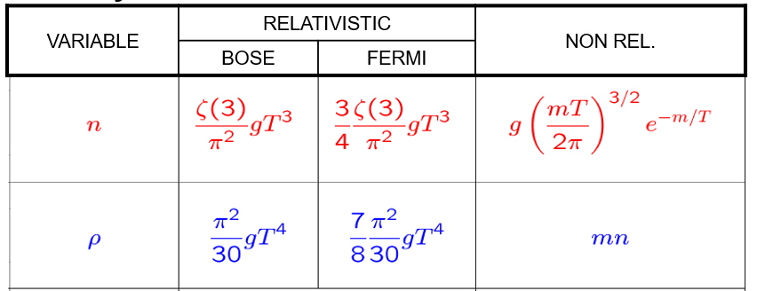
Thermal Equilibrium
8
30
At early Universe, all particles are in thermal equilibrium and their Bose/Fermi distribution functions are:

Slide 9
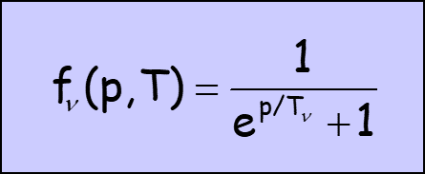
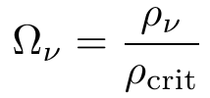
Cosmic Neutrino Background
9
30
Neutrinos decoupled at T ~ MeV, keeping a spectrum as that of a relativistic species
Number density（~112cm⁻³ per flavor）
Energy density
massless
massive

Slide 10
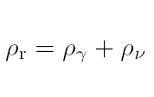

Relativistic Particles in Universe
10
30
At this stage, the radiation content of Universe contains
N_{eff}, effective number of relativistic neutrino-like particles
If considering the non-instantaneous decoupling, N_{eff} = 3.046
N_{eff} directly effect the expansion of Universe,

Slide 11
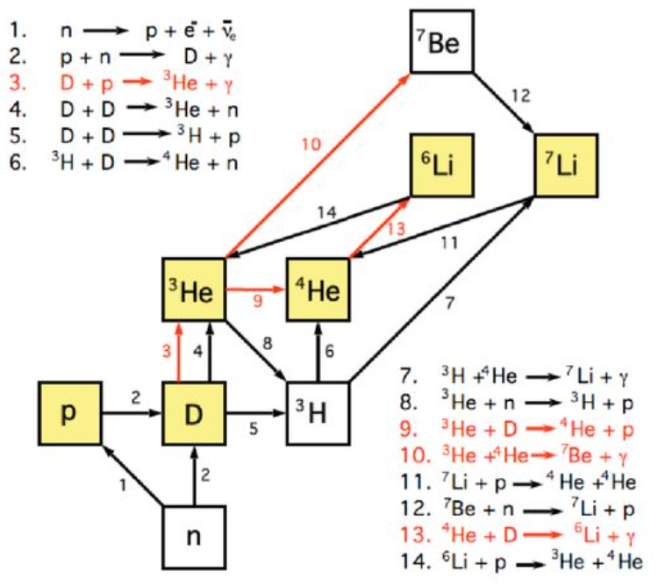
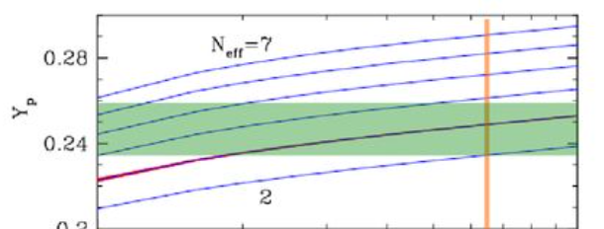

Primordial Nucleosynthesis
11
30
The BBN begins with the formation of Deuterium. Nearly all the free neutrons end up bound in the most stable light element ⁴He
⁴He abundance (Y_{p}) strongly depends on the expansion rate of Universe
Its measurement can be used to constrain the N_{eff}

Slide 12


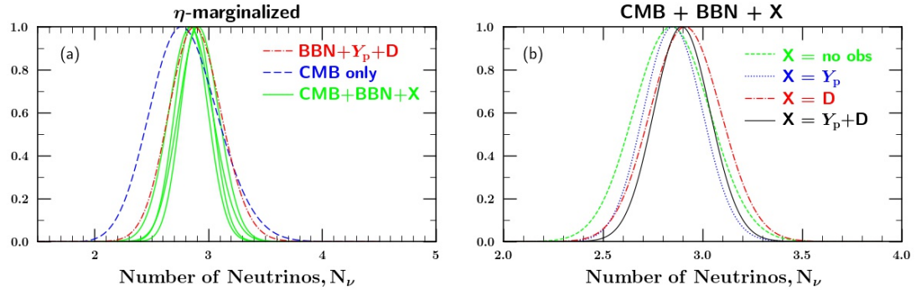
Recent Limits on N_{eff} (2207.13133)
12
30
Measurements of Y_{p} & [D/H] from BBN can give tight constraint
If including the Planck measurement from CMB further, we have

Slide 13
Effects of Neutrino
13
30
BBN
CMB
LSS
T ~ MeV
T < eV
N_{eff}
N_{eff} & m_{ν}

Slide 14
Cosmic Microwave Background
14
30
T ~ 0.1eV (z_{cmb} ~ 1100), free electrons were captured by protons to form the neutral hydrogen
The photon can travel freely, forming the CMB

Slide 15
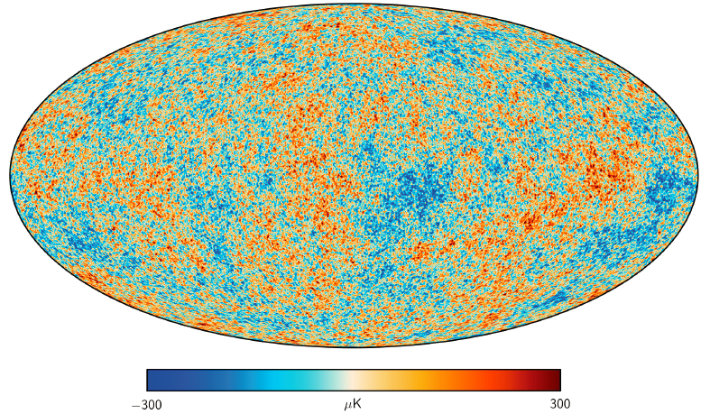
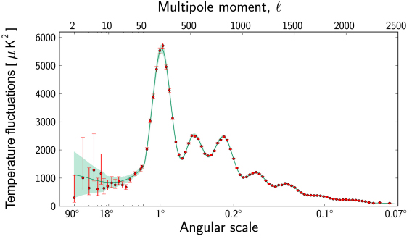




CMB Power Spectrum
15
30

Slide 16
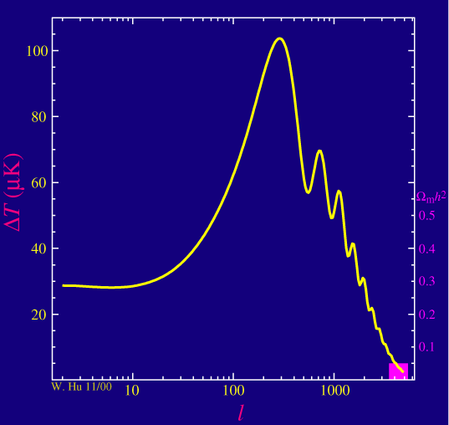
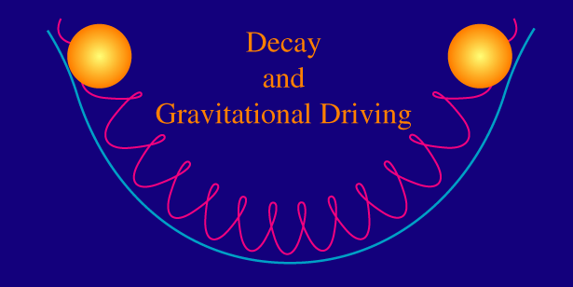
Early Integrated Sachs-Wolfe Effect
16
30
The time-variation of gravitational potentials which occurs during the radiation-dominated, but not during the matter-dominated era, and leads to an enhancement of PS

Slide 17
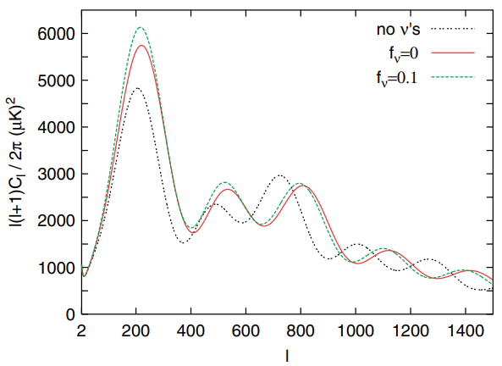
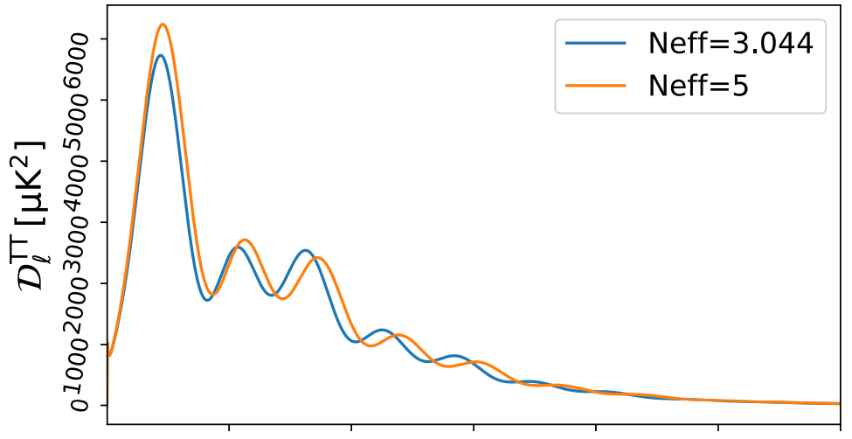
Effect of N_{eff}
17
30
The large value of N_{eff} will increase the energy density contributions of radiation. The effect of EISW will be enhanced.

Slide 18

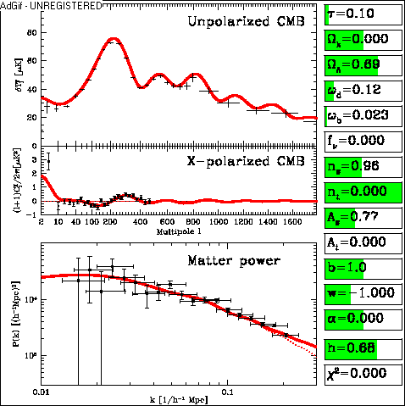

Matter/Radiation Equality
18
30
At z_{eq} ~ 3300, the energy density of matter and radiation are equal
For the massive Neutrino, f_{ν} > 0, it will delay the epoch of matter-radiation equality, which increases the energy density of radiation at z_{cmb}. The effect of EISW is enhanced further.

Slide 19
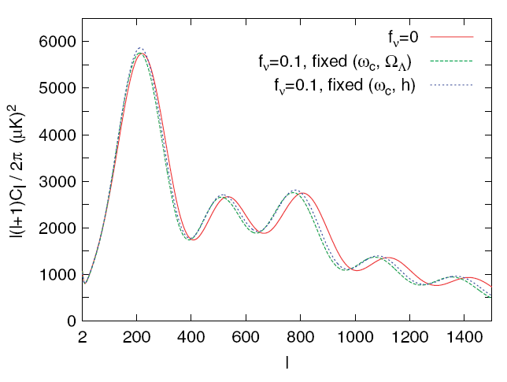
Degeneracies on CMB
19
30
Although these effects may suggest that the CMB is exquisitely sensitive to the neutrino mass, in practice, the shape of the CMB anisotropy spectra is governed by several parameters. Changing some of parameters can mimic the effects of Neutrino.
Latest constraints from Planck data
(1807.06209):

Slide 20
Effects of Neutrino
20
30
BBN
CMB
LSS
T ~ MeV
T < eV
N_{eff}
N_{eff} & m_{ν}

Slide 21
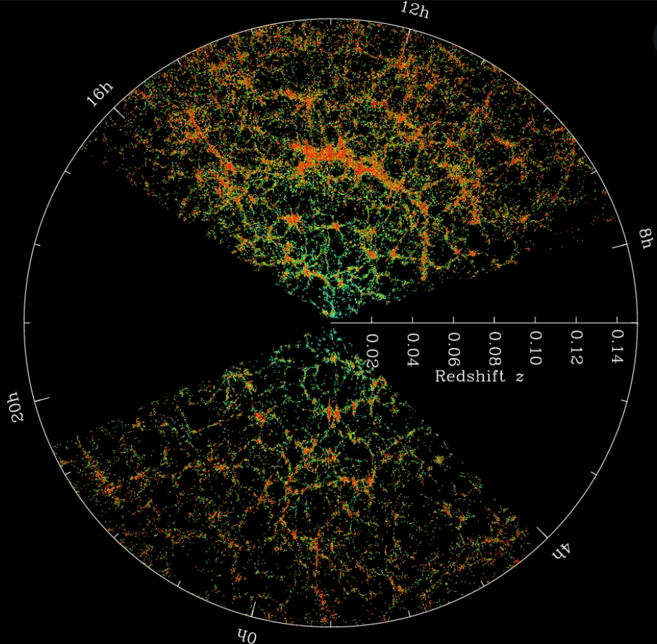




Large Scale Structure
21
30
In the late time of Universe, due to the gravitational instability, the fluctuations of energy density increase exponentially and finally form the observed large scale structure.

Slide 22
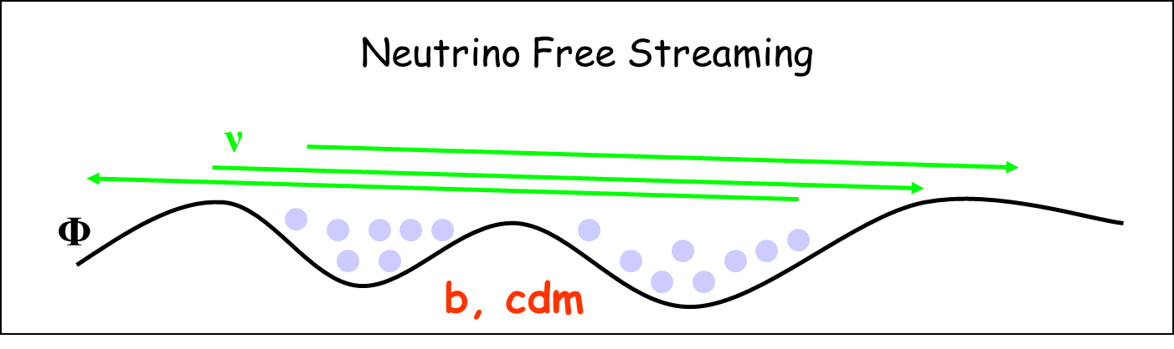
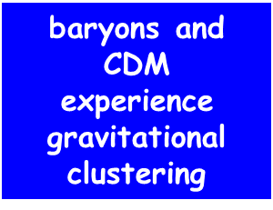
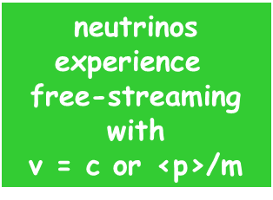
Effect of Massive Neutrino
22
30
Neutrinos cannot cluster as their thermal velocity exceeds the escape velocity of the gravitational potentials on small scales

Slide 23
Effect of Massive Neutrino
22
30
Neutrinos cannot cluster as their thermal velocity exceeds the escape velocity of the gravitational potentials on small scales

Slide 24

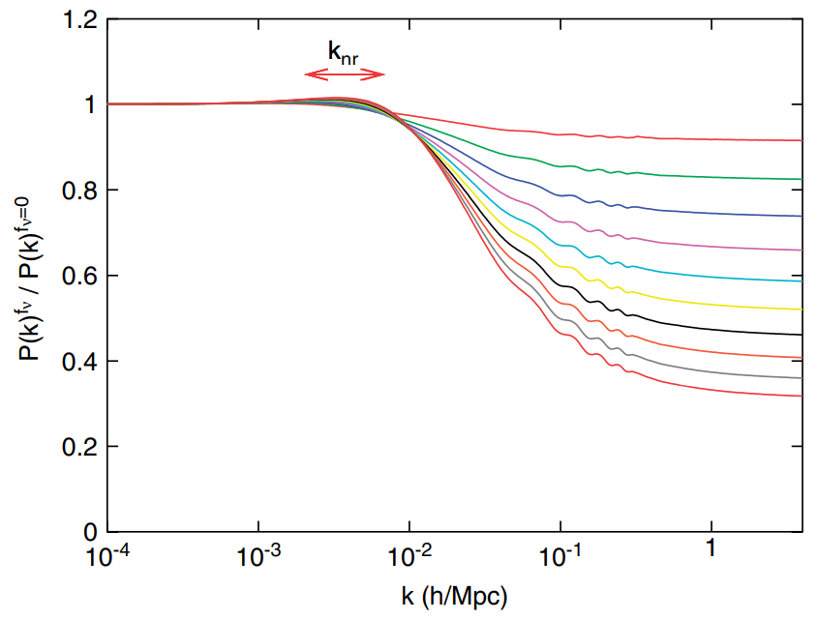

Suppression on PS
23
30
Due to the large thermal velocities, the clustering of Neutrino can only appear on scales below the neutrino free-streaming scale
For k > k_{fs}, the power spectrum
is subject to a scale-independent
reduction by a factor

Slide 25
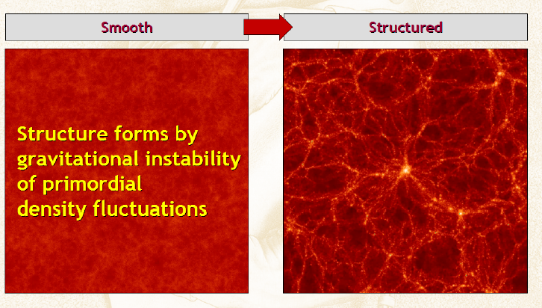
Hot Dark Matter
24
30

Slide 26
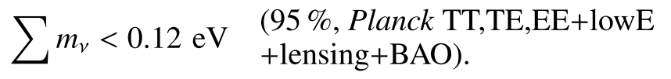


Limits on Neutrino before DESI DR2
25
30
Latest constraints from CMB and LSS measurements (1807.06209):
Tightest limit on the total Neutrino mass from the combination Planck+BAO+SNIa+RSD (2106.15267):

Slide 27
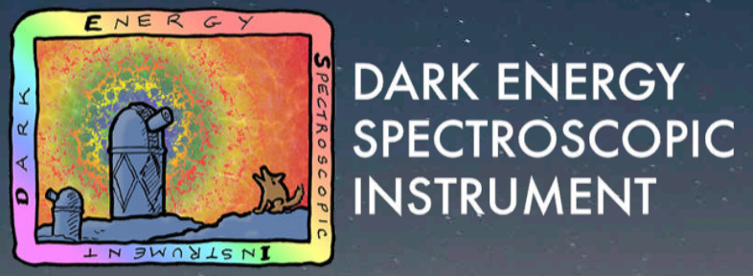
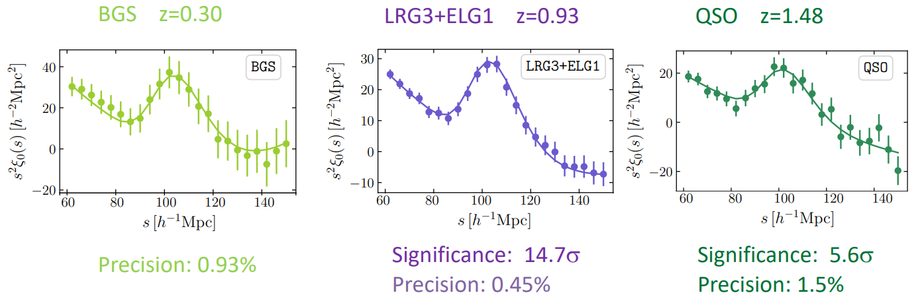
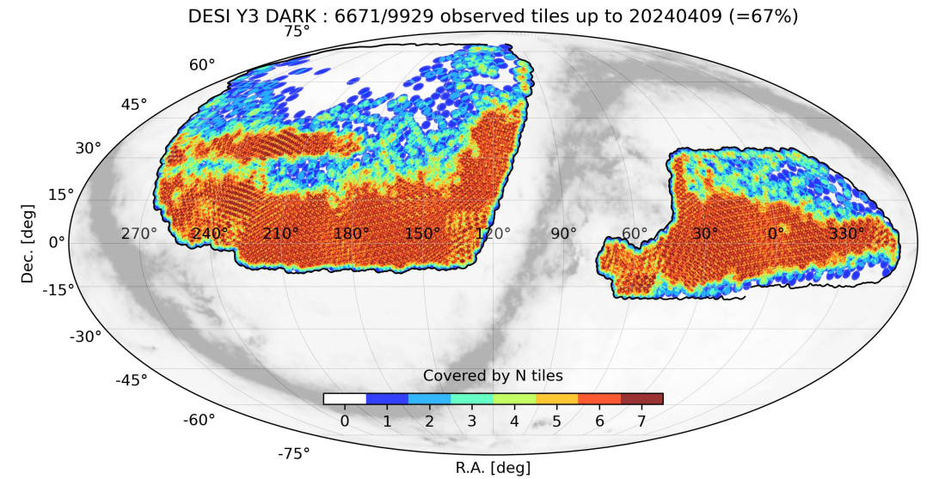
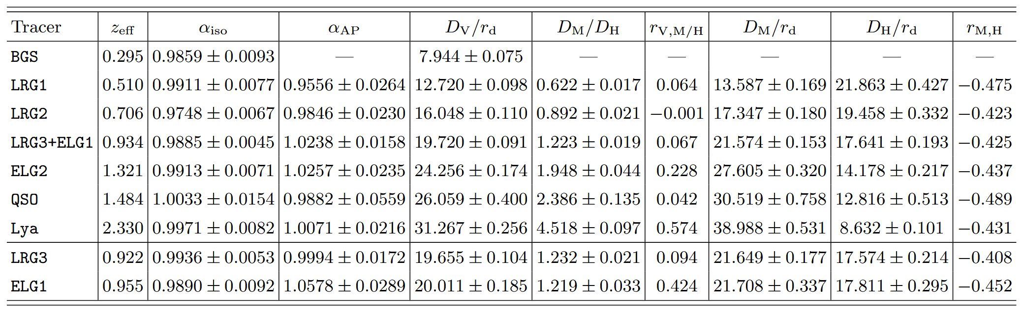
DESI DR2
26
30

Slide 28
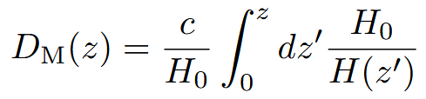


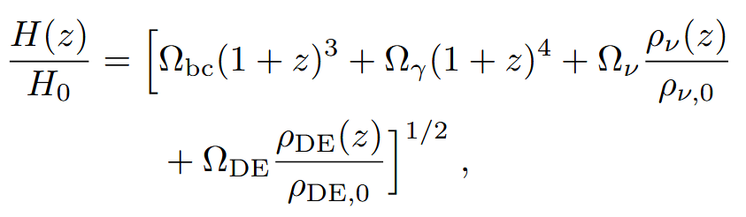
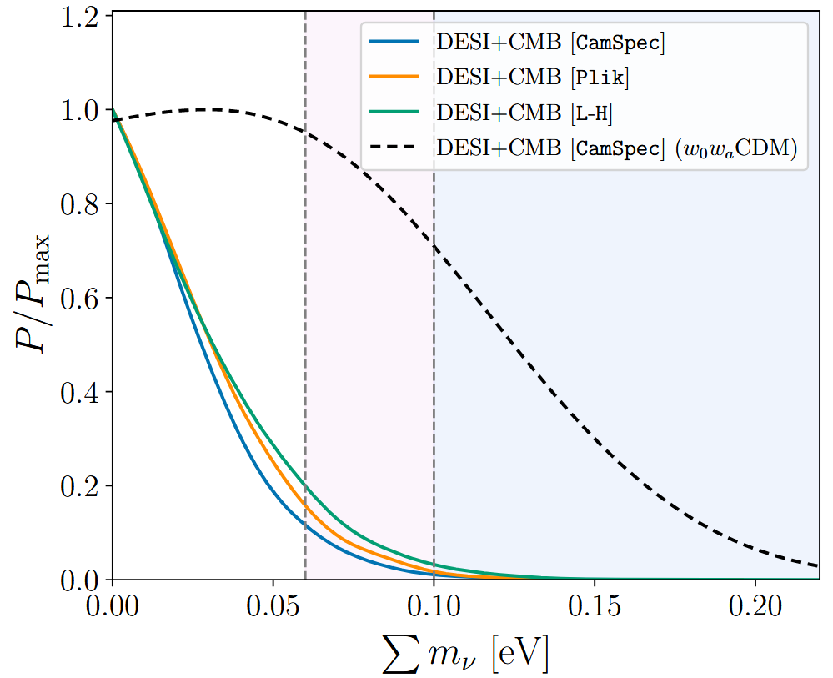
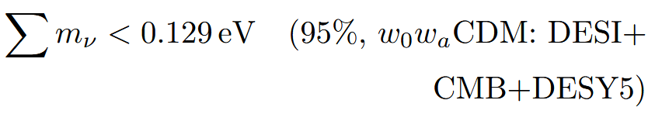
Limits from DESI DR2
27
30
Latest constraints from DESI DR2 BAO measurements (2503.14738):

Slide 29
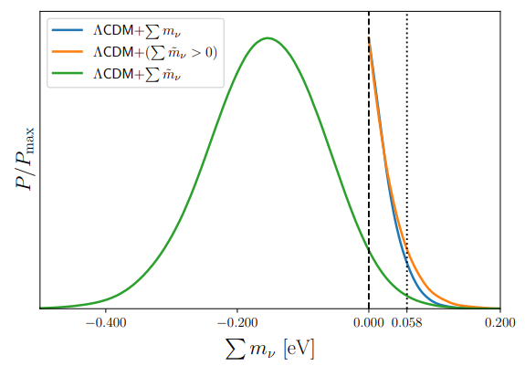
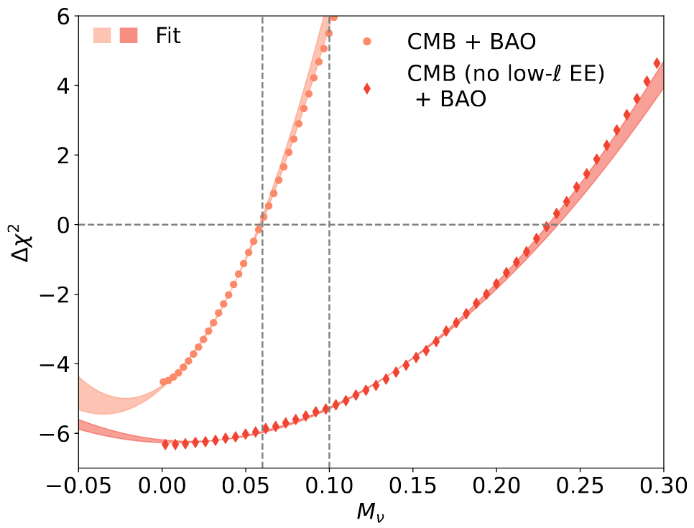
Negative Mass?
28
30
Possible degeneracies between Neutrino Mass and other cosmological parameters, like DE, optical depth, CMB lensing (2405.00836, 2504.21813)

Slide 30
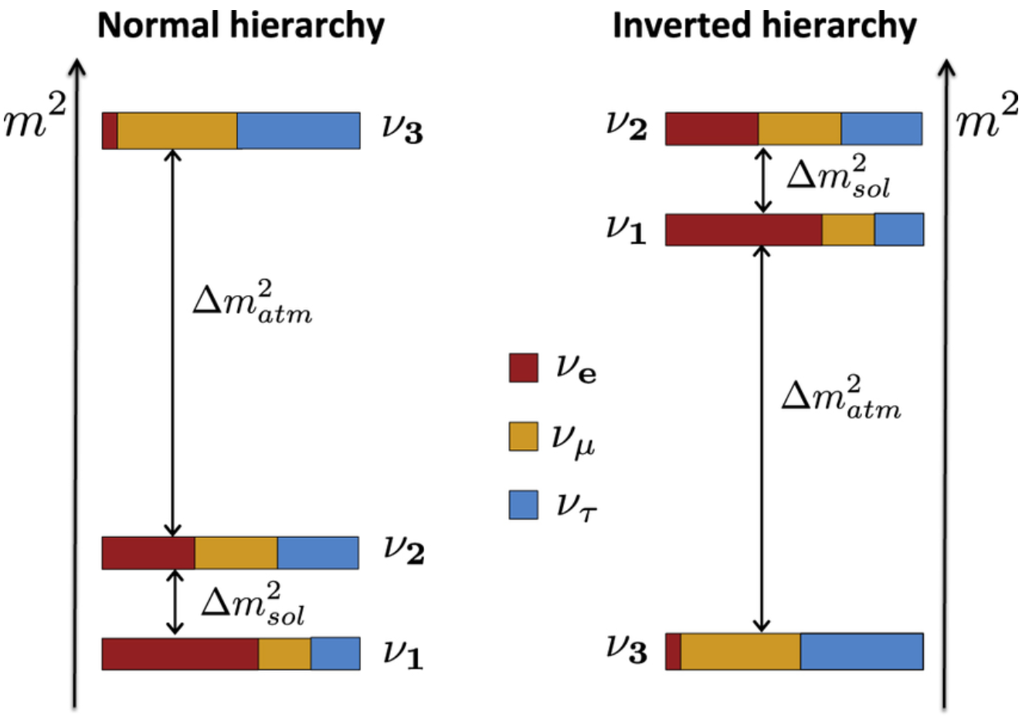
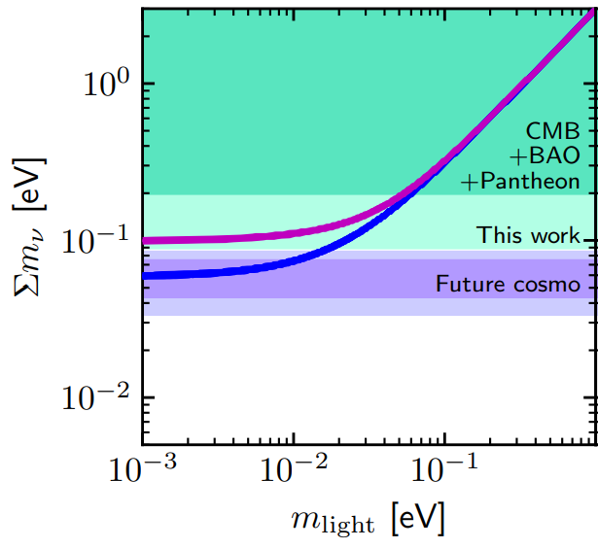



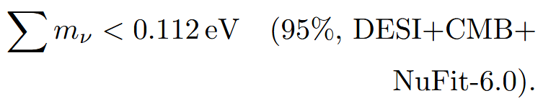
Neutrino Mass Ordering
29
30

Slide 31
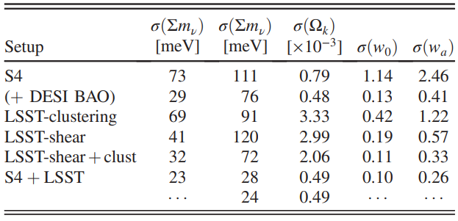
Future Perspective (1803.07561)
30
30
Besides the future CMB and LSS clustering, like CMB-S4 and LSST, there are some other complimentary observables:
CMB Lensing, Weak Lensing, Lyman-alpha Forests
Cosmic Voids: the only environment where the fraction of neutrinos over CDM + baryons can be large to boost the amplitude of the effect of neutrinos
(1903.05161)

Slide 32
中微子及相关新物理研讨会
NuPhyR
Thanks!

