Slide 1




Extracting particle mass on quantum computers: state preparation and measurement
Xiao-yang Wang (王啸洋)
RIKEN-iTHEMS (理化学研究所——数理创造研究中心)
collaborate with
Long Xiong, Xiao-xia Cai, Xiao Yuan
Yue-xin Su, Tong-yang Li
[arXiv:2504.12975]
[arXiv:2504.12896]
UCAS 雁栖湖 , Aug. 15

Slide 2
Main Content
Why quantum computer?
Procedures of extracting particle mass
Measurement without ancilla qubits
Performance guarantee of the state preparation
Conclusion and Outlook

Slide 3
Why quantum computer?
Many practical problems can be solve using quantum computers.
On classical computer, one can also use, e.g., Monte Carlo Algorithm.
3/44

Slide 4
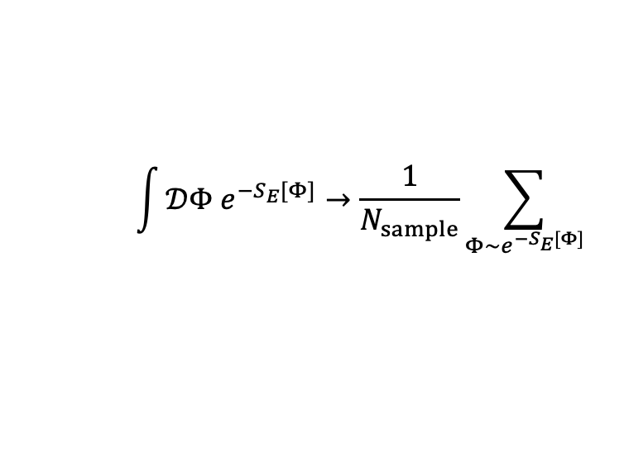



Why quantum computer?
Monte-Carlo Alg. performs the integration by sampling:
$$e^{{−iS}_{2}[Φ]}$$
$$\int{𝒟Φ e^{−S_{E}[Φ]}}→\frac{1}{N_{sample}}\sum_{Φ\sim e^{−S_{E}[Φ]}}{ }$$
Sign problem in Monte-Carlo algorithm.
$$Φ$$
$$e^{−S_{E}\left[Φ\right]}→e^{−S_{1}\left[Φ\right]}e^{−iS_{2}[Φ]}$$
4/44
Notes:
Monte Carlo-algorithm calculate this high-dimensional integration with boltzmann distribution by sample the configuration from the distribution
蒙特卡洛算法将计算具有玻尔兹曼分布的高维积分转化为针对此该概率分布的采样
然而在对玻尔兹曼分布进行采样时会遇到难以解决的符号问题
具体体现为玻尔兹曼分布中出现了复振幅。
而复振幅会随着Phi场的变化快速震荡
然而，很多我们关心的物理过程都出现了这样的复振幅

Slide 5
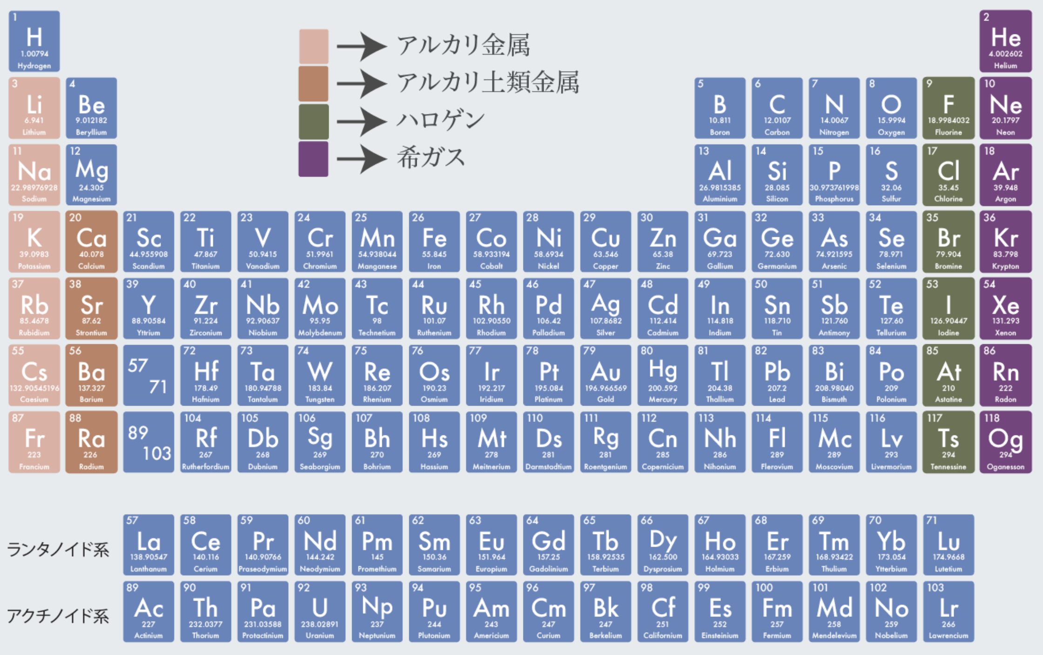
Why quantum computer?
Monte-Carlo Alg. performs the integration by sampling:
$$\int{𝒟Φ e^{−S_{E}[Φ]}}→\frac{1}{N_{sample}}\sum_{Φ\sim e^{−S_{E}[Φ]}}{ }$$
Sign problem in Monte-Carlo algorithm.
$$e^{−S_{E}\left[Φ\right]}→e^{−S_{1}\left[Φ\right]}e^{−iS_{2}[Φ]}$$
$$e^{−S_{E}\left[Φ\right]}→e^{−S_{1}\left[Φ\right]}e^{−iS_{2}[Φ]}$$
Real-time dynamics for thermalization and scattering
QCD phase diagram and particle mass
Strong-correlated systems with e-e interaction
…
5/44
Notes:
蒙特卡洛算法将计算具有玻尔兹曼分布的高维积分转化为针对此该概率分布的采样
然而在对玻尔兹曼分布进行采样时会遇到难以解决的符号问题
具体体现为玻尔兹曼分布中出现了复振幅。
而复振幅会随着Phi场的变化快速震荡
然而，很多我们关心的物理过程都出现了这样的复振幅

Slide 6

Why quantum computer?
Monte-Carlo Alg. performs the integration by sampling:
$$\int{𝒟Φ e^{−S_{E}[Φ]}}→\frac{1}{N_{sample}}\sum_{Φ\sim e^{−S_{E}[Φ]}}{ }$$
Sign problem in Monte-Carlo algorithm.
$$e^{−S_{E}\left[Φ\right]}→e^{−S_{1}\left[Φ\right]}e^{−iS_{2}[Φ]}$$
😀
Real-time dynamics for thermalization and scattering
QCD phase diagram and particle mass
Strong-correlated systems with e-e interaction
…
😱
$$Time \sim e^{A\left({2M}_{N}−3m_{π}\right)t}$$
6/44
Notes:
蒙特卡洛算法将计算具有玻尔兹曼分布的高维积分转化为针对此该概率分布的采样
然而在对玻尔兹曼分布进行采样时会遇到难以解决的符号问题
具体体现为玻尔兹曼分布中出现了复振幅。
而复振幅会随着Phi场的变化快速震荡
然而，很多我们关心的物理过程都出现了这样的复振幅

Slide 7
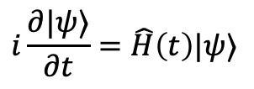
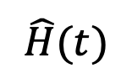

Why quantum computer?
Monte-Carlo Alg. performs the integration by sampling:
Possibility from quantum computers
$$\int{𝒟Φ e^{−S_{E}[Φ]}}→\frac{1}{N_{sample}}\sum_{Φ\sim e^{−S_{E}[Φ]}}{ }$$
QC use Hamiltonian, no sign problem.
$$S_{E}\left[Φ\right]$$
$$\hat{H}(t)$$
Sign problem in Monte-Carlo algorithm.
classical action
Hamiltonian
$$e^{−S_{E}\left[Φ\right]}→e^{−S_{1}\left[Φ\right]}e^{−iS_{2}[Φ]}$$
（non-Hermitian）
（Hermitian）
Natural real-time evolution
Real-time dynamics for thermalization and scattering
QCD phase diagram and particle mass
Strong-correlated systems with e-e interaction
…
$$i\frac{∂|ψ⟩}{∂t}=\hat{H}\left(t\right)|ψ⟩$$
✔️ No theoretical difficulties
How about this problem?
7/44
Notes:
蒙特卡洛算法将计算具有玻尔兹曼分布的高维积分转化为针对此该概率分布的采样
然而在对玻尔兹曼分布进行采样时会遇到难以解决的符号问题
具体体现为玻尔兹曼分布中出现了复振幅。
而复振幅会随着Phi场的变化快速震荡
然而，很多我们关心的物理过程都出现了这样的复振幅

Slide 8
Main Content
Why quantum computer?
Procedures of extracting particle mass
Measurement without ancilla qubits
Performance guarantee of the state preparation
Conclusion and Outlook

Slide 9
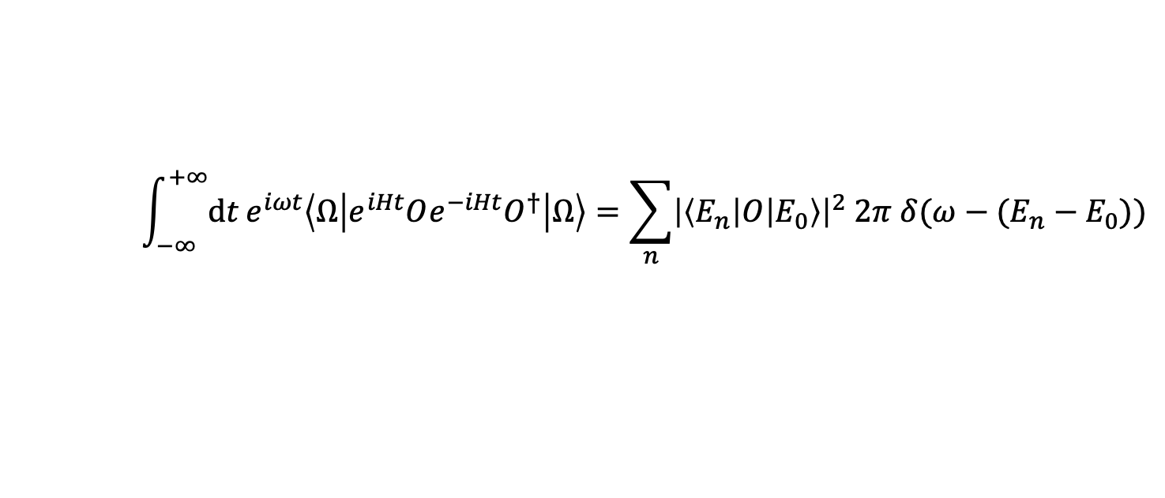
Extracting particle mass from correlation function
$$\int_{−∞}^{+∞}{dt}e^{iωt}\left\langle Ω\left|e^{iHt}Oe^{−iHt}O^{†}\right|Ω\right\rangle =\sum_{n}{{\left|\left\langle E_{n}\left|O\right|E_{0}\right\rangle \right|}^{2} 2π δ(ω−(E_{n}−E_{0}))}$$
real-time 2-point function
particle mass
9/44
Notes:
two-time correlation function evolved in time

Slide 10



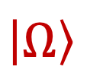
Extracting particle mass from correlation function
$$\int_{−∞}^{+∞}{dt}e^{iωt}\left\langle Ω\left|e^{iHt}Oe^{−iHt}O^{†}\right|Ω\right\rangle =\sum_{n}{{\left|\left\langle E_{n}\left|O\right|E_{0}\right\rangle \right|}^{2} 2π δ(ω−(E_{n}−E_{0}))}$$
$$\left\langle Ω\left|e^{iHt}Oe^{−iHt}O^{†}\right|Ω\right\rangle$$
$${\left|0\right\rangle }^{⊗N}$$
$${\left|Ω\right\rangle }^{ }$$
Model encoding
Quantum simulation
Measurement
Error mitigation
State preparation
10/44

Slide 11
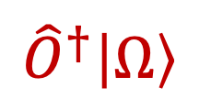

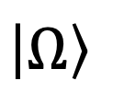
Extracting particle mass from correlation function
$$\int_{−∞}^{+∞}{dt}e^{iωt}\left\langle Ω\left|e^{iHt}Oe^{−iHt}O^{†}\right|Ω\right\rangle =\sum_{n}{{\left|\left\langle E_{n}\left|O\right|E_{0}\right\rangle \right|}^{2} 2π δ(ω−(E_{n}−E_{0}))}$$
$$\left\langle Ω\left|e^{iHt}Oe^{−iHt}O^{†}\right|Ω\right\rangle$$
$${\left|0\right\rangle }^{⊗N}$$
$${\left|Ω\right\rangle }^{ }$$
$${{\hat{O}}^{†}\left|Ω\right\rangle }^{ }$$
Model encoding
Quantum simulation
Measurement
Error mitigation
State preparation
11/44

Slide 12


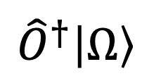
Extracting particle mass from correlation function
$$\int_{−∞}^{+∞}{dt}e^{iωt}\left\langle Ω\left|e^{iHt}Oe^{−iHt}O^{†}\right|Ω\right\rangle =\sum_{n}{{\left|\left\langle E_{n}\left|O\right|E_{0}\right\rangle \right|}^{2} 2π δ(ω−(E_{n}−E_{0}))}$$
$$\left\langle Ω\left|e^{iHt}Oe^{−iHt}O^{†}\right|Ω\right\rangle$$
$${\left|0\right\rangle }^{⊗N}$$
$${\left|Ω\right\rangle }^{ }$$
$${{\hat{O}}^{†}\left|Ω\right\rangle }^{ }$$
$$e^{−iHt}$$
Model encoding
Quantum simulation
Measurement
Error mitigation
State preparation
12/44

Slide 13



Extracting particle mass from correlation function
$$\int_{−∞}^{+∞}{dt}e^{iωt}\left\langle Ω\left|e^{iHt}Oe^{−iHt}O^{†}\right|Ω\right\rangle =\sum_{n}{{\left|\left\langle E_{n}\left|O\right|E_{0}\right\rangle \right|}^{2} 2π δ(ω−(E_{n}−E_{0}))}$$
$$\left\langle Ω\left|e^{iHt}Oe^{−iHt}O^{†}\right|Ω\right\rangle$$
$$⟨\hat{O}⟩$$
$${\left|0\right\rangle }^{⊗N}$$
$${\left|Ω\right\rangle }^{ }$$
$${{\hat{O}}^{†}\left|Ω\right\rangle }^{ }$$
$$e^{−iHt}$$
Model encoding
Quantum simulation
Measurement
Error mitigation
State preparation
13/44

Slide 14


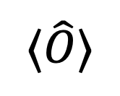
Extracting particle mass from correlation function
$$\int_{−∞}^{+∞}{dt}e^{iωt}\left\langle Ω\left|e^{iHt}Oe^{−iHt}O^{†}\right|Ω\right\rangle =\sum_{n}{{\left|\left\langle E_{n}\left|O\right|E_{0}\right\rangle \right|}^{2} 2π δ(ω−(E_{n}−E_{0}))}$$
$$\left\langle Ω\left|e^{iHt}Oe^{−iHt}O^{†}\right|Ω\right\rangle$$
$$sin (E_{n}−E_{0})t$$
$$⟨\hat{O}⟩$$
$${\left|0\right\rangle }^{⊗N}$$
$${\left|Ω\right\rangle }^{ }$$
$${{\hat{O}}^{†}\left|Ω\right\rangle }^{ }$$
[This talk]
$$e^{−iHt}$$
3
1
2
Model encoding
Quantum simulation
Measurement
Error mitigation
State preparation
14/44

Slide 15
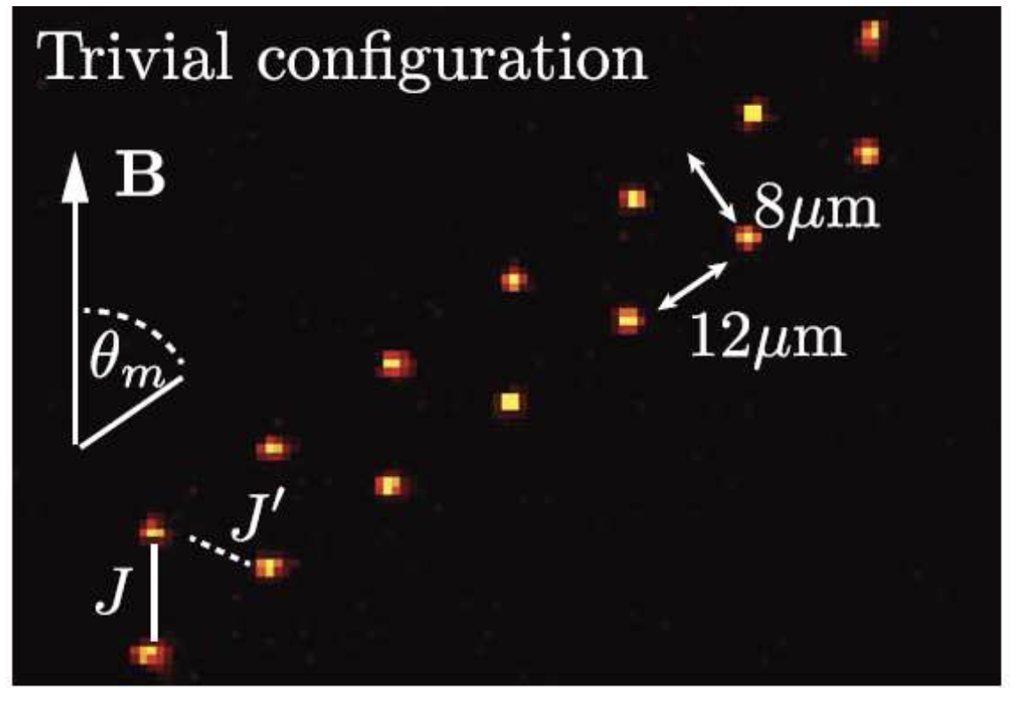

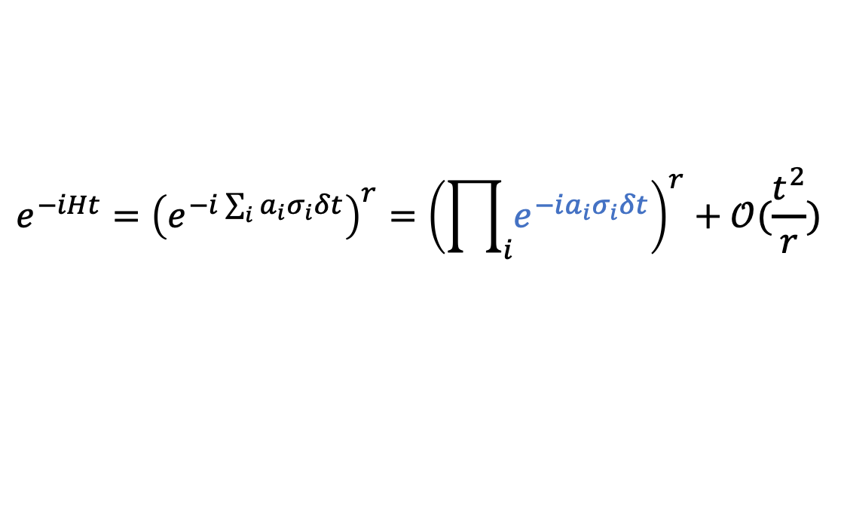

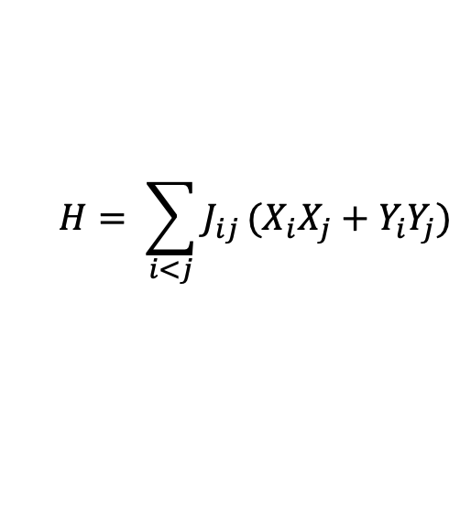
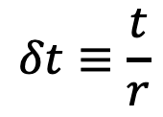
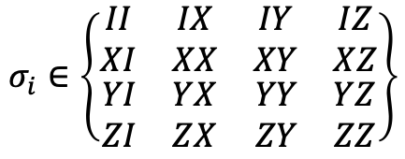
Time evolution on quantum computers
Analog quantum simulation: Construct a system that resemble $H$.
e.g. Rydberg atom array resembles Heisenberg $XY$ model:
$$H= \sum_{i<j}^{ }{J_{ij}}(X_{i}X_{j}+Y_{i}Y_{j})$$
[Problem-specific]
[De Léséleuc et. al. Science 2019]
$$e^{−iHt}$$
Digital quantum simulation: Trotter decomposition
[Universal]
$$e^{−iHt}={\left(e^{−i\sum_{i}{a_{i}σ_{i}}δt}\right)}^{r}={\left(\prod_{i}{e^{−ia_{i}σ_{i}δt}}\right)}^{r}+𝒪(\frac{t^{2}}{r})$$
$$δt≡\frac{t}{r}$$
$$σ_{i}∈\left\{\begin{matrix}\begin{matrix}II & IX \\ XI & XX\end{matrix} & \begin{matrix}IY & IZ \\ XY & XZ\end{matrix} \\ \begin{matrix}YI & YX \\ ZI & ZX\end{matrix} & \begin{matrix}YY & YZ \\ ZY & ZZ\end{matrix}\end{matrix}\right\}$$
Decomposed into Pauli gates and $CNOT$.
15/44

Slide 16









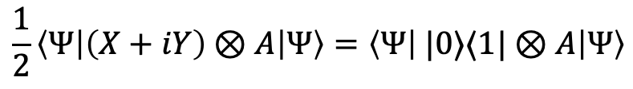



Correlation function using Hadamard test
To measure
$$\left\langle φ\left|A\left(t\right)B(0)\right|φ\right\rangle =\left\langle φ\left|e^{iHt}Ae^{−iHt}B\right|φ\right\rangle \sim$$
complex
whereas QC can only measure expectation like:
real
$$\left\langle φ\left|U^{†}OU\right|φ\right\rangle \sim$$
Hadamard test: introduce an ancilla qubit
$$\frac{1}{2}\left\langle Ψ\left|\left(X+iY\right)⊗A\right|Ψ\right\rangle =\left\langle Ψ\left| |0⟩⟨1|⊗A\right|Ψ\right\rangle$$
$$|0⟩$$
$$H$$
$$X/Y$$
$$=\left\langle φ\left| e^{iHt}A e^{−iHt}B\right|φ\right\rangle$$
$$|φ⟩$$
$$B$$
$$e^{−iHt}$$
$$A$$
complex
$$x+iy=z \sim$$
$$\left|0\right\rangle ⊗\left|φ\right\rangle +|1⟩⊗\left|φ\right\rangle$$
$$\left|0\right\rangle ⊗\left|φ\right\rangle +|1⟩⊗B\left|φ\right\rangle$$
$$\left|Ψ\right\rangle =\left|0\right\rangle ⊗e^{−iHt}\left|φ\right\rangle +|1⟩⊗e^{−iHt}B\left|φ\right\rangle$$
16/25
Notes:
We have to measure the real part and imaginary part separately. This is what the Hadamard test do
The expectation of X time A is real part. Y time A is imaginary part

Slide 17

Correlation function using Hadamard test
$n$-time correlation function can be measured by [J.S. Pedernals et. al. PRL (2014)]
$$U\left(t;t^{′}\right)≡e^{−iH(t−t^{′})}$$
Hadamard test: introduce an ancilla qubit
$$\frac{1}{2}\left\langle Ψ\left|\left(X+iY\right)⊗A\right|Ψ\right\rangle =\left\langle Ψ\left| |0⟩⟨1|⊗A\right|Ψ\right\rangle$$
$$|0⟩$$
$$H$$
$$X/Y$$
$$=\left\langle φ\left| e^{iHt}A e^{−iHt}B\right|φ\right\rangle$$
$$|φ⟩$$
$$B$$
$$e^{−iHt}$$
$$A$$
complex
$$x+iy=z \sim$$
$$\left|0\right\rangle ⊗\left|φ\right\rangle +|1⟩⊗\left|φ\right\rangle$$
$$\left|0\right\rangle ⊗\left|φ\right\rangle +|1⟩⊗B\left|φ\right\rangle$$
$$\left|Ψ\right\rangle =\left|0\right\rangle ⊗e^{−iHt}\left|φ\right\rangle +|1⟩⊗e^{−iHt}B\left|φ\right\rangle$$
17/25

Slide 18
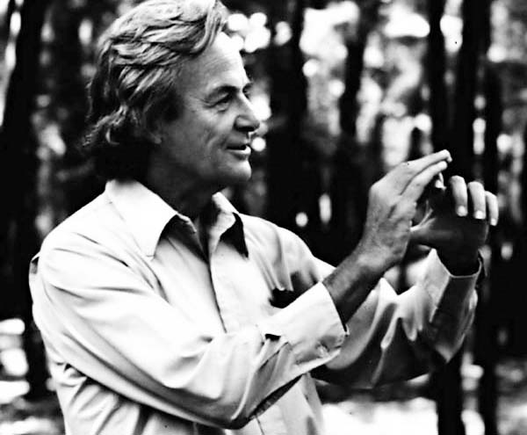
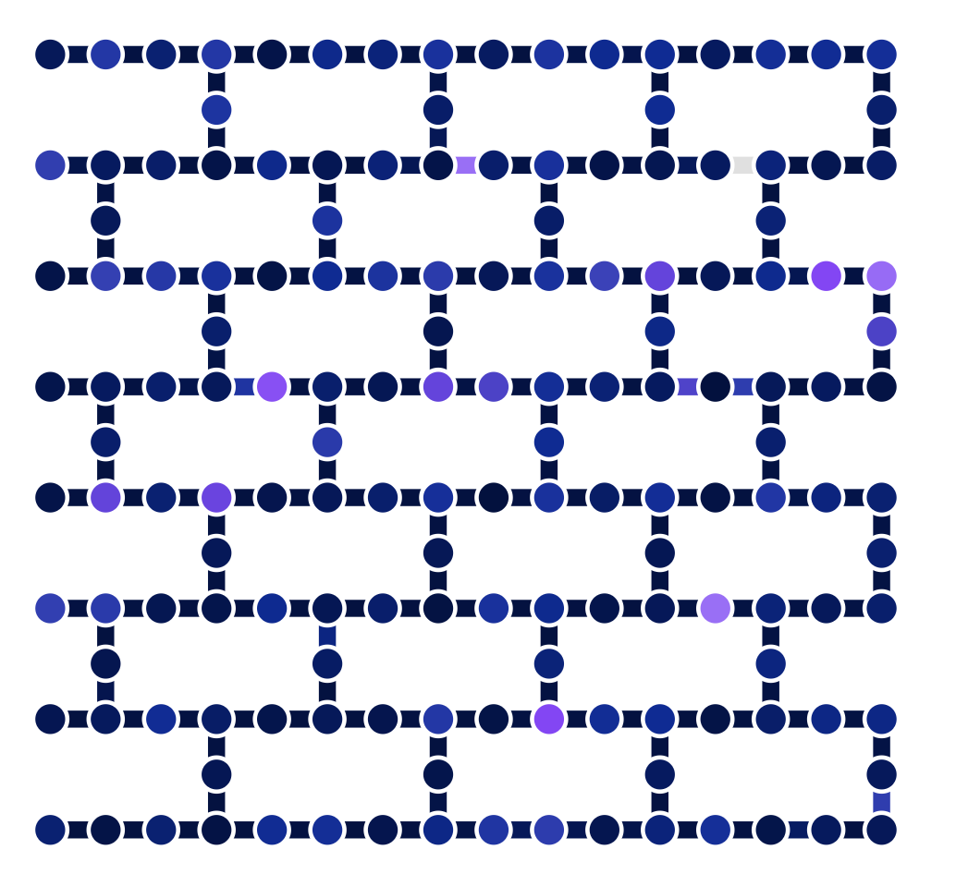
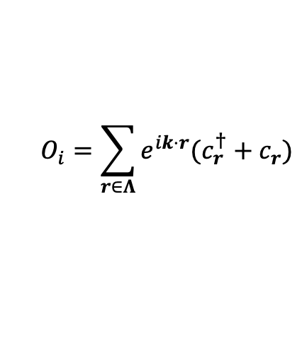
Correlation function using Hadamard test
$n$-time correlation function can be measured by [J.S. Pedernals et. al. PRL (2014)]
$$U\left(t;t^{′}\right)≡e^{−iH(t−t^{′})}$$
Challenges for near-term quantum computers:
Analog QC: The control operation is not straightforward to be realized in analog platforms.
If $O_{i}$ is applied on all spatial sites, the ancilla qubit should be connected
Digital QC:
with the entire system.
simulate nature with nature.
$$O_{i}=\sum_{r∈Λ}{e^{ik⋅r}(c_{r}^{†}+c_{r}^{ })}$$
Ancilla qubit is not natural.
The connectivity is limited!
18/25
Notes:
CNOT operation is digital, which is not compatible with the analog simulation

Slide 19
Main Content
Why quantum computer?
Procedures of extracting particle mass
Measurement without ancilla qubits
  method
  hardware demonstration
Performance guarantee of the state preparation
Conclusion and Outlook

Slide 20
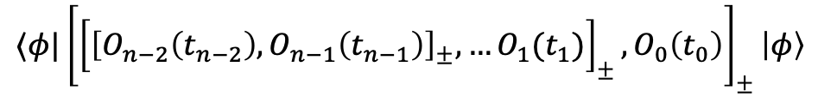






Correlation function without ancilla qubits
New method : To measure
$$⟨φ|{\left[{\left[{\left[O_{n−2}\left(t_{n−2}\right),O_{n−1}\left(t_{n−1}\right)\right]}_{±},…O_{1}(t_{1})\right]}_{±},O_{0}\left(t_{0}\right)\right]}_{±}\left|φ\right\rangle$$
${\left[⋅\right]}_{−}$: commutator;
${\left[⋅\right]}_{+}$: anti-commutator
$$U\left(t;t^{′}\right)≡e^{−iH(t−t^{′})}$$
$$e^{−iO_{j}τ_{j}}$$
: Real-time evolution of $O_{j}$.
$$\frac{e^{−O_{j}τ_{j}}}{\sqrt{⟨ψ\left|e^{−2τ_{j}O_{j}}\right|ψ⟩}}$$
: Quantum imaginary-time evolution of $O_{j}$. [M. Motta et al. Nat. Phys. (2020)]
20/44

Slide 21


Correlation function without ancilla qubits
New method : To measure
$$⟨φ|{\left[{\left[{\left[O_{n−2}\left(t_{n−2}\right),O_{n−1}\left(t_{n−1}\right)\right]}_{±},…O_{1}(t_{1})\right]}_{±},O_{0}\left(t_{0}\right)\right]}_{±}\left|φ\right\rangle$$
${\left[⋅\right]}_{−}$: commutator;
${\left[⋅\right]}_{+}$: anti-commutator
$$U\left(t;t^{′}\right)≡e^{−iH(t−t^{′})}$$
Compared with Hadamard test:
$$e^{−iO_{j}τ_{j}}$$
: Real-time evolution of $O_{j}$.
$$\frac{e^{−O_{j}τ_{j}}}{\sqrt{⟨ψ\left|e^{−2τ_{j}O_{j}}\right|ψ⟩}}$$
: Quantum imaginary-time evolution of $O_{j}$. [M. Motta et al. Nat. Phys. (2020)]
21/25

Slide 22
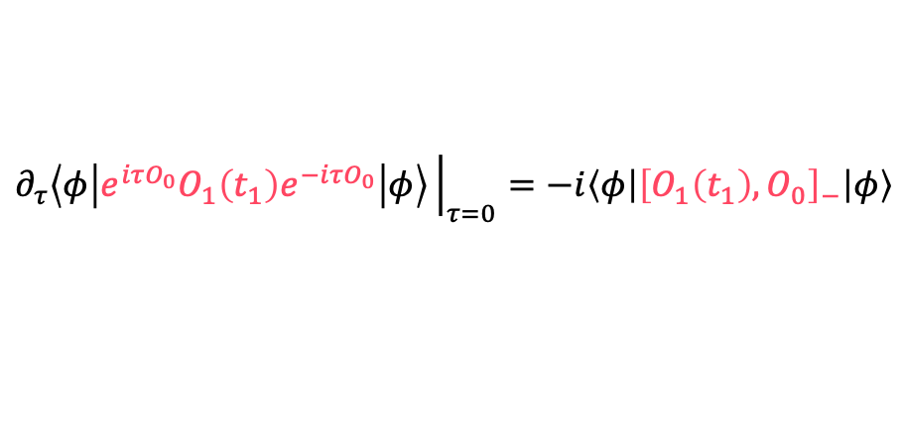

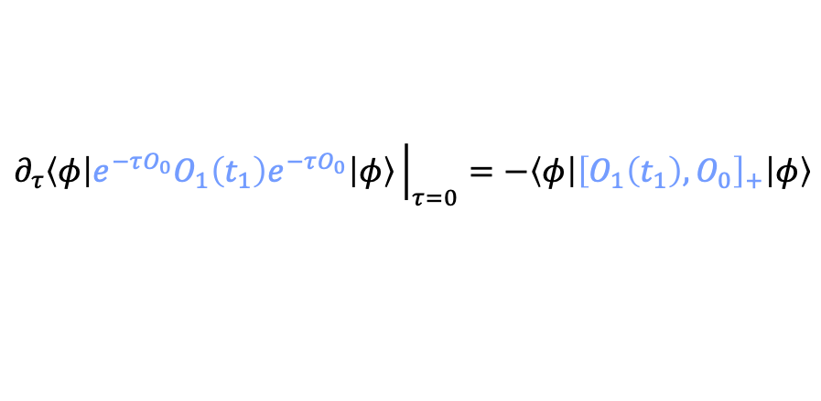
Correlation function without ancilla qubits
To measure 2-time correlation function:
$$\left\langle φ\left|{O_{1}\left(t_{1}\right)O}_{0}\right|φ\right\rangle$$
$$∂_{τ}\left\langle φ\left|e^{iτO_{0}}O_{1}\left(t_{1}\right)e^{−iτO_{0}}\right|φ\right\rangle {\left.​\right|}_{τ=0}=−i\left\langle φ\left|{\left[O_{1}\left(t_{1}\right), O_{0}\right]}_{−}\right|φ\right\rangle$$
$$∂_{τ}\left\langle φ\left|e^{−τO_{0}}O_{1}\left(t_{1}\right)e^{−τO_{0}}\right|φ\right\rangle {\left.​\right|}_{τ=0}=−\left\langle φ\left|{\left[O_{1}\left(t_{1}\right),O_{0}\right]}_{+}\right|φ\right\rangle$$
$$\left\langle φ\left|{\left[O_{1}\left(t_{1}\right), O_{0}\right]}_{−}\right|φ\right\rangle +\left\langle φ\left|{\left[O_{1}\left(t_{1}\right),O_{0}\right]}_{+}\right|φ\right\rangle =2\left\langle φ\left|{O_{1}\left(t_{1}\right)O}_{0}\right|φ\right\rangle$$
22/25
Notes:
The linear coefficient of the expectation corresponds to commutator of O0 and O1

Slide 23
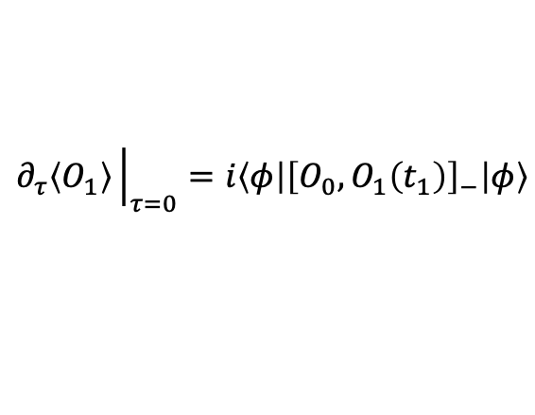
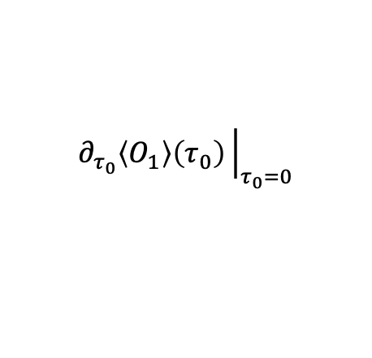

Correlation function without ancilla qubits
To measure 2-time correlation function:
$$\left\langle φ\left|{O_{1}\left(t_{1}\right)O}_{0}\right|φ\right\rangle$$
$$∂_{τ}\left\langle φ\left|e^{iτO_{0}}O_{1}\left(t_{1}\right)e^{−iτO_{0}}\right|φ\right\rangle {\left.​\right|}_{τ=0}=−i\left\langle φ\left|{\left[O_{1}\left(t_{1}\right), O_{0}\right]}_{−}\right|φ\right\rangle$$
$$∂_{τ}\left\langle φ\left|e^{−τO_{0}}O_{1}\left(t_{1}\right)e^{−τO_{0}}\right|φ\right\rangle {\left.​\right|}_{τ=0}=−\left\langle φ\left|{\left[O_{1}\left(t_{1}\right),O_{0}\right]}_{+}\right|φ\right\rangle$$
$$\left\langle φ\left|{\left[O_{1}\left(t_{1}\right), O_{0}\right]}_{−}\right|φ\right\rangle +\left\langle φ\left|{\left[O_{1}\left(t_{1}\right),O_{0}\right]}_{+}\right|φ\right\rangle =2\left\langle φ\left|{O_{1}\left(t_{1}\right)O}_{0}\right|φ\right\rangle$$
The partial derivative
can be evaluated accurately using parameter-shift rule.
The measurement circuit can be feasibly implemented on digital-analog quantum computers (DAQC).
$$∂_{τ}\left\langle O_{1}\right\rangle {\left.​\right|}_{τ=0}=i\left\langle φ\left|{\left[O_{0},O_{1}\left(t_{1}\right)\right]}_{−}\right|φ\right\rangle$$
[G. E. Crooks (2019)]
$$\left\langle O_{1}\right\rangle \left(τ=\frac{π}{4}\right)−\left\langle O_{1}\right\rangle \left(τ=−\frac{π}{4}\right)$$
$$∂_{τ_{0}}\left\langle O_{1}\right\rangle \left(τ_{0}\right){\left.​\right|}_{τ_{0}=0}$$
23/25
Notes:
The linear coefficient of the expectation corresponds to commutator of O0 and O1

Slide 24
Main Content
Why quantum computer?
Procedures of extracting particle mass
Measurement without ancilla qubits
  method
  hardware demonstration
Performance guarantee of the state preparation
Conclusion and Outlook

Slide 25
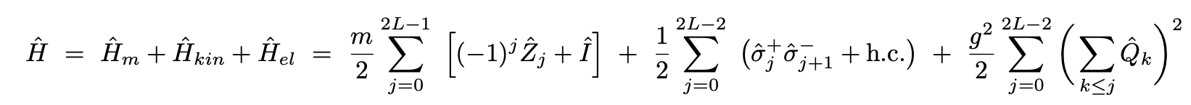

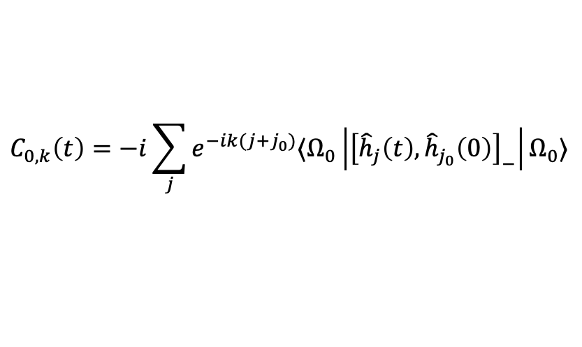
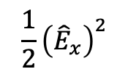




Hadron mass of Schwinger model
Schwinger model:
fermionic mass
kinematic term
electric energy
Lattice (12 qubits):
$$m{\overline{ψ}}_{x}ψ_{x}$$
$$−i{\overline{ψ}}_{x}{ γ}^{1}\left(∂_{1}−igA_{1}\right)ψ_{x}$$
$$\frac{1}{2}{\left({\hat{E}}_{x}\right)}^{2}$$
$${\hat{h}}_{j}={\overline{ψ}}_{j}{ γ}^{5}ψ_{j}$$
Our method
Hadamard test
measure 2-time correlation function:
$$C_{0,k}\left(t\right)=−i\sum_{j}{e^{−ik(j+j_{0})}⟨Ω_{0}\left|{\left[{\hat{h}}_{j}\left(t\right),{\hat{h}}_{j_{0}}\left(0\right)\right]}_{−}\right|Ω_{0}⟩}$$
Initial state:
Ground state of $H_{m}$:
$$\left|Ω_{0}\right\rangle =|0101…01⟩$$
25/25
Notes:
Our method can also be applied to bosonic spectrum

Slide 26


Hadron mass of Schwinger model
Schwinger model:
$${\hat{h}}_{j}={\overline{ψ}}_{j}{ γ}^{5}ψ_{j}$$
Fitting:
$${E(k)}_{ }^{2}={(m}_{h}c^{2})^{2}+{\left(ck\right)}^{2}$$
hardware demonstration on ibm_torino
Number of qubits: 12
low frequency
quantum noise
Low frequency quantum noise
Fourier transform
26/25

Slide 27
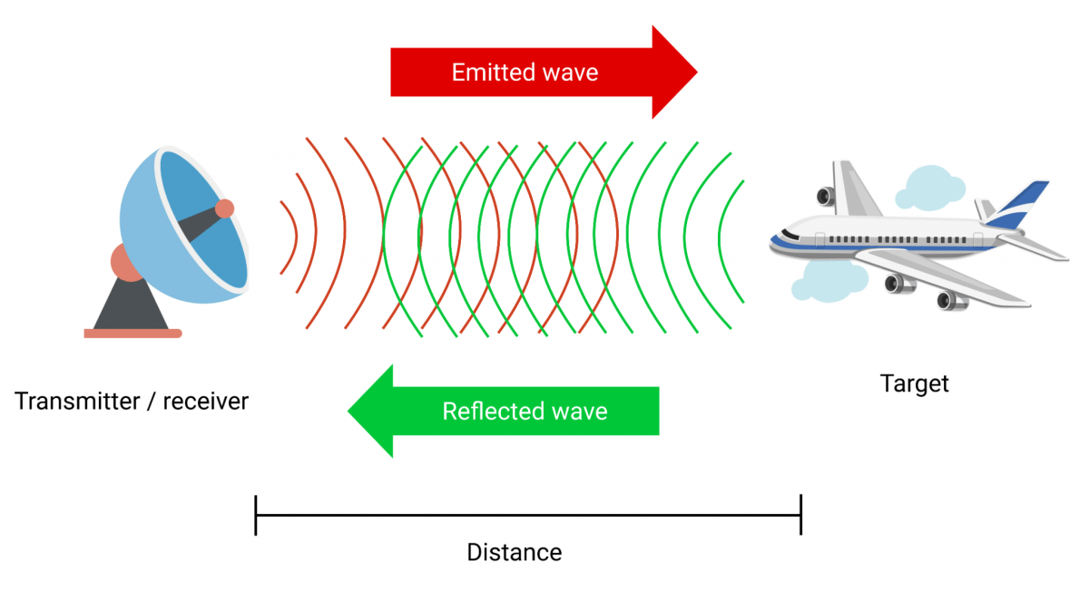
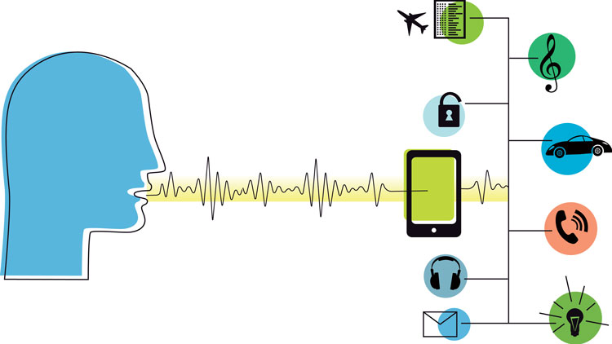
Classical signal processing
Speech signal processing
Radar signal processing
Signal processing
Prior knowledge:
Short-time signal is more reliable.
Noise is more random than signal.
27/25

Slide 28
Classical signal processing
A classical signal processing procedure:
Prior knowledge:
Short-time signal is more reliable.
Noise is more random than signal.
Signal filtering
Correlation analysis (CA)
28/25

Slide 29





Classical signal processing
ibm_torino results (12 qubits)
Noise reduced by
classical signal processing
Fourier transform
Hadron mass fitting results:
CA + filtering hadron mass:
$${E(k)}_{ }^{2}={(m}_{h}c^{2})^{2}+{\left(ck\right)}^{2}$$
$$m_{h}c^{2}=1.119\left(36\right)$$
relative error$=0.18\%$
noiseless Trotter results:
$$m_{h}c^{2}=1.117\left(24\right)$$
Exact:
29/25
$$m_{h}c^{2}=1.166$$

Slide 30

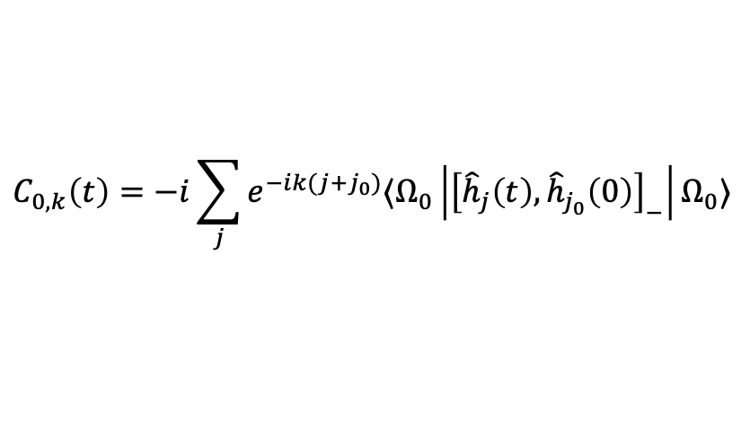
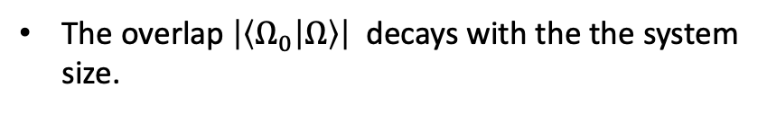
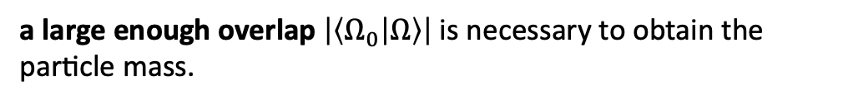

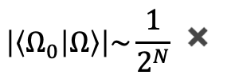

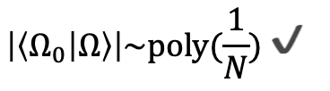
State preparation problem
measure 2-time correlation function:
$$C_{0,k}\left(t\right)=−i\sum_{j}{e^{−ik(j+j_{0})}⟨Ω_{0}\left|{\left[{\hat{h}}_{j}\left(t\right),{\hat{h}}_{j_{0}}\left(0\right)\right]}_{−}\right|Ω_{0}⟩}$$
Initial state:
bare vacuum:
$$\left|Ω_{0}\right\rangle =|0101…01⟩$$
true vacuum:
$$\left|Ω\right\rangle$$
a large enough overlap $\left|\left\langle Ω_{0} | Ω\right\rangle \right|$ is necessary to obtain the particle mass.
The overlap $\left|\left\langle Ω_{0} | Ω\right\rangle \right|$ decays with the the system size.
$$\left|\left\langle Ω_{0} | Ω\right\rangle \right|\sim const ✔️$$
$$\left|\left\langle Ω_{0} | Ω\right\rangle \right|\sim \frac{1}{2^{N}} ✖️$$
$$\left|\left\langle Ω_{0} | Ω\right\rangle \right|\sim poly(\frac{1}{N}) ✔️$$
Can we prepare the ground state accurately enough on QC?
30/44

Slide 31
Main Content
Why quantum computer?
Procedures of extracting particle mass
Measurement without ancilla qubits
Performance guarantee of the state preparation
  method
  hardware demonstration
Conclusion and Outlook

Slide 32


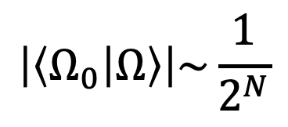
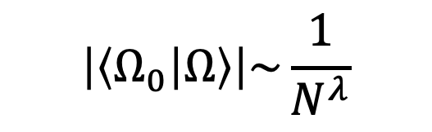
quantum state preparation algorithm
$$\left|\left\langle Ω_{0} | Ω\right\rangle \right|\sim \frac{1}{2^{N}}$$
$$\left|\left\langle Ω_{0} | Ω\right\rangle \right|\sim \frac{1}{N^{λ}}$$
Still a big gap from exponentially-vanishing overlap to polynomially-vanishing overlap.
Even without quantum noise!
32/44

Slide 33
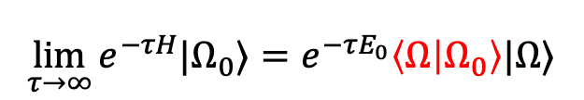
quantum state preparation algorithm
$$\left|\left\langle Ω_{0} | Ω\right\rangle \right|\sim \frac{1}{2^{N}}$$
$$\left|\left\langle Ω_{0} | Ω\right\rangle \right|\sim \frac{1}{N^{λ}}$$
(small)
(large)
SP Algorithm | Problem
Quantum adiabatic algorithm(QAA) | Require a large adiabatic gap.
Dissipative algorithm | Require a large Liouvillian gap.
Quantum imaginary time evolution(QITE) | Require a finite correlation length.
Imaginary time evolution(ITE) | Require large overlap with the initial state.
Variational quantum algorithm(VQA) | No large enough performance guarantee.
$$\lim_{τ→∞}{e^{−τH}|Ω_{0}⟩}=e^{−τE_{0}}\left\langle Ω | Ω_{0}\right\rangle |Ω⟩$$
33/44

Slide 34
quantum state preparation algorithm
$$\left|\left\langle Ω_{0} | Ω\right\rangle \right|\sim \frac{1}{2^{N}}$$
$$\left|\left\langle Ω_{0} | Ω\right\rangle \right|\sim \frac{1}{N^{λ}}$$
(small)
(large)
SP Algorithm | Problem
Quantum adiabatic algorithm(QAA) | Require a large adiabatic gap.
Dissipative algorithm | Require a large Liouvillian gap.
Quantum imaginary time evolution(QITE) | Require a finite correlation length.
Imaginary time evolution(ITE) | Require large overlap with the initial state.
Variational quantum algorithm(VQA) | No large enough performance guarantee.
No theoretical performance guarantee.
34/44

Slide 35
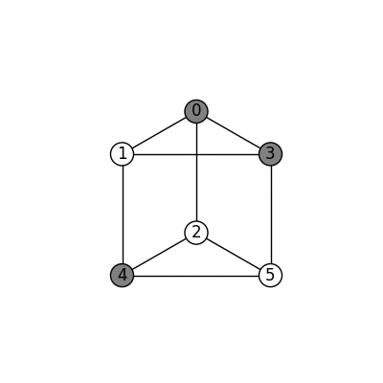







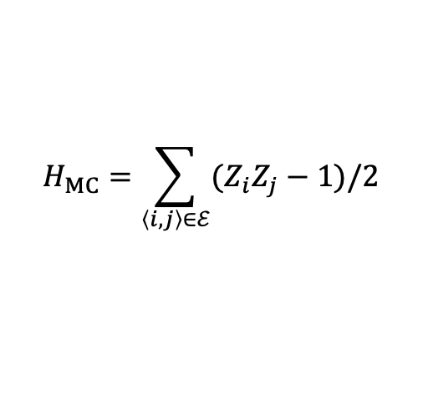

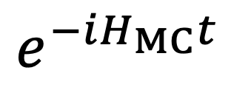
QAOA for MaxCut problem
MaxCut: Find a way to cut the maximum number of edges of a graph.
Ground state preparation of
$$H_{MC}=\sum_{\left\langle i,j\right\rangle ∈ℰ}{(Z_{i}Z_{j}−1)/2}$$
Quantum approximate optimization algorithm(QAOA):
$$e^{−iH_{MC}t}$$
$p$ rounds
$$|+⟩$$
$$|+⟩$$
$$e^{−iγ_{1}H}$$
$$e^{−iβ_{1}∑X}$$
$$e^{−iγ_{p}H}$$
$$e^{−iβ_{p}∑X}$$
$$|+⟩$$
$$|+⟩$$
35/44
Notes:
贫瘠高原现象是指从随机初始点开始优化过程制备基态。我们首先要计算梯度。而初始点的梯度会随着系统尺寸增加而指数减小。这导致梯度在量子计算机上无法精确计算

Slide 36
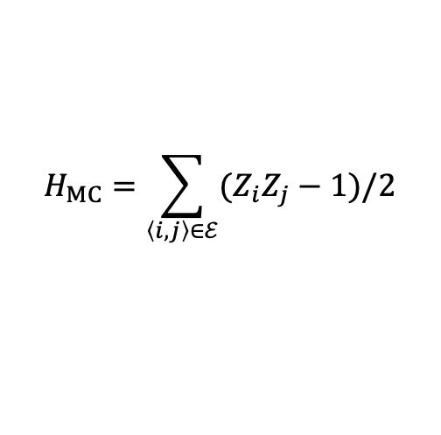
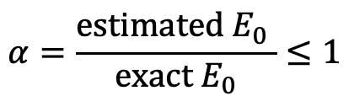
QAOA performance guarantee
QAOA has no large enough performance guarantee
characterized by approximation ratio:
$$α=\frac{estimated E_{0} }{exact E_{0}}≤1$$
$$H_{MC}=\sum_{\left\langle i,j\right\rangle ∈ℰ}{(Z_{i}Z_{j}−1)/2}$$
[J. Wurtz et.al. Phys. Rev. A 2021]
classical algorithm
Quantum approximate optimization algorithm(QAOA) :
$p$ rounds
$$|+⟩$$
$$|+⟩$$
$$e^{−iγ_{1}H}$$
$$e^{−iβ_{1}∑X}$$
$$e^{−iγ_{p}H}$$
$$e^{−iβ_{p}∑X}$$
$$|+⟩$$
$$|+⟩$$
36/44
Notes:
贫瘠高原现象是指从随机初始点开始优化过程制备基态。我们首先要计算梯度。而初始点的梯度会随着系统尺寸增加而指数减小。这导致梯度在量子计算机上无法精确计算

Slide 37


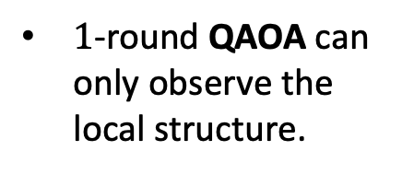
light-cone VQA for the MaxCut problem
$1$-round QAOA can only observe the local structure.
1-round light-cone VQA can observe the whole graph.
$R_{ZY}$ gate from imaginary time evolution:
$$e^{−τZZ}\left|++\right\rangle ∝e^{−iθ(τ)ZY}\left|++\right\rangle$$
[ X. Wang. et.al. Phys. Rev. A 2025]
37/44

Slide 38
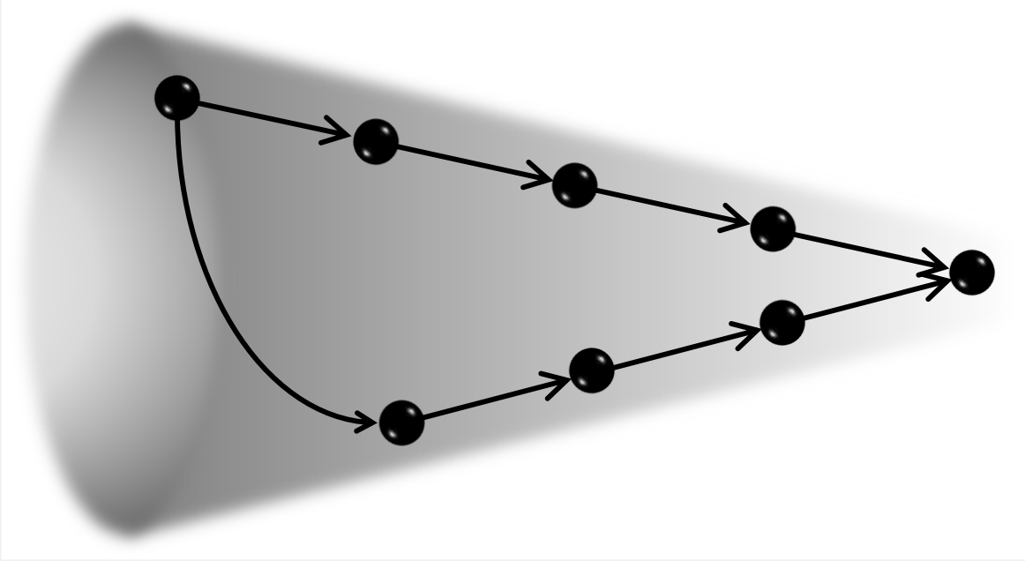

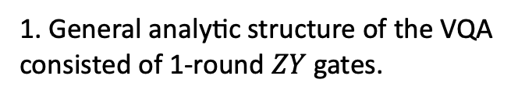






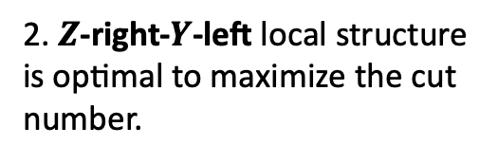










Optimality of the light-cone VQA
$$Z$$
2. $Z$-right-$Y$-left local structure is optimal to maximize the cut number.
Directed acyclic graph (DAG)
$$Y$$
$$q_{i} |+⟩$$
$$Z$$
✅
$$n_{L}^{Y_{i}},n_{L}^{Z_{i}}$$
$$n_{R}^{Y_{i}},n_{R}^{Z_{i}}$$
$$Y$$
$$Y$$
$$q_{i} |+⟩$$
$$Z_{i}$$
$$q_{j} |+⟩$$
$$Z_{j}$$
$$i$$
$$n_{L}^{Y_{j}},n_{L}^{Z_{j}}$$
$$n_{R}^{Y_{j}},n_{R}^{Z_{j}}$$
❌
$$j$$
$$k$$
$$k=n_{L}^{Y_{j}}+n_{L}^{Z_{j}}+n_{R}^{Y_{j}}+n_{R}^{Y_{i}}$$
1. General analytic structure of the VQA consisted of 1-round $ZY$ gates.
3. The directed graph should have no directed cycle.
4. The light-cone VQA has no directed cycle, thus is optimal.
38/44

Slide 39
light-cone VQA performance guarantee
Construction of the light-cone VQA for arbitrary graphs with time complexity $O(\# edges+\# nodes)$.
Performance guarantees of the light-cone VQA
[This work]
1-round light-cone VQA is better than 3-round QAOA.
39/44

Slide 40
Main Content
Why quantum computer?
Procedures of extracting particle mass
Measurement without ancilla qubits
Performance guarantee of the state preparation
  method
  numerical and hardware results
Conclusion and Outlook

Slide 41
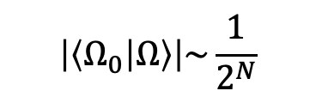

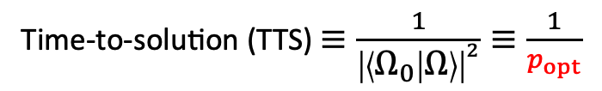


Noiseless simulation: exponential speed-up
$$\left|\left\langle Ω_{0} | Ω\right\rangle \right|\sim \frac{1}{2^{N}}$$
$$\left|\left\langle Ω_{0} | Ω\right\rangle \right|\sim \frac{1}{N^{λ}}$$
Time-to-solution (TTS) $≡\frac{1}{{\left|\left\langle Ω_{0} | Ω\right\rangle \right|}^{2}}≡\frac{1}{p_{opt}}$
✅
(for random 3-regular graphs)
heuristic
explanation
$$p_{opt}\sim N^{−2λ}$$
Light-cone ${VQA}_{1}$ solves random 3-regular graphs in polynomial time scaling, outperforming the exponential scaling of CPLEX and QAOA.
The exponential speed-up results from the light-cone structure.
41/44

Slide 42
hardware demonstration
72-qubit demonstration
ibm_fez
148-qubit demonstration
ibm_marrakesh
The 1-round light-cone VQA exceeds the known classical hardness threshold in both demonstrations, whereas QAOA does not.
The 1-round light-cone VQA is trained more efficiently than 3-round QAOA.

Slide 43
Main Content
Why quantum computer?
Procedures of extracting particle mass
Measurement without ancilla qubits
Performance guarantee of the state preparation
Conclusion and Outlook

Slide 44







Conclusion and Outlook
$$⟨\hat{O}⟩$$
$${\left|0\right\rangle }^{⊗N}$$
$${\left|Ω\right\rangle }^{ }$$
$${{\hat{O}}^{†}\left|Ω\right\rangle }^{ }$$
$$e^{−iHt}$$
Roadmap towards extracting particle mass on quantum computers using 2-time correlation functions.
Outlook
[This work]
larger $p$ ?
Performance of the light-cone VQA with large $p$?
Measure hadron spectrum to characterize chiral phase transition.
44/28
44/44

Slide 45



Chiral phase transition from hadron spectrum
NJL model
$$γ_{0}=Z, { γ}_{1}=−iY, { γ}_{5}=γ_{0}γ_{1}=−X$$
$$ℋ=\overline{ψ}\left(iγ_{1}∂_{1}+m\right)ψ−g{\left(\overline{ψ}ψ\right)}^{2}−μ\overline{ψ}γ_{0}ψ$$
$$ψ_{x}=\frac{1}{\sqrt{a}}\left(\begin{matrix}{\hat{f}}_{x,0} \\ {\hat{f}}_{x,1}\end{matrix}\right)$$
hopping term
mass term
interaction term
chemical potential
$$m_{h}$$
baryon density
Chiral phase transition point
Indication of chiral phase transition can be observed by the hadron spectrum

Slide 46
























































Collaborative
researchers
RIKEN Quantum: quantum computational science for basic research
①Physics
②Chemistry
③ Life
④Humanity
iTHEMS
Nomura (UCB)
https://rq.riken.jp/en/
⑤Comp. Science
All-RIKEN activity to foster breakthroughs in quantum computational science including people from
physics,
chemistry,
life sciences,
humanities,
computational science,
information science…
Hatsuda
(iTHEMS)
Isomura
(CBS)
AIP
Nakajima
(R-CCS)
Ozawa (FQSP)
Kimura
(RNC)
Aoki
(R-CCS)
Hiyama
(RNC)
Ito
(R-CCS)
Iriki
(iTHEMS)
Toyoizumi
(CBS)
⑥Info. Science
R-CCS
有田
(CEMS)
Hayata
(Keio)
Sugita
(PRI)
Yunoki
(PRI/RQC)
Seita
(iTHEMS)
Zhao
(AIP)
Quang
(AIP)
Hamazaki
(PRI)
Kawaguchi (Tokyo)
IBM
Quantinuum
PRI
RNC
CEMS
CBS
RQC
Shimizu
(Tsukuba)
Participating
researchers
Shirakawa
(R-CCS)
Sekino (PRI)
Doi (iTHEMS)
Chiu (iTHEMS)
Honda (iTHEMS)
Matsuura (iTHEMS)
Pathak
(R-CCS)
Wang (iTHEMS)
Le (iTHEMS)
Loetstedt (PRI)
Naito (RNC)
Yoshida (RNC)
Li (iTHEMS)
Researchers
Conducting
Collaborative
Research
proposals
Abe
(Keio)
S. Iso
(iTHEMS)
S. Fujii (TRIP)
Coordinator
Scientific Advisor
Kuwabara (Kyoto)
Medevielle
(Tokyo)
Pathak
(Kyoto)
Sugimoto (Keio)
Suzuki (NICT)
Taya
(Keio)
Terada
(nagoya)
Wang
(Keio)
Sakai
(Gakushuin)

Slide 47






Quantum Facilities at RIKEN
IBM Heron R2 “ibm_Kobe”*
(156 qubits)
RIKEN & Fujitsu QC **
(256 qubits)
Quantinuum H2 “黎明” ***
(20 qubits)
* https://www.riken.jp/pr/news/2025/20250624_1/index.html
** https://www.riken.jp/en/news_pubs/news/2025/20250422_1/index.html
*** https://www.quantinuum.com/press-releases/quantinuums-reimei-quantum-computer-now-fully-operational-at-riken-ushering-in-a-new-era-of-hybrid-quantum-high-performance-computing
Visit us!👉
Thanks for listening!
Notes:
We three available quantum chips collaborate with IBM, Fujitsu and quantinuum
You are welcome to visit and join us

Slide 48
谢谢！
Thanks for watching!

