Slide 1
Asteroid-mass soliton as the dark matter-baryon coincidence solution
arXiv:2504.08304v1
2025.08.14

Slide 2

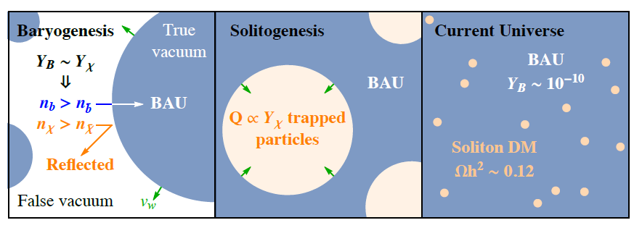
Motivation
Baryogenesis
Coincidence Problem:
Other Problems like: Neutrino mass, first-order phase transition…
Dark Matter

Slide 3





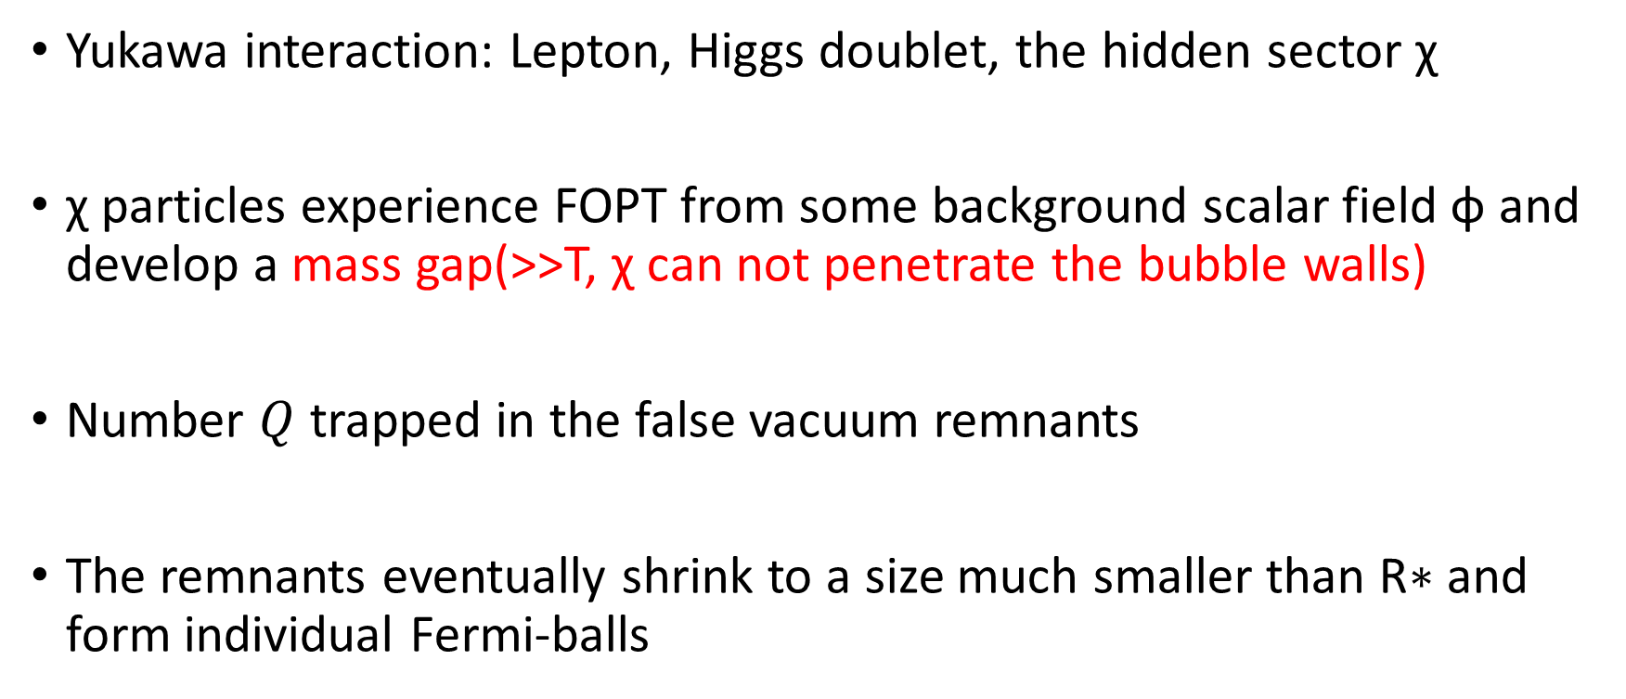
Coincident Fermi-ball DM
A similar size of lepton asymmetry and χ asymmetry
Yukawa interaction: Lepton, Higgs doublet, the hidden sector χ
χ particles experience FOPT from some background scalar field ϕ and develop a mass gap(>>T, χ can not penetrate the bubble walls)
Number $Q$ trapped in the false vacuum remnants
The remnants eventually shrink to a size much smaller than R∗ and form individual Fermi-balls

Slide 4


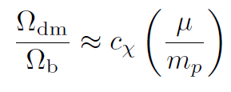



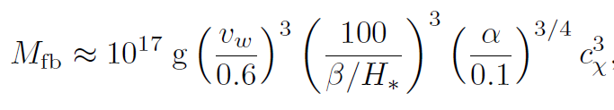
Coincident Fermi-ball DM
Energy ratio
χ mass
$V_{0}$ the free energy difference between the true and false vacua
O(1) coefficient
Proton mass
Degrees of freedom 80

Slide 5
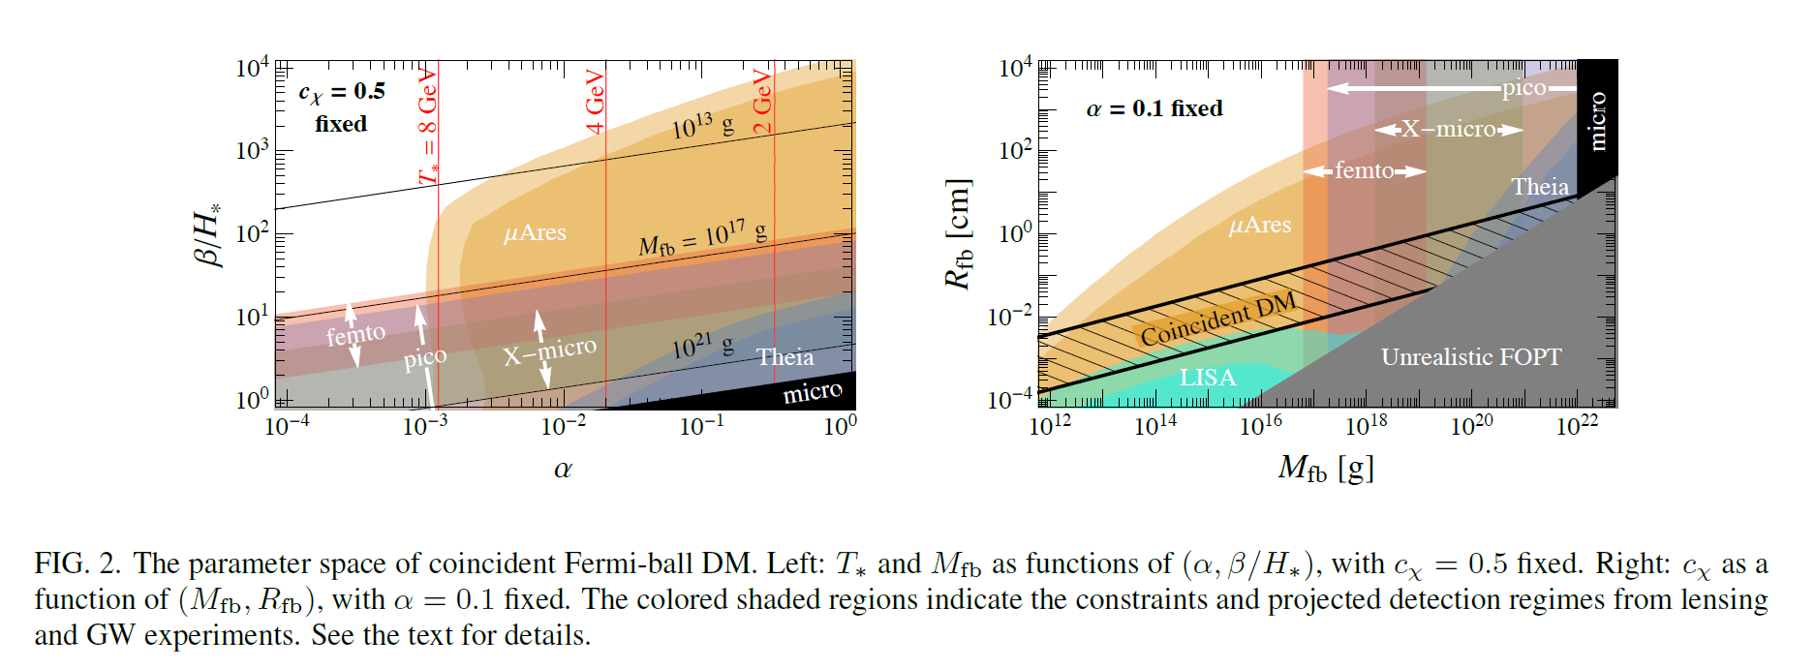
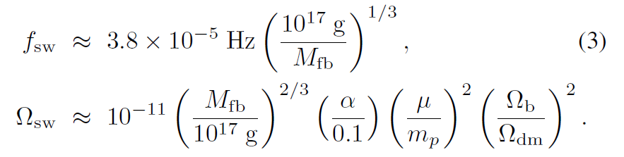
ByProduct: GW from FOPT

Slide 6


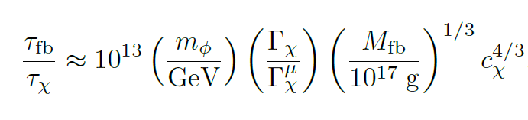
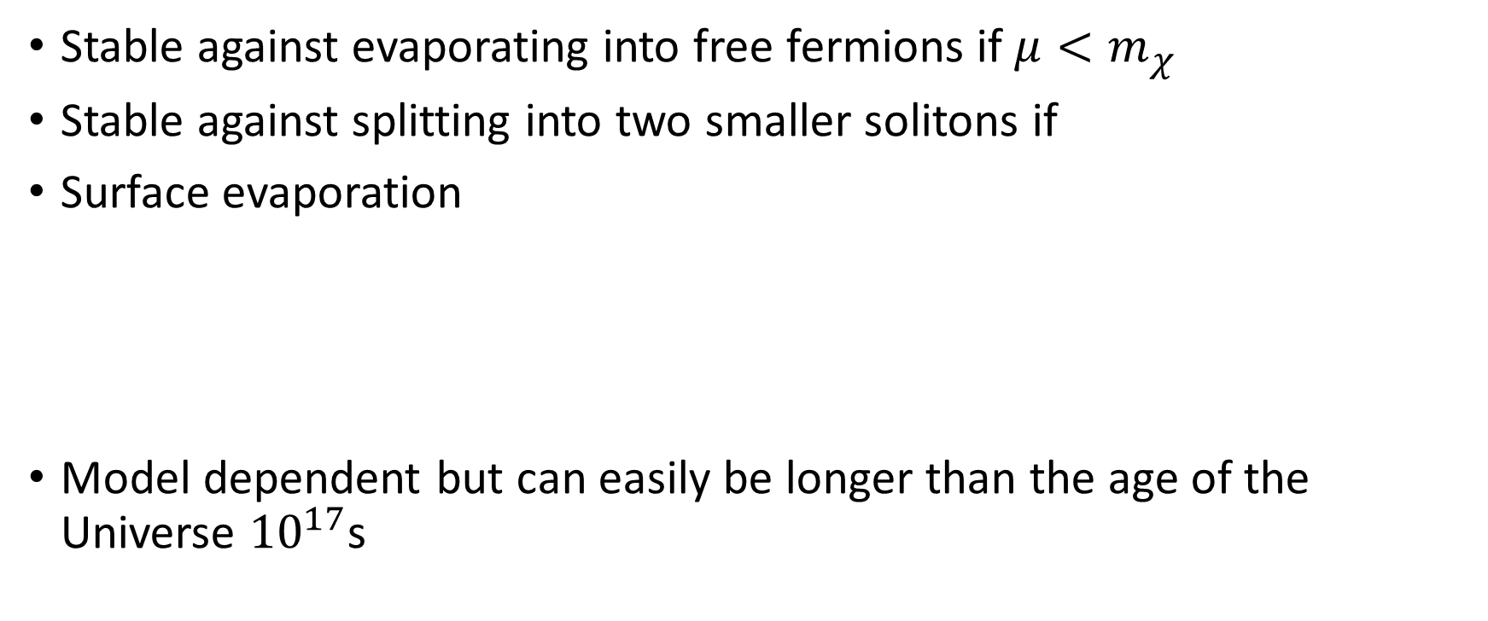
Lifetime
Stable against evaporating into free fermions if $μ<m_{χ}$
Stable against splitting into two smaller solitons if
Surface evaporation
Model dependent but can easily be longer than the age of the Universe ${10}^{17}$s

Slide 7
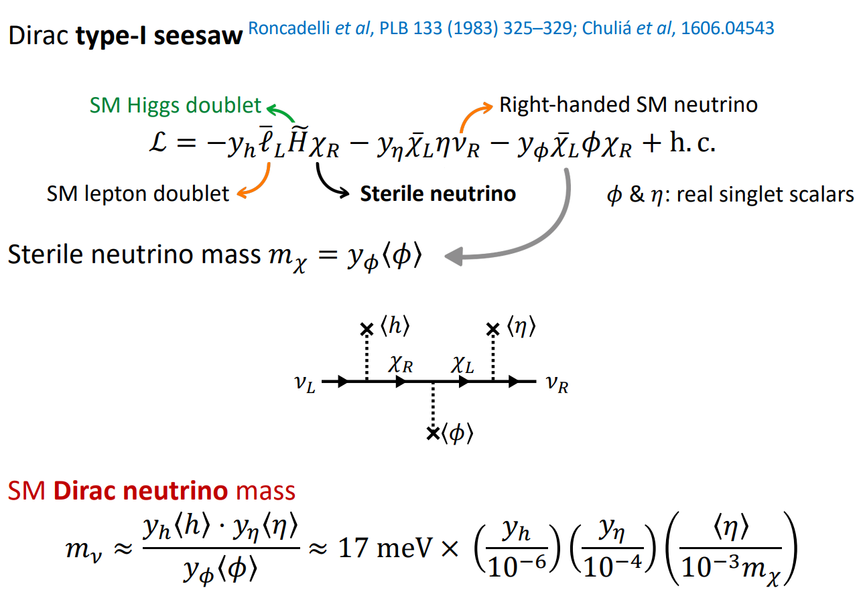
Example:
Neutrino Ball

Slide 8
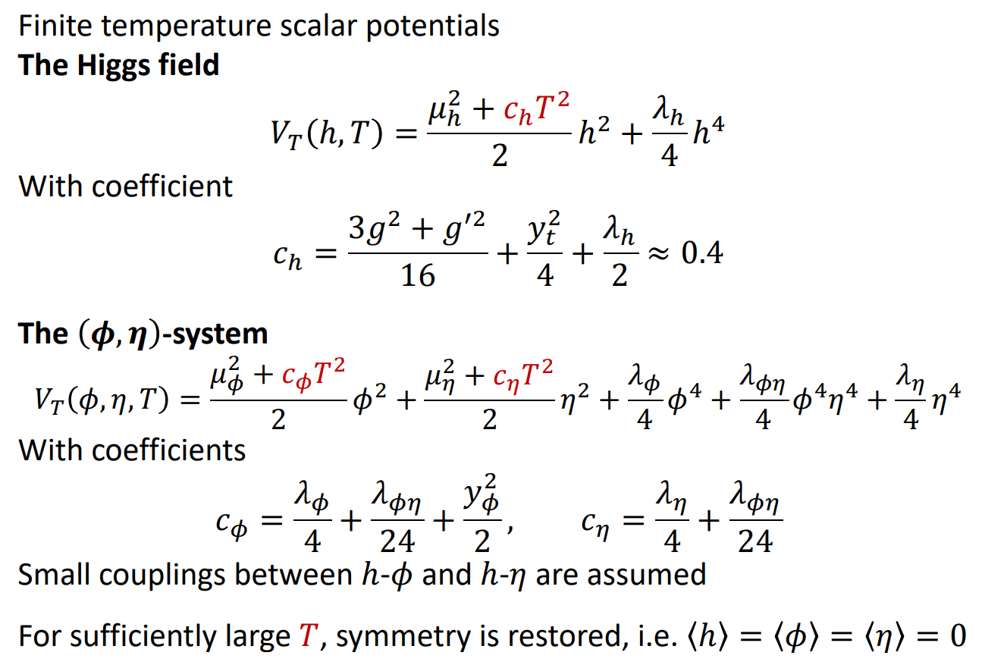
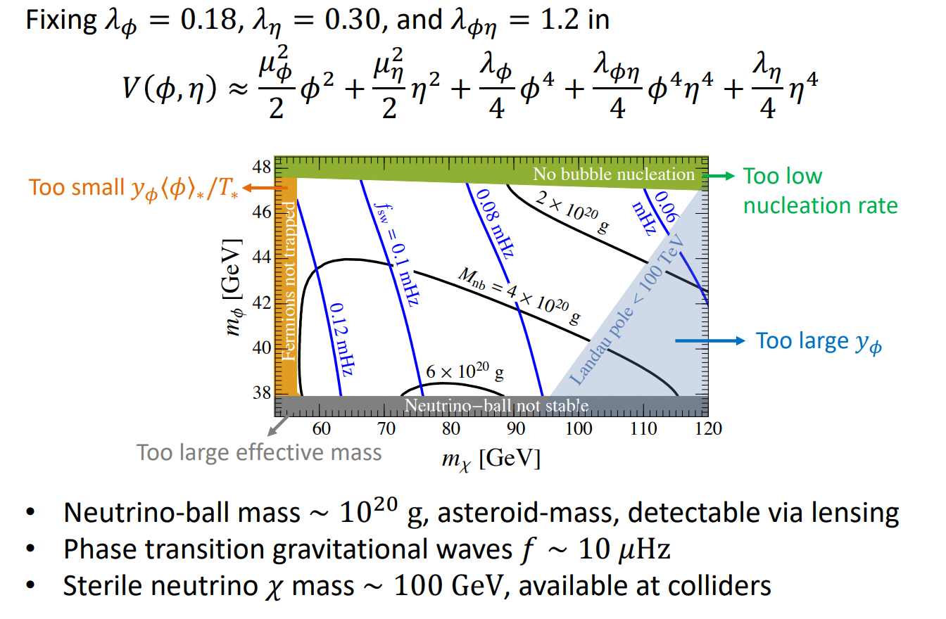
The domain-wall-catalyzed two Step FOPT

Slide 9
Conclusion
solve the coincidence problem
GWs, Asteroid-mass DM
Applicable:
Quark Nuggets, other fermion balls…

Slide 10
