Slide 1
Superheavy Dark Matter Production from Symmetry Restoration 1st PT During Inflation
He-Xu Zhang
arXiv:2208.14857
Authors: Haipeng An, Xi Tong, and Siyi Zhou
Jul 31, 2025
1

Slide 2

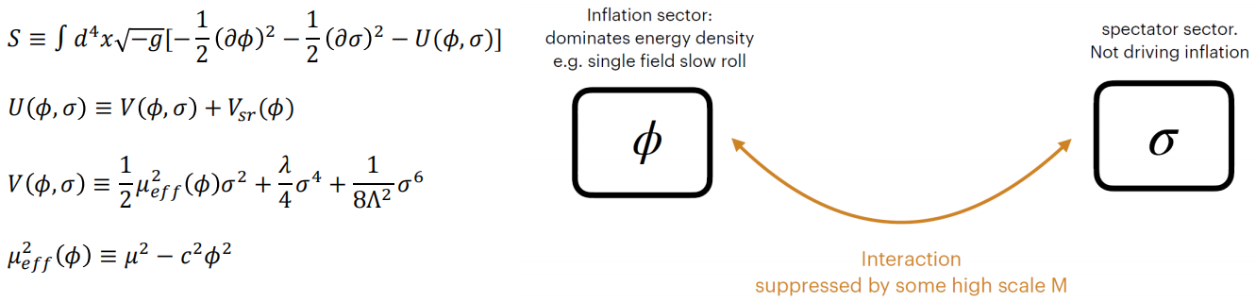
Symmetry Restoration 1st PT During Inflation
During inflation, the inflaton field typically travels
The change in the inflaton field value will induce the change in the effective potential in the 𝜎 sector

Slide 3
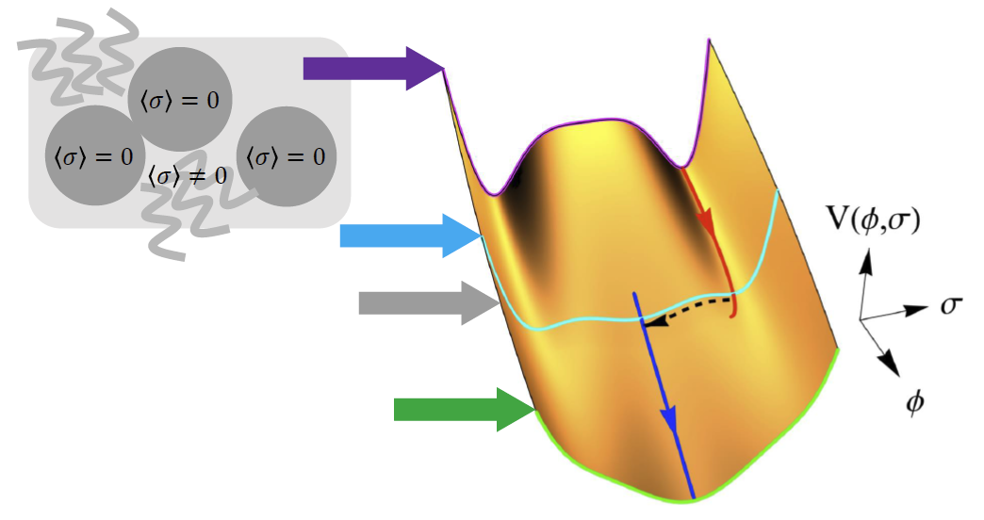
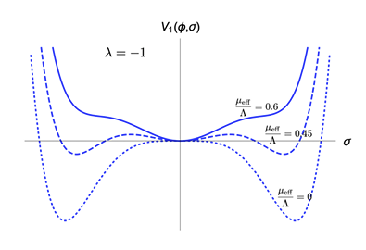
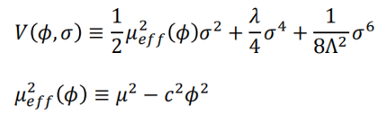
Symmetry Restoration 1st PT During Inflation
Inflation begins Symmetry broken phase
Symmetry restoration first order phase transition happens GW generated
Inflation ends
Symmetry restoration phase

Slide 4
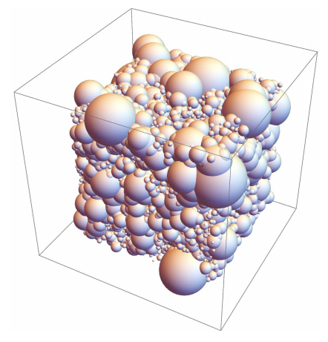


Symmetry Restoration 1st PT During Inflation
Typical mass scale of the 𝜎 particle is 𝑚_{𝜎}
The bubble nucleation rate per physical volume
where 𝑆₄ is the classical action of the bounce solution
Bubble nucleate at 𝑡′, the comoving radius at 𝑡 is
The fraction of the space that remains at the false vacuum at time 𝑡

Slide 5



Symmetry Restoration 1st PT During Inflation
Conditions on the parameter space
- Phase transition is strong first order
- The energy density of the spectator sector
is subdominant

Slide 6
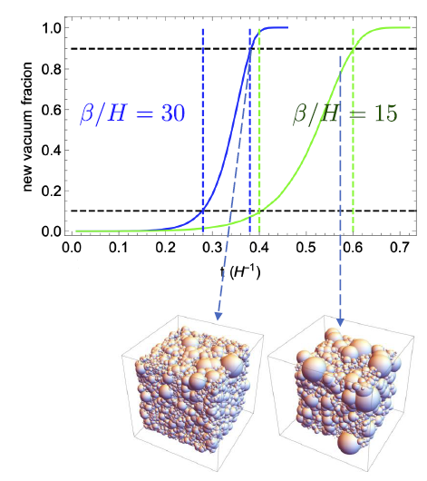
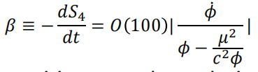

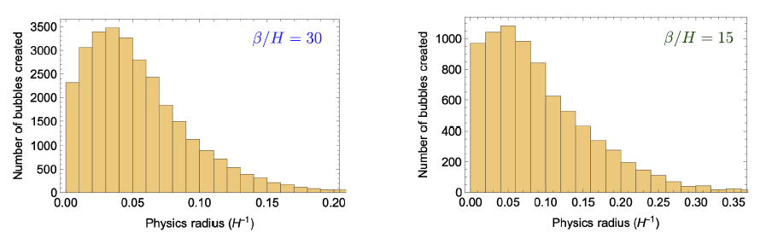
Symmetry Restoration 1st PT During Inflation
𝛽 describes how fast the phase transition
𝛽 ≫ 𝐻 phase transition completes during inflation
𝛽 also determines the bubble radius

Slide 7
Symmetry Restoration 1st PT During Inflation
After the phase transition
- 𝜎 particles are formed in the 𝑍₂ symmetric phase generated
- 𝜎 particles are stable and can be the dark matter candidate
Dark matter relic abundance
The energy density of dark matter today

Slide 8
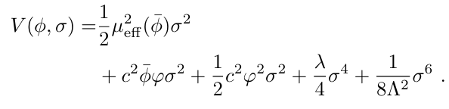

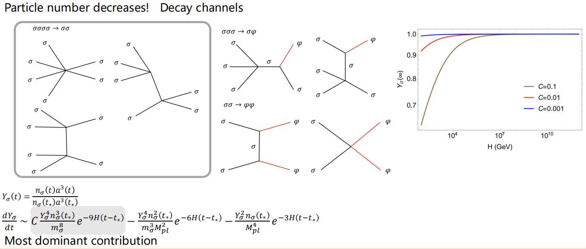

Dark Matter Decay Rate
The inflaton field can be decomposed into

Slide 9
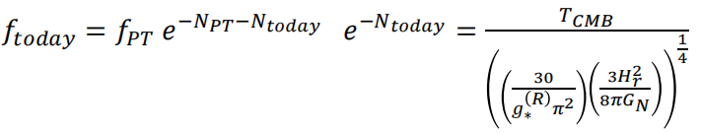


Gravitational wave from 1st PT during inflation
Final spectrum
GW spectrum in flat space
GW frequency
Due to the distortion from inflation, highest peak
If 𝜎 particles constitute all the dark matter today

Slide 10
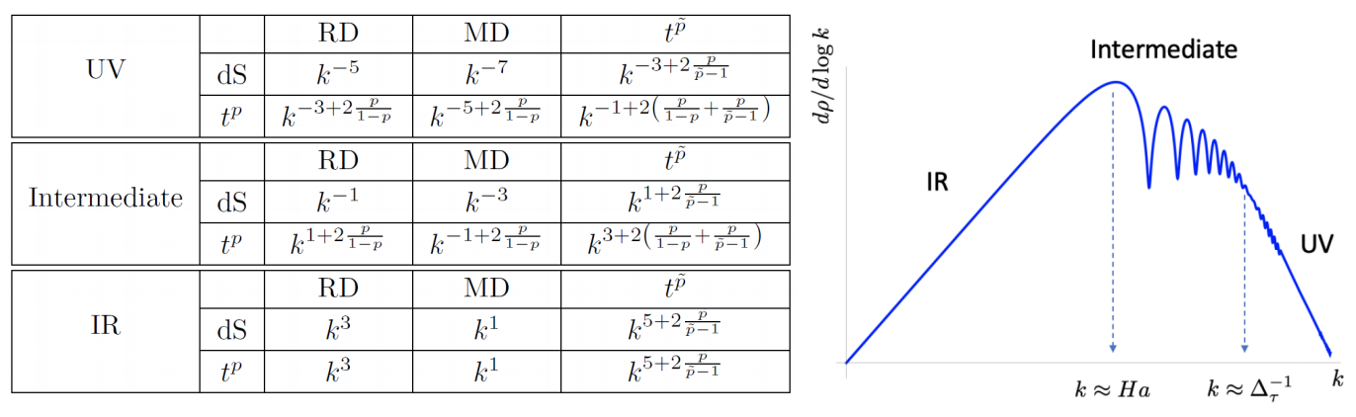
Gravitational wave from 1st PT during inflation
Magnitude of the signal is controlled by the latent heat released during first order phase transition
The frequency of the GW is linked to the Hubble parameter during inflation
The slope of the gravitational wave spectrum is determined by the evolution history of the universe

Slide 11
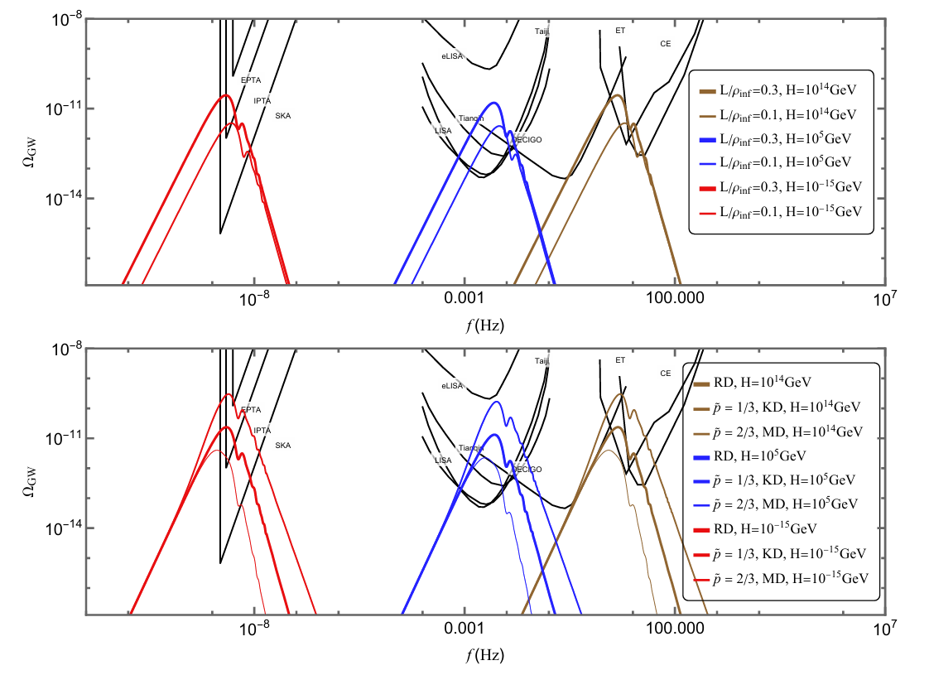
Gravitational wave from 1st PT during inflation

Slide 12
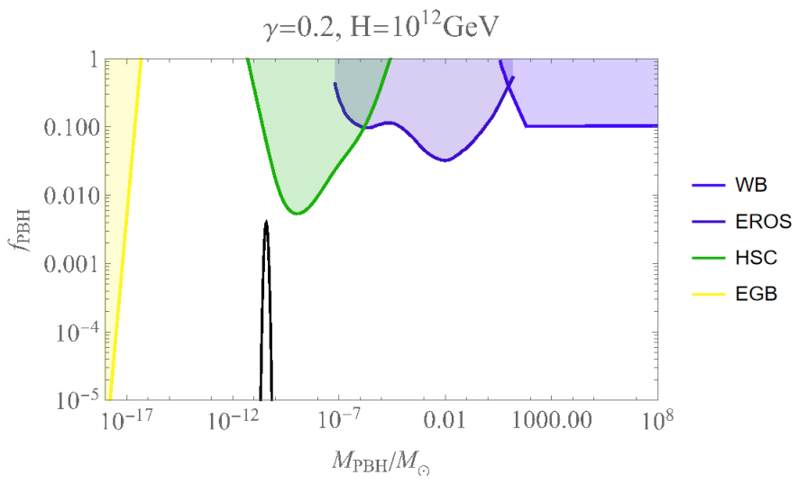
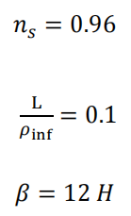
Primordial black hole
Large enhancement in the power spectrum
will produce primordial black hole
Phase transition happens at 25
e-folds before the end of inflation

Slide 13
Conclusion and Outlook
Dark matter can be heavy, the production rate is generically small
A mechanism to produce enough superheavy dark matter during inflation via symmetry restoration first order phase transition
Complementary gravitational wave signals
Large enhancement in the primordial power spectrum
Associated primordial black hole mass fraction

