Slide 1
Completing the framework of AdS/QCD: b₁ mesons
2025.7.24

Slide 2
Reference
1. Alvares, Raul, Carlos Hoyos, and Andreas Karch. "Improved model of vector mesons in holographic QCD." PRD 84.9 (2011): 095020.
arxiv: 1108.1191
2. Domokos, Sophia K., Jeffrey A. Harvey, and Andrew B. Royston. "Completing the framework of AdS/QCD: h₁/b₁ mesons and excited ω/ρ’s." JHEP 2011.5 (2011): 1-36.
arxiv: 1101.3315

Slide 3



Introduction
The hard wall model contains five dimensional (5d) fields A_{R}, A_{L}, X dual to the operators and
There are two additional dimension 3 operators
should be included for self-consistency of the model.
An immediate benefit resulting from the inclusion of this extra field is that one will obtain masses for isospin triplet vector mesons with
J^{PC}=1⁺⁻.

Slide 4


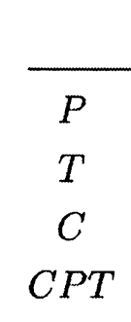
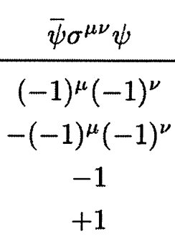
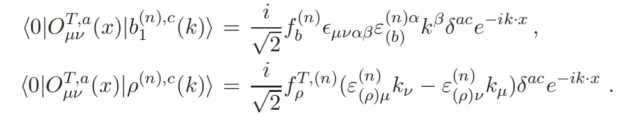
Operators and two-point functions
The operator is odd under C but contains both parity even and odd parts. Thus it has a non-zero amplitude to create both
Transverse part：
Longitudinal part:

Slide 5
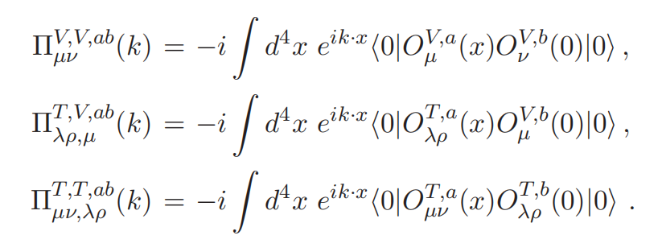
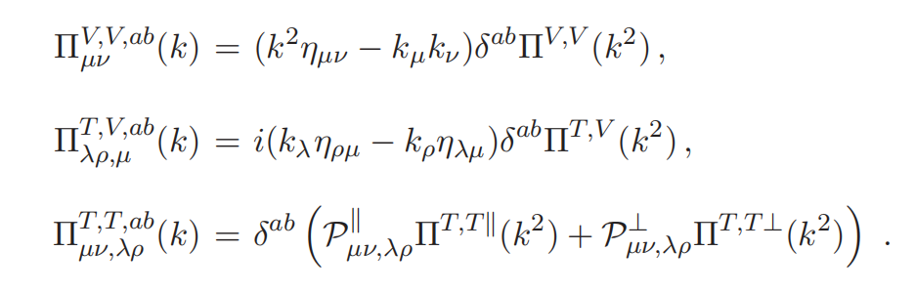
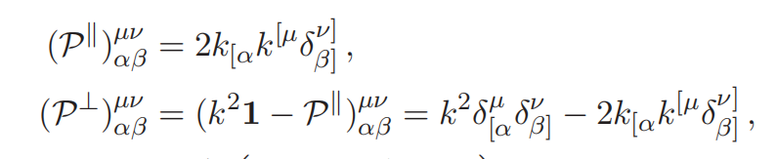
Operators and two-point functions
The relevant two-point functions are
These are longitudinal/transverse projection operators

Slide 6
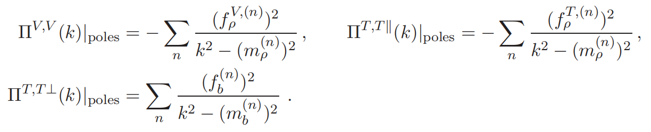
Operators and two-point functions
Poles of the two-point function in momentum-space mark the masses of excitations, while the residues at the poles provide the decay constants

Slide 7


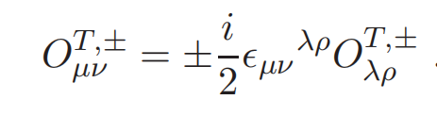


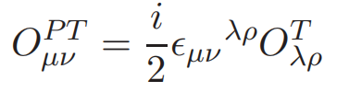


Operators and two-point functions
There are another important properties：
it is convenient to decompose the tensor into self-dual and anti-self-dual parts

Slide 8
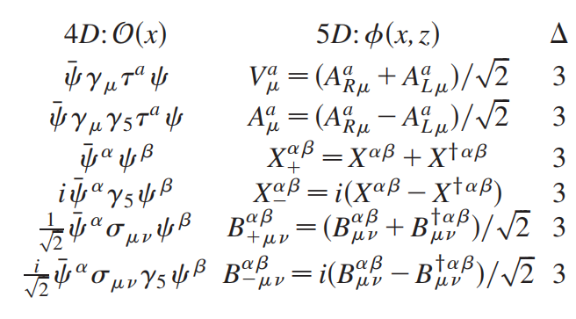
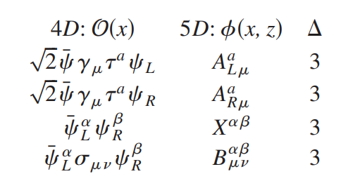

Holographic Model
Considering a complex two-index antisymmetric field B_{μν}.

Slide 9
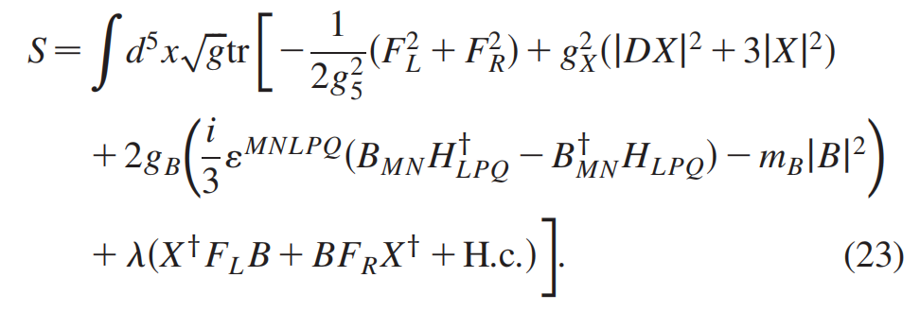
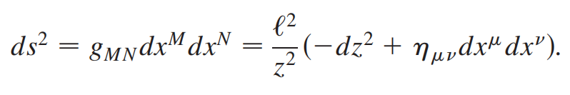
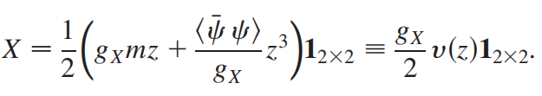

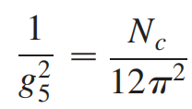
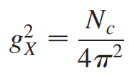
Holographic Model
a

Slide 10

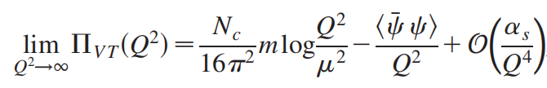
Holographic Model
How can the specific form and coupling constant of the terms related to B be determined?
1. Boundary value should satisfy
2. B₊ field and the V field are coupled.
3. Match the holographic correlation function with the OPE of QCD.

Slide 11
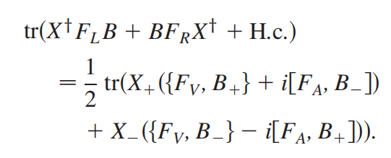
Holographic Model
2. B₊ field and the V field are coupled
The term determines how chiral symmetry breaking affects to the isospin triplet 1⁻⁻ vector mesons.

Slide 12
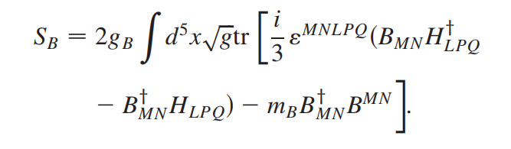
Holographic Model
1. Satisfying the constraint
The action of the complex B field should be first order, and to be a Chern–Simons action with a mass term
The duality condition follows from the equations of motion.

Slide 13
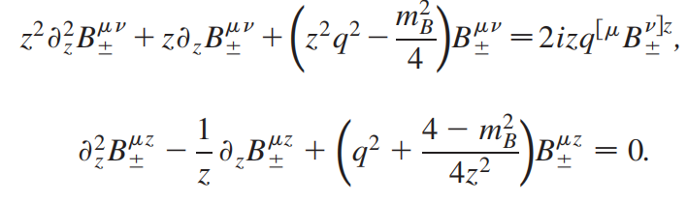
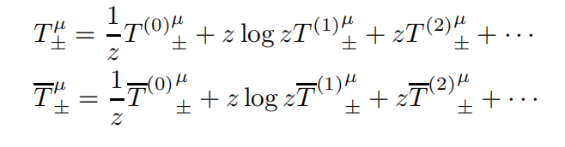


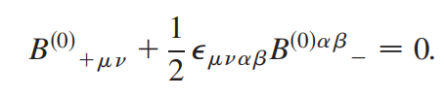
Holographic Model
1. Satisfying the constraint
EoM with λ=0 (after tedious calculation)
(1).
(2).

Slide 14


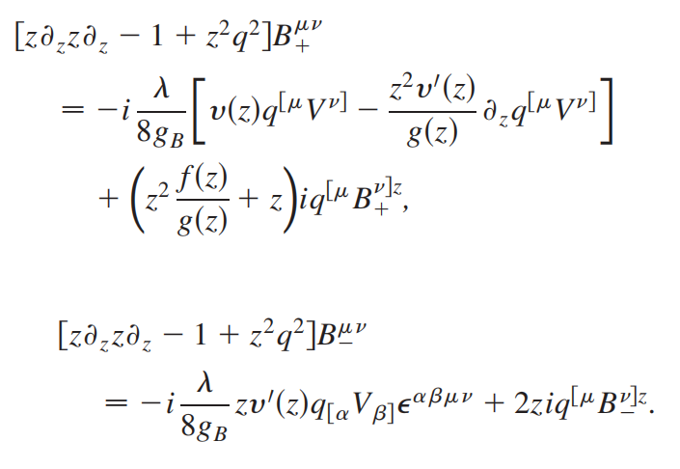
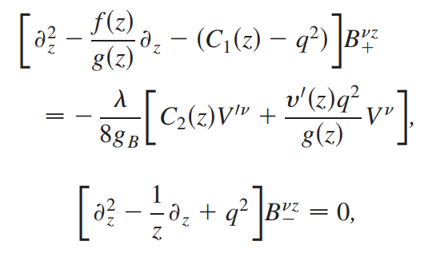
Holographic Model
EoMs when λ≠0
V:
A: B^{μν}:
B^{μz}:
Four decoupled sets:
1⁺⁺ 1⁻⁻
1⁺⁻

Slide 15
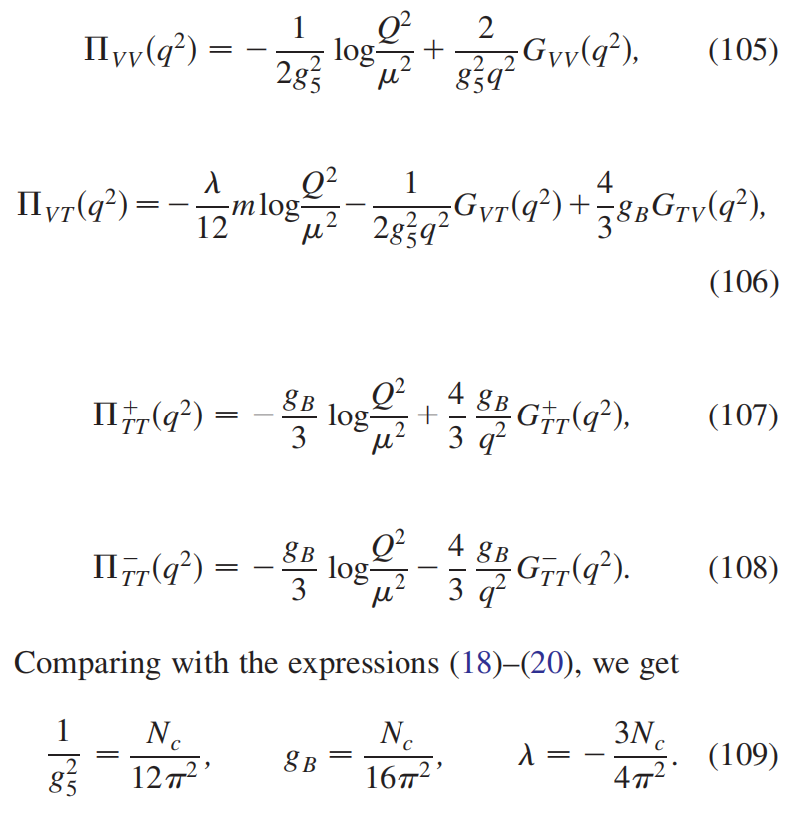
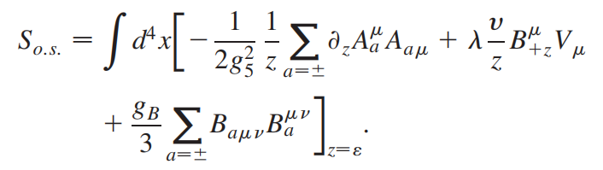
Holographic Model
Specify λ and g_{B}
On-Shell action
It is necessary to remove
some divergent terms as z → 0
through holographic renormalization.

Slide 16


Meson Spectrum
1. 1⁺⁻ meson
Fix the scale z_{m} using the physical value of the pion mass
Neumann boundary conditions at the cutoff.

Slide 17
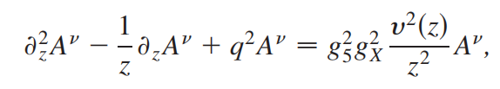


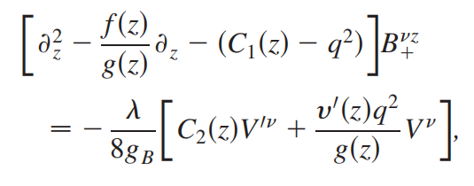
Meson Spectrum
2. 1⁺⁺ meson
3. 1⁻⁻ meson
These equations have an additional singular point at z* such that g(z*)=1
1.Constrain values of the quark mass and the condensate to eliminate the appearance of the singularity.
2. Impose suitable boundary conditions at the singular point

Slide 18




Meson Spectrum
3. 1⁻⁻ meson
Behaviors of solutions close to the singular point:
The lightest vector meson 1⁻⁻ is always heavier than both parity even mesons 1⁺⁺, 1⁺⁻ when

Slide 19
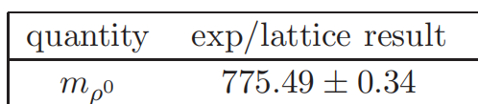







Meson Spectrum
When z*<z_{m}, the ‘‘box’’ is smaller and
the spectrum is lifted to higher values.
When z*>z_{m}, we can impose boundary conditions for the vector mesons at the singularity instead of introducing the cutoff.
For

Slide 20
Thanks

