Slide 1



Feedback of 2025 IDRC Review Report

Slide 2
TPC

Slide 3
Findings
TPC
The Time Projection Chamber (TPC) with pixelated micro-pattern gaseous detector readout has been chosen as the baseline for the central tracker. It offers continuous 3D tracking with minimal material budget over a large volume and provides particle identification (PID) capabilities. This is a solid and well-justified choice for the Reference TDR, building on extensive past TPC experience at lepton colliders and more recent developments from ALICE, the LCTPC, and DRD1 collaborations. Several technological advances have recently been achieved; notably, a novel ultra-light QM55 carbon fiber material is now used to construct the TPC cylinder.
However, realizing the TPC as the tracker will require further significant efforts, particularly in mechanical design, structural integrity, and achieving uniform magnetic field conditions (see also the comments and recommendations in the Magnet chapter). Full simulation and digitization tools, based on the software framework and reconstruction algorithms, have been developed and must now be used to produce an updated set of performance plots (e.g., separation power plots).
The possibility of using a drift chamber as an alternative tracking option is also presented in the TDR.

Slide 4
Findings
The Barcelona version of the TPC chapter shows clear progress in terms of section organization and clarity compared to the previous drafts:
  The overall structure is improved, with more logical sub-sections and better-defined description flow;
  The mechanical design aspects (inner/outer cylinders and support structures) are more consistently described;
  There is a better introductory explanation of the role of the TPC as the central tracking detector and its importance for the PID performance;
  Prototype development efforts are more explicitly referenced, including pad readout, based on micro-pattern gas detector studies;
These editorial and content enhancements are really appreciated and help to bring the chapter into more advanced stage. However, several technical issues raised in the previous review remain (partially) unresolved or are addressed only qualitatively.

Slide 5
Recommendations (Performance goals)
Clarify target performance: For each open topic (e.g., ion backflow, pad size), provide the expected performance goals (e.g., maximum tolerable distortion, acceptable ion backflow level, target spatial resolution) that guide the ongoing design effort;
Answer:
  The expected goal of IBF level is primary ion level.
  In Higgs mode, the maximum tolerable distortion is about 10 μm and target spatial resolution is about 100 μm (as shown in Section 1.3.2).
  In low lumi. Z mode, the maximum tolerable distortion is about 150 μm and target spatial resolution is roughly estimated to be 200 μm (not mentioned in the text).
  Most of the above expected performance goals are described in Section 6.3.3 (p194).

Slide 6
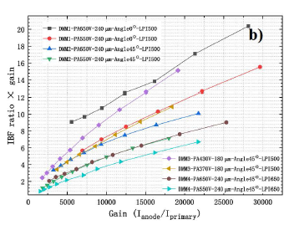
Recommendations (IBF + BG)
Ion backflow during operation in low-luminosity Z-mode remains the primary concern. Further simulations of TPC space-charge distortions induced by beam-related backgrounds are necessary to optimize the Machine-Detector Interface (MDI).
New module prototypes implementing advanced ion suppression techniques (e.g., double-grid structures or graphene layer coatings) should be studied.
The chapter still lacks a quantitative description of space-charge distortion and its impact on tracking
Answer:
  The ion backflow is discussed in section 6.3.2. By introducing a second mesh or applying a graphene coating to the amplification device, IBF can be effectively suppressed (p193).
  Double mesh Micromegas is selected as base line design for IBF suppression . The IBF × Gain can be reduced to below 1, as shown in Figure 6.18 (b) (p193).
  Graphene coating is IBF suppression scheme for future studies, which is described in Section 6.6 (p209).
Figure 6.18 (b)

Slide 7
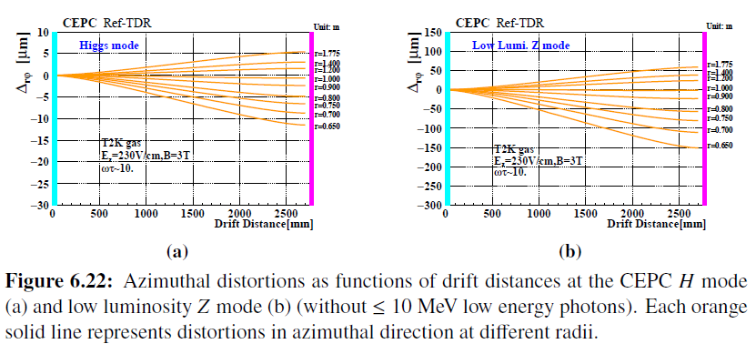
Recommendations (IBF + BG)
  Estimation of the space-charge distortion is presented in Section 6.3.3. Azimuthal distortions as functions of drift distances are shown in Figure 6.22 (p198)
  A preliminary estimation of shows that The maximum voxel occupancy in Higgs mode can be less than 7.5 × 10⁻⁴ in the innermost layer of TPC, which has little impact on track finding, as shown in Section 6.3.3.2
  The space-charge distortion effect was not included in the current tracking simulation. To simulate the impact from beam-induced background, including the effect of space-charge distortion, a complex model needs to be implemented. This work is under investigation and is incorporated into the future plans outlined in Section 15.4.

Slide 8
Recommendations (Calibration)
In the longer term, dedicated simulation efforts are needed to develop and refine a “data-driven“ approach for extracting space-charge corrections, based on the alignment and correction models developed for the ALICE TPC.
There is no indication or explanation of how correction strategies (e.g., ALICE-like data-driven approaches) can be implemented, at least qualitatively
Answer:
  An explanation on calibration was added in Section 6.3.4, with reference to the relevant paper on Alice TPC (p200).
    Charged tracks can be reconstructed with very high precision by combining both ITK and OTK, which provides significant advantages for the TPC calibration. Based on the full track reconstruction, the charged tracks can be refit excluding the measured TPC cluster, to provide a reference for the spatial position correction of the TPC cluster, following the approach used in ALICE TPC calibration [35].
  An explanation of track-based alignment for the TPC has been added in Section 6.3.4 (p200).
    As a sub-detector of the CEPC tracking system, track-based alignment of the TPC will be performed simultaneously with the silicon tracker system. The method and procedure can be found in Section 5.4.

Slide 9
Recommendations (Gas & Pad & readout Architecture)
Optimization of pad size and gas mixture must be finalized, clearly distinguishing between the digital pixel readout case and the pad readout case. These two approaches lead to distinctly different electronics requirements, particularly regarding the need for analog-to digital conversion in the pad case.
We understand that the choice between pad and digital pixel readout can not be finalized at this stage and remains uncertain. Still, some comments about the implications in terms of electronics complexity, data volume, and reconstruction performance would be beneficial
The absence of a baseline readout definition introduces uncertainty in downstream systems (DAQ, reconstruction).
Answer:
  We have added descriptions about choice of gas mixture in Section 6.1 (page175). The T2K gas mixture is selected due to low transverse diffusion and fast drift velocity.
  The readout can provide measurement of dn/d𝑥, significantly improving the performance of PID. A 500 μm × 500 μm high granularity readout was selected to achieve high spatial resolution, high rate capability, high PID capability and low total power consumption.
  Comments of the choice of the readout with analog ASIC have been added in Section6.1 (page176) and Section 6.2.4 (P185), where detailed design of readout and electronics are described.
  Based on the current detector channels (951404/endplate), data volume is estimated to be 19.8 Gbps and 42.9 Gbps for Higgs mode and low lumi. Z mode, respectively, which are summarized in Table12.3 of DAQ chapter (p425).

Slide 10
Recommendations (Readout Architecture)
While a final decision may not be ready, describe the criteria that will drive the selection of the readout scheme and how each option will be validated. Summarize the impact of this choice on reconstruction, electronics design, and system integration. Clarify what is called a pixel TPC (digital readout) and a pad TPC with ADCs. Quantify power consumption in the two cases and document cluster counting for a digital readout;
Answer:
  We clarified that based on the requirements of high spatial resolution, high rate capability, and relatively low total power consumption, high granularity readout is adopted as the baseline design in Section 6.1 (p176). This option will be validated through prototype beam tests. The corresponding impacts on reconstruction, electronics design, and system integration are described in Section6.2.2 (p179), Section 6.2.4 (p184) and Section 6.4 (p200)
  The high granularity readout with a pixel size of 500μm×500μm is introduced in Section 6.2.4, the corresponding power consumption is about 100mW/cm² based on the design specification of the analog readout ASIC, which dominate the total power consumption of the electronics. The cluster counting method to improve PID performance based on this readout scheme is described in Section 6.4.4 (p205)

Slide 11
Recommendations (R&D and Sim. plans)
Acknowledge open issues: clearly define which aspects of the TPC design (e.g., ion backflow mitigation, space-charge correction, gas mixture optimization) are still under investigation, and describe the R&D or simulation path that will be followed to finalize these aspects at the next stage;
Summarize how future simulations will validate TPC performance in full physics conditions (e.g., displaced vertices, Z-mode operation), if feasible;
Answer:
  The performance of readout module, the ion backflow mitigation, space-charge correction are still under investigation.
  The clear statement and R&D path of readout module and the ion backflow mitigation are described in Section 6.6 (p209)
  The simulation path are mentioned in Section 15.4 (p608,609), which will be added in Section 6.6
  The simulation plan includes the following, which will be added in the plan (Section 6.6):
    Impact of beam-induced background on TPC tracking
    Impact of space-charged distortion on both tracking and PID
    Impact of Non-uniform magnetic field on both tracking and PID

Slide 12
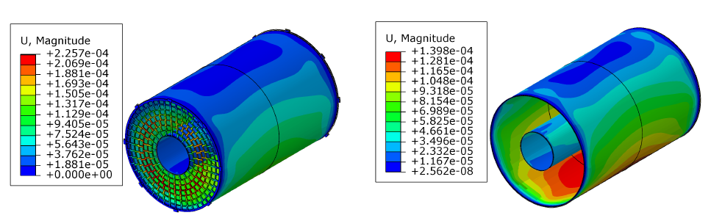
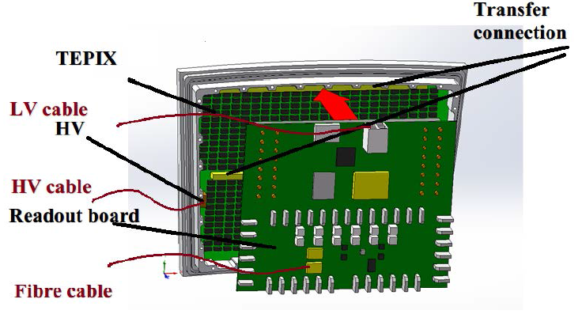
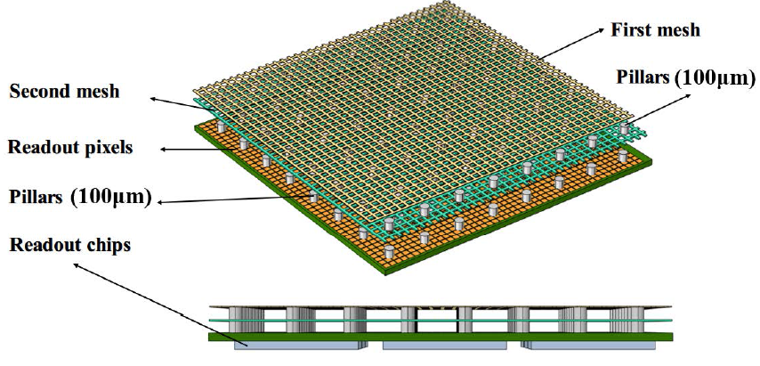
Recommendations (Text and Figures)
The structure of the TDR chapter needs better definition and further consolidation; some figures presented during the review must be updated in the document.
Answer:
  We have made significant modification for the chapter structure, rewriting Section 6.1 (overview), arranging and separating Section 6.2 (detailed design) and Section 6.3.1 (R&D efforts and results).
  Figures are updated and new figures are added, such as the FEA results, the cooling scheme, architecture of the readout electronics, the readout module and readout interposer.

Slide 13
Comments
Space-Charge Distortion and Ion Backflow
  The chapter still lacks a quantitative description of space-charge distortion and its impact on tracking
  Mitigation strategies (e.g., double GEMs, gating grids, graphene coating) are mentioned, but not developed or prioritized for future studies;
  There is no indication or explanation of how correction strategies (e.g., ALICE-like data-driven approaches) can be implemented, at least qualitatively
Answer
  Please refer to Recommendations (IBF+BG) and Recommendations (calibration)

Slide 14
Comments
Tracking performance
  There is no significant update on spatial or momentum resolution, dE/dx performance, tracking efficiency, or fake rate studies;
  Performance plots, especially in conjunction with the ITK/VTX system, are missing or remain in a preliminary stage;
Answer:
  The latest results are presented, including
    Spatial resolution and momentum resolution of the TPC are presented in Section 6.4.3. The spatial resolution is about 100 μm for a drift length of 2.75m (not includes distortion, p204). The momentum resolution reaches about 10⁻⁴ ( GeV/𝑐)⁻¹ for charged particles with momenta below 100 GeV/𝑐 (p205).
    Both dE/dx and dn/dx performance are shown in Figure 6.30 and 6.31 (p206~207).
    Averaged rack reconstruction efficiency is 99.7% for track momenta larger than 1 GeV with combined tracking system, which is presented in Section 15.1.1 (p559).
    As shown in Section 15.1.4, the kaon identification efficiency and purity are around 92% and 90.7%, respectively, using TOF and dn/dx with XGBoost models (p564)
  Momentum resolution with combined TPC and the silicon tracker is presented in Section 5.5.1 (p169). PID performance with combined TPC and OTK is presented in Section 6.4.4 (p207)

Slide 15
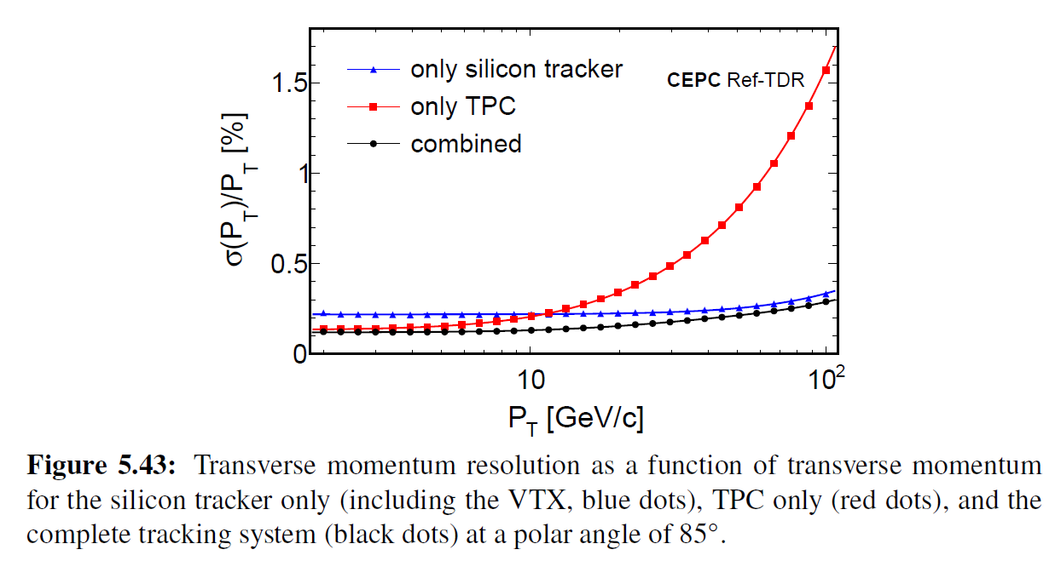
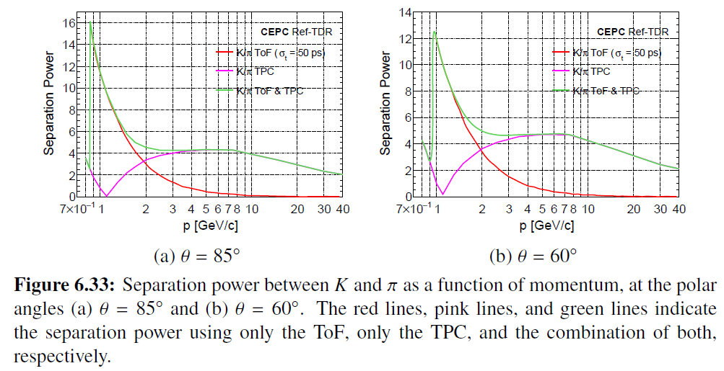
Comments

Slide 16
Comments
Gas Mixture and Ion Backflow Suppression
  No clear indication about choice of gas mixture is presented. Therefore, the interplay between gas properties, backflow suppression, and long-term stability cannot be sufficiently discussed.
Answer:
  We have added descriptions about choice of gas mixture in Section 6.1 (page175). The T2K gas mixture is selected due to low transverse diffusion and fast drift velocity.
  The backflow suppression is clearly discussed in 6.3.2 (p193). Double-mesh Micromegas is selected as base line design of the readout detector due to its good performance of IBF suppression, as shown in Figure6.18 (b)(page193).
  Gas-mixture optimization, circulation-system design, and long-term stability studies will be concerned in next R&D stage.

Slide 17
Comments
Since the IDRC 2024 review, significant progress has been made in the simulation of space charge distortions. For CEPC Higgs and low-luminosity Z runs, the maximum distortions after 3 meters of drift were found to be approximately 10 μm and 150 μm, respectively. Nevertheless, these figures require further verification, and careful evaluation of beam-related background effects must continue.
Answer:
  The simulations of space charge distortions is presented in Section 6.3.3.4 (p196). The simulation of beam-induced background in the TPC is also presented.
  For CEPC Higgs and low-luminosity Z runs, the maximum distortions after 3 meters of drift are approximately 10 μm and 150 μm, respectively. These results are based on two assumptions. One is the IBF can be suppressed to the primary ion level, and the other is that low energy photons with an energy below 10 MeV can be shielded, which is the requirement for the MDI optimization.
  If the low energy photons with an energy below 10 MeV cannot be shielded, the maximum space charge density will be 1-2 nC/m³ in the TPC, which will lead to larger distortions. The estimation of the TPC detector space charge distortion and optimization strategies are listed in table 6.7 (p199).

Slide 18
Comments
The choice of the pixel readout chip (TEPIX) with a 500 × 500 μm² pixel size is currently driven by power consumption considerations. A TPC module prototype with 10 × 300 readout channels (using 24 TEPIX chips) has been developed and is planned for beam testing at DESY in 2025. Larger prototypes will need to be developed and tested during the EDR phase.
Answer:
  Yes, we agree. We have a plan and preliminary design to develop larger prototypes to test and validate the readout modules, and to study the performance of the detector with full drift length, as detailed in Section 6.6 (p209)

Slide 19
Comments
If the alternative drift chamber option is pursued, it will be necessary to identify a hydrocarbon free gas mixture that maintains the required performance characteristics.
Answer:
  In next studies, we will concern and study hydrocarbon free gas mixtures.
  At this stage, based on the requirements of dn/dx method for low transverse diffusion, moderate drift velocity and primary ionization density (~ 16/cm), a gas mixture of He/iC₄H₁₀=90/10 is proposed as the working gas of drift chamber, which is mentioned in Section6.5 (p208).

Slide 20
Editorial additions
Include a concise summary table linking current detector parameters and technologies to physics requirements. This will help contextualize the design and highlight where validation is still pending;
Streamline English and revise references;
Answer:
  A summary table (Table 6.1) of the critical parameters and technologies of the TPC and descriptions of the physics requirements for TPC are presented in Section 6.1 (p174)
  Significant modifications have been made based on the recommendation of streamlining English and revising references, especially Section 6.1 (Overview) and Section 6.2 (detailed design)

