Slide 1



Feedback of 2025 IDRC Review Report

Slide 2
Detector Magnet

Slide 3
Draft V0.6.1
Dear Daniela
Thanks for sending us the CEPC Reference Detector TDR updated.
I have quickly read the magnet section.
I am pleased to see the solenoid section much advancing and reflecting our advice. I would evaluate that the SC solenoid magnet design would be generally appropriate for the reference TDR. Congratulations.
Particularly, the mechanical stress analysis has been much advanced and we can be more confident with the design to be reasonably reliable.
A few points would still need to be carefully discussed in particular:
- SC development,
- quench protection,
- Temperature distribution with 2-phase and thermo-syphon cooling enabling to be much uniform.
- R&D for HTS based superconducting coil.
I will be pleased to discuss more in the next step/meeting.
With my best regards,
Akira

Slide 4
Findings
SYSTEM MAGNET
The CEPC Ref-TDR superconducting solenoid design has made significant progress. The solenoid provides a central magnetic field of 3T (for tt ̄, Higgs, and W runs) and 2–3T (for Z runs), with an inner bore diameter of 7.07 m and a cryostat/yoke half-length of 4.53 m. It is enclosed within an iron yoke that also houses the muon detector. The variation of the solenoid magnetic field in the central tracker (TPC) region is currently calculated to be approximately 10%.
The solenoid coil design is based on four layers of Al-stabilized superconductor, supported by an aluminum-alloy outer support cylinder and cooled using a two-phase helium thermosiphon system. This general design concept is well established, drawing on the reliable design experience of the CERN-LHC CMS detector.
A key technology development effort focuses on Al-stabilized superconductors, with two approaches to mechanical reinforcement:
  Option A: Double-layered, two-step co-extrusion process.
  Option B: Single extrusion with micro-alloying for reinforcement, followed by a cold-work process.
Further R&D is planned for 2025.
The maximum von Mises stress on the Al-stabilizer during magnet excitation is evaluated at 96 MPa, which is close to the current yield strength of the Al-stabilizer material (105 MPa). Further mechanical evaluation is necessary to ensure an adequate safety margin, including the mechanical integrity of the NbTi/Cu superconductor itself.
Remaining technical challenges primarily concern the production of large-scale, high-strength Alstabilized superconductors, as well as ensuring the reliability of the numerous aluminum-pipe welds required in the thermosiphon cooling system

Slide 5
Comments
SYSTEM MAGNET
Field uniformity in the TPC region is a fundamental boundary condition for detector performance. The current 10% field variation must be carefully assessed to ensure it is acceptable for the required TPC performance. It is important to note that the ALICE detector has a different configuration, and that the ALICE magnet is much larger resulting in significantly better field quality in its TPC region compared to CEPC.
Impact on tracking:
It is impossible to achieve a uniform magnetic field in the experiment. Fortunately, the impact of non-uniform magnetic field on the momentum measurement can be minimized if the track fitting algorithm (i.e. Kalman filter) can deal with the non-uniform magnetic field with the measured magnetic field map.
The key issue is whether we use a right field map in software. Two requirements
Measurement precision of the magnetic field map is good enough.
Gradient of the field small enough (The map is smooth, without big fluctuation within small area)
CEPC magnetic field gradient of the TPC region:
  The gradient of TPC region is around 5.4*10⁻⁵ T/mm, which is small enough and meets the requirement
Measurement precision:
  If the measurement precision is 10⁻³ (i.e., position error during measurement is around 1mm), the deviation of B is around 5.4*10⁻⁵ T according the gradient, which meets the requirement of momentum resolution (~0.1%)
An example of BESIII
NUMF in BESIII is 5%, and measurement error of B is around 0.3%
The momentum resolution is good as the expected after the track fit with Kalman filter and track-based calibration. No significant impact from NUMF is observed.
Ref TDR: 349~352

Slide 6
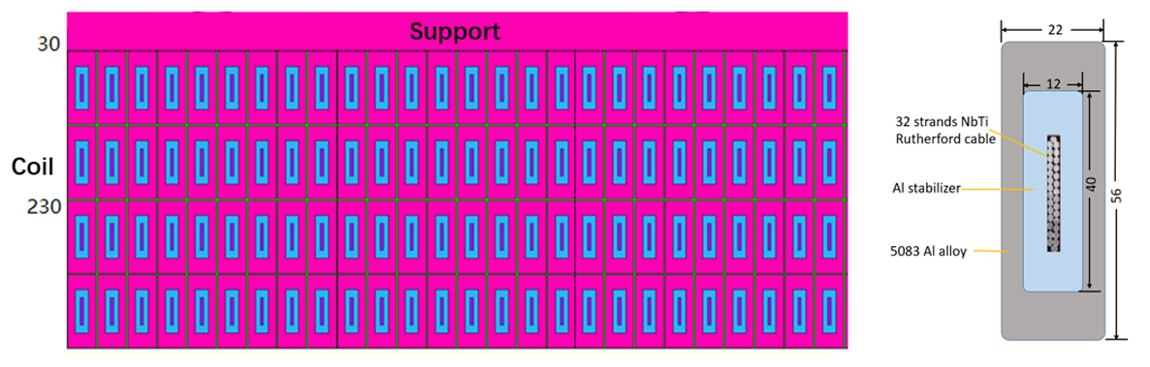
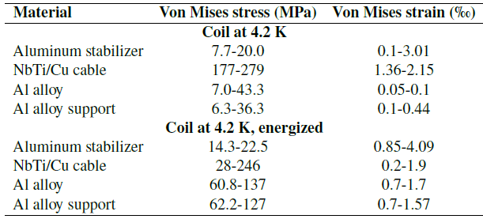
Comments
SYSTEM MAGNET
The committee recognizes the remarkable progress achieved in developing Al-stabilized superconductors, achieving a yield strength of 105 MPa at 4.2 K using micro-alloying (Ni + Be). However, further R&D is required to demonstrate the full mechanical performance of the conductor and the successful fabrication of full-scale Al-stabilized superconductor segments.
It is critical to demonstrate that the full conductor (NbTi/Cu + Al-stabilizer) can withstand mechanical stress up to 135 MPa. This threshold is about 50% higher than the maximum von Mises stress (~90 MPa) expected during operation at 3T. If achieving this mechanical strength proves difficult, increasing the thickness of the support cylinder could be considered, although this would be undesirable. As a last resort, if necessary, a reduction in the operating field strength may need to be discussed.
The stress issue can be addressed by either increasing the cross-sectional area of the aluminum stabilizer or enhancing the yield strength of its material. However, due to the current limitations in the size of the aluminum coating equipment and the overall design dimensions of the detector, it is relatively difficult to increase the cross-sectional area of the aluminum stabilizer. We made certain progress in the development of Box type conductor, which has a better mechanical performance. We will continue to do the R&D of high strength and RRR value aluminum stabilizer.
Secondary co-extrusion Box type Cable size and structure: 56mm*22mm (Box type)
Ref TDR: 352~353

Slide 7
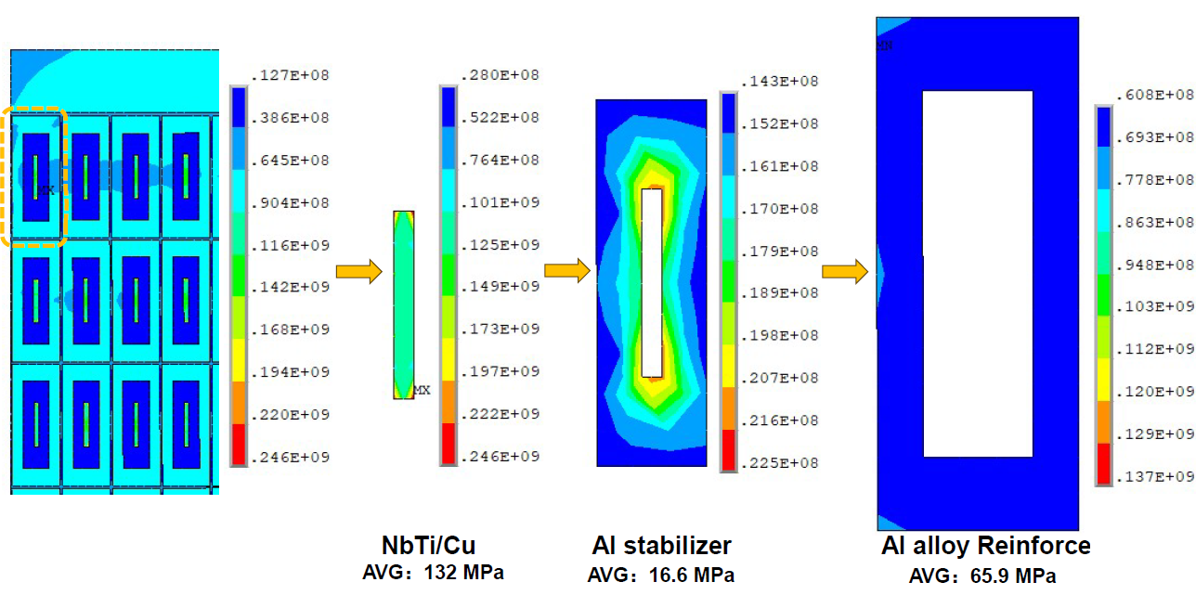
Comments
Ref TDR: 352~353
The maximum stress on the coil is 246 MPa, located in the NbTi/Cu cable. The high-purity aluminum stabilizer experiences a maximum stress of 22.5 MPa, while the aluminum alloy and aluminum alloy support reach maximum stresses of 137 MPa and 127 MPa, respectively. The maximum shear stress in the epoxy glass fiber is 10.6 MPa.
The average Von Mises stresses in this turn are 132 MPa for NbTi/Cu, 16.6 MPa for the aluminum stabilizer, and 65.9 MPa for the reinforcement.
Materials | Peak stress/MPa | Rp0.2@4.2 K/MPa | Safety margin
NbTi/Cu | 246 | >800 | 69%
4N8 Al | 22.5 | ~34 | 33.8%
5083 Al alloy | 137 | >500 | 72.6%
Maximum stresses in all coil materials remain within allowable limits, providing sufficient safety margins for stable coil operation.

Slide 8
Comments
SYSTEM MAGNET
Developing a scaled model coil, including full cooling and excitation tests, will be an important step. Without such a demonstrator, confidence in the readiness of the solenoid technology for CEPC will be limited.
Establishing a scaled model coil is really a necessary step before the processing of the detector magnet, and we will take this important process into consideration in our subsequent planning.
Two cooling channel designs are under consideration:
  Vertical Al-pipe channels, as used in CMS.
  Sloped or tilted serpentine channels, which may reduce the number of welds and save cryostat space.
The latter option could be advantageous for construction reliability
Thank you very much for your excellent suggestions. We will optimize the cooling system from two aspects: Design and Welding Technology
We will consider doing the design of the sloped serpentine cooling path, on one hand, meets the requirements of temperature distribution, and on the other hand, reduces the number of welds.
Regarding the welding of aluminum tubes, we had experience in welding small model coils, but we have not yet had experience in welding such a large number of pipes in a large-scale cooling structure. We will conduct verification experiments in the near future.
Ref TDR: 364~366

Slide 9
Recommendations
SYSTEM MAGNET
Carefully verify that the magnetic field uniformity of the CEPC Ref-TDR solenoid meets the TPC performance requirements without introducing unacceptable distortions to particle drift paths. If the current configuration proves insufficient, consider alternative design modifications—such as the addition of compensation windings in the forward and backward regions, as explored in ILD studies, or adjustments to the shape and configuration of the magnetic iron poles.
Based on analysis and simulations by our TPC colleagues, the current magnetic field non-uniformity meets the performance requirements.
Maintain the highest priority for the R&D of the Al-stabilized superconductor, aiming to demonstrate full-scale conductor fabrication, production of sufficient lengths, and mechanical performance that meets the required safety margins.
The full-scale conductor is very important. We will develop the full-scale conductor with sufficient length (100 m) in the year 2025 which meets the requirements of CEPC.
Ref TDR: 349~352
Ref TDR: 374

Slide 10
Recommendations
SYSTEM MAGNET
Develop a detailed plan for the construction and testing of a superconducting model coil, including demonstrations of cooling and excitation. Achieving this milestone is essential for progressing toward full-scale magnet construction.
Establishing a scaled model coil is really a necessary step before the processing of the detector magnet, and we will take this important process into consideration in our subsequent planning.
Finalize the cooling system design based on the thermosiphon concept, with particular attention to the reliability and quality assurance of aluminum-pipe welding procedures during construction
We will optimize the design of the cooling system. While we have experience in welding small model coils, we have not yet tackled the welding of such a large number of pipes in a large-scale cooling structure. We plan to conduct verification experiments in the near future to ensure reliability and quality assurance.

Slide 11
Finding and comments on Draft v0.4.1
The superconducting (SC) solenoid design for the CEPC Reference Detector Technical Design Report (Ref-TDR) has significantly progressed. Congratulations!
The solenoid provides a central magnetic field of 3T (for tt̄, Higgs, and W runs) and 2–3T (for Z runs), within an inner bore diameter of 7.07 m and a cryostat/yoke length of 9.06 m. As a fundamental number, the SC magnet stored energy (E) is 1.5 GJ with the coil mass (M) of 145 tons with E/M = ~ 10 kJ/kg. It is assembled with an iron yoke, helically assembled, also with muon detectors. The profile and uniformity of the solenoid magnetic field in the central tracker (TPC) region is expected to be approximately 7%. It would be OK, if the TPC may accept this field variation.
The solenoid coil is composed with four layers coils wound with Al-stabilized superconductor, supported by an outer support cylinder made of Al-alloy and cooled by using a two-phase helium natural convection flow with a thermo-siphon scheme. This design concept has been well experienced and established with previous collider detector programs, such as the CERN-LHC CMS detector and others.
The ‘box-type Al-stabilized superconductor’ with two step co-extrusion has been uniquely proposed, and the development is in progress. It is expected to successfully demonstrate the full-scale box-type conductor within 2025. It shall be a very important milestone and strongly encouraged. However, it is also important to keep backup solutions to be prepared for the box-type conductor development not to be successful.
This aligns with our development roadmap: the box-type conductor remains the primary focus, with parallel R&D on backup solutions.

Slide 12
Finding and comments on Draft v0.4.1
The mechanical stress analysis is advanced. However, the results have not been clear enough and the mechanical safety design has not been clearly described. It would be very important to determine necessary mechanical strength of the Al-stabilized superconductor with the box-type design and to be consistent with the performance test results from the conductor development. It must be critically evaluated.
We have updated the coil stress-analysis results and added the average stresses for every component within the cable. The peak stresses in all cable parts are now under control, each carrying a one-third safety margin. Mechanical safety: A full-scale conductor mechanical test campaign is underway; results will update the FEA model and be documented in 2025.
The SC coil winding design with a four-layer coil is to be wound by using an ‘inner coil winding technology’, and it sounds reasonable and promising. The demonstration by using a dummy conductor has been successfully made in cooperation with industry. It needs to be recognized as a preparation step for a SC model coil to be developed and SC performance to be demonstrated.
Establishing a scaled model coil is really a necessary step before the processing of the detector magnet, and we will take this important process into consideration in our subsequent planning using 100 m full-scale conductor.
The quench protection and safety design is based on two technologies of ‘partial energy extraction’ by using an external dump resister and ‘quench back’ inductively induced by the external support cylinder, functioning a single-turn secondary circuit. On the other hand, an expected energy extraction fraction of > 80% may need to be confirmed or updated. If the coil temperature would be increased to ~ 60 K on average after switching off the circuit, a half of the stored energy might be already dumped in the coil. The energy extraction ration would be more reasonable with a level of ~ 50%. The quench protection study may be further improved.
We will optimize the quench-protection system and refine the simulation process to confirm the reliability of the results. At the same time, we will adjust the quench protection in line with the progress of conductor development.

Slide 13
Recommendation on Draft v0.4.1
Proceed the ‘box-type’ Al-stabilized superconductor as the highest priority, aiming to demonstrate full-scale conductor fabrication, and to verify the superconducting and mechanical performance that meets the required safety margins. It will be important to demonstrate a sufficiently continuous length, at least, enabling to realize a superconducting model coil to be fabricated and the superconducting magnet performance demonstration. In parallel, backup solutions shall be continued to prepare for the case of the ‘box-type’ not to be practical.
This aligns with our development roadmap: the box-type conductor remains the primary focus, with parallel R&D on backup solutions.
Advance/improve the quench protection and safety study that reach a reasonable estimate for a balance of the coil temperature rise after the quench and the energy extraction ratio. It is a fundamental balance to be well understood.
We will optimize the quench-protection system and refine the simulation process to confirm the reliability of the results. At the same time, we will adjust the quench protection in line with the progress of conductor development.

Slide 14
Magnet Cost Comparison
The TDR quotes a magnet cost of about 22 MCHF, compared to around 130 MCHF for the more complex ILD system (which includes the yoke). A cross-check should be performed to understand and justify the difference between these two estimates.
An internal review of the magnet design was organized on May 16. A detailed comparison with ILD will be done afterwards and a dedicated internal cost review is foreseen.

