Slide 1
DETECTOR PEREORMANCE

Slide 2
Findings
DETECTOR PEREORMANCE
Although further improvements are possible and recommended, the collaboration’s response to the previous evaluation has been excellent and deserves recognition. The detector software, particularly the simulation component, now enables comprehensive studies of detector performance and physics benchmarks. Several design decisions have been made based on both detector and physics performance criteria. This progress has allowed the definition of a baseline detector concept. While still perfectible and requiring further detailed investigation, this is a significant and commendable step forward. The scope of physics performance studies has broadened considerably since the last assessment. The range of channels explored and the methodologies employed respond well to previous recommendations and collectively address key detector areas and primary physics topics.

Slide 3
Comments
DETECTOR PEREORMANCE
The Ref-TDR text could be improved and shortened by presenting certain aspects (e.g., particle identification, jet studies) more concisely, while still ensuring that the algorithms are described clearly and transparently.
Shortened and restructured: PID inputs and algorithms mainly described in Sec. 15.1.2, with properly reference to TPC chapter; Jets studies rewritten in Sec. 15.1.7 and 15.1.8, the JOI flavor tagging now chosen as default, and text on the BDT method reduced.
Many additional physics analyses are planned. Their presentation and motivation should be aligned with the main purpose of this document: demonstrating the feasibility and physics potential of the reference detector.
10 analyses conducted and documented in Sec. 15.2
Algorithms for particle identification, jet tagging, etc., are mentioned in multiple places and are still evolving. A systematic approach should be adopted to define and refer to these algorithms consistently across the document.
Restructured: XGBoost BDT approach is adopted for all PIDs, JOI chosen as default jet tagging method.

Slide 4
Recommendations
DETECTOR PEREORMANCE
The studies encompass both physics benchmarks and detector performance metrics. A clearer distinction between these two aspects would be beneficial. The editorial team is encouraged to organize the content into:
    Sub-detector technical performance — technical performance figures (used for sub-detector configuration decisions) should be placed in the relevant sub-detector chapters.
      Single photon reconstruction efficiency and resolutions now only shown in Section 7.3.4 (ECAL chapter)
      Track impact parameters now appear only in Section 4.7 (Vertex chapter )
      Plots for separation power of tof and dn/dx moved to Section 4.5 (Silicon Tracker chapter) and Section 6.4 (TPC chapter)
    Physics-related performance — to demonstrate baseline detector capabilities for physics analyses (e.g., particle identification, global variables like ETmiss), and to present the physics analyses themselves. This should be the main focus of the performance chapter.
      Sec 15.1 restructured to focus on physics-related performance
      Now Tau leptons (15.1.5) and Missing E/p/m (15.1.9) also included.

Slide 5
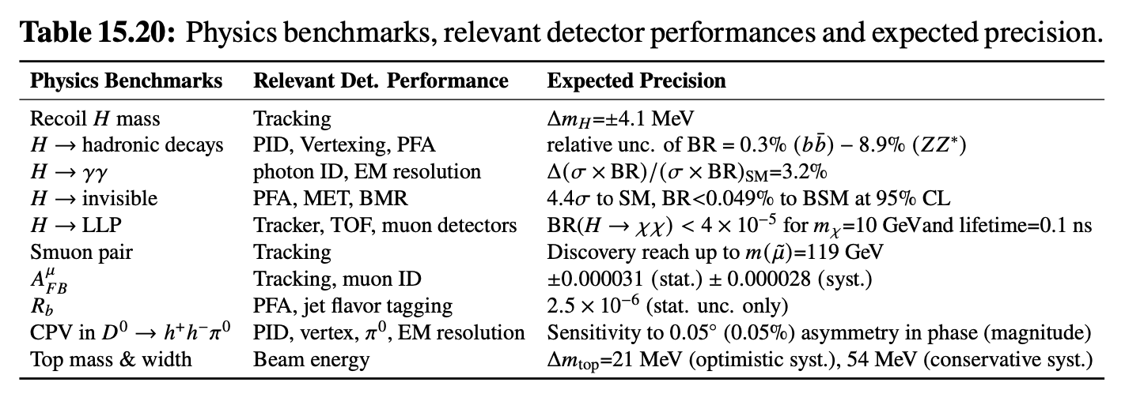
Recommendations
DETECTOR PEREORMANCE
The physics benchmarks listed in Table 15.3 are intended to demonstrate the performance of the reference detector. Each listed study should be discussed explicitly, explaining the role of the detector performance in achieving the result. Currently, only a subset (e.g., Higgs recoil mass, Higgs branching ratios, weak mixing angle from Z→μμ) are covered. Other channels (exotic Higgs decays, LLPs, CVP in D-meson decays) should also be summarized, possibly in a summary table.
Sections 15.2.2 – 15.2.11 discuss and cover 10 analyses listed in the Table 15.3, and Table 15.20 summarizes the achieved sensitivities for all those channels.

Slide 6
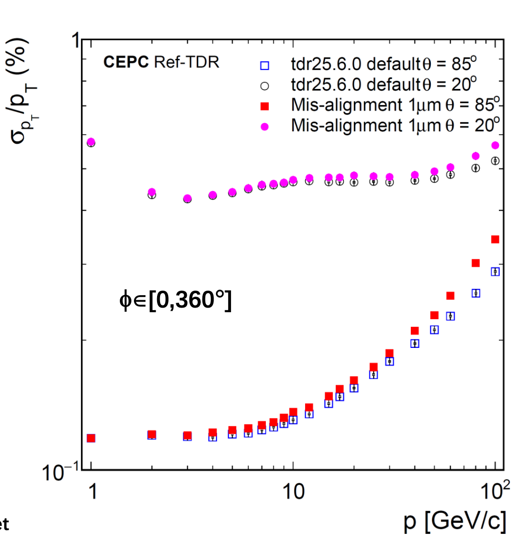
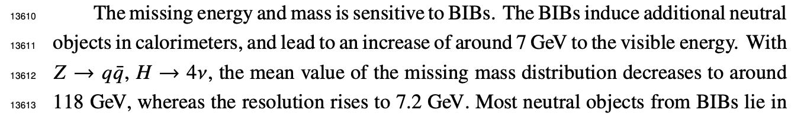
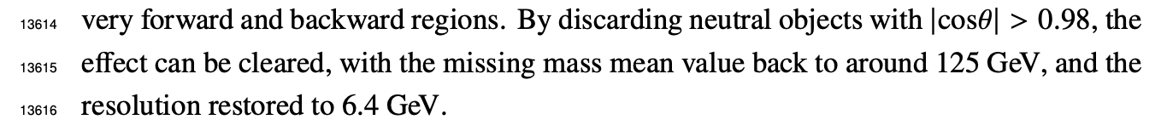
Recommendations
DETECTOR PEREORMANCE
The technical improvements planned for more detailed simulation (noise, event overlap, misalignments, calibration effects) should be pursued, and their impact on physics performance carefully demonstrated.
  Noise are included by default.
  Preliminary studies on beam induced background through event overlap, including incoherent pairs creation (dominant)
    No significant impact on tracking efficiency
    5% worse resolution – negligible impact
    Significant impact on missing energy/mass documented in 15.1.9,
    which can be mitigated by a requirement of |cosθ|<0.98 for neutral objects
With alignment precision expected (1 𝝁m), no significant misalignment effects expected on tracking
  the effect can be further reduced by correcting the bias according to angle (post-TDR development)
Calibration: PFA reconstruction includes preliminary simple calibration on ECAL/HCAL clusters
  Figure 7.18 shows the ECAL energy resolution for 5 different calibration precision ranging from 1 % to 10 %, indicates that the calibration precision of 1 % yields around a 0.3 % degradation on the constant term

Slide 7
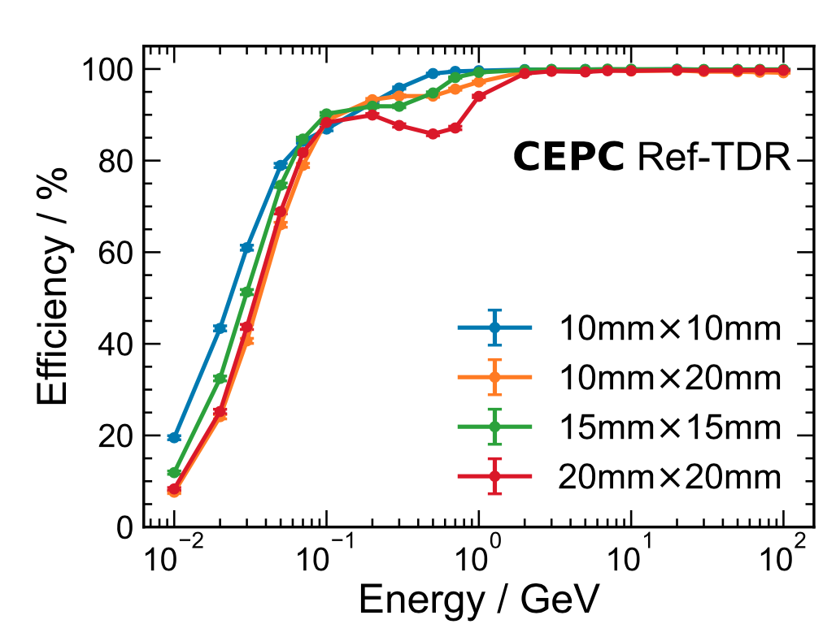
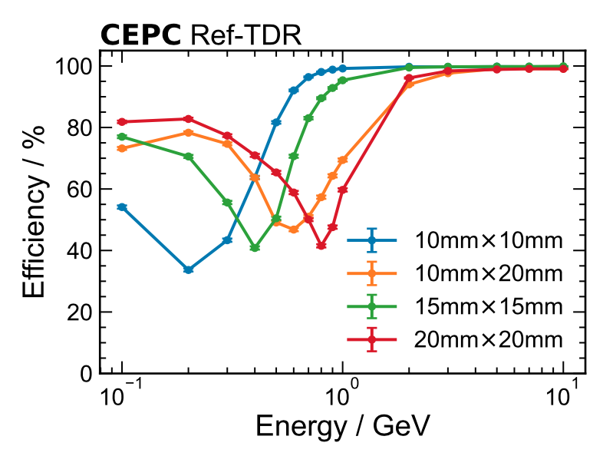
Recommendations
DETECTOR PEREORMANCE
Several specific technical issues should be clarified and potentially improved:
The photon efficiency behaviour around E = 1 GeV appears unusual and should be either justified or corrected, as it could impact EM/hadronic separation in PFA and influence missing energy and mass resolution.
corrected and shown in ECAL chapter, Figure 7.21(a).
No unusual behavior in the chosen configuration （15mmX15mm）
corrected

Slide 8
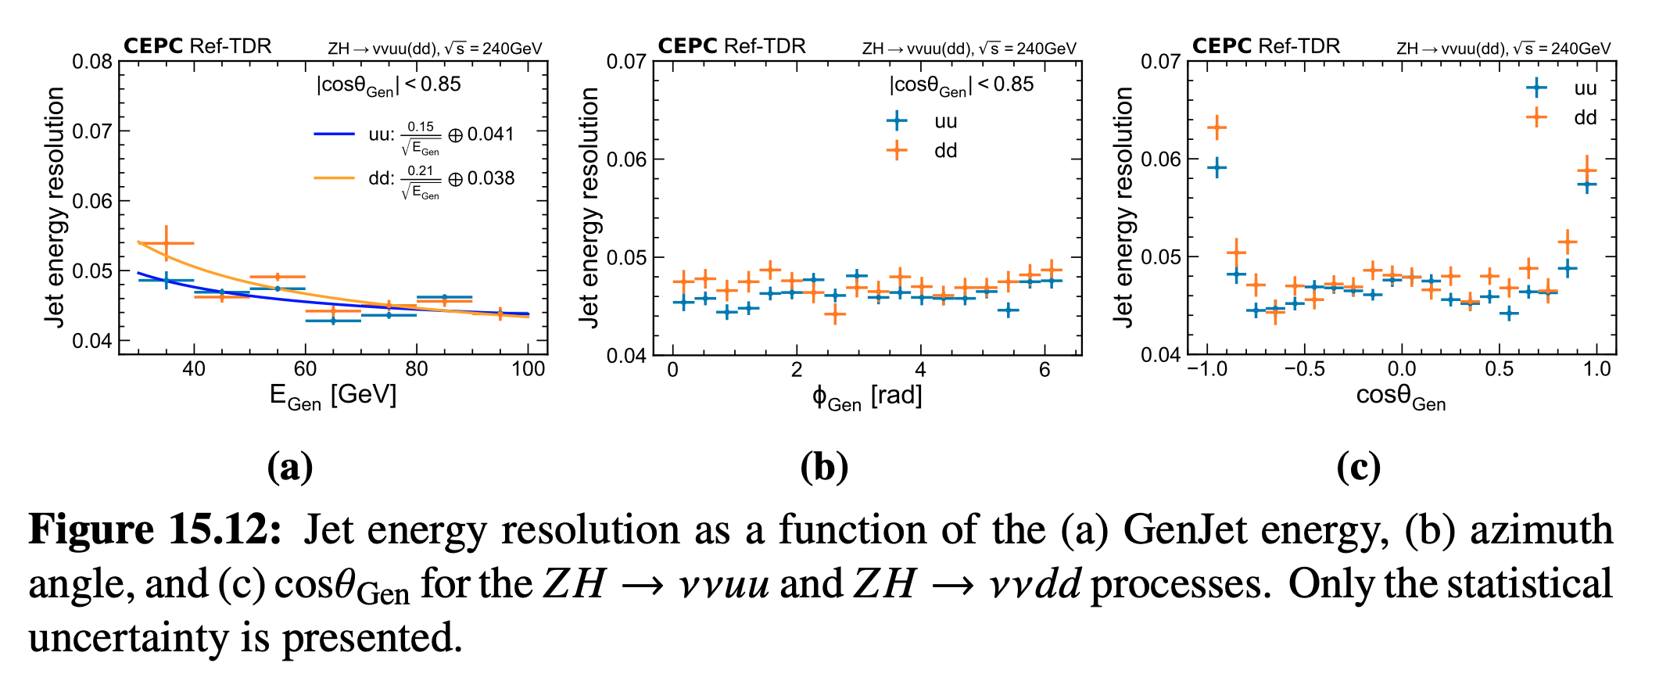
Recommendations
DETECTOR PEREORMANCE
Jet energy resolution for light quarks should be studied more systematically and used as a benchmark metric.
JER now made with u/d light quarks, similar performance seen as previous with b quarks

Slide 9
Recommendations
DETECTOR PEREORMANCE
Missing energy reconstruction should be further investigated, particularly in b- and c-jet events with tagged leptons and in BSM channels with large ETmiss.
New section 15.1.9 shows performance on ” Missing energy, momentum, mass”
Section 15.2.5 documents studies of the H->invisible channel
(Longer term) Tracking performance should be tested in exotic scenarios, such as long-lived particles.
Currently Section 15.2.6 shows studies on long-lived particles.
(If possible) Include photon conversions in tracking studies as a material probe and describe their treatment in PFA.
Figure 15.5 shows material budget and conversion rate vs. cos(theta).
Currently converted photon treated as two charged tracks in PFA, further improvement planed in post-TDR development.
Particle identification needs further organization and development:
  Currently, simple cuts are applied; more sophisticated algorithms (including ML-based methods) should be considered, balancing the ambition against available time and resources. A simpler multivariate approach could serve as an intermediate step.
  XGBoost is default now
  Different working points ("tight" for high purity, "loose" for high efficiency) should be defined and used consistently across analyses (e.g., Figure 15.7, where a 90% WP for muon/electron ID is mentioned). Coherence with PFA must be ensured (avoiding double-counting residual energy, etc.)
  BEST WP are now used consistently across analyses.

Slide 10
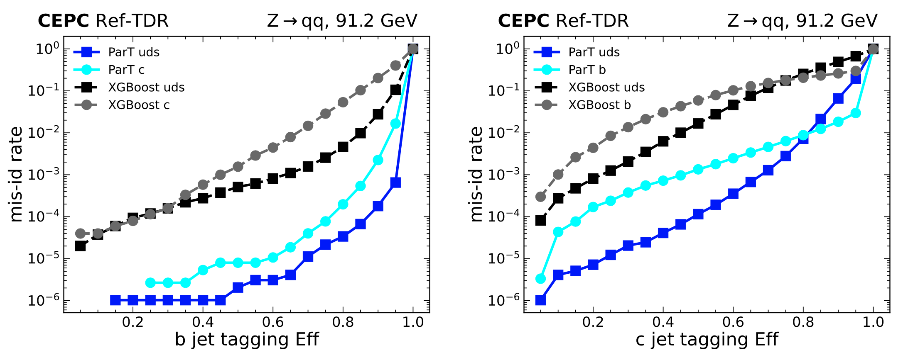
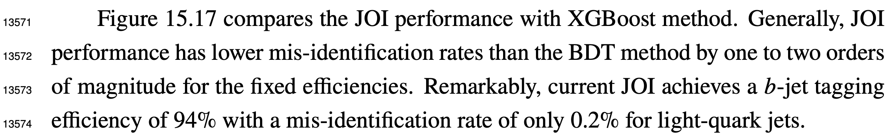
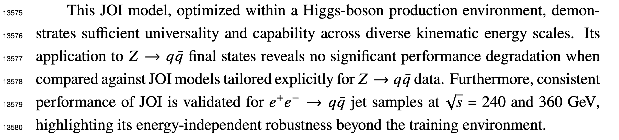
Recommendations
DETECTOR PEREORMANCE
The description of jet flavor identification needs to be streamlined. Currently, information is dispersed across sections (vertexing, tracking, PFA). A concise but complete description should be provided in one place
Now it’s all in Section 15.1.8
  A brief overview of standard Jet Flavour Tagging (JFT) is given in Section15.2.6, while Jet Origin Identification (JOI) is discussed in 15.2.7. However, it is unclear what performance gains are achieved by moving from JFT to JOI.
  Figure 15.17 shows the improvement from standard JFT to JOI: 1-2 orders of magnitude lower mis-ID rate
  Benchmark comparisons (b/c-tagging efficiency versus misidentification rates at Z-pole and ZH 240 GeV) should be provided to evaluate performance systematically.
  When JOI model trained with Higgs sample, and
  performance evaluated at ZH and Z-pole,
  no significant difference seen.

Slide 11
Recommendations
DETECTOR PEREORMANCE
The offline software environment is evolving rapidly. Performance studies should be conducted with synchronized and version-controlled frameworks, especially as CyberPFA depends critically on tracking, particle ID, calibration, and alignment inputs.
yes, all performance shown have been obtained with CEPCSW-25.3.7
A centralized database tracking the produced samples and their statistics should be maintained and updated (extending Table 15.4). Technical samples (e.g., single electrons, muons, decaying kaons for PFA studies) should be included and documented similarly for use in detector performance validation.
a centralized database created and maintained with IHEP gitlab service (in CEPCSW code repository)

Slide 12
Recommendations
DETECTOR PEREORMANCE
Longer-Term Considerations (for post-TDR development)
  Consider a dedicated chapter for jet flavour tagging, especially given the comprehensive nature of JOI (which involves many sub-detectors). Comparative studies between "ideal" and "compromised" performance would also help derive systematic uncertainties in the AI-based approach.
    Section 15.1.8 now focuses on JOI, and also show the comparative studies in Figure 15.16
  The confusion matrix (Fig. 15.22) suggests JOI could distinguish quarks from antiquarks. If validated, this could significantly improve flavour-specific AFB measurements. Physics benchmarks involving b/c-quark AFB (or even strange quarks) should be added if feasible.
    Study already ongoing, but not mature yet, no plan to include it in TDR
  Organizing "data challenges," as mentioned in the "Offline Software and Computing" section, could be valuable. These would serve both as benchmarks for detector performance and stress tests for computing models (through massive production, analysis, and quality checks)
    From the experience of March exercise, it will take ~2 months for full sample production and another 1-2 months for updating all results. We will organize such data challenges post-TDR

Slide 13
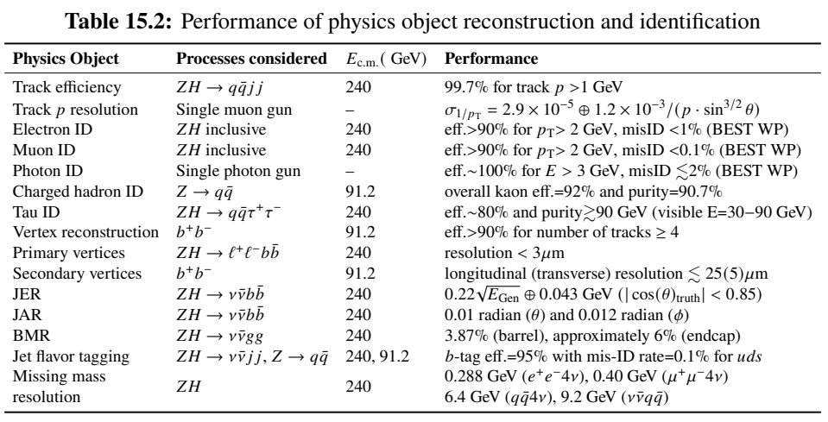
Comments on Draft v0.4.1
  The particle ID section 15.1 are now readable and well structured It would be nice if the section 15.1 ends up with a conclusion summarizing the salient performance features observed in these studies. I suggest a table of this type.
Section 15.1.10 is added to summarize the performance with a table with objects ordered consistently with the subsection structure.

Slide 14
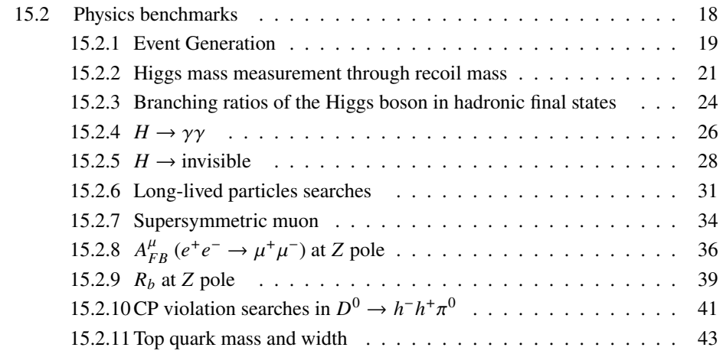
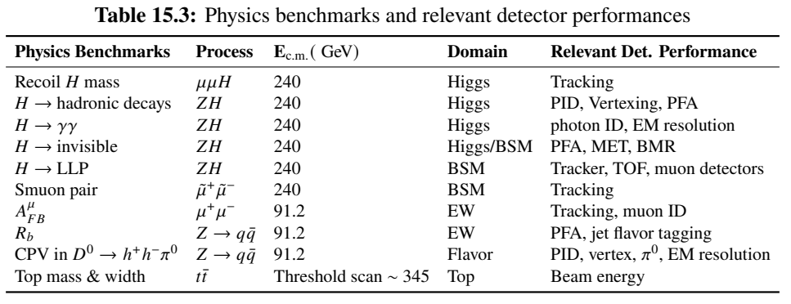
Comments on Draft v0.4.1
The physics benchmarks in section 15.2 should be listed by physics domain and in the same order as introduced in table 15.3
  We have updated the table based on the physics domain and center-of-mass energies. The subsections are ordered consistently now.
in table 15.3 W fusion appears out of order (the domain is “Higgs”). Maybe move it up together with “Higgs”.
  We have decided to remove the W fusion, as the analysis did not converge on time & is unlikely to do so in a short time scale.

Slide 15
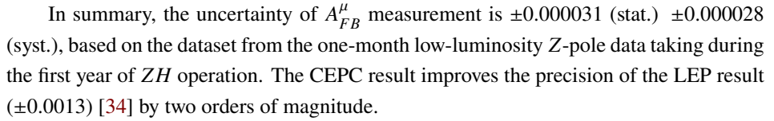
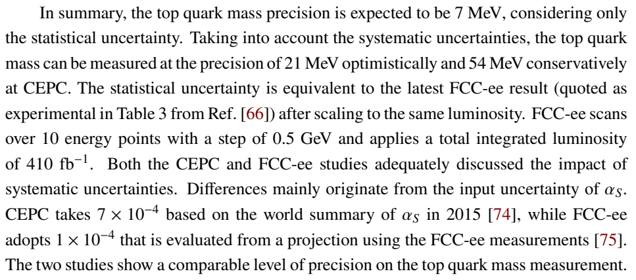
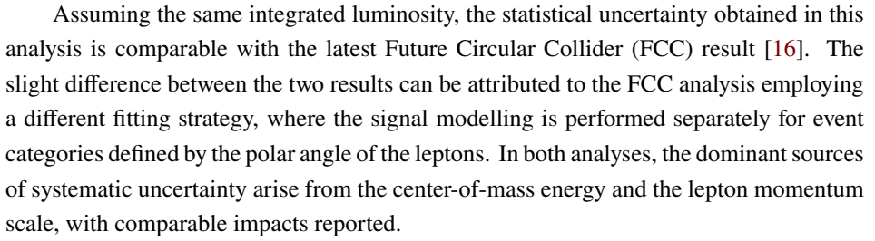
Comments on Draft v0.4.1
15.2 please make sure that each analysis presented have 1-2 phrases at the end to compare with a reference analysis (for instance present state of the art, limits from LHC or previous LEP results etc) This exists in some places but not everywhere.
  Sentences are added at the end of each
  analysis subsections.
-This is not necessarily for this document, but on a few benchmarks items (MHiggs, MTop etc.) it would be good to have a direct comparison with FCCee studies. (and good answers if significant differences are observed) → We don’t include in the document, but a direct comparison to FCCee are provided in the final review talk
Mhiggs
MTop

Slide 16
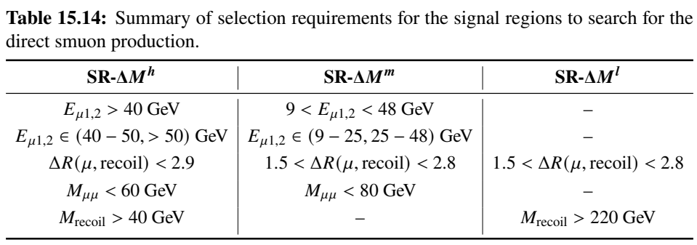
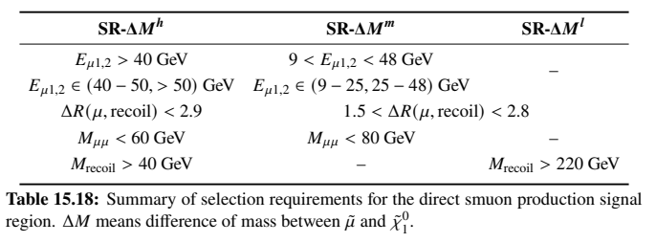
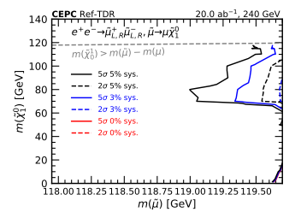
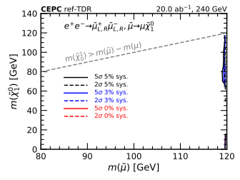
Comments on Draft v0.4.1
Table 15.18: maybe having the cell limits would help readability?
  Added a vertical line and made a few minor cosmetic changes (e.g. avoided merging cells)
-Figure 15.33 : are the contours right? They seem to be confined at the right of the figure and are not readable.
  The contours are correct, but indeed were
  not readable. We zoomed in the figure.
  The left side of the contours are fully
  excluded.
New
V0.4.1
V0.4.1
New

Slide 17
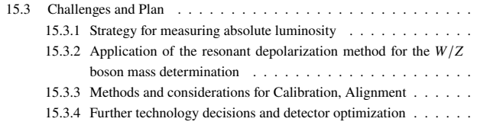
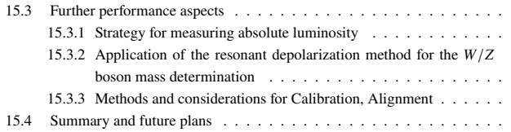
Comments on Draft v0.4.1
- The section 15.3 : I suggest to move the subsection 15.3.4 as a part of the final section, to be renamed as “Summary and future plans”.
- I suggest to rename the section 15.3 as: “Further performance aspects”
  The new structure is as below.
-I suggest a proof reading, there are a few editorial minute errors left in the text. (make the references uniform etc.) But in general the text is OK.
  We went through the chapter again and made detailed updates to improve readability.
V0.4.1
New

