Slide 1


Grant no. 12135007
Craig Roberts … http://inp.nju.edu.cn/
Emergent Hadron Mass:
Origins and Consequences III

Slide 2
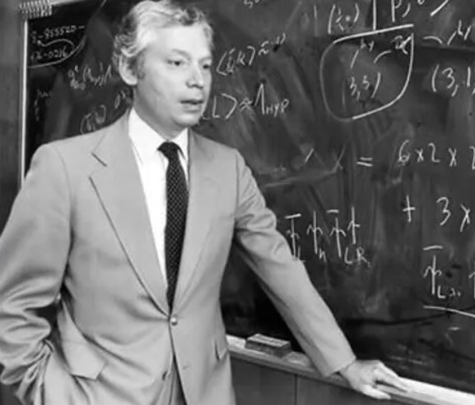
Nature of Physics
Steven Weinberg
Born: May 3, 1933, New York, NY
Died: July 23, 2021, Austin, TX
“The effort to understand the universe is one of the very few things that lifts human life a little above the level of farce and gives it some of the grace of tragedy.”
“Nothing in the last five hundred years has had so great an effect on the human spirit as the discoveries of modern science.”
“I know of no one who has participated actively in the advance of physics in the postwar period whose research has been significantly helped by the work of philosophers.”
“Science is the path to truth”

Slide 3
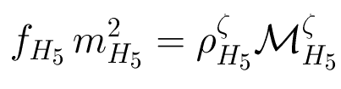
Dichotomy of the pion Mass Formula for 0— Mesons
Maris, Roberts and Tandy
nucl-th/9707003, Phys.Lett. B420 (1998) 267-273
Mass-squared of the pseudoscalar hadron
Sum of the current-quark masses of the constituents;
e.g., pion = m_{u}^{ς} + m_{d}^{ς} , where “ς” is the renormalisation point

Slide 4

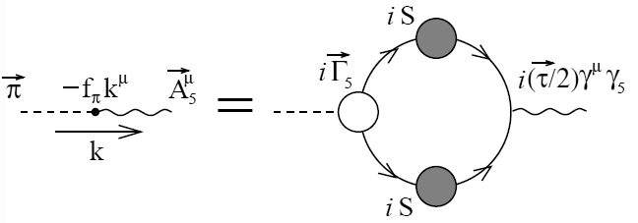
Dichotomy of the pion Mass Formula for 0— Mesons
Maris, Roberts and Tandy
nucl-th/9707003, Phys.Lett. B420 (1998) 267-273
Pseudovector projection of the Bethe-Salpeter wave function onto the origin in configuration space
Namely, the pseudoscalar meson’s leptonic decay constant, which is the strong interaction contribution to the strength of the meson’s weak interaction

Slide 5
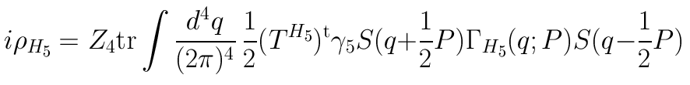
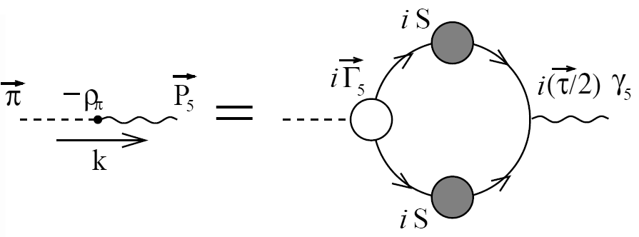
Dichotomy of the pion Mass Formula for 0— Mesons
Maris, Roberts and Tandy
nucl-th/9707003, Phys.Lett. B420 (1998) 267-273
Pseudoscalar projection of the Bethe-Salpeter wave function onto the origin in configuration space
Namely, a pseudoscalar analogue of the meson’s leptonic decay constant

Slide 6
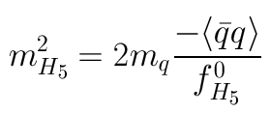
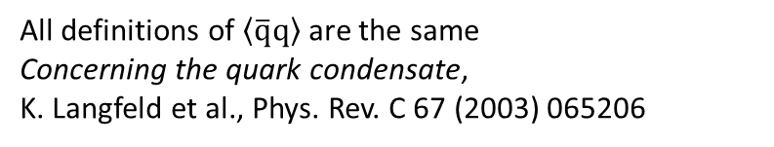
Dichotomy of the pion Mass Formula for 0— Mesons
Maris, Roberts and Tandy
nucl-th/9707003, Phys.Lett. B420 (1998) 267-273
Consider the case of light quarks; namely, m_{q} ≈ 0
If chiral symmetry is dynamically broken, then
f_{H5} → f_{H5}⁰ ≠ 0
ρ_{H5} → – < q-bar q> / f_{H5}⁰ ≠ 0
both of which are independent of m_{q}
Hence, one arrives at the corollary
The so-called
“vacuum quark condensate.”
It’s actually
contained within hadrons.
Gell-Mann, Oakes, Renner relation
1968
All definitions of $\left\langle \overline{q}q\right\rangle$ are the same
Concerning the quark condensate,
K. Langfeld et al., Phys. Rev. C 67 (2003) 065206

Slide 7

Dynamical Chiral Symmetry Breaking Vacuum Condensates?

Slide 8

“Orthodox Vacuum”
Vacuum = “frothing sea”
Hadrons = bubbles in that “sea”,
containing nothing but quarks & gluons
interacting perturbatively, unless they’re
near the bubble’s boundary, whereat they feel they’re trapped!
u
d
u
u
d
u
u
u
d

Slide 9
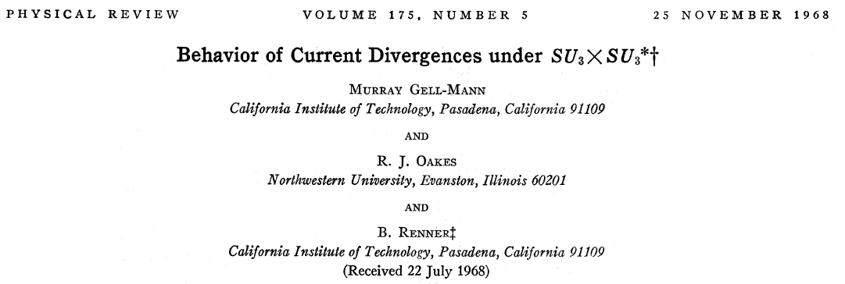
GMOR Relation

Slide 10

Gell-Mann – Oakes – Renner Relation
Behavior of current divergences under SU(3) x SU(3).
Murray Gell-Mann, R.J. Oakes , B. Renner
Phys.Rev. 175 (1968) 2195-2199
This paper derives a relation between
m_{π}² and the expectation-value < π|u₀|π>,
where u_{o} is an operator that is linear in the putative Hamiltonian’s explicit chiral-symmetry breaking term
NB. QCD’s current-quarks were not yet invented, so u₀ was not expressed in terms of current-quark fields
PCAC-hypothesis (partial conservation of axial current) is used in the derivation
Subsequently, the concepts of soft-pion theory
Operator expectation values do not change as t=m_{π}² → t=0
to take < π|u₀|π> → < 0|u₀|0> … in-pion → in-vacuum
Notes:
(8)

Slide 11

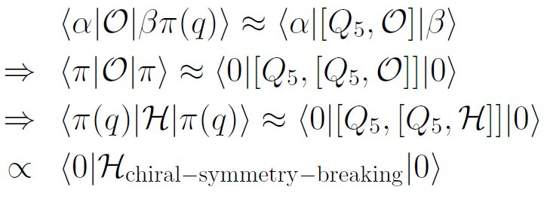

Gell-Mann – Oakes – Renner Relation
Behavior of current divergences under SU(3) x SU(3).
Murray Gell-Mann, R.J. Oakes , B. Renner
Phys.Rev. 175 (1968) 2195-2199
PCAC hypothesis; viz., pion field dominates divergence of the axial-vector current
Soft-pion theorem
In QCD,
this is and one therefore has
Zhou Guangzhao 周光召
Born 1929 Changsha, Hunan province
Commutator is chiral rotation
Therefore, isolates explicit
chiral-symmetry breaking term
in the putative Hamiltonian
Notes:
(8)

Slide 12
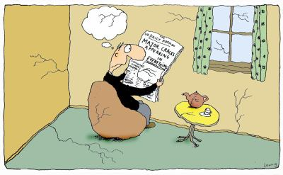
Gell-Mann – Oakes – Renner Relation
- (0.25GeV)³
Theoretical physics at its best.
But no one is thinking about how properly to consider or define what will come to be called the
vacuum quark condensate
So long as the condensate is
just a mass-dimensioned
constant, which approximates
another well-defined matrix
element, there is no problem.
Problem arises if one
over-interprets this number,
which textbooks have been doing
for a VERY LONG TIME.
Notes:
(8)

Slide 13
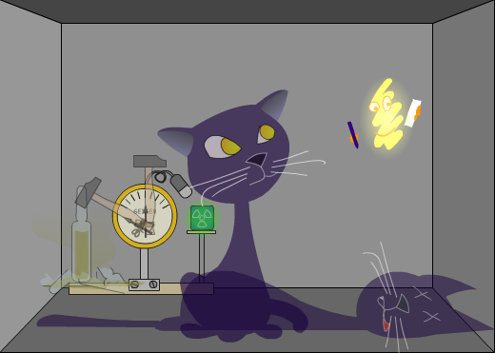
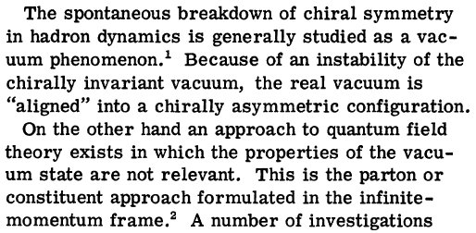
Note of Warning
Chiral Magnetism (or Magnetohadrochironics)
A. Casher and L. Susskind, Phys. Rev. D9 (1974) 436
These authors argue
that dynamical chiral-
symmetry breaking
can be realised as a
property of hadrons,
instead of via a
nontrivial vacuum exterior to the measurable degrees of freedom
The essential ingredient required for a spontaneous symmetry breakdown in a composite system is the existence of a divergent number of constituents
– DIS provided evidence for divergent sea of low-momentum partons – parton model.
Notes:
(10)

Slide 14
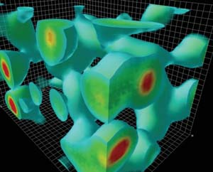

QCD Sum Rules
QCD and Resonance Physics. Sum Rules.
M.A. Shifman, A.I. Vainshtein, and V.I. Zakharov
Nucl.Phys. B147 (1979) 385-447; citations: 3713
Introduction of the gluon vacuum condensate
and development of “sum rules” relating properties of low-lying hadronic states to vacuum condensates
Notes:
(10)

Slide 15

QCD Sum Rules
QCD and Resonance Physics. Sum Rules.
M.A. Shifman, A.I. Vainshtein, and V.I. Zakharov
Nucl.Phys. B147 (1979) 385-447; citations: 3781
Introduction of the gluon vacuum condensate
and development of “sum rules” relating properties of low-lying hadronic states to vacuum condensates
At this point (1979), the cat was out of the bag: a physical reality was seriously attributed to a plethora of so-called vacuum condensates
Notes:
(10)

Slide 16
“quark condensate” 1960-1980
Instantons in non-perturbative QCD vacuum,
MA Shifman, AI Vainshtein… - Nuclear Physics B, 1980
Instanton density in a theory with massless quarks,
MA Shifman, AI Vainshtein… - Nuclear Physics B, 1980
Exotic new quarks and dynamical symmetry breaking,
WJ Marciano - Physical Review D, 1980
The pion in QCD
J Finger, JE Mandula… - Physics Letters B, 1980
No references to this phrase before 1980
20,000+ references to this phrase since 1980
Notes:
(10)

Slide 17

Universal Conventions
Wikipedia: (http://en.wikipedia.org/wiki/QCD_vacuum)
“The QCD vacuum is the vacuum state of quantum chromodynamics (QCD). It is an example of a non-perturbative vacuum state, characterized by many non-vanishing condensates such as the gluon condensate or the quark condensate. These condensates characterize the normal phase or the confined phase of quark matter.”
Notes:
(23)

Slide 18
Precedent?
Notes:
(10)

Slide 19
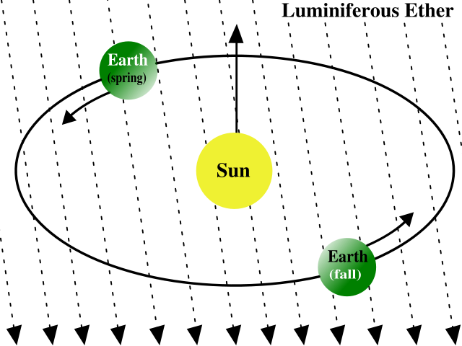
Precedent- Luminiferous Aether
Pre-1887
Since the Earth is in motion, the flow of aether across
the Earth should produce a detectable “aether wind”
Physics theories of the late 19th century postulated that, just as water waves must have a medium to move across (water), and audible sound waves require a medium to move through (such as air or water), so also light waves require a medium, the “luminiferous aether”.
Apparently unassailable logic
Until, of course, “… the most famous failed experiment to date.”
On the Relative Motion of the Earth and the Luminiferous Ether
Michelson, Albert Abraham & Morley, Edward Williams
American Journal of Science 34 (1887) 333–345.
Notes:
(10)

Slide 20
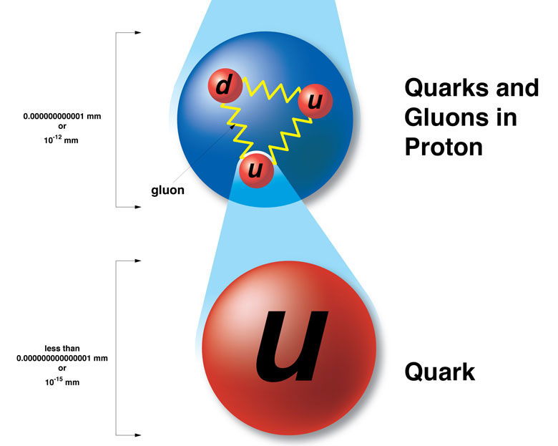
QCD
1973-1974
How should one approach this problem, understand it,
within Quantum ChromoDynamics?
Are the quark and gluon “condensates” theoretically well-defined?
Is there a physical meaning to this quantity or is it merely just a mass-dimensioned parameter in a theoretical computation procedure?
Notes:
(10)

Slide 21
QCD
1973-1974
Why does it matter?
Notes:
(10)

Slide 22
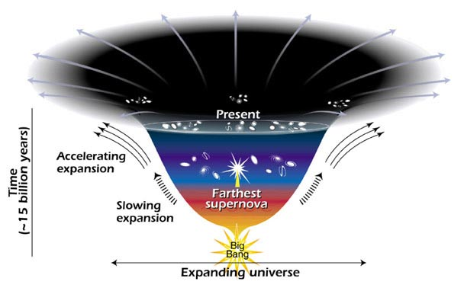
“Dark Energy”
Two pieces of evidence for an accelerating universe
Observations of type Ia supernovae
→ the rate of expansion of the Universe is growing
Measurements of the composition of the Universe point to a missing energy component with negative pressure:
CMB anisotropy measurements indicate that the Universe is at
Ω₀ = 1 ⁺⁄₋ 0.04.
In a flat Universe, the matter density and energy density must sum to the critical density. However, matter only contributes about ⅓ of the critical density,
Ω_{M} = 0.33 ⁺⁄₋ 0.04.
Thus, ⅔ of the critical density is missing.
Notes:
(10)

Slide 23
“Dark Energy”
In order to have escaped detection,
the missing energy must be smoothly
distributed.
In order not to interfere with the formation of structure (by inhibiting the growth of density perturbations) the energy density in this component must change more slowly than matter (so that it was subdominant in the past).
Accelerated expansion can be accommodated in General Relativity through the Cosmological Constant, Λ.
Einstein introduced the repulsive effect of the cosmological constant in order to balance the attractive gravity of matter so that a static universe was possible. He promptly discarded it after the discovery of the expansion of the Universe.
Contemporary cosmological observations mean:
Notes:
(10)

Slide 24

“Dark Energy”
“The advent of quantum field theory made consideration of the cosmological constant obligatory not optional.”
Michael Turner, “Dark Energy and the New Cosmology”
The only possible covariant form for the energy of the (quantum) vacuum; viz.,
is mathematically equivalent to the cosmological constant.
“It is a perfect fluid and precisely spatially uniform”
“Vacuum energy is almost the perfect candidate for dark energy.”
Notes:
(10)

Slide 25
“Dark Energy”
Enormous and even greater contribution from Higgs VEV!
QCD vacuum contribution
If chiral symmetry breaking is expressed in a nonzero expectation value of the quark bilinear, then the energy difference between the symmetric and broken phases is of order
M_{QCD}≈0.3 GeV
One obtains therefrom:
Mass-scale generated by
spacetime-independent
condensate
“The biggest embarrassment in theoretical physics.”
Notes:
(10)

Slide 26
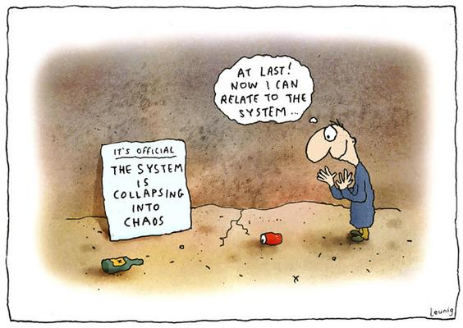
Resolution?

Slide 27
QCD
1973-1974
Are the condensates real?
Is there a physical meaning to the vacuum quark condensate (and others)?
Or is it merely just a mass-dimensioned parameter in a theoretical computation procedure?
Notes:
(10)

Slide 28
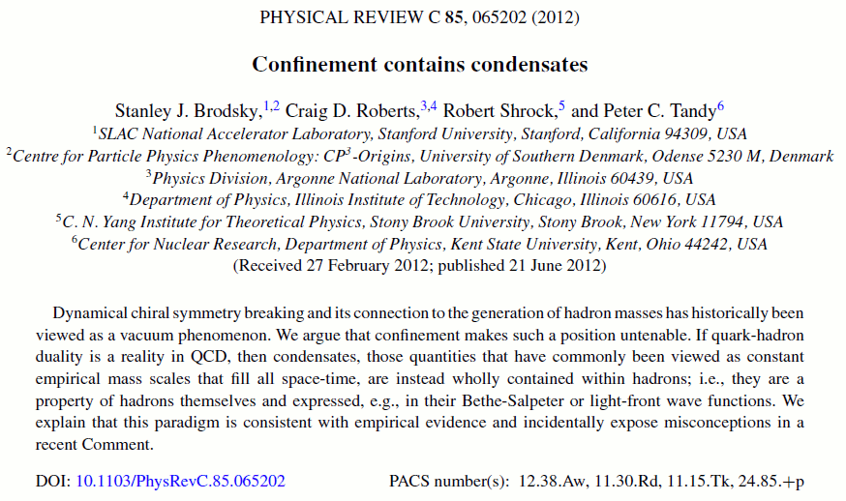
Confinement contains condensates

Slide 29

GMOR Relation
Expanding the concept of in-hadron condensates Lei Chang, Craig D. Roberts and Peter C. Tandy arXiv:1109.2903 [nucl-th], Phys. Rev. C85 (2012) 012201(R)
Valuable to highlight the precise form of the Gell-Mann–Oakes–Renner (GMOR) relation: Eq. (3.4) in Phys.Rev. 175 (1968) 2195
m_{π} is the pion’s mass
H_{χsb} is that part of the hadronic Hamiltonian density which explicitly breaks chiral symmetry.
The operator expectation value in this equation is evaluated between pion states.
Un-approximated form of the GMOR relation doesn’t make any reference to a vacuum condensate

Slide 30
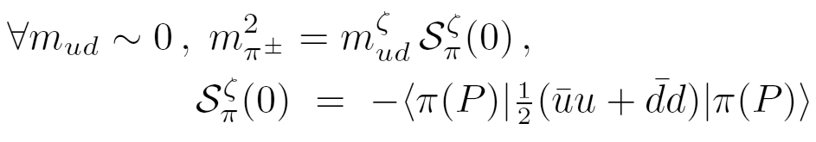
Gell-Mann Oakes Renner Relation
Expanding the concept of in-hadron condensates Lei Chang, Craig D. Roberts and Peter C. Tandy arXiv:1109.2903 [nucl-th], Phys. Rev. C85 (2012) 012201(R)
Readily demonstrated algebraically that the so-called Gell-Mann – Oakes – Renner relation is the following statement
Namely, the mass of the pion is completely determined by the pion’s scalar form factor at zero momentum transfer Q² = 0.
viz., by the pion’s scalar charge

Slide 31
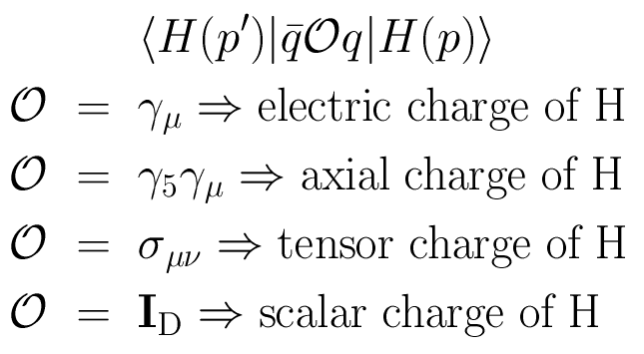
Hadron Charges
Matrix elements associated with hadron form factors
Scalar charge of a hadron is an intrinsic property of that hadron … no more a property of the vacuum than the hadron’s electric charge, axial charge, tensor charge, etc. …

Slide 32
“Orthodox Vacuum”
Vacuum = “frothing sea”
Hadrons = bubbles in that “sea”,
containing nothing but quarks & gluons
interacting perturbatively, unless they’re
near the bubble’s boundary, whereat they feel they’re trapped!
u
d
u
u
d
u
u
u
d

Slide 33
New Paradigm
Vacuum = perturbative hadronic fluctuations
but no nonperturbative condensates
Hadrons = complex, interacting systems
within which perturbative behaviour is
restricted to just 2% of the interior
u
d
u
u
d
u
u
u
d

Slide 34

Paradigm shift: In-Hadron Condensates
“Void that is truly empty solves dark energy puzzle”
Rachel Courtland, New Scientist 4th Sept. 2010
“The biggest embarrassment in theoretical physics.”
“EMPTY space may really be empty. Though quantum theory suggests that a vacuum should be fizzing with particle activity, it turns out that this paradoxical picture of nothingness may not be needed. A calmer view of the vacuum would also help resolve a nagging inconsistency with dark energy, the elusive force thought to be speeding up the expansion of the universe.”
Cosmological Constant:
Putting QCD condensates back into hadrons
reduces the mismatch between experiment and theory by a factor of 10⁴⁶
Possibly by far more, if technicolour-like theories
are the correct paradigm for extending the Standard Model

Slide 35
Whence “1” and yet “0” ?
No statement of the question
“How does the mass of the proton arise?”
is complete without the additional clause
“How does the pion remain massless?”
Natural visible-matter mass-scale must emerge simultaneously with apparent preservation of scale invariance in related systems
Expectation value of Θ₀ in pion is always zero,
irrespective of the size of the natural mass-scale for strong interactions = m_{p}
Modern Physics must
Elucidate the entire array of Empirical Consequences
of the Mechanism responsible
so that the Standard Model can be Tested and Bounded

Slide 36
Whence “0” ?

Slide 37
Whence “0” ?
The answer is algebraic

Slide 38
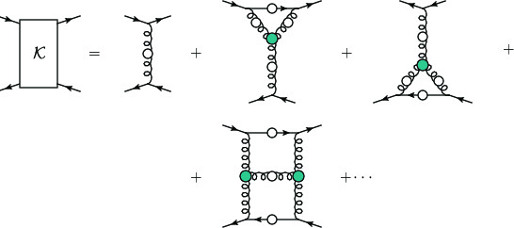
Pion masslessness
Pion’s Poincaré-invariant mass and Poincaré-covariant wave function are obtained by solving a Bethe-Salpeter equation.
This is a scattering problem
In chiral limit
two massless fermions interact via exchange of massless gluons … initial system is massless;
… and it remains massless at every order in perturbation theory
But complete the calculation using an enumerable infinity of dressings and scatterings
Then …

Slide 39
Pion masslessness
Munczek, H. J., Phys. Rev. D 52 (1995) pp. 4736-4740
Bender, A., Roberts, C.D. and von Smekal, L., Phys. Lett. B 380 (1996) pp. 7-12
Maris, P. , Roberts, C.D. and Tandy, P.C., Phys. Lett. B 420 (1998) pp. 267-273
Binosi, Chang, Papavassiliou, Qin, Roberts, Phys. Rev. D 93 (2016) 096010/1-7
Obtain a coupled set of gap- and Bethe-Salpeter equations
Bethe-Salpeter Kernel:
valence-quarks with a momentum-dependent running mass produced by self-interacting gluons, which have given themselves a running mass
Interactions of arbitrary but enumerable complexity involving these “basis vectors”
Chiral limit:
Algebraic proof
at any & each finite order in symmetry-preserving construction of kernels for
the gap (quark dressing)
and Bethe-Salpeter (bound-state) equations,
there is a precise cancellation between
mass-generating effect of dressing the valence-quarks
and attraction introduced by the scattering events
Cancellation guarantees that
simple system, which began massless,
becomes a complex system, with
a nontrivial bound-state wave function
attached to a pole in the scattering matrix, which remains at P²=0 …
Interacting, bound system remains massless!

Slide 40
Pion masslessness
Munczek, H. J., Phys. Rev. D 52 (1995) pp. 4736-4740
Bender, A., Roberts, C.D. and von Smekal, L., Phys. Lett. B 380 (1996) pp. 7-12
Maris, P. , Roberts, C.D. and Tandy, P.C., Phys. Lett. B 420 (1998) pp. 267-273
Binosi, Chang, Papavassiliou, Qin, Roberts, Phys. Rev. D 93 (2016) 096010/1-7
Obtain a coupled set of gap- and Bethe-Salpeter equations
Bethe-Salpeter Kernel:
valence-quarks with a momentum-dependent running mass produced by self-interacting gluons, which have given themselves a running mass
Interactions of arbitrary but enumerable complexity involving these “basis vectors”
Chiral limit:
Algebraic proof
at any & each finite order in symmetry-preserving construction of kernels for
the gap (quark dressing)
and Bethe-Salpeter (bound-state) equations,
there is a precise cancellation between
mass-generating effect of dressing the valence-quarks
and attraction introduced by the scattering events
Cancellation guarantees that
simple system, which began massless,
becomes a complex system, with
a nontrivial bound-state wave function
attached to a pole in the scattering matrix, which remains at P²=0 …
Interacting, bound system remains massless!
Quantum field theory statement:
In the pseudsocalar channel, the dynamically generated mass of the two fermions is precisely cancelled by the attractive interactions between them – iff –
f_{π} E_{π}(p²) = B(p²)
⇒ 2 M_{q} + U_{g} ≡ 0

Slide 41
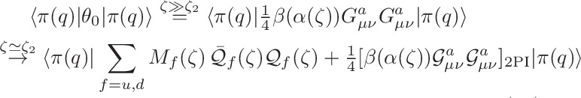
Pion masslessness
EHM Paradigm
̃ ̃
̃ ̃
Parton-basis chiral-limit expression of the expectation-value of the trace-anomaly in the pion at ζ ≫ ζ₂
Metamorphoses into a new expression, written in terms of a nonperturbatively-dressed quasi-particle basis and associated, evolved wave functions
1st term = positive = one-body dressing content of the trace anomaly … Plainly, a massless valence-quark acquiring a large mass through interactions with its own gluon field is an expression of the trace-anomaly in the one-body subsector of the complete pion wave function
2nd term = negative (attraction) = 2-particle-irreducible scattering event content of the scale-anomaly … Plainly, acquires a scale because the couplings, and the gluon- and quark-propagators in the 2PI processes have all acquired a mass-scale
Away from the chiral limit, and in other channels, the cancellation is incomplete.

Slide 42

Massless Pion
Chiral limit
⇒
“Zero” owes to cancellations between different operator-component contributions to the expectation value of Θ₀.
The cancellations are precise
Arising naturally because chiral symmetry – the apparent masslessness of the QCD action – is broken by strong dynamics in a very particular manner.
In the chiral limit, the pion is massless irrespective of the magnitude of any other hadron’s mass

Slide 43
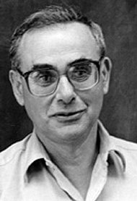
Enigma of mass
The quark level Goldberger-Treiman relation shows that DCSB has a very deep and far reaching impact on physics within the strong interaction sector of the Standard Model; viz.,
Goldstone's theorem: fundamentally an expression of equivalence between one-body problem
and the two-body problem in
the pseudoscalar channel.
This emphasises that Goldstone's theorem has a pointwise expression in QCD
Hence, pion properties are an almost direct measure of
the dressed-quark mass function.
Thus, enigmatically, the properties of the massless pion
are the cleanest expression of the mechanism that is
responsible for almost all the visible mass in the universe.
f_{π} E_{π}(p²) = B(p²)
Maris, Roberts and Tandy
nucl-th/9707003, Phys.Lett. B420 (1998) 267-273

Slide 44
S. Weinberg “The Quantum Theory of Fields … Volume I … Foundations ”
The point of view of this book is that quantum field theory is the way it is because (with certain qualifications) this is the only way to reconcile quantum mechanics with special relativity.

Slide 45
“Best” “Practical” Introductions to Quantum Field Theory and QCD
Mattuck, R. D., A guide to Feynman diagrams in the many-body problem (Dover Publications, inc., New York, 1976/1992)
Itzykson, Claude and Zuber, Jean-Bernard, Quantum Field Theory (McGraw-Hill Inc., New York, 1980)
Pascual, P. and Tarrach, R., QCD: Renormalization for the Practitioner, Lecture Notes in Physics 194 (Springer-Verlag, Berlin, 1984)
Roberts, C. D. and Williams, A. G., Dyson-Schwinger equations and their application to hadronic physics, Prog. Part. Nucl. Phys. 33 (1994) pp. 477-575. hep-ph/9403224
Roberts, C. D., Strong QCD and Dyson-Schwinger Equations, IRMA Lect. Math. and Theor. Phys. 21 (2015) pp. 356-458. arXiv:1203.5341

Slide 46
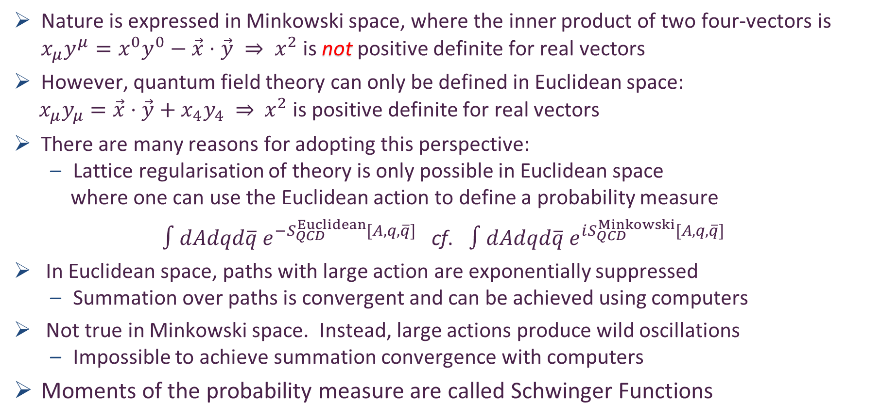
Nature’s Natural Space
Nature is expressed in Minkowski space, where the inner product of two four-vectors is $x_{μ}y^{μ}=x^{0}y^{0}−\vec{x}⋅\vec{y} ⇒ x^{2}$ is not positive definite for real vectors
However, quantum field theory can only be defined in Euclidean space:
$x_{μ}y_{μ}=\vec{x}⋅\vec{y}+x_{4}y_{4} ⇒{ x}^{2}$ is positive definite for real vectors
There are many reasons for adopting this perspective:
Lattice regularisation of theory is only possible in Euclidean space
where one can use the Euclidean action to define a probability measure
$∫dAdqd\overline{q} e^{−S_{QCD}^{Euclidean}[A,q,\overline{q}]}$ cf. $∫dAdqd\overline{q} e^{iS_{QCD}^{Minkowski}[A,q,\overline{q}]}$
In Euclidean space, paths with large action are exponentially suppressed
Summation over paths is convergent and can be achieved using computers
Not true in Minkowski space. Instead, large actions produce wild oscillations
Impossible to achieve summation convergence with computers
Moments of the probability measure are called Schwinger Functions

Slide 47
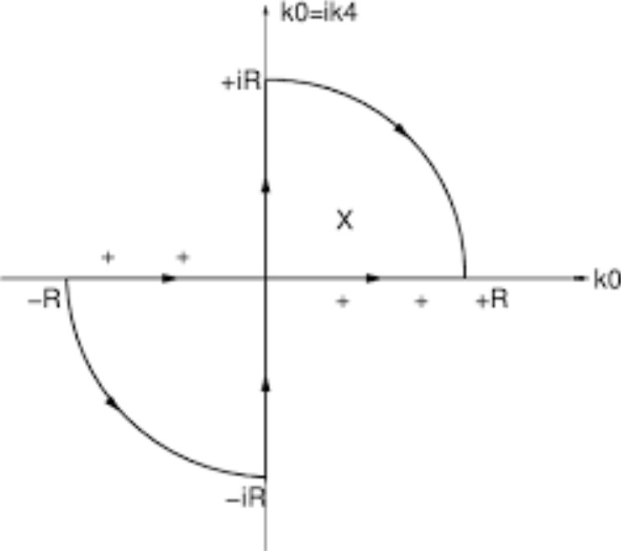
Nature’s Natural Space
Choice must be made because any “Wick rotation” between Minkowski space and Euclidean space is a purely formal exercise
validity is only guaranteed for perturbative calculations
If QCD really does (somehow) explain emergence of hadron mass and structure, then …
nonlinear, nonperturbative dynamics
must be crucial
Consequently …
when calculating & summing the necessarily infinite collection of processes associated with a given experimental observable
one cannot assume that any of the requirements necessary to mathematically justify a Wick rotation are satisfied
Nonanalyticities in these quadrants will break simple form correspondence between Minkowski and Euclidean space equations
May completely destroy all correspondences

Slide 48
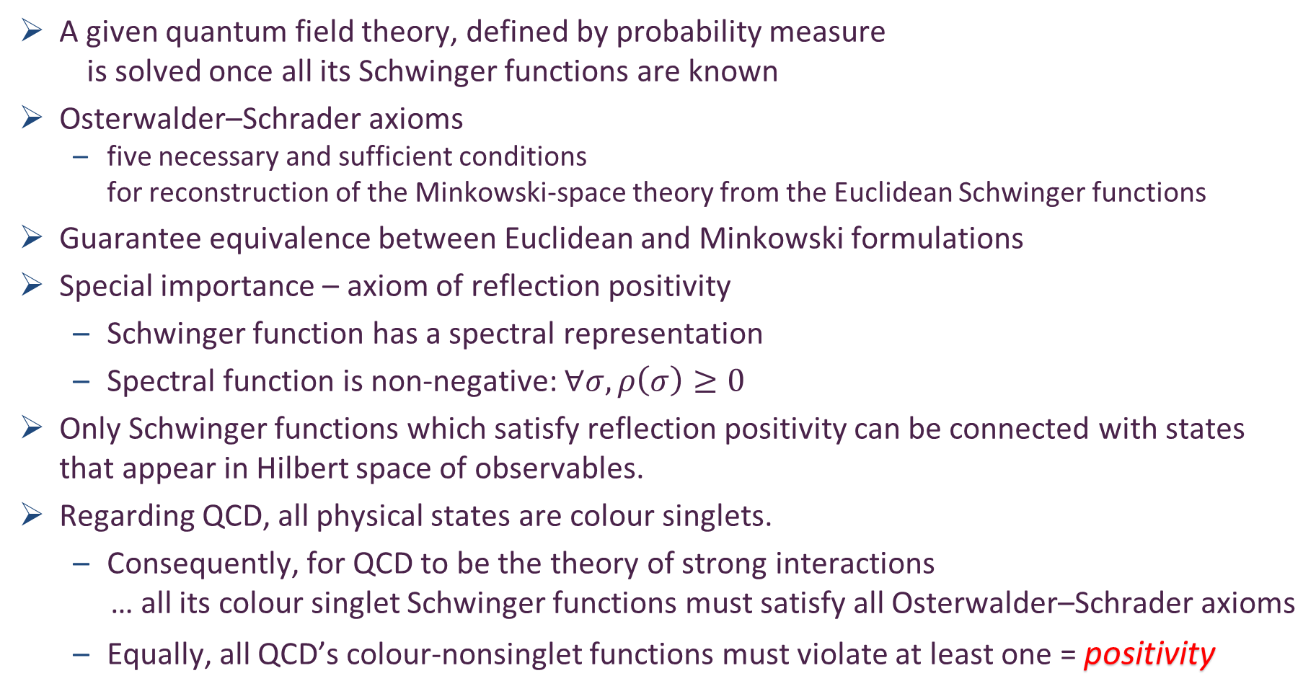

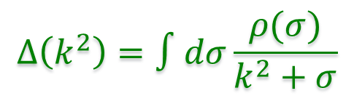
Nature’s Natural Space: Euclidean $↔$Minkowski
A given quantum field theory, defined by probability measure
is solved once all its Schwinger functions are known
Osterwalder–Schrader axioms
five necessary and sufficient conditions
for reconstruction of the Minkowski-space theory from the Euclidean Schwinger functions
Guarantee equivalence between Euclidean and Minkowski formulations
Special importance – axiom of reflection positivity
Schwinger function has a spectral representation
Spectral function is non-negative: $∀σ, ρ\left(σ\right)≥0$
Only Schwinger functions which satisfy reflection positivity can be connected with states that appear in Hilbert space of observables.
Regarding QCD, all physical states are colour singlets.
Consequently, for QCD to be the theory of strong interactions
… all its colour singlet Schwinger functions must satisfy all Osterwalder–Schrader axioms
Equally, all QCD’s colour-nonsinglet functions must violate at least one = positivity
$$Δ\left(k^{2}\right)=∫dσ\frac{ρ(σ)}{k^{2}+σ}$$

Slide 49
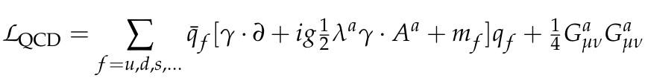
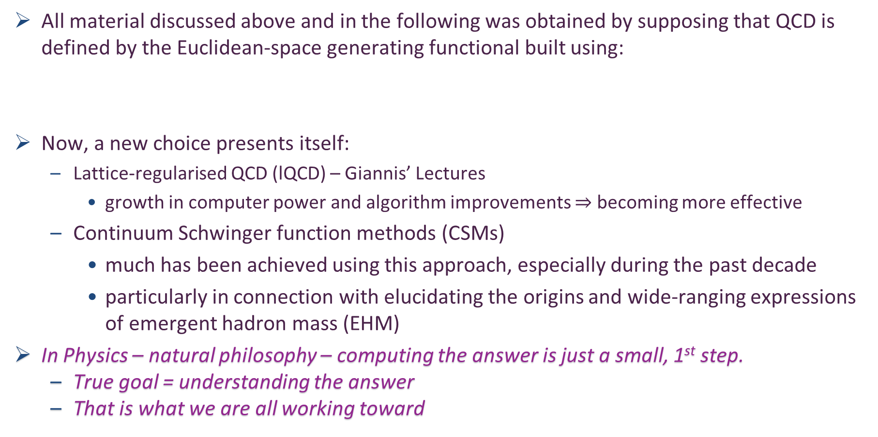
Schwinger Functions Methods
All material discussed above and in the following was obtained by supposing that QCD is defined by the Euclidean-space generating functional built using:
Now, a new choice presents itself:
Lattice-regularised QCD (lQCD) – Giannis’ Lectures
growth in computer power and algorithm improvements $⇒$ becoming more effective
Continuum Schwinger function methods (CSMs)
much has been achieved using this approach, especially during the past decade
particularly in connection with elucidating the origins and wide-ranging expressions of emergent hadron mass (EHM)
In Physics – natural philosophy – computing the answer is just a small, 1st step.
True goal = understanding the answer
That is what we are all working toward

Slide 50
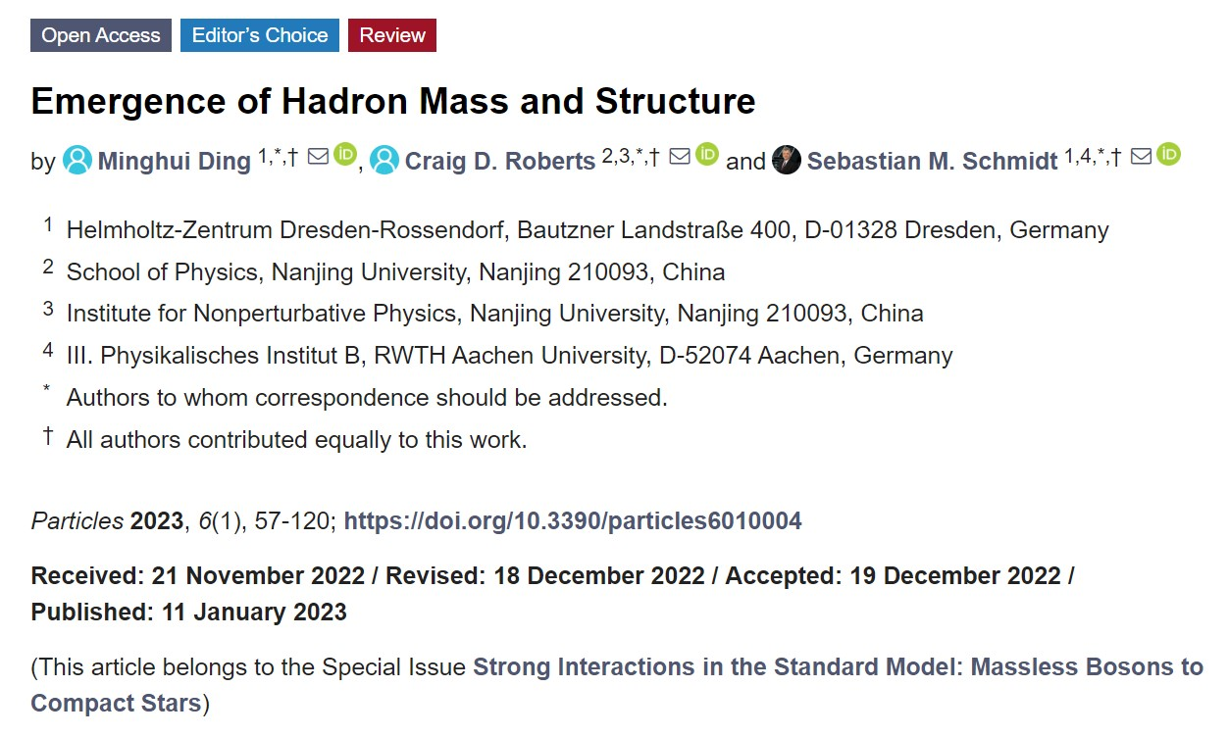

26,466

Slide 51
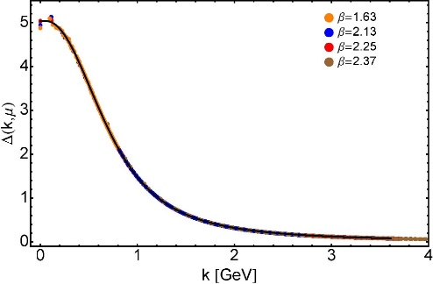
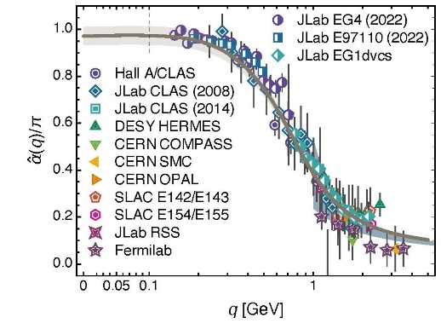
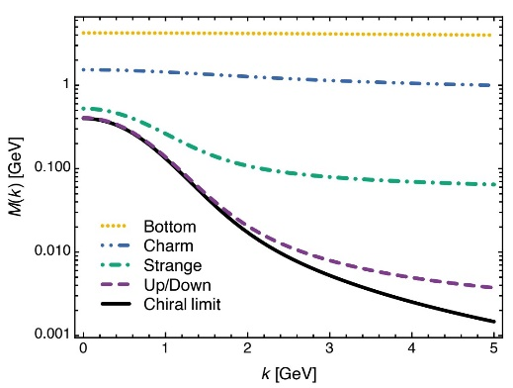
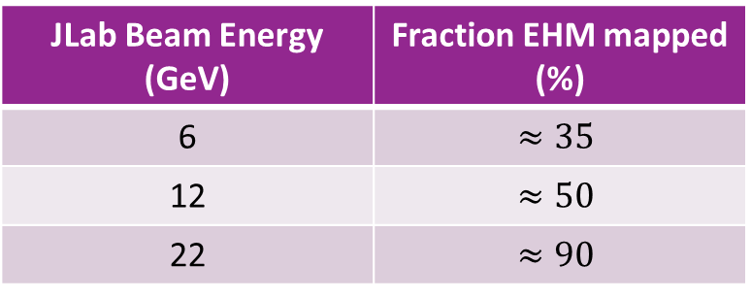
EHM Basics
Absent Higgs boson couplings, the Lagrangian of QCD is scale invariant
Yet …
Massless gluons become massive
A momentum-dependent charge is produced
Massless quarks become massive
EHM is expressed in
EVERY strong interaction observable
Challenge to Theory =
1. Elucidate all observable consequences of these phenomena
2. Highlight paths to measuring them
Challenge to Experiment =
Test the theory predictions so that
Boundaries of Standard Model can finally be drawn
Three pillars of EHM
JLab Beam Energy (GeV) | Fraction EHM mapped (%)
6 | $$≈35$$
12 | $$≈50$$
22 | $$≈90$$

Slide 52








Basic Questions for 21st Century Science
How Does the Mass of the Nucleon Arise?
How Does the Spin of the Nucleon Arise?
What Are the Emergent Properties of Dense Systems of Gluons?
Response … International community is operating, building, and planning facilities with the potential for delivering answers
Notes:
20+5

Slide 53

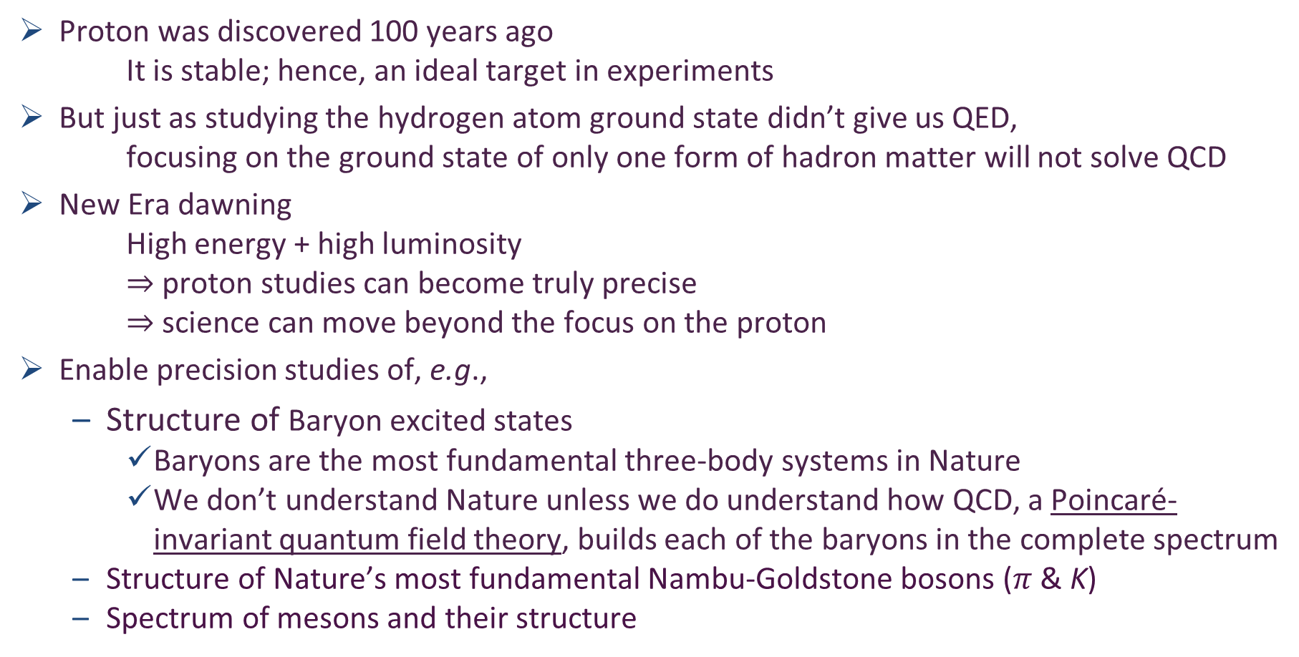
Exposing & Charting EHM
Proton was discovered 100 years ago
It is stable; hence, an ideal target in experiments
But just as studying the hydrogen atom ground state didn’t give us QED,
focusing on the ground state of only one form of hadron matter will not solve QCD
New Era dawning
High energy + high luminosity
$⇒$ proton studies can become truly precise
$⇒$ science can move beyond the focus on the proton
Enable precision studies of, e.g.,
Structure of Baryon excited states
Baryons are the most fundamental three-body systems in Nature
We don’t understand Nature unless we do understand how QCD, a Poincaré-invariant quantum field theory, builds each of the baryons in the complete spectrum
Structure of Nature’s most fundamental Nambu-Goldstone bosons ($π$ & K)
Spectrum of mesons and their structure
AMBER @ CERN
EIC
EicC & SCT & CEPC
JLab12 & JLab20+

Slide 54
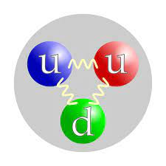
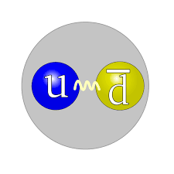
Structure of Hadrons
The most important lessons to be learnt in modern hadron physics are …
This is NOT a baryon
This is NOT a meson
Three “constituent” quarks “confined” within some three-dimensional volume by an instantaneous potential

Slide 55
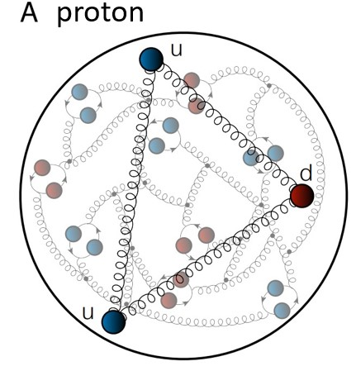
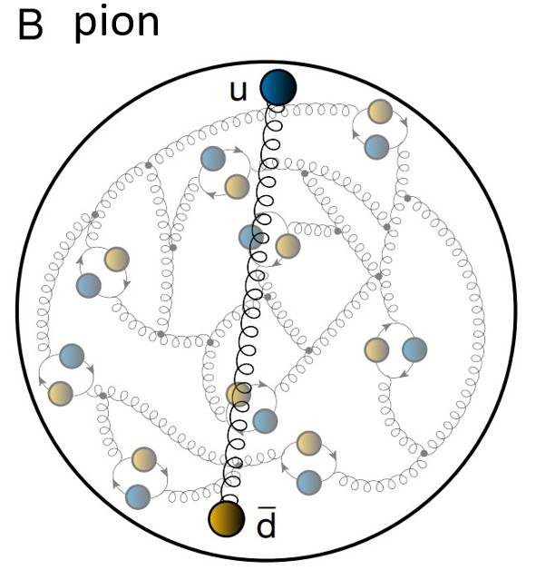
Structure of Baryons
The most important lessons to be learnt in modern hadron physics are …
This IS a baryon
This IS a meson
A few “valence” quark partons and/or antiquark partons, and infinitely many sea and glue partons confined by spacetime-dependent nonperturbative, nonlinear dynamics

Slide 56
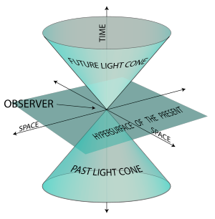
Light-front projection

Slide 57
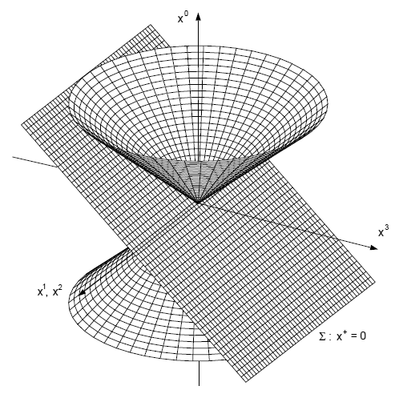
Light-front Quantisation
Quantum chromodynamics and other field theories on the light cone, S. J. Brodsky, H.-C. Pauli, S. S. Pinsky, Phys. Rept. 301 (1998) 299-486, e-Print: hep-ph/9705477 [hep-ph]
Light cone quantization: Foundations and applications, T. Heinzl, Lect. Notes Phys. 572 (2001) 55-142, e-Print: hep-th/0008096 [hep-th]
Hamiltonian formulation of quantum field theory.
Fields are specified on a particular initial surface:
Light front x⁺ = x⁰ + x³ = 0
Using LF quantisation:
quantum mechanics-like wave functions can be defined
quantum-mechanics-like expectation values can be defined and evaluated
Parton distributions are correlation functions at equal LF-time x⁺ ; namely, within the initial surface
x⁺ = 0, and can thus be expressed directly in terms of ground state LF wavefunctions

Slide 58
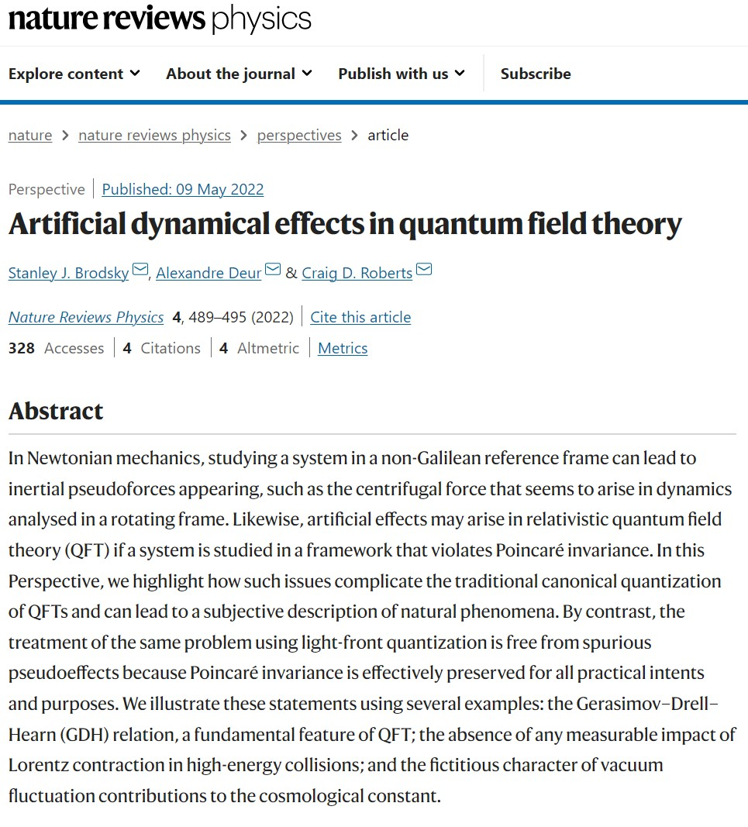
Key to arriving at sound understanding of observable phenomena is preserving Poincaré invariance
Fundamental scientific principle is that an observer’s choice of conventions cannot affect physical phenomena.
Effects that depend on such choices are artificial rather than objective features of Nature; thus, for example, physics cannot depend on the choice of units.
Most critically, physical effects cannot depend on the observer’s frame: valid phenomena should display Poincaré invariance for relativistic systems.

Slide 59
Invisibility of the Lorentz Contraction
Lorentz contraction is a subjective effect because it depends explicitly on the observer's motion relative to the contracted object
But is it fictitious?
Lorentz contraction is often invoked when describing relativistic collisions of composite objects
However, ascribing an objective meaning to Lorentz contraction can lead to erroneous descriptions
In fact, since Lorentz contraction is not a true observable, it cannot influence any observable properties of any sort of collision.

Slide 60
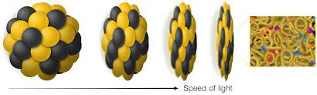


Invisibility of the Lorentz Contraction
In discussions of collisions involving composite objects
moving with relativistic velocities, it’s common to depict colliding objects as thin discs
(pancakes), so as to highlight Lorentz contraction.
However, if such contractions were fundamental to the dynamical description of the collision, a paradox would ensue because
The internal structure of hadrons is produced by a Poincaré-invariant action
It is therefore observable
It is thus frame-independent
Hence, it can’t depend on the motion of the object with respect to the observer
For instance …
the structure of the proton measured in deep inelastic lepton scattering in the laboratory frame, where the proton is at rest,
is the same as that when measured at a lepton-proton collider, where the proton is, supposedly, Lorentz-contracted.

Slide 61
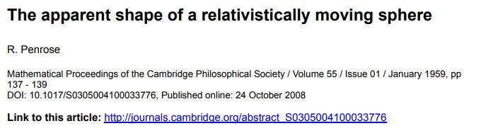
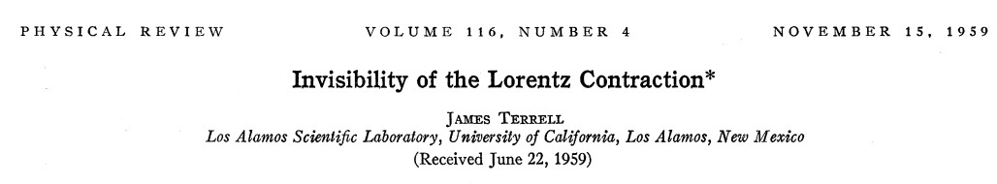
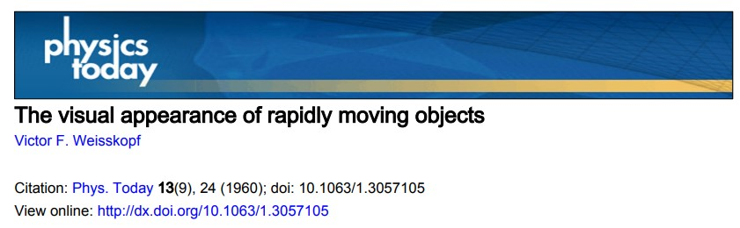
Invisibility of the Lorentz Contraction
1959 First explained by Roger Penrose
OM FRS HonFInstP
Nobel Prize in Physics 2022
1959 Further expounded by
James Terrell,
who was aware of Penrose’ work
1960 Terrell’s article was popularised by
Victor Weisskopf
Postdocs with Heisenberg,
Schrödinger, Pauli, Bohr
Amongst numerous other awards
... 1984: Albert Einstein Medal

Slide 62

Invisibility of the Lorentz Contraction
First explained by Roger Penrose
OM FRS HonFInstP
Nobel Prize in Physics 2022
Further expounded by
James Terrell,
who was aware of Penrose’ work
Terrell’s article was popularised by
Victor Weisskopf
Postdocs with Heisenberg,
Schrödinger, Pauli, Bohr
Amongst numerous other awards
... 1984: Albert Einstein Medal
Despite such pedigree, the fact of Lorentz contraction invisibility has largely been forgotten; if not denied.

Slide 63
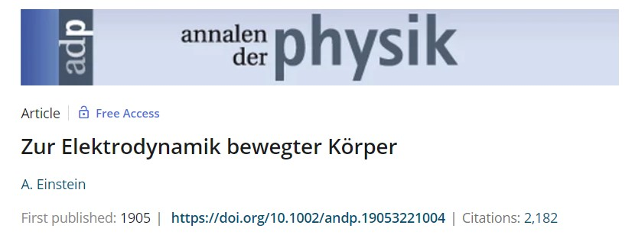
Invisibility of the Lorentz Contraction
light in the empty space always propagates at a certain velocity V, which is independent of the state of motion of the emitting body.
First explained by Roger Penrose
OM FRS HonFInstP
Nobel Prize in Physics 2022
Further expounded by
James Terrell,
who was aware of Penrose’ work
Terrell’s article was popularised by
Victor Weisskopf
Postdocs with Heisenberg,
Schrödinger, Pauli, Bohr
Amongst numerous other awards
... 1984: Albert Einstein Medal
Fallacy of visible Lorentz contraction has its roots in ignoring the fact that the speed of light is the same finite-number for all observers
Wir wollen diese Vermutung (deren Inhalt im folgenden ,,Prinzip der Relativität“ genannt werden wird) zur Voraussetzung erheben und ausserdem die mit ihm nur scheinbar unvertragliche Voraussetzung einfuehren, dass sich das Licht im leeren Raume stets mit einer bestimmten, vom Bewegungszustande des emittierenden Koerpers unabhangigen Geschwindigkeit V fortpflanze.

Slide 64
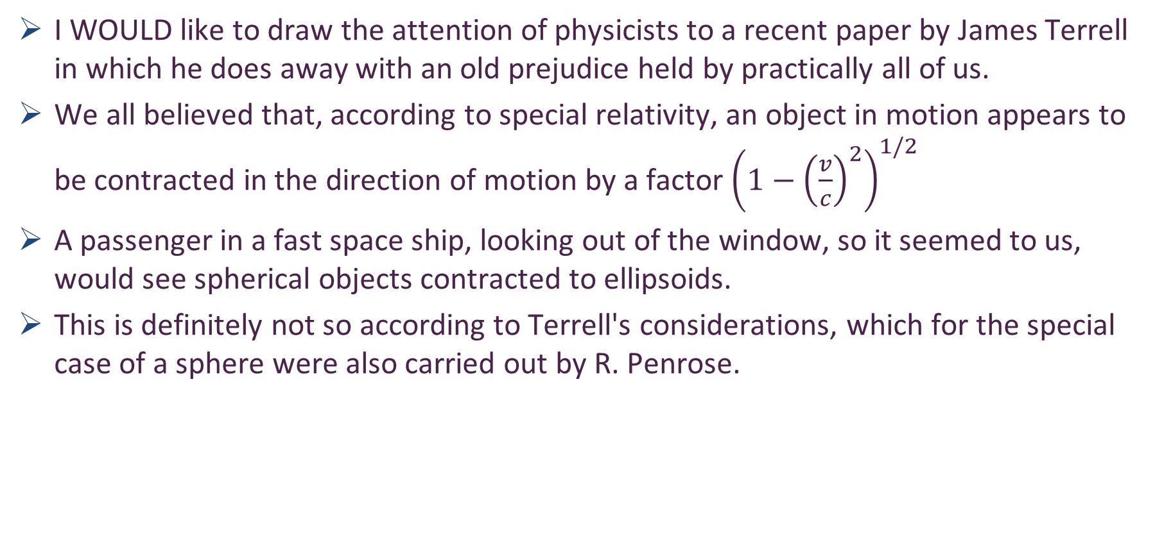
Invisibility of the Lorentz Contraction – Weisskopf
I WOULD like to draw the attention of physicists to a recent paper by James Terrell in which he does away with an old prejudice held by practically all of us.
We all believed that, according to special relativity, an object in motion appears to be contracted in the direction of motion by a factor ${\left(1−{\left(\frac{v}{c}\right)}^{2}\right)}^{1/2}$
A passenger in a fast space ship, looking out of the window, so it seemed to us, would see spherical objects contracted to ellipsoids.
This is definitely not so according to Terrell's considerations, which for the special case of a sphere were also carried out by R. Penrose.

Slide 65
Invisibility of the Lorentz Contraction – Weisskopf
The reason is quite simple
When we see or photograph an object, we record light quanta emitted by the object when they arrive simultaneously at the retina or at the photographic film
This implies that these light quanta have not been emitted simultaneously by all points of the object
The points further away from the observer have emitted their part of the picture earlier than the closer points
Hence, if the object is in motion, the eye or the photograph gets a "distorted" picture of the object, since the object has been at different locations when different parts of it have emitted the light seen in the picture
In special relativity, this distortion has the remarkable effect of canceling the Lorentz contraction so that objects appear undistorted but only rotated
This is exactly true only for objects which subtend a small solid angle

Slide 66
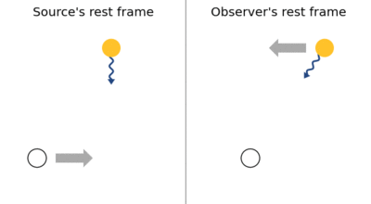
Invisibility of the Lorentz Contraction – Penrose
In order to prove the exact result that the sphere always presents a circular outline, it is convenient to consider the sphere at rest and the observer moving, this being allowable according to the special principle of relativity
Now it is only necessary to consider what transformation of the field of vision must be employed when passing from a stationary to a moving observer at the same point, and to show that this transformation is one which sends apparent circles into apparent circles
N.B. I (Penrose) am concerned, here, with a world-picture rather than a world-map, so that the finite velocity of the light coming from the sphere must be taken into account.
Aberration of light … a phenomenon which produces an apparent motion of celestial objects about their true positions, dependent on the velocity of the observer
Causes (point) objects to appear to be displaced towards the direction of motion of the observer compared to when the observer is stationary

Slide 67
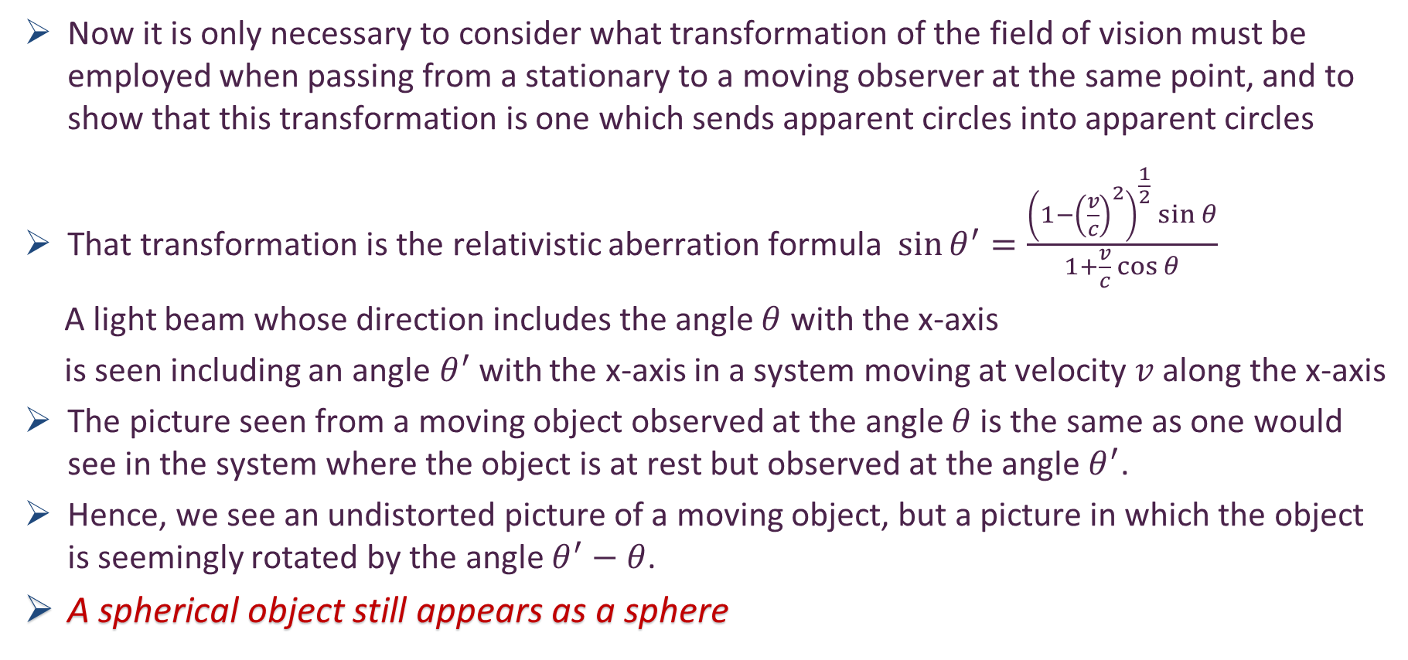
Invisibility of the Lorentz Contraction – Penrose
Now it is only necessary to consider what transformation of the field of vision must be employed when passing from a stationary to a moving observer at the same point, and to show that this transformation is one which sends apparent circles into apparent circles
That transformation is the relativistic aberration formula $\sin{θ^{′}=\frac{{\left(1−{\left(\frac{v}{c}\right)}^{2}\right)}^{\frac{1}{2}}\sin{θ}}{1+\frac{v}{c}\cos{θ}}}$
A light beam whose direction includes the angle $θ$ with the x-axis
is seen including an angle$θ^{′}$with the x-axis in a system moving at velocity $v$ along the x-axis
The picture seen from a moving object observed at the angle $θ$ is the same as one would see in the system where the object is at rest but observed at the angle $θ^{′}$.
Hence, we see an undistorted picture of a moving object, but a picture in which the object is seemingly rotated by the angle $θ^{′}−θ$.
A spherical object still appears as a sphere

Slide 68


Invisibility of the Lorentz Contraction – Weisskopf
Einstein is correct – these facts never challenged him
Special relativity entails that, in the appearance of an object, any Lorentz contraction merely compensates for elongation of the image caused by finite signal speed
The apparent rotation is always negative: $θ^{′}−θ<0$, which means that the object is turned such that it reveals more of its trailing side to the observer.
In the extreme case of $v≈c$, $θ^{′}$ is tiny for all values of $θ$,
except when ${180}^{∘}−θ≈{\left(1−{\left(\frac{v}{c}\right)}^{2}\right)}^{1/2}$.
Since $θ$ goes from 180° to 0° when an object moves by, we find for the case $v≈c$ that
we see the front side of the object only at the very beginning;
it turns around facing its trailing side at us quite early when we still see it coming at us
and remains doing so until it leaves us and naturally is seen from behind.
This paradox is not surprising when one recalls that the aberration angle is almost 180° when $v≈c$. Hence the light we see coming from the object when it is moving towards us, left the object backwards when observed from the object itself.
$$\sin{θ^{′}=\frac{{\left(1−{\left(\frac{v}{c}\right)}^{2}\right)}^{\frac{1}{2}}\sin{θ}}{1+\frac{v}{c}\cos{θ}}}$$

Slide 69


Contraction Paradox absent in Poincaré-invariant formulations
Example.
Using a light-front quantisation of QCD, the wave function of every system is independent of the system’s total momentum
$⇒$ wave function does not depend on the system’s 3-velocity
Example.
Use continuum Schwinger function methods to calculate the pion’s Poincaré-covariant Bethe-Salpeter wave function
Project that wave function onto the light-front – straightforward mathematical operation
Answer is independent of the pion total-momentum

Slide 70

$$Selected aspects \\ of meson physics$$

Slide 71




Era of Meson “Targets”
JLab & EIC & EicC
High luminosity electron ( + ion) beams
Access to meson targets via the Sullivan Process,
i.e., a baryon’s “meson cloud”
AMBER @ CERN SPS
High-intensity beams of pions
($\tilde{>}$ 10⁷ pions/sec in Phase-1 = approved)
and kaons (5 × 10⁶ kaons/sec Phase-2 = proposal
being prepared)
Drell-Yan, J/ψ production, prompt photon production
… from proton and nuclear targets

Slide 72


$π \& K$ DAs & Form Factors

Slide 73



Wave Functions of Nambu Goldstone Bosons
DAs are 1D projection of hadron’s light-front wave function, obtained by integration $∼\int{d^{2}k_{⊥}Ψ(x,k_{⊥})}$
Physics Goals:
Pion and kaon distribution amplitudes (DAs – φ_{π,K})
Nearest thing in quantum field theory to Schrödinger wave function
Consequently, fundamental to understanding π and K structure.
Scientific Context:
For 40 years, the x-dependence of the pion's dominant distribution amplitude (DA) has been controversial.
Modern theory $⇒$EHM expressed in x-dependence of $φ_{π,K}\left(x\right)$
$φ_{π}\left(x\right)$ is direct measure of dressed-quark running mass in chiral limit.
Kaon DA = asymmetric around midpoint of its domain of support (0<x<1)
Degree of asymmetry is signature of constructive interference between EHM and HB mass-generating mechanisms
LF longitudinal direction
Insights into the Emergence of Mass from Studies of Pion and Kaon Structure, Craig D. Roberts, David G. Richards, Tanja Horn and Lei Chang, NJU-INP 034/21, arXiv: 2102.01765 [hep-ph], Prog. Part. Nucl. Phys. 120 (2021) 103883/1-65

Slide 74

Pion’s valence-quark Distribution Amplitude
Imaging dynamical chiral symmetry breaking: pion wave function on the light front, Lei Chang, et al., arXiv:1301.0324 [nucl-th], Phys. Rev. Lett. 110 (2013) 132001 (2013) [5 pages].
Methods were developed that enable direct computation of the pion’s light-front wave function
φ_{π}(x) = twist-two parton distribution amplitude = projection of the pion’s Poincaré-covariant wave-function onto the light-front
Results have been obtained with rainbow-ladder DSE kernel, simplest symmetry preserving form; and the best DCSB-improved kernel that is currently available.
x^{α} (1-x)^{α}, with α=0.5

Slide 75



Meson leading-twist DAs
asymptotic
Continuum results exist & lQCD results arriving
Common feature = broadening/dilation
Origin = EHM
NO differences between π & K if EHM is all there is
Differences arise from Higgs-modulation of EHM mechanism
“Contrasting π & K properties reveals Higgs wave on EHM ocean”
kaon
pion
pion symmetric
kaon skewed
pion
kaon
Kaon DA vs pion DA
almost as broad
peak shifted to x=0.40(5)
〈ξ²〉 = 0.24(1), 〈ξ〉 = 0.035(5)
ERBL evolution logarithmic
Broadening & skewing persist to very large resolving scales – beyond LHC

Slide 76






$π$ & K DAs cf. asymptotic profile
Exposing strangeness: projections for kaon electromagnetic form factors, Fei Gao et al., arXiv:1703.04875 [nucl-th], Phys. Rev. D 96 (2017) 034024/1-8
Constraining the pion DA using Drell-Yan reactions on a proton, H.-Y. Xing (邢惠瑜) et al., NJU-INP 077/23, e-Print: 2308.13695 [hep-ph]
$$φ_{asymptotic}$$
EHM generates broadening in both $π$ & K
EHM + Higgs-boson interference responsible for skewing in kaon
HB-only $⇒$ peak shifted to $\frac{m_{u}^{HB}}{m_{s}^{HB}}×\frac{1}{2}≈0.02$ … wrong
Instead, EHM*HB for u and s quarks … $\frac{{EHM m_{u}→M}_{u}}{EHM m_{s}→M_{s}}×\frac{1}{2}≈0.4$
These features have widespread impact in studies of (hard) exclusive processes.
Broadening can be verified, e.g., in measurements of $π$ and $K$ electric charge distributions (elastic form factor measurements at large $Q^{2}$) & in $π+p$ Drell-Yan measurements

Slide 77




Hard Exclusive Processes e.g, meson form factors
Normalisation of large Q² behaviour of meson form factors is largely determined by EHM, expressed in
$f_{M}$ = order parameter for DCSB (EHM)
$φ_{M}\left(x\right)$ = meson wave function
Parton distribution functions (PDFs) and parton distribution amplitudes (PDAs) are connected through the hadron’s light-front wave function
Hadron’s LFWF is the key.
EHM is expressed in every hadron LFWF
LFWF correlates all observables
$$g_{u}=\frac{1}{x}, { g}_{q ̅}=\frac{1}{1−x}$$
High-energy nuclear and particle physics have long focused on finding evidence for power-law scaling in experimental data.
Certainly, an important first step; BUT it should be remembered that QCD is not found in scaling laws.
Instead, since quantum field theory requires deviations from strict scaling, then QCD is found in the existence and character of scaling violations.

Slide 78


Wave Functions of Nambu Goldstone Bosons
📖 Revealing the structure of light pseudoscalar mesons at the Electron-Ion Collider, J. Arrington et al., NJU-INP 036/21, arXiv: 2102.11788 [nucl-ex], J. Phys. G 48 (2021) 7, 075106
Scientific Context:
Today, continuum and lattice are delivering consistent predictions for φ_{π,K}(x)
Can signature features of interference between EHM and HB, which are manifest in low-order Mellin moments of the DAs, be probed experimentally?
Measurement
Elastic electromagnetic form factors
Breakaway from scaling at $Q^{2}≈6 GeV^{2}$
Thereafter, $Q^{2}$ dependence
is largely described by hard-scattering formula with realistic DA
Reveal QCD scaling violations for 1st time in hard elastic scattering
CSM prediction
& existing JLab data
CSM prediction
& JLab + EIC projections

Slide 79

Parton Distribution Functions
Deep inelastic scattering and the experiments at SLAC that are credited with the discovery of quarks

Slide 80

Parton Distribution Functions (DFs)
Hadron ($H$) parton DFs are probability densities
$p\left(x;ζ\right)dx$ describes the light-front fraction, $x$, of the hadron’s total momentum carried by parton species, $p$, within $H$ when that system is probed with resolution $ζ$
Scale ($ζ$) dependence is crucial
DFs are a much-prized source of hadron structure information
Following quark discovery experiments 50 years ago, measurements interpretable in terms of hadron DFs have been awarded a high priority.
For much of this time, DFs were inferred from global fits to data, with the results viewed as benchmarks.
Such fitting remains crucial, providing input for the conduct of a huge number of experiments worldwide
But the past decade has seen the dawn of a new theory era.
Continuum and lattice studies of QCD are beginning to yield robust predictions for DFs
These developments are exposing potential conflicts with the fitting results

Slide 81





All-orders $ζ$-evolution
All-Orders Evolution of Parton Distributions: Principle, Practice, and Predictions
Pei-Lin Yin (尹佩林) et al., e-Print: 2306.03274 [hep-ph]
Chin. Phys. Lett. Express 40 (2023) 091201/1-8.
New Paradigm
P1 – In the context of Refs. [73, 74], there exists at least one effective charge, $α_{1ℓ}(k^{2})$, which, when used to integrate the leading-order perturbative evolution (DGLAP) equations, defines an evolution scheme for parton DFs that is all-orders exact.
CSM Process-Independent charge serves this purpose
Hadron scale, $ζ_{H}$
Scale at which all properties of a given hadron are carried by valence degrees-of-freedom

Slide 82
NG Boson Distribution Functions
Insights into the Emergence of Mass from Studies of Pion and Kaon Structure, Craig D. Roberts, David G. Richards, Tanja Horn and Lei Chang, NJU-INP 034/21, arXiv: 2102.01765 [hep-ph], Prog. Part. Nucl. Phys. 120 (2021) 103883/1-65
Physics Goals:
Precise data that can be used to determine
Pion and Kaon Distribution Functions – valence, sea and glue
Provide the first complete charts of the internal structure of Nature's most fundamental Nambu-Goldstone bosons.
Today:
Existing pion data are more than 40-years-old
That data only covers the valence-quark domain
A forty-year controversy, with doubts persisting over whether the data agree with QCD predictions or challenge the truth of QCD
Regarding the kaon, worldwide, only 8 points of data exist

Slide 83


NG Boson Distribution Functions
Physics Goals:
Precise data that can be used to determine
Pion and Kaon Distribution Functions – valence, sea and glue
Provide the first complete charts of the internal structure of Nature's most fundamental Nambu-Goldstone bosons.
Future:
JLab, EIC, EicC
⇒ pion and kaon elastic electromagnetic form factors … reveal and quantify scaling
violations in hard exclusive processes … hard prediction of QCD, never seen
⇒ pion and kaon valence quark distribution functions at large $x_{B}$
AMBER
precision data to chart π and K structure: DFs of valence, sea and glue.
Glue is particularly important … because controversial, yet prominent theory predicts that pions contain (almost) zero glue.

Slide 84


Controversy over pion valence DF
QCD theory leads to the following statement:
At any $ζ>ζH$ for which experiment can be interpreted through parton distributions, then
$$x≃1⇒qπ\left(x;ζ\right)∝{\left(1−x\right)}^{β=2+γ}, γ>0$$
Consequence
Any analysis of DY, DIS, etc. experiment which returns $β$<2 conflicts with QCD.
Observations
All existing internally-consistent calculations preserve connection between large-k² behaviour of interaction and large-x behaviour of DF: J=0 … (1/k²)^{n} ⇔ (1-x)^{2n}
No existing calculation with n=1 produces anything other than (1-x)²
Internally-consistents calculation that preserve RG properties of QCD,
then 2 → 2+γ, γ>0, at any factorisation-valid scale
Controversy:
Contemporary data fits yield (1-x)^{1+γ}
Is QCD wrong?
Is existing large-x data a true measure of $qπ\left(x;ζ\right)$?
Are fitter-favoured analysis methods correct/complete?

Slide 85


π valence-quark distributions 24 Years of Theory Evolution → 2023
β^{contm}(ζ₅) = 2.66(12)
β^{lattice}(ζ₅) = 2.45(58)
Developments in continuum-QCD
enabled 1st parameter-free predictions of
valence, glue and sea distributions within the pion
Reveal that $uπ(x;ζ)$is hardened by EHM
Novel lattice-QCD algorithms beginning to yield results for pointwise behaviour of $uπ(x;ζ)$
Agreement between
new continuum prediction for $uπ(x;ζ)$ [Ding:2019lwe]
and lattice-QCD result [Sufian:2019bol]
Real strides toward understanding pion structure.
Standard Model prediction: stronger than ever before
After 30 years – new era dawning in which the ultimate experimental checks can be made:
M2 beam-line @ CERN … JLab12 … EIC … EicC

Slide 86

π DFs … Modern Theory Predictions vs Traditional Phenomenological Fits to Data
Valence:
momentum fraction similar
Phenomenological Fits … profile much harder
& inconsistent with QCD prediction
Glue:
Qualitative similarities on x ≥ 0.05, but marked quantitative disagreement, especially on complementary domain
Both continuum prediction and fit are very different from early phenomenology
Should be tested in new experiments that are directly sensitive to the pion’s gluon content.
E.g., prompt photon & J/Ψ production
Sea:
Prediction and fit disagree on entire x-domain
If pion’s gluon content is considered uncertain, then fair to describe sea-quark distribution as empirically unknown
Motivation for the collection and analysis of DY data with π± beams on isoscalar targets
CSM prediction
JAM valence
DSE prediction
glue & sea
JAM:
glue & sea

Slide 87

π DFs … Modern Theory Predictions vs Traditional Phenomenological Fits to Data
Valence:
momentum fraction similar
JAM … publication ignores NLL resummation … profile much harder & inconsistent with QCD prediction
Glue:
Similarities on x ≥ 0.05, but marked disagreement on important complementary domain
Both continuum prediction and JAM fit are very different from early phenomenology
Should be tested in new experiments that are directly sensitive to the pion’s gluon content.
Perhaps, prompt photon & J/Ψ production
Sea:
Prediction and fit disagree on entire x-domain
If pion’s gluon content is considered uncertain, then fair to describe sea-quark distribution as empirically unknown
Motivation for the collection and analysis of DY data with π± beams on isoscalar targets
DSE prediction
JAM valence
Exploratory lQCD results for pion’s glue DF are now available
DSE prediction
glue & sea
JAM:
glue & sea

Slide 88


Glue in π: Continuum (Eur. Phys. J. C 80 (2020) 1064/1-20) & Lattice Predictions (arXiv: Phys.Lett.B 823 (2021) 136778)
Two distinct methods for tackling QCD
Agree quantitatively on $g_{ }^{π}\left(x\right)$
continuum
Phenomenological analyses
exhibit qualitatively different behaviour
Highlights need for new data and improved phenomenology in order to turn that data into a real test of QCD and our understanding of Nambu-Goldstone modes.
AMBER @ CERN can provide the necessary precise data.
lattice
Regarding the distribution of glue in the pion, Lei Chang (常雷) and Craig D Roberts,
e-Print: 2106.08451 [hep-ph], Chin. Phys. Lett. 38 (8) (2021) 081101/1-6 - Editors' Suggestion

Slide 89


Status: Kaon
Programmes at JLab, AMBER
Proposals at EIC and EicC
Tackling the kaon structure function at EicC
Gang Xie et al. e-Print: 2109.08483 [hep-ph].
Chin. Phys. C 46 (2022) 6, 064107
Little empirical information available on K DFs ⇒ no recent phenom. inferences.
Valence-quark distributions: results from models and a single, recent lQCD study
Kaon’s glue and sea distributions: no results
Entirety of human history
– only 8 kaon data in existence
CERN … Phys. Lett. B 93 (1980) 354-356
One piece of available experimental information:
${u_{K}(x)}/{u_{π}\left(x\right)}$
Continuum prediction for ratio is consistent with data.
But, given large errors, this ratio is very forgiving of even large differences between various calculations of the individual DFs used to produce the ratio.
New, precise data critical if this ratio to be used as path to understanding the Standard Model’s Nambu-Goldstone modes;
Results for u_{π}(x;ζ₅), u_{K}(x;ζ₅) separately = better.
CSM
lQCD_{MSU}

Slide 90

Status: Kaon
Kaon parton distributions, Z.-F. Cui et al., arXiv:2006.14075 [hep-ph], Eur. Phys. J. C 80 (2020) 1064/1-20
Little empirical information available on K DFs ⇒ no recent phenom. inferences.
Valence-quark distributions: results from models and a single, recent lQCD study
Kaon’s glue and sea distributions: no predictions … until now
Glue and Sea – Predictions:
DFs similar to those in the pion
Detailed comparison requires use of mass-dependent splitting functions.
Development underway … Preliminary conclusions:
Light-front momentum fraction carried by s-quarks in the kaon increases by ∼ 5%;
Compensated by a commensurate decrease in fractions carried by glue (−1%) and sea (−2%).
Glue
Sea
Valence
Glue
Sea

Slide 91


Generalised Parton Distributions
“Standard” parton DFs
1D picture – dependence of in-hadron parton properties on the light-front (LF) fraction, $x$, of the hadron’s total momentum
Generalised parton distributions (GPDs)
Provide extension of 1D parton distribution functions into 3D images
Also describe hadron’s distributions of partons in plane perpendicular to bound-state's total momentum, i.e., within the light front itself.
LF longitudinal direction
LF transverse plane
Data relating to GPDs
deeply virtual Compton scattering
$γ^{∗}(q)T\left(p\right)→γ^{∗}\left(q^{′}\right)T(p^{′})$ – so long as at least one photon possesses large virtuality
deeply virtual meson production
$γ^{∗}(q)T\left(p\right)→M\left(q^{′}\right)T(p^{′})$, where $M$ is a meson
GPDs connect DFs with hadron form factors because
any DF may be recovered as forward limit $(p^{′}=p)$ of relevant GPD
any elastic form factor can be expressed via a GPD-based sum rule
GPD measurement … numerous experimental programmes – underway or planned at JLab, EIC, and EicC

Slide 92




$π$ mass distribution
Expectation value of the QCD energy-momentum tensor in the pion
= pion gravitational current
Contract with $δ_{μν}$: $Λ_{μμ}^{g}\left(K,0\right)=2m_{π}^{2}θ_{2}^{π}(Q^{2})$
$θ_{2}^{π}\left(Q^{2}=0\right)=1$ (canonical mass-normalisation)
$θ_{2}^{π}(Q^{2})$ measures mass distribution in $π$
$θ_{2}^{π}$ can be obtained as the first Mellin moment of the pion GPD
Zero owing to energy+momentum conservation
Pion GPD

Slide 93


Slide 94


Empirical determination of the pion mass distribution
Can reconstruct $π$ GPD from data on
$π$ em form factor
$π$ valence quark DF
GPDs connect DFs with hadron form factors because
any elastic form factor can be expressed via a GPD-based sum rule
any DF may be recovered as forward limit $(p^{′}=p)$ of relevant GPD
Working solely with
electron+pion scattering data
CERN – 1984, 1986
JLab 2000, 2006, 2007, 2008
existing pion + nucleus Drell-Yan data (CERN and FNAL – 1989)
two phenomenological fits to this data [Aicher:2010cb, Barry:2021osv] … use both
Employed a $χ^{2}$-based selection procedure to develop ensembles of model-independent representations of the three-dimensional pointwise behaviour of the pion generalised parton distribution (GPD).
These ensembles yield data-driven prediction for pion GPD

Slide 95


Pion Generalised Parton Distribution
Pion GPDs, reconstructed from available analyses of relevant Drell-Yan and electron+pion scattering data
Different ensembles only marginally compatible, owing to differences between analyses in
A = Aicher:2010cb; B = Barry:2021osv
Yet, both agree with lQCD based ensembles, within mutual uncertainties, because lQCD-constrained ensemble has large uncertainty – improvement of lQCD results useful
CSM prediction favours $u_{A}^{π}\left(x;ζ_{5}\right)$ensemble
In all cases, support of valence-quark GPD becomes increasingly concentrated in neighbourhood $x≃1$ with increasing $Δ^{2}$
Namely, greater probe momentum focuses attention on domain whereupon one valence-quark carries a large fraction of pion's light-front momentum
Revealing pion and kaon structure via generalised parton distributions, K. Raya, Z. –F. Cui (崔著钫) et al.,
NJU-INP 051/21, e-Print: 2109.11686 [hep-ph], Chin. Phys. C 46 (01) (2022) 013107/1-22

Slide 96



Pion charge distribution form factor
0th Moment of
pion GPD
All ensembles reproduce empirical $F_{π}\left(Δ^{2}\right)$
Blue – based on $u_{A}^{π}\left(x;ζ_{5}\right)$ ensembles
Orange – based on $u_{B}^{π}\left(x;ζ_{5}\right)$ ensembles
Comparison curves
dashed purple – CSM prediction for $F_{π}\left(Δ^{2}\right)$
grey band – Ensemble of $F_{π}\left(Δ^{2}\right)$results developed from DFs based on lattice-QCD results
Again, data-driven results in accord with modern theory predictions.
See, e.g., Sec. 4B in
📖 Insights into the Emergence of Mass from Studies of Pion and Kaon Structure,
C.D. Roberts, D.G. Richards, T. Horn and L. Chang,
NJU-INP 034/21, arXiv: 2102.01765 [hep-ph], Prog. Part. Nucl. Phys. 120 (2021) 103883/1-65

Slide 97



$π$ mass distribution
Expressed as $1^{st}$ Mellin-moment of pion GPD
Principal, dynamical coefficient in expectation value of the QCD energy-momentum tensor in the pion
= pion gravitational current
$θ_{2}(Δ^{2})$ is harder than $F_{π}(Δ^{2})$
i.e., the distribution of mass in the pion is more compact than the distribution of electric charge.
This is an empirical fact

Slide 98




$π$ mass radius
fm
Comparison value for charge radius: $r_{π}=0.64\left(2\right)$ fm
Data-driven prediction: $\frac{r_{π}^{θ_{2}}}{r_{π}}=0.79(3)$
Translates into spacetime volume ratio = $0.40(6)$
Pion mass distribution is concentrated within
just 40% of the spacetime volume of the charge distribution
charge
mass

Slide 99


$π$ mass distribution is harder
Empirical fact is readily understood physically
Pion wave function (hence, pion GPD) is independent of the probe.
It's the same whether 1 photon or 2 photons or graviton is the probing object.
However, probe itself focuses on different features of the target constituents
Target quark carries same charge, irrespective of its momentum.
So, pion LFWF alone controls distribution of charge.
Gravitational interaction of target quark depends on its momentum.
(The current = the energy momentum tensor)
Pion effective mass distribution therefore depends on interference between quark momentum growth and LFWF momentum suppression with increasing $Δ^{2}x^{2}$.
This pushes support to a larger momentum domain in the pion = smaller distance domain.
“Is there a specific aspect of the pion GPDs driven by the data which is responsible?”
Yes. EHM induced broadening of pion LFWF = GPD.
Given GPD overlap representation, they’re the same thing.

Slide 100


Slide 101



Fragmentation Functions
Fragmentation Function $D_{1}^{h/i}(z)$ is the number of hadrons $h$ inside parton $i$ in the light-front momentum-fraction range $[z,z+dz]$
Following processes play a crucial role in studies/inferences of FFs
Single-inclusive hadron production in electron-positron annihilation,
$e^{+}+e^{−}→h+X$ (single-inclusive annihilation = SIA):
$σ∼\hat{σ}⊗FF$ … $\hat{σ}$ pQCD hard cross-section
(reaction model)
Semi-inclusive deep-inelastic lepton-nucleon scattering (SIDIS), $ℓ+N→ℓ+h+X$: $σ∼\hat{σ}⊗PDF⊗FF$
Single-inclusive hadron production in proton-proton collisions, $p+p→h+X$:
$σ∼\hat{σ}⊗PDF⊗PDF⊗FF$
Typically adds terms in $α_{s}$
Soft-gluon re-summation ignored … crucial at large $z$
Continuity means all-$z$
Uncertain foundation for fitting

Slide 102

Fragmentation Functions
Fragmentation Function $D_{1}^{h/i}(z)$ is the number of hadrons $h$ inside parton $i$ in the light-front momentum-fraction range $[z,z+dz]$
Following processes play a crucial role in studies/inferences of FFs
Single-inclusive hadron production in electron-positron annihilation,
$e^{+}+e^{−}→h+X$ (single-inclusive annihilation = SIA):
$σ∼\hat{σ}⊗FF$ … $\hat{σ}$ pQCD hard cross-section
(reaction model)
Semi-inclusive deep-inelastic lepton-nucleon scattering (SIDIS), $ℓ+N→ℓ+h+X$: $σ∼\hat{σ}⊗PDF⊗FF$
Single-inclusive hadron production in proton-proton collisions, $p+p→h+X$:
$σ∼\hat{σ}⊗PDF⊗PDF⊗FF$
Can’t extract information about
PDFs from such processes
unless FFs are known
Typically adds terms in $α_{s}$
Soft-gluon re-summation ignored … crucial at large $z$
Continuity means all-$z$
Unreliable foundation for fitting

Slide 103




Unpolarised FFs
What is known about FFs?
Practically nothing
Around 6 different fitting groups
Inferred FFs are mutually inconsistent
Example, compare blue (MAPFF) with brown (JAM)
Results are
practitioner dependent
Uncertain information in
$⇒$ uncertain information out
Difficult to learn anything about DFs
Serious impediment to interpretation of data from modern and anticipated facilities
$$N … u→π$$
$$S … u→π$$
Purple dashed: elementary FF
Purple solid: FF after solving cascade equations

Slide 104

Polarised FFs
Today, for most polarized FFs, there is no information
… not from experiment and not from theory.
Majority of cases where experimental data exist, it’s for fragmentation into $Λ$ and/or $Λ^{−}$ hyperons, which are self-analyzing, i.e., they reveal their polarization through the angular dependence of the decay products.
The analysis of such experiments is difficult, since a large fraction of the produced $Λ$ particles comes from the decay of heavier hyperons rather than direct production.
For physics programmes at modern and anticipated facilities:
JLab-12, EIC, EicC, precise knowledge of FFs will be crucial.
Especially true for international TMD program.
Input from Belle II, at the next generation B-factory, SuperKEKB, will be important to provide multi-differential observables for identified light quark FFs.
For progress, for assisting phenomenology,
Theory predictions instead of fits are essential

Slide 105


Calculation of FFs
Issues
Probability density for confined quark or gluon to produce an on-shell hadron
FFs are essentially timelike
FFs involve hadrons in final states
FFs are essentially nonperturbative
No algorithm exists for computation of FFs using lattice-regularised QCD
This can be traced to
essentially timelike character of the hadron production process and
the sum over spectators $X$ in definition of FFs
… can’t simply be eliminated using closure because of (complicated) state $|P_{h},S_{h};X⟩$
… FFs describe production of many, many final-state on-shell hadrons

Slide 106


Calculation of FFs
Models
Simplest version = spectator models
a time-like off-shell parton fragments into a hadron and a single (real) spectator particle
Practitioner uses (favourite) quark + hadron Lagrangian to compute a (short) series of diagrams
Practitioner fits parameters to some selected data

Slide 107




Calculation of FFs
Models
Field + Feynman Jet Fragmentation approach
Readily handles multiple hadron production
Basic need is elementary fragmentation function:
$$d_{p}^{h}\left(z;ζ\right)$$
which is mathematical probability that initial parton, $p$, produces hadron, $h$
Using $d_{q}^{h}(z;ζ)$, one solves coupled set of linear cascade equations to determine complete FF, $D_{q}^{h}(z;ζ)$, which accounts for all hadrons produced from momentum of the initial quark
Sum rule: $\sum_{h}{\int_{0}^{1}{dz} D_{p}^{h}\left(z;ζ\right)=1}$
The hadron jet generated by parton $p$ contains all momentum of initial state
Boundary Conditions
$D_{p}^{h}\left(z;ζ\right)=_{x≃0}\frac{1}{z}$
$D_{p}^{h}\left(z;ζ\right)=_{x≃1}d_{p}(z;ζ)$

Slide 108

Elementary Fragmentation Functions
FF is timelike twin of the spacelike process
= leptoproduction on target $h$
$γ^{∗}\left(Q^{2}\right)+h→X⇔γ^{∗}\left(Q^{2}\right)→\overline{h}+X$
Crossing symmetry $⇒$ relation between DFs and FFs
Drell-Levy-Yan (DLY) Relation
Compute elementary FFs by analytic continuation of DFs onto domain $x>1$
$$d_{q}^{h}\left(z;ζ\right)∝zq^{h}(\frac{1}{z};ζ)$$
At some scale, EFFs and DFs are the same function
DLY was proved using operator definitions and crossing symmetry
Regarding evolution equations, the DLY relation has been proved to NNLO in pQCD
S. D. Drell, D. J. Levy, T.-M. Yan, A Theory of Deep Inelastic Lepton-Nucleon Scattering and Lepton Pair Annihilation Processes. 1., Phys. Rev. 187 (1969) 2159–2171.
S. D. Drell, D. J. Levy, T.-M. Yan, A Theory of Deep Inelastic Lepton Nucleon Scattering and Lepton Pair Annihilation Processes. 2. Deep Inelastic electron Scattering, Phys. Rev. D 1 (1970) 1035–1068.
S. D. Drell, D. J. Levy, T.-M. Yan, A Theory of Deep Inelastic Lepton-Nucleon Scattering and Lepton Pair Annihilation Processes. 3. Deep Inelastic electron-Positron Annihilation, Phys. Rev. D 1 (1970) 1617–1639.
V. Gribov, L. Lipatov, Deep inelastic e p scattering in perturbation theory, Sov. J. Nucl. Phys. 15 (1972) 438–450.
V. N. Gribov, L. N. Lipatov, e+ e- pair annihilation and deep inelastic e p scattering in perturbation theory, Sov. J. Nucl. Phys. 15 (1972) 675–684.

Slide 109

Elementary Fragmentation Functions
At some scale, EFFs and DFs are the same function
Any tool that can deliver sound pointwise form of DF at required scale, can then deliver complete array of FFs via Field + Feynman cascade equations
What is the scale?
Owing to scaling violations in QCD, one must identify validity scale for DLY relation:
$$d_{q}^{h}\left(z;ζ\right)∝zq^{h}(\frac{1}{z};ζ)$$
Natural (only) value is $ζ=ζ_{H}$, the hadron scale, whereat dressed valence degrees-of-freedom carry all properties of a given hadron
Existence of such a scale is guaranteed by the theory of effective charges in QCD
Choice is logical for, inter alia, following reasons.
A realistic hadron-scale valence quark DF vanishes at the endpoints, $x = 0, 1$
Ensures that DLY relation produces an elementary FF which vanishes at $z = 0, 1$
Guarantees that cascade equations have convergent solutions, without tuning
QCD scaling violations mean such cannot be guaranteed for $ζ>ζ_{H}$.

Slide 110

Fragmentation Functions and Confinement
DLY relation … at some scale, EFFs and DFs are the same function
$$d_{q}^{h}\left(z;ζ\right)∝zq^{h}(\frac{1}{z};ζ)$$
FFs express how a shower of coloured partons coalesce into colour singlet final states … this is the empirical expression of confinement
Overlap representation of parton DFs
$$q^{h}\left(x;ζ\right)∼∫d^{2}k_{⊥}{\left|Ψ_{q}^{h}\left(x,k_{⊥}^{2}\right)\right|}^{2}$$
parton DFs are obtained from square of hadron LFWF
Seeds of confinement, expressed in hadronisation, are already present in wave functions of the hadrons involved … unsurprising, perhaps, but important

Slide 111





Predictions for Fragmentation Functions using cascade equations
$$u→π^{+}+\overline{u}$$
favoured
Empirically, at energies below $∼100$ GeV,
$π, K$ dominate (98%) particle production
in SIA: $e^{+}+e^{−}→h+X$
So, illustrate procedure via predictions for $π, K$ FFs
Exploit $G$-parity symmetry, one has set of 9 coupled Volterra integral equations of 2nd kind
e.g. $u∉π^{−}$ so EFF$=0$
Need $u→π^{+}+\overline{u}→π^{+}+π^{−}+u …$
unfavoured

Slide 112





Pion and Kaon DFs $⇒$ EFFs
Continuum predictions for hadron scale pion and kaon valence-quark DFs
$$u_{π}\left(x;ζ_{H}\right)=n_{π}\ln{[1+{(\frac{1}{ρ^{2}})x}^{2}{\left(1−x\right)}^{2}} (1+γ_{π}^{2}\left[{\left({\left[1−x\right)}^{2}\right]}^{β_{π}}+{\left(x^{2}\right)}^{β_{π}}\right)]$$
$n_{π}=0.858$, $ρ_{π}=0.116$, $γ_{π}=1.967$, $β_{π}=5.938$
$$s_{K}\left(x;ζ_{H}\right)$$
Dilation and flattening are expressions of EHM
Skewing for kaon is expression of EHM + Higgs-Boson interference
$$u_{K}\left(x;ζ_{H}\right)=n_{K}\ln{[1+{(\frac{1}{ρ_{K}^{2}})x}^{2}{\left(1−x\right)}^{2}} (1+γ_{K}^{2}{\left(x^{2}\right)}^{α_{K}}{\left({\left[1−x\right]}^{2}\right)}^{β_{K}})]$$
$$s_{K}\left(x;ζ_{H}\right)=u_{K}(1−x;ζ_{H})$$
$n_{K}=0.444$, $ρ_{K}=0.0746$, $γ_{K}=6.276$, $α_{K}=0.710$, $β_{K}=1.650$
“ln” functional form is perfect for using DLY relation
Kaon and pion parton distributions, Zhu-Fang Cui et al., Eur. Phys. J. C 80 (2020) 11, 1064 ... 97 citations
CSM predictions confirmed, e.g., Quark and Gluon Momentum Fractions in the Pion and in the Kaon, ETMC, Phys. Rev. Lett. 134 (2025)

Slide 113








Elementary Fragmentation Functions
DLY relation $d_{q}^{h}\left(z;ζ\right)∝zq^{h}(\frac{1}{z};ζ)$
CSM DFs produce curves at right
Normalised
Elementary probability that $u$ quark produces some kind of hadron with some value of $z$ is unity
Owing to DLY relation, FF behaviour on $z≃1$ must match that of DFs on $x≃$1
Strict QCD predictions
Mesons ${{\left(1−x\right)}^{2+γ(ζ)}↔\left(1−z\right)}^{2+γ\left(ζ\right)}$
$$d_{u}^{π^{+}+π^{0}}(x;ζ_{H})$$
$$d_{s}^{K^{−}}(x;ζ_{H})$$
$$d_{u}^{K^{+}}(x;ζ_{H})$$
Prediction: EFF multiplicities
Determine multiplicities at all scales
Baryons … $2→3$

Slide 114


Empirical Fragmentation Functions
Solve cascade equations at $ζ_{H}$
Use all-orders (AO) scheme to evolve solutions to scales relevant for measurements, e.g., $ζ=ζ_{2}≔2$ GeV
AO scheme is nonperturbative extension of DGLAP
Exploits notion of effective charges in QCD
Approach guarantees that particle and momentum sum rules are preserved
$$\sum_{h}{\int_{0}^{1}{dz} D_{p}^{h}\left(z;ζ\right)=1}$$

Slide 115

Empirical Fragmentation Functions
Momentum sum rule is typically not enforced in global fitting schemes because …
No experiment can reach $z=0$.
For a given set of data, the empirical hadron final-state space is unknown because hadrons in addition to $π, K, p, \overline{p}$ might be produced and yet go undetected.
Contemporary FF fit procedures are typically only able to ensure that the results are consistent with some set of practitioner-dependent momentum sum rule bounds or inequalities.

Slide 116


Empirical Fragmentation Functions
Solve cascade equations at $ζ_{H}$
Use all-orders (AO) scheme to evolve solutions to scales relevant for measurements, e.g., $ζ=ζ_{2}≔2$ GeV
AO scheme is nonperturbative extension of DGLAP
Exploits notion of effective charges in QCD
Approach guarantees that particle and momentum sum rules are preserved
$$\sum_{h}{\int_{0}^{1}{dz} D_{p}^{h}\left(z;ζ\right)=1}$$
Issues with enforcing momentum sum rule in global fitting schemes

Slide 117


Empirical Fragmentation Functions
Focus on pion & compare CSM predictions (solid purple curves) with fits
N.B. Between groups, fits are mutually incompatible.
A, B … $u→π^{+,0}$ (favoured) nonsinglet and singlet.
Agreement only on $z>0.5$, i.e., valence quark domain
JAM nonsinglet FF result ($zD_{N}$) exhibits unexpected & unphysical divergence on $z≃0$.
This is the domain of glue and sea dominance; so, $zD_{N}=\frac{3}{2} z[D_{q}^{π^{+}}\left(z\right)−D_{\overline{q}}^{π^{+}}\left(z\right)]$ should vanish.

Slide 118

Empirical Fragmentation Functions
Focus on pion & compare CSM predictions (solid purple curves) with fits
N.B. Between groups, fits are mutually incompatible.
C … $s→π$ (unfavoured).
One might say there is qualitative agreement on the far valence domain, but only in the sense that this FF is small.
Otherwise, any agreement is only the result of an accidental curve crossing

Slide 119

Empirical Fragmentation Functions
Focus on pion & compare CSM predictions (solid purple curves) with fits
N.B. Between groups, fits are mutually incompatible.
D, E … $c, g→π$ (unfavoured).
There is no agreement on these FFs, which are very poorly constrained by data.

Slide 120

Empirical Fragmentation Functions
Focus on pion & compare CSM predictions (solid purple curves) with fits
N.B. Between groups, fits are mutually incompatible.
Continuum predictions provide coherent picture of fragmentation across all parton types
Quite generally, MAPFF fits (blue) highlight that FFs are practically unconstrained on $z ≲ 0.2$
The study indicates that, today, phenomenology does not deliver objective FF results:
results obtained are practitioner specific
This must improve if anything objective is to be learnt from modern and anticipated facilities

Slide 121





Hadron Jet Multiplicities
Relative multiplicity of charged and neutral kaons in $e^{+}+e^{−}→h+X$
Data exist, most recently from BESIII, last year
BESIII
Parameter-free prediction
Predictions for hadron jet multiplicities reveal SU$(3)$-flavour symmetry breaking in $R_{K}\left(ζ\right)$
Breaking significant at reaction energy scales $ζ≈3m_{p}$, but decreases in size with increasing reaction energy

Slide 122
Theory Frontier

Slide 123

Nature of Physics
Steven Weinberg
Born: May 3, 1933, New York, NY
Died: July 23, 2021, Austin, TX
“The effort to understand the universe is one of the very few things that lifts human life a little above the level of farce and gives it some of the grace of tragedy.”
“Nothing in the last five hundred years has had so great an effect on the human spirit as the discoveries of modern science.”
“I know of no one who has participated actively in the advance of physics in the postwar period whose research has been significantly helped by the work of philosophers.”
“Science is the path to truth”

Slide 124


