Slide 1


Grant no. 12135007
Craig Roberts … http://inp.nju.edu.cn/
Emergent Hadron Mass:
Origins and Consequences II

Slide 2
Why are we here?
Suppose quantum field theories are the correct paradigm for understanding Nature
We find ourselves in a Universe where time and space give us Four Dimensions (D = 4)
D = 4 is a critical point
Quantum Field Theories with D ≠ 4 possess an explicit mass-dimension
Couplings are mass-dimensioned, setting scale for all quantities
D > 4 … uncontrollable ultraviolet divergences
D < 4 … super-convergent, but hierarchy problem with dynamical effects being < 10% of explicit scale
Standard Model is built from scale-invariant classical field theories
(Ignoring Higgs couplings)
Such theories are renormalizable
Procedure introduces a mass scale
The size of the mass-scale is not determined by the theory
What determines the natural mass-scale for visible matter?
We know it is m_{Nature} ≈ m_{p} ≈ 1 GeV
How much tolerance exists? … We can exist so long as m_{Nature} = 1 ± ? GeV

Slide 3
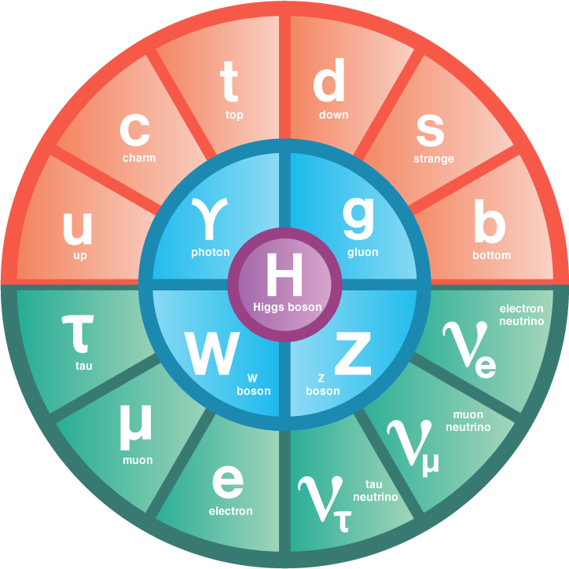
Standard Model of Particle Physics
Standard Model (SM) offers a description of all known fundamental physics except gravity, and gravity is something that has no discernible effect when particles are studied a few at a time.
Since LHC’s discovery of the Higgs in 2012, the Higgs Boson has been promoted to the
Centre of Things
Standard Model has
17 particles and 19 parameters,
most of which relate to the Higgs and all of which must be determined through comparison with experiment
SM supposedly describes most powerful forces in Nature; yet, somewhat unsatisfactory

Slide 4

Standard Model of Particle Physics
Strong Interactions in the Standard Model are supposed to be described by quantum chromodynamics (QCD)
Only two parameters are intrinsic to QCD
Higgs enters through current-quark masses
One of them – θ_{QCD} – appears to be zero (exactly or almost) … know this because nucleon EDM is unmeasurably small
Just one parameter remains to be fixed
Perhaps science has a chance of understanding QCD ∈ SM?

Slide 5
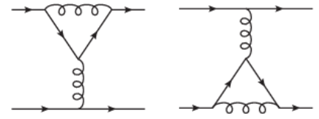
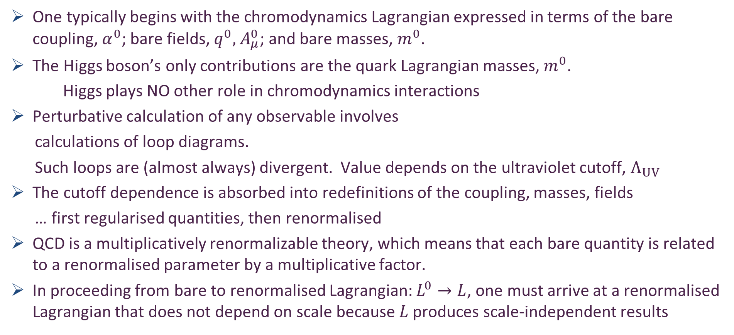

Regularisation and Renormalisation of chromodynamics $⇒$ QCD
One typically begins with the chromodynamics Lagrangian expressed in terms of the bare coupling, $α^{0}$; bare fields, $q^{0},$ $A_{μ}^{0}$; and bare masses, $m^{0}$.
The Higgs boson’s only contributions are the quark Lagrangian masses, $m^{0}$.
Higgs plays NO other role in chromodynamics interactions
Perturbative calculation of any observable involves
calculations of loop diagrams.
Such loops are (almost always) divergent. Value depends on the ultraviolet cutoff, $Λ_{UV}$
The cutoff dependence is absorbed into redefinitions of the coupling, masses, fields
… first regularised quantities, then renormalised
QCD is a multiplicatively renormalizable theory, which means that each bare quantity is related to a renormalised parameter by a multiplicative factor.
In proceeding from bare to renormalised Lagrangian: $L^{0}→L$, one must arrive at a renormalised Lagrangian that does not depend on scale because $L$ produces scale-independent results

Slide 6
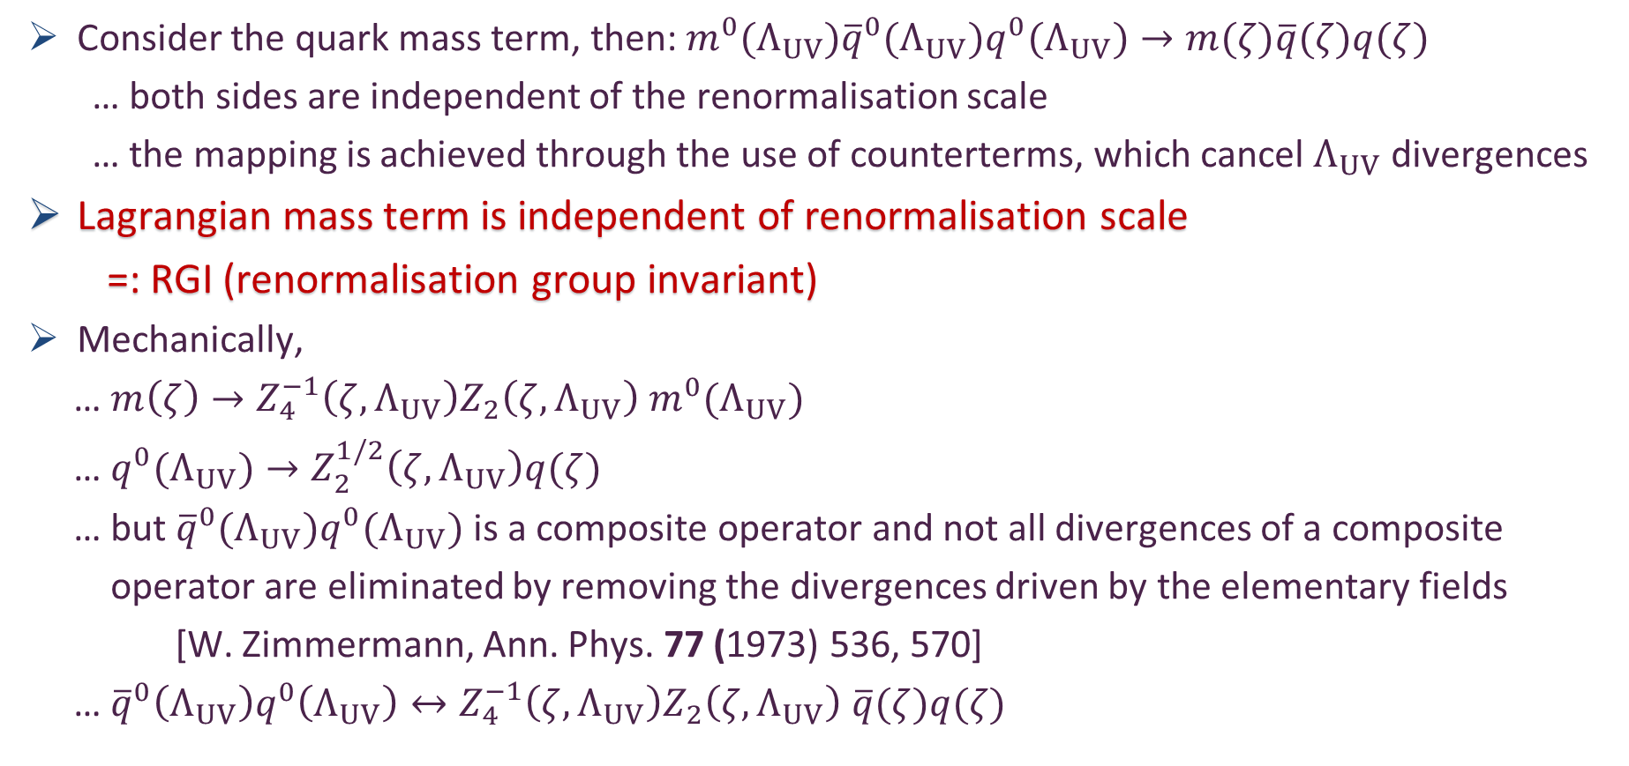
Regularisation and Renormalisation of chromodynamics $⇒$ QCD
Consider the quark mass term, then: $m^{0}(Λ_{UV}){\overline{q}}^{0}(Λ_{UV})q^{0}(Λ_{UV})→m(ζ)\overline{q}(ζ)q(ζ)$
… both sides are independent of the renormalisation scale
… the mapping is achieved through the use of counterterms, which cancel $Λ_{UV}$divergences
Lagrangian mass term is independent of renormalisation scale
=: RGI (renormalisation group invariant)
Mechanically,
… $m\left(ζ\right)→Z_{4}^{−1}\left(ζ,Λ_{UV}\right)Z_{2}\left(ζ,Λ_{UV}\right)$ $m^{0}(Λ_{UV})$
… $q^{0}(Λ_{UV})→Z_{2}^{1/2}\left(ζ,Λ_{UV}\right)q(ζ)$
… but ${\overline{q}}^{0}(Λ_{UV})q^{0}(Λ_{UV})$ is a composite operator and not all divergences of a composite
operator are eliminated by removing the divergences driven by the elementary fields
[W. Zimmermann, Ann. Phys. 77 (1973) 536, 570]
… ${\overline{q}}^{0}\left(Λ_{UV}\right)q^{0}\left(Λ_{UV}\right)↔Z_{4}^{−1}\left(ζ,Λ_{UV}\right)Z_{2}\left(ζ,Λ_{UV}\right)$ $\overline{q}(ζ)q(ζ)$

Slide 7
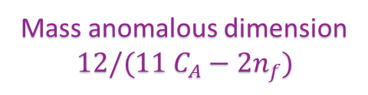
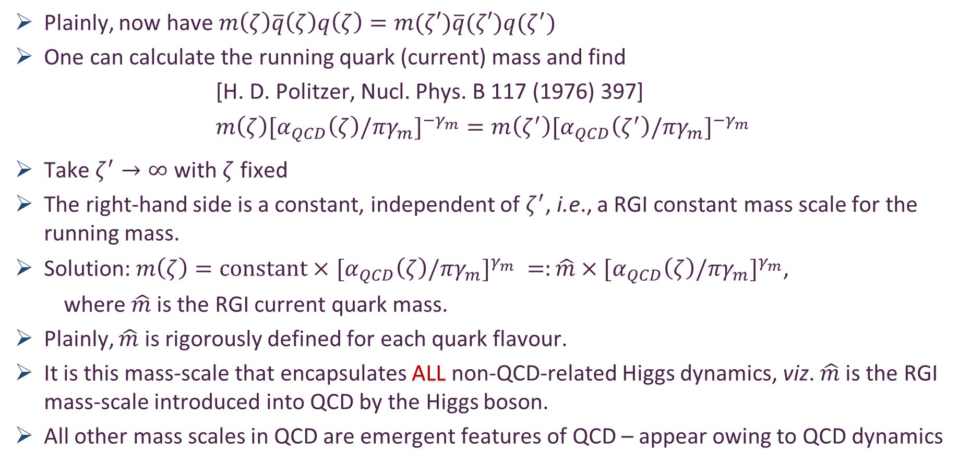
Running Quark Mass
Plainly, now have $m\left(ζ\right)\overline{q}\left(ζ\right)q\left(ζ\right)=m(ζ′)\overline{q}(ζ′)q(ζ^{′})$
One can calculate the running quark (current) mass and find
[H. D. Politzer, Nucl. Phys. B 117 (1976) 397]
$$m\left(ζ\right){[α}_{QCD}{\left(ζ\right)/πγ_{m}]}^{−γ_{m}}=m\left(ζ^{′}\right){[α}_{QCD}{\left(ζ^{′}\right)/πγ_{m}]}^{−γ_{m}}$$
Take $ζ^{′}→∞$ with $ζ$ fixed
The right-hand side is a constant, independent of $ζ^{′}$, i.e., a RGI constant mass scale for the running mass.
Solution: $m\left(ζ\right)=constant×$ ${[α}_{QCD}{\left(ζ\right)/πγ_{m}]}^{γ_{m}} =:\hat{m}×{[α}_{QCD}{\left(ζ\right)/πγ_{m}]}^{γ_{m}}$,
where $\hat{m}$ is the RGI current quark mass.
Plainly, $\hat{m}$ is rigorously defined for each quark flavour.
It is this mass-scale that encapsulates ALL non-QCD-related Higgs dynamics, viz. $\hat{m}$ is the RGI mass-scale introduced into QCD by the Higgs boson.
All other mass scales in QCD are emergent features of QCD – appear owing to QCD dynamics
Mass anomalous dimension
$$12/(11 C_{A}−2n_{f})$$

Slide 8
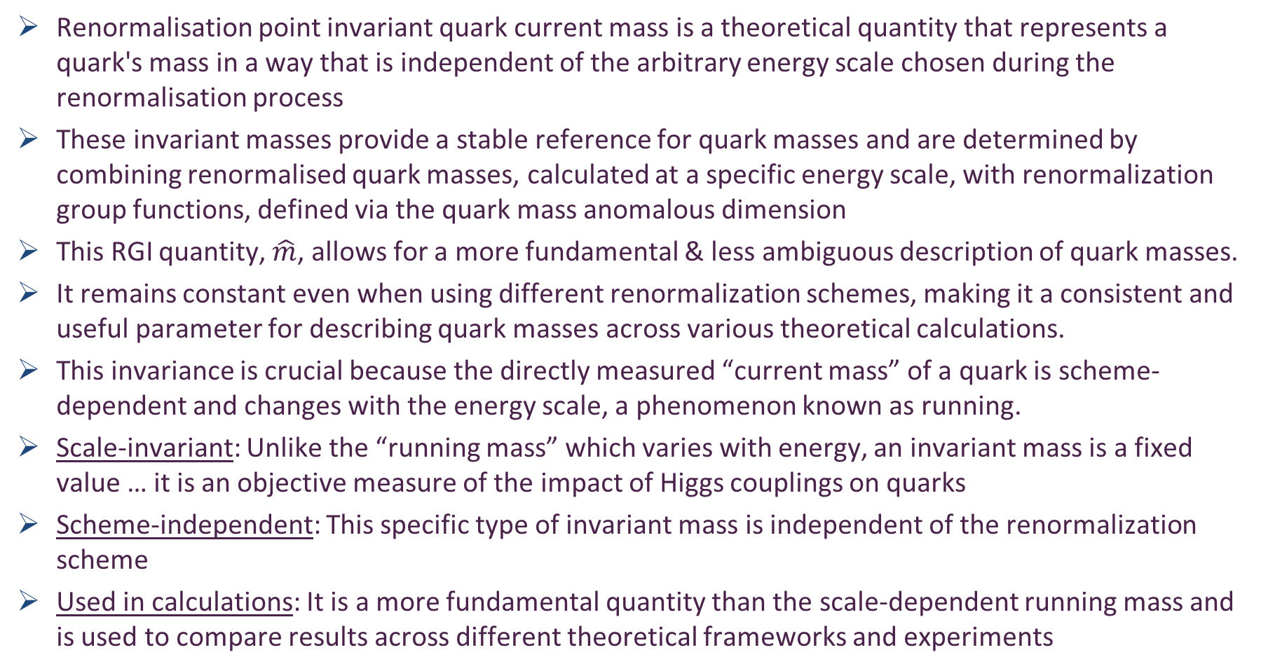
RGI Current Quark Mass … Google AI
Renormalisation point invariant quark current mass is a theoretical quantity that represents a quark's mass in a way that is independent of the arbitrary energy scale chosen during the renormalisation process
These invariant masses provide a stable reference for quark masses and are determined by combining renormalised quark masses, calculated at a specific energy scale, with renormalization group functions, defined via the quark mass anomalous dimension
This RGI quantity, $\hat{m}$, allows for a more fundamental & less ambiguous description of quark masses.
It remains constant even when using different renormalization schemes, making it a consistent and useful parameter for describing quark masses across various theoretical calculations.
This invariance is crucial because the directly measured “current mass” of a quark is scheme-dependent and changes with the energy scale, a phenomenon known as running.
Scale-invariant: Unlike the “running mass” which varies with energy, an invariant mass is a fixed value … it is an objective measure of the impact of Higgs couplings on quarks
Scheme-independent: This specific type of invariant mass is independent of the renormalization scheme
Used in calculations: It is a more fundamental quantity than the scale-dependent running mass and is used to compare results across different theoretical frameworks and experiments

Slide 9
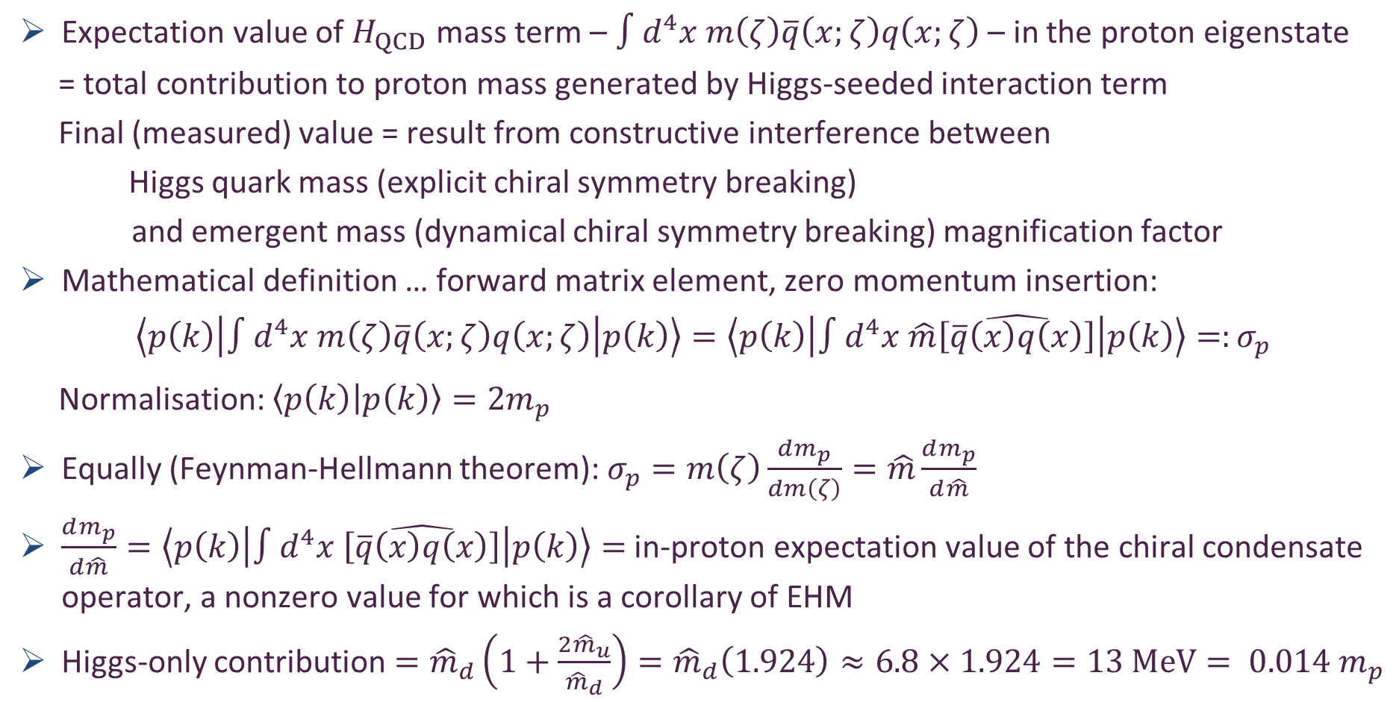

Nucleon $σ$ Term
Expectation value of $H_{QCD}$ mass term – $∫d^{4}x m\left(ζ\right)\overline{q}\left(x;ζ\right)q\left(x;ζ\right)$ – in the proton eigenstate
= total contribution to proton mass generated by Higgs-seeded interaction term
Final (measured) value = result from constructive interference between
Higgs quark mass (explicit chiral symmetry breaking)
and emergent mass (dynamical chiral symmetry breaking) magnification factor
Mathematical definition … forward matrix element, zero momentum insertion:
$$\left\langle p\left(k\right)\left|∫d^{4}x m\left(ζ\right)\overline{q}\left(x;ζ\right)q\left(x;ζ\right)\right|p\left(k\right)\right\rangle =\left\langle p\left(k\right)\left|∫d^{4}x \hat{m}\hat{\left[\overline{q}\left(x\right)q\left(x\right)\right]}\right|p\left(k\right)\right\rangle =:σ_{p}$$
Normalisation: $\left\langle p\left(k\right) | p\left(k\right)\right\rangle =2m_{p}$
Equally (Feynman-Hellmann theorem): $σ_{p}=m\left(ζ\right)\frac{dm_{p}}{dm\left(ζ\right)}=\hat{m}\frac{dm_{p}}{d\hat{m}}$
$\frac{dm_{p}}{d\hat{m}}=\left\langle p\left(k\right)\left|∫d^{4}x \hat{\left[\overline{q}\left(x\right)q\left(x\right)\right]}\right|p\left(k\right)\right\rangle =$ in-proton expectation value of the chiral condensate operator, a nonzero value for which is a corollary of EHM
Higgs-only contribution $={\hat{m}}_{d}\left(1+\frac{2{\hat{m}}_{u}}{{\hat{m}}_{d}}\right)={\hat{m}}_{d}\left(1.924\right)≈6.8×1.924=13 MeV= 0.014 m_{p}$

Slide 10
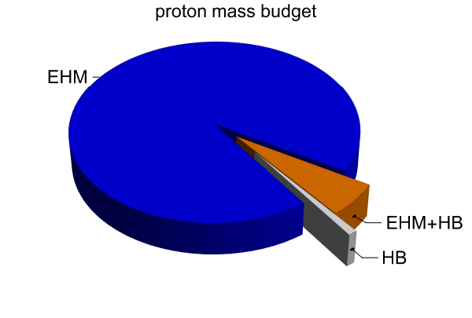

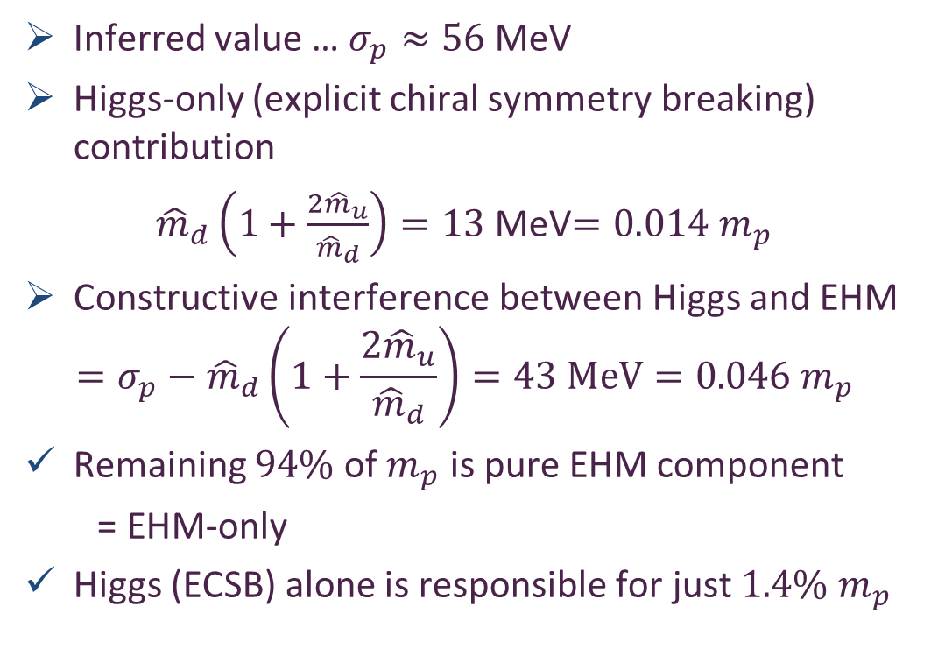
Nucleon $σ$ Term & Nucleon Mass Budget
Inferred value … $σ_{p}≈56$ MeV
Higgs-only (explicit chiral symmetry breaking) contribution
${\hat{m}}_{d}\left(1+\frac{2{\hat{m}}_{u}}{{\hat{m}}_{d}}\right)=13$ MeV$=0.014{ m}_{p}$
Constructive interference between Higgs and EHM
$$=σ_{p}−{\hat{m}}_{d}\left(1+\frac{2{\hat{m}}_{u}}{{\hat{m}}_{d}}\right)=43 MeV=0.046 m_{p}$$
Remaining $94\%$ of $m_{p}$ is pure EHM component
= EHM-only
Higgs (ECSB) alone is responsible for just $1.4\% m_{p}$

Slide 11
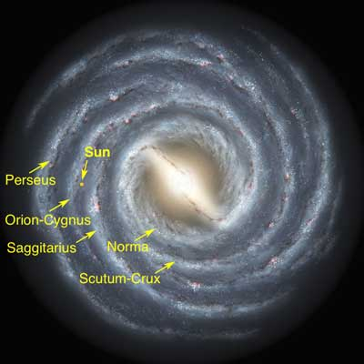
Emergent Phenomena … in the Standard Model(?)
Existence of our Universe depends critically on, inter alia, the following empirical facts:
Proton is massive
i.e., the mass-scale for strong interactions is vastly different to that of electromagnetism
Proton is absolutely stable
Despite being a composite object
constituted from three valence quarks
Pion is unnaturally light (not massless, but lepton-like mass)
Despite being a strongly interacting composite object built from a valence-quark and valence antiquark
Emergence: low-level rules producing high-level phenomena, with enormous apparent complexity

Slide 12
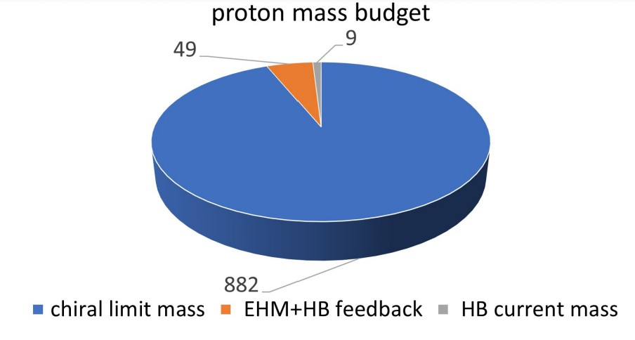
Emergence of Hadron Mass
Standard Model of Particle Physics has one known mass-generating mechanism
= Higgs Boson … impacts are critical to evolution of Universe as we know it
However, Higgs boson is alone responsible for just ∼ 1% of the visible mass in the Universe
Proton mass budget
Only 9 MeV/939 MeV is directly from Higgs
Evidently, Nature has another very effective mechanism for producing mass:
Emergent Hadron Mass (EHM)
Alone, it produces 94% of the proton’s mass
Remaining 5% is generated by constructive interference between EHM and Higgs-boson

Slide 13
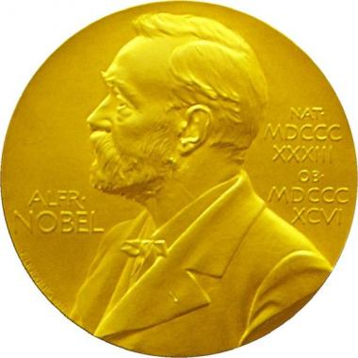
Mass in Nature
Phenomenological understanding of mass generation via Higgs-like mechanism
Notion behind Higgs mechanism
for mass generation
was introduced more than fifty years ago; and it became an essential piece of the SM.
2012 – Discovery of something seeming to possess all anticipated properties of the Higgs
SM became complete
Nobel Prize in physics awarded to Englert and Higgs
“. . . for the theoretical discovery of a mechanism that contributes to our understanding of the origin of mass of subatomic particles . . . ”
“… a mechanism that contributes …”
NOT the complete story. Far from it …

Slide 14

Mass in Nature
Phenomenological understanding of mass generation via Higgs-like mechanism
Phenomenological understanding of mass generation via Higgs-like mechanism
But the hierarchy problem is real
Quantum corrections to the mass of a scalar boson are quadratically divergent = not renormalisable
Large quantum contributions to $mass_{Higgs}^{2}$ would inevitably make the mass huge
Unless there is incredible fine-tuning cancellation between quadratic-divergent corrections and bare mass.
Notion behind Higgs mechanism
for mass generation
was introduced more than fifty years ago; and it became an essential piece of the SM.
2012 – Discovery of something seeming to possess all anticipated properties of the Higgs
SM became complete
Nobel Prize in physics awarded to Englert and Higgs
“. . . for the theoretical discovery of a mechanism that contributes to our understanding of the origin of mass of subatomic particles . . . ”
“… a mechanism that contributes …”
NOT the complete story. Far from it …

Slide 15
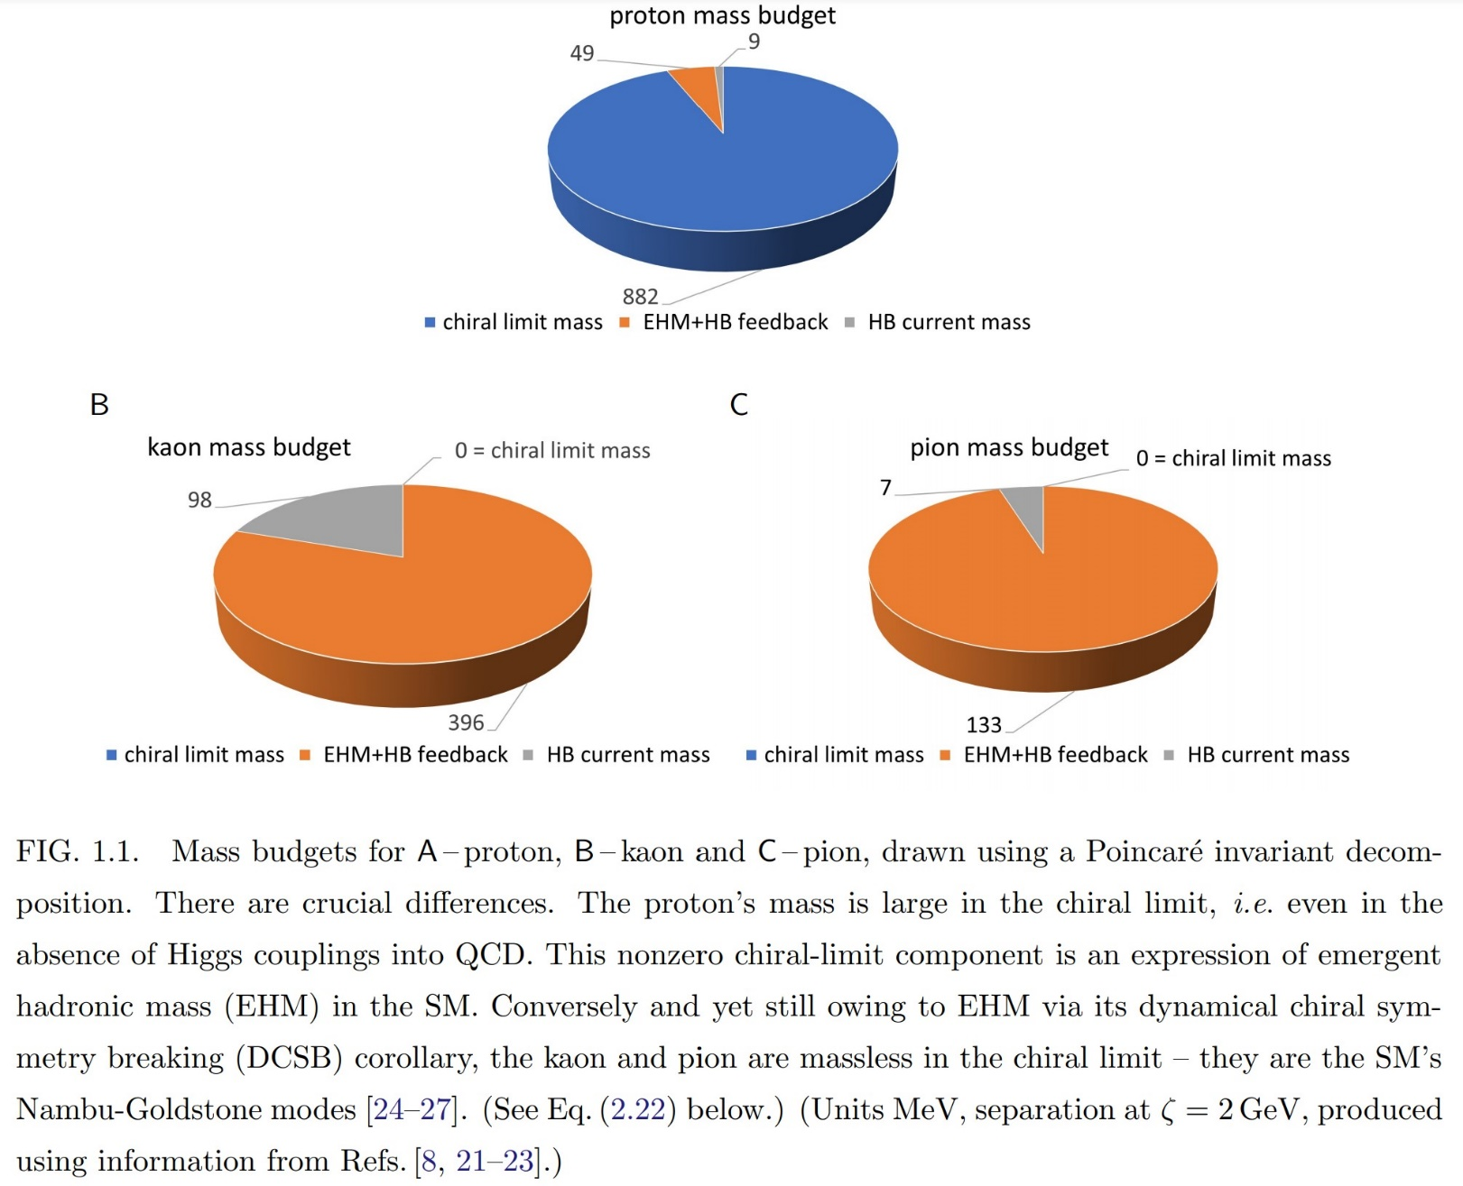
Emergence of Hadron Mass - Basic Questions
What is the origin of EHM?
Does it lie within the Standard Model, i.e., within QCD
What are the connections with …
Gluon and quark confinement?
Dynamical chiral symmetry breaking (DCSB)?
Nambu-Goldstone modes = π & K?
What is the role of Higgs in modulating observable properties of hadrons?
Critically, without Higgs mechanism of mass generation, π and K would be indistinguishable
What is and wherefrom mass?

Slide 16

It’s not just about MASS

Slide 17
Emergent Hadron Mass (EHM)
In Nature, mass and length^{–1} are effectively the same thing
Thus, asking for the origin of 99% of visible mass in the Universe is possibly/probably the same as asking what is the source of the proton’s size
Confinement scale!
Confinement is far more than the statement that Nature contains only colour-singlet combinations of gluons and quarks
Those combinations have fm-scale sizes – this is crucial
It wouldn’t be confinement if the scales were Å size
Confinement … only guarantee of proton stability
If one can’t measure them, what are the gluons and quarks in the QCD Lagrangian?
Are they anything more than a theoretical artifice; useful things for calculations in perturbation theory, but practically irrelevant when resolving detectable hadrons?
What degrees-of-freedom should be used to compute and understand hadron properties?

Slide 18
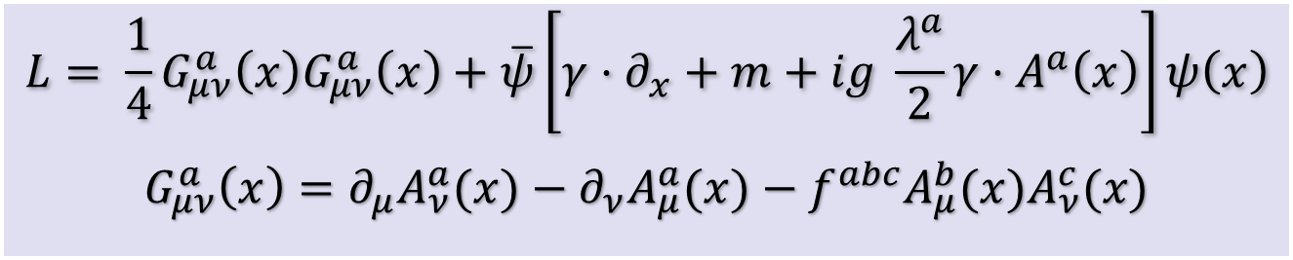

Quantum Chromodynamics
$$L= \frac{1}{4}G_{μν}^{a}\left(x\right)G_{μν}^{a}\left(x\right)+\overline{ψ}\left[γ⋅∂_{x}+m+ig \frac{λ^{a}}{2}γ⋅A^{a}\left(x\right)\right]ψ\left(x\right)$$
$$G_{μν}^{a}\left(x\right)=∂_{μ}A_{ν}^{a}(x)−∂_{ν}A_{μ}^{a}(x)−f^{abc}A_{μ}^{b}{(x)A}_{ν}^{c}(x)$$
One-line Lagrangian – expressed in terms of
massless gluon ($A_{μ}^{a}$) and Higgs-mass quark ($ψ$) partons
Which are NOT the degrees-of-freedom measured in detectors
Gluon and Quark Confinement
Advantages of the Color Octet Gluon Picture,
H. Fritzsch, Murray Gell-Mann, H. Leutwyler, Phys. Lett. B 47 (1973) 365-368
“The quarks come in three "colors," but all physical states and interactions are supposed to be singlets with respect to the SU(3) of color. Thus, we do not accept theories in which quarks are real, observable particles; nor do we allow any scheme in which the color non-singlet degrees of freedom can be excited.”

Slide 19
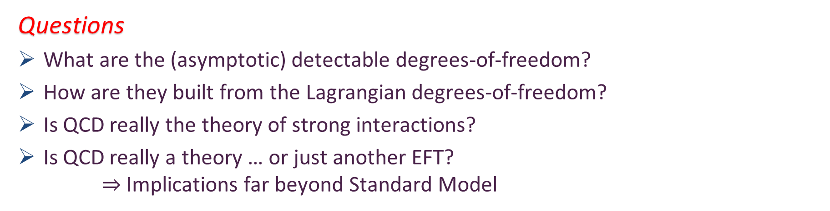
Quantum Chromodynamics
$$L= \frac{1}{4}G_{μν}^{a}\left(x\right)G_{μν}^{a}\left(x\right)+\overline{ψ}\left[γ⋅∂_{x}+m+ig \frac{λ^{a}}{2}γ⋅A^{a}\left(x\right)\right]ψ\left(x\right)$$
$$G_{μν}^{a}\left(x\right)=∂_{μ}A_{ν}^{a}(x)−∂_{ν}A_{μ}^{a}(x)−f^{abc}A_{μ}^{b}{(x)A}_{ν}^{c}(x)$$
Gluon and Quark Confinement
One-line Lagrangian – expressed in terms of gluon and quark partons
Which are NOT the degrees-of-freedom measured in detectors
Questions
What are the (asymptotic) detectable degrees-of-freedom?
How are they built from the Lagrangian degrees-of-freedom?
Is QCD really the theory of strong interactions?
Is QCD really a theory … or just another EFT?
$⇒$ Implications far beyond Standard Model

Slide 20
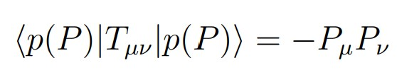
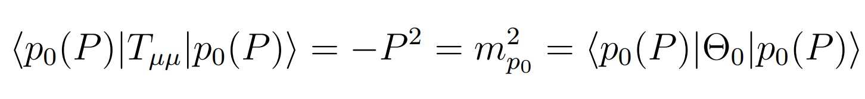
QCD’s scale anomaly
Prima Facie, the QCD Lagrangian
CANNOT support a nonzero value of this expectation value.

Slide 21

Strong Interactions in the Standard Model
Only apparent scale in chromodynamics is mass of the quark field
Quark mass is generated by Higgs boson couplings into QCD
In connection with everyday matter, that mass is less-then 0.5% of the empirical scale for strong interactions,
viz. more-than two orders-of-magnitude smaller
Plainly, the Higgs-generated mass is very far removed from the natural scale for strongly-interacting matter
Nuclear physics mass-scale – 1 GeV – is an emergent feature of the Standard Model
No amount of staring at L_{QCD} can reveal that scale
Contrast with quantum electrodynamics, e.g. spectrum of hydrogen levels measured in units of m_{e}, which appears in L_{QED}

Slide 22
Whence Mass?
Classical chromodynamics … non-Abelian local gauge theory
Remove the current mass … there’s no energy scale left
No dynamics in a scale-invariant theory; only kinematics … the theory looks the same at all length-scales … there can be no clumps of anything … hence bound-states are impossible.
Our Universe can’t exist
Higgs boson doesn’t solve this problem …
normal matter is constituted from light-quarks
the mass of protons and neutrons, the kernels of all visible matter, are 100-times larger than anything the Higgs can produce
Where did it all begin? … becomes … Where did it all come from?

Slide 23
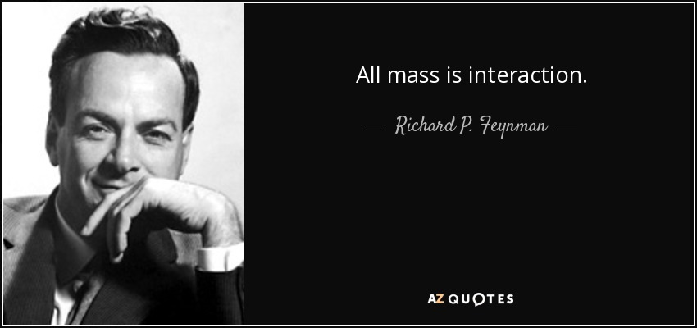

Slide 24

Trace Anomaly
In a scale invariant theory
the energy-momentum tensor must be traceless: T_{μμ} ≡ 0
Regularisation and renormalisation of (ultraviolet) divergences in Quantum Chromodynamics introduces a mass-scale
… dimensional transmutation:
Lagrangian’s constants (couplings and masses) become dependent on a mass-scale, ζ
α → α(ζ) in QCD’s (massless) Lagrangian density, L(m=0)
⇒ ∂_{μ}D_{μ} = δL/δσ = αβ(α) dL/dα = β(α) ¼G_{μν} G_{μν} = T_{ρρ} =: Θ₀
Quantisation of renormalisable four-dimensional theory forces nonzero value for trace of energy-momentum tensor
Trace anomaly
QCD β function … specifies how the coupling “runs”

Slide 25
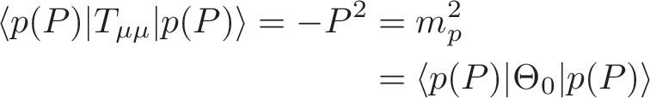
Trace Anomaly
Knowing that a trace anomaly exists does not deliver a great deal
… Indicates only that a mass-scale must exist
Key Question: Can one compute and/or understand the magnitude of that scale?
One can certainly measure the magnitude … consider proton:
In the chiral limit the entirety of the proton’s mass is produced by the trace anomaly, Θ₀
… In QCD at perturbative scales, Θ₀ measures the strength of gluon self-interactions
… so, from one perspective,
m_{p} is (somehow) completely generated by glue.
The mass of visible matter is almost entirely produced by massless non-matter fields

Slide 26

On the other hand …

Slide 27
Trace Anomaly
In the chiral limit, pion is massless Nambu-Goldstone boson:
⇒
Does this mean that the scale anomaly vanishes trivially in the pion state, i.e. gluons contribute nothing to the pion mass?
Difficult way to obtain “zero”!
Easier to imagine that “zero” owes to cancellations between different operator contributions to the expectation value of Θ₀.
Of course, such precise cancellation should not be an accident.
It could only arise naturally because
of some symmetry and/or symmetry-breaking pattern.

Slide 28
Whence “1” and yet “0” ?
No statement of the question
“How does the mass of the proton arise?”
is complete without the additional clause
“How does the pion remain massless?”
Natural visible-matter mass-scale must emerge simultaneously with apparent preservation of scale invariance in related systems
Expectation value of Θ₀ in pion is always zero,
irrespective of the size of the natural mass-scale for strong interactions = m_{p}

Slide 29
Whence “1” and yet “0” ?
No statement of the question
“How does the mass of the proton arise?”
is complete without the additional clause
“How does the pion remain massless?”
Natural visible-matter mass-scale must emerge simultaneously with apparent preservation of scale invariance in related systems
Expectation value of Θ₀ in pion is always zero,
irrespective of the size of the natural mass-scale for strong interactions = m_{p}
Modern Physics must
Elucidate the entire array of Empirical Consequences
of the Mechanism responsible
so that the Standard Model can be Tested and Bounded

Slide 30
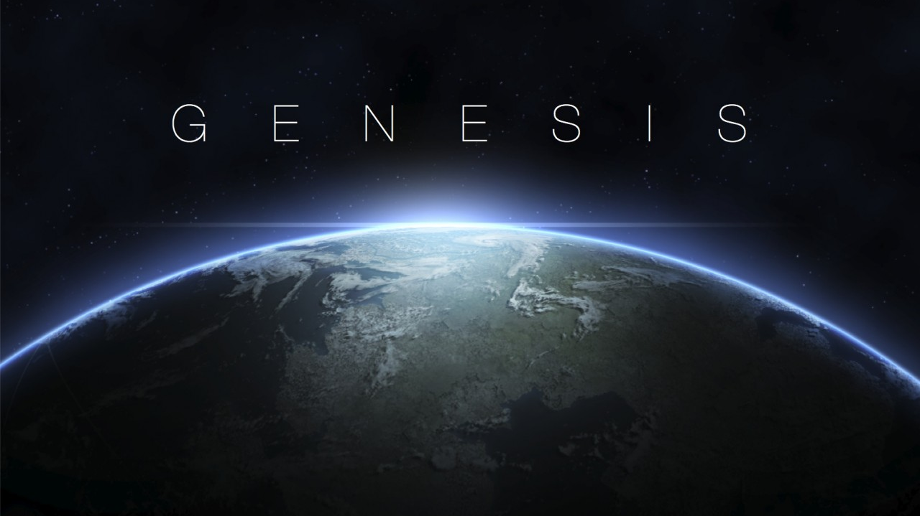

Slide 31


Slide 32
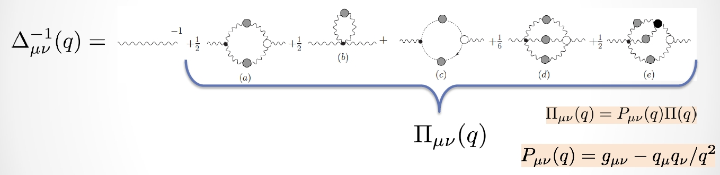
Gluon Dyson/Gap Equation
Pinch Technique: Theory and Applications
Daniele Binosi & Joannis Papavassiliou
Phys. Rept. 479 (2009) 1-152
Gluon self interactions modify the propagation characteristics of the gluon partons that define QCD.
They produce dressed gluons,
with a mathematical connection to the gluon partons, but with markedly different properties.

Slide 33


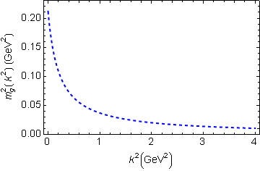
IR Behaviour of QCD
Running gluon mass
Gluons are cannibals – a particle class whose members become massive by eating each other!
μ_{g} ≈ ½ m_{p}
Expression of trace anomaly:
Massless glue becomes massive
Power-law suppressed in ultraviolet, so invisible in perturbation theory
Recent reviews …
Emergent Hadron Mass in Strong Dynamics
Daniele Binosi, e-Print: 2203.00942 [hep-ph]
Few Body Syst. 63 (2022) 2, 42
Gauge Sector Dynamics in QCD,
M. N. Ferreira, J. Papavassiliou, Particles 6 (1) (2023) 312–363.
Combining CSM, lQCD and pQCD analyses of QCD’s gauge sector

Slide 34
Gluon mass scale
QCD permits a gluon mass scale to emerge – the character of QCD is sufficient
However, the emergence of a gluon mass scale is not necessary
The magnitude of the gluon mass-scale is not contained within the SM
On the other hand, we exist; hence, it can be measured
QCD is a renormalizable quantum field theory
Perturbation theory is a valid tool for high-energy phenomena
Can fix the scale by something perturbative, e.g.
the value of QCD’s running coupling at the mass of the τ lepton
Once that number is fixed, then nonperturbative tools can predict the value of the gluon mass function on the entire domain of spacelike momenta

Slide 35
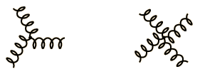
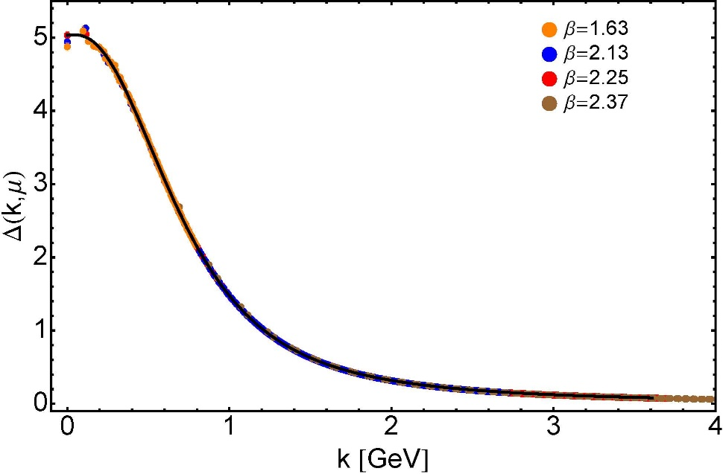


Modern Understanding Grew Slowly from Ancient Origins
More than 40 years ago
Dynamical mass generation in continuum quantum chromodynamics,
J.M. Cornwall, Phys. Rev. D 26 (1981) 1453 … $>1100$ citations
Owing to strong self-interactions, gluon partons $⇒$ gluon quasiparticles,
described by a mass function that is large at infrared momenta
3-gluon vertex
4-gluon vertex
$$\frac{1}{m_{g}^{2}}$$
Truly mass from nothing
An interacting theory, written in terms of massless gluon fields, produces dressed gluon fields that are characterised by a mass function that is large at infrared momenta
Gluon propagator … continuum and lattice QCD agree
QCD fact
Continuum theory and lattice simulations agree
Empirical verification?

Slide 36


Modern Understanding Grew Slowly from Ancient Origins
D. Binosi, Emergent Hadron Mass in Strong Dynamics, Few Body Syst. 63 (2022) 42.
M. N. Ferreira, J. Papavassiliou, Gauge Sector Dynamics in QCD, Particles 6 (1) (2023) 312–363.
EHM means
Gluons are massive – Schwinger Mechanism
More than 40 years ago
Dynamical mass generation in continuum quantum chromodynamics,
J.M. Cornwall, Phys. Rev. D 26 (1981) 1453 … $∼1050$ citations
Owing to strong self-interactions, gluon partons $⇒$ gluon quasiparticles,
described by a mass function that is large at infrared momenta
3-gluon vertex
4-gluon vertex
$$\frac{1}{m_{g}^{2}}$$
Truly mass from nothing
An interacting theory, written in terms of massless gluon fields, produces dressed gluon fields that are characterised by a mass function that is large at infrared momenta
Gluon propagator … continuum and lattice QCD agree
QCD fact
Continuum theory and lattice simulations agree
Empirical verification?

Slide 37
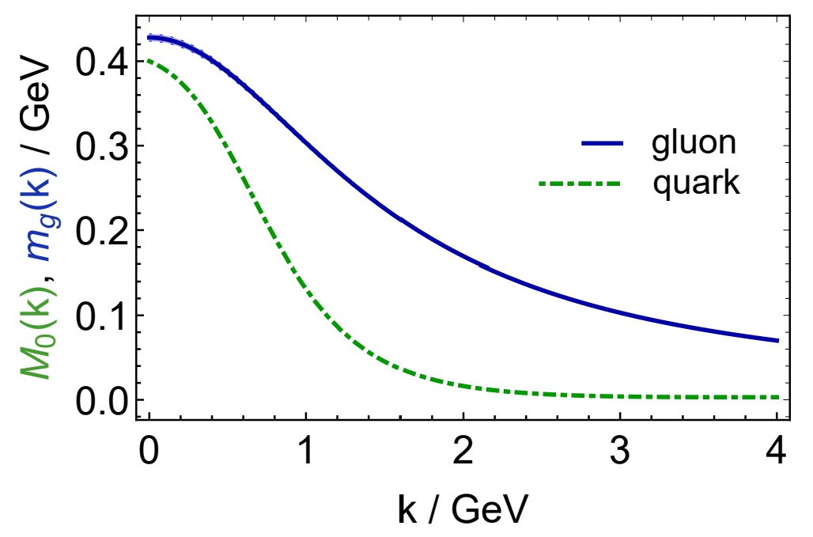

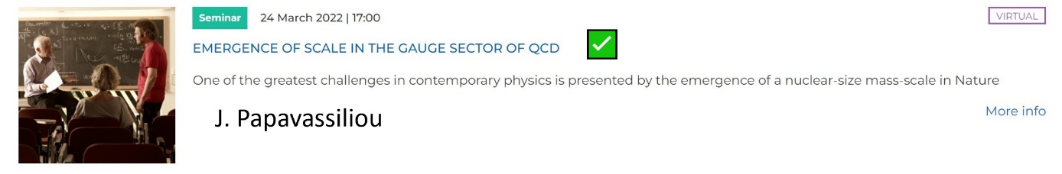
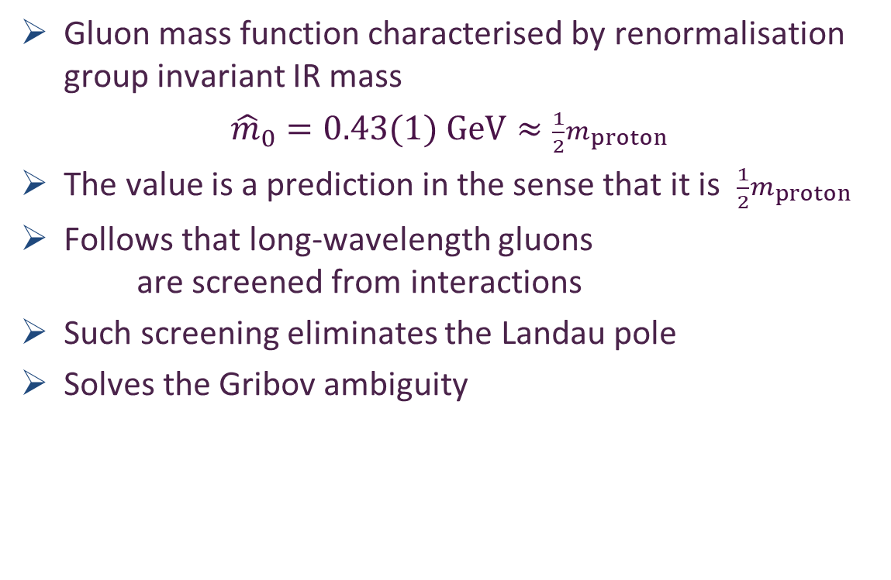
Today: Gluon Mass Function
Effective charge from lattice QCD, Zhu-Fang Cui, Jin-Li Zhang et al.,
NJU-INP 014/19, arXiv:1912.08232 [hep-ph], Chin. Phys. C 44 (2020) 083102/1-10
2014 total downloads
Gluon mass function characterised by renormalisation group invariant IR mass
${\hat{m}}_{0}=0.43(1) GeV≈\frac{1}{2}m_{proton}$
The value is a prediction in the sense that it is $\frac{1}{2}m_{proton}$
Follows that long-wavelength gluons
are screened from interactions
Such screening eliminates the Landau pole
Solves the Gribov ambiguity
https://www.youtube.com/watch?v=xlkvz2V8ZRw

Slide 38

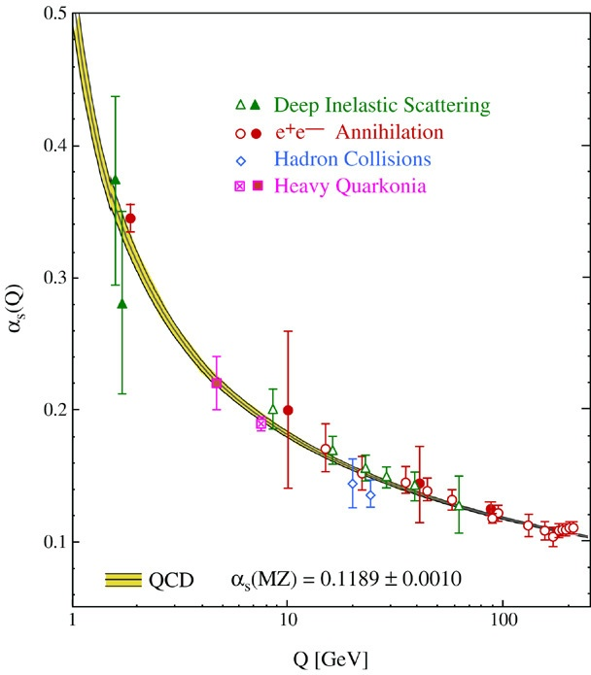
QCD’s Running Coupling
This is where we live
Asymptotic Freedom
Interaction becomes weaker
as energy grows
(as charges get closer together)
⇐
What’s happening
out here?!

Slide 39
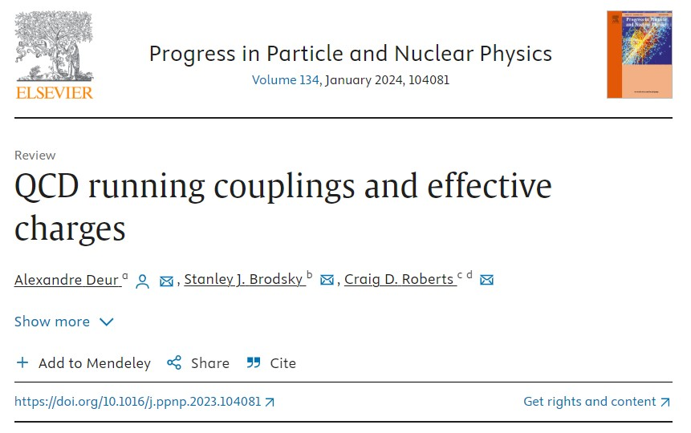
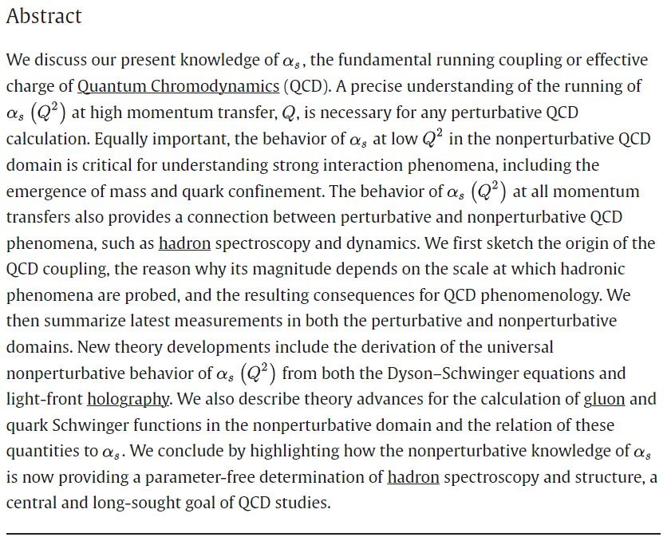

Slide 40
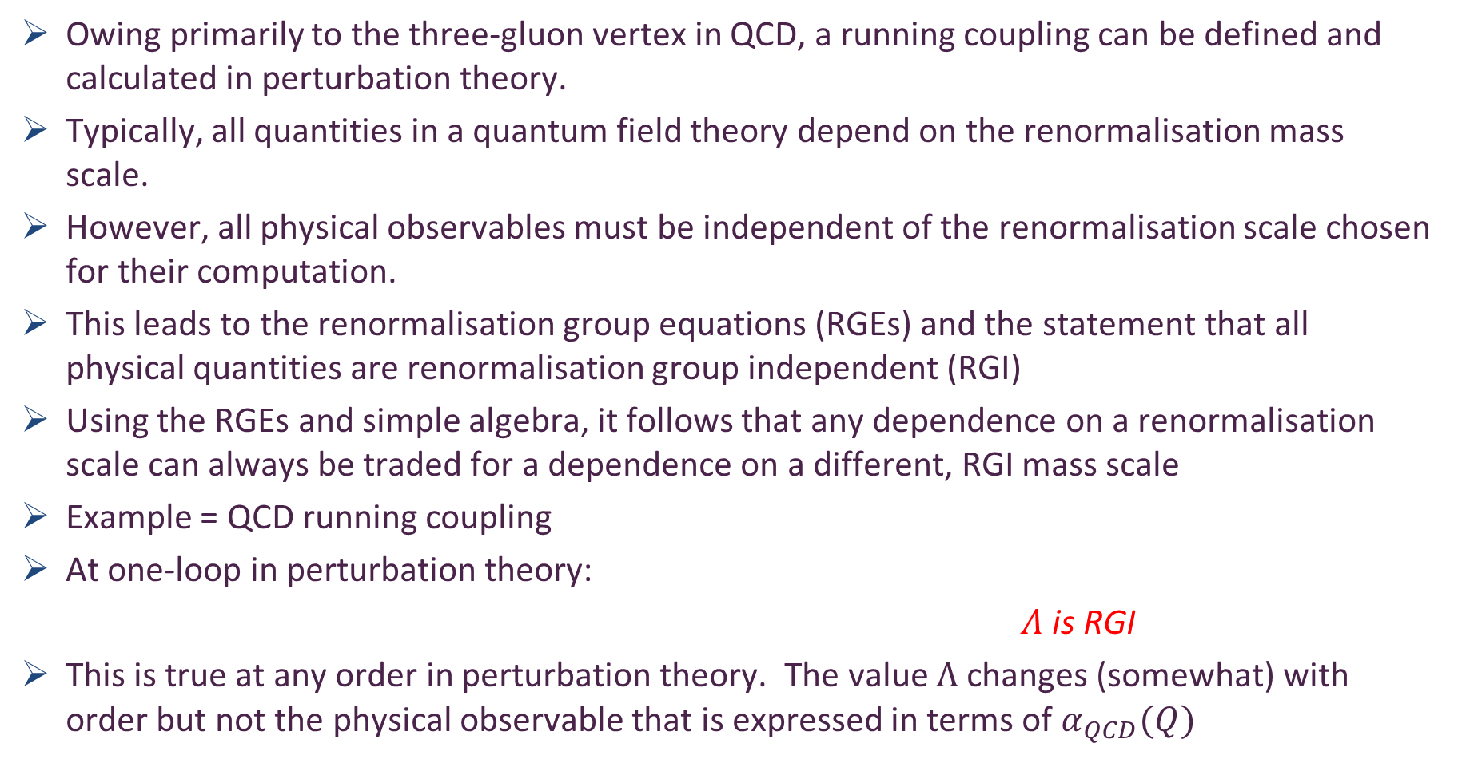
Asymptotic Freedom
Owing primarily to the three-gluon vertex in QCD, a running coupling can be defined and calculated in perturbation theory.
Typically, all quantities in a quantum field theory depend on the renormalisation mass scale.
However, all physical observables must be independent of the renormalisation scale chosen for their computation.
This leads to the renormalisation group equations (RGEs) and the statement that all physical quantities are renormalisation group independent (RGI)
Using the RGEs and simple algebra, it follows that any dependence on a renormalisation scale can always be traded for a dependence on a different, RGI mass scale
Example = QCD running coupling
At one-loop in perturbation theory:
$Λ$ is RGI
This is true at any order in perturbation theory. The value $Λ$ changes (somewhat) with order but not the physical observable that is expressed in terms of $α_{QCD}(Q)$

Slide 41
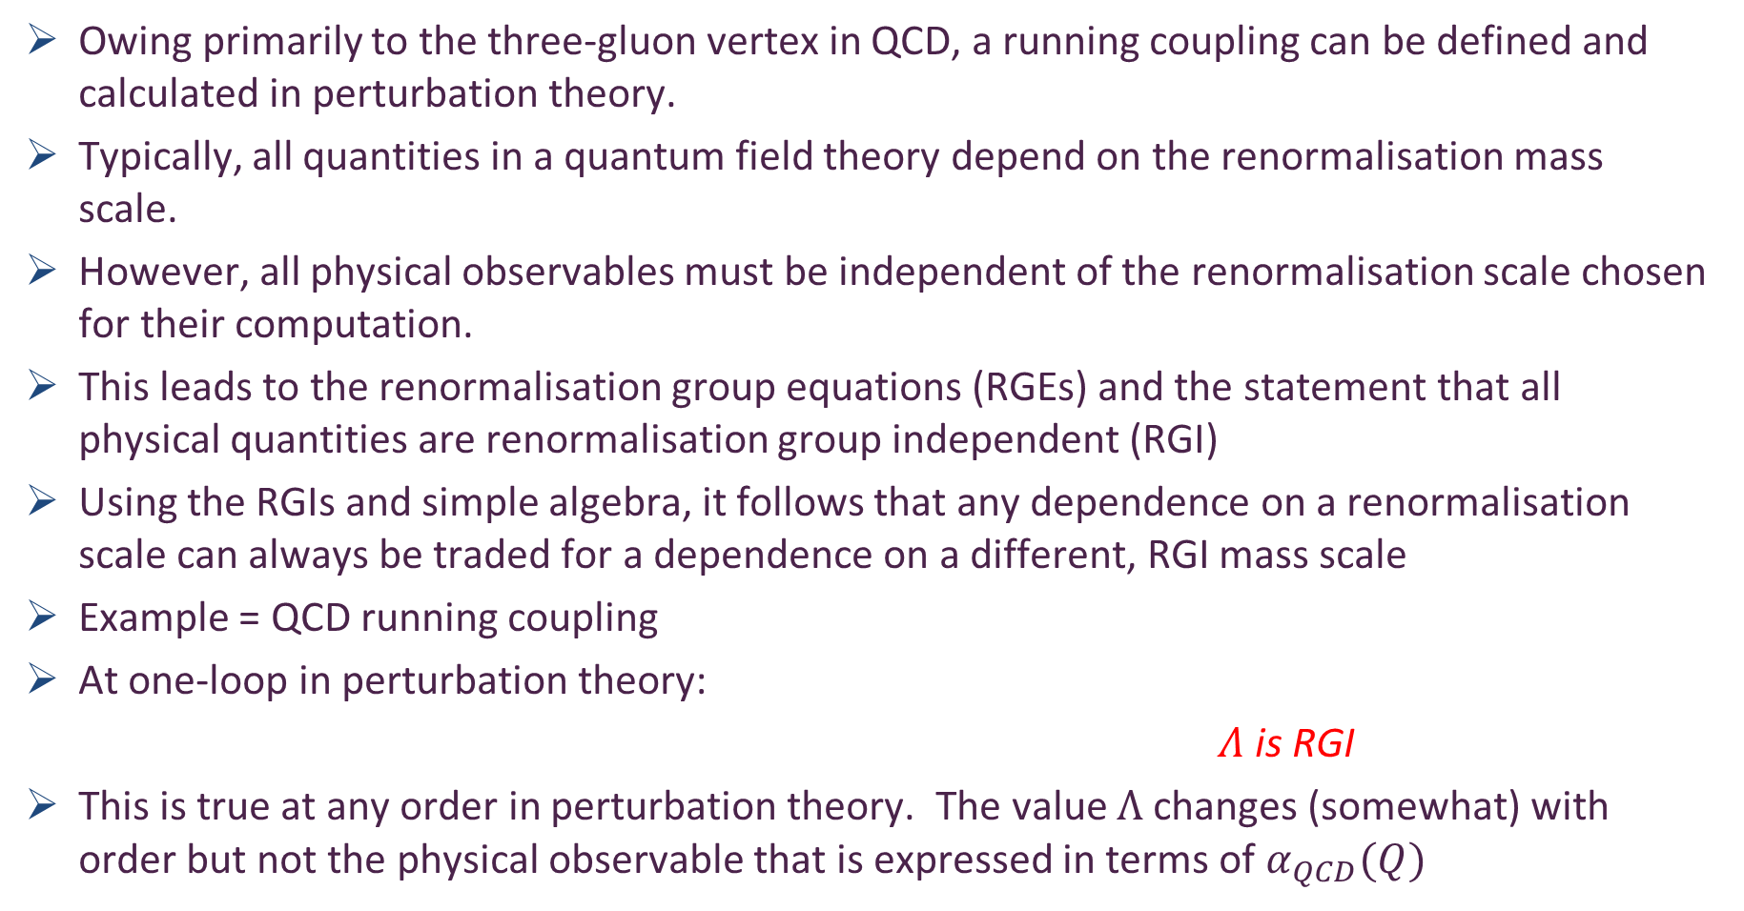
Asymptotic Freedom
2004 Nobel Prize in Physics : Gross, Politzer and Wilczek
Owing primarily to the three-gluon vertex in QCD, a running coupling can be defined and calculated in perturbation theory.
Typically, all quantities in a quantum field theory depend on the renormalisation mass scale.
However, all physical observables must be independent of the renormalisation scale chosen for their computation.
This leads to the renormalisation group equations (RGEs) and the statement that all physical quantities are renormalisation group independent (RGI)
Using the RGIs and simple algebra, it follows that any dependence on a renormalisation scale can always be traded for a dependence on a different, RGI mass scale
Example = QCD running coupling
At one-loop in perturbation theory:
$Λ$ is RGI
This is true at any order in perturbation theory. The value $Λ$ changes (somewhat) with order but not the physical observable that is expressed in terms of $α_{QCD}(Q)$

Slide 42
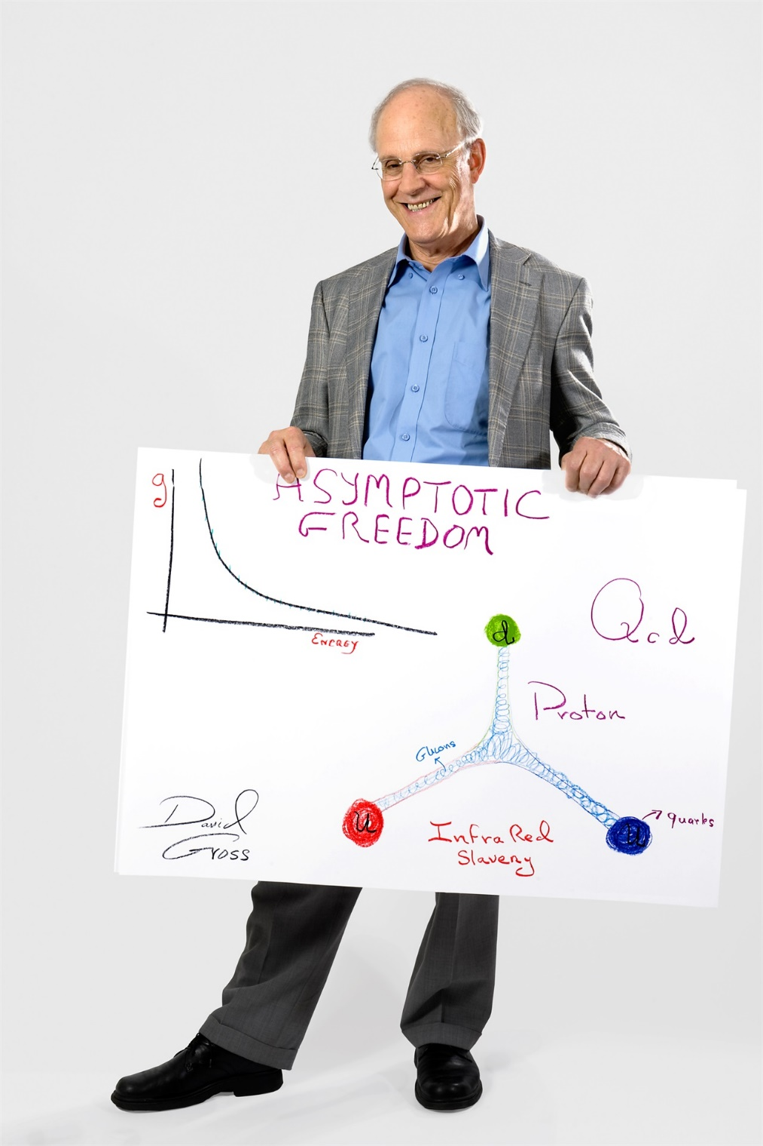
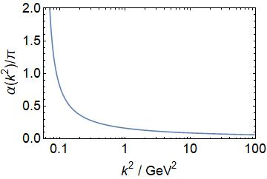
“Asymptotic freedom comes with a flip side”
“Imaginatively called infrared slavery”
Based on perturbative analyses, appearance of a Landau pole at infrared momenta, became common to assume coupling runs to infinity as k² runs to zero
Perturbative-QCD running coupling extrapolated onto infrared domain k² < 1 GeV²
Many people interpreted/still interpret this as being synonymous with confinement
Is the notion correct?

Slide 43

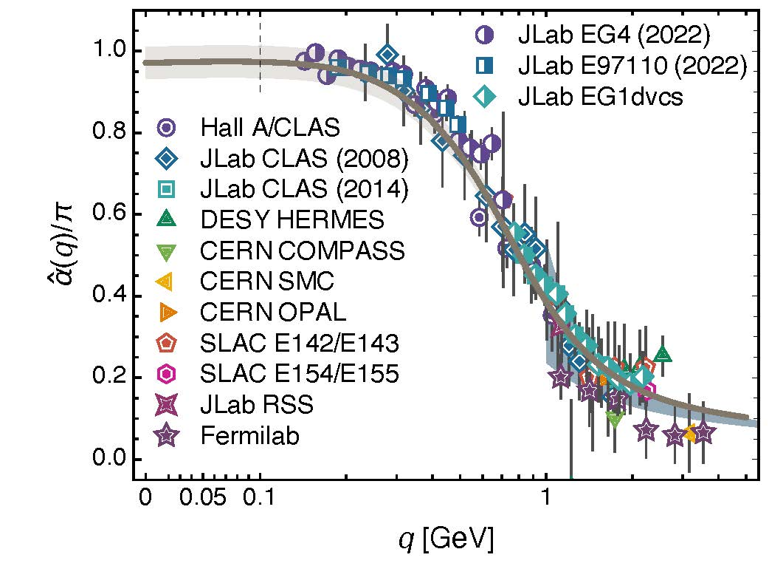
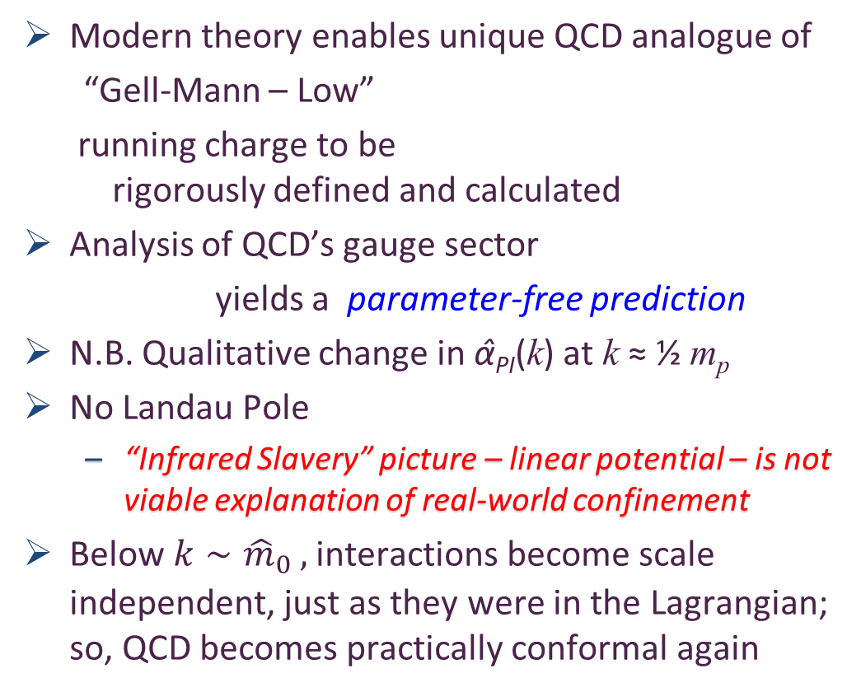
Process independent effective charge = running coupling
W orkshop on Dyson-Schwinger Equations in Modern Mathematics
and Physics (DSEMP2014) Trento, Italy, September 22-26, 2014
Effective charge from lattice QCD, Zhu-Fang Cui, Jin-Li Zhang et al.,
NJU-INP 014/19, arXiv:1912.08232 [hep-ph], Chin. Phys. C 44 (2020) 083102/1-10
3407 total downloads
Modern theory enables unique QCD analogue of
“Gell-Mann – Low”
running charge to be
rigorously defined and calculated
Analysis of QCD’s gauge sector
yields a parameter-free prediction
N.B. Qualitative change in α̂_{PI}(k) at k ≈ ½ m_{p}
No Landau Pole
“Infrared Slavery” picture – linear potential – is not viable explanation of real-world confinement
Below $k∼{{\hat{m}}_{0}}_{ },$interactions become scale independent, just as they were in the Lagrangian; so, QCD becomes practically conformal again
Process independent strong running coupling
Daniele Binosi et al., arXiv:1612.04835 [nucl-th], Phys. Rev. D 96 (2017) 054026/1-7
Experimental determination of the QCD effective charge α_{g1}(Q).
A. Deur; V. Burkert; J.-P. Chen; W. Korsch, Particles 5 (2022) 171
QCD Running Couplings and Effective Charges, Alexandre Deur, Stanley J. Brodsky and Craig Roberts, e-Print: 2303.00723 [hep-ph], Prog. Part. Nucl. Phys. 134 (2024) 104081

Slide 44
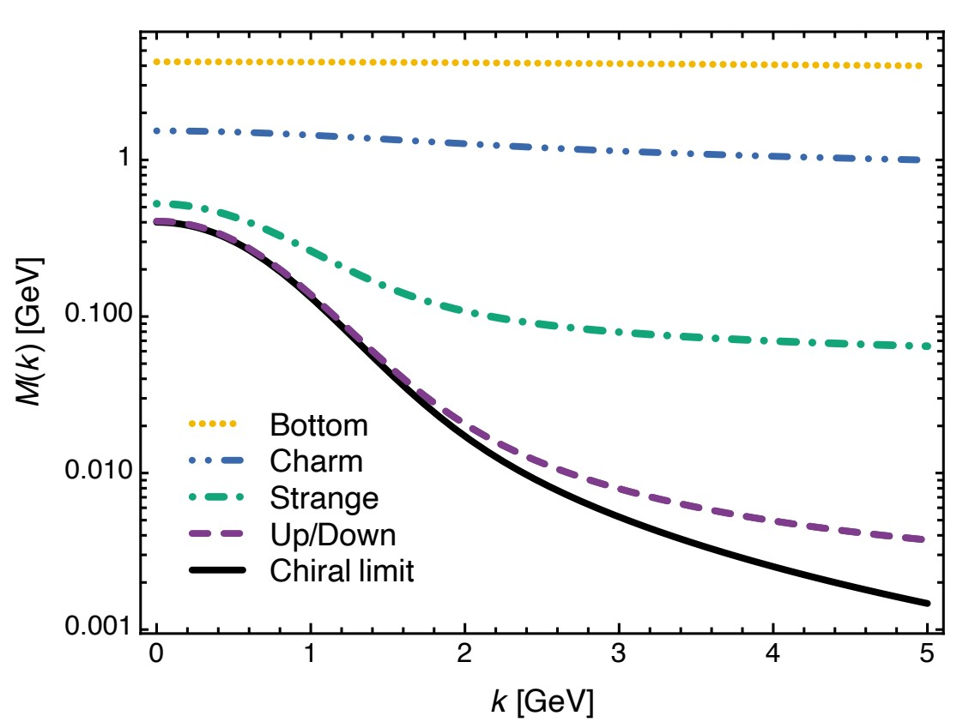
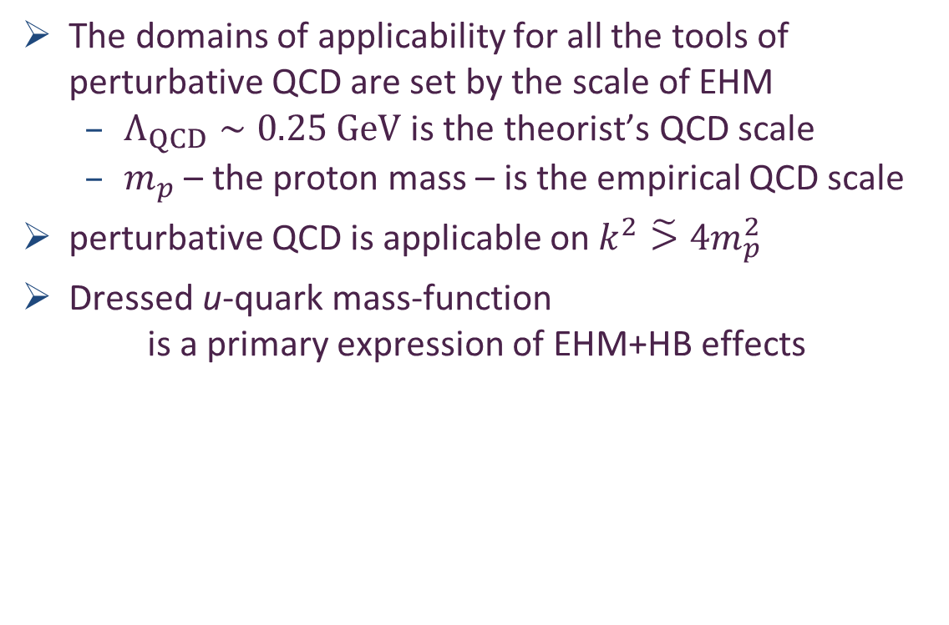
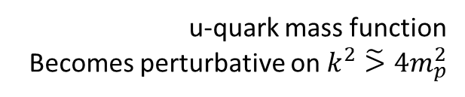
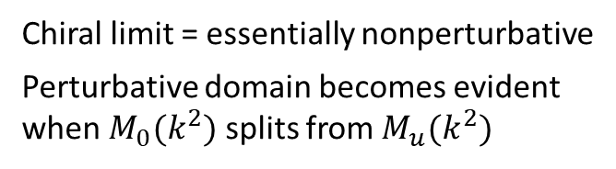
Perturbation Theory and the Onset of Nonperturbative Physics
Chiral limit = essentially nonperturbative
Perturbative domain becomes evident when $M_{0}(k^{2})$ splits from $M_{u}(k^{2})$
The domains of applicability for all the tools of perturbative QCD are set by the scale of EHM
$Λ_{QCD}∼0.25 GeV$ is the theorist’s QCD scale
$m_{p}$ – the proton mass – is the empirical QCD scale
perturbative QCD is applicable on $k^{2}\tilde{>}4m_{p}^{2}$
Dressed u-quark mass-function
is a primary expression of EHM+HB effects
Dressed-quark mass function
u-quark mass function
Becomes perturbative on $k^{2}\tilde{>}4m_{p}^{2}$

Slide 45
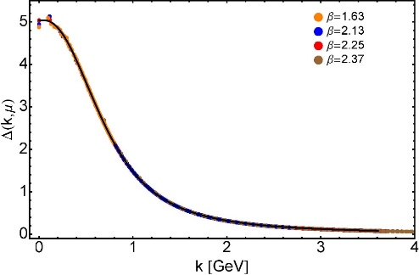

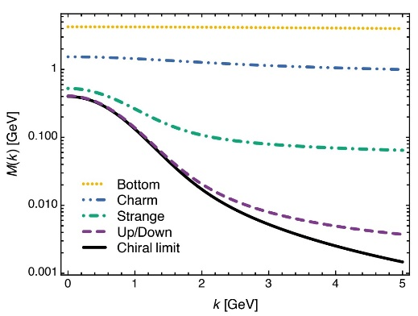
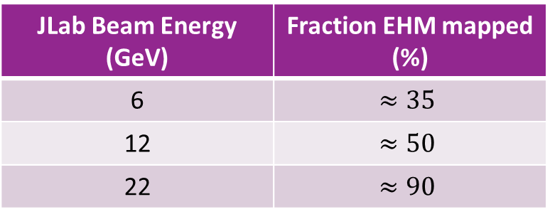
EHM Basics
Absent Higgs boson couplings, the Lagrangian of QCD is scale invariant
Yet …
Massless gluons become massive
A momentum-dependent charge is produced
Massless quarks become massive
EHM is expressed in
EVERY strong interaction observable
Challenge to Theory =
1. Elucidate all observable consequences of these phenomena
2. Highlight paths to measuring them
Challenge to Experiment =
Test the theory predictions so that
Boundaries of Standard Model can finally be drawn
Three pillars of EHM
JLab Beam Energy (GeV) | Fraction EHM mapped (%)
6 | $$≈35$$
12 | $$≈50$$
22 | $$≈90$$

Slide 46
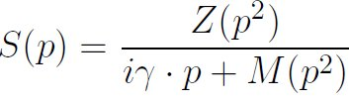
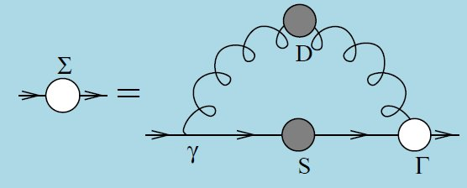
Quark Gap Equation

Slide 47
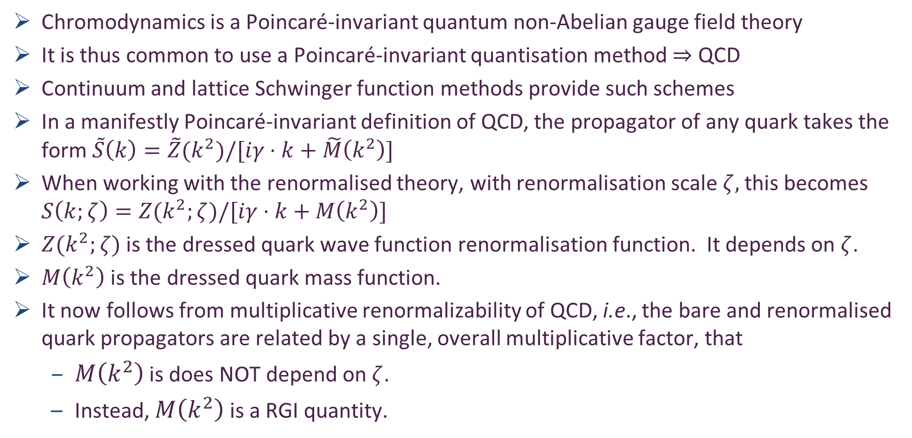
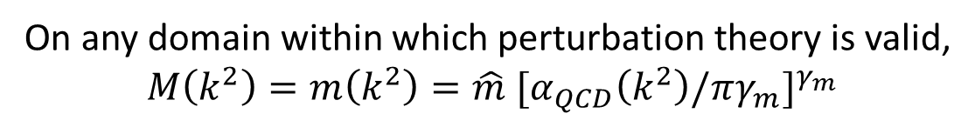
Renormalisation Group Invariant Running Quark Mass
Chromodynamics is a Poincaré-invariant quantum non-Abelian gauge field theory
It is thus common to use a Poincaré-invariant quantisation method $⇒$ QCD
Continuum and lattice Schwinger function methods provide such schemes
In a manifestly Poincaré-invariant definition of QCD, the propagator of any quark takes the form $\tilde{S}\left(k\right)=\tilde{Z}(k^{2})/[iγ⋅k+\tilde{M}\left(k^{2}\right)]$
When working with the renormalised theory, with renormalisation scale $ζ,$this becomes $S\left(k;ζ\right)=Z(k^{2};ζ)/[iγ⋅k+M\left(k^{2}\right)]$
$Z(k^{2};ζ)$ is the dressed quark wave function renormalisation function. It depends on $ζ$.
$M\left(k^{2}\right)$ is the dressed quark mass function.
It now follows from multiplicative renormalizability of QCD, i.e., the bare and renormalised quark propagators are related by a single, overall multiplicative factor, that
$M\left(k^{2}\right)$ is does NOT depend on $ζ$.
Instead, $M\left(k^{2}\right)$ is a RGI quantity.
On any domain within which perturbation theory is valid,
$$M\left(k^{2}\right)=m\left(k^{2}\right)=\hat{m}{ [α}_{QCD}{\left(k^{2}\right)/πγ_{m}]}^{γ_{m}}$$

Slide 48

Dynamical Chiral Symmetry Breaking
DCSB is a fact in QCD
Dynamical, not spontaneous
Add nothing to QCD ,
No Higgs field, nothing!
Effect achieved purely through
quark+gluon dynamics.
It’s the most important
mass generating mechanism
for visible matter in the Universe.
Responsible for ≈98% of the proton’s mass.
Higgs mechanism is (almost) irrelevant to light-quarks.

Slide 49

Pseudoscalar Mesons as Bound-States
Poincaré covariance entails that the bound-state (Bethe-Salpeter) amplitude for an isovector pseudoscalar meson (valence-quark and valence-antiquark) takes the form
{τ^{i=1,2,3}} = Pauli matrices
P = total momentum of system
k = relative momentum between valence degrees-of-freedom

Slide 50


Pseudoscalar Mesons as Bound-States
Bound-State amplitude is determined from the homogeneous Bethe-Salpeter equation (BSE):
χ(q;P) = S(q) Γ(q;P) S(q+P) , S = dressed-quark propagator
r,s,t,u represent colour, isospin, spinor indices
K = quark-antiquark scattering amplitude
A generalisation to quantum field theory of the Lippmann-Schwinger equation = one of the most-used equations in quantum mechanics … to describe scattering and bound states

Slide 51

Enigma of Mass

Slide 52

Axialvector Ward Green Takahashi Identity
Expression of (partial) conservation of axialvector (chirality) current
Identity between
axial vector vertex pseudoscalar vertex dressed quark propagator
Chiral limit
Quantum numbers $⇒$ pion appears as pole in axial vector vertex
$$P_{μ}Γ_{5μ}^{ud}\left(k;0\right)=−{f_{π}Γ}_{π}(k;0)$$
This says that leading amplitude in pion “wave function” is completely determined by the dressed-quark propagator

Slide 53



Pion’s Goldberger -Treiman relation
Maris, Roberts and Tandy
nucl-th/9707003, Phys.Lett. B420 (1998) 267-273
Pion’s Bethe-Salpeter amplitude
Solution of the Bethe-Salpeter equation
Dressed-quark propagator
Symmetry demands, via Axial-vector Ward-Takahashi identity:
$$M{(p}^{2})=\frac{B{(p}^{2})}{A{(p}^{2})}$$
B(k²)
Owing to DCSB
& Exact in
Chiral QCD
Miracle: two body problem solved, almost completely, once solution of one body problem is known

Slide 54
The most fundamental expression of Goldstone’s Theorem and DCSB
Rudimentary version of this relation is apparent in Nambu’s Nobel Prize work
Model independent
Gauge independent
Scheme independent
f_{π} E_{π}(p²) = B(p²)

Slide 55
Pion exists if, and only if, mass emerges dynamically
Rudimentary version of this relation is apparent in Nambu’s Nobel Prize work
Model independent
Gauge independent
Scheme independent
f_{π} E_{π}(p²) = B(p²)

Slide 56
QCD Fact Pion (Nambu-Goldstone modes) and mass
EHM demands equivalence between
one-body mass and two-body correlation strength
in Nature’s most fundamental Nambu-Goldstone bosons
Higgs boson couplings → 0
Pion exists and is massless
Pion Bethe-Salpeter amplitude
Pion wave function quark mass function
Thus, enigmatically, properties of the nearly massless pion are the cleanest expression of EHM in the Standard Model !
f_{π} E_{π}(p²) = B(p²)

Slide 57

Dichotomy of the pion Mass Formula for 0— Mesons
Maris, Roberts and Tandy
nucl-th/9707003, Phys.Lett. B420 (1998) 267-273
Mass-squared of the pseudoscalar hadron
Sum of the current-quark masses of the constituents;
e.g., pion = m_{u}^{ς} + m_{d}^{ς} , where “ς” is the renormalisation point

Slide 58


Dichotomy of the pion Mass Formula for 0— Mesons
Maris, Roberts and Tandy
nucl-th/9707003, Phys.Lett. B420 (1998) 267-273
Pseudovector projection of the Bethe-Salpeter wave function onto the origin in configuration space
Namely, the pseudoscalar meson’s leptonic decay constant, which is the strong interaction contribution to the strength of the meson’s weak interaction

Slide 59


Dichotomy of the pion Mass Formula for 0— Mesons
Maris, Roberts and Tandy
nucl-th/9707003, Phys.Lett. B420 (1998) 267-273
Pseudoscalar projection of the Bethe-Salpeter wave function onto the origin in configuration space
Namely, a pseudoscalar analogue of the meson’s leptonic decay constant

Slide 60


Dichotomy of the pion Mass Formula for 0— Mesons
Maris, Roberts and Tandy
nucl-th/9707003, Phys.Lett. B420 (1998) 267-273
Consider the case of light quarks; namely, m_{q} ≈ 0
If chiral symmetry is dynamically broken, then
f_{H5} → f_{H5}⁰ ≠ 0
ρ_{H5} → – < q-bar q> / f_{H5}⁰ ≠ 0
both of which are independent of m_{q}
Hence, one arrives at the corollary
The so-called
“vacuum quark condensate.”
It’s actually
contained within hadrons.
Gell-Mann, Oakes, Renner relation
1968
All definitions of $\left\langle \overline{q}q\right\rangle$ are the same
Concerning the quark condensate,
K. Langfeld et al., Phys. Rev. C 67 (2003) 065206

Slide 61

Dynamical Chiral Symmetry Breaking Vacuum Condensates?

Slide 62

“Orthodox Vacuum”
Vacuum = “frothing sea”
Hadrons = bubbles in that “sea”,
containing nothing but quarks & gluons
interacting perturbatively, unless they’re
near the bubble’s boundary, whereat they feel they’re trapped!
u
d
u
u
d
u
u
u
d

Slide 63

GMOR Relation

Slide 64

Gell-Mann – Oakes – Renner Relation
Behavior of current divergences under SU(3) x SU(3).
Murray Gell-Mann, R.J. Oakes , B. Renner
Phys.Rev. 175 (1968) 2195-2199
This paper derives a relation between
m_{π}² and the expectation-value < π|u₀|π>,
where u_{o} is an operator that is linear in the putative Hamiltonian’s explicit chiral-symmetry breaking term
NB. QCD’s current-quarks were not yet invented, so u₀ was not expressed in terms of current-quark fields
PCAC-hypothesis (partial conservation of axial current) is used in the derivation
Subsequently, the concepts of soft-pion theory
Operator expectation values do not change as t=m_{π}² → t=0
to take < π|u₀|π> → < 0|u₀|0> … in-pion → in-vacuum
Notes:
(8)

Slide 65



Gell-Mann – Oakes – Renner Relation
Behavior of current divergences under SU(3) x SU(3).
Murray Gell-Mann, R.J. Oakes , B. Renner
Phys.Rev. 175 (1968) 2195-2199
PCAC hypothesis; viz., pion field dominates divergence of the axial-vector current
Soft-pion theorem
In QCD,
this is and one therefore has
Zhou Guangzhao 周光召
Born 1929 Changsha, Hunan province
Commutator is chiral rotation
Therefore, isolates explicit
chiral-symmetry breaking term
in the putative Hamiltonian
Notes:
(8)

Slide 66

Gell-Mann – Oakes – Renner Relation
- (0.25GeV)³
Theoretical physics at its best.
But no one is thinking about how properly to consider or define what will come to be called the
vacuum quark condensate
So long as the condensate is
just a mass-dimensioned
constant, which approximates
another well-defined matrix
element, there is no problem.
Problem arises if one
over-interprets this number,
which textbooks have been doing
for a VERY LONG TIME.
Notes:
(8)

Slide 67


Note of Warning
Chiral Magnetism (or Magnetohadrochironics)
A. Casher and L. Susskind, Phys. Rev. D9 (1974) 436
These authors argue
that dynamical chiral-
symmetry breaking
can be realised as a
property of hadrons,
instead of via a
nontrivial vacuum exterior to the measurable degrees of freedom
The essential ingredient required for a spontaneous symmetry breakdown in a composite system is the existence of a divergent number of constituents
– DIS provided evidence for divergent sea of low-momentum partons – parton model.
Notes:
(10)

Slide 68


QCD Sum Rules
QCD and Resonance Physics. Sum Rules.
M.A. Shifman, A.I. Vainshtein, and V.I. Zakharov
Nucl.Phys. B147 (1979) 385-447; citations: 3713
Introduction of the gluon vacuum condensate
and development of “sum rules” relating properties of low-lying hadronic states to vacuum condensates
Notes:
(10)

Slide 69

QCD Sum Rules
QCD and Resonance Physics. Sum Rules.
M.A. Shifman, A.I. Vainshtein, and V.I. Zakharov
Nucl.Phys. B147 (1979) 385-447; citations: 3781
Introduction of the gluon vacuum condensate
and development of “sum rules” relating properties of low-lying hadronic states to vacuum condensates
At this point (1979), the cat was out of the bag: a physical reality was seriously attributed to a plethora of so-called vacuum condensates
Notes:
(10)

Slide 70
“quark condensate” 1960-1980
Instantons in non-perturbative QCD vacuum,
MA Shifman, AI Vainshtein… - Nuclear Physics B, 1980
Instanton density in a theory with massless quarks,
MA Shifman, AI Vainshtein… - Nuclear Physics B, 1980
Exotic new quarks and dynamical symmetry breaking,
WJ Marciano - Physical Review D, 1980
The pion in QCD
J Finger, JE Mandula… - Physics Letters B, 1980
No references to this phrase before 1980
20,000+ references to this phrase since 1980
Notes:
(10)

Slide 71

Universal Conventions
Wikipedia: (http://en.wikipedia.org/wiki/QCD_vacuum)
“The QCD vacuum is the vacuum state of quantum chromodynamics (QCD). It is an example of a non-perturbative vacuum state, characterized by many non-vanishing condensates such as the gluon condensate or the quark condensate. These condensates characterize the normal phase or the confined phase of quark matter.”
Notes:
(23)

Slide 72
Precedent?
Notes:
(10)

Slide 73

Precedent- Luminiferous Aether
Pre-1887
Since the Earth is in motion, the flow of aether across
the Earth should produce a detectable “aether wind”
Physics theories of the late 19th century postulated that, just as water waves must have a medium to move across (water), and audible sound waves require a medium to move through (such as air or water), so also light waves require a medium, the “luminiferous aether”.
Apparently unassailable logic
Until, of course, “… the most famous failed experiment to date.”
On the Relative Motion of the Earth and the Luminiferous Ether
Michelson, Albert Abraham & Morley, Edward Williams
American Journal of Science 34 (1887) 333–345.
Notes:
(10)

Slide 74

QCD
1973-1974
How should one approach this problem, understand it,
within Quantum ChromoDynamics?
Are the quark and gluon “condensates” theoretically well-defined?
Is there a physical meaning to this quantity or is it merely just a mass-dimensioned parameter in a theoretical computation procedure?
Notes:
(10)

Slide 75
QCD
1973-1974
Why does it matter?
Notes:
(10)

Slide 76

“Dark Energy”
Two pieces of evidence for an accelerating universe
Observations of type Ia supernovae
→ the rate of expansion of the Universe is growing
Measurements of the composition of the Universe point to a missing energy component with negative pressure:
CMB anisotropy measurements indicate that the Universe is at
Ω₀ = 1 ⁺⁄₋ 0.04.
In a flat Universe, the matter density and energy density must sum to the critical density. However, matter only contributes about ⅓ of the critical density,
Ω_{M} = 0.33 ⁺⁄₋ 0.04.
Thus, ⅔ of the critical density is missing.
Notes:
(10)

Slide 77
“Dark Energy”
In order to have escaped detection,
the missing energy must be smoothly
distributed.
In order not to interfere with the formation of structure (by inhibiting the growth of density perturbations) the energy density in this component must change more slowly than matter (so that it was subdominant in the past).
Accelerated expansion can be accommodated in General Relativity through the Cosmological Constant, Λ.
Einstein introduced the repulsive effect of the cosmological constant in order to balance the attractive gravity of matter so that a static universe was possible. He promptly discarded it after the discovery of the expansion of the Universe.
Contemporary cosmological observations mean:
Notes:
(10)

Slide 78

“Dark Energy”
“The advent of quantum field theory made consideration of the cosmological constant obligatory not optional.”
Michael Turner, “Dark Energy and the New Cosmology”
The only possible covariant form for the energy of the (quantum) vacuum; viz.,
is mathematically equivalent to the cosmological constant.
“It is a perfect fluid and precisely spatially uniform”
“Vacuum energy is almost the perfect candidate for dark energy.”
Notes:
(10)

Slide 79
“Dark Energy”
Enormous and even greater contribution from Higgs VEV!
QCD vacuum contribution
If chiral symmetry breaking is expressed in a nonzero expectation value of the quark bilinear, then the energy difference between the symmetric and broken phases is of order
M_{QCD}≈0.3 GeV
One obtains therefrom:
Mass-scale generated by
spacetime-independent
condensate
“The biggest embarrassment in theoretical physics.”
Notes:
(10)

Slide 80

Resolution?

Slide 81
QCD
1973-1974
Are the condensates real?
Is there a physical meaning to the vacuum quark condensate (and others)?
Or is it merely just a mass-dimensioned parameter in a theoretical computation procedure?
Notes:
(10)

Slide 82

Confinement contains condensates

Slide 83

GMOR Relation
Expanding the concept of in-hadron condensates Lei Chang, Craig D. Roberts and Peter C. Tandy arXiv:1109.2903 [nucl-th], Phys. Rev. C85 (2012) 012201(R)
Valuable to highlight the precise form of the Gell-Mann–Oakes–Renner (GMOR) relation: Eq. (3.4) in Phys.Rev. 175 (1968) 2195
m_{π} is the pion’s mass
H_{χsb} is that part of the hadronic Hamiltonian density which explicitly breaks chiral symmetry.
The operator expectation value in this equation is evaluated between pion states.
Un-approximated form of the GMOR relation doesn’t make any reference to a vacuum condensate

Slide 84

Gell-Mann Oakes Renner Relation
Expanding the concept of in-hadron condensates Lei Chang, Craig D. Roberts and Peter C. Tandy arXiv:1109.2903 [nucl-th], Phys. Rev. C85 (2012) 012201(R)
Readily demonstrated algebraically that the so-called Gell-Mann – Oakes – Renner relation is the following statement
Namely, the mass of the pion is completely determined by the pion’s scalar form factor at zero momentum transfer Q² = 0.
viz., by the pion’s scalar charge

Slide 85

Hadron Charges
Matrix elements associated with hadron form factors
Scalar charge of a hadron is an intrinsic property of that hadron … no more a property of the vacuum than the hadron’s electric charge, axial charge, tensor charge, etc. …

Slide 86
“Orthodox Vacuum”
Vacuum = “frothing sea”
Hadrons = bubbles in that “sea”,
containing nothing but quarks & gluons
interacting perturbatively, unless they’re
near the bubble’s boundary, whereat they feel they’re trapped!
u
d
u
u
d
u
u
u
d

Slide 87
New Paradigm
Vacuum = perturbative hadronic fluctuations
but no nonperturbative condensates
Hadrons = complex, interacting systems
within which perturbative behaviour is
restricted to just 2% of the interior
u
d
u
u
d
u
u
u
d

Slide 88

Paradigm shift: In-Hadron Condensates
“Void that is truly empty solves dark energy puzzle”
Rachel Courtland, New Scientist 4th Sept. 2010
“The biggest embarrassment in theoretical physics.”
“EMPTY space may really be empty. Though quantum theory suggests that a vacuum should be fizzing with particle activity, it turns out that this paradoxical picture of nothingness may not be needed. A calmer view of the vacuum would also help resolve a nagging inconsistency with dark energy, the elusive force thought to be speeding up the expansion of the universe.”
Cosmological Constant:
Putting QCD condensates back into hadrons
reduces the mismatch between experiment and theory by a factor of 10⁴⁶
Possibly by far more, if technicolour-like theories
are the correct paradigm for extending the Standard Model

Slide 89
Whence “1” and yet “0” ?
No statement of the question
“How does the mass of the proton arise?”
is complete without the additional clause
“How does the pion remain massless?”
Natural visible-matter mass-scale must emerge simultaneously with apparent preservation of scale invariance in related systems
Expectation value of Θ₀ in pion is always zero,
irrespective of the size of the natural mass-scale for strong interactions = m_{p}
Modern Physics must
Elucidate the entire array of Empirical Consequences
of the Mechanism responsible
so that the Standard Model can be Tested and Bounded

Slide 90
Whence “0” ?

Slide 91
Whence “0” ?
The answer is algebraic

Slide 92

Pion masslessness
Pion’s Poincaré-invariant mass and Poincaré-covariant wave function are obtained by solving a Bethe-Salpeter equation.
This is a scattering problem
In chiral limit
two massless fermions interact via exchange of massless gluons … initial system is massless;
… and it remains massless at every order in perturbation theory
But complete the calculation using an enumerable infinity of dressings and scatterings
Then …

Slide 93
Pion masslessness
Munczek, H. J., Phys. Rev. D 52 (1995) pp. 4736-4740
Bender, A., Roberts, C.D. and von Smekal, L., Phys. Lett. B 380 (1996) pp. 7-12
Maris, P. , Roberts, C.D. and Tandy, P.C., Phys. Lett. B 420 (1998) pp. 267-273
Binosi, Chang, Papavassiliou, Qin, Roberts, Phys. Rev. D 93 (2016) 096010/1-7
Obtain a coupled set of gap- and Bethe-Salpeter equations
Bethe-Salpeter Kernel:
valence-quarks with a momentum-dependent running mass produced by self-interacting gluons, which have given themselves a running mass
Interactions of arbitrary but enumerable complexity involving these “basis vectors”
Chiral limit:
Algebraic proof
at any & each finite order in symmetry-preserving construction of kernels for
the gap (quark dressing)
and Bethe-Salpeter (bound-state) equations,
there is a precise cancellation between
mass-generating effect of dressing the valence-quarks
and attraction introduced by the scattering events
Cancellation guarantees that
simple system, which began massless,
becomes a complex system, with
a nontrivial bound-state wave function
attached to a pole in the scattering matrix, which remains at P²=0 …
Interacting, bound system remains massless!

Slide 94
Pion masslessness
Munczek, H. J., Phys. Rev. D 52 (1995) pp. 4736-4740
Bender, A., Roberts, C.D. and von Smekal, L., Phys. Lett. B 380 (1996) pp. 7-12
Maris, P. , Roberts, C.D. and Tandy, P.C., Phys. Lett. B 420 (1998) pp. 267-273
Binosi, Chang, Papavassiliou, Qin, Roberts, Phys. Rev. D 93 (2016) 096010/1-7
Obtain a coupled set of gap- and Bethe-Salpeter equations
Bethe-Salpeter Kernel:
valence-quarks with a momentum-dependent running mass produced by self-interacting gluons, which have given themselves a running mass
Interactions of arbitrary but enumerable complexity involving these “basis vectors”
Chiral limit:
Algebraic proof
at any & each finite order in symmetry-preserving construction of kernels for
the gap (quark dressing)
and Bethe-Salpeter (bound-state) equations,
there is a precise cancellation between
mass-generating effect of dressing the valence-quarks
and attraction introduced by the scattering events
Cancellation guarantees that
simple system, which began massless,
becomes a complex system, with
a nontrivial bound-state wave function
attached to a pole in the scattering matrix, which remains at P²=0 …
Interacting, bound system remains massless!
Quantum field theory statement:
In the pseudsocalar channel, the dynamically generated mass of the two fermions is precisely cancelled by the attractive interactions between them – iff –
f_{π} E_{π}(p²) = B(p²)
⇒ 2 M_{q} + U_{g} ≡ 0

Slide 95

Pion masslessness
EHM Paradigm
̃ ̃
̃ ̃
Parton-basis chiral-limit expression of the expectation-value of the trace-anomaly in the pion at ζ ≫ ζ₂
Metamorphoses into a new expression, written in terms of a nonperturbatively-dressed quasi-particle basis and associated, evolved wave functions
1st term = positive = one-body dressing content of the trace anomaly … Plainly, a massless valence-quark acquiring a large mass through interactions with its own gluon field is an expression of the trace-anomaly in the one-body subsector of the complete pion wave function
2nd term = negative (attraction) = 2-particle-irreducible scattering event content of the scale-anomaly … Plainly, acquires a scale because the couplings, and the gluon- and quark-propagators in the 2PI processes have all acquired a mass-scale
Away from the chiral limit, and in other channels, the cancellation is incomplete.

Slide 96
Massless Pion
Chiral limit
⇒
“Zero” owes to cancellations between different operator-component contributions to the expectation value of Θ₀.
The cancellations are precise
Arising naturally because chiral symmetry – the apparent masslessness of the QCD action – is broken by strong dynamics in a very particular manner.
In the chiral limit, the pion is massless irrespective of the magnitude of any other hadron’s mass

Slide 97

Enigma of mass
The quark level Goldberger-Treiman relation shows that DCSB has a very deep and far reaching impact on physics within the strong interaction sector of the Standard Model; viz.,
Goldstone's theorem: fundamentally an expression of equivalence between one-body problem
and the two-body problem in
the pseudoscalar channel.
This emphasises that Goldstone's theorem has a pointwise expression in QCD
Hence, pion properties are an almost direct measure of
the dressed-quark mass function.
Thus, enigmatically, the properties of the massless pion
are the cleanest expression of the mechanism that is
responsible for almost all the visible mass in the universe.
f_{π} E_{π}(p²) = B(p²)
Maris, Roberts and Tandy
nucl-th/9707003, Phys.Lett. B420 (1998) 267-273

Slide 98



Grant no. 12135007
26,586

Slide 99


Slide 100

What is measurable?
S. Weinberg, Physica 96A (1979)
Elements of truth in this perspective
Notes:
(3)

Slide 101

Concept of in-hadron condensates

Slide 102

GMOR is synonymous with “Vacuum Quark Condensate”

