Slide 1


Craig Roberts … http://inp.nju.edu.cn/
Grant no. 12135007
Emergence of Mass
in the Standard Model
Emergent Hadron Mass:
Origins and Consequences

Slide 2
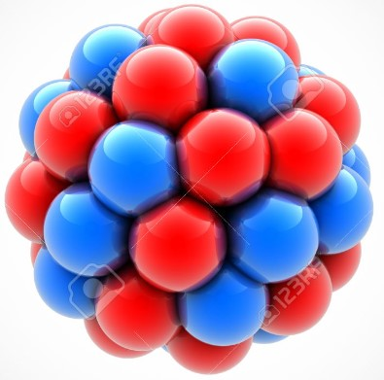
The Nature of Things
Looking at the known Universe, one could be awed by the many complex things it contains.
Even the Earth itself is complicated enough to generate many questions in our minds
Basic amongst them are those which focus on our own existence and composition.
Here, too, there are many levels to be explored, running right down to the nuclei
at the core of every atom and molecule
Even deeper, to the neutrons and protons (nucleons) that constitute those nuclei.
Faced with all this, physicists nevertheless assume that a few simple mathematical rules should be sufficient to provide a complete explanation of everything we can now perceive, and which might become perceptible in future.
This may be correct
Or it might be supreme arrogance = hubris

Slide 3

Basic Question:
How did we get here?

Slide 4


Slide 5
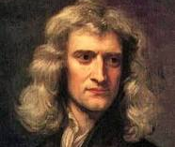
Great Unifications
“First Great Unification" – Isaac Newton –
350 years ago
Universal Law of Gravitation
A person, fixed on earth, realised that all objects attract each other with a force of gravitational attraction, no matter where they are in the Universe.
Unified the understandings of the observable phenomena of gravity on Earth with the observable behaviour of celestial bodies in space

Slide 6
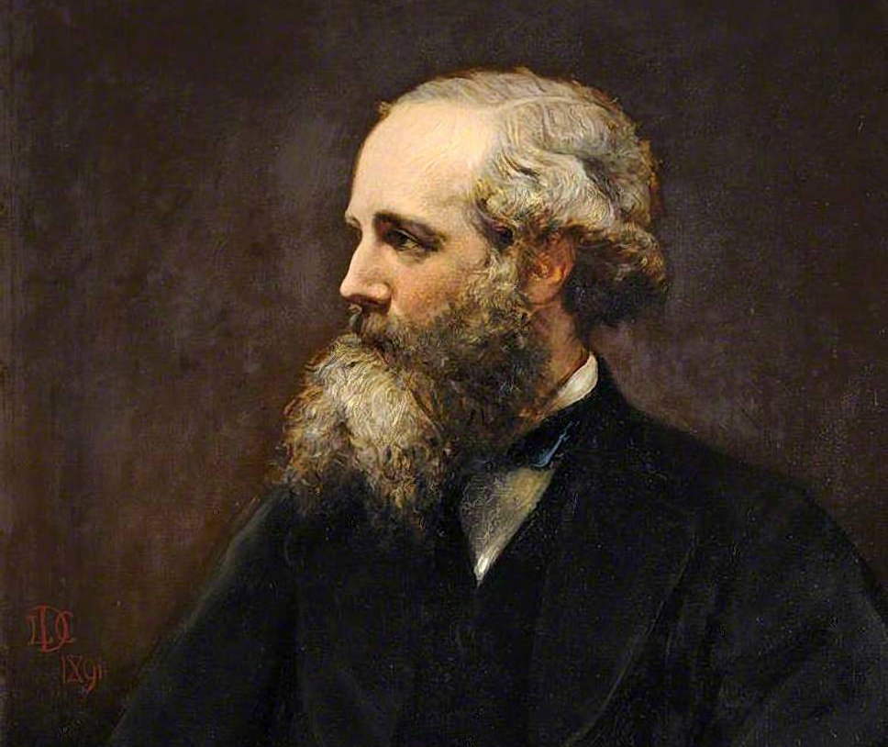
Great Unifications
“Second Great Unification" – 155 years ago – James Clerk Maxwell
Formulated the classical theory of electromagnetic radiation, unifying electricity + magnetism + light
as different manifestations of the same
phenomenon.
“A Dynamical Theory of the Electromagnetic Field” – 1865
Demonstrated that electric and magnetic fields travel through space as waves moving at the speed of light.
Unification of light and electrical phenomena led to Maxwell’s prediction of the existence of radio waves.

Slide 7
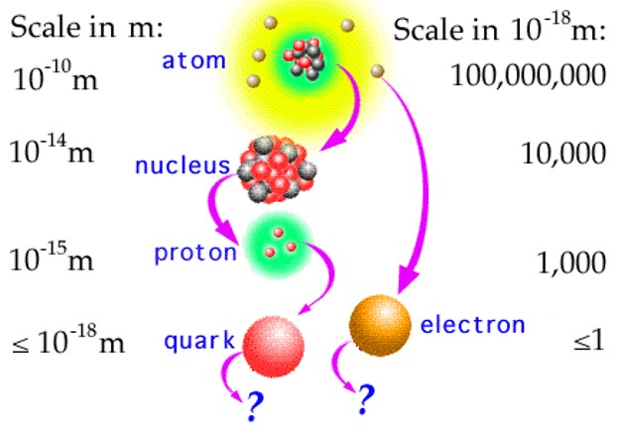
Great Unifications
“Third Great Unification" – Standard Model of Particle Physics
1967 – S. Weinberg “A Model of Leptons”
∼ 15,100 citations
“The most successful theory ever conceived …”
All particles predicted to exist have been found.
The masses of those particles lie within 1% of the theoretical values anticipated by the model.
55 Nobel Prizes awarded for key developments and discoveries
Description of all known fundamental physics except for gravity, and gravity has no detectable effect when particles are studied a few at a time.

Slide 8
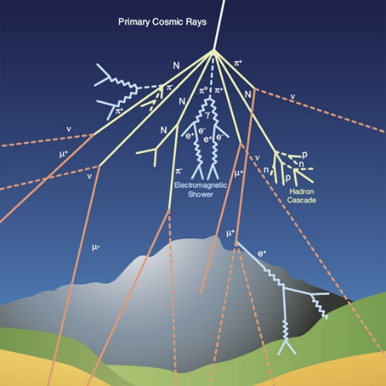
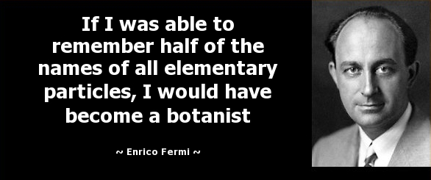
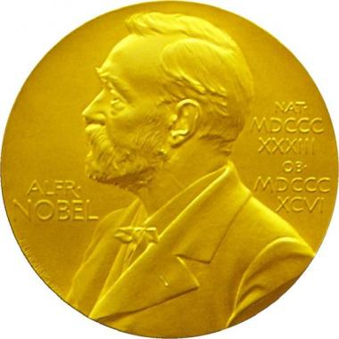
Standard Model - History
In the early 20th Century, the only particles of matter known to exist were
the proton, neutron, and electron.
With the advent of cosmic ray science and particle accelerators, numerous additional particles were discovered:
muon (1937), pion (1947), kaon (1947), Roper resonance (1963), …
By the mid-1960s, it was apparent that not all the particles could be fundamental.
A new paradigm was necessary.
Constituent-quark theory (1964) of Gell-Mann and Zweig, independently, was a crucial step forward.
Gell-Mann, Nobel Prize 1969: "for his contributions and discoveries concerning the classification of elementary particles and their interactions".
Nobel Prize 1938 “for his demonstrations of the existence of new radioactive elements produced by neutron irradiation, and for his related discovery of nuclear reactions brought about by slow neutrons”

Slide 9
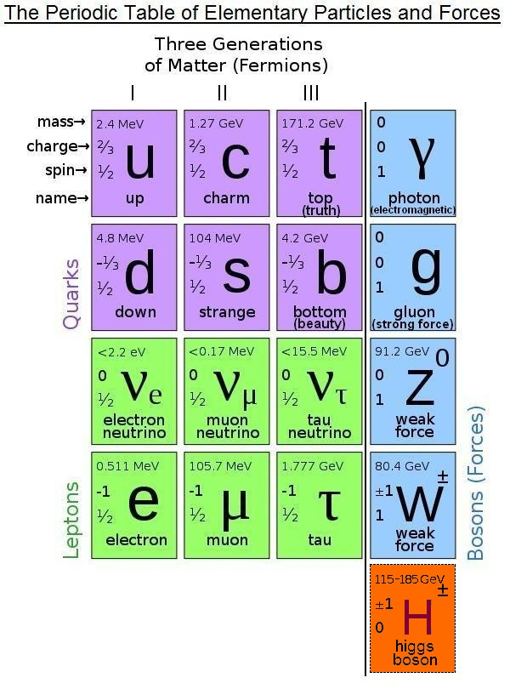
Standard Model of Particle Physics
Supposed to explain and unify all the forces of Nature, except Gravity
125
13 years ago

Slide 10
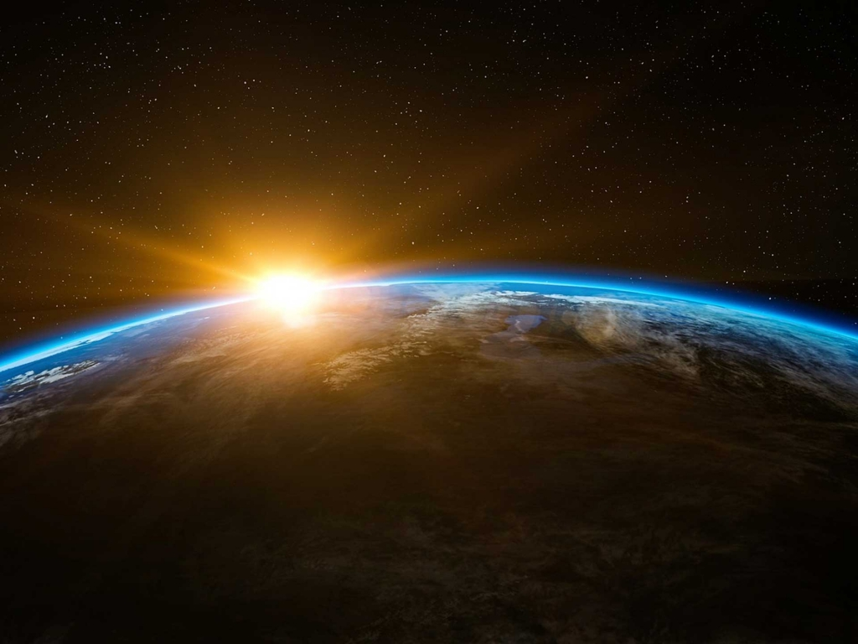
Origin of Mass:
The Frontier of Physics

Slide 11
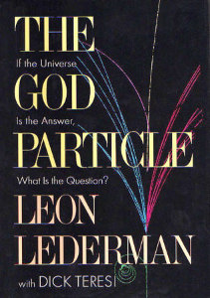
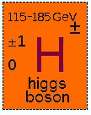
The God Particle
125

Slide 12
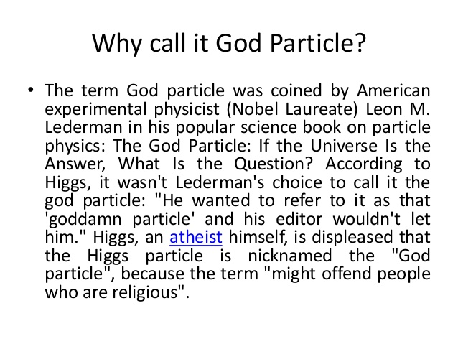
Higgs Boson

Slide 13

Higgs Boson

Slide 14
Higgs Boson
The Standard Model of particle physics lays out the basics of how elementary particles and forces interact in the universe.
However, the theory crucially fails to explain how particles actually get their mass.
Particle physicists believe the Higgs boson gives the particles mass and thus fills one of the key holes in modern physics.

Slide 15
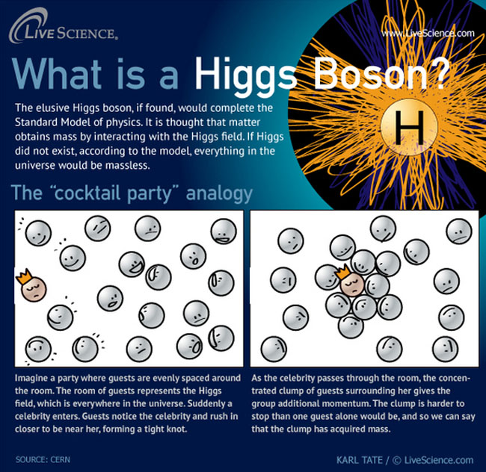
Higgs Boson

Slide 16

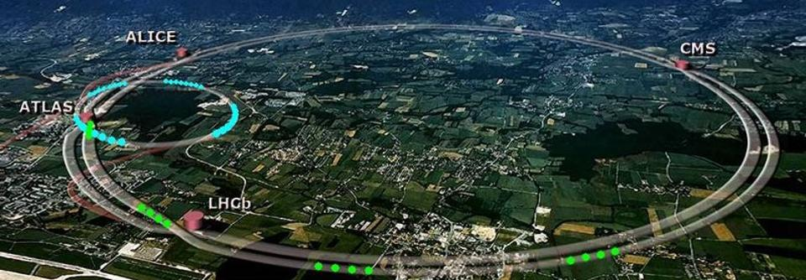

Searching for the God Particle
Found at CERN 2012 $∼$ decade ago
40 year effort, by 1000s of people, at facilities around the world
27km (17m) ring

Slide 17
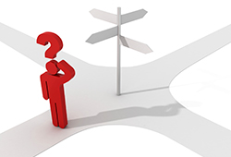
2013: Englert & Higgs
The 2013 Nobel Prize in Physics was awarded to Peter Higgs and Francois Englert following discovery of the Higgs boson at the Large Hadron Collider.
With this discovery the Standard Model of Particle Physics became complete.
Where to now?

Slide 18
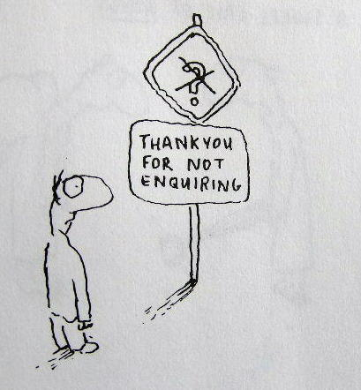
What is Mass?

Slide 19
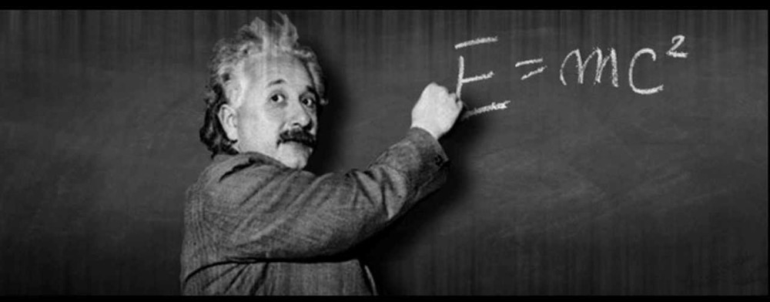

Meaning of Mass
Energy is Mass
Mass is Matter
What is the nature of “Matter” in the Standard Model?
Where does it obtain its mass?
What is the origin of its interaction scale – distance over which it’s effective?
How is it built from the elementary degrees-of-freedom?

Slide 20
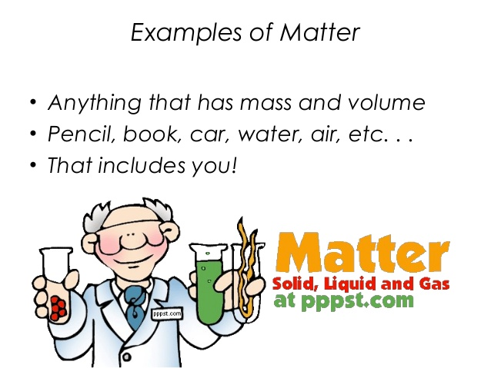
Matter
In classical physics
In particle physics,
that must change
In the Standard Model, at least, elementary particles
occupy zero volume
In stepping beyond the Standard Model, that might change
But we can say with certainty that elementary particles
occupy very little volume

Slide 21
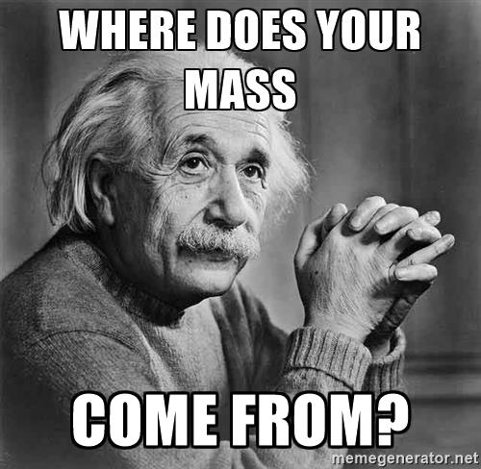
The Big Issue

Slide 22

Higgs Boson
The Higgs boson is often said to give mass to everything.

Slide 23


Higgs Boson
The Higgs boson is often said to
give mass to everything.
However, that is wrong.
It only gives mass to some very simple particles:
accounting for only 1% of the mass of more complex things like atoms, molecules and everyday objects, from your mobile phone to your pet llama.

Slide 24
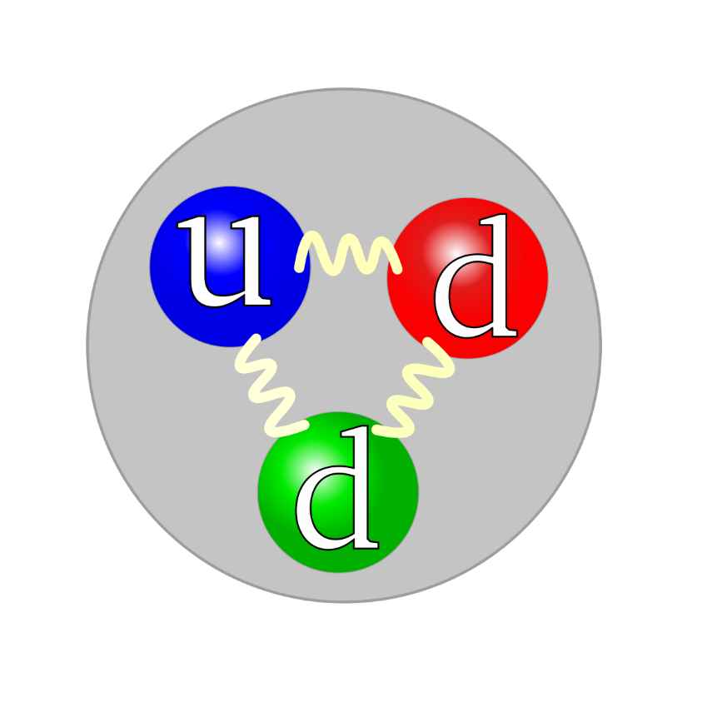
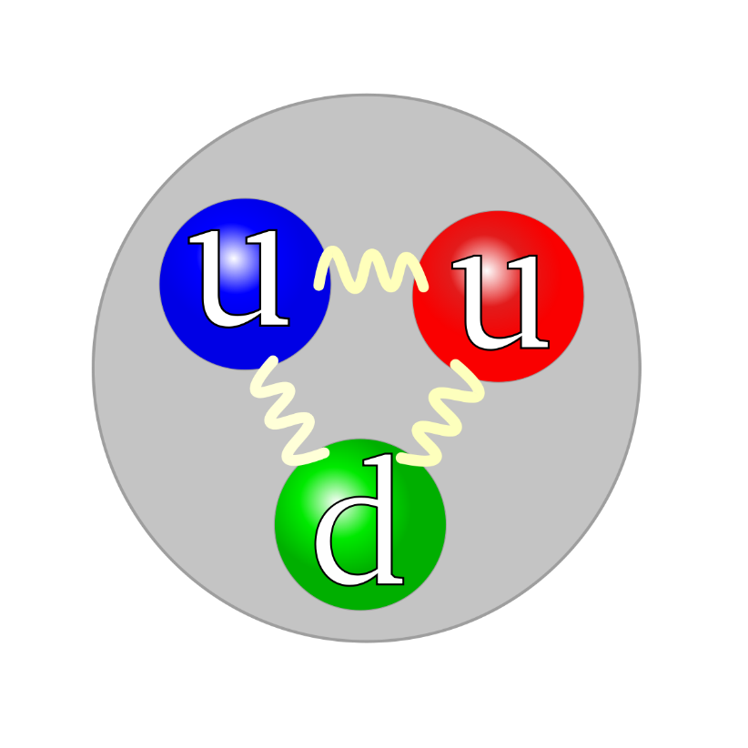
Where does our mass come from?
At the first level of approximation, the mass of everything we can see is simply the sum of the masses of all the neutrons and protons contained in the object
M_{A=N+Z} ≈ N*m_{n} + Z*m_{p}
neutron and proton masses are each 1 GeV (Giga electron volts),
i.e. approximately 2000 × m_{e}
Higgs boson produces the electron mass: m_{e}
But what produces the masses of the neutron and proton?
neutron
proton

Slide 25
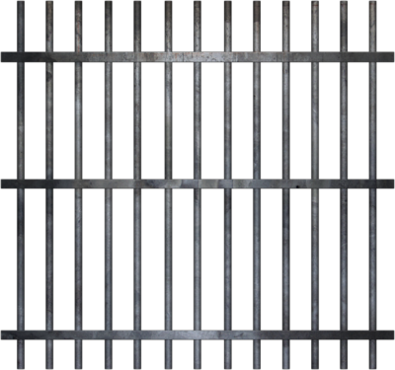
Origin of Mass
?
The vast majority of mass comes from the energy needed to hold quarks together inside nuclei

Slide 26
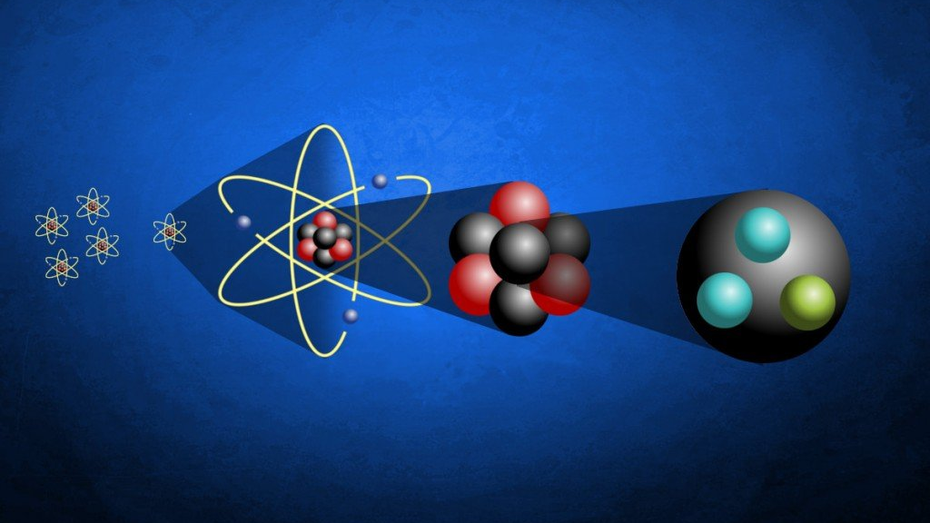
Quarks? What are quarks?

Slide 27
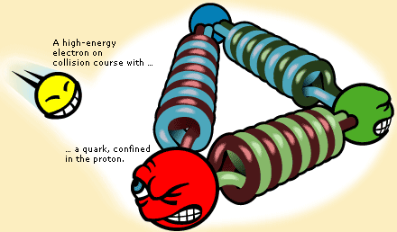
Quantum Chromodynamics

Slide 28
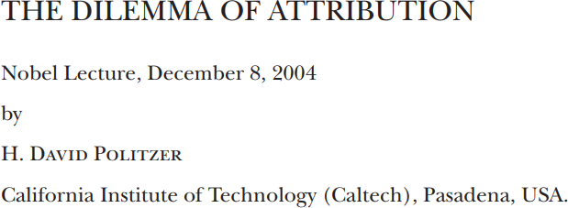

Strong Interactions in the Standard Model
The establishment by the mid-1970’s of QCD as the correct theory of the strong interactions completed what is now known prosaically as the Standard Model.
It offers a description of all known fundamental physics except for gravity, and gravity is something that has no discernible effect when particles are studied a few at a time.
However, the situation is a bit like the way that the Navier-Stokes equation accounts for the flow of water. The equations are at some level obviously correct, but there are only a few, limited circumstances in which their consequences can be worked out in any detail.
Nevertheless, many leading physicists were inclined to conclude in the late 1970’s that the task of basic physics was nearly complete, and we’d soon be out of jobs.
A famous example was the inaugural lecture of Stephen Hawking as Lucasian Professor of Mathematics, a chair first held by Isaac Barrow at Cambridge University. Hawking titled his lecture, “Is the End in Sight for Theoretical Physics?” And he argued strongly for “Yes”.

Slide 29
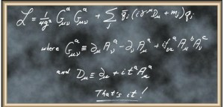
Quantum Chromodynamics (QCD)
Quite possibly, the most remarkable theory we have ever invented
One line is responsible for the
origin, mass and size of all visible matter!

Slide 30



Quantum Chromodynamics (QCD)
Quite possibly, the most remarkable theory we have ever invented
One line is responsible for the
origin, mass and size of all visible matter!

Slide 31
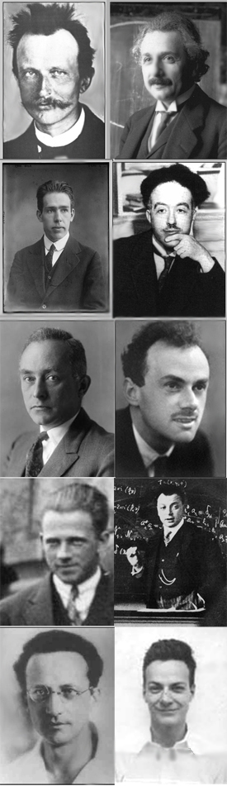
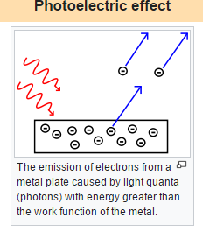
What is Quantum?
Inventors of Quantum Mechanics
Albert Einstein
Nobel Prize for explaining the photoelectric effect
1905 (prize 1921)
electromagnetic waves → photons
“According to the assumption to be contemplated here, when a light ray is spreading from a point, the energy is not distributed continuously over ever-increasing spaces, but consists of a finite number of 'energy quanta' that are localized in points in space, move without dividing, and can be absorbed or generated only as a whole.”
1926 … light quanta first called “photons” … Wolfers (optics) and Lewis (chemist)
Planck
Einstein
40 years later, then this huge, crucial step from Maxwell
Bohr
de Broglie
Born
Dirac
Heisenberg
Pauli
Schrödinger
Feynman

Slide 32
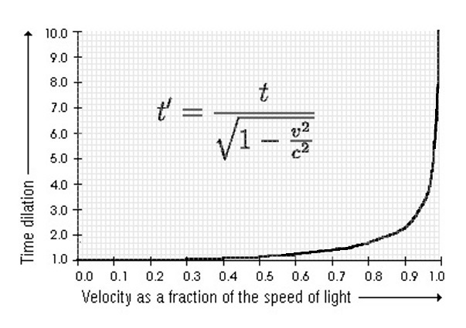
Special Relativity (Einstein again & again 1905)
Einstein's original treatment (1905) is
based on two postulates:
The laws of physics are invariant (i.e. identical) in all inertial systems (non-accelerating frames of reference).
The speed of light in a vacuum is the same for all observers, regardless of the motion of the light source.
Einstein “On the Electrodynamics of Moving Bodies”.
Resolution of the
inconsistency of Newtonian mechanics with Maxwell's equations of electromagnetism
lack of experimental confirmation for a hypothesized luminiferous aether
Corrects mechanics to handle situations involving motions at a significant fraction of the speed of light
Special relativity is the most accurate (classical) model of motion at any speed when gravitational effects are negligible.

Slide 33
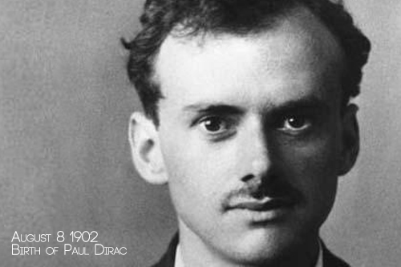
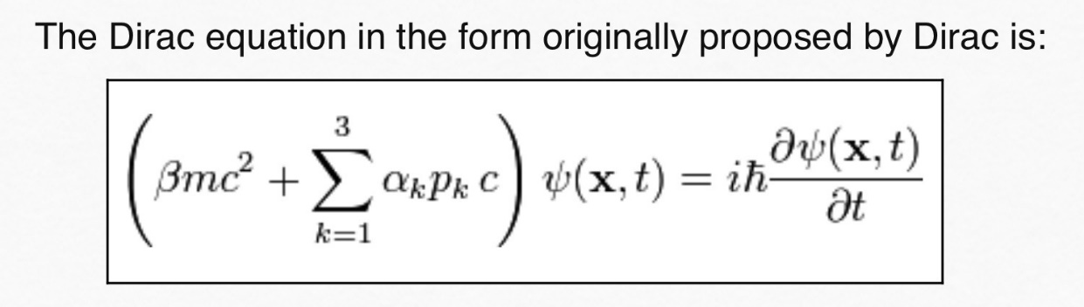
Unification of Quantum Mechanics & Special Relativity
Dirac gave us the “Dirac Equation” (1928), the first and only relativistic generalisation of the Schrödinger equation for spin-1/2
Nobel Prize 1933
2nd youngest person every to win Nobel – age 31
Dirac and his equation also gave us antiparticles
If we accept the view of complete symmetry between positive and negative electric charge so far as concerns the fundamental laws of Nature, we must regard it rather as an accident that the Earth (and presumably the whole solar system), contains a preponderance of negative electrons and positive protons.
It is quite possible that for some of the stars it is the other way about, these stars being built up mainly of positrons and negative protons.
In fact, there may be half the stars of each kind. The two kinds of stars would both show exactly the same spectra, and there would be no way of distinguishing them by present astronomical methods.

Slide 34
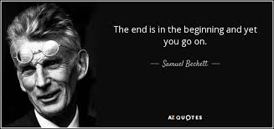
The Problem with Antimatter
Masslessness – the absence of mass – is impossible in nonrelativistic theories. Nonrelativistically, all particles must possess a mass.
Relativistically, masslessness is possible.
Einstein’s Photon is a massless particle
Antimatter = negative-energy matter
… So, for any given system
It costs ZERO energy to create a virtual matter+antimatter pair
or 10 such pairs, or 100 pairs, …
or infinitely many!
Quantum mechanics is an exactly solvable theory when the number of particles is finite
( ∼ 14, with today’s computers and realistic Hamiltonians)
Quantum mechanics is unsolvable when there are infinitely many particles
Relativistic quantum mechanics allows the existence of massless particles and antimatter (negative-energy matter)
– but the existence of either/both destroys relativistic quantum mechanics!

Slide 35
Solving the Problem with Antimatter
There is only one way known to combine quantum mechanics and special relativity
Relativistic Quantum Field Theory
1st example: Electromagnetism
Quantum electrodynamics (QED), 1946-1950
Feynman, Schwinger, Tomonaga
Nobel Prize (1965):
"for their fundamental work in quantum electrodynamics, with deep-ploughing consequences for the physics of elementary particles".

Slide 36
Solving the Problem with Antimatter
There is only one way known to combine quantum mechanics and special relativity
Relativistic Quantum Field Theory
2nd example: Weak interaction
Radioactive decays, parity-violating decays,
electron-neutrino scattering
Glashow, Salam, Weinberg - 1963-1973
Nobel Prize (1979):
"for their contributions to the theory of the unified weak and electromagnetic interaction between elementary particles, including, inter alia, the prediction of the weak neutral current".
125

Slide 37
Solving the Problem with Antimatter
3rd example:
Strong interaction … all of nuclear physics and anything made from nuclei = basically everything that we can see and/or touch
Existence and composition of the vast bulk of visible matter in the Universe:
proton, neutron
the forces that form them and bind them into nuclei
responsible for more than 98% of the visible matter in the Universe
Politzer, Gross and Wilczek – 1973-1974
Quantum Chromodynamics – QCD
Nobel Prize (2004):
"for the discovery of asymptotic freedom in the theory of the strong interaction".

Slide 38
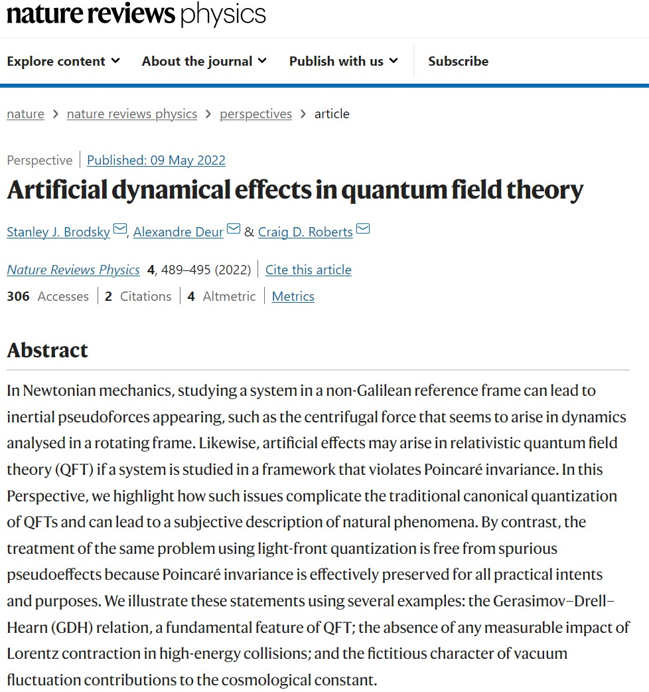
Key to using quantum field theory is Poincaré invariant calculations of observable phenomena
Fundamental scientific principle is that an observer’s choice of conventions cannot affect physical phenomena.
Effects that depend on such choices are artificial rather than objective features of Nature; thus, for example, physics cannot depend on the choice of units or quantisation scheme
Most critically, physical effects cannot depend on the observer’s frame: valid phenomena should display Poincaré invariance for relativistic systems.
Hallmark of modern Schwinger function methods

Slide 39
Mass: The Final Frontier

Slide 40
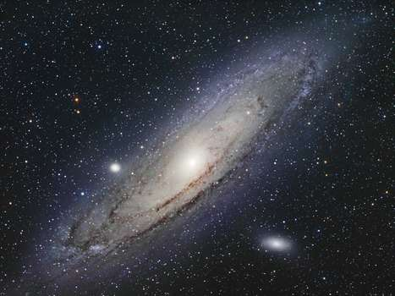
Character of Mass
Key questions posed to modern science:
What is the origin of mass?
What are the consequences of the appearance of mass?
When considering the source of mass, many people think of explicit mass, generated via the Higgs-mechanism
especially because the Higgs boson was discovered relatively recently at CERN (2012)
importance acknowledged by the Nobel Prize awarded to Englert and Higgs:
for the theoretical discovery of a mechanism that contributes to our understanding of the origin of mass of subatomic particles …

Slide 41
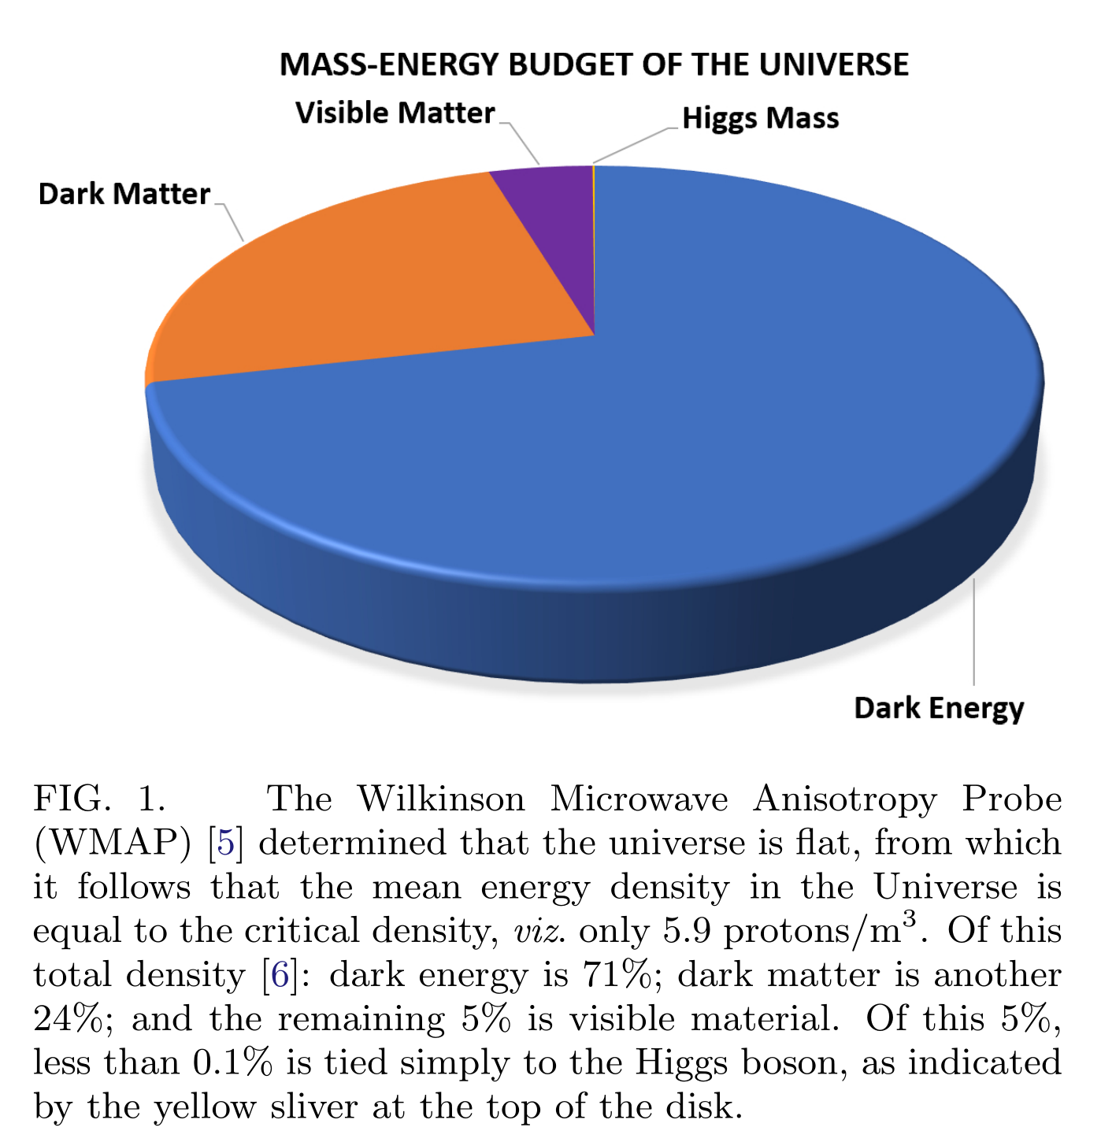
Character of Mass
Discovery of the Higgs was a watershed.
However, it should be placed in context.
Therefore, consider the mass-energy budget of the Universe
Dark energy = 71%
Dark Matter = 24%
Visible material = 5%
Higgs effect is just 0.1% of the visible matter
Little is known about the first two
Science can say almost nothing about 95% of the mass-energy in the Universe.
The explanation
lies outside the Standard Model.

Slide 42
Character of Mass
Little is known about Dark Energy and Dark Matter …
Science can say almost nothing about 95% of the mass-energy in the Universe.
On the other hand, the remaining 5% has forever been the source of everything tangible.
Yet, amongst this 5%, less-than 0.1% owes solely to the Higgs boson
Hence, even concerning visible material, too much remains unknown.

Slide 43
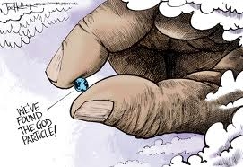

Slide 44
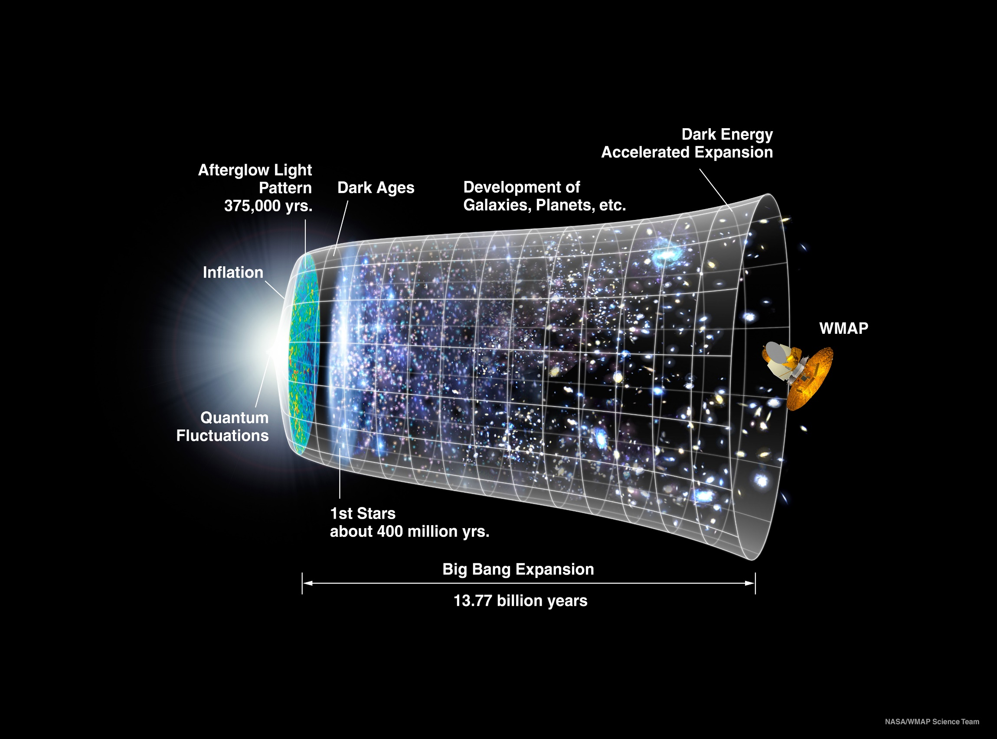
Our Universe
Mass originated 0.000001 seconds after the Big Bang
Its appearance was crucial to the formation of the Universe as we know it

Slide 45
Visible Mass
More than 98% of visible mass is contained within nuclei.
First approximation:
atomic weights = sum of the masses of all the nucleons they contain.
Each nucleon has a mass m_{N} ∼ 1 GeV ≈ 2000 m_{e}
Higgs boson produces m_{e}, but what produces m_{N} = remaining 1999 m_{e}?
This question is basic to the whole of modern physics
How can science explain the emergence of hadron mass
(EHM)?

Slide 46
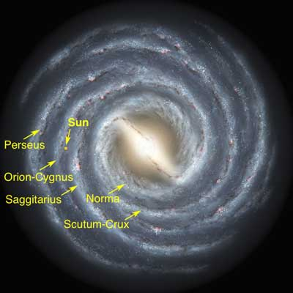
Emergent Phenomena in the Standard Model
Existence of our Universe depends critically
on the following empirical facts:
Proton is massive
i.e. the mass-scale for strong interactions is vastly different to that of electromagnetism
Proton is absolutely stable
Despite being a composite object
constituted from three valence quarks
Neither of these things is evident from just looking at the Standard Model Lagrangian
Emergence: low-level rules producing high-level phenomena, with enormous apparent complexity

Slide 47
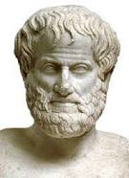
Emergentism
One might define emergent phenomena as those features of Nature which don’t readily admit explanation solely in terms of known or conjectured rules.
The concept is at least as old as Aristotle (384-322 BC), who argued that a compound item can have (emergent) properties in the whole which are not explicable merely through the independent actions of the item’s constituent parts.
His view is often represented by the statement:
“The whole is more than the sum of its parts”.
In this sense, emergence has its origins in the Greek “sunergos”: “together” plus “working” = origin of our concept of synergy (协同效应), viz. things working together more effectively than could be anticipated from their independent actions in isolation.
This perspective is typically contrasted with that described as reductionism; namely, the view that everything in Nature can ultimately be viewed as no more complex in principle than,
e.g. a (very good) watch, which is clearly a complex object; but, equally clearly, not more than the sum of its parts.

Slide 48
Emergentism
One might define emergent phenomena as those features of Nature which don’t readily admit explanation solely in terms of known or conjectured rules.
The concept is at least as old as Aristotle (384-322 BC), who argued that a compound item can have (emergent) properties in the whole which are not explicable merely through the independent actions of the item’s constituent parts.
His view is often represented by the statement:
“The whole is more than the sum of its parts”.
In this sense, emergence has its origins in the Greek “sunergos”: “together” plus “working” = origin of our concept of synergy (协同效应), viz. things working together more effectively than could be anticipated from their independent actions in isolation.
This perspective is typically contrasted with that described as reductionism; namely, the view that everything in Nature can ultimately be viewed as no more complex in principle than,
e.g. a (very good) watch, which is clearly a complex object; but, equally clearly, not more than the sum of its parts.
How does simplicity beget elegant complexity in the emergence
of the most fundamental structures in Nature?

Slide 49
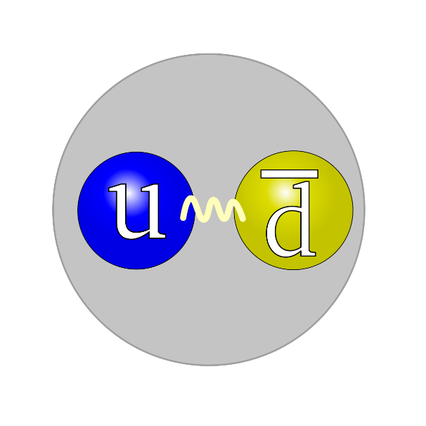
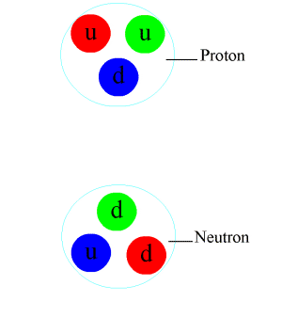
Pion
The pion is another one of the hadrons that was discovered as the standard model was being built
Predicted by Yukawa in 1935
It had to exist, otherwise there was nothing that could hold neutrons and protons together inside a nucleus
The pion, too, is crucial.
It MUST be unnaturally light, otherwise the force it produces would act over a range that is too short to be useful in binding nuclei

Slide 50
Quantum Chromodynamics
QCD is the first place that humankind has fully experienced the collision between quantum mechanics and special relativity
In attempting to match QCD with Nature, we confront the innumerable complexities of nonperturbative, nonlinear dynamics in relativistic quantum field theory, e.g.
loss of particle number conservation
frame and scale dependence of the explanations and interpretations of observable processes
and the evolving character of the relevant degrees-of-freedom
Electroweak theory and phenomena are essentially perturbative, possessing none of this complexity

Slide 51
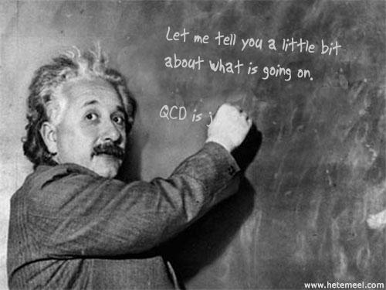

Slide 52
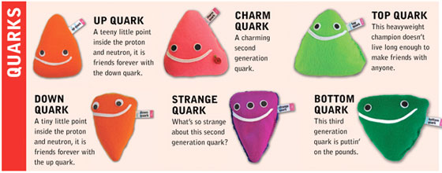


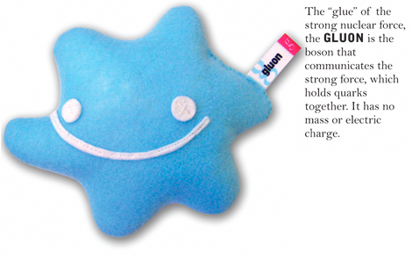
QCD
Light quarks = constituents of all ordinary matter
Lagrangian of QCD
Ψ = quark fields
G = gluon fields
The key to complexity in QCD … gluon field strength tensor
Generates gluon self-interactions,
whose consequences
are extraordinary

Slide 53
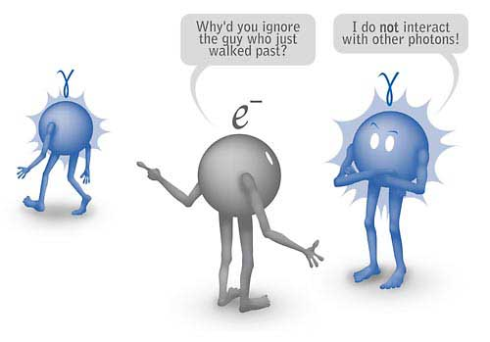
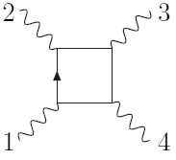
cf.Quantum Electrodynamics
QED is the archetypal gauge field theory
Perturbatively simple
but nonperturbatively undefined
Chracteristic feature:
Light-by-light scattering; i.e.,
photon-photon interaction – leading-order contribution takes
place at order α⁴. Extremely small probability because α⁴ ≈10⁻⁹ !
O(α⁴) ≈10⁻⁹

Slide 54
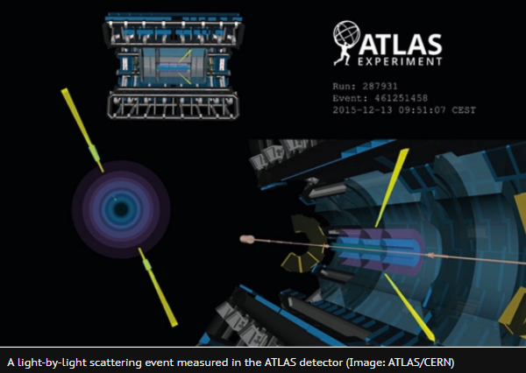
cf.Quantum Electrodynamics
Physicists from the ATLAS experiment at CERN have found the first direct evidence of high energy light-by-light scattering, a very rare process in which two photons – particles of light – interact and change direction. The result, published 16 August 2017, confirms one of the oldest predictions of quantum electrodynamics (QED).
QED is the archetypal gauge field theory
Perturbatively simple
but nonperturbatively undefined
Chracteristic feature:
Light-by-light scattering; i.e.,
photon-photon interaction – leading-order contribution takes
place at order α⁴. Extremely small probability because α⁴ ≈10⁻⁹ !
O(α⁴) ≈10⁻⁹

Slide 55
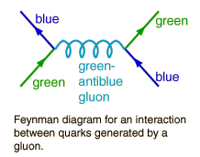
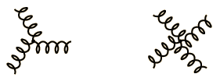
QCD
Relativistic Quantum Gauge Field Theory:
Interactions mediated by vector boson exchange
Vector bosons are perturbatively-massless
Similar interaction in QED
Special feature of QCD – gluon self-interactions
3-gluon vertex
4-gluon vertex

Slide 56
QCD
Novel feature of QCD
Tree-level interactions between gauge-bosons
O(α_{s}) cross-section cf. O(α_{em}⁴) in QED
One might guess that this
is going to have a big impact
Elucidating part of that impact is the origin
of the 2004 Nobel Prize to Politzer,
and Gross & Wilczek
3-gluon vertex
4-gluon vertex

Slide 57
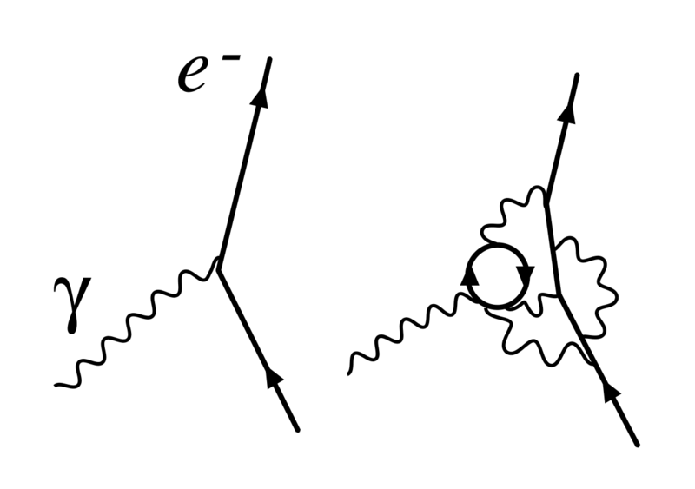
Running couplings
This news, delivered in a 2nd-year undergraduate lecture, is what turned me into a theoretical physicist.
I wanted to understand the origin and meaning of virtual particles
Quantum gauge-field theories are all typified by the feature that Nothing is Constant
Distribution of charge and mass, number of particles, etc., indeed, all the things that quantum mechanics holds fixed, depend upon wavelength of tool used to measure them
particle number is not conserved in quantum field theory … energy can create particles
Couplings and masses are renormalised via processes involving virtual-particles. Such effects make these quantities depend on the energy scale at which one observes them

Slide 58



QED cf. QCD?
2004 Nobel Prize in Physics : Gross, Politzer and Wilczek
500%
5 x10⁻⁵=0.7%
Add 3-gluon self-interaction
gluon
antiscreening
fermion
screening

Slide 59
QCD
This momentum-dependent coupling
translates into a coupling that
depends strongly on separation.
Namely, the interaction between quarks, between gluons, and between quarks and gluons grows rapidly with separation
Coupling is huge at separations r = 0.2fm ≈ ⅟₄ r_{proton}
0.5
0.4
↔
0.3
α_{s}(r)
0.2
0.1
0.002fm
0.02fm
0.2fm
r_{atom} /1,000,000

Slide 60
Origin of Mass
The vast majority of mass comes from the energy needed to hold quarks together inside nuclei

Slide 61


Confinement

Slide 62

Excerpt from the top-10
Can we quantitatively understand quark and gluon confinement in quantum chromodynamics and the existence of a mass gap?
Quantum chromodynamics is the theory describing the strong nuclear force. Carried by gluons, it binds quarks into particles like protons and neutrons. Apparently, the tiny subparticles are permanently confined: one can't pull a quark or a gluon from a proton because the strong force gets stronger with distance and snaps them right back inside.

Slide 63


Confinement?
Millennium prize of $1,000,000 for proving that SU_{c}(3) gauge theory is mathematically well-defined, which will necessarily prove or disprove a confinement conjecture

Slide 64

Confinement?

Slide 65

Light quarks & Confinement
Folklore … Hall-D Conceptual Design Report(5)
“The color field lines between a quark and an anti-quark form flux tubes.
A unit area placed midway between the quarks and perpendicular to the line connecting them intercepts a constant number of field lines, independent of the distance between the quarks.
This leads to a constant force between the quarks – and a large force at that, equal to about
16 metric tons.”

Slide 66






Light quarks & Confinement
Static picture of confinement
8 × 10⁻²⁷ g
4 × 10⁻²⁷ g
16 × 10⁺⁶ g

Slide 67
Light quarks & Confinement
Problem:
16 tonnes of force
makes a lot of pions.

Slide 68


Light quarks & Confinement
Problem:
16 tonnes of force
makes a lot of pions.

Slide 69

Light quarks & Confinement
G. Bali et al., PoS LAT2005 (2006) 308
In the presence of light quarks, pair creation seems to occur non-localized and instantaneously
No flux tube in a theory with light-quarks.
Flux-tube is not the correct paradigm for confinement in hadron physics

Slide 70
Light quarks & Confinement
G. Bali et al., PoS LAT2005 (2006) 308
In the presence of light quarks, pair creation seems to occur non-localized and instantaneously
No flux tube in a theory with light-quarks.
Flux-tube is not the correct paradigm for confinement in hadron physics
Confinement contains condensates Brodsky, Roberts, Shrock,Tandy arXiv:1202.2376 [nucl-th], Phys. Rev. C85 (2012) 065202
Nothing here, between the hadrons. No flux tubes, no condensates.
It’s the “trivial vacuum.”

Slide 71


Slide 72

QCD’s Running Coupling
This is where we live
⇐
What’s happening
out here?!

Slide 73


Process-independent effective-charge in QCD
RGI PI strong coupling
$α_{0}=0.97\left(4\right)π$
Modern continuum & lattice methods for analysing gauge sector enable QED-like effective charge to be defined in QCD
Combined continuum and lattice analysis of QCD’s gauge sector yields a parameter-free prediction
What is this telling us?
Process independent strong running coupling
Daniele Binosi et al., arXiv:1612.04835 [nucl-th], Phys. Rev. D 96 (2017) 054026/1-7
Process-independent effective coupling. From QCD Green functions to phenomenology,
Jose Rodríguez-Quintero et al., arXiv:1801.10164 [nucl-th]. Few Body Syst. 59 (2018) 121/1-9
Effective charge from lattice QCD, Zhu-Fang Cui, Jin-Li Zhang et al., NJU-INP 014/19, arXiv:1912.08232 [hep-ph]. Chin. Phys. C 44 (2020) 083102/1-10 … 3,405 downloads
QCD Running Couplings and Effective Charges, Alexandre Deur, Stanley J. Brodsky and Craig D. Roberts, Prog. Part. Nucl. Phys. 134 (2024) 104081/1-55

Slide 74
Textbook definition: Gauge Boson
A gauge boson is a force carrier, mediating one of Nature's fundamental interactions
All known gauge bosons have spin "1", i.e. all are vector bosons.
Owing to gauge invariance, no term of the form
m² B_{μ} B_{μ}
can appear in the gauge theory Lagrangian.
Thus, all gauge bosons are massless in the absence of a Higgs mechanism:
Photon … electromagnetism … known to be massless
W and Z bosons … weak interactions (radioactivity) … begin life massless, but known to become massive, owing to Higgs mechanism, which is abundantly clear in the Lagrangian
Gluon … there is no Higgs coupling and textbooks describe them as massless

Slide 75

Gluon Gap Equation
Pinch Technique: Theory and Applications
Daniele Binosi & Joannis Papavassiliou
Phys. Rept. 479 (2009) 1-152

Slide 76



Modern Hadron Theory
$$\frac{1}{m_{g}^{2}}$$
The photon is massless
D(k²) ∝ $\frac{1}{k2}$
W & Z bosons are massive because they eat some of the Higgs boson
But the Higgs doesn’t couple to QCD’s gluons
Nevertheless, gluons are massive
D_{g}(k²) ∝ $\frac{1}{k2+m_{g}^{2}}$
m_{g} ≈ ½ m_{p}
The dynamical generation of a large gluon mass is one piece in the answer to the confinement puzzle
This is not yet in the text books,
but it will be, one day

Slide 77


Slide 78
Much more to be said … but let’s keep it short
Proton is massive, i.e. the mass-scale for strong interactions is vastly different to that of electromagnetism
m_{p} ≈ 2000 × m_{e}
This is because the gluon acquires a large mass and it transfers that mass to the three valence-quarks from which the proton is made

Slide 79
Much more to be said … but let’s keep it short
Proton is absolutely stable, despite being a composite object constituted from three valence quarks
This is because the large gluon mass is strongly momentum dependent
large at long-range
small at short-range
This is a key to confinement

Slide 80
Much more to be said … but let’s keep it short
Pion is unnaturally light (but not massless), despite being a strongly interacting composite object built from a valence-quark and valence antiquark
This is because the dressed-gluons give
mass to the valence quarks and antiquarks in a
very special way, which is impossible in
quantum mechanics
A symmetry is dynamically broken and the
pion appears, almost magically, as a
massless bound-state of very massive constituents
Nambu-Goldstone Mode

Slide 81

Spontaneous(Dynamical) Chiral Symmetry Breaking = Mass Generation
The 2008 Nobel Prize in Physics was divided, one half awarded to Yoichiro Nambu
"for the discovery of the mechanism of spontaneous broken symmetry in subatomic physics"
Notes:
(19)

Slide 82

QCD is Unique
It is the only known fundamental theory with the capacity to sustain massless elementary degrees-of-freedom,
i.e. gluons and quarks.
Yet gluons and quarks acquire mass dynamically
Running quark mass
The only massless systems are its composite Nambu-Goldstone bosons: the pion and its close friends
All other everyday bound states possess nuclear-size masses, far in excess of anything that can directly be tied to the Higgs mechanism.

Slide 83
QCD is Unique
We have never before encountered an interaction such as that at work in QCD.
Confinement
Dynamical chiral symmetry breaking (DCSB)
Absolute stability of the proton
Magnitude of the proton’s mass and pion’s near masslessness
All these things, everything described above and much more, are tied to the strong self-interactions of gauge bosons.
QCD – “believed” somehow – explains the origin of mass, the formation of nuclei, and the life and death of stars
Charting QCD’s interaction, explaining and understanding everything of which it is capable, could change the way we look at the known Universe and beyond.

Slide 84
QCD is Unique
The capacity to move beyond the Standard Model might really depend upon first understanding what is within it
QCD, the strong interaction, stands in our way.
In fact, QCD potentially establishes the paradigm that will truly enable us to step beyond the Standard Model.
Solving QCD
is one of the most challenging problems in modern physics

Slide 85


Slide 86


Epilogue
Grant no. 12135007
LHC has NOT found the “God Particle”
because the Higgs boson is NOT the origin of mass
Higgs-boson only produces a little bit of mass
Higgs-generated mass-scales explain neither the proton’s mass
nor the pion’s (near-)masslessness
Hence LHC has, as yet, taught us very little about the origin, structure and nature of the nuclei whose existence support the Cosmos
Strong interaction sector of the Standard Model,
i.e. QCD, is the key to understanding the
origin, existence and properties
of (almost) all known matter
Answers will come during the next 30 years
Theoretical tools are reaching the point where sound predictions can be made
New experimental facilities are in operation, under construction, or being planned, that can validate those predictions

Slide 87


Slide 88

Paul Dirac - man of very few words
A US journalist’s interview with Dirac:
Journalist: “Now Doctor, will you give me in a few words the low-down on all your investigations?”
Dirac: “No.”
Journalist: “Good. Will it be alright if I put it this way – ‘Professor Dirac solves all the problems of mathematical physics, but is unable to find a better way of figuring out baseball’?”
Dirac: “Yes.”
Journalist: “Do you go to the movies?”
Dirac: “Yes.”
Journalist: “When?”
Dirac: “In 1920 – perhaps also in 1930.”

