Slide 1


Grant no. 12135007
Craig Roberts … http://inp.nju.edu.cn/
Emergent Hadron Mass:
Origins and Consequences

Slide 2
What is the point?
You’re at a party. Someone asks you what you do. What do you say?
  “I am a theoretical physicist, working on projects that may enable humanity to understand the structure of protons and nuclei.”
The other person asks: “Why?”
How do you answer that?
  You could say that humankind has always looked beyond the boundaries of knowledge.
  That is what differentiates between humankind and Earth’s other forms of life.
You could then add:
  “I am an explorer.”
  “I am attempting to draw the map that reveals all there is to know about the proton, the neutron, and all the other particles whose existence is essential for the appearance and evolution of life.”
  “No other animal can attempt that. Humankind is unique.”
  “This map may help to find our place in the Universe. Perhaps it is empty of other life? If so, then we will change that. If not, then we have the opportunity to change ourselves.”

Slide 3
What is the point?
You’re at a party. Someone asks you what you do. What do you say?
  “I am a theoretical physicist, working on projects that may enable humanity to understand the structure of protons and nuclei.”
The other person asks: “Why?”
How do you answer that?
  You could say that humankind has always looked beyond the boundaries of knowledge.
  That is what differentiates between humankind and Earth’s other forms of life.
You could then add:
  “I am an explorer.”
  “I am attempting to draw the map that reveals all there is to know about the proton, the neutron, and all the other particles whose existence is essential for the appearance and evolution of life.”
  “No other animal can attempt that. Humankind is unique.”
  “This map may help to find our place in the Universe. Perhaps it is empty of other life? If so, then we will change that. If not, then we have the opportunity to change ourselves.”
“The human spirit,
driven by an invincible force,
will never cease to ask:
What is beyond?”
—Louis Pasteur

Slide 4
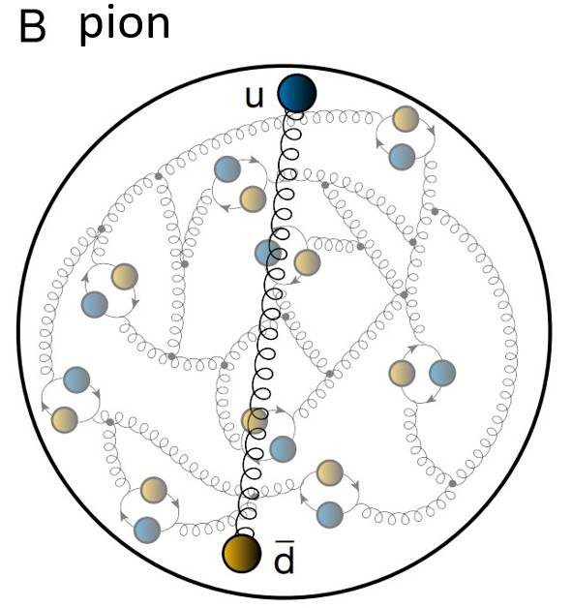

$$Selected aspects \\ of meson physics$$

Slide 5
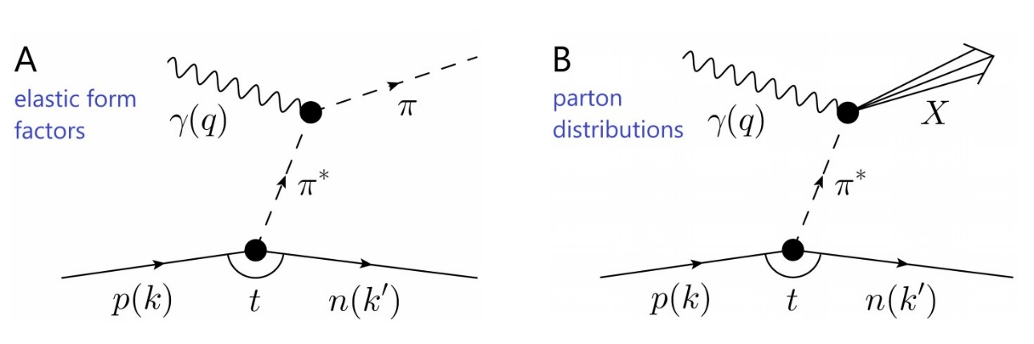
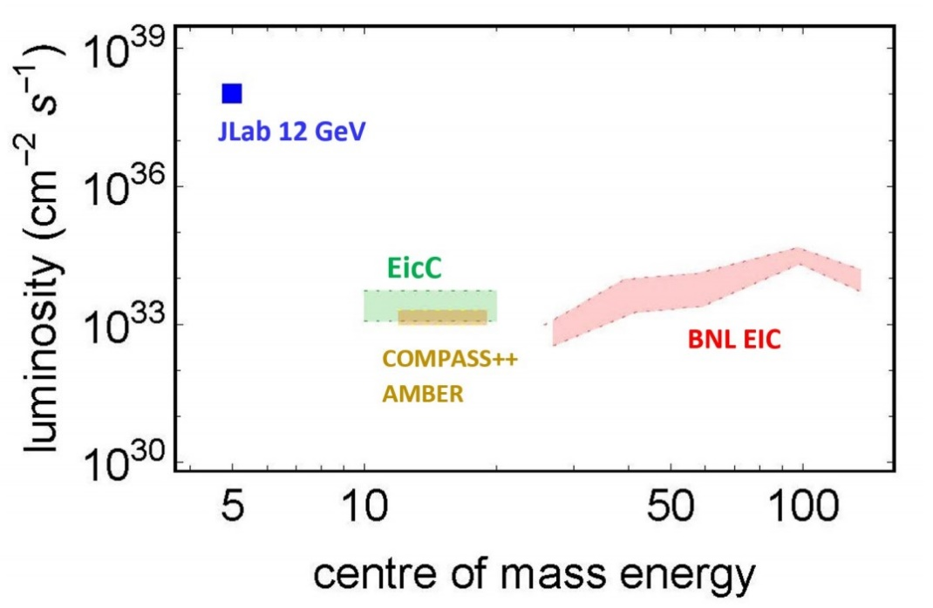
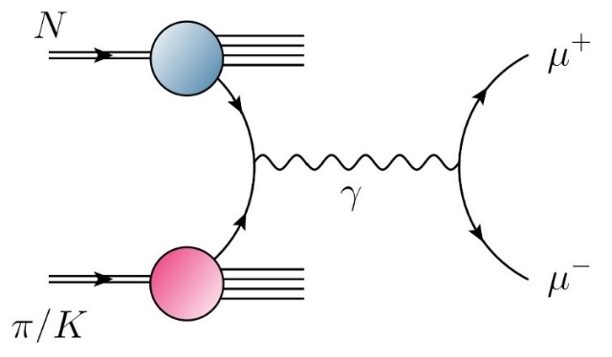
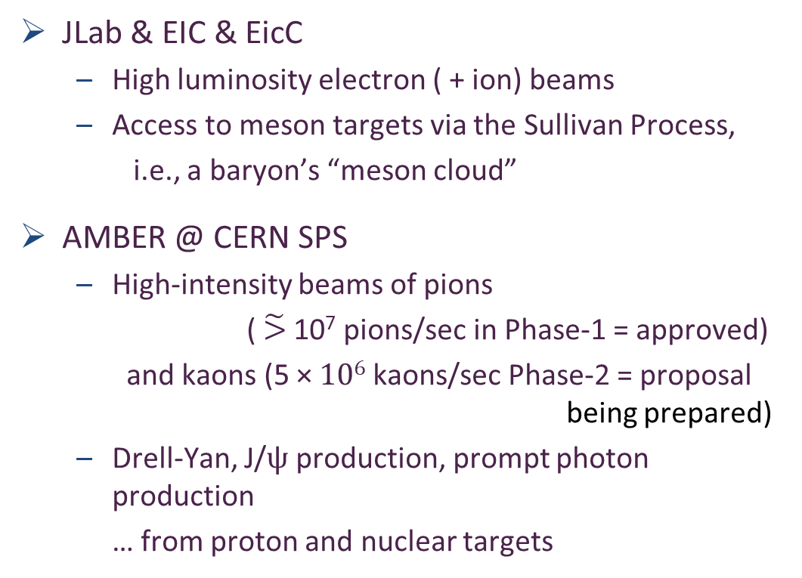
Era of Meson “Targets”
JLab & EIC & EicC
  High luminosity electron ( + ion) beams
  Access to meson targets via the Sullivan Process,
  i.e., a baryon’s “meson cloud”
AMBER @ CERN SPS
  High-intensity beams of pions
  ($\tilde{>}$ 10⁷ pions/sec in Phase-1 = approved)
    and kaons (5 × 10⁶ kaons/sec Phase-2 = proposal
                being prepared)
  Drell-Yan, J/ψ production, prompt photon production
  … from proton and nuclear targets

Slide 6
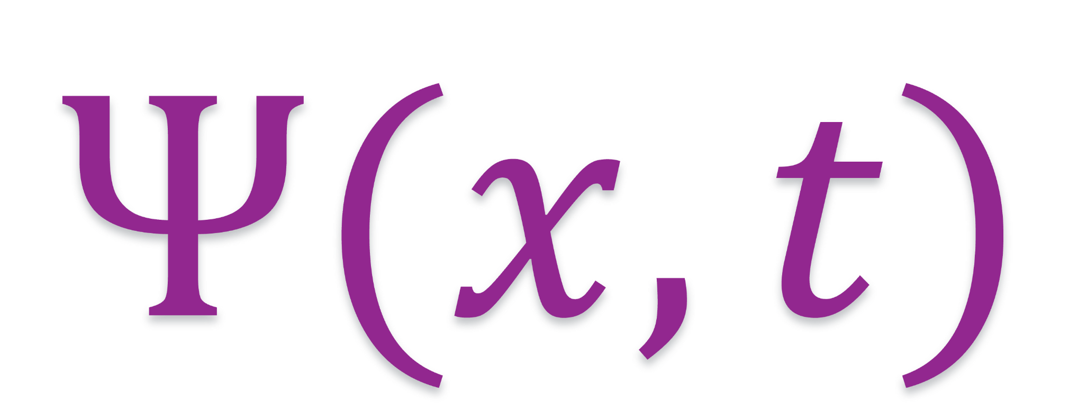
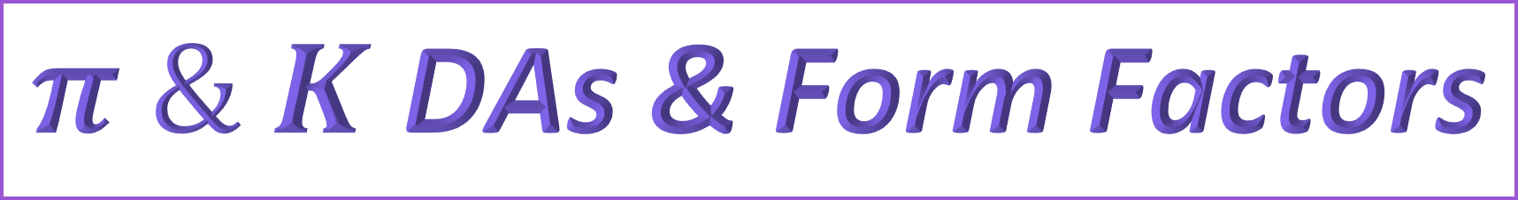
$π \& K$ DAs & Form Factors

Slide 7
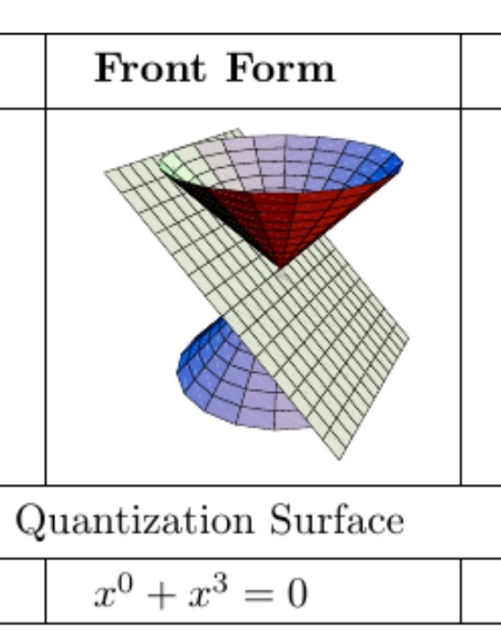
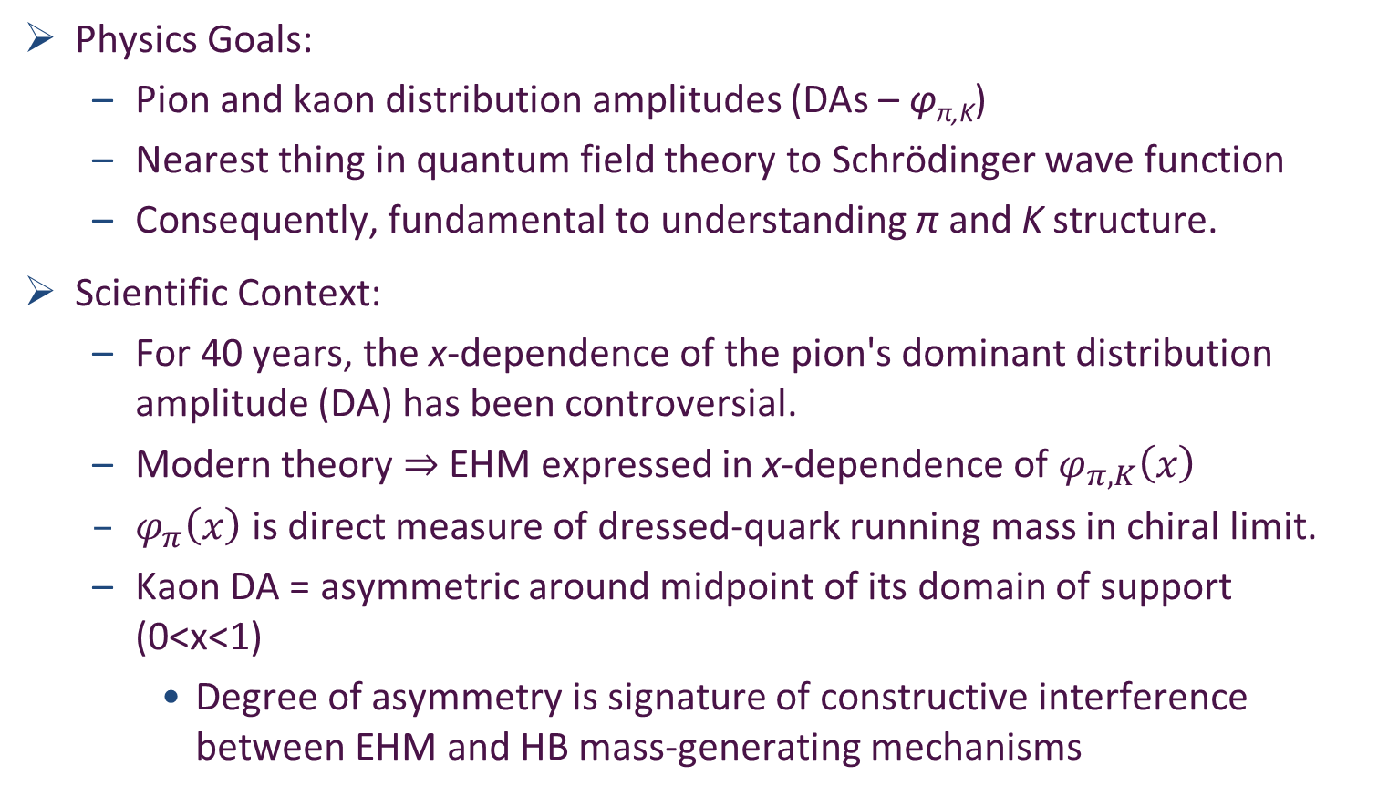
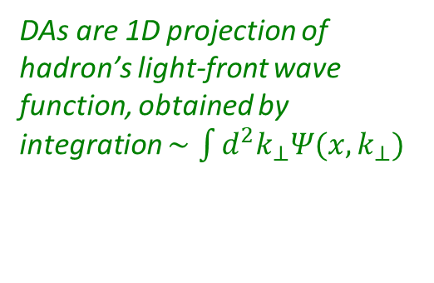
Wave Functions of Nambu Goldstone Bosons
DAs are 1D projection of hadron’s light-front wave function, obtained by integration $∼\int{d^{2}k_{⊥}Ψ(x,k_{⊥})}$
Physics Goals:
  Pion and kaon distribution amplitudes (DAs – φ_{π,K})
  Nearest thing in quantum field theory to Schrödinger wave function
  Consequently, fundamental to understanding π and K structure.
Scientific Context:
  For 40 years, the x-dependence of the pion's dominant distribution amplitude (DA) has been controversial.
  Modern theory $⇒$EHM expressed in x-dependence of $φ_{π,K}\left(x\right)$
  $φ_{π}\left(x\right)$ is direct measure of dressed-quark running mass in chiral limit.
  Kaon DA = asymmetric around midpoint of its domain of support (0<x<1)
    Degree of asymmetry is signature of constructive interference between EHM and HB mass-generating mechanisms
LF longitudinal direction
Insights into the Emergence of Mass from Studies of Pion and Kaon Structure, Craig D. Roberts, David G. Richards, Tanja Horn and Lei Chang, NJU-INP 034/21, arXiv: 2102.01765 [hep-ph], Prog. Part. Nucl. Phys. 120 (2021) 103883/1-65

Slide 8
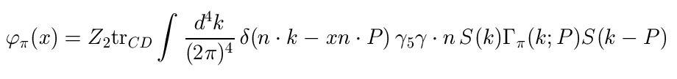
Pion’s valence-quark
Distribution Amplitude
Imaging dynamical chiral symmetry breaking: pion wave function on the light front, Lei Chang, et al., arXiv:1301.0324 [nucl-th], Phys. Rev. Lett. 110 (2013) 132001 (2013) [5 pages].
Methods were developed that enable direct computation of the pion’s light-front wave function
φ_{π}(x) = twist-two parton distribution amplitude = projection of the pion’s Poincaré-covariant wave-function onto the light-front
Results have been obtained with rainbow-ladder DSE kernel, simplest symmetry preserving form; and the best DCSB-improved kernel that is currently available.
  x^{α} (1-x)^{α}, with α=0.5

Slide 9
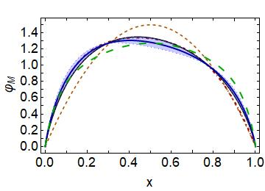

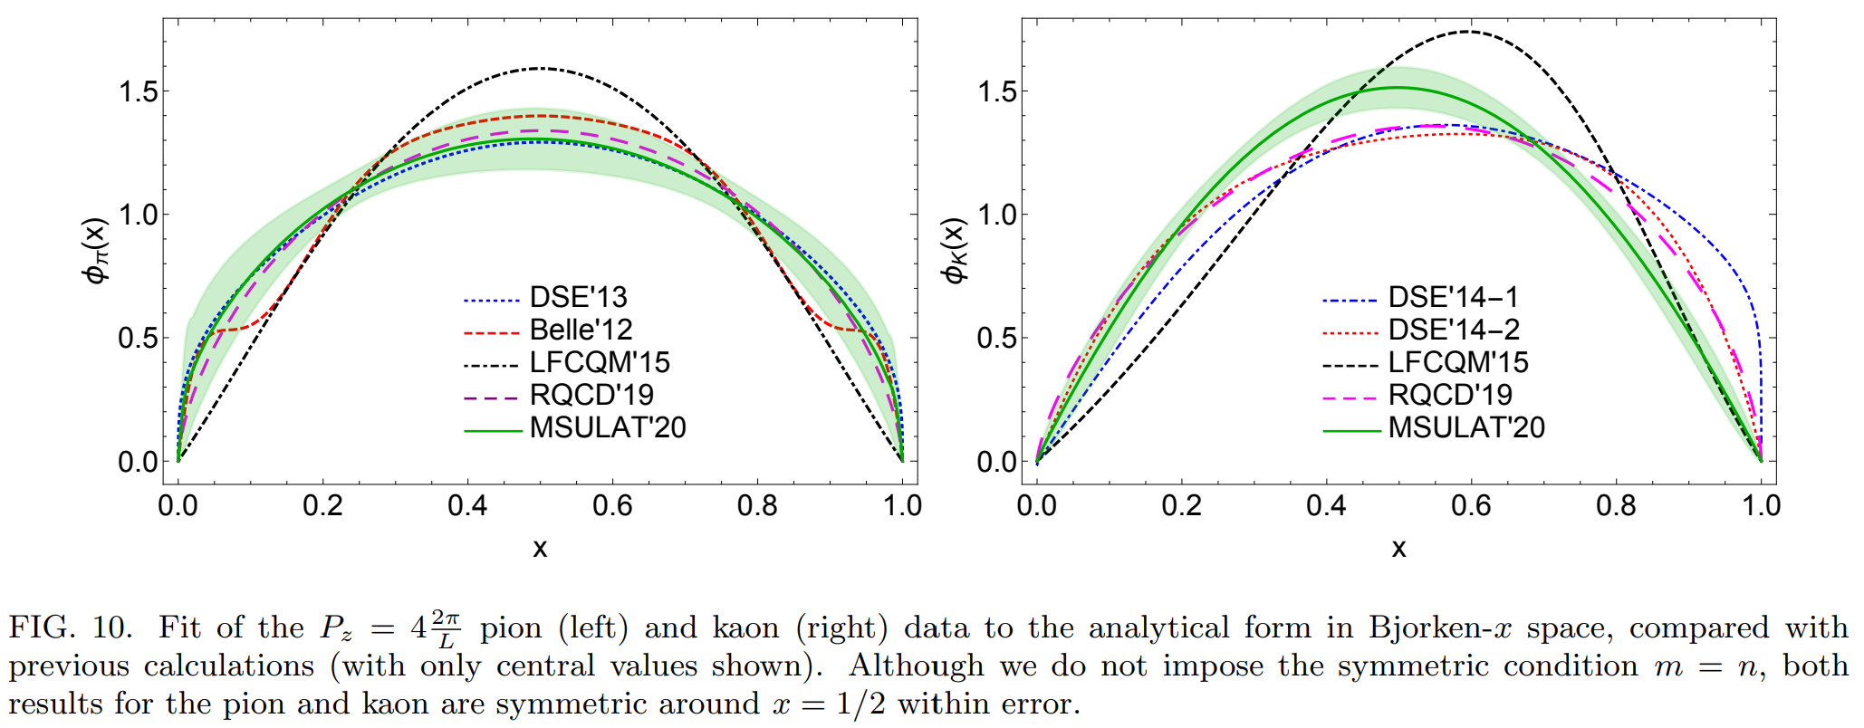
Meson leading-twist DAs
asymptotic
Continuum results exist & lQCD results arriving
  Common feature = broadening/dilation
  Origin = EHM
NO differences between π & K if EHM is all there is
  Differences arise from Higgs-modulation of EHM mechanism
  “Contrasting π & K properties reveals Higgs wave on EHM ocean”
kaon
pion
pion symmetric
kaon skewed
pion
kaon
Kaon DA vs pion DA
  almost as broad
  peak shifted to x=0.40(5)
  〈ξ²〉 = 0.24(1), 〈ξ〉 = 0.035(5)
ERBL evolution logarithmic
Broadening & skewing persist to very large resolving scales – beyond LHC

Slide 10
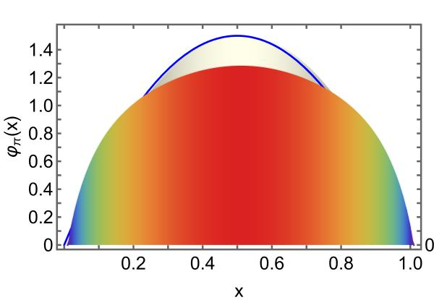
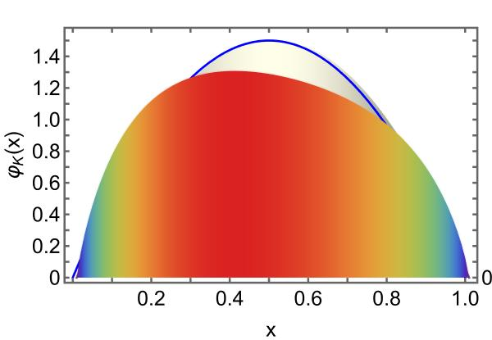


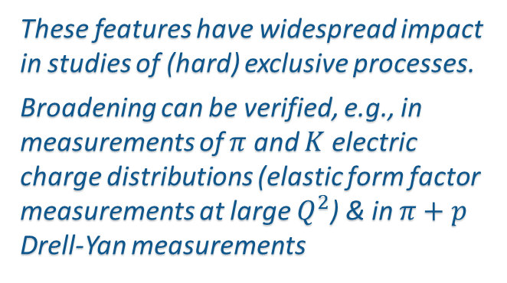
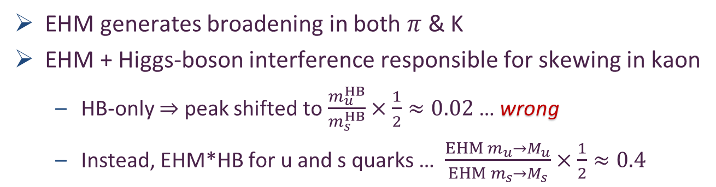
$π$ & K DAs cf. asymptotic profile
Exposing strangeness: projections for kaon electromagnetic form factors, Fei Gao et al., arXiv:1703.04875 [nucl-th], Phys. Rev. D 96 (2017) 034024/1-8
Constraining the pion DA using Drell-Yan reactions on a proton, H.-Y. Xing (邢惠瑜) et al., NJU-INP 077/23, e-Print: 2308.13695 [hep-ph]
$$φ_{asymptotic}$$
EHM generates broadening in both $π$ & K
EHM + Higgs-boson interference responsible for skewing in kaon
  HB-only $⇒$ peak shifted to $\frac{m_{u}^{HB}}{m_{s}^{HB}}×\frac{1}{2}≈0.02$ … wrong
  Instead, EHM*HB for u and s quarks … $\frac{{EHM m_{u}→M}_{u}}{EHM m_{s}→M_{s}}×\frac{1}{2}≈0.4$
These features have widespread impact in studies of (hard) exclusive processes.
Broadening can be verified, e.g., in measurements of $π$ and $K$ electric charge distributions (elastic form factor measurements at large $Q^{2}$) & in $π+p$ Drell-Yan measurements

Slide 11
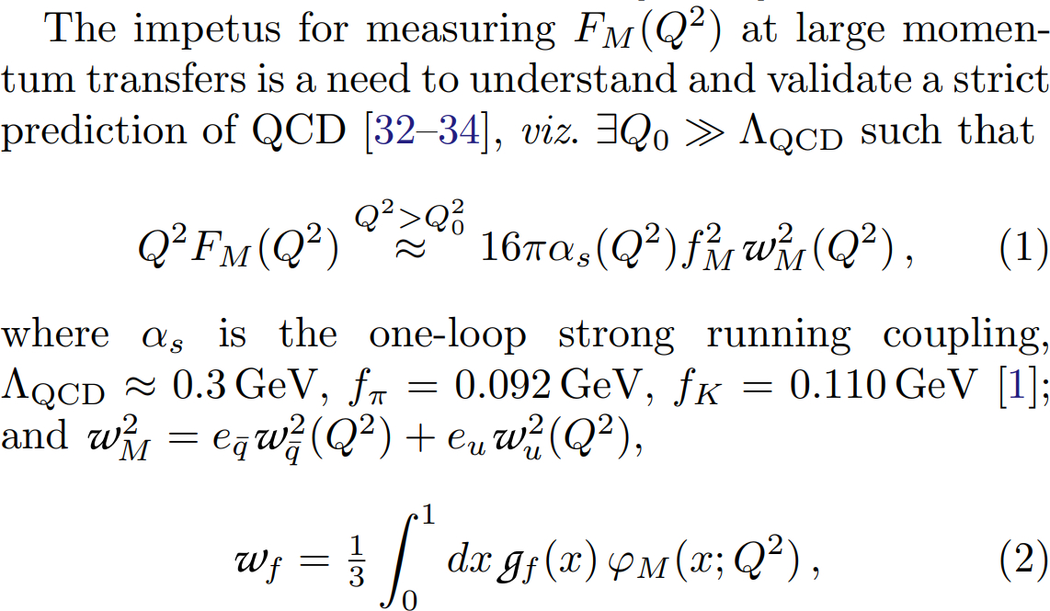
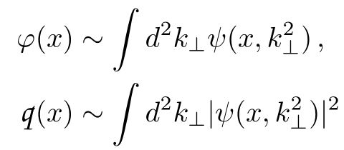
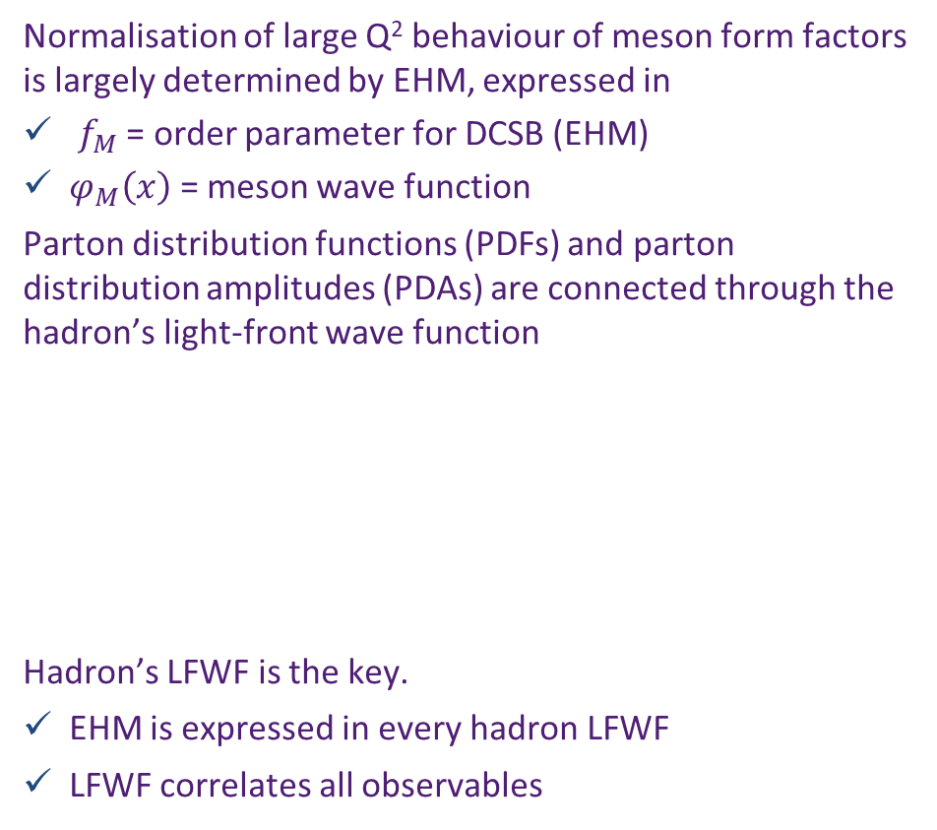

Hard Exclusive Processes e.g, meson form factors
Normalisation of large Q² behaviour of meson form factors is largely determined by EHM, expressed in
$f_{M}$ = order parameter for DCSB (EHM)
$φ_{M}\left(x\right)$ = meson wave function
Parton distribution functions (PDFs) and parton distribution amplitudes (PDAs) are connected through the hadron’s light-front wave function
Hadron’s LFWF is the key.
EHM is expressed in every hadron LFWF
LFWF correlates all observables
$$g_{u}=\frac{1}{x}, { g}_{q ̅}=\frac{1}{1−x}$$
High-energy nuclear and particle physics have long focused on finding evidence for power-law scaling in experimental data.
Certainly, an important first step; BUT it should be remembered that QCD is not found in scaling laws.
Instead, since quantum field theory requires deviations from strict scaling, then QCD is found in the existence and character of scaling violations.

Slide 12
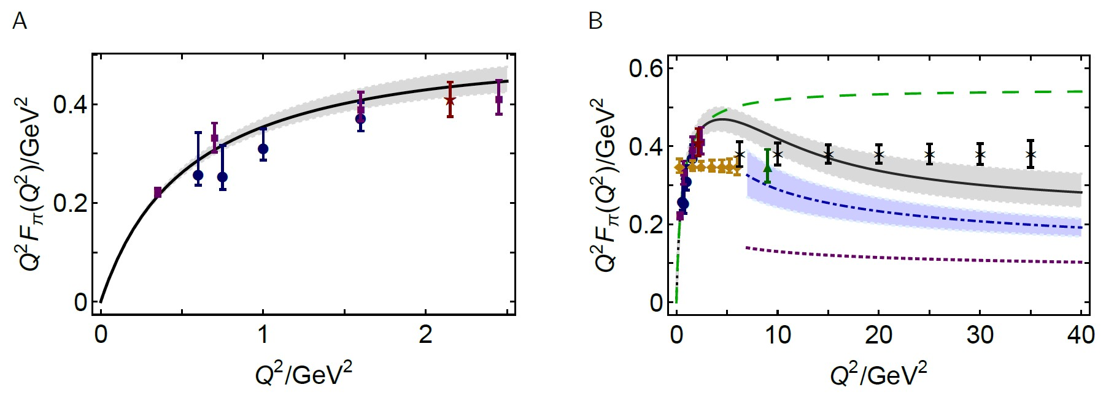
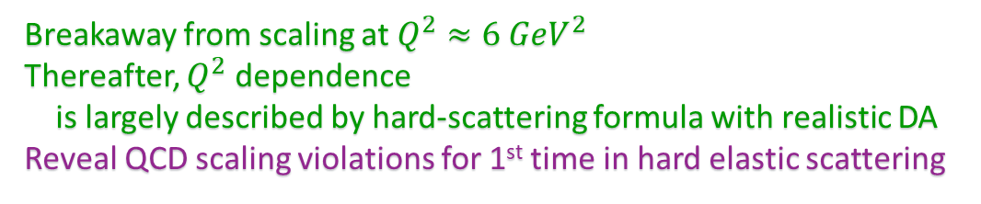
Wave Functions of Nambu Goldstone Bosons
📖 Revealing the structure of light pseudoscalar mesons at the Electron-Ion Collider, J. Arrington et al., NJU-INP 036/21, arXiv: 2102.11788 [nucl-ex], J. Phys. G 48 (2021) 7, 075106
Scientific Context:
  Today, continuum and lattice are delivering consistent predictions for φ_{π,K}(x)
  Can signature features of interference between EHM and HB, which are manifest in low-order Mellin moments of the DAs, be probed experimentally?
Measurement
Elastic electromagnetic form factors
Breakaway from scaling at $Q^{2}≈6 GeV^{2}$
Thereafter, $Q^{2}$ dependence
is largely described by hard-scattering formula with realistic DA
Reveal QCD scaling violations for 1st time in hard elastic scattering
CSM prediction
& existing JLab data
CSM prediction
& JLab + EIC projections

Slide 13
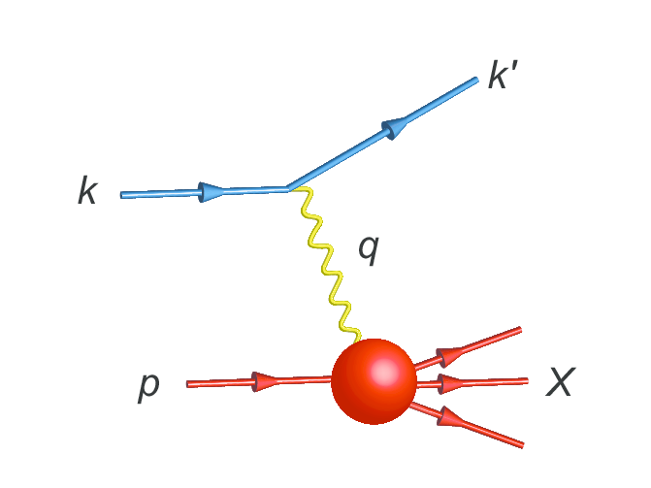
Parton Distribution Functions
Deep inelastic scattering and the experiments at SLAC that are credited with the discovery of quarks

Slide 14
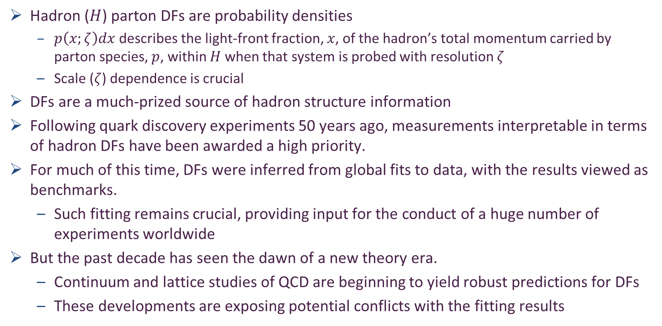
Parton Distribution Functions (DFs)
Hadron ($H$) parton DFs are probability densities
  $p\left(x;ζ\right)dx$ describes the light-front fraction, $x$, of the hadron’s total momentum carried by parton species, $p$, within $H$ when that system is probed with resolution $ζ$
  Scale ($ζ$) dependence is crucial
DFs are a much-prized source of hadron structure information
Following quark discovery experiments 50 years ago, measurements interpretable in terms of hadron DFs have been awarded a high priority.
For much of this time, DFs were inferred from global fits to data, with the results viewed as benchmarks.
  Such fitting remains crucial, providing input for the conduct of a huge number of experiments worldwide
But the past decade has seen the dawn of a new theory era.
  Continuum and lattice studies of QCD are beginning to yield robust predictions for DFs
  These developments are exposing potential conflicts with the fitting results

Slide 15
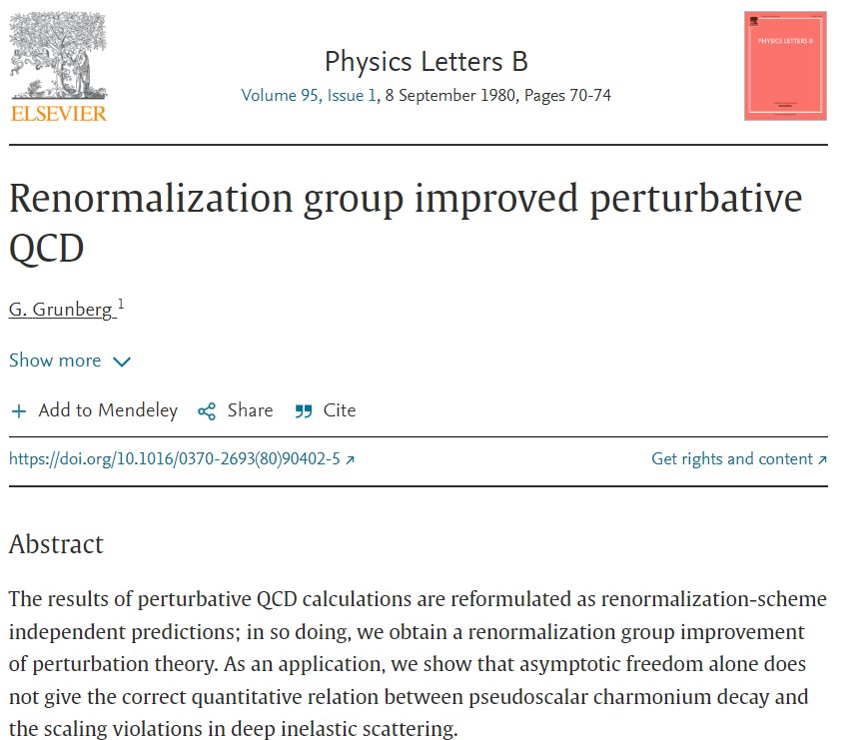
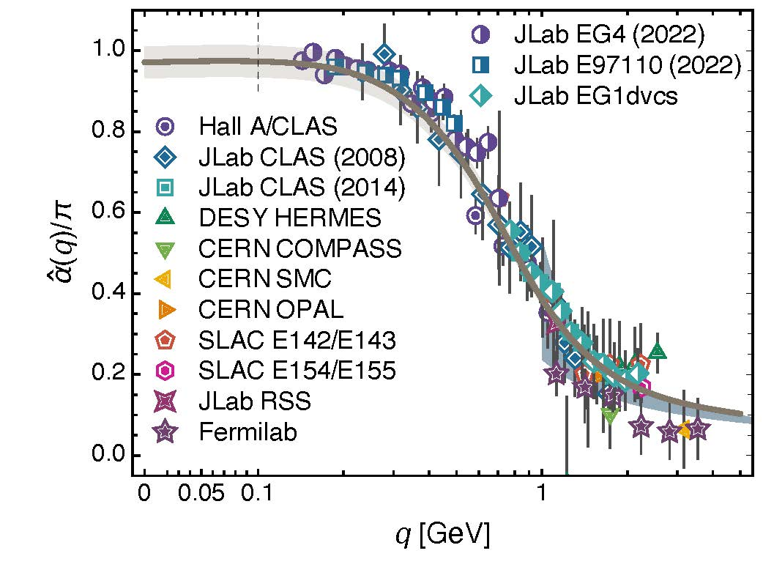
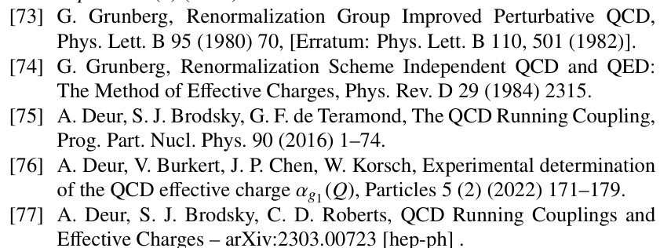
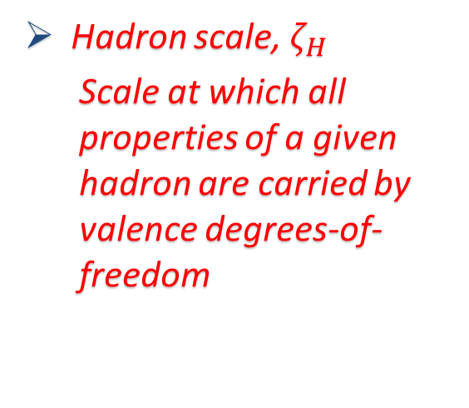
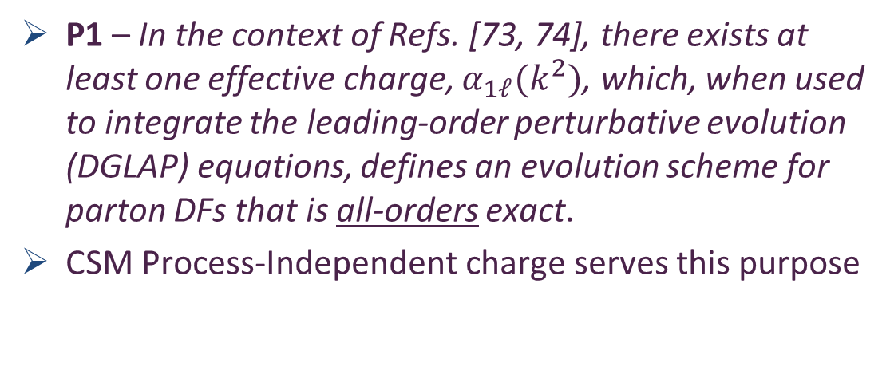
All-orders $ζ$-evolution
All-Orders Evolution of Parton Distributions: Principle, Practice, and Predictions
Pei-Lin Yin (尹佩林) et al., e-Print: 2306.03274 [hep-ph]
Chin. Phys. Lett. Express 40 (2023) 091201/1-8.
New Paradigm
P1 – In the context of Refs. [73, 74], there exists at least one effective charge, $α_{1ℓ}(k^{2})$, which, when used to integrate the leading-order perturbative evolution (DGLAP) equations, defines an evolution scheme for parton DFs that is all-orders exact.
CSM Process-Independent charge serves this purpose
Hadron scale, $ζ_{H}$
  Scale at which all properties of a given hadron are carried by valence degrees-of-freedom

Slide 16
NG Boson Distribution Functions
Insights into the Emergence of Mass from Studies of Pion and Kaon Structure, Craig D. Roberts, David G. Richards, Tanja Horn and Lei Chang, NJU-INP 034/21, arXiv: 2102.01765 [hep-ph], Prog. Part. Nucl. Phys. 120 (2021) 103883/1-65
Physics Goals:
  Precise data that can be used to determine
  Pion and Kaon Distribution Functions – valence, sea and glue
  Provide the first complete charts of the internal structure of Nature's most fundamental Nambu-Goldstone bosons.
Today:
  Existing pion data are more than 40-years-old
  That data only covers the valence-quark domain
  A forty-year controversy, with doubts persisting over whether the data agree with QCD predictions or challenge the truth of QCD
  Regarding the kaon, worldwide, only 8 points of data exist

Slide 17

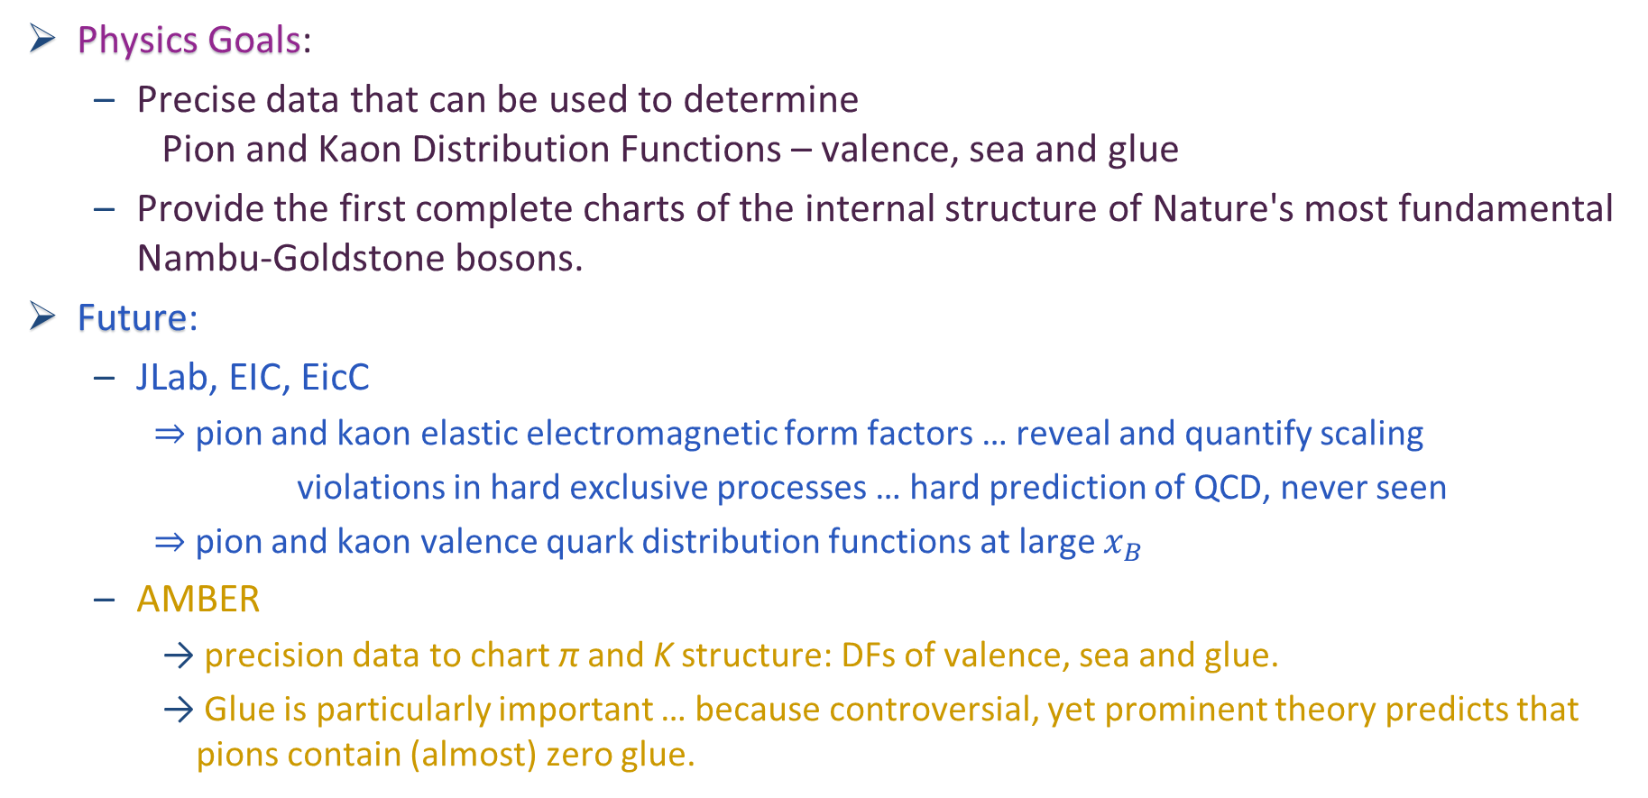
NG Boson Distribution Functions
Physics Goals:
  Precise data that can be used to determine
  Pion and Kaon Distribution Functions – valence, sea and glue
  Provide the first complete charts of the internal structure of Nature's most fundamental Nambu-Goldstone bosons.
Future:
  JLab, EIC, EicC
    ⇒ pion and kaon elastic electromagnetic form factors … reveal and quantify scaling
    violations in hard exclusive processes … hard prediction of QCD, never seen
    ⇒ pion and kaon valence quark distribution functions at large $x_{B}$
  AMBER
    precision data to chart π and K structure: DFs of valence, sea and glue.
    Glue is particularly important … because controversial, yet prominent theory predicts that pions contain (almost) zero glue.

Slide 18

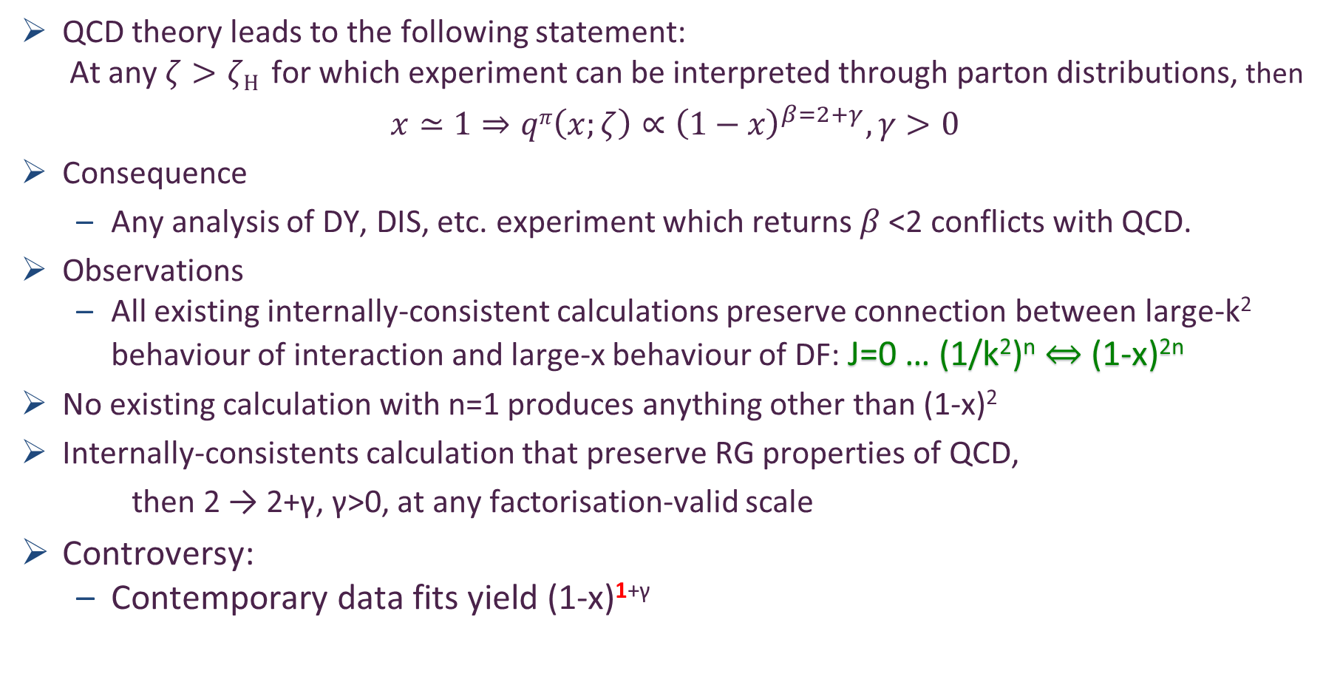
Controversy over pion valence DF
QCD theory leads to the following statement:
  At any $ζ>ζH$ for which experiment can be interpreted through parton distributions, then
$$x≃1⇒qπ\left(x;ζ\right)∝{\left(1−x\right)}^{β=2+γ}, γ>0$$
Consequence
  Any analysis of DY, DIS, etc. experiment which returns $β$<2 conflicts with QCD.
Observations
  All existing internally-consistent calculations preserve connection between large-k² behaviour of interaction and large-x behaviour of DF: J=0 … (1/k²)^{n} ⇔ (1-x)^{2n}
No existing calculation with n=1 produces anything other than (1-x)²
Internally-consistents calculation that preserve RG properties of QCD,
then 2 → 2+γ, γ>0, at any factorisation-valid scale
Controversy:
  Contemporary data fits yield (1-x)^{1+γ}
Is QCD wrong?
Is existing large-x data a true measure of $qπ\left(x;ζ\right)$?
Are fitter-favoured analysis methods correct/complete?

Slide 19
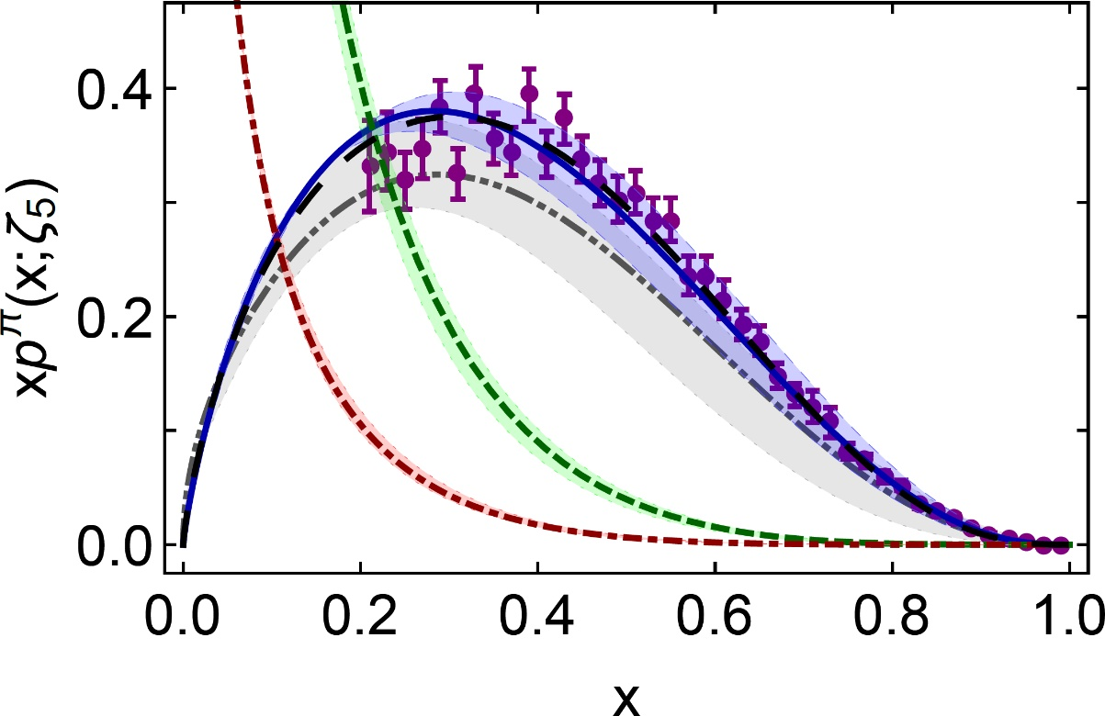
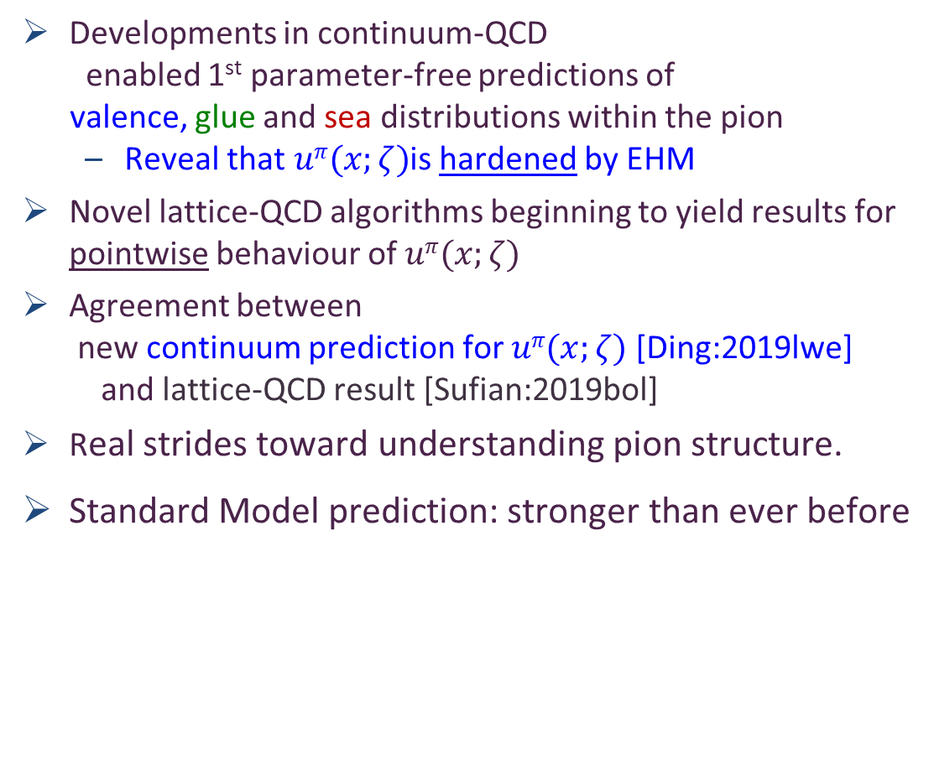
π valence-quark distributions
24 Years of Theory Evolution → 2023
β^{contm}(ζ₅) = 2.66(12)
β^{lattice}(ζ₅) = 2.45(58)
Developments in continuum-QCD
enabled 1st parameter-free predictions of
valence, glue and sea distributions within the pion
  Reveal that $uπ(x;ζ)$is hardened by EHM
Novel lattice-QCD algorithms beginning to yield results for pointwise behaviour of $uπ(x;ζ)$
Agreement between
  new continuum prediction for $uπ(x;ζ)$ [Ding:2019lwe]
  and lattice-QCD result [Sufian:2019bol]
Real strides toward understanding pion structure.
Standard Model prediction: stronger than ever before
After 30 years – new era dawning in which the ultimate experimental checks can be made:
M2 beam-line @ CERN … JLab12 … EIC … EicC

Slide 20
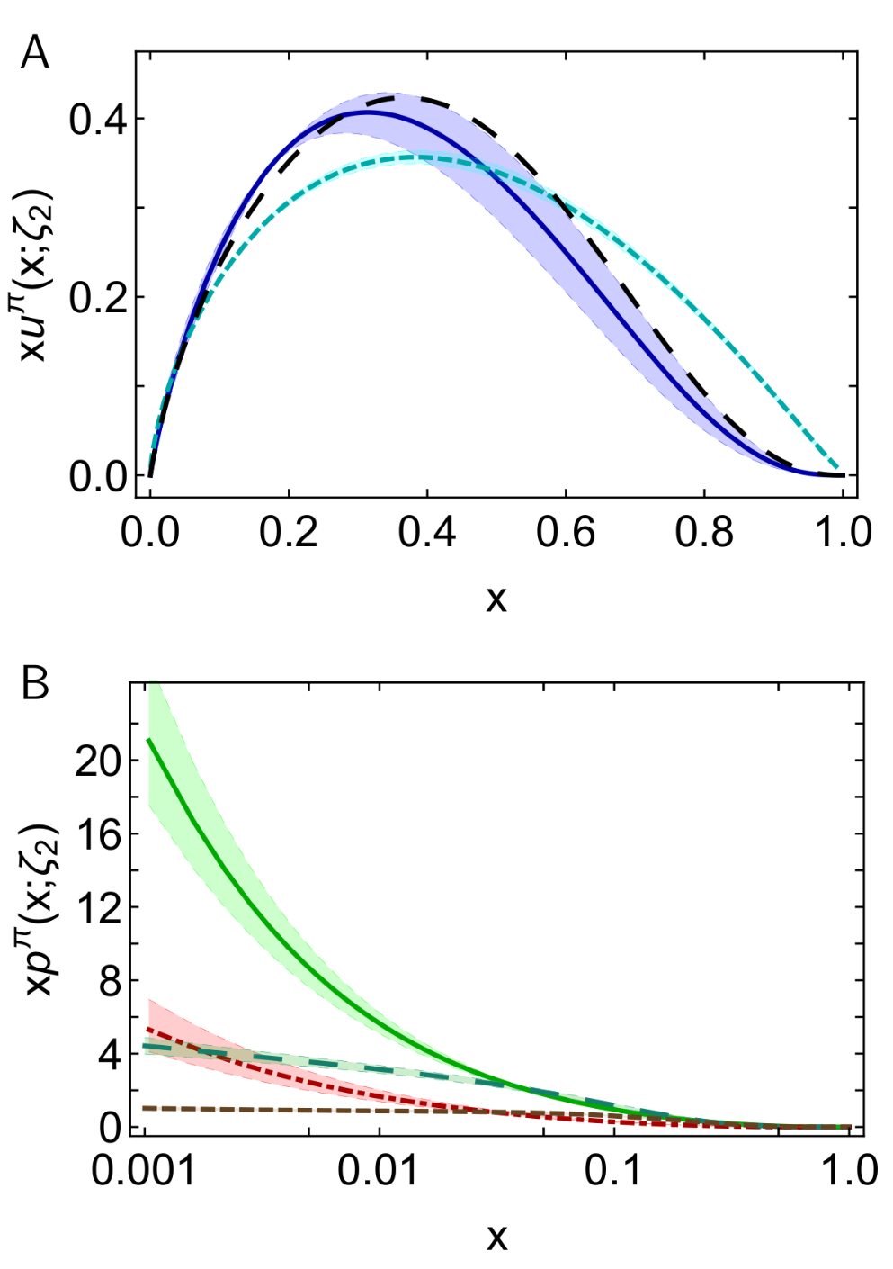
π DFs … Modern Theory Predictions vs Traditional Phenomenological Fits to Data
Valence:
  momentum fraction similar
  Phenomenological Fits … profile much harder
  & inconsistent with QCD prediction
Glue:
  Qualitative similarities on x ≥ 0.05, but marked quantitative disagreement, especially on complementary domain
  Both continuum prediction and fit are very different from early phenomenology
  Should be tested in new experiments that are directly sensitive to the pion’s gluon content.
    E.g., prompt photon & J/Ψ production
Sea:
  Prediction and fit disagree on entire x-domain
  If pion’s gluon content is considered uncertain, then fair to describe sea-quark distribution as empirically unknown
  Motivation for the collection and analysis of DY data with π± beams on isoscalar targets
CSM prediction
JAM valence
DSE prediction
glue & sea
JAM:
glue & sea

Slide 21
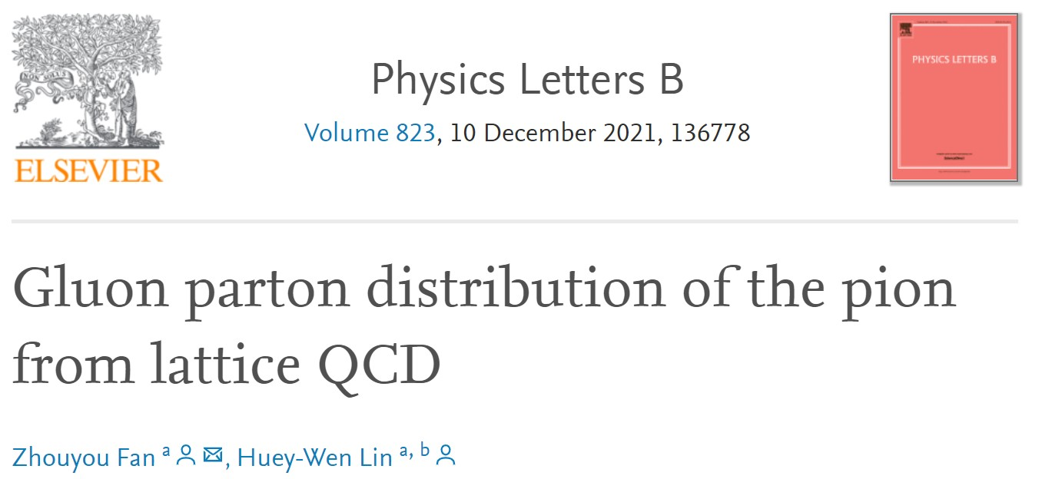
π DFs … Modern Theory Predictions vs Traditional Phenomenological Fits to Data
Valence:
  momentum fraction similar
  JAM … publication ignores NLL resummation … profile much harder & inconsistent with QCD prediction
Glue:
  Similarities on x ≥ 0.05, but marked disagreement on important complementary domain
  Both continuum prediction and JAM fit are very different from early phenomenology
  Should be tested in new experiments that are directly sensitive to the pion’s gluon content.
  Perhaps, prompt photon & J/Ψ production
Sea:
  Prediction and fit disagree on entire x-domain
  If pion’s gluon content is considered uncertain, then fair to describe sea-quark distribution as empirically unknown
  Motivation for the collection and analysis of DY data with π± beams on isoscalar targets
DSE prediction
JAM valence
Exploratory lQCD results for pion’s glue DF are now available
DSE prediction
glue & sea
JAM:
glue & sea

Slide 22
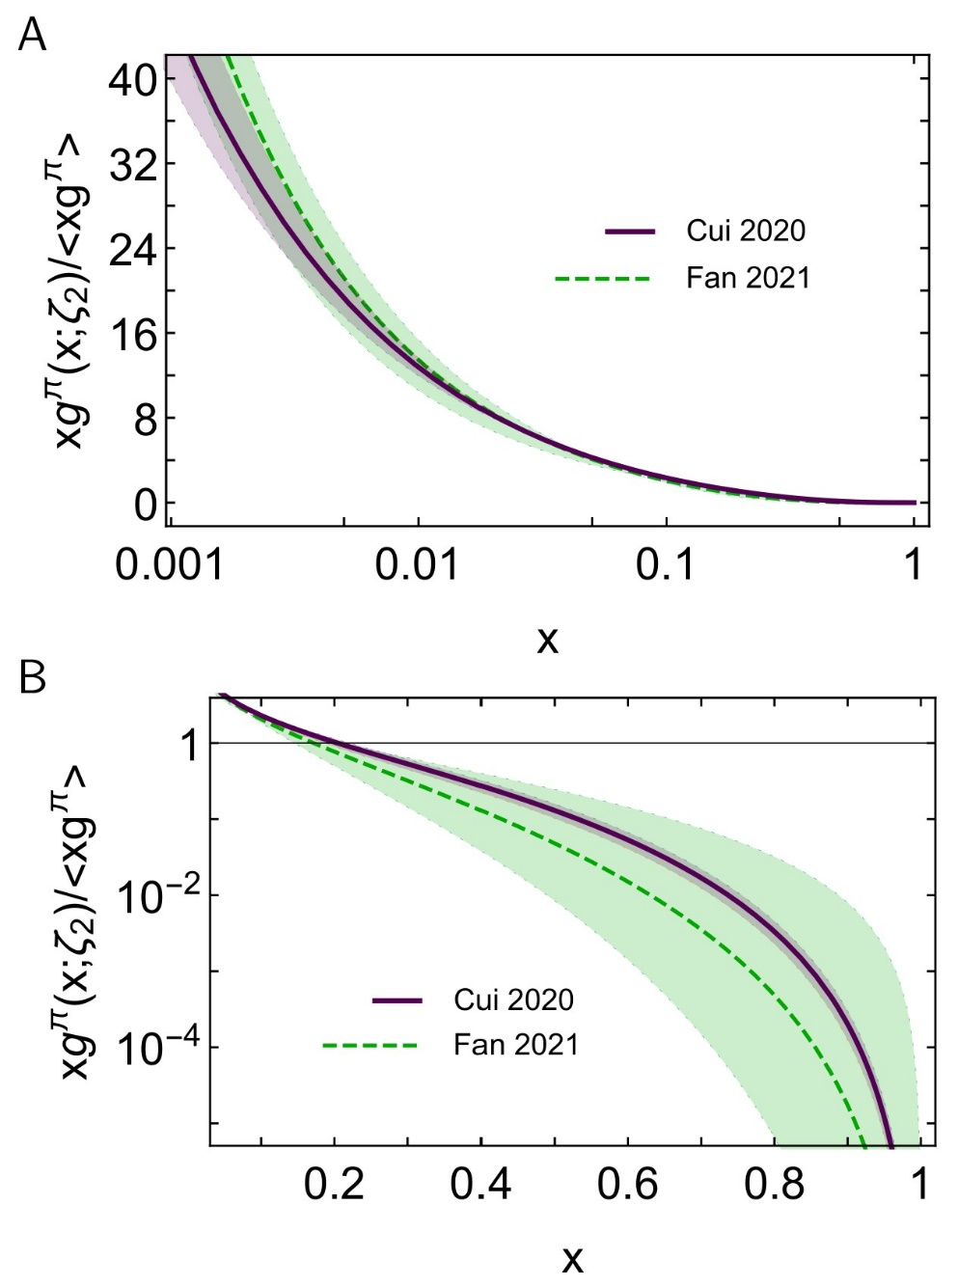

Glue in π: Continuum (Eur. Phys. J. C 80 (2020) 1064/1-20)
& Lattice Predictions (arXiv: Phys.Lett.B 823 (2021) 136778)
Two distinct methods for tackling QCD
Agree quantitatively on $g_{ }^{π}\left(x\right)$
continuum
Phenomenological analyses
exhibit qualitatively different behaviour
Highlights need for new data and improved phenomenology in order to turn that data into a real test of QCD and our understanding of Nambu-Goldstone modes.
AMBER @ CERN can provide the necessary precise data.
lattice
Regarding the distribution of glue in the pion, Lei Chang (常雷) and Craig D Roberts,
e-Print: 2106.08451 [hep-ph], Chin. Phys. Lett. 38 (8) (2021) 081101/1-6 - Editors' Suggestion

Slide 23
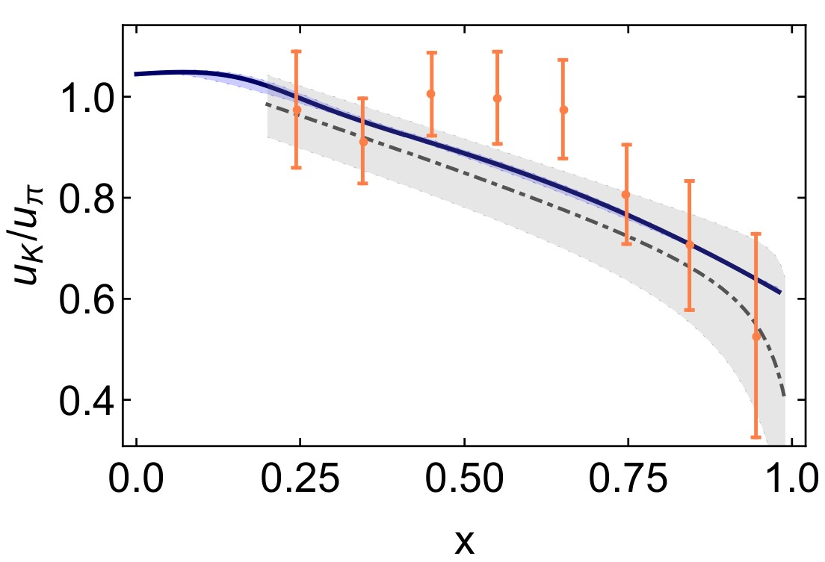
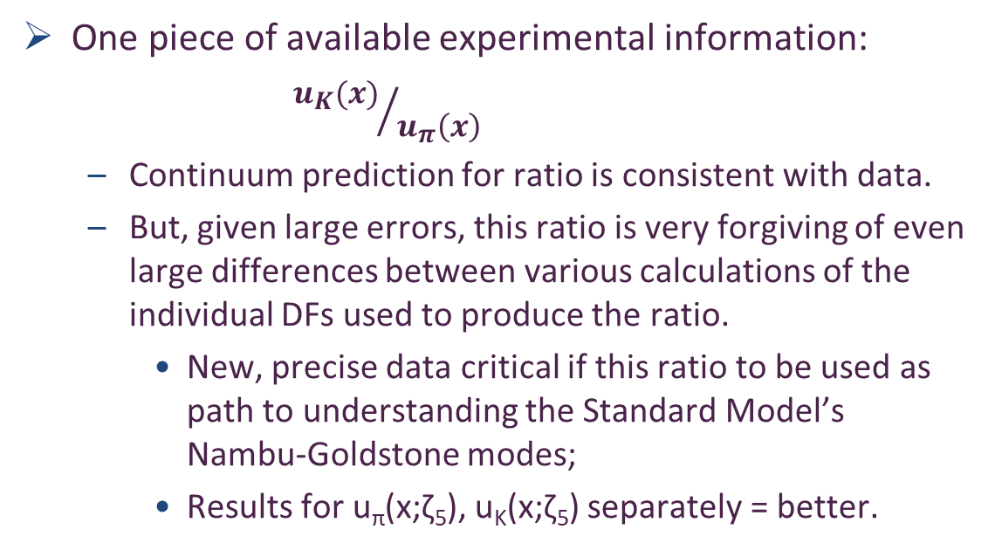
Status: Kaon
Programmes at JLab, AMBER
Proposals at EIC and EicC
Tackling the kaon structure function at EicC
Gang Xie et al. e-Print: 2109.08483 [hep-ph].
Chin. Phys. C 46 (2022) 6, 064107
Little empirical information available on K DFs ⇒ no recent phenom. inferences.
  Valence-quark distributions: results from models and a single, recent lQCD study
  Kaon’s glue and sea distributions: no results
Entirety of human history
– only 8 kaon data in existence
CERN … Phys. Lett. B 93 (1980) 354-356
One piece of available experimental information:
${u_{K}(x)}/{u_{π}\left(x\right)}$
  Continuum prediction for ratio is consistent with data.
  But, given large errors, this ratio is very forgiving of even large differences between various calculations of the individual DFs used to produce the ratio.
    New, precise data critical if this ratio to be used as path to understanding the Standard Model’s Nambu-Goldstone modes;
    Results for u_{π}(x;ζ₅), u_{K}(x;ζ₅) separately = better.
CSM
lQCD_{MSU}

Slide 24
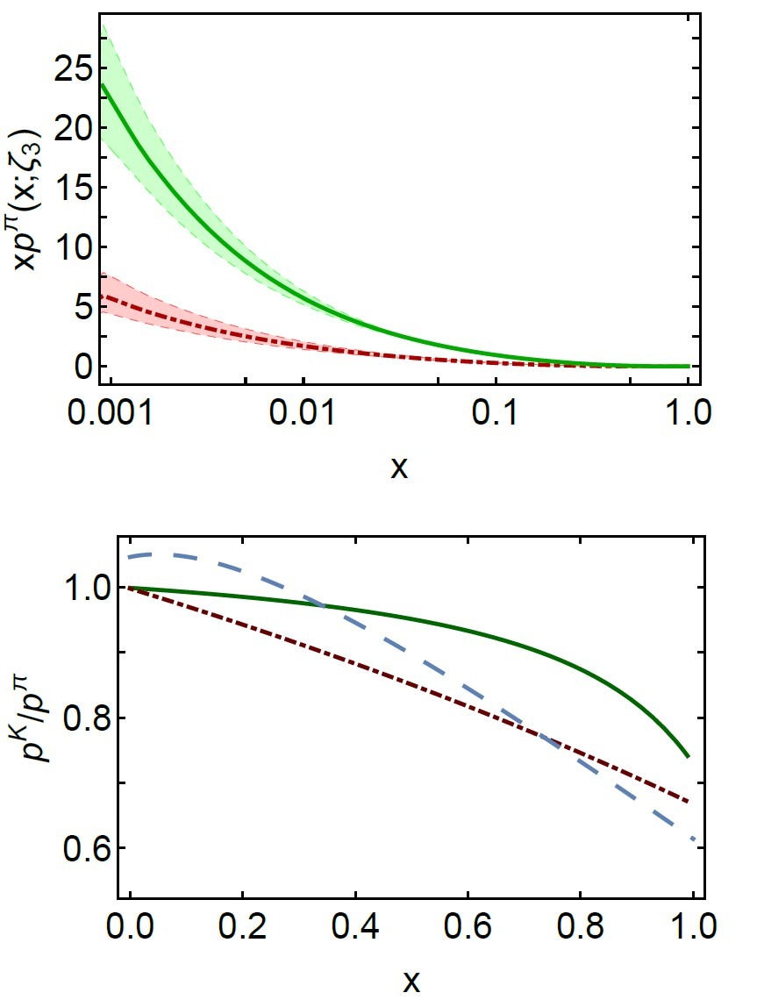
Status: Kaon
Kaon parton distributions, Z.-F. Cui et al., arXiv:2006.14075 [hep-ph], Eur. Phys. J. C 80 (2020) 1064/1-20
Little empirical information available on K DFs ⇒ no recent phenom. inferences.
  Valence-quark distributions: results from models and a single, recent lQCD study
  Kaon’s glue and sea distributions: no predictions … until now
Glue and Sea – Predictions:
  DFs similar to those in the pion
  Detailed comparison requires use of mass-dependent splitting functions.
  Development underway … Preliminary conclusions:
    Light-front momentum fraction carried by s-quarks in the kaon increases by ∼ 5%;
    Compensated by a commensurate decrease in fractions carried by glue (−1%) and sea (−2%).
Glue
Sea
Valence
Glue
Sea

Slide 25
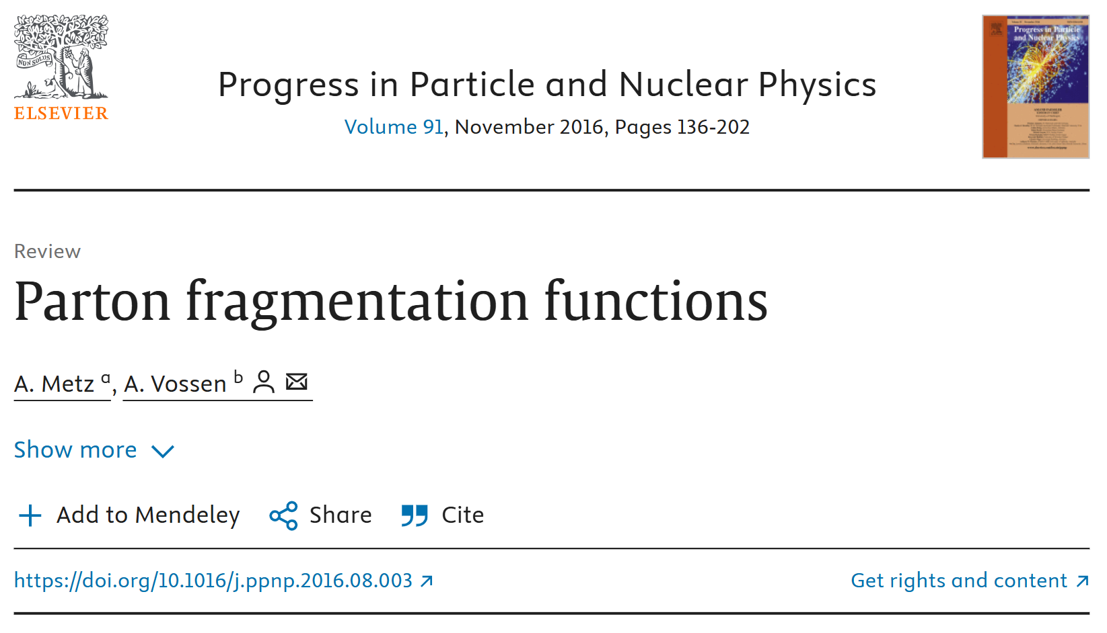

Slide 26
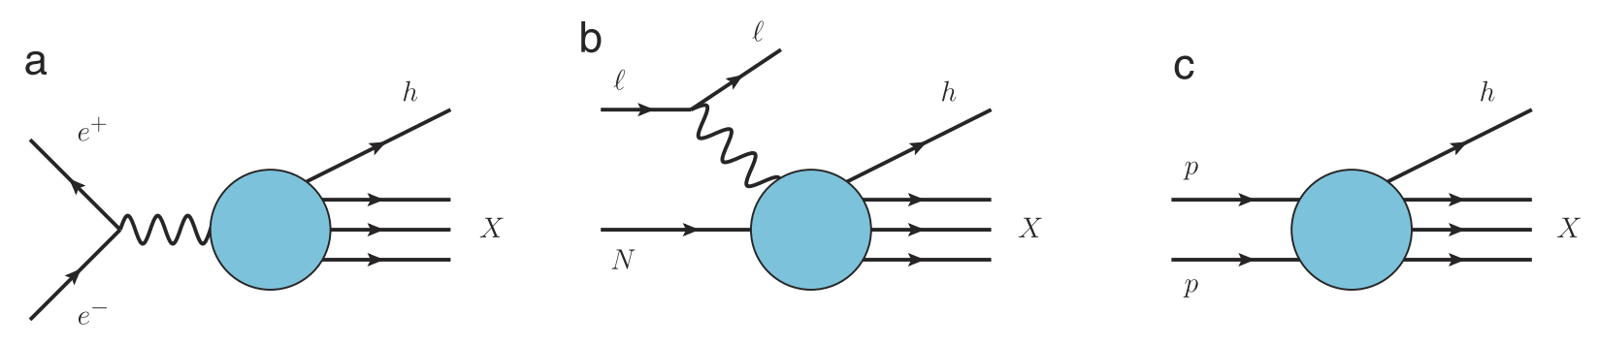
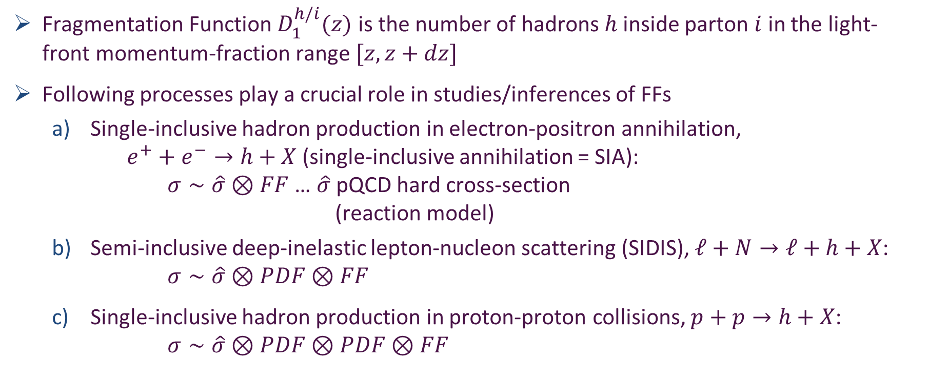
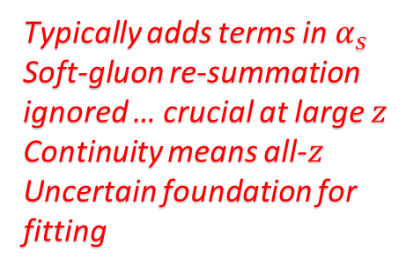
Fragmentation Functions
Fragmentation Function $D_{1}^{h/i}(z)$ is the number of hadrons $h$ inside parton $i$ in the light-front momentum-fraction range $[z,z+dz]$
Following processes play a crucial role in studies/inferences of FFs
  Single-inclusive hadron production in electron-positron annihilation,
  $e^{+}+e^{−}→h+X$ (single-inclusive annihilation = SIA):
  $σ∼\hat{σ}⊗FF$ … $\hat{σ}$ pQCD hard cross-section
  (reaction model)
  Semi-inclusive deep-inelastic lepton-nucleon scattering (SIDIS), $ℓ+N→ℓ+h+X$: $σ∼\hat{σ}⊗PDF⊗FF$
  Single-inclusive hadron production in proton-proton collisions, $p+p→h+X$:
  $σ∼\hat{σ}⊗PDF⊗PDF⊗FF$
Typically adds terms in $α_{s}$
Soft-gluon re-summation ignored … crucial at large $z$
Continuity means all-$z$
Uncertain foundation for fitting

Slide 27
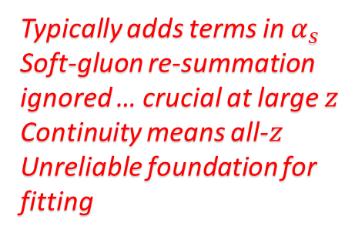
Fragmentation Functions
Fragmentation Function $D_{1}^{h/i}(z)$ is the number of hadrons $h$ inside parton $i$ in the light-front momentum-fraction range $[z,z+dz]$
Following processes play a crucial role in studies/inferences of FFs
  Single-inclusive hadron production in electron-positron annihilation,
  $e^{+}+e^{−}→h+X$ (single-inclusive annihilation = SIA):
  $σ∼\hat{σ}⊗FF$ … $\hat{σ}$ pQCD hard cross-section
  (reaction model)
  Semi-inclusive deep-inelastic lepton-nucleon scattering (SIDIS), $ℓ+N→ℓ+h+X$: $σ∼\hat{σ}⊗PDF⊗FF$
  Single-inclusive hadron production in proton-proton collisions, $p+p→h+X$:
  $σ∼\hat{σ}⊗PDF⊗PDF⊗FF$
Can’t extract information about
PDFs from such processes
unless FFs are known
Typically adds terms in $α_{s}$
Soft-gluon re-summation ignored … crucial at large $z$
Continuity means all-$z$
Unreliable foundation for fitting

Slide 28
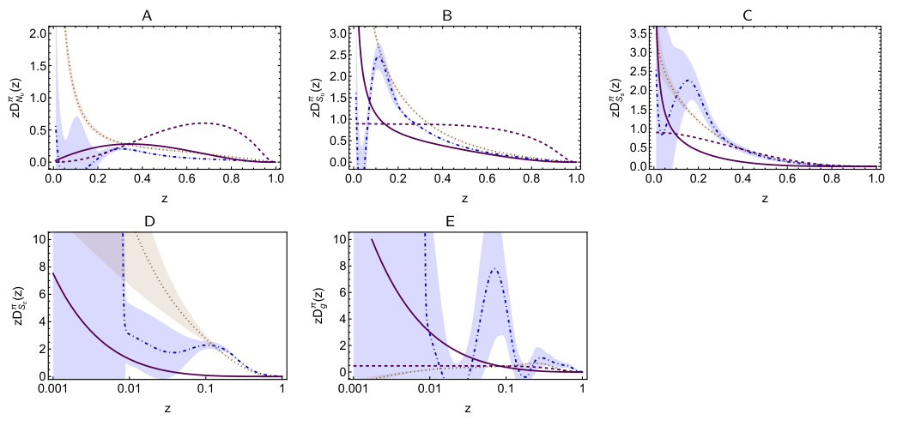
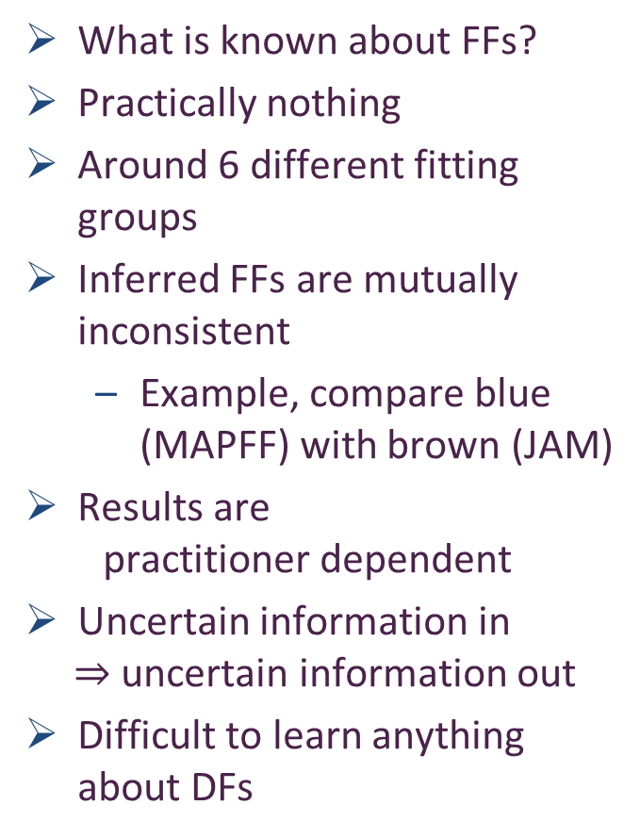


Unpolarised FFs
What is known about FFs?
Practically nothing
Around 6 different fitting groups
Inferred FFs are mutually inconsistent
  Example, compare blue (MAPFF) with brown (JAM)
Results are
practitioner dependent
Uncertain information in
$⇒$ uncertain information out
Difficult to learn anything about DFs
Serious impediment to interpretation of data from modern and anticipated facilities
$$N … u→π$$
$$S … u→π$$
Purple dashed: elementary FF
Purple solid: FF after solving cascade equations

Slide 29

Polarised FFs
Today, for most polarized FFs, there is no information
… not from experiment and not from theory.
Majority of cases where experimental data exist, it’s for fragmentation into $Λ$ and/or $Λ^{−}$ hyperons, which are self-analyzing, i.e., they reveal their polarization through the angular dependence of the decay products.
The analysis of such experiments is difficult, since a large fraction of the produced $Λ$ particles comes from the decay of heavier hyperons rather than direct production.
For physics programmes at modern and anticipated facilities:
JLab-12, EIC, EicC, precise knowledge of FFs will be crucial.
Especially true for international TMD program.
Input from Belle II, at the next generation B-factory, SuperKEKB, will be important to provide multi-differential observables for identified light quark FFs.
For progress, for assisting phenomenology,
Theory predictions instead of fits are essential

Slide 30
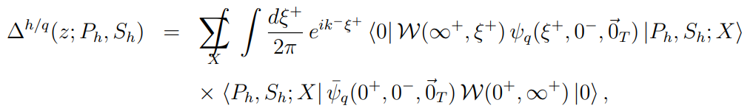
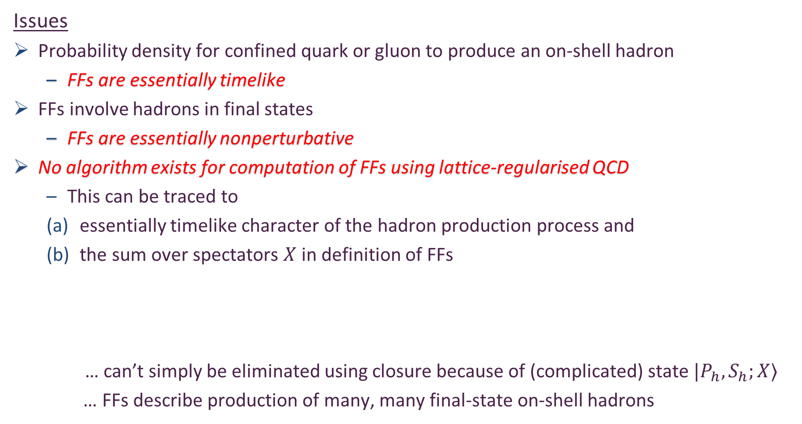
Calculation of FFs
Issues
Probability density for confined quark or gluon to produce an on-shell hadron
  FFs are essentially timelike
FFs involve hadrons in final states
  FFs are essentially nonperturbative
No algorithm exists for computation of FFs using lattice-regularised QCD
  This can be traced to
  essentially timelike character of the hadron production process and
  the sum over spectators $X$ in definition of FFs
    … can’t simply be eliminated using closure because of (complicated) state $|P_{h},S_{h};X⟩$
  … FFs describe production of many, many final-state on-shell hadrons

Slide 31


Calculation of FFs
Models
Simplest version = spectator models
  a time-like off-shell parton fragments into a hadron and a single (real) spectator particle
Practitioner uses (favourite) quark + hadron Lagrangian to compute a (short) series of diagrams
Practitioner fits parameters to some selected data

Slide 32




Calculation of FFs
Models
Field + Feynman Jet Fragmentation approach
  Readily handles multiple hadron production
Basic need is elementary fragmentation function:
$$d_{p}^{h}\left(z;ζ\right)$$
  which is mathematical probability that initial parton, $p$, produces hadron, $h$
Using $d_{q}^{h}(z;ζ)$, one solves coupled set of linear cascade equations to determine complete FF, $D_{q}^{h}(z;ζ)$, which accounts for all hadrons produced from momentum of the initial quark
Sum rule: $\sum_{h}{\int_{0}^{1}{dz} D_{p}^{h}\left(z;ζ\right)=1}$
  The hadron jet generated by parton $p$ contains all momentum of initial state
Boundary Conditions
  $D_{p}^{h}\left(z;ζ\right)=_{x≃0}\frac{1}{z}$
  $D_{p}^{h}\left(z;ζ\right)=_{x≃1}d_{p}(z;ζ)$

Slide 33

Elementary Fragmentation Functions
FF is timelike twin of the spacelike process
= leptoproduction on target $h$
$γ^{∗}\left(Q^{2}\right)+h→X⇔γ^{∗}\left(Q^{2}\right)→\overline{h}+X$
Crossing symmetry $⇒$ relation between DFs and FFs
Drell-Levy-Yan (DLY) Relation
Compute elementary FFs by analytic continuation of DFs onto domain $x>1$
$$d_{q}^{h}\left(z;ζ\right)∝zq^{h}(\frac{1}{z};ζ)$$
At some scale, EFFs and DFs are the same function
DLY was proved using operator definitions and crossing symmetry
Regarding evolution equations, the DLY relation has been proved to NNLO in pQCD
S. D. Drell, D. J. Levy, T.-M. Yan, A Theory of Deep Inelastic Lepton-Nucleon Scattering and Lepton Pair Annihilation Processes. 1., Phys. Rev. 187 (1969) 2159–2171.
S. D. Drell, D. J. Levy, T.-M. Yan, A Theory of Deep Inelastic Lepton Nucleon Scattering and Lepton Pair Annihilation Processes. 2. Deep Inelastic electron Scattering, Phys. Rev. D 1 (1970) 1035–1068.
S. D. Drell, D. J. Levy, T.-M. Yan, A Theory of Deep Inelastic Lepton-Nucleon Scattering and Lepton Pair Annihilation Processes. 3. Deep Inelastic electron-Positron Annihilation, Phys. Rev. D 1 (1970) 1617–1639.
V. Gribov, L. Lipatov, Deep inelastic e p scattering in perturbation theory, Sov. J. Nucl. Phys. 15 (1972) 438–450.
V. N. Gribov, L. N. Lipatov, e+ e- pair annihilation and deep inelastic e p scattering in perturbation theory, Sov. J. Nucl. Phys. 15 (1972) 675–684.

Slide 34

Elementary Fragmentation Functions
At some scale, EFFs and DFs are the same function
  Any tool that can deliver sound pointwise form of DF at required scale, can then deliver complete array of FFs via Field + Feynman cascade equations
What is the scale?
  Owing to scaling violations in QCD, one must identify validity scale for DLY relation:
$$d_{q}^{h}\left(z;ζ\right)∝zq^{h}(\frac{1}{z};ζ)$$
Natural (only) value is $ζ=ζ_{H}$, the hadron scale, whereat dressed valence degrees-of-freedom carry all properties of a given hadron
  Existence of such a scale is guaranteed by the theory of effective charges in QCD
Choice is logical for, inter alia, following reasons.
  A realistic hadron-scale valence quark DF vanishes at the endpoints, $x = 0, 1$
  Ensures that DLY relation produces an elementary FF which vanishes at $z = 0, 1$
  Guarantees that cascade equations have convergent solutions, without tuning
  QCD scaling violations mean such cannot be guaranteed for $ζ>ζ_{H}$.

Slide 35

Fragmentation Functions and Confinement
DLY relation … at some scale, EFFs and DFs are the same function
$$d_{q}^{h}\left(z;ζ\right)∝zq^{h}(\frac{1}{z};ζ)$$
FFs express how a shower of coloured partons coalesce into colour singlet final states … this is the empirical expression of confinement
Overlap representation of parton DFs
$$q^{h}\left(x;ζ\right)∼∫d^{2}k_{⊥}{\left|Ψ_{q}^{h}\left(x,k_{⊥}^{2}\right)\right|}^{2}$$
parton DFs are obtained from square of hadron LFWF
Seeds of confinement, expressed in hadronisation, are already present in wave functions of the hadrons involved … unsurprising, perhaps, but important

Slide 36





Predictions for Fragmentation Functions using cascade equations
$$u→π^{+}+\overline{u}$$
favoured
Empirically, at energies below $∼100$ GeV,
$π, K$ dominate (98%) particle production
in SIA: $e^{+}+e^{−}→h+X$
So, illustrate procedure via predictions for $π, K$ FFs
Exploit $G$-parity symmetry, one has set of 9 coupled Volterra integral equations of 2nd kind
e.g. $u∉π^{−}$ so EFF$=0$
Need $u→π^{+}+\overline{u}→π^{+}+π^{−}+u …$
To appear in EPJC
unfavoured

Slide 37





Pion and Kaon DFs $⇒$ EFFs
Continuum predictions for hadron scale pion and kaon valence-quark DFs
$$u_{π}\left(x;ζ_{H}\right)=n_{π}\ln{[1+{(\frac{1}{ρ^{2}})x}^{2}{\left(1−x\right)}^{2}} (1+γ_{π}^{2}\left[{\left({\left[1−x\right)}^{2}\right]}^{β_{π}}+{\left(x^{2}\right)}^{β_{π}}\right)]$$
$n_{π}=0.858$, $ρ_{π}=0.116$, $γ_{π}=1.967$, $β_{π}=5.938$
$$s_{K}\left(x;ζ_{H}\right)$$
Dilation and flattening are expressions of EHM
Skewing for kaon is expression of EHM + Higgs-Boson interference
$$u_{K}\left(x;ζ_{H}\right)=n_{K}\ln{[1+{(\frac{1}{ρ_{K}^{2}})x}^{2}{\left(1−x\right)}^{2}} (1+γ_{K}^{2}{\left(x^{2}\right)}^{α_{K}}{\left({\left[1−x\right]}^{2}\right)}^{β_{K}})]$$
$$s_{K}\left(x;ζ_{H}\right)=u_{K}(1−x;ζ_{H})$$
$n_{K}=0.444$, $ρ_{K}=0.0746$, $γ_{K}=6.276$, $α_{K}=0.710$, $β_{K}=1.650$
“ln” functional form is perfect for using DLY relation
Kaon and pion parton distributions, Zhu-Fang Cui et al., Eur. Phys. J. C 80 (2020) 11, 1064 ... 97 citations
CSM predictions confirmed, e.g., Quark and Gluon Momentum Fractions in the Pion and in the Kaon, ETMC, Phys. Rev. Lett. 134 (2025)

Slide 38








Elementary Fragmentation Functions
DLY relation $d_{q}^{h}\left(z;ζ\right)∝zq^{h}(\frac{1}{z};ζ)$
CSM DFs produce curves at right
Normalised
  Elementary probability that $u$ quark produces some kind of hadron with some value of $z$ is unity
Owing to DLY relation, FF behaviour on $z≃1$ must match that of DFs on $x≃$1
  Strict QCD predictions
  Mesons ${{\left(1−x\right)}^{2+γ(ζ)}↔\left(1−z\right)}^{2+γ\left(ζ\right)}$
$$d_{u}^{π^{+}+π^{0}}(x;ζ_{H})$$
$$d_{s}^{K^{−}}(x;ζ_{H})$$
$$d_{u}^{K^{+}}(x;ζ_{H})$$
Prediction: EFF multiplicities
Determine multiplicities at all scales
Baryons … $2→3$

Slide 39


Empirical Fragmentation Functions
Solve cascade equations at $ζ_{H}$
Use all-orders (AO) scheme to evolve solutions to scales relevant for measurements, e.g., $ζ=ζ_{2}≔2$ GeV
  AO scheme is nonperturbative extension of DGLAP
  Exploits notion of effective charges in QCD
Approach guarantees that particle and momentum sum rules are preserved
$$\sum_{h}{\int_{0}^{1}{dz} D_{p}^{h}\left(z;ζ\right)=1}$$

Slide 40

Empirical Fragmentation Functions
Momentum sum rule is typically not enforced in global fitting schemes because …
  No experiment can reach $z=0$.
  For a given set of data, the empirical hadron final-state space is unknown because hadrons in addition to $π, K, p, \overline{p}$ might be produced and yet go undetected.
Contemporary FF fit procedures are typically only able to ensure that the results are consistent with some set of practitioner-dependent momentum sum rule bounds or inequalities.

Slide 41


Empirical Fragmentation Functions
Solve cascade equations at $ζ_{H}$
Use all-orders (AO) scheme to evolve solutions to scales relevant for measurements, e.g., $ζ=ζ_{2}≔2$ GeV
  AO scheme is nonperturbative extension of DGLAP
  Exploits notion of effective charges in QCD
Approach guarantees that particle and momentum sum rules are preserved
$$\sum_{h}{\int_{0}^{1}{dz} D_{p}^{h}\left(z;ζ\right)=1}$$
Issues with enforcing momentum sum rule in global fitting schemes

Slide 42


Empirical
Fragmentation
Functions
Focus on pion & compare CSM predictions (solid purple curves) with fits
N.B. Between groups, fits are mutually incompatible.
A, B … $u→π^{+,0}$ (favoured) nonsinglet and singlet.
  Agreement only on $z>0.5$, i.e., valence quark domain
  JAM nonsinglet FF result ($zD_{N}$) exhibits unexpected & unphysical divergence on $z≃0$.
  This is the domain of glue and sea dominance; so, $zD_{N}=\frac{3}{2} z[D_{q}^{π^{+}}\left(z\right)−D_{\overline{q}}^{π^{+}}\left(z\right)]$ should vanish.

Slide 43

Empirical
Fragmentation
Functions
Focus on pion & compare CSM predictions (solid purple curves) with fits
N.B. Between groups, fits are mutually incompatible.
C … $s→π$ (unfavoured).
  One might say there is qualitative agreement on the far valence domain, but only in the sense that this FF is small.
  Otherwise, any agreement is only the result of an accidental curve crossing

Slide 44

Empirical
Fragmentation
Functions
Focus on pion & compare CSM predictions (solid purple curves) with fits
N.B. Between groups, fits are mutually incompatible.
D, E … $c, g→π$ (unfavoured).
  There is no agreement on these FFs, which are very poorly constrained by data.

Slide 45

Empirical
Fragmentation
Functions
Focus on pion & compare CSM predictions (solid purple curves) with fits
N.B. Between groups, fits are mutually incompatible.
Continuum predictions provide coherent picture of fragmentation across all parton types
Quite generally, MAPFF fits (blue) highlight that FFs are practically unconstrained on $z ≲ 0.2$
The study indicates that, today, phenomenology does not deliver objective FF results:
results obtained are practitioner specific
This must improve if anything objective is to be learnt from modern and anticipated facilities

Slide 46





Hadron Jet Multiplicities
Relative multiplicity of charged and neutral kaons in $e^{+}+e^{−}→h+X$
Data exist, most recently from BESIII, last year
BESIII
Parameter-free prediction
Predictions for hadron jet multiplicities reveal SU$(3)$-flavour symmetry breaking in $R_{K}\left(ζ\right)$
Breaking significant at reaction energy scales $ζ≈3m_{p}$, but decreases in size with increasing reaction energy

Slide 47
Theory Frontier

Slide 48
Hadron Gravitational Form Factors
Forces inside hadrons: pressure, surface tension, mechanical radius, and all that,
M. V. Polyakov, P. Schweitzer, Int. J. Mod. Phys. A 33 (2018) 26
  “The physics related to the form factors of the energy momentum tensor spans a wide spectrum of problems, and includes
  gravitational physics,
  hard exclusive reactions,
  hadronic decays of heavy quarkonia,
  and the physics of exotic hadrons described as hadroquarkonia.
  It also provides access to the “last global unknown property:” the D (pressure) term.

Slide 49



Hadron Gravitational Form Factors
Forces inside hadrons: pressure, surface tension, mechanical radius, and all that,
M. V. Polyakov, P. Schweitzer, Int. J. Mod. Phys. A 33 (2018) 26
    “The most natural way to probe EMT form factors, scattering off gravitons – see left image – is also the least practical one.
    A practical opportunity to access EMT form factors emerged with the advent of generalized parton distributions (GPDs), which describe hard-exclusive reactions, such as deeply virtual Compton scattering – see right image.”
This is because the in-hadron expectation value of the QCD energy momentum tensor … $⟨H|T_{μν}|H⟩$
  appears in the operator product expansion of the in-hadron matrix element of two vector currents … $⟨H|J_{μ}J_{ν}|H⟩$
X. D. Ji, Phys. Rev. Lett. 78, 610 (1997)
To use OPE, one of the photons, $γ^{∗}$, must be far off-shell (large $Q^{2})=$ deeply virtual Compton Scattering

Slide 50





Pion and kaon gravitational form factors
In general, on the order of 40 distinct terms
Construction via resolution of WGTI $⇒$ 14 physically important terms
Still many, but more easily manageable
Precisely same framework as used for electromagnetic form factors of these mesons
  Prediction and Unification
Need graviton-quark vertex … made available by analysis in Pion and kaon electromagnetic and gravitational form factors, Yin-Zhen Xu (徐胤禛) et al., e-Print: 2311.14832 [hep-ph], Eur. Phys. J. C 84 (2024) 2, 191/1-13
In-meson expectation value of EM tensor – gravitational current: 2 objective (measurable) form factors …
Vanishes owing to energy-momentum conservation: $Q_{μ}Λ_{μν}^{g}\left(P,Q\right)≡0$
mass
pressure

Slide 51



Meson Gravitational Form Factors
$θ_{1}\left(Q^{2}\right)$ is the pressure form factor
Provides access to pressure and shear-force distributions within the meson
Meson core pressures are more than an order of magnitude greater than those in neutron stars.
Calculations reveal that each meson’s mass radius is smaller than its charge radius, matching available empirical inferences
  Empirical Determination of the Pion Mass Distribution,
    Y-Z. Xu (徐胤禛) et al., e-Print: 2302.07361 [hep-ph], Chin. Phys. Lett. Express 40 (2023) 041201/1-7. Express Letter.
Bound states; so, pressure integrates to zero (von Laue, 1911)
Zero in pressure near maximum in shear force
Kaon more compact; so, pressure higher

Slide 52


$$Selected aspects \\ of baryon physics$$

Slide 53

Faddeev Equation for Baryons
Nucleon mass from a covariant three-quark Faddeev equation
G. Eichmann et al., Phys. Rev. Lett. 104 (2010) 201601
Poincaré-covariant analysis of heavy-quark baryons
Si-Xue Qin (秦思学) et al., Phys.Rev. D 97 (2018) 114017/1-13
Nucleon Gravitational Form Factors,
Z.-Q. Yao (姚照千) et al., Eur. Phys. J. A 61 (2025) 92/1-13

Slide 54


Nucleon as a Bound State
Nucleon charge and magnetisation distributions: flavour separation and zeroes,
Zhao-Qian Yao (姚照千), e-Print: 2403.08088 [hep-ph], Fund. Res. (2025) in press.
Nucleon bound-state problem can be addressed
in any approach that provides access to the three-quark six-point Schwinger function
  Using CSMs, one begins with the Poincaré-invariant Faddeev equation
  Today, there are $≈5$ people in the world who can solve this problem
The analysis to be described uses precisely the same approach (approximation and interaction) as that employed for pion and kaon electromagnetic form factors
  Thus, one arrives at unifying set of parameter-free predictions for all pion and kaon and nucleon elastic electromagnetic and gravitational form factors and their species separations to large values of momentum transfer
  All predictions link observables directly with fundamental QCD Schwinger functions and thereby expose novel expressions of emergent phenomena in QCD.

Slide 55



Nucleon Gravitational Form Factors
Current … complementing solution of Faddeev equation, then all elements are known
Current …
$A(Q^{2})$ mass distribution form factor
$$A\left(Q^{2}=0\right)=1$$
$J(Q^{2})$ spin distribution form factor
$$J\left(Q^{2}=0\right)=1/2$$
$D(Q^{2})$ pressure distribution form factor
$$D\left(Q^{2}=0\right)=?$$
Last unknown/unmeasured global property of nucleon

Slide 56


Predicted GFFs
Solid curves … CSM predictions
Points lQCD results [Hackett:2023rif]
  Agreement within (large) lattice uncertainties
Symmetry-preserving character of CSM analysis is evident in values of
  $A\left(0\right)=1$
  $J\left(0\right)=1/2$
With $J\left(0\right)=1/2$, confirm that the anomalous gravitomagnetic moment of a spin-$1/2$ system is zero [Kobzarev:1962wt, Teryaev:1999su, Brodsky:2000ii].
nucleon “D-term” … prediction $D\left(0\right)=−3.11(1)$
Is this big or small? For the pion, answer = -1.

Slide 57





Mass-energy density form factor
Mass-energy density form factor
Mechanical (normal force) radius, viz. force directed along 4-spherical radius vector
Poincaré- and scale-independent = observables
$r_{ch}=0.887(3)$fm
On the other hand, species separated form factors are frame- and scale-dependent
  Essentially subjective.
No comparison between proton charge radius and quark-flavour radius or proton’s gluon radius is objectively valid.
Even a comparison between quark and glue radii is subjective
  This ratio is different at different scales

Slide 58



GFF Species Decomposition (scale dependent, $ζ_{2}=2GeV$)
Considering light quarks alone:
$$D^{u+d}\left(0;ζ_{2}\right)=−1.73(5)$$
Inference from available DVCS data
$$D_{DVCS}^{u+d}\left(0;ζ_{2}\right)=−1.63(29)$$
CSM prediction is also in pointwise agreement with curve inferred from that data … see figure
BEG: Inference from existing DVCS data
V. D. Burkert, L. Elouadrhiri, F.-X. Girod, The pressure
distribution inside the proton, Nature 557 (7705) (2018) pp. 396–399.

Slide 59


GFF Species Decomposition (scale dependent, $ζ_{2}=2GeV$)
CSM prediction – species decomposition,
for each form factor:
$$\frac{F^{glue}\left(Q^{2};ζ\right)}{F^{quark}\left(Q^{2};ζ\right)}=constant(ζ)$$
$constant\left(ζ_{2}\right)=0.71(4)$
namely, the ratio of glue:quark contributions is the same
$Q^{2}$-independent number for each form factor
Important to test this prediction
lQCD results … see figure
  Consistent with prediction
  ${constant}_{lQCD}\left(ζ_{2}\right)=0.82(18)$

Slide 60


Proton Pressure Profiles
Pressure and shear-force density profiles: determined by $D\left(Q^{2}\right)$ for proton and $θ_{1}\left(Q^{2}\right)$ for pion
Pion (green) peak values are roughly twice those in the proton
  Expected because
    pressures $∼Ψ^{2}$
    similar interior QCD dynamics + more compact object
    $⇒\frac{p_{π}}{r_{π}^{2}}≈p_{p}/r_{p}^{2}$ & $r_{p}^{2}≈2{ r}_{π}^{2}$
Scale is order-of-magnitude greater than neutron star core
$r_{mass}=0.81\left(5\right)r_{ch}$ $>$ $r_{mech}=0.72\left(2\right)r_{ch}$
Species decomposition ($ζ_{2}$)
  $r_{mass}^{q}=0.62\left(4\right)r_{ch}$ $>$ $r_{mass}^{g}=0.52\left(3\right)r_{ch}$
  $r_{mech}^{q}=0.55\left(4\right)r_{ch}$ $>$ $r_{mech}^{g}=0.47\left(3\right)r_{ch}$
No existing experiment provides objective information on glue contributions to proton GFFs
J/ψ photoproduction: threshold to very high energy, Lin Tang (唐淋) et al.,
e-Print: 2405.17675 [hep-ph], Phys. Lett. B 856 (2024) 138904/1-7

Slide 61


Trace Anomaly Form Factor
Some practitioners imagine that objective access to in-proton expectation value of trace of QCD energy momentum tensor
$$⟨p_{k_{2}}|T_{μν}\left(Q\right)|p(k_{1}⟩$$
  possible via photoproduction from proton of vector mesons that share no valence degrees of freedom in common with the proton
Consequently, extensive new data available on
$$γ+p→J/ψ+p$$
Desire to calculate/predict the trace anomaly form factor
Also, its species decomposition
  In misguided attempt to decide whether the gluon parton density extends further than the proton charge radius
VMD assumption

Slide 62



Trace Anomaly Form Factor
Mass-energy density form factor
  Nonnegative function = good for a mass distribution
In-proton expectation value of QCD trace anomaly:
$θ(Q^{2})$ is not positive definite
  species decompositions have same feature.
Unusual outcome for global property of a nucleon mass distribution
Distributions of charge involve positive and negative charge carriers, hence can possess domains of negative support
All physical mass is positive definite, so there is no good reason why a form factor definitive of mass should become negative.
Somewhat arbitrary outcome: just $D_{M}→3D_{θ}$

Slide 63


Trace Anomaly Form Factor
Mass-energy density form factor
  Nonnegative function = good for a mass distribution
In-proton expectation value of QCD trace anomaly:
$θ(Q^{2})$ is not positive definite
  species decompositions have same feature.
Unusual outcome for global property of a nucleon mass distribution
Distributions of charge involve positive and negative charge carriers, hence can possess domains of negative support
All physical mass is positive definite, so there is no good reason why a form factor definitive of mass should become negative.
Somewhat arbitrary outcome: just $D_{M}→3D_{θ}$
Objective interpretation of this result = one particular combination of proton gravitational form factors has a larger slope than another chosen combination of electromagnetic form factors.
No sense in which this means that gluons are distributed over a larger spacetime volume than quarks because total form factor, being scale invariant, does not express information about a subjective species decomposition.

Slide 64
Photoproduction of heavy vector mesons from proton

Slide 65

EHM Measurements
How does the mass of the nucleon arise?
Once considered viable …
    Electromagnetic process ($V=J/ψ, Υ$) … $e+p→e^{′}+V+p$
    to access purely hadronic process … $V+p→V+p$
But …
  Deciphering the mechanism of near-threshold J/ψ photoproduction, M.-L. Du, V. Baru, F.-K. Guo et al., Eur. Phys. J. C 80, 1053 (2020)
  Vector-meson production and vector meson dominance, Yin-Zhen Xu, Si-Yang Chen, Zhao-Qian Yao et al., Eur. Phys. J. C 81 (2021) 895/1-11
  Near threshold heavy quarkonium photoproduction at large momentum transfer, P. Sun, X.-B. Tong, F. Yuan, Phys. Rev. D 105 (2022) 5, 054032
There is no objective, model-independent means by which to connect $e+p→e^{′}+V+p$ with $V+p→V+p$
Hence, vector meson photoproduction
    does not provide a path to the QCD trace anomaly
    (or anything else)

Slide 66




$J/ψ$ photoproduction: from threshold to very high energies
J/ψ photoproduction: threshold to very high energy, Lin Tang (唐淋), Yi-Xuan Yang (杨逸轩), Zhu-Fang Cui (崔著钫) and Craig D. Roberts, NJU-INP 089/24, e-Print: 2405.17675 [hep-ph], Phys. Lett. B 856 (2024) 138904/1-7
If GPD scheme valid at all, then only very near threshold.
All $W$ unification impossible
Some modern proposals for reaction model:
  GPD treatment – gain access to in-proton gluon gravitational form factors
  Coupled channels treatment – $P+ J/ψ p rescattering$
    S. Sakinah, T. S. H. Lee, H.-M. Choi, Dynamical Model of J/Ψ photoproduction on the nucleon – arXiv:2403.01958 [nucl-th] Phys. Rev. C 109 (2024) 6, 065204
    Suggestion = Final state interactions dominate cross-section near-threshold, so obscuring any connection with in-proton gluon distributions and/or gluon gravitational form factors.
  $γ+p→c+\overline{c}+P+p→J/ψ+p$
    Lin Tang (唐淋) et al. NJU-INP 089/24
    Exposes $c+\overline{c}$ content of the dressed photon
    Couples the intermediate $c+\overline{c}$system to
    proton’s valence quarks via Pomeron exchange

Slide 67



$J/ψ$ photoproduction: threshold differential cross-section
GPD model (dotted blue)
  overfitting issue
  concave differential cross-section with max. at low $\left|t\right|$
  trying to reconcile GlueX and $J/ψ$-007 data (some tension)
  all other reaction models produce convex $\frac{dσ}{dt}$
$P+J/ψp$ rescattering
  dashed green – $χ_{dof}^{2}=8$
$P+quark loop$
  solid purple – $χ_{dof}^{2}=7$

Slide 68




$J/ψ$ photoproduction: total cross-section, threshold to high-$W$
Reported ZEUS uncertainty in W is large, but uncertainty in $σ$ is small
Distorts $χ^{2}$
GPD model (dotted blue)
  Inapplicable on $W>5$ GeV
  $χ_{dof}^{2}$ undefined
$P+J/ψ$ $p$ rescattering
  dashed green
    ZEUS+H1 $χ_{dof}^{2}=2.1$
    H1 $χ_{dof}^{2}=1.6$
$P+quark loop$
  solid purple
    ZEUS +H1 $χ_{dof}^{2}=3.5$
    H1 $χ_{dof}^{2}=1.0$

Slide 69

$J/ψ$ photoproduction: from threshold to very high energies
Two reaction models provide viable unification
  differential and total cross-section data
GPD model does NOT
  Premature to connect γ + p → J/ψ + p photoproduction data with anything derived from/connected with GPDs
  Theory predicts that proton mass radius < proton charge radius – see Empirical Determination of the Pion Mass Distribution, Y-Z. Xu (徐胤禛) et al., e-Print: 2302.07361 [hep-ph], Chin. Phys. Lett. Express 40 (2023) 041201/1-7.
Best description of data is provided by CSM reaction model
  $(W,t)$ dependence of quark loop is important to differential cross-section near threshold
  Photoproduction probes quark structure of $γ→J/ψ$ not glue in proton

Slide 70
Structure of Baryons
Poincaré covariant Faddeev equation sums all possible exchanges and interactions that can take place between three dressed-quarks
Direct solution of Faddeev equation using rainbow-ladder truncation is now possible, but remains challenging problem – algorithms and numerical analysis

Slide 71



Structure of Baryons
Solution delivers
Poincaré-covariant
proton wave function
Poincaré covariant Faddeev equation sums all possible exchanges and interactions that can take place between three dressed-quarks
Direct solution of Faddeev equation using rainbow-ladder truncation is now possible, but remains challenging problem – algorithms and numerical analysis
For many/most applications, diquark approximation to quark+quark scattering kernel is used
Prediction: owing to EHM, strong diquark (quark + quark) correlations exist
within baryons - proton & neutron … both scalar and axial-vector diquarks are present
CSM prediction = presence of axialvector (AV) diquark correlation in the proton
AV Responsible for $≈40\%$ of proton charge

Slide 72


Structure of Baryons
Solution delivers
Poincaré-covariant
proton wave function
Poincaré covariant Faddeev equation sums all possible exchanges and interactions that can take place between three dressed-quarks
Direct solution of Faddeev equation using rainbow-ladder truncation is now possible, but numerical challenges remain
For many/most applications, diquark approximation to quark+quark scattering kernel is used
Prediction: owing to EHM:
proton wave function is not just S-wave, but contains strong P-wave contributions
baryon wave functions
necessarily contain
orbital angular momentum
CSM prediction = canonical normalization dominated by $S⊗S$, but receives large $S⊗P$ and $P⊗P$
contributions
Non-$S⊗S$make-up 6$0\%$ of proton charge

Slide 73



Diquarks - Facts
Theory predicts experimental observables that would constitute unambiguous measurable signals for the presence of diquark correlations.
Some connect with spectroscopy of exotics
  tetraquarks and pentaquarks
Numerous observables connected with structure of conventional hadrons, e.g.
  existence of zeros in d-quark contribution to proton Dirac and Pauli form factors
  $Q^{2}$-dependence of nucleon-to-resonance transition form factors
  $x$-dependence of proton structure functions
  Impact on structure functions of octet baryons with strangeness, especially cf. nucleon

Slide 74



Slide 75

Baryon Structure
Poincaré covariance $⇒$ irrespective of quark model assignments $n^{2s+1}ℓ_{J}$,
every hadron contains orbital angular momentum, e.g.,
  $π$ contains two S-wave components and two P-wave components
  Few systems are simply radial excitations of another
No separation of $J$ into $L+S$ is Poincaré invariant
  Consequently, e.g., negative parity states are not simply orbital angular momentum excitations of positive parity ground states
In quantum field theory,
there is no direct connection between parity and orbital angular momentum
  Parity is a Poincaré invariant quantum number
  $L$ is not Poincaré invariant = value depends on the observer’s frame of reference
QCD structure of hadrons – mesons and baryons – is far richer than can be produced by quark models, relativized or not
  Baryons are the most fundamental three-body systems in Nature
  If we don’t understand how QCD, a Poincaré-invariant quantum field theory, builds each of the baryons in the complete spectrum, then we don't understand Nature.

Slide 76






Composition of low-lying J=${\frac{3}{2}}^{±}$ $Δ$-baryons
Poincaré-covariant quark+diquark Faddeev equation
$⇒$ insights into the structure of four lightest $\left(I,J^{P}\right)=(\frac{3}{2},{\frac{3}{2}}^{±})$ baryon multiplets.
Prediction: Whilst these systems can contain isovector-axialvector $\left({1,1}^{+}\right)$ and isovector-vector $({1,1}^{−})$ diquarks, one may neglect the latter and still arrive at a reliable description.
$(\frac{3}{2},{\frac{3}{2}}^{+}$) are the simpler systems & features bear some resemblance
to quark model pictures
  Most prominent rest-frame orbital angular momentum component is $S$-wave
  $Δ\left(1600\right){\frac{3}{2}}^{+}$may fairly be viewed as radial excitation of $Δ\left(1232\right){\frac{3}{2}}^{+}$
$Δ\left(1600\right){\frac{3}{2}}^{+}$mainly $S$-wave, but significant $D$-wave.
$Δ\left(1232\right){\frac{3}{2}}^{+}$mainly $S$-wave.
Rest-frame angular momentum decompositions

Slide 77




Composition of low-lying J=${\frac{3}{2}}^{±}$ $Δ$-baryons
Poincaré-covariant quark+diquark Faddeev equation
$⇒$ insights into the structure of four lightest $\left(I,J^{P}\right)=(\frac{3}{2},{\frac{3}{2}}^{±})$ baryon multiplets.
Prediction: Whilst these systems can contain isovector-axialvector $\left({1,1}^{+}\right)$ and isovector-vector $({1,1}^{−})$ diquarks, one may neglect the latter and still arrive at a reliable description.
$(\frac{3}{2},{\frac{3}{2}}^{−}$) states are more complex
  $Δ\left(1940\right){\frac{3}{2}}^{−}$doesn’t look much
  like $Δ\left(1700\right){\frac{3}{2}}^{−}$radial excitation
  Rest-frame wave function of $Δ\left(1700\right){\frac{3}{2}}^{−}$is predominantly
  $P$-wave
  but $Δ\left(1940\right){\frac{3}{2}}^{−}$is largely $S$-wave
$Δ\left(1940\right){\frac{3}{2}}^{−}$mainly $S$-wave! Unlike quark model
$Δ\left(1700\right){\frac{3}{2}}^{−}$mainly $P$-wave.
Rest-frame angular momentum decompositions

Slide 78

Composition of low-lying J=${\frac{3}{2}}^{±}$ $Δ$-baryons
Poincaré-covariant quark+diquark Faddeev equation
$⇒$ insights into the structure of four lightest $\left(I,J^{P}\right)=(\frac{3}{2},{\frac{3}{2}}^{±})$ baryon multiplets.
Prediction: Whilst these systems can contain isovector-axialvector $\left({1,1}^{+}\right)$ and isovector-vector $({1,1}^{−})$ diquarks, one may neglect the latter and still arrive at a reliable description.
Large momentum transfer resonance electroexcitation experiments can test these predictions; so, will shed light on the nature of emergent hadron mass.
$(\frac{3}{2},{\frac{3}{2}}^{−}$) states are more complex
  $Δ\left(1940\right){\frac{3}{2}}^{−}$doesn’t look much
  like $Δ\left(1700\right){\frac{3}{2}}^{−}$radial excitation
  Rest-frame wave function of $Δ\left(1700\right){\frac{3}{2}}^{−}$is predominantly
  $P$-wave
  but $Δ\left(1940\right){\frac{3}{2}}^{−}$is largely $S$-wave
$Δ\left(1940\right){\frac{3}{2}}^{−}$mainly $S$-wave! Unlike quark model
$Δ\left(1700\right){\frac{3}{2}}^{−}$mainly $P$-wave.
Rest-frame angular momentum decompositions

Slide 79




Composition of low-lying J=${\frac{3}{2}}^{±}$ $Δ$-baryons
Poincaré-covariant quark+diquark Faddeev equation
$⇒$ insights into the structure of four lightest $\left(I,J^{P}\right)=(\frac{3}{2},{\frac{3}{2}}^{±})$ baryon multiplets.
Prediction: Whilst these systems can contain isovector-axialvector $\left({1,1}^{+}\right)$ and isovector-vector $({1,1}^{−})$ diquarks, one may neglect the latter and still arrive at a reliable description.
Example … recent progress
V. I. Mokeev et al., Phys. Rev. C 108 (2023) 2, 025204 New analyses of CLAS $ep→e^{′}π^{+}π^{−}p^{′}$ cross sections
Comparison with CSM predictions made 4 years before: Ya Lu et al. Phys. Rev. D 100 (2019) 034001/1-13
Remarkable agreement, suggesting confirmation of CSM predictions for structure of baryon wave functions
CSM
$(\frac{3}{2},{\frac{3}{2}}^{+}$) are the simpler systems & features bear some resemblance
to quark model pictures
  Most prominent rest-frame orbital angular momentum component is $S$-wave
  $Δ\left(1600\right){\frac{3}{2}}^{+}$may fairly be viewed as radial excitation of $Δ\left(1232\right){\frac{3}{2}}^{+}$
$Δ\left(1600\right){\frac{3}{2}}^{+}$mainly $S$-wave, but significant $D$-wave.
$Δ\left(1232\right){\frac{3}{2}}^{+}$mainly $S$-wave.
CSM
CSM
Rest-frame angular momentum decompositions

Slide 80


Exploited CSMs to identify and calculate all diagrams contributing to a symmetry preserving treatment of nucleon axial and pseudoscalar currents

Slide 81



Proton Spin Structure
Flavour separation of proton axial charge
d-quark receives large contribution from probe+quark in presence of axialvector diquark
  $\frac{g_{A}^{d}}{g_{A}^{u}}=^{0^{+}\&1^{+}}−0.32\left(2\right)$
  $\frac{g_{A}^{d}}{g_{A}^{u}}=^{0^{+} only}−0.054(13)$
Probability that scalar diquark only picture of proton is consistent with data = 1/7,100,000
Experiment: $\frac{g_{A}^{d}}{g_{A}^{u}}=^{0^{+}\&1^{+}}−0.27\left(4\right)$ $⇐$ strong pointer to importance of AV correlation
Hadron scale: $g_{A}^{u}+g_{A}^{d }(+g_{A}^{s}=0)=0.65\left(2\right)⇒$ quarks carry 65% of the proton spin
Poincaré-covariant proton wave function: remaining 35% lodged with quark+diquark orbital angular momentum
Extended to entire octet of ground-state baryons: dressed-quarks carry 50(7)% of proton spin at hadron scale
Contact interaction analysis of octet baryon axialvector and pseudoscalar form factors, Peng Cheng (程鹏), Fernando E. Serna, Zhao-Qian Yao (姚照千) et al., NJU-INP 063/22, e-Print: 2207.13811 [hep-ph], Phys. Rev. D 106,(2022) 054031
return

Slide 82

Proton and pion distribution functions in counterpoint
massive
almost massless
Today, notwithstanding the enormous expense of time and effort, much must still be learnt before proton and pion structure may be considered understood in terms of DFs
Most simply, what are the differences, if any, between the distributions of partons within the proton and the pion?
The question of similarity/difference between proton and pion DFs has particular resonance today as science seeks to explain EHM
How are obvious macroscopic differences between protons and pions expressed in the structural features of these two bound-states?
proton
pion

Slide 83


Phenomenology – global fits – of proton valence quark DFs
Example: NNPDF4.0 inferences of proton valence quark DFs
$d(x)$ is unknown on $x>0.7$
$u(x)$ is unknown on $x>0.9$
  Fits can be negative on these domains
  Impossible in theory
QCD makes firm predictions on valence-quark domain
They are overlooked in agnostic fitting procedures
To claim understanding of QCD, reliable path from data to theory DF predictions must be found
Agnostic: someone who does not know whether something is true, good, correct, etc.
Far valence domain

Slide 84



Proton & Deep Inelastic Scattering
The ratio of neutron and proton structure functions at large $x$ is keen discriminator between competing pictures of proton structure
Example:
  Only scalar diquark in the proton (no axial-vector): ${\lim_{x→1}{\frac{F_{2}^{n}\left(x\right)}{F_{2}^{p}\left(x\right)}=\frac{1}{4}} }_{ }^{ }$
  No correlations in the proton wave function
  (SU(4) spin-flavour) $\lim_{x→1}{\frac{F_{2}^{n}\left(x\right)}{F_{2}^{p}\left(x\right)}=\frac{2}{3}}$
Experiments have been trying to deliver reliable data on this ratio for fifty years!
MARATHON – a more-than ten-year effort, using a tritium target at JLab, has delivered precise results
$0^{+}$
only
D. Abrams, et al., Measurement of the Nucleon Fn2/Fp2 Structure Function Ratio by the Jefferson Lab MARATHON Tritium/Helium-3 Deep Inelastic Scattering Experiment – arXiv:2104.05850 [hep-ex],
Phys. Rev. Lett. 128 (2022) 132003

Slide 85


MARATHON EXPERIMENT
- Schlessinger point method
Valence quark ratio in the proton, Zhu-Fang Cui (崔著钫), Fei Gao (高飞), Daniele Binosi, Lei Chang (常雷), C. D. Roberts and S. M. Schmidt, NJU-INP 049/21, e-print: 2108.11493 [hep-ph], Chin. Phys. Lett. Express 39 (04) (2022) 041401/1-5: Express Letter
Schlessinger point method for interpolation and extrapolation of data
  based on continued-fraction representation of functions, augmented by statistical sampling
Delivers model-independent prediction for all ratios
  No reference to models or physics theories
Provides benchmark against which all pictures of nucleon structure can be measured

Slide 86


MARATHON EXPERIMENT
- Schlessinger point method
Valence quark ratio in the proton, Zhu-Fang Cui (崔著钫), Fei Gao (高飞), Daniele Binosi, Lei Chang (常雷), C. D. Roberts and S. M. Schmidt, NJU-INP 049/21, e-print: 2108.11493 [hep-ph], Chin. Phys. Lett. Express 39 (04) (2022) 041401/1-5: Express Letter
New mathematical method for interpolation and extrapolation of data
  based on continued-fraction representation of functions, augmented by statistical sampling
$0^{+}$only
Delivers model-independent prediction for all ratios
  No reference to models or physics theories
Provides benchmark against which all pictures of nucleon structure can be measured in future.
Probability that scalar diquark only models of nucleon might be consistent with available data is 1/141,000

Slide 87


Proton and pion distribution functions in counterpoint
Continuum Schwinger function methods
massive
almost massless
Proton via Faddeev equation
Pion via Bethe-Salpeter equation
proton
pion
🎆 Resolving the Bethe-Salpeter kernel, Si-Xue Qin and Craig D Roberts, NJU-INP 026/20, arXiv:2009.13637 [hep-ph], Express Letter in Chin. Phys. Lett. 38 (7) (2021) 071201/1-6 - Editors' Suggestion

Slide 88


Proton and pion DFs – QCD predictions
Valence-quark domain: there is a scale $ζ_{H}<m_{p}$ at which
$ζ>m_{p}$: val. $∝{\left(1−x\right)}^{β_{p,π}}$ , $β_{p}=3+γ_{p}$, $β_{π}=2+γ_{π}$
  Gluon DFs: $β_{p,π}^{glue}≥$ $β_{p,π}^{val}+1$
  Sea DFs: $β_{p,π}^{sea}≥$ $β_{p,π}^{val}+2$
These are simple consequence of DGLAP equations.
Notably, argument can be reversed:
  if large-x glue or sea DF exponent is smaller than that of valence DF at any given scale, then it is smaller at all lower scales.
DF with lowest exponent defines the valence degree-of-freedom.

Slide 89

Proton and pion distribution functions in counterpoint
Proton and pion distribution functions in counterpoint, Ya Lu (陆亚) et al.,
NJU-INP 056/22, e-Print: 2203.00753 [hep-ph], Phys. Lett. B 830 (2022) 137130
Valence-quark domain: there is a scale $ζ_{H}<m_{p}$ at which
$ζ>m_{p}$: val. $∝{\left(1−x\right)}^{β_{p,π}}$ , $β_{p}=3+γ_{p}$, $β_{π}=2+γ_{π}$
  Gluon DFs: $β_{p,π}^{glue}≥$ $β_{p,π}^{val}+1$
  Sea DFs: $β_{p,π}^{sea}≥$ $β_{p,π}^{val}+2$
These are simple consequence of DGLAP equations.
Notably, argument can be reversed:
  if large-x glue or sea DF exponent is smaller than that of valence DF at any given scale, then it is smaller at all lower scales.
DF with lowest exponent defines the valence degree-of-freedom.
Modern global analyses of proton DIS and related data encompass fits with role of glue and valence-quarks reversed!
Proton has valence glue but no valence quarks!
Further, no simultaneous global fits to proton and pion data have ever been performed
Largely because pion data are scarce
Existing approaches are unlikely to yield definitive answers because practitioners typically ignore QCD constraints

Slide 90
Proton and pion distribution functions in counterpoint
Proton and pion distribution functions in counterpoint, Ya Lu (陆亚) et al.,
NJU-INP 056/22, e-Print: 2203.00753 [hep-ph], Phys. Lett. B 830 (2022) 137130
Valence-quark domain: there is a scale $ζ_{H}<m_{p}$ at which
$ζ>m_{p}$: val. $∝{\left(1−x\right)}^{β_{p,π}}$ , $β_{p}=3+γ_{p}$, $β_{π}=2+γ_{π}$
  Gluon DFs: $β_{p,π}^{glue}≥$ $β_{p,π}^{val}+1$
  Sea DFs: $β_{p,π}^{sea}≥$ $β_{p,π}^{val}+2$
These are simple consequence of DGLAP equations.
CT18: large-x power of glue distribution at the scale ζ = mass_{charm} is (almost) identical to that of valence-quarks. With this behavior, the proton has valence-gluon degrees of freedom at all scales. That would make the proton a hybrid baryon, which it is not.
CT18Z: large-x power of glue distribution is a₂=1.87, whereas that on the valence quarks is a₂=3.15, i.e., at ζ = mass_{charm} valence-quarks are subleading degrees-of-freedom. Instead, gluons dominate on what is typically called the valence-quark domain.
Further, no simultaneous global fits to proton and pion data have ever been performed
Largely because pion data are scarce
Existing approaches are unlikely to yield definitive answers because practitioners typically ignore QCD constraints

Slide 91



Proton and pion distribution functions in counterpoint
Proton and pion distribution functions in counterpoint, Ya Lu (陆亚) et al.,
NJU-INP 056/22, e-Print: 2203.00753 [hep-ph], Phys. Lett. B 830 (2022) 137130
Symmetry-preserving analyses using continuum Schwinger function methods (CSMs) deliver hadron scale DFs that agree with QCD constraints
Valence-quark degrees-of-freedom carry all hadron’s momentum at $ζ_{H}$
Diquark correlations in proton, induced by EHM
    ${⇒u}_{V}(x)≠2d_{V}\left(x\right)$
Proton and pion valence-quark DFs have markedly different behaviour
  $u^{π}(x;ζ_{H})$ is Nature’s most dilated DF
  “Obvious” because of ${\left(1−x\right)}^{2}$ vs. ${\left(1−x\right)}^{3}$ behaviour and preservation of this unit difference under evolution
  Also “hidden” = strong EHM-induced broadening
dilation
u in proton
d in proton
u in pion
dilation

Slide 92


Proton valence-quark DFs: Continuum cf. Lattice
Owing to difficulties in handling so-called disconnected contributions, the calculation of individual valence DFs using lattice-regularised QCD (lQCD) is problematic
lQCD results are typically only available for isovector distributions, from which disconnected contributions vanish in the continuum limit.
Comparison of isovector distributions
$u^{p}\left(x;ζ_{3}\right)−d^{p}\left(x;ζ_{3}\right)$
Completely different approaches; yet good agreement, especially since refinements of both calculations may be anticipated.
Continuum: Proton and pion distribution functions in counterpoint, Ya Lu (陆亚) et al., NJU-INP 056/22, e-Print: 2203.00753 [hep-ph]
Lattice: Nucleon Isovector Unpolarized Parton Distribution in the Physical-Continuum Limit, H.-W. Lin et al., arXiv:2011.14971 [hep-lat]

Slide 93

Proton and pion distribution functions in counterpoint
– glue and sea
Predicted CSM glue-in-pion DF is confirmed by recent lQCD calculation
    [Regarding the distribution of glue in the pion, Lei Chang (常雷) and Craig D Roberts, e-Print: 2106.08451 [hep-ph], Chin. Phys. Lett. 38 (8) (2021) 081101/1-6]
Glue-in-π DF possess significantly more support on the valence domain than the glue-in-p DF
Sea-in-π DF possess significantly more support on the valence domain than sea-in-p DFs.
s and c sea DFs are commensurate in size with those of the light-quark sea DFs
For s-and c-quarks, too, the pion DFs possess significantly greater support on the valence domain than the kindred proton DFs.
These outcomes are measurable expressions of EHM

Slide 94




Neutron/Proton structure function ratio
CSM prediction = presence of axial-vector diquark correlation in the proton
Responsible for $≈40\%$ of proton charge
Ratio $1^{+}/0^{+}$ diquarks in proton wave function
  is measure of EHM
Structure function ratio is clear window onto $d_{V}(x)/u_{V}(x)$
  $U\left(x;ζ\right)=u\left(x;ζ\right)+\overline{u}\left(x;ζ\right)$, $D\left(x;ζ\right)=d\left(x;ζ\right)+\overline{d}\left(x;ζ\right)$
  $Σ\left(x;ζ\right)=s\left(x;ζ\right)+\overline{s}\left(x;ζ\right)$+ $c\left(x;ζ\right)+\overline{c}\left(x;ζ\right)$
Comparison with MARATHON data
    [D. Abrams, et al., Measurement of Nucleon $F_{2}^{n}/F_{2}^{p}$Structure Function Ratio by the Jefferson Lab MARATHON Tritium/Helium-3 Deep Inelastic Scattering Experiment – arXiv:2104.05850 [hep-ex], Phys. Rev. Lett. (2022) in press]
Agreement with modern data on entire x-domain – parameter free prediction
Sea quark dominance on x<0.2
Valence quark dominance on x>0.2
🎆 Valence quark ratio in the proton, Zhu-Fang Cui, (崔著钫), Fei Gao (高飞), Daniele Binosi, Lei Chang (常雷), Craig D. Roberts and Sebastian M. Schmidt, NJU-INP 049/21, e-print: 2108.11493 [hep-ph], Chin. Phys. Lett. Express 39 (04) (2022) 041401/1-5: Express Letter
Probability that scalar diquark only models of nucleon might be consistent with available data is 1/7,000,000

Slide 95





Asymmetry of antimatter in the proton
Proton = u + u + d
$⇒$ Pauli blocking: gluon splitting produces
$d+\overline{d}$ in preference to $u+\overline{u}$
Comparison with SeaQuest data
    [J. Dove, et al., The asymmetry of antimatter in the proton, Nature 590 (7847) (2021) 561–565.]
Gottfried sum rule
Most recent result from global fits [CT18]: 0.110(80)
$ζ=2 GeV…{\left\langle x\right\rangle }_{\overline{u}}↓25\% \& {\left\langle x\right\rangle }_{\overline{d}}↑25\%$
Proton and pion distribution functions in counterpoint, Ya Lu (陆亚), Lei Chang (常雷), Khépani Raya, Craig D. Roberts and José Rodríguez-Quintero, NJU-INP 056/22, e-Print: 2203.00753 [hep-ph], Phys. Lett. B 830 (2022) 137130/1-7
Parton distributions of light quarks and antiquarks in the proton, Lei Chang (常雷), Fei Gao (高飞) and Craig D. Roberts, NJU-INP 055/22, e-Print: 2201.07870 [hep-ph], Phys. Lett. B 829 (2022) 137078/1-7

Slide 96

Proton and pion distribution functions in counterpoint
CSMs have delivered 1st unified body of predictions for all proton and pion DFs – valence, glue, and four-flavour-separated sea.
Within mesons & baryons that share familial flavour structure, light-front momentum fractions carried by identifiable, distinct parton classes are identical at any scale.

Slide 97

Proton Spin Crisis

Slide 98


Proton Spin Crisis
Long story … 35+ years … $-billions …
Future … Electron Ion Collider
… Total project cost is expected to range from $1.7-2.8 billion
… First beam $∼2034$
USA NAS Report
EHM is the keystone for future experiments in hadroparticle physics

Slide 99




Origin of Proton Spin
Basic answer
This is NOT the proton
In relativistic quantum non-Abelian gauge field theory (QCD), this is the proton
2 valence $u$ quarks + 1 valence $d$ quark + sea of infinitely many quarks and antiquarks and gluons
$∃$orbital angular momentum in every frame
Infinitely many spin $\left(J\right)=1$ gluons can potentially carry a lot of the proton spin

Slide 100



Polarised quark distribution functions at $ζ=\sqrt{3}$GeV
Continuum predictions for helicity-dependent quark DFs deliver quantitative agreement with all available world data
COMPASS $Δu(x)$ lead to underestimate of $g_{A}$ by 25%
  Explains why COMPASS data lie below prediction
Polarised parton distribution functions and proton spin, Peng Cheng (程鹏), Yang Yu (俞杨), Hui-Yu Xing (邢惠瑜) et al., e-print: 2304.12469 [hep-ph], Phys. Lett. B 844 (2023) 138074/1-7

Slide 101



Polarised quark distribution functions at $ζ=\sqrt{3}$GeV
Continuum predictions for helicity-dependent quark DFs deliver quantitative agreement with all available world data
COMPASS $Δu(x)$ lead to underestimate of $g_{A}$ by 25%
  Explains why COMPASS data lie below prediction
Predictions for sea are consistent with available data
Polarised parton distribution functions and proton spin, Peng Cheng (程鹏), Yang Yu (俞杨), Hui-Yu Xing (邢惠瑜) et al., e-print: 2304.12469 [hep-ph], Phys. Lett. B 844 (2023) 138074/1-7

Slide 102




Polarised glue distribution functions at $ζ=\sqrt{3}$GeV
Parameter-free CSM prediction
compared with COMPASS data
    C. Adolph, et al., Leading-order determination of the gluon polarization from semi-inclusive deep inelastic scattering data, Eur. Phys. J. C 77 (4) (2017) 209
  e.g. average value over data window
  $0.167{\left(3\right)}_{CSM}$ cf. $0.113±0.038±{0.036}_{COMPASS}$
Comparison with phenomenological global fits
$$\int_{0.05}^{1}{dx ΔG(x;ζ=10GeV)}=0.199{\left(3\right)}_{CSM}$$
cf. DSSV14: $0.19(6)$
$ΔG/G$ is positive definite
Phenomenological fits should implement this constraint

Slide 103



Proton Spin
Polarised parton distribution functions and proton spin, Peng Cheng (程鹏), Yang Yu (俞杨), Hui-Yu Xing (邢惠瑜) et al., e-print: 2304.12469 [hep-ph], Phys. Lett. B 844 (2023) 138074/1-7
Recall page 42, which records
$a_{0}≈65\%$of proton spin
carried by valence quark
quasiparticle degrees of freedom at the hadron scale.
Under AO evolution, this value is independent of scale.
However, measurements of the proton spin are sensitive to
non-Abelian anomaly corrected combination $\left(n_{f}=4\right)$
CSM prediction: $a_{0}^{E}\left(ζ=\sqrt{3}GeV\right)=0.35(2)$
COMPASS: $a_{0}^{COMPASS}\left(ζ=\sqrt{3}GeV\right)=0.32(7)$
Parameter-free explanation
of proton spin measurement

Slide 104




Theory Predictions
Viable parameter-free explanation
of proton spin measurement
Novel approach to understanding character of proton internal structure has enabled derivation of algebraic formula for the gluon contribution to the proton spin
Reveals that gluon contribution is positive
and grows as resolving scale of the probe increases,
removing measurable spin from the quarks
Prediction for valence-quark part of proton spin: $a_{0}^{E}\left(ζ=\sqrt{3}GeV\right)=0.32(3)$
COMPASS (CERN) measurement (2016): $a_{0}^{COMPASS}\left(ζ=\sqrt{3}GeV\right)=0.32(7)$
Symmetry, symmetry breaking, and pion parton distributions, Minghui Ding, Khépani Raya et al., arXiv:1905.05208 [nucl-th], Phys. Rev. D 101 (2020) 054014/1-14
Parton distributions of light quarks and antiquarks in the proton, Lei Chang (常雷), Fei Gao (高飞) and Craig D. Roberts, e-Print: 2201.07870 [hep-ph], Phys. Lett. B 829 (2022) 137078/1-7
All-Orders Evolution of Parton Distributions: Principle, Practice, and Predictions, Pei-Lin Yin (尹佩林), Yin-Zhen Xu (徐胤禛), Zhu-Fang Cui (崔著钫) et al., e-Print: 2306.03274 [hep-ph], Chin. Phys. Lett. Express 40 (2023) 091201/1-8. Express Letter.
“Empirical $a_{0}$”

Slide 105

Proton and pion distribution functions in counterpoint
CSMs have delivered 1st ever unified body of predictions for all proton and pion DFs
– valence, glue, and four-flavour-separated sea, unpolarised and polarised
$x$-dependence of DFs is strongly hadron dependent
Smoking gun for EHM
  At any resolving scale, ζ, those in the pion are the hardest (most dilated).
All CSM DFs comply with QCD constraints on endpoint (low- and high-x) scaling behaviour.
However, existing global fits ignore QCD constraints, so:
  Fail to deliver realistic DFs, even from abundant proton data
  Meson data almost nonexistent and controversial results from fits
Only after imposing QCD constraints on future phenomenological data fits will it be possible to draw reliable pictures of hadron structure.
Especially important for attempts to expose and understand differences between Nambu-Goldstone bosons and seemingly less complex hadrons.

Slide 106
Emergent Hadron Mass
Grant no. 12135007
QCD is unique amongst known fundamental theories of natural phenomena
  Degrees-of-freedom used to express the scale-free Lagrangian are not directly observable
  Massless gauge bosons become massive, with no “human” interference
  Gluon mass ensures a stable, infrared completion of the theory through appearance of a running coupling that saturates at infrared momenta, being everywhere finite
  Massless fermions become massive, producing
    Massive baryons and simultaneously Massless mesons
Emergent features of QCD are expressed in every strong interaction observable
They can also be revealed via
EHM interference with Nature’s other known source of mass = Higgs
High energy and high luminosity facilities are the key to validating these concepts
  proving QCD to be 1st well-defined four-dimensional quantum field theory ever contemplated
This may open doors that lead far beyond the Standard Model

Slide 107


The Nature of Things
This is the Fascination
and Urgency of Physics
$${\text{L}}_{Nature}= ?$$
Is there a Lagrangian for Nature?
If so, then the natural mass/length scales for all things are contained within
Much more than that …
If there is ${\text{L}}_{Nature}$, then Logic, as expressed in Mathematics, is innate to Nature
Then, Mathematics is not something we invented to describe Nature
  It is a secret of Nature that we discovered
So that Nature is Mathematics and Mathematics describes everything
  Including us.
This may be true
  If so, then there are answers to the questions we have long asked
  And answers to questions we have not yet thought to ask

Slide 108

The Nature of Things
This is the Fascination
and Urgency of Physics
$${\text{L}}_{Nature}= ?$$
Is there a Lagrangian for Nature?
If so, then the natural mass/length scales for all things are contained within
Much more than that …
If there is ${\text{L}}_{Nature}$, then Logic, as expressed in Mathematics, is innate to Nature
Then, Mathematics is not something we invented to describe Nature
  It is a secret of Nature that we discovered
So that Nature is Mathematics and Mathematics describes everything
  Including us.
This may be true
  If so, then there are answers to the questions we have long asked
  And answers to questions we have not yet thought to ask
There are theories of many things,
But is there a theory of everything?

Slide 109

Thankyou
There are theories of many things,
But is there a theory of everything?

Slide 110


