Slide 1

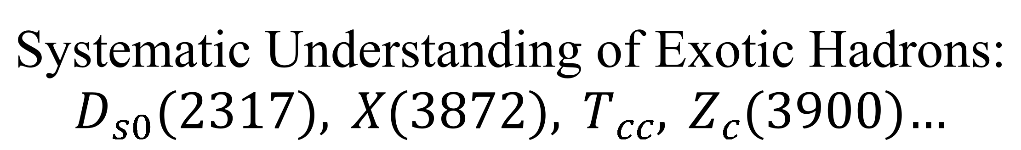
Systematic Understanding of Exotic Hadrons: $D_{s0}(2317), X(3872), T_{cc}, Z_{c}(3900)…$
Jia-jun Wu (UCAS)
IWSHSSI Nanjing Univ. 2025.10.15

Slide 2
Outline
Motivation
Hamiltonian Effective Field Theory (HEFT)
Study D_{s0}(2317), D_{s1}(2460), D_{s1}(2536), D_{s2}(2573)
Study T_{cc} - X(3872) – Zc(3900)
Summary

Slide 3
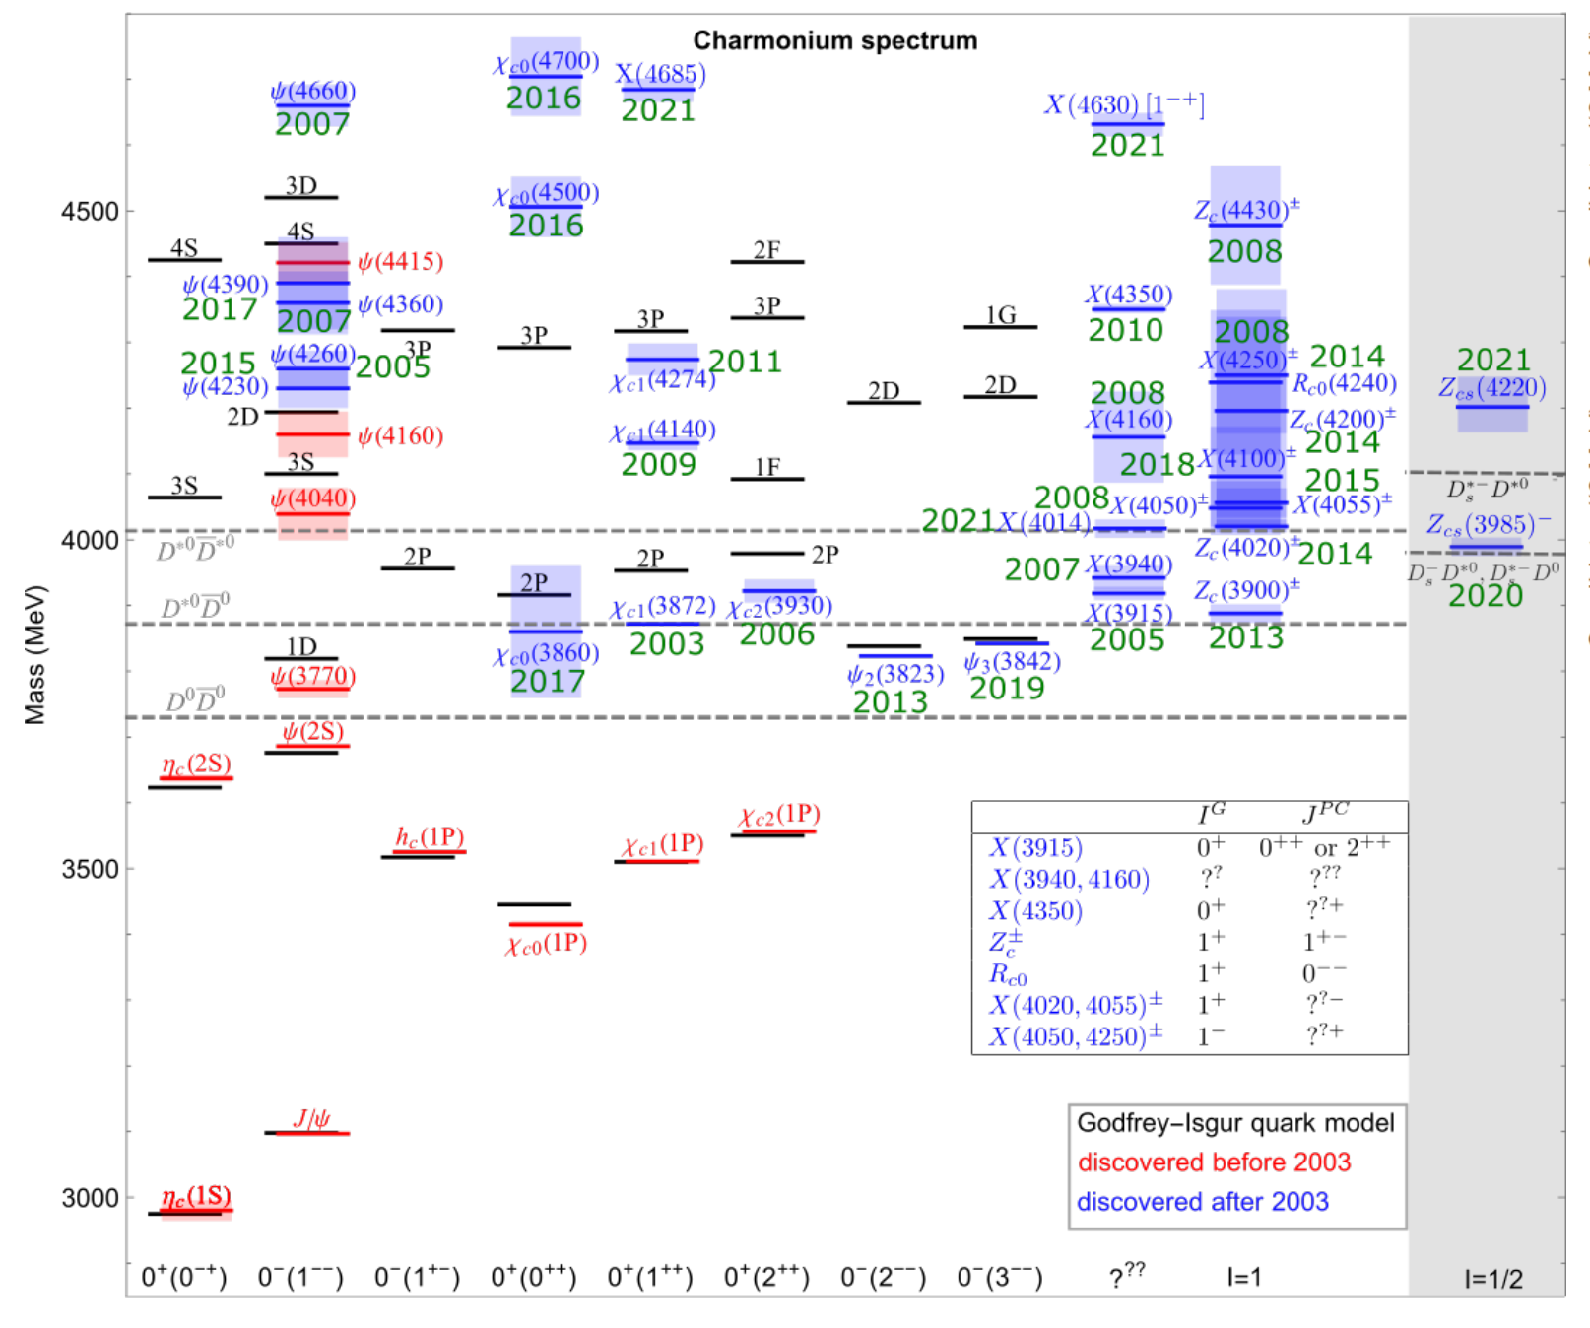
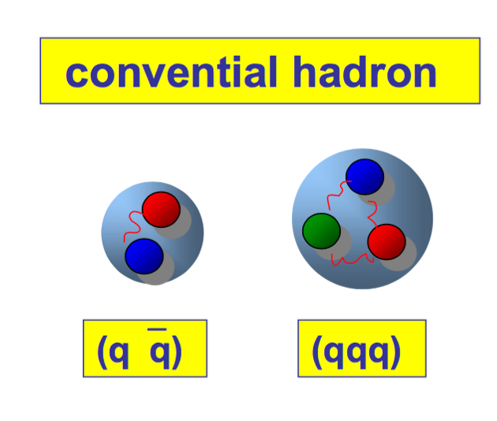
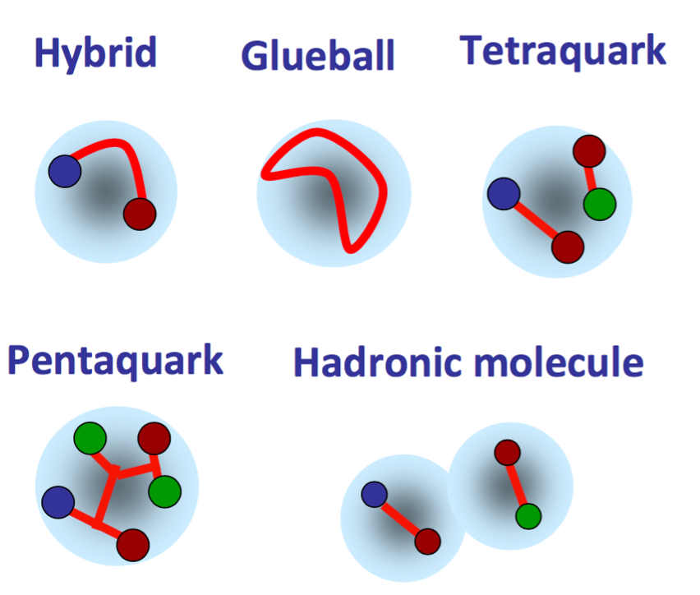

Background
Tranditional Qurk model
Excotic
Question：How is a hadron composed of these possible components?

Slide 4
Background
Question：How is a hadron composed of these possible components?
strong interaction
Colorful → quark level
Colorless → hadron level

Slide 5
Background
Question：How is a hadron composed of these possible components?
strong interaction
A more comprehensive framework for systematically describing hadrons
Colorful → quark level
Colorless → hadron level
Include quark level and hadron level.
Not only one, at least a set of hadron
A coupled channel model is necessary !

Slide 6
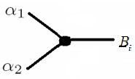
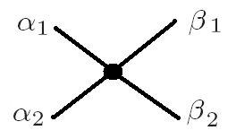
Introduction of HEFT
Strong interaction
Colorful → quark level
Colorless → hadron level
Resonance
(Mass, width, pole position, coupling)
|Β_{i}> bare state， bare mass m_{i}
|α(k_{α})> non-interaction channels
Quark level
Hadron level
HEFT
From 3P0 model, and the wavefunction of quark model
T matrix
(phase shift, Inelascity)
Lattice spectrum
One boson exchange (OBE)

Slide 7
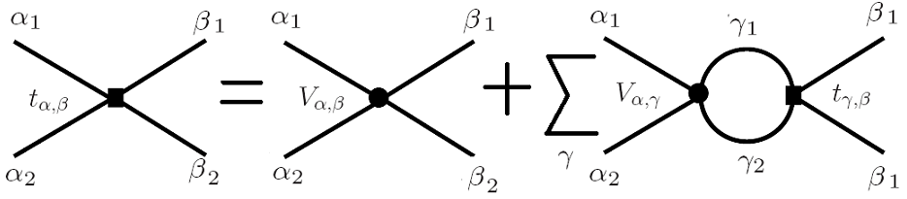
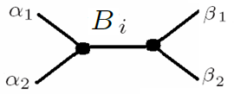
Introduction of HEFT
Argonne-Osaka Model
T Matrix:
Resonance
(Mass , Width, Pole position, Coupling)
HEFT
T matrix
(Phase Shifts, inelasticity)
Lattice Spectrum

Slide 8
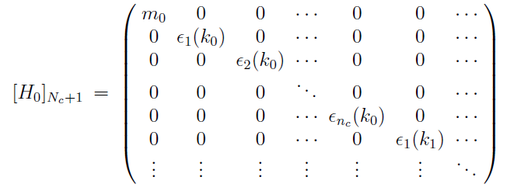
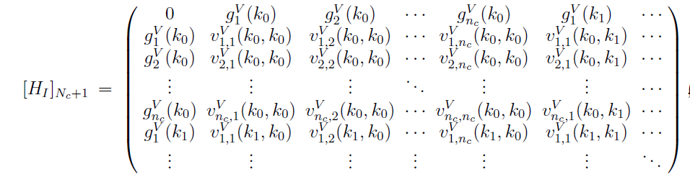
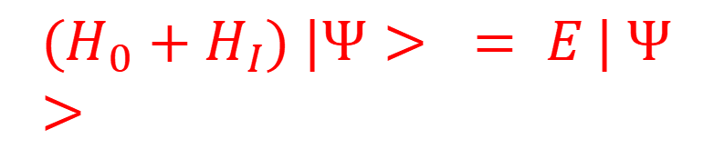
Introduction of HEFT
J.-j. Wu etc. PRC90 (2014), 055206
Hamiltonian with discrete momentum
Continuous
Resonance
(Mass , Width, Pole position, Coupling)
Discrete
HEFT
$${(H}_{0}+H_{I}) |Ψ> = E | Ψ>$$
Lattice Spectrum
Eigen-Value
T matrix
(Phase Shifts, inelasticity)
Eigen-Vector
Lattice Spectrum

Slide 9
Introduction of HEFT
J.-j. Wu etc. PRC90 (2014), 055206
Hamiltonian with discrete momentum
Continuous
Resonance
(Mass , Width, Pole position, Coupling)
Discrete
Complex Continuum
Momentum Space
HEFT
Real Continuum
Momentum Space
Real Discrete
Momentum Space
$${(H}_{0}+H_{I}) |Ψ> = E | Ψ>$$
Lattice Spectrum
Eigen-Value
T matrix
(Phase Shifts, inelasticity)
Eigen-Vector
Lattice Spectrum

Slide 10
HEFT Introduction
Simplest way, not project to the irrep, no moving system, ……
More detail information:
Kang Yu, Guang-Juan Wang, Jia-Jun Wu, Zhi Yang, JHEP04(2025)108
Yan Li, Jia-Jun Wu, T.-S.H. Lee, R.D. Young, JHEP08(2024)178
Continuous
Discrete
$${(H}_{0}+H_{I}) |Ψ> = E | Ψ>$$
Lattice Spectrum
Eigen-Value

Slide 11
Introduction of HEFT
1. Finite-volume matrix Hamiltonian model for a Δ→Nπ system
J.M.M. Hall, A.C.-P. Hsu, D.B. Leinweber, A.W.Thomas, R.D. Young Phys.Rev. D87 (2013) no.9, 094510
2. Finite-volume Hamiltonian method for coupled-channels interactions in lattice QCD
Jia-Jun Wu, T.-S.H.Lee, A.W.Thomas, R.D. Young Phys.Rev. C90 (2014) no.5, 055206
3. Lattice QCD Evidence that the Λ(1405) Resonance is an Antikaon-Nucleon Molecule
J.M.M. Hall, W. Kamleh, D. B. Leinweber, Benjamin J. Menadue, Benjamin J. Owen, A.W.Thomas, R.D. Young Phys.Rev.Lett. 114 (2015) no.13, 132002
4. Hamiltonian effective field theory study of the N∗(1535) resonance in lattice QCD
Zhan-Wei Liu, Waseem Kamleh, Derek B. Leinweber, Finn M. Stokes, Anthony W. Thomas, Jia-Jun Wu Phys.Rev.Lett. 116 (2016) no.8, 082004
5. Hamiltonian effective field theory study of the N∗(1440) resonance in lattice QCD
Zhan-Wei Liu, Waseem Kamleh, Derek B. Leinweber, Finn M. Stokes, Anthony W. Thomas, Jia-Jun Wu Phys.Rev. D95 (2017) no.3, 034034
6. Structure of the Λ(1405) from Hamiltonian effective field theory
Zhan-Wei Liu, Jonathan M.M. Hall, Derek B. Leinweber, Anthony W. Thomas, Jia-Jun Wu Phys.Rev. D95 (2017) no.1, 014506
7. Nucleon resonance structure in the finite volume of lattice QCD
Jia-jun Wu, H. Kamano, T.-S.H.Lee , Derek B. Leinweber, Anthony W. Thomas Phys.Rev. D95 (2017) no.11, 114507
8. Structure of the Roper Resonance from Lattice QCD Constraints
Jia-jun Wu, Derek B. Leinweber, Zhan-wei Liu, Anthony W.Thomas Phys.Rev. D97(2018) no.9, 094509
9. Kaonic Hydrogen and Deuterium in Hamiltonian Effective Field Theory
Zhan-wei Liu, Jia-jun Wu, Derek B. Leinweber, Anthony W. Thomas Phys.Lett.B 808(2020),135652
10. Partial Wave Mixing in Hamiltonian Effective Field Theory
Yan Li, Jia-jun Wu, Curtis D. Abell, Derek B. Leinweber, Anthony W. Thomas Phys.Rev. D101(2020) no.11,114501
11. Hamiltonian effective field theory in elongated or moving finite volume
Yan Li, Jia-jun Wu, Derek B. Leinweber, Anthony W. Thomas Phys.Rev. D103(2021) no.9, 094518
12. Regularisation in Nonperturbative Extensions of Effective Field Theory
Curtis D. Abell, Derek B. Leinweber, Anthony W. Thomas, Jia-jun Wu Phys.Rev. D106 (2022) no.3, 034506
13. Novel Coupled Channel Framework Connecting the Quark Model and Lattice QCD for the Near-threshold Ds States
Zhi Yang, Guang-Juan Wang, Jia-jun Wu, Shi-lin Zhu, Makoto Oka Phys.Rev.Lett.128(2022),112001
14. The investigations of the P-wave Bs​ states combining quark model and lattice QCD in the coupled channel framework
Zhi Yang, Guang-Juan Wang, Jia-jun Wu, Shi-lin Zhu, Makoto Oka JHEP01 (2023) 058
15. Effects of multiple single-particle basis states in scattering systems
Curtis D. Abell, Derek B. Leinweber, Anthony W. Thomas, Jia-jun Wu Annals Phys. 459(2023) 169531
16. Low-lying odd-parity nucleon resonances as quark-model like states
Curtis D. Abell, Derek B. Leinweber, Zhan-Wei Liu, Anthony W. Thomas, Jia-jun Wu PRD 108 (2023) 9, 094519
17. Investigation on the bottom analogs Tbb of Tcc+ Shushan Ren, Guang-Juan Wang, Zhi Yang, Jia-jun Wu Phys.Rev.D 110 (2024) 7, 074007
18. Study of the pion-mass dependence of ρ-meson properties in lattice QCD
Kang Yu, Yan Li, Jia-Jun Wu, Derek B. Leinweber, Anthony W. Thomas Phys.Rev.D 109 (2024) 3, 034505
19. Three-coupled-channel analysis of Zc(3900) involving DD¯*, πJ/ψ, and ρηc
Kang Yu, Guang-Juan Wang, Jia-Jun Wu, Zhi Yang, Phys.Rev.D 110 (2024) 11, 114029
20. New insight into the exotic states strongly coupled with the DD‾∗ from the Tcc+
Guang-Juan Wang, Zhi Yang, Jia-Jun Wu, Makoto Oka, Shi-Lin Zhu, Sci.Bull. 69 (2024) 3036-3042
21. Generalized boost transformations in finite volumes and application to Hamiltonian methods
Yan Li, Jia-Jun Wu, T.-S.H. Lee, R.D. Young, JHEP 08 (2024) 178
22. Spectral parameters of the ρ resonance from lattice QCD
CLQCD Corrlaboration Zhengli Wang, JHEP 08 (2025) 064
23 Finite volume Hamiltonian method for two-particle systems containing long-range potential on the lattice
Kang Yu, Guang-Juan Wang, Jia-Jun Wu, Zhi Yang, JHEP 04 (2025) 108
Resonance
(Mass , Width, Pole position, Coupling)
HEFT
T matrix
(Phase Shifts, inelasticity)
Lattice Spectrum

Slide 12
Introduction of HEFT
HEFT:
1. Build a Hamiltonian model;
2. If Experimental data available, we fit Experimental data to fix the parameters in the model;
If Lattice data available (close to physical pion mass), we fit these data;
If both, we can use both of them constraint the model parameters.
If we only have Lattice data with unphysical pion mass, we need another parameter for the mass dependence, such as mass slope.
3. From the fixed Hamiltonian, we can study the properties of Resonance. Especially, from the eigenvector in the finite volume, we can estimate the internal structure of the hadron.
T matrix
(Phase Shifts, inelasticity)
Resonance
(Mass , Width, Pole position, Coupling)
HEFT
Lattice Spectrum
1. Bulid Model
2. Fix Para.
3. Extract Phys.
Unphysical π mass ??
12

Slide 13
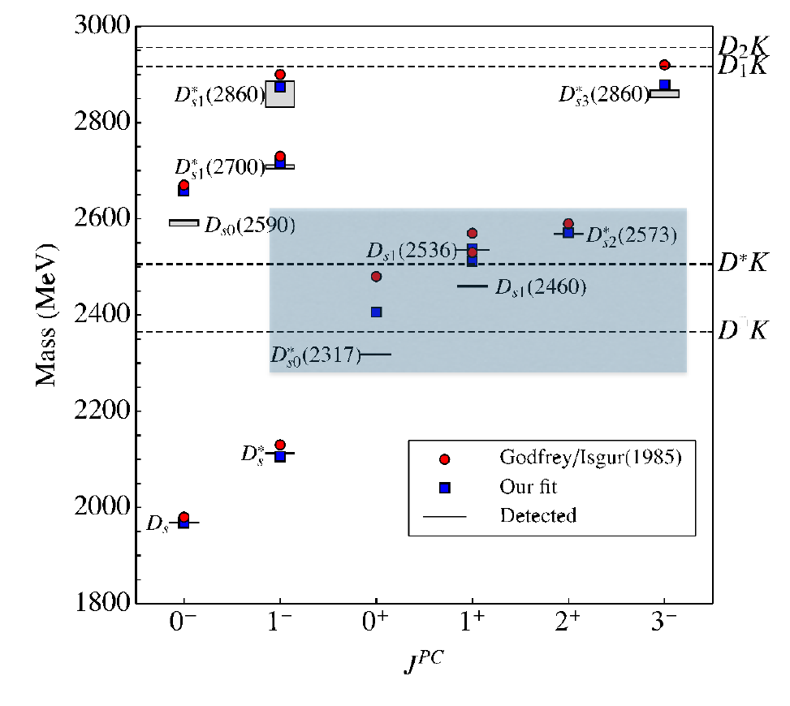
D_{s0}(2317), D_{s1}(2460), D_{s1}(2536), D_{s2}(2573)
Z. Yang, G.-J. Wang, J.-j. Wu, S.-l. Zhu, M. Oka Phys.Rev.Lett.128(2022),112001

Slide 14
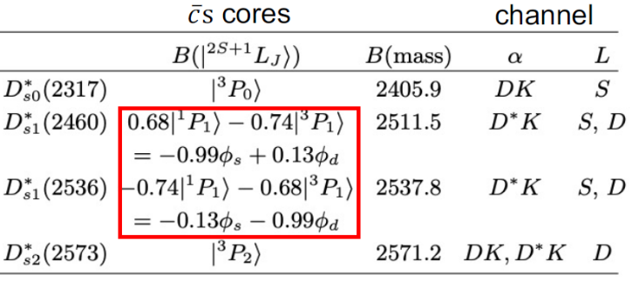
D_{s0}(2317), D_{s1}(2460), D_{s1}(2536), D_{s2}(2573)
Z. Yang, G.-J. Wang, J.-j. Wu, S.-l. Zhu, M. Oka Phys.Rev.Lett.128(2022),112001
1. Fix the bare mass and wave function from GI model；

Slide 15
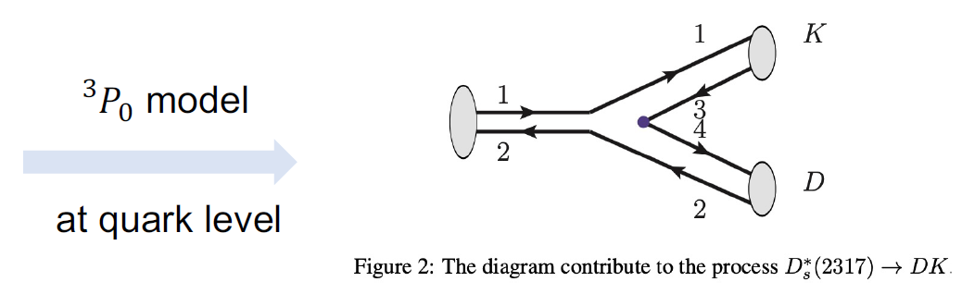
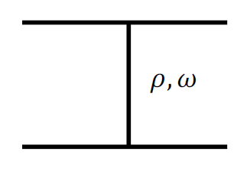
D_{s0}(2317), D_{s1}(2460), D_{s1}(2536), D_{s2}(2573)
Z. Yang, G.-J. Wang, J.-j. Wu, S.-l. Zhu, M. Oka Phys.Rev.Lett.128(2022),112001
1. Fix the bare mass and wave function from GI model；
2. The interaction of bare-channel and channel-channel；

Slide 16
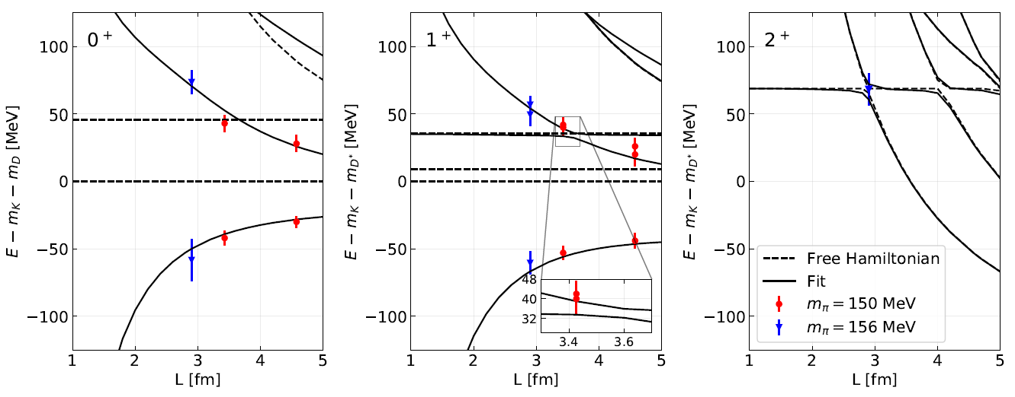
D_{s0}(2317), D_{s1}(2460), D_{s1}(2536), D_{s2}(2573)
Z. Yang, G.-J. Wang, J.-j. Wu, S.-l. Zhu, M. Oka Phys.Rev.Lett.128(2022),112001
1. Fix the bare mass and wave function from GI model；
2. The interaction of bare-channel and channel-channel；
3. Fit Lattice data；

Slide 17
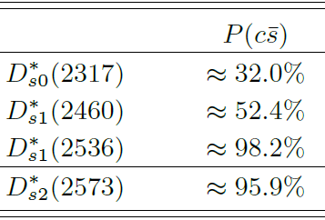
D_{s0}(2317), D_{s1}(2460), D_{s1}(2536), D_{s2}(2573)
Z. Yang, G.-J. Wang, J.-j. Wu, S.-l. Zhu, M. Oka Phys.Rev.Lett.128(2022),112001
1. Fix the bare mass and wave function from GI model；
2. The interaction of bare-channel and channel-channel；
3. Fit Lattice data；
Conclusion：
D*_{s0}(2317)-DK
D_{s1}(2460)-D*K
S-wave
Mass moving vs GI Model
D_{s1}(2536)-D*K
D_{s2}(2573)-D^{(*)}K
D-wave
Mass stable vs GI model

Slide 18
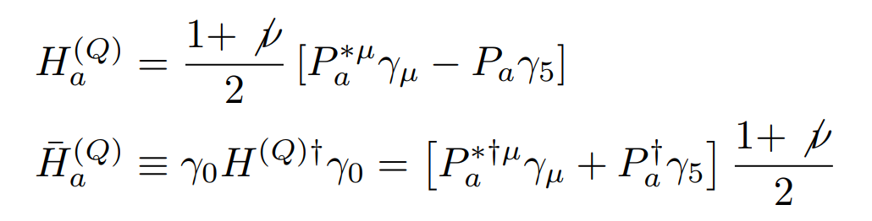
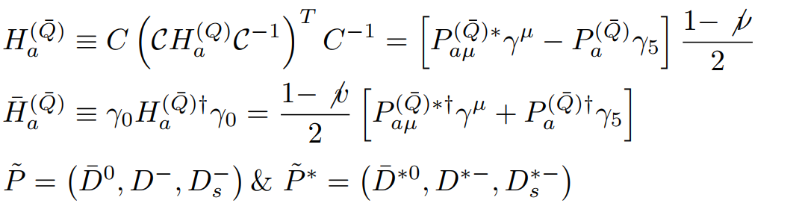



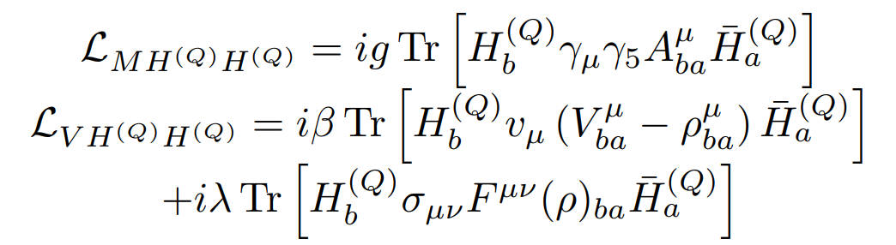
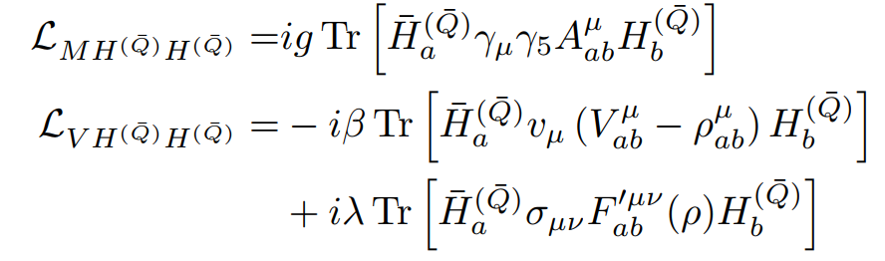
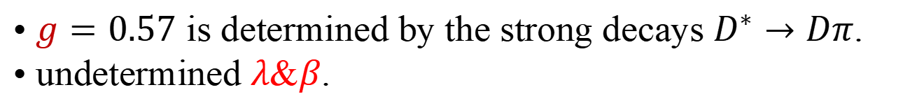


Study T_{cc} and X(3872)
3P0 model, the wave function determined from quark model
Choose proper model
Question：Two interactions ?
Too many solutions of a+b=5
Study X(3872) from T_{cc}
Interaction between D and D*
$$D^{(∗)}D^{(∗)}$$
$$D^{(∗)}\overline{D^{(∗)}}$$
Single boson exchange
• $g=0.57$ is determined by the strong decays $D^{∗}→Dπ$.
• undetermined $λ$&$β$.

Slide 19
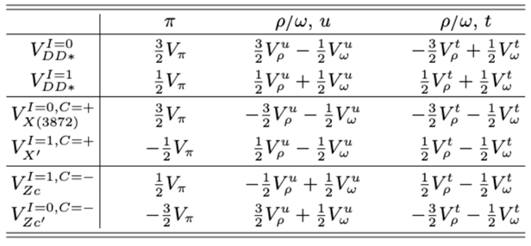
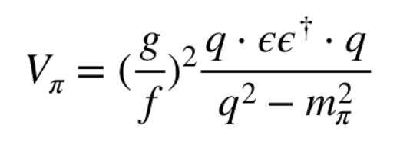
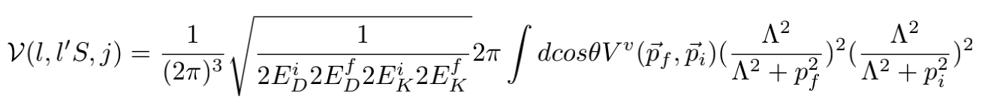
Study T_{cc} and X(3872)
Interaction between D and D*
Single boson exchange
Partial wave
Three free parameters: β，λ and Λ.

Slide 20
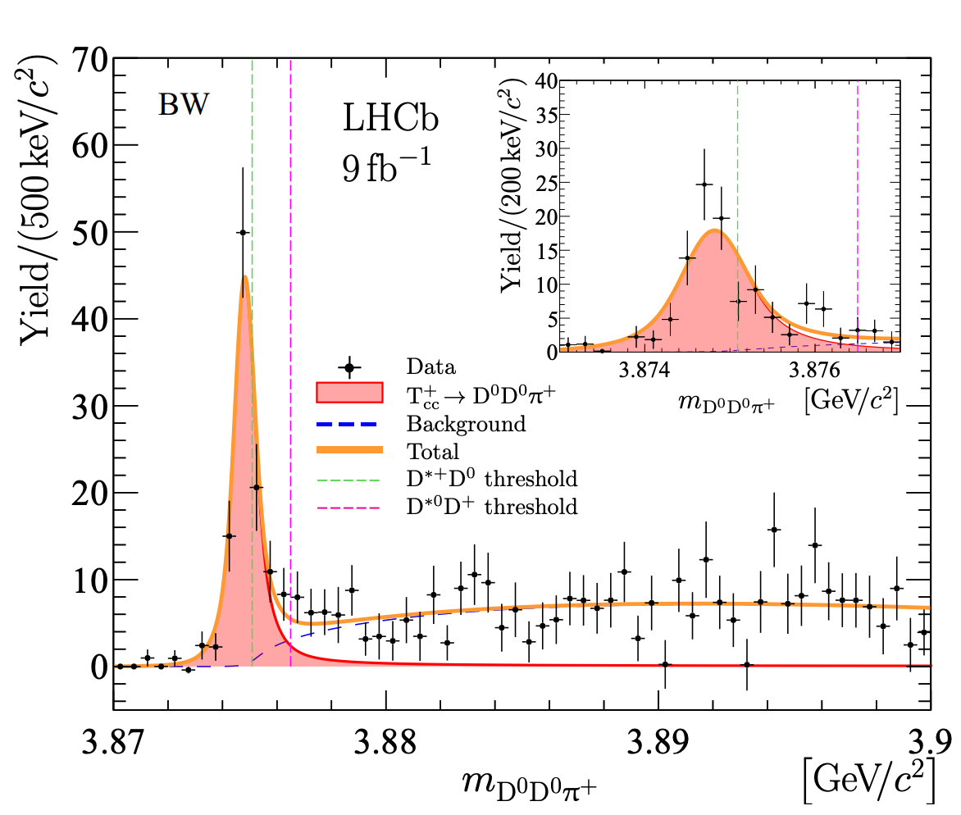
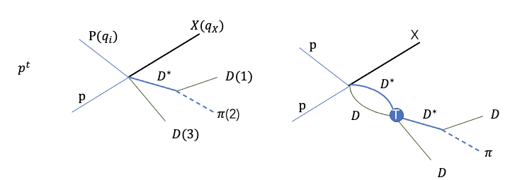
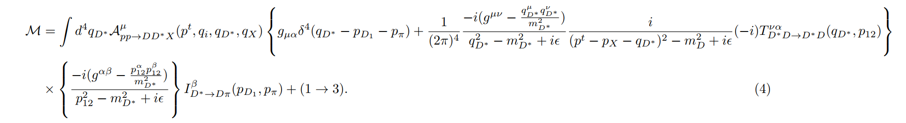

T_{cc} production
$$pp→X D^{0}D^{0}π^{+}$$

Slide 21
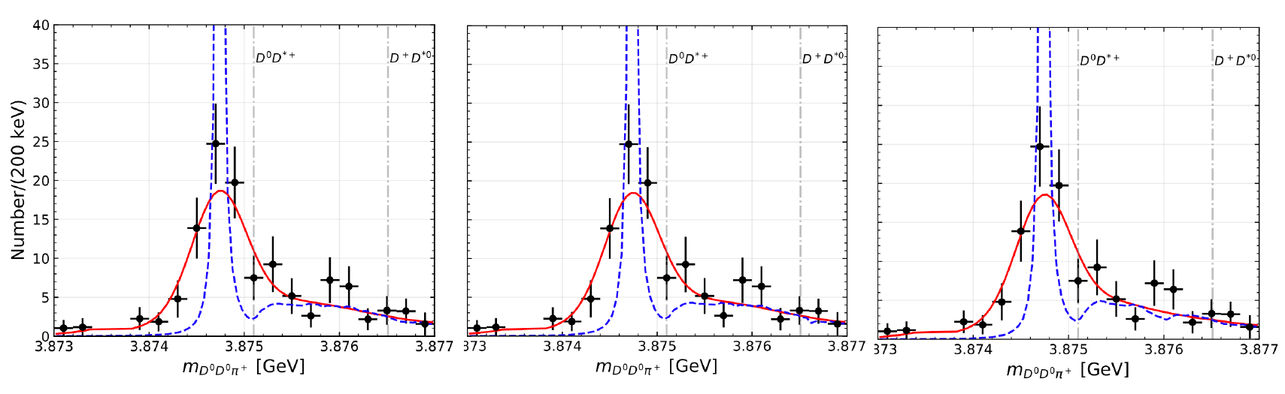
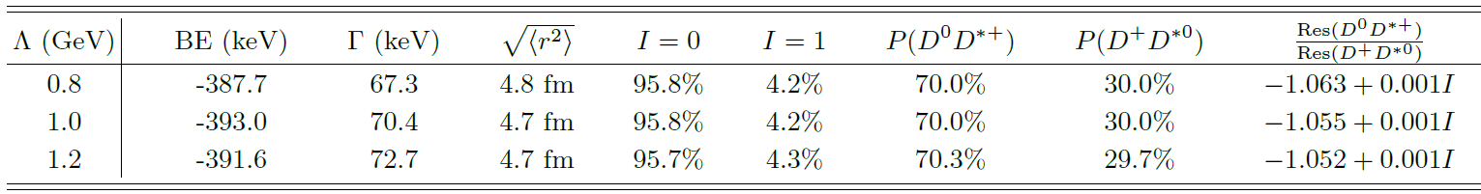
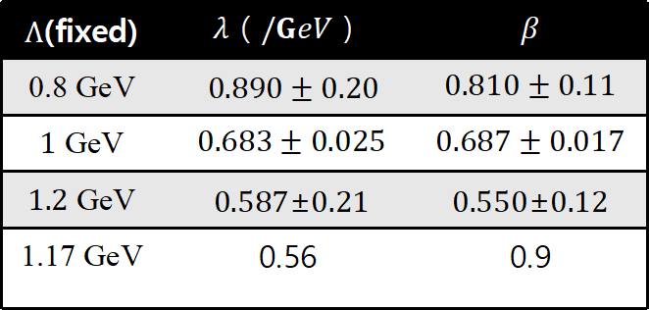
The generation of T_{cc}
$$pp→X D^{0}D^{0}π^{+}$$
$Λ$(fixed) | $$λ（/GeV）$$ | $$β$$
0.8 GeV | $0.890±0.20$ | $$0.810±0.11$$
$1$ GeV | $0.683±0.025$ | $$0.687±0.017$$
1.2 GeV | 0.587±0.21 | 0.550±0.12
﻿1.17 GeV | 0.56 | 0.9

Slide 22
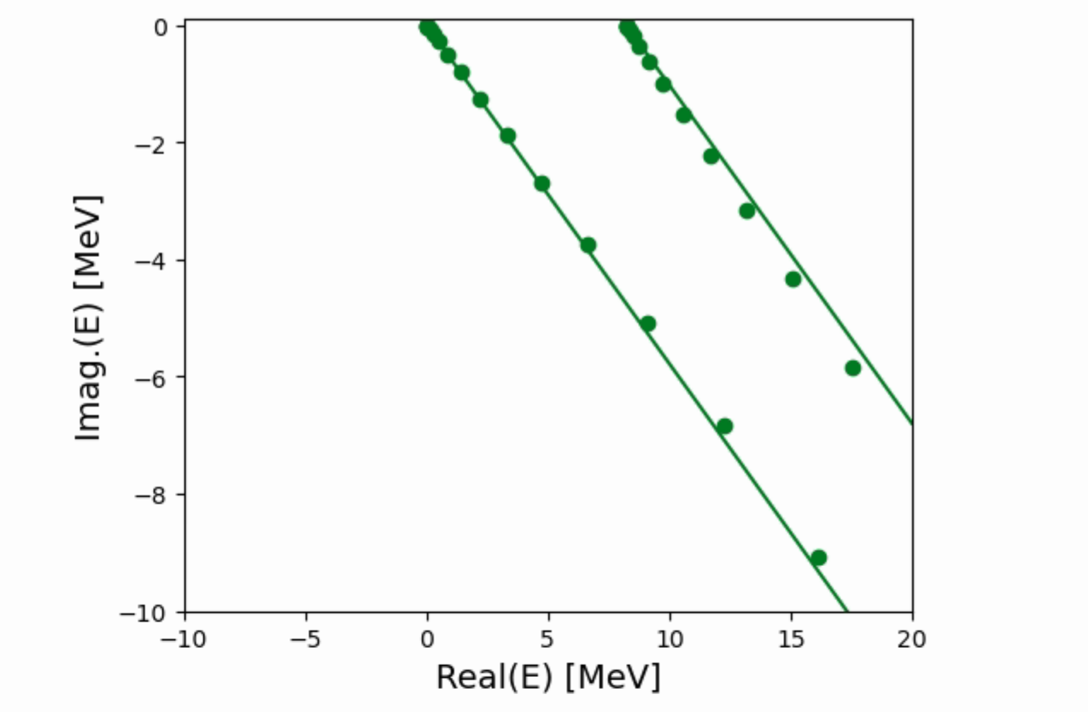
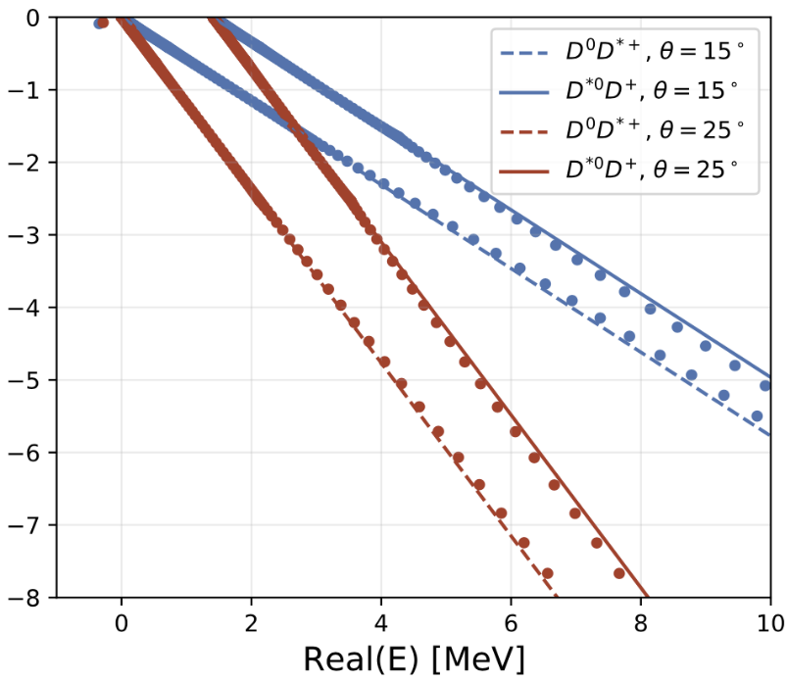
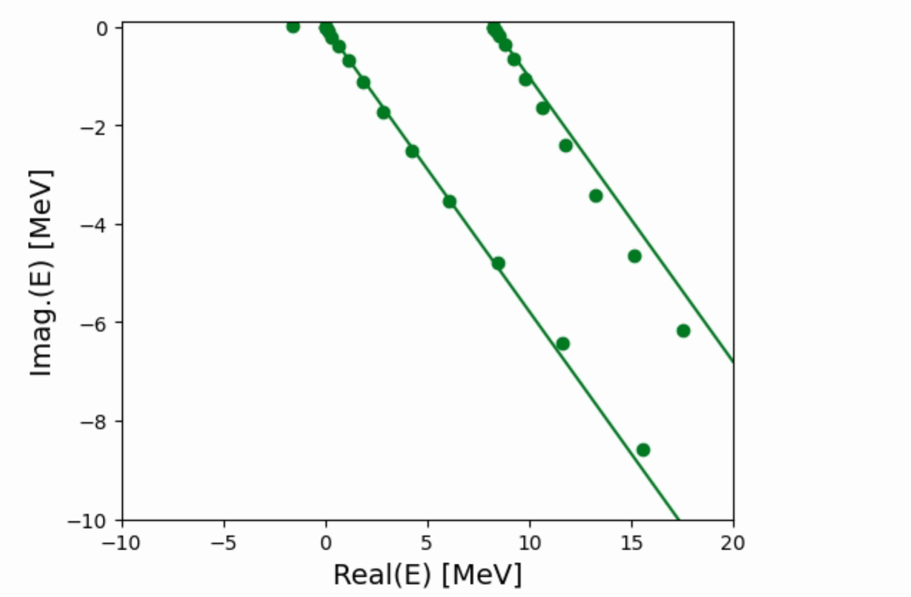
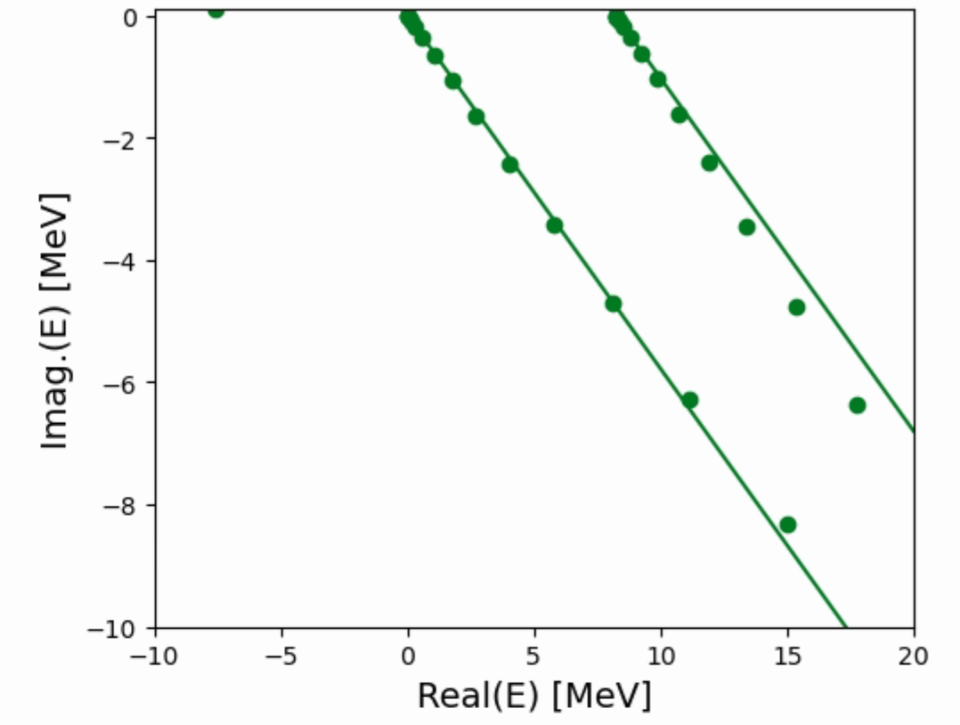

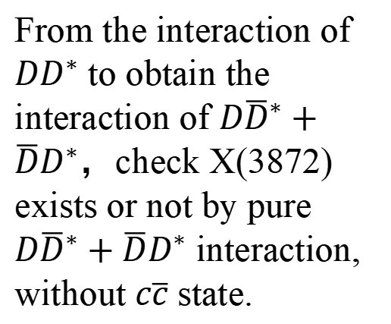





Produce X(3872) with pure $D{\overline{D}}^{∗}+\overline{D}D^{∗}$
Complex scaling method
From the interaction of $DD^{∗}$ to obtain the interaction of $D{\overline{D}}^{∗}+\overline{D}D^{∗}$，check X(3872) exists or not by pure $D{\overline{D}}^{∗}+\overline{D}D^{∗}$ interaction, without $c\overline{c}$ state.
• Bound state: $T_{cc}$
${m_{T}}_{cc}$=3874.7 MeV,
$ΔE=−393$ keV
$Γ_{T_{cc}}=70.4$ keV
• $\sqrt{⟨r^{2}⟩}=4.7 fm$
• $70.0\% D^{∗+}D^{0}, 30.0\% D^{+}D^{∗0}$
$$D{\overline{D}}^{∗}+\overline{D}D^{∗}$$
Λ=1.0GeV
$${V′}_{\overline{D^{∗}}D}=x∗V_{\overline{D^{∗}}D}$$
First of all，it is attractive interaction while it is not enough to form a bound state, while just a virtual state
$$D{\overline{D}}^{∗}+\overline{D}D^{∗}$$
$$D{\overline{D}}^{∗}+\overline{D}D^{∗}$$
$$x=1.5$$
$x=2$.0
3870.0 + 0.26 i MeV

Slide 23
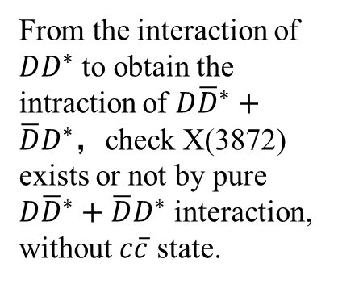
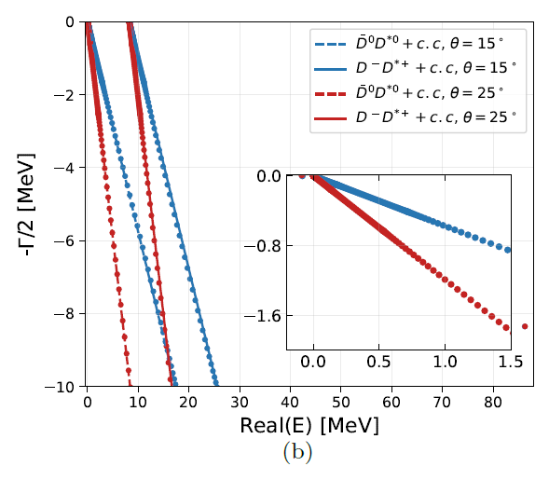
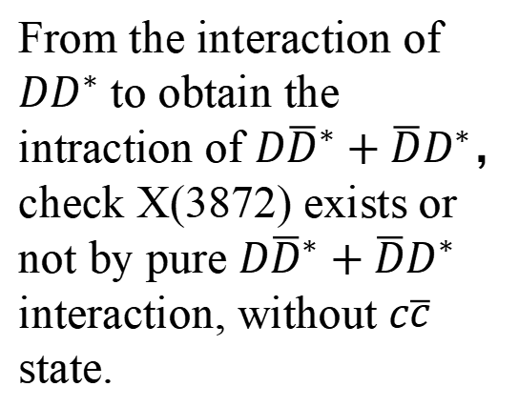
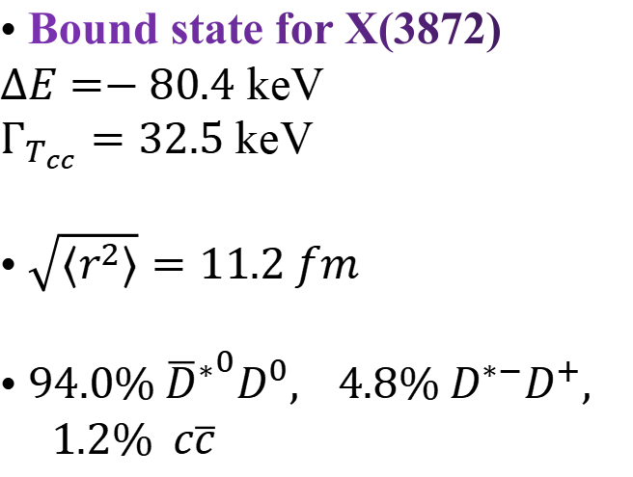
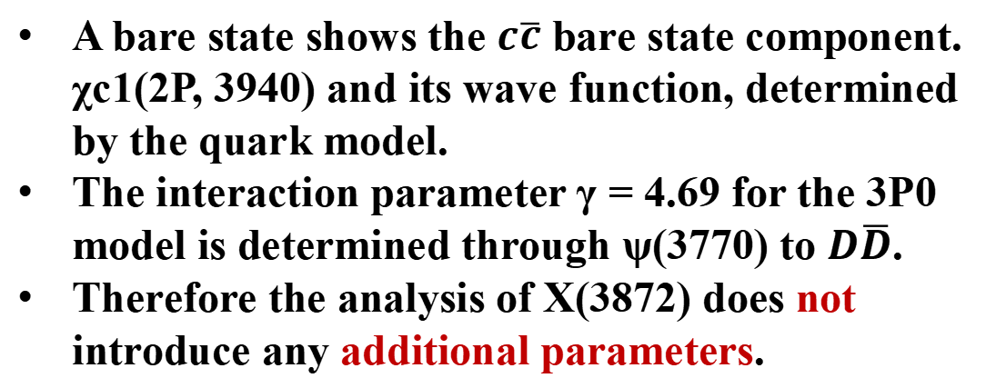
Produce X(3872) with $D{\overline{D}}^{∗}+\overline{D}D^{∗}$ and $c\overline{c}$
From the interaction of $DD^{∗}$ to obtain the intraction of $D{\overline{D}}^{∗}+\overline{D}D^{∗}$，check X(3872) exists or not by pure $D{\overline{D}}^{∗}+\overline{D}D^{∗}$ interaction, without $c\overline{c}$ state.
• Bound state: $T_{cc}$
${m_{T}}_{cc}$=3874.7 MeV,
$ΔE=−393$ keV
$Γ_{T_{cc}}=70.4$ keV
• $\sqrt{⟨r^{2}⟩}=4.7 fm$
• $70.0\% D^{∗+}D^{0}, 30.0\% D^{+}D^{∗0}$
Λ=1.0GeV
Attractive interaction BUT not enough to form a bound state
A bare state shows the $c\overline{c}$ bare state component. χc1(2P, 3940) and its wave function, determined by the quark model.
The interaction parameter γ = 4.69 for the 3P0 model is determined through ψ(3770) to $D\overline{D}$.
Therefore the analysis of X(3872) does not introduce any additional parameters.
• Bound state for X(3872)
$ΔE=−80.4$ keV
$Γ_{T_{cc}}=32.5$ keV
• $\sqrt{⟨r^{2}⟩}=11.2 fm$
• $94.0\% {{\overline{D}}^{∗}}^{0}D^{0}, 4.8\% {D^{∗−}D}^{+},$
$1.2\% c\overline{c}$

Slide 24
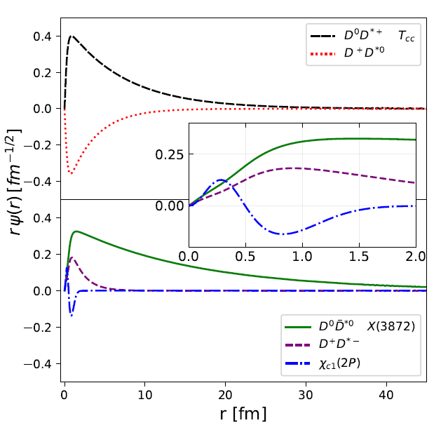
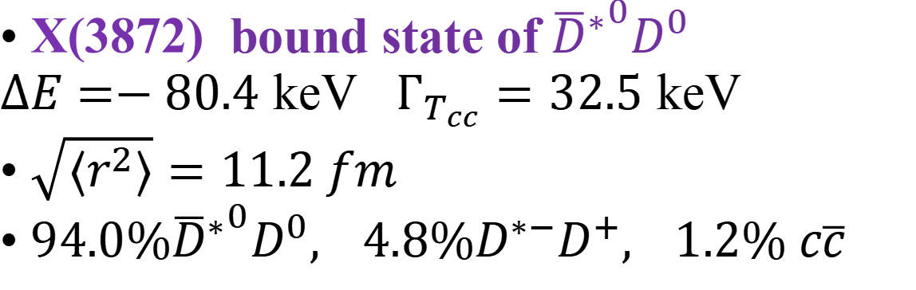
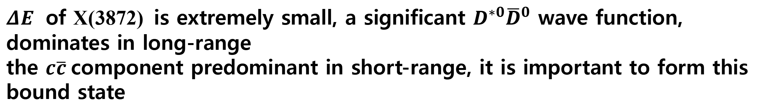
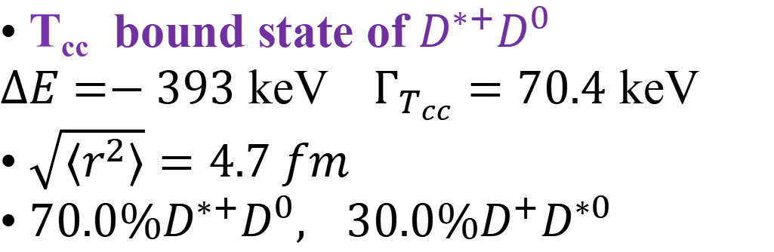
The nature of T_{cc} and X(3872)
• T_{cc} bound state of $D^{∗+}D^{0}$
$ΔE=−393$ keV $Γ_{T_{cc}}=70.4$ keV
• $\sqrt{⟨r^{2}⟩}=4.7 fm$
• $70.0\%D^{∗+}D^{0}, 30.0\%D^{+}D^{∗0}$
• X(3872) bound state of ${{\overline{D}}^{∗}}^{0}D^{0}$
$ΔE=−80.4$ keV $Γ_{T_{cc}}=32.5$ keV
• $\sqrt{⟨r^{2}⟩}=11.2 fm$
• $94.0\%{{\overline{D}}^{∗}}^{0}D^{0}, 4.8\%{D^{∗−}D}^{+}, 1.2\% c\overline{c}$
$ΔE$ of X(3872) is extremely small, a significant $D^{∗0}{\overline{D}}^{0}$ wave function, dominates in long-range
the $c\overline{c}$component predominant in short-range, it is important to form this bound state

Slide 25

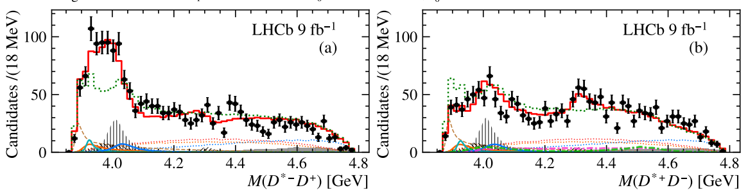
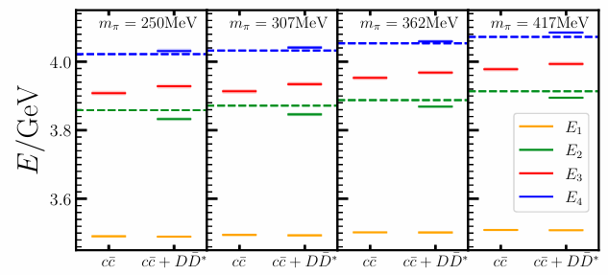
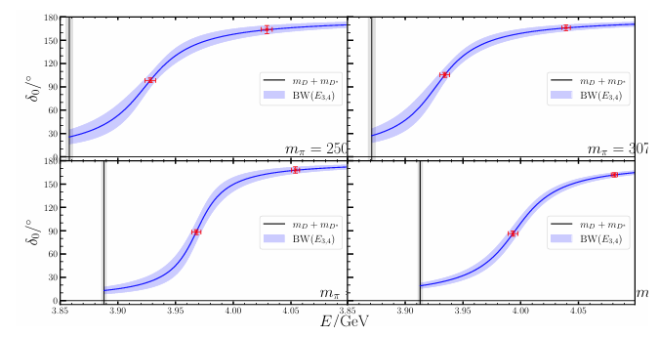
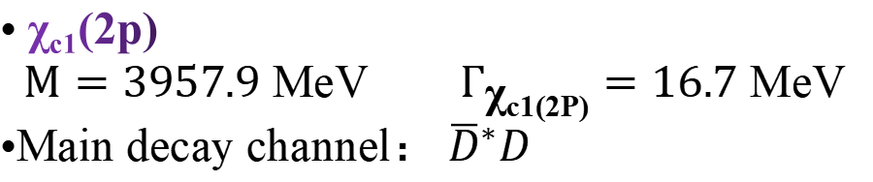


Prediction
Observation of new charmonium(-like) states in $B^{+}→D^{∗±}D^{∓}K^{+}$ decays
LHCb Collaboration 2406.03156
X(3872) Relevant $D{\overline{D}}^{∗}$ Scattering in $N_{f}=2$ Lattice QCD
H. Li, C. Shi, Y. Chen, M. Gong, J. Liang et al
CLQCD 2402.14541
• χ_{c1}(2p)
$M=3957.9$ MeV $Γ_{\text{χ}\text{c}\text{1(2}\text{P}\text{)}}=16.7$ MeV
•Main decay channel：${\overline{D}}^{∗}D$

Slide 26






$$Tcc − X(3872) − Zc(3900)$$
$DD^{∗}$, $D{\overline{D}}^{∗}$
interaction
$$J/ψπ，ηcρ$$
Yu, Wang, Wu, Yang
arXiv 2409.10865 ​
T_{cc}
Z_{c}(3900)
$c\overline{c}$ state
Heavy Quark Symmetry
Wang, Yang, Wu, Zhu, Oka
Scib.2024.07.012 ​
X(3872)
$$D^{(∗)}D^{(∗)}$$
Coupled channel
$c\overline{c}$ state and $D{\overline{D}}^{∗}$
Question：Two interactions ?
Too many solutions of a+b=5
Study X(3872) from T_{cc}
$$D^{(∗)}\overline{D^{(∗)}}$$

Slide 27


Zc(3900)
BESIII： $e^{+}e^{−}→J/ψπ^{+}π^{−}$, PRL 110, 252001 (2013)
Belle-II： $e^{+}e^{−}→J/ψπ^{+}π^{−}$, PRL 110, 252002 (2013)
CLEO-c： $e^{+}e^{−}→J/ψπ^{0}π^{0}$, PLB 727, 366 (2013)
BESIII： $e^{+}e^{−}→{\left(D{\overline{D}}^{∗}\right)}^{∓}π^{±}$, PRL 112, 022001 (2014)
PRD 92, 092006 (2015)
BESIII： $e^{+}e^{−}→η_{c}ρ^{±}π^{∓}$, IJMPA 33, 1830018 (2018)
Belle-II： ${\overline{B}}^{0}→J/ψπ^{+}K^{−}$, PRD 90, 112009 (2014)
LHCb: $B^{0}→J/ψπ^{+}π^{−}$, PRD 90, 012003 (2014)
LHCb: $B^{0}→ψ(nS)π^{+}K^{−}$, arXiv:2403.04051 [hep-ex].
[12] Braaten, PRLett. 111, 162003 (2013),
[13] Dias, Navarra, Nielsen, and Zanetti, PRD 88, 016004 (2013)
[14] Qiao, Tang, EPJC 74, 3122 (2014)
[15] Wang, CPC 45, 073107 (2021)
[16] Maiani, Polosa, Riquer, SB 66, 1616 (2021),
[17] Wang, Hanhart, Zhao, PRL 111, 132003 (2013),
[18] Aceti, Bayar, Oset, Torres, Khemchandani, Dias, Navarra, Nielsen, PRD 90, 016003 (2014)
[19] Albaladejo, Guo, Hidalgo-Duque, Nieves, PLB 755, 337 (2016)
[20] Gong, Guo, Meng, Tang, Wang, Zheng, PRD 94, 114019 (2016)
[21] He, Chen, EPJC 78, 94 (2018)
[22] Ortega, Segovia, Entem, Fernandez, EPJC 79, 78 (2019),
[23] Yang, Cao, Guo, Nieves, Valderrama, PRD 103, 074029 (2021)
[24] Yan, Peng, Sanchez, Valderrama, PRD 104, 114025 (2021)
[25] Du, Albaladejo, Guo, Nieves, PRD 105, 074018 (2022)
[26] Chen, Du, Guo, 2310.15965
[27] Lin, Wang, Cheng, Meng, Zhu, 2403.01727
[28] Swanson, PRD 91, 034009 (2015)
[29] Wang, Chen, Liu, Matsuki, EPJC 80, 1040 (2020)
[30] Detten, Baru, Hanhart, Wang, Winney, Zhao, 2402.03057
Compact tetraquark states [12–16]
$D{\overline{D}}^{∗}$ resonances or virtual molecular states [17–27]
Cusp effects [28]
Non resonant mechanisms [29, 30]

Slide 28


The lattice calculation of Zc(3900)
[1] Prelovsek, Leskovec, PLB 727, 172 (2013)
[2] Prelovsek, Lang, Leskovec, Mohler, PRD 91, 014504 (2015)
[3] Sadl,Collins,Guo,Padmanath,Prelovsek,Yan 2406.09842
[4] Hadron Spectrum, JHEP 12, 89 (2016)
[5] Y. Chen et al., PRD 89, 094506 (2014)
[6] Liu, Liu, Zhang, PRD 101, 054502 (2020)
[7] CLQCD Collaboration CPC 43 103103 (2019)
[1] using $πJ/ψ$ and $\overline{D}D^{∗}$ meson-meson interpolators at $m_{π}∼266$ MeV.
[2] included additional meson-meson and diquark-antidiquark interpolators in the simulation.
[3] combine with experimental data by $πJ/ψ$ and $\overline{D}D^{∗}$ two channel EFT they extract several poles around 3900 MeV.
[4] found that compact tetraquark operators had minimal impact on finite volume spectra at $m_{π}∼391$ MeV
[5, 6,7] using meson-meson interpolators at three different $m_{π}$ values, none of these studies identified a clear candidate for the Zc state.
[8] HAL QCD, PRL. 117, 242001 (2016) [9] HAL QCD JPG 45, 024002 (2018)
[8, 9] extracted the $πJ/ψ−\overline{D} D^{∗}−ρη_{c}$coupled-channel potential and reproduced the experimental line shape.
But they concluded that the Zc state is better understood as a threshold cusp rather than a conventional resonance.
The off-diagonal channel-channel interactions play an important role.

Slide 29











Formalism-Three channel model
Three channels $\overline{D}D^{∗}, J/ψπ, η_{c}ρ$
Heavy Quark Symmetry
$$D^{(∗)}D^{(∗)}$$
$\overline{D}D^{∗}→\overline{D}D^{∗}$
The interaction determined by Tcc
$$D^{(∗)}\overline{D^{(∗)}}$$
Only one free parameter $g′$
$$\overline{D}D^{∗}→J/ψπ, η_{c}ρ$$

Slide 30





Formalism-Feynman diagrams

Slide 31









Formalism-Feynman diagrams

Slide 32







Data Fit
Cascade decay dominated Fig.(c)
The threshold peak from the interference between (c) and (a)
The background play important at higher invariant mass of $D^{∗−}D^{0}$
Peak from Triangle Loop
Fig(a-c) is not important
The background give the bump
Why are two-particle loops similar as Fig（a） not important ?
How is the contribution of Kinematical effect from Triangle loop ?
How is the contribution of the re-scattering T matrix ?
Data very limit
Peak is mainly from Fig.(b)
No background considered

Slide 33



Data Fit-Two-body Loop
Since the scattering(Fig.b) is much weaker than direct decay (Fig.a). If we insist the contribution from Fig.b/c for $J\backslash ψππ$ dominate, it will ask for Fig.a for $\overline{D}D^{∗}π$ too large!
Coupled channel Constrain !
A more comprehensive framework for systematically describing hadrons

Slide 34




Data Fit- Kinematical effect from Triangle loop
The Kinematical effect from Triangle loop plays the role, but not full reason !

Slide 35

Data Fit- re-scattering T matrix
The threshold cusp is clear, which should play important contribution for the peak!

Slide 36

Pole Position
Three channels $\overline{D}D^{∗}, J/ψπ, η_{c}ρ$
Resonance
(Mass, width, pole position, coupling)
RS⁻⁻⁻
Heavy Quark Symmetry
$\overline{D}D^{∗}→\overline{D}D^{∗}$
The interaction determined by Tcc
HEFT
LSE
FV
$$\overline{D}D^{∗}→J/ψπ, η_{c}ρ$$
A bit far away from the Zc(3900), thus, from this calculation, we interpolate the peak around 3900 is not from an physical state!
T matrix
(phase shift, Inelascity)
Lattice spectrum

Slide 37


Finite volume spectra
Kang Yu, Guang-Juan Wang, Jia-Jun Wu, Zhi Yang, 2502.05789 (Accept by JHEP)
Three channels $\overline{D}D^{∗}, J/ψπ, η_{c}ρ$
Resonance
(Mass, width, pole position, coupling)
Heavy Quark Symmetry
$\overline{D}D^{∗}→\overline{D}D^{∗}$
The interaction determined by Tcc
HEFT
The points are all close to the free energy, which is also consistent with existed lattice data, and also consistent with our interpolation of the peak structure.
LSE
FV
$$\overline{D}D^{∗}→J/ψπ, η_{c}ρ$$
T matrix
(phase shift, Inelascity)
Lattice spectrum
Two body scattering information may rely on LQCD ! $DD^{∗}→DD^{∗}$

Slide 38

Summary
Introduction of HEFT, until now, it can be applied to calculate the finite volume effect of two body system.
The study of D_{s0}(2317) [$c\overline{s}$-DK(s-wave)], D_{s1}(2460) [$c\overline{s}$-DK*(s-wave)], D_{s1}(2536) [$c\overline{s}$](DK*(d-wave)), D_{s2}(2573) [$c\overline{s}$] DK*(d-wave).
Study Tcc - X(3872) – Zc(3900)
We can find $q\overline{q}$ and $qqq$ core are always there！
Interactions between hadrons are always there too !

Slide 39
Outlook
HEFT combines the Lattice data and Experimental data to constraint the Effective Model, and connects the Quark model (quark level bound state) and Hadron interaction (Hadron level physics), thus provides a complete formalism of physical sates and help us understand the nature of hadron deeply.
Thanks!

