Slide 1
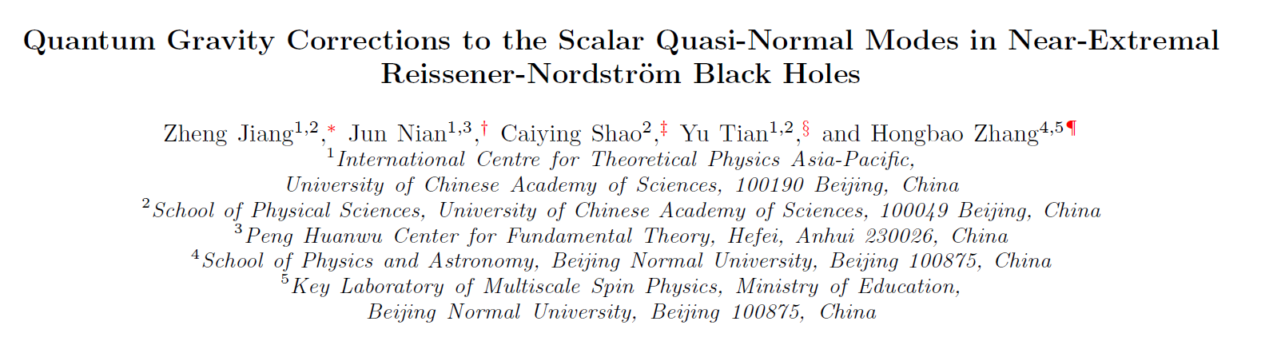
arXiv: 2506.22945

Slide 2
1.Introduction
Thermal fluctuations are suppressed in the low temperature regime, however, quantum fluctuations, which originate from the Heisenberg uncertainty principle and persist even at zero temperature, become dominant in the dynamical behavior of the system.
In near-extremal limit, the temperature is low and the quantum fluctuations become important.

Slide 3

1.Introduction
$AdS_{2}$-JT gravity/Schwarzian duality
dual
2-d Jackiw-Teitelboim gravity
1-d Schwarzian theory
(1)Integrating out the bulk part of the AdS2-JT gravity, the boundary extrinsic derivative is proportional to the Schwarzian derivative with respect to the reparametrization modes (Schwarzian modes).
(2)The IR theory of gravity can be determined by the boundary cutoff:
Fixing the proper length of the cutoff curve, quantum fluctuations of the AdS2 metric can be viewed as the reparametrization of the cutoff curve.

Slide 4
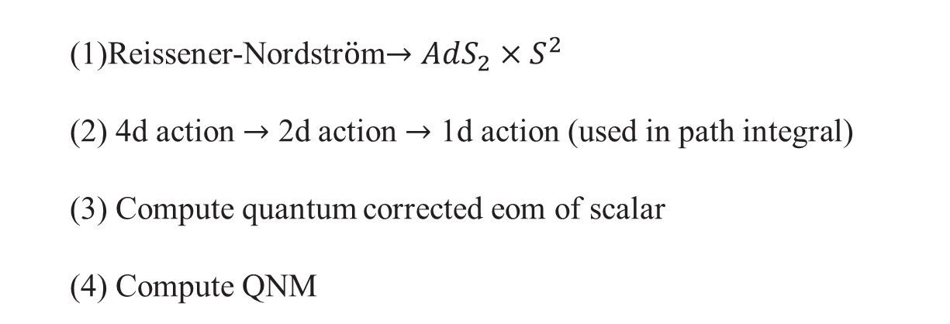
2.Ouline
(1)Reissener-Nordstr$\ddot{o}$m$→AdS_{2}×S^{2}$
(2) 4d action $→$ 2d action $→$ 1d action (used in path integral)
(3) Compute quantum corrected eom of scalar
(4) Compute QNM

Slide 5
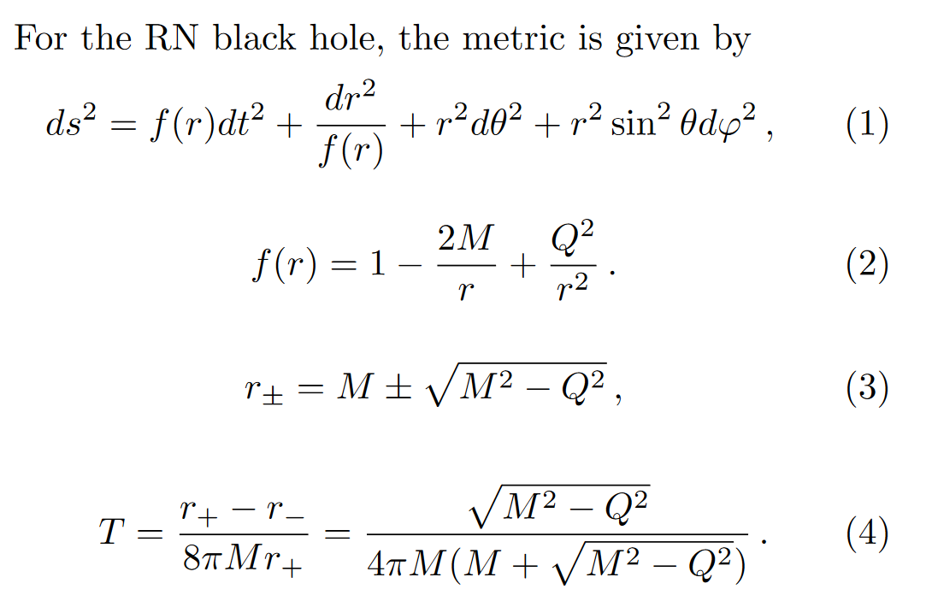
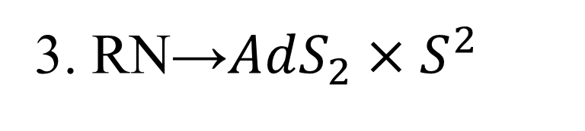
3. RN→$AdS_{2}×S^{2}$
Notice: both temperature and coordinate are noted as $T$

Slide 6
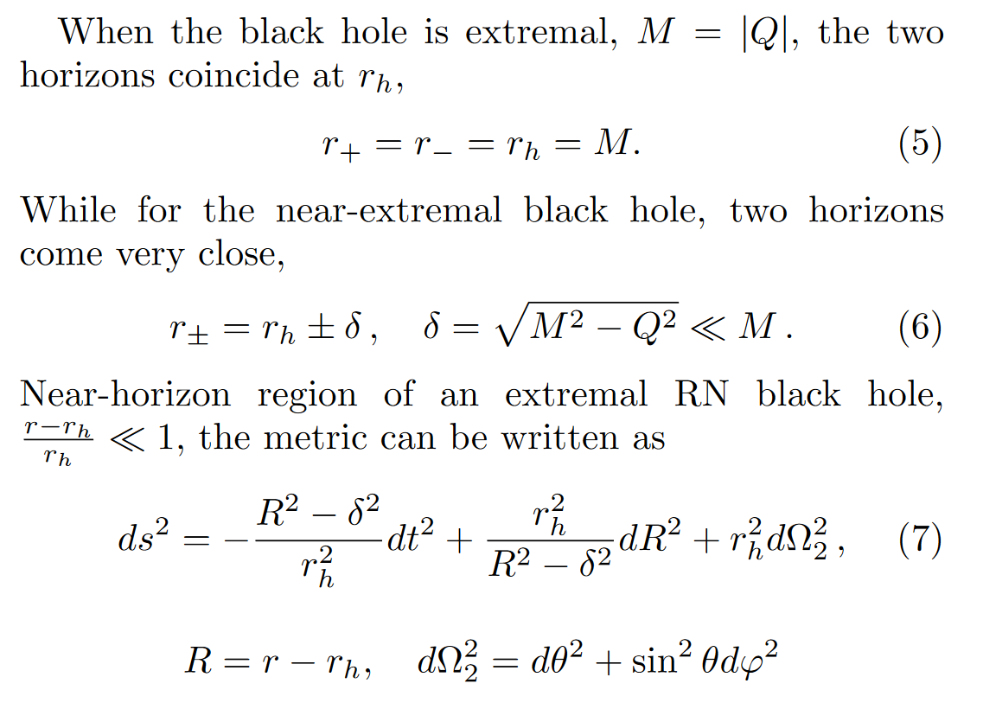

3. RN→$AdS_{2}×S^{2}$
Notice: temperature is proportional to $δ$

Slide 7
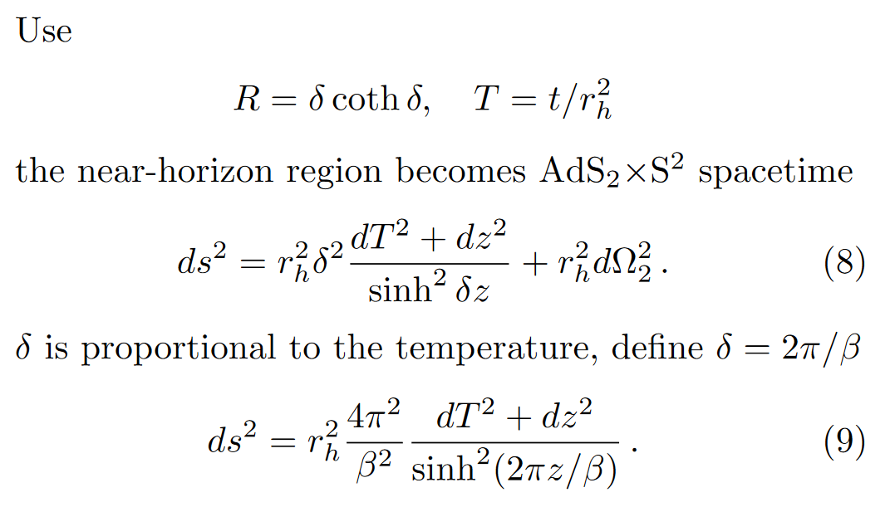
3. RN→$AdS_{2}×S^{2}$
Notice: temperature is proportional to $δ$

Slide 8
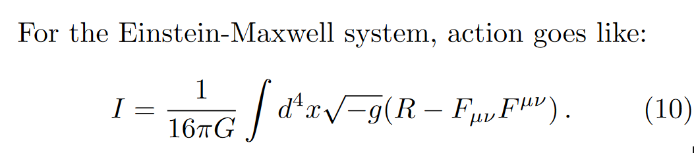
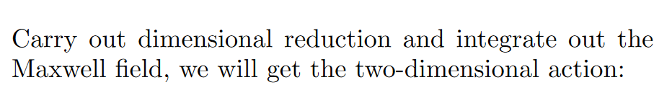
4. Action and Path integral

Slide 9
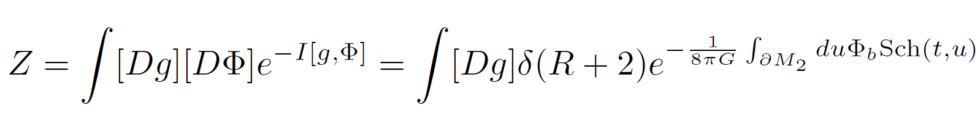
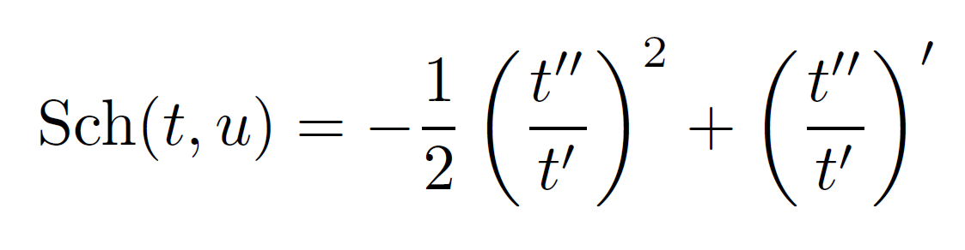
4. Action and Path integral
Integrating out the dilaton field

Slide 10
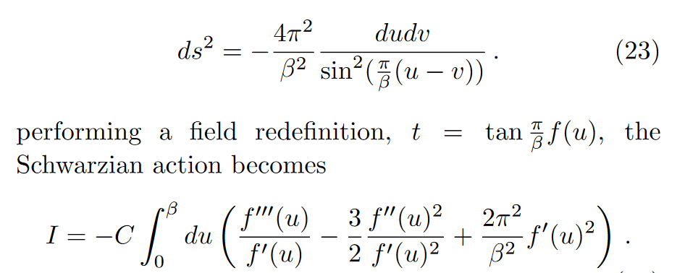

4. Action and Path integral
choose conformal gauge$→$reparameterize $x^{±}→$change coordinate:

Slide 11
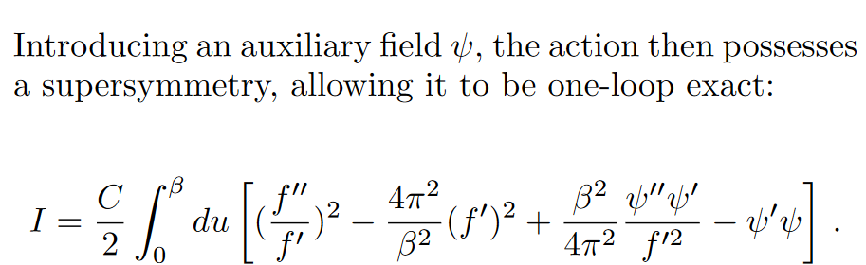
4. Action and Path integral

Slide 12
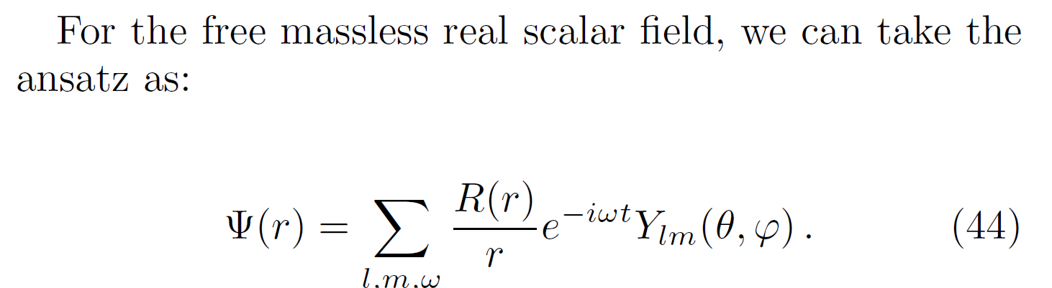
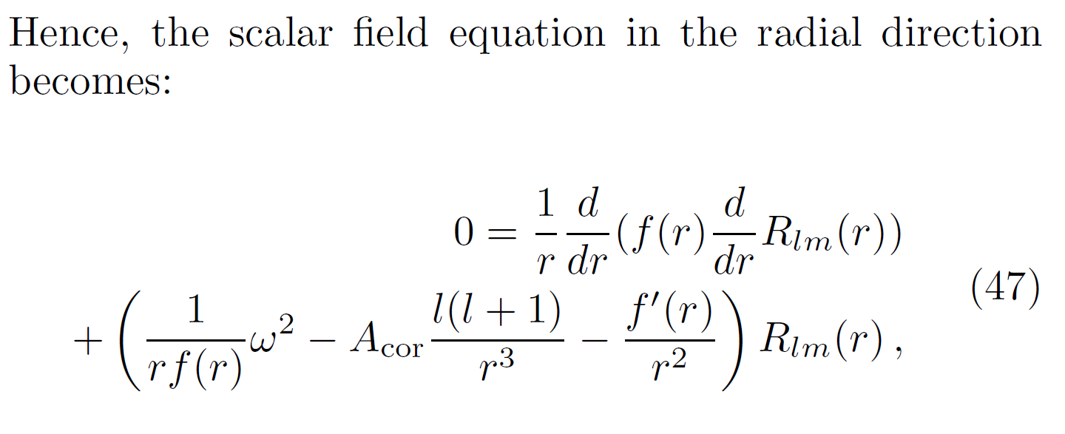
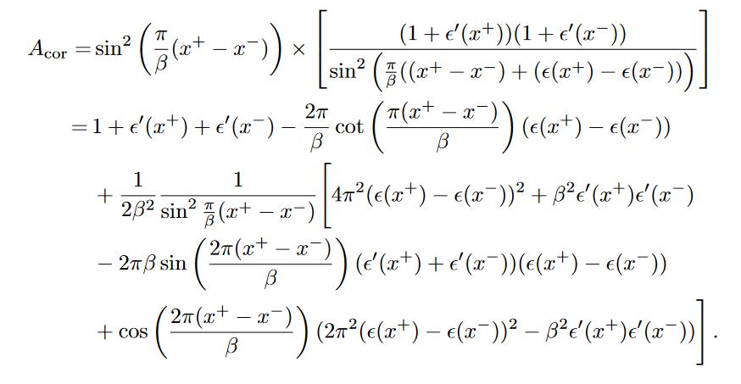
5. Quantum Correction

Slide 13
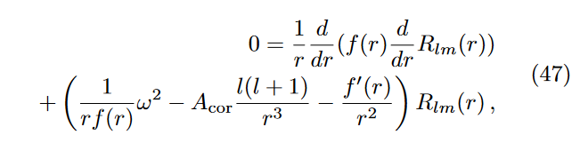
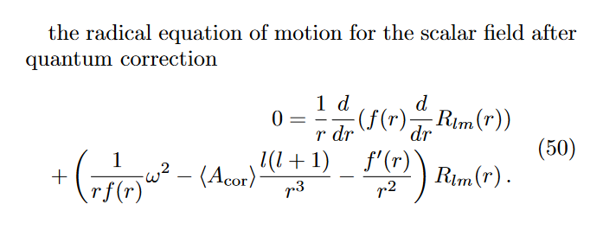
5. Quantum Correction

Slide 14
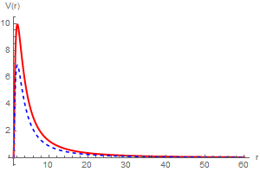
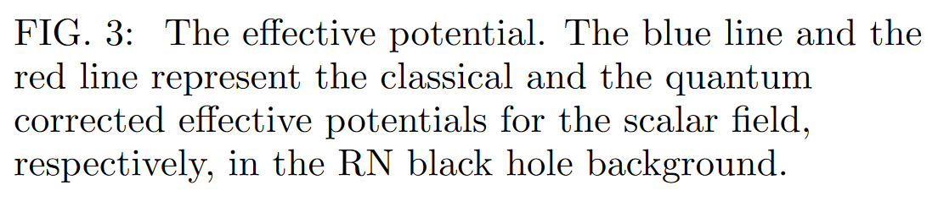
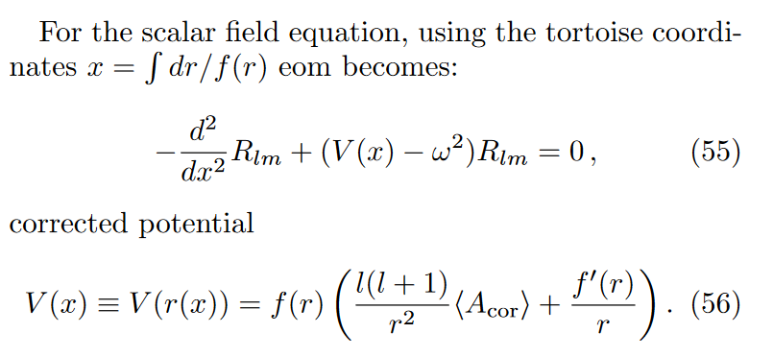
6. QNM

Slide 15
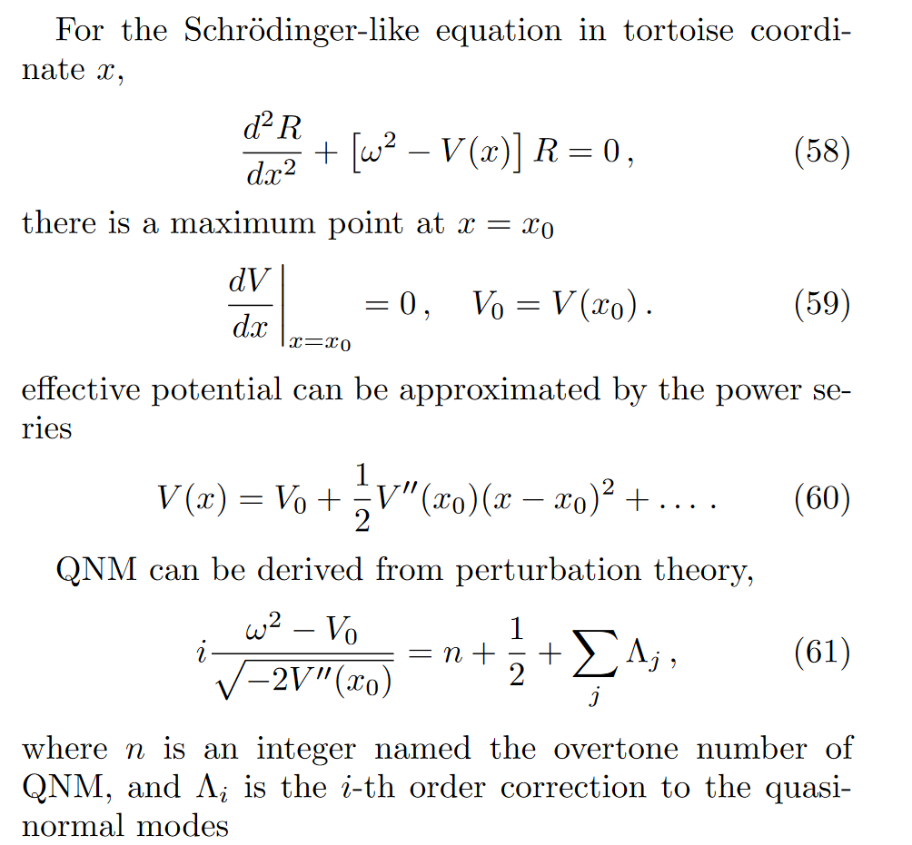
6. QNM

Slide 16
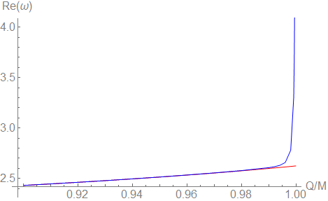
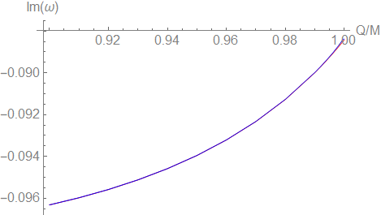
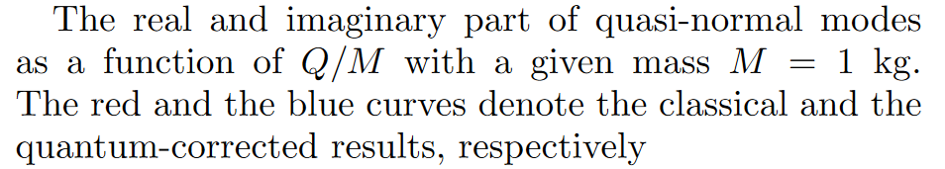
7. QNM Result
(1)Quantum correction large, when temperature low(or mass is small) (2)Real part of QNM is more sensitive to the quantum correction than the imaginary part.

Slide 17
8.Discussion:
For small mass near extremal RN black holes, QNM may be completely different from the classical solutions. The calculation may provide a new perspective on primordial black holes, as their masses could be very small.

Slide 18
Thanks For Listening!

