Slide 1
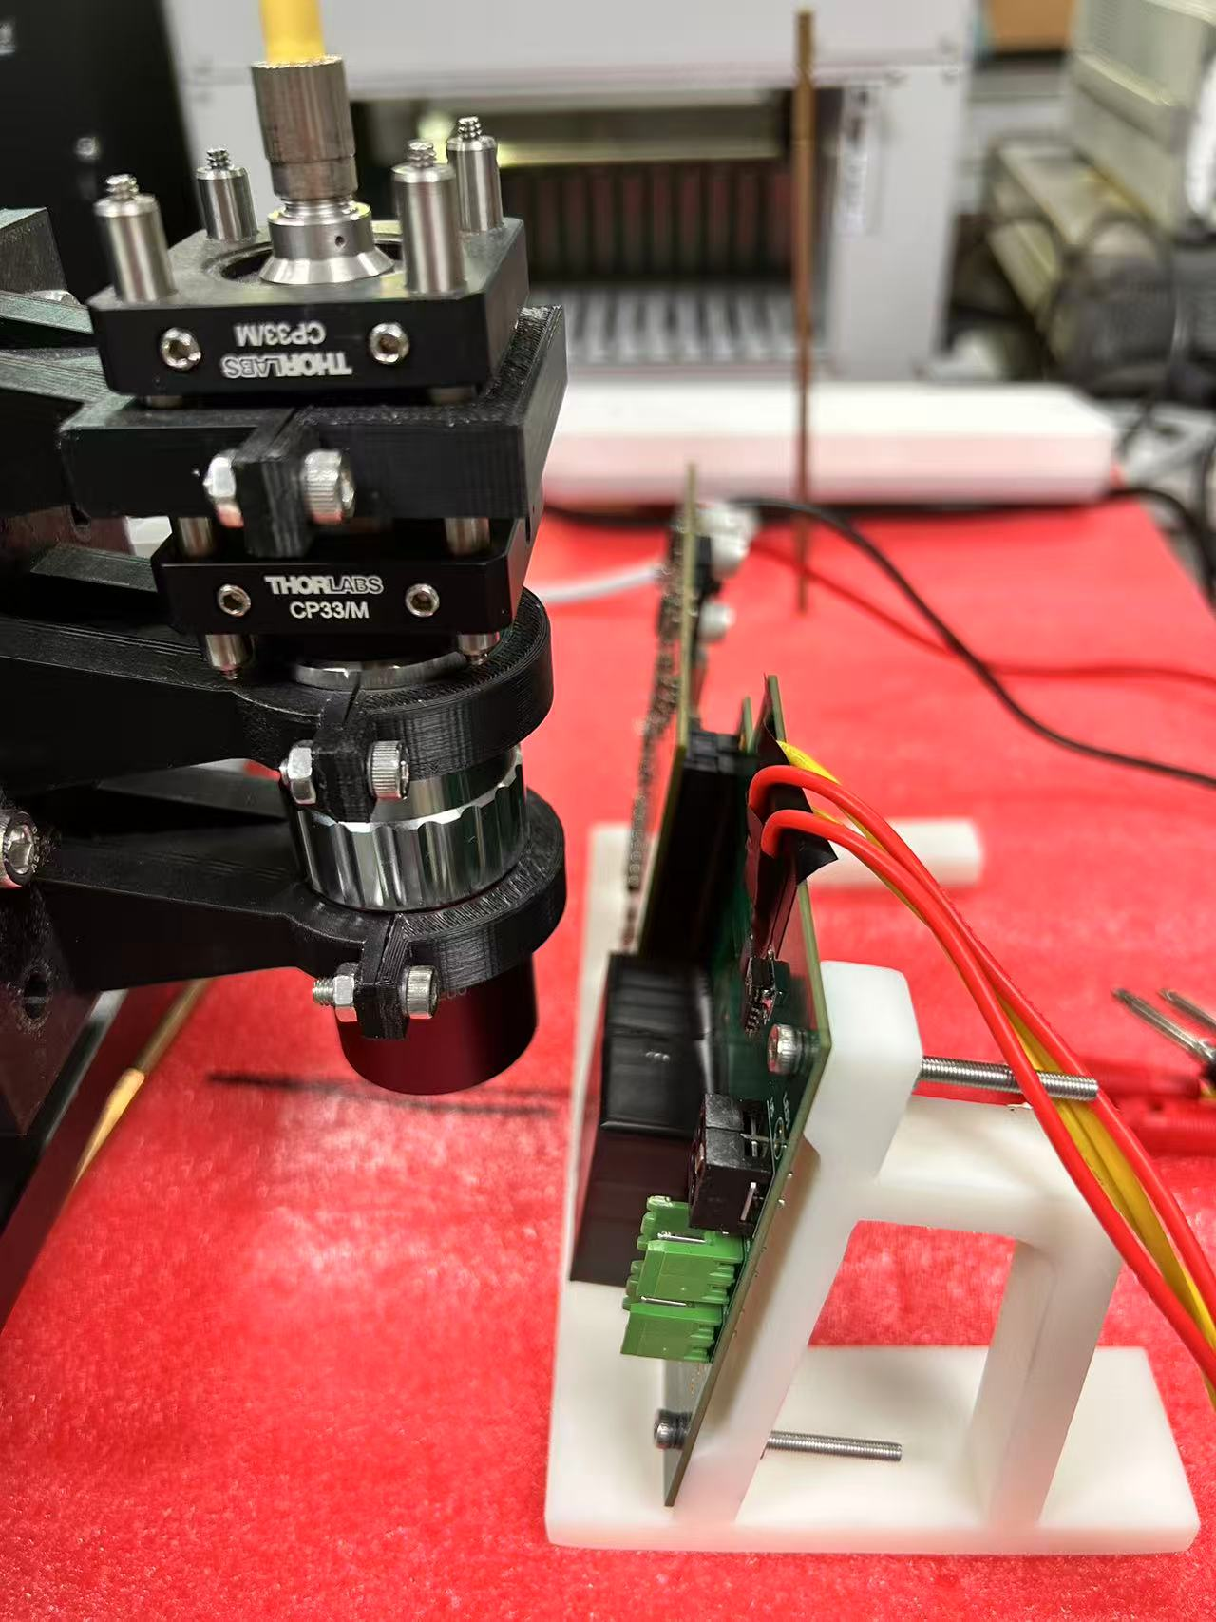
Issue can be addressed before review
Comment about Vertex design : Study readout frequency vs power consumption
About laser alignment: more study with illuminations at shallow angles on prototype sensors will be performance in a short time scale. ( Study hit maps in different angle from front side and from back side )
Comments about performance: Study physics performance (eg: Rb) of alternative layout
Study impact parameters performance with some inefficiency sensors scenario
(1% of N_hit =4)

