Slide 1
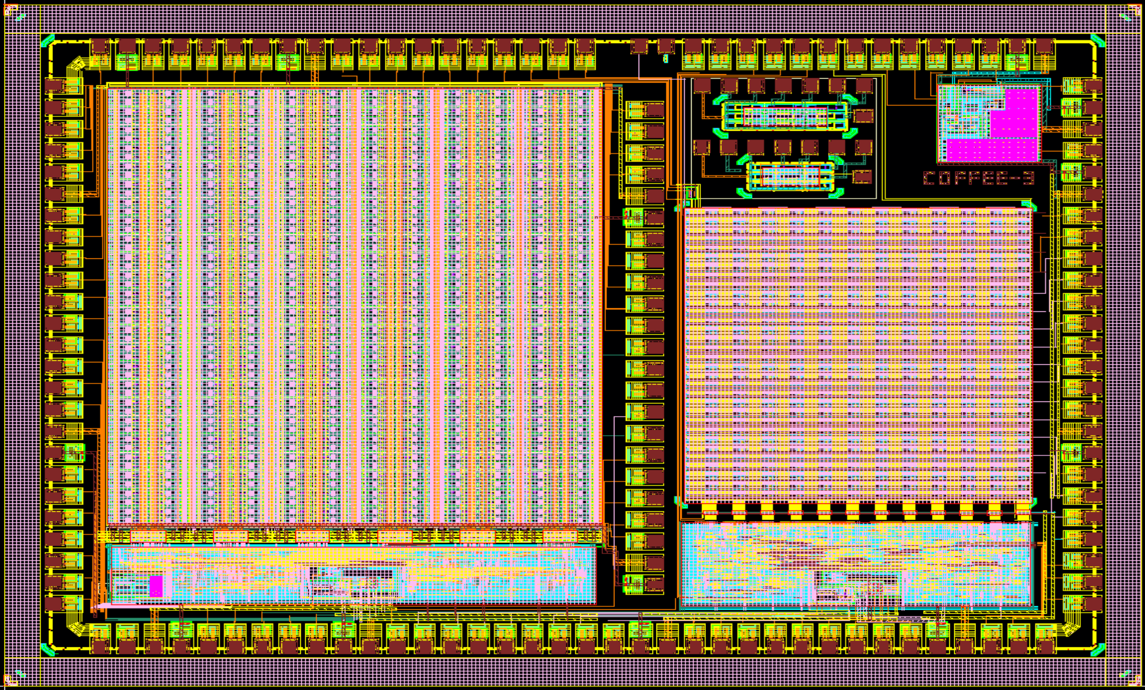
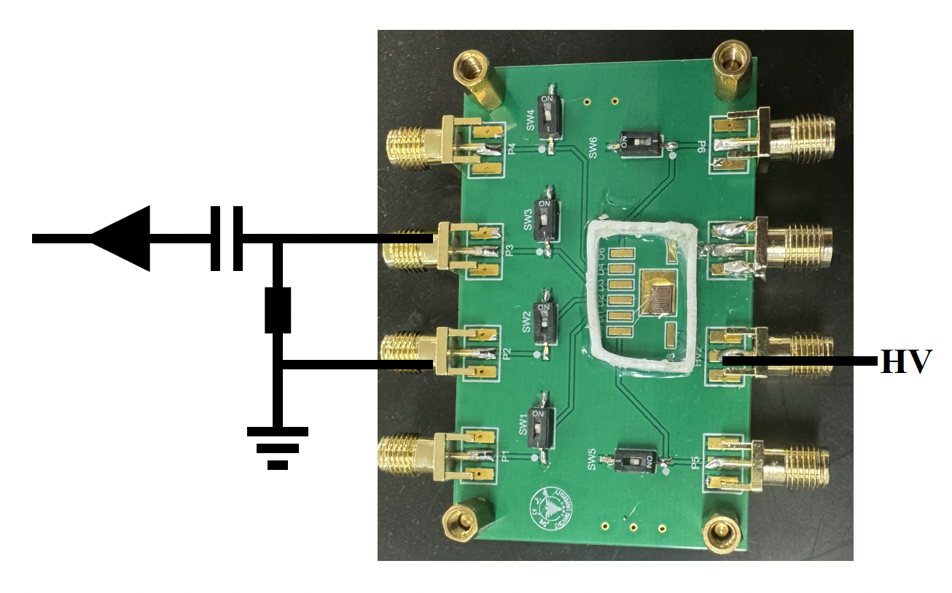
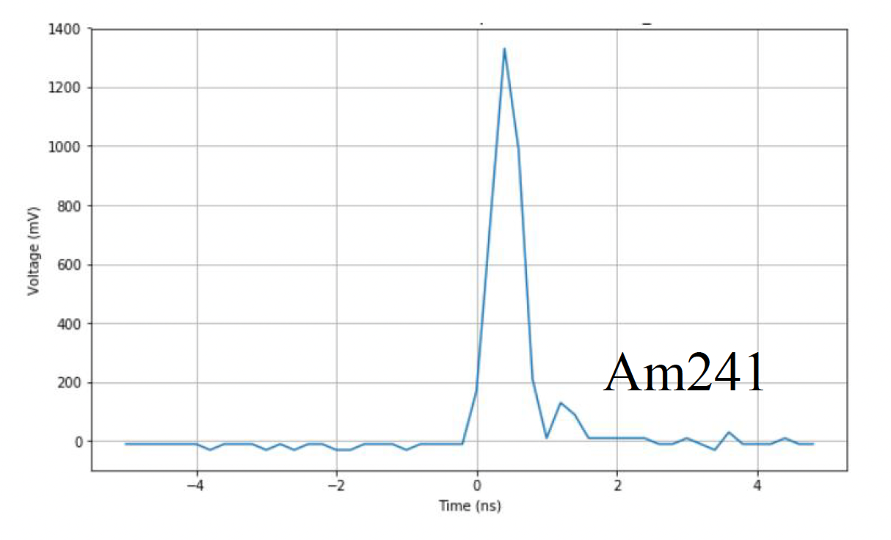
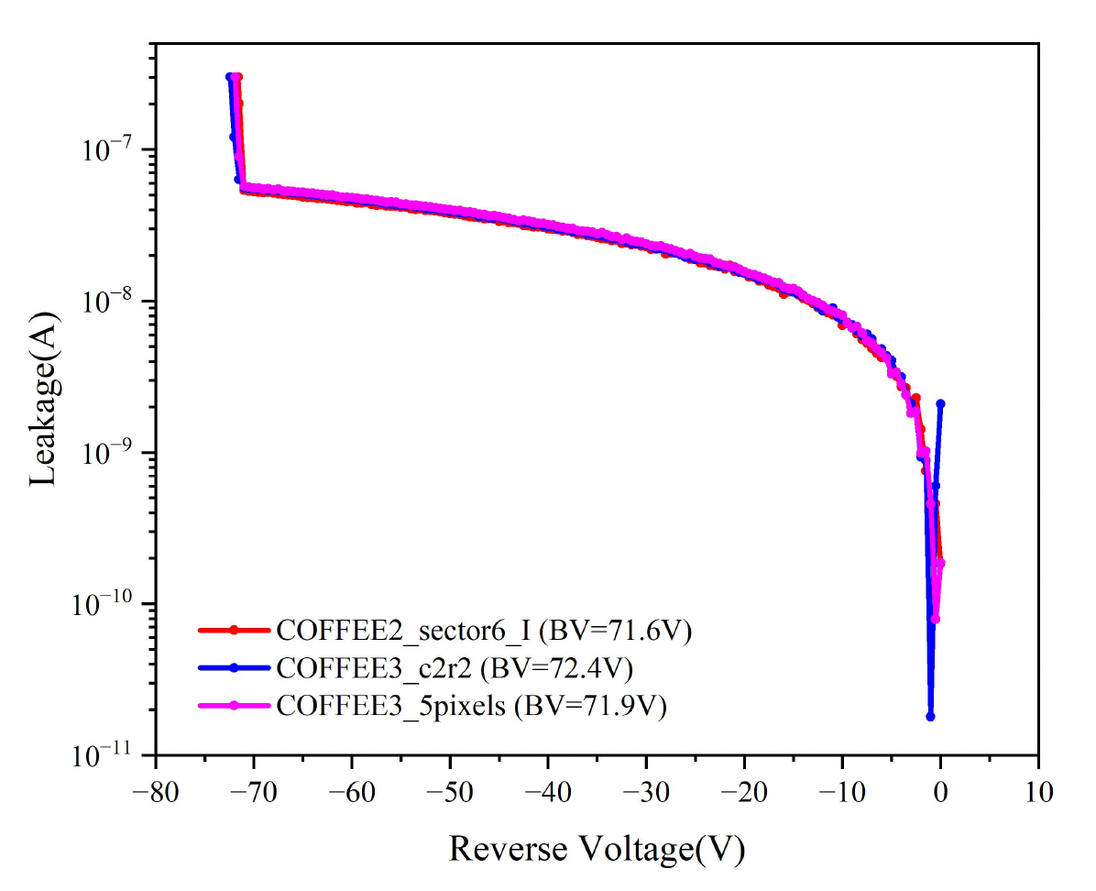
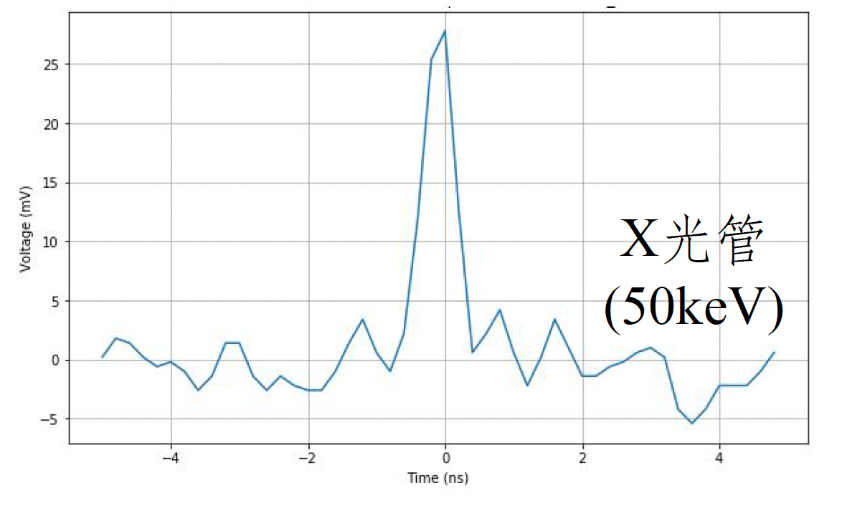
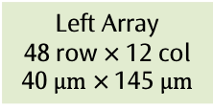
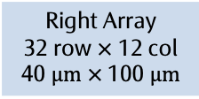
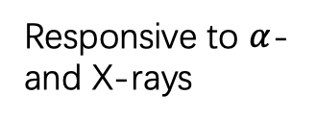
COFFEE3 tests
Passive diode array: validation of sensor performance; test result consistent with COFFEE2:
Passive diodes
PLL
Left Array
48 row $×$ 12 col
40 $μm$ $×$145 $μm$
Right Array
32 row $×$ 12 col
40 $μm$ $×$100 $μm$
Responsive to $α$- and X-rays
Breakdown voltage: -71V

Slide 2
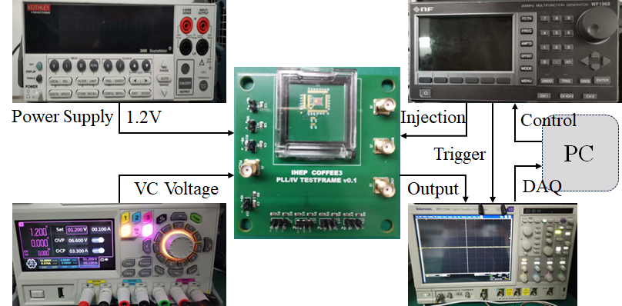
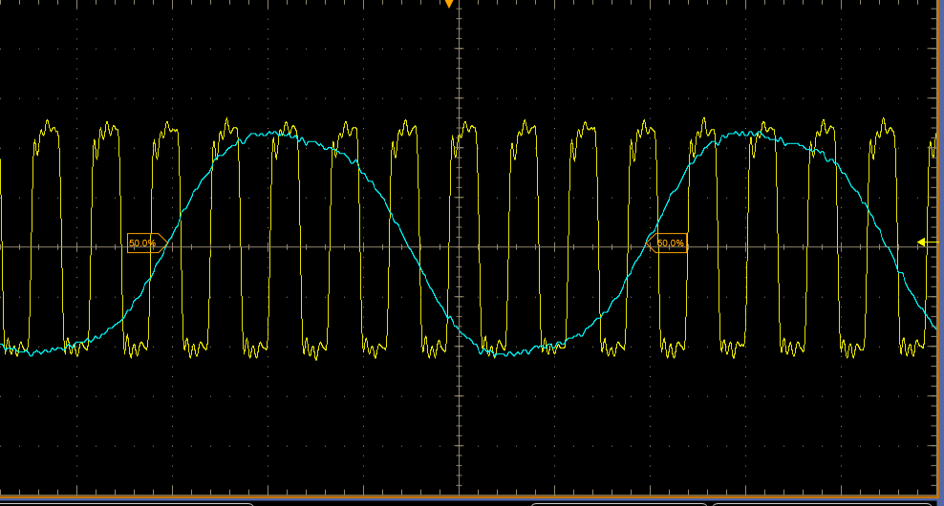
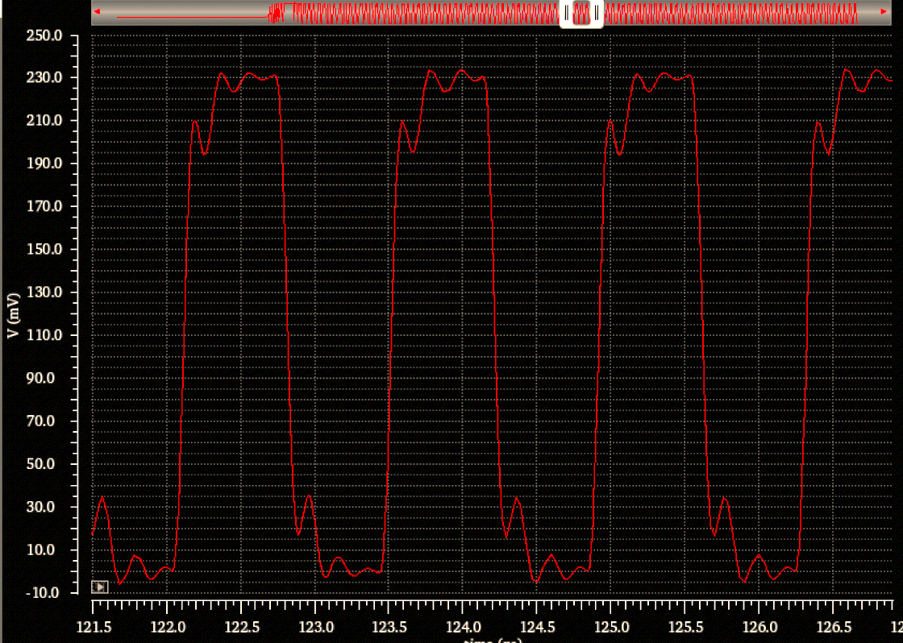
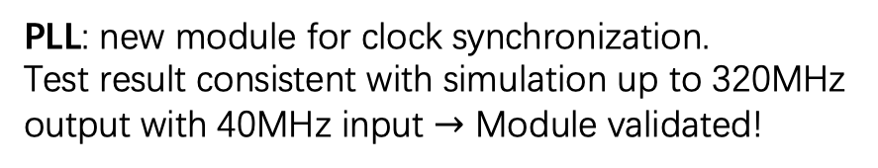
COFFEE3 tests
PLL: new module for clock synchronization.
Test result consistent with simulation up to 320MHz output with 40MHz input $→$ Module validated!
Passive diodes
PLL
Left Array
48 row $×$ 12 col
40 $μm$ $×$145 $μm$
Right Array
32 row $×$ 12 col
40 $μm$ $×$100 $μm$
320 MHz clock output with 40 MHz input
simulated 320 MHz output

Slide 3
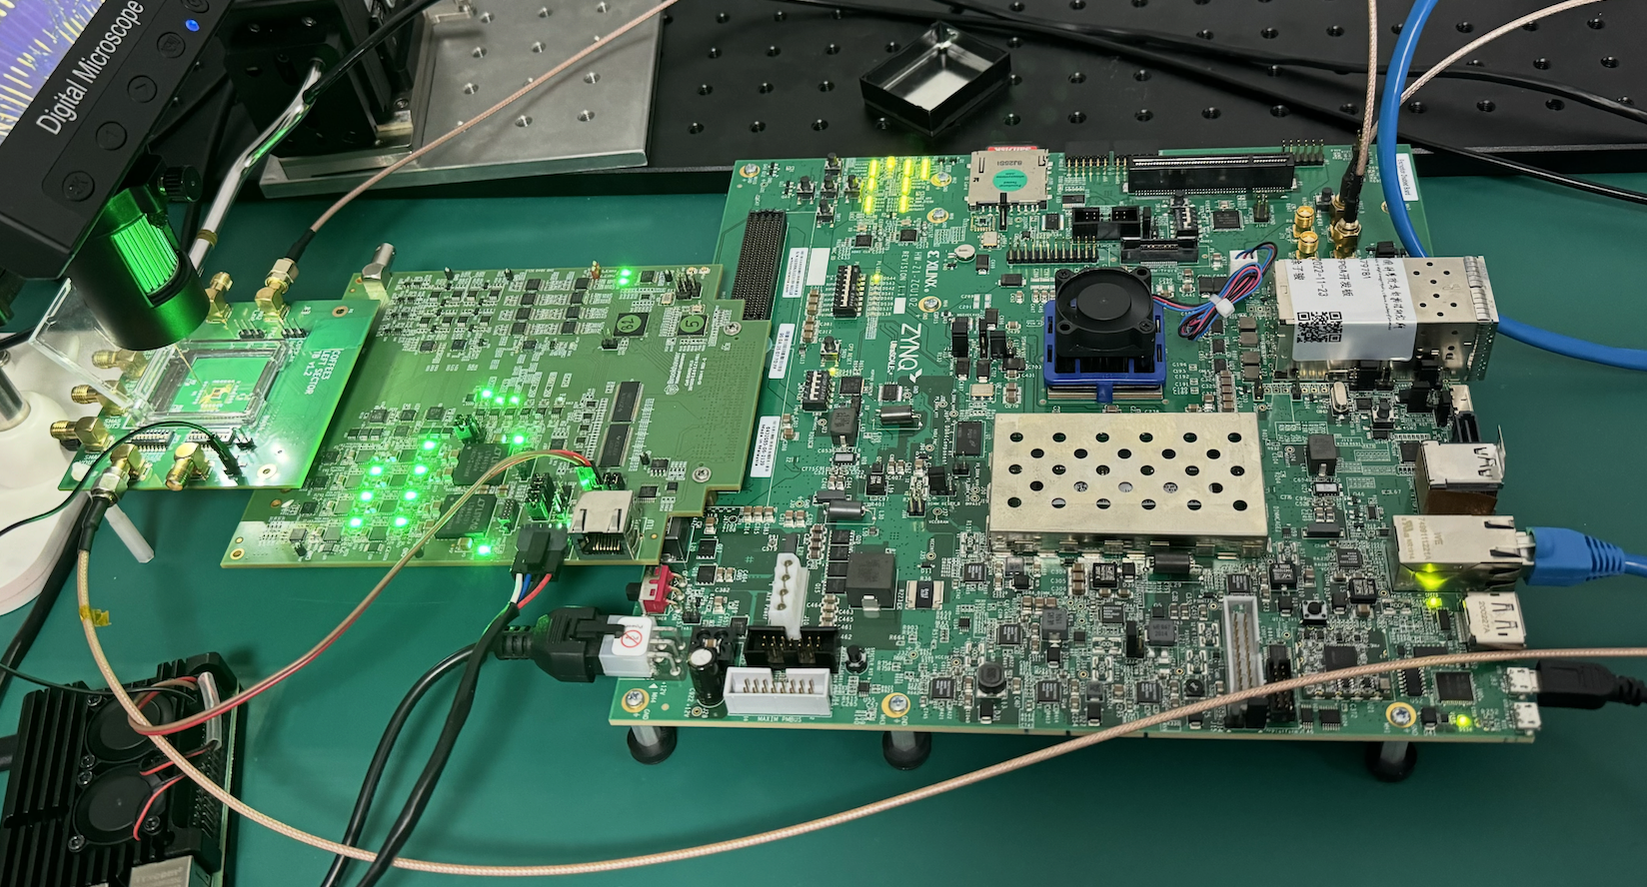
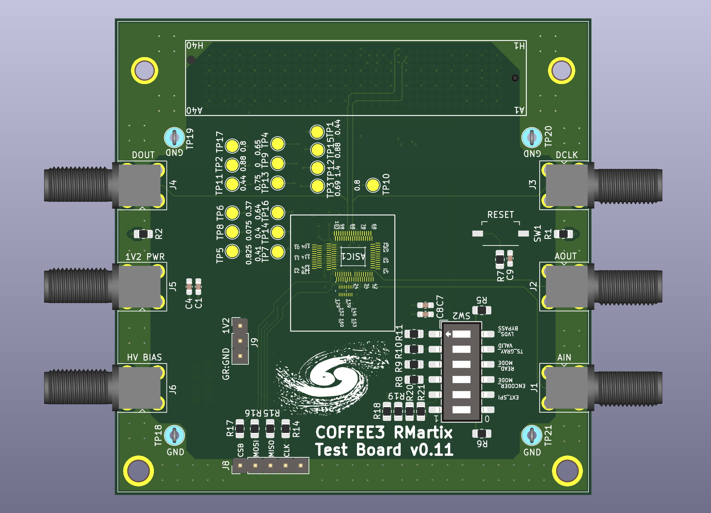
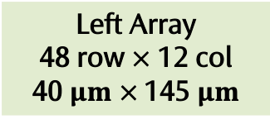
Left pixel array: readout architecture fully exploiting 55nm process potential, with in-pixel TDC etc. Need an extra deep p well
COFFEE3 tests
Passive diodes
Testing goals:
Pixel response to charge injection
TDC performance
LVDS driver
Column readout validation
…
PLL
Left Array
48 row $×$ 12 col
40 $μm$ $×$145 $μm$
Dedicated test PCB + CariBou readout board in place; SPI config successful
Right Array
32 row $×$ 12 col
40 $μm$ $×$100 $μm$
Right pixel array: architecture optimized for current Triple-well process, NMOS-only in pixel
Test PCB designed; Current test focusing on left array
Readout performance (time resolution, power, …) to be compared with left array

